Slide 1


Joint Inference in Image Databases via Dense Correspondence
Michael Rubinstein
MIT CSAIL
(while interning at Microsoft Research)

Slide 2
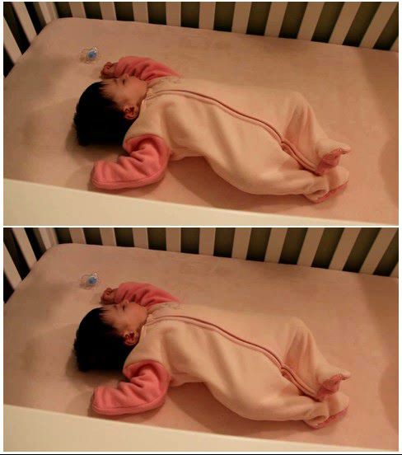
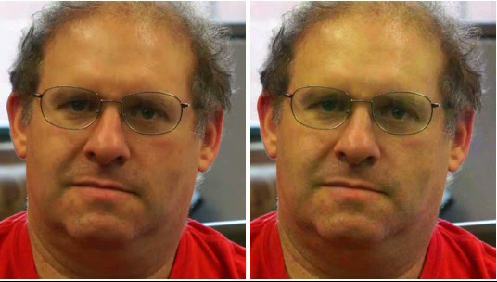
My work
Throughout the year (and my PhD thesis): Temporal Video Analysis and Visualization
This short talk: my work during the summers (MSR 2011, 2012)
  Inference in large, weakly-annotated image databases
Source
Source
Pulse signal amplified
Breathing motions amplified

Slide 3
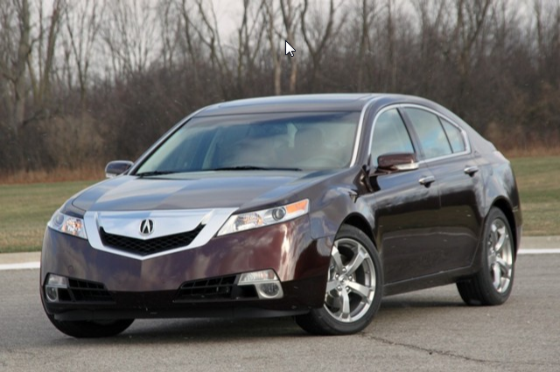
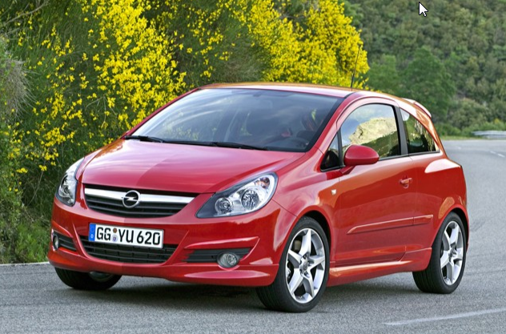
Videos vs. Image Datasets
Goal: we want to infer properties of pixels/regions
  Semantics, layers, geometry (depth), motion, …
Recent advances allow us to treat a set of images like videos!
  Correspondence between adjacent frames in videos: optical flow, layer models, tracking, …
  Correspondence between similar images in databases: Feature Matching, graph matching, Spatial Pyramid Matching (SPM), SIFT flow, …

Slide 4
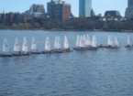
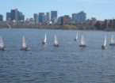
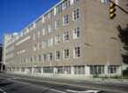
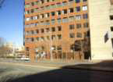
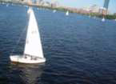
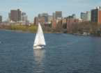
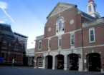
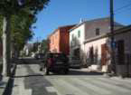
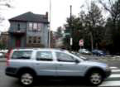
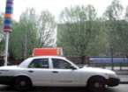
Image Correspondence is Challenging…
Query
Best match
Multiple objects; no global transform
Changing perspective, occlusions
Intra-class variation
Background clutter

Slide 5
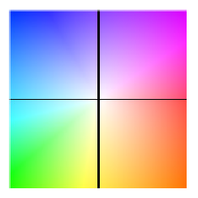
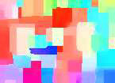
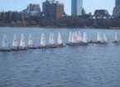
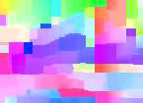
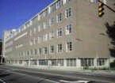
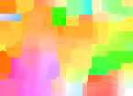

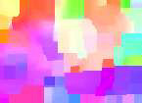

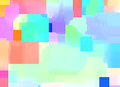
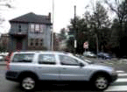
…but Good Solutions Exist
y
x
SIFT Flow [Liu et al. TPAMI 2011]
Query
Best match

Slide 6
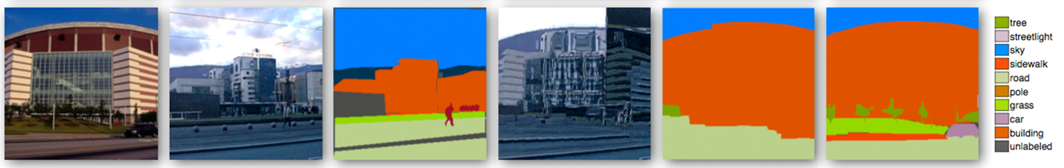
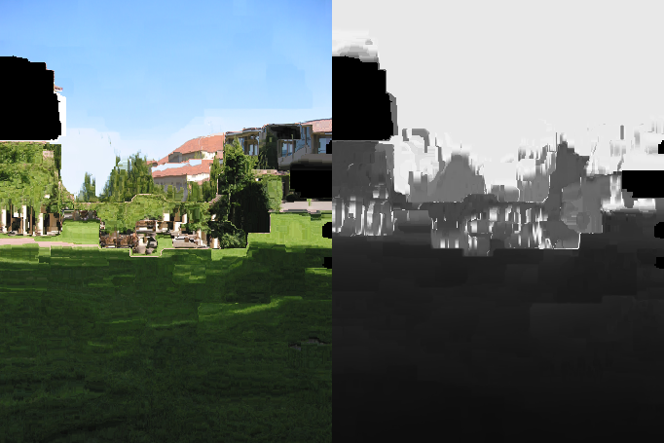
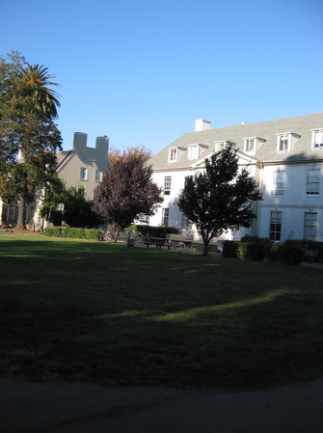
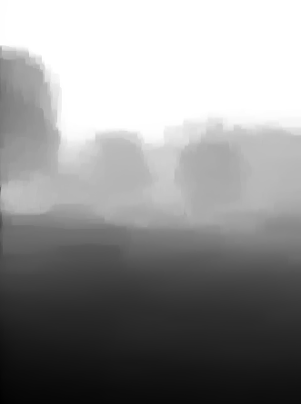
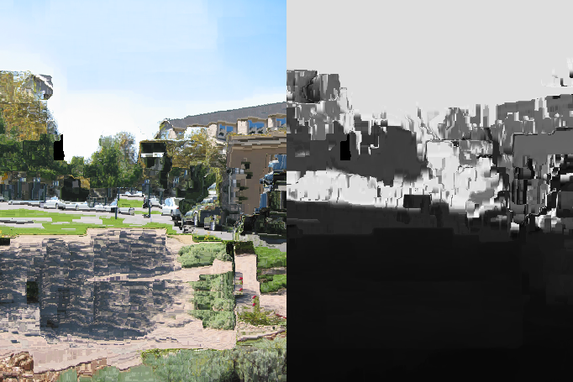
Correspondence-driven Approaches to Computer Vision
Annotation of
best match
Warp to
best match
Label
transfer
Query
Best match
Ground truth
Liu et al. TPAMI’11
Warped candidates and depths
Query
Inferred depth
+
Karsch et al. ECCV’12

Slide 7
How to densely label new images?
Annotated database
(class, depth, motion, …)
Well Explored
Image correspondence + information transfer
Query image
Image + transferred info

Slide 8
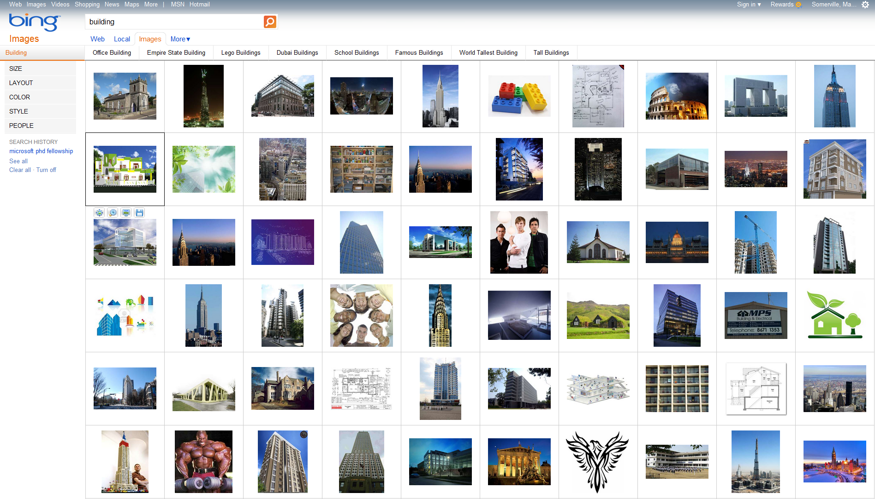
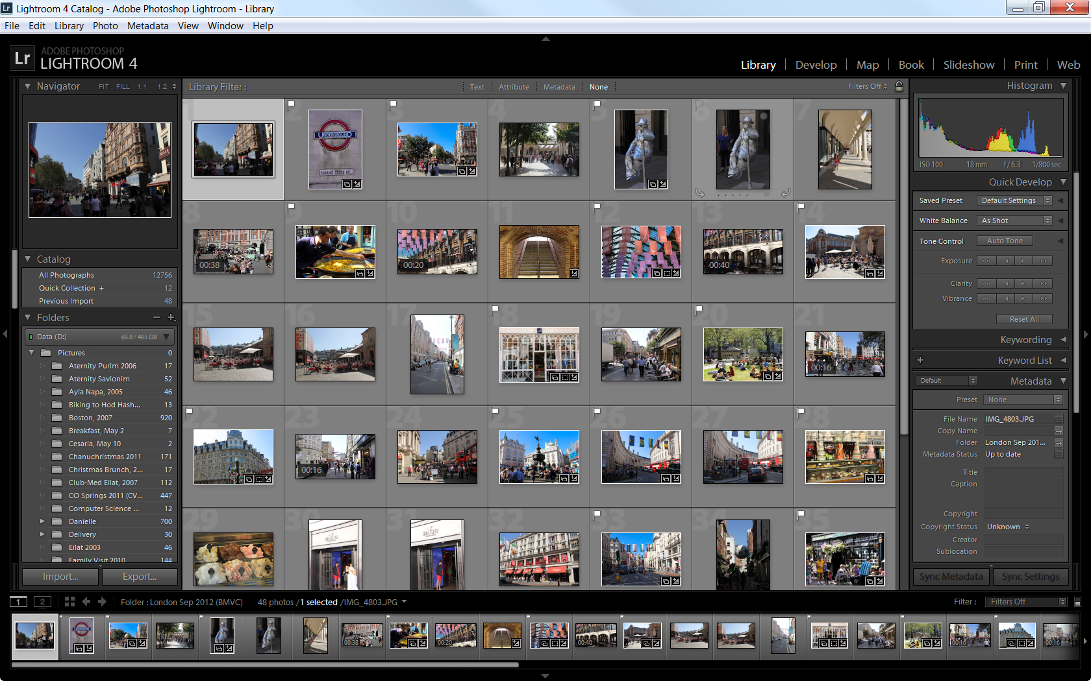
Big Visual Data
Pixel labels usually unavailable!
Photo collections
Internet

Slide 9
How to densely label new images?
Annotated database
(class, depth, motion, …)
Well Explored
Image correspondence + information transfer
Query image
Image + transferred info
Image correspondence + joint inference
Unannotated (partially annotated) database
Database +propagated info

Slide 10
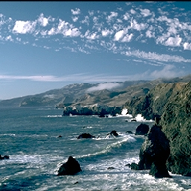
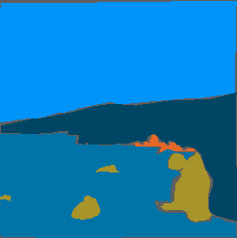
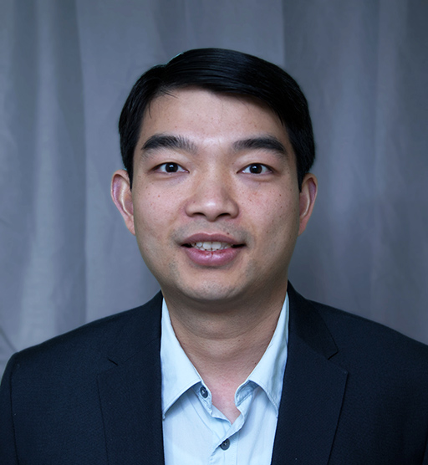
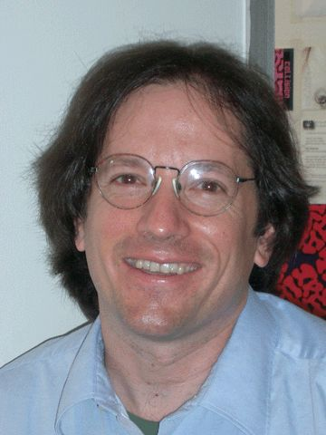
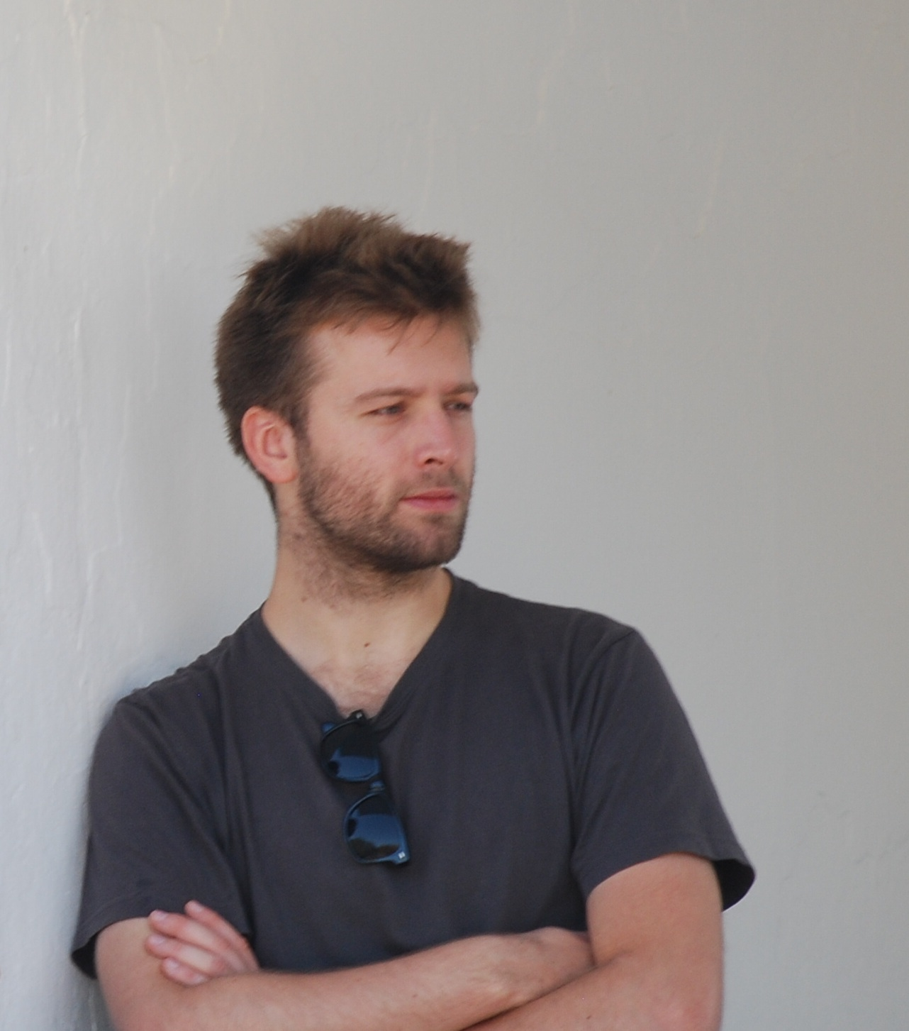
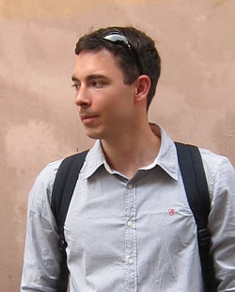
Joint Inference for Image Databases
Weakly supervised
Annotation Propagation in Large Image Databases via Dense Image Correspondence (ECCV 2012)
With Ce Liu, William T. Freeman
Unsupervised
Unsupervised Joint Object Discovery and Segmentation in Internet Images (CVPR 2013)
  With Ce Liu, Armand Joulin, Johannes Kopf
sky
mountain
sea
rock

Slide 11
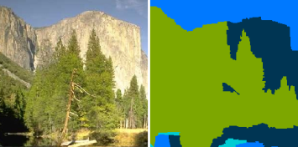
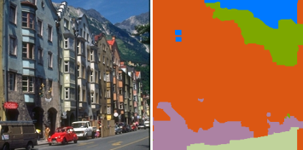
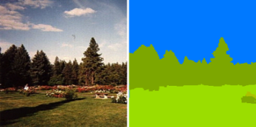
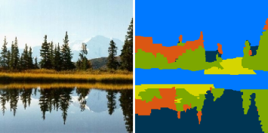
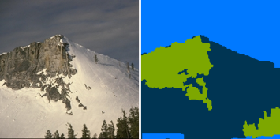
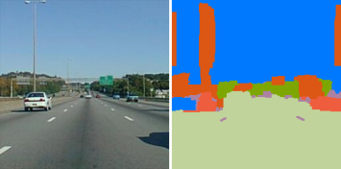
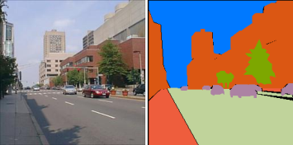
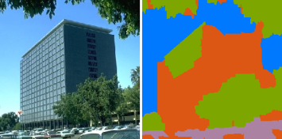
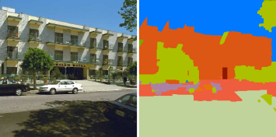
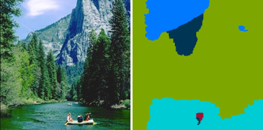

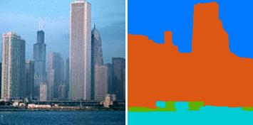
Annotation Propagation
Input: A large database of images where only some are tagged and very few (possibly none) are densely labeled
tree, sky, river
mountain
sky, mountain
tree
sidewalk, road, car
building, tree, sky
sky, river
building, bridge

Slide 12

Annotation Propagation
Output: The same database with all the pixels labeled and all the images tagged
tree, sky, river
mountain
tree, sky, road
car, building
tree, sky, plant
grass
mountain, field,
building, sky, tree
sky, mountain
tree
tree, sky, sidewalk
road, car, building
sidewalk, road, car
building, tree, sky
tree, sky, car
building
tree, staircase, sky
road, plant, door
sidewalk, car, building
tree, sky, river
person, mountain
sky, building
tree
sky, river
building, bridge

Slide 13
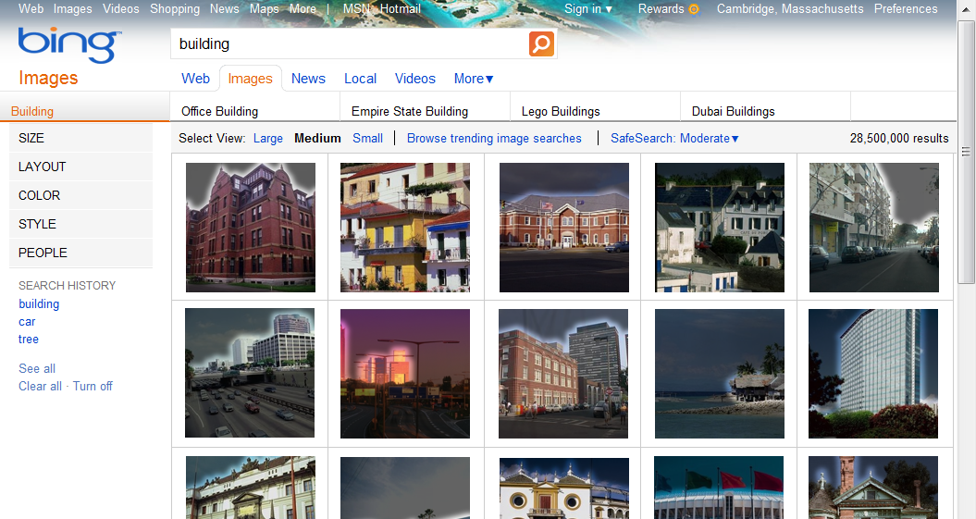
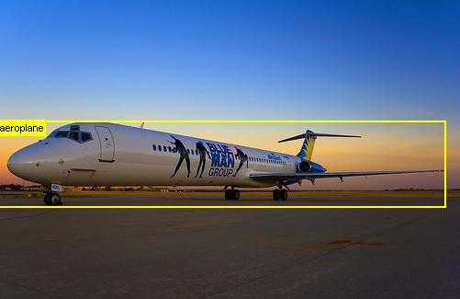
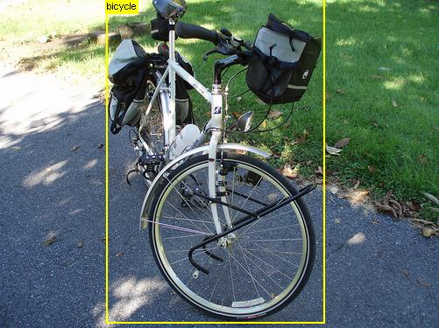

Dense pixel/region labeling is important
Enhanced image search
Constructing training sets for detectors/classifiers
Image editing
  User edit propagation
PASCAL 2012
HaCohen et al. 2013

Slide 14


Pixel-wise image graph
$P$(word | $I(p)$) – using machine learning

Slide 15





























Inference Results
Input image
MAP appearance
+ Intra-image reg.
+ Inter-image reg.
Input image local
evidence
Neighbors
Dense corr.
Neighbors warped
Neighbors local evidence warped

Slide 16

Optimization
Appearance Modeling
Coordinate descent, iterating between estimating the appearance model (learning) and tag propagation (inference)
Lots of engineering, but nothing revolutionary
  Partition message passing into intra- and inter-image updates
  Intra-image message passing on separate cores
  Parallel inter-image message passing
Propagation

Slide 17







From stronger local evidence to weaker local evidence
Input image
Local evidence + intra-image reg.
+ Inter-image reg.
neighbors
warp

Slide 18












Results on SUN Dataset
Textual tags available for only half the images in database
No detectors (e.g. sky detector, person detector, …)
No prior knowledge on labels, their locations, etc.
SUN dataset [Xiao et al. 2010] - 9556 images, 522 labels

Slide 19
Joint Inference for Image Databases
Weakly supervised
Annotation Propagation in Large Image Databases via Dense Image Correspondence (ECCV 2012)
With Ce Liu, William T. Freeman
Unsupervised
Unsupervised Joint Object Discovery and Segmentation in Internet Images (CVPR 2013)
  With Ce Liu, Armand Joulin, Johannes Kopf
sky
mountain
sea
rock

Slide 20
Object discovery and Co-segmentation
Input: A set of images containing some “common object”
Output: Every pixel in the dataset marked as belonging or not belonging to the “common object”
No additional information on the images or the object class

Slide 21



Object discovery and Co-segmentation
“Car”
Image search
Object discovery and segmentation
Images downloaded from the Internet
Our automatic segmentation results
State of the art co-segmentation [Joulin et al. CVPR 2012]

Slide 22

Benchmark “plane” Dataset (MSRC)

Slide 23

Real-world “plane” Dataset (Internet Search)

Slide 24

Image Graph
Image graph

Slide 25
Basic Idea
Pixels (features) belonging to the common object should be:
  Salient - Dissimilar to other pixels (features) in their image
  Sparse - Similar to other pixels (features) in other images (with respect to smooth transformations)
Captured by image saliency measures
Captured by (dense) image correspondence

Slide 26
One of these things is not like the others
Source
Saliency
Warped
neighbor
Matching
Score
Segmentation

Slide 27
One of these things is not like the others
Source
Saliency
Warped
neighbor
Matching
Score
Segmentation

Slide 28
One of these things is not like the others
Horse
Face

Slide 29

Car (4,347 images, 11% noise)

Slide 30

Horse (6,381 images, 7% noise)

Slide 31

Airplane (4,542 images, 18% noise)

Slide 32

Conclusion
Labels in big visual data are often unavailable/noisy
Dense image correspondence (SIFT flow, and others) useful to capture structure, resolve visual ambiguity
  Becoming a mature technology
Joint inference for weakly-labeled image databases
  Annotation Propagation: partial tags + very few (possibly none) pixel labels
  Object discovery and segmentation: only assuming some underlying “common object”
tree, sky, river
mountain
tree, sky, road
car, building
tree, sky, plant
grass
mountain, field,
building, sky, tree
sky, mountain
tree
tree, sky, sidewalk
road, car, building
sidewalk, road, car
building, tree, sky
tree, sky, car
building
tree, staircase, sky
road, plant, door
sidewalk, car, building
tree, sky, river
person, mountain
sky, building
tree
sky, river
building, bridge

Slide 33
Thank you!
Michael Rubinstein
MIT CSAIL

