Slide 1
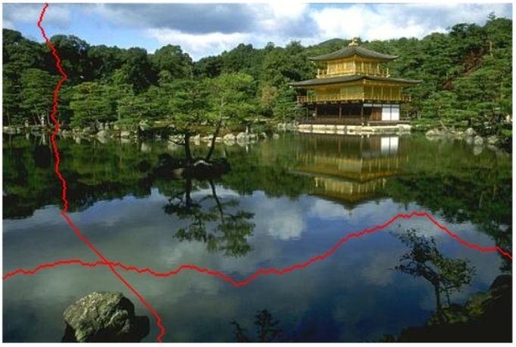
Seam-Carving and Content-driven Retargeting of Images (and Video)
Michael Rubinstein
MIT
Some slides borrowed from Ariel Shamir and Shai Avidan

Slide 2
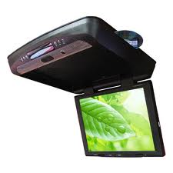

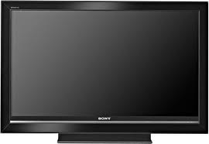

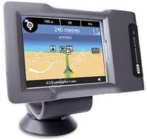

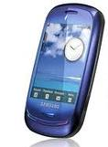





Display Devices

Slide 3


Content Retargeting
PC
iPhone

Slide 4

Page Layout

Slide 5
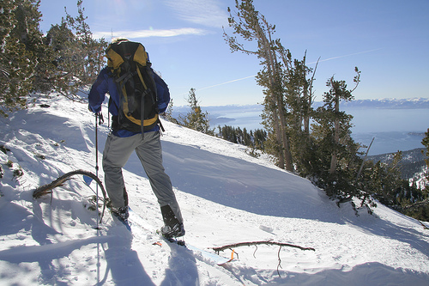

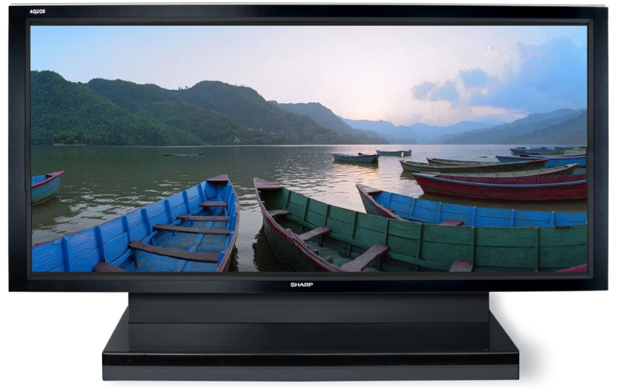
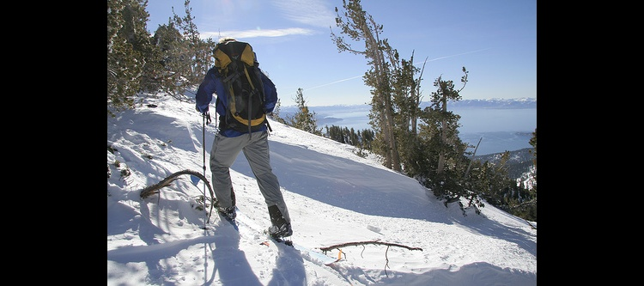


Simple Media Retargeting Operators
Letterboxing
Scaling
?
?

Slide 6
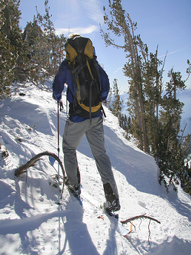
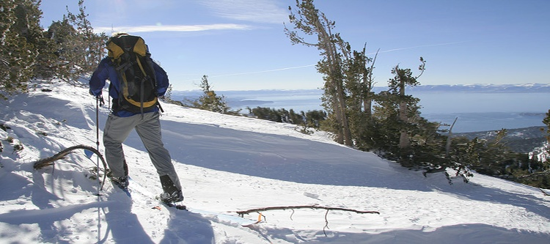
Content-aware Retargeting Operators
“Important”
content
Content-
aware
Content-
oblivious

Slide 7




Content-aware Retargeting
Scale
Crop
Content-aware
“less-Important”
content
Input

Slide 8
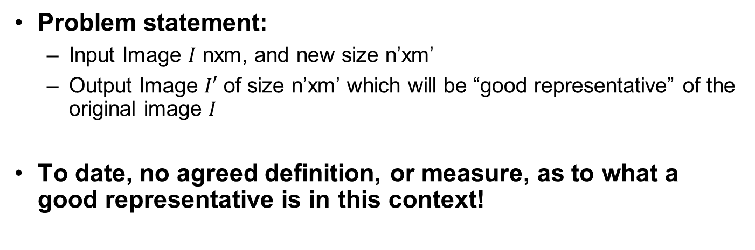
Image Retargeting
Problem statement:
  Input Image $I$ nxm, and new size n’xm’
  Output Image $I′$ of size n’xm’ which will be “good representative” of the original image $I$
To date, no agreed definition, or measure, as to what a good representative is in this context!

Slide 9
Image/Video Retargeting
In large, we would expect:
Adhere to the geometric constraints (display/aspect ratio)
Preserve the important content and structures
Limit artifacts
Perhaps a new representation that will support different sizes?
Very Ill-posed!
  How do we define important? Is there a universal ground truth?
  Would different viewers think the same about a retargeted image?
  What about artistic impression in the original content?
Notes:
Well-posed problem:
1. A solution exists
2. The solution is unique
3. The solution depends continuously on the data (numerical stability/conditioning)

Slide 10
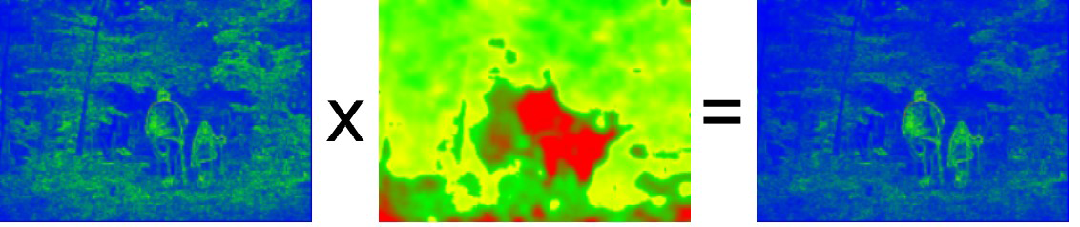
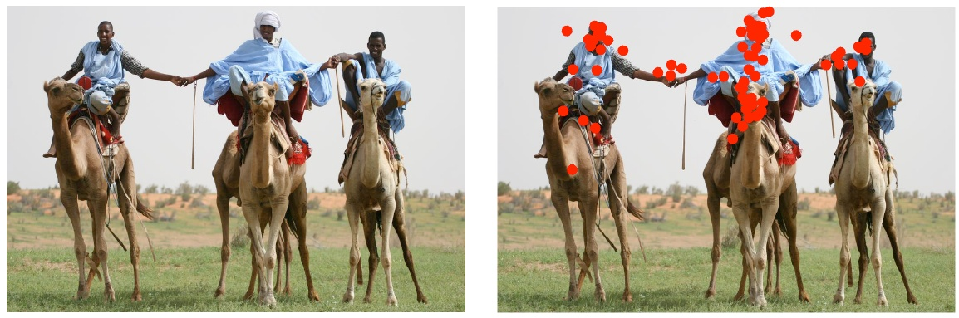
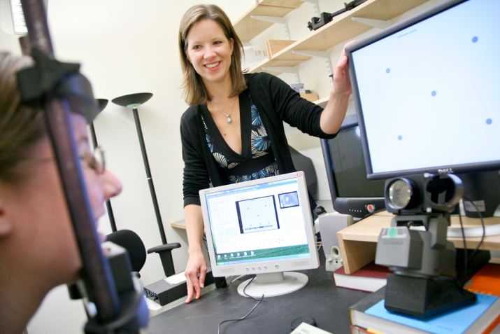
Importance (Saliency) Measures
A function S: p → [0,1]
More sophisticated: attention models, eye tracking (gazing studies), face detectors, …
Wang et al. 2008
Judd et al. ICCV09 Learning to predict where people look

Slide 11
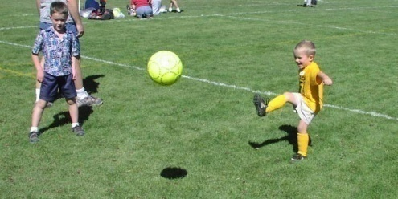
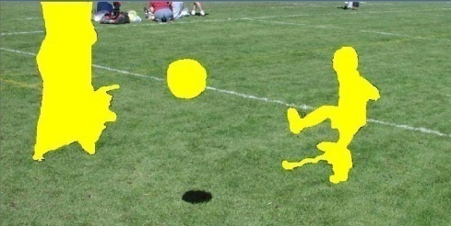
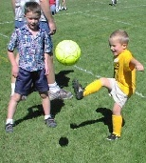
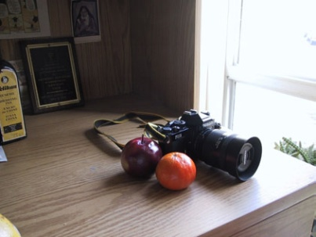
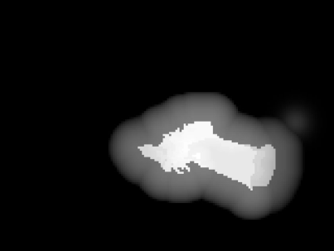
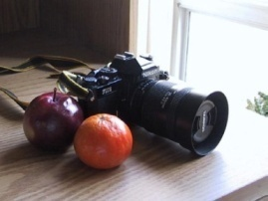
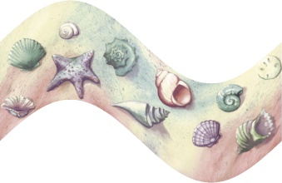

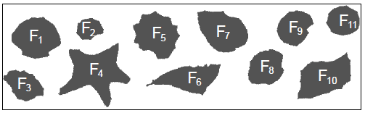
General Retargeting Framework
Define an energy function E(I)
(interest, importance, saliency)
2. Use some operator(s) to change the image I
Setlur et al.
[2005]
Recompose
Santella et al. [2005]
Crop
Gal et al. [2006]
Warp

Slide 12
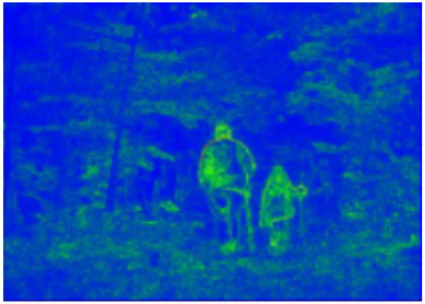
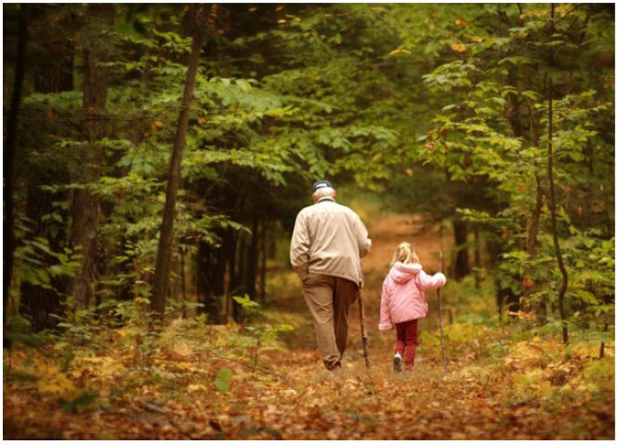
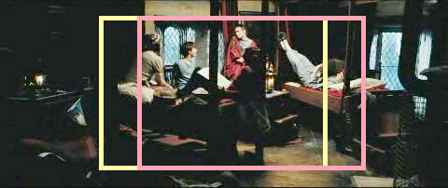



Previous Retargeting Approaches
Optimal Cropping Window
For videos: “Pan and scan”
  Still done manually in the movie industry
Liu and Gleicher, Video Retargeting: Automating Pan and Scan (2006)

Slide 13
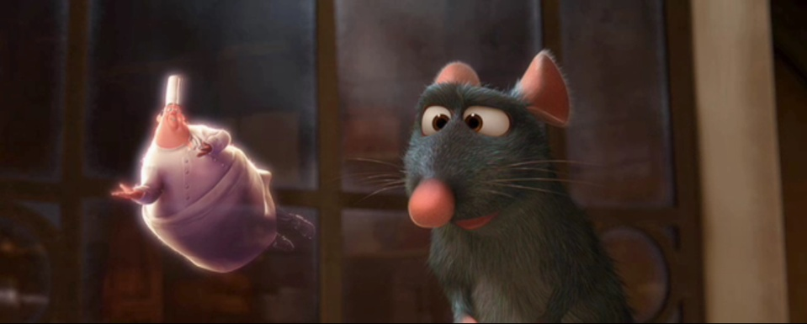


Cropping

Slide 14

Seam Carving
Assume m x n → m x n’, n’<n (summarization)
Basic Idea: remove unimportant pixels from the image
  Unimportant = pixels with less “energy”
Intuition for gradient-based energy:
  Preserve strong contours
  Human vision more sensitive to edges – so try remove content from smoother areas
  Simple, enough for producing some nice results
  See their paper for more measures they have used

Slide 15
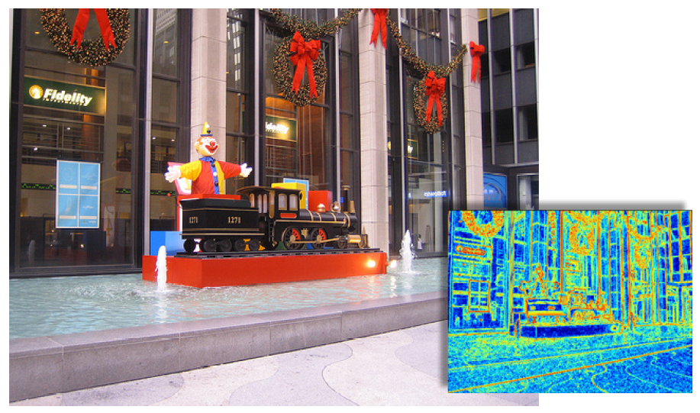
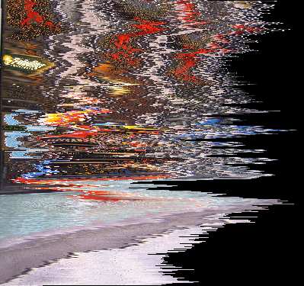
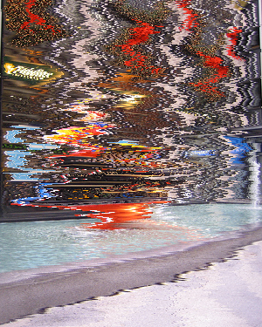
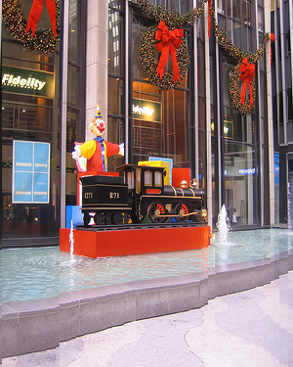
Pixel Removal
Optimal
Least-energy pixels
(per row)
Least-energy columns

Slide 16
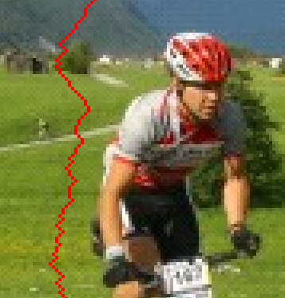
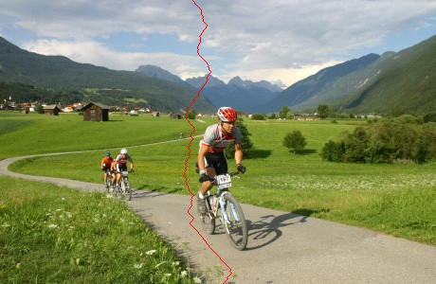
A Seam
A connected path of pixels from top to bottom (or left to right). Exactly one in each row

Slide 17
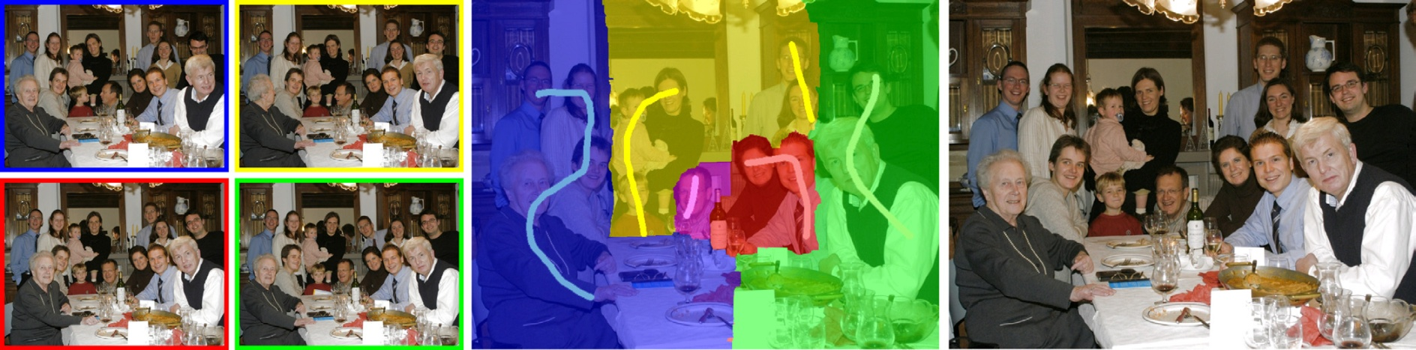
Seams in Images
Efros & Freeman [2001] – Texture synthesis
Kwatra et al. [2003] – Image and video synthesis
Agarwala et al. [2004] – Digital Photomontage
Perez et al. [2003] – Poisson Image Editing
Jia et al. [2006] – Drag-and-Drop Pasting
Rother et al. [2006] – Auto-Collage
Wang and Cohen [2006] – simultaneous matting and compositing
Mostly used for composition of two (or more) images or patches…
Agarwala et al., Interactive Digital Photomontage

Slide 18
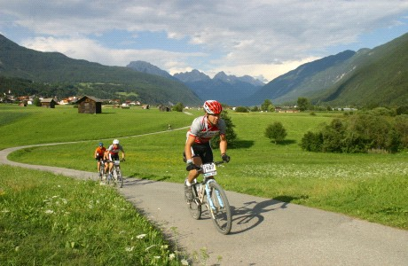
Finding the Seam?

Slide 19
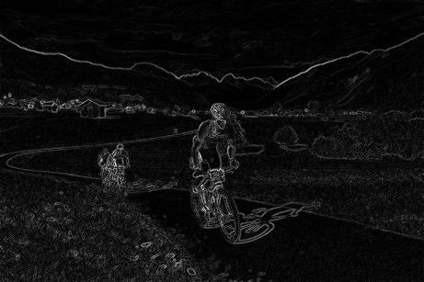
The Optimal Seam

Slide 20
The Optimal Seam
The recursion relation
Can be solved efficiently using dynamic programming in
  (s=3 in the original algorithm)

Slide 21
Dynamic Programming
Invariant property:
  M(i,j) = minimal cost of a seam going through (i,j) (satisfying the seam properties)
5 | 8 | 12 | 3
9 | 2 | 3 | 9
7 | 3 | 4 | 2
4 | 5 | 7 | 8

Slide 22
Dynamic Programming
5 | 8 | 12 | 3
9 | 2+5 | 3 | 9
7 | 3 | 4 | 2
4 | 5 | 7 | 8

Slide 23
Dynamic Programming
5 | 8 | 12 | 3
9 | 7 | 3+3 | 9
7 | 3 | 4 | 2
4 | 5 | 7 | 8

Slide 24
Dynamic Programming
5 | 8 | 12 | 3
9 | 7 | 6 | 12
14 | 9 | 10 | 8
14 | 14 | 15 | 8+8

Slide 25
Searching for Minimum
Backtrack (can store choices along the path, but do not have to)
5 | 8 | 12 | 3
9 | 7 | 6 | 12
14 | 9 | 10 | 8
14 | 14 | 15 | 16

Slide 26
Backtracking the Seam
5 | 8 | 12 | 3
9 | 7 | 6 | 12
14 | 9 | 10 | 8
14 | 14 | 15 | 16

Slide 27
Backtracking the Seam
5 | 8 | 12 | 3
9 | 7 | 6 | 12
14 | 9 | 10 | 8
14 | 14 | 15 | 16

Slide 28
Backtracking the Seam
5 | 8 | 12 | 3
9 | 7 | 6 | 12
14 | 9 | 10 | 8
14 | 14 | 15 | 16

Slide 29
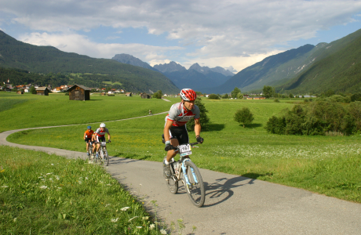


H & V Cost Maps
High cost
Low cost
Horizontal Cost
Vertical Cost

Slide 30
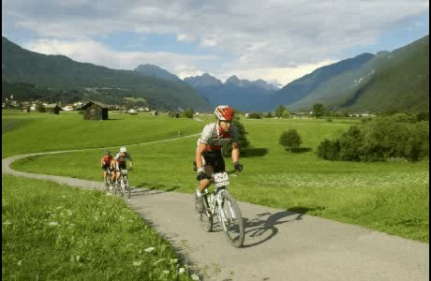
Seam Carving

Slide 31
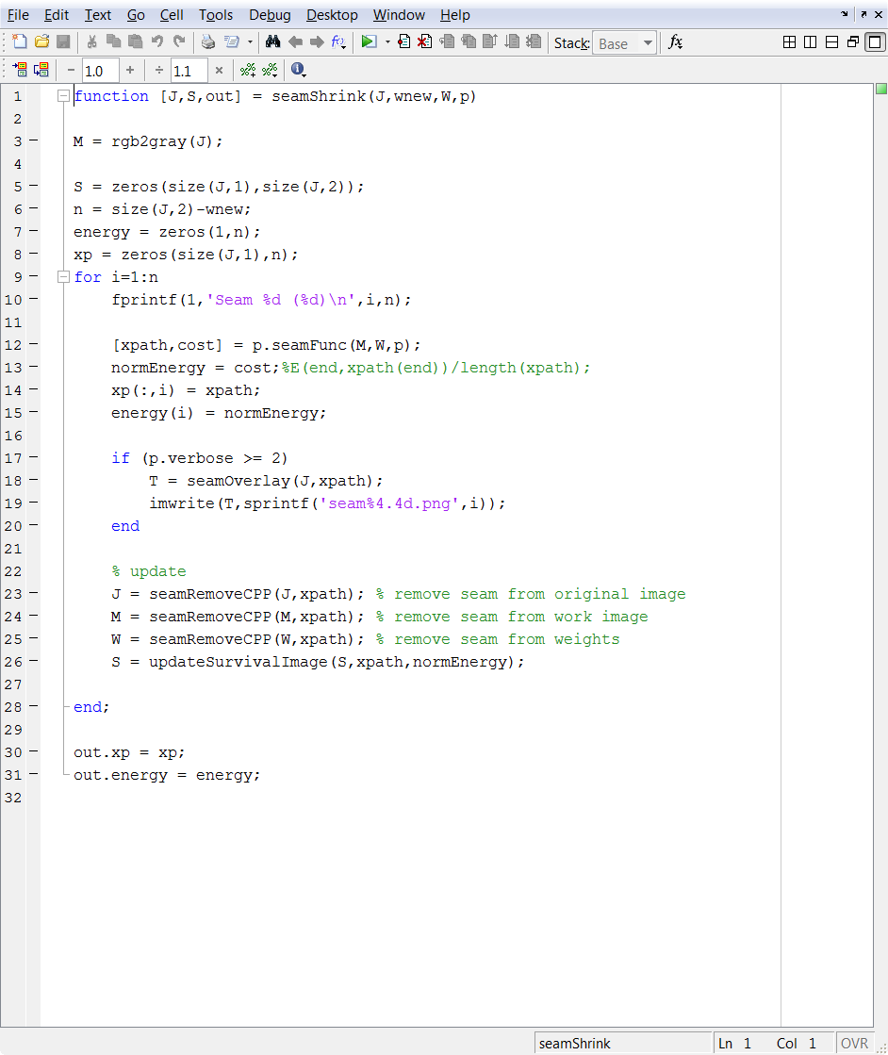
The Seam-Carving Algorithm
SEAM-CARVING(im,n’) // size(im) = mxn
Do (n-n’) times
  2.1. E ← Compute energy map on im
  2.2. s ← Find optimal seam in E
  2.3. im ← Remove s from im
Return im
For vertical resize: transpose the image
Running time:
  2.1 O(mn) 2.2 O(mn) 2.3 O(mn)
  O(dmn) d=n-n’

Slide 32
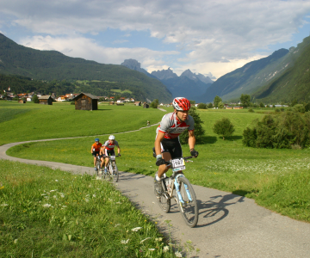
Changing Aspect Ratio

Slide 33
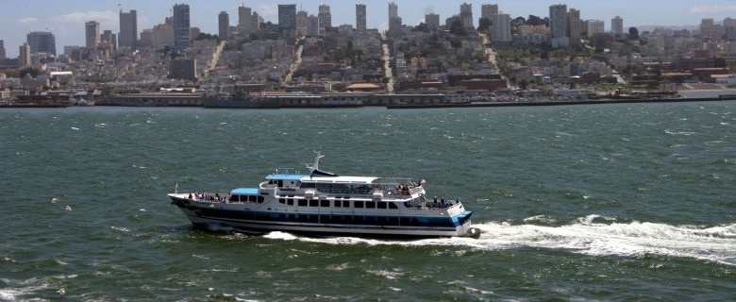
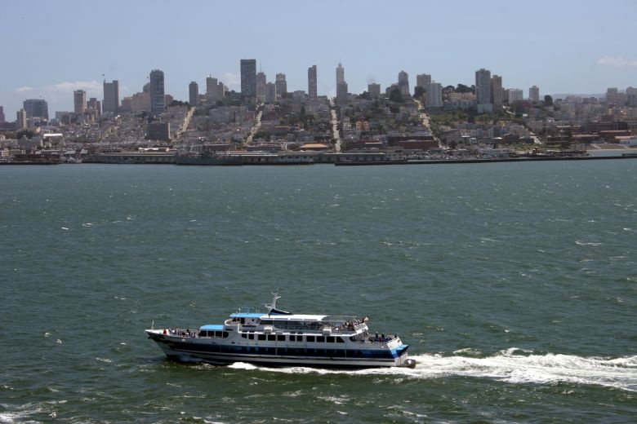

Changing Aspect Ratio
Seam Carving
Original
Scaling

Slide 34




Changing Aspect ratio
Cropping
Seams
Scaling

Slide 35
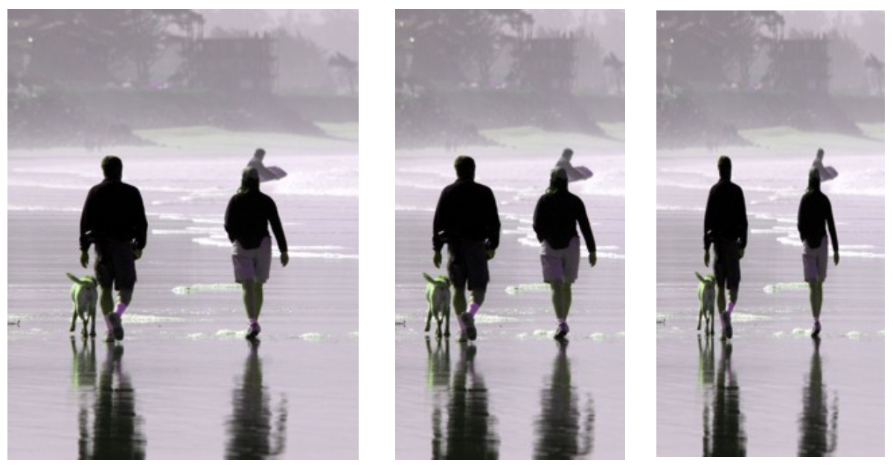
Changing Aspect Ratio
Scaling

Slide 36
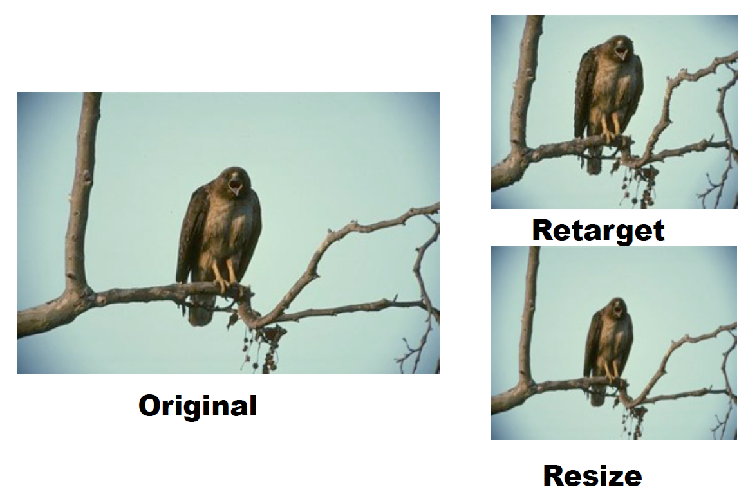
Changing Aspect Ratio
Scaling

Slide 37
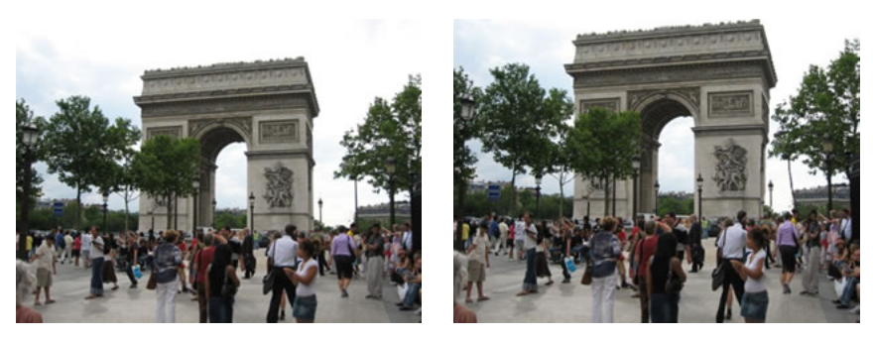
Content Enhancement

Slide 38
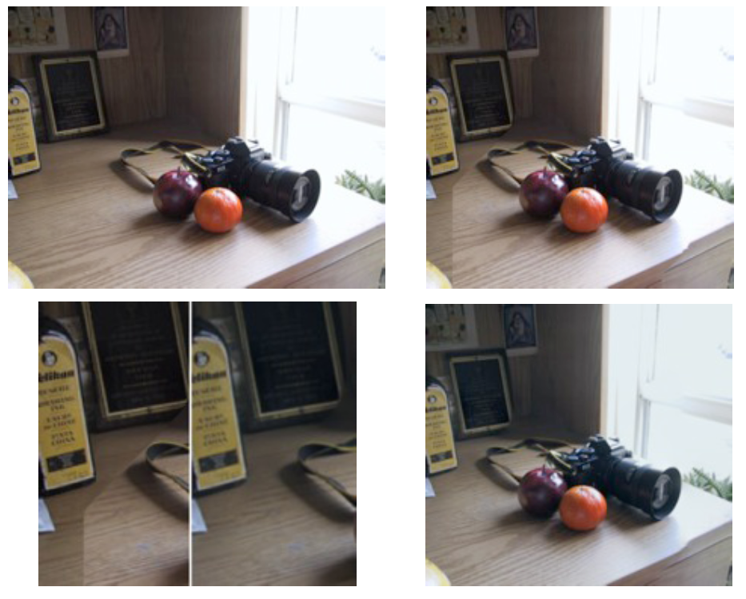
Seam Carving in the Gradient Domain

Slide 39
Questions?
Q: Will the result be the same if the image is flipped upside down?
A: Yes (up to numerical stability)
Q: Can we improve the running time?
A: Yes. by factor (account for locality of operations)

Slide 40
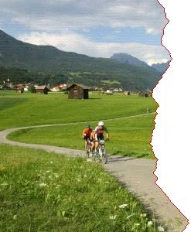
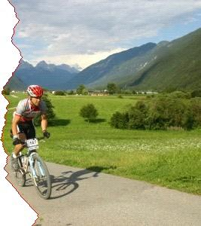
A Local Operator

Slide 41
Questions?
Q: Will the result be the same if the image is flipped upside down?
A: Yes (up to numerical stability)
Q: Can we improve the running time?
A: By factor (local operations)
Q: What happens to the overall energy in the image during seam carving?

Slide 42
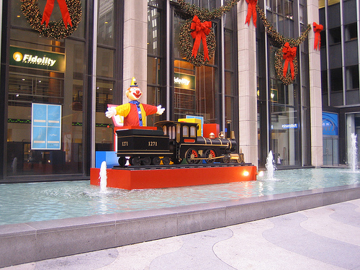
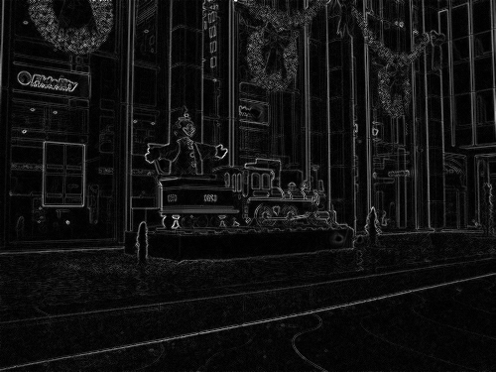
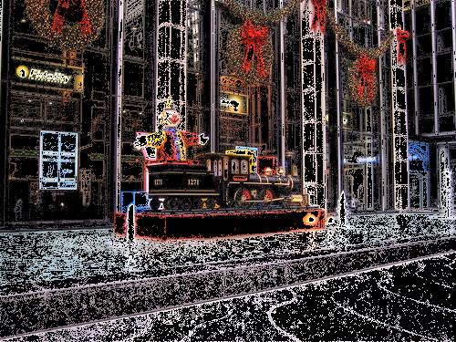



Preserved Energy
Energy
10%
30%
40%
75%
While resizing: remove as many low energy pixels and as few high energy pixels!

Slide 43
Preserved Energy
If we measure the average energy of pixels in the image after applying a resizing operator…
…the average should increase!
Average Pixel Energy
While resizing: remove as many low energy pixels and as few high energy pixels!
Image Reduction

Slide 44










Preserved Energy
Average Pixel Energy
Image Reduction
crop
column
seam
pixel
optimal

Slide 45


Both Dimensions?
m x n → m’ x n’
Remove horizontal seam first?
Remove vertical seams first?
Alternate between the two?
The optimal order can be found! → Dynamic Prog (again)

Slide 46

Retargeting in Both Dimensions
The recursion relation:

Slide 47

Optimal Order Map
Removal of vertical seams
0 | 13 | 16 | 19
16 | 17 | 22 | 28
19 | 31 | 25 | 35
24 | 28 | 29 | ???
32 | 35 | 33
41 | 38 | 35
Removal of horizontal seams

Slide 48
Optimal?
In a greedy sense…
Seam costs are not absolute
  Consider HVV (how many possibly orderings?)
  Cost(V) on HV not necessarily equal Cost(V) on VH
  But we keep track of only one: min(HV,VH)…
Vertical Seams
0 | V | VV
H | min(HV,VH) | ?
Horizontal Seams

Slide 49




Image Expansion (Synthesis)

Slide 50



Image Expansion – take 2
Scaling

Slide 51


Enlarged or Reduced?

Slide 52

Combined Insert and Remove
Insert & remove seams
Scaling

Slide 53
Questions?

Slide 54
Multi-Size Images
We can create a new representation of an image that will allow adapting it to different sizes!
  Precompute all seams once
  Realtime resizing / transmit with content

Slide 55



Multi-Size Images
First to be removed
…
Last to be removed

Slide 56

Multi-Size Image Representation
+

Slide 57


Multi-Size Image Representation

Slide 58
2D Multi-Size Representation?
Consistent index maps (see appendix in their paper)
Alternatives
  Use seams in one direction, row/column seams in the other direction
  Compute seams in one direction and use them to constrain seams in the other direction
    - If you can do that you’ll have a nice publication ☺

Slide 59
Auxiliary Energy
Recall our seam equation

Slide 60

With face detector

Slide 61

With User Constraints

Slide 62



Object Removal

Slide 63

Object Removal

Slide 64




Find the Missing Shoe!

Slide 65
Solution

Slide 66

Limitations

Slide 67
Preserved Energy - Revisited
Average Pixel Energy
Image Reduction
crop
column
seam
pixel
optimal

Slide 68


Inserted Energy

Slide 69
Minimize Inserted Energy
Instead of removing the seam of least energy, remove the seam that inserts the least energy to the image !

Slide 70
Tracking Inserted Energy
Three possibilities when removing pixel P_{i,j}
p_{i-1,j-1}
p_{i-1,j-1}
p_{i-1,j}
p_{i-1,j+1}
p_{i,j-1}
p_{i,j}
p_{i,j}
p_{i,j+1}

Slide 71
Pixel P_{i,j} : Left Seam
p_{i-1,j-1}
p_{i-1,j-1}
p_{i-1,j}
p_{i-1,j+1}
p_{i,j-1}
p_{i,j}
p_{i,j}
p_{i,j+1}

Slide 72
Pixel P_{i,j} : Right Seam
p_{i-1,j-1}
p_{i-1,j}
p_{i-1,j+1}
p_{i-1,j+1}
p_{i,j-1}
p_{i,j}
p_{i,j}
p_{i,j+1}

Slide 73
Pixel P_{i,j} : Vertical Seam
p_{i-1,j-1}
p_{i-1,j}
p_{i-1,j}
p_{i-1,j+1}
p_{i,j-1}
p_{i,j}
p_{i,j}
p_{i,j+1}

Slide 74
Old “Backward” Energy
E

Slide 75



New Forward Looking Energy
E

Slide 76
Adding “Pixel Energy”

Slide 77

Results
Backward
Input
Backward
Forward
Input
Forward

Slide 78



Results

Slide 79



Backward vs. Forward
Backward
Forward

Slide 80



Results

Slide 81




Discrete vs. Continuous
[Avidan and Shamir 2007]
[Wang et al 2008]
Continuous
Discrete

Slide 82


Non-homogeneous Scaling
Seam Carving
Scale-and-Stretch

Slide 83


Non-homogeneous Scaling
[Wang et al 2008]

Slide 84





Bidirectional Similarity [Simakov et al. CVPR 08]

Slide 85




Bidirectional Similarity

Slide 86
From Images to Videos
In general, video processing is a much (much!) harder problem
Cardinality
  Suppose 1min of video x 30 fps = 1800 frames
  Say your algorithm processes an image in 1 minute → 30 hours !!
Dimensionality/algorithmic
  Temporal coherency: human visual system is highly sensitive to motion!

Slide 87



Seam-Carving Video?
Naive… frame by frame independently
Time

Slide 88


Frame-by-frame Seam-Carving
*Representative seams

Slide 89

From 2D to 3D
1D paths in images
2D manifolds in video cubes

Slide 90

Challenges
Dynamic Programming no longer applicable
  Reduction to min-cut graph problem
Cut must fulfill seam constraints
  Monotonic (cut each row exactly once)
  Connected
Cut should be a
function!

Slide 91

Graph Construction
Not monotonic

Slide 92

Graph Construction
Monotonic, not connected

Slide 93


Graph Construction
Backward
Energy
Forward
Energy

Slide 94

Multiresolution Graph Cut
Lombaert et al. [2005]

Slide 95


Results
Rescale
Retarget

Slide 96



Results
Seams
Backward
Forward

Slide 97

Multi-size Video

Slide 98

Object Removal…

Slide 99
References
Seam Carving for Content-Aware Image Resizing – Avidan and Shamir 2007
Content-driven Video Retargeting – Wolf et al. 2007
Improved Seam Carving for Video Retargeting – Rubinstein et al. 2008
Optimized Scale-and-Stretch for Image Resizing – Wang et al. 2008
Summarizing Visual Data Using Bidirectional Similarity – Simakov et al. 2008
Multi-operator Media Retargeting – Rubinstein et al. 2009
Shift-Map Image Editing – Pritch et al. 2009
Energy-Based Image Deformation – Karni et al. 2009
Seam carving in Photoshop CS4: http://help.adobe.com/en_US/Photoshop/11.0/WS6F81C45F-2AC0-4685-8FFD-DBA374BF21CD.html

Slide 100

References

