Slide 1
Personal Information Management, Personal Information Retrieval?
Michael Bernstein, Max Van Kleek, David R. Karger, mc schraefel
{msbernst, emax}@csail.mit.edu
Notes:
Goal today: to cast IR in terms of PIM. We’re using techniques from HCIR. Show what’s working and what we need help with. Direct IR energies towards PIM, direct PIM energy towards IR.

Slide 2
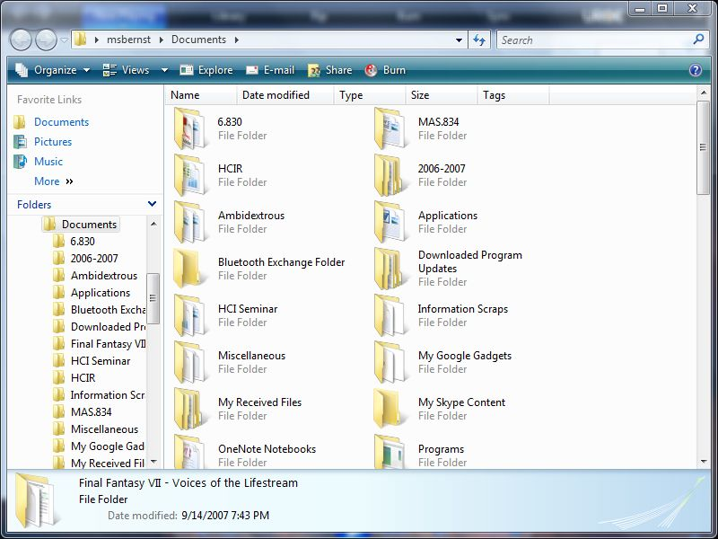
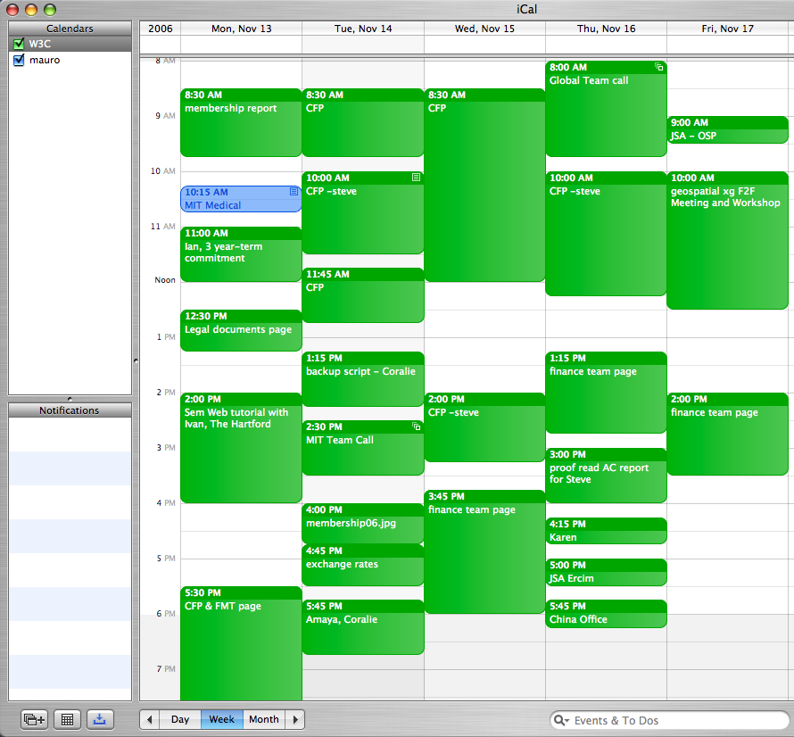
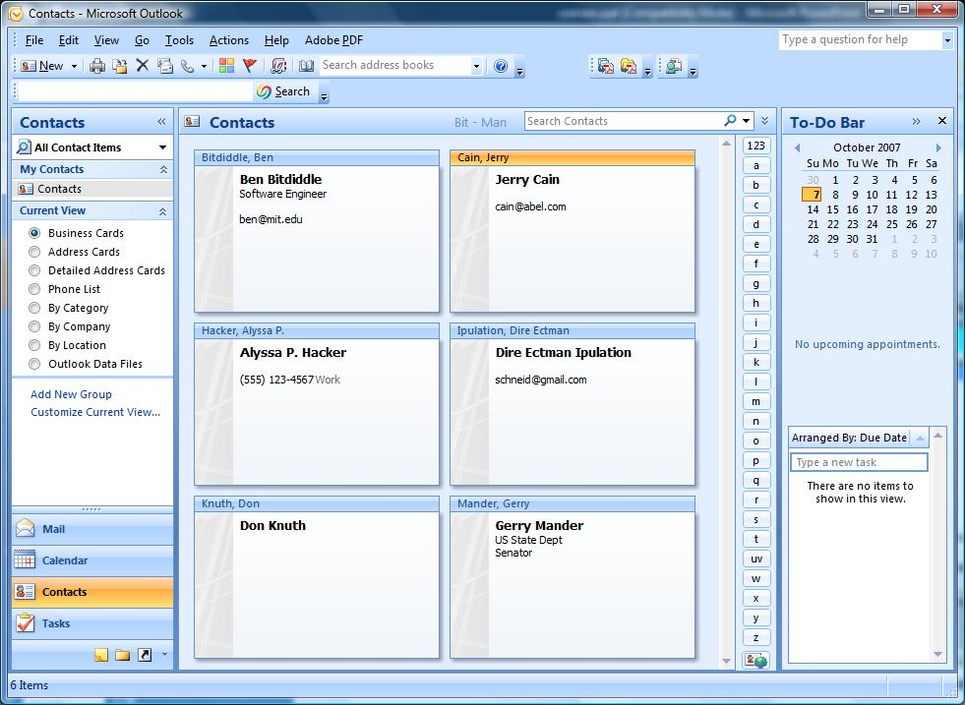
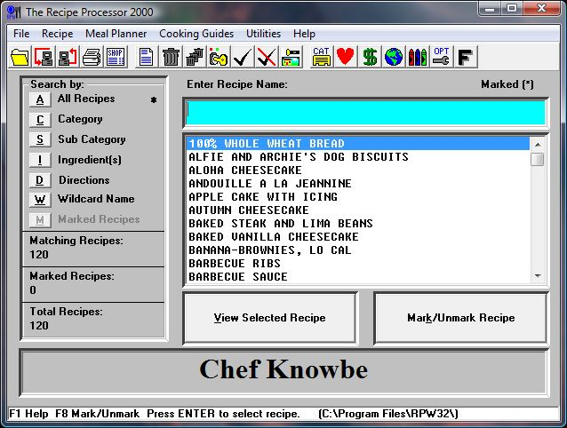
What is PIM?
Notes:
So, first of all, what is personal information management? [click] We can plan our days and [click] receive reminders, [click] remember people who might offer us jobs later, [click] work our data into hierarchies to organize it so that we can find it later, and [click] all sorts of unique things like figure out what’s for dinner tonight.

Slide 3
Personal information management or PIM is both the practice and the study of the activities people perform to acquire, organize, maintain, retrieve, use, and control the distribution of information items such as documents (paper-based and digital), Web pages, and email messages for everyday use to complete tasks (work-related and not) and to fulfill a person’s various roles (as parent, employee, friend, member of community, etc.).
[Jones and Teevan 2007]

Slide 4
Personal information management is both the practice and the study of the activities people perform to acquire, organize, maintain, retrieve, use, and control the distribution of information items such as documents […], Web pages, and email messages […]
[Jones and Teevan 2007]

Slide 5
Personal information management means getting control over your life.
[Michael Bernstein, personal communication, 10/23/2007]
Notes:
[laugh?].
OK, so it sounds like PIM is Outlook. But WE’RE interested in the things that we typically have a lot of trouble getting control over. Those are…

Slide 6
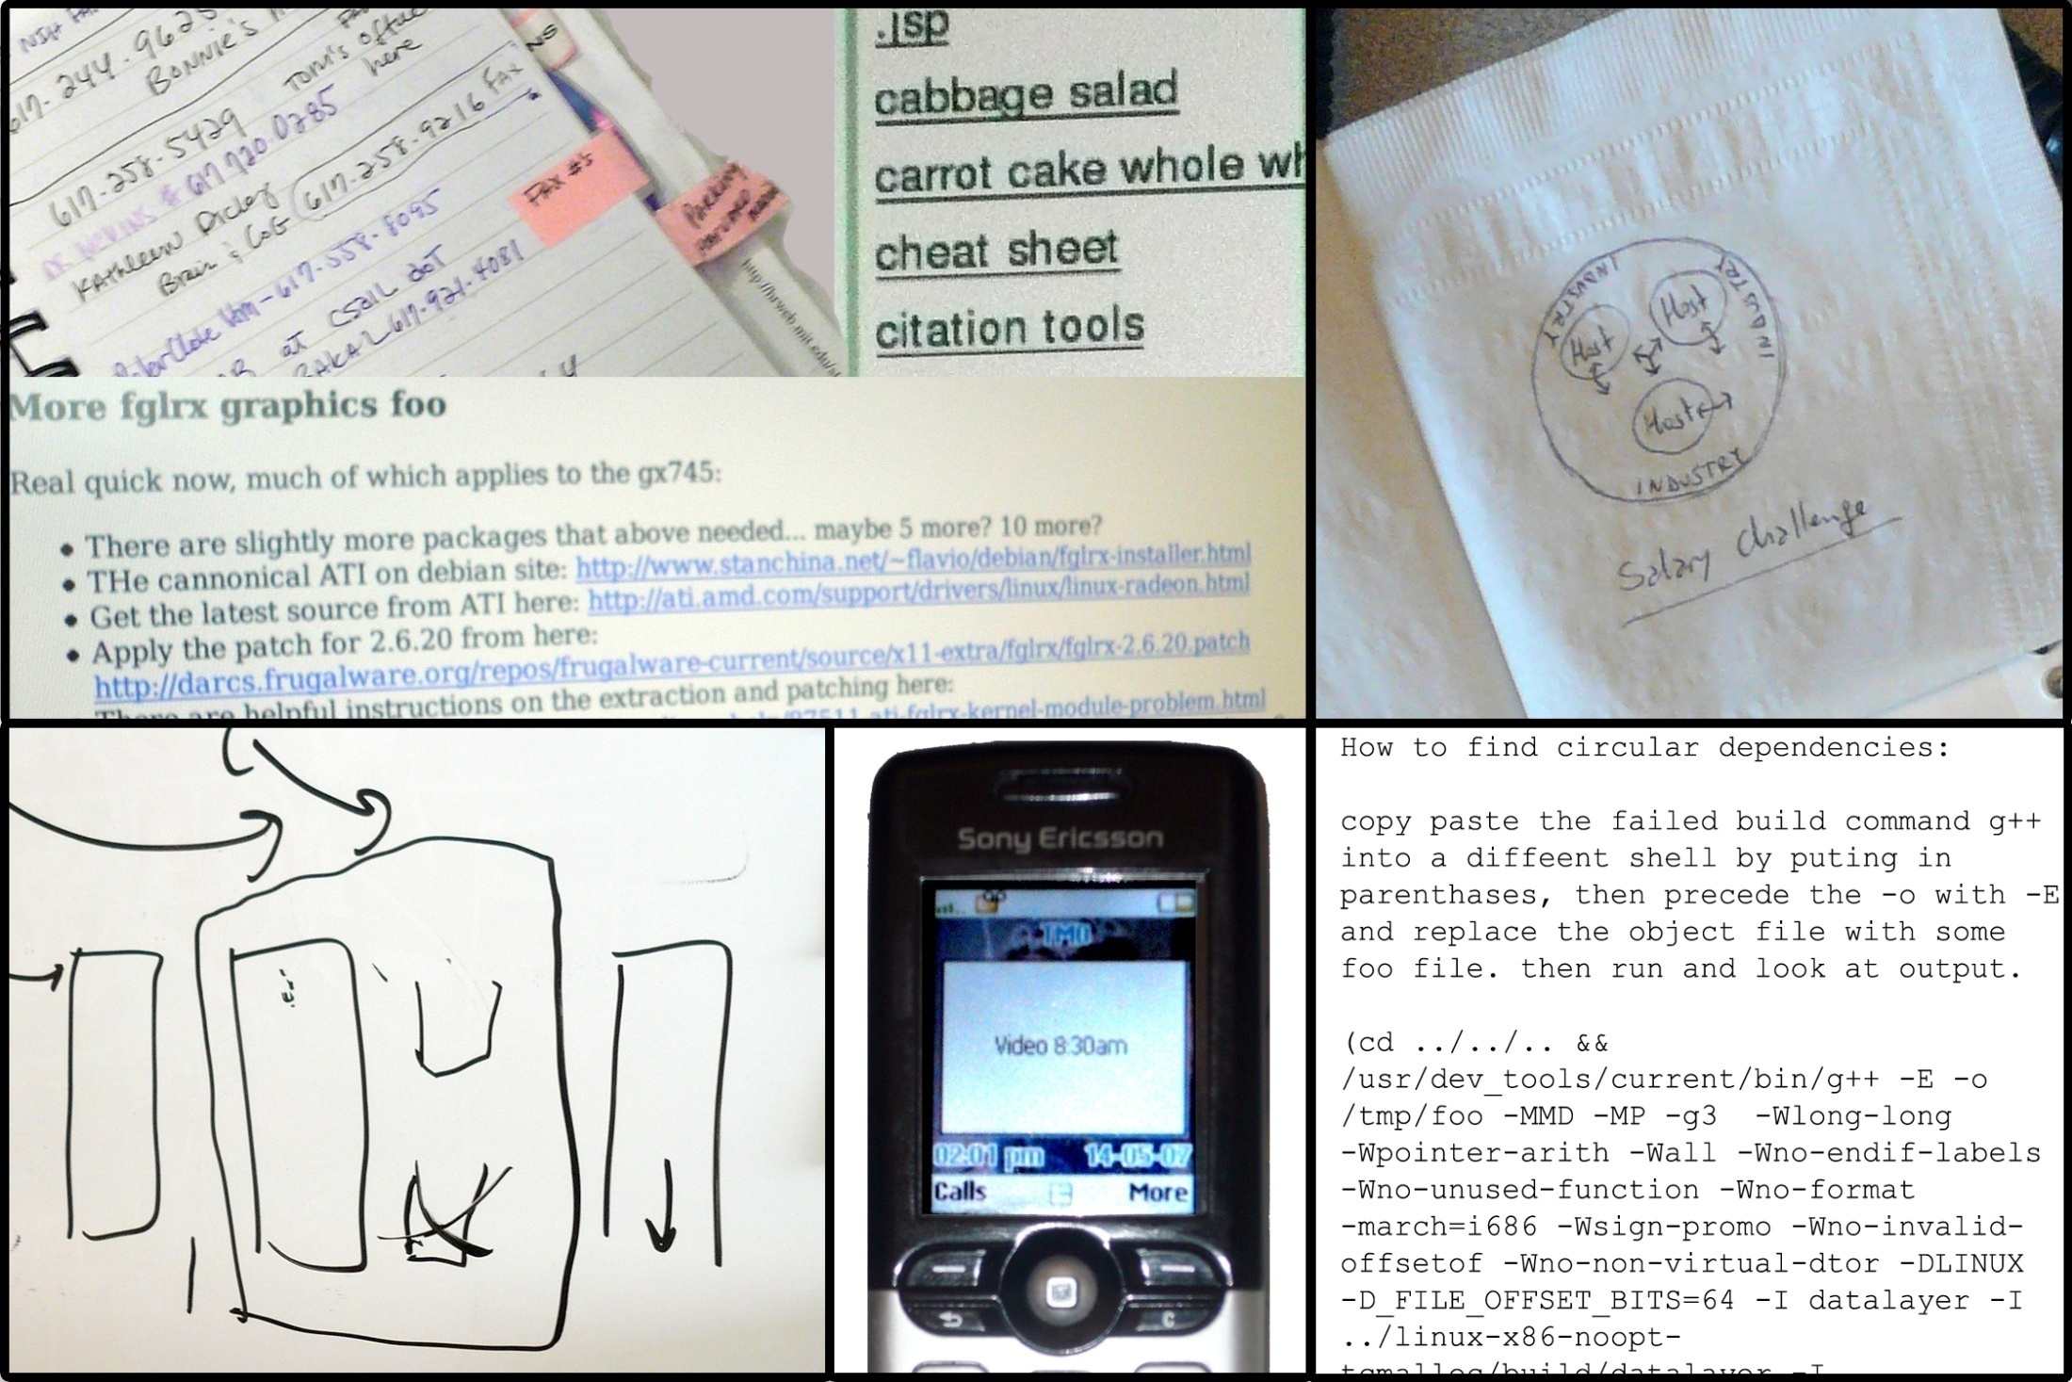
Contact Information
Recipes
E-mail
Brainstorms
Paper Scraps
Notebooks
Wikis and Blogs
How-tos
Sketches
Whiteboards
Appointments
Cell Phones
How-tos
todo.txt
Information Scraps
[in submission to ACM TOIS]
Notes:
information that escapes our applications. We call these “information scraps” – they are things that show up [click] scribbled into notebooks, into text files, in emails to yourself, and so on. Inside these scraps is [click] some typical information and some not-so-typical information – calendar appointments and reminders, contact information, notes and brainstorms, as well as less traditionally supported types such as how-tos and recipes.

Slide 7
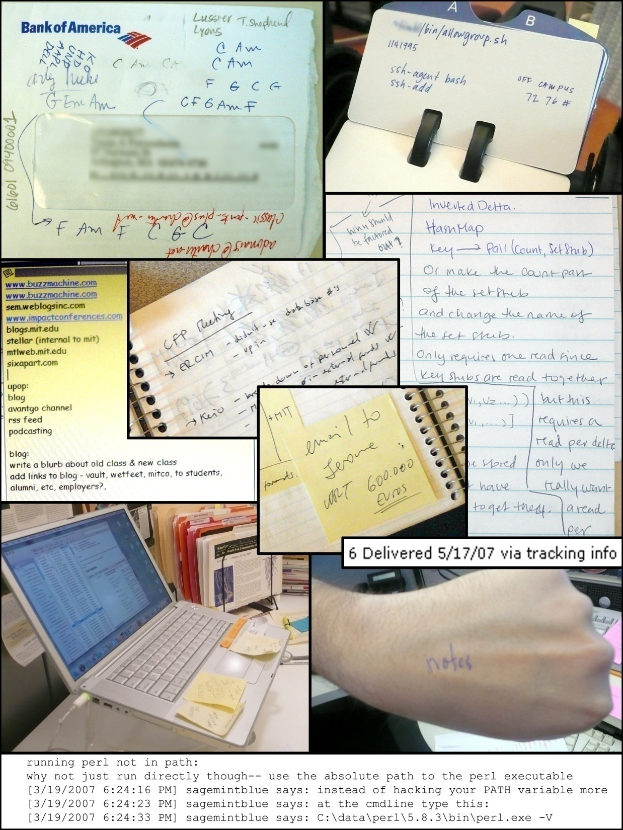
What should the IR system index?
How will the user search for it again?
Notes:
These are interesting because they are HARD.
What do you index? The contents? There’s so little as to have almost no content. (IR problem.) Well, looking at this one, it’s not clear exactly what you should be indexing and how you should be interpreting it. (Guesses for what it is?) If stuff nearby shows up in an index, it won’t make sense to the user.
[click for search
How would you think to search for it again? “What are the guitar tabs to Stereotypical Rock Song?”

Slide 8
HCIR in PIM
We are not retrieving documents from a corpus!
Retrieval, Reorganization, Reminding
Very short, incomplete text in unusual language
Importance of lightweight interaction
User has intimate knowledge of the corpus
Notes:
These are hard problems, both from an IR perspective and an HCI perspective. Model of “retrieving documents from a corpus” is inappropriate.

Slide 9
Outline
Motivation
Ethnographic Investigation
System design
Reflection

Slide 10
Ethnographic Study
27 participants, mainly knowledge workers
Method: semi-structured interviews and artifact examinations
Goal: learn more about existing information scrap practice
[in submission to ACM TOIS]
Notes:
Going to summarize some of the interesting findings we had, w.r.t. roles that infoscraps play

Slide 11
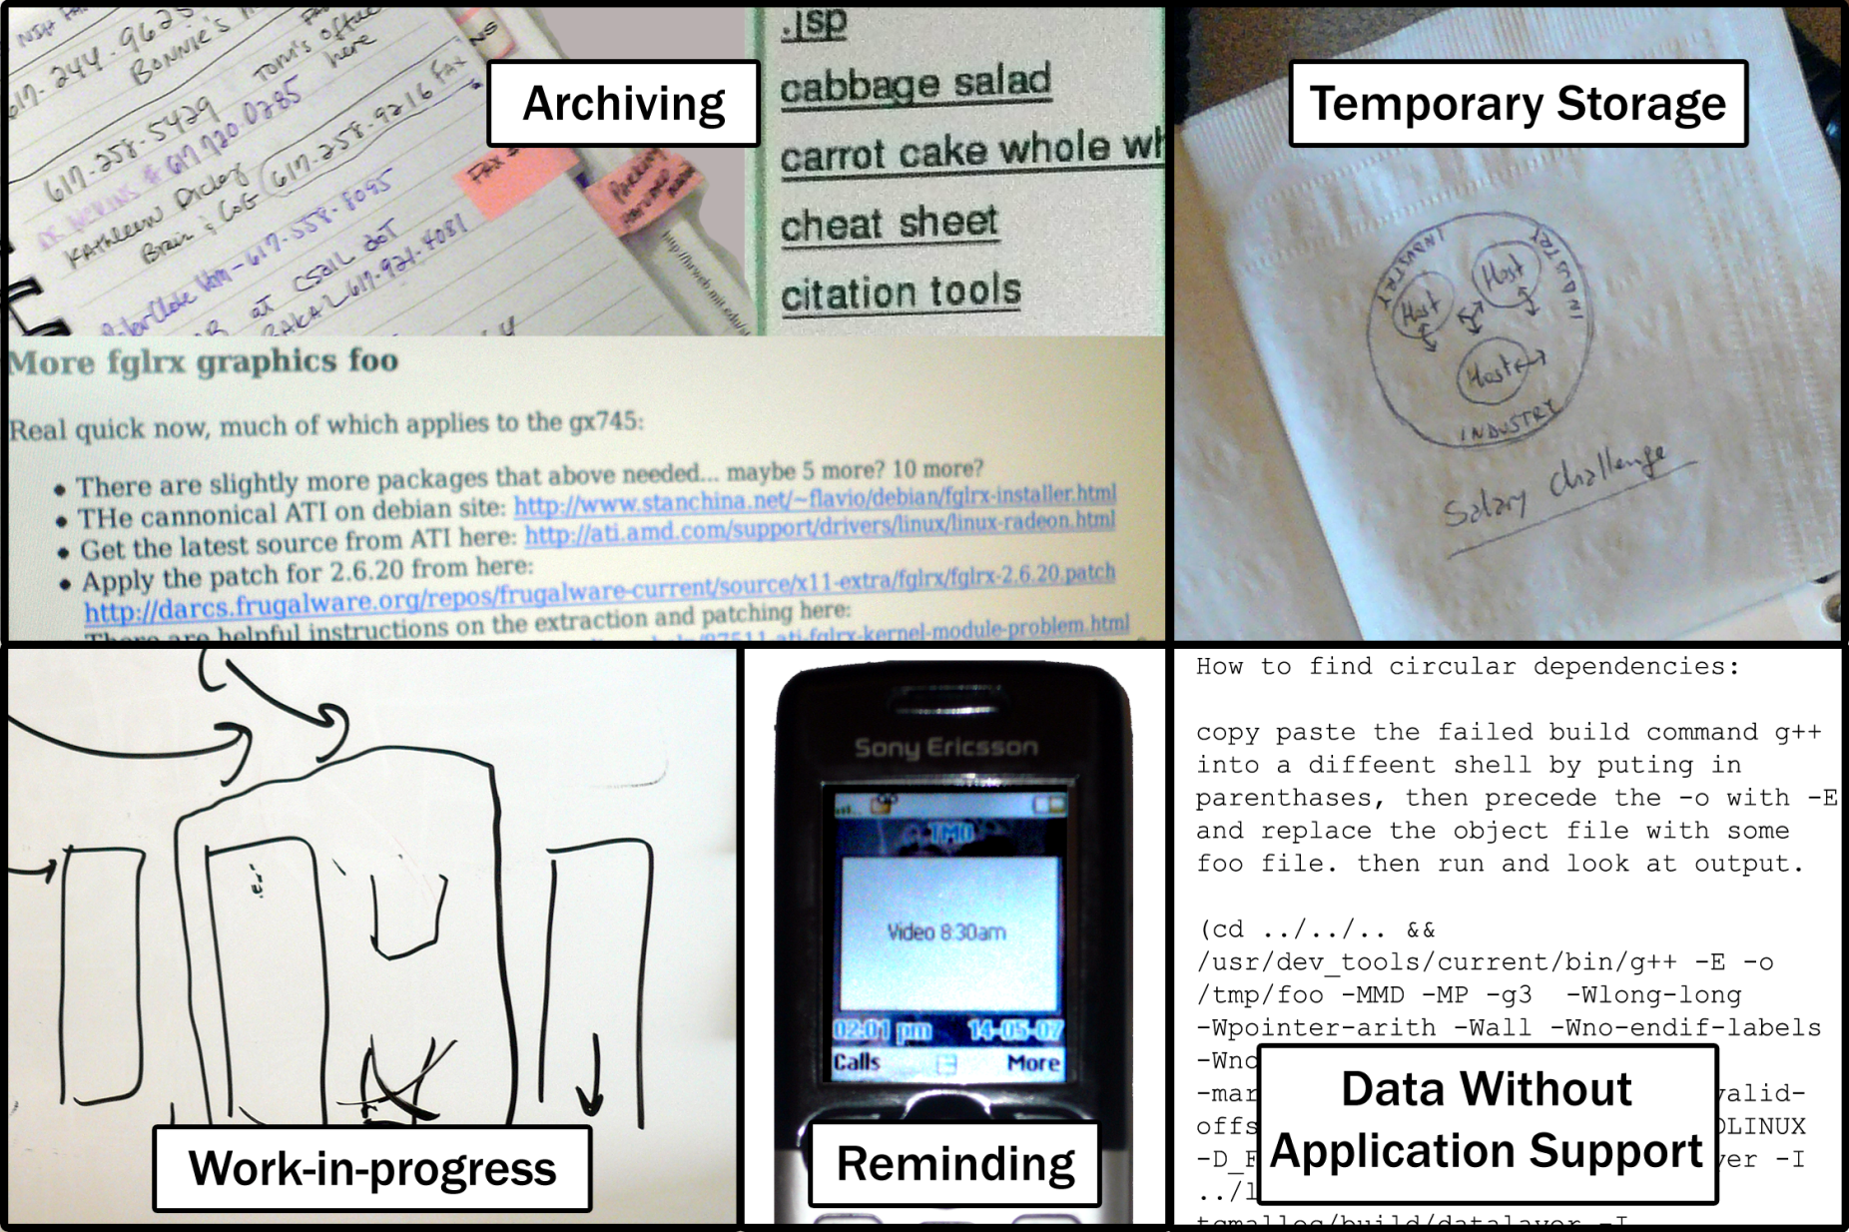
Roles that Information Scraps Play
Notes:
These might not want to be ranked highly a year after creation, b/c they were intended to be thrown away or transferred anyway

Slide 12
What can we do about this?

Slide 13
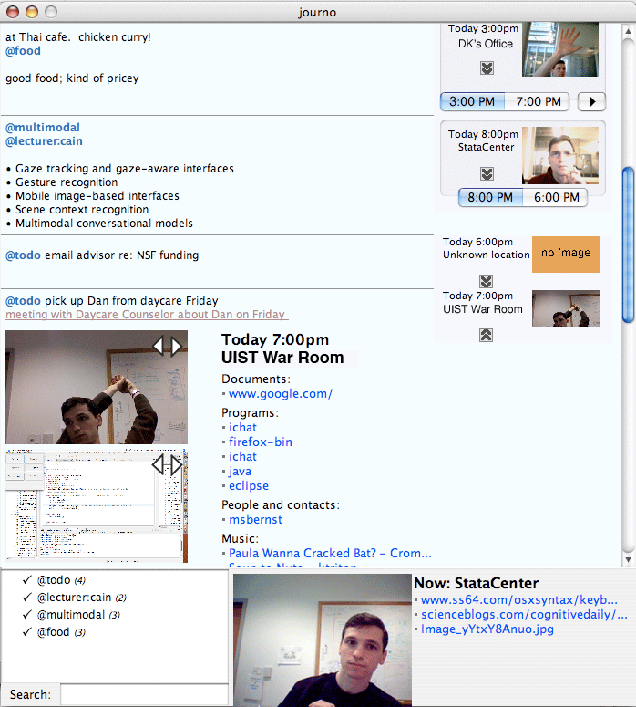
Jourknow
Notes:
We built a system called Jourknow, tailored towards these needs, and especially designed to service the information scrap space. I’m going to describe the Jourknow system and its particular design points to follow.

Slide 14
Jourknow
Quick Entry
Context
Structure Capture
Structure Exploitation
“meeting with Kwasi at 5pm about camping”
Type: Meeting
Time: 5pm
Type: Meeting
Time: 5pm
Attendees: Kwasi
Topic: Camping
Attendees: Kwasi
Topic: Camping
Notes:
14

Slide 15
Quick Entry
Enter New Note:
regina’s phone (617) 555-1234
Ctrl
Alt
Spacebar
Notes:
Hotkey invokation
Flow, Chick sent me holly
15

Slide 16
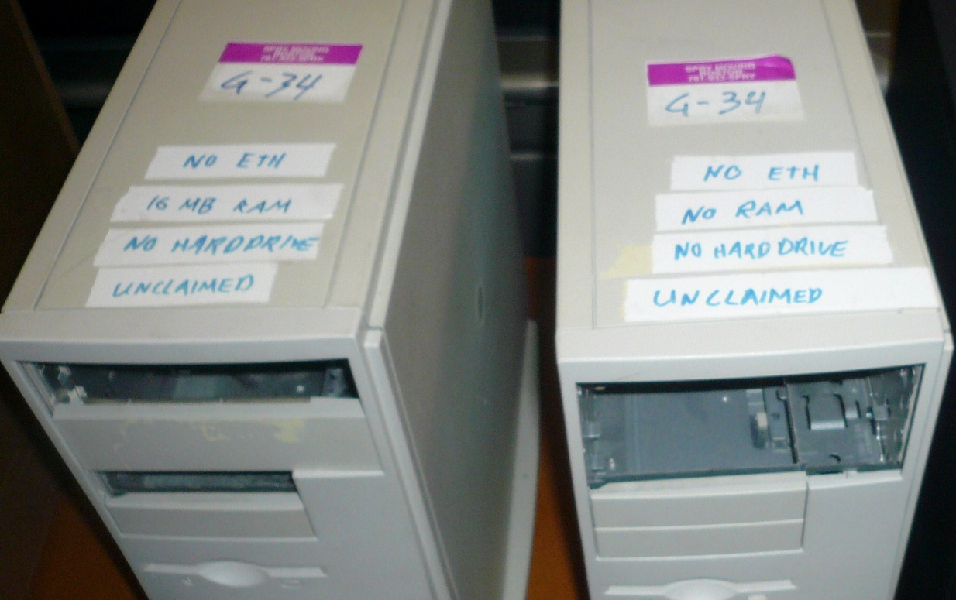
Context
We often remember aspects of our data extrinsic to the bits themselves
People [Cutrell]
Time [Ringel]
Pictures [Sellen]
Location [Rhodes]
Notes:
In many cases, the entire info content is what you are seeking (a mac address) so if you had _any_ query that would find the content, it would mean you already knew that answer before searching.

Slide 17
Context
Automatic context capture and association with note contents
Useful for re-contextualizing the note to divine its contents, or in re-finding the note
[Landmarks: Ringel], [SenseCam: Gemmell], [Chitty Chatty: Kalnikaite], [Remembrance Agent: Rhodes]

Slide 18
Notes:
[write description here]

Slide 19
Structure Capture – Pidgin
Notes:
The approach we take in our paper is a ‘pidgin’ language compromising between human flexibility and computer comprehension. The user has the option to type in either completely free text, or one of these pidgin languages. Here we have written a meeting recognizer similar to Google Calendar Quick Add. The phrase is parsed as the user types, and the system gives interactive feedback as the recognition occurs. The user can then inspect the text to identify recognized structure in the text.

Slide 20
Structure Exploitation: Application Push
meeting w/ karger at 5 about my thesis
Notes:
In many ways, the purpose of the Pidgin languages within Jourknow is to help the user generate some structure for help with later retrieval. Apps are good at this, so we can push.

Slide 21
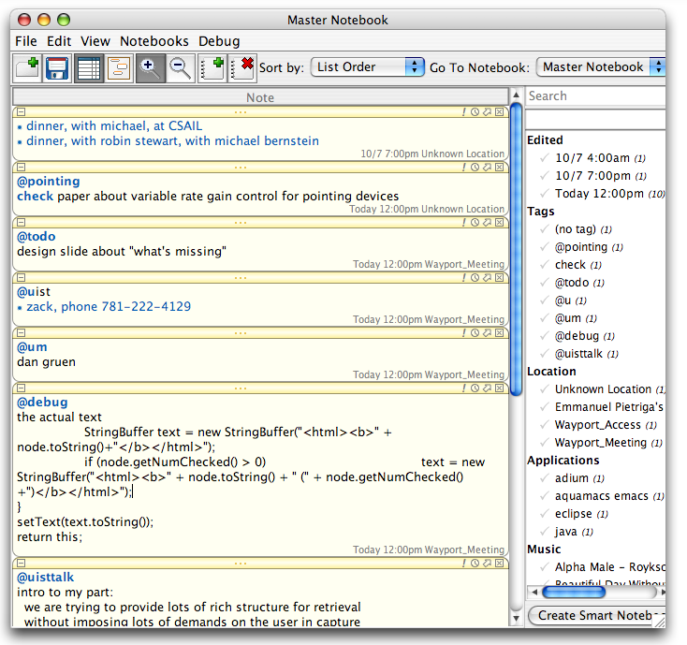
Structure Exploitation: Faceted Browsing
Notes:
Swapping out to a newer iteration of the interface…
Here we utilize faceted browsing techniques. filter notes back down to just content of interest. We provide the same hooks you just sawy -- thus find notes taken at Starbucks, or while listening to Aerosmith.
Here we take the set of notes…

Slide 22
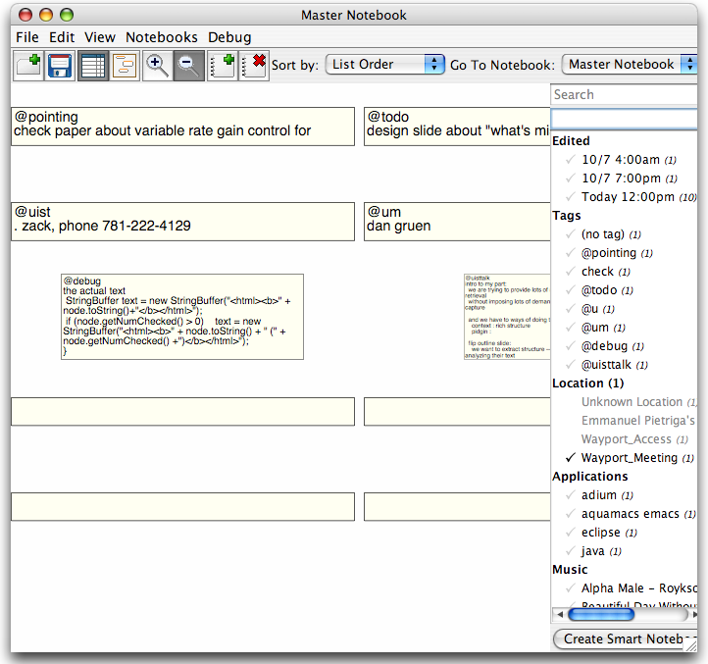
Structure Exploitation: Faceted Browsing
Notes:
And ask to show only notes taken while on the wonderfully reliable Wayport Meeting

Slide 23
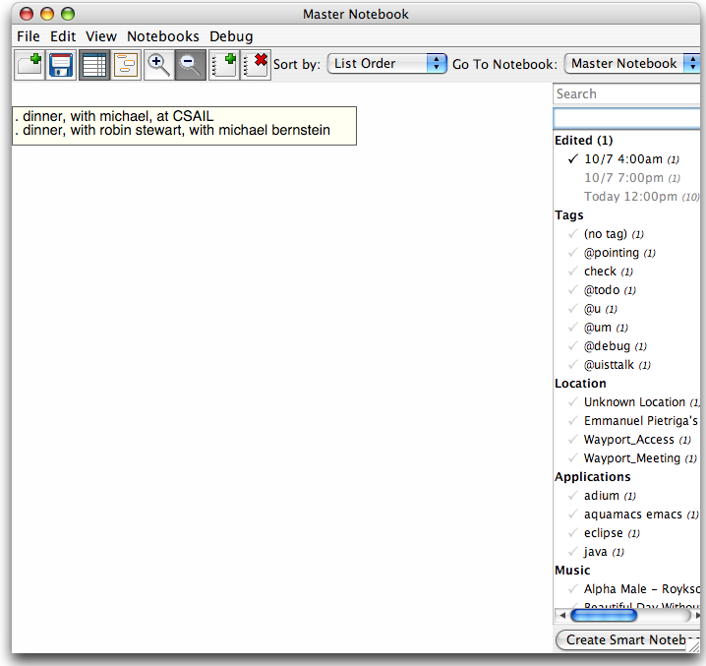
Structure Exploitation: Faceted Browsing
Notes:
And here look only for notes edited at 4am on the 7th. I assure you, we were just up early for our morning run.

Slide 24
Structure Exploitation: Pidgin Inspection
Notes:
Now we can consider facets on arbitrary data types too. Having captured some thoughts on restaurants, the user can then use a right-click interaction to accumulate the information across his or her notes. By right-clicking on the item Mike’s Pastries [click], Jourknow joins all the information it knows about Mike’s pastries. Likewise, by clicking on “restaurant” [click], it displays information on all restaurant items.

Slide 25
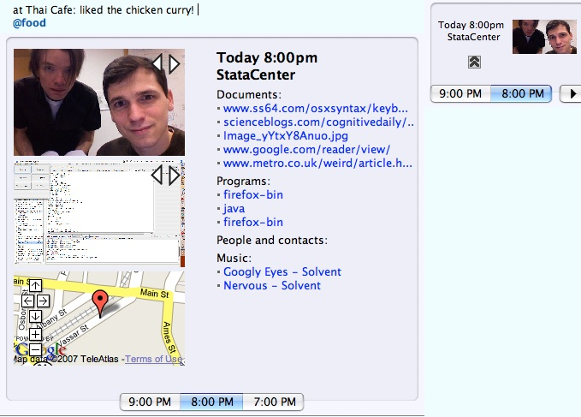
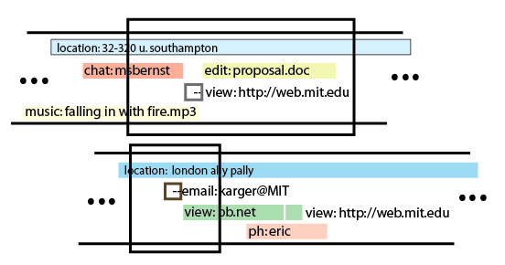
meeting with mc
at her office at 5pm tomorrow
BEGIN:VCALENDAR
VERSION:1.0
BEGIN:VEVENT
CATEGORIES:MEETING
STATUS:CONFIRMED
DTSTART: 20071010T1700Z
SUMMARY: Meeting with mc
LOCATION: her office
CLASS:PUBLIC
END:VEVENT
END:VCALENDAR
Structure extraction:
pidgins
Text and Context :
Activity capture, mining and correspondence

Slide 26
Reflections and Open Questions
Faceted browsing scaling to large numbers of contextual facets
Additional tools and techniques
Bringing together HCI and IR in a difficult domain to see where innovation might lie

Slide 27
Thank you!
jourknow.csail.mit.edu
jourknow@csail.mit.edu

