Slide 1
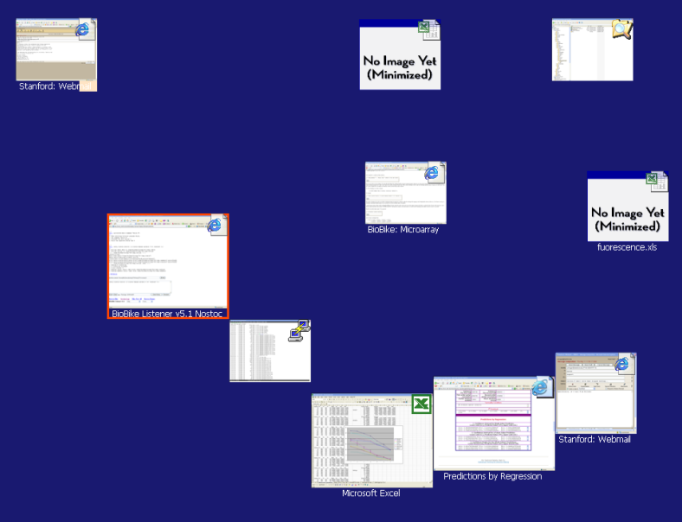
Taskposé
Exploring Fluid Boundaries in an Associative Window Visualization
Michael Bernstein Computer Science MIT | Jeff Shrager Symbolic Systems Stanford University | Terry Winograd Computer Science Stanford University
Notes:
If you can read this note, think about ways we can use a projector without that awkward “projecting-but-not-in-presentation-mode-yet” moment.

Slide 2
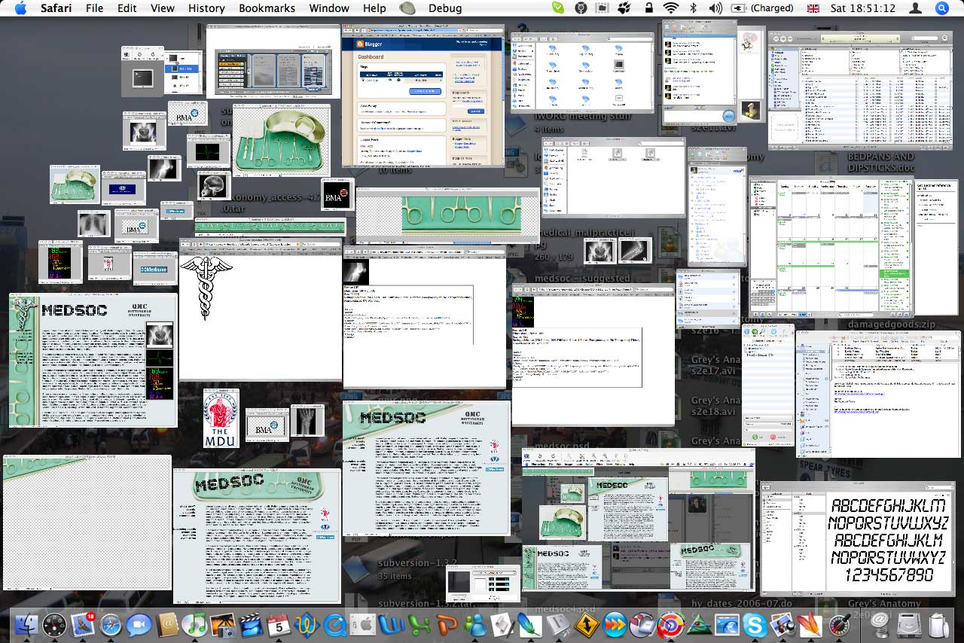
Artifacts of information work
http://blog.strawberryice.org.uk
[Hutchings et al. 2004, Czerwinski et al. 2004, Gonzales & Mark 2004]
Notes:
[pause] This is not my desktop.

Slide 3
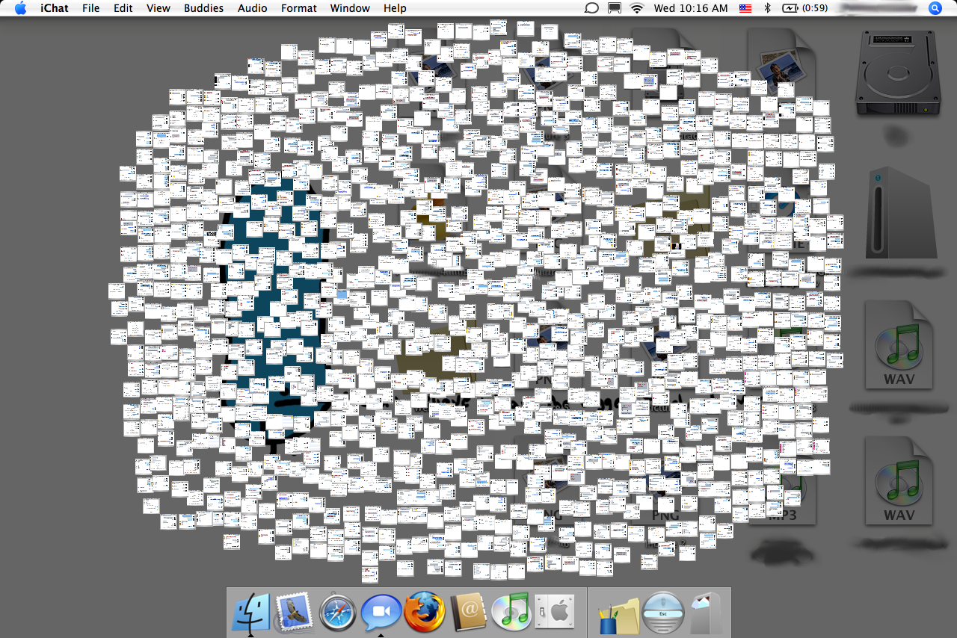
Artifacts of information work
http://flickr.com/photos/judxapp
[Hutchings et al. 2004, Czerwinski et al. 2004, Gonzales & Mark 2004]
Notes:
8 windows at once

Slide 4
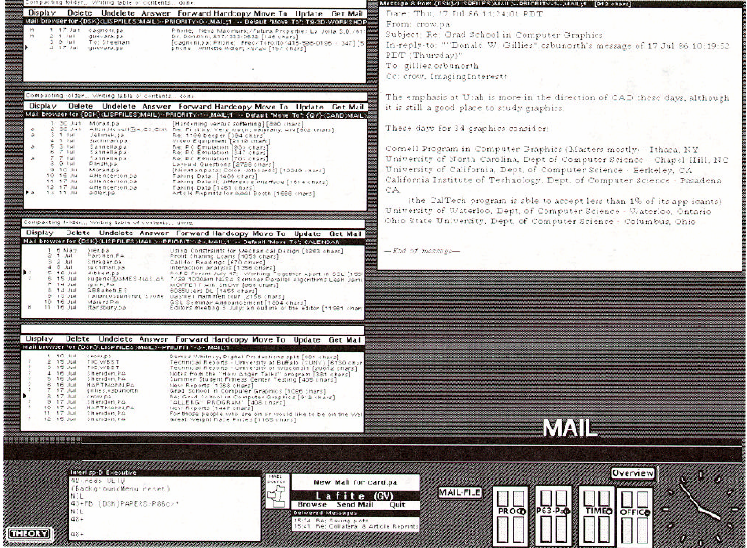
Rooms [Henderson & Card 1986]

Slide 5
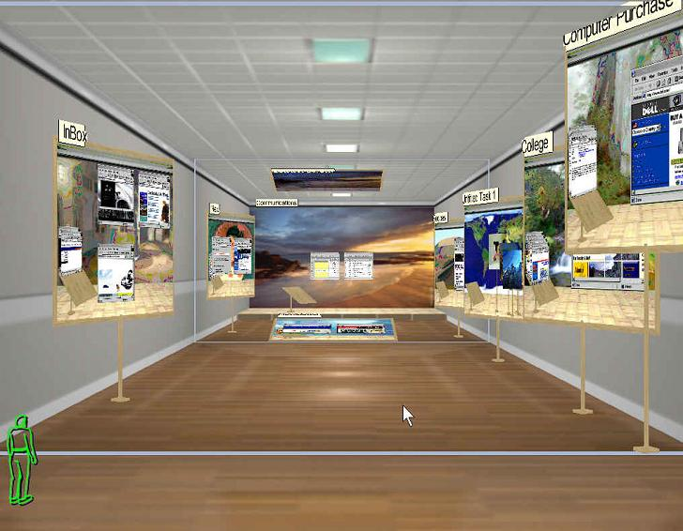
+
Task Gallery [Robertson et al. 2000]

Slide 6
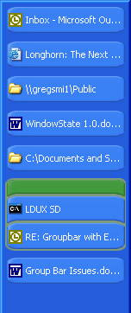
GroupBar [Smith et al. 2003]

Slide 7
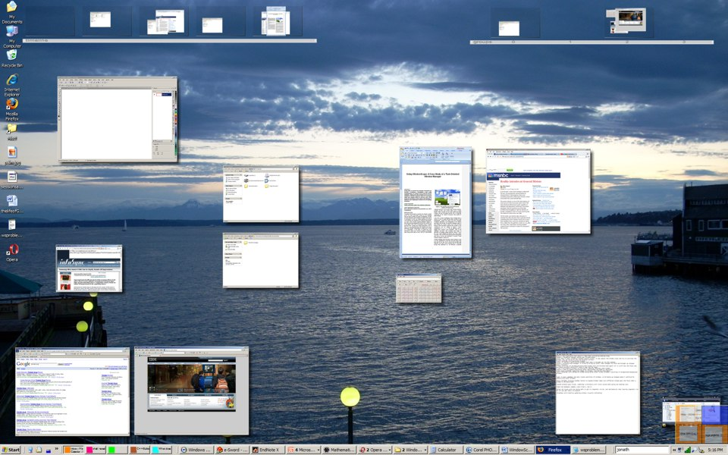
WindowScape [Tashman 2006]

Slide 8
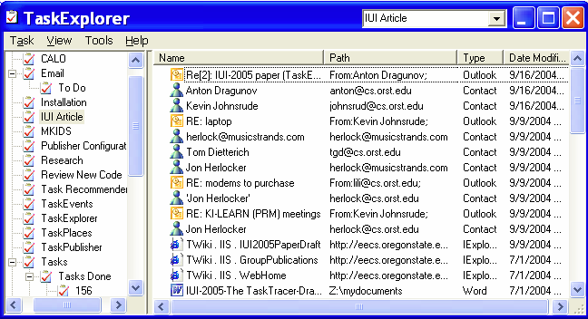
TaskTracer [Dragunov et al. 2004]

Slide 9
Classification
assigning each window to a relevant task
Microsoft Word
?
Firefox
AIM
Microsoft Excel
Firefox
Outlook
iTunes
Firefox

Slide 10
Classification Can Be The Wrong Model
vs.
When asked which task would be correct: “Users are often not 100% sure themselves or may provide different answers in different contexts. Users are often able to tell the system what it is not, but not what it is.”
[Stumpf et al. 2005], emphasis added

Slide 11
“Buying a Birthday Gift”

Slide 12
Classification
assigning each window to a relevant task
Microsoft Word
?
Firefox
AIM
Microsoft Excel
Firefox
Outlook
iTunes
Firefox

Slide 13
Association
a continuous measure of two windows’ relatedness
Microsoft Word
?
Firefox
AIM
Microsoft Excel
Firefox
Outlook
iTunes
Firefox

Slide 14
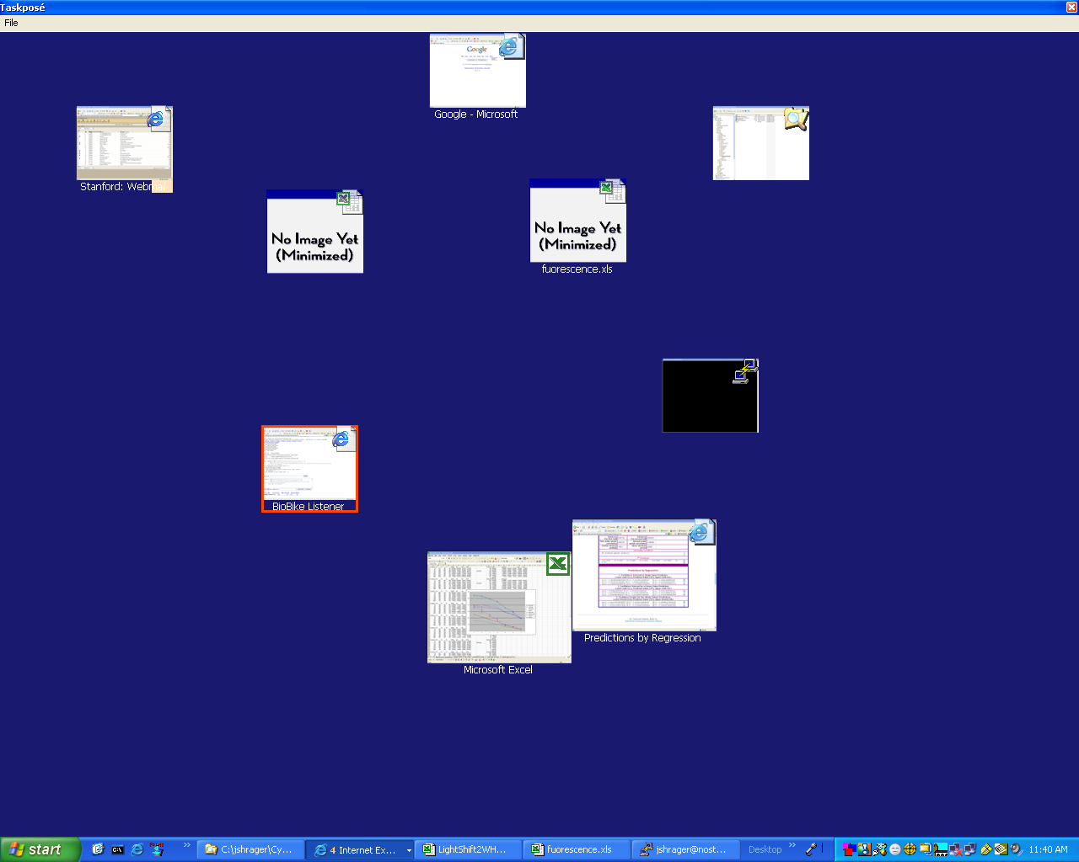

Slide 15
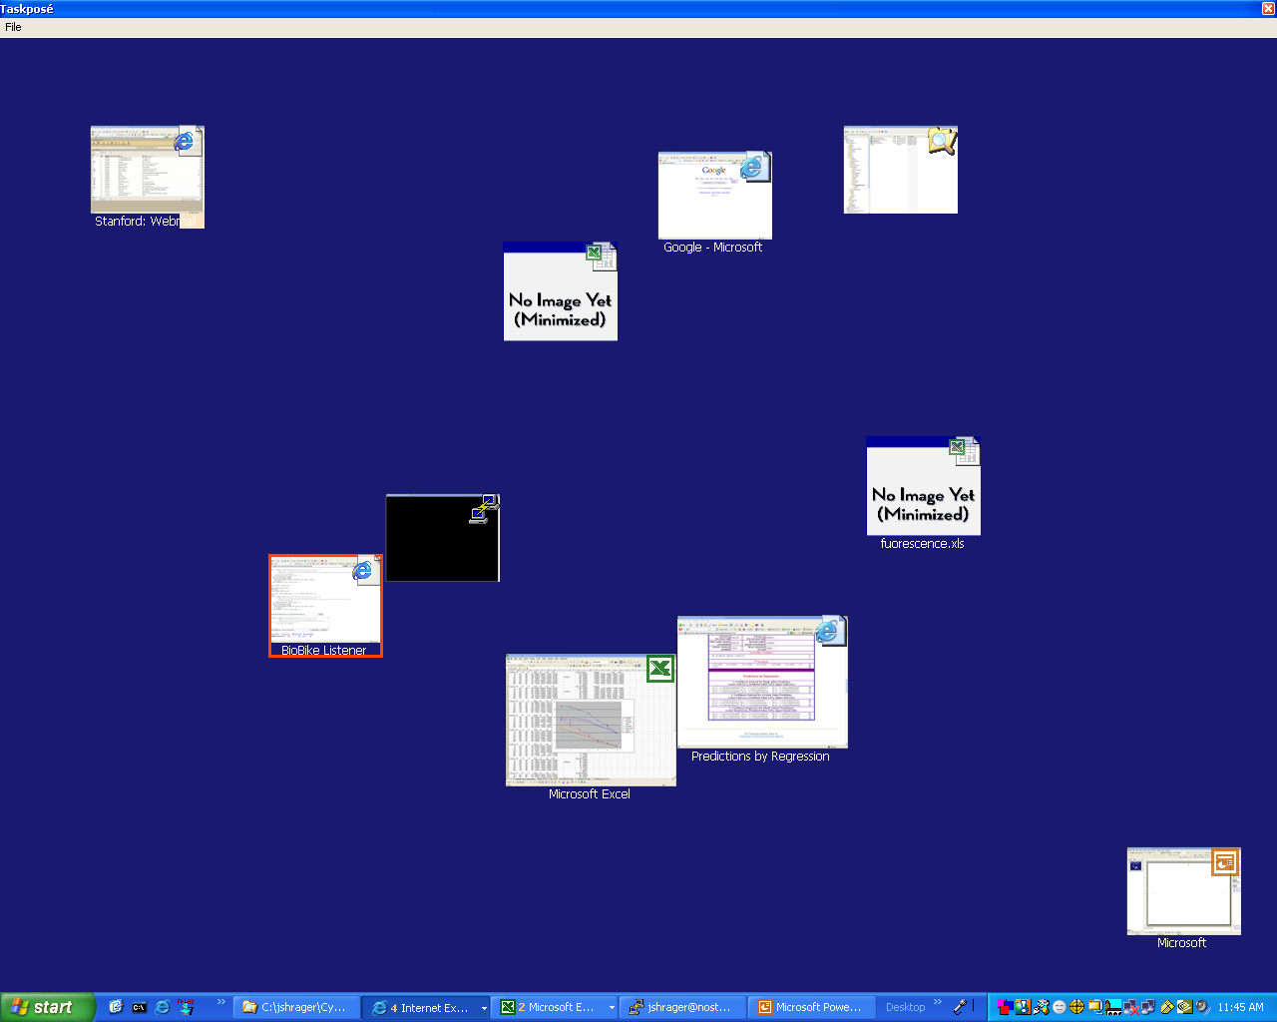

Slide 16
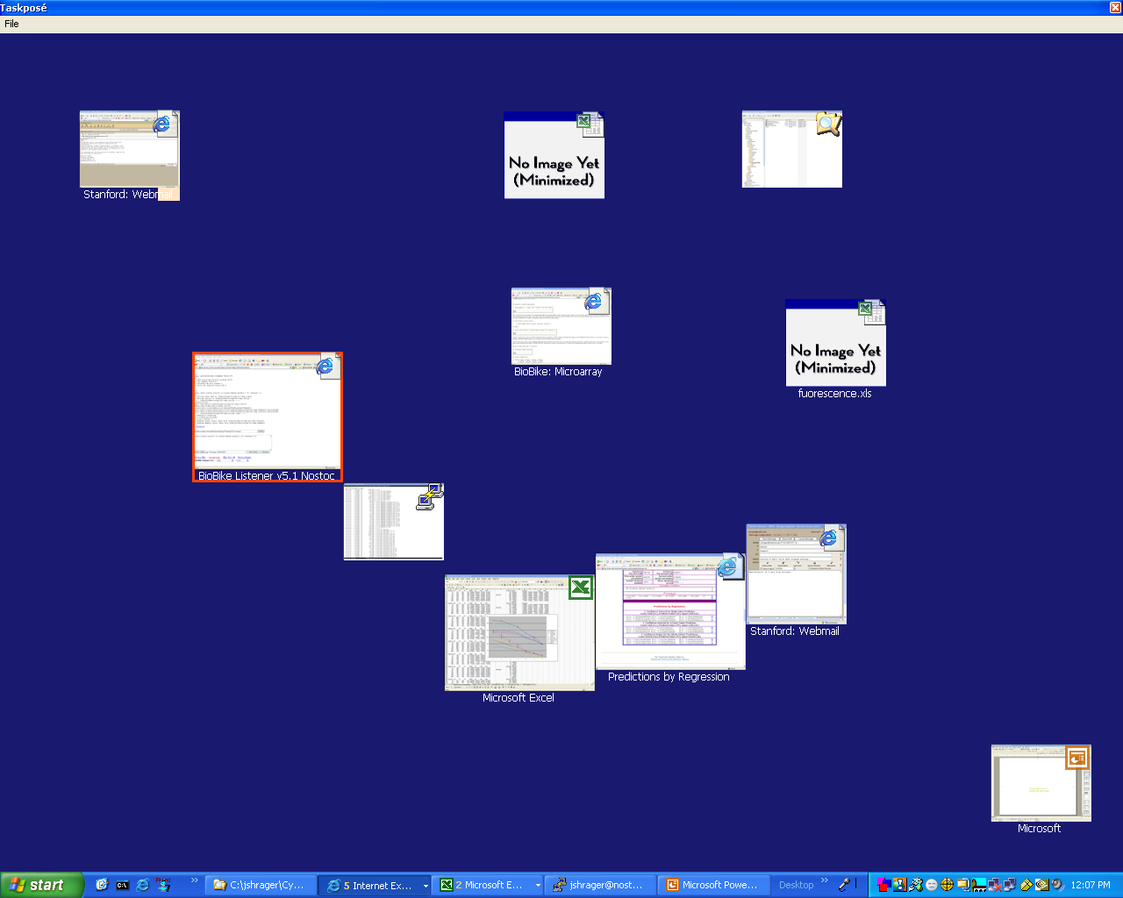

Slide 17
related windows move near each other
Notes:
No explicit task groupings – they emerge as gestalt groupings from the visualization

Slide 18
windows may belong to multiple groupings
Notes:
No explicit task groupings – they emerge as gestalt groupings from the visualization

Slide 19
large thumbnails anchor more important windows
Notes:
No explicit task groupings – they emerge as gestalt groupings from the visualization

Slide 20
laid out via a spring-embedded graph

Slide 21
Values to Calculate
Window Importance WindowRank algorithm
Pairwise Window Association WindowRank-weighted switch ratios

Slide 22
WindowRank Algorithm
Measure of window importance
PageRank algorithm run on a window switch graph
For each other Window X,
inherit X’s WindowRank…
…proportional to the number of switches X made to the window of interest.
WindowRank += 25
25% of switches
75% of switches
WindowRank = 100
WindowRank += 75

Slide 23
Window Association Algorithm
Simple proof-of-concept association algorithm
Weights window switch ratios by WindowRank
Window A’s vote is the ratio of switches it made to B…
…proportional to its WindowRank when compared to B

Slide 24
Field Study
10 undergraduate students were asked to use Taskposé one hour a day for one week on their main computer
Actual median usage was 40.8 hours, using Taskposé to switch windows 156 times

Slide 25
Lessons Learned
General support for an association-based window switch visualization
Window importance tracking (6.0 / 7) and relationship tracking (5.5 / 7) are useful
Importance tracking is accurate (5.5 / 7) but relationship tracking needs improvement (4.0 / 7)

Slide 26
Future Work
Improve association algorithms via machine learning techniques such as distance metric learning
Design a one-dimensional visualization
Directly compare a classificatory visualization to an associative visualization

Slide 27
Taskposé
Exploring Fluid Boundaries in an Associative Window Visualization
Michael Bernstein
msbernst@mit.edu
Special thanks to Todd Davies, Scott Klemmer, the Symbolic Systems Program and the Stanford HCI Group

