Slide 1
From the Impossibility of Obfuscation to a New Non-Black-Box
Simulation Technique
Nir Bitansky and Omer Paneth

Slide 2
The Result
Assuming OT there exist a
resettably-sound ZK protocol
(Previous constructions of
resettably-sound ZK relied on CRHF)

Slide 3



Zero-Knowledge Proofs
Zero
Knowledge
Soundness
$$x∈ℒ?$$
$$𝒫$$
$$𝒱$$

Slide 4


Zero-Knowledge Proofs
Soundness
$$x∉ℒ$$
$$𝒫^{∗}$$
$$𝒱$$

Slide 5


Zero-Knowledge Proofs
Zero
Knowledge
$$x∈ℒ$$
$$𝒫$$
$$𝒱^{∗}$$

Slide 6

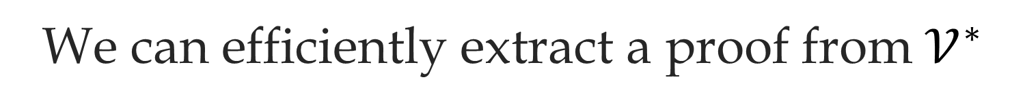
Intuition:
$𝒱^{∗}$ “knows” how to generate a proof itself!
$$𝒫$$
$$𝒱^{∗}$$
We can efficiently extract a proof from $𝒱^{∗}$

Slide 7
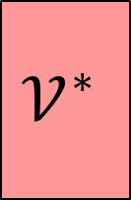
The Simulator
Accepting transcript:
$$𝒱^{∗}$$
Simulator

Slide 8


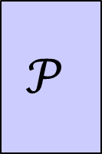
The Simulator
$$𝒫$$
$$𝒱^{∗}$$
$$≈$$
$$𝒱^{∗}$$
Simulator

Slide 9

Black-Box Simulator
$$𝒱^{∗}$$
Black Box Simulator

Slide 10


Non-Black-Box Simulator
$$𝒱^{∗}$$
Non Black Box Simulator

Slide 11
Black-Box vs. Non-Black-Box
Can Non-Black-Box Simulation really achieve more than
Black-Box Simulation?

Slide 12


Black-Box vs. Non-Black-Box
Constant-round public-coin ZK
(for NP, with negligible soundness error)
Not considering 3-round ZK from KEA
[Hada-Tanaka 98, Bellare-Palacio 04]
CRHF + PCP
Argument
Black Box Simulator
Non Black Box Simulator
[Goldreich-Krawczyk 90]
[Barak 01]

Slide 13
Black-Box vs. Non-Black-Box
Black Box Simulator
Non Black Box Simulator
Constant-round public-coin ZK | GK90,B01
Resettably-sound ZK | BGGL01
Constant-round bounded-concurrent ZK and MPC | B01,PR03
Constant-round ZK with strict polynomial-time simulation\knowledge extraction | BL02
Simultaneously resettable ZK and MPC | DGS09,GM11
Constant-round covert MPC | GJ10
Constant-round public-coin parallel ZK | PRT11
Simultaneously resettable WI proof of knowledge | COSV12

Slide 14
Non-Black-Box Simulation
BGGL01,B01,PR03,BL02,DGS9,GS09,
GM11,GJ10,PRT11,COSV12…
Barak 01
Barak 01

Slide 15
Non-Black-Box Simulation
BGGL01,B01,PR03,BL02,DGS9,GS09,
GM11,GJ10,PRT11,COSV12…
Barak 01
CRHF + PCP

Slide 16
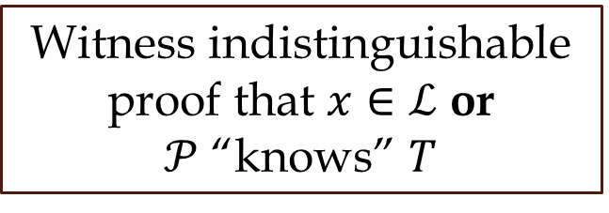



Barak’s ZK Protocol
The FLS paradigm: [Feige-Lapidot-Shamir 99]
$$𝒫$$
Generation protocol for trapdoor $T$
$$𝒱$$
Witness indistinguishable proof that $x∈ℒ$ or
$𝒫$ “knows” $T$

Slide 17
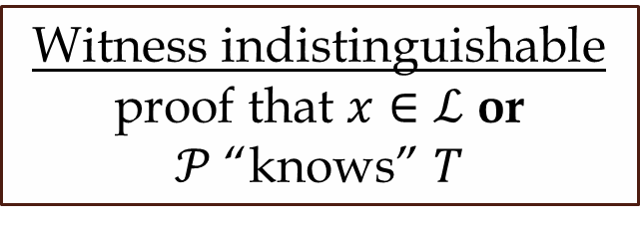
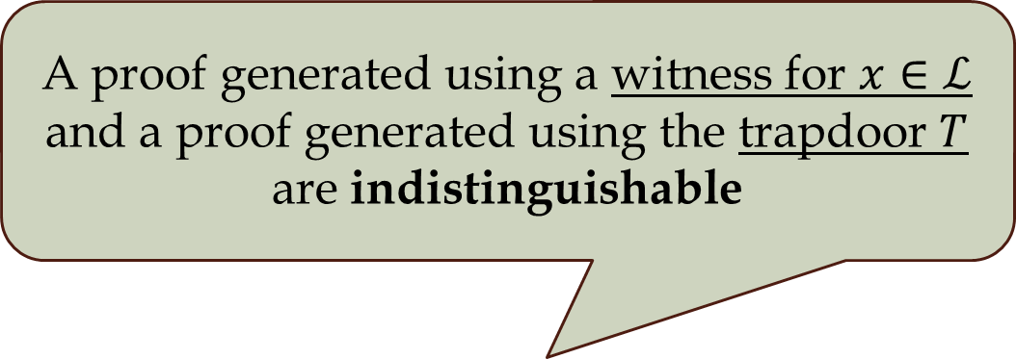
Barak’s ZK Protocol
The FLS paradigm: [Feige-Lapidot-Shamir 99]
A proof generated using a witness for $x∈ℒ$ and a proof generated using the trapdoor $T$
are indistinguishable
$$𝒫$$
Generation protocol for trapdoor $T$
$$𝒱$$
Witness indistinguishable proof that $x∈ℒ$ or $𝒫$“knows” $T$

Slide 18
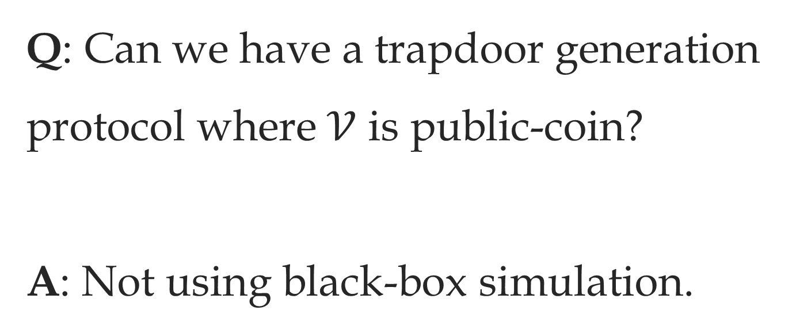
Barak’s ZK Protocol
Q: Can we have a trapdoor generation protocol where $𝒱$ is public-coin?
A: Not using black-box simulation.

Slide 19
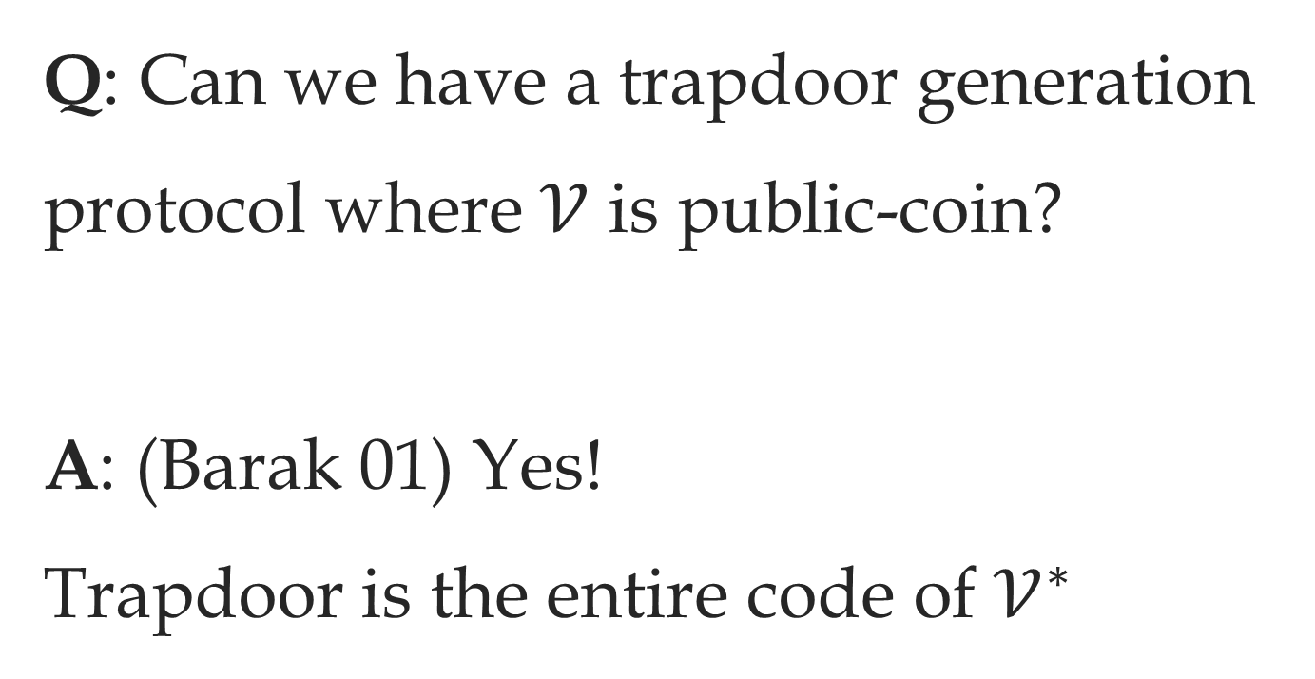
Barak’s ZK Protocol
Q: Can we have a trapdoor generation protocol where $𝒱$ is public-coin?
A: (Barak 01) Yes!
Trapdoor is the entire code of $𝒱^{∗}$

Slide 20

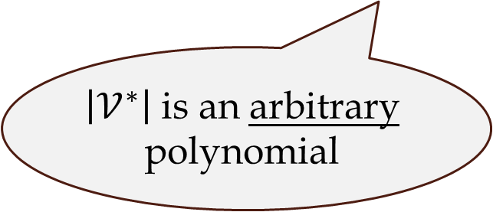
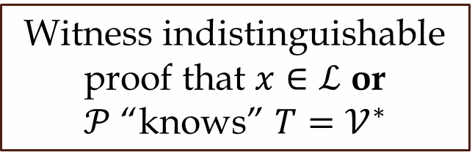

Problem of “Long” Trapdoor
(Or: problem of “short” messages)
$$𝒫$$
$$𝒱$$
Witness indistinguishable proof that $x∈ℒ$ or
$𝒫$ “knows” $T=𝒱^{∗}$
$\left|𝒱^{∗}\right|$ is an arbitrary polynomial

Slide 21
Barak’s ZK Protocol
Fixing the problem:
Use a Universal Argument – a succinct witness indistinguishable proof
based on PCPs [kilian 92, Barak-Goldreich 08]
Use a collision-resistant hash function to give a shrinking commitment to trapdoor.

Slide 22
Non-Black-Box Simulation
BGGL01,B01,PR03,BL02,DGS9,GS09,
GM11,GJ10,PRT11,COSV12…
Barak 01
CRHF + UA\PCP

Slide 23
Are Barak’s techniques inherent in non-black-box simulation?
Can its applications be achieved without collision-resistant hashing and universal arguments?
No!
Yes!

Slide 24


Resettable Protocols
$$A$$
$$B$$

Slide 25


Resettable Protocols
$$A$$
$$A$$
$$B$$

Slide 26


Resettable Protocols
$$A$$
$$B$$

Slide 27



Resettable ZK
[Canetti-Goldreich-Goldwasser-Micali 00]
$$x∈ℒ$$
$$𝒱^{∗}$$
$$𝒫$$

Slide 28



Resettably-Sound ZK
[Micali-Reyzin 01,
Barak-Goldreich-Goldwasser-Lindell 01]
$$x∉ℒ$$
$$𝒫^{∗}$$
$$𝒱$$

Slide 29


Resettably-Sound ZK
[Barak-Goldreich-Goldwasser-Lindell01, Goldreich-Krawczyk 90]
$$𝒫$$
Black Box Simulator
$$𝒱$$

Slide 30





Resettably-Sound ZK
Black Box Simulator
$$𝒱$$
$$𝒫^{∗}$$
$$𝒱$$
$$𝒱^{∗}$$
Black Box Simulator

Slide 31
Resettably-Sound ZK
[Barak-Goldreich-Goldwasser-Lindell 01]
$$𝒫$$
Non Black Box Simulator
$$𝒱$$
Using CRHF and UA

Slide 32
The Result
Assuming only OT there exist a constant-round resettably-sound ZK protocol that does not make use of UA.
The Technique
A new non-black-box simulation technique from the Impossibility of Obfuscation

Slide 33


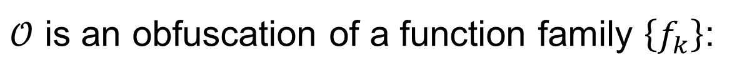



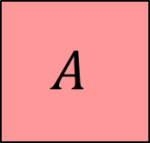



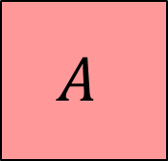
Program Obfuscation
$𝒪$ is an obfuscation of a function family $\left\{f_{k}\right\}$:
$$f_{k}$$
$$x$$
$$A$$
$$𝒪$$
$$k$$
$$Π_{k}$$
$$≈$$
$$f_{k}(x)$$
$$A$$
$$Π_{k}$$

Slide 34
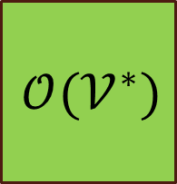

Obfuscation and ZK
If we can obfuscate $𝒱^{∗}$:
$$𝒱^{∗}$$
$$𝒪(𝒱^{∗})$$
Non Black Box Simulator
Black Box Simulator
Resettably-Sound ZK

Slide 35
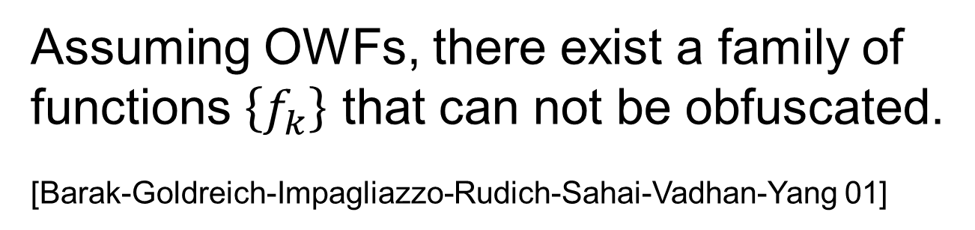
Obfuscation and ZK
Assuming OWFs, there exist a family of functions $\left\{f_{k}\right\}$ that can not be obfuscated.
[Barak-Goldreich-Impagliazzo-Rudich-Sahai-Vadhan-Yang 01]
Resettably-Sound ZK
“Easy”
Impossibility of obfuscation

Slide 36
Obfuscation and ZK
Assuming OWFs, there exist a family of functions $\left\{f_{k}\right\}$ that can not be obfuscated.
[Barak-Goldreich-Impagliazzo-Rudich-Sahai-Vadhan-Yang 01]
Resettably-Sound ZK
“Hard”
Impossibility of obfuscation + OT

Slide 37

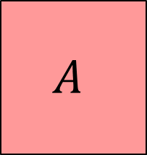

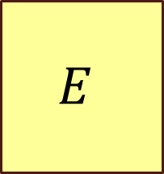

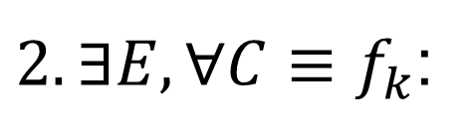

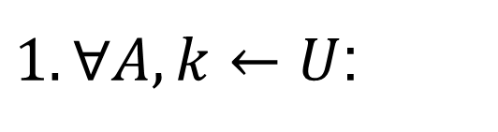
Unobfuscatable functions
$$f_{k}$$
$$A$$
$1. ∀A,k←U$:
$$k$$
$$E$$
$2. ∃E,∀C≡f_{k}$:
$$C$$
$$k$$

Slide 38






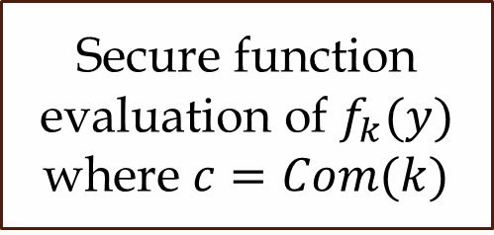

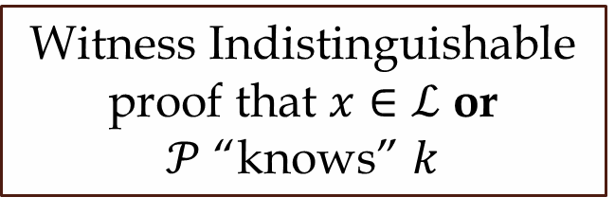


The Protocol
$$𝒫$$
$$c=Com(k)$$
$$𝒱$$
$$k←U_{n}$$
$$y=0$$
$$k$$
$$c$$
Secure function evaluation of $f_{k}(y)$ where $c=Com(k)$
$$d$$
$$f_{k}(y)$$
Witness Indistinguishable proof that $x∈ℒ$ or
$𝒫$ “knows” $k$

Slide 39





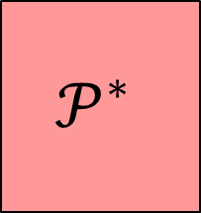



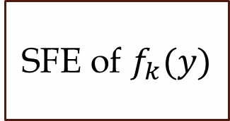

Proof Idea - Resettable Soundness
$$c=Com(k)$$
$$𝒫^{∗}$$
$$k←U_{n}$$
$$y$$
$$k$$
SFE of $f_{k}(y)$
$$𝒱$$
$$f_{k}(y)$$
$$f_{k}$$
$$𝒫^{∗}$$
$$k$$

Slide 40




Proof Idea – Zero Knowledge
Non Black Box Simulator
$$𝒱^{∗}$$
$$C≡f_{k}$$
$$E$$
$$k$$

Slide 41











Proof Idea – Zero Knowledge
$$C≡f_{k}$$
$$c=Com(k)$$
$$𝒱^{∗}$$
$$y$$
$$k$$
SFE of $f_{k}(y)$
$$f_{k}(y)$$
Non Black Box Simulator
$$𝒱^{∗}$$
$$C≡f_{k}$$
$$E$$
$$k$$

Slide 42



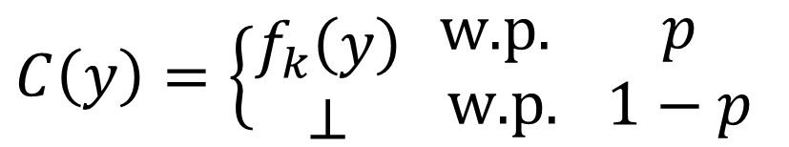
Proof Idea – Zero Knowledge
$$C≡f_{k}$$
$$c=Com(k)$$
$$𝒱^{∗}$$
$$y$$
$$⊥$$
SFE of $f_{k}(y)$
$$⊥$$
$$C\left(y\right)=\left\{\begin{matrix}f_{k}\left(y\right) \\ ⊥\end{matrix} \right.\begin{matrix}\text{w}\text{.}\text{p}\text{. } \\ \text{w}\text{.}\text{p}\text{.}\end{matrix} \begin{matrix}p \\ 1−p\end{matrix}$$

Slide 43













Proof Idea – Zero Knowledge
$$C≡f_{k}$$
$$C′≡f_{k}\backslash ⊥$$
$$𝒱^{∗}$$
$$⊥$$
$$y$$
$$f_{k}(y)$$
$$C′≡f_{k}\backslash ⊥$$
$$f_{k}(y)$$
$$𝒱^{∗}$$
$$\frac{1}{p}$$
…
$$C′≡f_{k}\backslash ⊥$$
$$𝒱^{∗}$$
$$⊥$$

Slide 44
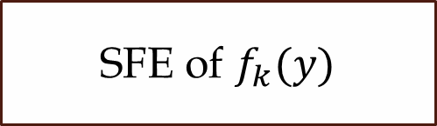


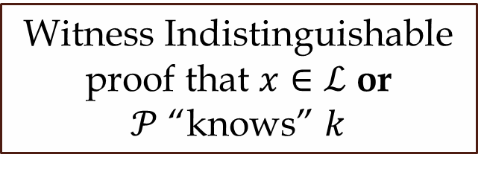








Proof Idea – Zero Knowledge
Non Black Box Simulator
$$c=Com(k)$$
$$𝒱^{∗}$$
$$k←U_{n}$$
$$y=0$$
$$k$$
SFE of $f_{k}(y)$
$$f_{k}(y)$$
$$𝒱^{∗}$$
$$C≡f_{k}$$
$$E$$
$$k$$
Witness Indistinguishable proof that $x∈ℒ$ or
$𝒫$ “knows” $k$
$$k$$

Slide 45


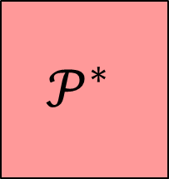


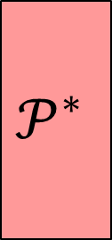

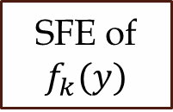

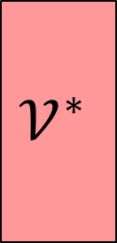
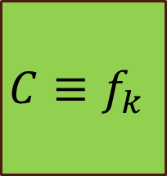





The SFE Protocol
$$f_{k}$$
$$𝒫^{∗}$$
$$c=Com(k)$$
$$𝒫^{∗}$$
$$y$$
$$k$$
SFE of $f_{k}(y)$
$$𝒱$$
$$f_{k}(y)$$
How to instantiate this box?
How to instantiate this box?
$$c=Com(k)$$
$$𝒱^{∗}$$
$$C≡f_{k}$$
$$y$$
$$k$$
$$f_{k}(y)$$
SFE of $f_{k}(y)$

Slide 46



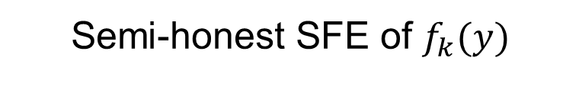



The SFE Protocol
$$𝒫$$
$$y$$
$$k$$
$$𝒱$$
Semi-honest SFE of $f_{k}(y)$
ZK proof of knowledge
$$𝒱$$
ZK proof of knowledge
$$f_{k}(y)$$

Slide 47
The SFE Protocol
$$𝒫$$
$$y$$
$$k$$
Semi-honest SFE of $f_{k}(y)$
ZK proof of knowledge
$$𝒱$$
ZK proof of knowledge
$$f_{k}(y)$$

Slide 48
The SFE Protocol
$$𝒫$$
$$y$$
$$k$$
Semi-honest SFE of $f_{k}(y)$
Based on resettably-sound ZK [BGGL01,GS09]
Resettably-sound ZK POK
$$𝒱$$
Resettable ZK POK
$$f_{k}(y)$$

Slide 49


The SFE Protocol
$$f_{k}$$
$$𝒫^{∗}$$
$$c=Com(k)$$
$$𝒫^{∗}$$
$$y$$
$$k$$
SFE of $f_{k}(y)$
$$𝒱$$
$$f_{k}(y)$$
$$x∉ℒ$$
$$x∈ℒ$$
$$c=Com(k)$$
$$𝒱^{∗}$$
$$C≡f_{k}$$
$$y$$
$$k$$
$$f_{k}(y)$$
SFE of $f_{k}(y)$

Slide 50



Instance-dependent SFE
$$x∈ℒ$$
$$x∉ℒ$$
${\text{SFE}}^{x}$of $f_{k}(y)$
ZK
Resettable POK
POK
Resettable ZK
+ Strongly unobfuscatable functions

Slide 51









Instance-dependent SFE
$$𝒫$$
$$B1$$
$$𝒱_{WI}$$
$$r$$
$$𝒫_{WI}$$
$$𝒱$$
$$B3$$
$$x∈ℒ$$
$$x∉ℒ$$
Resettable ZK
POK
WI

Slide 52

Instance-dependent SFE
$$\text{C}\text{om}(r)$$
$$𝒫$$
$$B1$$
$$𝒱_{WI}$$
$$r$$
$$𝒫_{WI}$$
$$𝒱$$
$$B3$$
$$x∈ℒ$$
$$x∉ℒ$$
POK
Resettable ZK

Slide 53

Instance-dependent SFE
$${\text{C}\text{om}}^{x}(r)$$
$$𝒫$$
$$B1$$
$$𝒱_{WI}$$
$$r$$
$$𝒫_{WI}$$
$$𝒱$$
$$B3$$
$$x∈ℒ$$
$$x∉ℒ$$
POK
Resettable ZK

Slide 54
Simulation Running Time
Non Black Box Simulator
$$𝒱^{∗}$$
$$C≡f_{k}$$
$$E$$
$$k$$

Slide 55





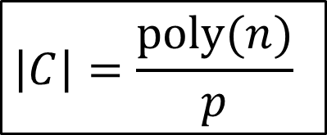








Simulation Running Time
$$C≡f_{k}$$
$$C′≡f_{k}\backslash ⊥$$
$$𝒱^{∗}$$
$$⊥$$
$$y$$
$$f_{k}(y)$$
$$C′≡f_{k}\backslash ⊥$$
$$f_{k}(y)$$
$$𝒱^{∗}$$
$$\frac{1}{p}$$
$$\left|C\right|=\frac{\text{poly}(n)}{p}$$
…
$$C′≡f_{k}\backslash ⊥$$
$$𝒱^{∗}$$
$$⊥$$

Slide 56
Proof Idea – Zero Knowledge
Non Black Box Simulator
$$c=Com(k)$$
$$𝒱^{∗}$$
$$k←U_{n}$$
$$y=0$$
$$k$$
SFE of $f_{k}(y)$
$$f_{k}(y)$$
$$𝒱^{∗}$$
$$C≡f_{k}$$
$$E$$
$$k$$
Witness Indistinguishable proof that $x∈ℒ$ or
$𝒫$ “knows” $k$
$$k$$

Slide 57

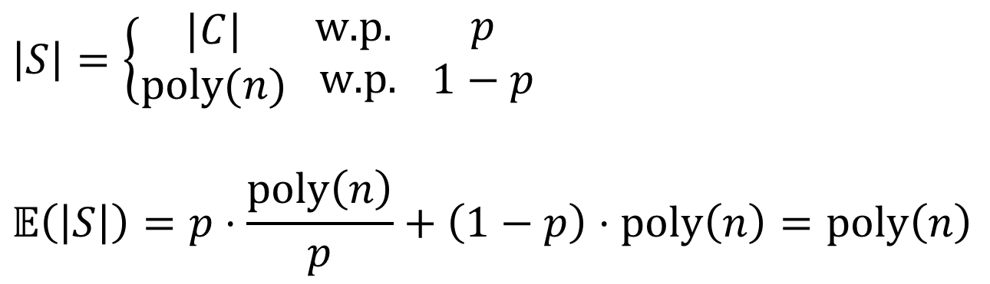



Simulation Running Time
Non Black Box Simulator
$$𝒱^{∗}$$
$$C≡f_{k}$$
$$E$$
$$k$$
$$\left|S\right|=\left\{\begin{matrix}|C| \\ \text{poly}(n)\end{matrix} \right.\begin{matrix}\text{w}\text{.}\text{p}\text{. } \\ \text{w}\text{.}\text{p}\text{.}\end{matrix} \begin{matrix}p \\ 1−p\end{matrix}$$
$$𝔼\left(\left|S\right|\right)=p⋅\frac{\text{poly}\left(n\right)}{p}+\left(1−p\right)⋅\text{poly}\left(n\right)=\text{poly}\left(n\right)$$

Slide 58
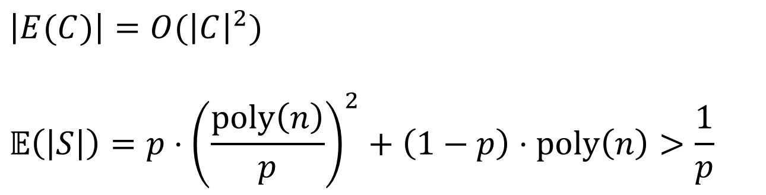
Simulation Running Time
Non Black Box Simulator
$$𝒱^{∗}$$
$$C≡f_{k}$$
$$E$$
$$k$$
$$\left|E(C)\right|=O({\left|C\right|}^{2})$$
$$𝔼\left(\left|S\right|\right)=p⋅{\left(\frac{\text{poly}\left(n\right)}{p}\right)}^{2}+\left(1−p\right)⋅\text{poly}\left(n\right)>\frac{1}{p}$$

Slide 59






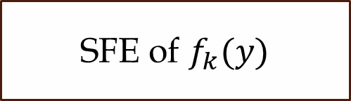


Simulation Running Time
$$𝒫$$
$$c=Com(k)$$
$$𝒱$$
$$k←U_{n}$$
$$y=0$$
$$k$$
SFE of $f_{k}(y)$
$$f_{k}(y)$$
Witness Indistinguishable proof that $x∈ℒ$ or
$𝒫$ “knows” $k$

Slide 60




Simulation Running Time
$$𝒫$$
$$c=Com(k)$$
$$𝒱$$
$$k←U_{n}$$
$$y=0$$
$$k$$
SFE of $f_{k}(y)$
$$f_{k}(y)$$
$$y=0$$
$$k$$
SFE of $f_{k}(y)$
$$f_{k}(y)$$
Witness Indistinguishable proof that $x∈ℒ$ or
$𝒫$ “knows” $k$

Slide 61
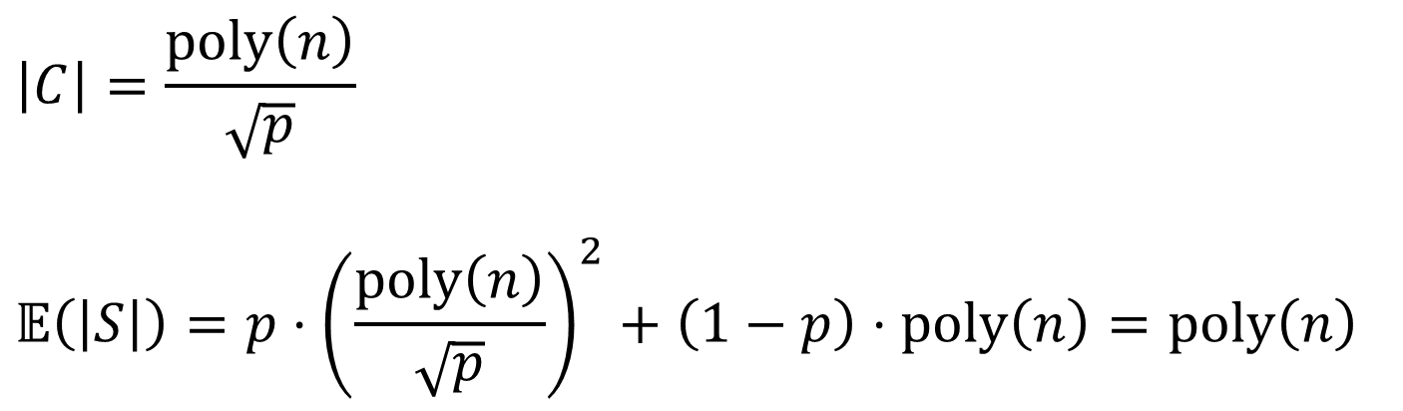



Simulation Running Time
Non Black Box Simulator
$$𝒱^{∗}$$
$$C≡f_{k}$$
$$E$$
$$k$$
$$\left|C\right|=\frac{\text{poly}\left(n\right)}{\sqrt{p}}$$
$$𝔼\left(\left|S\right|\right)=p⋅{\left(\frac{\text{poly}\left(n\right)}{\sqrt{p}}\right)}^{2}+\left(1−p\right)⋅\text{poly}\left(n\right)=\text{poly}\left(n\right)$$

Slide 62
Comparison to [Barak 01]
 | # rounds | Assumptions | Uses PCP\UA | Trapdoor Length | Public- Coin
Barak 01 | O(1) | CRHF | Yes | Long | Yes
This work | O(1) | OT | No | Short | No

Slide 63
One More Application

Slide 64






Simultaneously resettable ZK
$$x∉ℒ$$
$$x∈ℒ$$
$$𝒫^{∗}$$
$$𝒱^{∗}$$
$$𝒱$$
$$𝒫$$
[BGGL 01]: Can a protocol be resettable ZK
and resettably-sound simultaneously?

Slide 65
Simultaneously resettable ZK
$$x∉ℒ$$
$$x∈ℒ$$
$$𝒫^{∗}$$
$$𝒱^{∗}$$
$$𝒱$$
$$𝒫$$
[Deng-Goyal-Sahai 09]: Yes!

Slide 66
Simultaneously resettable ZK
Resettably-sound ZK
Non-black-box simulation
Long trapdoor
Bounded concurrent ZK
Short trapdoor
Black-box simulation
Concurrent ZK
Resettable ZK

Slide 67
Simultaneously resettable ZK
Resettably-sound ZK
Non-black-box simulation
Short trapdoor
Black-box simulation
Concurrent ZK
Resettable ZK

Slide 68




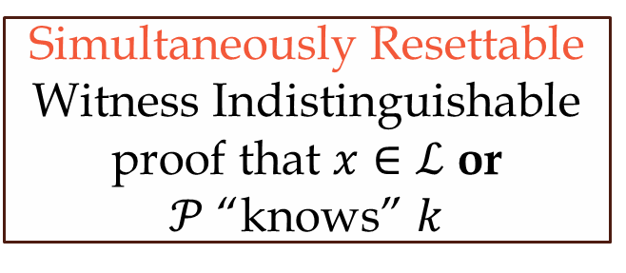

Simultaneously resettable ZK
$$𝒫$$
$$c=Com(k)$$
$$𝒱$$
$$k←U_{n}$$
$$y=0$$
$$k$$
$$×n$$
SFE of $f_{k}(y)$
$$f_{k}(y)$$
[Cho-Ostrovsky-Scafuro-Visconti 12]
Simultaneously Resettable Witness Indistinguishable proof that $x∈ℒ$ or
$𝒫$ “knows” $k$

Slide 69
?

