Slide 1
On the Impossibility of Approximate Obfuscation
Nir Bitansky and Omer Paneth

Slide 2


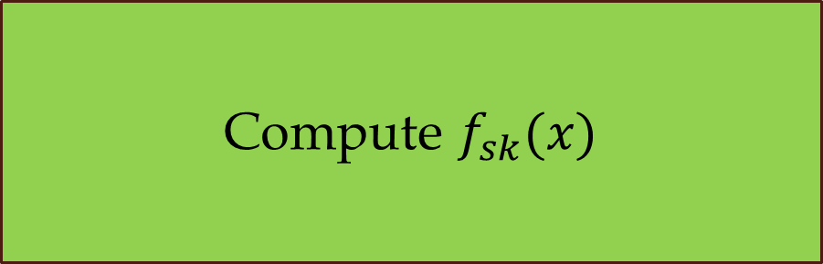
Program Obfuscation
$$x$$
Compute $f_{sk}(x)$
$$y=f_{sk}(x)$$

Slide 3
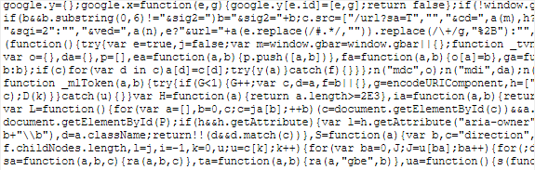
Program Obfuscation
$$x$$
$$y=f_{sk}(x)$$

Slide 4
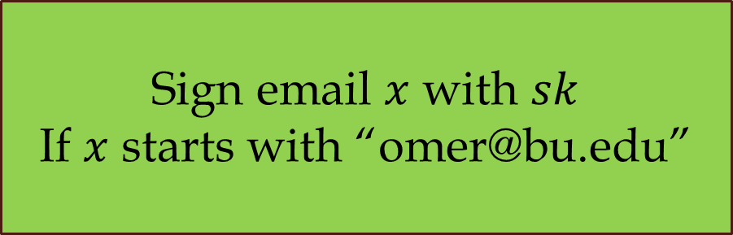

Program Obfuscation
$$x$$
Sign email $x$ with $sk$
If $x$ starts with “omer@bu.edu”
$$y=σ(x)/⊥$$

Slide 5
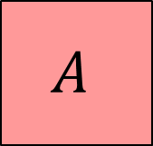

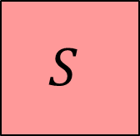
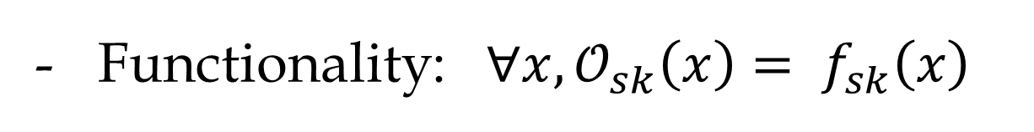

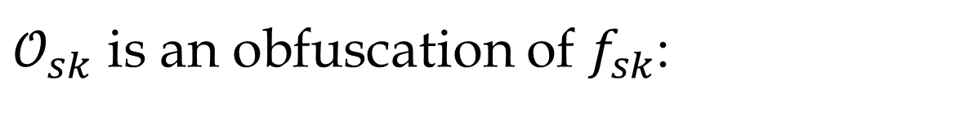

Virtual Black-Box
[Barak-Goldreich-Impagliazzo-Rudich-Sahai-Vadhan-Yang 01]
$𝒪_{sk}$ is an obfuscation of $f_{sk}$:
Functionality: ${∀x, 𝒪}_{sk}\left(x\right)= f_{sk}\left(x\right)$
Security:
$$f_{sk}$$
$$A$$
$$≈$$
$$S$$
$$𝒪_{sk}$$

Slide 6
Impossibility of Obfuscation
There exist families of functions
that cannot be obfuscated
[Barak-Goldreich-Impagliazzo-Rudich-Sahai-Vadhan-Yang 01]

Slide 7
Relaxed Security
[Barak et al. 01, Goldwasser-Rothblum07, Hofheinz-Malone-Lee-Stam07, Hohenberger-Rothblum-Shelat-Vaikuntanathan07, Bitansky-Canetti10]
Functionality: ${∀x, 𝒪}_{sk}\left(x\right)= f_{sk}\left(x\right)$
Security:
$$f_{sk}$$
$$A$$
$$≈$$
$$S$$
$$𝒪_{sk}$$

Slide 8
Relaxed Functionality?
Functionality: ${∀x, 𝒪}_{sk}\left(x\right)= f_{sk}\left(x\right)$
Security:
$$f_{sk}$$
$$A$$
$$≈$$
$$S$$
$$𝒪_{sk}$$

Slide 9
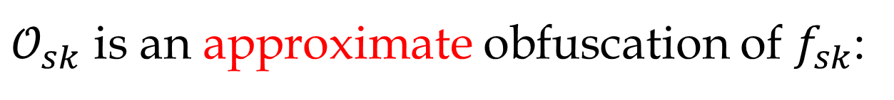
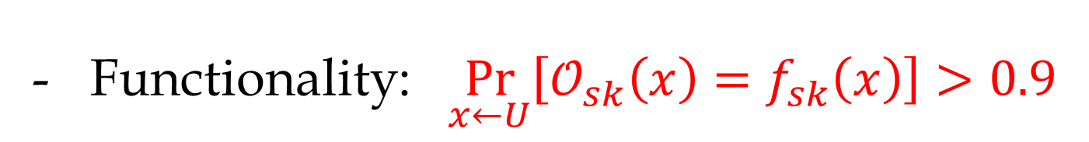
Approximate Obfuscation
[Barak-Goldreich-Impagliazzo-Rudich-Sahai-Vadhan-Yang 01]
$𝒪_{sk}$ is an approximate obfuscation of $f_{sk}$:
Functionality: $\underset{x←U}{Pr}\left[𝒪_{sk}\left(x\right)=f_{sk}\left(x\right)\right]>0.9$
Security:
$$f_{sk}$$
$$A$$
$$≈$$
$$S$$
$$𝒪_{sk}$$

Slide 10
Main Result
Assuming trapdoor permutations,
there exist families of functions
that cannot be approximately obfuscated
Motivation?
Positive applications

Slide 11




From Impossibility to Applications
Impossibility of approximate obfuscation
Non-black-box extraction
$$sk$$
Zero-knowledge with
resettable security
$$A_{sk}$$
Worst-case extractable signatures
$$x$$
$$f_{sk}(x)$$

Slide 12
Plan
[BGIRSVY 01]:
Impossibility of Obfuscation
Unobfuscatable Functions
This work:
Impossibility of
Approximate Obfuscation
Robust Unobfuscatable Functions
Applications

Slide 13

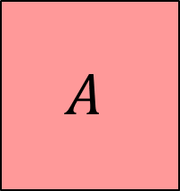

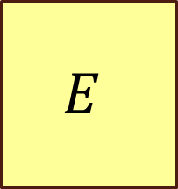
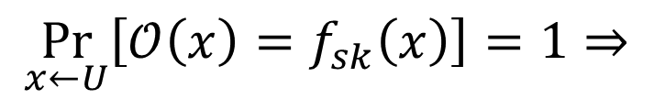

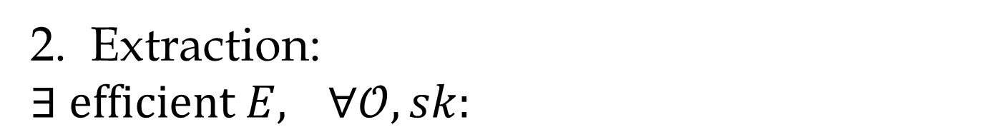

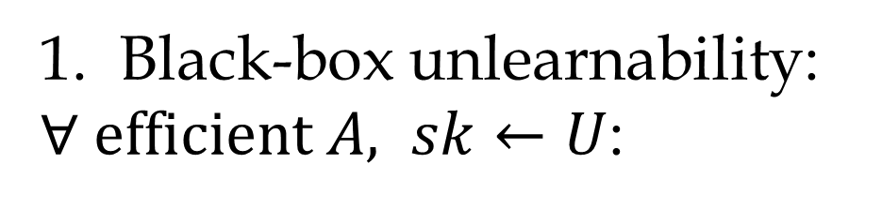
Unobfuscatable Functions
From Barak et al.
$$f_{sk}$$
Black-box unlearnability:
$∀ efficient A, sk←U$:
$$A$$
$$sk$$
Extraction:
$∃ efficient E,$ $∀𝒪,sk:$
$$E$$
$$\underset{x←U}{Pr}\left[𝒪\left(x\right)=f_{sk}\left(x\right)\right]=1⇒$$
$$𝒪$$
$$sk$$

Slide 14
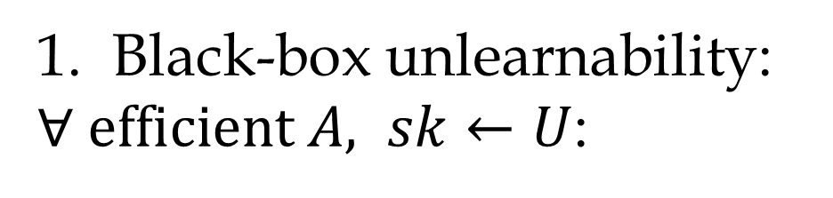
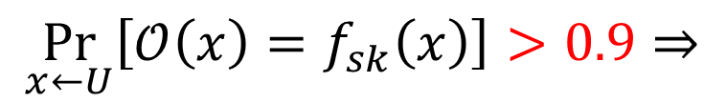
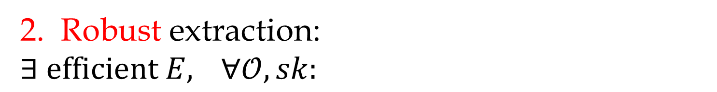
Robust Unobfuscatable Functions
$$f_{sk}$$
Black-box unlearnability:
$∀ efficient A, sk←U$:
$$A$$
$$sk$$
Robust extraction:
$∃ efficient E,$ $∀𝒪,sk:$
$$E$$
$$\underset{x←U}{Pr}\left[𝒪\left(x\right)=f_{sk}\left(x\right)\right]>0.9⇒$$
$$𝒪$$
$$sk$$

Slide 15




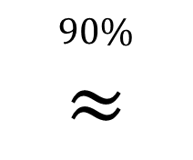



Robust Unobfuscatable Functions
$$90\%$$
$$≈$$
$$𝒪$$
$$f_{sk}$$
$$f_{sk}$$
$$A$$
$$≈$$
$$S$$
$$𝒪$$
$$E$$
$$sk$$
$$sk$$

Slide 16
RUFs Construction

Slide 17
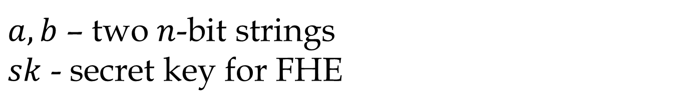
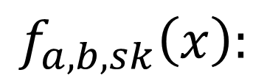
Unobfuscatable Functions
Construction of Barak et al. (using FHE for simplicity)
$$f_{a,b,sk}\left(x\right):$$
$a,b$ – two $n$-bit strings
$sk$ - secret key for FHE

Slide 18



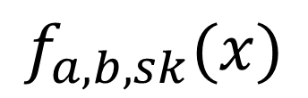
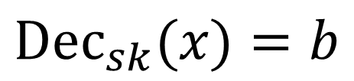










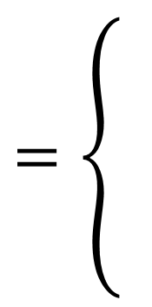
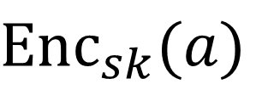

Unobfuscatable Functions
$$0^{n}$$
$$Enc\left(a\right)$$
$$Enc\left(b\right)$$
$$f$$
$$f$$
$$a$$
$$b$$
$$f$$
$$=\left\{\begin{matrix}\begin{matrix} \\ \end{matrix} \\ \begin{matrix} \\ \end{matrix}\end{matrix}\right.$$
$$b$$
$$x=a$$
$$Enc_{sk}(a)$$
$$x=0^{n}$$
$$f_{a,b,sk}(x)$$
$$b$$
$$Dec_{sk}(x)=b$$
$$⊥$$
$$\text{o}\text{.}\text{w}\text{.}$$

Slide 19



Black-Box Unlearnability
$$0^{n}$$
$$Enc\left(a\right)$$
$$Enc\left(b\right)$$
$$f$$
$$f$$
$$a$$
$$b$$
$$f$$
$$f$$
$$A$$
$$b$$

Slide 20





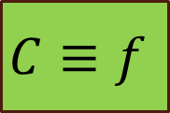
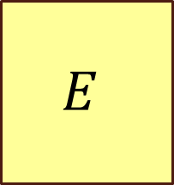

Extraction
$$0^{n}$$
$$Enc\left(a\right)$$
$$Enc\left(b\right)$$
$$C$$
$$Eval(C)$$
$$C$$
$$a$$
$$b$$
$$C$$
$$C$$
$$E$$
$$C≡f$$
$$b$$

Slide 21

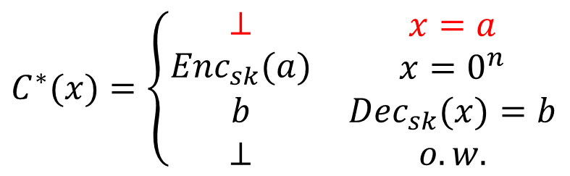

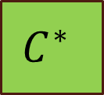


Robust Extraction?
$$0^{n}$$
$$Enc\left(a\right)$$
$$Enc\left(b\right)$$
$$C^{∗}$$
$$C^{∗}$$
$$a$$
$$b$$
$$E$$
$$C^{∗}(x)=\left\{\begin{matrix}\begin{matrix}⊥ \\ Enc_{sk}(a)\end{matrix} & \begin{matrix}x=a \\ {x=0}^{n}\end{matrix} \\ \begin{matrix}b \\ ⊥\end{matrix} & \begin{matrix}Dec_{sk}(x)=b \\ o.w.\end{matrix}\end{matrix}\right.$$
$$C^{∗}$$
$$b$$

Slide 22
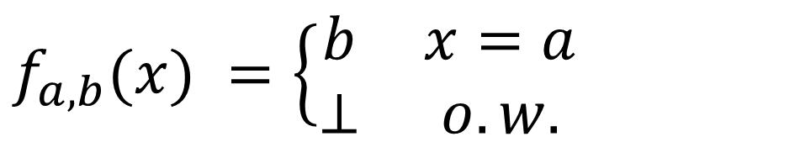
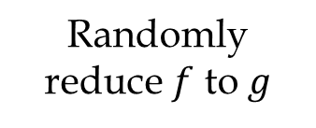
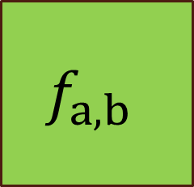
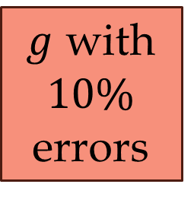
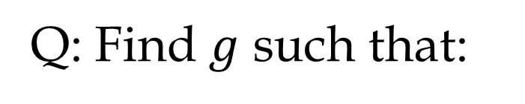
A Taste of the Construction
$$f_{a,b}(x) =\left\{\begin{matrix}b & x=a \\ ⊥ & o.w.\end{matrix}\right.$$
Q: Find $g$ such that:
Randomly
reduce $f$ to $g$
$g$ with $10\%$ errors
$$f_{a,b}$$

Slide 23
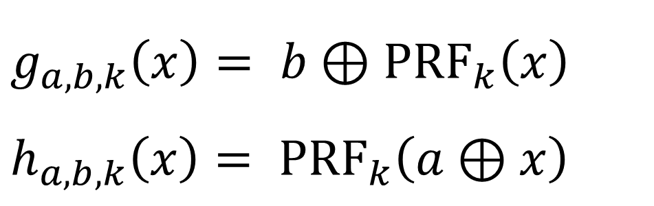
Getting Robustness
$$f_{a,b}(x) =\left\{\begin{matrix}b & x=a \\ ⊥ & o.w.\end{matrix}\right.$$
$$g_{a,b,k}\left(x\right)= {b⊕\text{PRF}}_{k}\left(x\right)$$
$$h_{a,b,k}\left(x\right)= {\text{PRF}}_{k}\left(a⊕x\right)$$

Slide 24


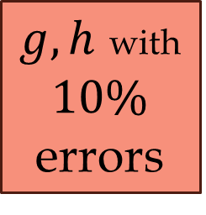

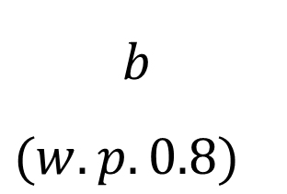



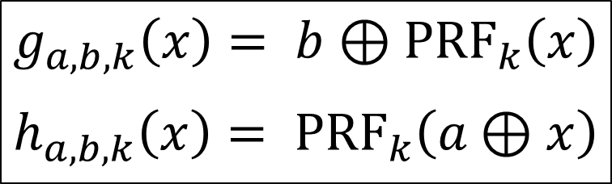





$$r←U$$
$$f$$
$$r$$
$$b⊕PRF(r)$$
$$g$$
$$b$$
$(w.p. 0.8)$
$$a$$
$$⊕$$
$$a⊕r$$
$$PRF(r)$$
$$h$$
$g,h$ with $10\%$ errors
$$f_{a,b}$$
$$g_{a,b,k}\left(x\right)= {b⊕\text{PRF}}_{k}\left(x\right)$$
$$h_{a,b,k}\left(x\right)= {\text{PRF}}_{k}\left(a⊕x\right)$$

Slide 25

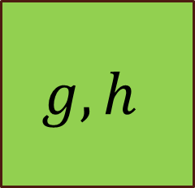
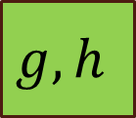

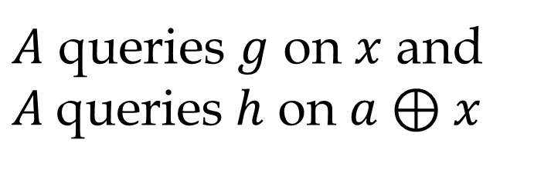


$$g,h$$
$$A$$
$A$ queries $g$ on $x$ and $A$queries $h$ on $a⊕x$
$$a$$
$$a$$
$$b$$
$$g,h$$
$$f_{a,b}$$
$$g_{a,b,k}\left(x\right)= {b⊕\text{PRF}}_{k}\left(x\right)$$
$$h_{a,b,k}\left(x\right)= {\text{PRF}}_{k}\left(a⊕x\right)$$

Slide 26
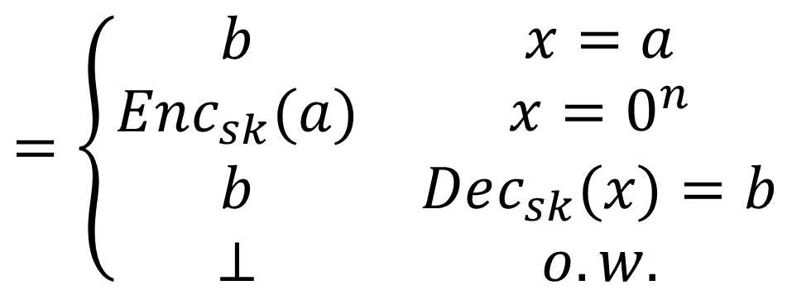
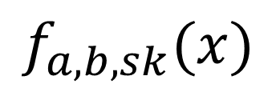
Construction of RUFs
$$=\left\{\begin{matrix}\begin{matrix}b \\ Enc_{sk}(a)\end{matrix} & \begin{matrix}x=a \\ {x=0}^{n}\end{matrix} \\ \begin{matrix}b \\ ⊥\end{matrix} & \begin{matrix}Dec_{sk}(x)=b \\ o.w.\end{matrix}\end{matrix}\right.$$
$$f_{a,b,sk}(x)$$

Slide 27




Assumptions
RUFs from trapdoor permutations.
Weak RUFs from OWF only:
$$∀x: 𝒪\left(x\right)∈\left\{f_{sk}\left(x\right),⊥\right\}$$
$$E$$
$$𝒪$$
$$sk$$

Slide 28
Applications

Slide 29










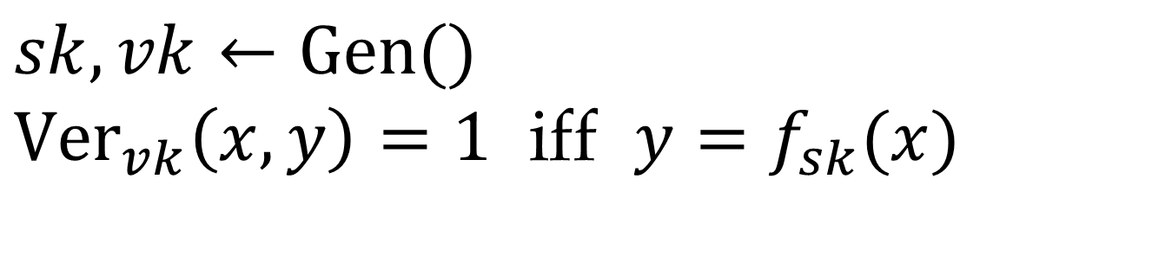
Publicly-Verifiable RUOFs
$$sk,vk←\text{Gen}\text{()}$$
${\text{Ver}}_{vk}\left(x,y\right)=\text{1}$ iff $y=f_{sk}(x)$
$$vk$$
$$vk$$
$$f_{sk}$$
$$A$$
$$E$$
$$sk$$
$$𝒪$$
$$sk$$
$$sk,vk←\text{Gen}\text{()}$$
$$\underset{x←U}{Pr}\left[{\text{Ver}}_{vk}\left(x,𝒪\left(x\right)\right)=\text{1}\right]>\frac{1}{poly(n)}$$

Slide 30



Resettably-Sound ZK
[Micali-Reyzin 01, Barak-Goldreich-Goldwasser-Lindell 01]
$$x∈ℒ?$$
$$𝒫$$
Standard
ZK
Resettable
Soundness
$$𝒱$$

Slide 31



Resettable Soundness
[Micali-Reyzin 01, Barak-Goldreich-Goldwasser-Lindell 01]
$$x∉ℒ$$
$$𝒫^{∗}$$
$$𝒱$$

Slide 32

Resettable Soundness
[Micali-Reyzin 01, Barak-Goldreich-Goldwasser-Lindell 01]
$$x∉ℒ$$
$$𝒱$$
$$𝒫^{∗}$$
$$𝒱$$

Slide 33






No Black-Box Simulator
[Barak-Goldreich-Goldwasser-Lindell 01]
Resettable soundness
Zero-knowledge
(black-box simulator)
$$𝒱^{∗}$$
$$𝒱$$
$$𝒫^{∗}$$
$$𝒮$$
$$𝒫^{∗}$$
$$𝒱$$

Slide 34

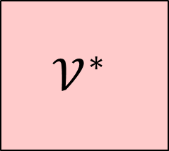




Resettably-Sound ZK
[Barak-Goldreich-Goldwasser-Lindell 01, BP 12, Chung-Pass-Seth 13]
Resettable soundness
Zero-knowledge
(non-black-box simulator)
$$𝒱$$
$$𝒫^{∗}$$
$$𝒫^{∗}$$
$$𝒱^{∗}$$
$$𝒮$$
$$𝒱$$

Slide 35




Resettably-Sound ZK
$$vk$$
$$𝒫$$
$$𝒱$$
$$sk,vk$$
$$x←U$$
$$f_{sk}(x)$$
Witness indistinguishable proof:
$x∈ℒ$ or $𝒫$ “knows” $sk$

Slide 36

Resettably-Sound ZK
$$vk$$
$$𝒫$$
$$𝒱$$
$$sk,vk$$
$$x$$
$$f_{sk}(x)$$
Witness indistinguishable proof:
$x∈ℒ$ or $𝒫$ “knows” $sk$

Slide 37













Analysis
Resettable soundness
Zero-knowledge
$$f_{sk}$$
$$𝒫^{∗}$$
$$𝒱^{∗}≈f_{sk}$$
$$w.p.\frac{1}{p\left(n\right)}$$
$$𝒮$$
$$𝒫^{∗}$$
$$x$$
$$𝒱^{∗}$$
$$𝒮im$$
$$f_{sk}(x)$$
$$𝒱$$
$$E$$
$$sk$$
$$sk$$

Slide 38
More Resettable Crypto
Resettably-sound ZK from OWFs
(Different approach from Chung-Pass-Seth 13)
Simultaneously-resettable ZK from OWFs
(using srWI by Chung-Ostrovsky-Pass-Visconti 13)
4-message resettably-sound ZK
3-message simultaneously-resettable
WI proof of knowledge

Slide 39








Worst-Case Extractable Signatures
Digital Signatures:
$$∀sk,vk$$
$${\text{Sign}}_{sk}$$
$$m_{i}$$
$$A$$
$${σ(m}_{i})$$
$${\text{Sign}}_{sk}$$
$$vk$$
$$m,σ\left(m\right),$$
$$m∉\left\{m_{i}\right\}$$

Slide 40






Worst-Case Extractable Signatures
For every $sk,vk:$
$$A$$
$A$breaks security for $sk,vk$
$$E$$
$$⟹$$
$$sk$$

Slide 41
Thank You.
#define _ -F<00||--F-OO--;
int F=00,OO=00;main(){F_OO();printf("%1.3f\n",4.*-F/OO/OO);}F_OO(){
          _-_-_-_
          _-_-_-_-_-_-_-_-_
          _-_-_-_-_-_-_-_-_-_-_-_
          _-_-_-_-_-_-_-_-_-_-_-_-_-_
          _-_-_-_-_-_-_-_-_-_-_-_-_-_-_
          _-_-_-_-_-_-_-_-_-_-_-_-_-_-_
          _-_-_-_-_-_-_-_-_-_-_-_-_-_-_-_
          _-_-_-_-_-_-_-_-_-_-_-_-_-_-_-_
          _-_-_-_-_-_-_-_-_-_-_-_-_-_-_-_
          _-_-_-_-_-_-_-_-_-_-_-_-_-_-_-_
          _-_-_-_-_-_-_-_-_-_-_-_-_-_-_
          _-_-_-_-_-_-_-_-_-_-_-_-_-_-_
          _-_-_-_-_-_-_-_-_-_-_-_-_-_
          _-_-_-_-_-_-_-_-_-_-_-_
          _-_-_-_-_-_-_-_
          _-_-_-_
}
IOCCC 88

