Slide 1
From Runtime Verification to Runtime Intervention and Adaptation
Martin Rinard
MIT EECS, MIT CSAIL
Massachusetts Institute of Technology
Cambridge, MA 02139

Slide 2
Standard RV Story
Application
Run application
Evaluate formula
If formula is false, then have found bug!
Generate a report
Wait for fix
End of story
x = 0 and y < 10
Logical
Formula

Slide 3
Why Standard RV Story is Suboptimal
Fixes take time
Fix may never happen
  Organization may have higher priorities
  Developers may be gone to other projects
  May have lost source code
  Organization may no longer exist

Slide 4
Better RV Story
Application
Run application
Evaluate formula
If formula is false, then have found bug!
Change something to make formula true
Keep going
x = 0 and y < 10
Logical
Formula

Slide 5
Failure-Oblivious Computing
[Rinard, Cadar, Dumitran, Roy, Leu, and Beebee OSDI 2004]

Slide 6
Standard C Programming Model
Allocated Data Blocks
Linear Address Space
p

Slide 7
Standard C Programming Model
Allocated Data Blocks
Linear Address Space
*p += x

Slide 8
Standard C Programming Model
Allocated Data Blocks
Linear Address Space
*(p+10) +=x

Slide 9
Standard C Programming Model
Allocated Data Blocks
Linear Address Space
*(p+30) += x
Notes:
Because of linear address space, you can even use pointer arithmetic to access a different data block from the one that the base pointer points into.

Slide 10
Standard C Programming Model
Allocated Data Blocks
Linear Address Space
*(p+30) += x
Bounds Violation!
Data corruption…
Segmentation violation…
Security vulnerability…
Notes:
A real big-ticket problem, however, is the possibility of security vulnerabilities. Many exploits take advantage of bounds errors to inject code into the application and cause the injected code to execute.

Slide 11
Standard RV Story
Formula is
“address within bounds of accessed block”
Insert formula before every read and write
Find out of bounds accesses

Slide 12
Bounds Checked C Programming Model
Base Data Block ≠ Accessed Data Block ⇒ Illegal Access!
Linear Address Space
*(p+30) += x
Track base data block for each pointer
Dynamically check that each access falls within the bounds of the base data block
If not, access is illegal
Jones&Kelly IWAD 1997, Ruwase&Lam NDSSS 2004

Slide 13
Standard RV Bounds Check Story
Bounds violation (illegal access) is irrefutable evidence of a fault in the program
Unsafe to continue because program is outside its anticipated execution envelope
So you generate a bug report and terminate program
Hopefully someone comes along and fixes bug

Slide 14
Better RV Bounds Check Story
Programs are complex systems
Should tolerate localized memory errors
  Perform dynamic bounds checks
  Discard out of bounds writes
  Manufacture values for out of bounds reads
  Continue to execute along normal path
Called failure-oblivious computing

Slide 15
Consequences of Failure-Oblivious Computing
No corruption of other data blocks
No segmentation violation
No abnormal termination
No addressing exceptions
No security vulnerabilities (from out of bounds writes)

Slide 16
Consequences of Failure-Oblivious Computing
No corruption of other data blocks
No segmentation violation
No abnormal termination
No addressing exceptions
No security vulnerabilities (from out of bounds writes)
But what about errors in continued execution?

Slide 17
Experiment
Implemented compiler that generates failure-oblivious code
Acquired programs (servers)
  Pine, Mutt (mail user agent)
  Apache (web server)
  Sendmail (mail transfer agent)
  Midnight Commander (file manager)
Found bounds violation errors
  Potential security vulnerabilities
  Vulnerability-tracking web sites

Slide 18
Experiment
Generated three versions of each program
  SC – standard compilation
  BC – bounds check compilation (terminates program on bounds violations)
  FO – failure-oblivious compilation (continues through bounds violations)
Ran each version on workload containing inputs that attempted to exploit vulnerability

Slide 19
Results
Continues
Correctly?
Secure?
Initializes?
Pine
Mutt
Sendmail
Apache
Midnight
SC
BC
FO
SC
BC
FO
SC
BC
FO
No
Maybe
Yes
Not Applicable
Notes:
Last question is - does the server behave correctly even for the attack input? In other words, assume we fixed the error. Is there any observable difference between this correct server and the other versions of the server? For both Pine and Apache, the FO servers both process the attack input correctly. Sendmail and Midnight commander are somewhat unusual cases. When presented with the attack input, Sendmail performs a length check that would cause the attack input to fall into an anticipated error case. Simply fixing the bounds check error would not change this behavior, so the fixed version and failure oblivious versions would generate the same bad input response. There is another bug in the Midnight Commander code that contains the buffer overflow, so simply fixing the bug would not cause Midnight Commander to behave correctly.

Slide 20
Let’s Take A Look At A Vulnerability

Slide 21
Pine Error
Send mail message
Carefully crafted FROM field
To: john.doe@cs.uni.edu
From: <code>\"\"\"\"\"<addr>

Slide 22
Pine Error
Mail Folder
Send mail message
Carefully crafted FROM field
To: john.doe@cs.uni.edu
From: <code>\"\"\"\"\"<addr>
To: john.doe@cs.uni.edu
From: <code>\"\"\"\"\"<addr>

Slide 23
Pine Vulnerability
Mail Folder
Send mail message
Carefully crafted FROM field
To: john.doe@cs.uni.edu
From: <code>\"\"\"\"\"<addr>
To: john.doe@cs.uni.edu
From: <code>\"\"\"\"\"<addr>
Pine reads message
Processes FROM field
Overflows buffer
Pine

Slide 24
Pine
a
\
“
\
“
\
“
\
FROM field
rfc822_cat
Buffer
Two Quoting Rules
\ replaced by \\
“ replaced by \ “
FROM field can double in size
Buffer is not twice size of FROM field

Slide 25
Pine
a
\
“
\
“
\
“
\
FROM field
rfc822_cat
a
\
\
\
“
\
\
\
“
Buffer
\
\
\
“
\
\
Two Quoting Rules
\ replaced by \\
“ replaced by \ “
FROM field can double in size
Buffer is not twice size of FROM field

Slide 26
Pine and Failure-Oblivious Computing
a
\
“
\
“
\
“
\
FROM field
rfc822_cat
a
\
\
\
“
\
\
\
Buffer
Writes beyond end of buffer discarded
FROM field effectively truncated

Slide 27
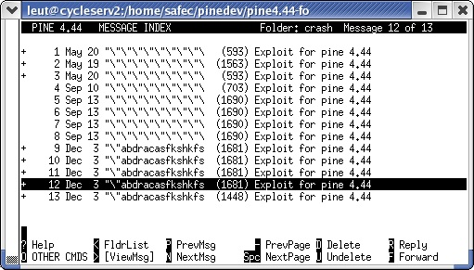
FROM fields that overflow buffer
Truncated at 18 characters in user interface

Slide 28
Apache
To redirect all gif files to corresponding jpg files on another server, use this RedirectMatch command:
RedirectMatch (.*)\.gif$ http://www.images.com$0.jpg
Capture regular expression here
Reference regular expression here
/u/red.gif
http://www.images.com/u/red.jpg
Captured regular expression
Captured regular expression

Slide 29
Storing Captured Regular Expression Information
RedirectMatch (.*)\.gif$ http://www.images.com$0.jpg
/u/red.gif
http://www.images.com/u/red.jpg
Array of structures that stores captured regular expressions
  Start offset
  End offset
Array has ten elements
Space for ten captured regular expressions
0
6

Slide 30
Overflow In Captured Expression Array
RedirectMatch C(0*)(1*)(2*)(3*)(4*)(5*)(6*)(7*)(8*)(9*)(A*) index.html?input=$11
C0123456789A
index.html?input=11
11
12
Offsets for eleventh captured regular expression written beyond array bounds
10
11
9
10
8
9
7
8
6
7
5
6
4
5
3
4
2
3
1
2

Slide 31
Apache and Failure-Oblivious Computing
RedirectMatch C(0*)(1*)(2*)(3*)(4*)(5*)(6*)(7*)(8*)(9*)(A*) index.html?input=$11
C0123456789A
index.html?input=11
Offsets for eleventh captured regular expression discarded
10
11
9
10
8
9
What about referencing eleventh, ..., captured regular expressions?
Can't reference - names are $0-$9
Failure-oblivious computing fix matches subsequent developer fix
7
8
6
7
5
6
4
5
3
4
2
3
1
2

Slide 32
Other Applications
Servers have short error propagation distances
  Localized errors in one request
  Tend not to propagate to next request
  (or even to interface of current request)
  Inherently have good modularity
Effect of failure-oblivious computing
  Discarding out of bounds writes eliminates global data structure corruption
  Keeps errors localized
  Server survives to process subsequent requests
Subsequent requests serviced without errors
Notes:
These errors give us some insight into the interaction between failure-oblivious computing and the characteristics of the servers. Can we generalize this insight to project how failure-oblivious computing might work for other servers?

Slide 33
Input Rectification
[Long, Ganesh, Carbin, Sidiroglou, and Rinard ICSE 2012]

Slide 34

Context
Content
(Images, Videos, …)
Application
Network

Slide 35
Context
Content
(Pictures, Videos, …)
Application
Network

Slide 36

The Problem
Content
(Pictures, Videos, …)
Application
Malicious
Content
Network

Slide 37
Thinking About The Problem
All Content
Comfort Zone

Slide 38
Thinking About The Problem
Comfort zone characterized by features
  Length of data fields
  Values of integer fields
Malicious content has atypical features
  Long data fields
  Large or negative integer fields

Slide 39
A Standard RV (Sort Of) Solution
Content
(Pictures, Videos, …)
Application
Malicious
Content
Filter
Network

Slide 40
A Standard RV (Sort Of) Solution
Content
(Pictures, Videos, …)
Application
Malicious
Content
Filter
Network
Atypical Content
(Outside Comfort Zone)

Slide 41
Drawbacks
Lose desirable, safe, but atypical content
Also lose desirable malicious content!
Users may be unhappy/unwilling to use filters

Slide 42
A Better RV Solution - Rectification
All Content
Apply Rectifier
Comfort Zone

Slide 43
Potential Advantages
Delivers all of data in typical content files
May deliver (most) of desirable data in
  Safe but atypical content files
  Malicious content files
Users may accept rectification

Slide 44
Realizing the Idea
Training Content
(Defines Comfort Zone)
Constraints
Field lengths
Integer field values
Correlations
Constraint
Learning
Application
Constraints
Rectifier
Safe
Content
Potentially
Malicious
Content

Slide 45
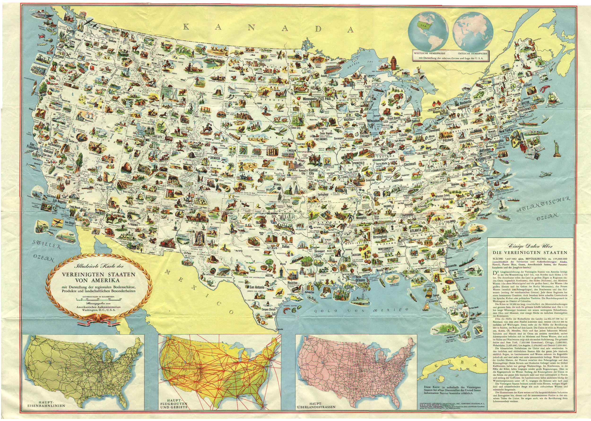


Example: Training
…
width
…
data
…
…
width
…
data
…
…
width
…
data
…
Constraint
Learning
size(data) <= 7235692
width <= 15964

Slide 46


Example: Rectification
…
width (8568)
…
data (8608057 bytes)
…
Rectifier
size(data) <= 7235692
width <= 15964
…
width (8568)
…
data (truncated to 7235692 bytes)
…

Slide 47
Experimental Results

Slide 48
Methodology
Acquired applications with (real-world) vulnerabilities
Acquired training and test content files
Used training files to train rectifier
Applied rectifier to obtain rectified files
Evaluated how much desirable data is retained (Human Evaluation via Mechanical Turk)

Slide 49
Applications
Swfdec 0.5.5 (Shockwave player)
Dillo 2.1 (lightweight web browser)
ImageMagick 6.5.2-8 (image processing toolkit)
Google Picasa 3.5 (photo management)
VLC 0.8.6h (media player)
Content Formats
SWF (Flash video)
PNG (image)
JPEG (image)
TIFF (image)
WAV (sound)
All Have Vulnerabilities

Slide 50
Question: Does Rectification Eliminate Vulnerabilities?
Answer: Yes
Obtained input files that exploit vulnerabilities
Rectified these input files
Ran applications on rectified files
Rectified files did not trigger vulnerabilities

Slide 51
Question: How many safe files does rectifier leave intact?
Answer: Between 98%-100%

Slide 52
Question: How much desirable data does rectifier preserve in modified files?
Started with files that rectifier modified
Mechanical Turk workers rate difference
Workers classified files into four categories
  No difference
  Minor difference
  Substantially different
  Totally different

Slide 53
Mechanical Turk Classification Results
(For Files Modified During Rectification)

Slide 54
Why Doesn’t Rectification Affect Appearance?
Input files typically have many components
Only some of which affect the appearance
…
title
author
subject
…
Width
…
Data
…
These fields do not affect the appearance
These fields affect the appearance
Rectification often modifies fields
(like metadata) that do not affect the appearance

Slide 55
Insight
Some components are more important than others
Vulnerabilities and errors are often associated with less important components
Less important => less intensively engineered
Key goal
  Ensure less important components
  Don’t interfere with more important components
  In many cases input rectification does this

Slide 56
Even if rectification does affect appearance
Result can be very reasonable

Slide 57
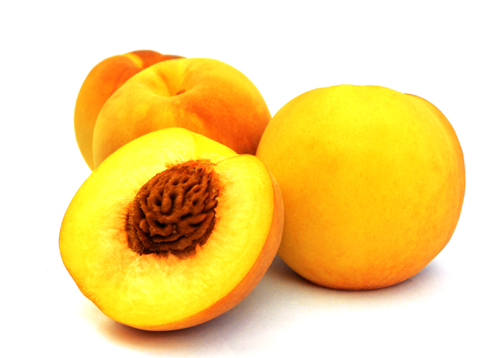

Substantially different

Slide 58


Minor difference

Slide 59
Substantially different

Slide 60


Minor difference
Truncation

Slide 61
Minor difference

Slide 62
Potential Question:
Does Rectification Work on ALL Input Files?
Implemented a static analysis
  Start with error in program
  Derive condition that ensures error can’t happen
  Propagate condition back through program
  Obtain safety condition on input file values
Result
  Learned condition implies statically derived safety condition
  So rectification nullifies error for ALL input files

Slide 63
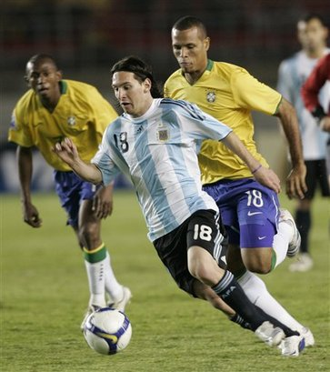

We Are Proposing A Role Change
To Active Participants
From Passive Observers

Slide 64
Other Active Participation Techniques
ClearView
[Perkins et. al. SOSP 2009]
  Learn invariants
  Dynamic patches enforce invariants when attacked
Data Structure Repair[Demsky and Rinard ICSE 2005, OOPSLA 2003]
  Data structure consistency properties
  Check and enforce after data structure updates
  Cyclic Memory Allocation[Nguyen and Rinard ISMM 2007]
  Allocate from cyclic buffer
  Eliminate memory leaks
  Infinite Loop Exit
  [Carbin, Misailovic, Kling and Rinard ECOOP 2011, OOPSLA 2012]
  Detect infinite loops
  Exit to continue execution

Slide 65
Result is Immortal Software
Identify all potential fatalities
  Addressing errors
  Infinite loops
  Memory leaks
Eliminate via active participation techniques
  Failure-oblivious computing
  Infinite loop execution
  Cyclic memory allocation

Slide 66
Performance

Slide 67
Problem
Program Takes Too Long To Run
(Or Consumes Too Much Energy)

Slide 68
Solution
[Misailovic et. al. ICSE 2010, Sidiroglou et. al. FSE 2011]
Profile program
Find loops that take most time
Perforate the loops
  Don’t execute all loop iterations
  Instead, skip some iterations
for (i = 0; i < n; i++) { … }

Slide 69
Solution
[Misailovic et. al. ICSE 2010, Sidiroglou et. al. FSE 2011]
Profile program
Find loops that take most time
Perforate the loops
  Don’t execute all loop iterations
  Instead, skip some iterations
for (i = 0; i < n; i++) { … }
for (i = 0; i < n; i += 2) { … }

Slide 70
Solution
[Misailovic et. al. ICSE 2010, Sidiroglou et. al. FSE 2011]
Profile program
Find loops that take most time
Perforate the loops
  Don’t execute all loop iterations
  Instead, skip some iterations
for (i = 0; i < n; i++) { … }
for (i = 0; i < n; i += 4) { … }

Slide 71
Solution
[Misailovic et. al. ICSE 2010, Sidiroglou et. al. FSE 2011]
Profile program
Find loops that take most time
Perforate the loops
  Don’t execute all loop iterations
  Instead, skip some iterations
for (i = 0; i < n; i++) { … }
for (i = 0; i < n; i += 8) { … }

Slide 72
Solution
[Misailovic et. al. ICSE 2010, Sidiroglou et. al. FSE 2011]
Profile program
Find loops that take most time
Perforate the loops
  Don’t execute all loop iterations
  Instead, skip some iterations
Result
  Program consumes fewer computational resources
  Runs faster (or takes less energy) (or both)

Slide 73
Common Reaction
OK, I agree program should run fast
But you can’t do this because you’ll get the wrong result!

Slide 74
Our Response
OK, I agree program should run fast
But you can’t do this because you’ll get the wrong result!
You won’t get the wrong result
You’ll get a different result

Slide 75
Not a Correctness Issue
Accuracy Issue

Slide 76
Accuracy Metric
Original
Program
Output Abstraction
(Application-Specific)
Input
Output
Peak Signal to
Noise Ratio
Selected Output Component
Or
Measure of Output Accuracy
c
Peak Signal to
Noise Ratio
Perforated
Program
Metric is Relative Difference

Slide 77
Accuracy Metric (One Output)
Original output o
New output o’
−
o
o
'
=
q
o

Slide 78
Accuracy Metric in General
Original output o₁, …, o_{n}
New output o’₁, …, o’_{n}
n
o
−
o
'
1
∑
i
i
q
=
n
o
i
=
1
i

Slide 79
Exploring This Idea
Acquire benchmarks
  Programs
  Inputs (training and production)
Choose output abstractions
  Choose relevant parts of output
  Choose accuracy metric (when appropriate)
Perform experiments
  Apply loop perforation
  Measure performance vs. accuracy trade off

Slide 80
Parsec Benchmarks
x264 (H.264 video encoding)
bodytrack (human movement tracking)
swaptions (swaption pricing)
ferret (image search)
canneal (digital circuit place and route)
blackscholes (European option pricing)
streamcluster (online point clustering)

Slide 81
Output Abstractions (Define Accuracy Metrics)
x264 – peak signal to noise ratio, size of encoded video
bodytrack – body vectors (head, torso, legs, …) (accuracy metric uses weighted relative difference)
streamcluster – B³ cluster quality metric (in [0,1]) (accuracy metric is original - perforated)
swaptions – swaption price
ferret - #common images/#total images
canneal – routing cost
blackscholes – option price
Provided by domain expert or user
Not provided by software developer

Slide 82
Finding Perforatable Loops
Search Problem
  Step 1: Find loops that can perforate in isolation
  Step 2:
    Start with loops that can perforate in isolation
    Find sets of loops that can perforate together
Rationale
  Many loops are not perforatable at all
  Get rid of these loops in Step 1
  Step 2 works with more productive search space

Slide 83
How Do You Know It Is OK To Perforate?
Use testing!
Run program on test inputs
If time improves and accuracy is acceptable
Then it is OK to perforate the loop!

Slide 84
Individual Loop Perforation Results for x264, b=10%
¼
½
¾
1st
% Instructions
Encode
82%
x264_mb_analyse_inter_p16x16
64%
x264_pixel_sad_16x16, 1
55%
x264_pixel_sad_16x16, 2
54%
x264_me_search_ref
25%
pixel_satd_wxh, 1
18%
pixel_satd_wxh, 2
18%
refine_subpel
12%
pixel_sub_wxh, 1
9%
pixel_sub_wxh, 2
7%
Error/Crash/Timeout
b ≤ Accuracy
Speedup ≤ 1
Accuracy < b and 1 < Speedup
Notes:
Encode - iterates over all frames to be encoded
X264_mb_analyse_inter_p16x16 – loop compares different macroblocks in frame, calls *sad* functions, perforating loop compares fewer macroblocks
*sad* functions – compute match between reference and current macroblocks, perforating loops subsamples points in macroblocks used to compute match metric
X264_me_search_ref -
*satd* functions – alternative implementation of same functionality as *sad* functions, perforating has same effect
refine_subpel – subpixel refinement, compares block with four adjacent blocks (NEWS, diamond), perforating loop compares with fewer adjacent blocks
pixel_sub_wxh – subtracts arrays of individual pixels, called from *satd* functions, perforating loop subtracts fewer pixels, affects match metric (unacceptably)
The function \verb+pixel_satd_wxh+, identified by the Quality of Service Profiler as the best optimization candidate, calculates the similarity metric between two
blocks. Perforating either of the loops in this loop nest causes the encoder to sample fewer points when calculating the similarity metric. The amount of QoS loss accumulated in the program after perforating both loops is 0.048 for the tractor input and 0.073 for the blue\_sky input, with respective speedups of 1.80 and 1.5. The majority of the QoS loss comes from the increased video size. Successful perforation of both loops in the same loop nest indicates that there is a positive interaction between the loops, and possibly an additional amount of redundancy in computation, which makes the loop nest even more palatable as an optimization candidate. (x264_pixel_sad_* functions implement the same functionality)
The loop from \verb+refine_subpel+, which was also selected in the cumulative perforation results, performs a sub-pixel refinement computation\footnote{Subpixel refinement computation shifts block across the frames for non-integer increment. The new pixel values are calculated by
interpolating the existing pixels. }. The perforatable loop calls the similarity metric computation function \verb+pixel_sad*+ during the search for good
matches.
pixel_sub_wxh, subtracts pixels between current and reference blocks, called from pixel_sad* or pixel_satd*. Perforating these loops causes unacceptable distortion

Slide 85
Multiple Loop Perforation Results

Slide 86
Individual Loop Perforation Results for bodytrack, b=10%
¼
½
¾
1st
% Instructions
mainPthreads
99%
ParticleFilter::Update
77%
ImageMeasurements::ImageErrorInside, 1
37%
ImageMeasurements::ImageErrorInside, 2
37%
ImageMeasurements::ImageErrorEdge, 1
29%
ImageMeasurements::ImageErrorEdge, 2
29%
ImageMeasurements::InsideError, 1
28%
ImageMeasurements::InsideError, 2
24%
TrackingModel::GetObservation
17%
ImageMeasurements::EdgeError, 1
14%
Error/Crash/Timeout
b ≤ Accuracy
Speedup ≤ 1
Accuracy < b and 1 < Speedup
Notes:
mainPthreads – Performs the calcuation for each frame. Perforating this loop causes the program to process subset of the frames.
ParticleFilter::Update – iterates over annealing steps. Perforating loop causes computation to execute fewer annealing steps.
ImageMeasurements::* - calculate error metrics between generated model (from image processing) and underlying probabilistic model. Perforating these loops causes calculations to throw out terms in error functions. Different loops iterate over different parts of model. Red ball at ¾ for InsideError,2 is infinite loop/timeout.
TrackingModel – reads data from cameras, initializes data structures. Perforating loop causes some data to not be initialized.
The loop in the function \verb+ParticleFilter::Update+ is the main computation for each frame. The computation rooted at this loop refines the probabilistic estimation model of the human body position by performing particle filtering. For each frame the algorithm performs several annealing steps. In each step, the algorithm stochastically disperses a number of points according to the previous body position model, and compares the number of points that cover the body. The
algorithm uses a fitness function to compare the new model with the previous one.
GetObservation --- reads the data from the cameras. Perforating this loop causes the internal data structures to remain uninitialized.
The functions from the class \verb+ImageMeasurements+ use this model to calculate the fitness of the provisional body part estimation.

Slide 87
Multiple Loop Perforation Results

Slide 88
Real-Time Control Experiments
Real-time applications
Platform with fluctuating characteristics
  Multicore computer, lose some cores
  Voltage/clock frequency changes
Use dynamic loop perforation to satisfy real-time requirements in face of fluctuations

Slide 89
Setup
At each point in time, have
  C = set of currently perforated loops
  W = waiting loops (can perforate but not yet perforated)
  P = C ∪ W
Application generates heartbeat
  Heartbeat too slow?
    Increase perforation
    Move highest priority loop from W to C
  Heartbeat too fast?
    Decrease perforation
    Move lowest priority loop from C to W

Slide 90
Experiments
Two applications
  X264
  BodyTrack
Two scenarios
  Core losses
  Voltage scaling (clock rate drops)
Perforation rate ½, Accuracy bound 0.10

Slide 91
Lose 3 of 8 cores
x264 Core Loss Experiment
1.6
8
1.4
7
1.2
6
1
5
Performance
Number of Perforated Loops
0.8
4
0.6
3
0.4
Baseline
2
No perforation
0.2
Dynamic perforation
1
Number of perforated loops
0
0
0
100
200
300
400
Time (heartbeat)
Notes:
Baseline rate is 7.6 frames per second at 8 processors.

Slide 92
Lose 3 of 8 cores
BodyTrack Core Loss Experiment
1.6
8
1.4
7
1.2
6
1
5
Performance
Number of Perforated Loops
0.8
4
0.6
3
0.4
Baseline
2
No perforation
0.2
Dynamic perforation
1
Number of perforated loops
0
0
0
50
100
150
200
250
Time (heartbeat)
Notes:
Performance does not drop to 5/8 of 8 core performance because does not get perfect scalability to 8 cores.
So at 5 cores, uses machine more efficiently than on 8 cores. Each point is average throughput over last 20 heartbeats.
Perforates one loop at a time. Baseline heartbeat rate is 4.4 beats per second for bodytrack. Goal is to keep rate within [.9, 1.15] times 4.4 beats per second. All loops perforated at ½ rate. Makes a perforation change decision (potential) every 10 or so heartbeats.

Slide 93
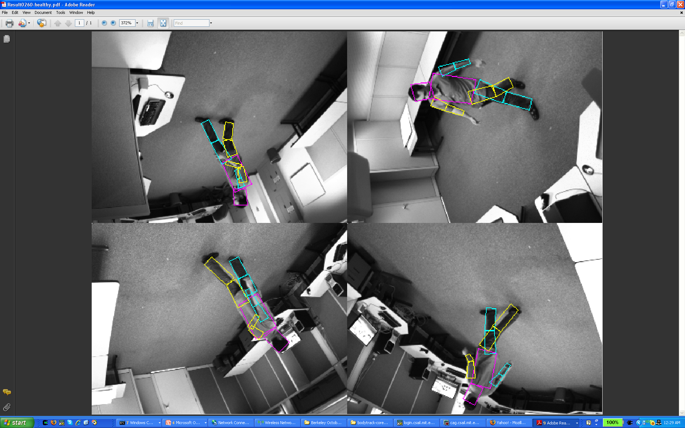
bodytrack, No Perforation

Slide 94
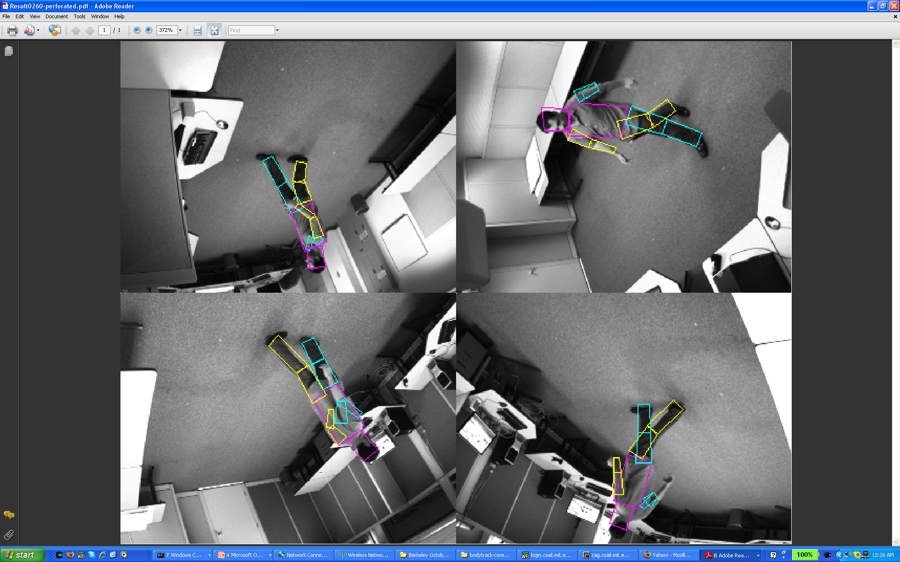
bodytrack, With Perforation (Core Loss)

Slide 95
x264 Frequency Scaling Experiment
Frequency Drops (2.53 GHz → 1.6 GHz)
Frequency Rises (1.6 GHz → 2.53 GHz)
1.6
8
Baseline
1.4
No perforation
7
Dynamic perforation
1.2
Number of perforated loops
6
1
5
Performance
Number of Perforated Loops
0.8
4
0.6
3
0.4
2
0.2
1
0
0
0
100
200
300
400
500
Time (heartbeat)
Notes:
2.53 GHz to 1.6 GHz

Slide 96
BodyTrack Frequency Scaling Experiment
Frequency Drops (2.53 GHz → 1.6 GHz)
Frequency Rises (1.6 GHz → 2.53 GHz)
1.6
8
Baseline
1.4
No perforation
7
Dynamic perforation
Number of perforated loops
1.2
6
1
5
Performance
Number of Perforated Loops
0.8
4
0.6
3
0.4
2
0.2
1
0
0
0
50
100
150
200
250
Time (heartbeat)

Slide 97




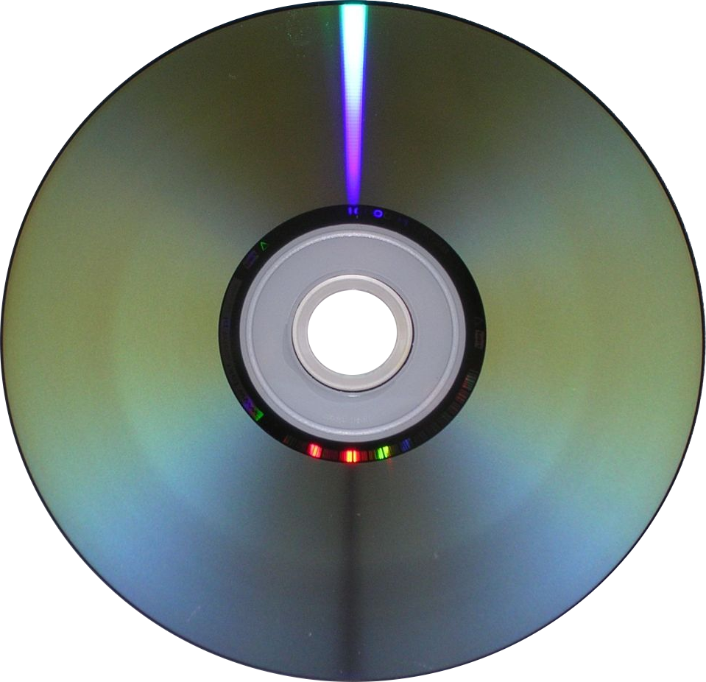
x264
Uncompressed Video Frame Sequence
Encoder
Compressed Video Stream

Slide 98
Motion Estimation
Reference
Frame
Current
Frame
?
All Perforated Loops Are In Motion Estimation Computation

Slide 99
x264 Loop Nest
Sum of Hadamard transformed differences loop nest
(computes match metric between cur and ref blocks)
short temp[4][4];
for (i = 0; i < h; i += 4) {
for (j = 0; j < w; j += 4) {
element_wise_subtract(temp, cur, ref, cs, rs);
hadamard_transform(temp, 4);
value += sum_abs_matrix(temp, 4);
}
cur += 4*cs; ref += 4*rs;
}
return value;

Slide 100
Perforated x264 Loop Nest
Sum of Hadamard transformed differences loop nest
(computes match metric between cur and ref blocks)
short temp[4][4];
for (i = 0; i < h; i += 8) {
for (j = 0; j < w; j += 8) {
element_wise_subtract(temp, cur, ref, cs, rs);
hadamard_transform(temp, 4);
value += sum_abs_matrix(temp, 4);
}
cur += 4*cs; ref += 4*rs;
}
return value;
Perforation Effect
New block match metric
Uses block with best match
(as measured by metric)
New metric works fine

Slide 101
Why Not Just Skip Motion Estimation?
Runs 6.8 times faster
But encoded video is 3.55 times bigger!

Slide 102
Common Loop Perforation Patterns
Heuristic Searches Driven By Metrics
  Loop perforation produces less accurate but more efficiently computable metric
  Program runs faster with acceptable accuracy
Converging Loops
  Loops converge to a result
  Loop perforation stops close to convergence
Monte Carlo Simulations

Slide 103
Research Trajectory
Seminal work was empirical
  Task skipping [Rinard ICS 2006]
  Loop perforation
  [Sidiroglou, Hoffman, Misailovic, and Rinard FSE 2011]
Next steps involve static guarantees for approximate computations
  Integrity guarantees (relational reasoning)
  [Carbin, Kim, Misailovic, and Rinard PLDI 2012]
  Accuracy guarantees (probabilistic reasoning)
  [Zhu, Misailovic, Kelner, and Rinard POPL 2012]
  [Misailovic, Roy, and Rinard SAS 2011]

Slide 104
New Perspective and Value System
Old Value
Understanding
Engineering
Correctness
New Value
System works
Active Participation
Acceptability
  Accurate enough
  Often enough
  Meaningful survival

Slide 105
Conclusion
Active participation, not passive observation
New, simple solutions to hard problems
  Security vulnerabilities, memory leaks
  Addressing errors, infinite loops
  Program optimization
Unlike traditional approaches, we automatically change the semantics (which is the point)
New perspective, new value system, and new techniques

