Slide 1
Complexity of Computing the Margin of Victory for Various Voting Rules
Ronald L. Rivest
Emily Shen
Lirong Xia
CAEC, Nov. 18, 2011
Notes:
Feel free to ask questions

Slide 2
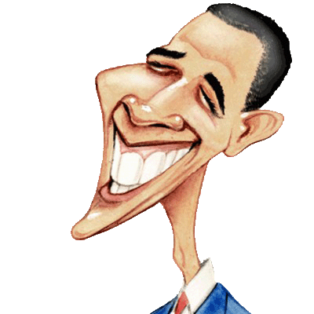
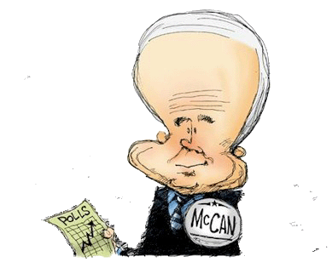
Voting
> >
voting rule
> >
> >

Slide 3
Criteria for voting rules
Lots of voting rules (plurality, approval, instant runoff voting, etc.) – How to choose one?
“Traditional” criteria: monotonicity, consistency, majority, etc.
More recently: computational complexity of manipulation (strategic voting)
We consider: efficient auditability – specifically, computational complexity of computing margin of victory (related to manipulation problems)

Slide 4
Margin of Victory (MoV)
Definition: Given a profile of ballots, the margin of victory is the smallest number k such that k modified ballots could change the election winner
Margin of victory is critical to efficient, effective post-election audits
To provide a given level of statistical confidence, landslide election requires much less checking than a close election
Margin of victory is a measure of closeness of election, suggests level of political mandate won by winner

Slide 5
Margin of Victory Examples
Plurality
A:10 votes, B: 15 votes, C: 4 votes
Margin of victory = 3
Instant-runoff voting (IRV)
Margin of victory = 1
A>B>C | B>A>C | C>A>B
10 | 15 | 4
Notes:
Split into 2 slides, work through STV example

Slide 6
The MoV computational problem
Computational problem MoV: compute margin of victory of a profile of ballots
Decision problem MoVk: Is the margin of victory at most k?
MoV problem closely related to previously studied manipulation problems: UCM, bribery
Notes:
Define profile
At most k or equal to k?

Slide 7
Margin of Victory & Related Manipulation Problems
Problem | Objective | By | Desired Complexity
Margin of Victory | Change the winner | Changing votes | Low
Unweighted Coalitional Manipulation | Make a given candidate win | Adding votes | High
Bribery | Make a given candidate win | Changing votes | High
Notes:
Write out problem names
Want complexity:
Low
High
High

Slide 8
Our Results
Voting rule | Margin of Victory | Unweighted Coalitional Manipulation
Positional scoring rules Including Borda | P | P (1 manipulator) | [BTT89]
 |  | NPC (2 or more) | [XCP10] [DKNW11] [BNW11]
Plurality with runoff | P | P | [ZPR09]
Copeland | NPC and FPT | P (1 manipulator) | [BTT89]
 |  | NPC (2 or more) | [FHS08,10]
Maximin | NPC and FPT | P (1 manipulator) | [BTT89]
 |  | NPC (2 or more) | [XZP⁺09]
STV | NPC for MoV₁ | NPC | [BO91]
Ranked pairs | NPC for MoV₁ | NPC | [XZP⁺09]
Nanson’s rule | ? | NPC | [NWX11]
Baldwin’s rule | ? | NPC | [NWX11]
This work
Notes:
Add approval results
Write out NP-complete?

Slide 9
Poly-time margin algorithm for plurality with runoff
Let d be the current winner
For every k
Check whether there is a way to make d not in the runoff by changing k votes
Check for every adversarial c, every threshold l, whether there is a way to change k votes such that
c and d are ranked at the top for at least l times
Any other alternative is ranked at the top for no more than l times
c beats d in their pairwise election

Slide 10
IRV Margin of Victory = 1 is NP-Complete
Proof by reduction from unweighted coalitional manipulation problem
Tweak UCM1 profile P to get new profile P’ by:
Adding a new candidate d
Ranking d just below c in P
Adding |P|+1 voters who all rank d as 1st choice
Show: MoV of P’ is 1 if and only if UCM1 has a solution
Notes:
MoV1, UCM1 vs written out

Slide 11
Summary and Future Work
We studied complexity of computing the margin of victory for some common voting rules
Future work:
Complexity of MoVk (k > 1) for IRV, ranked pairs
Practical algorithms to compute/approximate margin of victory for IRV, ranked pairs
Heuristics, approximation algorithms

