Slide 1
Auditing Elections “in other ways”
Ronald L. Rivest
MIT
MAA Panel on
Can Mathematics Help Us Trust Our Elections Again?
Joint Mathematics Meetings (Denver, Colorado)
January 17, 2020

Slide 2
Outline
Security Requirements
Evidence-based Elections
Software Independence
Auditing of Paper Ballots
k-cut for sampling
Bayesian audits
Ternary plurality trees
Not:
Russians
Fake news
Gerrymandering
Voter ID
Best Voting Rule

Slide 3
How do we vote? Paper Ballots, mostly (About 80% of voters use them) Optical scanners are used for efficient tabulation

Slide 5
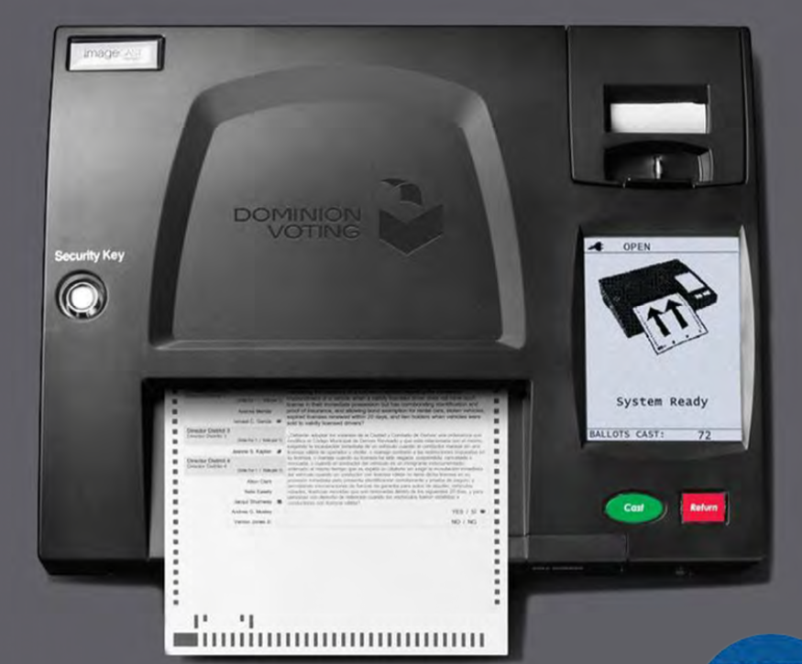

Slide 6
Scanners may introduce errors
Differences in interpretation between machine interpretation, and hand interpretation based on “voter intent” rules.
Stray marks (e.g. caused by folds)
Configuration errors
Programming errors
Hacking (adversarial attack)

Slide 7
Security Requirements

Slide 8
Security Requirements
Only eligible voters may vote, and each eligible voter votes at most once.
Each cast vote is secret, even if voter wishes otherwise! -- No vote-selling! -- No receipt showing how you voted!
Final outcome is verifiably correct.
No ``trusted parties’’ – all are suspect! Vendors, voters, election officials, candidates, spouses, other nation-states, …

Slide 9
Evidence-Based Elections
An election system should not only
accurately figure out who won,
but should also
provide convincing evidence
that the winner really won.
(Stark & Wagner 2012)

Slide 10
Software Independence
(Rivest & Wack, 2006)

Slide 11
Software Independence
Software is not to be trusted!
A voting system is software independent if an undetected error in the software can not cause an undetectable change in the election outcome.
Strongly software-independent if it is possible to correct any such outcome error
Not good to say: “The computer said so!”
Example: Paper ballots (with hand recount)

Slide 12
NASEM Report (9/6/18)
National Academies report ”Securing the Vote”
www.nap.edu/futureofvoting
41 recommendations

Slide 13
NASEM Recommendations Use voter verifiable paper ballots! Perform statistical audit of tabulation! …

Slide 14
Election with paper ballots
Print ballots; setup
Mark Choices; Verify Vote; Cast Vote!
Use optical scanners to give initial (“reported”) outcome
Perform statistical audit of tabulation of cast paper ballots

Slide 15
Auditing of Paper Ballots

Slide 16
Audits are about:
Sampling cast paper ballots at random
Counting, or Sampling with k-cut
Figuring out what the sampled ballots say about the tabulation that yielded the reported election results
Risk-Limiting audits, or Bayesian audits

Slide 17
General audit structure
Cast Votes
Sample
Draw an initial random sample of ballots.
Interpret them by hand.
Stop if tabulation is now confirmed to desired confidence level.
If all ballots have now been examined, you have done a full recount, and are done. Otherwise increase sample size; return to 2.

Slide 18
A statistical tabulation audit does not check:
correctness of the tally (as opposed to the outcome)
voter eligibility
voter authentication
usability
privacy
chain of custody of paper ballots

Slide 19
Two auditing paradigms
Ballot-polling audits: Uses the cast paper ballots only. Like ``exit poll’’ of ballots…
Ballot-comparison audits: Compares sampled paper ballots with corresponding electronic records (``cast vote records’’ – CVRs)
Ballot comparison audit is more efficient by a factor of roughly (1 / margin-of-victory).

Slide 20
Sampling with k-cut

Slide 21
Finding a random ballot
Counting is standard method:
generate index pseudorandomly
count down to obtain selected ballot
k-cut is new method (Sridhar & Rivest ‘18)
perform k = 6 “cuts” (each moving some top portion of ballot stack to bottom)

Slide 22
Counting
Please count to ballot 572 out of these 901 !

Slide 23
k-cut
Get random number hint H between 1 and 99 (google “random number generator” for app)
Cut (take) approximately H % of ballots off top and move to bottom. OK to “eye-ball” it.
Repeat above k = 6 times.
Take top ballot as randomly selected ballot.

Slide 24
k-cut video

Slide 25
Remarks on k-cut
Can be about 5X faster (depending…)
May need to decrease risk limit a tad to allow for residual non-uniformity of sampling
Analysis: Markov chain convergence
k-cut does not work for ballot-comparison audits where you are looking for ballot with specific ID.
For details, see: https://arxiv.org/abs/1811.08811

Slide 26
Auditing other outcome rules

Slide 27
Social choice functions
Not all elections are plurality
For example, some elections are ranked-choice: ballot gives voter’s preferences: A > C > D > B
A specified ``social choice function’’ maps collections of ballots to outcomes.
Example: IRV (Instant Runoff Voting) – Keep eliminating candidate with fewest first-choice votes until some candidate has a majority of first-choice votes.

Slide 28
Black-box audits
“Black-box audits” only need to
draw random samples
derive many variant collections from a random sample
apply the social choice function in a “black-box” manner to those variant collections, to determine the winners of those collections.
Black-box audits thus apply to any voting system (any social choice function) !
Example: Bayesian audits.

Slide 29
Bayesian audits

Slide 30
Audit Rochester Hills MI (12/3/2018)
Reported results for Proposition: 22,999 Yes 12,343 No 1,324 Other
Sample results for Proposition for sample of size 76: 50 Yes 26 No 0 Other
So… ???

Slide 31
Compare RLA with Bayesian
RLA Question: What is current ``risk’’? (Probability that if reported winner is incorrect, audit would nonetheless accept it if audit stopped now.)
Bayesian Question: What is probability that reported winner would lose if all ballots were examined? (“upset probability”)

Slide 32
Bayesian Method (ballot polling)
Draw an initial random sample of cast ballots.
Extend for remaining ballots, but simulating what you might see: replace each draw of a paper ballot with copy of random earlier ballot. (Polya’s Urn)
Find winner for all (drawn and simulated) ballots.
Repeat steps 2—3 many times, measuring fraction of time reported winner loses.
Repeat with larger sample if fraction > 5%.

Slide 33
Figure
Sample (76)
Extension (36590)
Y Y N Y Y Y … Y N
Each new element of extension is copy of random ballot to its left.

Slide 34
Figure
Sample (76)
Extension (36590)
Y Y N Y Y Y … Y N N
Each new element of extension is copy of random ballot to its left.

Slide 35
Figure
Sample (76)
Extension (36590)
Y Y N Y Y Y … Y N N Y
Each new element of extension is copy of random ballot to its left.

Slide 36
Figure
Sample (76)
Extension (36590)
Y Y N Y Y Y … Y N N Y N
Each new element of extension is copy of random ballot to its left.

Slide 37
Figure
Sample (76)
Extension (36590)
Y Y N Y Y Y … Y N N Y N … … … … N Y
Each new element of extension is copy of random ballot to its left.

Slide 38
Results in Rochester Hills, MI
RLA results:
Risk measured at 2.1 %
(Kellie Ottoboni using SUITE tool)
Bayesian results: 99.7 % of time Yes wins 0.3 % of time No wins (Mayuri Sridhar using BPTOOL)
Both methods confirm tabulation.

Slide 39
Remarks
Bayesian methods extend to:
Ballot-comparison audits
Hybrid audits (CVR and no-CVR strata)
IRV or other complex voting schemes
For more details see https://arxiv.org/abs/1801.00528

Slide 40
Ternary Plurality Trees

Slide 41
Example ternary plurality tree
Leaves are ballots, in pseudorandom order Each node is “majority vote” of its children

Slide 42
Example ternary plurality tree
This is different social choice function.
But one that is very close to plurality (Valiant).

Slide 43
Example ternary plurality tree
To audit an election with n = 3^{k} votes, only need to audit 2^{k} = n^{0.63} leaves,
worst-case.

Slide 44
Conclusions
Math and statistics can help to make elections much more secure.
Post-election audits are the way to go, with either statistical audits (RLAs, or Bayesian audits if needed), or worst-case audits (based on TPTs if feasible).

Slide 45
The End
Thanks for your attention!
(and thanks to NSF CSOI and to Verified Voting!)

