Slide 1
PACT
Ronald L. Rivest
MIT Institute Professor
Responsible Data in the time of a Pandemic
July 14, 2020

Slide 2
Outline
(Disambiguation Page)
Manual Contact Tracing
Digital Contact Tracing
Ranging Accuracy – TC4TL (Too Close For Too Long)
Privacy
Integration with PH
Adoption
Effectiveness
Conclusions

Slide 3
(Disambiguation Page)
PACT (aka “PACT-East”) [This talk] “Private Automated Contact Tracing” http://pact.mit.edu/
PACT (aka “PACT-West”) “Privacy Sensitive Protocols and Mechanisms for Mobile Contact Tracing” https://arxiv.org/abs/2004.03544

Slide 4
Manual Contact Tracing
When a person (“index case”) tests positive, finding all or most of the people he may have exposed (“contacts”) is called contact tracing.
Manual CT is based on interviews with the index case, and phone calls to contacts.
CT allows contacts to be quarantined, symptom-checked, and tested.
CT is a powerful method for “flattening the curve”, as it removes infectious people from circulation.
Classic method, used widely for many pandemics.
Limitations: speed, compliance, and recall ability.

Slide 5
Digital Contact Tracing
PACT protocol inspired by Apple “Find My” (taught by Yael Kalai and me in Spring 2020 security course)
Uses Bluetooth by Apple devices to sense proximity.
Phone broadcasts values; these change frequently for privacy protection.
Public DB allows owner to find “where lost phone was last seen” while protecting privacy.
PACT protocol is similar: phone broadcast changing “chirps”.
If owner tests positive, can upload to DB the seeds for generating chirps.
Others can check if they have heard chirps of infected parties.
Similar protocols developed concurrently: DP3T, TCN, …

Slide 6
PACT (East) team
PACT organized early March
Leadership:
MIT campus: me, Danny Weitzner
MIT Lincoln Lab: Marc Zissman, Israel Soibelman
MGH: Louise Ivers (Medical / Public-Health advisor)
Many organizations represented: MIT, MIT Lincoln Lab, MGH, Weizmann, BU, Brown, IBM, CMU, MITRE, Northeastern, Qualcomm, Sandia, …
> 100 people (particularly strong on “layer 1” = BT ranging)
Strong relationships with other teams, Apple|Google, other vendors, jurisdictions, public health, …
PACT role: technology evaluator and advisor, not app developer; more interest in “helping good things happen” than “taking credit”

Slide 7
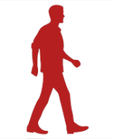
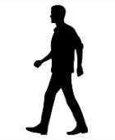
TC4TL Accuracy (Measuring Distance/Time)
CDC says “too close for too long” should be < 6 feet for > 15 minutes.
BT is for local communications (<30m) -- can it be used for ranging?
Received signal strength (RSSI) depends on:
Transmitter power
Phone orientation (carriage)
In-pocket / out-of-pocket
Indoors / Outdoors (multipath)
Intervening bags of water (bodies!) – but not intervening walls!
This may be the biggest challenge for BT-based contact tracing.
Chirp Log
Chirp Log
Approx 6 feet
Bluetooth
Chirp
Contact Distance
Index Case
Contact

Slide 8
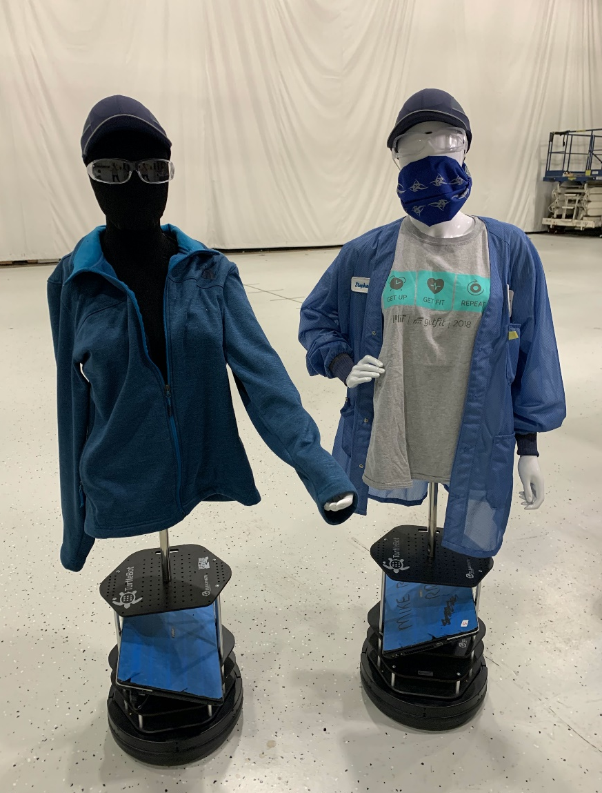
TC4TL (Cont.)
Getting sufficient samples can also be dicey (battery drain!)
MIT LL has put incredible effort into BT phenomenlogy
Paper by Gary Hatke et al. on arXiv gives details https://arxiv.org/abs/2006.15711 (June 30, 2020)
Data Collection Coalition – collects BT ranging data
NIST challenge applying ML to TC4TL: https://www.nist.gov/itl/iad/mig/nist-tc4tl-challenge
PACT also exploring fixed beacons, wearables, ultrasound, UWB

Slide 9
Privacy
No data leaves phone without user consent.
No usage of GPS locations.
Phone broadcasts changing pseudorandom “chirps”, so no tracking.
Phone records “chirps it has heard”
Infected users (who test positive) may post seeds for their chirps.
Phone matches (locally!) against posted DB of “infected chirp seeds”
No need for central DB to store sensitive personal information
Match causes user to be alerted (stay-at-home, watch symptoms, test!)
Extensions exist for dealing with replay & relay attacks.

Slide 10
Integration with PH
Goal is to improve and extend manual contact tracing, not to replace it.
Contacts need information about what to do, where to obtain support services, etc.
Digital contact tracing should feed into MCT software.
Digital contact tracing can make MCT faster and more complete.

Slide 11
Adoption can be a challenge
For DCT to be effective, both parties need to be running DCT service.
50% adoption rate may mean only 25% of contacts get logged.
Apple and Google have announced AEN (Automatic Exposure Notification) an API in iPhones and Androids, providing interoperability. (A huge, and very welcome, development! Thanks, A|G!!)
People may resist adoption because:
Mistaken fear of “big brother” (privacy concerns; police; ICE; housing)
Confusing UI (e.g. request on Android for “location services” permission)
Rollouts in EU (Switzerland, Germany, Denmark) have >10% so far.

Slide 12
Effectiveness
Can digital contact tracing really help? Can it save lives?
Ferretti et al. (Science, May 8 2020) show via model:
“Immediate notification through a contact-tracing mobile phone app could, however, be sufficient to stop the epidemic if used by a sufficiently high proportion of the population.”
Singapore: digital contact tracing does reveal new contacts, beyond those found by manual contact tracing.
Even if it didn’t reveal new contacts, it may allow for faster alerts.
But: mask-wearing may decrease number of strangers you infect, and thus decrease utility of DCT…

Slide 13
Conclusions
We have come a long ways since COVID-19 appeared; notably:
Decentralized privacy-preserving protocols
Much better understanding of BT phenomenology
Apple-Google collaboration on AEN API
Yet there remain significant challenges:
Improving ranging accuracy
Dealing with fragmented nature of US health care
Achieving sufficient adoption rates

