Slide 1
How to Have a “Net-Zero Life”
Ronald L. Rivest
MIT Institute Professor
rivest@mit.edu
CSAIL Annual Meeting
Chatham, Massachusetts
June 8—10, 2022
(version 5/30/2022)

Slide 2
Outline
Motivation and My Story
What is a “Net-Zero Life”??
(1) US CO2 Emissions per year
What can one do?
(2) Slice up by income taxes paid
(3) What is cost of offsetting one tonne of CO2? How does ClimateVault work?
(4) Extend Analysis for Net-Zero Life
Discussion
Act!

Slide 3
Motivation
Climate change is real. (See IPCC report.)
We need to act to preserve beauty of earth for our kids and grandkids.
Reducing emissions is the main thing.

Slide 4
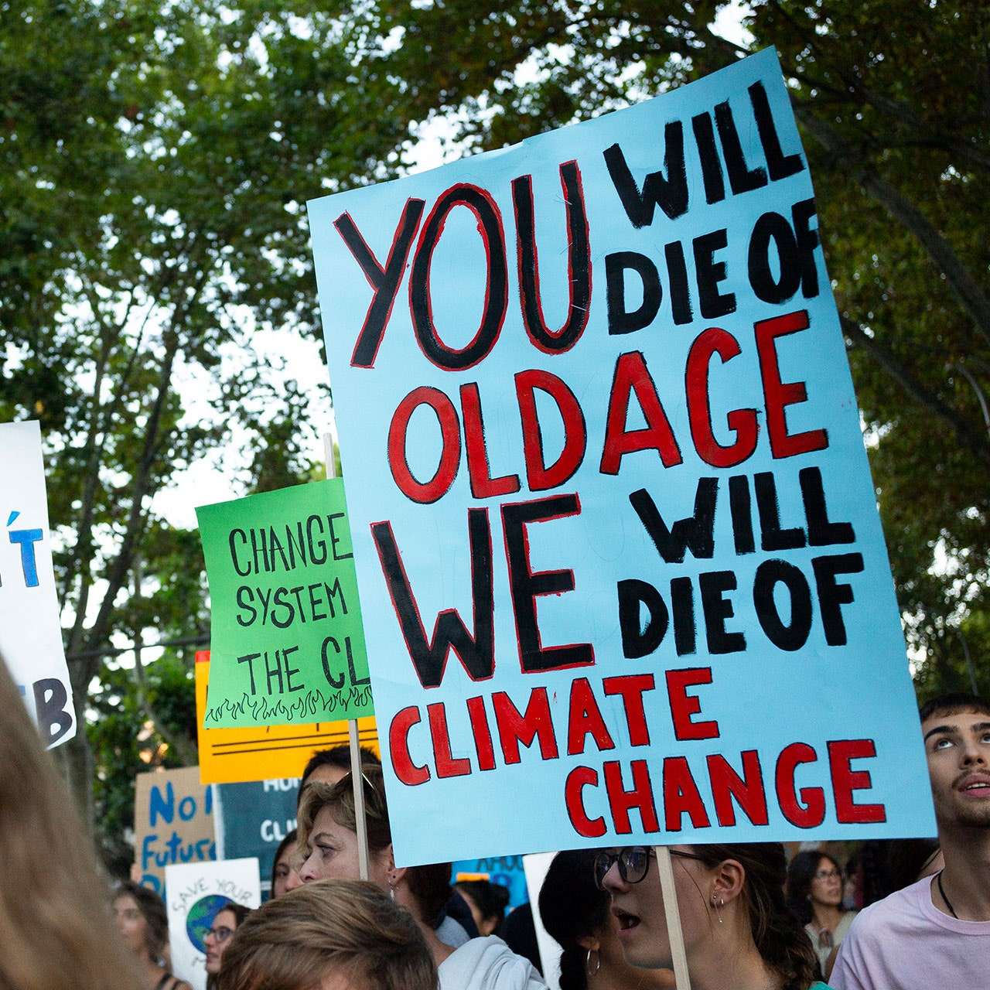
Motivation
Some say:
Climate change is a “boomers” problem… They caused it! They should fix it!
Computer scientists can’t help with climate change! They deal with bits. Not with atoms or molecules!

Slide 5
My Story
Initially I thought,
“Climate change is sure depressing! What can one do? The problem feels intractable.”
Then I realized that a mode of effective individual action is possible, through:
A change of perspective (a “Net-Zero Life”)
Offsets (e.g. the services of ClimateVault )
Let me show you how.
Perhaps I can persuade you to act, as well!

Slide 6
What is a “Net-Zero Life”?
One has a “Net-Zero Year” if over that year, one’s net CO2 emissions are zero (or negative).
One has a “Net-Zero Life” if over one’s lifetime, one’s net CO2 emissions are zero (or negative).
Can an individual reasonably aim to have a Net-Zero Life? (Yes!)
(Some companies (e.g. Microsoft) doing this at the corporate level: https://www.theverge.com/2020/1/16/21068799/microsoft-carbon-capture-climate-change)

Slide 7
(1) US CO2 Emissions per year
An estimate (using metric: 1 tonne = 1000kg = 2205 lbs).
We use rough estimates – single digit precision OK.
For one tonne CO2: Burn about 100 gallons of gasoline ($500)
US emits about 6 billion tonnes CO2 / year.
Per US person, that’s about 20 tonnes CO2 per year.

Slide 8
What can one do?
One can:
Buy an electric car!
Use solar energy!
Use a heat pump!
Fly less!
Eat less meat!
Be a climate activist and/or researcher!
Vote!
Get your employer / organization to be net-zero!
Engage in civil disobedience! (The Ministry for the Future)
Buy offsets for one’s CO2

Slide 9
(2) Divvy up CO2 emissions by income taxes paid
Rather than doing specific accounting for mileage, flights, etc., we suggest donations as a “percentage surcharge” of income taxes, to make this fair and feasible for all.
Total US personal incomes taxes paid = $1.6 trillion. It is a progressive tax; many pay nothing; the rich pay more. Average income tax paid is $5000.
One tonne CO2 corresponds to $250 in income taxes paid.
An individual’s slice of CO2 emissions: (income-tax / $250) tonnes CO2

Slide 10
(3) Cost of offsetting one tonne of CO2
Use carbon offsets (they are controversial, but getting better).
Using “cap-and-trade” permits, retiring CO2 costs about $25 / tonne of CO2 offset (see next slide)
Offsetting 20 tonnes of CO2 costs about $500.

Slide 11
How does ClimateVault work?
ClimateVault (climatevault.org) uses “cap-and trade” markets in New England and California where permits must be bought at auction to emit CO2. (Offset options other than ClimateVault are available.)
ClimateVault buys permits and “puts them in the vault, unused.” Emissions allowed by these permits never happen.
MIT may use ClimateVault. John Deutch & Ernie Moniz involved.
Anyone may donate to CV to buy permits. (Tax-deductible!) A permit to emit one tonne of CO2 costs less than $25.

Slide 12
Cost for a Net-Zero Year
Since $25 is 10% of $250:
for a Net-Zero Year, one might donate about 10% of income-tax

Slide 13
(4) What about a “Net-Zero Life”?
Average US person lives to be about 90 years old
Suppose one has (about) years left to live (e.g., years = 90 – age).
For a “Net-Zero Life” one might donate about (10% of income-tax) * (90 / years) each year for the remaining years.

Slide 14
Example of Net-Zero Life cost
Suppose one is 60 years old with a personal income tax of $25,000.

Slide 15
Example of Net-Zero Life cost
Suppose one is 60 years old with a personal income tax of $25,000. (10 % of income-tax) * (90 / years)

Slide 16
Example of Net-Zero Life cost
Suppose one is 60 years old with a personal income tax of $25,000. (10 % of income-tax) * (90 / years) = $2500 * (90 / 30)

Slide 17
Example of Net-Zero Life cost
Suppose one is 60 years old with a personal income tax of $25,000. (10 % of income-tax) * (90 / years) = $2500 * (90 / 30) = $7500 per year, for the next 30 years.

Slide 18
Discussion
“Having a net-zero life” --- a reachable goal for many individuals.
Extends the notion of “net-zero year” to include past and future CO2 emissions.
If everyone did it, we would reverse US CO2 emissions. (In principle; offsets and ClimateVault wouldn’t scale this far.)

Slide 19
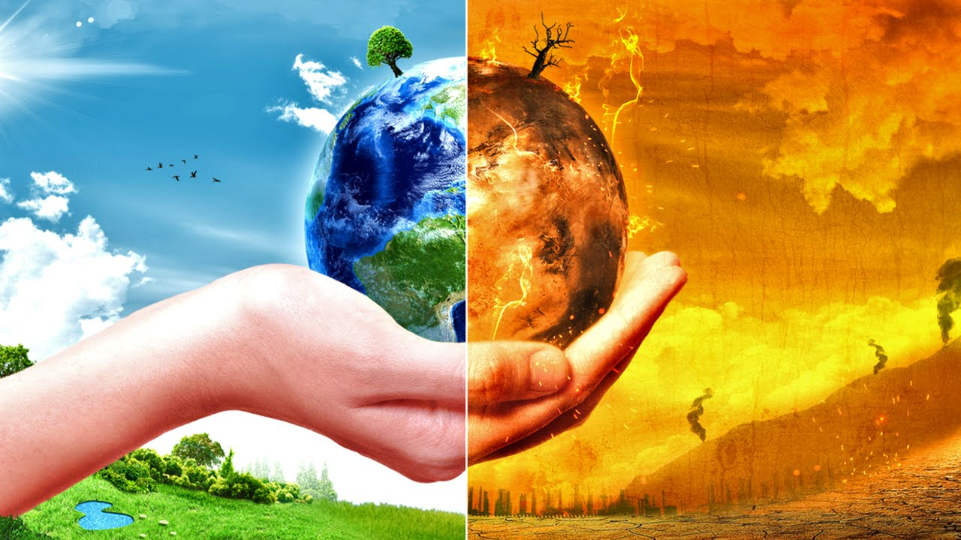
Act!
It is your choice how to help with climate change.
You can do something! You can help!
Have a Net-Zero Year! Donate 10% of income-tax
Have a Net-Zero Life! Donate (10% of income-tax) * (90 / years)

Slide 20
Thanks!
The End

