Slide 1
Systematically DIFFERENTIATING Parametric Discontinuities
Sai Bangaru*, Jesse Michel*
Kevin MU, Tzu-Mao Li
Gilbert Bernstein &
Jonathan Ragan-Kelley
Notes:
Hey all!
I’m (Sai Bangaru/Jesse Michel), and I’ll now be presenting our work on a new method of automatic differentiation for graphics

Slide 2
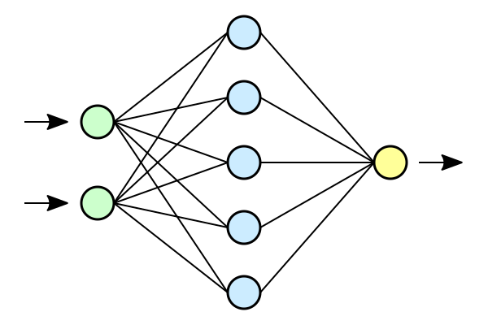
Gradient-based optimization is ubiquitous
Function
Parameters
(t)
Loss
(L)
Train ML models
Notes:
Gradient-based optimization is one of the most widely used optimization techniques.
For example, we use it to train neural networks.

Slide 3
Gradient-based optimization for inverse problems
Program
Parameters
t
Optimal control
Topology
opt.
Output
Y
Target
Y’
Bundle adjustment
L-BFGS
Levenberg-Marquardt
Gauss-Newton
Notes:
But gradient-based optimization was widely used before neural networks to solve inverse problems.
For instance, optimal control, topology optimization, and bundle adjustment programs use gradient-based methods such as (*) L-BFGS, Gauss-Newton, and Levenberg-Marquardt in order to iteratively update parameters, changing the function output in order to minimize an objective.
------------------------------------------------------------------
For example, in graphics, optimization techniques like L-BFGS and Non-linear least squares methods like Gauss-newton and Levenberg-Marquardt have been successfully employed to solve control problems and <BLAH>
-------------
Optimal control algorithms like L-BFGS.
NLLS regression like Gauss-newton, Levenberg-Marquardt.
----
Old:
Exciting recent work in area applied a generalization of this training framework to be able to approximately invert arbitrary programs. This is typically achieved through an iterative optimization process, where the goal is to update parameters so that the output of the program matches the output for a specific target output. Automatic differentiation efficiently computes derivatives that are used to iteratively update the original. The update step might use first-order derivatives as in gradient descent and Frank-Wolfe algorithm, or use higher-order derivatives as in Newton’s method.
A key point here is that many applications are enabled by the ability to compute derivatives with automatic differentiation.

Slide 4
These programs can be graphics programs
Program
ray_trace(t)
Parameters
3D Scene Description
Path traced render
Notes:
But can we use a similar framework to solve inverse problems with graphics programs?
For instance, we can imagine a ray-tracing program whose parameters are shapes, and whose output is a physically-realistic image.
Or,
--------------------------------------------
We might ask, if it is possible to use these techniques to optimize graphics programs to solve inverse problem? In general, the answer is yes, but many applications don’t work immediately with off-the-shelf tools. For example, consider a ray tracer that takes in a scene description and produces a realistic path traced image. Or,

Slide 5
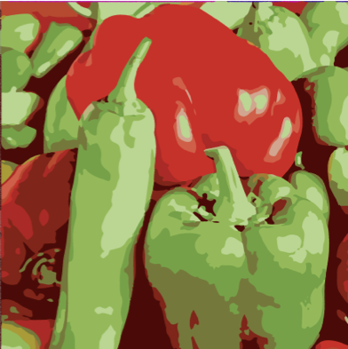
These programs can be graphics programs
Program
rasterize(t)
Parameters
Layered Paths
Rasterized image
Notes:
we could have a rasterization program that composes several layers of vector paths to produce a final rasterized image.

Slide 6
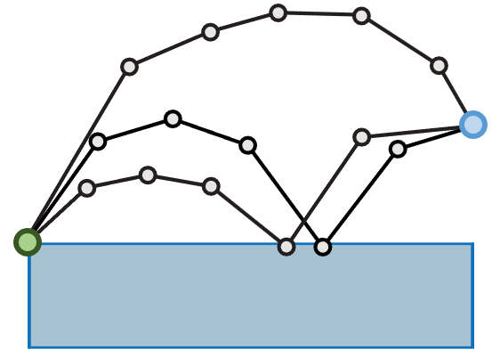
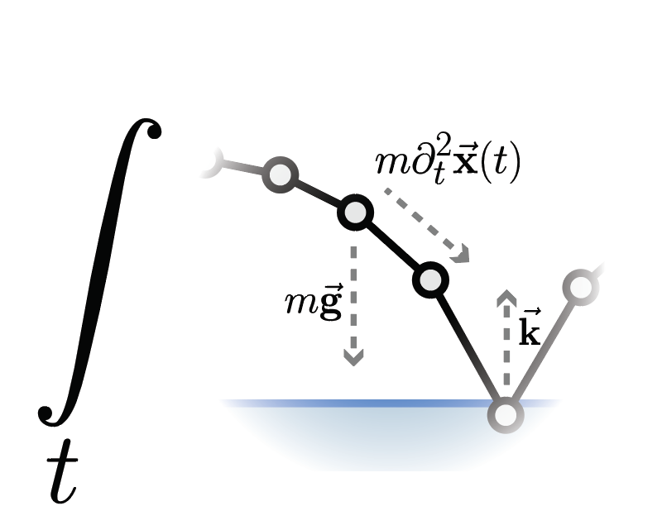
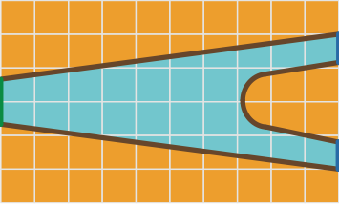
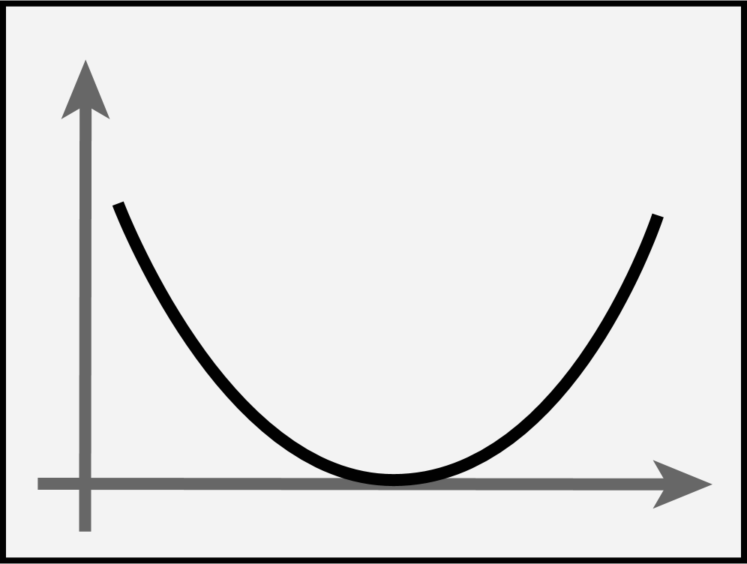
They can also be physical simulations
Integral of
Lagrangian
L
Program
Space-time trajectory
simulate(t)
Finite elements mesh
Notes:
, or even a physical simulator. For example, physically-valid configurations may be characterized as (*) extrema of the Lagrangian integrated over time.
(Jesse: my vote is to remove all animations on slides 4 – 9. I think this will give the audience more time to visually parse them)

Slide 7
Programs can also include a mix of different domains
Generally easy to differentiate
Much harder to differentiate in general
Program
Latent
Variables
Z
ray_trace
(t)
Backpropagate gradient
Notes:
One exciting direction is mixing graphics programs and with other programs such as deep learning models to build stronger reasoning capabilities. (*) As an example, the output of a neural network can be used as the (*) input to a ray tracer. The entire chain can then be trained through (*) backpropagation!
HOWEVER, this requires that we have access to the gradient of all of the components of the system. (*) Deep neural networks are, by design, easy to differentiate. But, (*) computing the derivative of arbitrary graphics programs is often difficult, but what exactly is challenging about them?
ANIMATIONS very off..
-------
Add autograd to this.. DONE

Slide 8
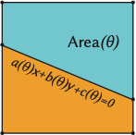
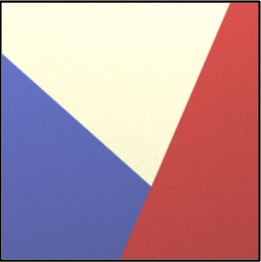
Programs in graphics are typically integrals
Etc..
Why is it difficult to differentiate such integrals?
(Bangaru 2020)
(Du 2020)
Notes:
One common pattern is that graphics programs are typically _integrals_ over regions (*). As an example, a ray tracer constructs an image by integrating the color value over a small region inside each pixel in order to produce an anti-aliased image.
In a similar manner, a finite element simulation (*) aims to integrate quantities such as stress and strain over discretized regions of space and a very similar situation plays out for the problem of trajectory optimization (*) where the integral is over the 1D trajectory rather than a grid.
There are, of course, _many_ other graphics applications (*) that are characterized using integrals. (*) But, why does integration pose a challenge to automatic differentiation frameworks?
(In this scope we only focus on applications that are essentially computing integrals Emphasize that)

Slide 9
What’s tricky about differentiating integrals?
$$\frac{d}{dt}$$
$$\int{\operatorname{sigmoid}{(x∙t)} dx }$$
$$\frac{d}{dt}$$
and commute!
Simple continuous functions
(popular in deep networks)
$$\int{\frac{d}{dt}\text{sigmoid}\text{(}\text{x} \text{∙} \text{t}\text{)}dx }$$
Use traditional auto-diff!
Notes:
To see why, consider the integral of a function composed of (*) operations typically used in deep learning such as the sigmoid and dot product operators. When the function is continuous, (*) the derivative of the integral is simply the integral of the derivative. This implies that we can just use (*) traditional autodiff to obtain a derivative expression and integrate it through numerical means.
Unfortunately,

Slide 10
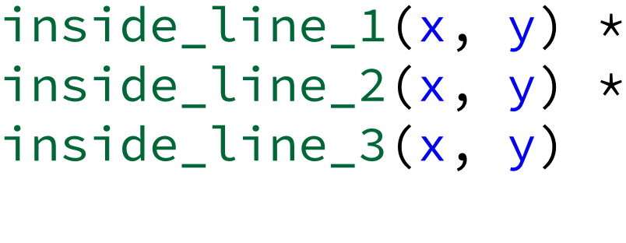
What’s tricky about differentiating integrals in graphics?
Discontinuous programs are very common in graphics
Rasterize
Parameters
Vertex positions
Image
Image pixels
Notes:
discontinuities are prevalent in graphics.
For example, in triangle rasterization (*), a set of vertices are processed into an image a triangle.
At a high-level, a rasterizer attempts to find the occupied area in each pixel (*), and it accomplishes this by (*) _testing_ whether points in the pixel lie in the intersection of half planes using conditions.
More concretely, we’d test if the point is below line 1(*), to the right of line 2, and above line 3 (*).
This is a simple construction that is widely used.
Unfortunately, differentiating integrals of discontinuous functions like this is challenging.

Slide 11
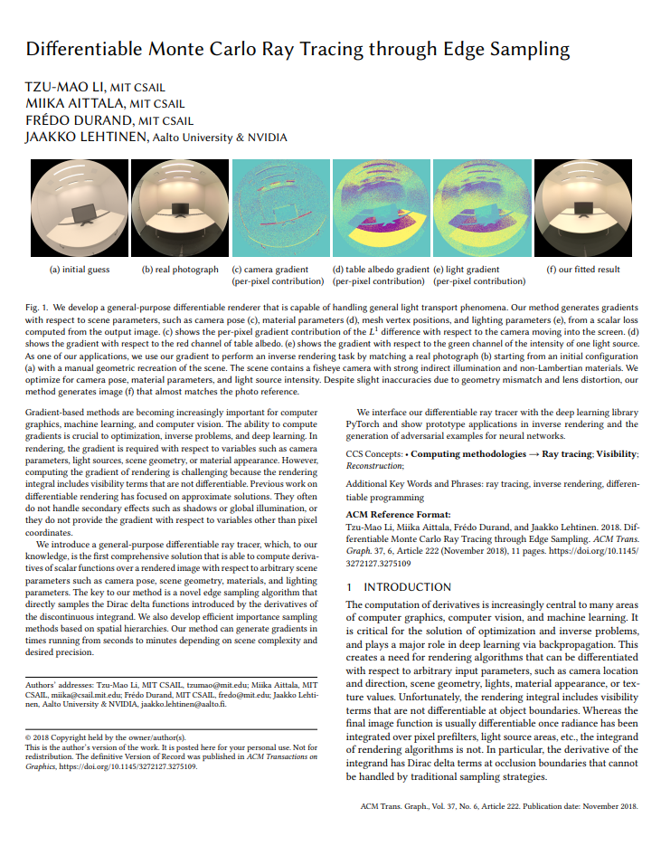
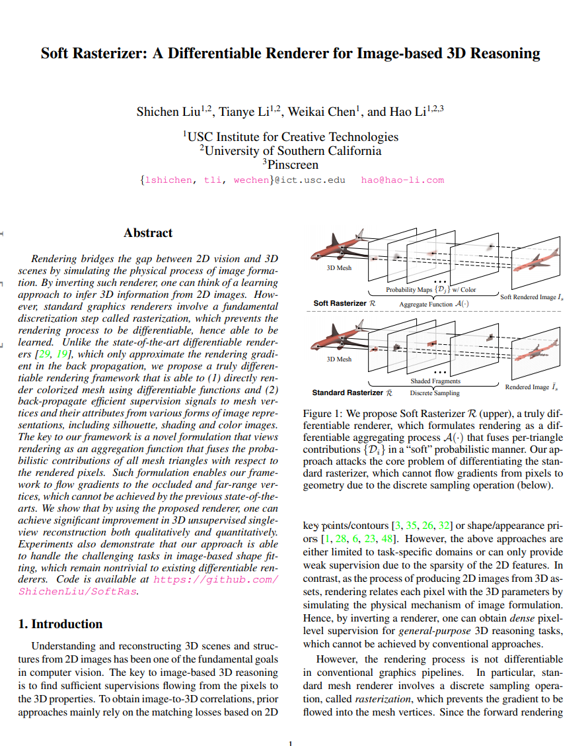
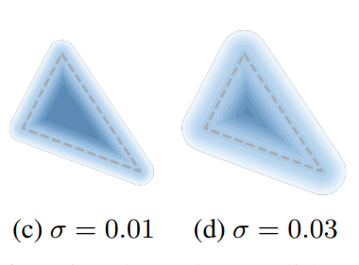
Existing solutions to this specific problem
Integrals of
discontinuities
These are specific hand-derived solutions
Edge-sampling
(Li 2018)
ray_trace(t)
Automatic
Differentiation?
Derivative program
rasterize(t)
$$\frac{d}{dt}$$
?
Soft rasterizer
(Liu 2019)
simulate(t)
Notes:
This problem has some recent solutions.
(*) For instance, the edge-sampling method identifies this discontinuity problem
and proposes a solution for triangle mesh rendering.
The SoftRasterizer paper (*) proposes a soft approximation
for triangles and avoids discontinuities entirely.
One issue with these works is (*) that they hand-derive solutions for their fixed pipeline,
which doesn’t transfer easily to different domains.
For instance, SoftRas cannot be applied directly to a finite elements simulation without manual re-derivation.
(*)It is natural to wonder, then, if we can automate the process (*),
and the goal of our work is to provide a systematic solution to this question
In order to further motivate the need for a new approach,
we first show why naively applying an existing auto-diff method does not work well for this class of problems.
-----
This is not to say that hand-derived methods don’t work. There are several approaches that successfully provide solutions for their problem domains, (including some presented at this very session!)?
TODO: reference session somehow. DONE (20-min won’t be played at the session)

Slide 12
Overview
Motivation
Differentiate before you discretize: an example
Teg: A new differentiable language
Applications
Future Work
Notes:
Now that we've motivated differentiating graphics programs with parametric discontinuities, we show a simple example.

Slide 13
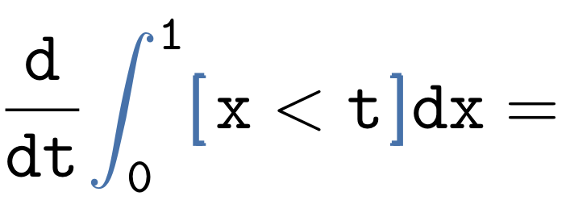
Introducing our example
Notes:
Our example is the derivative with respect to t of an integral with the parametric discontinuity x < t.
The bracket notation is defined so that if x is less than t then the integrand is 1 and it is 0 otherwise

Slide 14
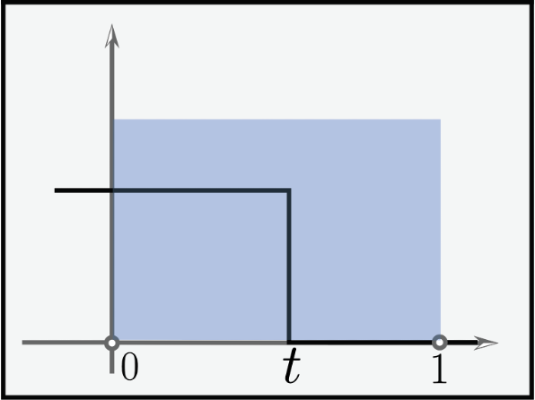
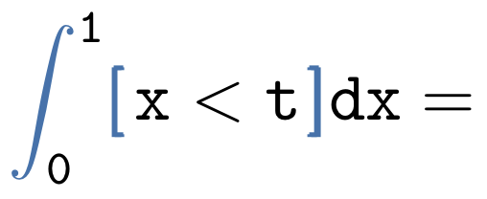
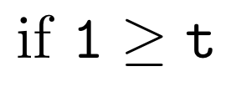
Derivative of the analytical integral
Notes:
In order to ground the problem, we compute the solution by analytically integrating and then differentiating.
Just from looking at the graph we can see that if t is negative we integrate over no mass.
If t is between 0 and 1, the value of the function is 1 for distance t, so the integral is t.
and if t is greater than 1, then the value of the integral is 1.
Computing the derivative with respect to t is easy.
We just compute the derivative for each part of the piecewise function (*).
The derivative with respect to t of (*)0 is 0, of (*)t is 1, and of (*)1 is 0.
Notice that the function is 1 in the range 0 to 1 and 0 otherwise.
(*) We may more compactly express this with our bracket notation.
(Would be nice to have the three graphs here.)

Slide 15
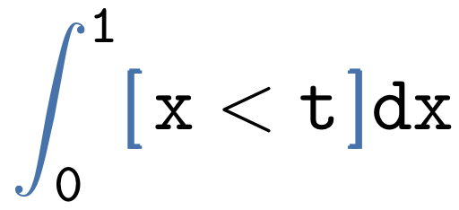
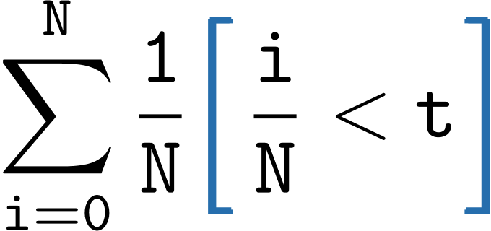
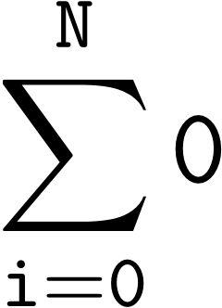
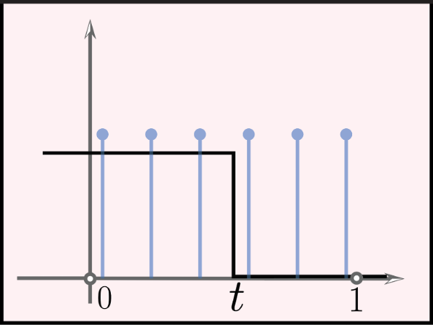
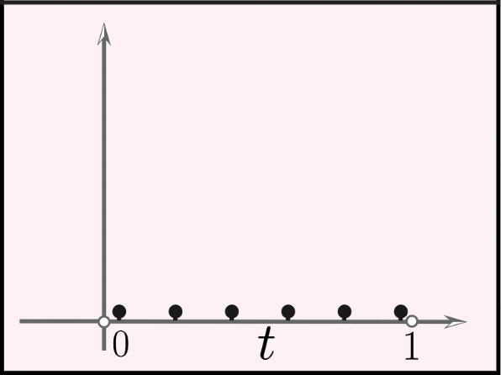
Naïve autodiff of integrals with derivatives
DISCRETIZE
DIFFERENTIATE
Notes:
In practice, we cannot compute integrals analytically.
As a result, it is common to use numerical techniques such as quadrature or Monte Carlo estimation.
Thus, we first (*) discretize the integral at a number of points and then (*) differentiate each of the samples.
The derivative is 0. Why? Because the function is constant for all sample points.
Unfortunately, this answer is (*) incorrect.
While in general, autodiff is correct almost everywhere, this implementation does not encode the semantics of the integral.

Slide 16
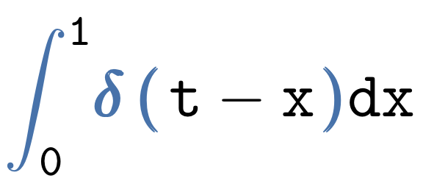
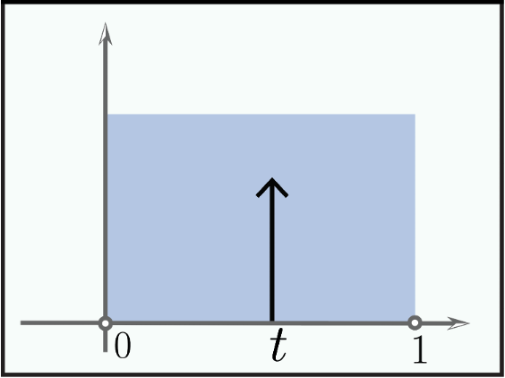
Correct derivatives of integrals with discontinuities
DIFFERENTIATE
Notes:
Instead, we will now compute the derivative without discretizing.
The derivative of the step function is 0 everywhere except t where it is infinity, as represented by delta of t-x.
-----
Remember that derivative of discontinuity is dirac.
We’ll figure out how to actually evaluate this later.

Slide 17
Integrals with discontinuities break autodiff
Notes:
To recap, (*) discretizing before you (*) differentiate produces the (*) incorrect result, but (*) just differentiating produces the correct answer.
TODO: Labels

Slide 18
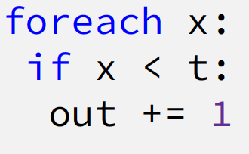
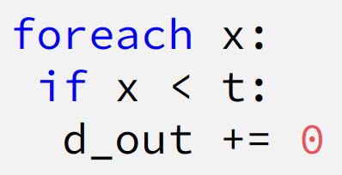
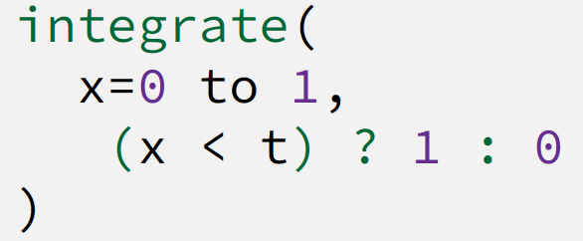
The need for an integral primitive
Add integral primitive
Notes:
Let’s quickly look at this in code.
(*) Discretizing involves iterating over the variable of integration and incrementing whenever x < t.
(*)The derivative just applies to the body of the conditional, so the answer is 0.
(*) It is necessary to have an integral primitive in order to write the code for the initial expression,
(*) and likewise for the derivative
--------
Todo: fix animations.

Slide 19
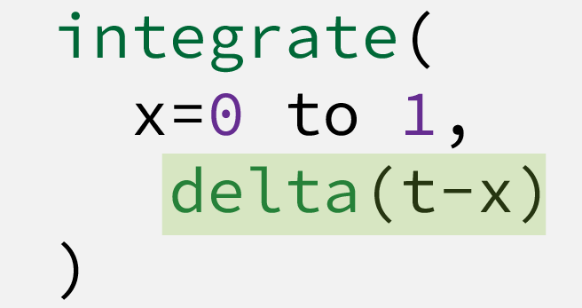
Do we need a delta primitive?
Add a delta
Notes:
Additionally, in order to express the derivative, we use a (*) Dirac delta.

Slide 20
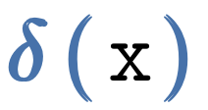
Options adding using deltas
Option 1: Add a delta primitive
L
Option 2: Introduce then eliminate deltas
L
L
L
Notes:
This presents two alternate ways to add deltas to the language L. Option 1: we add deltas as a primitive.
(*)Option 2: we only introduce deltas after computing the derivative.
The idea is then to eliminate all the deltas, giving an expression in the original language.

Slide 21
Evaluating simple expressions with deltas
Sifting Property
Notes:
To select between options 1 and 2, we look at some of the properties of the deltas.
The sifting property states the integral from a to b of delta(x)f(x) is f(0) if 0 is between a and b and 0 otherwise.

Slide 22
Evaluating simple expressions with deltas
Notes:
The next property states that without an integral, a delta is 0.
This is true for automatic differentiation, because the guarantee is only almost everywhere correctness.

Slide 23
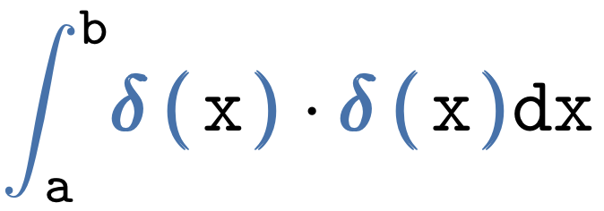
Products of deltas are problematic
Notes:
The integral of a product of deltas is not well defined (*) as detailed by Schwartz in the 1950s.

Slide 24
1. Adding a delta primitive doesn’t work
L
Notes:
We discard option 1 (*) because a large class of derivatives expressible in the language would be ill-defined(*)!

Slide 25
2. Introduce then eliminate deltas
Notes:
Option 2 looks promising. We are guaranteed that the derivative of a delta-free expression will be linear in deltas because the derivative is a linear operator (*).

Slide 26
2. Introduce then eliminate deltas
L
L
L
Higher-order derivatives
Notes:
So, our pipeline looks like this.
Start with a program in the language, take the derivative, introducing deltas, and then eliminate these deltas.
Since the derivative expression is in the language, we say that the language is closed under differentiation (*).
By repeatedly applying this process, we can compute higher-order derivatives.

Slide 27
Correct derivatives of integrals with discontinuities
elim
???
DIFFERENTIATE
ELIMINATE
Notes:
Back to the example, all that remains is to eliminate the delta.

Slide 28
Delta elimination via Sifting
Change of coordinates
Notes:
To do this, we must first apply a (*) change of coordinates that translates the delta (*),
and only after that can we apply the sifting property.
For the sake of completeness, we show the math worked out.
-------
TODO: new slide, replace the equation, then
We set t – x to x’, add the jacobian adjustment, for aesthetic reasons we flip the bounds of integration to consume the negative sign. And finally we apply the sifting property.

Slide 29
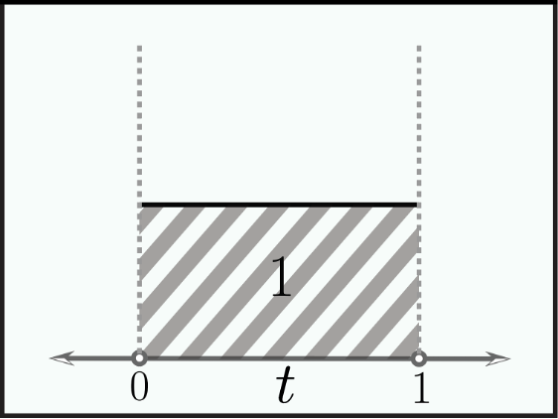
Recap: Differentiate first, then discretize
elim
Notes:
To recap, we first compute the derivative, introducing a delta term, and then eliminate the delta, (*) producing the correct answer.
But how do we generalize this Sai?

Slide 30
Overview
Motivation
Differentiate before you discretize: an example
Teg: A new differentiable language
Applications
Future Work
Notes:
Hi, I’m Sai, and I’m going to explain how by using our language, Teg.

Slide 31
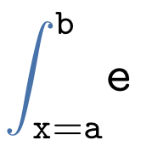
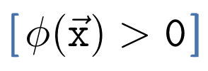
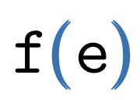
Building a differentiable language
Notes:
The terms in our language, Teg, are constants (*), variables (*), sums (*), products (*), integrals (*), discontinuities (*), and builtin functions (*).
Our goal in this work is to carefully study a core calculus that we can prove correct and that is easy to extend. This language is relatively simple, for example, it lacks looping facilities. However, even as-is, it is practically useful as we will demonstrate.
-----
TODO: reorganize?
TODO: Make each jump

Slide 32
Delta Elimination in complex expressions
DIFFERENTIATE
Notes:
Let’s take a look at the kind of expressions that we might see in practice. They are not equations, but potentially large programs that can contain multiple delta terms corresponding to multiple discontinuities. We show how to use a set of passes to handle such expressions.
---------------------
We aim to compute derivatives of expressions with parametric discontinuities. To start, we build a derivative expression that introduces deltas that must be eliminated. Given a complicated expression, we describe this process.
(This doesn’t convey the key point of the slide. We need to say that we want to handle general expressions, so we need general passes and semantics)

Slide 33
Pass 1: Expression Normalization
Distribute * over +
Obtain sum of terms
Notes:
The first pass brings the expression to a normal form to isolates the delta terms.
We do this by splitting the input into a sum of products, one for each delta.

Slide 34
Pass 1: Expression Normalization
Distribute over +
Notes:
And then we split each term into it’s own integral. In the end, each delta is surrounded by a single stack of integrals and multiplied by a single expression.

Slide 35
Pass 2: Delta Normalization
Not in normal form
Notes:
In the second pass, (*) Teg reparameterizes the (*) delta expression (*) so it contains a single variable of integration. In this example, Teg (*) first converts (*) to polar coordinates.

Slide 36
Pass 2: Delta Normalization
Not in normal form
Notes:
This new expression still isn’t in (*) normal form. (*)Teg performs (*) another reparameterization from 2r - t to r'.

Slide 37
Pass 2: Delta Normalization
Final coordinates are in normal form!
Notes:
This reparameterization (*) results in an expression in normal form (*) – with a single variable of integration in the delta.

Slide 38
Pass 2: Delta Normalization
Notes:
The process of performing the first (*) and second (*) change of coordinates is identical. For simplicity, we focus on the second.

Slide 39
Pass 2: Delta Normalization
Derivative
Inverse
Notes:
Teg applies the change of coordinates to the bounds of integration and the delta (*). It then substitutes the old variables for the new variables (*) using the inverse of the condition. And finally, Teg adds the (*) Jacobian term to account for the change of variables.

Slide 40
Discontinuities should be diffeomorphisms
Specify: inverse and derivative
Notes:
So, in order to successfully eliminate deltas, we restrict the discontinuities to diffeomorphisms -- they must have an inverse and be differentiable.
For example, (*) y=x is a diffeomorphism,
(*) the sigmoid function is a diffeomorphism,
(*) but sin(x) is not a diffeomorphism.

Slide 41
Pass 3: Delta Annihilation using Sifting property
Recall: Sifting property
Notes:
At this point, the delta expression is in the (*) normal form so Teg applies the sifting property, which annihilates the delta with it’s corresponding integral (*), and evaluates the rest of the expression at r’=0 (*).
------
In pass 3, we apply the sifting property to annihilate deltas with the corresponding integrals.
See our paper for more detail and a characterization of degenerate cases that are problematic.

Slide 42
All passes together
…
…
…
1. Normalize
expression
2. Change-of-coordinates
Delta-free!
3. Annihilate (Sifting)
…
…
…
Notes:
Taken together, these passes describe a method to differentiate general integrals with discontinuities. Our process first breaks (*) down complex expressions into one piece per delta term. (*) Each term is then reparameterized to bring it to a normal form, (*) and then subsequently eliminated via Sifting.

Slide 43
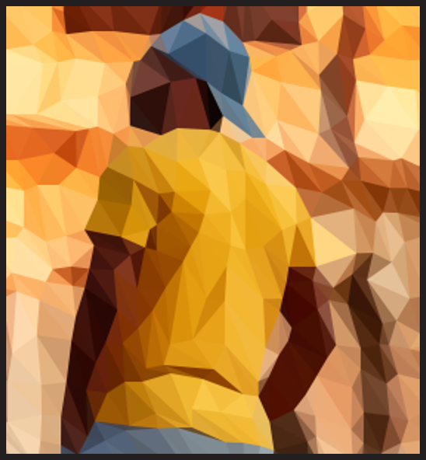
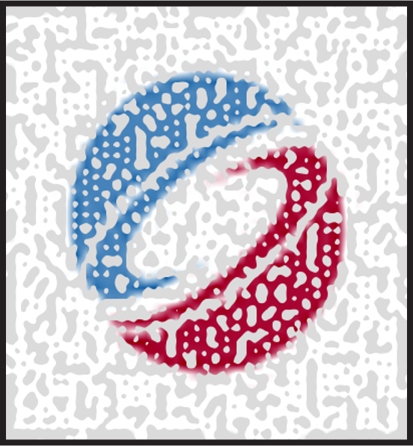
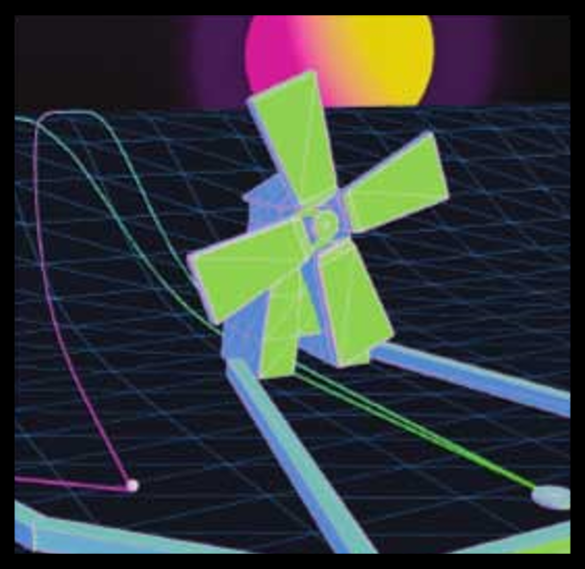
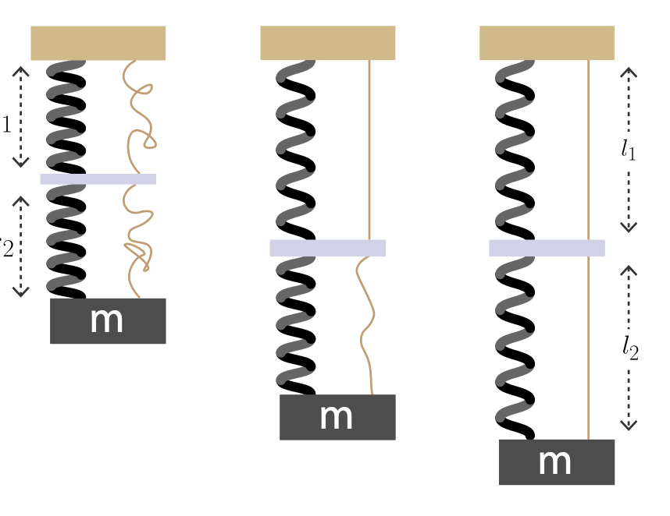
Overview
Motivation
Differentiate before you discretize: an example
Teg: A new differentiable language
Applications
Future Work
Notes:
But what is it useful for?
As we noted in the introduction, nearly every domain in graphics contains some form of integral estimation. Teg automates the challenge of differentiation, and provides an opportunity to revisit applications that are difficult to differentiate by hand.
We now present applications spanning image stylization, shading and physical simulation.
(* However, thus far, we have only used toy examples, for the purpose of demonstrating certain features.
Now we’re going to apply (*) our method to a three different applications. First, we’ll show that our generalized method still works successfully for (*) differentiable rendering, then we demonstrate the use of diffeomorphisms to handle (*) complex discontinuities in a thresholded shader, and finally apply it to a completely different domain, (*) physical trajectory simulation. Omitted from this presentation, is an application in design and fabrication problems
Every sub-domain of graphics contains applications which deal with integrating over parametric discontinuities.
It is critical to solve inverse problems in a diverse set of graphics applications
In summary, we have now generalized an idea originally from differentiable rendering, by converting it into a set of program transformation passes and providing a system using composable diffeomorphisms to allow for the differentiation of increasingly complex discontinuities.
Differentible rendering -> image processing
-----
(*Now that we’ve explained how Teg works, we will present some exciting applications.*)

Slide 44
Image stylization through loss minimization
rasterize(t)
-
Backpropagate using our approach
Target image
Parameters
(Triangle mesh)
Triangulated image
Notes:
For our first application, we look at image style filters, a staple of image processing applications like Photoshop. One instance of this is image triangulation, which is particularly relevant (*) here since it can be solved by differentiating a rasterizer, and then minimizing a loss function.
Note that in order for this to work properly we must account for the delta terms in the derivative.
---------------
Artists frequently want to produce stylized images, but manual stylization is time consuming. An instance of this is image triangulation, where we try to approximate an image with a tight triangular mesh. (*)
This is particularly relevant to our approach because one elegant way to achieve this is to write a 2D triangle rasterizer to produce a triangulated image and then (*) solve the inverse problem by differentiating this pipeline.
(Maybe: Our approach allows for the automatic differentiation of such)

Slide 45
Ignoring -terms produces 0 gradient
s account for discontinuities
No gradient
Target Image
Initialization
Uniform Color per Triangle
Optimize with
Ours
Optimize with
Traditional Auto-diff
Notes:
Starting from the same (*) initialization, we optimize for a triangulated image using the gradients from Teg and (*) compare against traditional auto-diff.
It turns out that not accounting for the delta terms in this program, (*) leads to a failed optimization. In fact, there is no gradient whatsoever, because traditional auto-diff only differentiates and the color is constant in the triangle.

Slide 46
Position-dependent color still requires -terms
Linear Interpolation
Target Image
Optimized with
(Ours)
Optimized with
(Traditional Autodiff)
Notes:
What if, instead we had linearly varying color, to provide a non-0 gradient? (*) Well, we find a significant part of the gradient is still from these delta terms.
You can see here along the natural lines in the image, that ignoring these causes the optimization to simply fail due to incorrect gradients.
----------------------
Old:
The interpolation _does_ provide some non-0 gradient but a significant portion of the gradient is still from the delta component.
Linearly interpolating between the colors at each vertex produces a different effect.
Once again, using Teg works quite well.
Interestingly, there is some derivative signal for traditional autodiff not from the parametric discontinuities. However, due to the gradients not being correct, the results lok work, with less clarity on the boundary of the tower, for example.

Slide 47
Thresholded noise shaders
Perlin noise map
Thresholded noise
(Discontinuous)
Threshold
… * [noise > t] * …
Inverse problem:
Optimize noise to fit a target pattern
Bozo’s Donut
(Perlin 1985)
Notes:
We now turn to a new application in noise-based shaders, which contain more complex discontinuities that we haven’t dealt with so far.
(*)
The original Perlin noise paper shows several ways to transform noise to produce beautiful effects. (*) One of these, Bozo’s donut, is particularly useful because it produces sharp patterns by thresholding a noise map. This technique is prominently used in procedural modelling, which means differentiating this effect can enable exciting inverse design problems. (as well as enhance existing differentiable renderers)
-----
(To be able to differentiate discontinuous shaders is of particular interest since it enhances existing differentiable renderers as well as enable new inverse design problems.)

Slide 48
Inverse shader design using our approach
Goal: Adjust noise parameters to match guide
Guide image
Initial random noise
Optimized with
Ours
Notes:
We apply our differentiation approach to a design problem where we optimize random noise to fit a target image (*)
As we show here, we can successfully solve for our design objective because our derivatives correctly account for the thresholding.

Slide 49
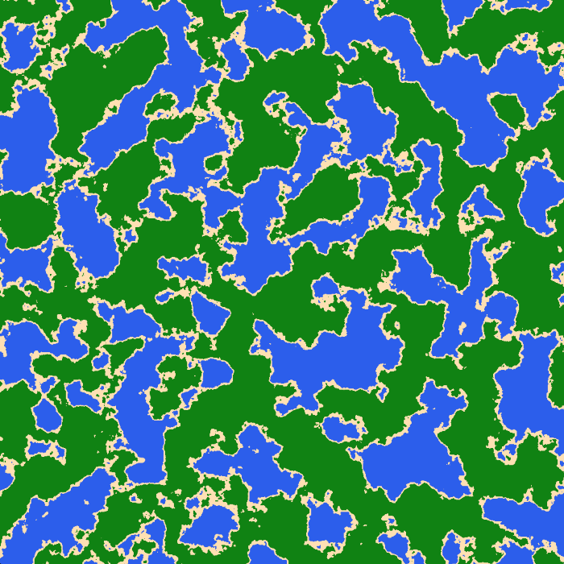
Shaders: Thresholded Perlin noise example
Perlin noise shader
Thresholded Perlin noise
Threshold
… * [noise > t] * …
Image Credits: Yvan Scher
Notes:
(Sai: maybe slightly confusing, but we can handle this later)
HELP SAI!
We fit the parameters of a discontinuous procedural shader to a target image. A common pattern in procedural shaders is to
threshold Perlin noise – the noise function is compared to a threshold to decide which color to use for producing
textures with segmented regions. The thresholding produces complex discontinuities that require special treatment.
Thresholded perlin noise is useful for automatically generating terrain. For example, the image on the right is an automatically generated map of land and water, which could be part of a scene in a game.

Slide 50
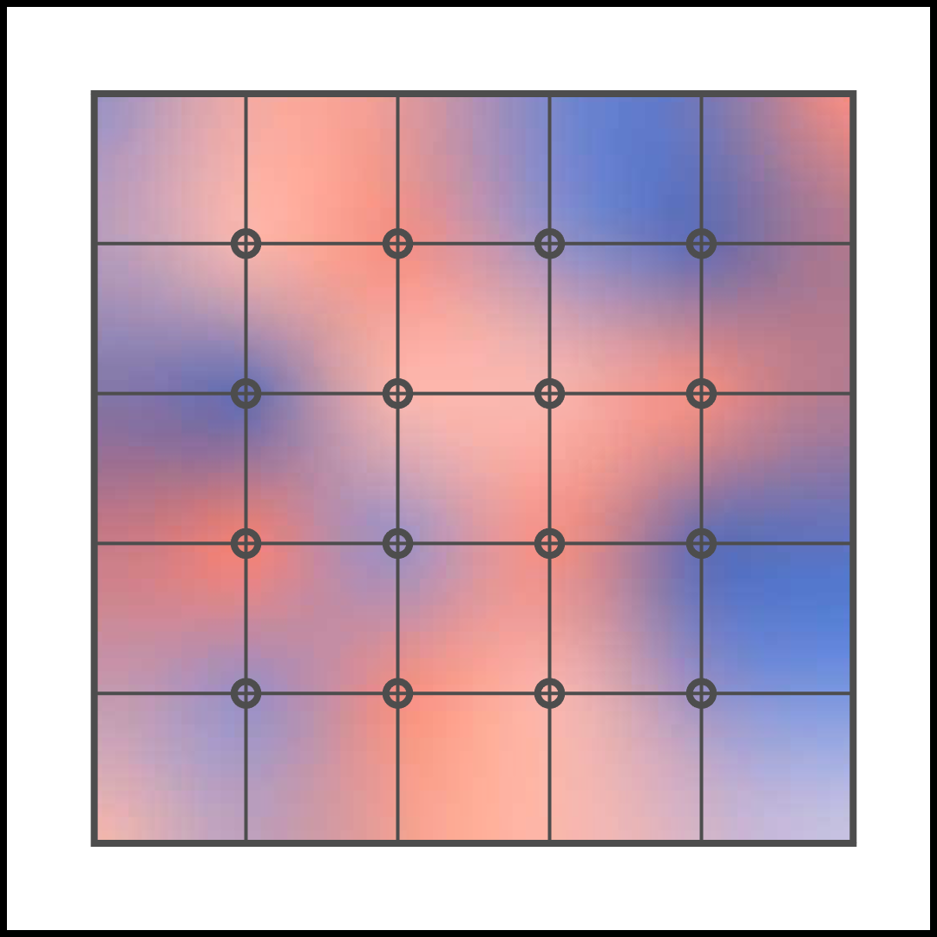
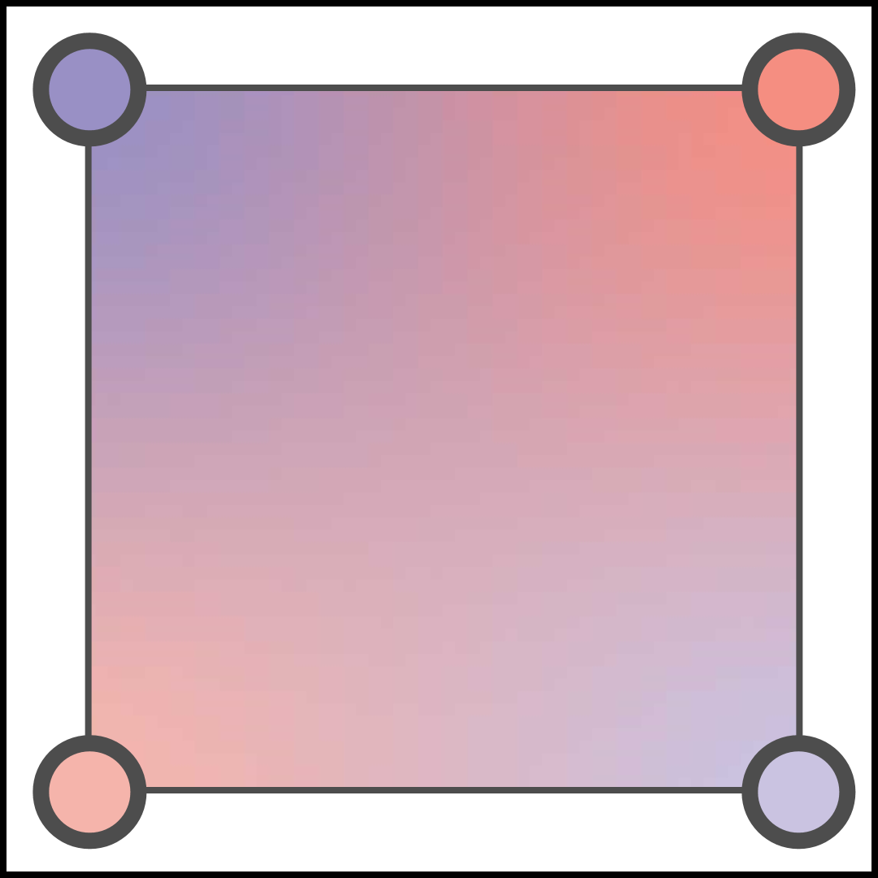
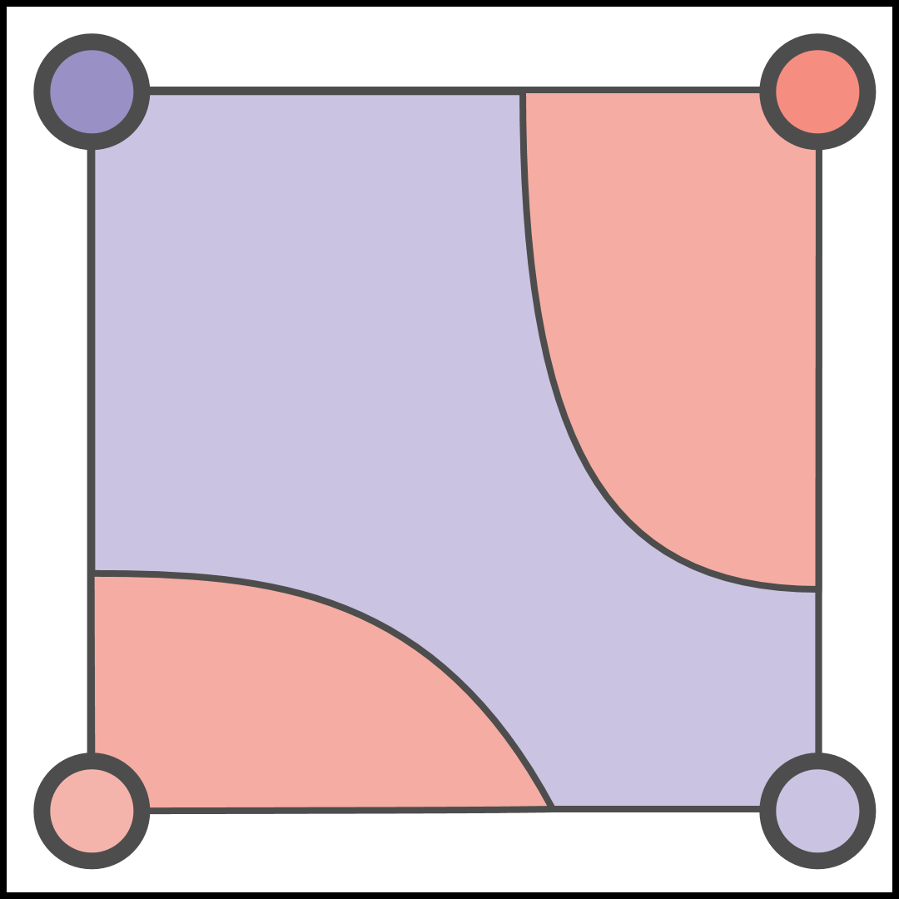
Thresholded noise maps have complex discontinuities
Within each texture cell
Threshold
Bilinear interpolation
Notes:
The shader we use for this first computes a noise map on a texture and uses interpolation within each texel(*). Then we apply a flat threshold to this map. Note that the discontinuities are highly non-linear which are presently tricky to manually differentiate.

Slide 51
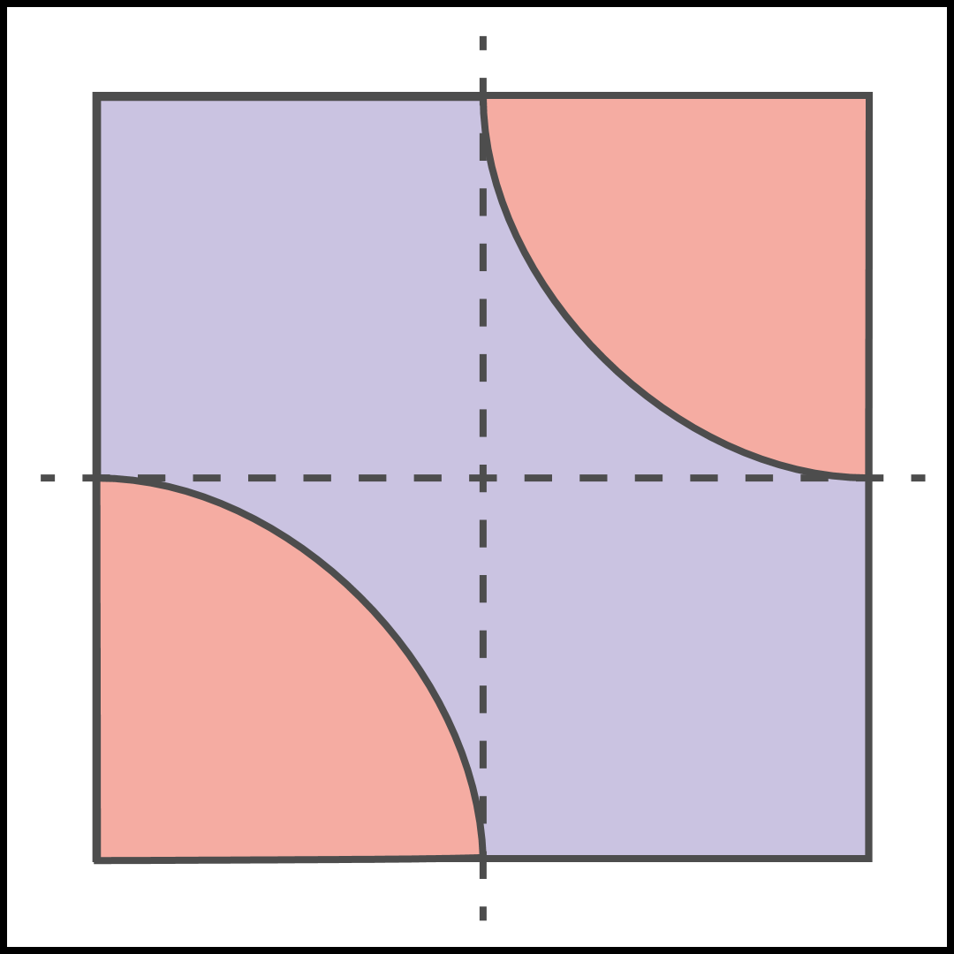
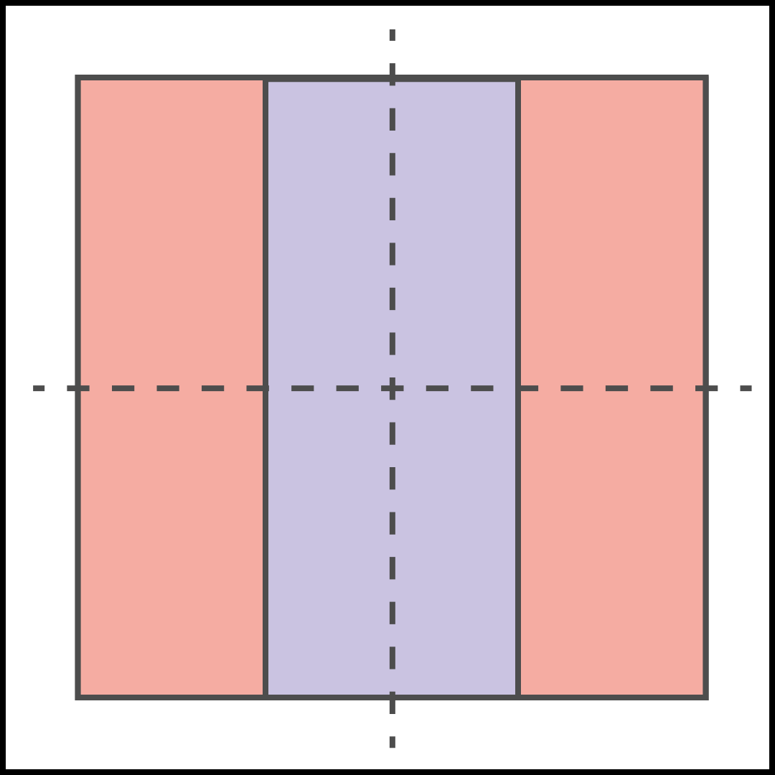
Our approach enables this through diffeomorphisms
Transform to
Hyperbolic coordinates
Scale + Translate
(Diffeomorphism)
Notes:
As shown earlier, our framework allows a user to specify a change of coordinates (*) in order to bring a delta term into a linear form. In this specific case, that can be achieved by first centering the curve, and then moving to hyperbolic coordinates.
But what happens when you don’t account for these delta terms?
(Maybe:This is now in a form where our compiler applies an automatic translation to eliminate the delta)
(But what happens if you use don’t account for the parametric discontinuities?
Teg automatically can optimize through thresholded bilinear interpolation by scaling and translating to produce axis-aligned discontinuities, then producing affine discontinuities that as we showed earlier can be reperameterized to normal form. )

Slide 52
Ignoring delta terms produces incorrect results!
Boundaries have no gradient
(only colors)
Optimizes for boundaries!
Without deltas
Initialization
Guide image
Ours
Notes:
Well, like our image processing example, ignoring those terms results in different, and visibility sub-optimal solutions.
(*) We stress that it is important for shaders to account for their boundary terms, because otherwise, your derivatives can have the wrong sign and cause your loss to diverge.
----------------------
(For the top example, we augment our shader with a color map, while the bottom example uses just two colors. )
Using uniform colors leaves the no-delta case with no boundary gradient, -----
TODO: Same as before

Slide 53
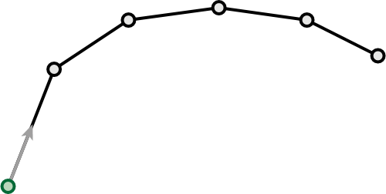
Inverse physical simulation is hard with multiple shooting
Constant time-steps
Velocity v
v₃
v₂
v₁
Notes:
As we stressed earlier, these discontinuities are _not_ limited to just image processing or rendering. They are also widely encountered in animation, particularly when dealing with contact and collisions.
And such is the case in animation. (*) Consider the animator’s task of finding a physically-consistent trajectory for a bouncing ball. One way to do this is multiple (*) shooting, which generates physical trajectories by simulating the ODE with constant time-steps. To solve the inverse problem, it differentiates and attempts to match the final step with the target

Slide 54
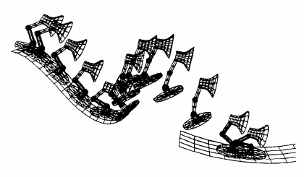
Inverse physical simulation is hard with multiple shooting
Constant time-steps
Ill-defined derivative
due to penetration
Spacetime constraints (1988)
Notes:
But using constant time steps becomes a problem, when it comes to hard contact! Specifically, the points can penetrate the surface and create ill-defined derivatives, and this can make an optimization unstable.

Slide 55
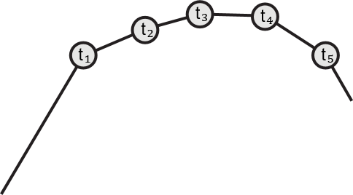
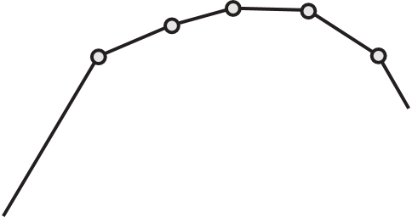
Inverse physical simulation with space-time constraints
Positions x
x₃
x₄
x₂
x₁
x₅
Time-stamps t
Spacetime constraints (1988)
Notes:
Instead we look at the second option, proposed by the popular Spacetime constraints paper.
(*)
Instead of optimizing for the initial velocity, (*) we optimize over entire trajectories which are defined (*) by their positions and (*) their time-stamps.
We then optimize for a physically-correct path by minimizing the gradient of the Lagrangian integrated over the trajectory.
----------------------------------
As we stressed earlier, these discontinuities are _not_ limited to just image processing or rendering, they show up in different forms in physical simulation, but they’re particularly prominent when handling contact or collisions.
Specifically, we look at the optimization framework posed by the popular Spacetime constraints paper.
As a concrete example, imagine that an artist is trying to move a bouncing ball between two points which are the constraints. There are many such trajectories, but the space-time constraints method employs the principle of least action to find a physically-consistent trajectory. It does this by finding that trajectory whose integral of the Lagrangian has zero gradient.
This is a powerful inverse method widely used in animation for decades, but note that to find these zero gradient trajectories, we need the derivatives of this Lagrangian integral.

Slide 56
Physical simulation with space-time constraints
V₁
V₂
Notes:
Note that in this form, a trajectory point can be fixed _to_ the surface to model hard contact. We can do this because the time of contact is now a variable parameter.
Now, the velocity, is a discontinuous function and it becomes important to account for discontinuities, as we will now demonstrate.
------------------------
And even for a simple case of the bouncing ball, the collision with the floor introduces discontinuities into this integral.
In graphics, this is a problem because the trajectory points are assumed to be at fixed time steps
The velocity of the ball along the curve is discontinuous at the point of contact, and remember that the time of contact is a variable parameter.
This means the velocity is a piecewise discontinuous function and the point of discontinuity is dependent on parameters. This is where our approach produces a sound derivative.

Slide 57
Comparison with ignoring boundaries
Optimized with boundaries
(Physically correct)
Optimized without boundaries
(Physically incorrect)
Notes:
Here, we use our method to optimize for a billiards trickshot and compare against traditional auto-diff. We see that ignoring delta terms (*) leaves us with a trajectory that defies physics, by changing velocity spontaneously, which stands in contrast to the clean trajectory in the former case.

Slide 58
Trajectory Optimization
Random initial trajectory
(Physically incorrect)
Optimized trajectories
(Physically correct)
Contact discontinuities
Time discontinuities
End points
Notes:
Finally, we show two minigolf hole-in-one trickshots.
(*) We start the optimization off with a randomly initialized path that is clearly implausible.
And for this demonstration we introduce several complications such as friction, (*) as well as discontinuous terms due to contact and the blades of the windmill.
(*) We show two optimal solutions to this problem, one with and one without, a bounce.
--------------------------------------
Consider a minigolf task, where we want to hit a hole-in-one from a starting position, while hitting a pre-specified sequence of walls along the way. We want to find a path for the ball satisfying its equations of motion and additional boundary conditions, including: that it begins at the start location and the ends at the hole at a specific time. However, this problem is complicated because of discontinuities in the velocity trajectories at points of contact, and contact times that are not known a priori.

Slide 59
Overview
Motivation
Differentiate before you discretize: an example
Teg: A new differentiable language
Applications
Limitations & Conclusions

Slide 60
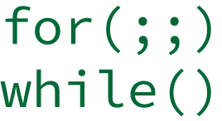
Limitations
Diffeomorphisms
Scalability
Modularity
…
1
2
Scalar variables
(no indexing)
4
5
Requires global transforms
Expression lang
(no looping)
Linear
Quadratic
Code duplication
User-defined!
Notes:
Before we wrap up, we look at a few limitations of our approach.
(*) A key requirement for discontinuities in our program is that they must be reducible to a single variable.
(*) Our system is able to do this automatically for certain linear and quadratic expressions, and we also allow the user to specify their own changes of coordinates while our system handles the necessary substitutions and Jacobian adjustments.
However, it is critical that these expressions are diffeomorphisms and this limits the expressions to those with a known inverse function.
(*)
Additionally, our semantics currently have no support for indexing or tensors, (*). And, we also assume that the programs are in an expression language – they are loop free.
(*)
Our transformation processes are also global. Every delta term is transformed in tandem with its associated integral, which means the two pieces cannot be differentiated separately as modules. (*) And this problem gets worse when there are several delta terms, since expressions get duplicated for each delta term.
There is important future work in solving these issues in order to scale to large applications.
----
TODO: ‘expression-only language’

Slide 61
Conclusions
Graphics programs
ray_trace(t)
rasterize(t)
simulate(t)
Notes:
So in _summary_ we’ve first looked at what’s (*) challenging about differentiating graphics programs and isolated the issue to the (*) integrals over discontinuities
We then (*) proposed a new approach using (*) Dirac deltas to account for discontinuities. This (*) avoids the issue with traditional auto-diff which discretizes first and losses this information.
(*) And because deltas cannot be evaluated meaningfully as a primitive, we show that we can then eliminate these using changes of coordinates followed by sifting.
We hope that this approach provides new insights for applications previously thought to be too difficult to differentiate by hand.

Slide 62
Acknowledgements
We’d like to thank:
Fredo Durand,
Ante Qu,
Paul Zhang,
Joshua Fishman,
Tao Du,
Samuel Tenka &
Luke Anderson
Funded by DARPA grant
HR00112090017
Project Website!
Notes:
(*) We’d like to thank our collaborators. Please visit our website for more! Thank, YOU.

