Slide 1
Unbiased Warped-Area Sampling for Differentiable Rendering
Sai Praveen Bangaru
Tzu-Mao Li
Frédo Durand
Notes:
Hello everybody!
My name is Sai Praveen Bangaru and I will be presenting our work at MIT CSAIL on unbiased differentiable rendering using area-sampling.

Slide 2
Rendering
Vertex List
v1 0.92 -0.9 1.8
v2 0.42 -0.9 1.8
v3 -0.92 0.9 1.8
v4 0.65 -0.9 1.8
v5 1.21 -0.9 1.8
v6 -1.21-0.9 1.8
v7 1.21 -0.9 1.8
v8 1.21 -0.9 1.8
v9 1.21 -0.9 1.8
Index List
p1 0 1 2
p2 2 3 4
p3 4 1 2
v4 0.65 -0.9 1.8
v5 1.21 -0.9 1.8
v6 -1.21-0.9 1.8
v7 1.21 -0.9 1.8
v8 1.21 -0.9 1.8
v9 1.21 -0.9 1.8
render(θ)
L1 0.5 0.0 -0.5
L2 -0.5 0.0 -0.5
L3 0.5 0.0 -0.5
…
Light List
Rendering Method
3D Scene Description
2D Image I
Parameters θ
Notes:
It’s useful to think of the rendering process as a function that takes a 3D scene description made up of various parameters as an input and outputs a 2D image.

Slide 3
Differentiable Rendering
render(θ)
Vertex List
v1 0.92 -0.9 1.8
v2 0.42 -0.9 1.8
v3 -0.92 0.9 1.8
v4 0.65 -0.9 1.8
v5 1.21 -0.9 1.8
v6 -1.21-0.9 1.8
v7 1.21 -0.9 1.8
v8 1.21 -0.9 1.8
v9 1.21 -0.9 1.8
Index List
p1 0 1 2
p2 2 3 4
p3 4 1 2
v4 0.65 -0.9 1.8
v5 1.21 -0.9 1.8
v6 -1.21-0.9 1.8
v7 1.21 -0.9 1.8
v8 1.21 -0.9 1.8
v9 1.21 -0.9 1.8
Rendering Method
2D Image $I$
L1 0.5 0.0 -0.5
L2 -0.5 0.0 -0.5
L3 0.5 0.0 -0.5
…
Light List
render’(θ)
3D Scene Description
Parameters θ
Differentiable Rendering
Method
Differential $\frac{∂I}{∂θ}$
Notes:
Differentiable rendering can roughly be thought of as the derivative of this function with some scene parameters theta like vertex positions or the camera direction

Slide 4
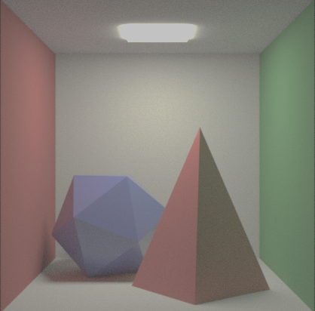
Why Differentiable Rendering?
render⁻¹(θ)
Motivation 1
Inverting rendering process
Vertex List
v1 0.92 -0.9 1.8
v2 0.42 -0.9 1.8
v3 -0.92 0.9 1.8
v4 0.65 -0.9 1.8
v5 1.21 -0.9 1.8
v6 -1.21-0.9 1.8
v7 1.21 -0.9 1.8
v8 1.21 -0.9 1.8
v9 1.21 -0.9 1.8
$$θ0$$
$$θ_{i}$$
render(θ)
$$I$$
Index List
p1 0 1 2
p2 2 3 4
p3 4 1 2
v4 0.65 -0.9 1.8
v5 1.21 -0.9 1.8
v6 -1.21-0.9 1.8
v7 1.21 -0.9 1.8
v8 1.21 -0.9 1.8
v9 1.21 -0.9 1.8
render⁻¹($I$)
L
-
L1 0.5 0.0 -0.5
L2 -0.5 0.0 -0.5
L3 0.5 0.0 -0.5
…
Light List
$$θ_{i}=θ_{i−1}−α∗\frac{∂L}{∂θ}$$
$$I$$
$$θ_{i}$$
Gradient descent on
Inverse Renderer
Image $I$
3D Scene Description
Analysis-by-Synthesis
Parameters θ
Notes:
Image derivatives are useful for a variety of applications. One popular motivation is inverse rendering, which attempts to retrieve this 3D scene from a given 2D image. This is usually achieved through an Analysis-by-synthesis approach which
uses gradients produced by a differentiable renderer to iteratively refine parameter estimates.

Slide 5
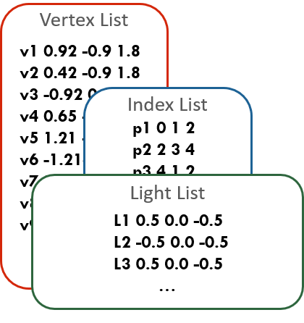
Why Differentiable Rendering?
Motivation 2
Deep Learning (adversarial robustness, etc..)
3D Scene
2D Image
render(θ)
…
Backpropagation
Notes:
Differentiable rendering is also heavily motivated by machine learning. It can be very useful to be able to use a renderer as a cog in a neural network.
For instance, adversarial robustness testing uses a renderer at the front to generate inputs to a convolutional network.

Slide 6
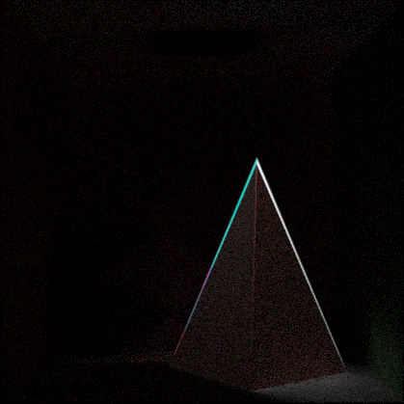
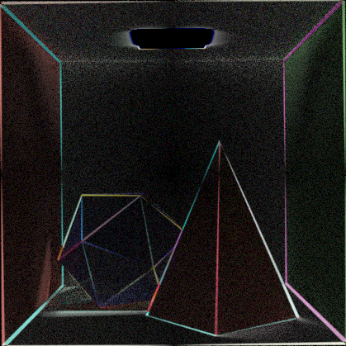
SCENE Parameter Derivatives
Image
$$I$$
θ: Object Translation
θ: Vertex position
θ: Camera Rotation
Differential
$$\frac{∂I}{∂θ}$$
Notes:
Here we show a visualization of the derivative of various pixels with respect to three different scene parameters: vertical position of the blue polyhedron, the vertical position of the
pyramid’s top vertex and the camera’s rotation. The images on top visualize how the scene changes when we change a parameter theta, while the bottom row shows the derivative of each pixel’s intensity with respect to the chosen parameter.
We can see that parameters that cause sharp edges to change their configuration have derivatives that are concentrated along these moving edges. We could try to use automatic differentiation to compute this derivative.
(TODO: Fix the differential)

Slide 7
Auto-Diff Has a Visibility Problem
Sudden discontinuity Auto-diff fails due to edges
Smooth function Auto-diff computes correct derivative
Notes:
However, there are issues with a standard automatic differentiation approach.
Consider a pixel in this interior region of the polyhedra. We see that the intensity changes smoothly as a function of the
parameter and we can therefore apply some form of automatic differentiation to the underlying
computation.
However, consider the region along the edges. The intensity here is a discontinuous function of theta which means auto-diff fails to produce the correct derivative.

Slide 8
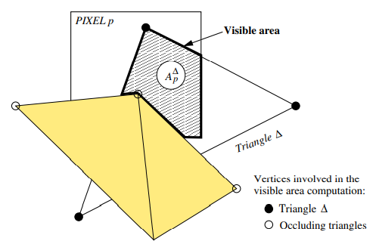
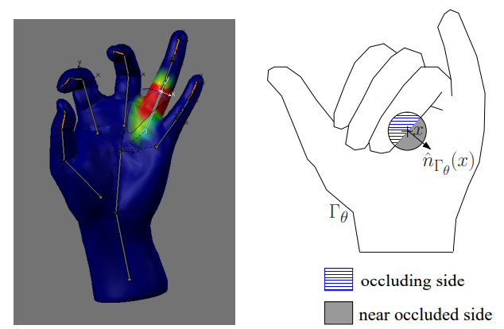
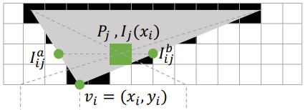
Rasterization APPROACHES ARE LIMITED
Key Idea: Analytical occupancy
Key Idea: Approximating visibility
[Jalobeanu 2004]
Challenges for Rasterization
Soft Rasterizer [Liu 2019]
[de La Gorce 2008]
Neural 3D Mesh Renderer [Kato 2017]
Notes:
Previously, there have been methods that solve this issue using a modified rasterization approach. These typically either find analytical occupancy which is limited in its application, or they approximate the sharp boundaries by smoothing them out.

Slide 9
Rendering As an Integral
Secondary Integral
Primary Integral
θ
θ
Goal: Differentiate these integrals
Notes:
Mathematically speaking, the rendering process can be thought of as evaluating an integral for each pixel of an image. This idea can also be extended to handle global illumination effects
since the intensity at an arbitrary point in the scene can be computed by integrating over the hemisphere of rays originating from the pixel. The contents of these integrals change with parameters theta, and the goal of differentiable rendering is to compute the derivative of the integrated quantity

Slide 10
MONTE CARLO ESTIMATION
$$\int_{D}^{ }{ }$$
$$≈$$
$$=$$
{ }
Integral over pixel space D
Summation over area-samples
RGB pixel value
Notes:
For the moment we focus on the primary integral, but keep in mind that our discussion also applies automatically to secondary effects. These integrals have to be numerically estimated using random Monte-Carlo area samples to produce a single integrated value for the pixel.

Slide 11
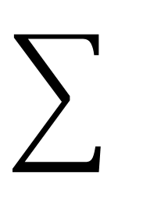
Discontinuous Integrands
(Incorrect)
Attempt 1 Apply auto-diff to summation
$$\int_{D}^{ }{ }$$
$$≉$$
{ }
θ
Integral over pixel space D
Summation over area-samples
Notes:
TODO: Make derivative image fade in.
Since our goal is to differentiate this integral w.r.t theta, we can try to apply automatic differentiation to the
discretized summation, but as we can see in the visualized derivative, the majority of the contribution is actually concentrated in the infinitesimal region along the moving boundaries.
The area samples completely miss the actual derivative, and here they seem to add up to roughly 0 contribution, while we expect a non-0 derivative since the pixel should become more blue as theta changes.
TODO: Elaborate here about the color.
TODO: Blink the edge

Slide 12
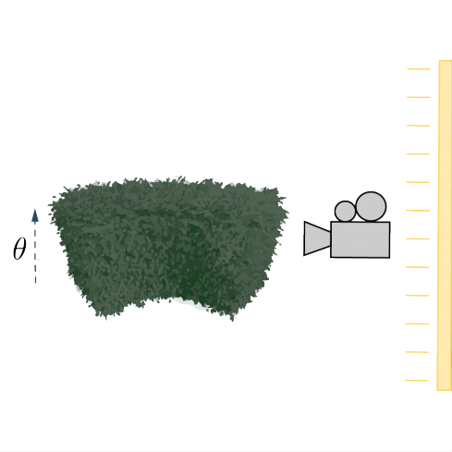
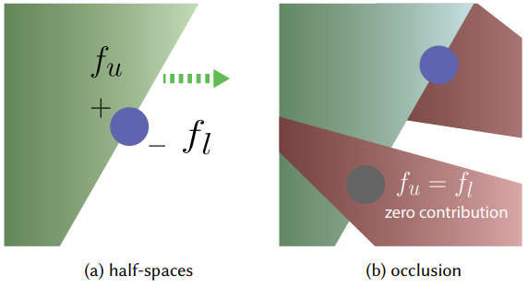
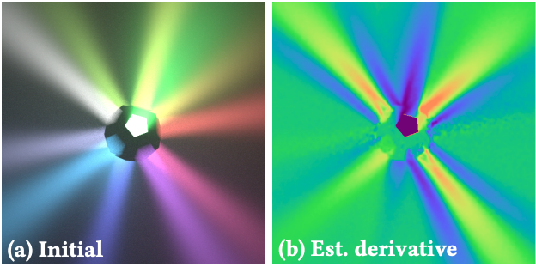
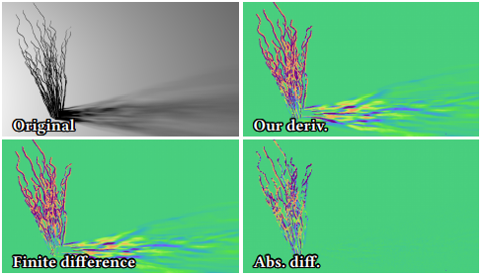
Edge-Sampling
Challenges for Edge-Sampling
Edge-Sampling for
MC Differentiable Rendering
[Li 2018]
A Differential Theory of
Radiative Transfer
[Zhang 2019]
Path Space Differentiable
Rendering
[Zhang 2020]
: Boundary samples
Silhouette classification
Occlusion
Depth complexity
: Area samples
Arbitrary silhouette sampling is hard!
Notes:
To solve this problem, Li et al produced the first work that computes the correct estimate by explicitly finding and sampling these
boundaries. They do this by finding and sampling the silhouette of 3D objects as viewed from the camera point.
Zhang’s 2019 paper extended this to the full radiative transfer equation and
The subsequent 2020 paper samples boundaries directly in path space.
However, edge-sampling has several issues that area-sampling doesn’t. For one, since global illumination can require integrating the radiance at arbitrary points in the scene, finding silhouette edges requires complex data structures just for book-keeping these edges. It must also deal with the fact that samples on edges can be occluded by other geometry. And this problem only gets worse for scenes with complicated geometry where a large majority of boundary points end up being occluded.

Slide 13
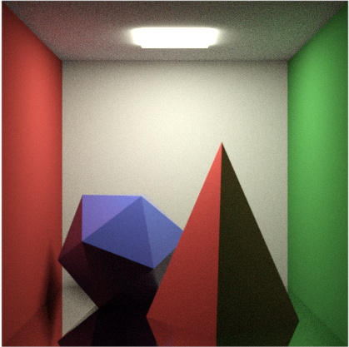
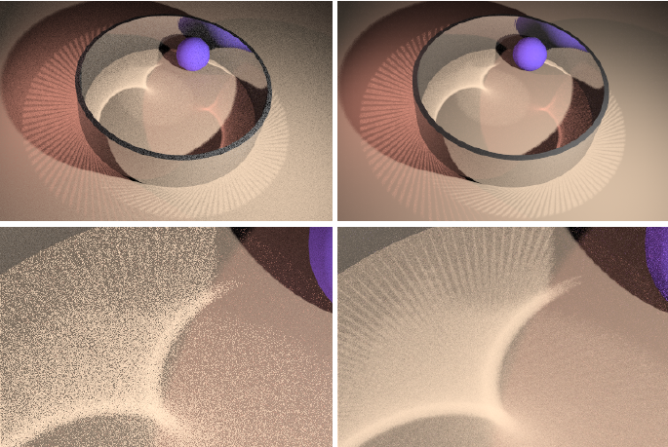
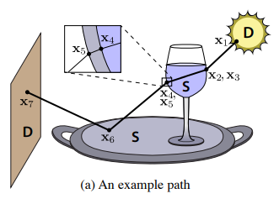
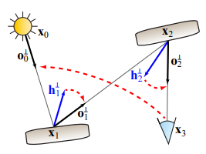
Edge-Sampling has trouble with SPECULAR REFLECTIONS
Rendering Caustics
(Near-)Perfect Mirror
Manifold-Exploration
MLT
[Jakob 2012]
Natural Constraint Representation
for MLT
[Kaplanyan 2014]
Notes:
Edge-Sampling also has issues with perfectly specular surfaces. In order to compute the derivative, we would have to sample a point on the edge and then attempt to connect it back to the camera through a point on the surface. The challenge here is that there’s only one such valid connection, and every other connection results in zero contribution.
This is similar to the problem of rendering caustics and can require complex methods to track surface constraints, as shown by previous work.
(Practically speaking, since edge-sampling techniques require such connections, they are not usually effective for applications like optimizing systems of perfect reflectors or lenses.) TODO: Shorten

Slide 14
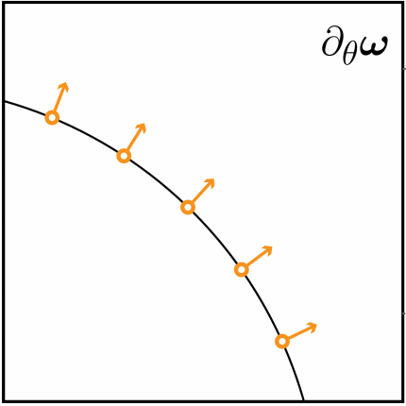
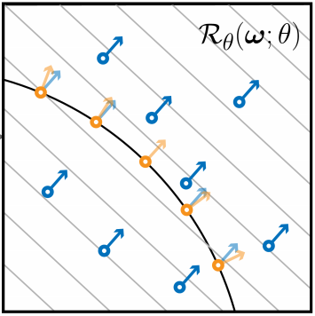
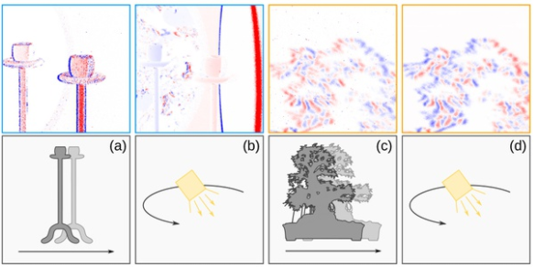
AreA-Sampling
Transform samples with θ. Avoids discontinuities.
Challenges for Reparameterization
Reparameterizing Discontinuous
Integrands for Differentiable Rendering
[Loubet 2019]
Heuristic Approximation!
May not work for all samples.
In general, Loubet 2019 does not remove all discontinuities
+ Fast (No inversion needed)
- Approximate method
Notes:
These challenges faced by edge-sampling methods motivated Loubet et al to look into approaches that don’t need to find samples on edges. They apply a transformation to the sample points that translates them as a function of theta. Roughly speaking, their method transforms these samples along with the boundaries such that no samples actually have to cross region boundaries, and auto-diff can now be applied to these transformed samples.
Unfortunately, finding such a perfect transform is a hard problem, and while their proposed heuristic works well for simple configurations, it is approximate. Therefore, some samples _can_ cross region boundaries and this produces a biased estimate.

Slide 15
Summary Of methods
Rasterization
Edge-sampling
Area-sampling
+ Fast
+ Exact derivative
+ Fast (No complex sampling)
- Approximate visibility
- Depth complexity
- No perfect specularities
- Approximate derivative
- No secondary effects
- Complex data structures
Notes:
In summary, previous work can be roughly categorized into rasterization, edge-sampling and area-sampling approaches. Rasterization methods are fast but approximate. Edge-Sampling, on the other hand, computes the exact derivative of the entire rendering equation, but requires complex data structures and suffers from depth complexity and specular surfaces.
Finally, the only area-sampling method so far is very light-weight _but_ approximate.

Slide 16
Our Approach
Notes:
In this work, we will show an approach that is unbiased like edge-sampling but uses only light-weight area-samples, thus retaining the best of both domains.
We do this by first showing that edge-sampling methods are effectively trying to compute a boundary integral, and then using the divergence theorem to show that there must be an equivalent area integral. We will then reason about the form of this area integral by defining a warp field and then demonstrate an algorithm to compute this warp field in a tractable way using a path tracer.

Slide 17
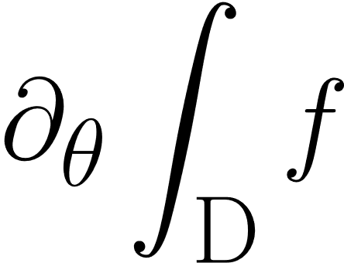
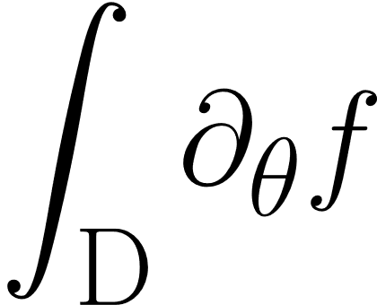
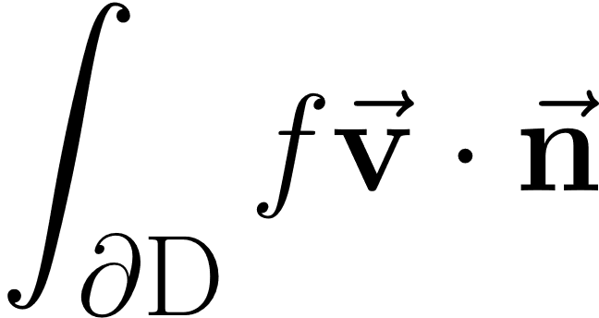
The Reynolds Transport Theorem
Reynolds Transport Theorem [Reynolds 1903]
: Set of continuous points
: Set of discontinuous points
$$=$$
$$+$$
Interior term
Edge term
Notes:
Now we’ve previously established that automatic differentiation has a visibility problem. So how _do_ we compute the derivative of an integral? This can be expressed using the Reynolds transport theorem. Essentially, the derivative of an integral is the sum of two parts. The first is the integral of the derivative defined over the interior set D of continuous points. Note that this term is equivalent to applying autodiff.
The second component is an integral over all the discontinuous points and this captures the contribution from the change of boundaries that we saw earlier.

Slide 18
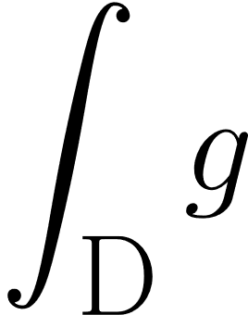
Converting Edge-Samples to Area-SAmples
is estimated through edge-samples
Goal: Rewrite into area integral
Notes:
Now edge-sampling tries to estimate this term by generating samples on these boundaries. But, is it possible to estimate this quantity without having to generate such samples? In other words, can we rewrite this boundary integral to an area integral that is defined in the interior set D.

Slide 19
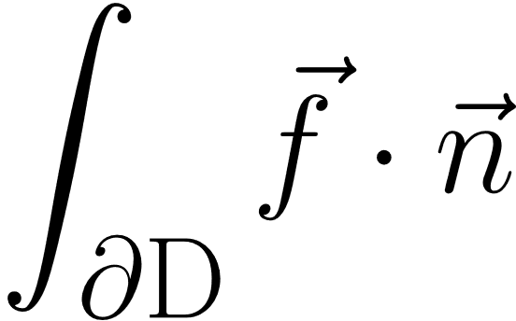
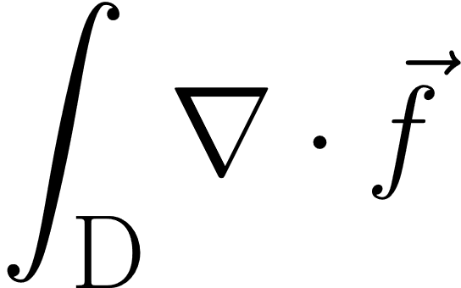
The Divergence Theorem
[Gauss 1813]
Notes:
For this, we apply the divergence theorem, which states that for a integral of some vector quantity over the boundary of a domain, there is an equivalent integral of the divergence of this vector quantity over the interior of the domain.

Slide 20
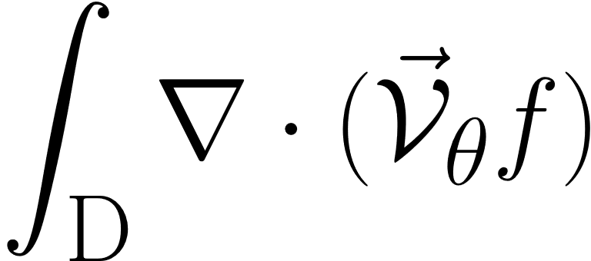
Applying the Divergence Theorem TO the Edge Integral
Goal: Rewrite into area integral
Solution: Rewrite into
can be estimated through area-samples
Notes:
We can now realize our goal of rewriting the edge integral into an area integral. This is simple an integral over the divergence of the vector quantity f times v. We run into a subtle problem here. The vector v that we get from the Reynolds transport theorem is only defined on the discontinuous set of boundaries shown in blue in the illustration. This means we must use a different quantity defined over the continuous set D, and we refer to this as the warp field V_theta. But assuming we can find such a field, these two integrals are now equivalent, and the key difference is that we can now estimate this using just area samples.
TODO: highlights
TODO: ‘using divergence theorem’
TODO: But how do we estimate this using area samples.

Slide 21
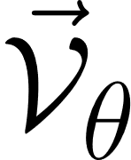
Quick RECAP
Used Reynolds transport theorem to find the boundary integral
Rewrote to using the divergence theorem.
Have to define the vector field over domain D
Notes:
So far we have used the Reynolds transport theorem to find the boundary integral, then converted this into an area integral over the area. But we now have to define what this V_theta is and how to compute it without knowledge of boundaries.

Slide 22
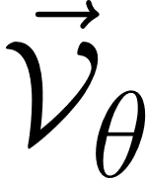
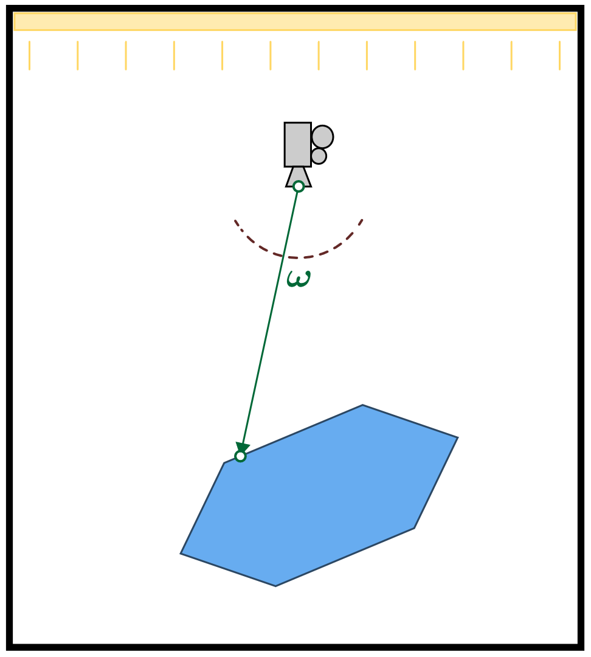
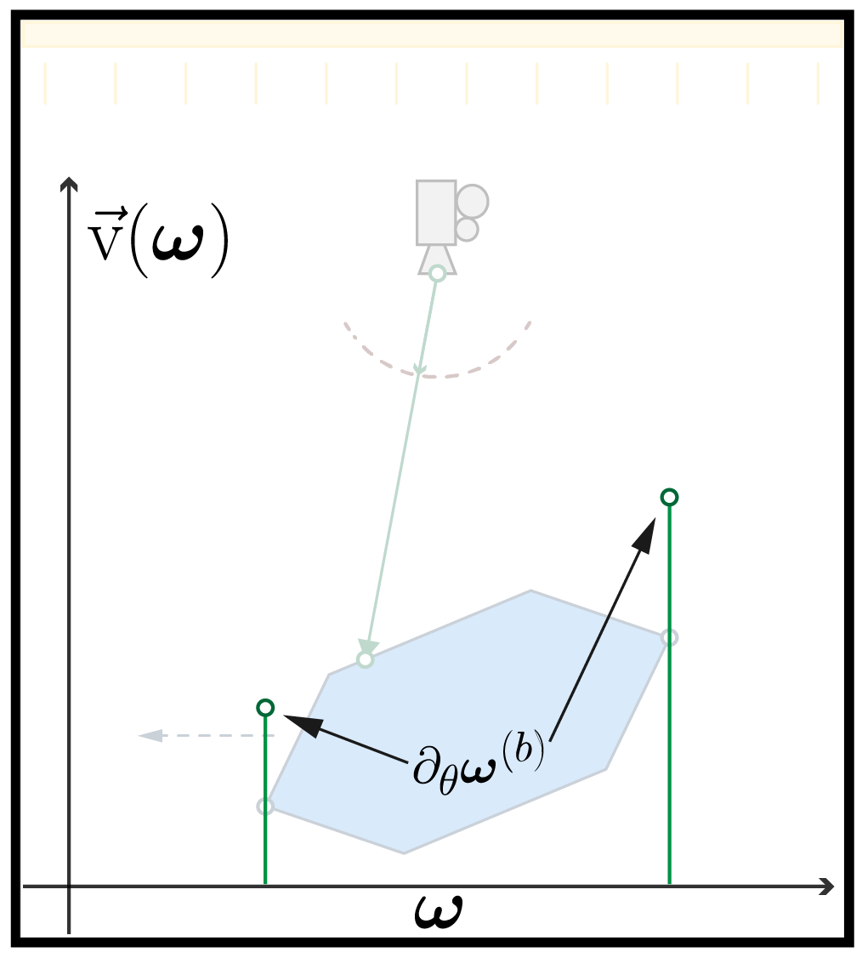
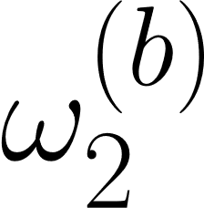
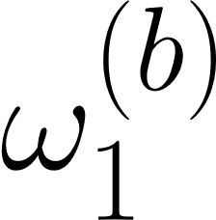
A 2D Example Scene
N-1 dimensions
Defined along edges
N dimensional extension
Defined at non-edge points
, the domain of integration
Ambiguous
, the discontinuous set
?
Notes:
In order to visualize the warp field its helpful to consider a 2D example. Consider a scene where our image is simply the integral of the intensity over the domain of the semicircle centered on the camera. In this example, the _boundaries_ of the integral are simply the points that correspond to the silhouette of the polygon when projected onto the camera.

Slide 23
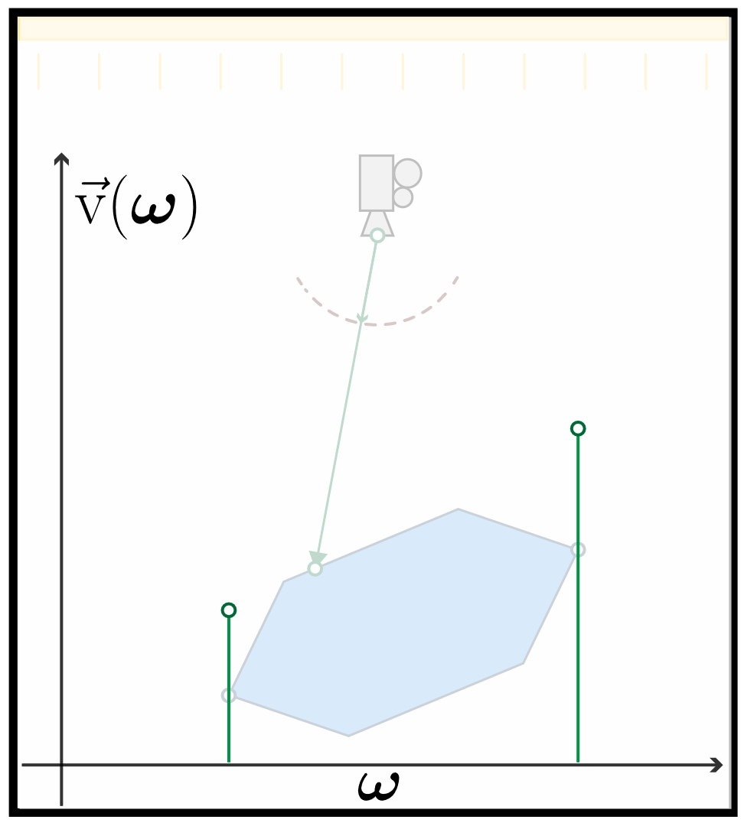
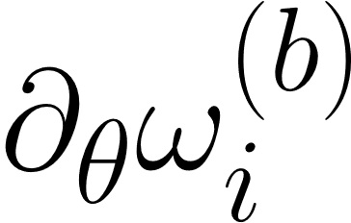
Velocity : the Boundary derivative
: Derivative of boundary position w.r.t θ
θ
Notes:
Now, the velocity v is the rate at which these values change as the underlying scene moves with theta. If we plot these values onto a graph, we see that this is only defined on the set of discontinuous points, and is undefined everywhere else. This is the quantity that edge-sampling would compute for its integral.

Slide 24
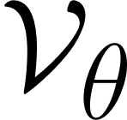
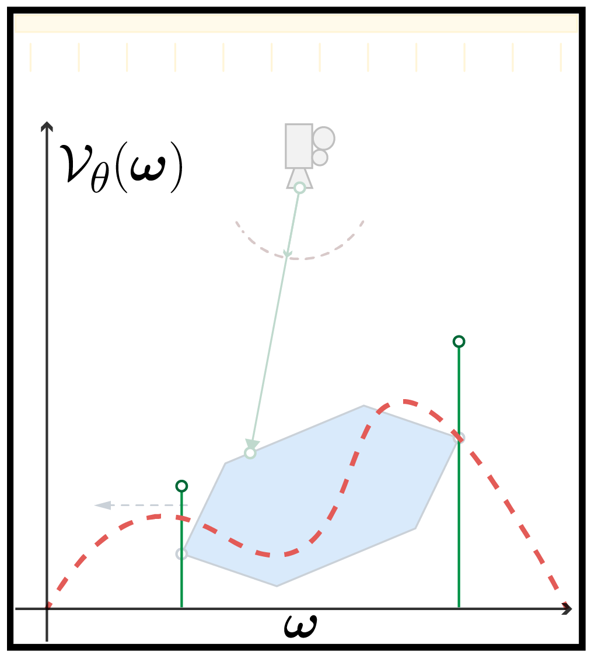
Warp Field : Extension of to all points
: defined over $D$
: defined over $∂D$
Notes:
But remember that _we_ want to compute the equivalent _area_ integral. We need to find a warp field V_theta defined over the entire domain (not just the silhouette points). The key questions now are, what is this warp field? and how do we compute it? Turns out we need to satisfy two conditions on the warp field.

Slide 25
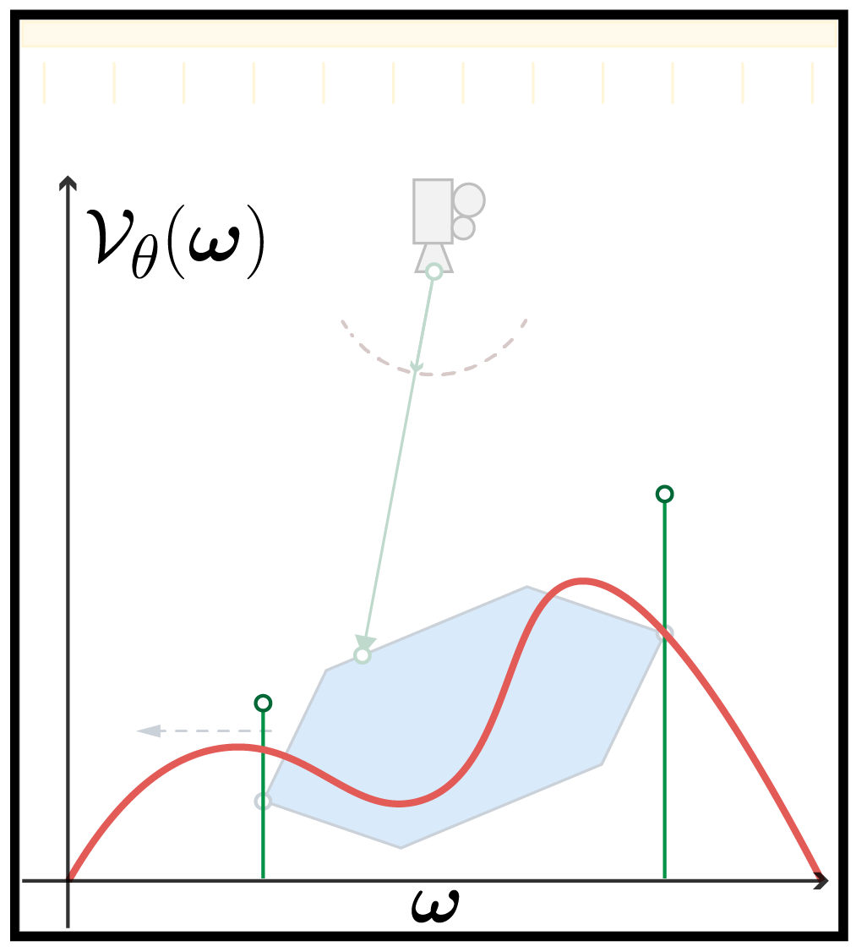
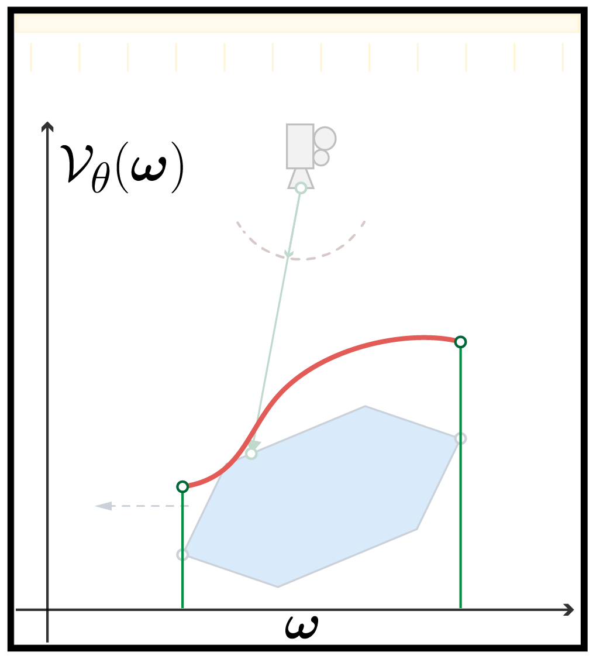
Validity of
Rule 1: Continuous
Notes:
The first one says that the warp must be continuous. This is easy to see because if V is not continuous, its divergence doesn’t exist. For example, this field is continuous, while this field isn’t.

Slide 26
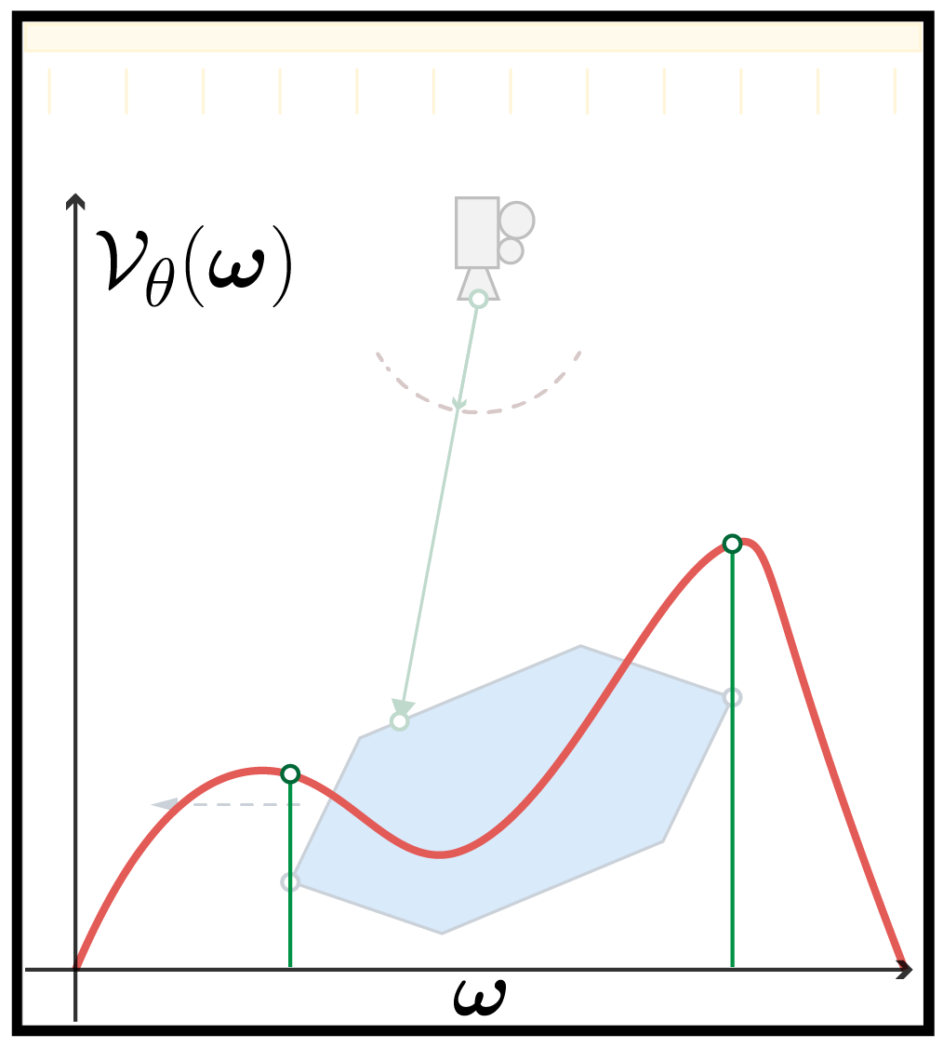
Validity of
Rule 2: Boundary Consistent
Notes:
The second rule is that it must be equal with the velocity at all boundary points. This rule follows directly from the divergence theorem. As an example, this field on the left is boundary consistent, while this field on the right is not consistent. If we have a field that satisfies both these rules, then our integral conversion is correct. Our problem has now been reduced to smoothly interpolating the velocity at discontinuous points, to the rest of the domain.

Slide 27
Interpolation without knowledge of boundaries
Available quantities
Origin point
Ray
Intersection
Primitive
No access to discontinuity points
Notes:
Producing this interpolation can be a bit tricky. Unlike a traditional interpolation problem, the only quantities we know about a specific sample are the origin point, the ray and the intersected primitive. What we don’t know are the locations of the discontinuities. If we did, then we could apply an edge-sampling approach. Our primary goal is to interpolate while avoiding the cost of locating these boundaries. and so we call this the ‘blind interpolation’ problem where don’t have explicit access to the positions of the control points.

Slide 28
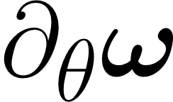
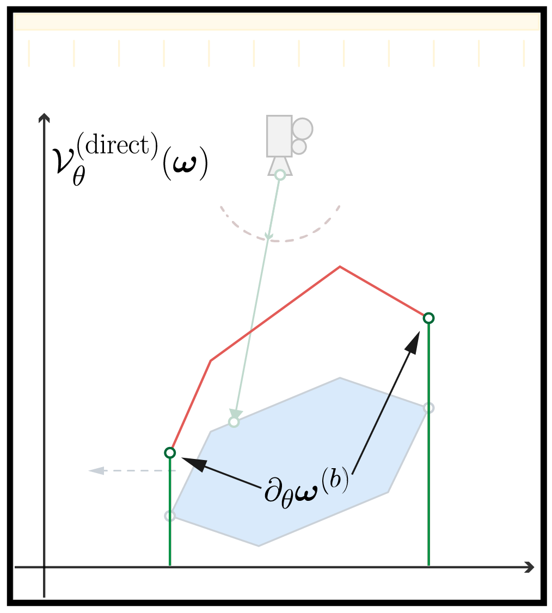
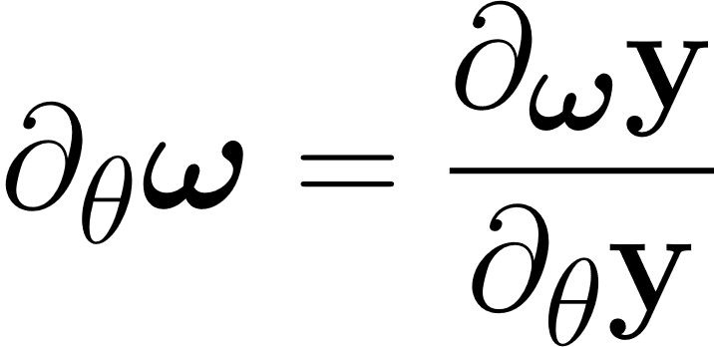
Constructing
Attempt 1 Find through implicit derivative
(Incorrect)
At all points (not just boundaries)
+ Boundary consistent
- Not continuous
Notes:
One way to find such an interpolation is to use the implicit derivative approach. We know the intersection point Y is a function of both our ray direction omega and the scene parameter theta. This means the two quantities are implicitly related through the intersection function. We can then find the derivative of omega w.r.t theta just by taking the ratio of their individual derivatives.
When we plot the result, we see that the warp field is by definition consistent at the boundaries, but isn’t defined anywhere outside the surface because the intersection doesn’t exist. So this isn’t continuous.
Intuitively, the next step to solve this is to blur it in some way

Slide 29
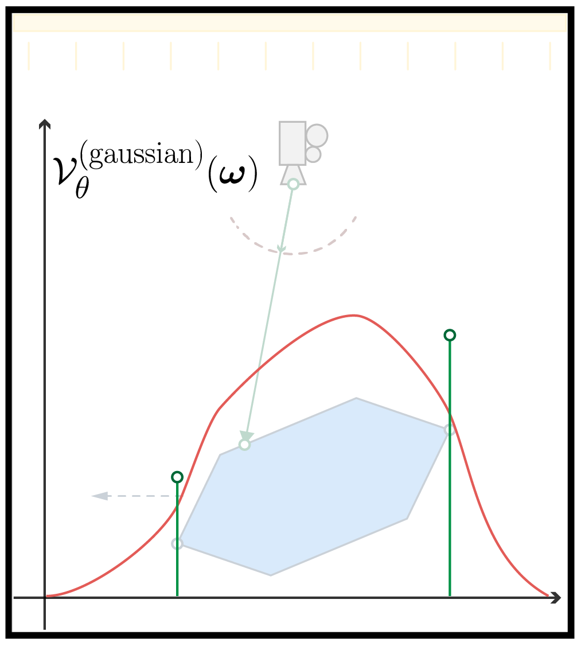
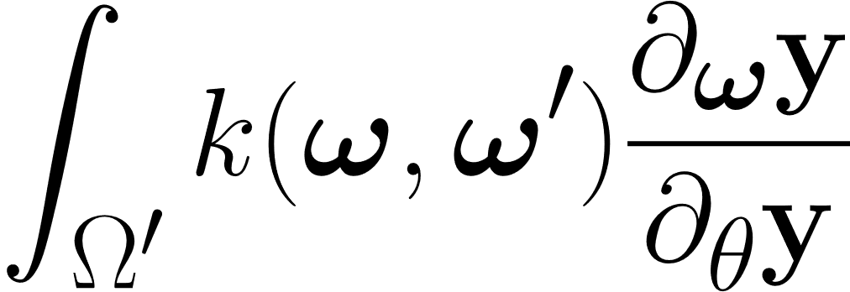
Constructing
Attempt 2 Filter Attempt 1 with a Gaussian filter
(Incorrect)
k(.,.) = Gaussian filter
+ Continuous
- Not boundary consistent
Notes:
And that’s our second attempt. We convolve the entire domain with a uniform blur kernel by introducing another integral. Predictably, the resulting warp field is continuous, but we see that a uniform blur has no guarantees on preserving consistency at the boundary points.

Slide 30
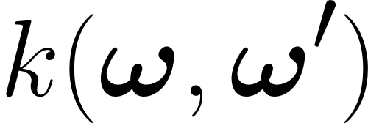
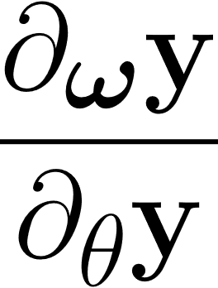
Boundary-Aware Weighting
=
Goal: Find weights s.t. at boundaries.
Ideal weighting function
Approach Dirac delta near boundaries
Notes:
At a high-level, what we want to do is blur the function at interior points while keeping the non-filtered values
at the boundaries. And for this we need boundary dependent weights that are smooth in the interior of the surface, but a sharp Dirac delta at
boundary points. Intuitively, this works because convolving a function with a Dirac delta just returns the same function.

Slide 31
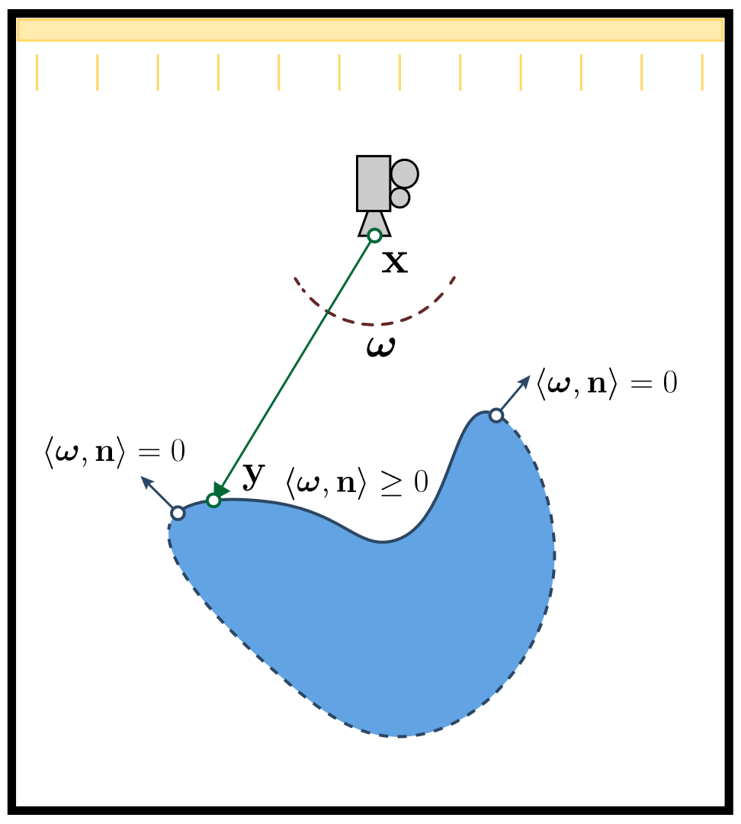
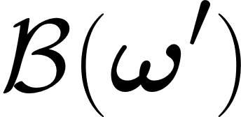
Boundary-Aware Weighting
Available quantities
Implicit Boundary through geometric normals
Don’t have
Discontinuity set (Boundary sampling)
Origin point
Implicit function of the boundary
(Boundary testing)
Do have
Ray
: Boundary test function
Intersection
Non-linearity
Primitive
such that
= 0 for
at boundaries
Notes:
However, remember that we don’t actually have access to the set of discontinuities. We can only access the current intersection point and its local geometry.
It turns out that we can still achieve our goal if we can instead compute some function B(.) whose zero-set is the set of discontinuous points.
Intuitively, this is an implicit representation of the boundary and comes with the advantage that it is much easier to compute when compared to explicitly finding the
boundary.
As an example, imagine we have a smooth shape, we can now use the dot product of the ray direction with the intersection’s normal as the boundary function.
Our implementation uses a slightly modified version of this that works for arbitrary triangular meshes.
(We’d also like to stress here that this implicit boundary term can be constructed easily for a variety of 3D representations, allowing our method to be extended in this manner.)
Please visit our project website for more examples of implicit boundaries.

Slide 32
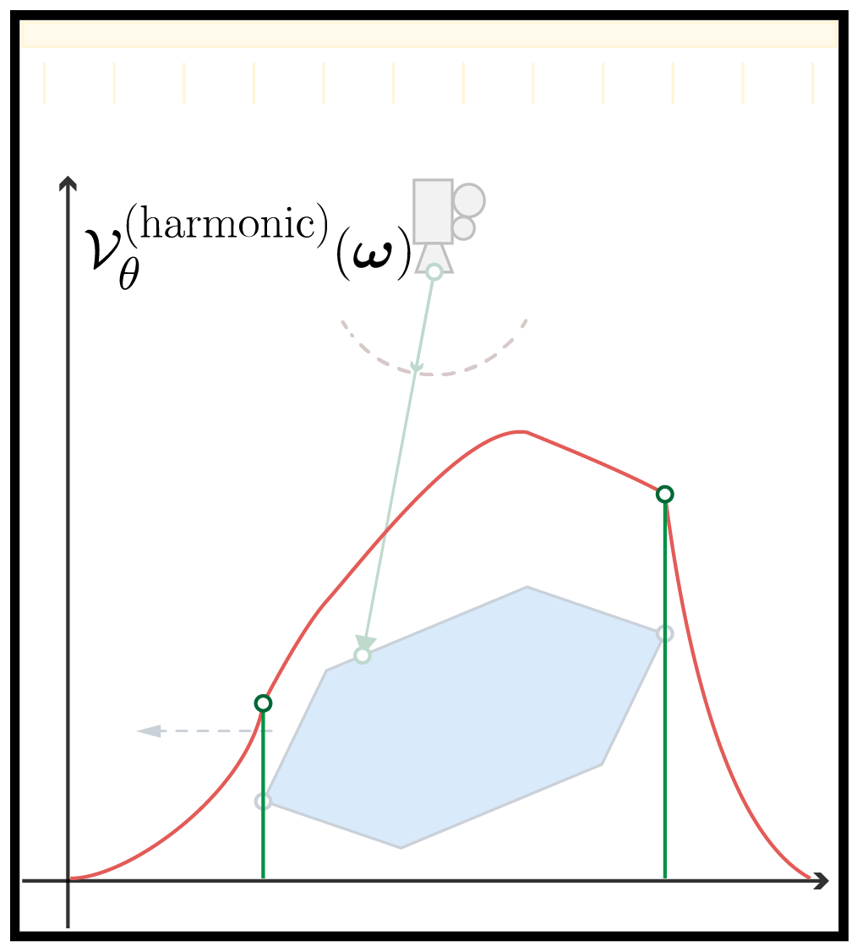
Constructing
Our Approach Filter Attempt 1 with harmonic weights
Distance function
Boundary test
+ Boundary consistent
+ Continuous
Notes:
For our final attempt, we design weights based on harmonic interpolation. Harmonic weights are just the inverse of the distance between the two points.
However, instead of using only distance, we pad it with our implicit boundary function.
Effectively this means the contribution of a boundary point approaches infinity as the sample point approaches the boundary. This weighting scheme now produces a field that is both boundary consistent and continuous.

Slide 33
Computing
1. Sample path using path tracer (N paths)
For each bounce:
2. Sample auxiliary rays (N’ rays)
3. Compute boundary term B() locally
4. Compute weight k(.,.) and
5. Find weighted mean
Notes:
Now that we have a warp field, we need to numerically compute it. Since we have to evaluate an integral, we use an inner Monte Carlo process.
Putting them all together our process first uses a traditional path tracer to sample a light path.
At each bounce, we sampling auxiliary rays for the inner integral. We then use autodiff to find the implicit derivative and the weights
at each of these auxiliary rays. Finally, we compute the weighted mean of all these rays to find an estimate for the warp at the current bounce.
We’d also like to point out that this method is structurally similar to the reparameterization method by Loubet et al. The main difference is that our weighting method produces an unbiased estimate.

Slide 34
Additional DEtails
Russian Roulette
Variance Reduction
Relationship with
Reparameterization
Notes:
There are a few additional details that we do not cover here, but are required for our method to produce usable gradients. The first is the use of Russian roulette truncation when computing the weighted mean, because the weighted mean estimator is not unbiased for a fixed sample count. We also use both antithetic sampling and control variates since the choice of kernel can cause very high variance in some regions. Finally, we derive the relationship between our method and the reparameterization method, which suggests that a warp field can be written as a transformation and vice versa.

Slide 35
RESULTS
Notes:
Now we move on to some results from our method.

Slide 36
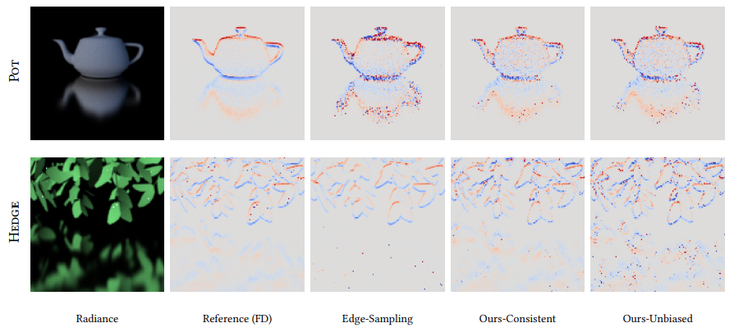
VARIANCE Comparison with edge-sampling
Reference
Derivative
Ours
without
Russian roulette
Ours
with
Russian roulette
Image
$$I$$
Li et al. 2018
Notes:
We first compare against edge-sampling. Both methods use 64spp here. We see that edge-sampling has trouble with specular reflections. This phenomenon gets worse for more complex geometry like the Hedge.
By contrast, our approach avoids this problem because we use a typical path tracer for derivative samples and benefit from the importance sampling.

Slide 37
BIAS Comparison with Reparameterization
Illustration
Image
Reference
Ours
Loubet et al. 2019
$$I$$
Rotating cylindrical objects present a complicated scenario for area-sampling
Notes:
We compare our bias with the reparameterization method on some scenes that are particularly challenging for area-sampling. Rotating cylinders present a situation where the warp of interior points is not representative of the warp at the silhouettes. For the reparameterization method, this manifests as bias at the _penumbra_ of the shadow, where we expect zero gradient.
Our method avoids this issue because of harmonic weighting which ensures a boundary consistent warp field.

Slide 38
BIAS Comparison with Reparameterization
Illustration
Image
Reference
Ours
Loubet et al. 2019
$$I$$
Extremely complex geometry like foliage can cause heuristic to fail
Notes:
When we use complex geometry like a plant or a hedge where each pixel can involve hundreds of overlapping primitives, the heuristic function used by the reparamterization method can fail and produce incorrect transformations leading to a lot of bias in the resulting derivatives.

Slide 39
Pose Estimation Can fail with Biased Gradients
Multiple Initializations
Optimization trajectories
Notes:
But does this bias actually matter for our applications? We see that for a 6 DoF pose estimation problem for complex geometry, the bias from the heuristic causes badly behaved gradients that can cause the optimization to diverge completely. We also verify the robustness of our method by using several different initializations. Our method converges on almost all initializations.

Slide 40
Contributions
Edge-integral to
Area-integral
Warp field conditions
Harmonic interpolation
Notes:
To summarize our contributions, we have first demonstrated the application of the divergence theorem to convert the edge-integral into an area-integral over a warp field. We then derived the conditions on this field for the conversion to be valid, and finally we described one approach to computing such a warp field using harmonic interpolation and implicit boundaries. We believe that our findings also offer clarity on the relationship between the two major approaches to differentiable rendering.

Slide 41
Acknowledgements
This project was funded by the Toyota Research Institute.
Project
Page
Code available on redner
Code coming soon on mitsuba-2
Notes:
We’d like to thank TRI and MIT for financial support. Please visit the link in the QR code for the project page if you’d like to know more or to download our code which is now available on both redner and mitsuba-2

