Slide 1
Extracting Multi-Person Respiration from Entangled RF Signals
Shichao Yue
Hao He Hao Wang Hariharan Rahul Dina Katabi
Notes:
Hello everyone, I am Shichao. Today, I will present my work Extracting Multi-Person Respiration from Entangled RF Signals. This is a joint work with my colleagues Hao He, Hao Wang, Rahul and Dina from MIT.

Slide 2
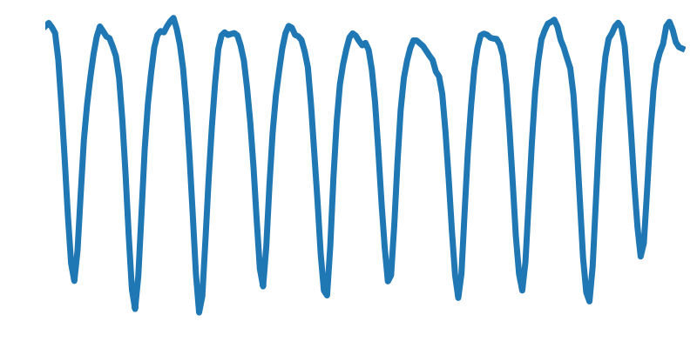
Wireless Breathing Monitoring
Exhale
Inhale
Received Signal
Scenario
Notes:
Past work shows that we can monitor human’s breathing remotely without any physical contact. As shown on the right, by transmitting wireless signals and analyzing the signal that bounds off human body [animate], we can measure breathing accurately, as shown on the left [animate], with each trough representing an inhale [animate], and each crest representing an exhale [animate]. The amplitude of each peak represent the volume of each breath.

Slide 3
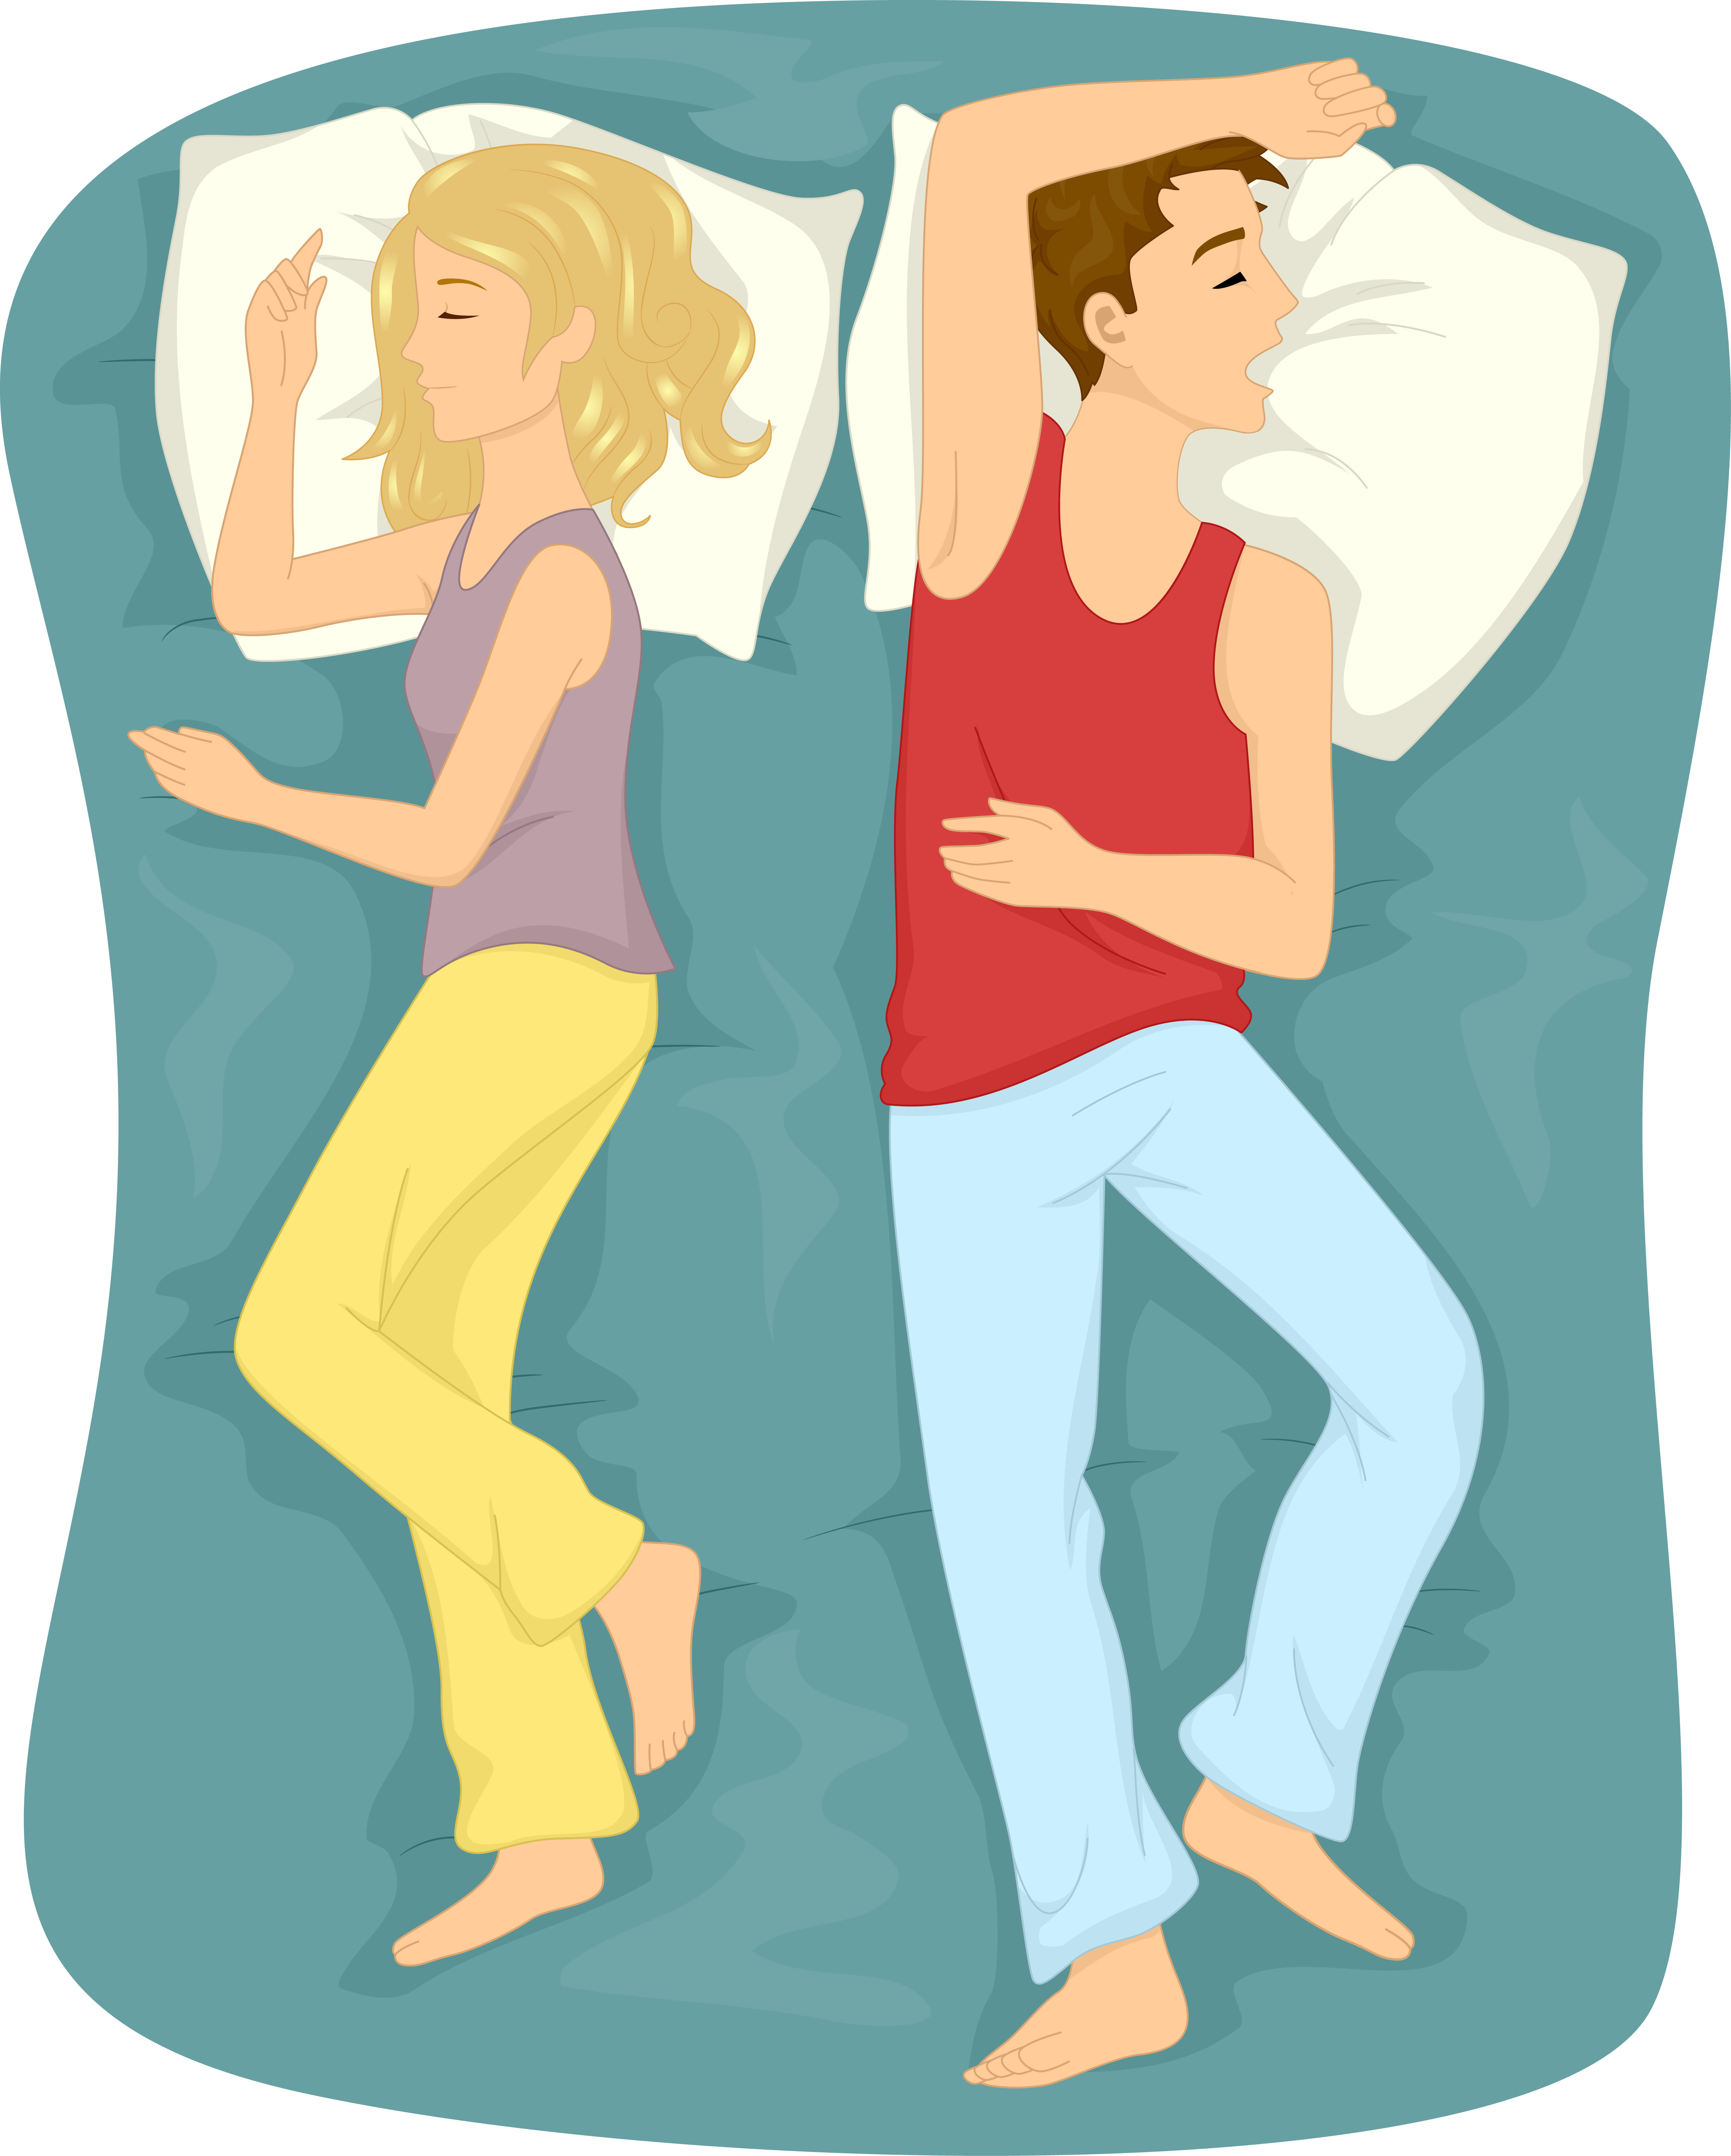
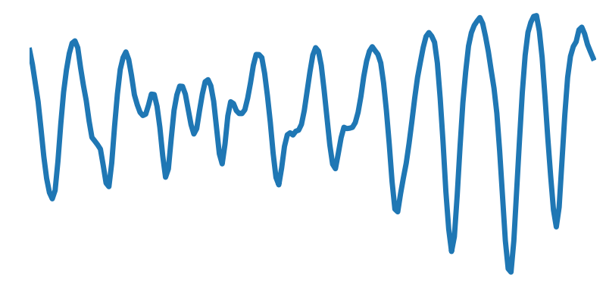
Wireless Breathing Monitoring
Current systems cannot separate two breathing!
Received Signal
Scenario
Notes:
However, if we apple the same method to a scenario where there are two people that are close to each other, let’s say for example, two people sharing the same bed, as shown on the right, this is what we got [animate]. It looks wired because it is the combination of two breathing signals. [animate] Because of the interference, current systems cannot work correctly under such scenario.

Slide 4
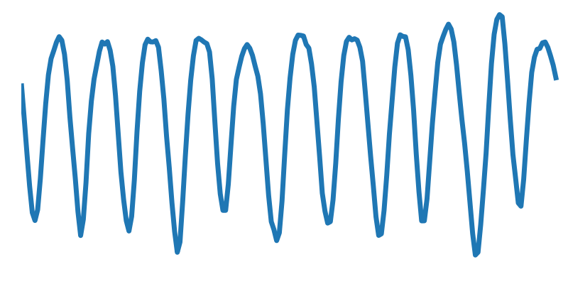
Non-Contact Sleep Analysis
Notes:
But this is an important scenario. Given the fact that most non-contact sleep analysis are based on breathing signals, [animate] if we can correctly extract the breathing in such cases, we can let those techniques benefit a much larger population, and patients do not need to sleep alone to be monitored.

Slide 5
DeepBreath
Measure multi-person respiration with zero separation
Propose algorithms to enable full-night breathing monitoring
Evaluate it with 151 hours of data from 13 couples
Notes:
So today, I will introduce our system called DeepBreath, that tackles exactly this problem. We provide a solution to measure multiple-person respiration even they are zero-distance separated. Also, we propose a series of algorithms to enable full-night breathing monitoring. Finally, we evaluate our system with 151 hours of data from 13 different couples. I will talk about this three points in detail.

Slide 6
Blind Source Separation
M3
…
…
M2
…
…
P2
P3
P1
M1
Notes:
Ok, let’s begin with the first point. How can we separate breathing signals when they are entangled with each other? Have we seen a similar problem somewhere else? Blind source separation problem. For example, [animate] during a party, we have three conversations going on simultaneously. [animate] If we have only one microphone, no surprise that it will receive a mixture of voices. [animate] However, if we have multiple microphones in different locations, we can actually extract each individual voice source.

Slide 7
Blind Source Separation
M3
M2
P2
P3
P1
M1
Notes:
Take one particular microphone as an example. It is receiving voices from all three persons, but with different volume. If the people is closer, the received voice is louder. [animate] Therefore we can think of it as their signals are multiplied by a coefficient represented by the function w. This function is large if the person and the microphone are close, and small if far.

Slide 8
Blind Source Separation
M3
M2
Independent Component Analysis
P2
P3
P1
M1
Observation
Coefficient
Source
Notes:
And we can express the signal it receives by following equation. The left hand size is the received signal, and we call it, observation [animation]. And the right hand side is the summation of all the coefficient and source products [animation]. If we can express the observation in this way, and we have a bunch of observations, we can use an algorithm called Independent Component Analysis [animation] to determine the coefficient, and thus extract the source from this mixture.

Slide 9
Separate Breathing Signal
P2
P3
P1
*Assume radios are based on FMCW,
yet it is applicable to other radio types
Notes:
Then, how can we apply this framework to our problem? Instead of audio sources, we have people breathing and reflects RF signals. And we substitute the microphones with radio systems. Following analysis assume those radios are a special kind radios that based on FMCW, yet is also applicable to other radios like doppler radar.

Slide 10
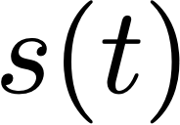
Separate Breathing Signal
P2
P3
P1
Notes:
Let’s again focus on one radio and see what it receives from one single person. Suppose the radio is sensing the motion of the people, denoted by this s(t). Then let’s see what’s the signal the radio receives

Slide 11
Separate Breathing Signal
For a subcarrier centered at frequency ƒ
P2
P3
P1
Notes:
The received signal is such a complicated equation. Don’t be panic, we are not going into details. Just noticing that s(t) is both in a sinc function and an exponent, making it nearly impossible to be separated as an individual term.

Slide 12
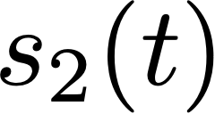
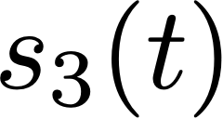
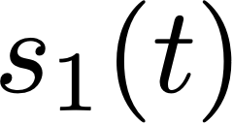
Separate Breathing Signal
?
P2
P3
P1
Notes:
For multi-person case, fortunately, wireless signal added up linearly at the receiver, therefore the received signal can be expressed as following. However, compared with target form, as shown on the bottom, we are forced to decompose this very complicated term into a product of coefficient and source signal. How can we do this?

Slide 13
Breathing is a small motion
Taylor Expansion
Removing constants
Notes:
The observation is that, breathing is a small motion. [animate] It is a small vibration centered at a constant value. So what can we do? Yes, Taylor expansion! By apply first order Taylor expansion and removing all the constants, this is what we’ve got. [animate]. Noticing that this equation has exactly the form we want. Therefore we obtain the observations that can be feed into ICA, and extracts breathing signals out from this mixture.

Slide 14
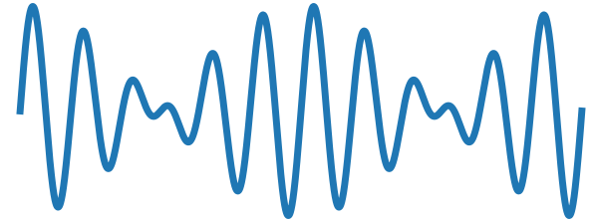
Frequency Modulated Continuous Wave
Received Signal
Sub-Carriers
Notes:
Finally, let me answer why we use FMCW radios. FMCW stands for Frequency Modulated Continuous Wave. At a high level, what FMCW does is that [animate], we can analyze the received signal in multiple sub-carriers. Each sub-carrier encodes different information and acts like virtual antennas at different locations.

Slide 15
Separate Breathing Signal
P2
P3
P1
FMCW
Notes:
Back to our scenario, with FMCW, one radio is enough to produce multiple observations with different mixing pattern. [animate] Therefore we don’t need multiple radios anymore. We can just hang one device on the wall, and it will just work automatically. And this concludes my analysis to the first point, let’s move on.

Slide 16
What about big motions?
Notes:
After previous analysis, a natural question to ask is, what about big motions?

Slide 17
CNN-based Motion Detector
Notes:
Even during sleep, people will toss and turn, resulting in a big movement that cannot be approximated by Taylor expansion, and thus break the ICA. This is a 5 minutes example from our dataset, and there are two big motions, as highlighted in red rectangles. We cannot use periodicity to detect motion because the signal is a mixture. [animate] Instead, in order to detect it robustly, we proposed a motion detector that is based on convolutional neural network.

Slide 18
CNN-based Motion Detector
Notes:
Then we can remove the motion and apply ICA on each period.

Slide 19
Are we done?
Notes:
So, are we done?

Slide 20
Notes:
Sadly no. Here is our previous example. [animate] If we separate the breathing for each period, this is what we’ve got.

Slide 21
Alice
Alice?
Bob
Bob?
Notes:
Let’s zoom in on the results. [animate] Suppose those two breathing are coming from Alice and Bob, and in the first period, the top one is from Alice and the second one from Bob. [animate]
Can we still assume the same order in the second period?

Slide 22
Alice
Bob?
Bob
Alice?
ICA produce unordered results
Notes:
Or inverted orderer? [animate] Both can be possible, because ICA produce unordered result. In order to produce full breathing reconstruction, we need to figure out which components come from the same person.

Slide 23
Identity Matching Problem
Notes:
We call this problem as Identity Matching Problem.

Slide 24
Similarity
A1
A2
A3
B1
B2
B3
Notes:
To solve it, our idea is that, if two segments come from the same person, they should have some similar property. The metric we are using is based on an term called ICA mixing matrix, and is explained in our paper. Then, with this metric, we can evaluate how good is one assignment. Let me explain this with an example. [animate] Here is our previous reconstructed breathing signals. [animate] Let’s first give each segment a name.

Slide 25
Similarity
0.8
0.2
0.1
A1
A2
A3
Alice
B1
B2
B3
Bob
0.4
0.5
0.9
Score: 2.9
Notes:
Then let’s have one assignment, where the segments on the top row are from Alice, and the bottom row are from Bob. To evaluate how good it is, we can compute the similarity between all the segments from the same person, and the sum of all the similarity is the score of this assignment.

Slide 26
Similarity
0.8
0.7
0.8
A1
B2
A3
Alice
B1
A2
B3
Bob
0.7
0.5
0.9
Score: 4.4
Notes:
Then if we have a different assignment, we can also compute the score for this one.

Slide 27
Similarity
0.8
0.7
0.8
A1
B2
A3
Alice
B1
A2
B3
Bob
0.7
0.5
0.9
Score: 4.4
Notes:
Then if we have a different assignment, we can also compute the score for this one.

Slide 28
Similarity
0.8
0.8
0.2
0.1
0.7
0.8
A1
A2
A3
A1
B2
A3
B1
B2
B3
B1
A2
B3
0.4
0.5
0.7
0.5
Dynamic Programming
0.9
0.9
Notes:
And within those two assignment, we should choose one with higher score. A naive solution to find the best assignment is to enumerate through all the possibilities. However the total number of possibilities grows exponentially with the number of periods. Therefore, to solve it efficiently, we proposed a dynamic programming algorithm to bring the complexity down to linear.

Slide 29
Put It Together
Detect Motion with Deep Learning
Separate Breathing with ICA
Match Identity with Dynamic Programming
Notes:
So, as a summary, our system contains three steps. [animate] First, we use a deep-learning based motion detector to remove all the motions. [animate] Then, for each period, we use ICA to separate breathing signals from sub-carrier signals. [animate] Finally we match the identity with a dynamic programming algorithm.

Slide 30
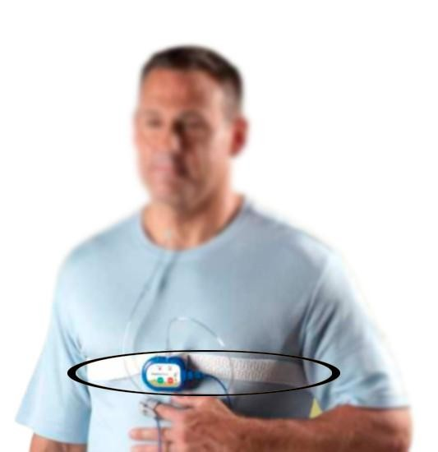
Evaluation
Experiment:
13 couples, 13 different bedrooms
21 nights, 151 hours
Unconstrained experiment in their own homes
Ground Truth:
SleepView, an FDA-approved sleep monitor.
Notes:
To do that, we conducted an extended experiment. We test our system with 13 couples, that’s in 13 different bedrooms. And we collected 21 nights, in total 151 hours of data. And most importantly, our experiment is an unconstrained experiment, which means that the subjects can just sleep as normal. And for ground truth, we asked each of our subject to put on a FDA-approved sleep monitor. That sleep monitor comes with a breathing belt, that can provide accurate breathing signals.

Slide 31
Representative Examples
16.0 Breath/min
16.0 Breath/min
Notes:
Before I show you any numbers, I want to show some representative examples. Here are ground truth breathing signals from a couple in the same 2 minutes. They are both breathe normally. And there is an interesting fact, if we count the breathing rate, we will find out that, both people has exactly the same breathing rate. Yet even they has the same breathing rate, our system is able to reconstruct the breathing signal correctly, as plotted on top of the ground truth. As you can see, the reconstructed signal matches perfectly with the ground truth.

Slide 32
Representative Examples
Breathing Stopped
Notes:
Here is another example. The top breathing signal looks normal, yet in the bottom one, the breathing stoped for several seconds. This might be an indicator for some sleep diseases like sleep apnea. And our system is able to reconstruct the breathing signal perfectly.

Slide 33
Result
Average Correlation: 0.915
Notes:
And in terms of numbers, we do not only cares about breathing rate, but also the volume of each breath. Therefore, we use a metric call correlation coefficient to measure how similar our signal is compared to the ground truth. So in the plot, the x axis is the 13 couples, and for each couple I will plot the correlation for each individual. And here is the result, you can see that the correlation for all the individual is very high, and on average the correlation is 0.915. In comparison, if we put two breathing belt, one around chest and one around belly, the correlation between these two breathing signal is around 0.916. This indicates quality of our reconstructed signal is comparable to a breathing belt.

Slide 34
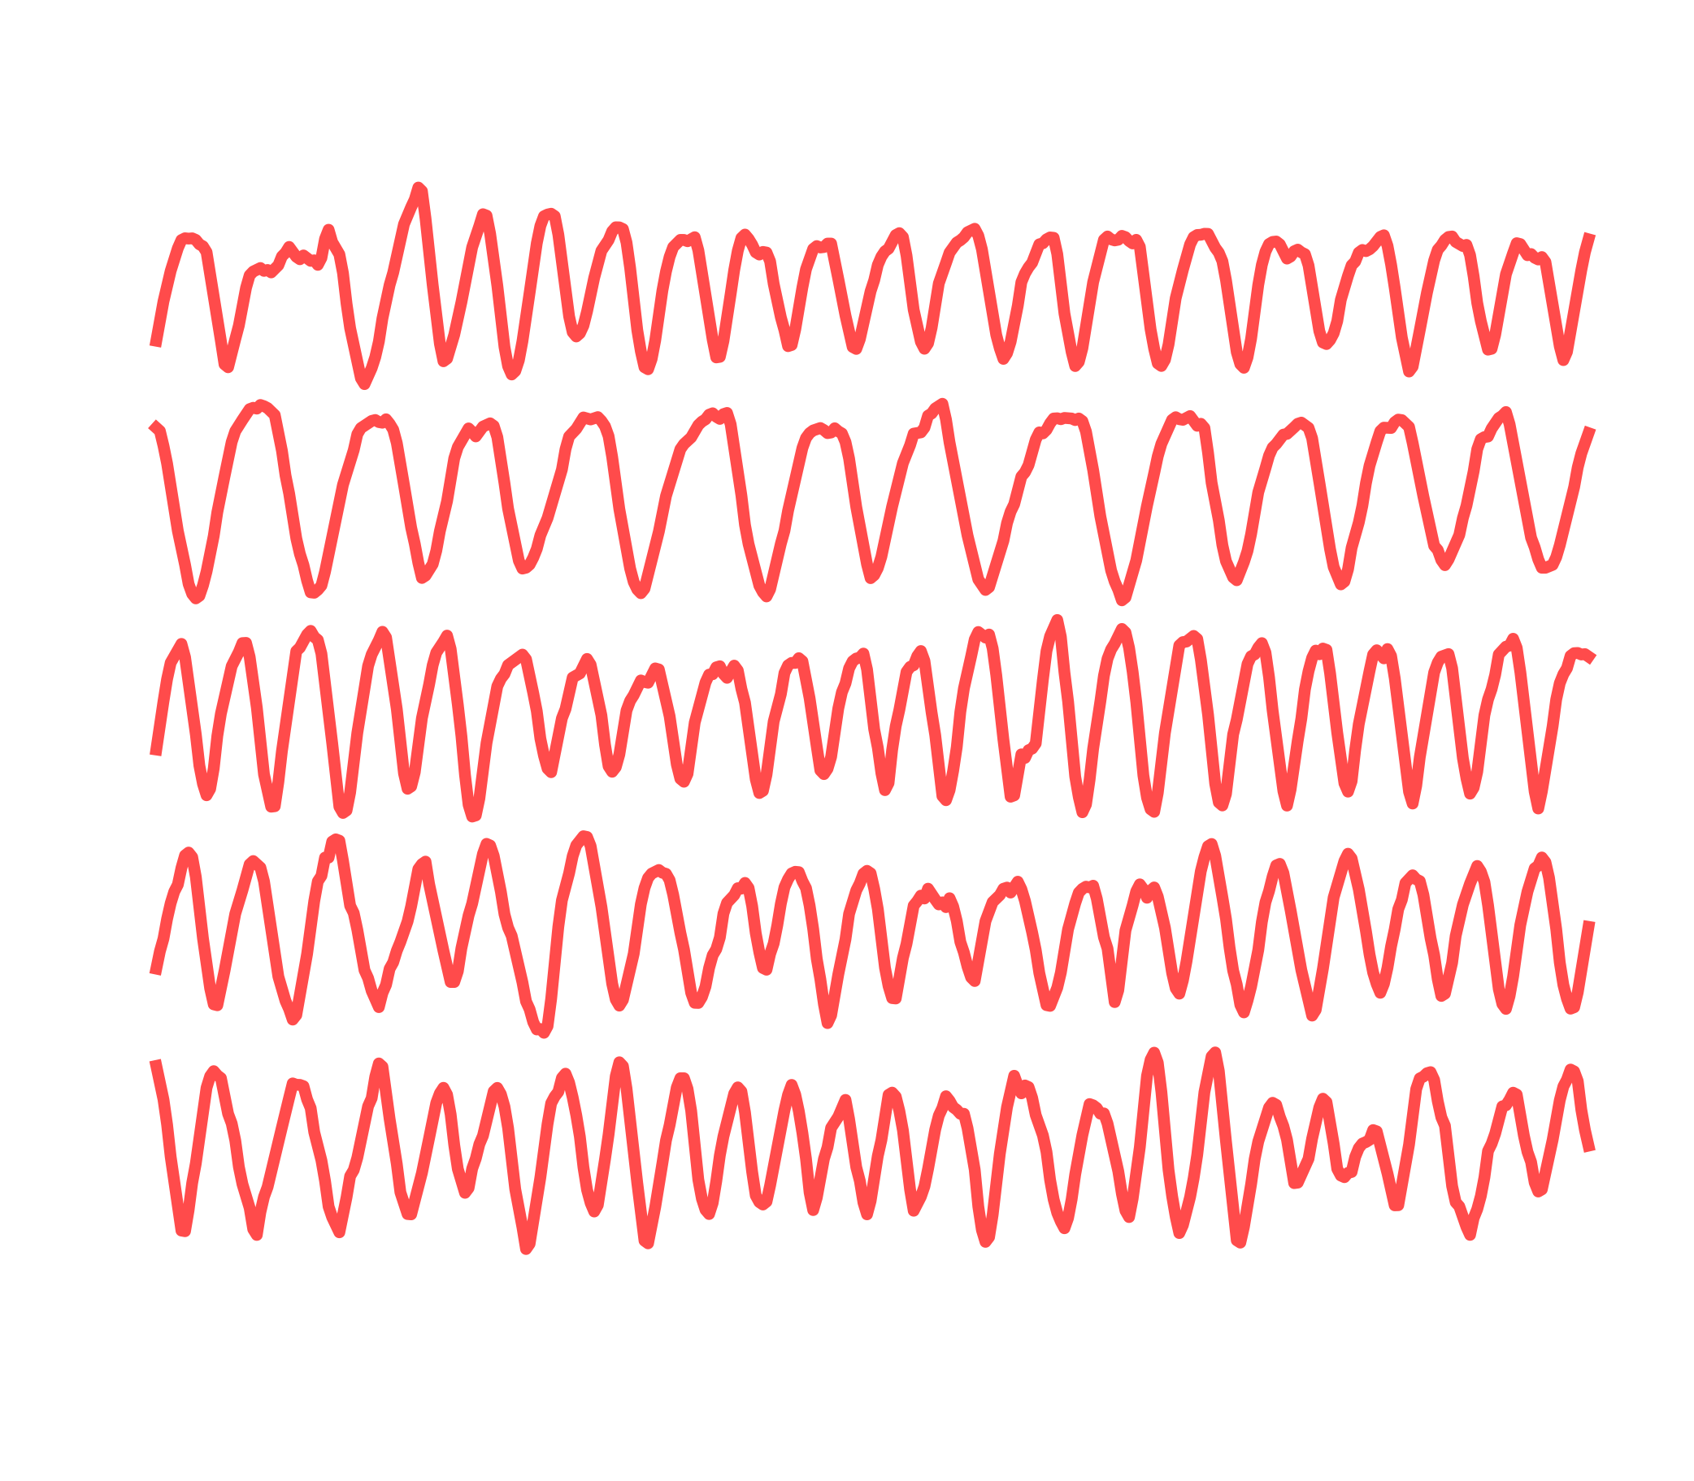
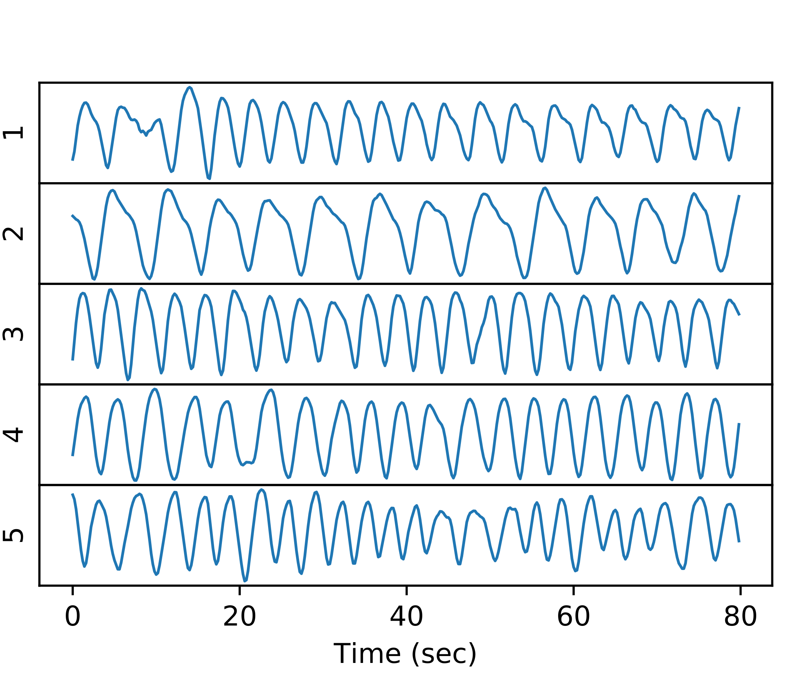
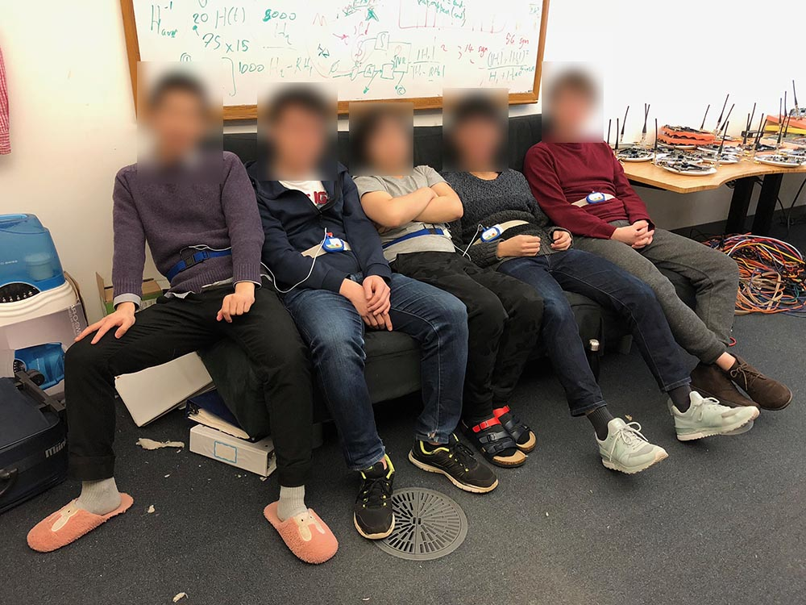
Notes:
[animate] Finally, our system is not constrained to only two people. Let me show you one final experiments: five people sitting in the same couch. This is the most crowded scenario we can create. [animate] And even in this scenario, our system is able to recover all five people’s breathing with very high quality, as shown on the right.

Slide 35
Related Work
Minimum separation > 1.5m [Adib 15’, Yang 16’, Hsu 17’]
Requires different breathing rates, and can only report breathing rates [Wang 16’ Zhang 18’ Wang 16’, Nandakumar 15’]
Requires manual input user location [Nandakumar 15’, Wang 16’]

Slide 36
Conclusion
The first system to recover breathing signals even zero-distance separated
A complete system that can provide full night breathing reconstruction
Reconstructed signal quality for each individual is comparable to a breathing belt
For more information, please visit http://breath.csail.mit.edu

