Slide 1
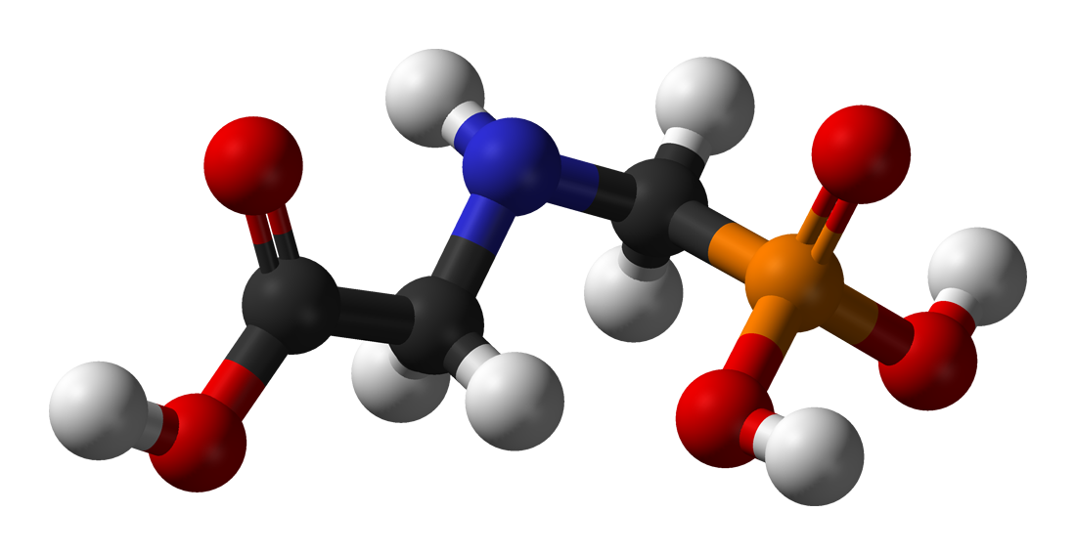
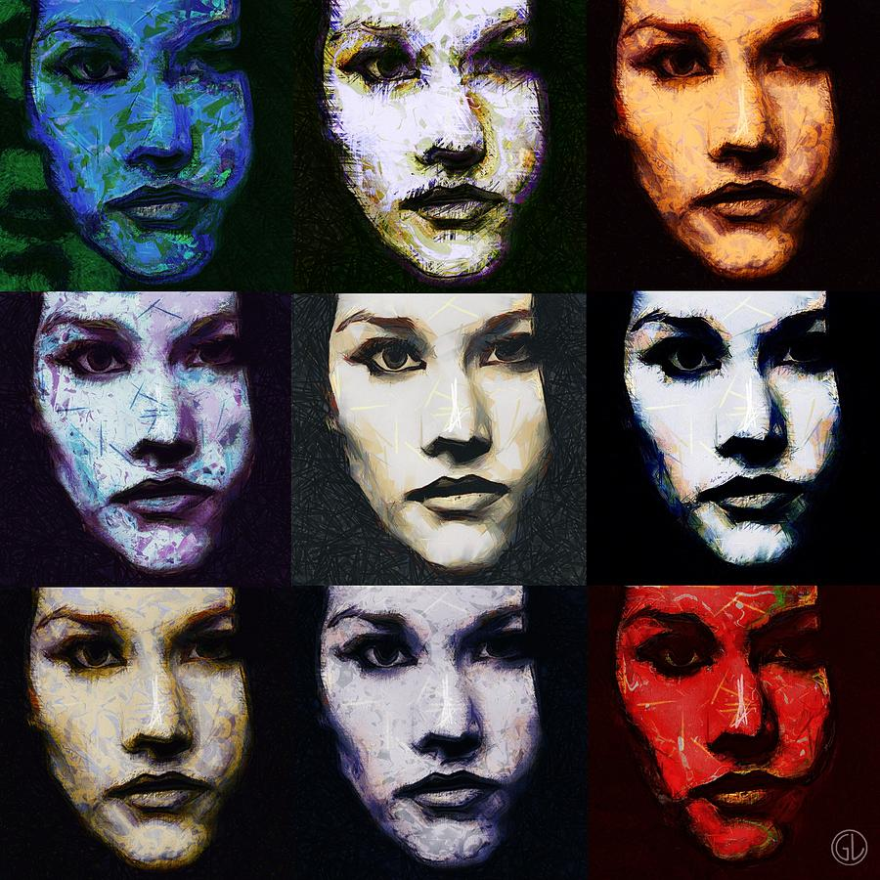
The Many Faces of Glyphosate
Stephanie Seneff
AutismOne
Thursday, May 21, 2015

Slide 2
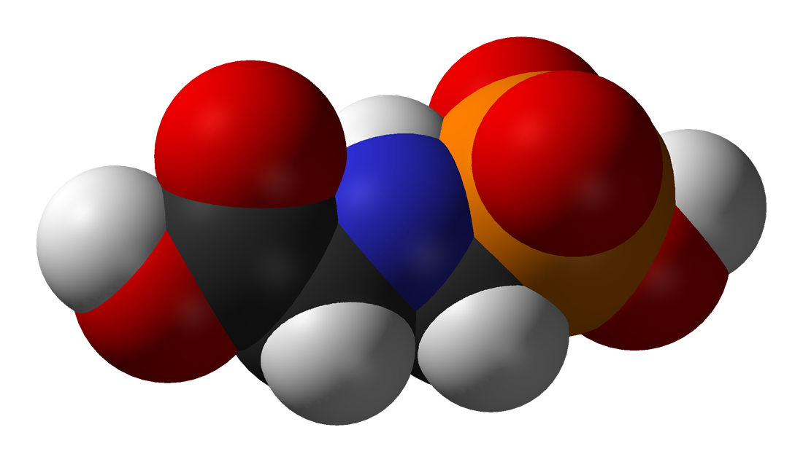
GLYPHOSATE

Slide 3
Outline
Introduction
Autism and Mitochondrial Impairment
Glyphosate and Folic Acid
Glyphosate and Vaccines
Impaired Thyroid Function
Low Manganese in Autism
Endocrine Disruption
Nancy Swanson's Paper

Slide 4
Introduction

Slide 5
US Health Status
US makes up 5% of the world’s population but consumes more than 50% of the world’s pharmaceutical drugs
We spend more on health care than Japan, France, China, UK, Italy, Canada, Brazil, Spain, and Australia, combined
US ranks last or near last among developed nations on infant mortality and life expectancy
We also suffer from more chronic illnesses
We consume 25% of the world supply of glyphosate

Slide 6
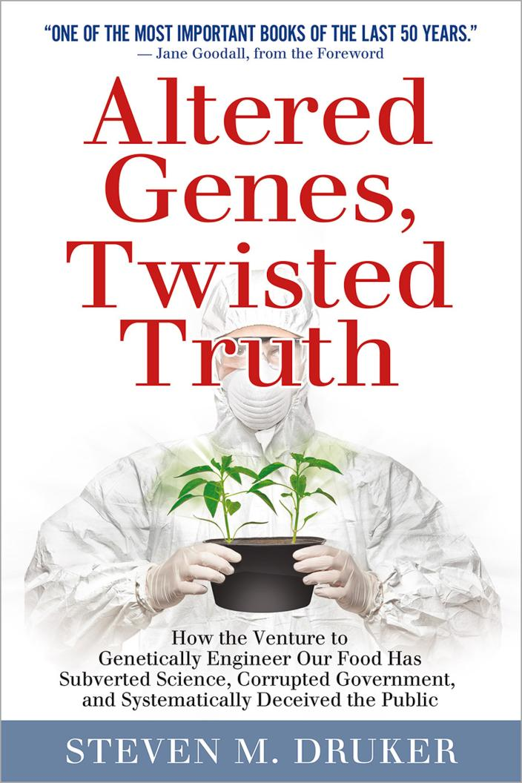
New Book!
Genetic engineering is recklessly subjecting our health and the health of the environment to unacceptable risks.
Not based on sound science, but rather on evasion of the standards of science.
For over 30 years, esteemed institutions have systematically contorted the truth to conceal the risks.

Slide 7
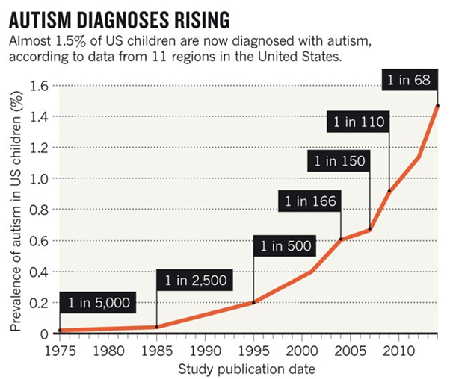
A Frightening Trend*
?
?
12 years
*K. Weintraub, Nature 479, Nov. 3 2011, 22-24.
Notes:
./NatureAutismRising.pdf

Slide 8
Percentage of children with Autism in the US
50%
2032

Slide 9
Percentage of children with Autism in the US
50%
Half the children born in 2032 will be diagnosed with autism
2032

Slide 10
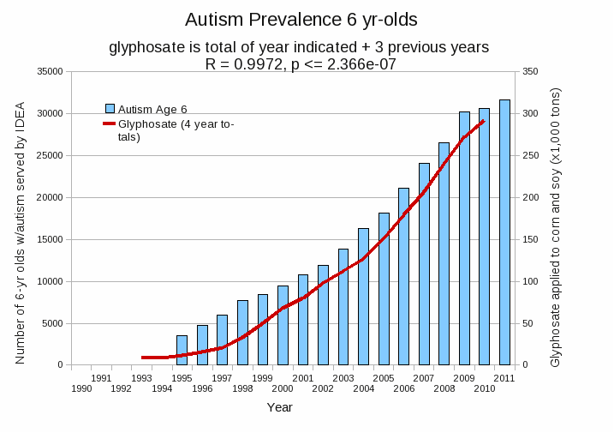
Autism Prevalence: 6 year olds
R = 0.9972
*Plot provided by Nancy Swanson, with permission
Data sources: autism: US Department of Education; Glyphosate: US Department of Agriculture
Notes:
Nancy/latest_plots/6-yr-old autism.gif
autism: USDE
oil consumption: USDA
glyphosate: USDA
GE crops: USDA
Mortality data: CDC

Slide 11
Main Toxic Effects of Glyphosate*
Kills beneficial gut bacteria and allows pathogens to overgrow
Interferes with function of cytochrome P450 (CYP) enzymes
Chelates important minerals (iron, cobalt, manganese, etc.)
Interferes with synthesis of aromatic amino acids and methionine
Leads to shortages in critical neurotransmitters
Disrupts sulfate synthesis and sulfate transport
*Samsel and Seneff, Entropy 2013, 15, 1416-1463

Slide 12
Nutrients, Hormones and Neurotransmitters Disrupted by Glyphosate
Folate, vitamin K, vitamin A, vitamin D, cobalamin
Aromatic amino acids, methionine
Iron, manganese, cobalt, selenium, zinc, sulfur
Serotonin, melatonin, dopamine, epinephrine
Melanin (skin tanning agent), thyroid hormone
NAD, glutathione (antioxidant defenses)

Slide 13
Balancing the Scales
manganese
iron
iron
manganese
Autism
ADHD
Alzheimer’s
Parkinson’s
Glyphosate disrupts the body’s ability to distribute the minerals safely: Everybody walks a tight rope between deficiency and toxicity

Slide 14
Autism and
Mitochondrial Impairment

Slide 15
Autism and Mitochondrial Impairment*
Mitochondrial impairment is a key feature of autism, especially in the brain
Impaired detox of glutamate by astrocytes (requires manganese)
Excess stimulation of NMDA receptors in neurons
Glyphosate excites NMDA receptors and prevents glutamate metabolism
*Dayan Goodenowe and Elodie Pastural , Chapter 4
.intechopen.com/books/autism-a-neurodevelopmental-journey-from-genes-to-behaviour/
the-biochemical-basis-of-autistic-behavior-and-pathology
Notes:
Samantha/autism_mitochondria_glutamate.pdf

Slide 16
Mitochondria are Key!
“Damage to mitochondria is now understood to play a role in the pathogenesis of a wide range of seemingly unrelated disorders such as schizophrenia, bipolar disease, dementia, Alzheimer's disease, epilepsy, migraine headaches, strokes, neuropathic pain, Parkinson's disease, ataxia, transient ischemic attack, cardiomyopathy, coronary artery disease, chronic fatigue syndrome, fibromyalgia, retinitis pigmentosa, diabetes, hepatitis C, and primary biliary cirrhosis.”*
*J Neustadt and SR Pieczenik, Molecular Nutrition and Food Research 2008;52:780-788
Notes:
./Duty\ to\ Warn\ Mitochondrial\ Disorders\ Drug\ and\ Vaccine-induced\ Collateral\ Damage\ from\ Big\ Pharma.doc .
./DrugsCauseMitochondrialDamage.PDF .

Slide 17
Mitochondria are Key!
“Damage to mitochondria is now understood to play a role in the pathogenesis of a wide range of seemingly unrelated disorders such as schizophrenia, bipolar disease, dementia, Alzheimer's disease, epilepsy, migraine headaches, strokes, neuropathic pain, Parkinson's disease, ataxia, transient ischemic attack, cardiomyopathy, coronary artery disease, chronic fatigue syndrome, fibromyalgia, retinitis pigmentosa, diabetes, hepatitis C, and primary biliary cirrhosis.”*
Many of these conditions are going up in prevalence in step with glyphosate usage on corn and soy crops
Glyphosate makes manganese unavailable to mitochondria, and they need manganese to protect them from oxidative damage
*J Neustadt and SR Pieczenik, Molecular Nutrition and Food Research 2008;52:780-788
Notes:
./Duty\ to\ Warn\ Mitochondrial\ Disorders\ Drug\ and\ Vaccine-induced\ Collateral\ Damage\ from\ Big\ Pharma.doc .
./DrugsCauseMitochondrialDamage.PDF .

Slide 18
Pesticides and Neuroinflammatory Response*
*Figure 1 , HR Dhaini, Encyclopedia of Neuroscience, Chapter 14,
Springer Berlin Heidelberg., D, Hirokawa N, Windhorst U, Ed. pp.2734-2739
Notes:
./pesticide_induced_neuroinflammation.pdf
In book: Encyclopedia of Neuroscience, Chapter: Part 14, Publisher: Springer Berlin Heidelberg., Editors: Binder MD, Hirokawa N, Windhorst U, pp.2734-2739

Slide 19
Mechanisms underlying the neurotoxicity induced by glyphosate*
“Taken together, these results demonstrated that Roundup® might lead to excessive extracellular glutamate levels and consequently to glutamate excitotoxicity and oxidative stress in rat hippocampus. “ - quote from abstract
*D Cattani et al., Toxicology 320 (2014) 34–45
Notes:
Glyphosate/
mechanisms_glyphosate_neurotoxicity_glutamate_rats_2014.pdf
./Vasquez_on_glyphosate_neurotoxicity_rats.text

Slide 20
Glyphosate and Folic Acid

Slide 21
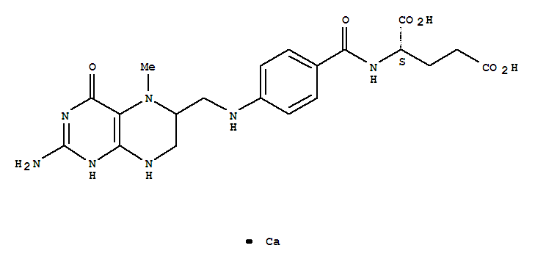
Glyphosate and Folic Acid
methyltetrahydrofolate
Folic acid is an oxidized, unmethylated synthetic form of folate
Converting it to methyl tetrahydrafolate is costly
Liver glutathione and NAD are oxidized (bad)
Methionine is depleted (bad)
Both NAD and folate are derived from the shikimate pathway
Brain folate receptor antibodies may be a consequence of folic acid in the blood

Slide 22
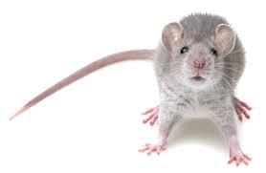
“High folic acid consumption leads to pseudo-MTHFR deficiency, altered lipid metabolism, and liver injury in mice”*
Fed mice excessive amounts of folic acid
Reduced methylation capacity in liver
CYP7A1 level was dramatically reduced. (rate limiting enzyme in bile acid synthesis)
Caused liver damage and fatty liver disease
*KE Christensen e tal., Am J Clin Nutr 2015;101:646–58.
Notes:
Csail/2015/SallyFallon/high_folic_acid_causes_pseudo_MTHFR_deficiency.pdf

Slide 23
Glyphosate and Vaccines

Slide 24
Glyphosate and Vaccines
MMR, Varicella, flu vaccine and rabies vaccine contain glutamate (a neurotoxin)
Glyphosate disrupts conversion of glutamate to glutamine (detox)
DTaP, HEP-B, Gardasil and others contain aluminum (a neurotoxin)
Glyphosate escorts aluminum to the pineal gland where it accumulates, causing sleep disorder and many associated neurological diseases

Slide 25
Impaired Thyroid Function

Slide 26
Impaired Thyroid Function
Low thyroid hormone in mother → 4-fold increased risk to autism in child*
Thyroid hormone is derived from tyrosine, a product of the shikimate pathway
Thyroid depends on selenium to protect it from oxidative damage (chelated by glyphosate)
*GC Román et al., Ann Neurol. 2013 Nov;74(5):733-42.
Notes:
Whence???
Samantha/low_thyroid_hormone_mom_autism.text

Slide 27
Low Manganese in Autism

Slide 28
Low Manganese in Teeth Linked to Autism*
Studied lead, mercury and manganese levels in tooth enamel of shed primary teeth in 84 children
Manganese accumulated after birth was down by 60% in autistic children
No other result was statistically significant
*MM Abdullah et al., J Autism Dev Disord. 2012 Jun;42(6):929-36.
Notes:
Samantha/heavy_metal_in_childrens_tooth_enamel_as_diagnostic_autism.pdf

Slide 29
Low Manganese in Teeth Linked to Autism*
Studied lead, mercury and manganese levels in tooth enamel of shed primary teeth in 84 children
Manganese accumulated after birth was down by 60% in autistic children
No other result was statistically significant
Other studies have shown low serum manganese and low manganese in urine samples in association with autism
*MM Abdullah et al., J Autism Dev Disord. 2012 Jun;42(6):929-36.
Notes:
Samantha/heavy_metal_in_childrens_tooth_enamel_as_diagnostic_autism.pdf

Slide 30
Endocrine Disruption

Slide 31
Glyphosate Disrupts Sex Hormone Synthesis in Adrenal Glands*
Glyphosate was cytotoxic to adrenal cells and interfered with synthesis of sex hormones
Roundup’s toxicity was two orders of magnitude higher than glyphosate acting alone
*F Young et al., Integrative Pharmacology, Toxicology and Genotoxicology 2015; 1(1): 12-19.
Notes:
Glyphosate/endocrine_disruption_cytotoxicity_glyphosate_2015.pdf

Slide 32
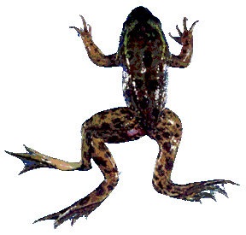
Glyphosate is an endocrine disruptor that promotes breast cancer*
Low and environmentally relevant concentrations of glyphosate possess estrogenic activity
Glyphosate caused human hormone-dependent breast cancer cells to proliferate at concentrations of parts per trillion
Additive effect from genistein, a phytoestrogen in soybeans
* S. Thongprakaisang et al., Food Chem Toxicol. 2013 Jun 8. S0278-6915(13)00363-3.
Notes:
./glyphosate_and_breast_cancer.text
Swine/glyphosate_breast_cancer.pdf
Please make a note that this study shows Glyphosate effects down to parts per trillion (10 to the minus12th).
In this study, we found that glyphosate at a log interval concentration ranging from 10-12 to 10-6 M increased the cell proliferation of a hormorne dependent breast cancer T47D ce

Slide 33
Nancy Swanson’s Paper

Slide 34
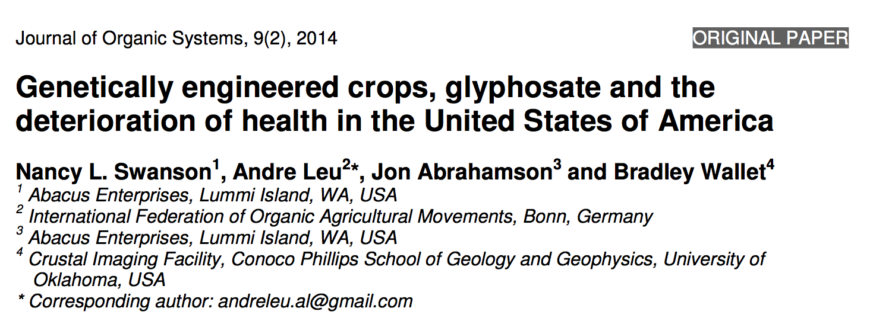
Paper Recently Published

Slide 35
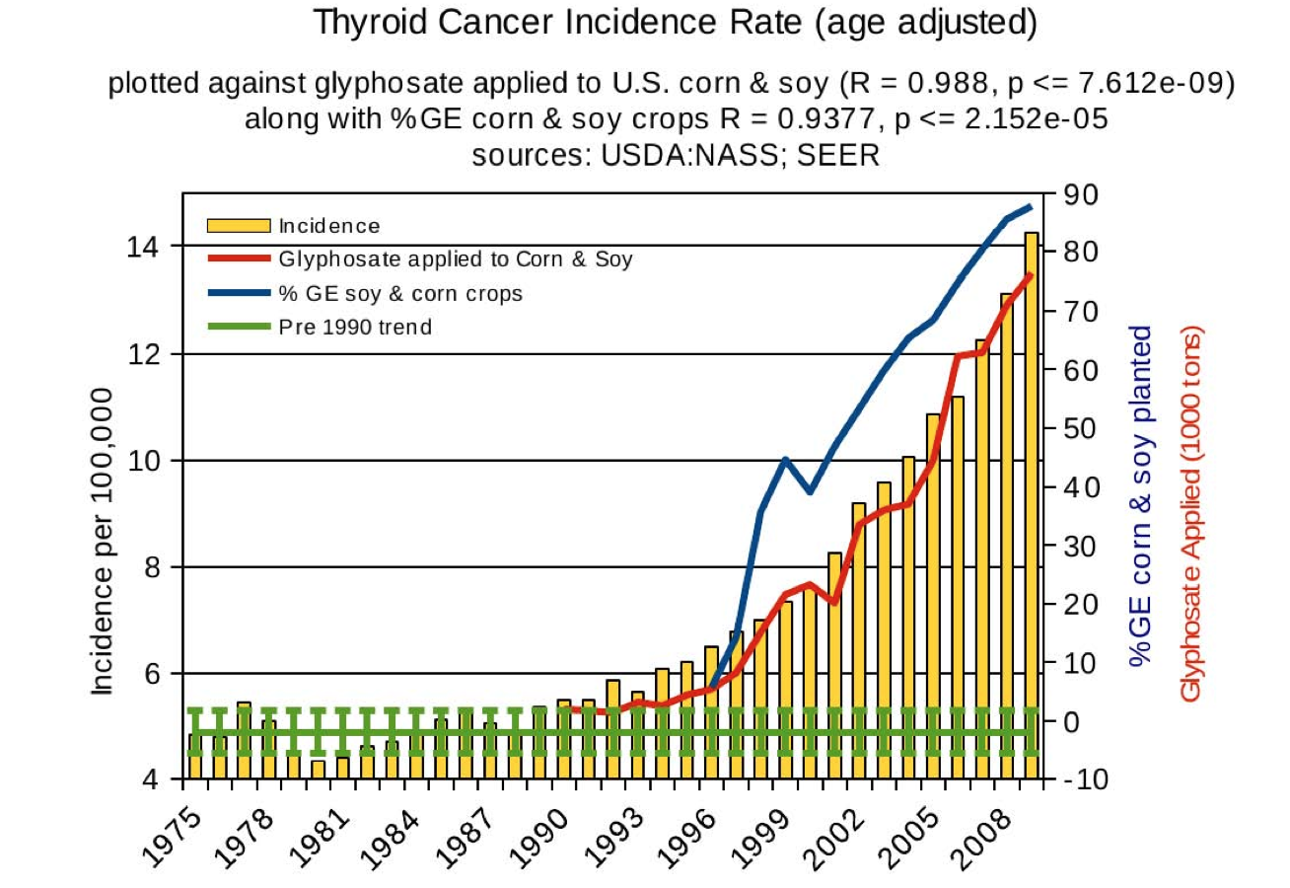
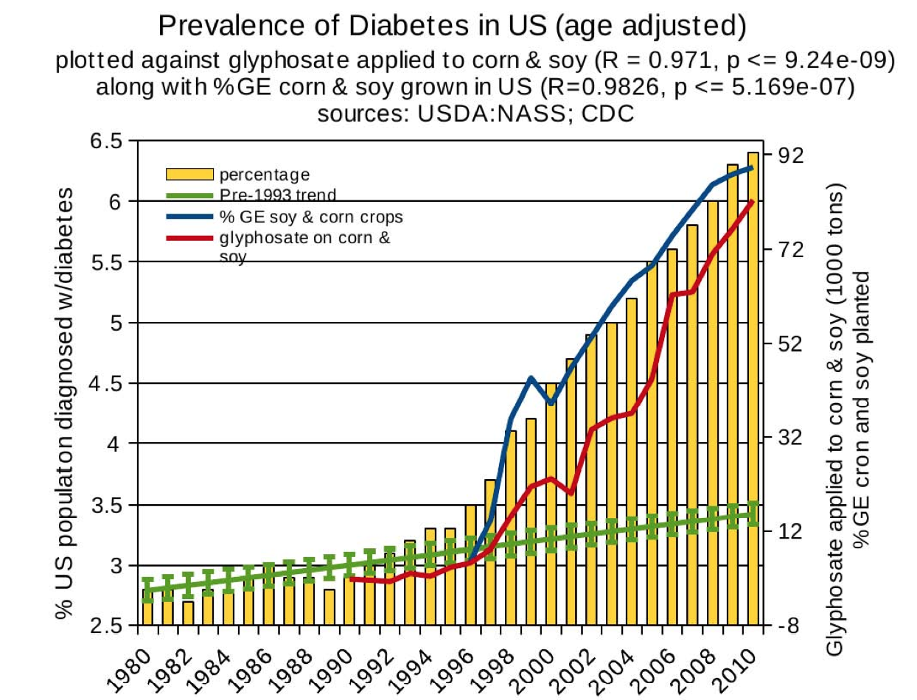
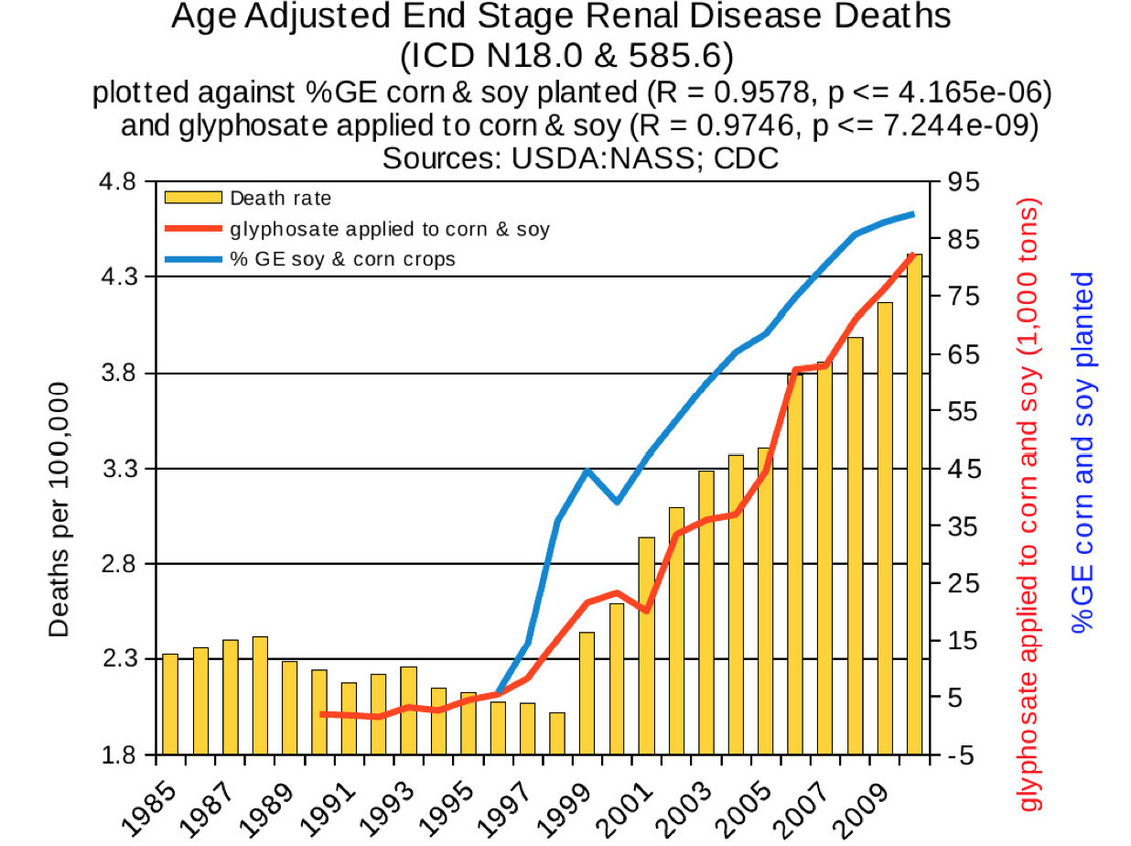
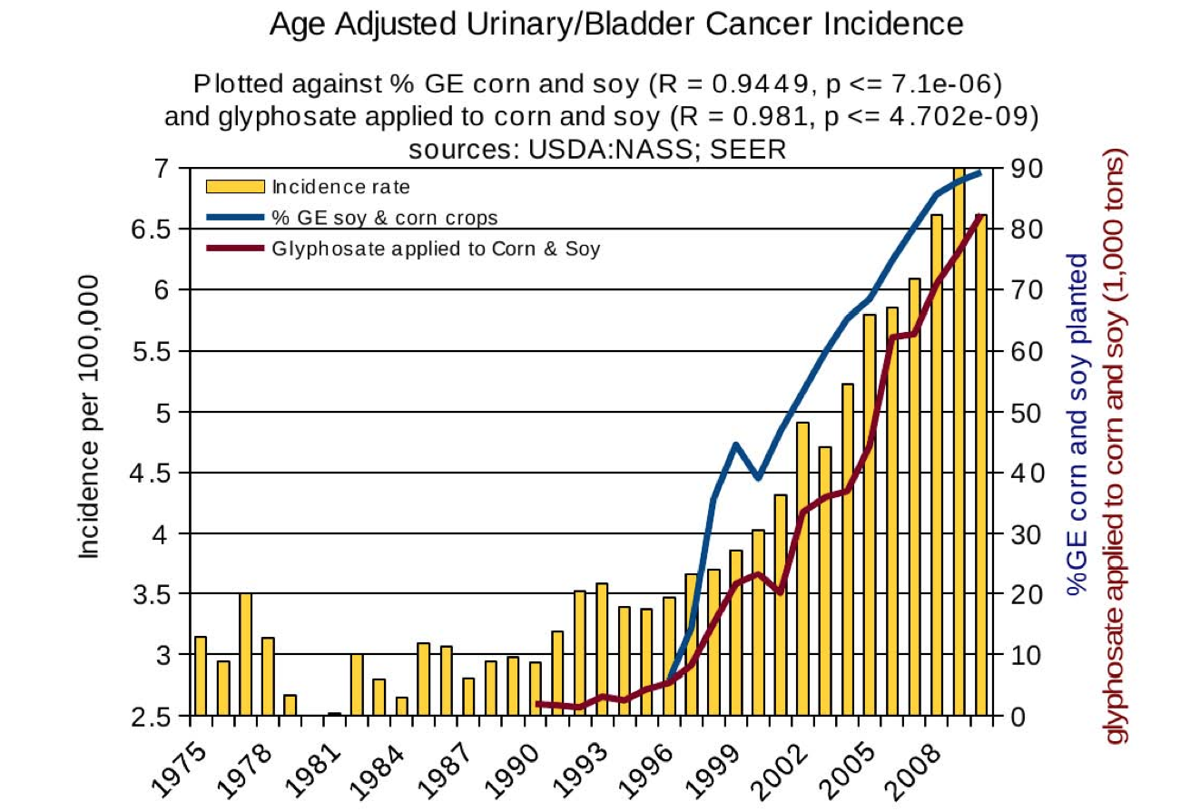
Thyroid cancer
Diabetes
End stage
renal disease
Urinary/bladder
cancer

Slide 36
Go Organic!

Slide 37
Summary
Glyphosate is a major contributor to the autism epidemic, as well as in the deterioration of health in America more generally
Key factor is disrupted glutamate metabolism due to manganese deficiency leading to neurotoxicity
The bioavailability of many essential vitamins, minerals, and neurotransmitters is disrupted by glyphosate
Glyphosate works synergistically with vaccines to cause harm

