Slide 1
Download these slides
people.csail.mit.edu/seneff/2015/WAPF_folate.pptx

Slide 2
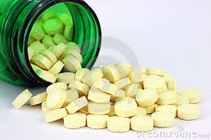
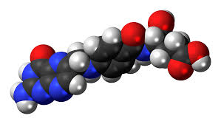
Folic Acid Supplementation: Why This is Not a Good Idea
Stephanie Seneff
WAPF
Sunday, Nov. 15, 2015

Slide 3
"I think we risk becoming the best-informed society that has ever died of ignorance."
Rubén Blades

Slide 4
“It is simply no longer possible to believe much of the clinical research that is published, or to rely on the judgment of trusted physicians or authoritative medical guidelines. I take no pleasure in this conclusion, which I reached slowly and reluctantly over my two decades as editor of the New England Journal of Medicine.”
Marcia Agnell.

Slide 5
1 in 45!

Slide 6
Outline
Glyphosate and Folic Acid
Folic Acid Biology
Evidence of Harm
Interaction with Minerals
What you can do!
Summary

Slide 7
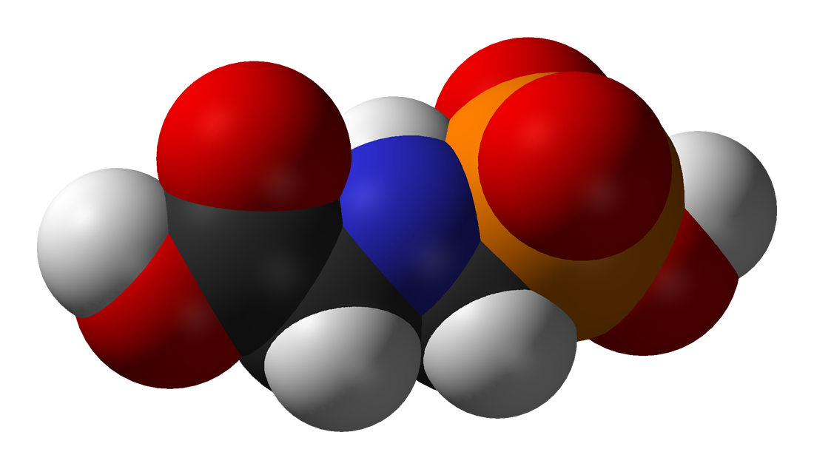
Glyphosate and Folic Acid

Slide 8
The Big Picture*
Synthetic folic acid is different from natural folate in important ways
Excess supplementation leads to high circulating doses in the blood
Alters the functions of hundreds of genes
One obvious effect is low birth weight → autism
Children with autism were more likely to have mothers taking folic acid supplements during pregnancy
Folic acid supplementation alone can lead to the dysregulation of over 1000 genes
*MC DeSoto and RT Hitlan, Journal of Pediatric Biochemistry 2 (2012) 251–261
Notes:
./synthetic_folic_acid_supplementation_linked_to_autism_2012.pdf
M. Catherine DeSoto∗ and Robert T. Hitlan

Slide 9
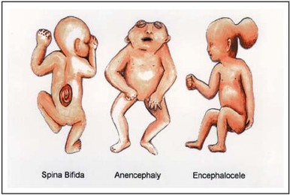
A Bit of History
Neural tube developmental defects like spina bifida and anencephaly (no brain) are due to a very rare but catastrophic developmental disorder linked to low folate during the first trimester of pregnancy
Excess retinoic acid expression during development causes neural tube developmental defects
The US first considered adding folic acid supplements to grains in 1996, and introduced the mandate in 1998
GMO “Roundup Ready” crops were just beginning to be introduced in 1996 and had obtained widespread adoption by 1998

Slide 10
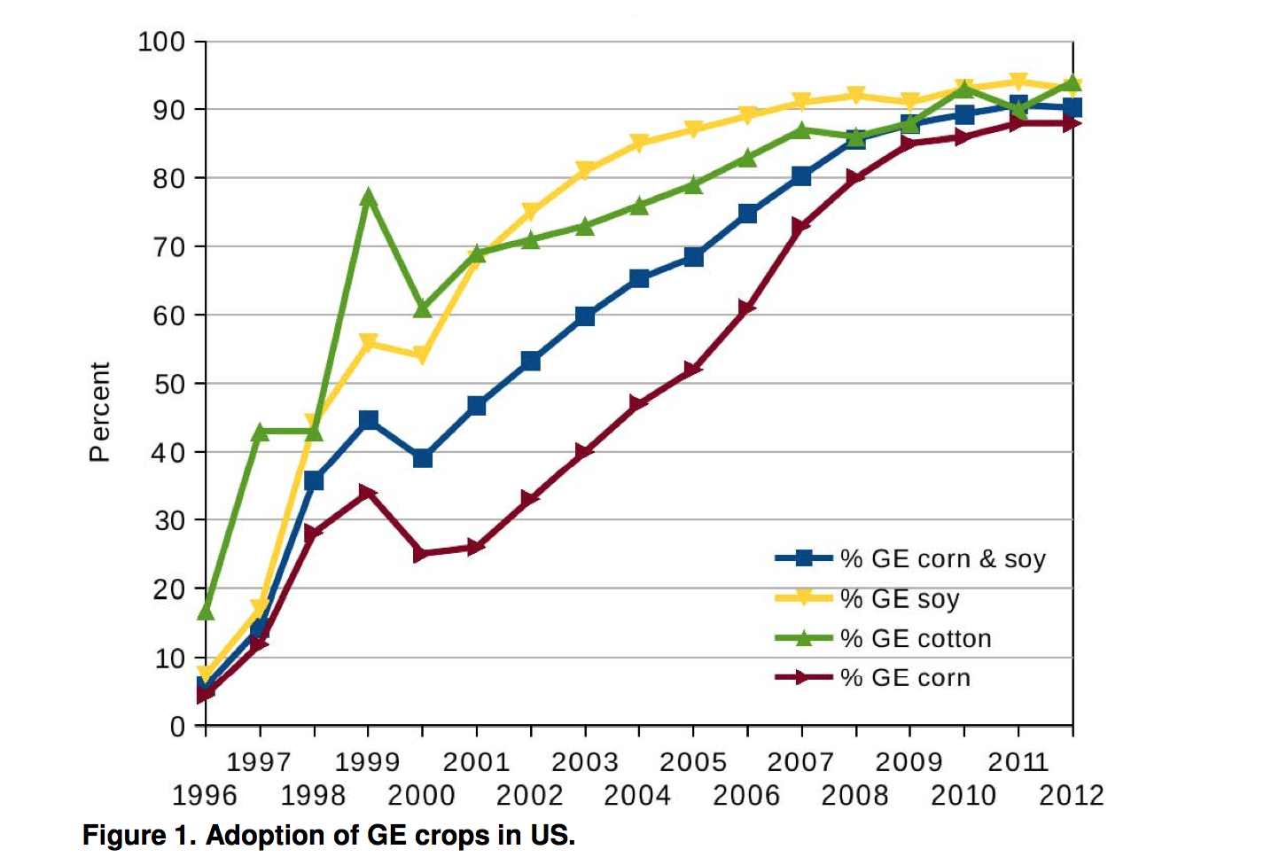
Adoption of “Roundup Ready” Crops*
* N. Swanson et al., Journal of Organic Systems 20145;9(2): 6-37.

Slide 11
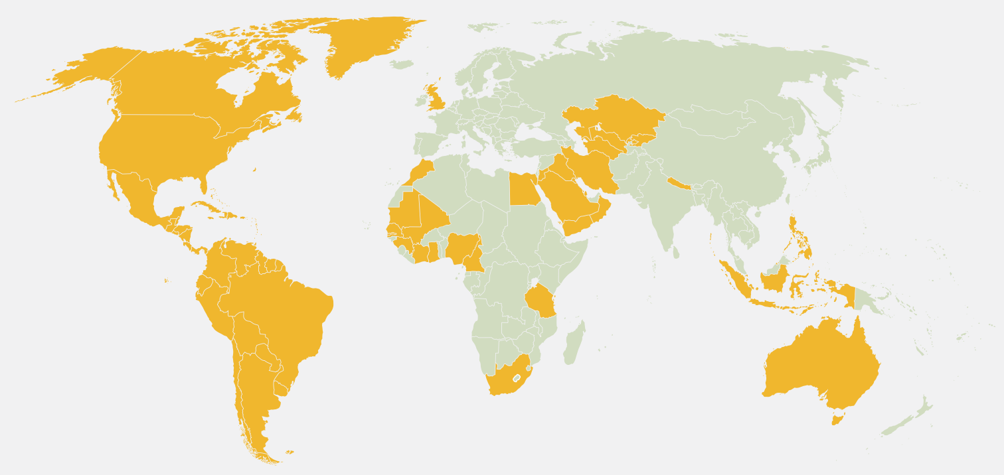
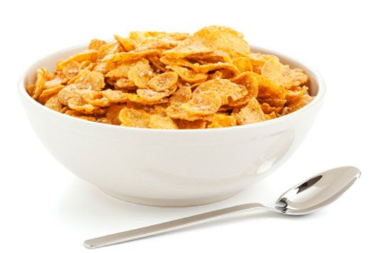
Folic Acid and/or Iron Fortification*
*B Handforth and S. Zimmerman,
Sight and Life 27 (1); 70-75, 2013
Notes:
Gerry/*/*Improving_Nutrition_in_Europe_–_Renowned_Experts_Highlight_Flour_Fortification_marked.pdf
./European_pressure_to_introduce_folate.pdf
Note: All countries in orange fortify flour with at least iron and folic acid except Australia which does not include iron, and Venezuela, the United Kingdom, and the Philippines which do not include folic acid.
Source:The Flour Fortification Initiative, 2012

Slide 12
Folic Acid and/or Iron Fortification*
Europe has steadfastly refused to adopt
policy of folic acid or iron supplementation!
*B Handforth and S. Zimmerman,
Sight and Life 27 (1); 70-75, 2013
Notes:
Gerry/*/*Improving_Nutrition_in_Europe_–_Renowned_Experts_Highlight_Flour_Fortification_marked.pdf
./European_pressure_to_introduce_folate.pdf
Note: All countries in orange fortify flour with at least iron and folic acid except Australia which does not include iron, and Venezuela, the United Kingdom, and the Philippines which do not include folic acid.
Source:The Flour Fortification Initiative, 2012

Slide 13
U.S. Regulation on Wheat*
TITLE 21--FOOD AND DRUGS; Subpart B: Requirements for Specific Standardized Cereal Flours and Related Products
Sec. 137.165 Enriched flour.
a) It contains in each pound 2.9 milligrams of thiamin, 1.8 milligrams of riboflavin, 24 milligrams of niacin, 0.7 milligrams of folic acid, and 20 milligrams of iron.
*http://www.accessdata.fda.gov/scripts/cdrh/cfdocs/cfcfr/CFRSearch.cfm?fr=137.165

Slide 14
Factors in Celiac Disease?
We have an epidemic in gluten intolerance and celiac disease today in the U.S.
Wheat products contain added folic acid and added iron
Wheat is often sprayed with glyphosate right before the harvest
Do these three factors work synergistically to contribute to celiac disease?

Slide 15
Glyphosate and Anencephaly*
Yakima, Benton and Franklin counties in Washington State have an unusually high number of pregnancies affected by anencephaly
75 pesticides were analyzed in studying contamination due to surrounding agriculture
47 (63%) of these were detected
Glyphosate was applied in large amounts, but was not studied
5% solution of glyphosate was also used heavily around irrigation ditches to control weeds
Main herbicide recommended due to its “low toxicity”
*Barbara H. Peterson. Farm Wars, http://farmwars.info/?p=11137

Slide 16
“Glyphosate, Brain Damaged Babies, and
Yakima Valley - A River Runs Through It”*
8
6
4
2
0
Noxious aquatic weed
control program with
Glyphosate ‘Rodeo’
1980 1990 2000 2010 2020
“Glyphosate, Three Rivers, and Anencephaly”
Yakima Harold Republic
Slide thanks to Prof. Don Huber, with permission
*Farm Wars 3/6/14
Notes:
From Don Huber:
Attached/LondonGlyphosate/
2014-0618_Huber_short.ppt

Slide 17
Glyphosate Upregulates Retinoic Acid*
CYP Enzyme Suppression
Small Brain
*A. Carrasco, Teratogenesis by glyphosate based herbicides and other pesticides. Relationship with the retinoic acid pathway. In Breckling, B. & Verhoeven, R. (2013) GM-Crop Cultivation – Ecological Effects on a Landscape Scale. Theorie in der Ökologie 17. Frankfurt, Peter Lang.

Slide 18
Gut Microbes Provide Folate to Host!*
“In conclusion, the findings from this study suggest that the quantity of microbially synthesized folate in the large intestine of human infants is sufficiently large to potentially affect the folate status of the host. The results of the analysis … suggest that a significant fraction of folate is in a form (monoglutamylated) that can be readily absorbed. “
*TH Kim et al., J Nutr. 2004 Jun;134(6):1389-94.
Notes:
./large_pool_available_folate_from_gut_microbes_humans_and_pigs_2004.pdf
./folate_from_gut_microbes_1991_J_Nutr.pdf

Slide 19
Gut Microbes Produce Bioavailable Folate*
Strains of lactobacillus and bifidobacteria were shown to synthesize folate
Both of these are especially susceptible to glyphosate toxicity
"Rats fed a probiotic formulation of folate-producing bifidobacteria exhibited increased plasma folate level, confirming that the vitamin is produced in vivo and absorbed"
*M Rossi et al., Nutrients 2011, 3, 118-134
Notes:
./folate_production_by_gut_microbes_2011.pdf

Slide 20
Gut Microbes Produce Bioavailable Folate*
Strains of lactobacillus and bifidobacteria were shown to synthesize folate
Both of these are especially susceptible to glyphosate toxicity
"Rats fed a probiotic formulation of folate-producing bifidobacteria exhibited increased plasma folate level, confirming that the vitamin is produced in vivo and absorbed"
Glyphosate disrupts the shikimate pathway in gut microbes.
Folate, produced by gut microbes, depends on the shikimate pathway
*M Rossi et al., Nutrients 2011, 3, 118-134
Notes:
./folate_production_by_gut_microbes_2011.pdf

Slide 21
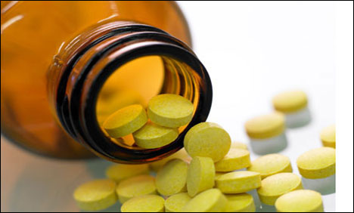
US Aggressive Campaign: A Down Side to Folic Acid?
In addition to fortification, US FDA recommends folic acid (FA) supplements for women of childbearing age
However, excessive FA supplementation has been linked with increased incidences of asthma* and autism** among children.
*MB Bekkers et al. Eur Respir J 2012;39(6):1468–1474.
**CM Beard et al, Med Hypotheses 2011;77(1):15–17.
Notes:
2015/AutismOne/a\ on\ gaba\ receptor\ upregulates\ genes-\ autism.pdf
Bekkers MB, Elstgeest LE, Scholtens S, Haveman-Nies A, de Jongste JC, Kerkhof M, Koppelman GH, Gehring U, Smit HA, Wijga AH (2012) Maternal use of folic acid supplements during pregnancy, and childhood respiratory health and atopy. Eur Respir J 39(6):1468–1474
Beard CM, Panser LA, Katusic SK (2011) Is excess folic acid supplementation a risk factor for autism? Med Hypotheses 77(1):15–17

Slide 22
Inverse Correlation Between Neural Tube Defects and Autism Trends*
Proposed mechanism involves increased GABA receptor activity (neuronal inhibition)
GABA increase has been linked to autism**
*Figure 4, K. Vasquez et al., Adv Exp Med Biol. 2013;775:101-9.
**SH Fatemi et al., J Autism Dev Disord 2010;40(6):743–750.
Notes:
Fig. 8.4 Depicts the trend of neural tube defect decreasing, at the same time the prevalence of autism was increasing
2015/AutismOne/fa\ on\ gaba\ receptor\ upregulates\ genes-\ autism.pdf
From Sylvia

Slide 23
How much folic acid is too much?*
For children < 8 years old -- tolerable upper limit set at 300-400 mcg.
One cup of breakfast cereal has 400 mcg
> 10% of pregnant women are taking > 1000 mcg/day folic acid supplements on top of dietary folic acid fortification
Natural folate found in food sources has never been a problem
*NIH Dietary Supplement Fact Sheet: Folate
http://ods.od.nih.gov/factsheets/folate
Notes:
./synthetic_folic_acid_supplementation_linked_to_autism_2012.pdf
p. 3
Reference 23

Slide 24
“Folate, vitamin B12 and homocysteine in relation to birth defects and pregnancy outcome”*
"However, intervention with folic acid alone may not only be inefficient, but may even cause harm to women living in regions where vitamin B12 deficiency is endemic. The scientists, clinicians and policy-makers in different countries should carefully investigate and evaluate the relevance of the present guidelines in their own populations."
* H Refsum, British Journal of Nutrition (2001), 85, Suppl. 2, S109±S113.
Notes:
JudyHoy/folate_B12_homocysteine_birth_defects.pdf
Particularly w/ B12 deficiency in India w/ vegetarian diet.

Slide 25
Folic Acid Biology

Slide 26
“Folic acid fortification: the good, the bad, and the puzzle of vitamin B-12”*
Low B-12 (cobalamin) / High folic acid →
5-fold increased risk to anemia
5-fold increased risk to cognitive impairment
4% of elderly tested met this criterion
~1.8 million elderly might be at increased risk of cognitive impairment and anemia because of an imbalance between folate and vitamin B-12.
* A David Smith, Am J Clin Nutr 2007;85:3-5.
Notes:
WAPF/folic_acid_good_bad_puzzling.pdf

Slide 27
“Folic acid fortification: the good, the bad, and the puzzle of vitamin B-12”*
Low B-12 (cobalamin) / High folic acid →
5-fold increased risk to anemia
5-fold increased risk to cognitive impairment
4% of elderly tested met this criterion
~1.8 million elderly might be at increased risk of cognitive impairment and anemia because of an imbalance between folate and vitamin B-12.
"Is it ethical to save one infant from developing a neural tube defect but increase the risk of poorer health in ~1000 elderly persons?”
* A David Smith, Am J Clin Nutr 2007;85:3-5.
Notes:
WAPF/folic_acid_good_bad_puzzling.pdf

Slide 28
What’s the difference between folic acid and folate???
Folate is the form of the B vitamin that is found in nature: you can never overdose on it
Folate is typically methylated
Folic acid is a synthetic molecule, and it’s stable
Folic acid is missing four hydrogen ions – THIS IS VERY IMPORTANT!!!
Folic acid is oxidized, and
to convert it to folate is costly for the body

Slide 29
Folic Acid is Complex
Folic acid is a synthetic, oxidized form of folate
It induces oxidative stress in the liver
This can lead to folic acid build-up (unnatural) in the blood
This interferes with nitric oxide release which is important for promoting blood flow
Folic acid in the blood may also cause the antibodies to folate receptors in the brain associated with cerebral folate deficiency

Slide 30
Crucial Difference between Folic Acid and Folate*
“Unlike natural folates, which are metabolized to THF in the mucosa of the small intestine, folic acid undergoes initial reduction and methylation in the liver, where conversion to the THF form requires dihydrofolate reductase. The low activity of this enzyme in the human liver, combined with a high intake of folic acid, may result in unnatural levels of unmetabolized folic acid entering the systemic circulation.”
*http://chriskresser.com/folate-vs-folic-acid
Notes:
http://chriskresser.com/folate-vs-folic-acid

Slide 31
In the Liver….*
Dihydrofolate reductase reduces dihydrofolic acid (DHF) to tetrahydrofolic acid (THF) using NADPH as electron donor
DHF
THF
2NADPH
2NADP+
OXIDIZED!!!
*http://en.wikipedia.org/wiki/Dihydrofolate_reductase

Slide 32
eNOS needs NADPH, NOT NADP+!!
L-arginine + H⁺ + 2 O₂ + 3/2 NADPH
citrulline + nitric oxide + 3/2 NADP⁺
Relaxes blood vessels; promotes flow

Slide 33
Consequences
Liver ends up with NADP+ rather than NADPH
Methyl groups get depleted in the liver
eNOS is unable to synthesize adequate nitric oxide → constricted blood vessels; poor oxygen supply
Unmetabolized folic acid ends up in the blood and can bind to receptors in the brain, messing up brain folate homeostasis (more later)

Slide 34
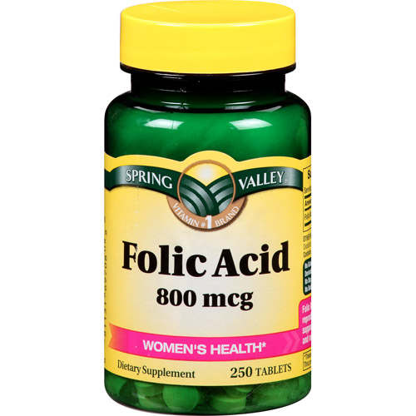
A Problem with Folic Acid
Excess folic acid drives biopterin towards the
oxidized form, which is not good!
REDUCED
HHHH
HHHH
BH4
Tetrahydrobiopterin
Tetrahydrofolate
Tetrahydrobiopterin
+HH
-HH
Dihydrofolate
Dihydrobiopterin
Dihydrofolate
HH
HH
OXIDIZED

Slide 35
A Problem with Folic Acid
Low BH4 in the cerebrospinal fluid is linked to autism*
REDUCED
HHHH
HHHH
BH4
Tetrahydrobiopterin
Tetrahydrofolate
Tetrahydrobiopterin
+HH
-HH
Dihydrofolate
Dihydrobiopterin
Dihydrofolate
HH
HH
OXIDIZED
*RE Frye et al., Neurotherapeutics. 2010 July ; 7(3): 241–249.
Notes:
Samantha/BH4_treatment_for_autism_2010.pdf

Slide 36
A Problem with Folic Acid
BH4 is essential for nitric oxide release, which promotes blood flow
REDUCED
HHHH
HHHH
BH4
Tetrahydrobiopterin
Tetrahydrofolate
Tetrahydrobiopterin
+HH
-HH
Dihydrofolate
Dihydrobiopterin
Dihydrofolate
HH
HH
OXIDIZED
*RE Frye et al., Neurotherapeutics. 2010 July ; 7(3): 241–249.
Notes:
Samantha/BH4_treatment_for_autism_2010.pdf

Slide 37
eNOS Requires BH4 to Synthesize Nitric Oxide*
BH4 catalyzes the reaction that produces nitric oxide by breaking down L-arginine
When BH4 is depleted, eNOS produces superoxide (O₂⁻) instead
Superoxide causes oxidative damage and is a major source of reactive oxygen
BUT: it is needed to synthesize sulfate!!!
*T Scott-Burden, Circulation 1995; 91: 248-250.
Notes:
./folate_and_nitrate_inducedendothelial_dysfunction_nitrate_tolerance.pdf

Slide 38
Simplified Methyl Cycle
MTHFR gene variants linked to autism*
Protein and DNA methylation
Depends on NADPH
Inhibited by phosphorylation
Inhibited by dihydrofolate
Methionine
THF
MTHFR
B12
MTHF
superoxide
Homocysteine
Sulfate
Cysteine
Glutathione
*M Boris et al., Journal of American Physicians and Surgeons 2004;9(4): 106-108.
Notes:
methylenetetrahydrofolate reductase gene (MTHFR),

Slide 39
Too Many Vitamins!
*Figure 2, S-S Zhou et al., Autism Research and Treatment 2013, Article ID 963697
Notes:
./vitamins_deplete_methionine_through_conjugation.pdf

Slide 40
Generating Methionine from Homocysteine
Folate trap: One or more of these requirements are missing; Methyl group stays stuck on folate (inactive)
There is a belief that elevated serum homocysteine is bad, but the homocysteine is desperately needed to produce sulfate
Methionine
Methionine synthase
Homocysteine
Methionine
Homocysteine
Requirements:
Working MTHFR enzyme
Cobalamin (vitamin B12)
Zinc
Vitamin B6
Methyl tetrahydrofolate

Slide 41
Transsulfuration Pathway*
*Figure 1, DA Geier et al., Neurochem Res (2009) 34:386–393.
Notes:
WAPF/transsulfuration_biomarkers_autism_2009.pdf

Slide 42
Transsulfuration Pathway*
Three very important molecules!!!
*Figure 1, DA Geier et al., Neurochem Res (2009) 34:386–393.
Notes:
WAPF/transsulfuration_biomarkers_autism_2009.pdf

Slide 43
Recapitulation
The timing of mandatory folic acid enrichment is uncanny: hide pending epidemic in spina bifida?
Folic acid is synthetic, and it leads to excessive oxidation in the liver and/or depleted BH₄
Folate trap leads to redirection of homocysteine towards sulfate to detox xenobiotics
An excess of unmetabolized folic acid paradoxically leads to cerebral folate deficiency
More generally, too many vitamins (and drugs!) can deplete the supply of sulfur-containing metabolites

Slide 44
Evidence of Harm

Slide 45
Early Infant Exposure to Excess Multivitamin: A Risk Factor for Autism?*
High multivitamin feeding is very common in early infancy
Excess vitamins may cause neurotoxicity and disturb monoamine-neurotransmitter metabolism by depleting the body’s methyl-groups and sulfate pools
Autism is often associated with abnormal levels of monoamine neurotransmitters
*S-S Zhou et al., Autism Research and Treatment Volume 2013, Article ID 963697
Notes:
./vitamins_deplete_methionine_through_conjugation.pdf
dopamine, noradrenaline, adrenaline and serotonin,

Slide 46
“High folic acid consumption leads to pseudo-MTHFR deficiency, altered lipid metabolism, and liver injury in mice”*
Fed mice excessive amounts of folic acid
Reduced methylation capacity in liver
CYP7A1 level was dramatically reduced. (rate limiting enzyme in bile acid synthesis)
Caused liver damage and fatty liver disease
Works synergistically with glyphosate to disrupt bile flow
*KE Christensen e tal., Am J Clin Nutr 2015;101:646–58.
Notes:
Csail/2015/SallyFallon/high_folic_acid_causes_pseudo_MTHFR_deficiency.pdf

Slide 47
Folic Acid Supplements in Late Pregnancy increase Risk to Asthma in Children *
Prospective cohort of Australian families
Folic acid supplements in late pregnancy increases risk of asthma in children at 3.5 and 5.5 years
Supports possible role of folate-impaired methylation in altering fetal immune phenotype towards Th2
*MJ Whitrow et al., American Journal of Epidemiology 2009;170:1486–1493
Notes:
Csail/2015/SallyFallon/asthma_linked_to_folic_acid_supplements.pdf
support to the idea that a Th2 predominant immune response may play a role in autism pathogenesis.

Slide 48
Folic Acid and Autism Risk*
Effects of ubiquitous synthetic supplementation of vitamins is unpredictable
Blanket approach may harm those with specific gene variants
Folic acid supplementation during gestation is associated with an increased risk for autism.
Unexpected increases in asthma and breathing problems associated with folic acid use
Excess methylation during gestation leads to epigenetic changes?
Folic acid supplements during gestation linked to premature birth and low birth weight
*MC DeSoto and RT Hitlan, Journal of Pediatric Biochemistry 2 (2012) 251–261
Notes:
synthetic_folic_acid_supplementation_linked_to_autism_2012.pdf

Slide 49
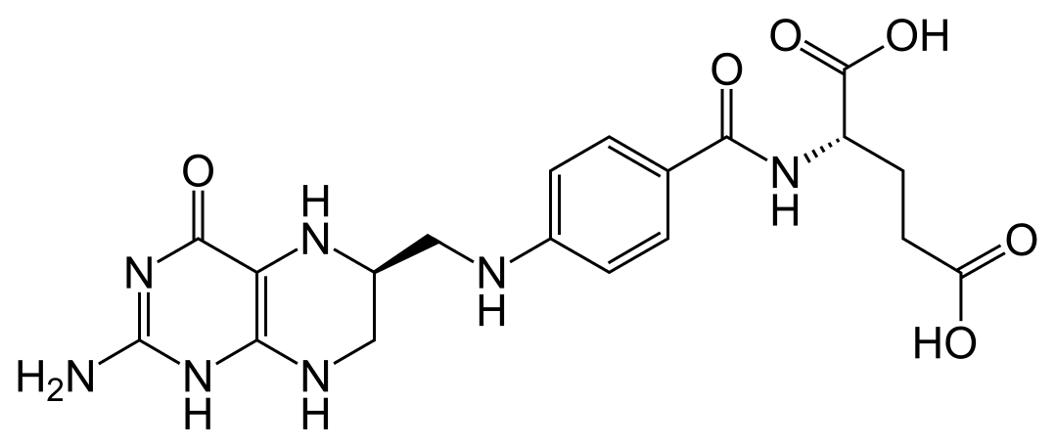
“Cerebral folate deficiency with developmental delay, autism, and response to folinic acid”*
Folinic acid is a form of TETRAHYDRO-folate
* P Moretti et al., Neurology March 22, 2005 vol. 64 no. 6 1088-1090

Slide 50
“Cerebral folate deficiency with developmental delay, autism, and response to folinic acid”*
Folinic acid is a form of TETRAHYDRO-folate
Folate receptor antibodies due to
excess folic acid in the blood???
* P Moretti et al., Neurology March 22, 2005 vol. 64 no. 6 1088-1090

Slide 51
Folic Acid Worsens Cerebral Folate Deficiency*
Cerebral folate deficiency is a condition where cerebral spinal fluid concentrations of 5-methyl-tetrahydrofolate (5MTHF) are anomalously low despite adequate levels in the blood
Symptoms appear beginning at 4 months of age
Irritability and sleep disturbances →
Slowed head growth, visual disturbances, hearing loss
Treatment is oral administering of folinic acid.
Folic acid supplements worsen the condition
* Hyland et al., J Inherit Metab Dis. 2010 Oct;33(5):563-70.
Notes:
SallyFallon/cerebral_folate_deficiency_folic_acid_bad.text

Slide 52
“Cerebral Folate Deficiency in Autism Spectrum Disorders”*
Folinic acid has an excellent safety record and has been shown to normalize cerebrospinal levels of 5MTHF in children with autism.
“As folic acid (the inactive, oxidized form of folate) can compete for the binding site on FR1, it is probably wise to discontinue the use of folic acid-containing supplements.”
*R Frye and D. Rossignol. Autism Science Digest Issue 2: 9-15.
Notes:
./Frye_cerebral_folate_deficiency.pdf

Slide 53
Folic Acid Increases Cancer Risk?*
6261 Patients in Norway with ischemic heart disease
(no folic acid fortification in flour)
Treatment with 0.8 mg/d of folic acid from 1998 to 2005
Results:
Serum folate increased six-fold in treatment group
10% of treatment group and only 8.4% of controls developed cancer
4% of treatment group died from cancer, and only 2.9% of controls.
16.1% of treatment group died of any cause and only 13.8% of controls.
Hypothesis: folic acid enhances DNA replication and neoplastic growth
*M Ebbing et al., JAMA 2009 302(19) 2119-2126
Notes:
Mostly lung cancer
./cancer_folic_acid_B12.text

Slide 54
Increased cancer cell proliferation in prostate cancer patients with high levels of serum folate *
Folic acid supplementation is associated with increased risk to prostate cancer
40% of patients were taking folic acid supplements
Serum levels in top quartile were 6-fold above adequate levels
Nearly half of them did not take supplements
Serum folate levels correlate with tumor folate levels and with tumor growth
* JJ Tomaszewski et al., Prostate. 2011; 71(12): 1287–1293.
Notes:
./prostate_cancer_linked_to_excess_folic_acid.pdf

Slide 55
Prospective Danish Cohort Study*
"supplemental folic acid was associated with a significantly increased mortality, whereas no other micronutrient supplement was associated with mortality."
55,453 middle-aged Danes
Others have found increased risk to colorectal adenomas, prostate cancer, lung cancer, and mortality.
* N Roswall et al, Nutrition Research 2012; 56:5466.
Notes:
Folate_notes.text
./micronutrients_folic_acid_Denmark_mortality.pdf

Slide 56
Folic Acid and Colon Cancer in Chile*
Mandatory folic acid supplementation introduced in 2000
Colon cancer
Breast cancer
*S Hirsch et al., Eur J Gastroenterol Hepatol. 2009;21(4):436-9.
Notes:
WAPF/Colon\ cancer\ in\ Chile\ before\ and\ after\ the\ start\ of\ the\ flour\ fortification\ program\ with\ folic\ acid.pdf .

Slide 57
Folic Acid Supplement Trial in Africa: Failed!*
Trial conducted in Pemba, Zanzibar
Cumulative hazard probability
15% more deaths in the treatment groups
Time since enrollment (days)
*S Sazawal et al., The Lancet Jan 14, 2006; 367:133-143.
Notes:
./folic_acid_supplment_study_Africa_Failed.pdf

Slide 58
Interaction with Minerals

Slide 59
Folic Acid and Zinc*
Folic acid forms insoluble chelate with zinc in the gut and prevents absorption
“The findings from this study raise questions about the significance of self-medication with folic acid and the inclusion of folic acid in prenatal vitamin preparations for zinc nutriture.”
*DB Milne et al., The American Journal of Clinical Nutrition 39: 1984, 535-539.
Notes:
./folic_acid_suppresses_zinc_absorption_1984.pdf

Slide 60
“Iron-Fortified vs Low-Iron Infant Formula” *
Children who received 12.7 mg/L of iron-fortified formula as infants had lower cognitive and visual-motor scores at 10 years than those receiving low-iron formula
“Iron is an essential nutrient of which both too little and too much are problematic. If unneeded iron were absorbed, the brain might be vulnerable to adverse effects of excess iron.”
*B Lozoff et al. Arch Pedatr Addlesc Med 166(3), 208-215, 2012.
Notes:
./12_2012_Iron-Fortified\ vs\ Low-Iron\ Infant\ Formula_Lozoff_marked.pdf

Slide 61
This Detoxification Scheme is Essential in Red Blood Cells
Inhibited by glyphosate
Product of shikimate pathway
Depleted by glyphosate
Depends on selenium

Slide 62
This Detoxification Scheme is Essential in Red Blood Cells
Inhibited by glyphosate
Product of shikimate pathway
G6PD Deficiency Leads to Hemolysis and Anemia
Depleted by glyphosate
Depends on selenium

Slide 63
This Detoxification Scheme is Essential in Red Blood Cells
Inhibited by glyphosate
Product of shikimate pathway
Free iron released from damaged RBC’s
oxidizes artery wall
Depleted by glyphosate
Depends on selenium

Slide 64
Iron in the US Food Supply: per capita per day, 1909-2000*
*Source: Figure 41, USDA Nutrient Content of the U.S. Food Supply, 1909-2000
Notes:
./FoodSupply1909-2000.pdf p. 45

Slide 65
Sources of Iron in the US Food Supply*
*Source: Figure 42, USDA Nutrient Content of the U.S. Food Supply, 1909-2000
Notes:
/FoodSupply1909-2000.pdf p. 47

Slide 66
A Role for Copper Deficiency*
Copper catalyzes methionine synthase → elevated homocysteine with copper deficiency
Copper catalyzes superoxide dismutase, an antioxidant
PON-1, another antioxidant, breaks down homocysteine: it depends on copper too!
Homocysteine thiolactone suppresses lysyl oxidase, an enzyme that maintains healthy artery walls
Result: arterial damage and heart disease!
*LM Klevay, Cellular and Molecular Biology 2006;52(5):11-15.
Notes:
heart/homocysteine_copper_folate_heart_disease_links.pdf

Slide 67
Glyphosate Binding to Metals*
Bound →
COPPER!!
Unbound →
Plot provided by Frank Dean, personal communication
Notes:
Glyphosate/Gly\ chelation,Lundgar-78.pdf

Slide 68
Glyphosate Binding to Metals*
Bound →
Glyphosate chelates copper making it unavailable
COPPER!!
Unbound →
Plot provided by Frank Dean, personal communication
Notes:
Glyphosate/Gly\ chelation,Lundgar-78.pdf

Slide 69
Recapitulation: Effects of Glyphosate
Glyphosate preferentially kills microbes in the gut that synthesize folate
Folate synthesis requires the pathway that glyphosate disrupts
Glyphosate damages red blood cells, causing release of free iron, which is toxic, while also causing anemia
Glyphosate chelates copper making it unavailable
Glyphosate induces excess retinoic acid leading to neural tube defects
Glyphosate causes oxidative damage in the liver, working synergistically with supplemental folic acid
Depletes the supply of NADPH and glutathione

Slide 70
“Neurobehavioural effects of developmental toxicity”*
“Our very great concern is that children worldwide are being exposed to unrecognised toxic chemicals that are silently eroding intelligence, disrupting behaviours, truncating future achievements, and damaging societies, perhaps most seriously in developing countries.
A new framework of action is needed.”*
*P Grandjean and PJ Landrigan. The Lancet March 2014; 13: 330-338
Notes:
Samantha/Neurobehavioral_effects_of_developmental_toxicity.pdf
p. 336.

Slide 71
What You Can Do

Slide 72
Eat Organic Whole Foods

Slide 73
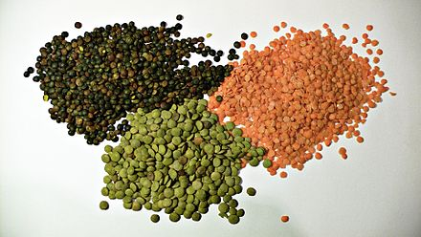
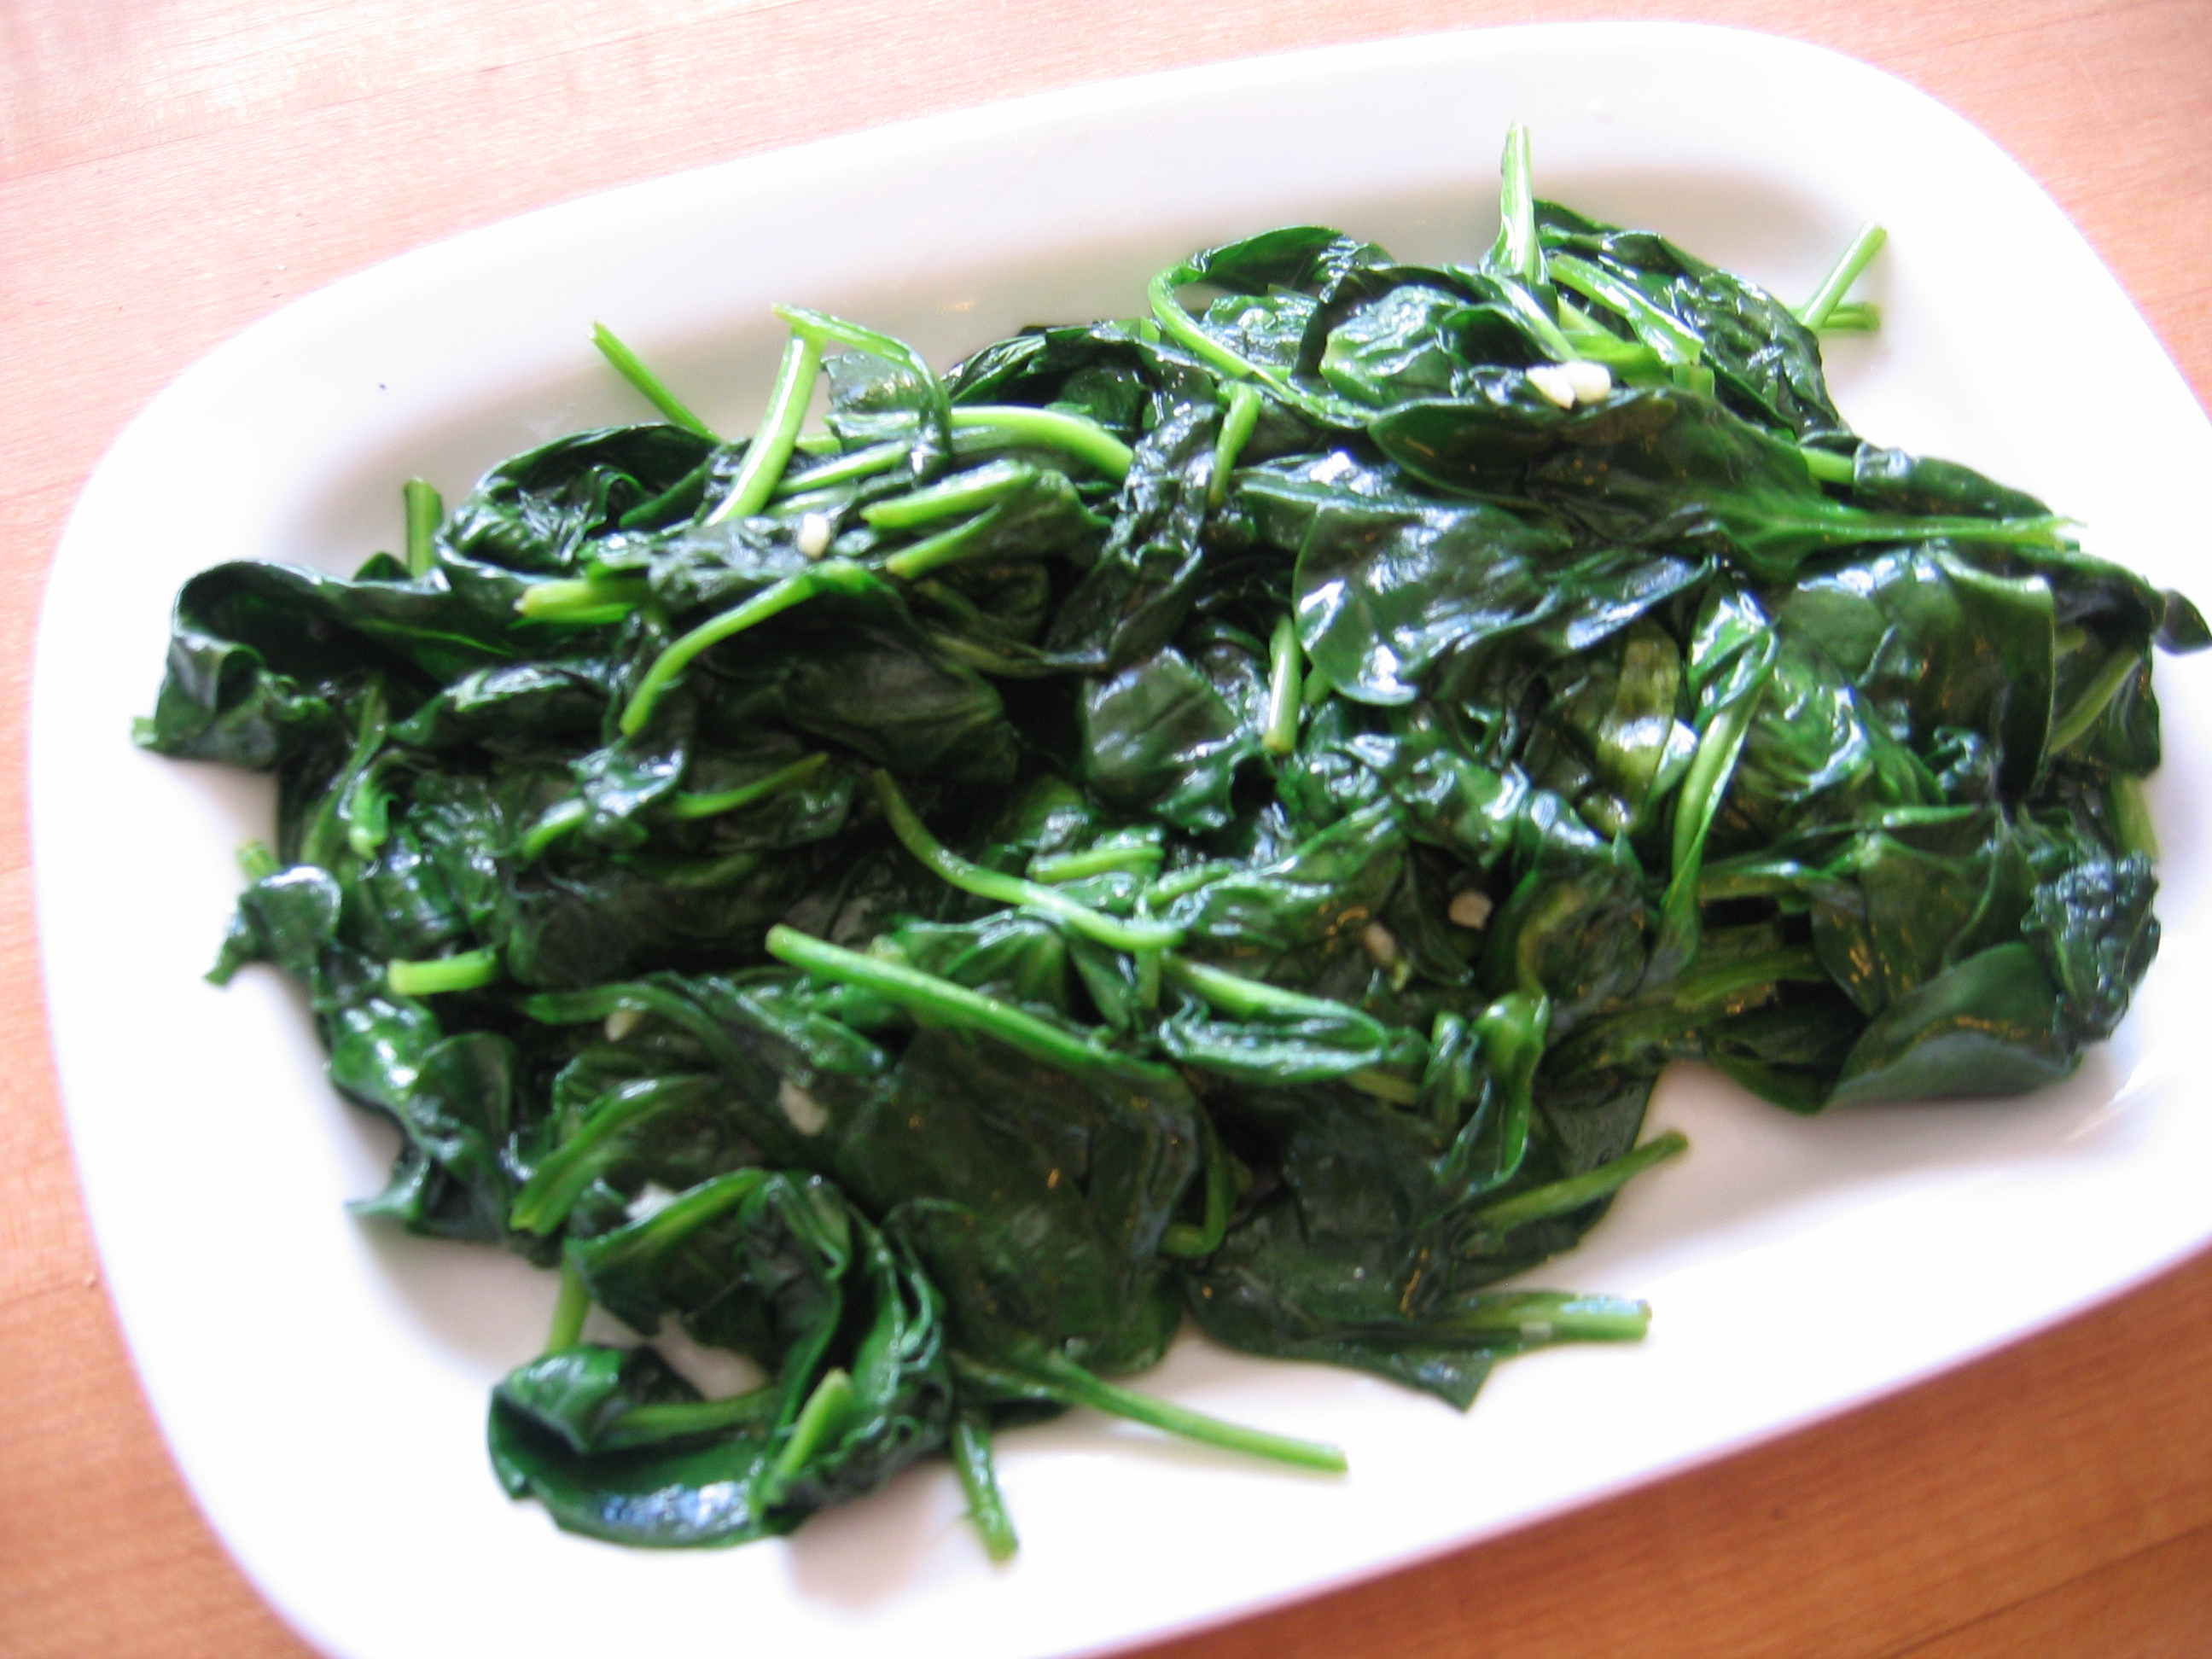
Eat Foods that Contain Folate
Notes:
Rich sources of folate include spinach, dark leafy greens, asparagus, turnip, beets, and mustard greens, Brussels sprouts, lima beans, soybeans, beef liver, brewer's yeast, root vegetables, whole grains, wheat germ, bulgur wheat, kidney beans, white beans, lima beans, mung beans, salmon, orange juice, avocado, and milk. In addition, all grain and cereal products in the U.S. are fortified with folic acid. Source: Vitamin B9 (Folic acid) | University of Maryland Medical Center http://umm.edu/health/medical/altmed/supplement/vitamin-b9-folic-acid#ixzz3WRIDDE2h University of Maryland Medical Center Follow us: @UMMC on Twitter | MedCenter on Facebook

Slide 74
And campaign for removing legislation that requires fortification!
Avoid Foods Fortified with Folic Acid and Iron

Slide 75
Don’t Use Roundup in your Yard!!

Slide 76
Summary
Glyphosate likely plays a role in spina bifida
Folic acid fortification of wheat-based products is most likely a big mistake
Folic acid is a synthetic form of folate that causes oxidative damage in the liver, depletes antioxidants, and can lead to cerebral folate deficiency
Linked to autism and cancer, among others
Iron supplements are likely also causing harm
Eating an organic diet that is rich in folate is the best way to protect from folate deficiency

