Slide 1
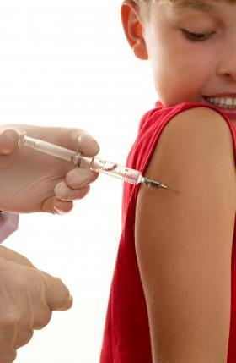
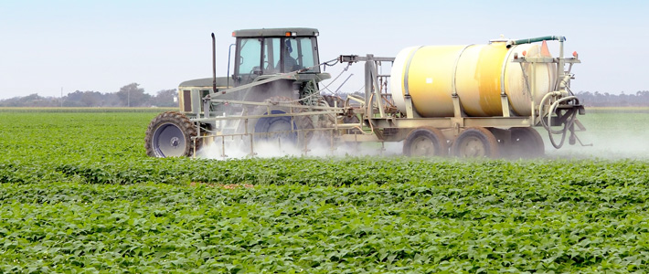
Roundup, MMR and Autism -- A Toxic Connection
Stephanie Seneff
MIT CSAIL
Aug. 4, 2016

Slide 2
In a time of universal deceit,
telling the truth is a revolutionary act.
— George Orwell

Slide 3
Key Take Away Message
Glyphosate
Glyphosate and MMR conspire to cause autoimmune disease
Glyphosate has been linked to autism
MMR Vaccine
Autism
MMR vaccine has been linked to autism

Slide 4
Outline
Introduction
Glyphosate, glutamate, manganese and autism
Glyphosate as a glycine analogue
Vaccines
MMR, glyphosate and autoimmunity
Gardasil (HPV Vaccine)
How you can protect yourself and your family
Summary

Slide 5
1 in 68

Slide 6
US Health Status
US makes up 5% of the world’s population but consumes more than 50% of the world’s pharmaceutical drugs
We spend more on health care than Japan, France, China, UK, Italy, Canada, Brazil, Spain, and Australia, combined
US ranks last or near last among developed nations on infant mortality and life expectancy
We also suffer from more chronic illnesses
We consume 25% of the world supply of glyphosate

Slide 7
“Chronic and autoimmune diseases are now epidemic in America. Marked by such symptoms as fatigue, brain fog, gastro-intestinal problems, achy joints, low-level fevers, rashes, fibromyalgia, neurodegenerative diseases, obsessive compulsive disorder, and ADHD, these emerging illnesses have become severely debilitating to the public and extremely profitable for pharmaceutical companies who now make billions in palliative treatments aimed at managing symptoms.”
Dylan Charles, Editor, Waking Times
Notes:
http://www.wakingtimes.com/2016/07/27/non-lethal-biological-warfare-agents-linked-to-autoimmune-disease-epidemic/

Slide 8
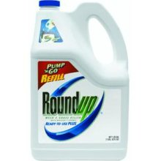
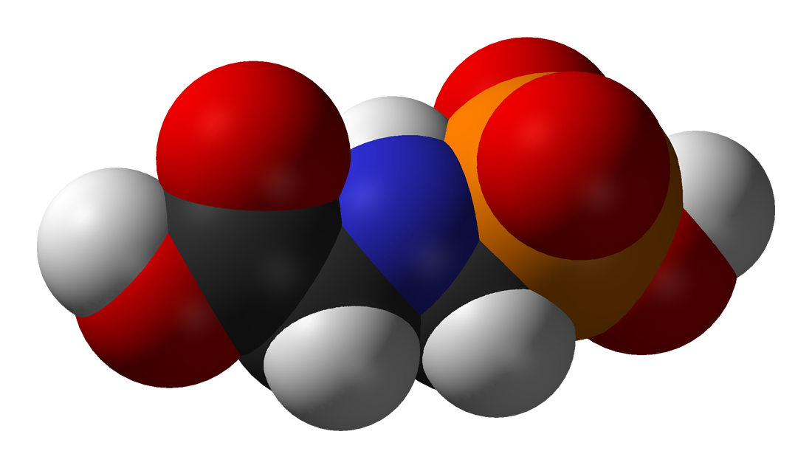
GLYPHOSATE

Slide 9
Roundup and GMO Crops
GMO Roundup-Ready corn, soy, canola, sugar beets
cotton, tobacco and alfalfa
What is glyphosate?

Slide 10
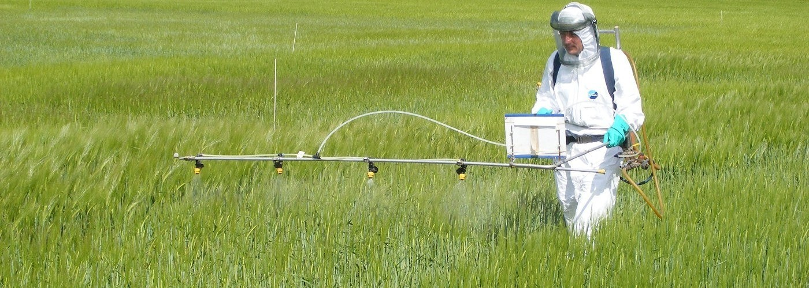
Roundup as a Desiccant/Ripener just before Harvest
Wheat, Oats, Barley, Rye, Sugar cane, Beans, Lentils, Peas, Flax, Sunflowers, Pulses, Chick Peas

Slide 11
“Herbicide Resistant Ryegrass Troubling for Wheat Growers”*
“If you see ryegrass at harvest following an Axial XL application, it may be resistant. And you can scatter seed all over the field with the combine.”
“A reduced-tillage approach, using a burndown herbicide ahead of planting in a stale seedbed, also holds promise for improved control.”
“ ‘We may be able to knock out 80% to 90% of the resistant ryegrass with glyphosate.’ ”
-- Jim Swart, integrated pest management specialist
*Ron Smith, Western Farm Press, Mar. 23, 2013
Notes:
Glyphosate/pesticides_for_wheat_slides.pdf
glyphosate/Axial_XL.text

Slide 12
“Glyphosate Now the Most-Used Agricultural Chemical Ever”* By Douglas Main, Feb 2, 2016 Newsweek
Glyphosate usage has increased 50-fold since 1996, when GMO glyphosate-resistant crops were introduced in the US.
Today, 50 times more glyphosate is allowed by the EPA on corn grain than in 1996
Half of the American farmers' fields have weeds that are resistant to glyphosate
New GMO crops offer dual resistance to glyphosate & 2,4-D → Enlist Duo
*www.newsweek.com/glyphosate-now-most-used-agricultural-chemical-ever-422419
Notes:
./Newsweek_on_glyphosate_overuse.text

Slide 13
Is Glyphosate Toxic?
Monsanto has argued that glyphosate is harmless to humans because our cells don’t have the shikimate pathway, which it inhibits
However, our gut bacteria DO have this pathway
We depend upon them to supply us with essential amino acids (among many other things)
Other ingredients in Roundup greatly increase glyphosate’s toxic effects and are themselves toxic
Insidious effects of glyphosate accumulate over time
Most studies are too short to detect damage

Slide 14
Main Toxic Effects of Glyphosate*
Interferes with function of cytochrome P450 (CYP) enzymes
Chelates important minerals (iron, cobalt, manganese, etc.)
Interferes with synthesis of aromatic amino acids and methionine
Leads to shortages in critical neurotransmitters and folate
Disrupts sulfate synthesis and sulfate transport
*Samsel and Seneff, Entropy 2013, 15, 1416-1463

Slide 15
Glyphosate: The Central Mechanisms*
Glyphosate acts as an antibiotic to disrupt gut bacteria, leading to overgrowth of pathogens
Disruption of liver CYP enzymes leads to impaired bile flow and low vitamin D
This disrupts sulfate synthesis and transport
Also impairs detoxification of other toxic chemicals
Damage to red blood cells leads to anemia and toxicity due to free iron
Hypoxia ensues → low grade encephalopathy
Leaky gut and leaky brain barrier lead to neuronal exposure to dangerous metals and neurotoxins
* A Samsel and S Seneff, Entropy 2013, 15(4), 1416-1463

Slide 16
Glyphosate, Glutamate, Manganese and Autism

Slide 17
Glyphosate Depletes Iron, Manganese and Zinc in Plants*
*D Huber, What About Glyphosate-Induced Manganese Deficiency?
Fluid Journal 2007: 20-22.
Notes:
Glyphosate/glyphosate_induced_manganese_deficiency_plants_Huber.pdf

Slide 18
Severe Deficiency in Serum Manganese and Cobalt in Cows*
Cobalt
Manganese
Eight different farms: all cows tested had glyphosate in the urine
*M. Krüger et al., J Environ Anal Toxicol 2013, 3:5
Notes:
glyphosate//cows_cobalt_deficiency_glyphosate.pdf

Slide 19
Severe Deficiency in Serum Manganese and Cobalt in Cows*
cobalamin
deficiency
Cobalt
???
Manganese
Eight different farms: all cows tested had glyphosate in the urine
*M. Krüger et al., J Environ Anal Toxicol 2013, 3:5
Notes:
glyphosate//cows_cobalt_deficiency_glyphosate.pdf

Slide 20
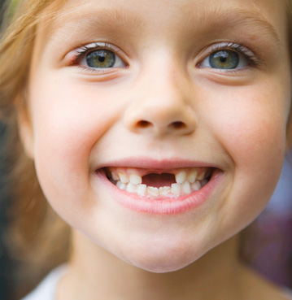
Low Manganese in Teeth Linked to Autism*
Studied lead, mercury and manganese levels in tooth enamel of shed primary teeth in 84 children
Manganese accumulated after birth was down by 60% in autistic children
No other result was statistically significant
*MM Abdullah et al., J Autism Dev Disord. 2012 Jun;42(6):929-36.
Notes:
Samantha/heavy_metal_in_childrens_tooth_enamel_as_diagnostic_autism.pdf

Slide 21
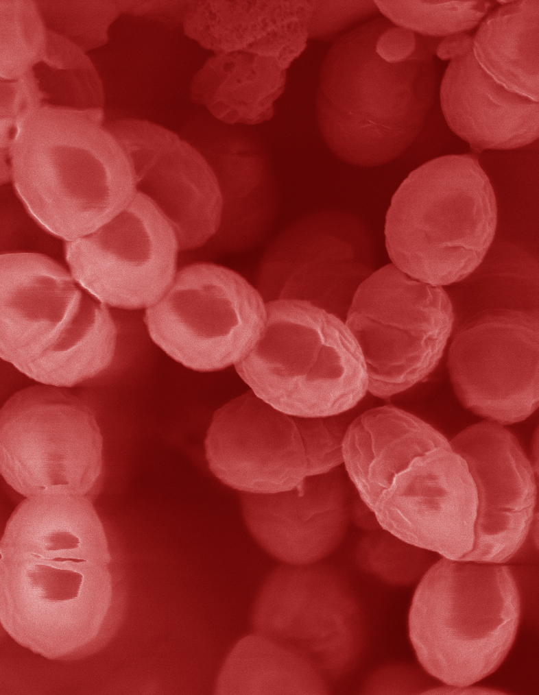
Lactobacillus Depends on Manganese!*
Many lactic acid bacteria contain very high intracellular manganese levels
Scavenges toxic oxygen species, particularly superoxide
Manganese deprivation suppresses growth
* FS Archibald and M-N Duong. Journal of Bacteriology Apr 1084, 1-8.
Notes:
Glyphosate/manganese/manganese_acquisition_by_lactobacillus.pdf

Slide 22
Lactobacillus Depends on Manganese!*
Many lactic acid bacteria contain very high intracellular manganese levels
Scavenges toxic oxygen species, particularly superoxide
Manganese deprivation suppresses growth
Lactobacillus levels are low in the gut in association with autism
* FS Archibald and M-N Duong. Journal of Bacteriology Apr 1084, 1-8.
Notes:
Glyphosate/manganese/manganese_acquisition_by_lactobacillus.pdf

Slide 23
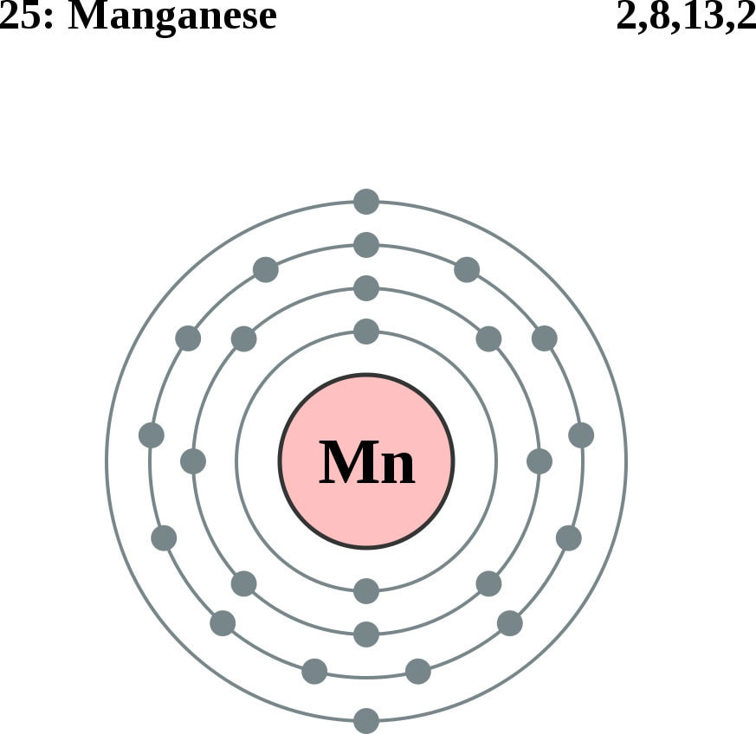
Glutamine Synthesis Depends on Manganese!
Glutamine synthetase
glutamate
glutamine
water
ammonium
Ammonium and glutamate toxicity in the brain
can arise because of insufficient manganese

Slide 24
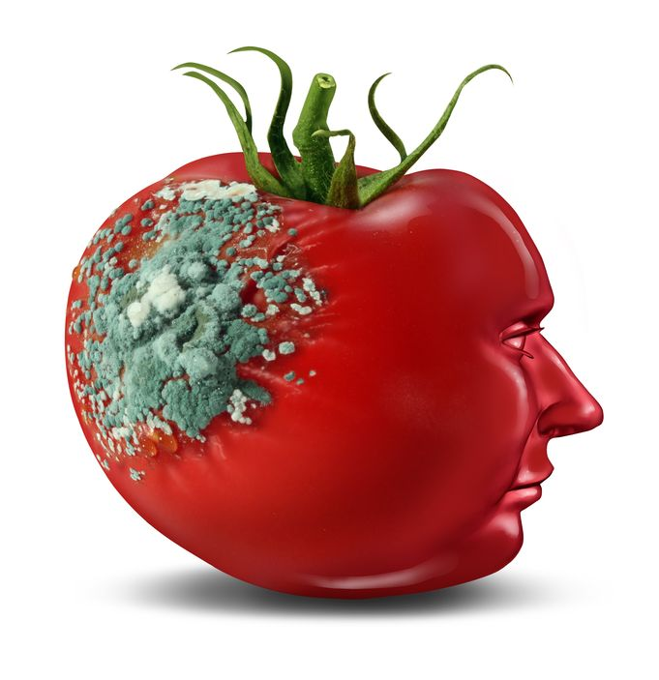
Glyphosate and Glutamate*,**
Acute exposure activates NMDA receptors and voltage-dependent calcium channels
Oxidative stress and neural cell death
Increased glutamate release into the synaptic cleft → excessive extracellular glutamate levels
Decreased glutathione content
Increased peroxidation of lipids (fats)
*http://www.greenmedinfo.com/blog/roundup-weedkiller-brain-damaging-neurotoxin
**D Cattani et al., Toxicology 2014; 320: 34-45.
NMDA = N-methyl D-aspartate
Notes:
N-methyl D-aspartate
http://www.greenmedinfo.com/blog/roundup-weedkiller-brain-damaging-neurotoxin
acute exposure (30 minutes) and chronic (pregnancy and lactation) exposure.
Rat hippocampus
Why was this referenced??
T. Bohn et al. Food Chemistry 153, 15 June 2014, 207-215.

Slide 25
“Alteration of Plasma Glutamate and Glutamine Levels in Children with High-Functioning Autism”*
*C. Shimmura et al. PLoSone October 2011 6(1):e25340
Notes:
Table 1. Plasma Levels of Amino Acids and related compounds in Control Subjects and Individuals with HFA.
Glyphosate/glutamate_glutamine_autism_2011.pdf

Slide 26
Journal of Personal Science: One Child’s Autism Eliminated by Removal of Glutamate From Her Diet* By Katherine Reid
First Round:
Kale, cucumber, cilantro, nuts, seeds, fruits
Magnesium B-complex, vitamin D3, omega 3 fats (EPA, DHA)
Probiotics
Gluten free and casein free (no wheat, no milk)
Child improved significantly but still had autistic behaviors
Second Round:
ADD: ELIMINATE FREE GLUTAMATE
Child lost the "autism" label!
*blog.sethroberts.net/2013/05/17/journal-of-personal-science-
one-childs-autism-eliminated-by-removal-of-glutamate-from-her-diet
Notes:
./glutamate_autism_personal_story.pdf

Slide 27
Glyphosate as a
Glycine Analogue

Slide 28
A Bit of Basic Biology
Proteins are the “work horses” of the body
Enzymes, ion channels, pumps, receptors, etc.
Proteins are “beads on a string” synthesized from about 20 building blocks called “amino acids”
The DNA code is how genetic information gets translated into proteins
G,C,A and T stand for four nucleotides and a triple-code specifies a particular amino acid (64 total)
Glycine is the smallest and simplest amino acid
GGT, GGC, GGA, GGG all code for glycine

Slide 29
Glyphosate is a non-coding amino acid analogue of glycine
H
Glycine
Glyphosate

Slide 30
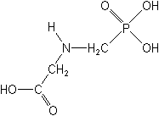
What If Glyphosate Could Insert Itself Into Protein Synthesis???
glyphosate
Code for Glycine
GGC
mRNA
. . .
. . .
Glyphosate
Alanine
Proline
-- Any proteins with conserved glycine residues are likely to be affected in a major way

Slide 31
Extra Piece Sticks Out at Active Site
Substrate no longer fits in active site
Active Site
Extra Stuff
Glyphosate
Alanine
Proline
glycine
Peptide chain

Slide 32
Some Predicted Consequences*
Neural tube defects
Autism
Impaired collagen → osteoarthritis
Steatohepatitis (fatty liver disease)
Obesity and adrenal insufficiency
Hypothyroidism
Impaired iron homeostasis and kidney failure
Insulin resistance and diabetes
Cancer
*A Samsel and S Seneff, Journal of Biological Physics and Chemistry 2016;16:9-46.

Slide 33
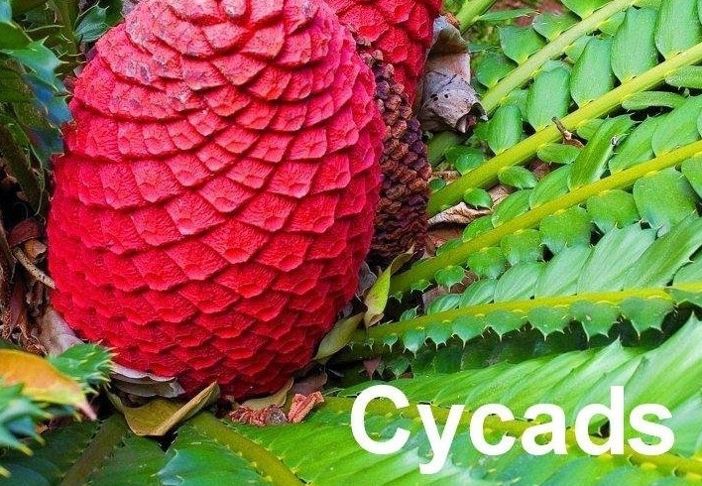
An Analogy: ALS in Guam
An epidemic in ALS in Guam was traced to a natural toxin found in cycads
BMAA is a non-coding amino acid that gets inserted by mistake in place of serine
Defective versions of a glutamate transporter have been linked to ALS*
The transporter has an essential serine-rich region in its sequence**
BMAA = beta-Methylamino-L-alanine
*Antioxidants & Redox Signaling 2009;11: 1587-1602.
**DJ Slotboom et al., PNAS 1999; 96(25): 14282-14287.
Notes:
cyanobacteria_BMAA_article.pdf
Slotbloom_1999_conserved_serine_glutamate_transporter.pdf
Dunlop.pdf
ALS_glutamate_transporter_link_2009.pdf
Guam/
*ALS_glutamate_transporter_link_2009.pdf
ChrisShawChapter7GuamFantastic.docx
Dunlop.pdf
**Slotbloom_1999_conserved_serine_glutamate_transporter.pdf

Slide 34
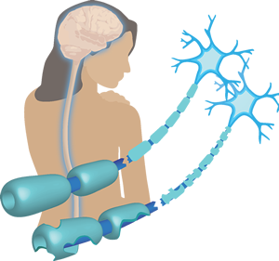
Another Analogy: MS & Sugar Beets*
Sugar beets contain an analogue of proline called Aze
Remarkable correlation between MS frequency and proximity to sugar beet agriculture
Myelin basic protein contains a concentration of proline residues that are absolutely essential for its proper function
Aze = Azetidine-2-carboxylic acid
*E. Rubenstein, J Neuropathol Exp Neurol 2008;67(11): 1035-1040.
Notes:
./misincorporation_of_proline_analogue_MS.pdf

Slide 35
Into The Wild*
Chris McCandless died in the Alaskan wilderness in 1992
A staple of McCandless' diet was seeds from a wild potato plant which contained L-canavanine, a non-coding amino acid analogue of L-arginine
Author Jon Krakauer determined that McCandless was slowly poisoned by L-canavanine
*J Krakauer et al., Wilderness & Environmental Medicine 2015; 26: 36-42.

Slide 36
Vulnerable Proteins: Resulting Pathologies
Conserved Glycines | Disease Profile
Hormone-sensitive Lipase | Obesity
Insulin Receptor | Diabetes
Amyloid Beta Plaque | Alzheimer’s Disease
GABA Receptor | Autism
Lipocalin | Kidney Failure
ACTH | Adrenal Insufficiency
Cytochrome C Oxidase | Mitochondrial Disease
Alpha Synuclein | Parkinson’s Disease
Myosin | Chronic Fatigue Syndrome
*A Samsel and S Seneff, Journal of Biological Physics and Chemistry 2016;16:9-46.

Slide 37
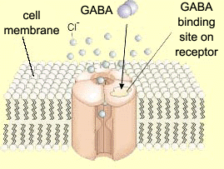
Impaired GABA¹ Receptor Activity and Autism
Autism has been linked to a weakened response of the inhibitory GABA receptor to stimuli*
The GABA receptor has a conserved glycine at the entrance to the first membrane-spanning domain that is essential for its function**
1. GABA = Gamma amino butyric acid
*CD Robertson et al., Current Biology 2016;26: 80-85
**BX Carlson et al., Mol Pharmacol. 2000;57(3):474-84
Notes:
2016/Anthony/
reduced_GABAergic_activity_autism_brain.pdf
ABA_conserved_glycine_2000.pdf

Slide 38
"Glyphosate-Based Herbicides Produce Teratogenic Effects on Vertebrates by Impairing Retinoic Acid Signaling"*
"GBH (Glyphosate-Based Herbicides) produced similar effects in chicken embryos, showing a gradual loss of rhombomere domains, reduction of the optic vesicles, and microcephaly. This suggests that glyphosate itself was responsible for the phenotypes observed, rather than a surfactant or other component of the commercial formulation."
*A Paganelli et al. Chem. Res. Toxicol 2010;23(10): 1586-1595.
Notes:
glyphosate/Carrasco_paper_BestOne_teratogenic_effects_glyphosate_2010.pdf
JudyHoy/JoshPaper/Madrid-Carrasco.pdf p. 27.

Slide 39
"Glyphosate-Based Herbicides Produce Teratogenic Effects on Vertebrates by Impairing Retinoic Acid Signaling"*
Retinoic acid receptors contain two highly conserved glycines that are essential for their proper function
"GBH (Glyphosate-Based Herbicides) produced similar effects in chicken embryos, showing a gradual loss of rhombomere domains, reduction of the optic vesicles, and microcephaly. This suggests that glyphosate itself was responsible for the phenotypes observed, rather than a surfactant or other component of the commercial formulation."
*A Paganelli et al. Chem. Res. Toxicol 2010;23(10): 1586-1595.
Notes:
glyphosate/Carrasco_paper_BestOne_teratogenic_effects_glyphosate_2010.pdf

Slide 40
Vaccines

Slide 43
Recommended Vaccine Schedule by CDC*
*http://www.cdc.gov/vaccines/schedules/hcp/child-adolescent.html

Slide 44
“How is disinterested vaccine safety governance even remotely possible when HHS employees stand as heroes at the head of the parade when a new vaccine is invented within its walls, while agency leaders are leading the cheering section, approving the new product’s launch, making the market for the product with its policy recommendations, and then turning around to cash multimillion-dollar checks?”
Mark Blaxill, A LICENSE TO KILL?
Chapter 19 in VACCINE EPIDEMIC, Louise Kuo Habakus, MA and Mary Holland, JD, Editors
Notes:
Csail/2014/project/Blaxill/gardasillicensetokill.pdf
Department of Health and Human Services

Slide 45
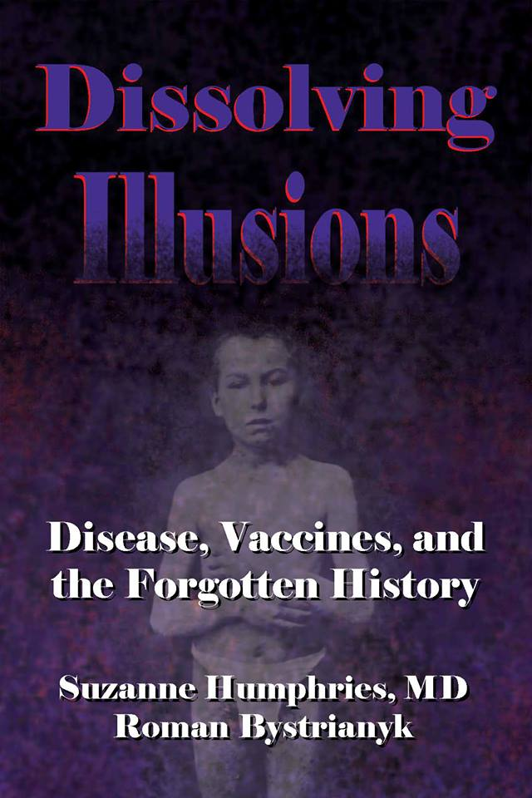
Dr. Suzanne Humphries
Dissolving Illusions

Slide 46
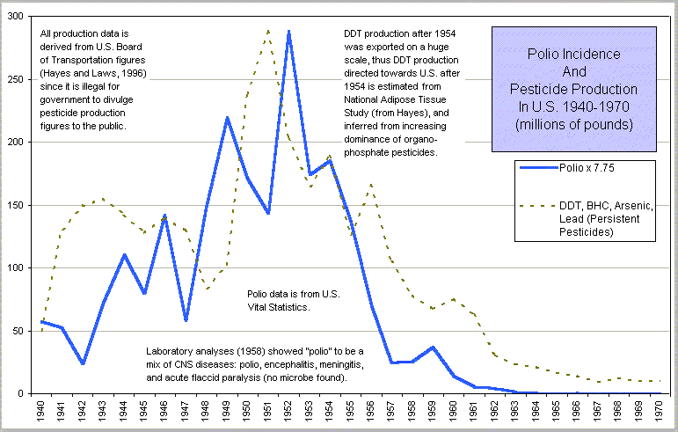
Polio and Pesticides*
*From Dissolving Illusions, Suzanne Humphries
Notes:
BHC (Benzene Hexa Chloride)

Slide 47
Vaccine Induced Immune Overload*
Mercury, aluminum, formaldehyde, MSG, neomycin, gentamycin, streptomycin, polymyxin B, polyethylene glycol, squalene, killed and/or live viruses, viral contaminants, etc.
→ Type 1 and type 2 diabetes, NASH, autism, asthma, food allergies, thyroiditis, vasculitis and autoimmune rheumatic diseases like lupus, rheumatoid arthritis, psoriasis and metabolic syndrome.
*Classen JB, J Mol Genet Med 2014, S1:025
Notes:
samantha/vaccine-induced-immune-overload.pdf
./vaccine_overload.pdf
http://www.thepeoplesvoice.org/TPV3/Voices.php/2014/06/16/vaccine-induced-immune-overload-and-the-

Slide 48
Autoimmune Disease and Molecular Mimicry*
A peptide sequence in a foreign protein resembles a sequence in a human protein
The immune system develops antibodies to the foreign protein and then these act as autoantibodies and attack the human protein that looks similar
This is how you get autoimmune disease
The foreign protein could be from a virus in a vaccine or from a live infection or it could be from a food source like wheat gluten
*MF Cusick et al., Clin Rev Allergy Immunol. 2012; 42(1): 102–111.
Notes:
./molecular_mimicry_autoimmunity_2012.pdf

Slide 49
Why do we have an epidemic in
autoimmune disease in America today?

Slide 50
Hypothesis
Cumulative glyphosate exposure sets up a weakened immune system, a leaky gut barrier and a leaky brain barrier
Vaccines introduce foreign proteins that may contain glyphosate as a contaminant
Child develops overactive antibody response to foreign protein contaminated with glyphosate and, through molecular mimicry, this leads to autoimmune disease

Slide 51
A Model from Gut Dysbiosis to Autoimmunity*
*Figure 1, R. Ponte et al. EBioMedicine 1016;4:40-49.
Notes:
./reversing_gut_damage_in_HIV_great_figure_2016.pdf

Slide 52
Aluminum Adjuvant in Vaccines*
DTaP (diphtheria, tetanus, and pertussis): 170–625 mcg, depending on manufacturer
Hepatitis A: 250 mcg
Hepatitis B: 250 mcg
Hib (for meningitis; PedVaxHib brand only): 225 mcg
HPV: 225 mcg
Pediarix (DTaP–hepatitis B–polio combination): 850 mcg
Pentacel (DTaP–Hib–polio combination): 330 mcg
Pneumococcus: 125 mcg
*vactruth.com/2014/01/28/toxic-levels-of-aluminum/

Slide 53
"Autoimmune (autoinflammatory) syndrome induced by adjuvants” (ASIA)*
Alum-containing vaccines become insidiously unsafe in certain individuals
Increased risk to develop autoimmune diseases
Chronic fatigue, muscle pain, joint pain, brain fog
Alum nanoparticles adsorb vaccine antigens on their surface -> resistance to proteolysis
Defects in autophagy → biopersistence of alum particles
Trojan horse effect: immune cells carry Al into brain
Leaky brain barrier →Alum accumulates in brain
*RK Gherardi et al., Frontiers in Neurology February 2015; 6:4.

Slide 54
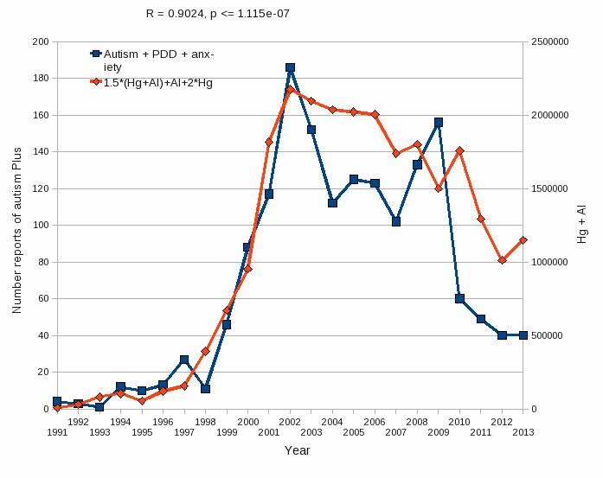
Aluminum & Mercury Autism & PDD & Anxiety
VAERS
database
Formula: Al + 1.5 x (Al w/ Hg) + 2.0 x Hg

Slide 55
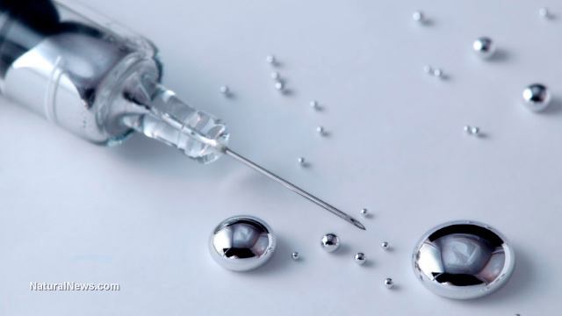
Methodological Issues and Evidence of Malfeasance in Research Purporting to Show Thimerosal in Vaccines Is Safe*
Over 165 studies have found Thimerosal to be harmful:
Death, allergic reactions, malformations, autoimmune reactions, developmental delay
Neurodevelopmental disorders, including tics, speech delay, language delay, attention deficit disorder, and autism
Six studies used by the CDC to support Thimerosal’s safety are flawed
*B Hooker et al., BioMed Research International 2014, Article ID 247218
Notes:
Samantha/Thimerosal_not_safe_Geier_2014

Slide 56
Glutamate is an Additive in Vaccines!
Flu vaccines (FluMist), MMR (measles, mumps and rubella), Rabies vaccine and Varicella vaccine (chicken pox) all contain glutamate
Anecdotal evidence links these vaccines with autism
My own studies on VAERS revealed a correlation between autism and MMR*
Glyphosate’s depletion of manganese prevents glutamate breakdown
*S. Seneff et al., Entropy 2012, 14, 2227-2253.
Notes:
Seizures facial swelling anaphylactic shock
Joint pain

Slide 57
Symptoms of Adverse Reactions to MMR before and after 2002*
*Data analyzed from the VAERS database

Slide 58
Symptoms of Adverse Reactions to MMR before and after 2002*
Joint pain
seizures
shortness of breath
hives
These are all characteristic symptoms of allergies to MSG
eczema
anaphylactic shock
Facial swelling
swelling
swelling
*Data analyzed from the VAERS database

Slide 59
Elevated Blood Glutamate Levels in Autism*
Meta analysis
Twelve studies involving 880 participants and 446 incident cases
Highly significant result (P< 0.001) for elevated blood glutamate in association with autism
Glutamate levels in the blood and central nervous system are closely correlated
Glutamic acid decarboxylase converts glutamate to GABA (an inhibitory neurotransmitter) and is decreased in autism
High glutamate may play a role in seizures
*Z Zheng et al., Plos ONE July 8, 2016 111(7): e0158688
Notes:
./high_glutamate_plasma_autism_2016.pdf

Slide 60
MMR, Glyphosate and Autoimmunity

Slide 61
MMR and Autism
Dr. Andrew Wakefield found a connection in 1998 in a now retracted publication*
He also identified a connection between gut dysbiosis and autism
CDC claimed proof of no link in a 2004 paper**
Whistleblower, Dr. William Thompson, has come forward:
Data supported significant increased risk for autism in black males who received the vaccine early vs late
Demand for birth certificate hid this finding
In a secret meeting, documents were destroyed to hide the evidence
*A Wakefield et al., The Lancet 1998; 351 (9103): 637–41. (RETRACTED)
**F DeStefano et al., Pediatrics 2004;113;259-266 .

Slide 63
Vaxxed, The Movie: Suppressed Study by the CDC*
7-fold increase in autism for children previously perfectly healthy getting the MMR vaccine before 18 months versus those waiting until after 3 years old
2.6-fold increase in autism in black boys who similarly got the vaccine early versus late
Del Bigtree: “Our democracy is now sick and dying because media is not doing its job”**
* http://www.vaxxed.com
** Del Bigtree, Producer, Speech published July 3, 2016
https://www.youtube.com/watch?v=qY1SkwuwOFws

Slide 64
Autism, Glyphosate, Vaccine Reactions*
Glyphosate application to corn and soy, US
Children with Autism, US
# Adverse Reactions in VAERS
*Collaboration with Dr. Nancy Swanson
Notes:
Individuals with Disabilities Education Act

Slide 65
Glyphosate in Vaccines?
For MMR, flu vaccine, and rabies vaccine, live virus is grown on gelatin derived from ligaments of pigs
Pigs are fed GMO Roundup-Ready corn and soy feed
The main component of gelatin is collagen
By far the most common amino acid in collagen is glycine: glyphosate substitution is likely!
There is also a significant amount of glutamate
Excite NMDA receptors in the brain
Glyphosate’s known stimulation of NMDA receptors could cause neuronal burnout

Slide 66
Precedent: Glyphosate in Drugs?*
Trasylol (aprotinin) is a protein derived from bovine lung used to reduce bleeding during open heart surgery
Rare acute reaction to Trasylol involves precipitous drop in blood pressure, acute kidney failure, and sudden death
Piglets injected with glyphosate salts had similar acute reaction with high mortality rate
Cows fed GMO Roundup-Ready feed had highest residue levels of glyphosate in lungs
*S Seneff et al., Agricultural Sciences 2015; 6:1472-1501.
Notes:
Trypsin inhibitor

Slide 67
Measles Virus and Hemagglutinin*
The measles virus synthesizes the protein hemagglutinin
Antibodies to hemagglutinin are essential following MMR vaccination to induce immunity
Hemagglutin bears a sequence resemblance to myelin basic protein (MBP) → potential for autoimmune reaction
MBP is essential for the formation of the myelin sheath surrounding nerve fibers
Children with a rare genetic defect involving deletion of MBP can suffer from microcephaly**
Autoantibodies to MBP along with excessive levels of antibodies to measles hemagglutinin are linked to autism***
*Oldstone, MBA, Ed. Molecular mimicry: Infection inducing autoimmune disease.
Springer Berlin Heidelberg; January 9, 2006.
**AD Kline et al., Am J. Hum. Genet. 1993;52:895-906.
***VK Singh et al., J Biomed Sci 2002;9(4):359-64.

Slide 68
Autism and Measles Hemagglutinin*
125 autistic children and 92 control children
60% of the children with autism had high levels of antibodies to measles hemagglutinin specific to the MMR vaccine
90% of these had autoantibodies to myelin basic protein (MBP)
0% of the control children had high antibody titers to either hemagglutinin or MBP
There were no elevations in antibodies detected against any proteins in the mumps or rubella viruses
*VK Singh et al., J Biomed Sci 2002;9(4):359-64.

Slide 69
Gardasil (HPV Vaccine)

Slide 70
“In 2006, after only three to five years of clinical trials, the FDA approved for marketing the most expensive vaccine in the history of the world, Gardasil, which has been proclaimed as preventative for cancer of the cervix, a claim that was never proved and which has, to date, not prevented a single case of cervical cancer ... mainly because cancer of the cervix takes 20 to 50 years to develop.”
-- Gary G. Kohls, a retired medical doctor in Duluth.
Notes:
http://www.duluthnewstribune.com/opinion/4068271-doctors-response-risks-costs-hpv-vaccine-far-outweigh-any-benefit

Slide 71
Are aluminum adjuvants plus Gardasil a uniquely damaging neuroinflammatory cocktail?*
Aluminum is routinely added to the "Placebo" which is completely unethical
New kind of aluminum adjuvants in Gardasil have more "reactogenicity"
Reformulated Gardasil-9 vaccine contains more than twice the amount of aluminum as its quadrivalent predecessor
Vaccine-induced antibodies bind not only the target foreign antigen but also host proteins (due to molecular mimicry)
*http://info.cmsri.org/the-driven-researcher-blog/
are-aluminum-adjuvants-plus-gardasil-a-uniquely-damaging-neuroinflammatory-cocktail
Notes:
Claire Dwoskin published July 28, 2016
./ClaireDwoskin_on_Gardasil.text

Slide 72
Are aluminum adjuvants plus Gardasil a uniquely damaging neuroinflammatory cocktail?*
Aluminum is routinely added to the "Placebo" which is completely unethical
New kind of aluminum adjuvants in Gardasil have more "reactogenicity"
Reformulated Gardasil-9 vaccine contains more than twice the amount of aluminum as its quadrivalent predecessor
Vaccine-induced antibodies bind not only the target foreign antigen but also host proteins (due to molecular mimicry)
“the number of viral matches and their locations make the occurrence of side autoimmune cross-reactions in the human host following HPV16-based vaccination almost unavoidable.”**
** D Kanduc, J Exp Ther Oncol. 2009;8(1):65-76.
Notes:
Kanduc_cross_reactivity.text
Claire Dwoskin published July 28, 2016
./ClaireDwoskin_on_Gardasil.text

Slide 73
Notes:
Colombia_HPV_acute_reactions_review_2016.pdf

Slide 74
HPG and Autoimmune Disease*
61 girls in Colombia: severe reaction to HPV (Gardasil) vaccine
Average age 14.5 years
Aluminum-based adjuvant enhances immune response
Autoimmune hypersensitivity type II reaction
High serum auto-antibody titers against nerve tissue
Molecular mimicry at play
*Pompilio Martinez, MD

Slide 75
Paresthesia = numbness/
tingling
Paresis = weakness
Pompilio Martinez, MD
Notes:
Colombia_HPV_acute_reactions_review_2016.pdf
https://pompiliomartinez.wordpress.com/2016/03/04/motor-and-sensory-clinical-findings-in-girls-vaccinated-against-the-human-papillomavirus-from-carmen-de-bolivar-colombia/

Slide 76
Booster Shot is More Dangerous
Notes:
Colombia_HPV_acute_reactions_review_2016.pdf

Slide 77
POTS and Gardasil*
Gardasil contains a yeast enzyme that breaks down thiamine (thiaminase)
Transketolase test was strongly positive for thiamine deficiency in three children suffering from post-Gardasil POTS (Postural Orthostatic Tachycardia Syndrome)
Thiamine deficiency severely affects the limbic system and brainstem → POTS
*Dr. Derrick Lonsdale, http://sanevax.org/gardasil-vitamin-deficiency/
Notes:
./POTS_after_Gardasil.text
https://www.hormonesmatter.com/post-gardasil-pots-thiamine-deficiency/
POTS_Gardasil_DrLonsdale_2013.pdf
Sulfite due to glyphosate → thiamine deficiency
Also, Gardasil is a yeast vaccine and an enzyme called thiaminase,
whose action destroys thiamine, is known to be in the
yeast. Thiaminase disease has been reported in Japan in association
with dietary thiamine deficiency.

Slide 78
POTS and Gardasil*
Gardasil contains a yeast enzyme that breaks down thiamine (thiaminase)
Transketolase test was strongly positive for thiamine deficiency in three children suffering from post-Gardasil POTS (Postural Orthostatic Tachycardia Syndrome)
Thiamine deficiency severely affects the limbic system and brainstem → POTS
Thiamine synthase contains a double-glycine repeat at the very end of the protein**
**A Zuin et al. Cells 2014; 3: 690-701.
*Dr. Derrick Lonsdale, http://sanevax.org/gardasil-vitamin-deficiency/
Notes:
./POTS_after_Gardasil.text
https://www.hormonesmatter.com/post-gardasil-pots-thiamine-deficiency/
POTS_Gardasil_DrLonsdale_2013.pdf
Sulfite due to glyphosate → thiamine deficiency
Also, Gardasil is a yeast vaccine and an enzyme called thiaminase,
whose action destroys thiamine, is known to be in the
yeast. Thiaminase disease has been reported in Japan in association
with dietary thiamine deficiency.

Slide 79
New Paper on Gardasil and Mice*
Experiment on mice injected with Gardasil vaccine
Mice exhibit behaviors indicative of depression
Anti-HPV antibodies were found in the blood
Cross-reactivity induced antibodies targeting mouse brain protein (p < 0.002) and phospholipid extracts (p < 0.001)
Microglial activation in the hippocampus
Aluminum nanoparticles contained in the vaccine likely contribute
They can cross the blood-brain barrier via macrophage-dependent Trojan horse mechanism.
Conclude:
Gardasil via its Al adjuvant and HPV antigens can trigger neuro-inflammation and autoimmune reactions leading to depression
*R. Inbar et al., Immunol Res. 2016. Published online 16 July, 2016.
Notes:
Vaccines/Lucija_Shaw_new_paper_Gardasil_autoimmune_brain_reaction_2016.pdf
./Gardasil_Lucija_notes.text

Slide 80
How You can Protect Yourself and Your Family

Slide 81
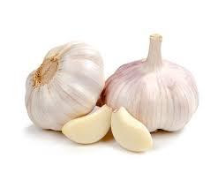
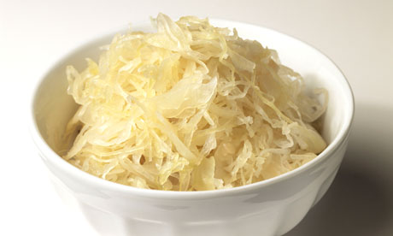
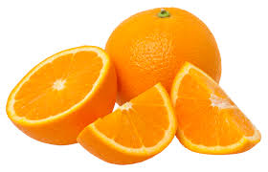
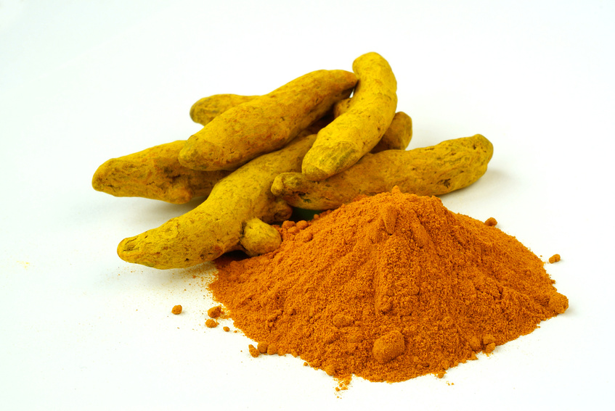
Some Important Nutrients
Curcumin
Garlic
Vitamin C
Probiotics
Methyl tetrahydrofolate
Cobalamin
Glutathione
Taurine
Epsom salt baths

Slide 82
Go Organic!

Slide 83
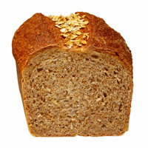
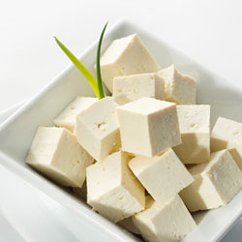
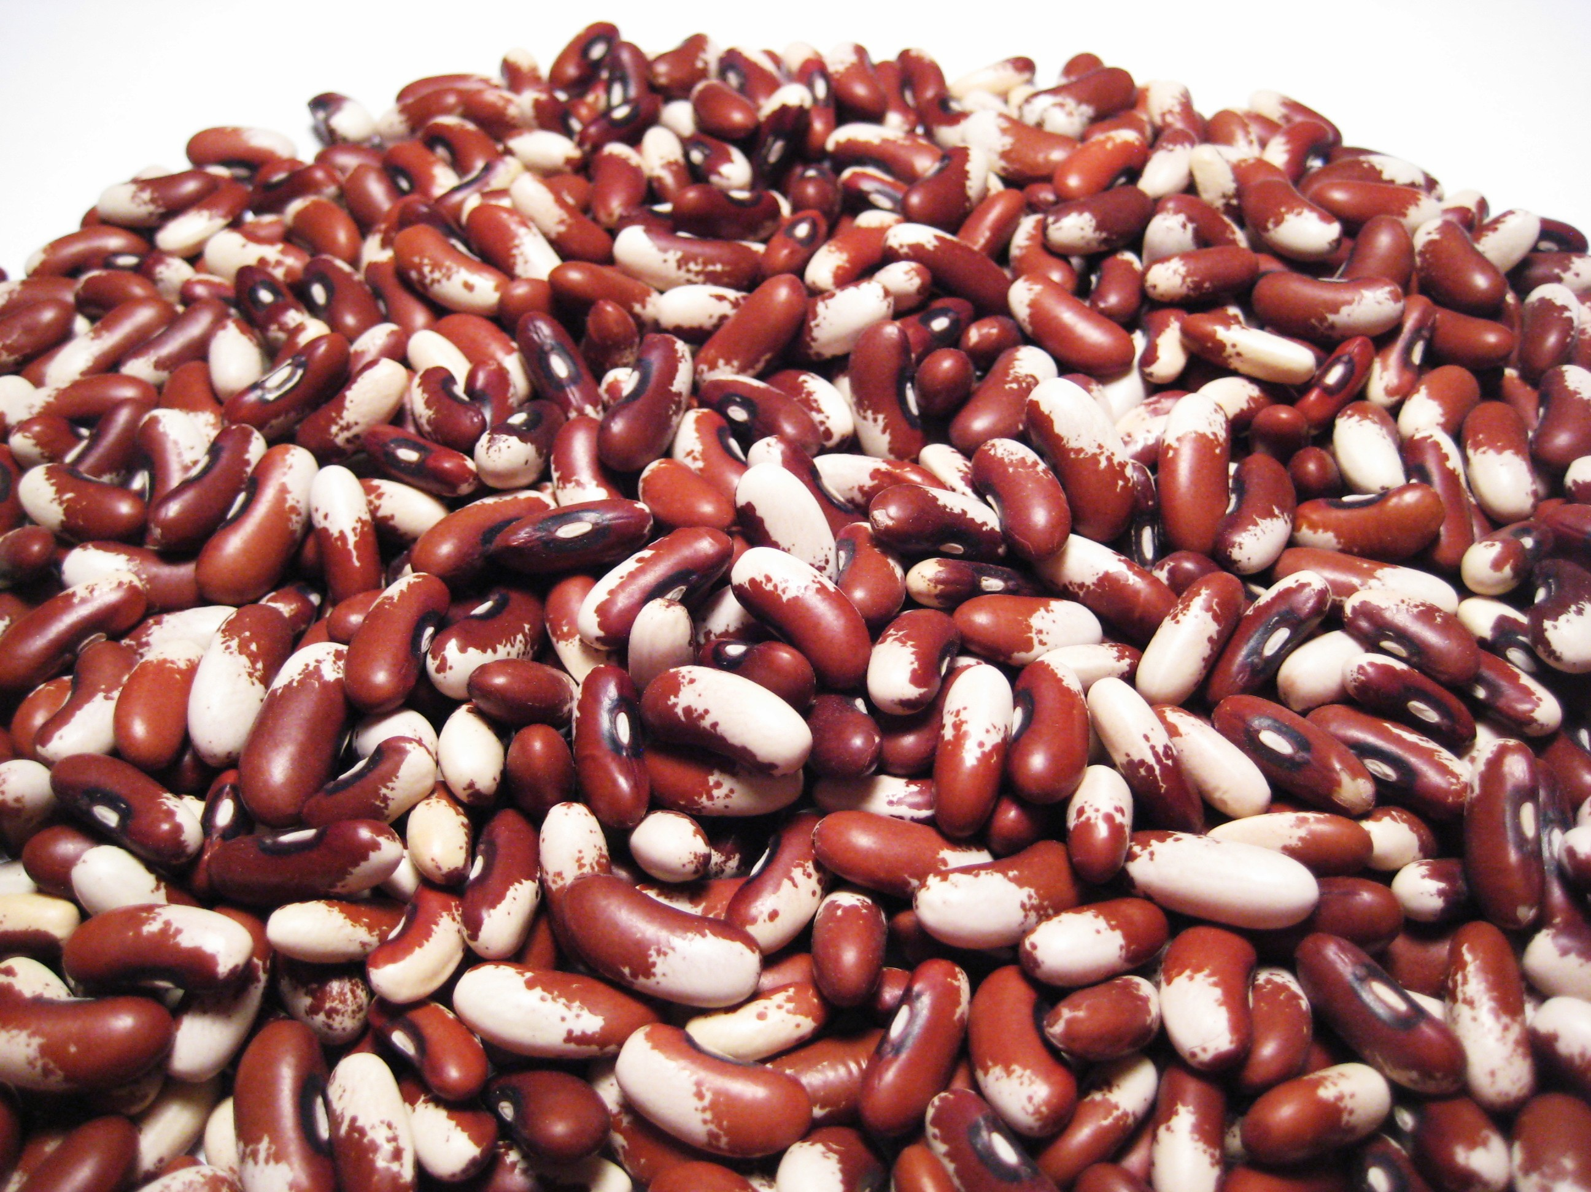
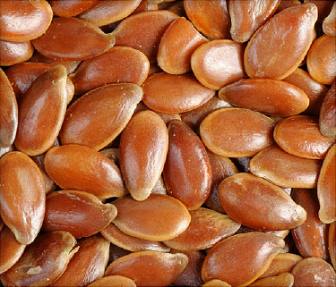
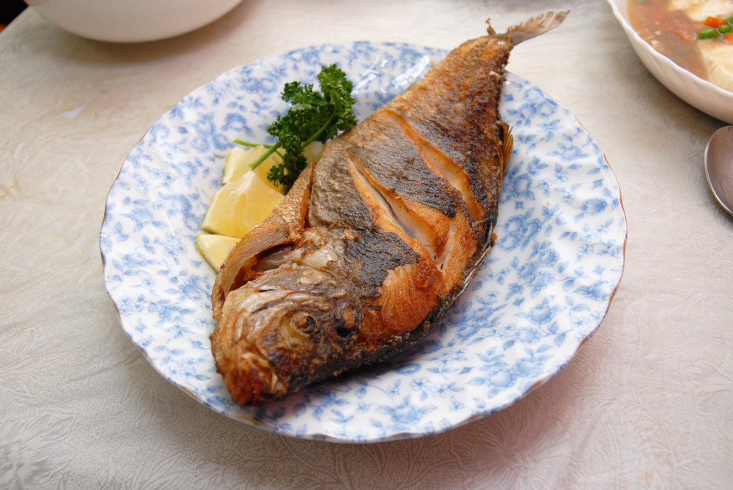
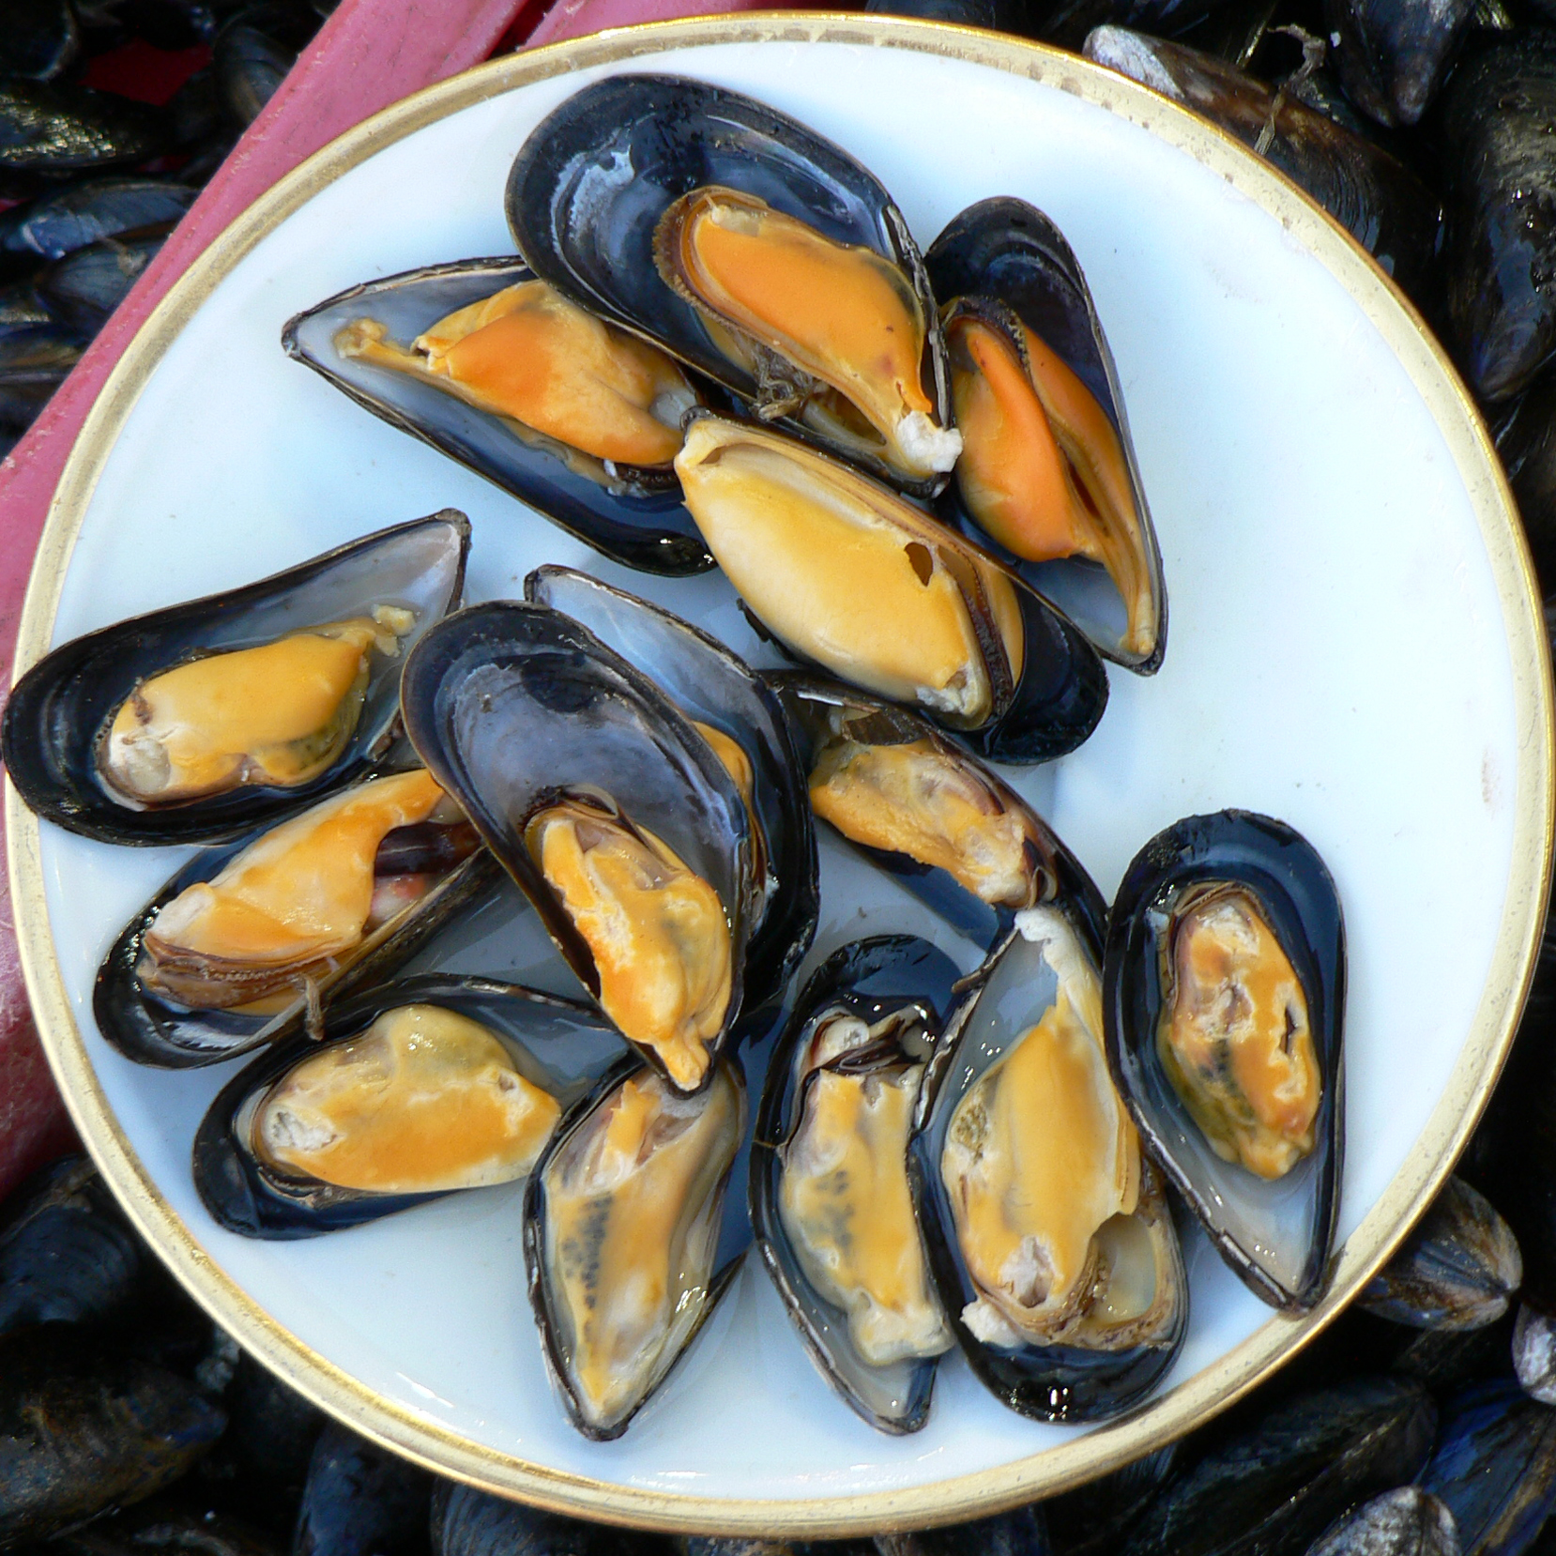
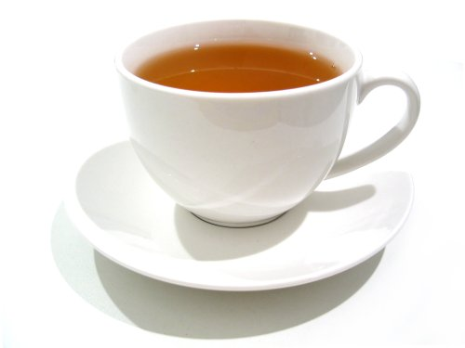
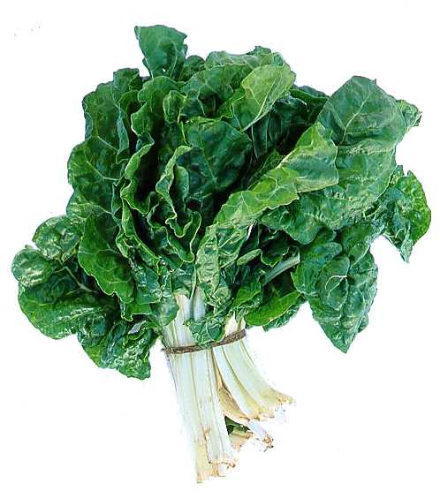
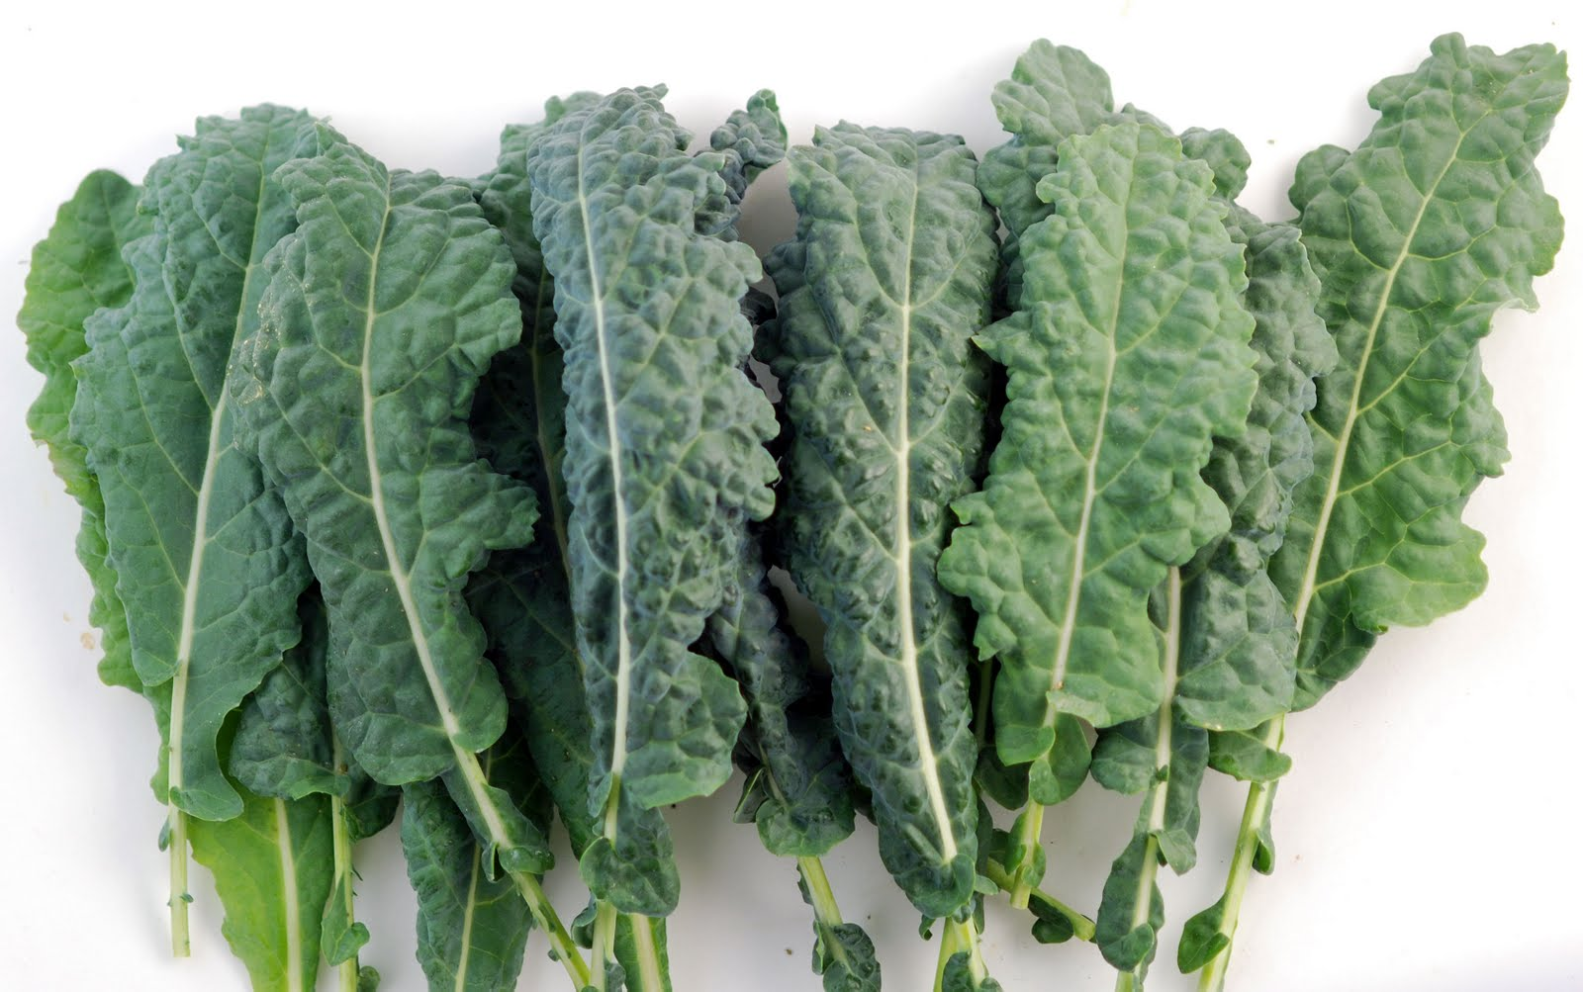
Eat Foods Containing Manganese

Slide 84
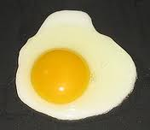
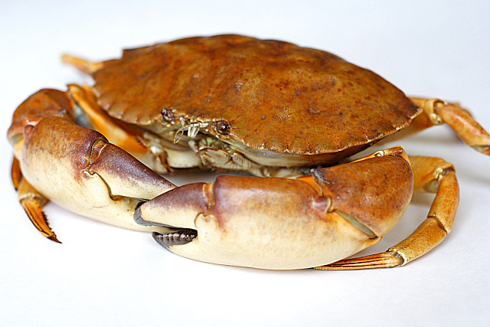
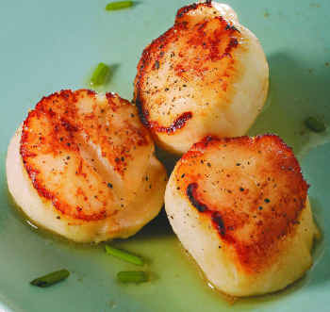
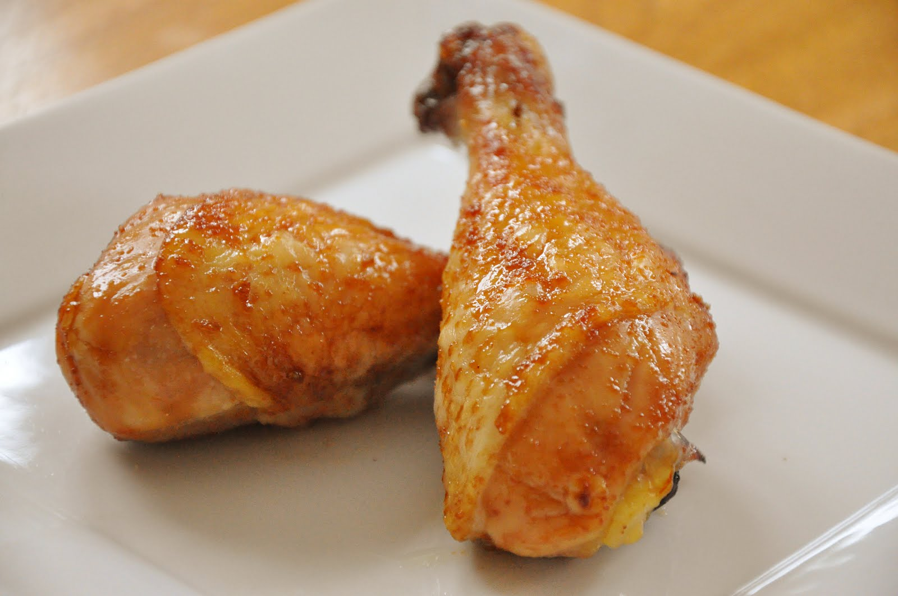
Eat Foods Containing Sulfur
Notes:
http://healthyeatingclub.com/info/books-phds/books/foodfacts/html/data/data5g.html

Slide 85
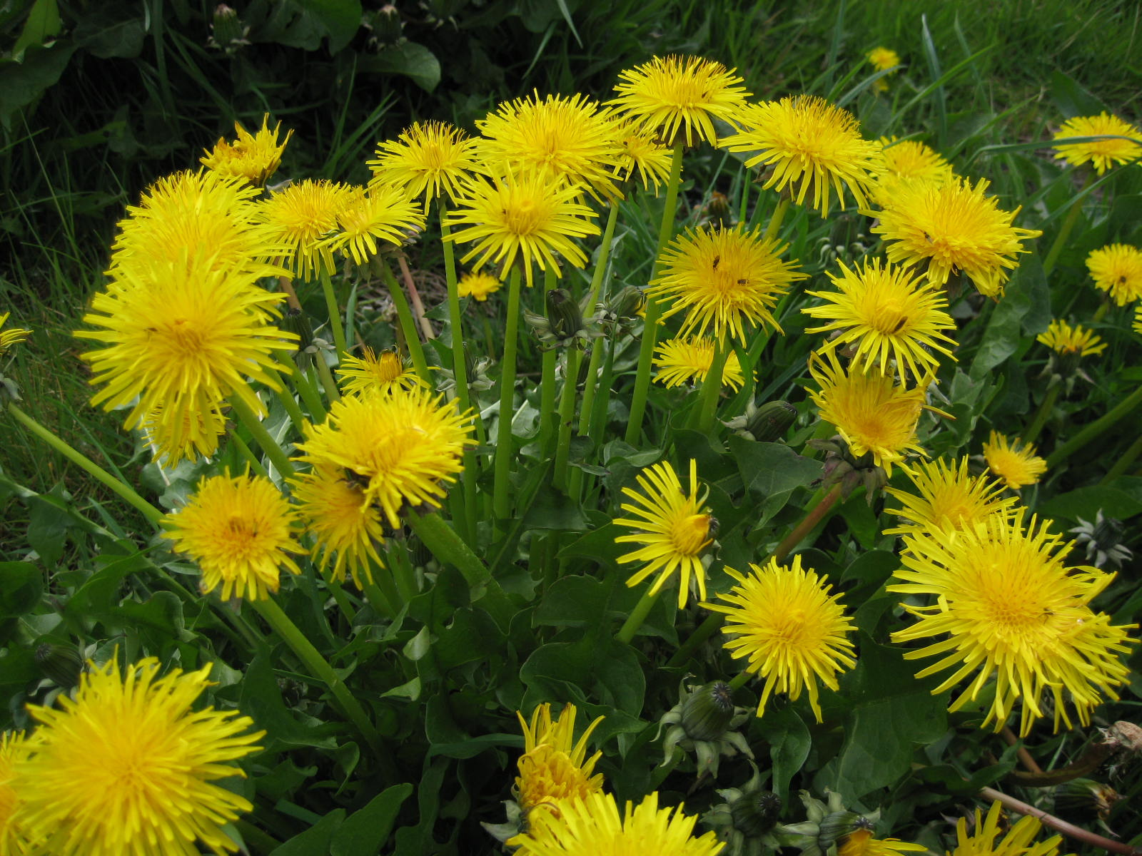
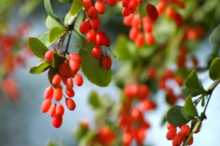
Extracts from Common Plants Can Treat Glyphosate Poisoning*
Roundup is toxic to hepatic and embryonic cells at doses far below those used in agriculture and at residue levels present in some GM food.
Extracts from common plants such as dandelions, barberry, and burdock can protect from damage, especially if administered prior to exposure.
*C Gasnier et al. Journal of Occupational Medicine and Toxicology 2011, 6:3

Slide 86
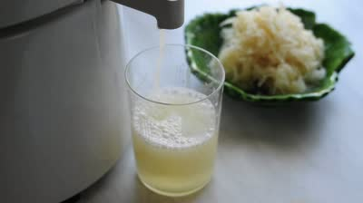
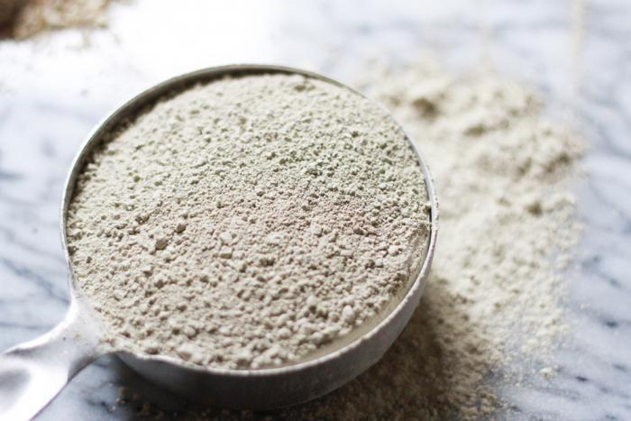
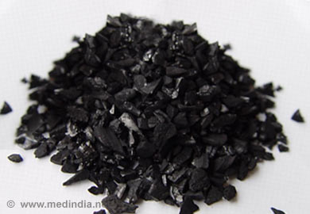
Treating Glyphosate Poisoning in Animals (e.g., cows) *
Activated charcoal, bentonite clay, humic and fulvic acids, and sauerkraut juice have been shown to be effective in reducing urinary levels of glyphosate and improving animal health
Sauerkraut
Juice
Fulvic Acid
Activated Charcoal
Bentonite Clay
*H Gerlach et al., J Environ Anal Toxicol 2014, 5:2
Notes:
Glyphosate/Monika_cows_humic_acid_fulvic_acid_treat_glyphosate.pdf
Activated charcoal
活性炭
clay
粘土
Niántǔ
Huóxìngtàn

Slide 87
Get Grounded

Slide 88
Say ‘No’ to Vaccines!
Refuse all vaccines that aren’t mandated
Delay and space out the mandated vaccines
Especially, postpone Hep-B at birth and delay MMR from 12 months to 3 years

Slide 89
Key Take Away Message
Glyphosate
Glyphosate and MMR conspire to cause autoimmune disease
Glyphosate has been linked to autism
MMR Vaccine
Autism
MMR vaccine has been linked to autism

Slide 90
Summary
Children (and adults!) today in the US suffer from many autoimmune diseases
I believe this is due mainly to synergistic toxicity between glyphosate and vaccines
Glyphosate can substitute for glycine by mistake during protein synthesis, causing many diseases
Molecular mimicry: If glyphosate infiltrates measles virus protein, it could explain an intense autoimmune reaction in the brain leading to autism
MMR and Gardasil are particularly problematic vaccines
Organic diet rich in manganese and sulfur, grounding and sunlight exposure can help you stay healthy

