Slide 1
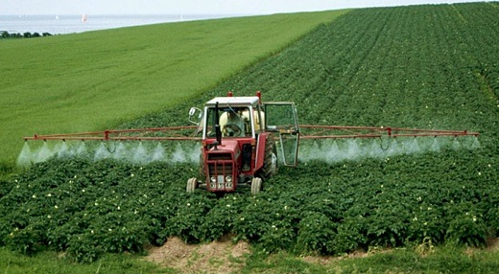
GMOs & glyphosate -- real threats to human & environmental health
Stephanie Seneff
MIT CSAIL
April 28, 2016

Slide 2
“Those who have the privilege to know, have the duty to act..”
Albert Einstein

Slide 3
Outline
Overview
Evidence of Toxicity
Glyphosate in Proteins
Sugar Beets, Glyphosate, MS and Madcow
Collagen, Arthritis and Vaccines
Neurological Diseases
Diabetes, Obesity and Adrenal Insufficiency
How to Safeguard Yourself and Your Family
Summary

Slide 4
Overview

Slide 5
1 in 68

Slide 6
Roundup and GMO Crops
GMO Roundup-Ready corn, soy, canola, sugar beets
cotton, tobacco and alfalfa
What is glyphosate?

Slide 7
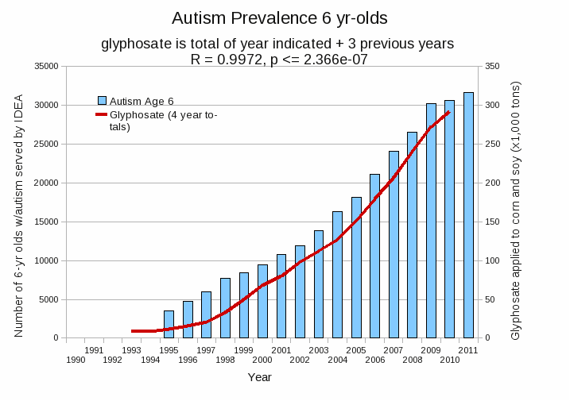
Autism Prevalence: 6 year olds*
R = 0.9972
* Figure 15, Seneff et al., Agricultural Sciences, 2015, 6, 42-70
Notes:
Nancy/latest_plots/6-yr-old autism.gif
autism: USDE
oil consumption: USDA
glyphosate: USDA
GE crops: USDA
Mortality data: CDC

Slide 8
Growth of GM “Roundup-Ready” Corn, Soy and Cotton in US, 1996-2012*
*N. Swanson et al., Journal of Organic Systems, 9(2), 2014, 6-37.

Slide 9
“Glyphosate Now the Most-Used Agricultural Chemical Ever”* By Douglas Main, Feb 2, 2016 Newsweek
Glyphosate usage has increased 50-fold since 1996, when GMO glyphosate-resistant crops were introduced in the US.
Today, 50 times more glyphosate is allowed by the EPA on corn grain than in 1996
Half of the American farmers' fields have weeds that are resistant to glyphosate
New GMO crops offer dual resistance to glyphosate & 2,4-D → Enlist Duo
*www.newsweek.com/glyphosate-now-most-used-agricultural-chemical-ever-422419
Notes:
./Newsweek_on_glyphosate_overuse.text

Slide 10
Sobering Statistics on Glyphosate Residues*
0.1 ppb: altered the gene function of over 4000 genes in the livers and kidneys of rats.
0.1 ppb: severe organ damage in rats
0.1 ppb: Permitted level for glyphosate and all other herbicides in EU tap water
10 ppb: toxic effects on the livers of fish
700 ppb: Permitted level for glyphosate in U.S. tap water**
11,900 ppb: found in Genetically Modified (GMO) Soybeans
** Canada: 280 ppb
*http://detoxproject.org/glyphosate-in-numbers/

Slide 11
Sobering Statistics on Glyphosate Residues*
0.1 ppb: altered the gene function of over 4000 genes in the livers and kidneys of rats.
0.1 ppb: severe organ damage in rats
0.1 ppb: Permitted level for glyphosate and all other herbicides in EU tap water
10 ppb: toxic effects on the livers of fish
700 ppb: Permitted level for glyphosate in U.S. tap water**
11,900 ppb: found in Genetically Modified (GMO) Soybeans
Zen Honeycutt, of Moms Across America found levels in human breast milk that were 1600 times higher than the upper limit allowed in water in Europe
** Canada: 280 ppb
*http://detoxproject.org/glyphosate-in-numbers/

Slide 12
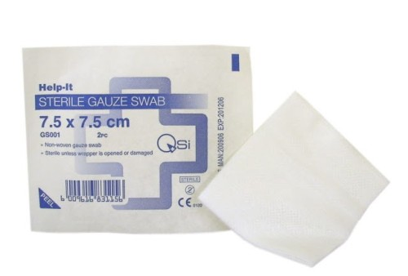
Glyphosate in Cotton Products*
“The vast majority ‒ 85 percent ‒ of tampons, cotton and sanitary products tested in a new Argentinian study contained glyphosate”
In 2014, 96 percent of cotton produced in the United States was genetically modified to resist glyphosate
*https://www.rt.com/usa/319524-tampons-cotton-glyphosate-monsanto/

Slide 13
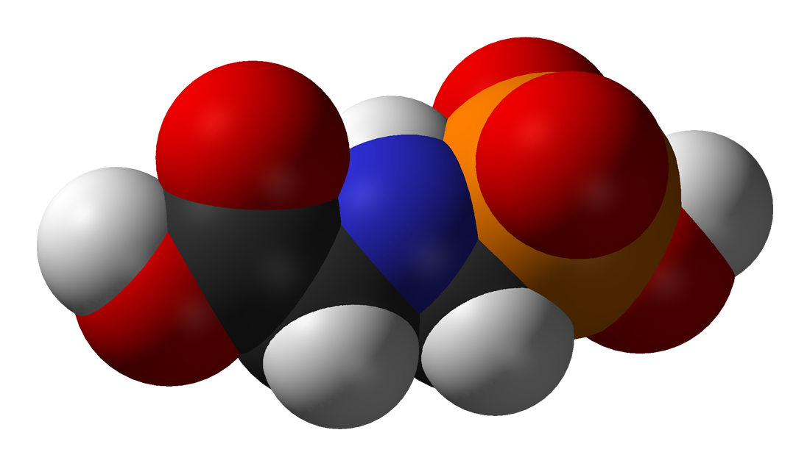
Is Glyphosate Toxic?
Monsanto has argued that glyphosate is harmless to humans because our cells don’t have the shikimate pathway, which it inhibits
However, our gut bacteria DO have this pathway
We depend upon them to supply us with essential amino acids (among many other things)
Other ingredients in Roundup greatly increase glyphosate’s toxic effects and are themselves toxic
Insidious effects of glyphosate accumulate over time
Most studies are too short to detect damage

Slide 14
Main Toxic Effects of Glyphosate*
Interferes with function of cytochrome P450 (CYP) enzymes
Chelates important minerals (iron, cobalt, manganese, etc.)
Interferes with synthesis of aromatic amino acids and methionine
Leads to shortages in critical neurotransmitters and folate
Disrupts sulfate synthesis and sulfate transport
*Samsel and Seneff, Entropy 2013, 15, 1416-1463

Slide 15
Glyphosate: The Central Mechanisms*
Glyphosate acts as an antibiotic to disrupt gut bacteria, leading to overgrowth of pathogens
Disruption of liver CYP enzymes leads to impaired bile flow and low vitamin D
This disrupts sulfate synthesis and transport
Also impairs detoxification of other toxic chemicals
Damage to red blood cells leads to anemia and toxicity due to free iron
Hypoxia ensues → low grade encephalopathy
Leaky gut and leaky brain barrier lead to neuronal exposure to dangerous metals and neurotoxins
* A Samsel and S Seneff, Entropy 2013, 15(4), 1416-1463

Slide 16
Evidence of Toxicity

Slide 17
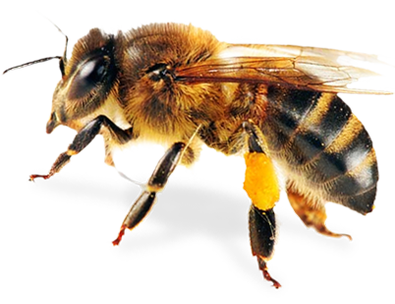
Inhibition of Cytochrome P450 Enzymes (CYPs) by Various Pesticides*
Study in rats on 2,4-D, clofibrate, MCPA, and glyphosate
*E Hetanen et al., Acta Pharmacol. Et Toxicol. 1983, 53, 103-1 12.
Notes:
./glyphosate_inhibits_CYPS_and_other_issues.pdf
Fig. 1. The concentration of hepatic cytochrome P-450 in rats exposed to clofibrate, glyphosate, 2,4dichlorophen- oxyacetic acid (2,4-D) or 4-chloro-2-methylphenoxyace- tic acid (MCPA) for 2 weeks. The doses of 2,4-D and MCPA are also shown. The meansfS.E.M. are shown. The statistical significances were analyzed with Student's t-test using controls as a reference group. The following symbol is used: *: P<0.05.

Slide 18
Glyphosate Depletes Iron, Manganese and Zinc in Plants*
*D Huber, What About Glyphosate-Induced Manganese Deficiency? Fluid Journal, 20-22.
Notes:
Glyphosate/glyphosate_induced_manganese_deficiency_plants_Huber.pdf

Slide 19
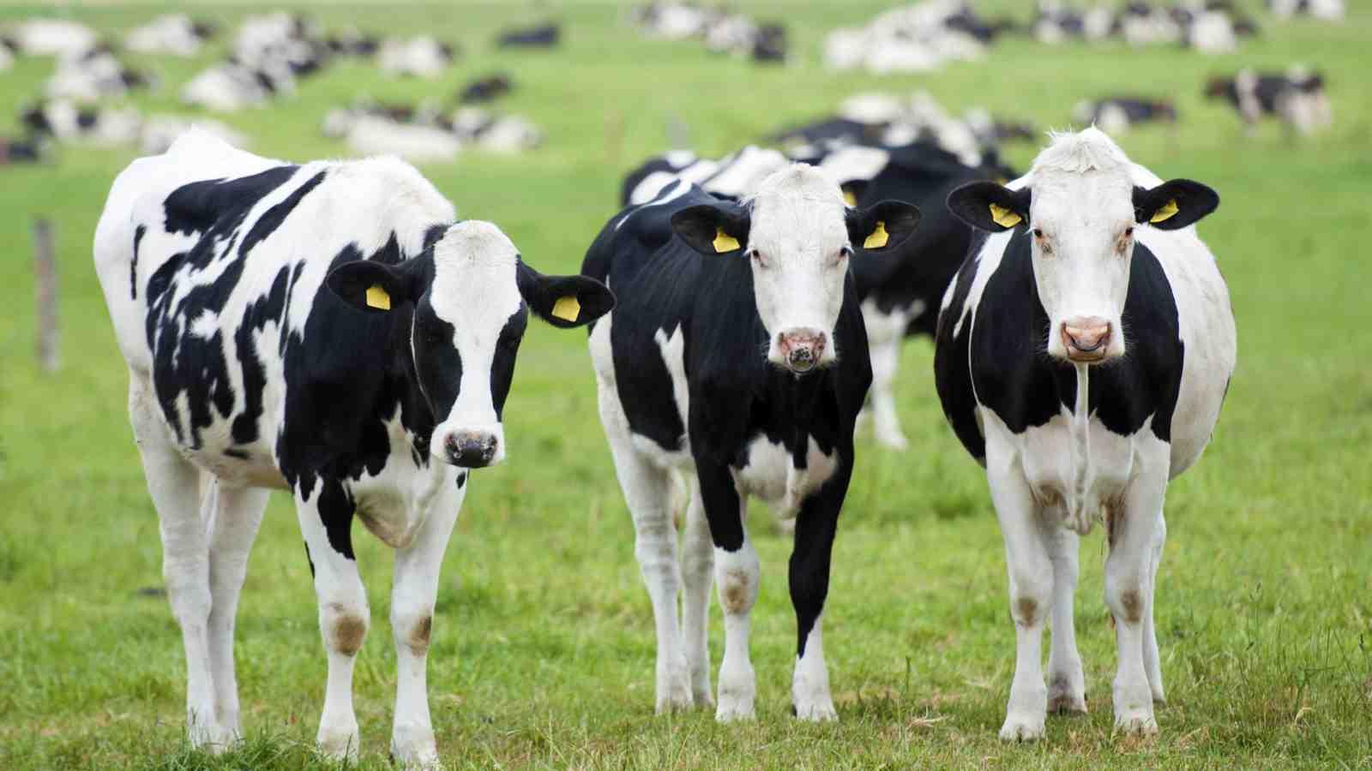
Severe Deficiency in Serum Manganese and Cobalt in Cows*
Cobalt
Manganese
Eight different farms: all cows tested had glyphosate in the urine
*M. Krüger et al., J Environ Anal Toxicol 2013, 3:5
Notes:
glyphosate//cows_cobalt_deficiency_glyphosate.pdf

Slide 20
Some Consequences of Manganese Deficiency
Lactobacillus critically depend on manganese
Manganese superoxide dismutase protects mitochondria from oxidative damage
Manganese is essential for detoxing glutamate (neurotoxin)
Pituitary depends on manganese to release thyroid stimulating hormone
Chondroitin sulfate synthesis in bones

Slide 21
The Enhancing Effect of Adjuvants*
“Adjuvants in pesticides are generally declared as inerts, and for this reason they are not tested in long-term regulatory experiments. It is thus very surprising that they amplify up to 1000 times the toxicity of their APs [Active Principles] in 100% of the cases where they are indicated to be present by the manufacturer.”
*R. Mesnage et al.BioMed Research International 2014; Article ID:179691.
Notes:
Glyphosate/seralini_2014_pesticide_toxicity_adjuvants.pdf

Slide 22
Roundup Safety Claims Disputed*
“It is commonly believed that Roundup is among the safest pesticides. … Despite its reputation, Roundup was by far the most toxic among the herbicides and insecticides tested. This inconsistency between scientific fact and industrial claim may be attributed to huge economic interests, which have been found to falsify health risk assessments and delay health policy decisions.”
*R. Mesnage et al., Biomed Research International, Volume 2014 (2014),
Article ID 179691
Notes:
Glyphosate/ Mesnage_Seralini_2014_glyphosate_toxicity_proven.pdf
This is the first time that all these formulated pesticides have been tested on human cells well below agricultural dilutions.
adjuvants were also more cytotoxic through the disruption of membrane and mitochondrial respiration,
1000-fold enhancement w/ adjuvants

Slide 23
Mammary Tumors in Rats*
Rats through their entire lifespan exposed to Roundup at levels well below established safety limits
*G.-E. Séralini et al., Food Chem. Toxicol. 2012;50(11):4221-4231
Notes:
Images/seralini_rats.png
./seralini_paper.pdf

Slide 24
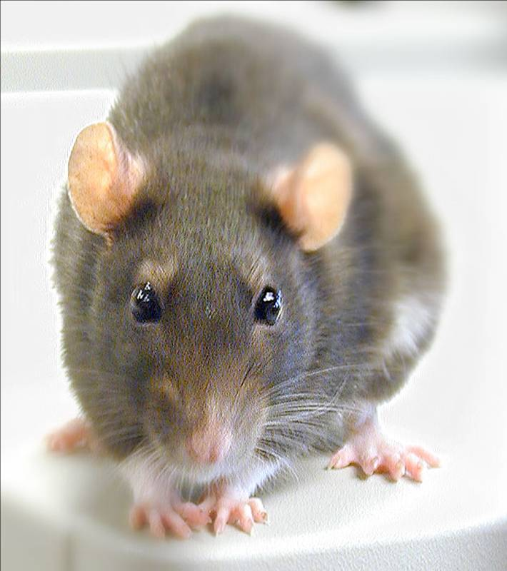
Conclusions from Rat Study *
Female rats had greatly increased risk of mammary tumors
Males had significantly increased risk of liver and kidney disease
Sex hormone disruption for both males and females
Enhanced oxidative stress
Effects didn’t become apparent until after 4 months
*G.-E. Séralini et al., Food and Chemical Toxicology, 2012, in press
Notes:
Spacedoc/mercola/GMOS_mouse_study_2012.pdf

Slide 25
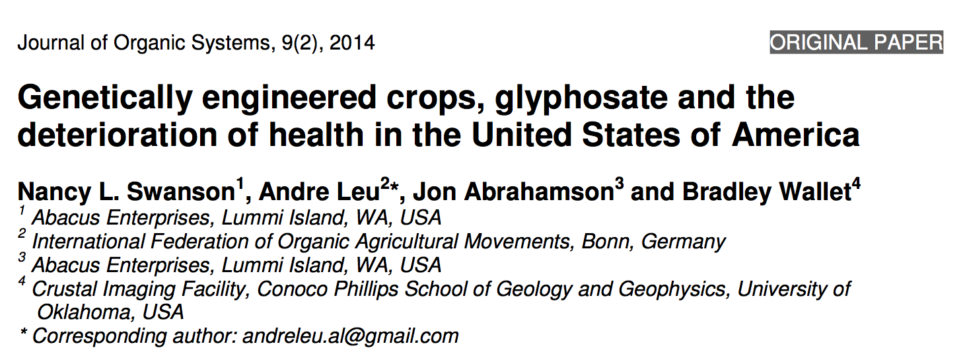
Paper Showing Strong Correlations between Glyphosate Usage and Chronic Disease

Slide 26
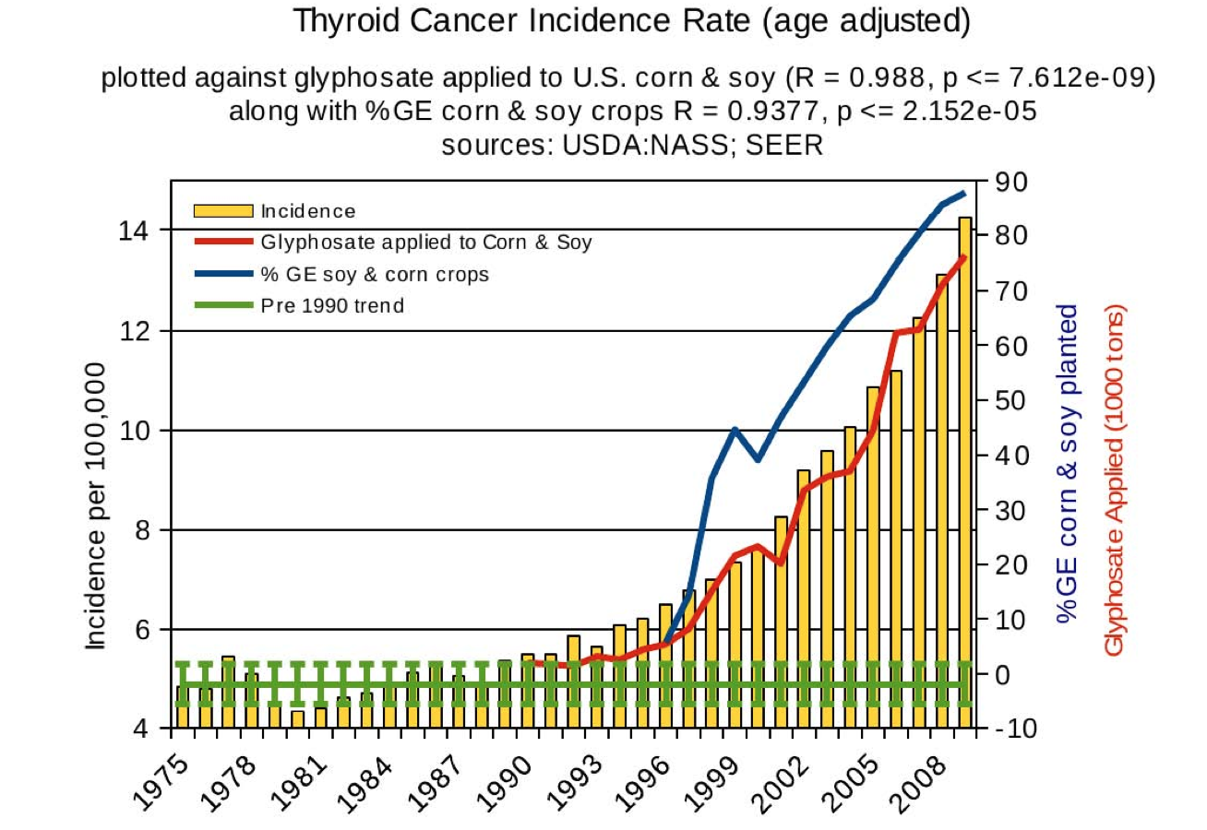
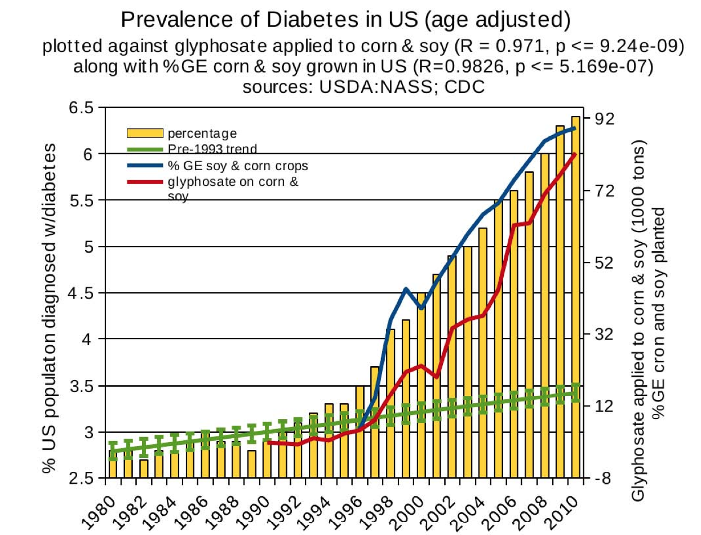
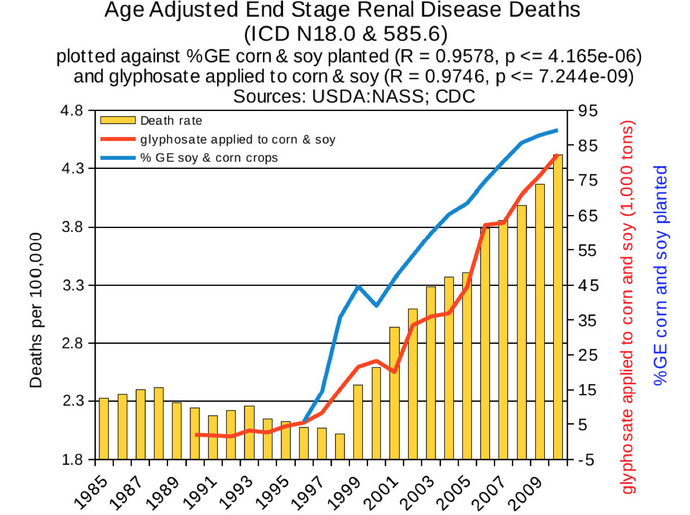
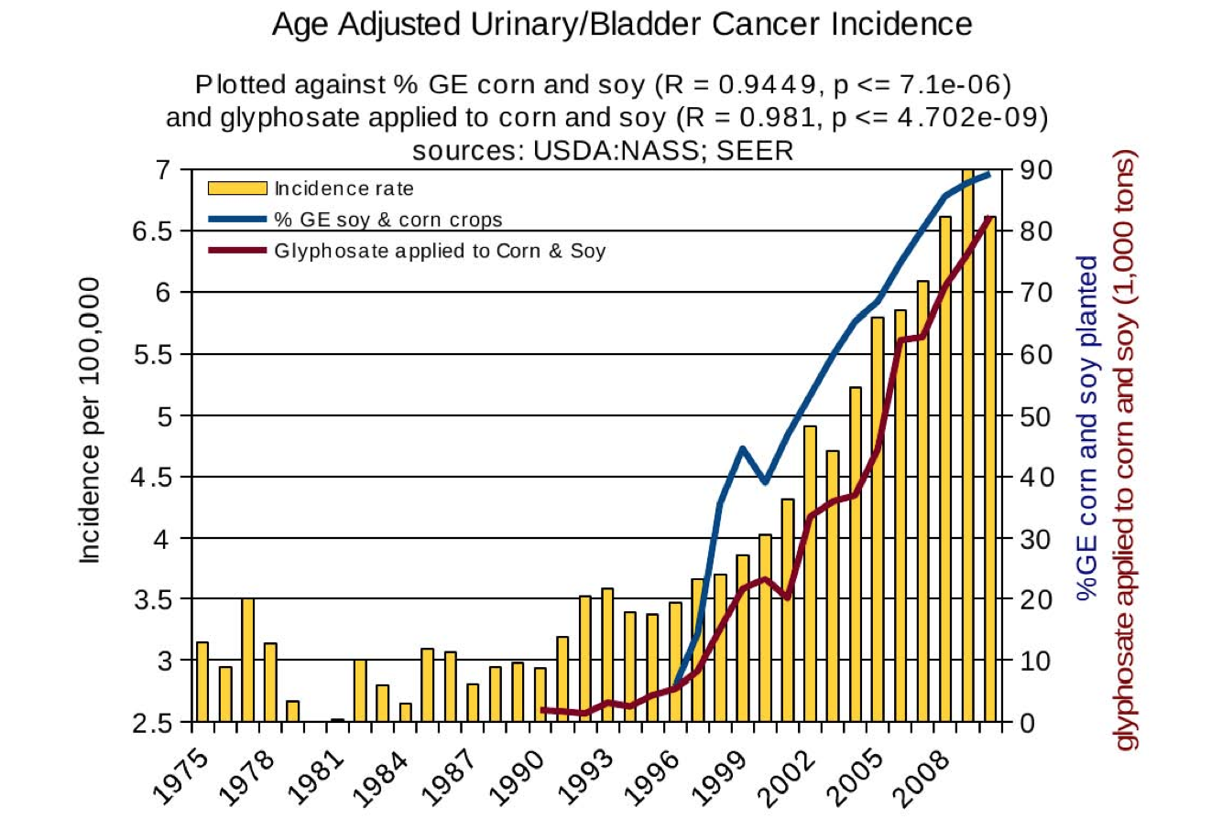
Thyroid cancer
Diabetes
End stage
renal disease
Urinary/bladder
cancer

Slide 27
Thyroid cancer
Diabetes
In 2015, WHO declared glyphosate a “probable carcinogen”
End stage
renal disease
Urinary/bladder
cancer

Slide 28
Quote from the Conclusion*
“Although correlation does not necessarily mean causation, when correlation coefficients of over 0.95 (with p-value significance levels less than 0.00001) are calculated for a list of diseases that can be directly linked to glyphosate, via its known biological effects, it would be imprudent not to consider causation as a plausible explanation.”
*NL Swanson et al. Journal of Organic Systems 9(2), 2014, p. 32,

Slide 29
Glyphosate and Antibiotic Resistance
E. coli develop resistance to glyphosate by overexpression of efflux pumps*
These pumps can also export multiple antibiotics → antibiotic resistance
These efflux pumps enable pathogens to adhere to and invade host cells**
Multiple gut pathogens could potentially develop multi-antibiotic resistance with chronic exposure to glyphosate
*JM Staub et al. J Ind Microbiol Biotechnol (2012) 39:641–647
**LJV Piddock, Nature Reviews 2006;4:629-636.
Notes:
Personal/Project/glyphosate/resistance/

Slide 30
Glyphosate in Proteins

Slide 31
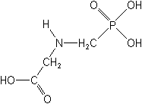
What If Glyphosate Could Insert Itself Into Protein Synthesis???
glyphosate
Code for glycine
GGC
mRNA
. . .
. . .
Glyphosate
Alanine
Proline
Any proteins with conserved glycine residues are likely to be affected in a major way

Slide 32
What If Glyphosate Could Insert Itself Into Protein Synthesis???
Glyphosate is a synthetic non-coding amino acid analogue of glycine
glyphosate
Code for glycine
GGC
mRNA
. . .
. . .
Glyphosate
Alanine
Proline
Any proteins with conserved glycine residues are likely to be affected in a major way

Slide 33
Some Predicted Consequences
Neurological diseases
Neural tube defects
Celiac disease
Impaired collagen → osteoarthritis
Steatohepatitis (fatty liver disease)
Obesity and adrenal insufficiency
Impaired iron homeostasis and kidney failure
Insulin resistance and diabetes
Cancer
Autoimmune diseases

Slide 34
Circumstantial Evidence from the Rhizosphere*
Researchers used RNA sequence analysis to quantify changes in microbial protein expression in presence of glyphosate
Found significant increase in production of enzymes related to protein synthesis and protein breakdown
Rhizosphere
* MM Newman et al., Science of the Total Environment 553 (2016) 32–41
Notes:
Glyphosate/Changes\ in\ microbial\ pops\ due\ to\ glyphosate\ -\ Mollie\ 2016.pdf

Slide 35
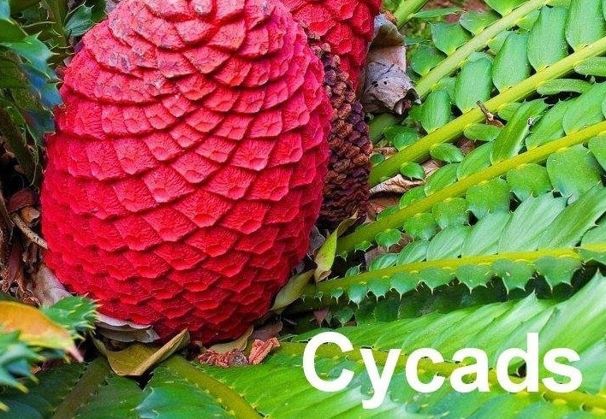
An Analogy: ALS in Guam
An epidemic in ALS in Guam was traced to a natural toxin found in cycads
BMAA is a non-coding amino acid that gets inserted by mistake in place of serine
Defective versions of a glutamate transporter have been linked to ALS*
The transporter has an essential serine-rich region in its sequence**
*Antioxidants & Redox Signaling 2009;11: 1587-1602.
**DJ Slotboom et al., PNAS 1999; 96(25): 14282-14287.
Notes:
cyanobacteria_BMAA_article.pdf
Slotbloom_1999_conserved_serine_glutamate_transporter.pdf
Dunlop.pdf
ALS_glutamate_transporter_link_2009.pdf
Guam/
*ALS_glutamate_transporter_link_2009.pdf
ChrisShawChapter7GuamFantastic.docx
Dunlop.pdf
**Slotbloom_1999_conserved_serine_glutamate_transporter.pdf

Slide 36
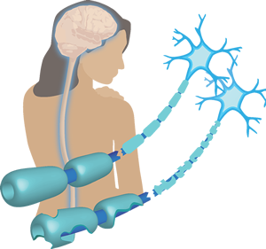
Another Analogy: Multiple Sclerosis & Sugar Beets*
Sugar beets contain an analogue of proline called Aze
Remarkable correlation between MS frequency and proximity to sugar beet agriculture, worldwide
Myelin basic protein contains a cluster of proline residues that are absolutely essential for its proper function
*E. Rubenstein, J Neuropathol Exp Neurol 2008;67(11): 1035-1040.
Notes:
./misincorporation_of_proline_analogue_MS.pdf

Slide 37
Into The Wild*
Chris McCandless died in the Alaskan wilderness in 1992
A staple of McCandless' diet was seeds from a wild potato plant which contained L-canavanine, a non-coding amino acid analogue of L-arginine
Author Jon Krakauer determined that McCandless was slowly poisoned by L-canavanine
*J Krakauer et al., Wilderness & Environmental Medicine 2015; 26: 36-42.

Slide 38
Sugar Beets, Glyphosate,
MS and Madcow

Slide 39
Madcow Disease: Bovine Spongiform Encephalopathy
Symptoms include lower limb paralysis similar to multiple sclerosis
Related to Creutzfeldt-Jakob disease and kuru in humans, "scrapie" in sheep, and chronic wasting disease in deer
Cows are fed large amounts of sugar beet pulp (residue from sugar processing)
Is this a causal agent?
Notes:
Slide_notes.text

Slide 40
UK Epidemic in Madcow
"Dried molassed sugar-beet pulp" fed to British cows as of 1986.*
Madcow epidemic in great Britain began in the 1980's and peaked in 1993.
*RG Hemingway et al., A note on the effect of molasses inclusion in
sugar beet pulp on the yield and composition of the milk of dairy
cows. Animal Production 1986;42(3) :417-420.
Notes:
./sugar_beets_fed_to_British_cows_1986.text
“for many years”

Slide 41
Root Rot: Fungus Infection
Aze has been shown to have anti-fungal properties*
Glyphosate increases risk to fungus infection causing root rot in sugar beets**
This suggests that glyphosate might increase Aze production in sugar beets
*B Bach et al., Specialia Experientia 1978;34(6):688-688.
**R Larson et al. Pest Manag Sci. 2006;62(12):1182-92.
Notes:
./Aze_sponges_anti_fungal_properties.pdf

Slide 42
Relationship to Glyphosate-Metabolizing Microbes*
Diseased cows test high in antibodies to two bacterial species: Pseudomonas aeruginosa and Acetobacter
These two microbes are among very few that can metabolize glyphosate
Humans with MS, type I diabetes and Celiac disease also test high for these antibodies
Authors propose autoantibodies to both white and gray matter brain components due to molecular mimicry
*A Ebringer et al., Ann N Y Acad Sci 2005;1050:417-28.
A Ebringer et al., Medical Hypotheses 2012;78(6):763-769.
Notes:
Multiple_sclerosis_acinetobacter.text
./Acinetobacter_role_in_MS_MedHyp_2012.pdf

Slide 43
Relationship to Glyphosate-Metabolizing Microbes*
Diseased cows test high in antibodies to two bacterial species: Pseudomonas aeruginosa and Acetobacter
These two microbes are among very few that can metabolize glyphosate
Humans with MS, type I diabetes and Celiac disease also test high for these antibodies
Authors propose autoantibodies to both white and gray matter brain components due to molecular mimicry
Hypothesis:
These microbes are exposed to high levels of glyphosate and they incorporate it into their proteins by mistake, leading to impaired proteolysis and antibody development
*A Ebringer et al., Ann N Y Acad Sci 2005;1050:417-28.
A Ebringer et al., Medical Hypotheses 2012;78(6):763-769.
Notes:
Multiple_sclerosis_acinetobacter.text
./Acinetobacter_role_in_MS_MedHyp_2012.pdf

Slide 44
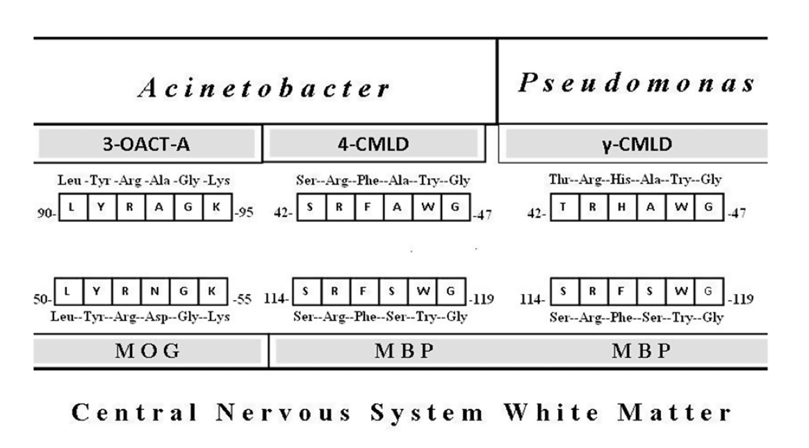
Homologous Sequences*
* A Ebringer et al., Medical Hypotheses 78 (2012) 763–769
Notes:
./Acinetobacter_role_in_MS_MedHyp_2012.pdf
Myelin oligodendrocyte glycoprotein
./acinetobacter_Pseudomonas_MS_homologies_2003.pdf

Slide 45
Collagen,
Arthritis and Vaccines

Slide 46
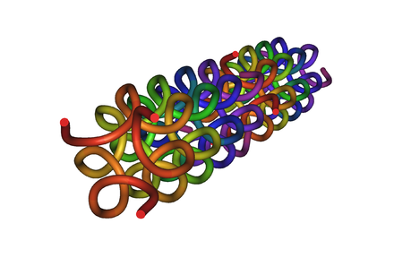
Collagen and Gelatin
25% of the protein in our body is collagen
Collagen forms a triple helix with building block triples of Gly-X-X, where X is often proline.
Glyphosate substitution for glycine will disrupt triple-helix formation and lead to diseases of the vasculature, joints and bones
Gelatin is derived from collagen in ligaments sourced from cows and pigs fed glyphosate- contaminated GMO Roundup-Ready feed

Slide 47
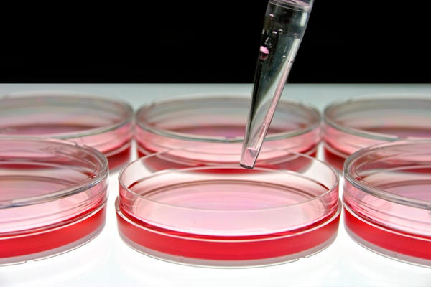
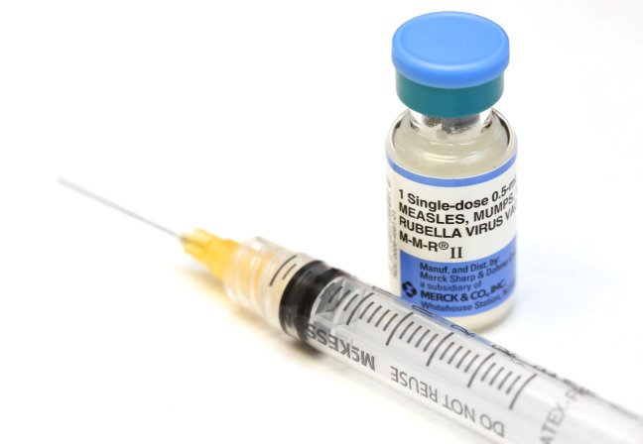
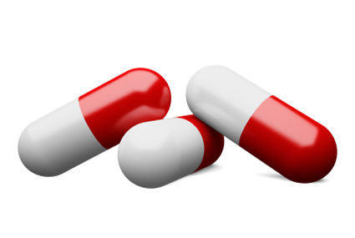
Gelatin!!

Slide 48
Glyphosate in Vaccines?
For MMR, flu vaccine, and rabies vaccine, live virus is grown on gelatin derived from ligaments of pigs
Pigs are fed GMO Roundup-Ready corn and soy feed
Gelatin contains significant amounts of both glycine and glutamate
These two neurotransmitters together excite the NMDA receptors in the brain
Glyphosate substitution in the protein for glycine is a possibility!
Glyphosate stimulation of NMDA receptors could cause neuronal burnout

Slide 49
Autism, Glyphosate, Vaccine Reactions*
Glyphosate application to corn and soy, US
Children with Autism, US
# Adverse Reactions in VAERS
*Collaboration with Dr. Nancy Swanson
Notes:
Individuals with Disabilities Education Act

Slide 50
Symptoms of Adverse Reactions to MMR before and after 2002*
*Data analyzed from the VAERS database

Slide 51
Symptoms of Adverse Reactions to MMR before and after 2002*
Joint pain
seizures
shortness of breath
hives
These are all characteristic symptoms of allergies to MSG
eczema
anaphylactic shock
Facial swelling
swelling
swelling
*Data analyzed from the VAERS database

Slide 52
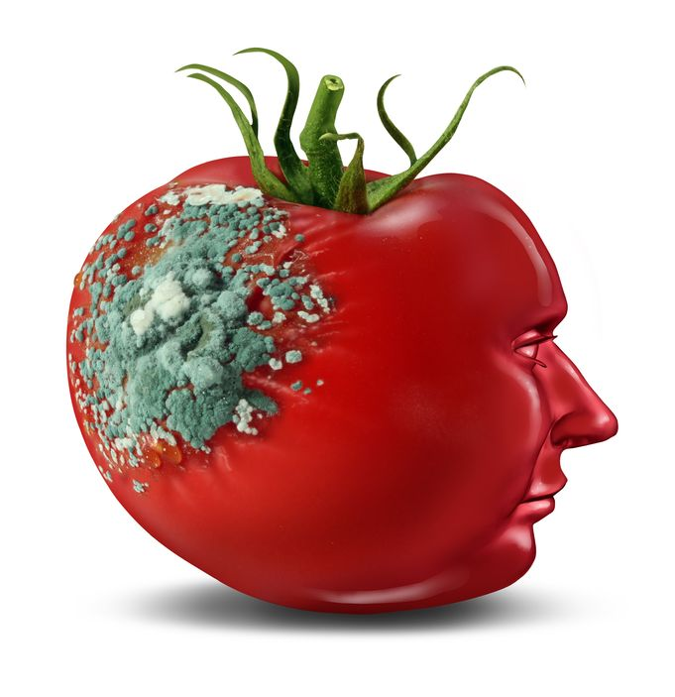
Glyphosate and Glutamate*
Acute exposure activates NMDA receptors and voltage-dependent calcium channels
Oxidative stress and neural cell death
Increased glutamate release into the synaptic cleft → excessive extracellular glutamate levels
Decreased glutathione content
Increased peroxidation of lipids (fats)
*http://www.greenmedinfo.com/blog/roundup-weedkiller-brain-damaging-neurotoxin
Notes:
http://www.greenmedinfo.com/blog/roundup-weedkiller-brain-damaging-neurotoxin
acute exposure (30 minutes) and chronic (pregnancy and lactation) exposure.
Rat hippocampus
Why was this referenced??
T. Bohn et al. Food Chemistry 153, 15 June 2014, 207-215.

Slide 53
MMR, Glyphosate, Molecular Mimicry
MMR vaccine “takes” if child develops antibodies to measles hemagglutinin*
Hemagglutinin has strong sequence similarity to myelin basic protein (MBP)
A measles virus infection in the brain could induce autoantibodies to MBP
This over time would destroy the myelin sheath
Children with autism have high titers of antibodies to hemagglutinin and autoantibodies to MBP**
*RL de Swart et al., Journal of Virology 2005; 11547-11551.
**VK Singh et al., J Biomed Sci 2002;9(4):359-64

Slide 54
MMR, Glyphosate, Molecular Mimicry
MMR vaccine “takes” if child develops antibodies to measles hemagglutinin*
Hemagglutinin has strong sequence similarity to myelin basic protein (MBP)
A measles virus infection in the brain could induce autoantibodies to MBP
This over time would destroy the myelin sheath
Children with autism have high titers of antibodies to hemagglutinin and autoantibodies to MBP**
Glyphosate induces leaky gut due to overgrowth of pathogens, and this leads to a leaky brain barrier permitting antibody access to the brain
*RL de Swart et al., Journal of Virology 2005; 11547-11551.
**VK Singh et al., J Biomed Sci 2002;9(4):359-64

Slide 55
Neurological Diseases

Slide 56
Neurological Diseases
At least four neurological diseases related to misfolded proteins involve conserved glycine residues
Disease | Protein | Reference
Alzheimer’s | Amyloid beta | Goure et al.
Parkinson’s disease | Alpha synuclein | Du et al.
ALS | TDP-43 | Pesiridis et al.
Prion diseases | Prion proteins | Harrison et al.
WF Goure et al., Alzheimer's Research & Therapy 2014; 6: 42.
H-N Du et al., Biochemistry 2003; 42: 8870-8878.
S Pesiridis et al., Hum Mol Genet 2009; 18(R2): R156-R162.
CF Harrison et al., J Biol Chem 2010; 285(26): 20213-20223.
Notes:
transactive response DNA binding protein
TAR DNA binding protein

Slide 57
Neurological Diseases
At least four neurological diseases related to misfolded proteins involve conserved glycine residues:
Alzheimer’s: Amyloid-beta
Parkinson’s Disease: Alpha-synuclein
ALS: TDP-43
Madcow/Prion diseases: Prion proteins
In all cases, the issue is a rare soluble peptide rather than the precipitated plaque.
The glycine residues are strongly implicated in the disease process
Glyphosate increases the protein’s solubility

Slide 58
Deaths from Senile Dementia*
*Plot provided by Dr. Nancy Swanson

Slide 59
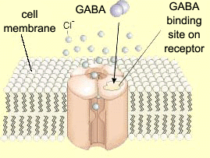
Impaired GABA Receptor Activity and Autism
Autism has been linked to a weakened response of the inhibitory GABA receptor to stimuli*
The GABA receptor has a conserved glycine at the entrance to the first membrane-spanning domain that is essential for its function**
*CD Robertson et al., Current Biology 2016;26: 80-85
**BX Carlson et al., Mol Pharmacol. 2000;57(3):474-84
Notes:
2016/Anthony/
reduced_GABAergic_activity_autism_brain.pdf
ABA_conserved_glycine_2000.pdf

Slide 60
Diabetes, Obesity
and Adrenal Insufficiency

Slide 61
Is Glyphosate Making Us Obese?

Slide 62
Regulating Fat Release
Fats released from fat cells
Hormone sensitive lipase
Notes:
adrenalin

Slide 63
Impaired Fatty Acid Release from Fat Cells
Hormone sensitive lipases (aka triacylglycerol lipases)
Release fatty acids from fat cells
Supply cholesterol to adrenal glands and sex glands for hormone synthesis
Respond to glucagon, adrenalin, dopamine, and ACTH
Depend on multiple conserved glycines*:
Contain HGGG motif as “oxyanion hole”
Member of the class of “serine proteases” that contain a GXSXG motif essential for enzyme activity
*RC Wilmouth et al. Nat. Struct. Biol 2001;8: 689-694.

Slide 64
Impaired Fatty Acid Release from Fat Cells
Hormone sensitive lipases (aka triacylglycerol lipases)
Release fatty acids from fat cells
Supply cholesterol to adrenal glands and sex glands for hormone synthesis
Respond to glucagon, adrenalin, dopamine, and ACTH
Depend on multiple conserved glycines*:
Contain HGGG motif as “oxyanion hole”
Member of the class of “serine proteases” that contain a GXSXG motif essential for enzyme activity
Impaired hormone sensitive lipases have been linked to obesity, atherosclerosis and type II diabetes**
**SJ Yeaman, Biochem. J. (2004) 379, 11-22.
*RC Wilmouth et al. Nat. Struct. Biol 2001;8: 689-694.

Slide 65
Glyphosate Usage & Death due to Obesity*
*N Swanson et al., Journal of Organic Systems, 9(2), 2014

Slide 66
“The Association of Maternal Obesity and Diabetes With Autism and Other Developmental Disabilities”*
2734 children (102 ASD cases) in Boston area born between 1998 and 2014.
Mothers with obesity and pregestational diabetes had nearly four-fold increased risk to producing a child with autism
My observation: Glyphosate use on corn and soy crops correlates well temporally with all three conditions
*L Mengying et al., Pediatrics, February, 2016.

Slide 67
Adrenal Insufficiency
Roundup has been shown to severely impair adrenal hormone synthesis*
*A Pandey and M Rudraiah, Toxicology Reports 2 (2015) 1075-1085.

Slide 68
Insulin Receptor & Diabetes*,**
Glucagon release is regulated by insulin receptors (IRs)
When IRs are dysfunctional in mice, excess glucose is released from the liver, leading to elevated blood sugar and diabetes
Eight repeats of a glycine-centered motif determine IR 3-D structure
ATP-binding site contains a GXGXXG motif***
*PE Cryer, Endocrinology 2012;153(3):1039-1048.
**D Kawamori et al., Cell Metab 2009;9:350-361.
***DR Knighton et al., Proc Natl Acad Sci U S A. 1993;90(11):5001-5.
Notes:
%./insulin_signaling_alpha_cells_glucagon_secretion_2009.pdf

Slide 69
Diabetes and Glyphosate*
*Figure 14, Swanson et al. Journal of Organic Systems 2014; 9(2):6-37.

Slide 70
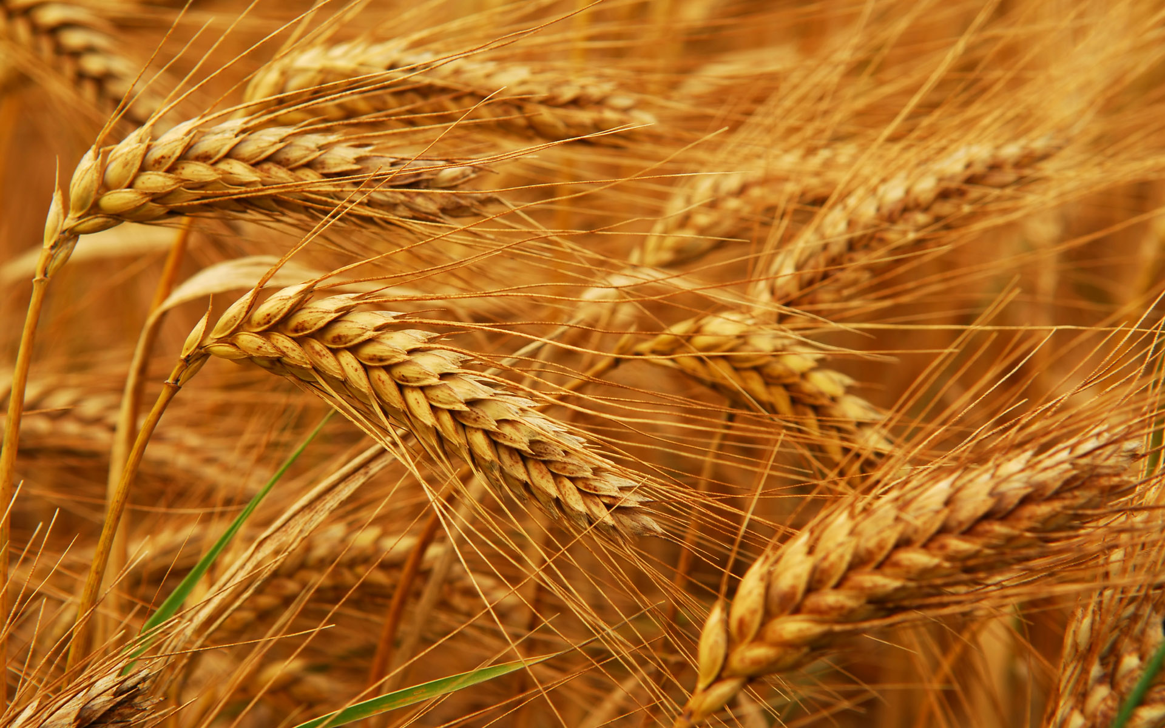
Glyphosate and Celiac Disease*
Glyphosate
Use on wheat
Celiac disease
*Samsel and Seneff, Interdiscip Toxicol. 2013;6(4): 159–184.

Slide 71
Celiac Disease and Prolyl Aminopeptidase
Gluten intolerance and Celiac disease result from inability to break down gluten, which is enriched in proline*
Prolyl aminopeptidase, the enzyme that breaks down proline-containing peptides, depends on manganese as a catalyst
Prolyl aminopeptidase also contains a highly conserved GxSxGG motif plus two other regions with conserved glycines**
Malabsorption due to celiac disease can lead to nutritional deficiencies and symptoms of autism***
*G. Janssen et al., PLoS One 2015; 10(6): e0128065
**F Morel et al., Biochimica et Biophysica Acta 1999;1429: 501-505
***SJ Genuis and TP Bouchard, J Child Neurol. 2010;25(1):114-9
Notes:
Plos One:
Ineffective Degradation of Immunogenic Gluten Epitopes by Currently Available Digestive Enzyme Supplements
Glyphosate/ineffective_proteolysis_of_proline_in_gluten_digestive_enzymes.pdf

Slide 72
Celiac Disease and Prolyl Aminopeptidase
Gluten intolerance and Celiac disease result from inability to break down gluten, which is enriched in proline*
Prolyl aminopeptidase, the enzyme that breaks down proline-containing peptides, depends on manganese as a catalyst
Prolyl aminopeptidase also contains a highly conserved GxSxGG motif plus two other regions with conserved glycines**
Malabsorption due to celiac disease can lead to nutritional deficiencies and symptoms of autism***
Wheat is routinely sprayed right before harvest with glyphosate as a desiccant
Other treated plants include
Sugar cane, barley, peanuts, maize and legumes
*G. Janssen et al., PLoS One 2015; 10(6): e0128065
**F Morel et al., Biochimica et Biophysica Acta 1999;1429: 501-505
***SJ Genuis and TP Bouchard, J Child Neurol. 2010;25(1):114-9
Notes:
Plos One:
Ineffective Degradation of Immunogenic Gluten Epitopes by Currently Available Digestive Enzyme Supplements
Glyphosate/ineffective_proteolysis_of_proline_in_gluten_digestive_enzymes.pdf

Slide 73
How to Safeguard Yourself
and Your Family

Slide 74
Go Organic!

Slide 75
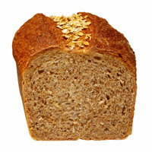
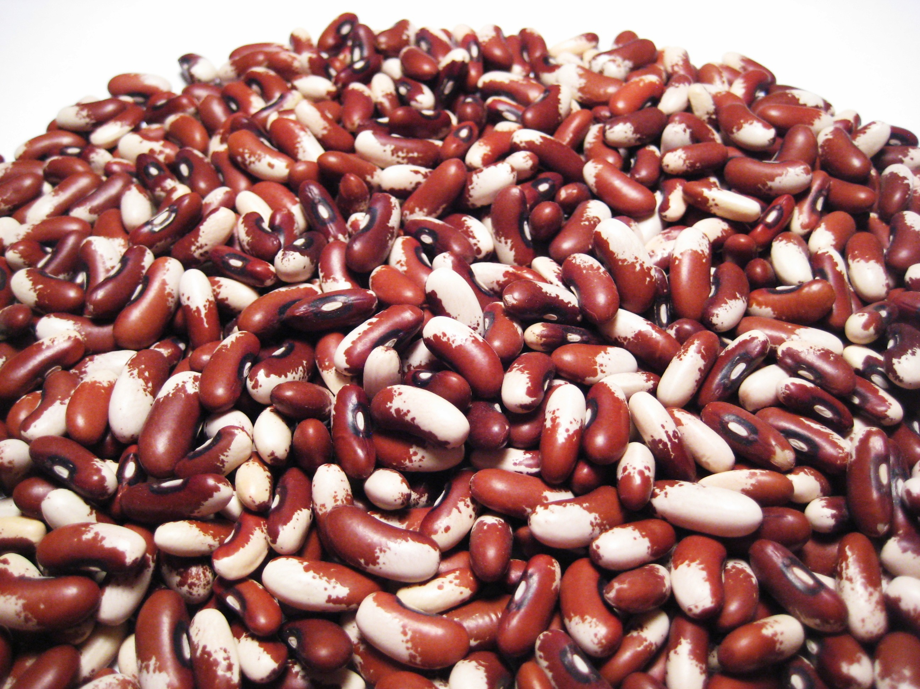
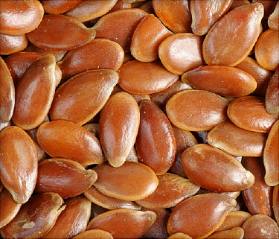
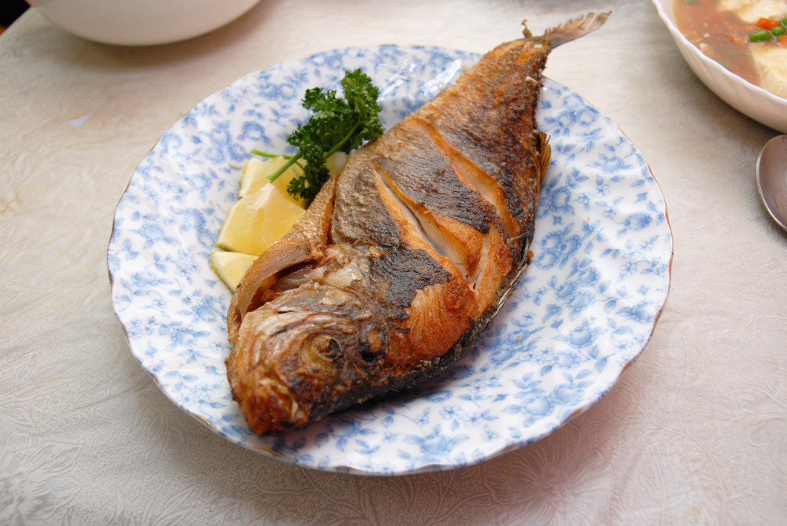
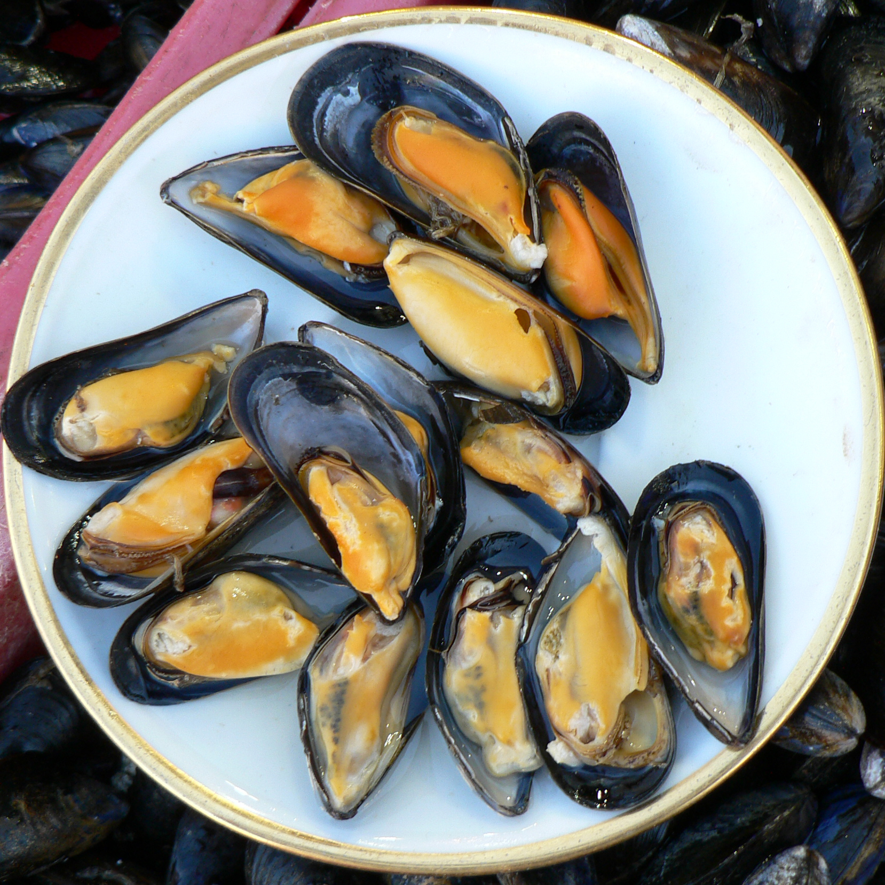
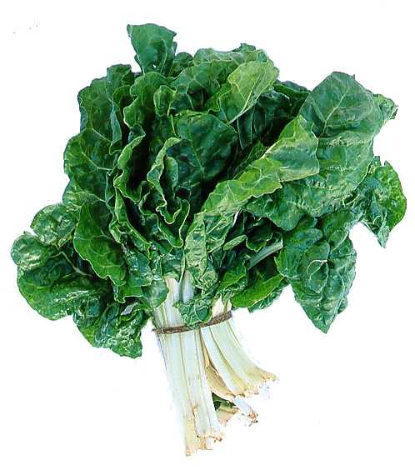
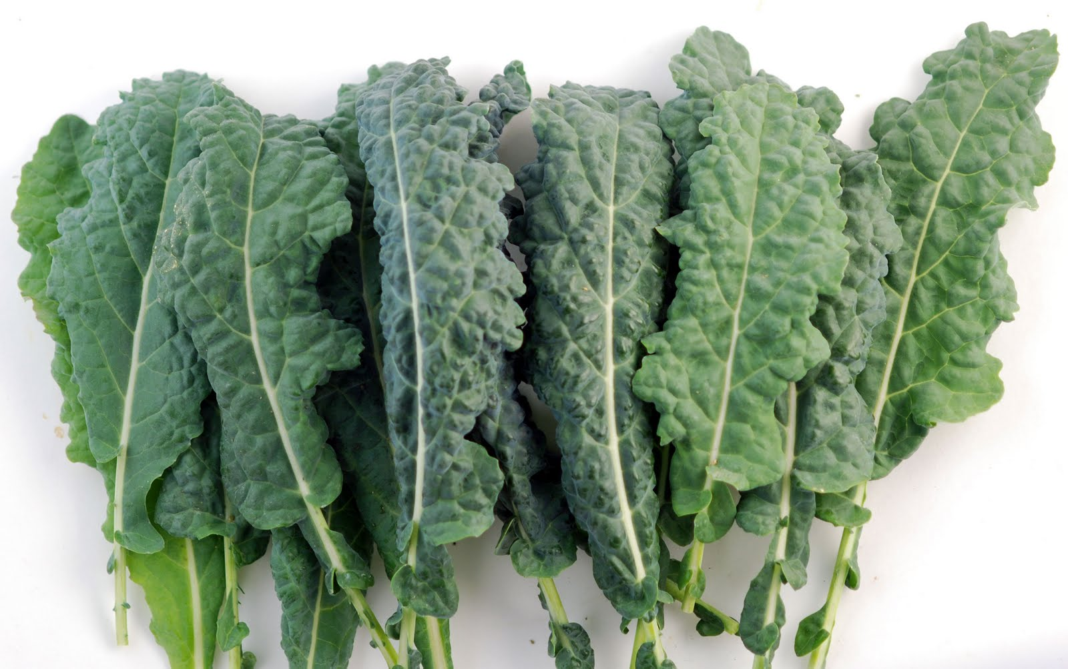
Eat Foods Containing Manganese

Slide 76
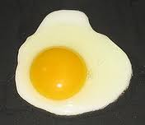
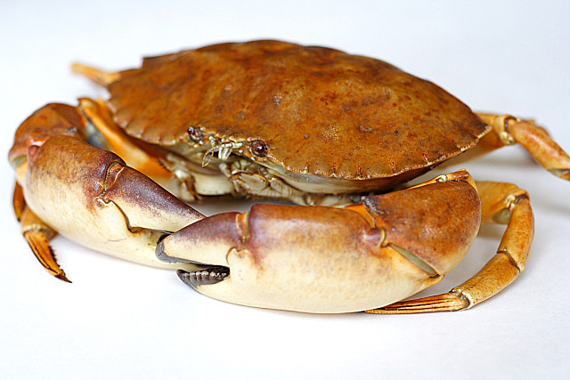
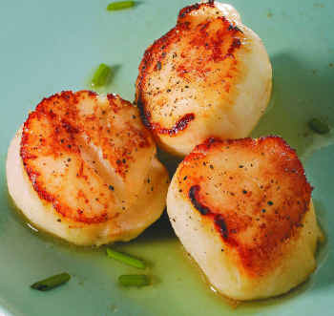
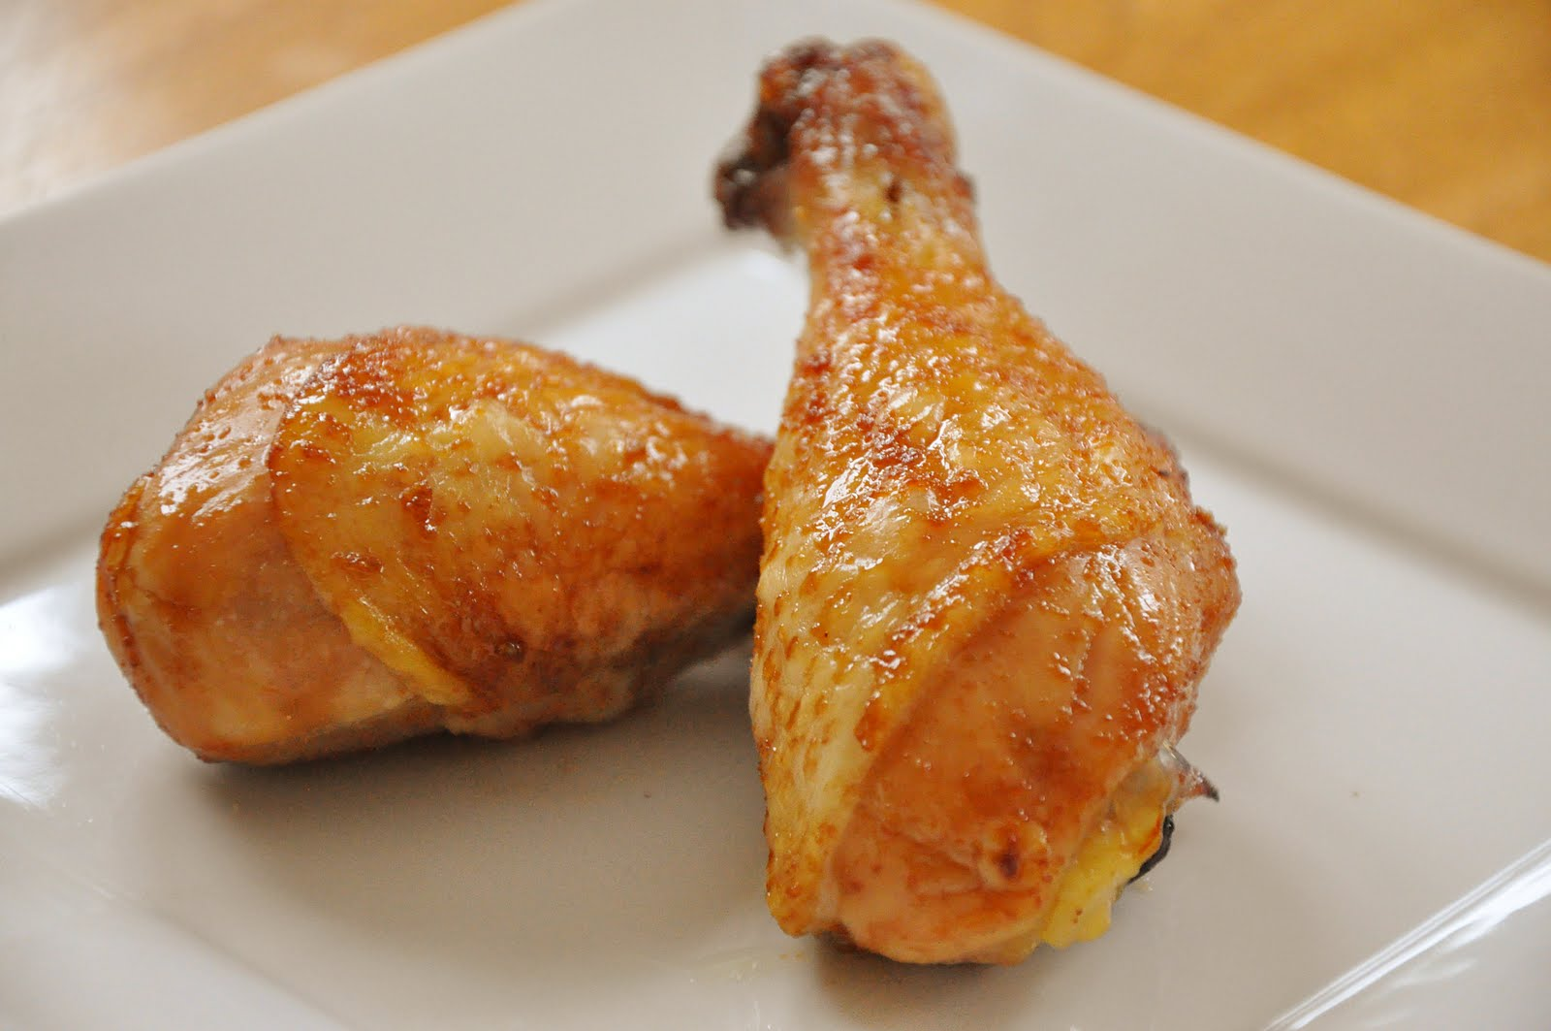
Eat Foods Containing Sulfur
Notes:
http://healthyeatingclub.com/info/books-phds/books/foodfacts/html/data/data5g.html

Slide 77
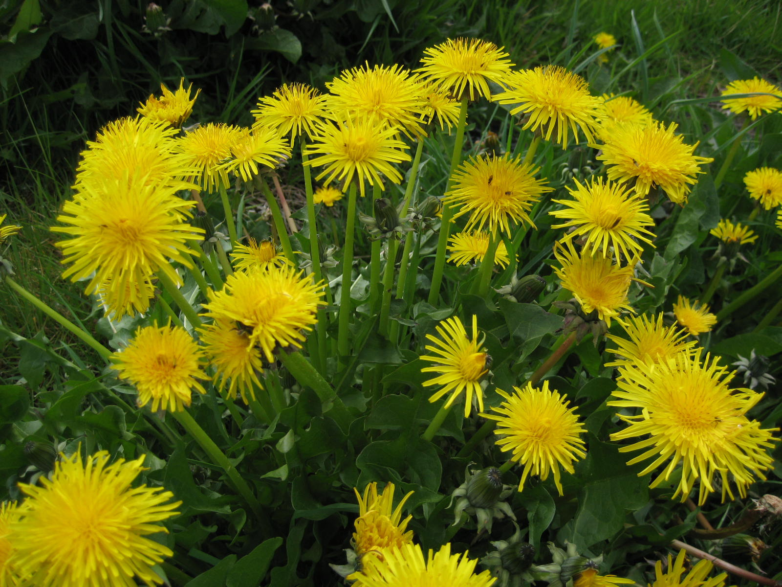
Extracts from Common Plants Can Treat Glyphosate Poisoning*
Roundup is toxic to hepatic and embryonic cells at doses far below those used in agriculture and at residue levels present in some GM food.
Extracts from common plants such as dandelions, barberry, and burdock can protect from damage, especially if administered prior to exposure.
*C Gasnier et al. Journal of Occupational Medicine and Toxicology 2011, 6:3

Slide 78
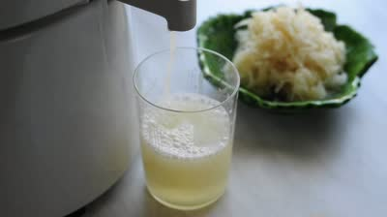
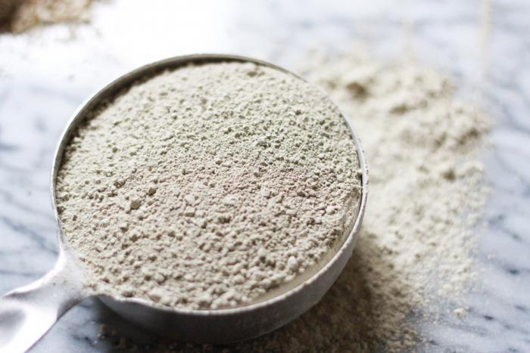
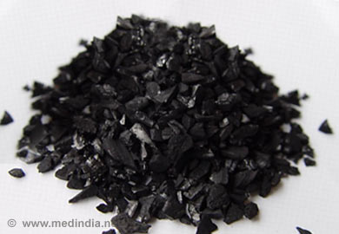
Treating Glyphosate Poisoning in Animals (e.g., cows) *
Activated charcoal, bentonite clay, humic and fulvic acids, and sauerkraut juice have been shown to be effective in reducing urinary levels of glyphosate and improving animal health
Sauerkraut
Juice
Fulvic Acid
Activated Charcoal
Bentonite Clay
*H Gerlach et al., J Environ Anal Toxicol 2014, 5:2
Notes:
Glyphosate/Monika_cows_humic_acid_fulvic_acid_treat_glyphosate.pdf
Glyphosate/in_vitro_humic_acid_neutralized_glyphosate.text
Activated charcoal
活性炭
clay
粘土
Niántǔ
Huóxìngtàn

Slide 79
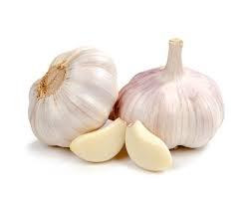
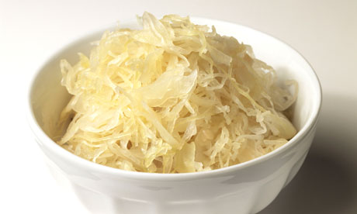
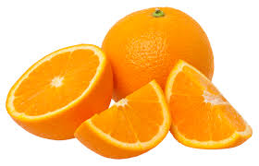
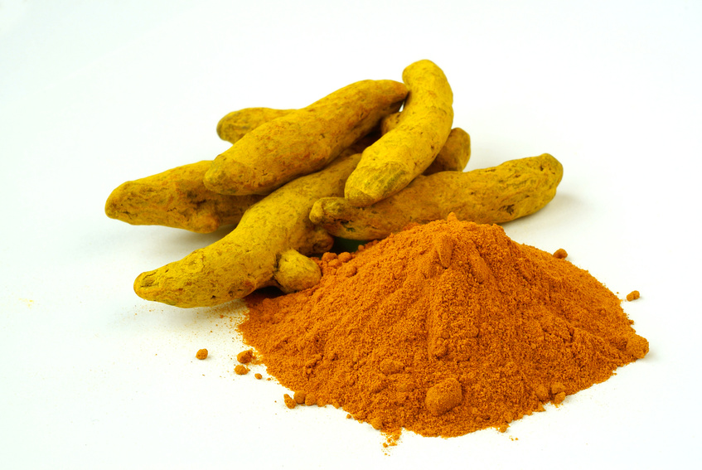
Some Important Nutrients
Curcumin
Garlic
Vitamin C
Probiotics
Methyl tetrahydrofolate
Cobalamin
Glutathione
Taurine
Epsom salt baths

Slide 80
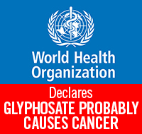
Grass Roots Efforts
California EPA moved to label glyphosate a "probable carcinogen"
Richmond, California banned glyphosate usage on public land
Tony Mitra, an activist in Canada, proposes that people should pressure the mayors of their municipalities into testing glyphosate levels in water and food products.*
* See: http://www.tonu.org/2016/04/26/glyphosate-update/

Slide 82
Summary
Glyphosate is the most damaging chemical in our environment today
We have been grossly misled into believing that it is non-toxic to humans
The strong correlations between glyphosate usage on core crops and the alarming rise in the incidence of a long list of diseases are supported by evidence of harm
Glyphosate’s toxicity is easily explained by its biological mechanisms, particularly its potential ability to substitute for glycine during protein synthesis
Its effects are insidious and cumulative
We need to switch to sustainable organic agriculture and ban glyphosate across the globe

