Slide 1
Download These Slides
http://people.csail.mit.edu/seneff/WAPF_Zika1.pptx

Slide 2
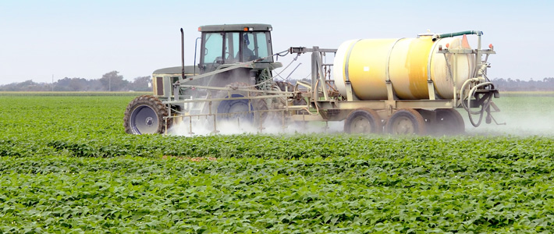
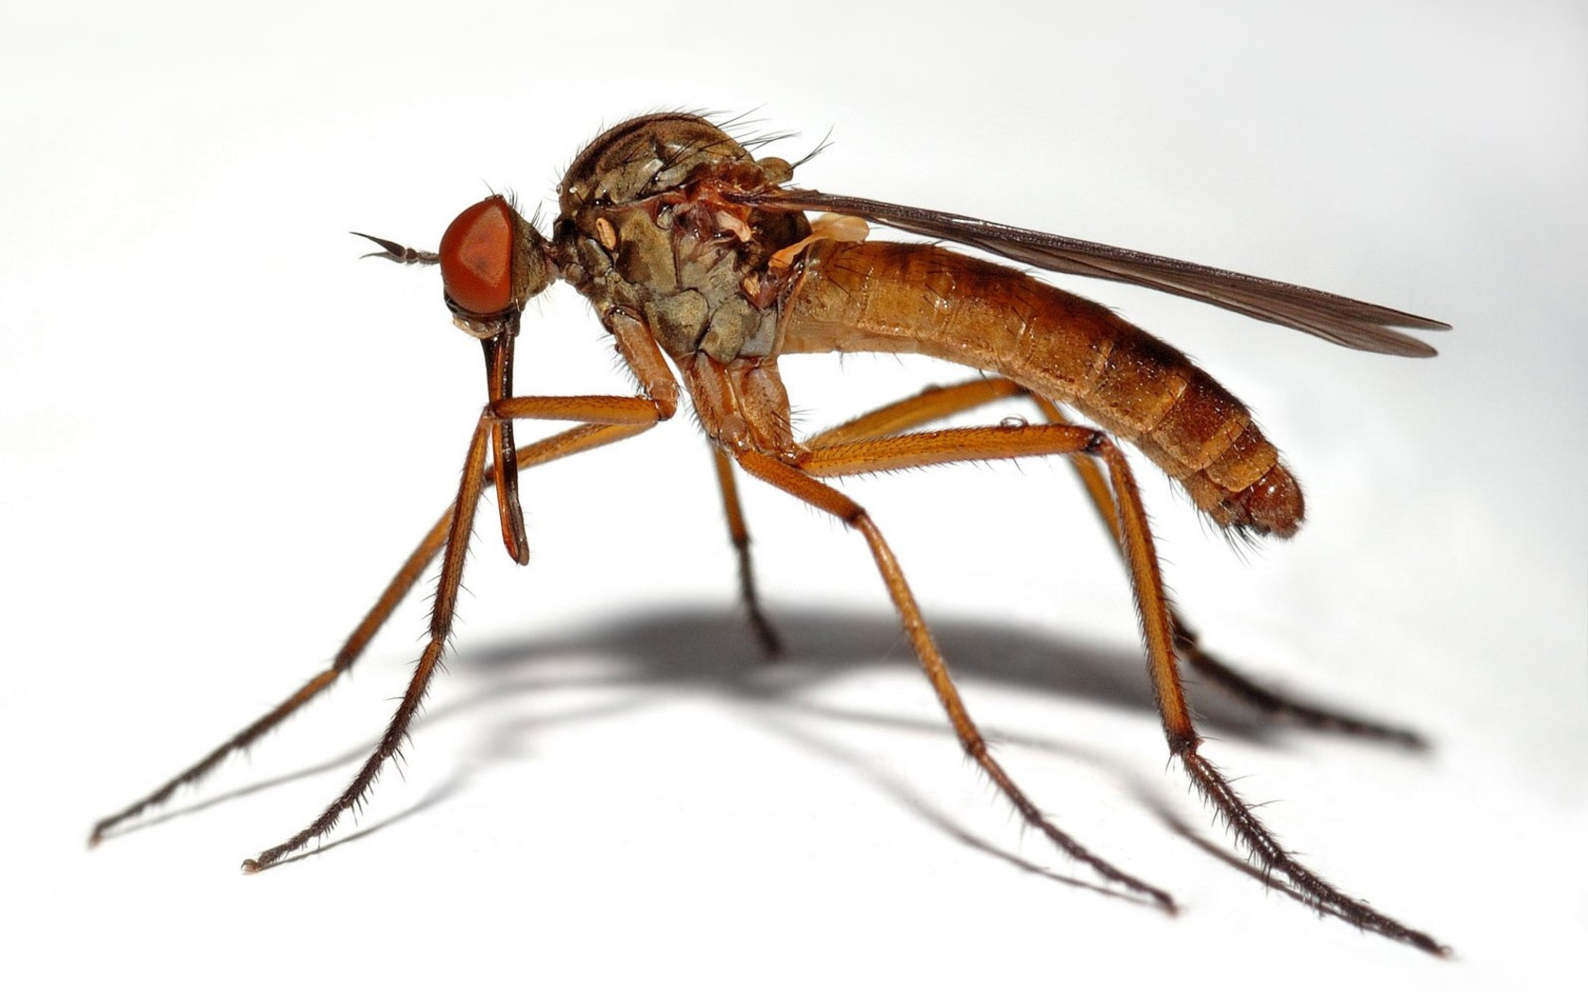
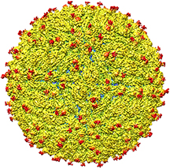
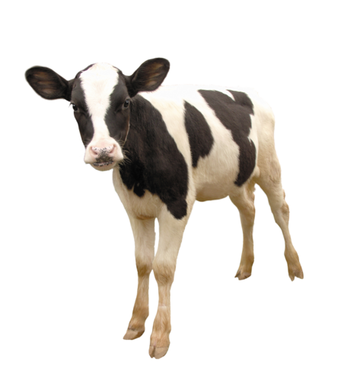
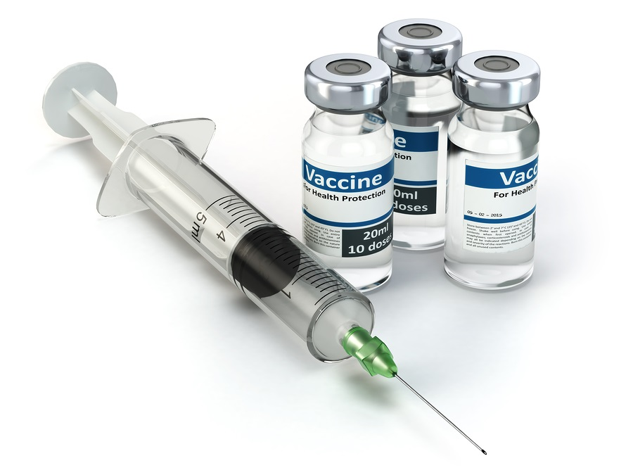
Microcephaly in Brazil: Is it Really Just Zika?
Part I
Stephanie Seneff
WAPF Wise Traditions
November 12, 2016

Slide 4
Outline
Part I
Introduction: Zika Hype
Vaccines and Autoimmunity
Glyphosate as a Glycine Analogue
Beriberi (Thiamine Deficiency)
Role for Vaccines in Microcephaly?
Part II
Role for Herbicides in Microcephaly?
Fighting Zika: Is the Cure Worse than the Disease?
Summary

Slide 5
Introduction:
Zika Hype

Slide 6
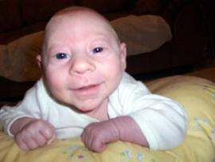
Zika Virus and Microcephaly: Could there be something more to the story?
Zika has been around since the mid 1900’s and it has never been known to cause microcephaly

Slide 7
Zika Causes Microcephaly: There's No Doubt!*
“Zika Virus Causes Birth Defects, Health Officials Confirm.”
New York Times
“CDC Confirms Zika Virus Causes Microcephaly, Other Birth Defects”
Washington Post
“Zika Definitely Causes Birth Defects, U.S. Officials Announce”
TIME magazine
“It’s Official: Zika Virus Causes Birth Defects”
NBC News.
*SA Rasmussen et al. N Engl J Med 2016; 374:1981-1987.
Notes:
./Zika_hype.pdf
http://www.thevaccinereaction.org/2016/09/cdc-bets-farm-on-zika-based-on-conclusion-of-rasmussen-jamieson-honein-petersen-paper/
All four researchers are CDC employees.

Slide 8
Quote from a Comment by “Marie”*
“When it comes to autism, the ‘slogan’ of the medical system and the CDC is that ‘correlation does not equal causation’ (meaning that if a child gets an MMR shot and regresses into autism, that doesn’t prove it was the vaccine that caused autism).”
“Why is it a different story when it comes to the Zika virus and microcephaly?”
*http://www.thevaccinereaction.org/2016/09/
cdc-bets-farm-on-zika-based-on-conclusion-of-rasmussen-jamieson-honein-petersen-paper/

Slide 9
CBS 60 Minutes Segment Last Sunday*
Showed how Zika has spread out of Africa, first to SE Asia and then on to the Americas
Two pregnant women infected by Zika showcased in the segment - both of them appeared to have healthy babies
Interviewed Anthony Fauci, director of the National Institute of Allergy and Infectious Diseases
Fauci portrayed no doubt that there was anything else going on with respect to microcephaly besides Zika
Emphasized urgency for US government to fund vaccine development
Promoted plasmid DNA Zika vaccine under development
Congress has just approved $1.1 Billion to fight Zika
*Dr. John LaPook,
www.cbsnews.com/news/60-minutes-zika-in-the-united-states-mosquito-disease
Notes:
./plasmid_sixty_minutes.text
Sunday, Nov. 6, 2016
./60_minutes.pdf

Slide 10
The Situation in Brazil*
“The Brazilian government, unlike the CDC, may finally be waking up to the likely possibility of environmental factors being the cause. Brazil’s northeast region is the fastest economically developing area of the country. Enforcement of environmental regulations—when they exist at all—is lax. Lots of industrial and agricultural chemicals are used. Lots of pesticides, larvicides, and herbicides, including the highly toxic Agent Orange.”
*http://www.thevaccinereaction.org/2016/09/
cdc-bets-farm-on-zika-based-on-conclusion-of-rasmussen-jamieson-honein-petersen-paper/

Slide 11
"Brazil opens probe as cases of Zika babies defy predicted patterns"*
"Initial analysis makes it clear the women with affected fetuses have a clear 'profile.' Some 77 per cent of them are black or mixed-race (the national figure is 52 per cent), and the great majority are poor... Most of the mothers are young (between 14 and 24) whereas typically birth defects affect older women."
*http://www.theglobeandmail.com/news/world/
brazil-opens-probe-as-cases-of-zika-babies-defy-predicted-patterns/
article31268428/%20%c2%a0/

Slide 12
Odd Distribution in Brazil*
“Scientists in Brazil have been puzzled by the fact that cases of congenital Zika syndrome have clustered in the northeast part of the country, and that the expected surge in cases elsewhere in the country has not happened. …
Of the 1749 confirmed cases of microcephaly or other central nervous system birth defects, 85% were concentrated in the northeast.”
*Collucci C. Brazil to investigate if other factors act with Zika to cause congenital defects. The BMJ Aug. 11, 2016.

Slide 13
Dr. Sherri Tenpenny’s Interpretation*
Problem: Oops. We created a vaccine-induced disaster, using the MMR and toxic pertussis vaccines together in young women who were pre-pregnant and pregnant. Coupled with Monsanto’s pesticides in the water, we have to find something to blame. ...
Reaction: How about blaming a common mostly-benign virus! We’ve done that before, and it works. ...
Solution: Let’s get General Director Margaret Chan at the WHO to declare Zika Infection to be an international emergency. ...
*https://truthkings.com/zika-virus-fools/

Slide 14
A (satirical) catalog of major injuries that result from Zika infection*
“It will include most if not all injuries that result from vaccines, pesticides, GMO food, pharmaceutical drugs, the high-carbohydrate low-fat standard American diet, and anything else that might lead to a successful lawsuit against Big Pharma or Big Chem. Zika might just become the standard defense for suit against corporations. `It wasn’t our product that harmed this little baby, it was Zika!’ “
*John P Thomas, Health Impact News, August 29, 2016
Notes:
./ZikaMindControl.pdf

Slide 15
“The recent outbreak of Zika-presumed microcephaly in Brazil and other regions is a sobering example of how our ‘kill the enemy‘ approach to health and medicine may be fundamentally flawed. Worse yet, it serves as a prime example of how political and economic forces are overriding our common humanity and usurping medical science.”
- Dr. Chandler Marrs
Notes:
https://www.hormonesmatter.com/zika-microcephaly/

Slide 16
Brazil, Zika and Microcephaly*
Up to 5,000 cases reported, but only 404 cases confirmed – 0.003% of the live births
25,000 cases of microcephaly have been reported in the US: 0.006% of live births
Only 17 of the 404 confirmed cases in Brazil have been directly linked to Zika
* https://www.hormonesmatter.com/zika-microcephaly/
Notes:
https://www.hormonesmatter.com/zika-microcephaly/
./Zika_microcephaly_article.pdf

Slide 17
Zika and Microcephaly in Colombia*
65,726 cases of Zika infection reported, including in 11,944 pregnant women as of April 2, 2016.
None of the 1850 monitored patients gave birth to a child with microcephaly
92% of 50 microcephaly cases examined had no evidence of Zika infection.
The 4 cases who tested positive for Zika had had no symptoms of infection.
Conclusion:
"Preliminary surveillance data in Colombia suggest that maternal infection with the Zika virus during the third trimester of pregnancy is not linked to structural abnormalities in the fetus.”
*O Pacheco et al. NEJM Epub ahead of print, June 16, 2016.
Notes:
./Zika_virus_in_Colombia.pdf
./zika.email.text

Slide 18
Other Possibilities?*
Glyphosate in the food (Roundup)
The larvicide, Pyriproxifen, in the water supply
The Tdap vaccine, administered in the third trimester (since 2014)
Poverty/malnutrition: particularly thiamine deficiency
The very poor get whole cell DPT vaccine instead of the more expensive Tdap
* https://www.hormonesmatter.com/zika-microcephaly/
Notes:
https://www.hormonesmatter.com/zika-microcephaly/
./Zika_microcephaly_article.pdf

Slide 19
Some Other Potential Factors
Pesticides: GMO Roundup-Ready crops plus a new GMO resistance gene to glufosinate
Synergistic toxicity of glyphosate & (aluminum, mercury, glutamate) in Tdap and flu vaccines
Measles outbreak in NE Brazil; aggressive MMR booster campaign?
GMO mosquito introduced into same area where microcephaly is highest
Supposed to reduce mosquito burden: fewer mosquitoes = more infection??
Notes:
./Brazil_article_on_Zika.text
Because of a measles outbreak, there was a major vaccination campaign with MMR (measles/mumps/rubella) in Pernambuco, Brazil, in late 2014.
http://wwwnc.cdc.gov/eid/article/21/9/15-0391_article

Slide 20
Brazil is Agrochemical Capital of the World*
70% of Brazil's food is contaminated by pesticides
Highest per-capita consumption rate in the world
1/3 of agrochemicals used in Brazil have been banned in the EU and US due to impacts on human health and the environment
Brazilian lawmakers support the interests of powerful agriculture lobby groups
A bill has been introduced that would replace the word "pesticide" with "plant health protection.”
29% of 1,665 samples of food showed residues that either exceeded allowable levels or contained unapproved chemicals.
*www.globalresearch.ca/
seventy-percent-of-brazilian-food-contaminated-by-agrochemicals/5531682

Slide 21
Anecdotal Evidence
Feb 8 PBS Evening News segment on Zika: interviewed young mother of a child with microcephaly
The closing remark was that the mother would have to quit her job as an agricultural worker to tend to the child

Slide 22
Both Macrocephaly and Microcephaly are linked to Autism*
126 autistic children studied
16.7% diagnosed with macrocephaly
15.1% diagnosed with microcephaly
Both of these numbers are abnormally high, compared to the general population
These abnormal brain developmental features are milder forms of the more severe defects associated with neural tube disorders
*E Fombonne et al., J Autism Dev Disord 1999;29(2):113-9.
Notes:
Samantha/macrocephaly_microcephaly_autism.text

Slide 23
Autism, Glyphosate, Vaccine Reactions*
Glyphosate application to corn and soy, US
Children with Autism, US
# Adverse Reactions in VAERS
*Collaboration with Dr. Nancy Swanson
Notes:
Individuals with Disabilities Education Act

Slide 24
Vaccines and
Autoimmunity

Slide 25
Brief Introduction to Antibodies
Antigens are foreign molecules, usually proteins
A complex process takes place in the thymus gland early in life to create DNA codes for a large number of antibodies, each sensitive to specific protein patterns
Each antibody has two heavy chains and two light chains
Each immune B cell produces unique antibodies
Antibodies bind to antigens to mark them for clearance
Light chain
Heavy chain

Slide 26
Brief Introduction to Antibodies
Antigens are foreign molecules, usually proteins
A complex process takes place in the thymus gland early in life to create DNA codes for a large number of antibodies, each sensitive to specific protein patterns
Each antibody has two heavy chains and two light chains
Each immune B cell produces unique antibodies
Antibodies bind to antigens to mark them for clearance
Autoimmune disease develops when antibodies recognize self proteins as if they were foreign
Light chain
Heavy chain

Slide 27
Autoimmune Disease and Molecular Mimicry*
A peptide sequence in a foreign protein resembles a sequence in a human protein
The immune system develops antibodies to the foreign protein and then these act as autoantibodies and attack the human protein that looks similar
This is how you get autoimmune disease
The foreign protein could be from a virus in a vaccine or from a live infection or it could be from a food source like wheat gluten
*MF Cusick et al., Clin Rev Allergy Immunol. 2012; 42(1): 102–111.
Notes:
./molecular_mimicry_autoimmunity_2012.pdf

Slide 28
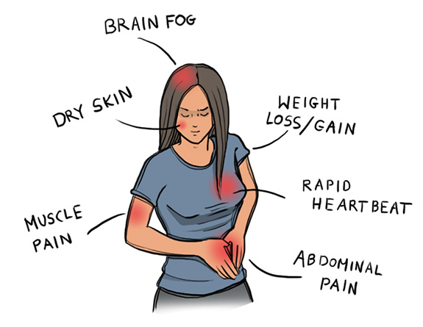
Autoimmune Disease Statistics*
Autoimmune Disease (AD) is a major health problem
Annual direct health care costs for AD in US estimated to be ~$100 billion
At least 23.5 million Americans suffer from one or more autoimmune diseases
Among the top-10 causes of death in females under 64 years old
Immunosuppressant treatments have devastating side effects
*https://www.aarda.org/autoimmune-information/autoimmune-statistics/

Slide 29
Why do we have an epidemic in
autoimmune disease in America today?

Slide 30
Hypothesis
Cumulative glyphosate exposure sets up a weakened immune system, a leaky gut barrier and a leaky brain barrier
Proteins in foods like gluten and casein are contaminated with glyphosate, and this makes them resistant to digestion
Vaccines introduce foreign proteins that may contain glyphosate as a contaminant
Child develops overactive antibody response to foreign protein contaminated with glyphosate and, through molecular mimicry, this leads to autoimmune disease

Slide 31
How Vaccines Work
The goal of a vaccine is to fool your immune system into “thinking” that cellular-based immunity is impaired, so that specific memory antibodies to the antigen will develop
This is done by adding “adjuvants” like aluminum, LPS, and unmethylated CpG DNA
Whenever you develop specific antibodies there is a danger that they will become autoantibodies

Slide 32
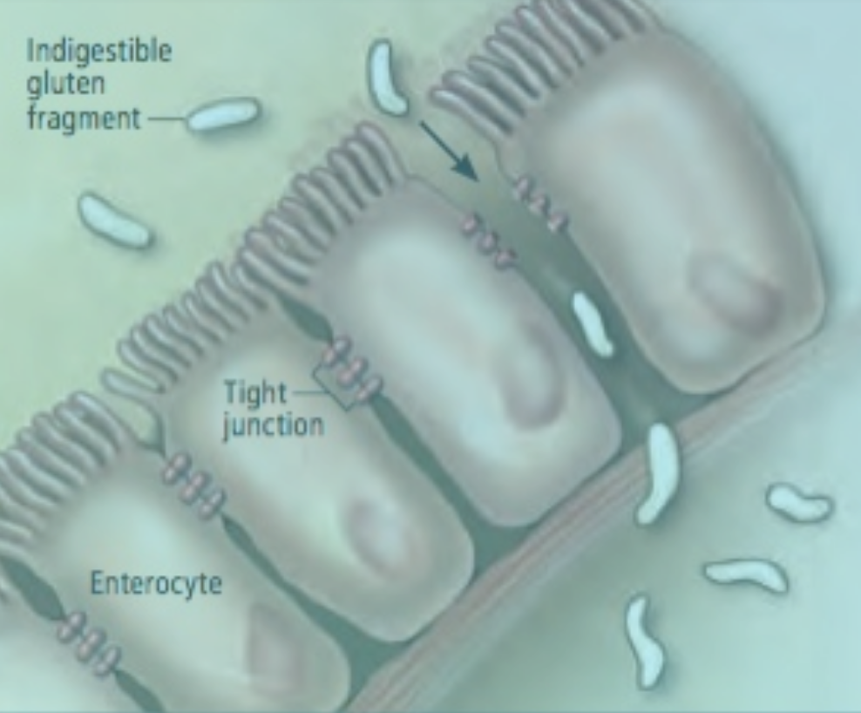
“If the inside lining of the gastrointestinal tract (the mucosa) is attacked by auto-antibodies, you can develop leaky gut syndrome. Crohn’s disease and colitis are also caused by auto-antibody attack of the GI tract itself. If the islet (insulin producing) cells of the pancreas are attacked by auto-antibodies, you develop insulin dependent (juvenile) diabetes.”*
*Rebecca Carley, MD, https://vaccinesbytheoutliers.wordpress.com/2016/08/18/
i-just-never-knew-auto-antibodies-were-such-a-drag/
Notes:
https://vaccinesbytheoutliers.wordpress.com/2016/08/18/i-just-never-knew-auto-antibodies-were-such-a-drag/

Slide 33
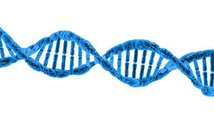
“If you develop auto-antibodies against the very DNA in the nucleus of all cells, you develop systemic Lupus (thus, the autoimmune potential of DNA vaccines being developed now is self-evident.)”
“The brain and spinal cord can also be attacked with auto-antibodies (vaccine induced encephalitis).”*
*Rebecca Carley, MD, https://vaccinesbytheoutliers.wordpress.com/2016/08/18/
i-just-never-knew-auto-antibodies-were-such-a-drag/
Notes:
https://vaccinesbytheoutliers.wordpress.com/2016/08/18/i-just-never-knew-auto-antibodies-were-such-a-drag/

Slide 34
Quantifying the possible cross-reactivity risk of an HPV16 vaccine (Gardasil) *
"The number of viral matches and their locations make the occurrence of side autoimmune cross-reactions in the human host following HPV16-based vaccination almost unavoidable."
*D. Kanduc. J Exp Ther Oncol. 2009;8(1):65-76.

Slide 35
Antiphospholipid Syndrome (APS)*
Phospholipids are mistakenly viewed as foreign substances
Sufferers are mostly women and many have experienced multiple pregnancy losses
Diverse symptoms including blindness, deep vein thrombosis, pulmonary embolism, headaches and migraines, miscarriages, cognitive dysfunction, multiple sclerosis
Tetanus vaccine implicated
Autoimmune attack on plasma protein beta-2-glycoprotein-I (β2GPI) due to molecular mimicry with tetanus toxoid (antigen in tetanus vaccine)
*M Blank M and Y. Shoenfeld. Clin Immunol. 2004 Aug;112(2):190-9.

Slide 36
“In other words, the vaccines we give our children are liquids filled with a host of unknown particles, most of which came from the cells of non-humans: from chickens, monkeys and even from cancer cells. Truly we do not know what we are doing or what are the long-term consequences. All that is known for sure is that vaccines are a very cheap form of public medicine often provided by governments to assure the public that they really do care for the safety of our children.”
-- Janine Roberts
Fear of the Invisible.
Notes:
http://www.globalresearch.ca/vaccines-dark-inferno/15452

Slide 37
The FDA says:
“It is not possible for a manufacturer of live viral vaccines to validate the process for clearance of adventitious agents”*
*http://www.fda.gov/BiologicsBloodVaccines/
GuidanceComplianceRegulatoryInformation/Guida nces/default.htm.

Slide 38
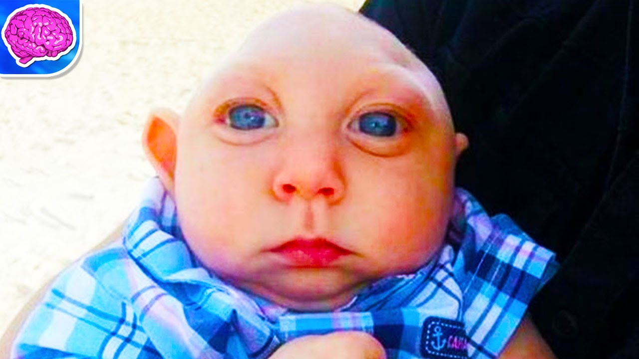
Human Immunodeficiency with Microcephaly*
Mutations in several genes involved in DNA repair mechanisms lead to a severe condition characterized by both immune deficiency and autoimmune disease, along with microcephaly at birth and developmental delay
Profound defects observed in neuronal proliferation
These genes are crucial for the development of the memory B and T cells early in life
*D Buck et al., Cell 2006;124: 287-299.
Notes:
./Cernunnos_mutation_immunodeficiency_microcephaly_2005.pdf

Slide 39
Human Immunodeficiency with Microcephaly*
Mutations in several genes involved in DNA repair mechanisms lead to a severe condition characterized by both immune deficiency and autoimmune disease, along with microcephaly at birth and developmental delay
Profound defects observed in neuronal proliferation
These genes are crucial for the development of the memory B and T cells early in life
Immune system development, DNA repair following oxidative damage or UV exposure and neuronal cell proliferation are all intimately linked together
*D Buck et al., Cell 2006;124: 287-299.
Notes:
./Cernunnos_mutation_immunodeficiency_microcephaly_2005.pdf

Slide 40
Recapitulation
Antibodies to foreign protein can become autoantibodies and attack native proteins, causing disease through molecular mimicry
The peptides in vaccines such as HPV and tetanus resemble human peptides and cause autoimmune disease
Vaccines contain many toxic excipients like aluminum, mercury, formaldehyde
It is not possible to make vaccines that are free of unanticipated contaminants: toxic chemicals, human DNA and other viruses are all possibilities
Most worrisome is the potential for glyphosate to get into viral proteins and cause resistance to breakdown followed by autoimmune disease
Immune system development, DNA repair and neuronal propagation are intimately connected → microcephaly

Slide 41
Glyphosate as a
Glycine Analogue

Slide 42
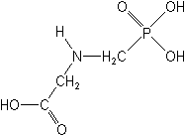
What If Glyphosate Could Insert Itself Into Protein Synthesis???
glyphosate
Code for Glycine
GGC
mRNA
. . .
. . .
Glyphosate
Alanine
Proline
-- Any proteins with conserved glycine residues are likely to be affected in a major way

Slide 43
Glyphosate is a non-coding amino acid analogue of glycine
H
Glycine
Glyphosate

Slide 44
Extra Piece Invades the Active Site
Substrate no longer fits in active site
Active Site
Extra Stuff
Glyphosate
Alanine
Proline
glycine
Peptide chain

Slide 45
Extra Piece Invades the Active Site
Substrate no longer fits in active site
This explains how glyphosate disrupts EPSPS in the shikimate pathway: Multiple bacteria have developed resistance by replacing active site glycine with alanine and this is the basis for GMO Roundup Ready crops*
Active Site
Extra Stuff
Glyphosate
Alanine
Proline
glycine
Peptide chain

Slide 46
Inhibition of EPSPS by glyphosate: Resistant E coli mutant*
Mutant with alanine substituted for glycine 96
Wild type with glycine 96
*Figure 3, S Eschenburg et al. Planta 2002;216:129-135.

Slide 47
Some Predicted Consequences
Neural tube defects
Autism
Impaired collagen → osteoarthritis
Steatohepatitis (fatty liver disease)
Obesity and adrenal insufficiency
Hypothyroidism
Impaired iron homeostasis and kidney failure
Insulin resistance and diabetes
Cancer

Slide 48
An Analogy: ALS in Guam
An epidemic in ALS in Guam was traced to a natural toxin found in cycads
BMAA is a non-coding amino acid that gets inserted by mistake in place of serine
Defective versions of a glutamate transporter have been linked to ALS*
The transporter has an essential serine-rich region in its sequence**
*Antioxidants & Redox Signaling 2009;11: 1587-1602.
**DJ Slotboom et al., PNAS 1999; 96(25): 14282-14287.
Notes:
cyanobacteria_BMAA_article.pdf
Slotbloom_1999_conserved_serine_glutamate_transporter.pdf
Dunlop.pdf
ALS_glutamate_transporter_link_2009.pdf
Guam/
*ALS_glutamate_transporter_link_2009.pdf
ChrisShawChapter7GuamFantastic.docx
Dunlop.pdf
**Slotbloom_1999_conserved_serine_glutamate_transporter.pdf

Slide 49
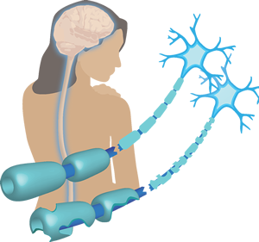
Another Analogy: MS & Sugar Beets*
Sugar beets contain an analogue of proline called Aze
Remarkable correlation between MS frequency and proximity to sugar beet agriculture
Myelin basic protein contains a concentration of proline residues that are absolutely essential for its proper function
*E. Rubenstein, J Neuropathol Exp Neurol 2008;67(11): 1035-1040.
Notes:
./misincorporation_of_proline_analogue_MS.pdf

Slide 50
Into The Wild*
Chris McCandless died in the Alaskan wilderness in 1992
A staple of McCandless' diet was seeds from a wild potato plant which contained L-canavanine, a non-coding amino acid analogue of L-arginine
Author Jon Krakauer determined that McCandless was slowly poisoned by L-canavanine
*J Krakauer et al., Wilderness & Environmental Medicine 2015; 26: 36-42.

Slide 51
Vulnerable Proteins: Resulting Pathologies
Conserved Glycines | Disease Profile
Hormone-sensitive Lipase | Obesity
Insulin Receptor | Diabetes
Amyloid Beta Plaque | Alzheimer’s Disease
OGG1 | DNA Damage → Cancer
Glycine decarboxylase | Neural tube defects
ACTH | Adrenal Insufficiency
Cytochrome C Oxidase | Mitochondrial Disease
Alpha Synuclein | Parkinson’s Disease
TDP-43 | ALS

Slide 52
Vulnerable Proteins: Resulting Pathologies
Conserved Glycines | Disease Profile
Hormone-sensitive Lipase | Obesity
Insulin Receptor | Diabetes
Amyloid Beta Plaque | Alzheimer’s Disease
OGG1 | DNA Damage → Cancer
Glycine decarboxylase | Neural tube defects
ACTH | Adrenal Insufficiency
Cytochrome C Oxidase | Mitochondrial Disease
Alpha Synuclein | Parkinson’s Disease
TDP-43 | ALS

Slide 53
Glycine decarboxylase deficiency causes neural tube defects and features of non-ketotic hyperglycinemia in mice*
Fascinating article about mice with a deficiency in a protein involved in generating methyl groups from glycine → methylfolate deficiency
These mice have very high rate of neural tube defects
Those that are viable have swollen ventricles (a feature of autism) and delayed development
Methylation pathway impairment is a common feature of autism
*YJ Pai et al., Nature Communications 2015; 6:6388

Slide 54
Glycine decarboxylase deficiency causes neural tube defects and features of non-ketotic hyperglycinemia in mice*
Fascinating article about mice with a deficiency in a protein involved in generating methyl groups from glycine -> methylfolate deficiency
These mice have very high rate of neural tube defects
Those that are viable have swollen ventricles (a feature of autism) and delayed development
Methylation pathway impairment is a common feature of autism
Glycine decarboxylase has a glycine-rich region that maintains shape and flexibility of active site**
**A Kume et al., JBC 1991; 266(5): 3323-3329

Slide 55
Recapitulation
Glyphosate, acting as a glycine analogue, may get into proteins by mistake in place of glycine
This has devastating consequences on any protein with highly conserved glycines
It is the best explanation available for how glyphosate disrupts the shikimate pathway in weeds to kill them
There are multiple examples of natural non-coding amino acid analogues that cause diseases such as ALS and multiple sclerosis
Glyphosate substituting for glycine in glycine decarboxylase would be a direct path to neural tube defects and autism due to impaired methylation capacity

Slide 56
Beriberi
(Thiamine Deficiency)

Slide 57
Beriberi in NE Brazil*
Epidemic of beriberi in Maranhão state, NE Brazil since May, 2006
Thiamine deficiency syndrome
1028 cases with 32 deaths
Suggest fungus growth in “yellow” rice as cause (mycotoxin)
Rice is a staple of the impoverished population
*CAR Rosa et al., Food Additives and Contaminants 2010;27(2):241-248.

Slide 58
Impaired thiamine pyrophosphate transport*
A human genetic defect in a gene that transports TPP into the mitochondria leads to severe microcephaly
Glycine at residue 177 replaced with alanine
TPP is essential for proper mitochondrial function (generation of ATP for cellular energy supplies)
*MJ Lindhurst et al., PNAS 2006 103(43):15927-15932.
Notes:
glyphosate/Lindhurst_2006_thiamine_pyrophosphate_defect_glycine_microcephaly.pdf

Slide 59
Impaired thiamine pyrophosphate transport*
A human genetic defect in a gene that transports TPP into the mitochondria leads to severe microcephaly
Glycine at residue 177 replaced with alanine
TPP is essential for proper mitochondrial function (generation of ATP for cellular energy supplies)
Glyphosate substitution for glycine at 177 would have even more drastic effects
*MJ Lindhurst et al., PNAS 2006 103(43):15927-15932.
Notes:
glyphosate/Lindhurst_2006_thiamine_pyrophosphate_defect_glycine_microcephaly.pdf

Slide 60
Thiamine & Microcephaly*
Slc25a19 mutation: glycine at residue 177 substituted by alanine → Amish lethal microcephaly (MCPHA)
Defective transport of thiamine pyrophosphate (TPP) into mitochondria
This inhibits activity of alpha-keto glutarate (AKG) dehydrogenase → high urinary AKG
Mouse model showed severe defects in development of head region of neurotube, anemia, and embryonic lethality
*ML Lindhurst et al. PNAS 2006; 103(43): 15927-15932.
Notes:
glyphosate/Lindhurst_2006_thiamine_pyrophosphate_defect_glycine_microcephaly.pdf

Slide 61
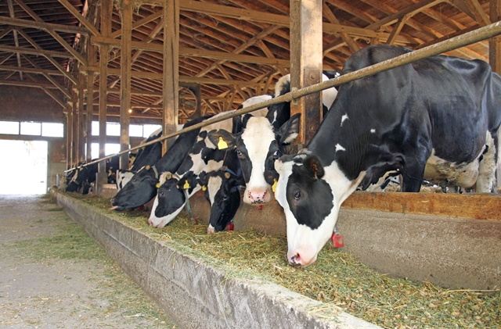
Polioencephalomalacia (PEM)*
Neurological disease in cows characterized by decay of neurons in the cerebral cortex
Contributes to substantial economic loss to livestock industry
Thiamine deficiency and sulfur toxicity have been well recognized as major factors.
High dietary S may increase the metabolic demand for thiamine pyrophosphate (TPP)
Sulfite destroys thiamine
*S Amat et al. Research in Veterinary Science 2013;95: 1081-1087.
Notes:
Glyphosate/sulfur_thiamine_ruminants_disease_2013.pdf
Wow!

Slide 62
Polioencephalomalacia (PEM)*
Neurological disease in cows characterized by decay of neurons in the cerebral cortex
Contributes to substantial economic loss to livestock industry
Thiamine deficiency and sulfur toxicity have been well recognized as major factors.
High dietary S may increase the metabolic demand for thiamine pyrophosphate (TPP)
Sulfite destroys thiamine
Sulfite oxidase converts sulfite to sulfate and depends on molybdenum as a cofactor.
Molybdenum is chelated by glyphosate,
making it unavailable.
*S Amat et al. Research in Veterinary Science 2013;95: 1081-1087.
Notes:
Glyphosate/sulfur_thiamine_ruminants_disease_2013.pdf
Wow!

Slide 63
Sulfur and Thiamine Deficiency*
*S Amat et al. Research in Veterinary Science 2013;95: 1081-1087.
Notes:
Glyphosate/excess_sulfur_low_thiamine_encephalitis_cows_2012.pdf

Slide 64
“it can be inferred that systemic failure to synthesize metabolically requisite levels of TPP in the brain may be at the core of biochemical lesions in the pathogenesis of PEM associated with excess dietary S intake.”*
*S Amat et al., Research in Veterinary Science 2013;95:1081-1087.
Notes:
Glyphosate/excess_sulfur_low_thiamine_encephalitis_cows_2012.pdf

Slide 65
Sulfur Supplementation in Cows*
Cows benefit from sulfur supplements when they’re grazing on grass, but sulfur stunts growth once they switch to the GMO Roundup Ready corn/soy feed for finishing
*EL Richter. The effect of dietary sulfur on performance, mineral status, rumen hydrogen sulfide, and rumen microbial populations in yearling beef steers. Graduate thesis. Iowa State University. 2011.

Slide 66
Bird Paralysis in Europe*
Multiple species of birds in northern Europe are suffering (since 1982) from a severe deficiency in thiamine leading to disease and depopulation.
Idiopathic paralytic disease
Inability to fly, inability to walk, and death
Tremor and seizures
Breeding failure
*L. Balk et al., PNAS 2009;106(29):12001-12006.
Notes:
./bird_paralysis_Europe_thiamine_deficiency.pdf

Slide 67
Recapitulation
Epidemic in beriberi (thiamine deficiency) in NE Brazil since 2006
Attributed to mycotoxin in fungus growing in rice
Impaired thiamine pyrophosphate transport causes microcephaly
Genetic defect: substitution of alanine for glycine 177
Cause of "Amish Lethal Microcephaly”
Glyphosate substitution could cause a similar disease profile
Polioencephalomalacia (PEM) is a disease in cows causing severe loss to herds
Attributed to thiamine deficiency due to toxicity of sulfite
Sulfur supplementation is beneficial to grazing cows but toxic to cows being fed GMO Roundup-Ready feed
An epidemic in bird paralysis due to thiamine deficiency is decimating multiple bird species in Northern Europe.
Disease first appeared in 1982, when glyphosate was first marketed

Slide 68
Role for Vaccines
In Microcephaly?

Slide 69
Tdap Vaccinations for All Pregnant Women in Brazil Mandated in Late 2014*
Growing incidence of pertussis (whooping cough) in Brazil from 2007 to 2014.
Brazil recommended Tdap (adult DtAP) for all pregnant women beginning in 2014
Used UK GSK Boostrix Tdap vaccine
It contains aluminum, formaldehyde, polysorbate 80 , glycine, bovine casein, bovine extract
According to GSK, neither the safety nor effectiveness of Boostrix have been established in pregnant women.
*http://www.thevaccinereaction.org/2016/02/
tdap-vaccinations-for-all-pregnant-women-in-brazil-mandated-in-late-2014/
Notes:
http://www.thevaccinereaction.org/2016/02/tdap-vaccinations-for-all-pregnant-women-in-brazil-mandated-in-late-2014/

Slide 70
Tdap Vaccinations for All Pregnant Women in Brazil Mandated in Late 2014*
Growing incidence of pertussis (whooping cough) in Brazil from 2007 to 2014.
Brazil recommended Tdap (adult DtAP) for all pregnant women beginning in 2014
Used UK GSK Boostrix Tdap vaccine
It contains aluminum, formaldehyde, polysorbate 80 , glycine, bovine casein, bovine extract
According to GSK, neither the safety nor effectiveness of Boostrix have been established in pregnant women.
Infants are especially vulnerable to pertussis because their mom’s vaccine-based immunity has worn off
*http://www.thevaccinereaction.org/2016/02/
tdap-vaccinations-for-all-pregnant-women-in-brazil-mandated-in-late-2014/
Notes:
http://www.thevaccinereaction.org/2016/02/tdap-vaccinations-for-all-pregnant-women-in-brazil-mandated-in-late-2014/

Slide 71
Notes:
./DPT_vanishing_white_matter_microcephaly.text
./ZikaBasecamp.text
atypical_vanishing_white_matter_disease_microcephaly_DPT_shot.pdf

Slide 72
Vanishing White Matter Disease*
Originally called “childhood ataxia with central nervous system hypomyelinating”
White matter in brain replaced by cerebrospinal fluid
Regression of milestones after trauma or infection
Case Study:
1 1/2 year old girl suffered fever and convulsions following booster dose of DPT vaccine
Head size 3 standard deviations below norm
*VK Gowda et al., Journal of Pediatric Neurology 2014;12:167-170.
Notes:
atypical_vanishing_white_matter_disease_microcephaly_DPT_shot.pdf

Slide 73
Glyphosate and Aluminum: Partners in Crime*
Tdap vaccine contains aluminum as adjuvant
Glyphosate cages aluminum to promote entry
Glyphosate promotes calcium uptake by voltage-activated channels
Aluminum gains entry as calcium mimetic
Glyphosate induces pathogens like C. difficile in gut, leading to leaky gut syndrome
C. diff produces p-cresol which promotes aluminum uptake by cells
p-Cresol is a known biomarker for autism
p-Cresol is an important factor in kidney failure which leads to aluminum retention in tissues → dementia
*S Seneff et al., Agricultural Sciences 2015;6:42-70

Slide 74
“Measles Reemergence in Ceará, Northeast Brazil, 15 Years after Elimination”*
CDC post: 21(9), September 2015
Measles “eliminated” in Brazil in 2000 w/ massive vaccination campaign
From December 2, 2013, through December 31, 2014, in the state of Ceará, NE Brazil, 681 measles cases were reported
19% were patients aged 20 to 29
Either measles infection or MMR vaccine could be a factor
*http://wwwnc.cdc.gov/eid/article/21/9/15-0391_article
Notes:
Preferentially under one year old or older than 15 years.

Slide 75
Glyphosate in Vaccines?
For MMR, flu vaccine, and rabies vaccine, live virus is grown on gelatin derived from ligaments of pigs
Pigs are fed GMO Roundup-Ready corn and soy feed
Gelatin (derived from collagen) contains significant amounts of both glycine and glutamate
These two neurotransmitters excite the NMDA receptors in the brain
Glyphosate substitution by mistake for glycine is a possibility!
Glyphosate stimulation of NMDA receptors could cause neuronal burnout

Slide 76
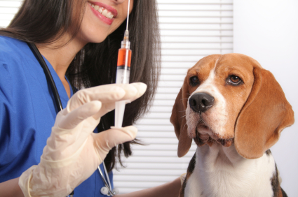
The Purdue Vaccination Studies and Auto-antibodies*
“The Purdue studies also found that vaccinated dogs were developing autoantibodies to their own collagen”
*http://www.dogsnaturallymagazine.com/purdue-vaccination-studies/

Slide 77
Glyphosate Contamination in Vaccines (Parts Per Billion)*
Merck ZOSTAVAX 0.42 Shingles
Merck MMR-II 2.90 Measles, Mumps and Rubella
Merck VARIVAX 0.41 Varicella, Chicken Pox
MERCK PNEUMOVAX ND Pneumococcal 18
MERCK PROQUAD 0.43 Measles, Mumps, Rubella, Varicella
GSK ENERGIX-B 0.33 Heptatitis B
*http://www.tonu.org/2016/08/31/vaccine-glyphosate-link/

Slide 78
Glyphosate Contamination in Vaccines (Parts Per Billion)*
Merck ZOSTAVAX 0.42 Shingles
Merck MMR-II 2.90 Measles, Mumps and Rubella
Merck VARIVAX 0.41 Varicella, Chicken Pox
MERCK PNEUMOVAX ND Pneumococcal 18
MERCK PROQUAD 0.43 Measles, Mumps, Rubella, Varicella
GSK ENERGIX-B 0.33 Heptatitis B
Interview: Anthony Samsel with Tony Mitra
https://www.youtube.com/watch?v=k33iFXHlOnY
*http://www.tonu.org/2016/08/31/vaccine-glyphosate-link/

Slide 79
Glyphosate and Glutamate*,**
Acute exposure to glyphosate activates NMDA receptors and voltage-dependent calcium channels
Oxidative stress and neural cell death
Increased glutamate release into the synaptic cleft → excessive extracellular glutamate levels
Decreased glutathione content
Increased peroxidation of lipids (fats)
*http://www.greenmedinfo.com/blog/roundup-weedkiller-brain-damaging-neurotoxin
**D Cattani et al., Toxicology 2014; 320: 34-45.
Notes:
http://www.greenmedinfo.com/blog/roundup-weedkiller-brain-damaging-neurotoxin
acute exposure (30 minutes) and chronic (pregnancy and lactation) exposure.
Rat hippocampus
Why was this referenced??
T. Bohn et al. Food Chemistry 153, 15 June 2014, 207-215.

Slide 80
“Food allergy to gelatin in children with systemic immediate type reactions, including anaphylaxis, to vaccines”*
26 children with acute reactions (e.g., anaphylaxis)
24/26 children tested positive for anti-gelatin IgE
7 were allergic to foods containing gelatin
26 control children had no antibodies
* M Sakaguchi et al., J Allergy Clin Immunol 1996 Dec;98(6 Pt 1):1058-61.

Slide 81
Symptoms of Adverse Reactions to MMR before and after 2002*
*Data analyzed from the VAERS database

Slide 82
Symptoms of Adverse Reactions to MMR before and after 2002*
Joint pain
seizures
shortness of breath
hives
These are all characteristic symptoms of allergies to MSG
eczema
anaphylactic shock
Facial swelling
swelling
swelling
*Data analyzed from the VAERS database

Slide 83
Measles Virus and Hemagglutinin*
The measles virus synthesizes the protein hemagglutinin
Antibodies to hemagglutinin are essential following MMR vaccination to induce immunity
Hemagglutin bears a sequence resemblance to myelin basic protein (MBP) → potential for autoimmune reaction
MBP is essential for the formation of the myelin sheath surrounding nerve fibers
Children with a rare genetic defect involving deletion of MBP can suffer from microcephaly**
Autoantibodies to MBP along with excessive levels of antibodies to measles hemagglutinin are linked to autism***
*Oldstone, MBA, Ed. Molecular mimicry: Infection inducing autoimmune disease.
Springer Berlin Heidelberg; January 9, 2006.
**AD Kline et al., Am J. Hum. Genet. 1993;52:895-906.
***VK Singh et al., J Biomed Sci 2002;9(4):359-64.

Slide 84
Autism and Measles Hemagglutinin*
125 autistic children and 92 control children
60% of the children with autism had high levels of antibodies to measles hemagglutinin specific to the MMR vaccine
90% of these had autoantibodies to myelin basic protein (MBP)
0% of the control children had high antibody titers to either hemagglutinin or MBP
There were no elevations in antibodies detected against any proteins in the mumps or rubella viruses
*VK Singh et al., J Biomed Sci 2002;9(4):359-64.

Slide 85
Precedent: Glyphosate in Drugs?*
Trasylol (aprotinin) is a protein derived from bovine lung used to reduce bleeding during open heart surgery
Rare acute reaction to Trasylol involves precipitous drop in blood pressure, acute kidney failure, and sudden death
Piglets injected with glyphosate salts had similar acute reaction with high mortality rate
Cows fed GMO Roundup-Ready feed had highest residue levels of glyphosate in lungs
*S Seneff et al., Agricultural Sciences 2015; 6:1472-1501.
Notes:
Trypsin inhibitor

Slide 86
Recapitulation
Tdap mandated during pregnancy in Brazil since 2014
Pertussis toxin in vaccine can cause vanishing white matter disease
Measles epidemic in NE Brazil has motivated MMR booster shot in young adults
MMR has been found to be contaminated with glyphosate
Measles live virus grown on gelatin derived from collagen of pigs and cows
Gelatin contains large amounts of glycine → glyphosate
Glyphosate and glutamate are synergistically toxic to cause neuronal burn-out through excessive NMDA receptor activity
Dogs have been shown to develop allergies to their own collagen following vaccination
Aluminum (in Tdap) and glyphosate are synergistically toxic

Slide 87
Summary
There has been too much hype regarding the idea that Zika virus may cause an epidemic in microcephaly in US
Microcephaly “epidemic” in Brazil is localized to NE Brazil, where there is a toxic soup of other chemicals that can cause microcephaly
The new practice of routinely vaccinating pregnant women may be a contributing factor
Thiamine deficiency is another likely factor, and this is particularly relevant for children in poverty

Slide 88
What’s coming in Part II
A Role for Herbicides?
Glyphosate
Glufosinate (Liberty Herbicide)
Fighting Zika: Is the Cure Worse than the Disease?
Controlling mosquitoes with pesticides
GMO mosquitoes and molecular mimicry
A viral infection in cows
Zika vaccine development
Summary

