Slide 1
Download These Slides
http://people.csail.mit.edu/seneff/WAPF_Zika2.pptx

Slide 2
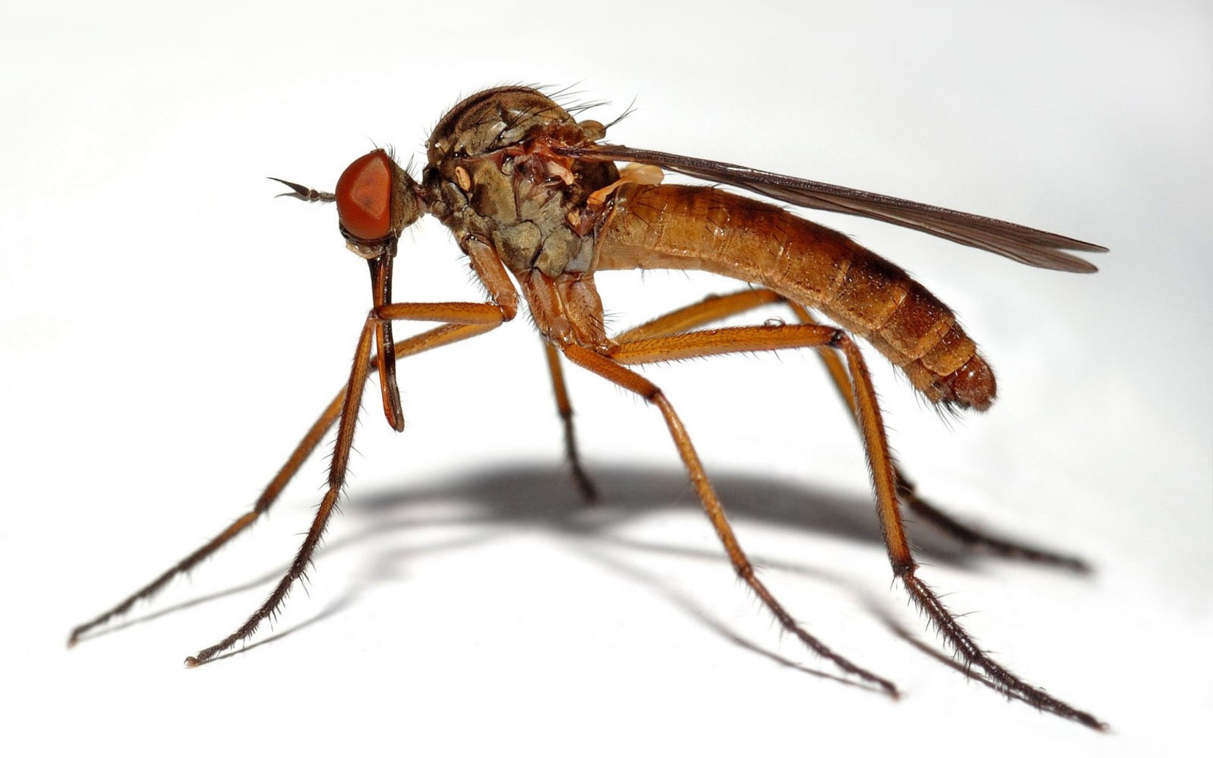
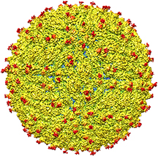
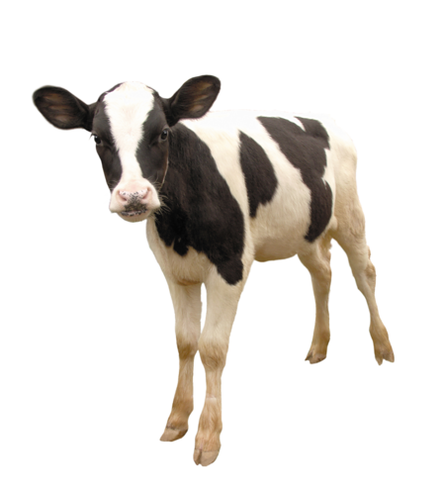
Microcephaly in Brazil: Is it Really Just Zika?
Part II
Stephanie Seneff
WAPF Wise Traditions
November 12, 2016

Slide 3
Outline (Part II)
A Role for Herbicides?
Glyphosate
Glufosinate (Liberty Herbicide)
Fighting Zika: Is the Cure Worse than the Disease?
Controlling mosquitoes with pesticides
GMO mosquitoes and molecular mimicry
A viral infection in cows
Zika vaccine development
Summary

Slide 4
A Role for Herbicides?

Slide 5
Glyphosate

Slide 6
Sugar Cane and Roundup*
Roundup is used to ripen sugar cane in NE Brazil at harvest
The workers harvest by machete and chop off a small chunk of stalk to chew on as they harvest throughout the day
They suffer from end-stage kidney failure
Kidney failure is much lower in other regions where they have switched to a different ripening agent besides glyphosate
The workers also take stalk sections home for the family to eat
* Prof.. Don Huber, Personal Communication

Slide 7
Sugar Cane, Sugar Beets and Ethanol*
Brazil is a leader in introducing flexible fuel vehicles (FFVs) into the market.
Designed to run on gasoline or gasoline-ethanol blends of up to 85% ethanol (E85)
Brazil has a major industry converting sugar from sugar beets and sugar cane to ethanol
Ethanol-based fuels produce toxic carcinogens: formaldehyde and acetaldehyde**
There is likely glyphosate present in the fuel
*https://en.wikipedia.org/wiki/Pernambuco
** MZ Jacobson, Environ. Sci. Technol., 2007, 41 (11), pp 4150–4157
Notes:
James_Lyons_Weiler/ethanol.email.text

Slide 8
Trucks in Brazil Lining Up Following Truckers’ Strike: February, 2015*
*kticradio.com/agricultural/deal-reached-in-brazil-truckers-strike-trucks-still-blocked/
Notes:
Recife

Slide 9
“Glyphosate-Based Herbicides Produce Teratogenic Effects on Vertebrates by Impairing Retinoic Acid Signaling”*
*A Paganelli et al., Chem Res Toxicol 2010; 23(10):1586-1595.

Slide 10
"Glyphosate-Based Herbicides Produce Teratogenic Effects on Vertebrates by Impairing Retinoic Acid Signaling"*
"GBH (Glyphosate-Based Herbicides) produced similar effects in chicken embryos, showing a gradual loss of rhombomere domains, reduction of the optic vesicles, and microcephaly. This suggests that glyphosate itself was responsible for the phenotypes observed, rather than a surfactant or other component of the commercial formulation."
*A Paganelli et al. Chem. Res. Toxicol 2010;23(10): 1586-1595.
Notes:
glyphosate/Carrasco_paper_BestOne_teratogenic_effects_glyphosate_2010.pdf

Slide 11
"Glyphosate-Based Herbicides Produce Teratogenic Effects on Vertebrates by Impairing Retinoic Acid Signaling"*
Retinoic acid receptors contain a highly conserved glycine that is essential for their proper function
"GBH (Glyphosate-Based Herbicides) produced similar effects in chicken embryos, showing a gradual loss of rhombomere domains, reduction of the optic vesicles, and microcephaly. This suggests that glyphosate itself was responsible for the phenotypes observed, rather than a surfactant or other component of the commercial formulation."
*A Paganelli et al. Chem. Res. Toxicol 2010;23(10): 1586-1595.
Notes:
glyphosate/Carrasco_paper_BestOne_teratogenic_effects_glyphosate_2010.pdf

Slide 12
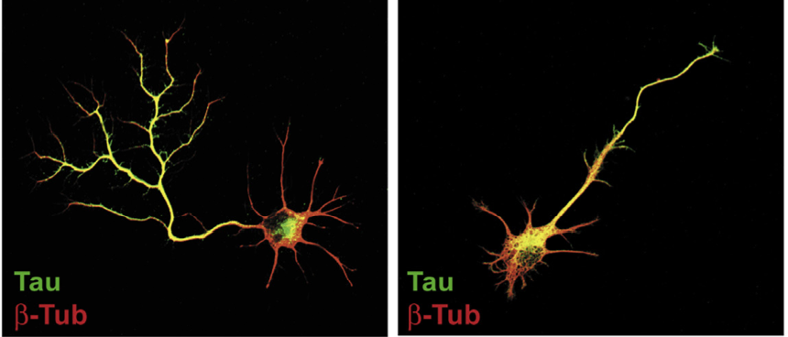
“Neuronal development and axon growth are altered by glyphosate through a WNT non-canonical signaling pathway”*
Neurons grown in culture & exposed to glyphosate
“They elicited shorter and unbranched axons and they also developed less complex dendritic arbors compared to controls”
+ Glyphosate
*RP Coullery et al., NeuroToxicology 2016;52:150-161.
Notes:
./Coullery_glyphosate_neurotoxicity_2016.pdf

Slide 13
Glyphosate Could Cause Microcephaly through Impaired Methylation Pathway
Disrupted folate one-carbon metabolism (methylation pathway)
Folate carries the methyl group that methylates DNA during development to regulate gene expression
Folate is produced for the host by gut microbes from the shikimate pathway which glyphosate suppresses
Methyl group is provided by metabolism of glycine
A critical enzyme in this pathway depends on a glycine-rich region that glyphosate could disrupt
Notes:
Glycine decarboxylase

Slide 14
Glyphosate and Anencephaly*
Yakima, Benton and Franklin counties in Washington State have an unusually high number of pregnancies affected by anencephaly
75 pesticides were analyzed in studying contamination due to surrounding agriculture
47 (63%) of these were detected
Glyphosate was applied in large amounts, but was not studied
5% solution of glyphosate was also used heavily around irrigation ditches to control weeds
Main herbicide recommended due to its “low toxicity”
*Barbara H. Peterson. Farm Wars, http://farmwars.info/?p=11137

Slide 15
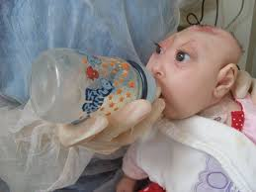
“Glyphosate, Brain Damaged Babies, and
Yakima Valley - A River Runs Through It”*
8
6
4
2
0
Noxious aquatic weed
control program with
Glyphosate ‘Rodeo’
1980 1990 2000 2010 2020
“Glyphosate, Three Rivers, and Anencephaly”
Yakima Harold Republic
Slide thanks to Prof. Don Huber, with permission
*Farm Wars 3/6/14
Notes:
From Don Huber:
Attached/LondonGlyphosate/
2014-0618_Huber_short.ppt

Slide 16
Pigs and GMO Roundup-Ready Feed
"In my experience, farmers have found increased production costs and escalating antibiotic use when feeding GM crops. In some operations, the livestock death loss is high, and there are unexplained problems including spontaneous abortions, deformities of new-born animals, and an overall listlessness and lack of contentment in the animals.”
Howard Vlieger, Iowa-based Farmer, author of paper on pigs comparing GMO vs non-GMO feed

Slide 17
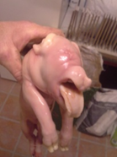
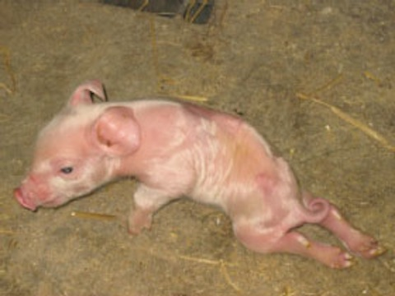
Ib Pedersen’s Danish Piglets*
“In a period of two years and 8 months, we have photographed 128 deform-born pigs.
The types of deformities are catalogued as follows:
Tails – 28, Spinal – 20, Cranial -16, feet – 16, Sex organ – 16, legs – 13, Ear – 9, kidney – 2, Skin – 2, missing anus – 2, Eye – 1, Thong – 1, Stomach born outside – 1, Motoric problems.”
*http://www.theecologist.org/News/news_analysis/2560697/
changing_to_nongmo_soy_transformed_the_health_of_my_pigs.html

Slide 18
Recapitulation
Glyphosate is used on both sugar cane and sugar beets grown in Brazil
Brazil produces an ethanol-based fuel from sugar beets and sugar cane
Glyphosate's impairment of retinoic acid signaling can cause microcephaly
Glyphosate suppresses neuronal growth in vitro
Glyphosate disrupts the supply of methyl groups for methylation multiple ways
Glyphosate is the likely cause of the anencephaly epidemic in Yakima, WA.
Pigs and piglets fed glyphosate-laden GMO feed are suffering from many health issues, including cranial deformities.

Slide 19
Glufosinate
(Liberty Herbicide)

Slide 20
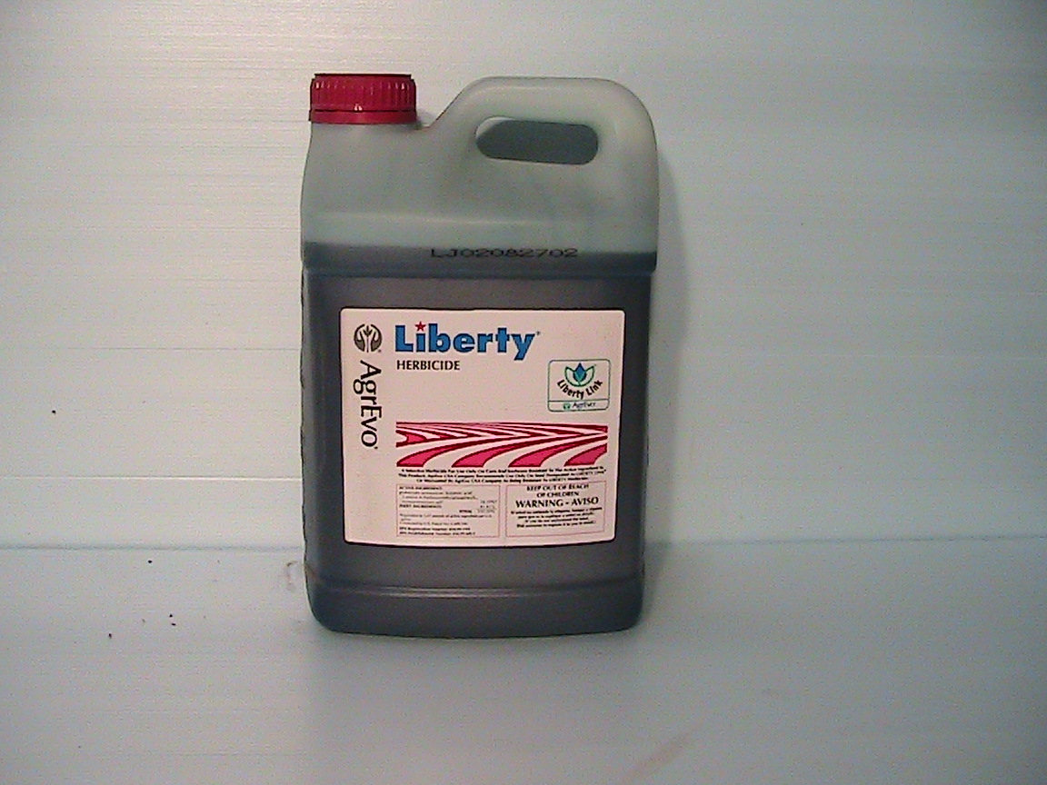
Glyphosate Resistant Weeds
Widespread appearance of glyphosate-resistant weeds has necessitated ever-increasing applications of glyphosate on Roundup-Ready crops
Liberty is an alternative herbicide to kill these resistant weeds – glufosinate!
LibertyLink is a GMO modification to support glufosinate resistance

Slide 21
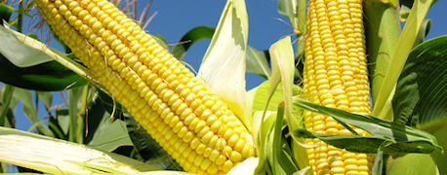
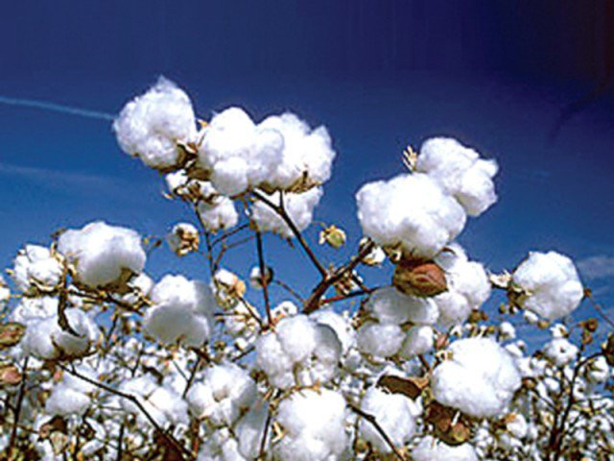
Increased Use of Glufosinate after 2010
LibertyLink is a Bayer-owned brand of genes for use in agriculture providing tolerance to Liberty herbicide and glufosinate
LibertyLink is the only GMO herbicide tolerant gene other than Roundup-Ready on the market.
LibertyLink versions of cotton, corn and soybeans are approved in Brazil
LibertyLink soybeans approved in 2010

Slide 22
Glufosinate is a Glutamate Analogue!*
Its toxicity to plants is based on its disruption of glutamine synthetase by pretending to be glutamate
This causes a build-up of excess ammonia and glutamate and a depletion of glutamine
As an analogue of glutamate, it could substitute for glutamate during protein synthesis – and this could lead to microcephaly!
*G Haerlein, Rev Environ Contam Toxicol 1994;138:73-145.
Notes:
./glufosinate_ammonium_abstract.text

Slide 23
Protein Disruption Through Coding Errors
Amino Acid | Imposter | Protein | Disease
serine | BMAA | Glutamate transporter | ALS (Lou Gehrig’s)
proline | Aze | Myelin basic protein | Multiple Sclerosis
glutamate | glufosinate | Asparagine synthetase | Microcephaly Immune deficiency
glycine | glyphosate | Many proteins | Autism, microcephaly, etc.
Asparagine synthetase

Slide 24
Microcephaly and Asparagine Synthetase*
Loss-of-function mutation in asparagine synthetase causes a severe condition
Congenital microcephaly, intellectual disability, progressive cerebral atrophy, and intractable seizures
Mutant mice have enlarged ventricles, reduced thickness of cortex, and learning disabilities
*EK Ruzzo et al., Neuron 2013;80(2):429-41.

Slide 25
Microcephaly and Asparagine Synthetase*
Loss-of-function mutation in asparagine synthetase causes a severe condition
Congenital microcephaly, intellectual disability, progressive cerebral atrophy, and intractable seizures
Mutant mice have enlarged ventricles, reduced thickness of cortex, and learning disabilities
Asparagine synthetase has a conserved glutamate that is essential for its function**
*EK Ruzzo et al., Neuron 2013;80(2):429-41.
** ME Meyer et al., Biochemistry 2010;49(43):9391-401.
Notes:
asparagine_synthetase_deficiency_microcephaly.pdf

Slide 26
A Theory Emerges: Glyphosate/Glufosinate Synergy
Glyphosate disrupts glutamine synthesis through chelation of manganese
Glutamine is precursor to asparagine
Glufosinate disrupts enzyme that synthesizes asparagine
Both shortages of glutamine and impaired enzyme activity result in severe deficiency in asparagine → microcephaly

Slide 27
A Bit of Chemistry
NH₄
Glutamate
Glutamine
Aspartate
Glutamine synthetase
glufosinate
Glyphosate
Asparagine synthetase
Asparagine deficiency
Leads to microcephaly and
Impaired immunity
Asparagine

Slide 28
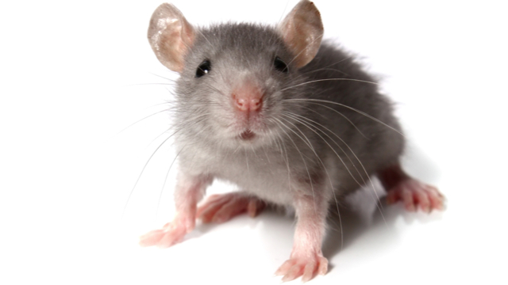
Glufosinate Induces Autistic Symptoms in Mice*
1 mg/kg administered three times a week to dam during gestation and lactation
Offspring demonstrated autistic behaviors – socialization impairment, repetitive activities
Dose was about 5 times lower than the EPA approved dose
* A. Laugeray et al., Frontiers in Behavioral Neuroscience 2014;8:390.
Notes:
./glufosinate_induces_autism_in_mice.pdf

Slide 29
Glufosinate Induces Autistic Symptoms in Mice*
1 mg/kg administered three times a week to dam during gestation and lactation
Offspring demonstrated autistic behaviors – socialization impairment, repetitive activities
Dose was about 5 times lower than the EPA approved dose
We can expect a dramatic rise in the use of glufosinate on core crops as more and more weeds become resistant to Roundup
* A. Laugeray et al., Frontiers in Behavioral Neuroscience 2014;8:390.
Notes:
./glufosinate_induces_autism_in_mice.pdf

Slide 30
Recapitulation
In Brazil, glyphosate-resistant weeds have necessitated the addition of glufosinate as a supplementary herbicide on new GMO versions of corn, soy and cotton resistant to both chemicals
Glufosinate is a non-coding amino acid analogue of glutamate that has been shown to cause microcephaly and autism in animal studies
Glyphosate and glufosinate would conspire to interfere with the synthesis of asparagine in the brain, and this can lead to microcephaly

Slide 31
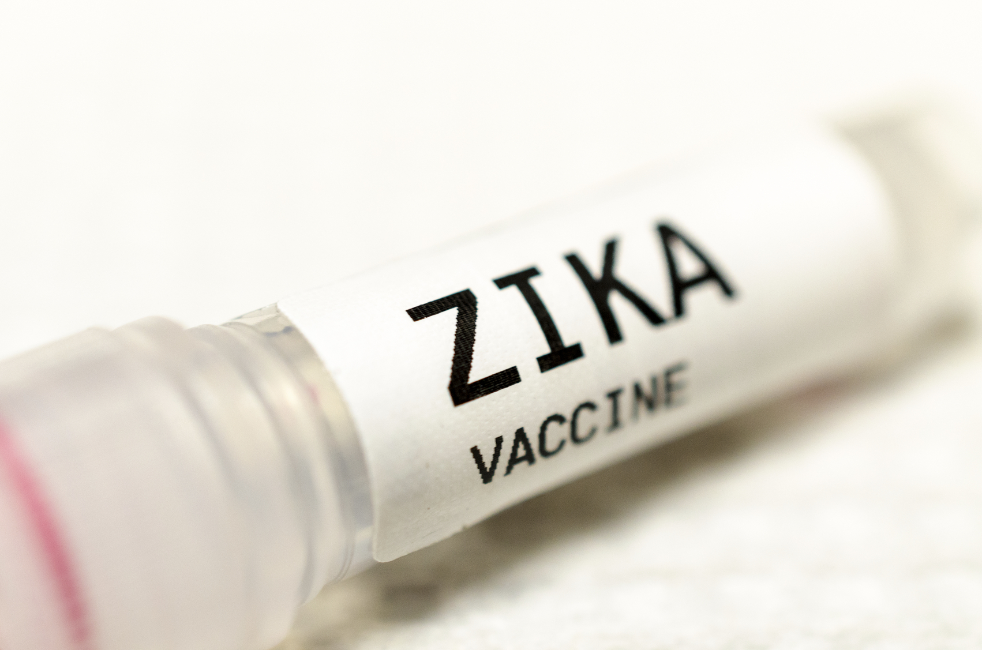
Fighting Zika:
Is the Cure
Worse than the Disease?

Slide 32
Controlling Mosquitoes
with Pesticides

Slide 33
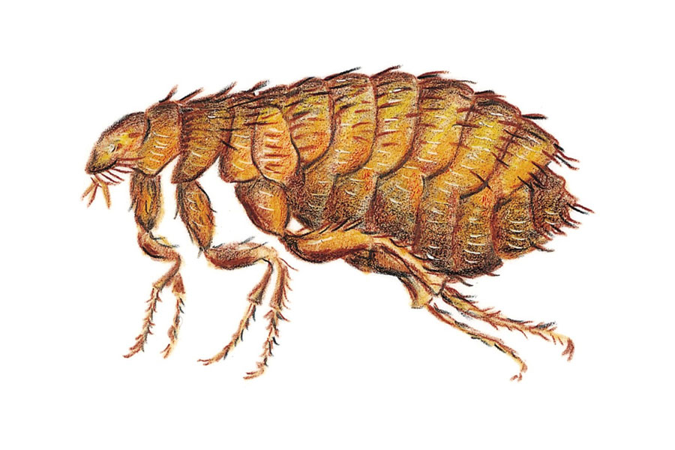
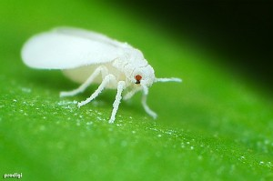
Pyriproxyfen: Insecticide*
Pyriproxyfen is a commonly used larvicide to control mosquitoes, fleas on pets and the whitefly in agriculture
Brazil is the only country that puts pyriproxyfen in the drinking water to control mosquitoes (since 2014)
Pyriproxyfen is a powerful juvenile hormone analog
Juvenile hormone controls metamorphosis and reproduction in insects
*D Evans et al., A Possible Link Between Pyriproxyfen and Microcephaly.
http://necsi.edu/research/social/pandemics/pyriproxyfen
Notes:
./pyriproxifen_and_microcephaly.pdf

Slide 34
Pyriproxyfen: Insecticide, Cont’d*
Juvenile hormone and retinoic acid (vitamin A) are both lipid-soluble terpenoids
Isotretinoin (a vitamin A analogue) causes microcephaly in human babies via maternal exposure
Juvenile hormone and its analogs bind to the vertebrate retinoic acid receptor
This could prevent the normal retinoic acid from binding to the receptor and cause developmental disorders in mammals
Liver CYP enzymes needed to detox pyriproxyfen are suppressed by glyphosate
*D Evans et al., A Possible Link Between Pyriproxyfen and Microcephaly.
http://necsi.edu/research/social/pandemics/pyriproxyfen
Notes:
./pyriproxifen_and_microcephaly.pdf
pyriproxifen_detoxed_by_CYP_enzymes.pdf
Accutane

Slide 35
Aerial Spraying to Combat Mosquitos Linked to Increased Risk of Autism in Children*
Swampy region in central New York
Health officials use airplanes to spray pyrethroid pesticides each summer
Motivated by concern about eastern equine encephalitis virus carried by mosquitoes
25% increased risk to autism and developmental delay compared to regions where pyrethroid pesticides are not sprayed
*www.aap.org/en-us/about-the-aap/aap-press-room/pages/
Aerial-Spraying-to-Combat-Mosquitos-Linked-to-Increased-Risk-of-Autism-in-Children.aspx
Notes:
https://www.aap.org/en-us/about-the-aap/aap-press-room/pages/Aerial-Spraying-to-Combat-Mosquitos-Linked-to-Increased-Risk-of-Autism-in-Children.aspx

Slide 36
Massive New Study Suggests Pesticide the Cause of Microcephaly — NOT Zika Virus*
"The mathematical analysis demonstrates that there are at least 60,000 Zika-infected pregnancies in Colombia, yet the near absence of microcephaly calls for a renewed investigation into the cause of this birth defect.”
"Pyriproxyfen had never been applied to drinking water on such a scale as it was in Brazil, which began the application in 2014–just before the outbreak of microcephaly."
*http://complete-health-and-happiness.com/
massive-new-study-suggests-pesticide-the-cause-of-microcephaly-not-zika-virus/?t=DM

Slide 37
Spraying Naled to Control Zika
Planes flew over Miami Beach last August and September spraying naled to control mosquitoes -- allegedly to fight Zika

Slide 38
Naled spraying in the United States*
Naled is a neurotoxic organophosphate pesticide
Naled’s breakdown product DICHLORVOS (another organophosphate insecticide) interferes with prenatal brain development. In laboratory animals, exposure for just 3 days during pregnancy when the brain is growing quickly reduced brain size 15 percent.**
The European Union bans the use of naled, calling it "a potential and unacceptable risk" to human health and the environment
*http://www.cnn.com/2016/09/09/health/florida-zika-spraying-starts/
**http://nospray.org/naled-insecticide-fact-sheet/

Slide 39
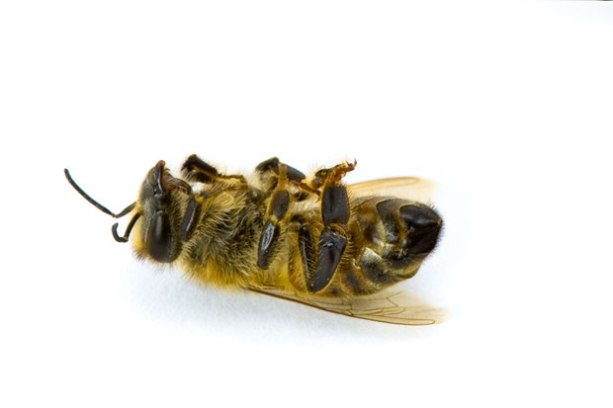
Naled kills bees*
Headline: ‘Like it’s been nuked’: Millions of bees dead after South Carolina sprays for Zika mosquitoes
For the first time, an airplane dispensed Naled in a fine mist, raining insect death from above between 6:30 a.m. and 8:30 a.m. Sunday.
A profile of the chemical in Cornell University’s pesticide database warned that “Naled is highly toxic to bees.”
*Ben Guarino, The Washington Post, September 1, 2016.
Notes:
Dorchester County S. Carolina
Flowertown Bee Farm and Supply, in Summerville — 46 hives died on the spot, totaling about 2.5 million bees.
https://www.washingtonpost.com/news/morning-mix/wp/2016/09/01/like-its-been-nuked-millions-of-bees-dead-after-south-carolina-sprays-for-zika-mosquitoes/

Slide 40
Naled May Be DDT and Zika May Be Polio All Over Again*
In the mid 1940's, US government fumigation campaign massively sprayed DDT due to the belief that mosquitoes might be spreading polio.
The rise and fall in paralytic polio rates echoed the rise and fall in DDT usage
"Is it possible that Naled, which is intended to kill off the mosquitoes believed to be carrying a virus theorized to cause microcephaly, may itself end up causing microcephaly, as well as other birth defects?"
*Marco Cáceres, Aug 29, 2016
http://www.thevaccinereaction.org/2016/08/
naled-may-be-ddt-and-zika-may-be-polio-all-over-again/
Notes:
./spraying_Naled_for_Zika.pdf

Slide 41
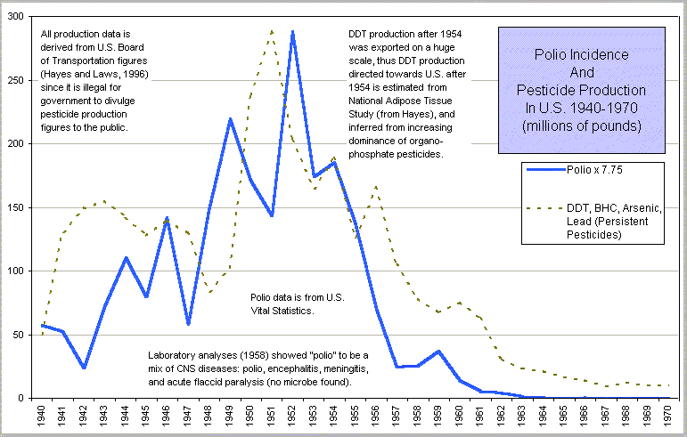
Polio and Pesticides*
*From Dissolving Illusions, Suzanne Humphries
Notes:
BHC (Benzene Hexa Chloride)

Slide 42
Recapitulation
Efforts to control mosquitoes through toxic pesticides may be a causal factor in microcephaly
In NE Brazil, pyriproxyfen has been added to the drinking water since 2014
Neighboring Colombia, with high Zika infection rates, has no associated microcephaly
Pyrethroid pesticides sprayed in NY were associated with increased autism risk
Naled is an organophosphate pesticide sprayed in the US to control mosquitoes: banned in Europe
Decimated bee colony in South Carolina
DDT sprayed to control mosquitoes during the polio epidemic may have led to paralysis attributed to polio virus
History repeats itself with Zika?

Slide 43
GMO Mosquitoes
and Molecular Mimicry

Slide 44
GMO Mosquitoes*
Millions of GMO Aedes aegypti mosquitoes released in Brazil, beginning in 2011, to combat dengue fever
This species also carries Zika virus
Mosquito called OX513A developed by Oxitec: engineered to require tetracycline to survive
Field releases in Itaberaba, in the semi-arid northeast region of Brazil
*Janet Fang, Genetically Modified Mosquitoes Released In Brazil, July 7, 2015
http://www.iflscience.com/plants-and-animals/
dengue-fighting-mosquitoes-are-suppressing-wild-populations-brazil/

Slide 45
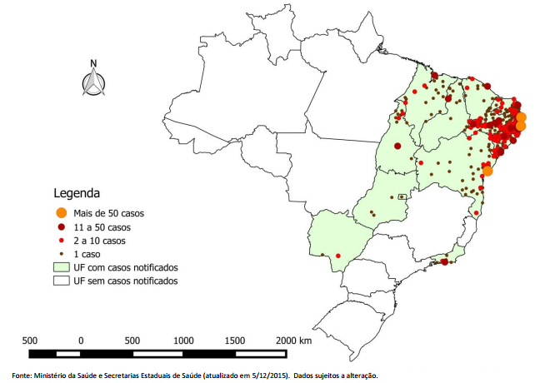
GMO Mosquito Introduced Here
Notes:
Juazeiro de Norte

Slide 46
GMO Mosquitoes, cont’d*
Grown in contained spaces in Cayman Islands
Fed sucrose as larvae followed by blood as adults (sucrose comes from sugar beets or sugar cane)
Males engineered to become infertile without access to tetracycline
They could be harboring more glyphosate than mosquitoes in the wild
*AF Harris et al., Nature Biotechnology 2011; 29:1034-1037.
Notes:
./GM_mosquito2.pdf

Slide 47
Zika and Molecular Mimicry
Studies from the Vaccine Induced Immunological Damage (VIID) Program (James Lyons Weiler)
Zika E Protein: GWGNGCGLFGKGSLV
IGG heavy chain: GYSSGCGYWGQGTLV
Lots of glycines! – These could get displaced by glyphosate during protein synthesis!!
Likely to disrupt protein folding and cause resistance to breakdown
→ Autoimmune reaction to similar protein (IGG heavy chain)
Notes:
IPAK STUDY 6: Zika E protein (ZEP) vs. Homo sapiens Immunoglobulin
(IMG heavy chain) (NEW IPAK FIND, JANUARY 2016)

Slide 48
Zika and Molecular Mimicry
Studies from the Vaccine Induced Immunological Damage (VIID) Program (James Lyons Weiler)
Zika E Protein: GWGNGCGLFGKGSLV
IGG heavy chain: GYSSGCGYWGQGTLV
Lots of glycines! – These could get displaced by glyphosate during protein synthesis!!
Likely to disrupt protein folding and cause resistance to breakdown
→ Autoimmune reaction to similar protein (IGG heavy chain)
A Zika virus growing in a GMO mosquito is likely to end up with glyphosate in its proteins
Notes:
IPAK STUDY 6: Zika E protein (ZEP) vs. Homo sapiens Immunoglobulin
(IMG heavy chain) (NEW IPAK FIND, JANUARY 2016)

Slide 49
A Chromosomal Breakage Syndrome With Profound Immunodeficiency*
Chromosomal Breakage Syndrome: case study
Spontaneous chromosomal breaks, gaps and rearrangements in T-cells
Failure to thrive, microcephaly, immune deficiency, neurological abnormalities
Very low levels of immunoglobulins
*ME Conley et al., Blood 1986;67(5):1251-1256.
Notes:
WIKI
All of these processing events result in an antigen-binding region that is highly variable, even when the same gene segments are recombined. V(D)J recombination allows for the generation of immunoglobulins and T cell receptors to antigens that neither the organism nor its ancestor(s) need to have previously encountered, allowing for an adaptive immune response to novel pathogens that develop or to those that frequently change (e.g., seasonal influenza). However, a major caveat to this process is that the DNA sequence must remain in-frame in order to maintain the correct amino acid sequence in the final protein product. If the resulting sequence is out-of-frame, the development of the cell will be arrested, and the cell will not survive to maturity. V(D)J recombination is therefore a very costly process that must be (and is) strictly regulated and controlled.

Slide 50
A Chromosomal Breakage Syndrome With Profound Immunodeficiency*
Chromosomal Breakage Syndrome: case study
Spontaneous chromosomal breaks, gaps and rearrangements in T-cells
Failure to thrive, microcephaly, immune deficiency, neurological abnormalities
Very low levels of immunoglobulins
Suggests a link between microcephaly and low immunoglobulins which can arise because of an autoimmune response to IgG heavy chain via Zika protein mimicry
*ME Conley et al., Blood 1986;67(5):1251-1256.
Notes:
WIKI
All of these processing events result in an antigen-binding region that is highly variable, even when the same gene segments are recombined. V(D)J recombination allows for the generation of immunoglobulins and T cell receptors to antigens that neither the organism nor its ancestor(s) need to have previously encountered, allowing for an adaptive immune response to novel pathogens that develop or to those that frequently change (e.g., seasonal influenza). However, a major caveat to this process is that the DNA sequence must remain in-frame in order to maintain the correct amino acid sequence in the final protein product. If the resulting sequence is out-of-frame, the development of the cell will be arrested, and the cell will not survive to maturity. V(D)J recombination is therefore a very costly process that must be (and is) strictly regulated and controlled.

Slide 51
PNKP & Microcephaly*
The body relies on DNA repair mechanisms to repair chromosomal breaks and errors
PNKP is intimately involved in DNA repair
PNKP is both a phosphatase and a kinase: it takes away and adds phosphate groups to DNA
Mutations in PNKP have been shown to cause microcephaly, seizures and defective DNA repair
Glyphosate substitution for conserved glycines in PNKP would disrupt both of its activities
*JJ Reynolds et al., Nucleic Acids Res 2012;40(14):6608-19.
Notes:
PNKP = ?
polynucleotide kinase/phosphatase
James_Lyons_Weiler/DNA_Impact\ of\ PNKP\ mutations\ associated\ with\ microcephaly,\ seizures\ and\ developmental\ delay\ on\ enzyme\ activity\ and\ DNA\ strand\ break\ repair.pdf

Slide 52
Recapitulation
New GMO mosquito engineered to control mosquito populations was introduced into NE Brazil just before the microcephaly crisis
GMO mosquito may harbor Zika virus contaminated with glyphosate in its proteins
A Zika peptide strongly resembles the IGG heavy chain
Both peptides have many glycine residues
Molecular mimicry could lead to low immunoglobulin and immune deficiency
A chromosomal breakage syndrome is associated with very low immunoglobulin levels and microcephaly

Slide 53
A Viral Infection in Cows

Slide 54
Another Virus Involved?*
Adriana Melo was the Brazilian doctor who first reported a potential link between Zika and microcephaly
She found bovine viral diarrhoea virus (BVDV) proteins in the brains of 3 fetuses with microcephaly from Paraíba state.
Their brains tested positive for Zika RNA, but NOT Zika protein
*D Butler. Brazil asks whether Zika acts alone to cause birth defects.
Nature News, 25 July 2016.
Notes:
Brazil_notes.text
http://www.nature.com/news/brazil-asks-whether-zika-acts-alone-to-cause-birth-defects-1.20309

Slide 55
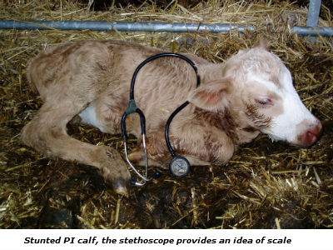
BVDV in Cows
BVDV is a serious problem among cows worldwide
BVDV is immunosuppressive and it causes respiratory problems and infertility
A fetus exposed in utero can become a persistent carrier because it identifies the virus proteins as "self" proteins
In MMR, MMRV, Rotavirus and Varicella vaccines, the live virus is grown on fetal bovine serum
Notes:
Brazil_notes.text

Slide 56
“Zika virus may not be alone: proteomics associates a bovine-like viral diarrhea virus to microcephaly”*
Detected BVDV proteins in brain autopsy of three microcephalic fetuses with Zika virus infection
One sentence summary:
"Proteomics analysis lead us to suspect the presence of a Bovine-like viral diarrhea virus (BVDV-like) in the brain tissue of fetuses bearing microcephaly during the outbreak in Paraíba State, Brazil, 2015."
*biorxiv.org/content/biorxiv/early/2016/07/15/062596.full.pdf
Notes:
Zika_not_alone_BVDV.pdf
Zika_not_alone.text

Slide 57
“Herd-level prevalence and risk factors for bovine viral diarrhea virus infection in cattle in the State of Paraíba, Northeastern Brazil”*
A cross-sectional study from September 2012 to January 2013
2443 animals were sampled from 478 herds
65.5% of the herds were found to be infected
39.1% of the individual animals were infected
Large number of calves was a risk factor
*LG Fernandes et al., Trop Anim Health Prod. 2016 Jan;48(1):157-65.

Slide 58
The Smoking Gun?
BVDV is a member of the Pestivirus family
BVDV was detected in serum of two children with microcephaly in the US*
MMR vaccine: live viruses are grown on fetal bovine serum
BVDV has been detected in MMR**
Virulent BVDV strain has been traced to Brazil as the original source***
*BJ Potts et al., The Lancet 1987; 329(8539): 972-973.
**R Harasawa et al. J Clin Microbiol 1994;32: 1604-1605.
***M Giangaspero, Tropical Medicine & Surgery 2013;1:6.
Notes:
WIKI_on_bovine_diarrhea.text
bovine_diarrhea_virus_in_biological_products_2013.pdf

Slide 59
The Smoking Gun?
BVDV is a member of the Pestivirus family
BVDV was detected in serum of two children with microcephaly in the US*
MMR vaccine: live viruses are grown on fetal bovine serum
BVDV has been detected in MMR**
Virulent BVDV strain has been traced to Brazil as the original source***
IgG is the immunoglobulin that is tested to diagnose antibodies to BVDV and infer infection in cows*
*C Bachofen et al., Journal of Veterinary Diagnostic Investigation 2013;25(5) 655-661.
Notes:
WIKI_on_bovine_diarrhea.text
bovine_diarrhea_virus_in_biological_products_2013.pdf

Slide 60
The Smoking Gun?
Does the attack on IgG induced by glyphosate-contaminated Zika protein lead to an impaired immune system (reduction in IgG) and vulnerability to fetal brain infection with BVDV (potentially a contaminant in vaccines)?
Notes:
Brazil_notes.text
http://www.nature.com/news/brazil-asks-whether-zika-acts-alone-to-cause-birth-defects-1.20309

Slide 61
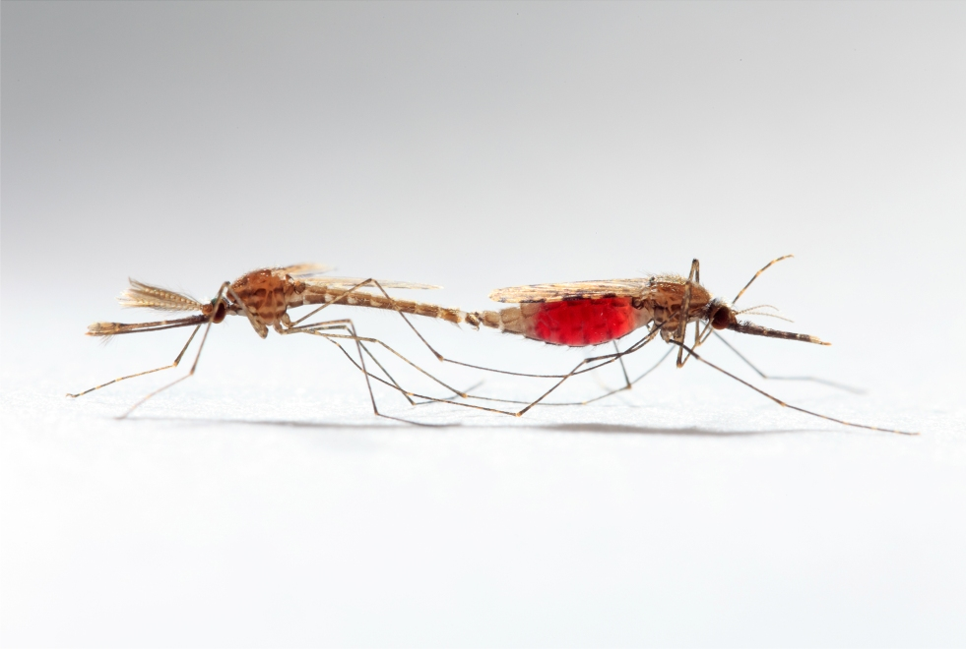
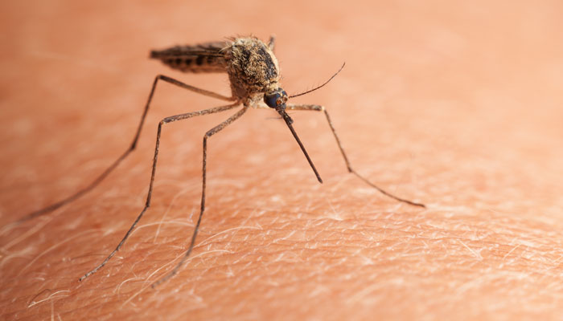
GMO mosquito passes glyphosate-contaminated Zika to female
2
1
Female bites woman
3
Woman develops immune deficiency
6
Woman gets MMR vaccine containing glyphosate-contaminated BVDV
4
Baby born with microcephaly
During pregnancy, fetal brain is attacked by autoantibodies due to immune reaction to BVDV
5

Slide 62
Zika Vaccine Development

Slide 63
What is Zika?
Zika is a flavivirus: this family also includes dengue, West Nile, yellow fever, Japanese encephalitis and tick-borne encephalitic viruses.
Flaviviruses contain an RNA genome (not DNA) surrounded by a lipid (fatty) membrane inside a protein shell.
The protein is glycosylated: bound to complex sugar chains dangling around the exterior
Notes:
PurdueZika.pdf

Slide 64
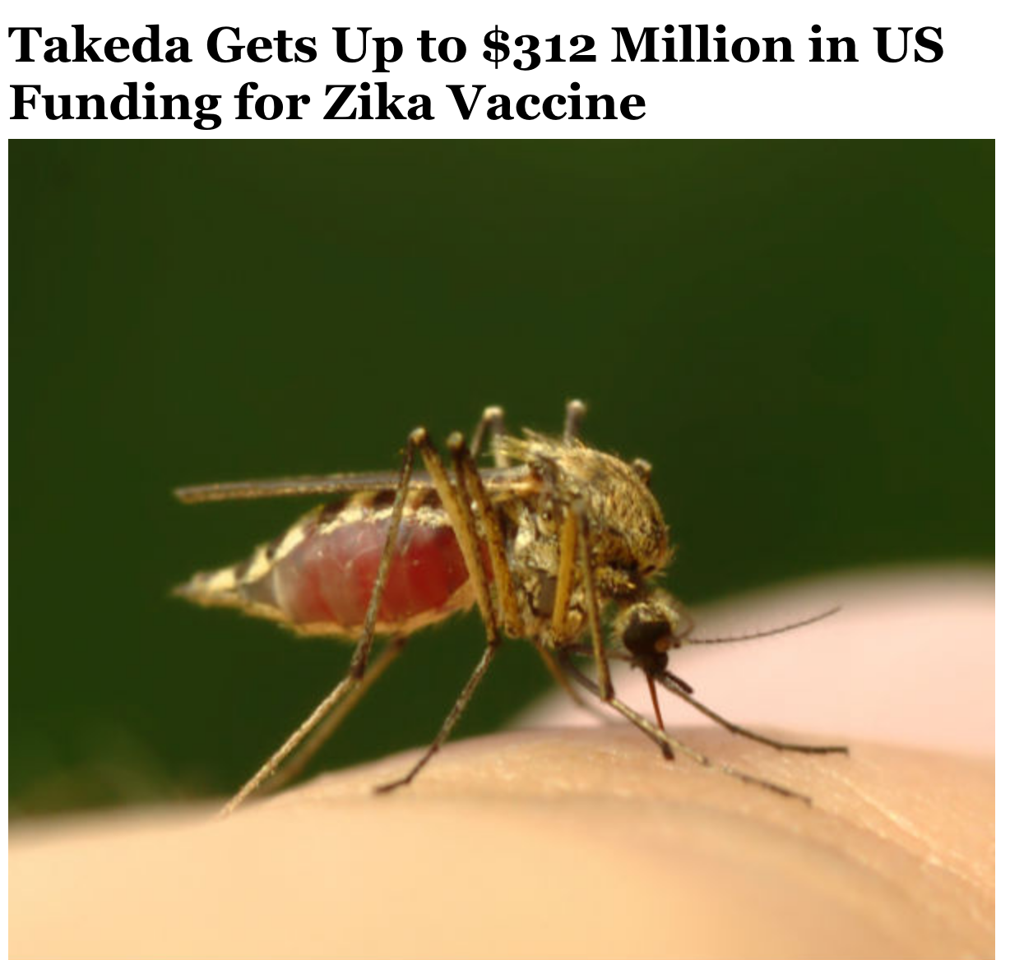
Notes:
http://www.newsmax.com/Finance/StreetTalk/Zika-Takeda-vaccine-mosquito/2016/09/02/id/746460/
Takeda will harness its work against dengue, a virus from the same family, to develop a vaccine against Zika.

Slide 65
“Takeda will harness its work against dengue, a virus from the same family, to develop a vaccine against Zika.”
Notes:
http://www.newsmax.com/Finance/StreetTalk/Zika-Takeda-vaccine-mosquito/2016/09/02/id/746460/
Takeda will harness its work against dengue, a virus from the same family, to develop a vaccine against Zika.

Slide 66
“DENVax: live attenuated vaccine
developed using wildtype DEN2 strain attenuated in primary dog kidney cells and further attenuated by mutation in NS3 gene.”
Notes:
http://www.newsmax.com/Finance/StreetTalk/Zika-Takeda-vaccine-mosquito/2016/09/02/id/746460/
Takeda will harness its work against dengue, a virus from the same family, to develop a vaccine against Zika.

Slide 67
Merck’s Recent Research on Dengue Virus Vaccines*
Chimeric yellow fever-dengue constructs: Two different virus species are merged
In vitro, two or three cDNA fragments are ligated together from separate plasmids and used to generate a full-length dengue viral cDNA template
The fragments contain the code for antigen from multiple strains of Dengue
Viral RNA is produced by a human cell as a copy of the assembled cDNA template
“With the advent of recombinant DNA technology and infectious clone systems, it is now possible to generate recombinant flaviviruses entirely from cloned cDNA using reverse genetics.”
*D Govindarajan et al., PLoS One. 2016; 11(3): e0152209.
Notes:
./Mercks_engineered_Dengue_vaccines.pdf

Slide 68
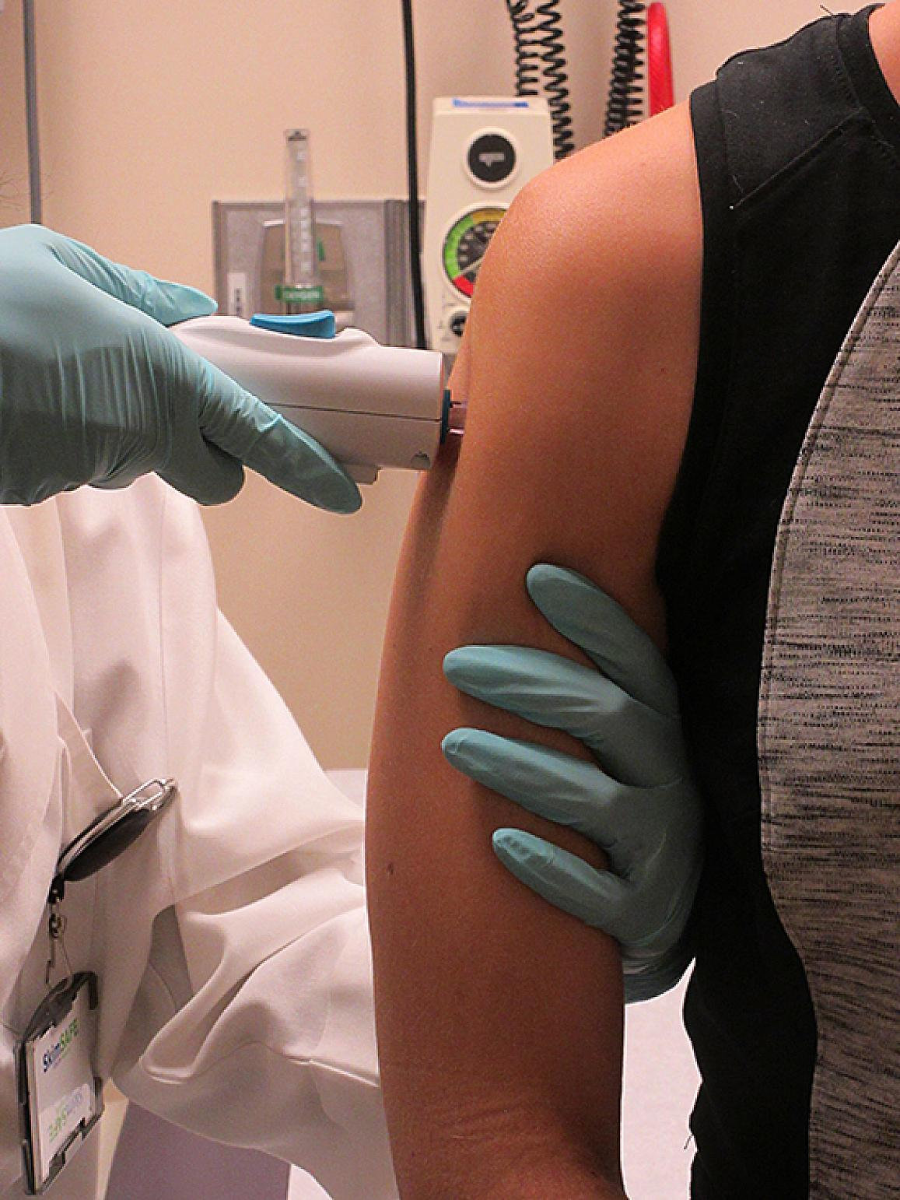
New DNA Plasmid Zika Vaccine*
“A safe and effective vaccine to prevent Zika virus infection and the devastating birth defects it causes is a public health imperative.”
Dr. Anthony S. Fauci, NIAID Director
*National Institutes of Health News Release August 3, 2016
Notes:
./NIH_Zika_vacccine_tests.text
https://www.nih.gov/news-events/news-releases/nih-begins-testing-investigational-zika-vaccine-humans

Slide 69
New DNA Plasmid Zika Vaccine*
“A safe and effective vaccine to prevent Zika virus infection and the devastating birth defects it causes is a public health imperative.”
Dr. Anthony S. Fauci, NIAID Director
US Congress has approved $1.1 Billion to develop a Zika vaccine
*National Institutes of Health News Release August 3, 2016
Notes:
./NIH_Zika_vacccine_tests.text
https://www.nih.gov/news-events/news-releases/nih-begins-testing-investigational-zika-vaccine-humans

Slide 70
“Inovio Pharmaceutical's DNA Vaccine for Zika Virus Induces Robust Immune Responses in Preclinical Study”*
DNA vaccine constructs targeting multiple Zika virus antigens were synthetically generated using Inovio's SynCon vaccine technology.
These SynCon constructs were administered using Inovio's CELLECTRA® electroporation delivery technology.
Inovio's Zika DNA vaccine resulted in the development of detectable specific antibodies in the blood, in all vaccinated mice.
*Inovio news release
Notes:
http://ir.inovio.com/news/news-releases/news-releases-details/2016/Inovio-Pharmaceuticals-DNA-Vaccine-for-Zika-Virus-Induces-Robust-Immune-Responses-in-Preclinical-Study/default.aspx
the action or process of introducing DNA or chromosomes into bacteria
or other cells using a pulse of electricity to briefly open the pores
in the cell membranes.

Slide 71
DNA Plasmid Vaccines*
“When the vaccine is injected into the arm muscle, cells read the genes and make Zika virus proteins, which self-assemble into virus-like particles.”
“The body mounts an immune response to these particles, including neutralizing antibodies and T cells.”
*https://www.nih.gov/news-events/news-releases/
nih-begins-testing-investigational-zika-vaccine-humans

Slide 72
The role of CpG in DNA vaccines*
DNA vaccines: plasmid DNA induces human cells to produce the antigen that then induces the antibody to the virus, bacterium or parasite whose proteins are encoded in the plasmid
Stimulatory unmethylated CpG motifs in the plasmid DNA significantly enhance immune response
*MJ McCluskie et al., Springer Semin Immunopathol. 2000;22(1-2):125-32.
Notes:
./CpG_in_DNA_vaccines.text
- Lots of stuff here.

Slide 73
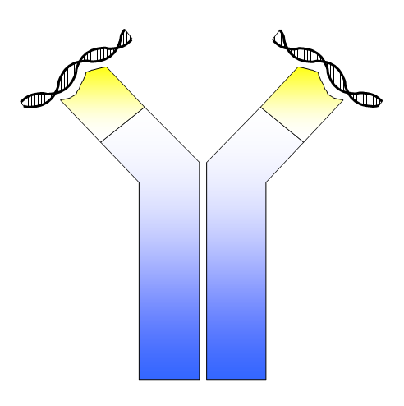
"Do DNA vaccines induce autoimmune disease?"*
Examined plasmid DNA vaccines [like Zika vaccines under development]
Looked for (and found) anti-DNA autoantibodies
Anti DNA autoantibodies are directly linked to Lupus
Looked for (but didn't find) anti-muscle cell autoantibodies and myositis: muscle tissue degeneration
*G Mor et al., Hum Gene Ther. 1997 Feb 10;8(3):293-300.
Notes:
./DNA_vaccines_autoimmune_disease.text

Slide 74
Concerns about Plasmid-based DNA Vaccines*
Are they likely to induce systemic or organ-specific autoimmune disease?
Will they tend to induce tolerance rather than immunity?
Are they effective in individuals with depressed immune function?
*DM Klinman et al., Springer Semin Immunopathol 1997; 19: 245.

Slide 75
A Dark Scenario
Zika vaccine contains peptide that resembles immunoglobulin heavy chain and is accidentally contaminated with glyphosate
Through molecular mimicry, woman develops autoantibodies to IgG antibody
MMR vaccine or flu vaccine contains bovine diarrhea virus as a contaminant
Mother’s weakened immune system can’t fight the virus
Fetus develops microcephaly due to bovine virus infection
Zika vaccine causes microcephaly, which is what it was intended to prevent!!

Slide 76
Recapitulation
The US government has allocated $1.1 billion for Zika vaccine development
Industry researchers are developing exotic plasmid vaccines as “pseudo viruses” blended from multiple strains of multiple species
DNA version of genetic code for RNA viruses
Human cells synthesize the antigen and then develop antibodies to it
Unmethylated CpG DNA in the vaccine sends alarm bells to the immune system and acts as adjuvant
A dark scenario predicts microcephaly as a direct consequence of the Zika vaccine, following contamination with glyphosate and bovine diarrhea virus

Slide 77
Summary
The microcephaly epidemic in NE Brazil has generated a world-wide panic situation that is uncalled for
Many other factors besides Zika can plausibly contribute to microcephaly
Glyphosate, glufosinate, thiamine deficiency, multiple vaccines, BVDV, GMO mosquito, larvicides, insecticides
Push to spray toxic chemicals to kill mosquitoes and to introduce GMO mosquitoes and to develop new vaccines against Zika will backfire

