Slide 1
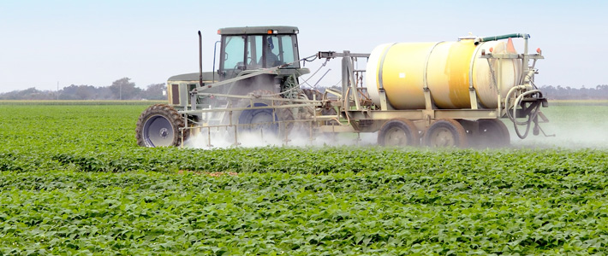
Glyphosate and Autism
Stephanie Seneff, MIT
People’s Assembly
The Hague, Netherlands
Oct 14, 2016

Slide 2
“Those who have the privilege to know, have the duty to act.”
Albert Einstein

Slide 3
Outline
Introduction
Manganese deficiency and autism
Glyphosate insertion into proteins in place of glycine: multiple links to autism
Summary

Slide 4
Introduction

Slide 5
“A comparison of temporal trends in United States autism prevalence to trends in suspected environmental factors”*
Data suggest ~75-80% of the tracked increase in autism since 1988 is due to an actual increase in the disorder rather than to changing diagnostic criteria
Polybrominated diphenyl ethers (fire retardants), aluminum adjuvants, and the herbicide glyphosate have increasing trends that correlate positively to the rise in autism.
*Cynthia Nevin, Environmental Health 2014, 13:73
Notes:
Samantha/autism_environmental_trends_aluminum_glyphosate_Cynthia_2014.pdf

Slide 6
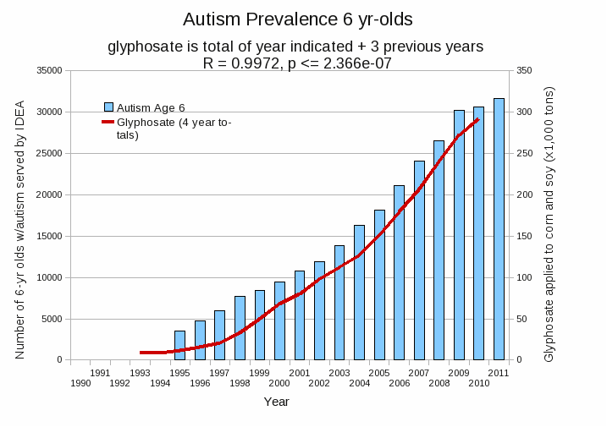
Autism Prevalence: 6 year olds*
R = 0.9972
* Figure 15, Seneff et al., Agricultural Sciences, 2015, 6, 42-70
Notes:
Nancy/latest_plots/6-yr-old autism.gif
autism: USDE
oil consumption: USDA
glyphosate: USDA
GE crops: USDA
Mortality data: CDC

Slide 7
Glyphosate and Autism: Some Biological Mechanisms
Disruption of gut microbes¹
Children with autism suffer from many digestive issues
Metal chelation (especially manganese)²
Manganese deficiency leads to impaired mitochondrial function and glutamate toxicity in the brain
Disruption of sulfur metabolism, glutathione deficiency, impaired methylation pathways¹
Inhibition of pituitary release of thyroid stimulating hormone → hypothyroidism³
Moms with hypothyroidism have 4-fold increased risk to autism in the fetus
1. Samsel and Seneff, Entropy 2013;15(4):1416-1463.
2. Samsel and Seneff, Surg Neurol Int. 2015;6:45.
3. Beecham and Seneff, Journal of Autism 2016;3:1.

Slide 8
Manganese deficiency
and autism

Slide 9
Glyphosate Depletes Iron, Manganese and Zinc in Plants*
*D Huber, What About Glyphosate-Induced Manganese Deficiency?
Fluid Journal 2007: 20-22.
Notes:
Glyphosate/glyphosate_induced_manganese_deficiency_plants_Huber.pdf

Slide 10
Severe Deficiency in Serum Manganese and Cobalt in Cows*
Cobalt
Manganese
Eight different farms: all cows tested had glyphosate in the urine
*M. Krüger et al., J Environ Anal Toxicol 2013, 3:5
Notes:
glyphosate//cows_cobalt_deficiency_glyphosate.pdf

Slide 11
Severe Deficiency in Serum Manganese and Cobalt in Cows*
cobalamin
deficiency
Cobalt
???
Manganese
Eight different farms: all cows tested had glyphosate in the urine
*M. Krüger et al., J Environ Anal Toxicol 2013, 3:5
Notes:
glyphosate//cows_cobalt_deficiency_glyphosate.pdf

Slide 12
Some Consequences of Manganese Deficiency
Lactobacillus critically depend on manganese
Manganese superoxide dismutase protects mitochondria from oxidative damage
Manganese is essential for detoxing glutamate (neurotoxin)
Pituitary depends on manganese to release thyroid stimulating hormone
Chondroitin sulfate synthesis in bones

Slide 13
Low Manganese in Teeth Linked to Autism*
Studied lead, mercury and manganese levels in tooth enamel of shed primary teeth in 84 children
Manganese accumulated after birth was down by 60% in autistic children
No other result was statistically significant
*MM Abdullah et al., J Autism Dev Disord. 2012 Jun;42(6):929-36.
Notes:
Samantha/heavy_metal_in_childrens_tooth_enamel_as_diagnostic_autism.pdf

Slide 14
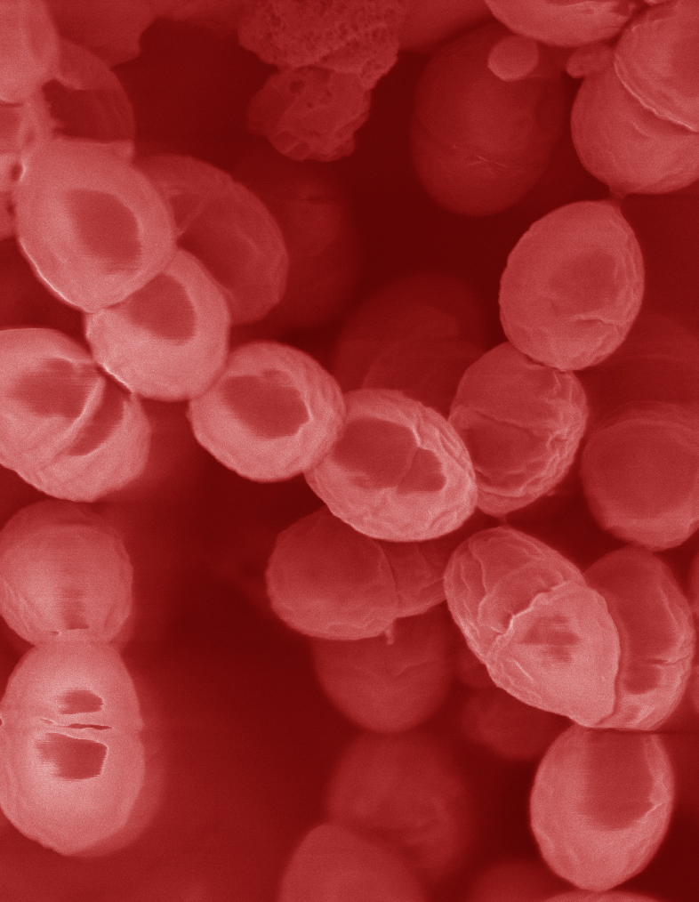
Lactobacillus Depends on Manganese!*
Many lactic acid bacteria contain very high intracellular manganese levels
Scavenges toxic oxygen species, particularly superoxide
Manganese deprivation suppresses growth
* FS Archibald and M-N Duong. Journal of Bacteriology Apr 1084, 1-8.
Notes:
Glyphosate/manganese/manganese_acquisition_by_lactobacillus.pdf

Slide 15
Lactobacillus Depends on Manganese!*
Many lactic acid bacteria contain very high intracellular manganese levels
Scavenges toxic oxygen species, particularly superoxide
Manganese deprivation suppresses growth
Lactobacillus levels are low in the gut in association with autism
* FS Archibald and M-N Duong. Journal of Bacteriology Apr 1084, 1-8.
Notes:
Glyphosate/manganese/manganese_acquisition_by_lactobacillus.pdf

Slide 16
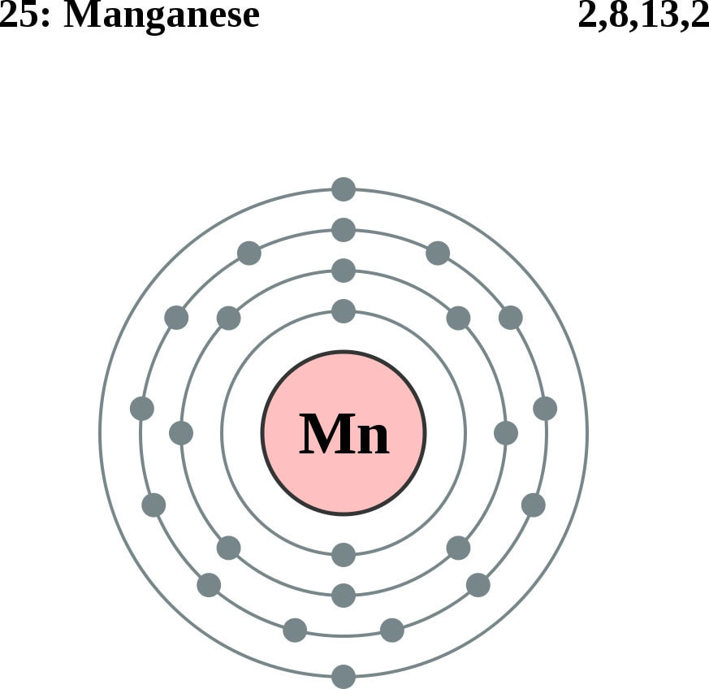
Glutamine Synthesis Depends on Manganese!
Glutamine synthetase
glutamate
glutamine
water
ammonium
Ammonium and glutamate toxicity in the brain
can arise because of insufficient manganese

Slide 17
Glyphosate and Glutamate*,**
Acute exposure activates NMDA receptors and voltage-dependent calcium channels
Oxidative stress and neural cell death
Increased glutamate release into the synaptic cleft → excessive extracellular glutamate levels
Decreased glutathione content
Increased peroxidation of lipids (fats)
*http://www.greenmedinfo.com/blog/roundup-weedkiller-brain-damaging-neurotoxin
**D Cattani et al., Toxicology 2014; 320: 34-45.
NMDA = N-methyl D-aspartate
Notes:
N-methyl D-aspartate
http://www.greenmedinfo.com/blog/roundup-weedkiller-brain-damaging-neurotoxin
acute exposure (30 minutes) and chronic (pregnancy and lactation) exposure.
Rat hippocampus
Why was this referenced??
T. Bohn et al. Food Chemistry 153, 15 June 2014, 207-215.

Slide 18
“Alteration of Plasma Glutamate and Glutamine Levels in Children with High-Functioning Autism”*
*C. Shimmura et al. PLoSone October 2011 6(1):e25340
Notes:
Table 1. Plasma Levels of Amino Acids and related compounds in Control Subjects and Individuals with HFA.
Glyphosate/glutamate_glutamine_autism_2011.pdf

Slide 19
Glyphosate insertion into
proteins in place of glycine:
Multiple links to autism

Slide 20
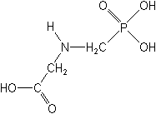
What If Glyphosate Could Insert Itself Into Protein Synthesis???
glyphosate
Code for Glycine
GGC
mRNA
. . .
. . .
Glyphosate
Alanine
Proline
-- Any proteins with conserved glycine residues are likely to be affected in a major way

Slide 21
Extra Piece Sticks Out at Active Site
Substrate no longer fits in active site
Active Site
Extra Stuff
Glyphosate
Alanine
Proline
glycine
Peptide chain

Slide 22
Extra Piece Sticks Out at Active Site
Substrate no longer fits in active site
This explains how glyphosate disrupts EPSPS in the shikimate pathway: Multiple bacteria have developed resistance by replacing active site glycine with alanine and this is the basis for GMO Roundup Ready crops*
Active Site
Extra Stuff
Glyphosate
Alanine
Proline
glycine
Peptide chain
*T Funke et al., Molecular basis for the herbicide resistance of Roundup Ready crops. PNAS 2006;103(35):13010-13015.

Slide 23
Inhibition of EPSPS by glyphosate: Resistant E coli mutant*
Mutant with alanine substituted for glycine 96
Wild type with glycine 96
*Figure 3, S Eschenburg et al. Planta 2002;216:129-135.

Slide 24
Some Links to Autism through Protein Glycine Dependencies*
Protein Phosphatase 1 has essential glycines and depends on manganese as catalyst
Deficiencies lead to hypothyroidism
Glycine is a major source of methyl groups for methylation pathways
Critical enzyme in glycine cleavage system depends on conserved glycines
GABA receptor has highly conserved glycine residue
Prolyl aminopeptidase involved in gluten metabolism has multiple glycine dependencies
*A Samsel and S Seneff. J Biol Phys & Chem 2016;16:9-46.

Slide 25
“Metabolic biomarkers of increased oxidative stress and impaired methylation capacity in children with autism”*
“Conclusions: An increased vulnerability to oxidative stress and a decreased capacity for methylation may contribute to the develop- ment and clinical manifestation of autism.”
*S Jill James et al., Am J Clin Nutr 2004;80:1611–7.

Slide 26
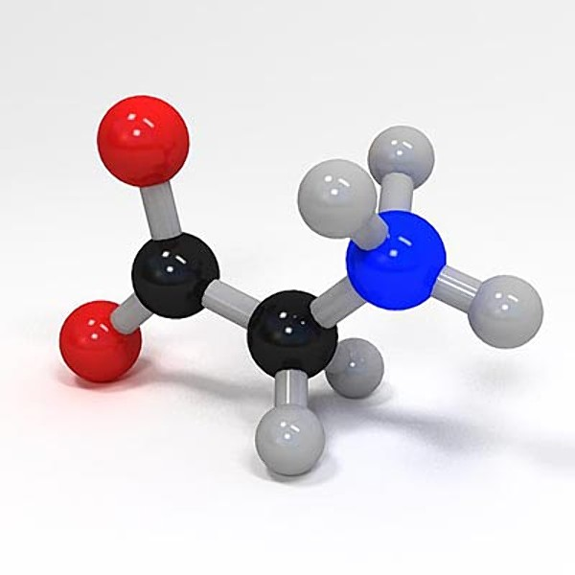
Glycine, Methyl-folate and One-carbon Metabolism
Glycine is a key source of methyl groups for the one-carbon cycle via the glycine cleavage system
A glycine-rich region maintains shape and flexibility of glycine decarboxylase, a key enzyme in the glycine cleavage system*
Methyl group
Methyl Folate
*A Kume et al., JBC 1991; 266(5): 3323-3329.

Slide 27
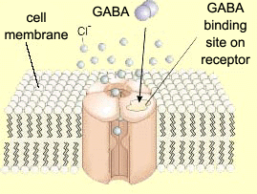
Impaired GABA¹ Receptor Activity and Autism
Autism has been linked to a weakened response of the inhibitory GABA receptor to stimuli*
The GABA receptor has a conserved glycine at the entrance to the first membrane-spanning domain that is essential for its function**
1. GABA = Gamma amino butyric acid
*CD Robertson et al., Current Biology 2016;26: 80-85
**BX Carlson et al., Mol Pharmacol. 2000;57(3):474-84
Notes:
2016/Anthony/
reduced_GABAergic_activity_autism_brain.pdf
ABA_conserved_glycine_2000.pdf

Slide 28
Celiac Disease and Prolyl Aminopeptidase
Gluten intolerance and Celiac disease result from inability to break down gluten, which is enriched in proline*
Prolyl aminopeptidase, the enzyme that breaks down proline-containing peptides, depends on manganese as a catalyst
Prolyl aminopeptidase also contains a highly conserved GxSxGG motif plus two other regions with conserved glycines**
Malabsorption due to celiac disease can lead to nutritional deficiencies and symptoms of autism***
*G. Janssen et al., PLoS One 2015; 10(6): e0128065
**F Morel et al., Biochimica et Biophysica Acta 1999;1429: 501-505
***SJ Genuis and TP Bouchard, J Child Neurol. 2010;25(1):114-9
Notes:
Plos One:
Ineffective Degradation of Immunogenic Gluten Epitopes by Currently Available Digestive Enzyme Supplements
Glyphosate/ineffective_proteolysis_of_proline_in_gluten_digestive_enzymes.pdf

Slide 29
Celiac Disease and Prolyl Aminopeptidase
Gluten intolerance and Celiac disease result from inability to break down gluten, which is enriched in proline*
Prolyl aminopeptidase, the enzyme that breaks down proline-containing peptides, depends on manganese as a catalyst
Prolyl aminopeptidase also contains a highly conserved GxSxGG motif plus two other regions with conserved glycines**
Malabsorption due to celiac disease can lead to nutritional deficiencies and symptoms of autism***
Wheat is routinely sprayed right before harvest with glyphosate as a desiccant
*G. Janssen et al., PLoS One 2015; 10(6): e0128065
**F Morel et al., Biochimica et Biophysica Acta 1999;1429: 501-505
***SJ Genuis and TP Bouchard, J Child Neurol. 2010;25(1):114-9
Notes:
Plos One:
Ineffective Degradation of Immunogenic Gluten Epitopes by Currently Available Digestive Enzyme Supplements
Glyphosate/ineffective_proteolysis_of_proline_in_gluten_digestive_enzymes.pdf

Slide 30
Summary
The United States is facing an epidemic in autism
Glyphosate likely plays an important role
Many of the known features of autism can be explained by the known toxicological mechanisms of glyphosate
Two key factors are manganese deficiency and disrupted proteins due to glyphosate substituting by mistake for essential glycine residues during protein synthesis

