Slide 1
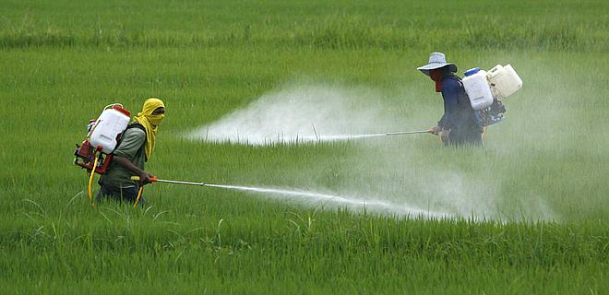
Why Glyphosate Should be Banned, Globally
Stephanie Seneff
MIT CSAIL
April, 2017

Slide 2
Professor Don Huber wrote…
“The irresponsible application of this massive experiment with glyphosate and GMO crops appears to be more of a generalized ecocide than a benefit to society as commercially promoted.
Future historians may well look back upon our time and write ... about how willing we are to sacrifice our children and jeopardize future generations for this massive experiment we call genetic engineering that is based on failed promises and flawed science.”

Slide 3
Outline
Overview
Gut Dysbiosis and Autism
Lab Animals and Farm Animals
Diabetes, Obesity & Glyphosate
Autoimmune Disease
Endocrine Disruption and Developmental Disorders
Kidney Failure
Species in Distress
Fusarium and Root Rot
Massive Die-off of Marine Life
Solutions
Summary

Slide 4
Overview

Slide 5
The Big Picture
Background
Weeds => Roundup => Glyphosate
Mega farms => GMOs (Roundup-Ready Crops)
The Problem
We were told Glyphosate is safe, since it disrupts the Shikimate pathway that humans do not have
But our gut bacteria have it, and they provide essential services to us
Consequences
Incidents of many diseases have sky-rocketed
Many creatures are affected; the earth is suffering
What to do
Educate
Advocate => legislate, litigate
Change the way we grow and consume food
Extend our time horizon => for our grandchildren's’ grandchildren
It’s everyone’s responsibility, but why Belize?
Small countries have advantages
New opportunities, eco-tourism, teaching organic farming, etc
Become a world leader

Slide 6
Silent Spring (1962)
Argued that uncontrolled and unexamined pesticide use was harming and even killing not only animals and birds, but also humans.

Slide 7
Roundup and GMO Crops
GMO Roundup-Ready corn, soy, canola, sugar beets
cotton, tobacco and alfalfa
What is glyphosate?

Slide 8
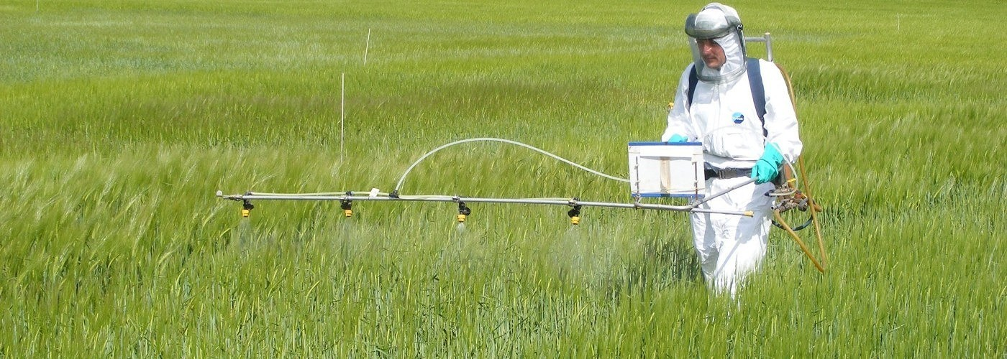
Roundup as a Desiccant/Ripener just before Harvest
Wheat, Oats, Barley, Rye, Sugar cane, Beans, Lentils, Peas, Flax, Sunflowers, Pulses, Chick Peas

Slide 9
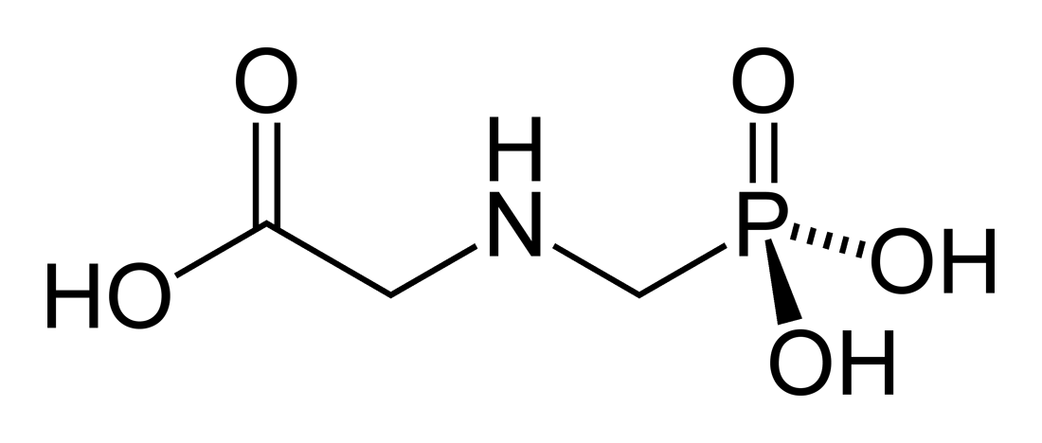
Glyphosate!!
Glyphosate is now the #1 herbicide in use in the U.S. and is increasingly used around the world
Developed and patented by Monsanto in the 1970’s
Introduced into the US food chain in 1974
Came out from under patent in 2000
Inhibits an enzyme in the shikimate pathway involved in the synthesis of tyrosine, tryptophan and phenylalanine (the three aromatic amino acids)
Huge expansion of GMO corn, soy, cotton and canola crops has led to sharp increases in the last two decades
Notes:
WIKI

Slide 10
Glyphosate vs. Other Pesticides: Usage in the United States*
Glyphosate
*http://sustainablepulse.com/wp-content/uploads/GMO-health.pdf

Slide 11
Adoption of GM Crops in U.S.
HT = herbicide (glyphosate) tolerant

Slide 12
Glyphosate and Superweeds: U.S.*
*http://sustainablepulse.com/wp-content/uploads/GMO-health.pdf
Notes:
Glyphosate/Nancy/GMO-health.pdf
http://sustainablepulse.com/wp-content/uploads/GMO-health.pdf

Slide 13
Glyphosate Acronym*
G Glycine mimicry, Gut bacteria disruption
L Lymphoma - the cancer most often linked to G
Liver, one of the key organs damaged by G
YP CYP-450 enzyme impairment by G
H Hemoglobin activity reduced due to chelation of iron and suppressed synthesis of the pyrrole ring
O Osteoarthritis due to collagen disruption
S Shikimate pathway suppression - 'good' gut bacteria disrupted
Sulfur pathways disrupted
A Acinar Cells damaged in pancreas: leads to pancreatitis
T Tubule damage in kidneys: kidney failure
Transition metal chelation, Tryptophan deficiency
E Enzyme disruption through metal chelation and glycine substitution during protein synthesis
*Thanks to David Fichtenberg

Slide 14
Shikimate Pathway Disruption
Phenylalanine, tryptophan, tyrosine
shikimate
Glyphosate
Neurotransmitters (serotonin, melatonin, dopamine, adrenalin)
thyroid hormone
chorismate
vitamin K
folate

Slide 15
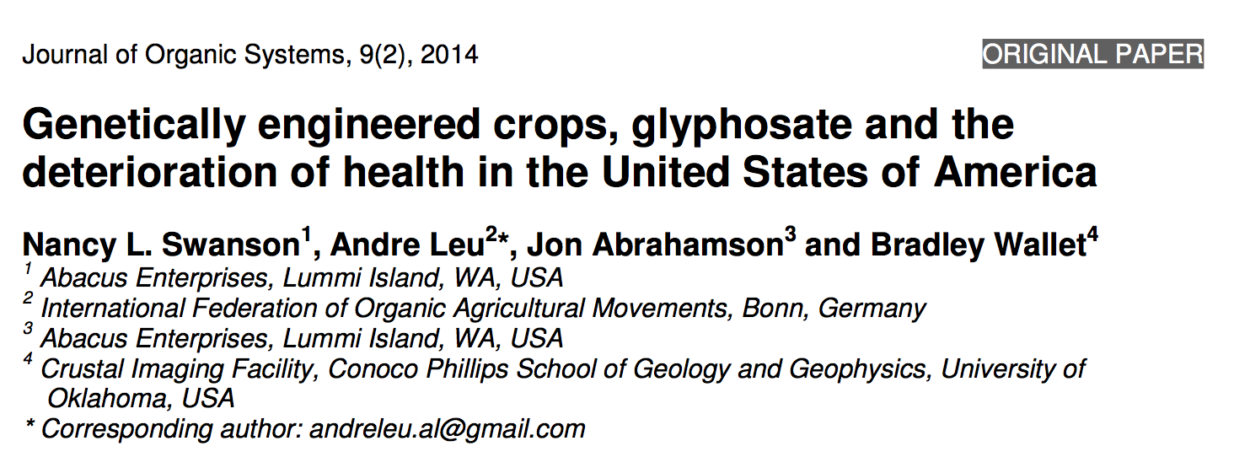
Paper Showing Strong Correlations between Glyphosate Usage and Chronic Disease

Slide 16
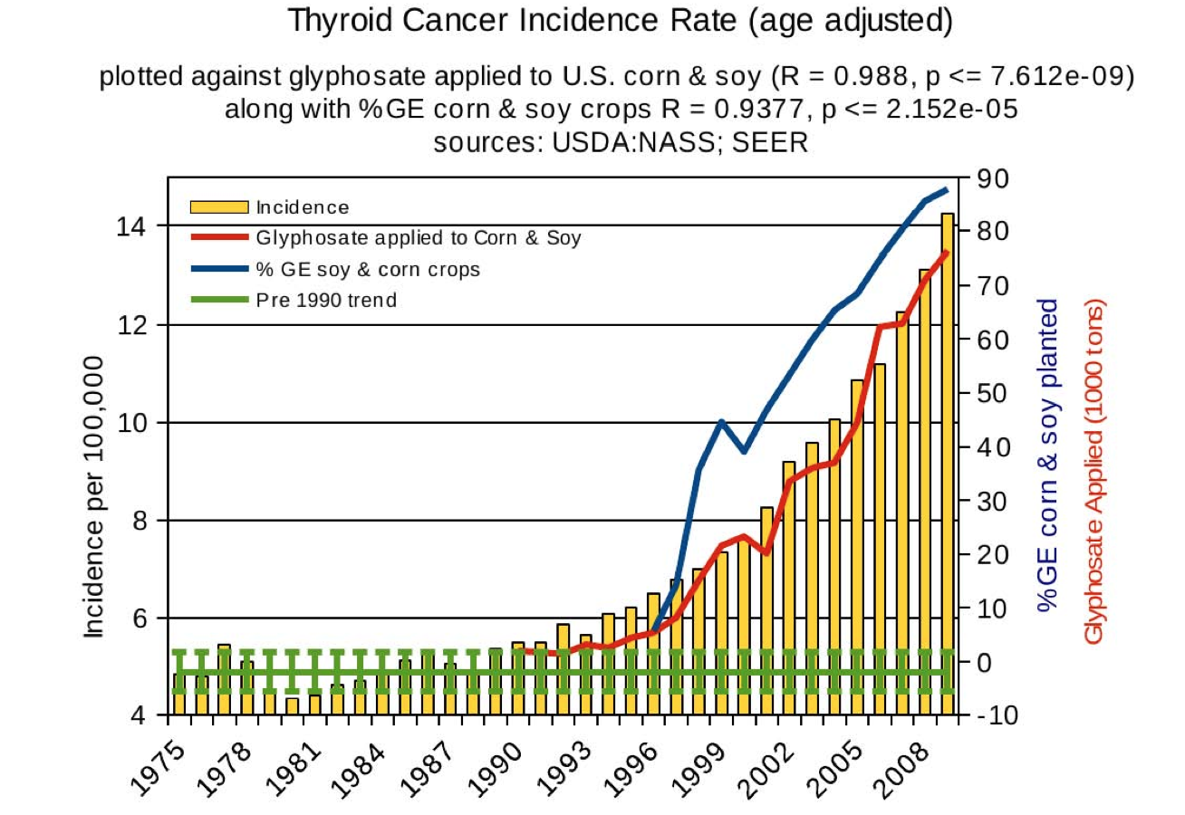
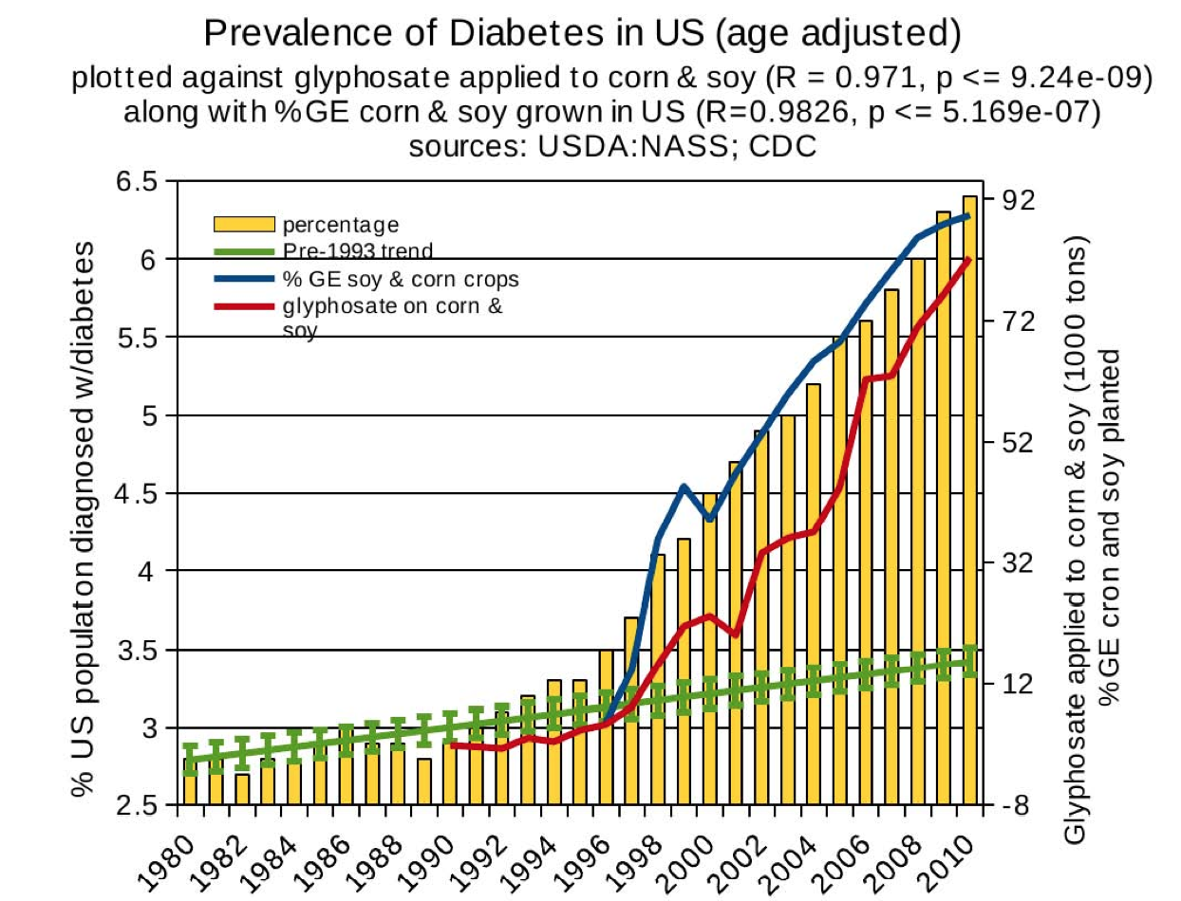
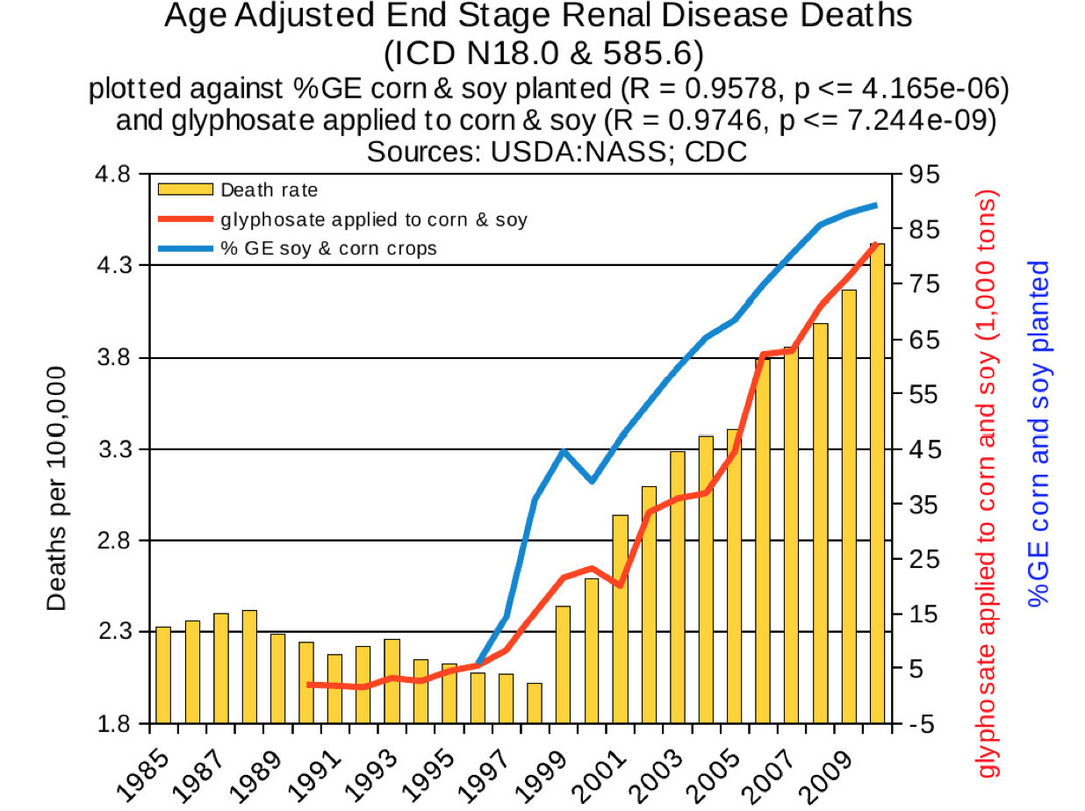
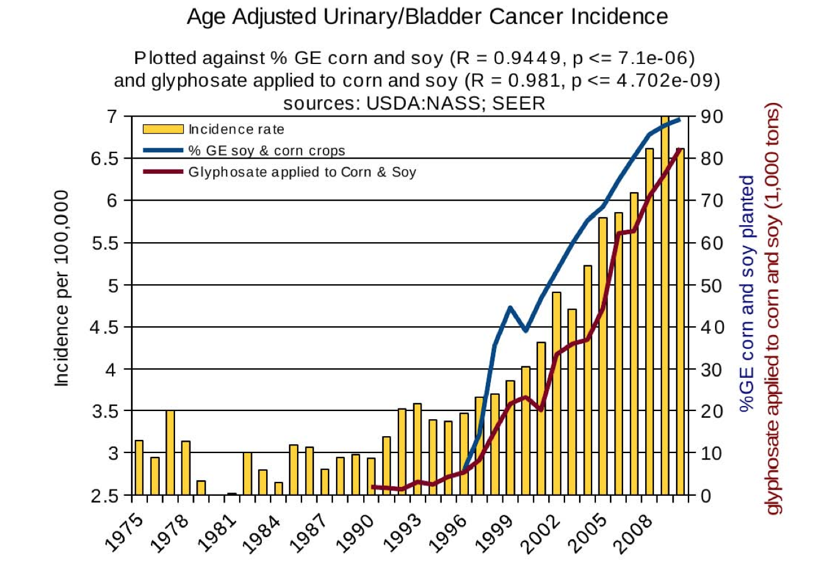
Thyroid cancer
Diabetes
End stage
renal disease
Urinary/bladder
cancer

Slide 17
Thyroid cancer
Diabetes
In 2015, WHO declared glyphosate a “probable carcinogen”
End stage
renal disease
Urinary/bladder
cancer

Slide 18
Quote from the Conclusion*
“Although correlation does not necessarily mean causation, when correlation coefficients of over 0.95 (with p-value significance levels less than 0.00001) are calculated for a list of diseases that can be directly linked to glyphosate, via its known biological effects, it would be imprudent not to consider causation as a plausible explanation.”
*NL Swanson et al. Journal of Organic Systems 9(2), 2014, p. 32,

Slide 19
Wales: Excessive Roundup Use and Multiple Debilitating Diseases*
Rosemary Mason says that in Wales there are cancer/disease hotspots in the surrounding villages where Roundup has been sprayed
Brain tumors, cancers of the breast, ovary, prostate, lung ,oesophagus, colon, pancreas, rectum, and kidney as well as non-Hodgkin’s lymphoma, uterine carcinoma and multiple myeloma
Parkinson’s disease, multiple sclerosis, motor-neurone disease and Alzheimer’s/dementia
Many of the cancers are aggressive and unusual
Resemble the cancers that were seen in factory workers in the pesticides industry in the 1960s.
*www.countercurrents.org/2017/01/27/the-british-government-has-
colluded-with-monsanto-and-should-be-held-accountable-in-the-international-criminal-court/
Notes:
./RosemaryMasonWales2017.text
./RosemaryWales2017.pdf
http://www.countercurrents.org/2017/01/27/the-british-government-has-colluded-with-monsanto-and-should-be-held-accountable-in-the-international-criminal-court/

Slide 20
Cancer Statistics in Belize*
Cancer Type Mortality Rate Change since 1990
All cancer 87.3 48%
Pancreatic cancer 7.3 540%
Ovarian cancer 4.7 539%
Liver cancer 6.3 429%
Testicular cancer 0.1 193%
Prostate cancer 30.4 93%
Lung cancer 19.8 64%
Breast cancer 15.0 62%
Colon cancer 19.4 58%
*global-disease-burden.healthgrove.com

Slide 21
Cancer Rates in North America
Canada
United States
Belize
http://global-disease-burden.healthgrove.com/l/29531/Cancer-in-Belize

Slide 22
Carey Gillam on Monsanto Corruption*
“The documents show discussions by Monsanto officials about many troubling practices, including ghostwriting a glyphosate manuscript that would appear to be authored by a highly regarded, independent scientist who Monsanto and other chemical industry players would pay for participation. One such scientist would need `less than 10 days’ to do the work needed but would require payment of more than $21,000, the records show.”
*www.huffingtonpost.com/entry/58cc5541e4b0e0d348b34348

Slide 23
Class Action Lawsuit*
*https://www.classaction.com/roundup-weed-killer/lawsuit/

Slide 24
Is Glyphosate in Our Food?
Wheat desiccated with Roundup
High fructose GMO corn syrup
GMO soy protein filler
GMO Canola Oil
Cows fed GMO corn and soy
Potatoes desiccated with herbicides

Slide 25
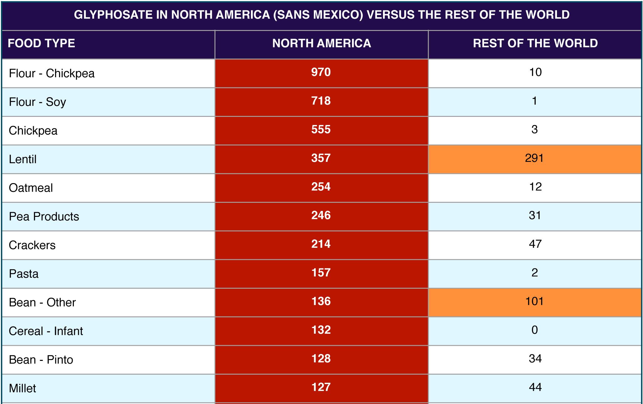
Glyphosate Levels in Foods (ppb)*
*From the Canadian government, analyzed by Tony Mitra, Canadian activist

Slide 26
More Data from Tony Mitra

Slide 27
On Glyphosate Contamination in Food Products …
“It is heartbreaking to see how this toxic, dangerous and unnecessary technology can strong arm its way into every facet of a supposedly democratic system and pollute its science, regulatory mechanism, academia, media, and the widest imaginable swath of political process, leaving virtually no clear avenue for the people to correct this wholesale chemical attack on society and an assault on nature.”
Tony Mitra, Canadian activist
Notes:
http://www.tonu.org/2017/02/01/wheat/

Slide 28
Some symptoms of severe glyphosate poisoning*
Pulmonary edema
Respiratory distress sometimes necessitating intubation
Dysrrhythmia
Renal failure
Altered consciousness
Shock (very low blood pressure)
Blood parameters
Acidosis
Low serum oxygen
High white blood cell count
High serum phosphate, potassium; low serum bicarbonate
*H-L Lee et al, Academic Emergency Medicine 2000; 7(8):906-910.
Notes:
./glyphosate_suicide_attempts.pdf

Slide 29
Gut Dysbiosis and Autism

Slide 30
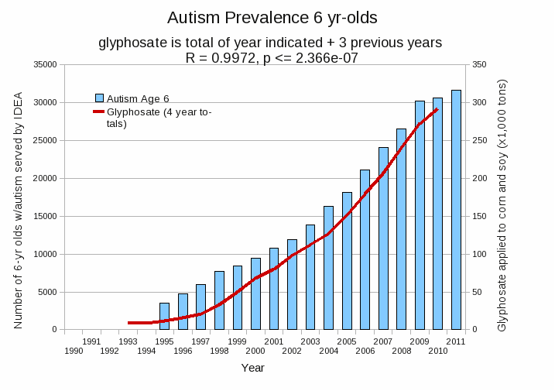
Autism Prevalence: 6 year olds*
R = 0.9972
* Figure 15, Seneff et al., Agricultural Sciences, 2015, 6, 42-70
Notes:
Nancy/latest_plots/6-yr-old autism.gif
autism: USDE
oil consumption: USDA
glyphosate: USDA
GE crops: USDA
Mortality data: CDC

Slide 31
*
Triplets: two boys, one girl. Both boys have autism and girl has seizure disorder
Very high levels of glyphosate in urine in all three
Clostridia overgrowth due to glyphosate disruption of gut microbes
Toxic Clostridia metabolites lead to excess dopamine expression
Damage to neurons in the brain through oxidative stress
*W. Shaw. Integrative Medicine 2017;16(1);50-57.
Notes:
./Shaw_on_glyphosate_triplets_autism.text

Slide 32
Pathogen Overgrowth in Poultry*
Clostridia
Salmonella
*Plot provided by Dr. Martin Michener
Notes:
From Marty Michener!
Sheehata paper.

Slide 33
More evidence linking autism to Clostridia overgrowth*
14 autistic children with gut disorder compared to 21 controls
Significant increase in Clostridia species in the gut in autistic children
Associated with reduced tryptophan levels and increased expression of inflammatory markers
Tryptophan is a product of the shikimate pathway, which glyphosate blocks
Proposed role for antibiotics
Glyphosate is a patented antimicrobial agent (2010)
*RA Luna et al., Cellular and Molecular Gastroenterology and Hepatology 2017;3(2): 218-230

Slide 34
Glyphosate and AMPA in GMO Soy*
“we were able to discriminate GM, conventional and organic soybeans without exception, demonstrating ‘substantial non-equivalence’ in compositional characteristics for ‘ready-to-market’ soybeans.
*Figure 1, T. Bøhn et al., Compositional differences in soybeans on the market: glyphosate accumulates in Roundup Ready GM soybeans. Food Chemistry (2013) Epub ahead of print.

Slide 35
Soy Formula Linked to Seizures in Autism*
"There was a 2.6-fold higher rate of febrile seizures, a 2.1-fold higher rate of epilepsy comorbidity and a 4-fold higher rate of simple partial seizures in the autistic children fed soy-based formula"
*CJ Westmark, PLOSOne March 12, 2014, DOI: 10.1371/journal.pone.0080488.
Notes:
./SoyFormulaSeizuresAutism.pdf

Slide 36
Deaths from Senile Dementia*
*Plot provided by Dr. Nancy Swanson

Slide 37
Lab Animals and
Farm Animals

Slide 38
Mammary Tumors in Rats*
Rats through their entire lifespan exposed to Roundup at levels well below established safety limits
*G-E Séralini et al. Environmental Sciences Europe 2014, 26:14
Notes:
Images/seralini_rats.png
./seralini_paper.pdf
1-Seralini&al.ESEU-RepublishedInVivo_June2014.pdf
2-Seralini et al-RetTR- 1-s2.0-S0278691512005637-main.pdf
3 Seralini&al.ESEU-Conflicts_June2014.pdf

Slide 39
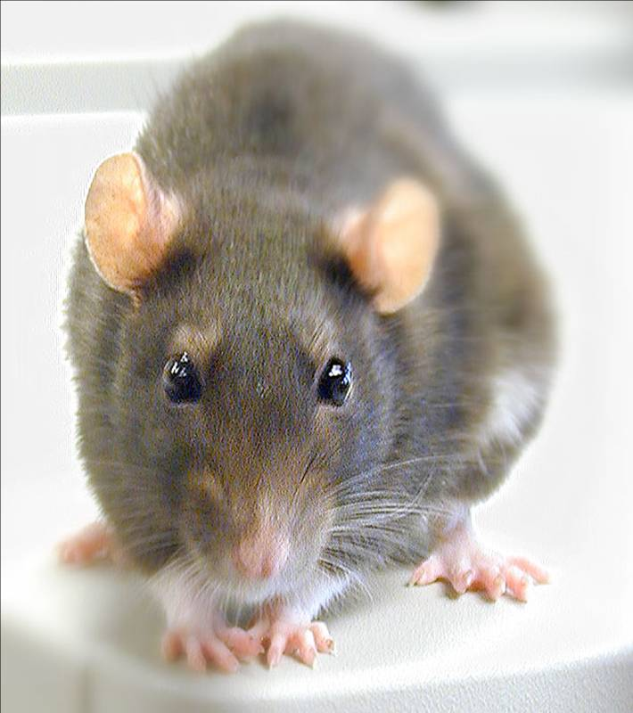
Conclusions from Rat Study *
Female rats had greatly increased risk of mammary tumors
Males had significantly increased risk of tumors of the liver and kidney
Sex hormone disruption for both males and females
Enhanced oxidative stress
Very significant kidney dysfunction
Effects didn’t become apparent until after 4 months
*G-E Séralini et al. Environmental Sciences Europe 2014, 26:14
Notes:
Spacedoc/mercola/GMOS_mouse_study_2012.pdf

Slide 40
Severe Deficiency in Manganese and Cobalt in Cows*
Cobalt
Manganese
Eight different farms: all cows tested had glyphosate in the urine
*M. Krüger et al., J Environ Anal Toxicol 2013, 3:5
Notes:
./cows_cobalt_deficiency_glyphosate.pdf

Slide 41
Severe Deficiency in Manganese and Cobalt in Cows*
Manganese deficiency has also been linked to autism**
**A Samsel and S Seneff. Surgical Neurology International 2015, 6:45.
Cobalt
Manganese
Eight different farms: all cows tested had glyphosate in the urine
*M. Krüger et al., J Environ Anal Toxicol 2013, 3:5
Notes:
./cows_cobalt_deficiency_glyphosate.pdf

Slide 42
Infertility in Cattle*
Cows with fatty liver disease had statistically significant indicators of impaired fertility
Elevated GGT and deficient glutathione in the follicular fluids
Evidence of ketosis leading to impaired glucose supply to the developing egg
*B Sarentonglaga et al., J. Reproduction and Development 2013;59(2): 168-173.
Notes:
GGT_BHBA_liver_disease_cattle_infertility_2013.pdf

Slide 43
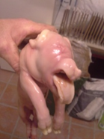
Ib Pedersen: Pig Farmer in Europe*
“The summary of my findings is, without a doubt, that Roundup sprayed on crops is the direct reason for the increase in fertility problems, abortions and deformities in animals and as a farmer, knowing how nature works, I quite expect that people are already affected.
Glyphosate is everywhere.”
Notes:
./farm_study_pigs_Ib_Pedersen_2016.docx .

Slide 44
Infertility in China*
Sperm donor applicants in Hunan Province, China
30,000 young Chinese men
Percentage of healthy sperm
2001: 56%
2015: 18%
Linear Projection:
2022: 0%
Infertility is a growing problem in the industrialized world
*C Huang et al., Fertility and Sterility Jan. 2017; 107(1): 83-88.
Notes:
glypghosate/decline_semen_quality_China_2017.pdf
`

Slide 45
Diabetes, Obesity
& Glyphosate

Slide 46
US Health Status
US makes up 5% of the world’s population but consumes more than 50% of the world’s pharmaceutical drugs
We spend more on health care than Japan, France, China, UK, Italy, Canada, Brazil, Spain, and Australia, combined
US ranks last or near last among developed nations on infant mortality and life expectancy
We also suffer from more chronic illnesses
We consume 25% of the world supply of glyphosate

Slide 47
Obesity in US over Time*
Glyphosate was introduced into the food chain in 1975
*Figure 1 in R.J. Johnson et al., Am J Clin Nutr 2007;86:899–906.
Notes:
Sugar intake per capita in the United Kingdom from 1700 to 1978 (30, 31; E) and in the United States from 1975 to 2000 (32; 􏰏) is compared with obesity rates in the United States in non-Hispanic white men aged60–69y(17;F).Valuesfor1880-1910arebasedonstudiesconducted in male Civil War veterans aged 50–59 y (18).

Slide 48
The First Signs of Obesity in Certain Arctic Groups Have Been Linked to Instant Noodles*
Yamalo-Nenets region: autonomous district on Arctic Ocean in NW Siberia
Only exposed to “convenience foods” in last few years
Already showing signs of obesity for the first time in history
Wheat is now routinely sprayed with glyphosate right before harvest
*.sciencealert.com/the-first-signs-of-obesity-in-certain-arctic-
groups-have-been-linked-to-instant-noodles
Notes:
./arctic_instant_noodles.text

Slide 49
Obesity vs Fast Food Diet*
*Figure 1, De Vogli et al., Bull World Health Organ 2014;92:99–107A
Notes:
./fast_food_and_obesity_WHO.pdf

Slide 50
Diabetes Prevalence in US vs GMOs and Glyphosate*
*NL Swanson et al. Journal of Organic Systems 9(2), 2014, p. 32,

Slide 51
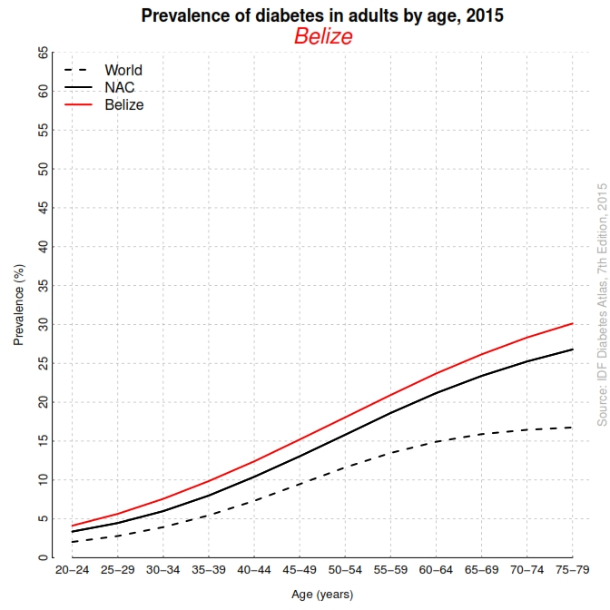
Diabetes in Belize (Prevalence by Age in 2015)*
Belize
Population (%)
NAC
World
Age (years)
*http://www.idf.org/membership/nac/belize

Slide 52
Autoimmune Disease

Slide 53
Autoimmune Disease Statistics*
Autoimmune Disease (AD) is a major health problem
Annual direct health care costs for AD in US estimated to be ~$100 billion
At least 23.5 million Americans suffer from one or more autoimmune diseases
Among the top-10 causes of death in females under 64 years old
Immunosuppressant treatments have devastating side effects
*https://www.aarda.org/autoimmune-information/autoimmune-statistics/

Slide 54
Why do we have an epidemic in
autoimmune disease in America today?

Slide 55
Hypothesis
Glyphosate exposure sets up a weakened immune system, a leaky gut barrier and a leaky brain barrier
Glyphosate contamination in proteins makes them hard to break down
Person develops overactive antibody response to foreign protein contaminated with glyphosate and, through molecular mimicry, this leads to autoimmune disease
This easily explains gluten intolerance and other food allergies

Slide 56
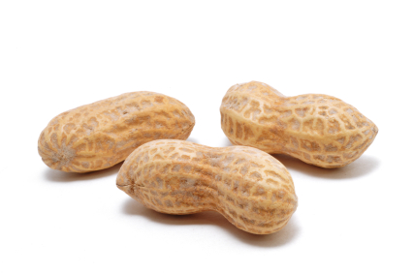
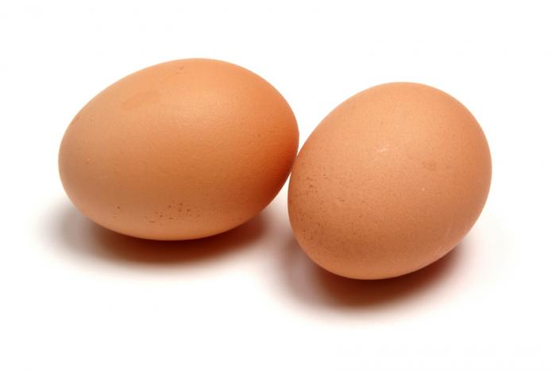
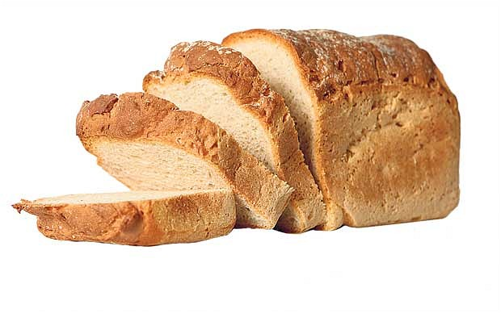
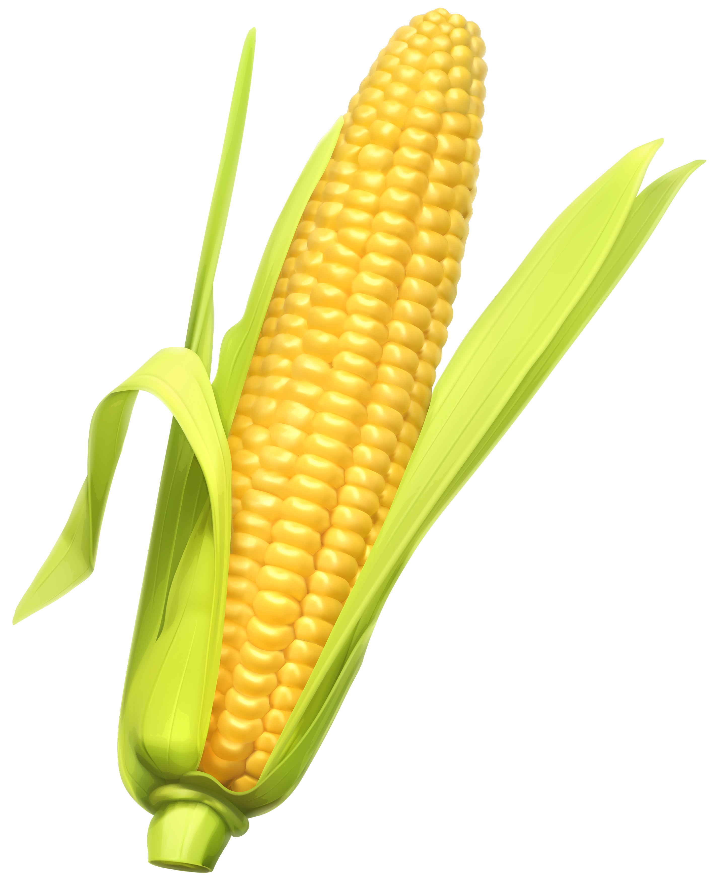
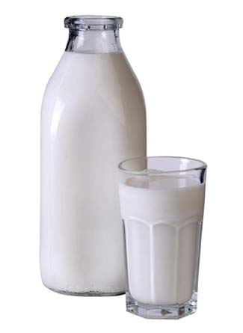
Food Allergies

Slide 57
Food Allergies
All of these foods can be expected to be contaminated with glyphosate, given how they’re produced

Slide 58
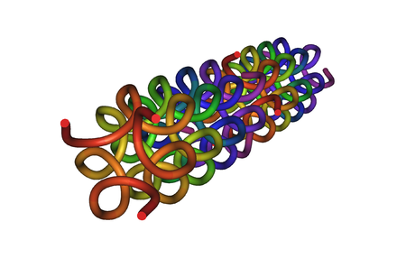
Collagen and Gelatin
25% of the protein in our body is collagen
25% of the amino acids in collagen are glycines
Glyphosate substitution for glycine will disrupt triple-helix formation and lead to diseases of the vasculature, joints and bones
Gelatin is derived from collagen in bones and ligaments sourced from cows and pigs fed glyphosate-contaminated GMO Roundup-Ready feed

Slide 59
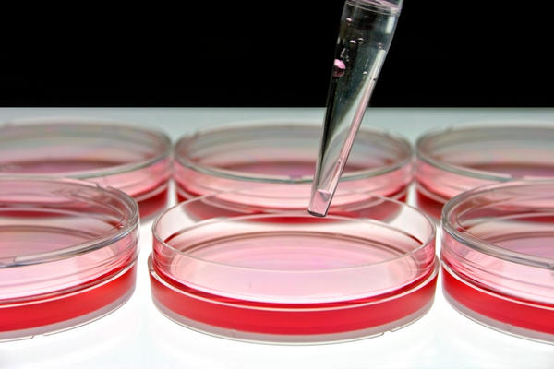
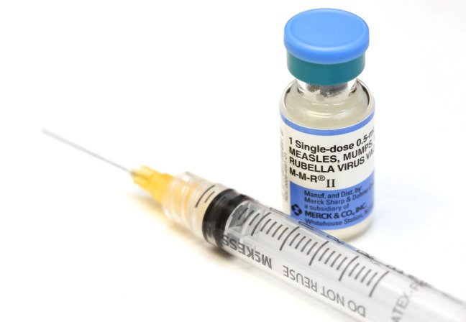
Products Containing Gelatin !!

Slide 60
Drugs and Autoimmune Disease*
Drugs that treat autoimmune disease have a huge problem with side effects
They suppress the immune system, and increase risk to tuberculosis, invasive fungal infections and lymphomas (cancers of the immune system)
Humira is a TNF-alpha inhibitor, which blocks the immune response
It costs about $3,100 per month
U.S. prescriptions for Humira have taken off in recent years: 1.5 million in 2011; 2.4 million in 2015.
It was linked to more than 209,000 adverse event reports since 2013, including more than 4,200 deaths.
* usatoday.com/story/news/nation-now/2017/03/19/
analysis-reports-drug-side-effects-increase-fivefold-12-years/99384190/
Notes:
rug_side_effects_rising_2017.text

Slide 61
Chronic Pain*
“The list of different types of chronic pain syndrome seems to be growing every day, including complex regional pain syndrome, failed back syndrome, fibromyalgia, interstitial cystitis, myofascial pain syndrome, postvasectomy pain, vulvodynia, pelvic pain syndrome – and on and on.“
*P. 42, Anna Lembke, Drug dealer, MD
.John’s Hopkins U Press, Baltimore, MD
Notes:
Book:

Slide 62
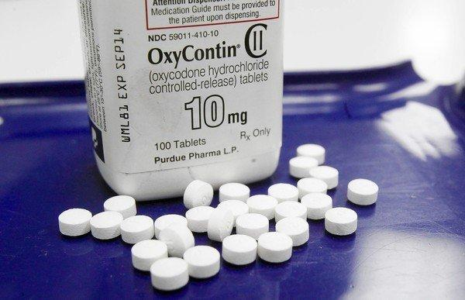
US Department of Health and Human Services Data on Pain-Killer Drug Abuse*
Drug overdose is the leading cause of injury death in the United States
Heroin, morphine, and prescription pain relievers
More people died from drug overdoses in 2014 than in any previous year on record
More than 6 out of 10 involved an opioid drug
More than 650,000 opioid prescriptions are dispensed every day
*http://www.hhs.gov/opioids/about-the-epidemic/
Notes:
./Factsheet-opioids-061516.pdf

Slide 63
Endocrine Disruption and
Developmental Disorders

Slide 64
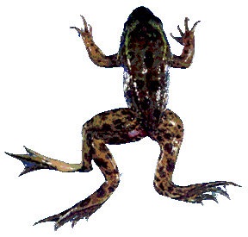
Glyphosate is an endocrine disruptor that promotes breast cancer*
Low and environmentally relevant concentrations of glyphosate possess estrogenic activity
Glyphosate caused human hormone-dependent breast cancer cells to proliferate at concentrations of parts per trillion
* S. Thongprakaisang et al., Food Chem Toxicol. 2013 Jun 8. S0278-6915(13)00363-3.
Notes:
./glyphosate_and_breast_cancer.text
Swine/glyphosate_breast_cancer.pdf
Please make a note that this study shows Glyphosate effects down to parts per trillion (10 to the minus12th).
In this study, we found that glyphosate at a log interval concentration ranging from 10-12 to 10-6 M increased the cell proliferation of a hormorne dependent breast cancer T47D ce

Slide 65
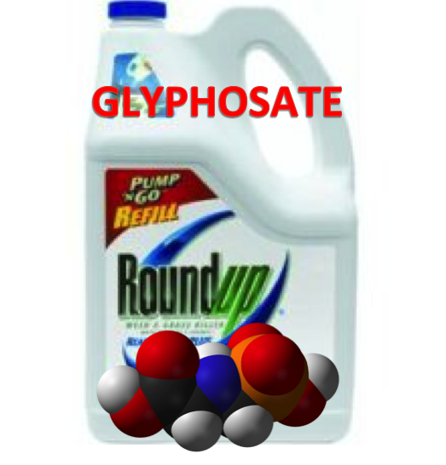
Roundup Inhibits Steroidogenesis by Disrupting StAR Protein Expression*
In vitro study on testicular Leydig cells
Roundup reduced testosterone synthesis by 94%
Effect due to both StAR suppression and CYP suppression
Roundup reduced StAR protein levels by 90%
Reduction in StAR expression in the adrenal gland disrupts synthesis of stress hormones and sex hormones
*LP Walsh et al., Environ Health Perspect 2000; 108:769-776
Notes:
Roundup_inhibits_StAR_protein_expression.pdf
Leydig cells produce testosterone

Slide 66
“Glyphosate-Based Herbicides Produce Teratogenic Effects on Vertebrates by Impairing Retinoic Acid Signaling”*
*A Paganelli et al., Chem Res Toxicol 2010; 23(10):1586-1595.

Slide 67
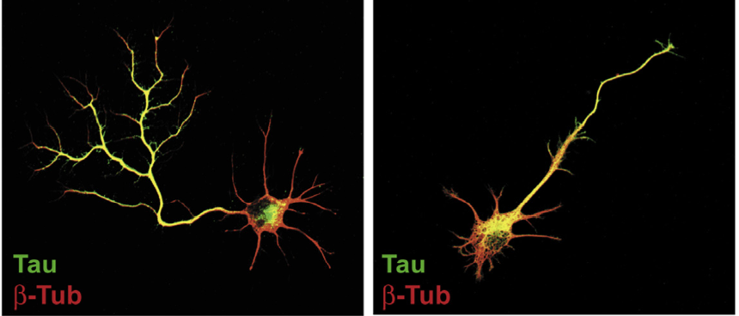
“Neuronal development and axon growth are altered by glyphosate through a WNT non-canonical signaling pathway”*
Neurons grown in culture & exposed to glyphosate
“They elicited shorter and unbranched axons and they also developed less complex dendritic arbors compared to controls”
+ Glyphosate
*RP Coullery et al., NeuroToxicology 2016;52:150-161.
Notes:
./Coullery_glyphosate_neurotoxicity_2016.pdf

Slide 68
Glyphosate Could Cause Microcephaly through Impaired Methylation Pathway
Glyphosate disrupts methionine synthesis in plants and in E. coli
Methionine is the universal methyl donor
Disrupted folate one-carbon metabolism (methylation pathway)
Folate carries the methyl group that methylates DNA during development to regulate gene expression
Folate is produced for the host by gut microbes from the shikimate pathway
Methyl group is provided by metabolism of glycine; a critical enzyme in this pathway depends on a glycine-rich region that glyphosate could disrupt
Notes:
Glycine decarboxylase

Slide 69
Glyphosate and Anencephaly*
Yakima, Benton and Franklin counties in Washington State have an unusually high number of pregnancies affected by anencephaly
75 pesticides were analyzed in studying contamination due to surrounding agriculture
47 (63%) of these were detected
Glyphosate was applied in large amounts, but was not studied
5% solution of glyphosate was also used heavily around irrigation ditches to control weeds
Main herbicide recommended due to its “low toxicity”
*Barbara H. Peterson. Farm Wars, http://farmwars.info/?p=11137

Slide 70
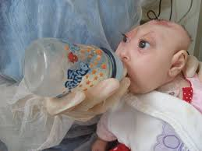
“Glyphosate, Brain Damaged Babies, and
Yakima Valley - A River Runs Through It”*
8
6
4
2
0
Noxious aquatic weed
control program with
Glyphosate ‘Rodeo’
1980 1990 2000 2010 2020
“Glyphosate, Three Rivers, and Anencephaly”
Yakima Harold Republic
Slide thanks to Prof. Don Huber, with permission
*Farm Wars 3/6/14
Notes:
From Don Huber:
Attached/LondonGlyphosate/
2014-0618_Huber_short.ppt

Slide 71
Newborn Genitourinary Disorders* (hypospadias, hydrocele, etc.)
*Hoy et al., Poult Fish Wildl Sci 2015, 3:1
Notes:
Nearly six-fold increase from 1998 to 2010.
Figure 31: Hospital discharge rates for newborn genitourinary disorders compared to glyphosate applications to wheat, corn and soy crops. The genitourinary disorders include: Other disorders of the kidney and ureter (ICD 593); hydrocele (watery uid around one or both testicles (ICD 778.6); hypospadias (ICD 752.6); and hydronephrosis- obstruction of urine flow (ICD 591). The Pearson correlation coefficient between the genitourinary disorders and glyphosate use is R=0.9585.

Slide 72
Kidney Failure

Slide 73
Kidney Failure in Agricultural Workers*
Agricultural workers in sugar cane fields in Central America and in India and Sri Lanka are dying at a young age in record numbers from kidney failure
Second-most common cause of death in men in El Salvador
Attributed to toxic metals (arsenic, cadmium) + nitrates in well water + glyphosate
Glyphosate chelates arsenic and then unloads it in the acidic environment of the renal tubules**
* CM Orantes-Navarro et al., Adv Chronic Kidney Dis 2017;24(2):101-106.
**C Jayasumana et al. Int. J. Environ. Res. Public Health 2014, 11, 2125-2147.
Notes:
Glyphosate/interstitial_nephritis_agriculture_2017.;pdf
http://www.ticotimes.net/More-news/News-Briefs/What-is-killing-the-young-men-of-Canas-_Wednesday-August-07-2013
./diabetes_farmers_costa_rica.pdf

Slide 74
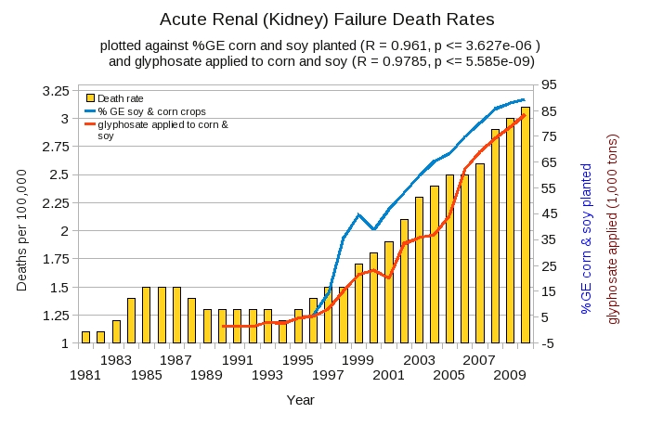
U.S. Acute Kidney Disease Death Rate Plotted Against Glyphosate and GMOs*
*Plot prepared by Nancy Swanson from available data online

Slide 75
Bacterial Siderophores & Kidney Disease
Proximal tubular necrosis
Free iron in the tubule causes damage due to oxidative stress
Defective iron uptake from bacterial siderophores in the proximal renal tubule can cause simultaneous iron deficiency and iron toxicity*
*K Mori et al. The Journal of Clinical Investigation 2005;115(3):610-621.

Slide 76
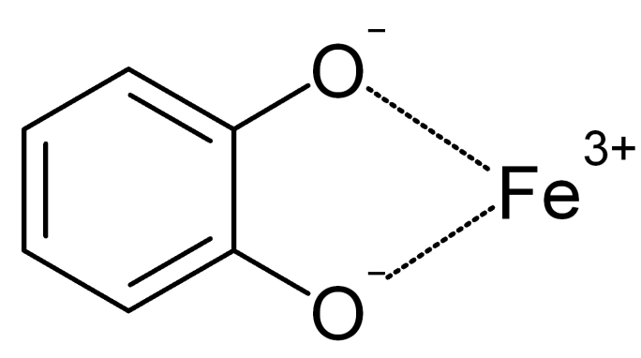
How Proximal Tubule Gets Iron*
Proximal Tubule
Protein that synthesizes siderophore in Bacillus depends on two conserved glycines
Protein that uptakes siderophore in renal tubule contain a conserved GXW motif
Bacillus
siderophore
*K Mori et al. The Journal of Clinical Investigation 2005;115(3):610-621.
Notes:
W is tryptophan

Slide 77
How Proximal Tubule Gets Iron*
Proximal Tubule
Protein that synthesizes siderophore in bacillus depends on two conserved glycines
Protein that uptakes siderophore in renal tubule contain a conserved GXW motif
Glyphosate substitution for glycine in these proteins would disrupt their function
Bacillus
siderophore
*K Mori et al. The Journal of Clinical Investigation 2005;115(3):610-621.
Notes:
W is tryptophan

Slide 78
May, 2015
*naturalsociety.com/sri-lankas-newly-elected-president-bans-glyphosate-effective-immediately/

Slide 79
Species in Distress

Slide 80
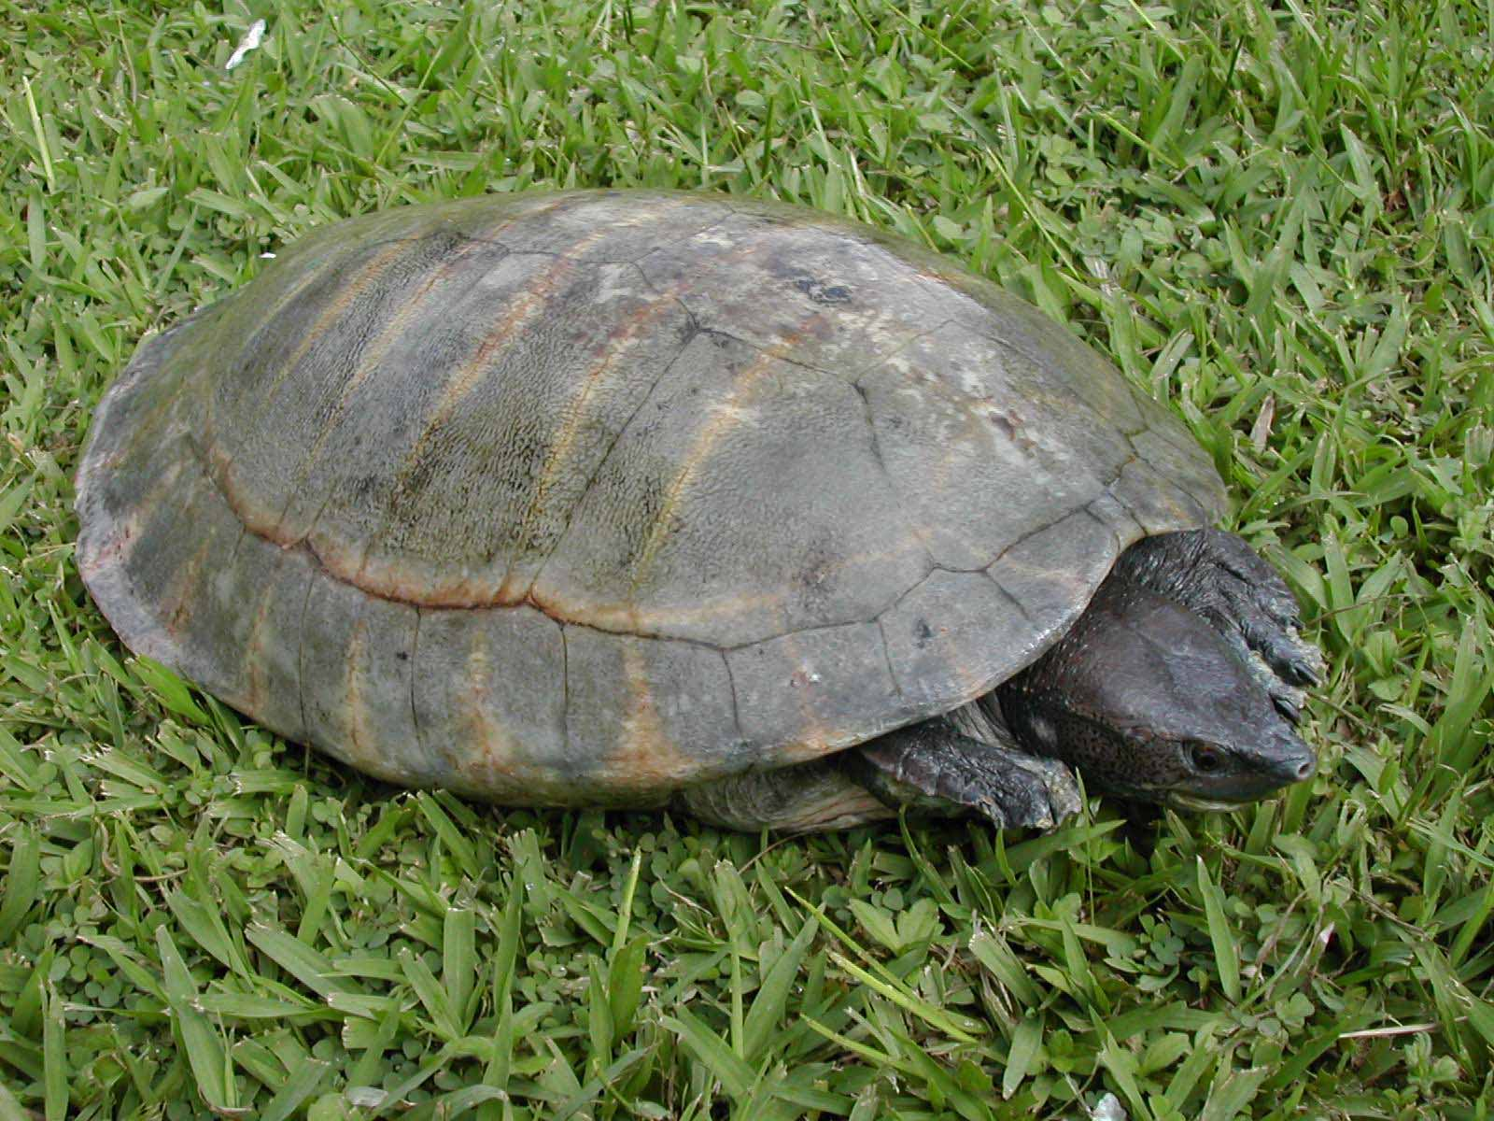
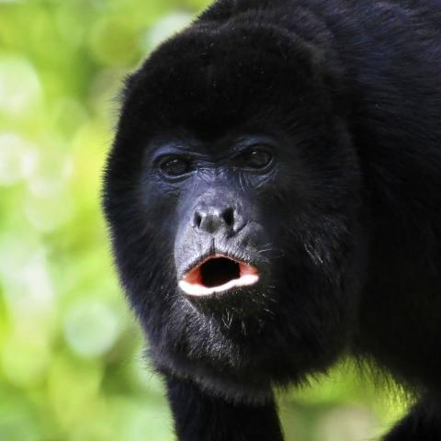
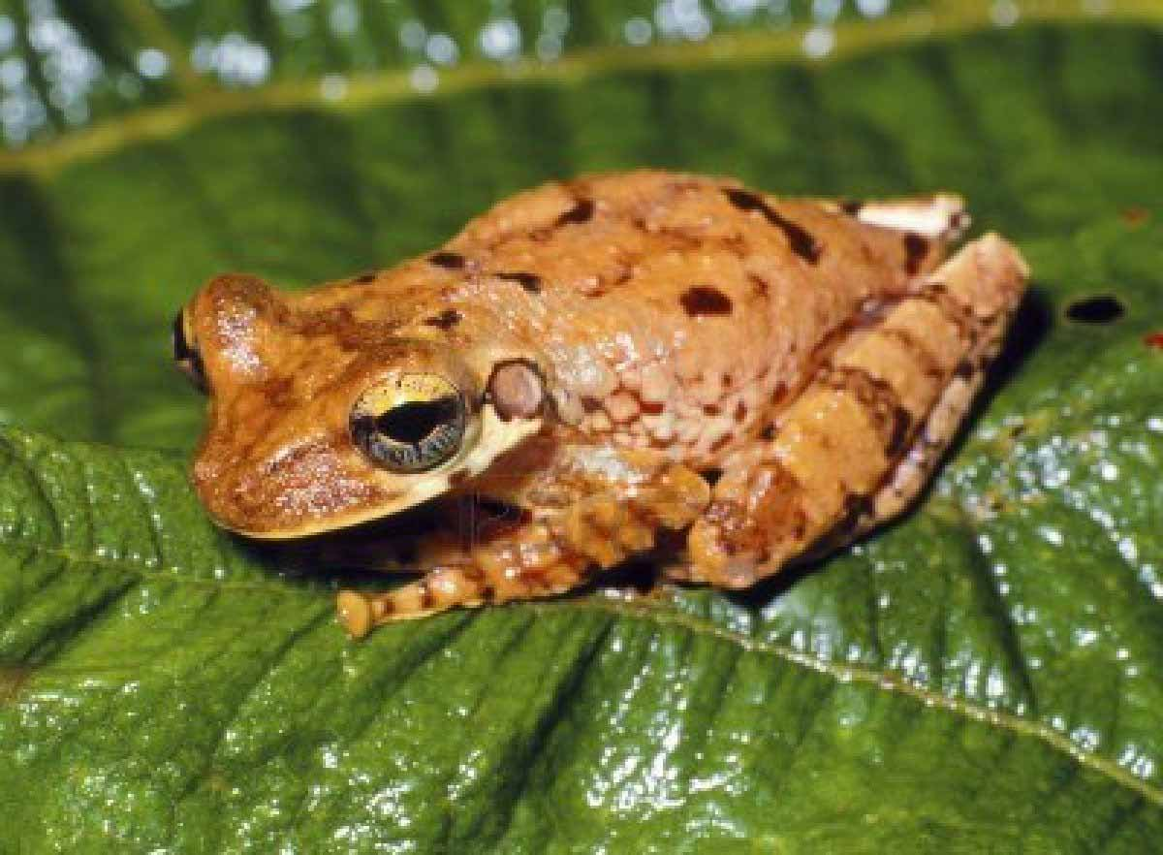
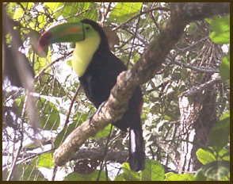
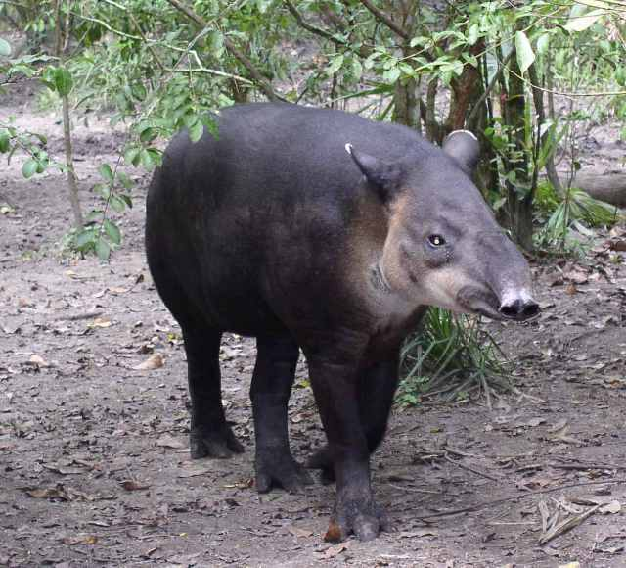
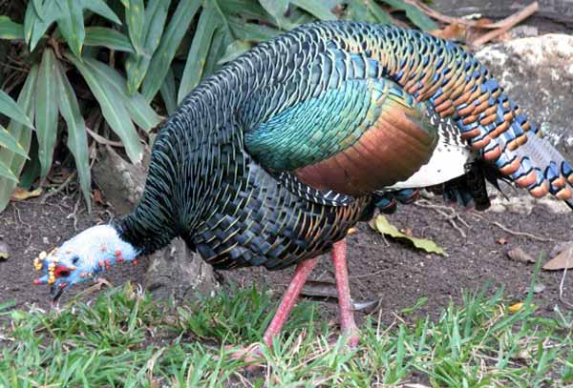
Belize has one of the world’s most rich and diverse flora and fauna
River Turtle
Bromeliad Tree Frog
Black Howler Monkey
Toucan
Ocellated Turkey
Baird’s Tapir
Notes:
glyphosate_in_Belize_2011.pdf

Slide 81
Many farms surrounding the Maya Mountain Protected Area make heavy use of glyphosate to control weeds
Glyphosate was detected in ALL sites where water samples were drawn
Chiquibul, Las Cuevas, Mount Margaret, Natural Arch, Outlier, Tiger Fern and Victoria Peak
One sample tested above the maximum sensitivity of the test kit (> 5 ppb)
Notes:
Glyphosate_in_Belize_2011.pdf

Slide 82
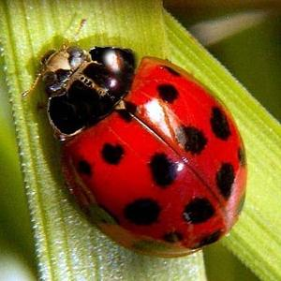
Where Have all the Insects Gone?
“The nine-spotted beetle commonly made her home on farmlands for the rich source of insects these regions provided.”
“Until the mid-1970s, the nine-spotted beetle was one of the most common ladybug beetles”
*http://animals.pawnation.com/causes-decline-ninespotted-beetle-6492.html
Notes:
Bees, butterflies, beetles, grasshoppers, lady bugs, preying mantises, fire flies, toads.

Slide 83
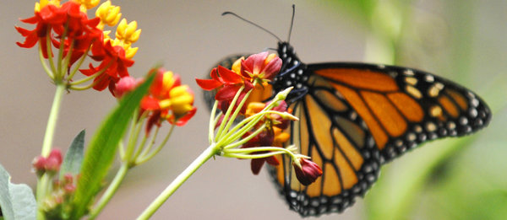
Monarch Butterfly Collapse*
“.. farmers have switched in droves to new varieties of crops that are genetically engineered to tolerate the most widely used weed killer in the United States. The resulting use of weed killers has wiped out much of the milkweed that once grew between crop rows and on buffer strips separating fields and roads.”
Glyphosate
*M. Wines, New York Times, Dec. 20, 2013.
nytimes.com/2013/12/21/us/setting-the-table-for-a-fluttering-comeback-with-milkweed.html

Slide 84
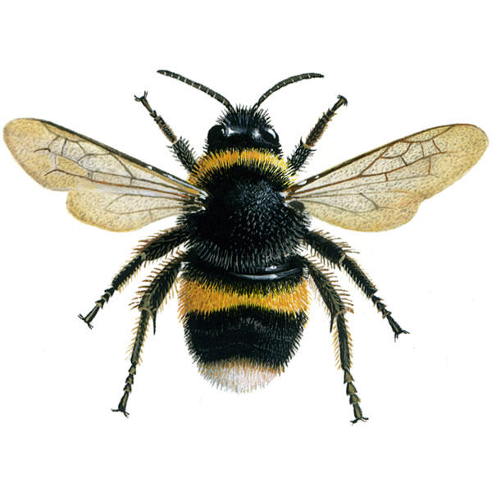
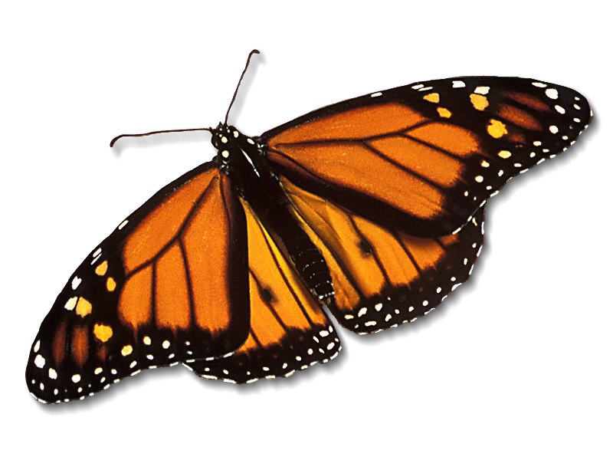
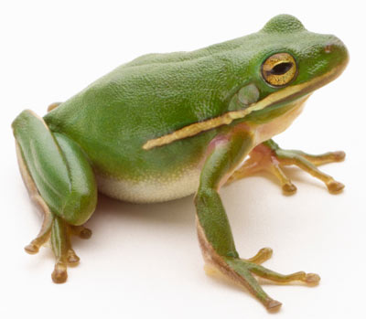
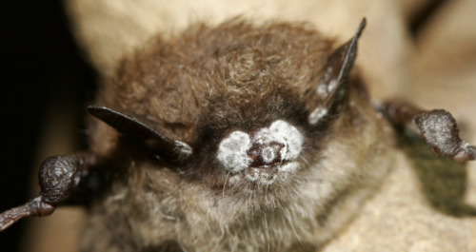
We Should be Alarmed!*
Bee Colony Collapse Disorder
Fungus Infection
Dissolving starfish
Disappearing monarch butterflies
Fungus Infection
After bees, butterflies are the second largest pollinators.
Bats eat an enormous number of insects
Fungus Infection
White-nose bat syndrome
Fungus Infection
*R. Mason et al., Journal of Environmental Immunology and Toxicology 1:1, 3-12; 2013
Notes:
Frogs -- drop 3.7% every year, meaning they could disappear in half of the habitats they now occupy nationwide in 26 years
Monarch butterflies – milkweed being killed by glyphosate
http://salsa3.salsalabs.com/o/1881/p/dia/action3/common/public/?action_KEY=12506

Slide 85
“Emerging fungal threats to animal, plant and ecosystem health”*
“The past two decades have seen an increasing number of virulent infectious diseases in natural populations and managed landscapes. In both animals and plants, an unprecedented number of fungal and fungal-like diseases have recently caused some of the most severe die-offs and extinctions ever witnessed in wild species, and are jeopardizing food security.”
*M.C. Fisher et al., Nature Reviews 2012;484(7393), 186-194.
Notes:
./nature_fungus.text
./nature_fungus.pdf

Slide 86
Glyphosate and Fungus*
“Glyphosate stimulation of fungal growth and enhanced virulence of pathogens such as Fusarium, Gaeumannomyces, Phytophthora, Pythium, and Xylella can have serious consequences for sustainable production of a wide range of susceptible crops and lead to the functional loss of genetic resistance that is dependent on metabolites through the shiki- mate pathway (Larson et al., 2006).”
*GS Johal and DM Huber, European Journal of Agronomy 2009;31(3):144-152.
Notes:
./DonHuber_glyphosate_and_plant_diseases_2009.pdf

Slide 87
Bee Colony Collapse Syndrome
Bees are exposed to many insecticides from pollen
Their resistance to neonicotinoids depends on CYP enzymes
These enzymes are disrupted by glyphosate
Disruption of CYP enzymes in the liver would impair humans’ ability to detoxify many environmental toxicants: synergistic effect
Notes:
./email_thread.text

Slide 88
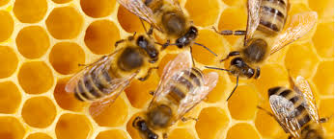
“Why Honeybees Don’t Have A Chance In The Midst Of Pesticides”*
Glyphosate depletes micronutrients in nectar
Glyphosate kills beneficial microbes in gut
Lactobacillus and Bifidobacterium
Glyphosate disrupts honeybee hormones, leading to inefficient foraging and disorientation
Neonicotinoids are a straightforward nerve poison
“Put glyphosate and neonics [neonicotinoids] together in the environment, as we have, and the bees don’t have a chance!”
Prof. Don Huber
*Evaggelos Vallianatos, huffingtonpost.com/entry/why-honeybees-dont-have
-a-chance-in-the-midst-of-pesticides_us_58c1ec02e4b0c3276fb7831c

Slide 89
Honey Bees Have Fewer CYP Genes than other Insects*
“It is also a parsimonious interpretation that the deficit of detoxification genes in the honeybee will translate to less pesticide detoxification capability, which would then explain the species’ unusual sensitivity to pesticides.”
*Claudianos et al., Insect Molecular Biology (2006) 15(5), 615–636.
Notes:
AnthonySamsel/nextpaper/honey_be_detox_deficit_CYP_enyzme_2006

Slide 90
Prof. Don Huber on Bee Colony Collapse Syndrome*
Glyphosate chelates minerals making them unavailable, especially manganese
Glyphosate kills Lactobacillus and Bifidobacter which interferes with digestion of honey and bee bread by larvae
Makes bees more susceptible to mites and viruses
Acting as an endocrine disruptor, glyphosate causes brain fog in the bees, and they can't find their way back to the hive after foraging
Neonicotinoids have a similar, synergistic effect
Glyphosate is a contaminant even in organic honey because it is pervasive
Probiotics + mineral solutions counter glyphosate's effects remarkably
*personal communication

Slide 91
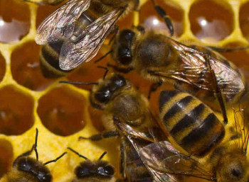
Successful Treatment Protocol for Bees*
Average loss rates in bee hives in the U.S. for the winter of 2015-2016 was 38%
Slide Ridge Honey had only a 5% loss rate
Their success was attributed to mineral supplements and probiotics
*biomineralstechnologies.com/save-the-bees/honeybee-update-2017
Notes:
http://biomineralstechnologies.com/save-the-bees/honeybee-update-2017
Bio Minerals Technologies

Slide 92
Glyphosate was found in 59% of Honey Samples*
USA
*F Rubio et al., J Environ Anal Toxicol 2014, 5:1
Notes:
..glyphosate_in_honey_2014.pdf
*F Rubio et al., J Environ Anal Toxicol 2014, 5:1
Figure 5: Concentration of glyphosate (ng/g) in honey samples listed by honey origin and the allowance of GMO use: (A) Brazil, (B) Canada, (C) China, (D) Germany, (E) Greece, (F) Hungary, (G) India, (H) Korea, (I) blend of Mexico, Brazil, and Uruguay, (J) New Zealand, (K) Spain, (L) Taiwan, (M) blend of Ukraine and Vietnam, (N) USA, (O) blend of USA and Argentina, (P) blend of USA, Argentina and Canada, (Q) blend of USA, South America, (R) unknown origin. Dashed line represents LOQ of method (15 ng/g). ). Error bars represent concentrations obtained during duplicate analysis.

Slide 93
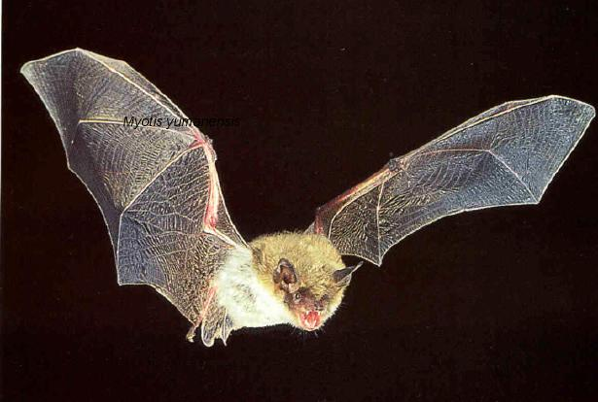
White Nose Syndrome: Bats
Has reached epidemic proportions in US Northeast since 2006
Corresponds to increases in glyphosate application
At least one million bats have died since 2006.
Gravest threat to bats ever seen
Bats wake up repeatedly during hibernation
Suggests melatonin deficiency
*W. Quarles, The IPM Practiioner, 33(9-10), June, 2013, 1-5.
Notes:
Csail/2013/Anthony/bats_white_nosed_syndrome_pesticides.pdf

Slide 94
Beak Deformities in Chickadees*
Beak deformities involving excess keratin synthesis have been appearing among chickadees and other birds in the Great Lakes region, in central Alaska and in areas exposed to California agricultural run-off
No link could be found with investigated toxic chemicals and metals
Glyphosate was not investigated
*CM Handel and C van Hemert, Environ Toxicol Chem 34, 2015; 314-327.

Slide 95
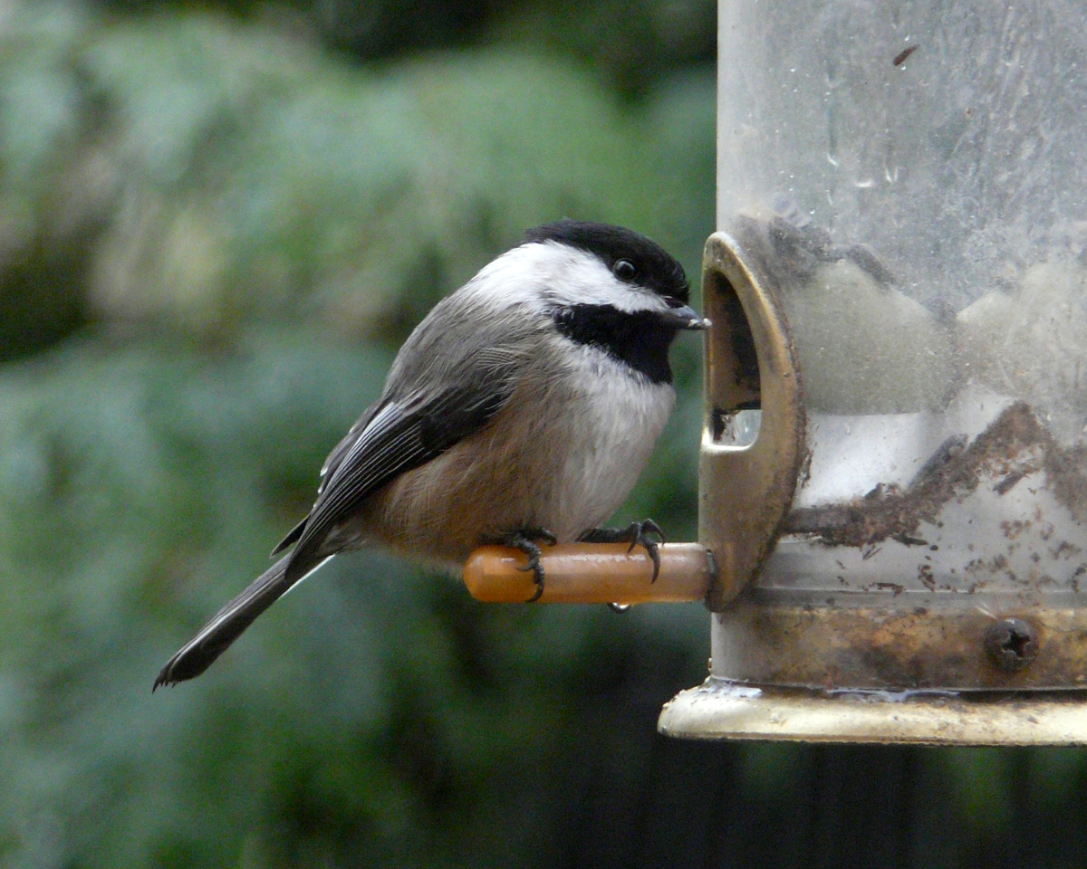
Beak Deformities in Chickadees*
Beak deformities involving excess keratin synthesis have been appearing among chickadees and other birds in the Great Lakes region, in central Alaska and in areas exposed to California agricultural run-off
No link could be found with investigated toxic chemicals and metals
Glyphosate was not investigated
Chickadees frequent bird feeders to consume sunflower seeds sprayed with glyphosate just before harvest
*CM Handel and C van Hemert, Environ Toxicol Chem 34, 2015; 314-327.

Slide 96
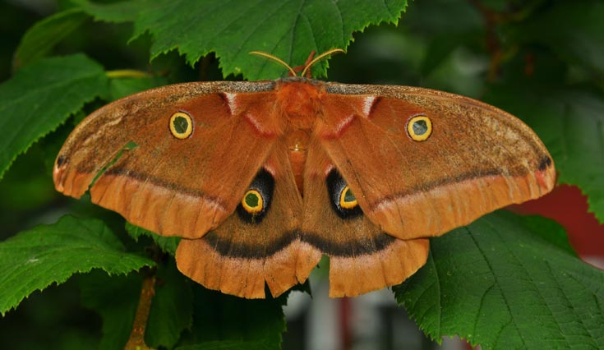
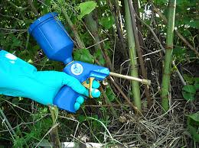
A personal witness to the devastating demise of wild pollinators and other species as glyphosate herbicide residues increase in the environment*
Dr. Rosemary Mason’s nature reserve in South Wales
Overnight moth count from 2006
143 species in numbers up to 500.
Same experiment, 2013
51 species, max count 50
"By August 2014, a naturalist friend with a reserve 3 miles away had stopped doing moth counts. He said there were so few that it wasn’t worth the effort."
*https://gmandchemicalindustry9.wordpress.com/tag/dr-rosemary-mason/
Notes:
https://gmandchemicalindustry9.wordpress.com/tag/dr-rosemary-mason/
./RosemaryMason.text
Japanese Knotweed

Slide 97
Recapitulation
Many species are under stress today – ladybugs, bees, bats, starfish, birds, butterflies, etc.
Although glyphosate is easily implicated in many cases, investigations rarely consider glyphosate due to its perceived nontoxicity and high cost of testing
Glyphosate explains the explosive growth in fungus infection associated with many species die-offs

Slide 98
Fusarium and Root Rot

Slide 99
Fusarium Infection in Bananas

Slide 100
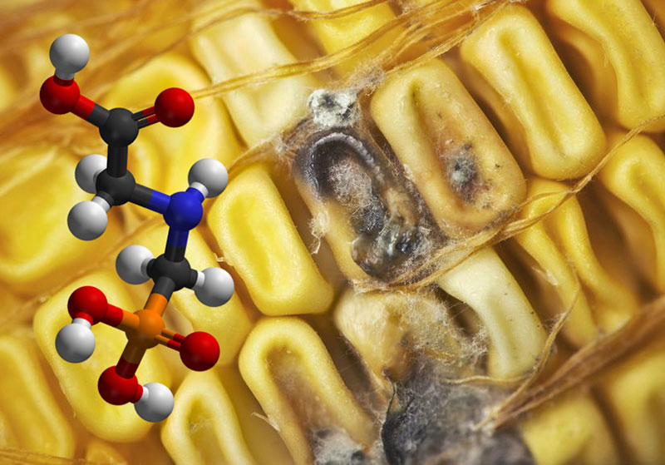
Roundup herbicide enhances the growth of aflatoxin-producing fungi*
Fungus is a growing threat in GMO Roundup-Ready corn
Research is consistent with studies on other fungal strains such as Fusarium, Rust fungi and Blight fungi
*Barberis et al., Journal of Environmental Science and Health, Part B: Pesticides, Food Contaminants, and Agricultural Wastes. 2013, 48(12), 1070-1079.
Notes:
http://www.greenmedinfo.com/blog/breaking-study-links-roundup-weedkiller-overgrowth-deadly-fungal-toxins-1
13. Barberis CL, Carranza CS, Chiacchiera SM, Magnoli CE. Influence of herbicide glyphosate on growth and aflatoxin B1 production by Aspergillus section Flavi strains isolated from soil on in vitro assay. Journal of Environmental Science and Health, Part B: Pesticides, Food Contaminants, and Agricultural Wastes. 2013, 48(12), 1070-1079.

Slide 101
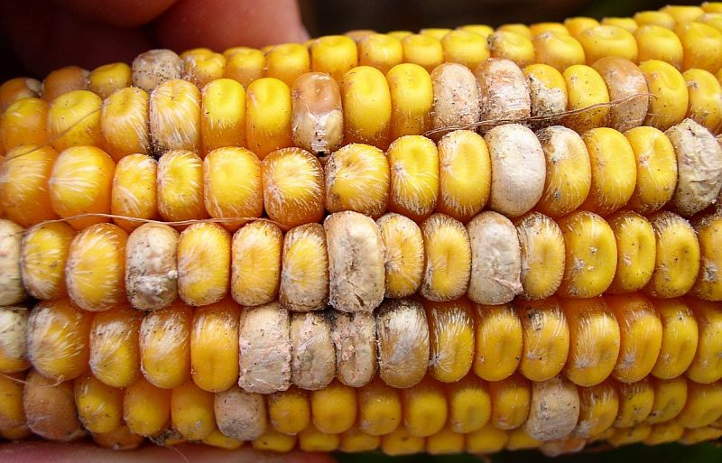
Glyphosate and Fusarium*
Long-term exposure of soil micro- organisms to glyphosate leads to a fungal community dominated by Fusarium spp.
Fusarium species increase following glyphosate exposure for both peanuts and maize crops.
Significant increase in soil Fusarium within 2 weeks after glyphosate application at recommended rates
Culture-based studies showed that five strains of Fusarium could metabolize glyphosate, using its phosphorus atom as a source of phosphorus.
*RJ Kremer and NE Means. European Journal of Agronomy 2009;31(3): 153-161.
Notes:
./Kremer_Means_glyphosate_rhizosphere_2009

Slide 102
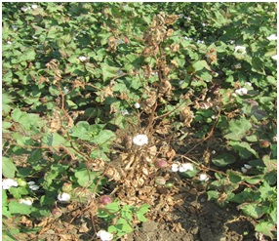
Fusarium in Cotton*
There has been a resurgence of Fusarium wilt in Roundup-Ready cotton crops in Australia and "previous high levels of wilt resistance appear to be less effective under glyphosate management programs”
*Johal GS, Huber DM. 2009. Eur J Agron 31(3):144-52.

Slide 103
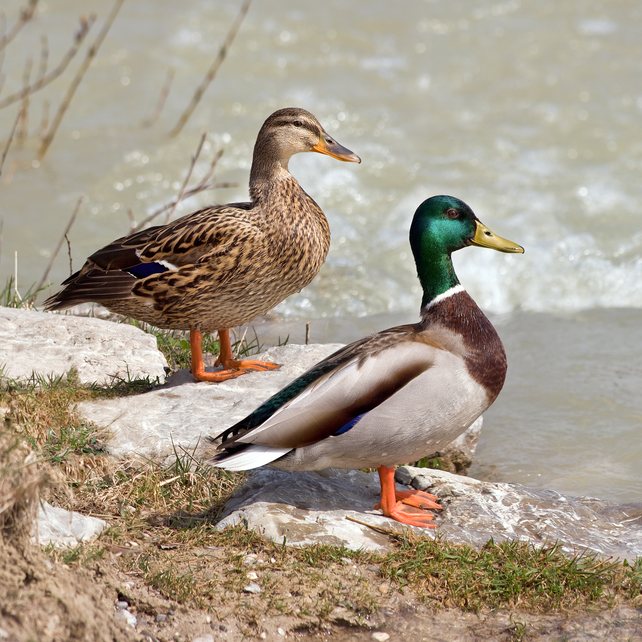
“Aspergillosis has been the culprit in several rapid die-offs among waterfowl. From 8 December until 14 December 2006, over 2,000 Mallards died in the Burley, Idaho area of the USA, an agricultural community approximately 150 miles southeast of Boise. Moldy waste grain from the farmland and feedlots in the area is the suspected source.”*
*http://www.proliberty.com/observer/20061209.htm
Notes:
https://en.wikipedia.org/wiki/Aspergillosis

Slide 104
Corynespora Root Rot in Soybeans*
Non-inoculated control
Inoculatd +
glyphosate
Inoculated
*figure 1, S Johal and DM Huber, European Journal of Agronomy 2009;31(3):144-152.
Notes:
./DonHuber_glyphosate_and_plant_diseases_2009

Slide 105
Take-all root rot in wheat*
Glyphosate exposed
*figure 2, S Johal and DM Huber, European Journal of Agronomy 2009;31(3):144-152.
Notes:
./DonHuber_glyphosate_and_plant_diseases_2009

Slide 106
Some Mechanisms*
Glyphosate is toxic to Mn- reducing and N-fixing organisms in the soil
Residual glyphosate reduces root uptake of Fe, Mn and Cu.
Cereals exposed to glyphosate experience reduced resistance to disease due in part to Mn deficiency, inhibition of root growth by glyphosate, and increase in Mn-oxidizing organisms in the rhizosphere
* S Johal and DM Huber, European Journal of Agronomy 2009;31(3):144-152.

Slide 107
Massive Die-off of Sea Life

Slide 108
Dead fish, crabs and lobsters: Nova Scotia marine mystery growing*
“As many as 20,000 fish, lobsters, starfish, scallops, crabs and other animals have turned up dead at Savary Park.”
December 27, 2016
*www.ctvnews.ca/canada/
dead-fish-crabs-and-lobsters-nova-scotia-marine-mystery-growing-1.3218705

Slide 109
*www.metronews.ca/news/halifax/2016/12/27/
starfish-crabs-mussels-lobster-wash-up-nova-scotia-beaches.html
Notes:
http://www.metronews.ca/news/halifax/2016/12/27/starfish-crabs-mussels-lobster-wash-up-nova-scotia-beaches.html

Slide 110
*
Dead Whale
“A marine mystery is confounding residents of southwest Nova Scotia who are watching thousands of dead fish, starfish, crabs, clams, scallops and lobster wash up on the shore.”
*www.cbc.ca/news/canada/nova-scotia/
fish-kill-off-st-marys-bay-lobster-clams-crabs-beach-1.3913265
Notes:
http://www.cbc.ca/news/canada/nova-scotia/fish-kill-off-st-marys-bay-lobster-clams-crabs-beach-1.3913265

Slide 111
The Answer to the Mystery!
Notes:
./NovaScotiaGlyphosate_trees.text
https://www.localxpress.ca/local-news/nova-scotia-gives-ok-to-spray-hundreds-of-hectares-of-woodland-with-glyphosate-378654
The Nova Scotia govenment just approved Vision Max (Glyphosate) to be sprayed on our forests to manage tree lots this past fall. Prior to the mass die off we had a lot of rain. I think it is runoff from the spraying. https://www.localxpress.ca/local-news/nova-scotia-gives-ok-to-spray-hundreds-of-hectares-of-woodland-with-glyphosate-378654
Tera Abraham Facebook

Slide 112
Counties in Nova Scotia Where Forests Were Sprayed with Glyphosate
Sprayed with Glyphosate
Savary Park
Bay of Fundy

Slide 113
“Glyphosate persistence in seawater”*
“Glyphosate degraded most rapidly under low light conditions at 25 °C with none detected by day 180, and most slowly in the dark at 31 °C where 52% remained by day 330“
*P. Mercurio et al., Marine Pollution Bulletin, 2014, In press
Notes:
Glyphosate/glyphosate_persistance_sea_coral_2014.pdf
http://www.greenmedinfo.com/blog/roundup-weed-killer-threatens-coral-reefs-persists-seawater

Slide 114
Solutions

Slide 115
Treating Glyphosate Poisoning in Cows*
Activated charcoal, bentonite clay, humic and fulvic acids, and sauerkraut juice have been shown to be effective in reducing urinary levels of glyphosate and improving animal health
Sauerkraut
Juice
Fulvic Acid
Activated Charcoal
Bentonite Clay
*H Gerlach et al., J Environ Anal Toxicol 2014, 5:2
Notes:
Glyphosate/Monika_cows_humic_acid_fulvic_acid_treat_glyphosate.pdf
Activated charcoal
活性炭
clay
粘土
Niántǔ
Huóxìngtàn

Slide 116
Treating Glyphosate Poisoning in Cows*
Acetobacter in sauerkraut juice (and apple cider vinegar) are on the very short list of microbes that can fully metabolize glyphosate (detox it)
Activated charcoal, bentonite clay, humic and fulvic acids, and sauerkraut juice have been shown to be effective in reducing urinary levels of glyphosate and improving animal health
Sauerkraut
Juice
Fulvic Acid
Activated Charcoal
Bentonite Clay
*H Gerlach et al., J Environ Anal Toxicol 2014, 5:2
Notes:
Glyphosate/Monika_cows_humic_acid_fulvic_acid_treat_glyphosate.pdf
Activated charcoal
活性炭
clay
粘土
Niántǔ
Huóxìngtàn

Slide 117
Reverse Osmosis: Water Treatment*
Tens of thousands of people in Rajarata, Sri Lanka have died due to kidney failure.
Reverse osmosis technique can produce clean and safe water for human consumption at reasonable cost.
Sieves out arsenic, cadmium, glyphosate and other agrochemicals, fluoride, viruses, bacteria and algae.
Evidence supports drop in kidney disease following adoption of RO drinking water
Agrichemical lobby fears repercussion when message gets out to the world
*Eng Harsha Kumar Suriyaarachchi, Former Vice chairman of NWSDB,
Former General Manager of Water Resources Board. Sri Lanka.
Posted on December 24, 2016
Notes:
./SriLanka_water_purification.text

Slide 118
Superweeds Are Now a Huge Problem*
76.8% of samples submitted to a U of Illinois Plant Clinic from 10 states across the Midwest showed glyphosate resistance
“GM crops are on the edge of failure in the U.S. as farmers are asked to fork out more and more money on herbicides to try to control the superweeds. We simply can’t afford it! It is near the end of the road for these crops and many of my friends in the Midwest are on the edge of turning back to conventional farming methods.”
Bill Giles, an Illinois farmer
*sustainablepulse.com/2017/02/04/farmers-losing-midwest-superweeds-
fight-as-glyphosate-resistance-reaches-over-75/#
Notes:
http://sustainablepulse.com/2017/02/04/farmers-losing-midwest-superweeds-fight-as-glyphosate-resistance-reaches-over-75/#

Slide 119
Fixing the Soil*
Dirt is inert; soil is alive
Missouri farmer JR Bollinger grew corn and soy on a former coal mine
“We tried … all kinds of goodies: humates, … sea minerals, microbes, fish meal and biochar powder.”
Earthworms till the soil
Soil microbes are crucial for soil health
Greatly reduce fertilizer needs and improve yield
JR Bollinger
*ecofarmingdaily.com/wormhole-customizing-biological-methods-large-scale-farming/
David Yarrow
Down the Wormhole: Customizing Biological Methods for Large Scale Farming
Belize Ag Report 2017;34:5-17.
Notes:
Missouri reclaimed coal mine

Slide 120
From Uniformity to Biodiversity*
"Industrial Agriculture:" crop monocultures and industrial-scale feedlots
Chemical fertilizers, pesticides, antibiotics → multiple negative outcomes
Diversify farming landscapes: holistic strategies
Retain carbon in the ground, support biodiversity, rebuild soil fertility, sustainable high yields
Political incentives must be shifted to promote ecofriendly agriculture.
*Emile A. Frison, REPORT 02. 2016
IPES Food: International Panel of Experts on Sustainable Food Systems
Notes:
Ecofarming.pdf., .text

Slide 121
Solving Global Climate Change through Agriculture*
“Agriculture, with its unique ability to sequester carbon on … billions and billions of acres, is the only industry poised to reverse global warming. Improved management of cropping and grazing heals land, boosts soil fertility, prevents flooding, enhances drought resilience, increases the nutritional content of food and restores wildlife habitat — while sequestering carbon.
*http://www.rutlandherald.com/articles/using-soil-to-fight-climate-change/

Slide 122
Beyond Organic: Certified Demeter Biodynamic
Demeter is the Greek Goddess of grain and fertility
Views the farm as a living “holistic organism”
The Demeter certification program was established in 1928, and as such was the first ecological label for organically produced foods
*www.demeter-usa.org/learn-more/biodynamic-farm-standard.asp
Notes:
Stephen: The basic pasture rotation is sheep, cows, then chickens
They are certified Demeter Biodynamic for part of their operation, but not egg production because they have been having difficulty getting organic feed that’s free of DL-methionine — allowed by USDA organic, but not Demeter. I suggested they get the USDA certification (I think they already exceed USDA standards) to help boost sales, while continuing their attempt to get DL-free feed. I also gave them materials needed to be considered for Cornucopia’s listing. They really exceed at animal husbandry; the owner told me all of his animals live happy, carefree lives in the outdoors with all nature meant them to have…they only have one bad day.

Slide 123
Small Organic Farms are the Answer
Bluebird Hill Organic Farm, North Carolina

Slide 124
One More Quote*
“It’s interesting that in 2016, for the first time in almost 20 years, what we saw is a decrease in the amount of acreage where genetically engineered crops are growing around the world. This represents the fact that this technology is failing, in the sense of superweeds and superpests are popping up all over the world.”
Ronnie Cummins, founder of the Organic Consumers Association
*articles.mercola.com/sites/articles/archive/2017/03/26/market-rejection-of-gmos-grows.aspx
Notes:
http://articles.mercola.com/sites/articles/archive/2017/03/26/market-rejection-of-gmos-grows.aspx

Slide 125
Summary
Glyphosate usage is going up dramatically in the US and around the world, in step with the dramatic rise in a number of debilitating diseases and conditions
Autism, dementia, diabetes, obesity, kidney failure, several different cancers, autoimmune disease, endocrine disruption, infertility, etc.
Glyphosate is a major causal factor in health problems in farm animals and in massive die-offs of multiple wild species on land and in the sea
Glyphosate is an insidious, cumulative toxic chemical that needs to be banned, globally
We need to find the path back towards sustainable, organic agriculture

Slide 126
The Big Picture
Background
Weeds => Roundup => Glyphosate
Mega farms => GMOs (Roundup-Ready Crops)
The Problem
We were told Glyphosate is safe, since it disrupts the Shikimate pathway that humans do not have
But our gut bacteria have it, and they provide essential services to us
Consequences
Incidents of many diseases have sky-rocketed
Many creatures are affected; the earth is suffering
What to do
Educate
Advocate => legislate, litigate
Change the way we grow and consume food
Extend our time horizon => for our grandchildren's’ grandchildren
It’s everyone’s responsibility, but why Belize?
Small countries have advantages
New opportunities, eco-tourism, teaching organic farming, etc
Become a world leader

