Slide 1
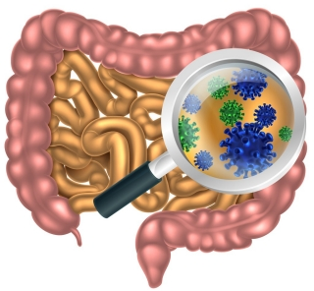
Autism and Glyphosate: Connecting the Dots.
Stephanie Seneff
MIT CSAIL
CHNC
May 5, 2018

Slide 2
Outline
Introduction
Glyphosate as a Glycine Analogue
Autism and the Gut
Heparan Sulfate Deficiency
Impaired Calcium Channels
Other Issues
Summary

Slide 3
Introduction

Slide 4
Roundup and GMO Crops
GMO Roundup-Ready corn, soy, canola, sugar beets
cotton, tobacco and alfalfa
What is glyphosate?

Slide 5
Glyphosate vs. Other Pesticides: Usage in the United States*
Glyphosate
*http://sustainablepulse.com/wp-content/uploads/GMO-health.pdf

Slide 6
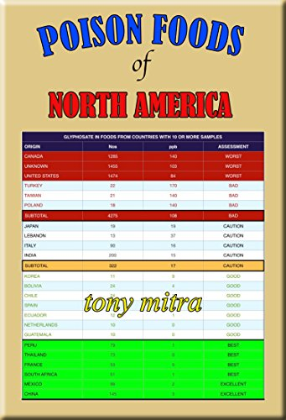
Glyphosate is Pervasive in Our Food Supply!

Slide 7
Main Toxic Effects of Glyphosate*
Disrupts gut microbiome increasing pathogens
Interferes with synthesis of aromatic amino acids and methionine by gut microbes
Leads to shortages in critical neurotransmitters (serotonin, dopamine, melatonin, epinephrine) and folate
Interferes with function of cytochrome P450 (CYP) enzymes in the liver
Chelates important minerals (iron, cobalt, manganese, etc.)
Disrupts sulfate synthesis and sulfate transport
*Samsel and Seneff, Entropy 2013, 15, 1416-1463

Slide 8
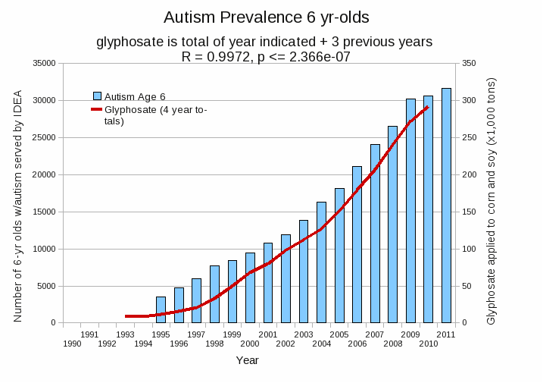
Autism Prevalence: 6 year olds
R = 0.9972
*Plot provided by Nancy Swanson, with permission
Data sources: autism: US Department of Education; Glyphosate: US Department of Agriculture
Notes:
Nancy/latest_plots/6-yr-old autism.gif
autism: USDE
oil consumption: USDA
glyphosate: USDA
GE crops: USDA
Mortality data: CDC

Slide 9
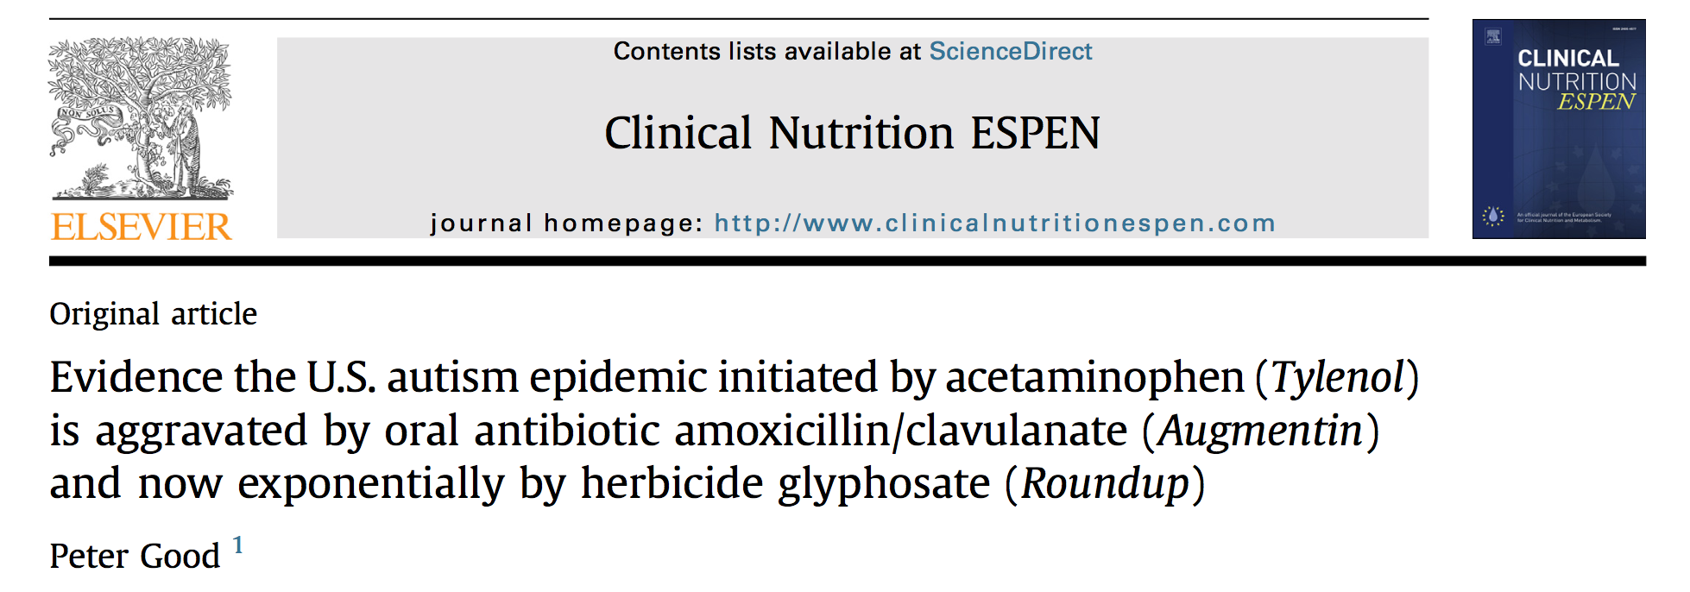
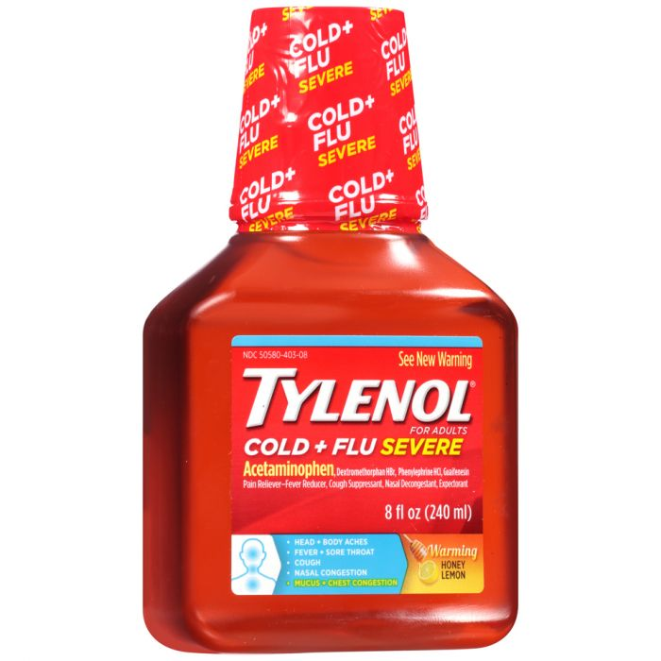
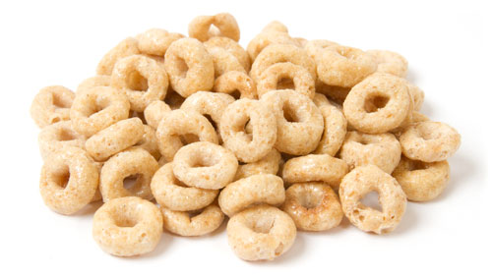
Acetaminophen depletes sulfate and glutathione
Oral antibiotics and glyphosate disrupt gut microbes
Glyphosate inhibits aromatase that converts androgen to estrogen
Placental/postnatal estrogens:
Dehydrate and mature brain myelin sheaths
Mature corpus callosum
Elevate brain serotonin and oxytocin
Estrogen depletion leads to extreme male brain, low brain blood flow, hyperexcitability and social anxiety
Notes:
Peter Good’s new article
PeterGood_autism_glyphosate_2017.pdf
http://clinicalnutritionespen.com/article/S2405-4577(17)30102-X/abstract

Slide 10
Recapitulation
Glyphosate is by far the most used herbicide on the planet
Its exponential growth over the past two decades matches perfectly with the growth in autism in the US
Glyphosate is pervasive in the food supply
Glyphosate disrupts mineral homeostasis, liver CYP enzymes and the gut microbiome
Synergistic effects with antibiotics and Tylenol lead to estrogen insufficiency and impaired development of corpus callosum and myelin sheath in the brain
Hypermale brain, low serotonin, anxiety and excitability

Slide 11
Glyphosate as a
Glycine Analogue

Slide 12
Glyphosate is a non-coding amino acid analogue of glycine
H
Glycine
Glyphosate

Slide 13
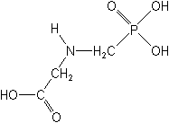
What If Glyphosate Could Insert Itself Into Protein Synthesis by mistake???
glyphosate
Code for glycine
GGC
mRNA
. . .
. . .
Glyphosate
Alanine
Proline
Any proteins with conserved glycine residues are likely to be affected in a major way

Slide 14
Extra Piece Sticks Out at Active Site
Substrate no longer fits in active site
Active Site
Extra Stuff
Glyphosate
Alanine
Proline
glycine
Peptide chain

Slide 15
Extra Piece Sticks Out at Active Site
Substrate no longer fits in active site
Multiple species of bacteria
and multiple species of weeds
have developed resistance to glyphosate
by swapping out a crucial glycine residue in
the enzyme EPSP synthase in the shikimate
pathway, replacing it with alanine.*
A bacterial gene coding for alanine instead of glycine is the basis of the GMO Roundup-Ready crops**
Active Site
Extra Stuff
Glyphosate
Alanine
Proline
glycine
Peptide chain
*S Seneff et al. J Bioinfo Proteomics Rev 2016; 2(3): 1-21.
**T Funke et al. Proc Natl Acad Sci U S A 2006; 103(35): 13010-13015.

Slide 16
Inhibition of EPSPS by glyphosate: Resistant E coli mutant*
Mutant with alanine substituted for glycine 96
Wild type with glycine 96
*Figure 3, S Eschenburg et al. Planta 2002;216:129-135.

Slide 17
Quote from Monsanto Study (1989)*
Study exposed bluegill sunfish to carbon-14 radiolabelled glyphosate
Measured radiolabel in tissues greatly exceeded measured glyphosate levels
Proteolysis recovered more glyphosate
20% yield → 70% yield
"Proteinase K hydrolyses proteins to amino acids and small oligopeptides, suggesting that a significant portion of the 14C activity residing in the bluegill sunfish tissue was tightly associated with or incorporated into protein.”
*WP Ridley and KA Chott. Monsanto unpublished study. August, 1989.

Slide 18
Autism and the Gut

Slide 19
Autism and the Gut*
“Prospective, controlled studies suggest that as many as 70% of autistic children exhibit chronic GI-related symptoms [1,5,6] including diarrhea, laxative-dependent constipation, abdominal distension, failure to thrive, weight loss, feeding problems, and abdominal pain related to extreme irritability, aggression, and self-injury.”
*SJ Walker et al. PLOS One March 2013; 8(3):e58058.
Notes:
Walker_et_al_unique_gene_expression_profile_ASD_2013.pdf

Slide 20
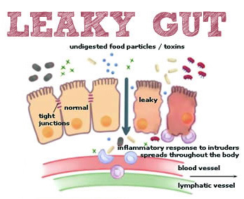
Notes:
Excellent article!!
./glyphosate_vaccines_autism.pdf
http://kinseimindbody.com/synergistic-destruction-how-vaccines-and-gmos-converge-to-fuel-autism-and-neurodegenerative-conditions/

Slide 21
Glyphosate and the Gut: Pathogen Overgrowth*
Glyphosate is an antimicrobial agent that preferentially kills beneficial microbes, allowing pathogens to flourish in the gut
Immune cells invade the gut and release inflammatory cytokines
This causes increased risk to inflammatory bowel diseases such as Crohn’s and ulcerative colitis
* Samsel and Seneff. Entropy 2013; 15: 1416-1463.

Slide 22
Pathogen Overgrowth in Poultry Microbes Exposed to Glyphosate*
Clostridia
Salmonella
Bifidobacteria
*Plot provided by Dr. Martin Michener
Notes:
From Marty Michener!
Sheehata paper.

Slide 23
Glyphosate and the Gut: Digestive Enzymes
Glyphosate has been found as a contaminant in digestive enzymes trypsin, pepsin and lipase*
Trypsin impairment prevents proteins like gluten in wheat from being digested
Undigested proteins induce release of zonulin which opens up gut barrier**
Zonulin lingers because trypsin is defective
*A Samsel and S Seneff. J Biol Phys Chem 2017;17:8-32
** JJ Gildea et al. J Clin Nutr Diet. 2017, 3:1.
Notes:
Glyphosate/ZachBushPaper_tight_junctions_glyphosate_2017.pdf

Slide 24
Trypsin, Pepsin and Lipase are all contaminated with glyphosate*
Enzyme | Glyphosate (PPB)
Pepsin (ELISA) | <40
Pepsin (GC-MS) | 430
Pepsin (HPLC-MSMS) | 290
Trypsin (ELISA) | 62
Lipase (ELISA) | 24
*A Samsel and S Seneff. Journal of Biological Physics and Chemistry 2017;17: 8-32

Slide 25
Trypsin, Pepsin and Lipase are all contaminated with glyphosate*
Trypsin’s activation domain contains four crucial glycine rich subdomains:*
N-terminus to Gly 19
Gly 142 to Pro 152
Gly 184 to Gly 193
Gly 216 to Asn 223
Enzyme | Glyphosate (PPB)
Pepsin (ELISA) | <40
Pepsin (GC-MS) | 430
Pepsin (HPLC-MSMS) | 290
Trypsin (ELISA) | 62
Lipase (ELISA) | 24
*A Samsel and S Seneff. Journal of Biological Physics and Chemistry 2017;17: 8-32

Slide 26
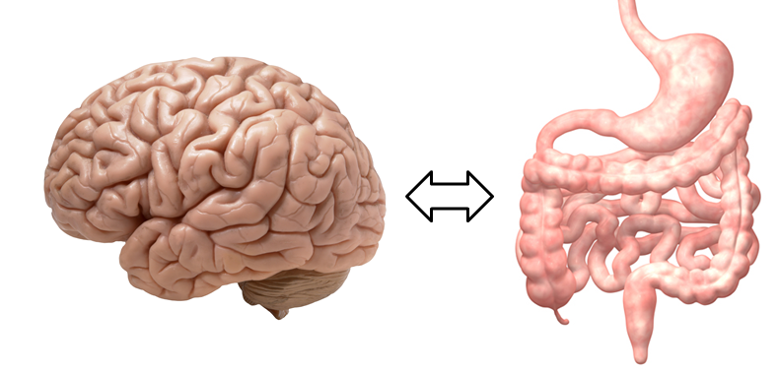
A Scenario for Gluten Intolerance
Glyphosate in wheat
Leaky brain barrier
Zonulin
Trypsin defective
Autoimmune
neurological
disease
Zonulin released
Gliadin
Leaky barrier
Systemic immune response induces multiple complex symptoms

Slide 27
Glyphosate and Celiac Disease*
Glyphosate
Use on wheat
Celiac disease
*Samsel and Seneff, Interdiscip Toxicol. 2013;6(4): 159–184.

Slide 28
Celiac Disease, Glyphosate and Non Hodgkin’s Lymphoma
Glyphosate preferentially kills Bifidobacteria*
Bifidobacteria are depleted in celiac disease**
Celiac disease is associated with increased risk to non Hodgkin’s lymphoma***
Glyphosate itself is also linked directly to non Hodgkin’s lymphoma****
*A.A. Shehata et al., Curr Microbiol. 2013 Apr;66(4):350-8.
** M. Velasquez-Manoff, NY Times Sunday Review, Feb. 23, 2013.
*** C. Catassi et all, JAMA. 2002 Mar 20;287(11):1413-9.
****M. Eriksson et al., Int J Cancer. 2008 Oct 1;123(7):1657-63.
Notes:
**./ bifidobacteria_celiac_disease.text
Cancer/Celiac_disease_increases_hodgkins_lymphoma.text
./Celiac_and_bacteria.text

Slide 29
*Figure 20, NL Swanson et al. Journal of Organic Systems 9(2), 2014, p. 25.

Slide 30
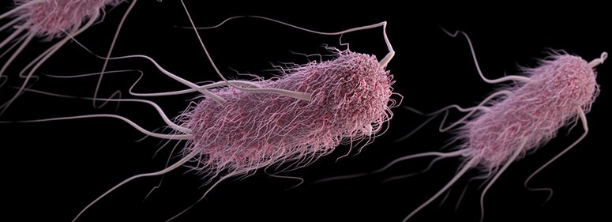
Glyphosate Induces Antibiotic Resistance*
Actinobacteria produce a free radical scavenger in response to glyphosate that provides resistance to a wide range of antibiotics, including penicillin
E. coli exposed to glyphosate develop an "efflux pump" that increases resistance to the fluoroquinolone Ciprofloxacin and the aminoglycoside Kanamycin.
Same effect observed in Salmonella exposed to glyphosate
*AHC Van Bruggen et al. Science of the Total Environment 2018;616-617: 255–268.

Slide 31
Glyphosate Usage and Papers on Antibiotic Resistance*
*AHC Van Bruggen et al. Science of the Total Environment 2018;616-617: 255–268.
Notes:
./VanBruggen_glyphosate_antibiotic_resistance_2017.pdf

Slide 32
A BTBR Mouse Model of Autism*
These mice had all the mouse features of autism
They were fed “standard rodent chow” – glyphosate contaminated?
Some features in the gut:
Reduced levels of bile acids (due to impaired CYP7A1 activity in the liver)
Further reduced levels of secondary bile acids (impaired metabolism by gut microbes)
Reduced levels of Lactobacillus and Bifidobacteria (microbes that metabolize bile acids)
These microbes are preferentially killed by glyphosate
Serotonin deficiency (due in part to tryptophan conversion to kynurenine to fight infection)
Serotonin is derived from tryptophan, a product of the shikimate pathway which glyphosate disrupts
*AV Glubeva et al. EBioMedicine. 2017 Oct;24:166-178.
Notes:
Anthony/scleroderma/mouse_model_autism_bile_acids_tryptophan_gut_microbes_2017.pdf

Slide 33
Glyphosate Disrupts Cytochrome P450 (CYP) Enzymes*
Glyphosate has been shown to severely suppress CYP enzymes in rat liver
CYP enzymes have a unique FXXGXRXCXG motif with two and sometimes three critical glycine residues**
GLYCINES
*A Samsel and S Seneff. Entropy 2013; 15: 1416-1463.
**K Syed and SS Mashele. PLOS ONE 2014; 9(4):| e95616.
Notes:
glyphosate/CYPs_contained_glycine_rich_motif_2014.pdf
Glyphosate/glyphosate_rats_CYP_enzyme_suppression_2006.pdf

Slide 34
Glyphosate Disrupts Cytochrome P450 (CYP) Enzymes*
Glyphosate has been shown to severely suppress CYP enzymes in rat liver
CYP enzymes have a unique FXXGXRXCXG motif with two and sometimes three critical glycine residues**
CYP enzymes are needed to produce bile acids for digesting fats, to activate vitamin D and to detoxify many environmental toxicants
GLYCINES
*A Samsel and S Seneff. Entropy 2013; 15: 1416-1463.
**K Syed and SS Mashele. PLOS ONE 2014; 9(4):| e95616.

Slide 35
BTBR mice have low acetate, and glyphosate disrupts acetate synthesis in gut*
BTBR mice
Children with autism had only 3.5 mg/ml acetate in stool samples compared to 5.1 in controls.**
Glyphosate and pH
Glyphosate and Acetate
*LN Nielsen et al. Environmental Pollution 2018;233:364e376.
**Adams et al. BMC Gastroenterology 2011; 11:22.
Notes:
./low_acetate_gut_autism_2011.pdf
scleroderma/glyphosate_reduces_acetate_gut_2018.pdf
rats

Slide 36
BTBR mice have low acetate, and glyphosate disrupts acetate synthesis in gut*
BTBR mice
Children with autism had only 3.5 mg/ml acetate in stool samples compared to 5.1 in controls.**
Elevated pH linked to glyphosate exposure results in small intestinal bacterial overgrowth (SIBO)

Slide 37
Acetate synthesis by gut microbes depends on glycine and folate*
"The glycine is converted to serine by the addition of methylenetetrahydrofolate, and the resulting serine is converted to pyruvate, which is decarboxylated to form acetate.”
*LJ Waber and HG Wood. J Bacteriol. 1979 Nov; 140(2): 468–478.

Slide 38
Sulfur Reducing Bacterial Overgrowth with Diet High in Simple Sugars and Fat*
Mouse study, two diets
High fat, high simple sugars
Low fat, high complex carbohydrates
Mice fed diet (1) had overgrowth of Desulfovibrio due to extraction of sulfate from host mucins
Associated with low levels of short chain fatty acids, acetate and propionate
High levels of H₂S led to suppression of cytochrome c oxidase in the mitochondria of host colonic cells
Lower metabolic activity; Reduced uptake of nutrients.
These results are consistent with observations of Desulfovibrio overgrowth, low acetate and propionate, and reduced nutrient uptake linked to autism
*FE Rey et al. Proc Natl Acad Sci U S A. 2013 Aug 13; 110(33): 13582-13587.
Notes:
./metabolic_niche_sulfate_reducing_bacteria_human_gut_2013.pdf

Slide 39
Sulfur Reducing Bacterial Overgrowth with Diet High in Simple Sugars and Fat*
Mouse study, two diets
High fat, high simple sugars
Low fat, high complex carbohydrates
Mice fed diet (1) had overgrowth of Desulfovibrio due to extraction of sulfate from host mucins
Associated with low levels of short chain fatty acids, acetate and propionate
High levels of H₂S led to suppression of of cytochrome c oxidase in the mitochondria of host colonic cells
Lower metabolic activity; Reduced uptake of nutrients.
These results are consistent with observations of Desulfovibrio overgrowth, low acetate and propionate, and reduced nutrient uptake linked to autism
Cheap vegetable-based fats (corn oil, soybean oil, cottonseed oil, canola oil) and simple sugars (cane sugar, beet sugar, high fructose corn syrup) can all be expected to be contaminated with glyphosate
*FE Rey et al. Proc Natl Acad Sci U S A. 2013 Aug 13; 110(33): 13582-13587.
Notes:
./metabolic_niche_sulfate_reducing_bacteria_human_gut_2013.pdf

Slide 40
Dissimilatory sulfate reduction induced by glyphosate
Multiple enzymes involved in assimilatory sulfate reduction in E coli are disrupted by glyphosate (PAPS reductase, APS kinase, sulfite reductase)*
Causes deficiency in sulfur-containing amino acids
Leads to increase in Desulfovibrio and Bilophila wadsworthia species
Dissimilatory sulfate reduction → excessive hydrogen sulfide gas → brain fog
Disrupted sulfur assimilation leads to impaired iron absorption**
Iron deficiency anemia is an epidemic worldwide
*W Lu et al. Mol Biosyst. 2013 Mar;9(3):522-30.
**BH Hudson et al. PNAS 2018 ePub ahead of print.
Notes:
./sulfur_assimilation_defects_iron_deficiency_anemia.pdf
Downregulated paper

Slide 41
Myosin in the Gut
Myosin is a motor protein found in high levels in skeletal muscles
Myosin is also essential for gut motility (peristalsis) and for the release of bile acids into the upper intestine
Myosin contains a highly conserved glycine at position 699*
If this is changed to alanine, the proteins’ contractile ability is reduced to less than 1%.
Glyphosate has been shown in fish studies to suppress myosin expression**
*F Kinose et al. The Journal of Cell Biology 1996;134(4): 895-909.
**Ana Paula Rezende dos Santos et al., Chemosphere 2017;168:933e943.
Notes:
Glyphosate/chemosphere_2017_glyphosate_histomorpholgical_changes_liver_guppies.pdf
Anthony/scleroderma/glycine_699_pivotal_for_motor_activity_skeletal_myosin.pdf

Slide 42
Myosin in the Gut
Myosin is a motor protein found in high levels in skeletal muscles
Myosin is also essential for gut motility (peristalsis) and for the release of bile acids into the upper intestine
Myosin contains a highly conserved glycine at position 699*
If this is changed to alanine, the proteins’ contractile ability is reduced to less than 1%.
Glyphosate has been shown in fish studies to suppress myosin expression**
SIBO (Small Intestinal Bacterial Overgrowth) is associated with impaired peristalsis*
*AC Dukowicz et al. Gastroenterol Hepatol (N Y) 2007; 3(2): 112-122.
Notes:
Glyphosate/chemosphere_2017_glyphosate_histomorpholgical_changes_liver_guppies.pdf
Anthony/scleroderma/glycine_699_pivotal_for_motor_activity_skeletal_myosin.pdf

Slide 43
Evidence Linking Autism to Clostridia Overgrowth*
14 autistic children with gut disorder compared to 21 controls
Significant increase in Clostridia species in the gut in autistic children
Associated with reduced tryptophan levels and increased expression of inflammatory markers
Tryptophan is a product of the shikimate pathway, which glyphosate blocks
Macrophages in inflamed tissue take up tryptophan, reducing bioavailability to the brain
Proposed role for antibiotics
Glyphosate is a patented antimicrobial agent (2010)
*RA Luna et al., Cellular and Molecular Gastroenterology and Hepatology 2017;3(2): 218-230

Slide 44
*
Triplets: two boys, one girl. Both boys have autism and girl has seizure disorder
Very high levels of glyphosate in urine in all three
Clostridia overgrowth due to glyphosate disruption of gut microbes
Clostridia produce toxins HPHPA and p-cresol, which block the conversion of dopamine to norepinephrine.
Damage to neurons in the brain through oxidative stress
*W. Shaw. Integrative Medicine 2017;16(1);50-57.
Notes:
./Shaw_on_glyphosate_triplets_autism.text

Slide 45
Pathogen Overgrowth in Poultry Microbes Exposed to Glyphosate*
Clostridia
Salmonella
Bifidobacteria
*Plot provided by Dr. Martin Michener
Notes:
From Marty Michener!
Sheehata paper.

Slide 46
Recapitulation
Autism is linked to multiple GI issues
Glyphosate induces leaky gut and disrupts digestive enzymes, leading to autoimmune disease and gluten intolerance
Glyphosate preferentially harms beneficial bacteria, particularly Bifidobacteria
Glyphosate suppression of myosin and bile acids leads to impaired peristalsis and SIBO
Glyphosate causes overgrowth of Clostridia and Desulfovibrio resulting in toxic metabolites
Impaired supply of acetate, sulfate, sulfur-containing amino acids, folate and serotonin cause multiple symptoms

Slide 47
Heparan Sulfate Deficiency

Slide 48
Sulfate in Fetal Development*
Fetus depends on mother for sulfate supply
Sulfate is essential for transporting sterols (like estrogen and DHEA) and supplying extracellular matrix proteins everywhere with sufficient negative charge
Sulfate detoxifies xenobiotics like acetaminophen (tylenol) and is essential for excreting toxins like aluminum and mercury
Sulfate is severely deficient in autistic children (1/3 the normal level of free sulfate in blood stream)
* Dawson, “Sulfate in Fetal Development,” Semin Cell Dev Biol 2011
Notes:
Cancer/sulfate_in_fetal_development.pdf
Dawson PA. Sulfate in fetal development. Semin Cell Dev Biol (2011), doi:10.1016/j.semcdb.2011.03.004

Slide 49
“Heparan sulfate deficiency in autistic postmortem brain tissue from the subventricular zone of the lateral ventricles”*
“Aberrant extracellular matrix glycosaminoglycan function localized to the subventricular zone of the lateral ventricles may be a biomarker for autism, and potentially involved in the etiology of the disorder.”
*BL Pearson et al., Behav Brain Res. 2013;243:138-45
Notes:
Samantha/heparan_sulfate_deficiency_autism_postmortem_brain.pdf

Slide 50
“Heparan sulfate deficiency in autistic postmortem brain tissue from the subventricular zone of the lateral ventricles”*
“Aberrant extracellular matrix glycosaminoglycan function localized to the subventricular zone of the lateral ventricles may be a biomarker for autism, and potentially involved in the etiology of the disorder.”
New neurons develop from stem cells in this zone through the action of “fractones” composed of heparan sulfate proteoglycans (HSPGs)**
*BL Pearson et al., Behav Brain Res. 2013;243:138-45
**F. Mercier et al., Neuroscience Letters 506 (2012) 208–213
Notes:
Samantha/heparan_sulfate_deficiency_autism_postmortem_brain.pdf

Slide 51
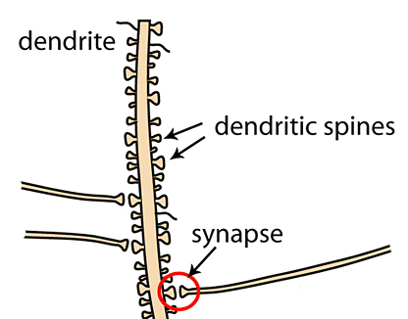
Impaired Dendrite Outgrowth in Autism could be Due to Glycine Substitution by glyphosate
Major brain HSPG syndecan-2 mediates dendritic outgrowth in hippocampus*
Heparan sulfate chains in syndecan 2 are attached to serine residues that have adjacent glycine residues**
Substitution of other amino acids for glycine here disrupts heparan sulfate binding
Dendritic spines are defective in autism***
*IM Ethell and Y. Yamaguchi. J Cell Biol. 1999;144(3):575–86.
**L Zhang et al. JBC 1995; 270(45) Nov 10, 27127-27135.
***M Phillips and L Pozzo-Miller. Neurosci Lett. 2015; 601: 30-40
Notes:
In ~/csail/2018/Felix/
./syndecan-2_induces_maturation_dendritic_spines_hippocampus_1999.pdf
This is good for ser-gly reference:
./Zhang_1995_serine_glycine_sequence_binds_heparan_sulfate.pdf
**L Zhang et al. JBC 1995; 270(45) Nov 10, 27127-27135.
./dendritic_spine_dysgenesis_in_autism.pdf
***M Phillips and L Pozzo-Miller. Neurosci Lett. 2015; 601: 30-40

Slide 52
The third ventricle is depleted in heparan sulfate in association with autism in both humans and mice*,**
Heparan sulfate depleted
*B.L. Pearson et al., Behav Brain Res. 2013 Apr 15;243:138-45.
**F Mercie et al., Neurosci Lett 506, 2012, 208-213.
Notes:
Where are they?

Slide 53
Pineal gland normally supplies melatonin sulfate to the ventricles at night during sleep, but both melatonin and sulfate supplies are depleted by glyphosate
Heparan sulfate depleted
Pineal Gland
*B.L. Pearson et al., Behav Brain Res. 2013 Apr 15;243:138-45.
**F Mercie et al., Neurosci Lett 506, 2012, 208-213.
Notes:
Where are they?

Slide 54
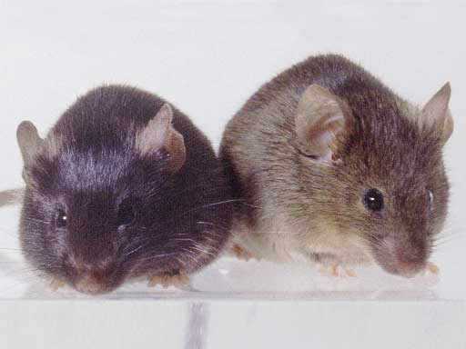
“Autism-like socio-communicative deficits and stereotypies in mice lacking heparan sulfate”*
Experiment with “designer” mice: defect specifically led to impaired heparan sulfate synthesis in brain
Mice exhibited all the classic features of autism – both cognitive and social
* F. Irie et al., PNAS Mar. 27, 2012, 109(13), 5052-5056.
Notes:
vitaminK/mice_no_heparan_sulfate_get_autism_2012.pdf
Samantha/heparan_sulfate_knockout_mice_get_autism.pdf

Slide 55
“Autism-like socio-communicative deficits and stereotypies in mice lacking heparan sulfate”*
Experiment with “designer” mice: defect specifically led to impaired heparan sulfate synthesis in brain
Mice exhibited all the classic features of autism – both cognitive and social
” Remarkably, these mutant mice recapitulate almost the full range of autistic symptoms, including impairments in social interaction, expression of stereotyped, repetitive behavior, and impairments in ultrasonic vocalization.”
* F. Irie et al., PNAS Mar. 27, 2012, 109(13), 5052-5056.
Notes:
vitaminK/mice_no_heparan_sulfate_get_autism_2012.pdf
Samantha/heparan_sulfate_knockout_mice_get_autism.pdf

Slide 56
“Reduced sulfate plasma concentrations in the BTBR T+tf/J mouse model of autism”*
BTBR mice were created through multiple generations of inbreeding among laboratory mice
Mice likely fed glyphosate-contaminated mouse feed
They exhibit autistic behaviors
They have multiple gut issues as previously discussed
They also have low plasma sulfate and reduced heparan sulfate in the brain ventricles
Their corpus callosum fails to develop
*MJ Corley et al. Physiology & Behavior 107 (2012) 663–665
Notes:
Samantha/Sulfate\ low\ in\ BTBR\ autistic\ mice\ 2012.pdf

Slide 57
Corpus Callosum
Heparan sulfate depleted
Pineal Gland
Notes:
Where are they?

Slide 58
"Since previous work has suggested that blood sulfate concentration may determine the rate of sulfation [36], we hypothesize that BTBR deficiencies in plasma sulfate may disturb processes related to properly sulfated glycoaminoglycans and metabolism of neurotransmitters.”*
*MJ Corley et al. Physiology & Behavior 107 (2012) 663–665.
Notes:
Samantha/Sulfate\ low\ in\ BTBR\ autistic\ mice\ 2012.pdf

Slide 59
Vitamin D Prevents Sulfate Wasting*
Activated vitamin D prevents sulfate wasting from the kidney in urine
Mice engineered to have defective vitamin D receptors or with vitamin D deficiency had significantly reduced serum sulfate levels
This was associated with sulfate depletion in the skeleton
*M.J.G. Bolt et al., Am J Physiol Endocrinol Metab 287: E744 –E749, 2004.
Notes:
SteveKette/vitamin_D_regulates_sulfate_kidney.pdf

Slide 60
Inflammation and Vitamin D: The Infection Connection*
The problem appears to be a bottleneck in the production of 25(OH) vitamin D in the liver
D3 → 25(OH) D3 → 1,25(OH)2 D3
Liver Kidney
Both steps depend on CYP enzymes
Liver CYPs are destroyed by glyphosate and aluminum??
→ 1,25(OH2) D3 >> 25(OH) D3
*M. Mangin et al., Inflamm Res 2014; 63:803-819.
Notes:
Treasures/inflammation_and_vitaminD_supplements_bad.pdf
Brilliant paper!!!

Slide 61
Taurine → Heparan sulfate
Taurine is a non-coding amino acid and the only sulfonated amino acid
It is stored in large amounts in the heart and brain
The heart releases taurine during a heart attack, and seizures induce taurine release by the brain
Taurine is conjugated to bile acids in the liver and shipped to the gut
Gut microbes (mainly Bifidobacteria) deconjugate taurine and metabolize it to sulfate
Most melatonin and serotonin in the body is produced in the gut, and conjugated to sulfate before being shipped to the brain
Does this supply sulfate to the brain??
*W Lu et al. Mol Biosyst. 2013 Mar;9(3):522-30.

Slide 62
Taurine → Heparan sulfate
Taurine is a non-coding amino acid and the only sulfonated amino acid
It is stored in large amounts in the heart and brain
The heart releases taurine during a heart attack, and seizures induce taurine release by the brain
Taurine is conjugated to bile acids in the liver and shipped to the gut
Gut microbes (mainly Bifidobacteria) deconjugate taurine and metabolize it to sulfate
Most melatonin and serotonin in the body is produced in the gut, and conjugated to sulfate before being shipped to the brain
Does this supply sulfate to the brain??
In a study on E coli exposed to glyphosate, the most highly suppressed enzyme observed was a taurine transporter*
*W Lu et al. Mol Biosyst. 2013 Mar;9(3):522-30.

Slide 63
Recapitulation
Sulfate is essential in fetal development and to protect from toxic chemicals
Heparan sulfate is deficient in the brain ventricles in both humans and mice with autism
Sulfate supply to brain depends on serotonin sulfate and melatonin sulfate, which are disrupted by glyphosate
Vitamin D protects from sulfate wasting
Activation by CYP enzymes in liver impaired by glyphosate
Taurine buffers sulfate in the brain and heart
Gut microbes that are damaged by glyphosate (E.g., Bifidobacteria) metabolize it to sulfate

Slide 64
Impaired Calcium Channels

Slide 65
Timothy Syndrome*
A complex multisystem disorder
A glycine mutation in the gene that encodes Ca(V)1.2 L-type calcium channel leads to loss of channel inactivation and intracellular calcium overload in various cell types.
Multi-organ dysfunction:
Congenital heart disease, immune deficiency, irregular sleep patterns, hypoglycemia, cognitive abnormalities and autism
*I Splawski et al.. Cell Vol 2004; 119: 19-31.
Notes:
csail/2018/books/autismcachannelopathyPart1.pdf

Slide 66
A Calcium Channel Glycine Mutation: Timothy Syndrome*
This single mutation of a glycine residue
causes severe disability and early death
*I Splawski et al.. Cell Vol 2004; 119: 19-31.
Notes:
./calcium_channel_dysfunction_arrhythmia_autism.pdf

Slide 67
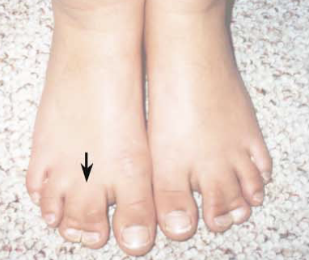
“CaV1.2 Calcium Channel Dysfunction Causes a Multisystem Disorder Including Arrhythmia and Autism”*
Single mutation in calcium channel: G406R = Timothy Syndrome
Long QT syndrome and life-threatening cardiac arrhythmias
Disrupted timing of the cardiac action potentials
Intermittent hypoglycemia - life threatening
Disrupted insulin signaling in the pancreas
Developmental issues: congenital heart diseases and syndactyly
These children typically don't survive beyond early childhood
Very high rate of autism
*I Splawski et al.. Cell Vol 2004; 119: 19-31.
Notes:
AutismOne/calcium_channel_dysfunction_arrhythmia_autism.pdf
R = arginine

Slide 68
More Highly Conserved Glycines in Calcium Channel*
Timothy Gene Mutation
*Figure 1. J Teng et al. Biochimica et Biophysica Acta 2010;1798: 966-974.
Notes:
2018/Anthony/calcium_channel_glycine_mutations_Timothy_syndrome.text
./L_type_calcium_channnels_conserved_glycine.pdf

Slide 69
More Highly Conserved Glycines in Calcium Channel*
If this glycine residue is replaced by a negatively charged amino acid (e.g., glyphosate), it causes a similar problem as Timothy Syndrome: excessive calcium entry
*Figure 1. J Teng et al. Biochimica et Biophysica Acta 2010;1798: 966-974.
Notes:
2018/Anthony/calcium_channel_glycine_mutations_Timothy_syndrome.text
./L_type_calcium_channnels_conserved_glycine.pdf

Slide 70
More Highly Conserved Glycines in Calcium Channel*
Calcium mediates processes as diverse as synaptic transmission, muscle contraction, insulin secretion, fertilization, and gene expression
*Figure 1. J Teng et al. Biochimica et Biophysica Acta 2010;1798: 966-974.
Notes:
./L_type_calcium_channnels_conserved_glycine.pdf

Slide 71
"The pesticide increased intracellular Ca2+ concentration by opening L-type voltage-dependent Ca2+ channels ..., leading to Ca2+ overload within the cells, which set off oxidative stress and necrotic cell death."
Notes:
Glyphosate/glyphosate_mouse_testis_seralini_2013.pdf

Slide 72
"In GBH [glyphosate-based herbicide]-poisoned persons, a high incidence of QTc interval prolongation and atrioventricular conduction blocks (from minimal to high grade) were reported along with arrhythmias, longer QTc and older age predicting mortality "
Long-QT Syndrome!
Notes:
Glyphosate/glyphosate_cardiotoxic_effects_rat_ventricular_myocardium_in_vitro_Seralini_2016.pdf

Slide 73
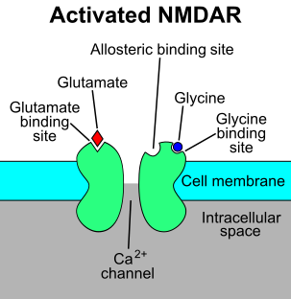
Glyphosate, Calcium Channels and Glutamate*
Acute exposure to the hippocampus in the brain activates NMDA receptors and voltage-dependent calcium channels
Oxidative stress and neural cell death
Increased glutamate release into the synaptic cleft → neurotoxicity
Glyphosate
Calcium uptake
Through calcium channels
*D. Cattani et al. / Toxicology 320 (2014) 34–45
Notes:
Glyphosate/mechanisms_glyphosate_neurotoxicity_glutamate_rats_2014.pdf
http://www.greenmedinfo.com/blog/roundup-weedkiller-brain-damaging-neurotoxin
acute exposure (30 minutes) and chronic (pregnancy and lactation) exposure.
Why was this referenced??
T. Bohn et al. Food Chemistry 153, 15 June 2014, 207-215.

Slide 74
Glyphosate and Glutamate*
*Figure 9, D. Cattani et al. / Toxicology 320 (2014) 34–45
Notes:
Glyphosate/mechanisms_glyphosate_neurotoxicity_glutamate_rats_2014.pdf
Fig.9. Fig.9. Proposed mechanism underlying hippocampal neurotoxicity of Roundup®. The pesticide causes Ca2+ influx by activating NMDA receptors
and L-type voltage-dependent Ca2+ channels (L-VDCC) setting off oxidative stress and cell death. The mechanisms underlying Roundup® neurotoxicity involve the activation of Ca2+ /calmodulin-dependent protein kinase II (CaMKII) and extracellular signal-regulated kinase (ERK). Astrocytes play a key role in removing glutamate from the synaptic cleft and metabolizing it to glutamine, which serve as a glutamate precursor in neurons. Our results demonstrated that Roundup® reduced glutamate uptake and metabolism within glial cells, associated with increased release of this neurotransmitter in the synaptic cleft. Moreover, Roundup® leads to glutamine synthetase, aspartate aminotransferase (AST) and alanine aminotransferase (ALT) enzymatic activity inhibition, attesting that either glutamate uptake or its metabolism is impaired in hippocampal astrocytes exposed to the herbicide. Moreover, Roundup® reduced GSH levels and increased the amounts of thiobarbituric acid reactive species (TBARS), characterizing oxidative damage. Also, exposure to the pesticide decreased the activity of gamma-glutamyl transferase (GGT) and glucose-6-phosphate dehydrogenase, supporting the depletion of GSH. In this context, the GGT inhibition induced by Roundup® could decrease the amino acid availability to GSH de novo synthesis and the decreased activity of G6PD may reduce NADPH levels, necessary to reduce glutathione. Taken together these results demonstrated that Roundup® might lead to excessive extracellular glutamate levels and consequently to excitotoxic condition and energetic deficit in rat hippocampus.

Slide 75
Glyphosate and Glutamate*
Glyphosate inhibits glutamine synthetase (GS) possibly through manganese chelation
*Figure 9, D. Cattani et al. / Toxicology 320 (2014) 34–45
Notes:
Glyphosate/mechanisms_glyphosate_neurotoxicity_glutamate_rats_2014.pdf
Fig.9. Fig.9. Proposed mechanism underlying hippocampal neurotoxicity of Roundup®. The pesticide causes Ca2+ influx by activating NMDA receptors
and L-type voltage-dependent Ca2+ channels (L-VDCC) setting off oxidative stress and cell death. The mechanisms underlying Roundup® neurotoxicity involve the activation of Ca2+ /calmodulin-dependent protein kinase II (CaMKII) and extracellular signal-regulated kinase (ERK). Astrocytes play a key role in removing glutamate from the synaptic cleft and metabolizing it to glutamine, which serve as a glutamate precursor in neurons. Our results demonstrated that Roundup® reduced glutamate uptake and metabolism within glial cells, associated with increased release of this neurotransmitter in the synaptic cleft. Moreover, Roundup® leads to glutamine synthetase, aspartate aminotransferase (AST) and alanine aminotransferase (ALT) enzymatic activity inhibition, attesting that either glutamate uptake or its metabolism is impaired in hippocampal astrocytes exposed to the herbicide. Moreover, Roundup® reduced GSH levels and increased the amounts of thiobarbituric acid reactive species (TBARS), characterizing oxidative damage. Also, exposure to the pesticide decreased the activity of gamma-glutamyl transferase (GGT) and glucose-6-phosphate dehydrogenase, supporting the depletion of GSH. In this context, the GGT inhibition induced by Roundup® could decrease the amino acid availability to GSH de novo synthesis and the decreased activity of G6PD may reduce NADPH levels, necessary to reduce glutathione. Taken together these results demonstrated that Roundup® might lead to excessive extracellular glutamate levels and consequently to excitotoxic condition and energetic deficit in rat hippocampus.

Slide 76
Recapitulation
Timothy syndrome is a rare disorder that can be caused by a glycine mutation in the L-type calcium channel
It is associated with congenital heart defects, immune deficiency, long QT syndrome and autism
Three other highly conserved glycine residues in this calcium channel are also essential for its proper function.
Mutations lead to excessive calcium uptake
Glyphosate has been shown to induce excessive calcium uptake in experiments on multiple cell types, Sertoli cells in the testes, cardiomyocytes, leading to long QT syndrome, and neurons, leading to glutamate toxicity

Slide 77
Other Issues
Glyphosate chelates manganese
Autism is associated with low manganese in the hair, teeth and urine
Manganese is needed for glutamine synthesis, and glutamine is depleted in autism
Manganese deficiency also leads to impaired ammonia clearance by the liver, linked to autism
Glyphosate’s antibacterial effects lead to yeast overgrowth, a common feature of autism
Glyphosate interferes with folate synthesis and with synthesis of methionine by gut microbes, causing methylation deficiencies

Slide 78
Summary
Glyphosate is pervasive in our environment and its exponential growth matches the alarming increase in autism in the US
Glyphosate's disruption of liver CYP enzymes impairs detoxification of other chemicals, disrupts bile acids, and prevents vitamin D activation
Glyphosate may show an insidious cumulative toxic effect by erroneously substituting for glycine during protein synthesis
Multiple mouse studies have demonstrated a link between gut dysbiosis and impaired neurodevelopment in autism
Severe deficiency in heparan sulfate in the ventricles and defective or nonexistent corpus callosum
Overgrowth of gut pathogens leads to accumulation of toxic metabolites that disrupt neurotransmitter signaling and cause brain fog
Glyphosate has been shown to overexcite calcium channels in studies on neurons, Sertoli cells and cardiomyocytes
Calcium channel glycine mutations are linked to autism

