Slide 1
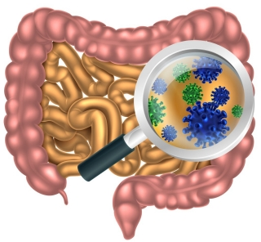
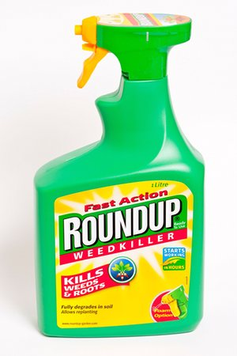
Glyphosate and the Gut
Stephanie Seneff
MIT CSAIL
AutismOne 2018

Slide 2
Outline
Autism and Gut Issues
Pathogen Overgrowth
Digestive Enzyme Impairment
Celiac disease
Antibiotic Resistance
BTBR Mouse model of Autism
Impaired CYP enzymes and Bile Acid Synthesis
Impaired Myosin and Peristalsis
Clostridia Overgrowth and Autism
Summary

Slide 3
Autism and the Gut*
“Prospective, controlled studies suggest that as many as 70% of autistic children exhibit chronic GI-related symptoms [1,5,6] including diarrhea, laxative-dependent constipation, abdominal distension, failure to thrive, weight loss, feeding problems, and abdominal pain related to extreme irritability, aggression, and self-injury.”
*SJ Walker et al. PLOS One March 2013; 8(3):e58058.
Notes:
Walker_et_al_unique_gene_expression_profile_ASD_2013.pdf

Slide 4
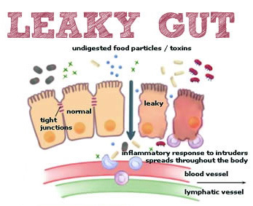
Notes:
Excellent article!!
./glyphosate_vaccines_autism.pdf
http://kinseimindbody.com/synergistic-destruction-how-vaccines-and-gmos-converge-to-fuel-autism-and-neurodegenerative-conditions/

Slide 5
Glyphosate and the Gut: Pathogen Overgrowth
Glyphosate is an antimicrobial agent that preferentially kills beneficial microbes, allowing pathogens to flourish in the gut*
Immune cells invade the gut and release inflammatory cytokines
This causes increased risk to inflammatory bowel diseases such as Crohn’s and ulcerative colitis
* Samsel and Seneff. Entropy 2013; 15: 1416-1463.

Slide 6
Pathogen Overgrowth in Poultry Microbes Exposed to Glyphosate*
Clostridia
Salmonella
Bifidobacteria
*Plot provided by Dr. Martin Michener
Notes:
From Marty Michener!
Sheehata paper.

Slide 7
Glyphosate and the Gut: Digestive Enzymes
Glyphosate has been found as a contaminant in digestive enzymes trypsin, pepsin and lipase*
Trypsin impairment prevents proteins like gluten in wheat from being digested
Undigested proteins induce release of zonulin which opens up gut barrier**
Zonulin lingers because trypsin is defective
*A Samsel and S Seneff. J Biol Phys Chem 2017;17:8-32
** JJ Gildea et al. J Clin Nutr Diet. 2017, 3:1.
Notes:
Glyphosate/ZachBushPaper_tight_junctions_glyphosate_2017.pdf

Slide 8
Trypsin, Pepsin and Lipase are all contaminated with glyphosate*
Enzyme | Glyphosate (PPB)
Pepsin (ELISA) | <40
Pepsin (GC-MS) | 430
Pepsin (HPLC-MSMS) | 290
Trypsin (ELISA) | 62
Lipase (ELISA) | 24
*A Samsel and S Seneff. Journal of Biological Physics and Chemistry 2017;17: 8-32

Slide 9
Glyphosate is a non-coding amino acid analogue of glycine
H
Glycine
Glyphosate

Slide 10
Glyphosate is a non-coding amino acid analogue of glycine
Glyphosate substitution by mistake for glycine during protein synthesis could explain glyphosate contamination in trypsin
H
Glyphosate

Slide 11
Trypsin, Pepsin and Lipase are all contaminated with glyphosate*
Trypsin’s activation domain contains four crucial glycine rich subdomains:*
N-terminus to Gly 19
Gly 142 to Pro 152
Gly 184 to Gly 193
Gly 216 to Asn 223
*A Samsel and S Seneff. Journal of Biological Physics and Chemistry 2017;17: 8-32

Slide 12
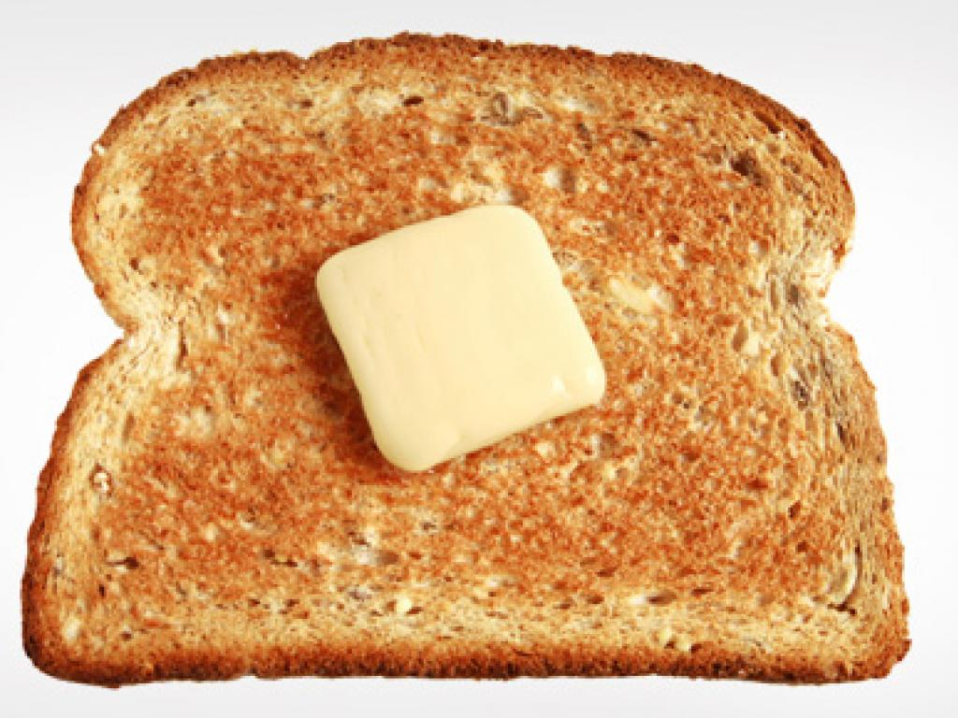
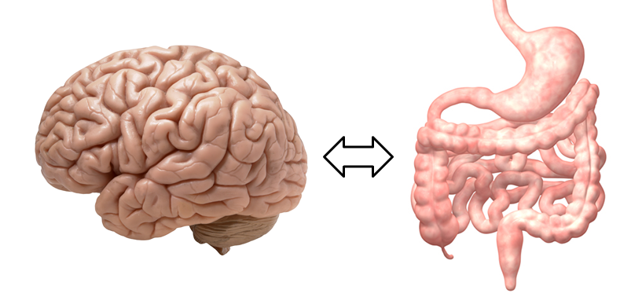
A Scenario for Gluten Intolerance
Glyphosate in wheat
Leaky brain barrier
Zonulin
Trypsin defective
Autoimmune
neurological
disease
Zonulin released
Gliadin
Leaky barrier
Systemic immune response induces multiple complex symptoms

Slide 13
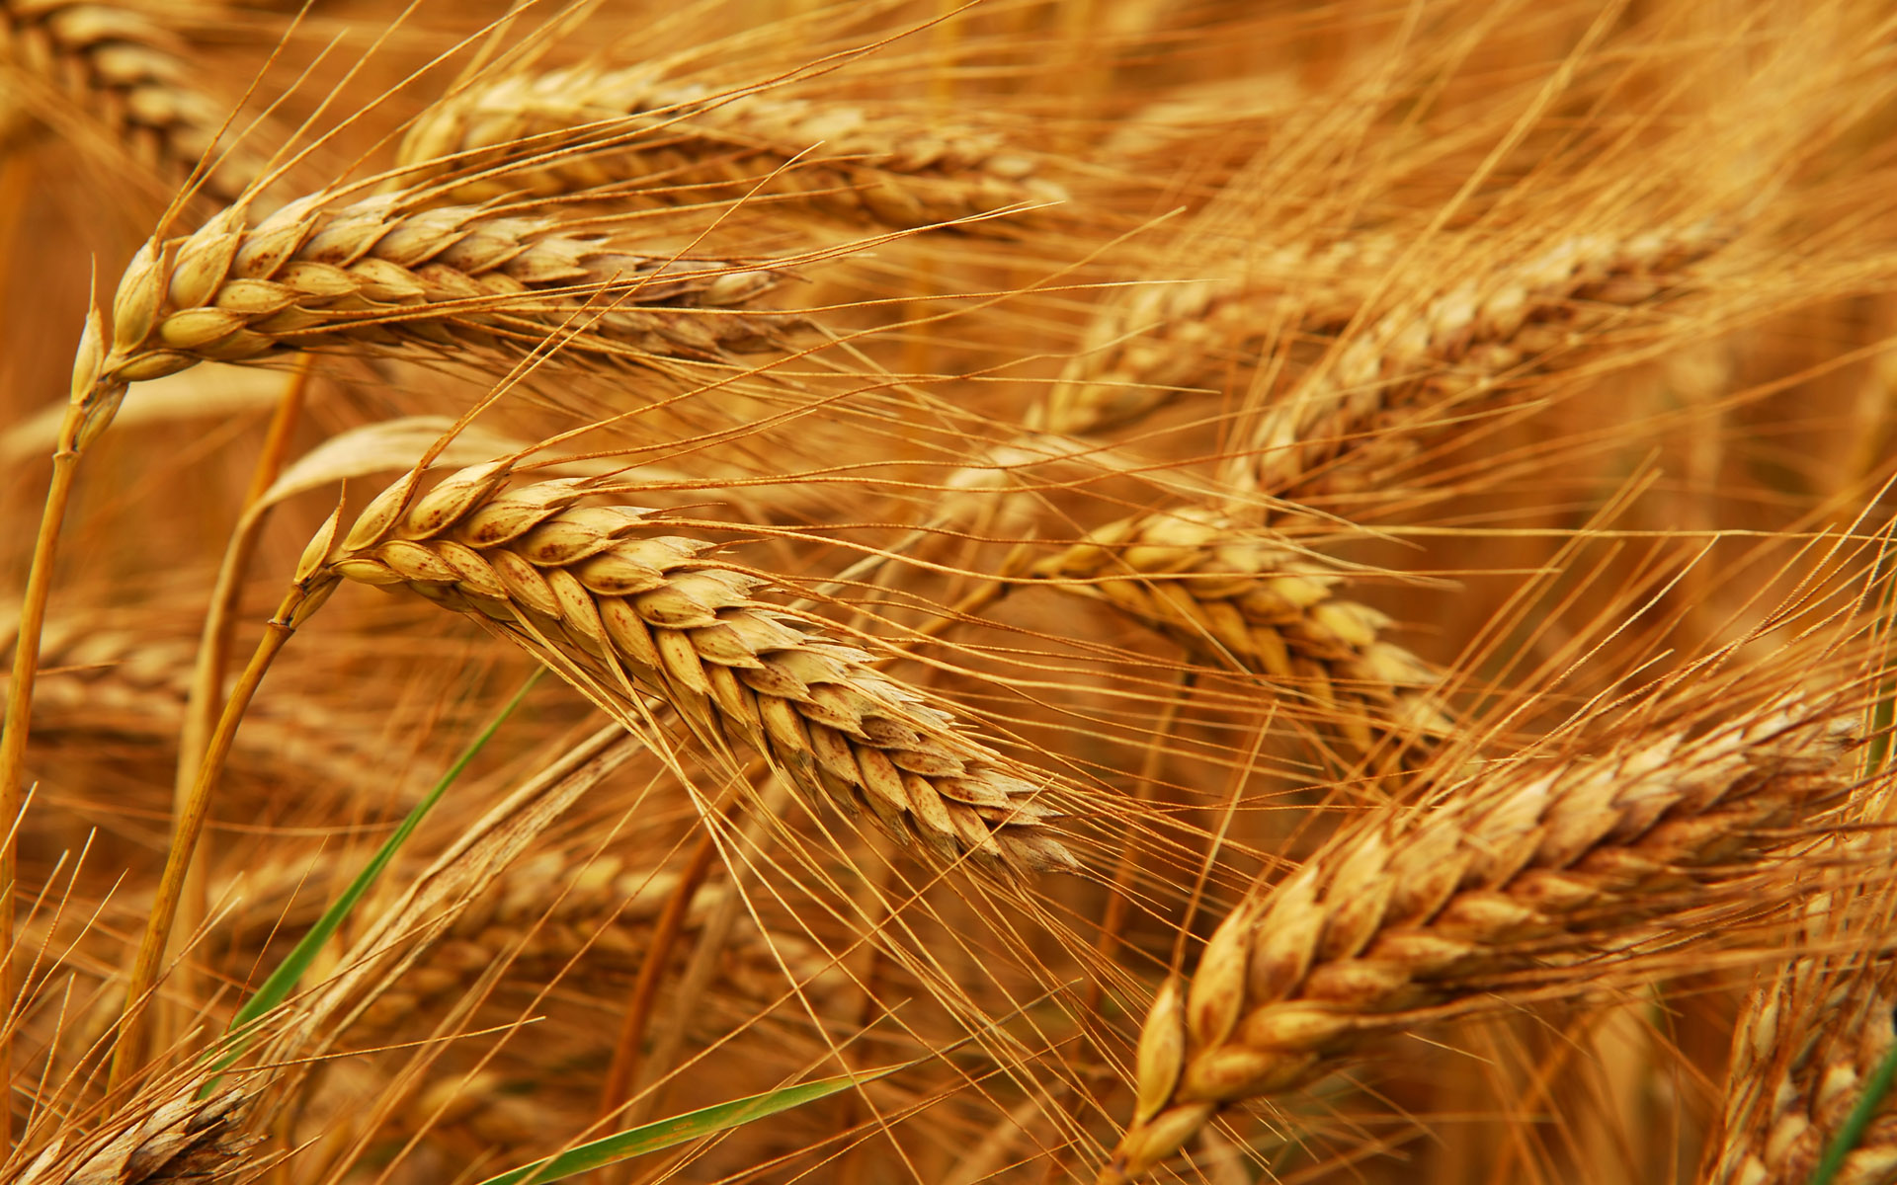
Glyphosate and Celiac Disease*
Glyphosate
Use on wheat
Celiac disease
*Samsel and Seneff, Interdiscip Toxicol. 2013;6(4): 159–184.

Slide 14
Celiac Disease, Glyphosate and Non Hodgkin’s Lymphoma
Glyphosate preferentially kills Bifidobacteria*
Bifidobacteria are depleted in celiac disease**
Celiac disease is associated with increased risk to non Hodgkin’s lymphoma***
Glyphosate itself is also linked directly to non Hodgkin’s lymphoma****
*A.A. Shehata et al., Curr Microbiol. 2013 Apr;66(4):350-8.
** M. Velasquez-Manoff, NY Times Sunday Review, Feb. 23, 2013.
*** C. Catassi et all, JAMA. 2002 Mar 20;287(11):1413-9.
****M. Eriksson et al., Int J Cancer. 2008 Oct 1;123(7):1657-63.
Notes:
**./ bifidobacteria_celiac_disease.text
Cancer/Celiac_disease_increases_hodgkins_lymphoma.text
./Celiac_and_bacteria.text

Slide 15
*Figure 20, NL Swanson et al. Journal of Organic Systems 9(2), 2014, p. 25.

Slide 16
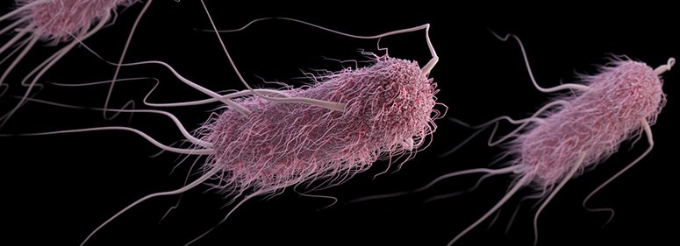
Glyphosate Induces Antibiotic Resistance*
Actinobacteria produce a free radical scavenger in response to glyphosate that provides resistance to a wide range of antibiotics, including penicillin
E. coli exposed to glyphosate develop an "efflux pump" that increases resistance to the fluoroquinolone Ciprofloxacin and the aminoglycoside Kanamycin.
Same effect observed in Salmonella exposed to glyphosate
*AHC Van Bruggen et al. Science of the Total Environment 2018;616-617: 255–268.

Slide 17
Glyphosate Usage and Papers on Antibiotic Resistance*
*AHC Van Bruggen et al. Science of the Total Environment 2018;616-617: 255–268.
Notes:
./VanBruggen_glyphosate_antibiotic_resistance_2017.pdf

Slide 18
A BTBR Mouse Model of Autism*
These mice had all the mouse features of autism
They were fed “standard rodent chow” – glyphosate contaminated?
Some features in the gut:
Reduced levels of bile acids (due to impaired CYP7A1 activity in the liver)
Further reduced levels of secondary bile acids (impaired metabolism by gut microbes)
Reduced levels of Lactobacillus and Bifidobacteria (microbes that metabolize bile acids)
These microbes are preferentially killed by glyphosate
Serotonin deficiency (due in part to tryptophan conversion to kynurenine to fight infection)
Serotonin is derived from tryptophan, a product of the shikimate pathway which glyphosate disrupts
*AV Glubeva et al. EBioMedicine. 2017 Oct;24:166-178.
Notes:
Anthony/scleroderma/mouse_model_autism_bile_acids_tryptophan_gut_microbes_2017.pdf

Slide 19
Glyphosate Disrupts Cytochrome P450 (CYP) Enzymes*
Glyphosate has been shown to severely suppress CYP enzymes in rat liver
CYP enzymes have a unique FXXGXRXCXG motif with two and sometimes three critical glycine residues**
GLYCINES
*A Samsel and S Seneff. Entropy 2013; 15: 1416-1463.
**K Syed and SS Mashele. PLOS ONE 2014; 9(4):| e95616.

Slide 20
Glyphosate Disrupts Cytochrome P450 (CYP) Enzymes*
Glyphosate has been shown to severely suppress CYP enzymes in rat liver
CYP enzymes have a unique FXXGXRXCXG motif with two and sometimes three critical glycine residues**
CYP enzymes are needed to produce bile acids for digesting fats, to activate vitamin D and to detoxify many environmental toxicants
GLYCINES
*A Samsel and S Seneff. Entropy 2013; 15: 1416-1463.
**K Syed and SS Mashele. PLOS ONE 2014; 9(4):| e95616.

Slide 21
BTBR mice have low acetate, and glyphosate disrupts acetate synthesis in gut*
BTBR mice
Children with autism had only 3.5 mg/ml acetate in stool samples compared to 5.1 in controls.**
*LN Nielsen et al. Environmental Pollution 2018;233:364e376.
**Adams et al. BMC Gastroenterology 2011; 11:22.
Notes:
./low_acetate_gut_autism_2011.pdf
scleroderma/glyphosate_reduces_acetate_gut_2018.pdf
Sprague Dawley rats

Slide 22
BTBR mice have low acetate, and glyphosate disrupts acetate synthesis in gut*
BTBR mice
Children with autism had only 3.5 mg/ml acetate in stool samples compared to 5.1 in controls.**
Elevated pH linked to glyphosate exposure results in small intestinal bacterial overgrowth (SIBO)
*LN Nielsen et al. Environmental Pollution 2018;233:364e376.
**Adams et al. BMC Gastroenterology 2011; 11:22.
Notes:
./low_acetate_gut_autism_2011.pdf
scleroderma/glyphosate_reduces_acetate_gut_2018.pdf

Slide 23
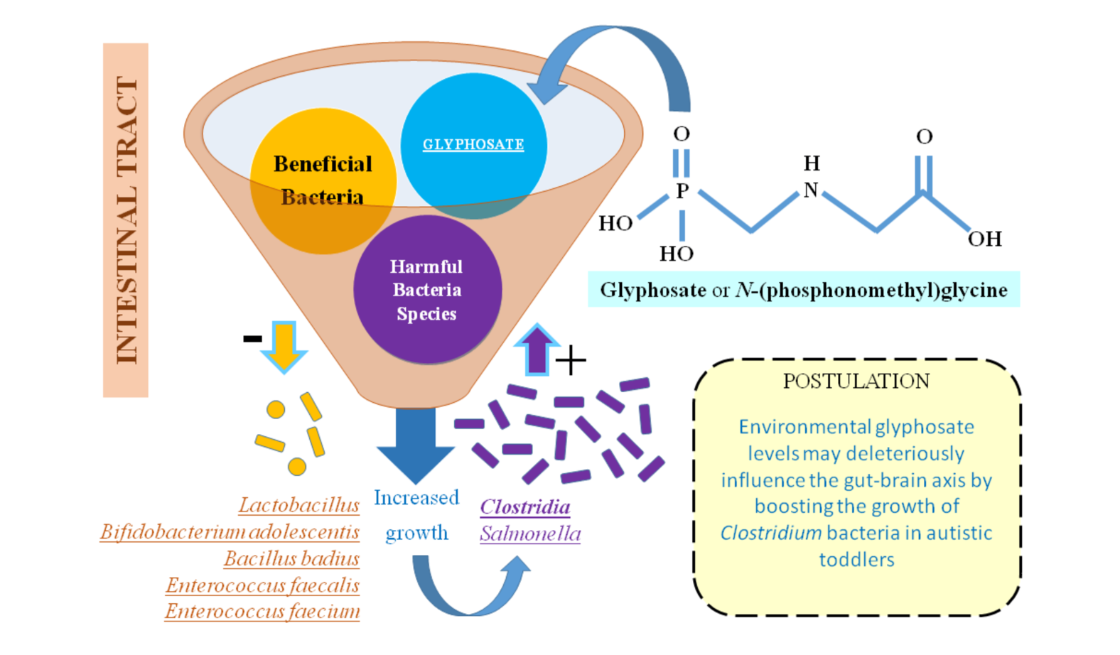
Glyphosate, Pathogens, Autism*
*Figure 2. I Argou-Cardozo and F Zeidán-Chuliá. Med. Sci. 2018; 6: 29.
Notes:
Glyphosate/glyphosate_Clostridia_autism_WOW_2018.pdf
Figure 2. Glyphosate (GLY) may hypothetically contribute to ASD etiology by deleteriously influencing gut microbiome. Literature evidence suggests the link between Clostridium bacteria and developing and/or aggravating autism among children, highlighted by the present systematic review. Environmental exposure to GLY could contribute to such interplay by affecting the growth of normal gastrointestinal flora and therefore, allowing the growth of harmful bacteria species such as Clostridium, which are not sensitive to this pesticide.

Slide 24
Glyphosate, Pathogens, Autism*
A new paper In Press from the Ramazzini Institute in Italy showed that the gut microbiome was disrupted in rats exposed to "safe" levels of glyphosate.
*Figure 2. I Argou-Cardozo and F Zeidán-Chuliá. Med. Sci. 2018; 6: 29.
Notes:
Glyphosate/glyphosate_Clostridia_autism_WOW_2018.pdf
Figure 2. Glyphosate (GLY) may hypothetically contribute to ASD etiology by deleteriously influencing gut microbiome. Literature evidence suggests the link between Clostridium bacteria and developing and/or aggravating autism among children, highlighted by the present systematic review. Environmental exposure to GLY could contribute to such interplay by affecting the growth of normal gastrointestinal flora and therefore, allowing the growth of harmful bacteria species such as Clostridium, which are not sensitive to this pesticide.

Slide 25
Evidence Linking Autism to Clostridia Overgrowth*
14 autistic children with gut disorder compared to 21 controls
Significant increase in Clostridia species in the gut in autistic children
Associated with reduced tryptophan levels and increased expression of inflammatory markers
Tryptophan is a product of the shikimate pathway, which glyphosate blocks
Macrophages in inflamed tissue take up tryptophan, reducing bioavailability to the brain
Proposed role for antibiotics
Glyphosate is a patented antimicrobial agent (2010)
*RA Luna et al., Cellular and Molecular Gastroenterology and Hepatology 2017;3(2): 218-230
Notes:
samantha/distinct_microbiome_profile_in_autism_serotonin_2017.pdf

Slide 26
*
Triplets: two boys, one girl. Both boys have autism and girl has seizure disorder
Very high levels of glyphosate in urine in all three
Clostridia overgrowth due to glyphosate disruption of gut microbes
Clostridia produce toxins HPHPA and p-cresol, which block the conversion of dopamine to norepinephrine.
Damage to neurons in the brain through oxidative stress
*W. Shaw. Integrative Medicine 2017;16(1);50-57.
Notes:
./Shaw_on_glyphosate_triplets_autism.text

Slide 27
Myosin in the Gut
Myosin is a motor protein found in high levels in skeletal muscles
Myosin is also essential for gut motility (peristalsis) and for the release of bile acids into the upper intestine
Myosin contains a highly conserved glycine at position 699*
If this is changed to alanine, the protein’s contractile ability is reduced to less than 1%.
Glyphosate has been shown in fish studies to suppress myosin expression**
*F Kinose et al. The Journal of Cell Biology 1996;134(4): 895-909.
**Ana Paula Rezende dos Santos et al., Chemosphere 2017;168:933e943.
Notes:
Glyphosate/chemosphere_2017_glyphosate_histomorpholgical_changes_liver_guppies.pdf
Anthony/scleroderma/glycine_699_pivotal_for_motor_activity_skeletal_myosin.pdf

Slide 28
Myosin in the Gut
Myosin is a motor protein found in high levels in skeletal muscles
Myosin is also essential for gut motility (peristalsis) and for the release of bile acids into the upper intestine
Myosin contains a highly conserved glycine at position 699*
If this is changed to alanine, the proteins’ contractile ability is reduced to less than 1%.
Glyphosate has been shown in fish studies to suppress myosin expression**
SIBO (Small Intestinal Bacterial Overgrowth) is associated with impaired peristalsis*
*AC Dukowicz et al. Gastroenterol Hepatol (N Y) 2007; 3(2): 112-122.
Notes:
Glyphosate/chemosphere_2017_glyphosate_histomorpholgical_changes_liver_guppies.pdf
Anthony/scleroderma/glycine_699_pivotal_for_motor_activity_skeletal_myosin.pdf

Slide 29
Summary
Glyphosate contamination in food proteins makes them hard to break down
This leads to autoimmune disease
Digestive enzymes are contaminated with glyphosate
Undigested proteins induce Celiac disease and leaky gut
Glyphosate is a key factor in the emergence of antibiotic resistant pathogens
The BTBR mouse model of autism is consistent with glyphosate damage in the gut
Glyphosate promotes Clostridia overgrowth
This induces inflammatory bowel disease, an epidemic today
Autism has been linked to Clostridia overgrowth
Clostridia release toxins that induce an inflammatory response

