Slide 1
Impacts of Glyphosate on Our Biochemistry and DNA Expression
Direct and Indirect Impacts to Genetic Expression
Cynthia Smith
Congressional Hearing, June 14, 2016

Slide 2
Impacts of Glyphosate Due To:
(1) Nutrient Cofactor Depletions
  Direct negative impact to many enzymes that run our biochemistry as a result of depletion of their nutrient cofactors by glyphosate metabolism
    Enzymes do not have their “tools” (nutrient cofactors) to do their jobs
  Direct negative impact to “good” GI bacteria, and all that flows from that via Immune System
  Dr. Stephanie Seneff discussed
(2) The Domino Effect
  E.g., glyphosate chelates Mn-> depleted Lactobacillus-> crippled SOD enzyme-> increased oxidative stress and/or anxiety.
(3) Glyphosate forms peptoids and mis-incorporates into protein structure just as any other glycine analog; the mis-folding effect
  Resulting proteins/enzymes are mis-folded and dysfunctional, including some used for Phase 2 liver detoxification and DNA/RNA formation
  Dr. Anthony Samsel discussed
(4) Modification by Glyphosate of “which portion” of our DNA can and/or cannot be copied to make our enzymes - Epigenetics
  Methylation
  Histone winding
  DNA polymorphisms, exacerbated
Notes:
http://surgicalneurologyint.com/surgicalint_articles/glyphosate-pathways-to-modern-diseases-iii-manganese-neurological-diseases-and-associated-pathologies
http://www.gmoevidence.com/dr-samsel-glyphosate-chelation-of-manganese-is-a-serious-problem/
(3) http://www.ncbi.nlm.nih.gov/pmc/articles/PMC3471221/

Slide 3
(1) Gyphosate: causes Nutrient Depletions & increases oxalate burden
Ingested glyphosate depletes specific nutrient cofactors required for enzyme, carrier protein and receptors function. For example, ingested glyphosate -> glyoxylate -> oxalate depletes the active form of Vitamin B6 (P5P) and Mn.

Slide 4
Notes:
Lactate dehydrogenase (LDH) is one such enzyme that directly competes with GRHPR for substrates and converts glyoxylate to oxalate. However, due to the relatively large concentration of NADPH compared to NADH under normal cellular concentration, the GRHPR activity is greater than that of LDH so the production of glycolate is dominant

Slide 5
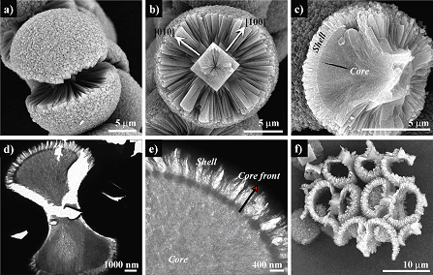
What is an Oxalate?
  What is an Oxalate?
  Organic acids
  Diet: Plant “defense system”
  Fungus: Aspergillus, Candida
  Human metabolism
  Can cause kidney stones
  In addition to kidney stones…
  Connection with autism
    84% of the children on the autistic spectrum had oxalate values outside the normal range (mean ± 2 sd)
    Vit B6 depletion-> CBS impact->high sulfur and/or ammonia; low glutathione
    http://www.greatplainslaboratory.com/home/eng/oxalates.asp
  Connection with vulvar pain (vulvodynia)
    http://www.vulvarpainfoundation.org/Low_oxa-late_treatment.htm
https://www2.cpfs.mpg.de/web/forschung/forschproj/biomi/biogr.aspx?action=PrintView

Slide 6
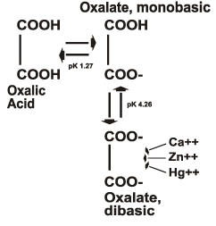
Why Should I Care about Oxalates?
  Leaky Gut; oxalates can travel into tissues
    May form crystals in the heart, bone, brain, kidney (stones)
  Inhibit glycolysis
    Impairs carb metabolism to Acetyl CoA -> Krebs
  Vitamin B6 is a cofactor for one of the primary enzymes that degrade oxalate in the body, so it can become depleted in the presence of high oxalates.
    Vit B6 is key to making neurotransmitters
    Oxalates (2-) also bond with:
      Minerals (Mn, Ca, Zn) preventing their absorption
      Hg & Pb preventing their release
    http://www.greatplainslaboratory.com/home/eng/oxalates.asp
    Mn is key to SOD function, and quenching oxidative stress at mitochondrial level; heart, muscles, digestion
      Congestive heart failure
      Heartburn

Slide 7
Indications of High Glyphosate -> Glyoxylate -> Oxalate
  High GI yeast (e.g., high Arabinose)
    Possible low Lactobacillus when oxalates excessive
  Low Vitamin B6
    Nutrient Cofactor required for oxalate degrading enzymes, but also for neurotransmitter production
      Lysine required for P5P docking and activation
  Low Vitamin C (oxidizes to oxalates). Vit C is one of our antioxidants.
    In the presence of high free Cu and/or Fe
  Low Zn (bounded-up by oxalates) Zn is required for many enzymatic functions; GI enzymes, Neurotransmitter enzymes, Sulfation enzymes, etc.
  Low Manganese (Mn)

Slide 8
(2) Gyphosate : A negative Domino Effect on health
Ingested glyphosate depletes specific nutrient cofactors required for enzyme, carrier protein and receptors function. For example, ingested glyphosate depletes the active form of Vitamin B6 (P5P) and Manganese (Mn). P5P and Mn is a required nutrient cofactor for many of the neurotransmitter enzymes.

Slide 9
Domino Effect: Example 1; There Are Many
  Glyphosate chelates Mn so it is not useable by Mn-dependent enzymes
  Low Mn depletes Lactobacillus growth, which impacts immune system control…auto-immune, cancer, fighting off viruses.
  Low Mn cripples SOD2 (Mn-SOD) enzyme that protects our mitochondria = energy production and brain health
  Low Mn increases oxidative stress and/or anxiety as the overloaded ammonia clearing pathway requires Mn for SOD2 to “put out the fire” of oxidative stress.
    Over-stimulated NMDA receptors -> Neuropathologies (e.g., AD, Autism)
  Cascade effect as BH4 is depleted when addressing impacts of glyphosate and clearing ammonia from “stressed” pathway, as well as arginine → excessive ammonia
  Neurotransmitter levels impacted by low BH4. Dopamine, Nor-epi, Epi and Serotonin require BH4 for their production.
    Vicious cycle wrt neurotransmitter production
    Prozac?

Slide 10
Domino Effect: Example 2; Impacts due to Chelation of Fe
Global impact to heme –dependent Phase I liver detox enzymes (CYP450’s)
  Impaired ability to detoxify xenobiotics
  Impaired ability to detoxify hormones, and potential build up of dangerous estrogen intermediary metabolites (4-OH)
Major impact to the CBS enzyme; big player in the Transsulfuration Pathway
  Cystathionine beta-synthase (CBS) is a unique heme-containing enzyme that catalyzes a P5P-dependent condensation of serine and homocysteine to give cystathionine.
  High homocysteine (a sulfur containing amino acid) is a marker for heart disease.

Slide 11
Domino Effect: Example 3; Sulfate Anion Transporter 1 (aka gene SLC26A1) Impact
SLC26A1 has high affinity uptake of sulfate. Accepts oxalate also. Mediates sulfate and oxalate transport:
  Therefore oxalate may “compete” with sulfate for the transporter.
  Excess glyoxylate, and oxalate, likely, disrupt sulfate homeostasis in the liver
Sulfate gets dumped/wasted in presence of high glyoxylate and oxalate burden
  Sulfate is critical for bile acid formation; assimilation of fatty acids
  Sulfate is critical to Phase 2 Liver Detox
    Sulfation involves binding toxins with sulfur-containing amino acids so they can be excreted. Sulfur-containing amino acids include methionine, glycine and n-acetyl-cysteine
Notes:
http://www.journal-of-hepatology.eu/article/S0168-8278(10)00901-3/fulltext
http://surgicalneurologyint.com/surgicalint_articles/glyphosate-pathways-to-modern-diseases-iii-manganese-neurological-diseases-and-associated-pathologies/
Endogenous substances cleared:
DHEA
Quercitin
Bile acids
Safrole
Tyramine
Thyroxine
Estrogens
Testosterone
Cortisol
Catecholamines
Melatonin
3-hydroxy coumarin
25 hydroxy Vitamin D
Ethyl alcohol

Slide 12
What My Clients Report
Brain fog, poor memory
GI Issues
  Bloating
Low energy
  Poor ATP production
  Oxidative stress at cellular level (impaired SOD2 due to low Mn)
  Poor fat assimilation so less “fuel” for Krebs
    Food in stools, bloating, floating stool, gas, heartburn
      Think about how many folks are medicating heartburn with PPIs, and resulting impact to Vit B12 absorption and impaired methylation and all that flows from that.
      Carb cravings to compensate for lose of fatty acid “fuels”
Extreme PMS and Infertility
Low libido
Kidney stones as a high oxalate accumulation
  Genetics are in play, encourage by conversion of Glyphosate to Oxalates.

Slide 13
(3) Gyphosate : Resulting proteins/enzymes are mis-folded and dysfunctional
Glyphosate forms peptoids and mis-incorporates into protein structure just as any other glycine analog

Slide 14
Glyphosate: Synthetic Amino Acid
Mis-incorporates into proteins/enzymes as any other Glycine analog would
Amino acids determine protein structure, folding and function.
Capable of acetylation, methylation (purines and pyrimidines), formylation (purines & histone modification), nitrosylation
Resulting proteins are mis-folded and dysfunctional which leads to
  APOPTOSIS -> cellular destruction and a field of debris inducing chronic inflammation.
  Destruction of collagen, elastin, basement membrane structure i.e. and negative consequences to every gland and organ
  Bioaccumulation and passing to subsequent generations via sperm and egg

Slide 15
(4) Gyphosate : negative impacts to genetic expression via epigenome
Modification of “which portion” of our DNA can and cannot be copied as a blueprint for making our enzymes, carrier proteins and receptors

Slide 16
Our Genes Have Not Changed These Past Few Generations, So What the Heck is Going On?
Increased;
  Infertility
  Depression, Bi-polar
  Autism Spectrum Disorders, Parkinsons, AD
  ADHD and other neuro-excitatory issues
  Autoimmune disease rates, including autoimmune dementia
  Type II Diabetes
  And more ….
How many of us over 50 recall a childhood classmate on the Autism Spectrum, or with Type II diabetes?

Slide 17
Epigenome: What is It?
Epigenome is
  A “record” of the chemical changes to the DNA and histone protein of an organism;
  Changes can be passed down to an organism’s offspring via transgenerational epigenetic inheritance.
    “The sins of the father”
  Changes to the epigenome can result in changes to the structure of chromatin (histones that compact DNA) and changes to the function of the genome.
  Is involved in regulating gene expression, development, tissue differentiation, and suppression of transposable elements.
  Can be dynamically altered by environmental conditions (e.g., food, toxicants, viruses, etc.).
Interesting video on Epigenetics from NOVA:
http://topdocumentaryfilms.com/the-ghost-in-our-genes/
Notes:
https://www.ncbi.nlm.nih.gov/pubmed/17320505
Conley, A.B., King Jordan, I. (2012). Endogenous Retroviruses and the Epigenome. In: Witzany, G. (ed). Viruses: Essential Agents of Life, Springer, Dordrecht, pp. 309-323
Human Epigenome Project

Slide 18
Epigenome

Slide 19
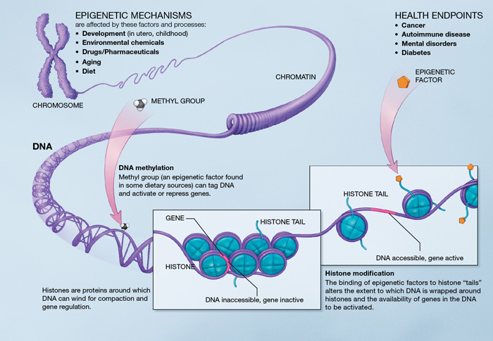
Epigenome

Slide 20

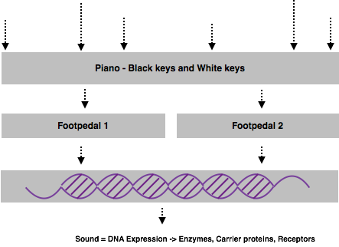


Epigenome Analogy
Finger Strike 6
Finger Strike 3
Finger Strike 4
Finger Strike 1
Finger Strike 2
Finger Strike 5

Slide 21
Glyphosate -> Impact to Gene Expression
Glyphosate mis-incorporates into proteins/enzymes as any other Glycine analog would
Glyphosate is therefore capable of acetylation
  Participates in co-translational & post-translational modification of protein
    Histones
    P53 (Tumor suppressor protein)
    Tubulins
Direct DNA/RNA Impacts:
Glyphosate is therefore capable of methylation mis-expression
  Methylation participates in purine and pyrimidine biosynthesis
  Glyphosate is therefore capable of formylation mis-expression
  Formylation participates in purine biosynthesis & histone modification
Glyphosate is therefore capable of nitrosylation mis-expression
  Nitrosylation participates in DNA repair mechanism and regulation of cellular processes
Exacerbates DNA Expression
SNPs -- Sterling will discuss
Notes:
Pyrimidines – Nucelobases Cytosine, Thymine, Urasil
Purines – Nucleobases Adenine, Guanine
RNA - Uracil replaces Thymine

Slide 22
Example: Methylation
Notes:
NOTE: Purines and Pyrimidine generation requires methylation pathway

