Slide 1
Glyphosate Correlations with Disease
Stephanie Seneff
U.S. Congressional Hearing
June 14, 2016

Slide 2
1 in 68

Slide 3
US Health Status
US makes up 5% of the world’s population but consumes more than 50% of the world’s pharmaceutical drugs
We spend more on health care than Japan, France, China, UK, Italy, Canada, Brazil, Spain, and Australia, combined
US ranks last or near last among developed nations on infant mortality and life expectancy
We also suffer from more chronic illnesses
We consume 25% of the world supply of glyphosate

Slide 5
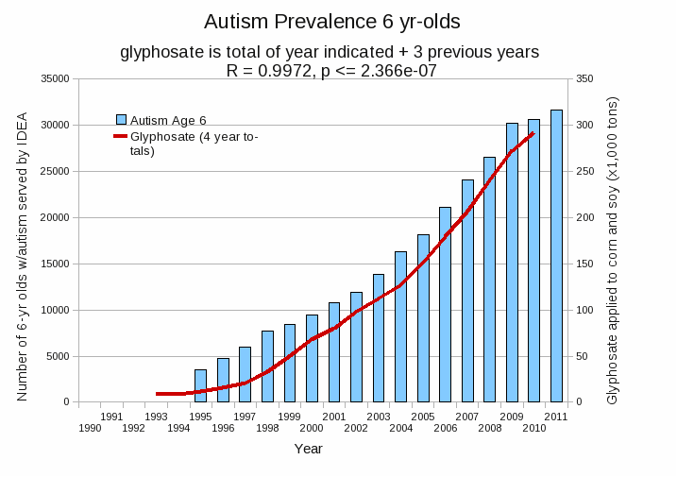
Autism Prevalence: 6 year olds*
R = 0.9972
* Figure 15, Seneff et al., Agricultural Sciences, 2015, 6, 42-70
Notes:
Nancy/latest_plots/6-yr-old autism.gif
autism: USDE
oil consumption: USDA
glyphosate: USDA
GE crops: USDA
Mortality data: CDC

Slide 6
Infant Mortality Rate
US

Slide 7
Herbicide Use on Corn in US
glyphosate

Slide 8
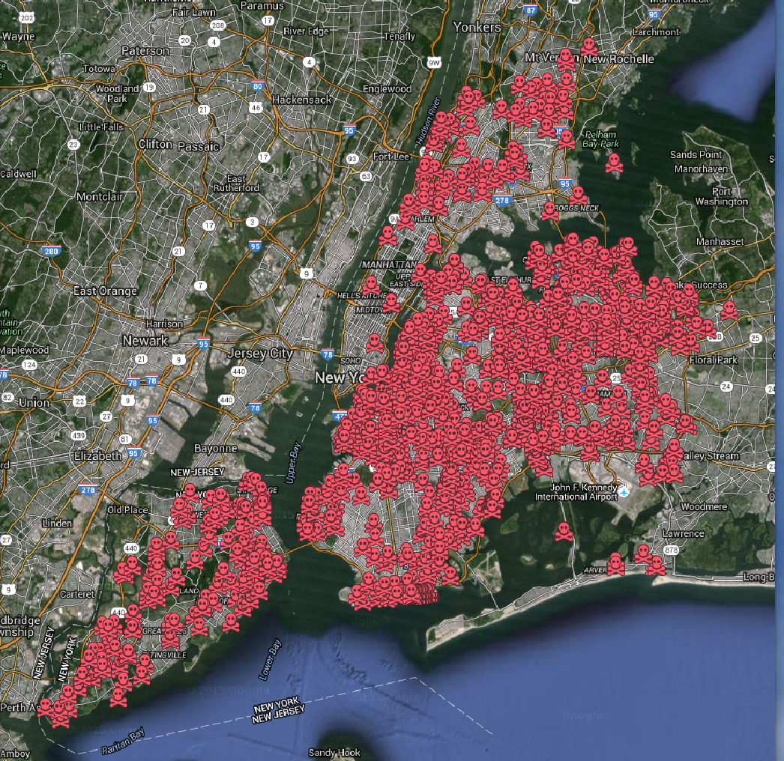
Use of Glyphosate in Public School Yards in California and Public Parks in New York City

Slide 9
Obesity in US over Time*
Glyphosate was introduced into the food chain in 1975
*Figure 1, R.J. Johnson et al., Am J Clin Nutr 2007;86:899–906.
Notes:
Sugar intake per capita in the United Kingdom from 1700 to 1978 (30, 31; E) and in the United States from 1975 to 2000 (32; 􏰏) is compared with obesity rates in the United States in non-Hispanic white men aged60–69y(17;F).Valuesfor1880-1910arebasedonstudiesconducted in male Civil War veterans aged 50–59 y (18).

Slide 10
Autism, Glyphosate, Vaccine Reactions*
Glyphosate application to corn and soy, US
Children with Autism, US
# Adverse Reactions in VAERS
*Collaboration with Dr. Nancy Swanson
Notes:
Individuals with Disabilities Education Act

Slide 11
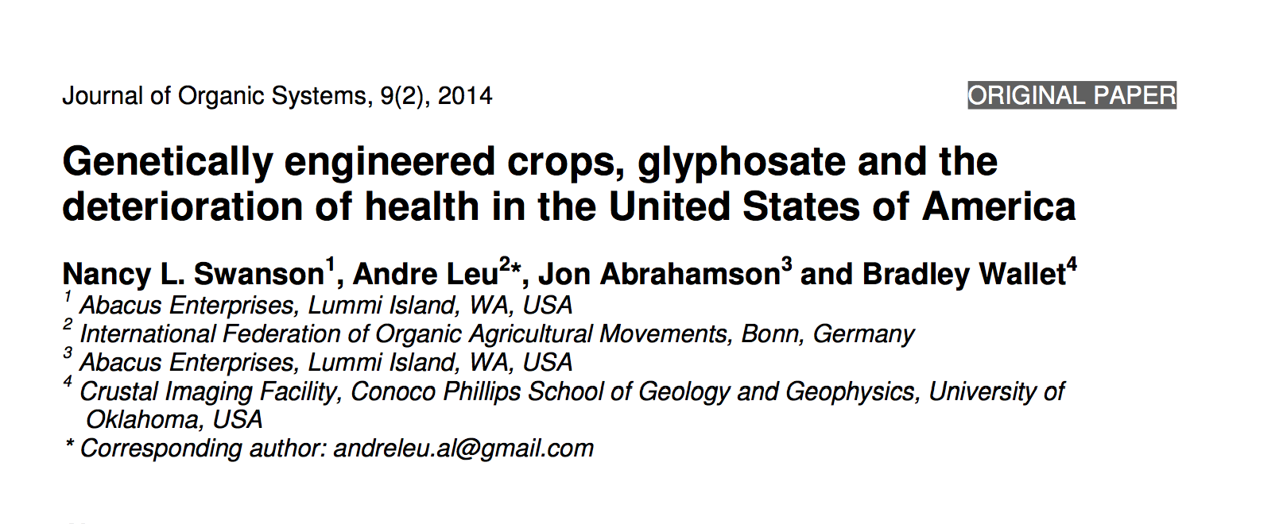

Slide 12
Diabetes
*Figure 14, Swanson et al. Journal of Organic Systems 2014; 9(2):6-37.

Slide 13
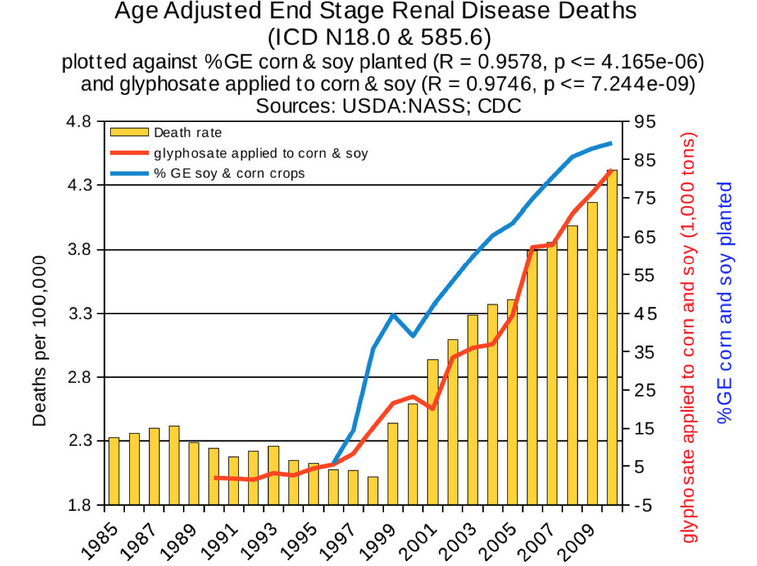
End stage
renal disease
*Figure 18, Swanson et al. Journal of Organic Systems 2014; 9(2):6-37.

Slide 14
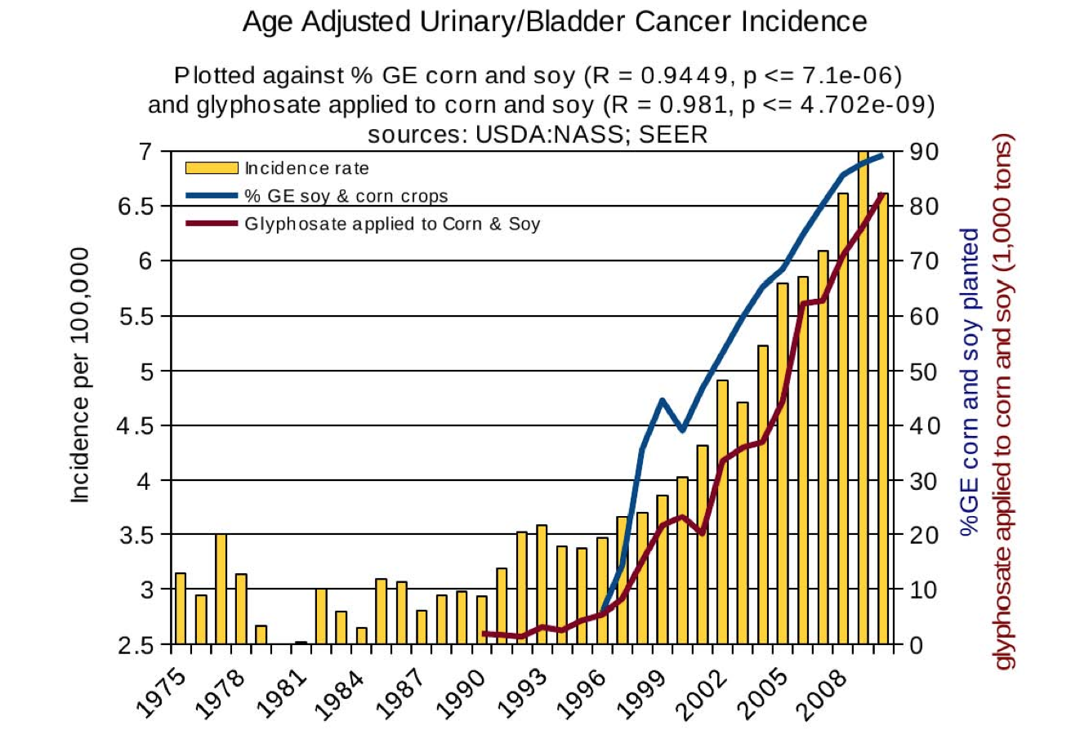
Urinary/bladder cancer
*Figure 9, Swanson et al. Journal of Organic Systems 2014; 9(2):6-37.

Slide 15
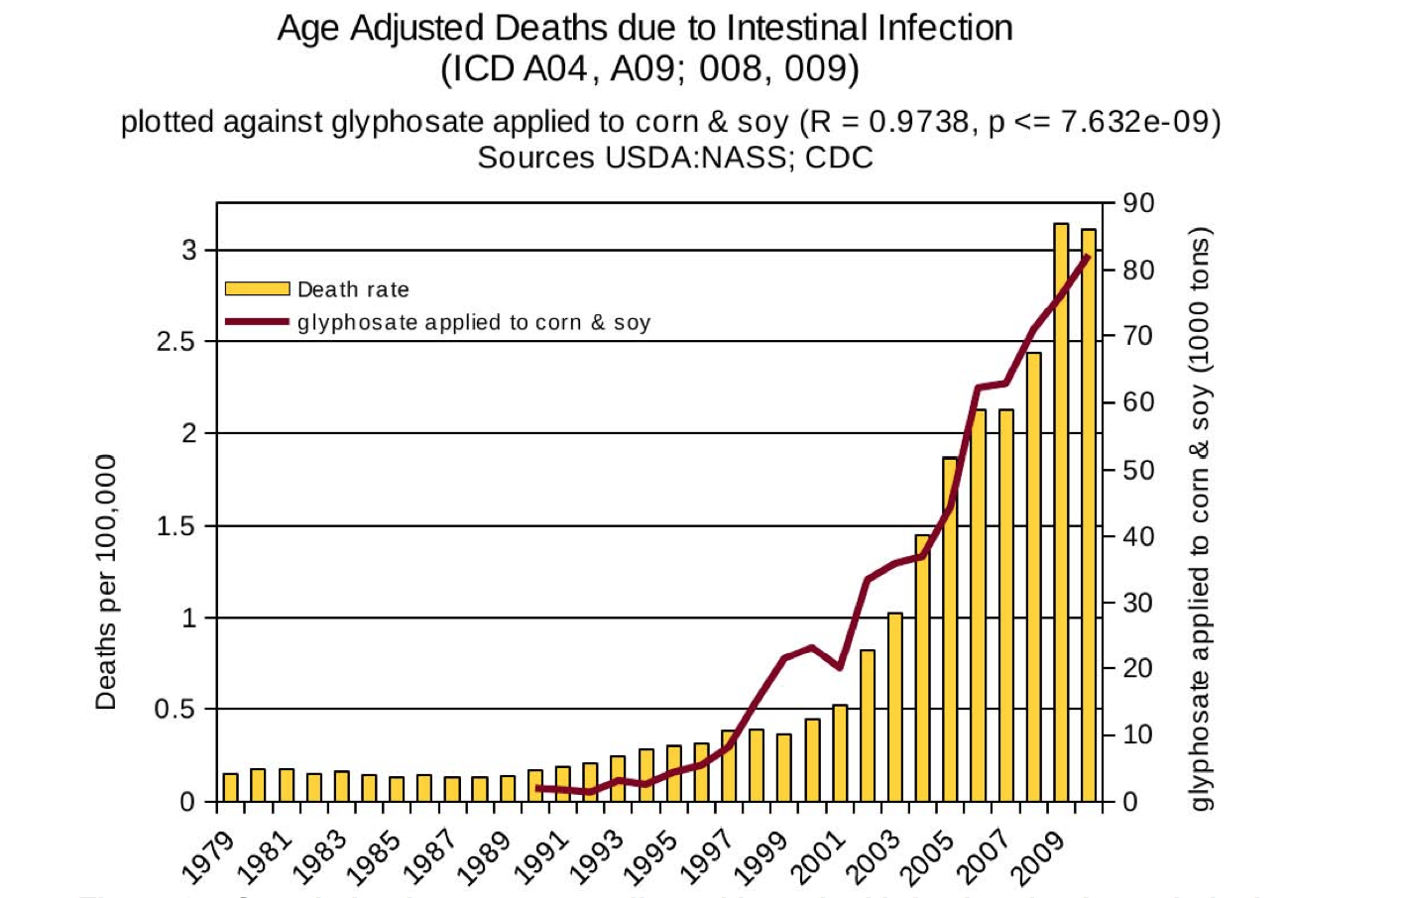
Deaths from
intestinal infection
*Figure 21, Swanson et al. Journal of Organic Systems 2014; 9(2):6-37.

Slide 16
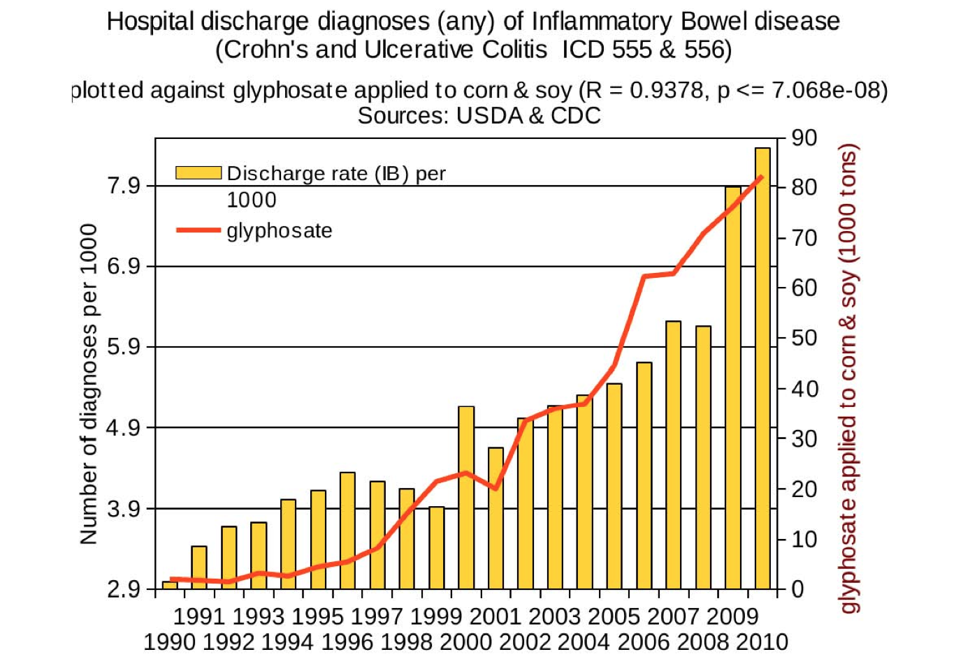
Inflammatory Bowel Disease
*Figure 20, Swanson et al. Journal of Organic Systems 2014; 9(2):6-37.

Slide 17
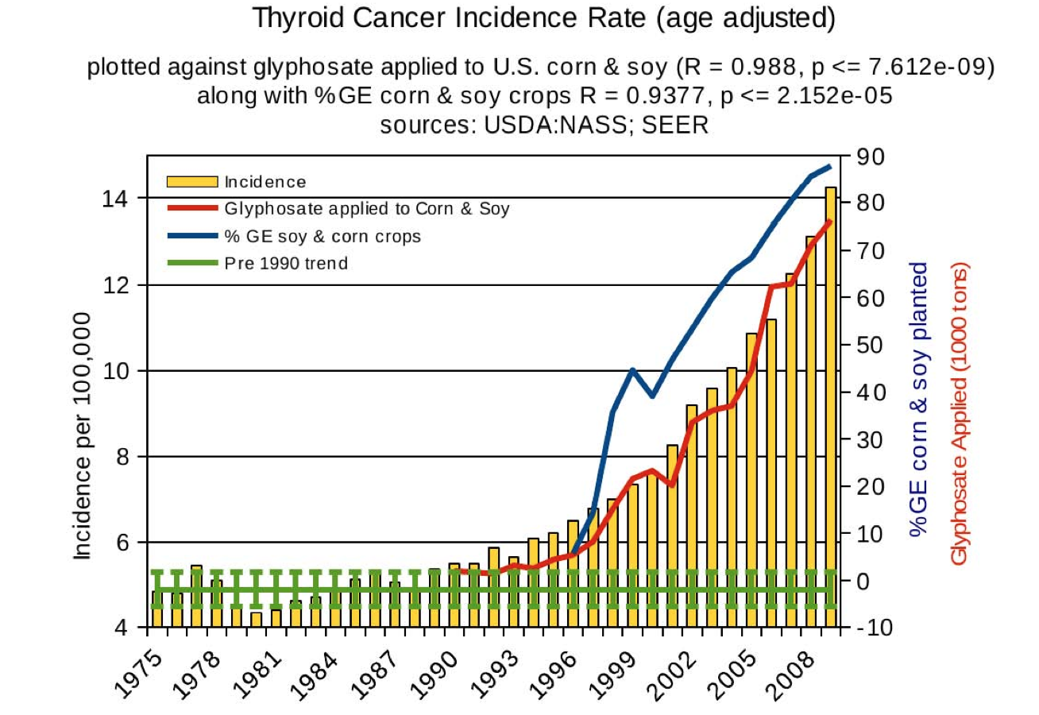
Thyroid cancer
*Figure 10, Swanson et al. Journal of Organic Systems 2014; 9(2):6-37.

Slide 18
Deaths from Senile Dementia
*Figure 24, Swanson et al. Journal of Organic Systems 2014; 9(2):6-37.

Slide 19
Death due to Obesity
*Figure 13, N Swanson et al., Journal of Organic Systems, 9(2), 2014

Slide 20
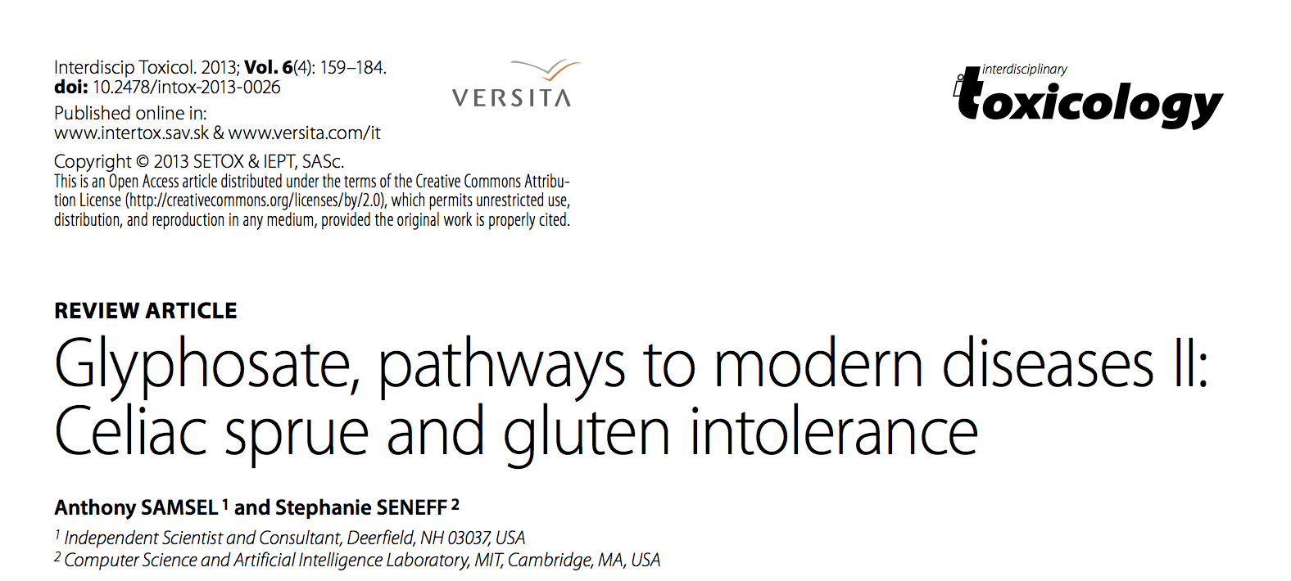

Slide 21
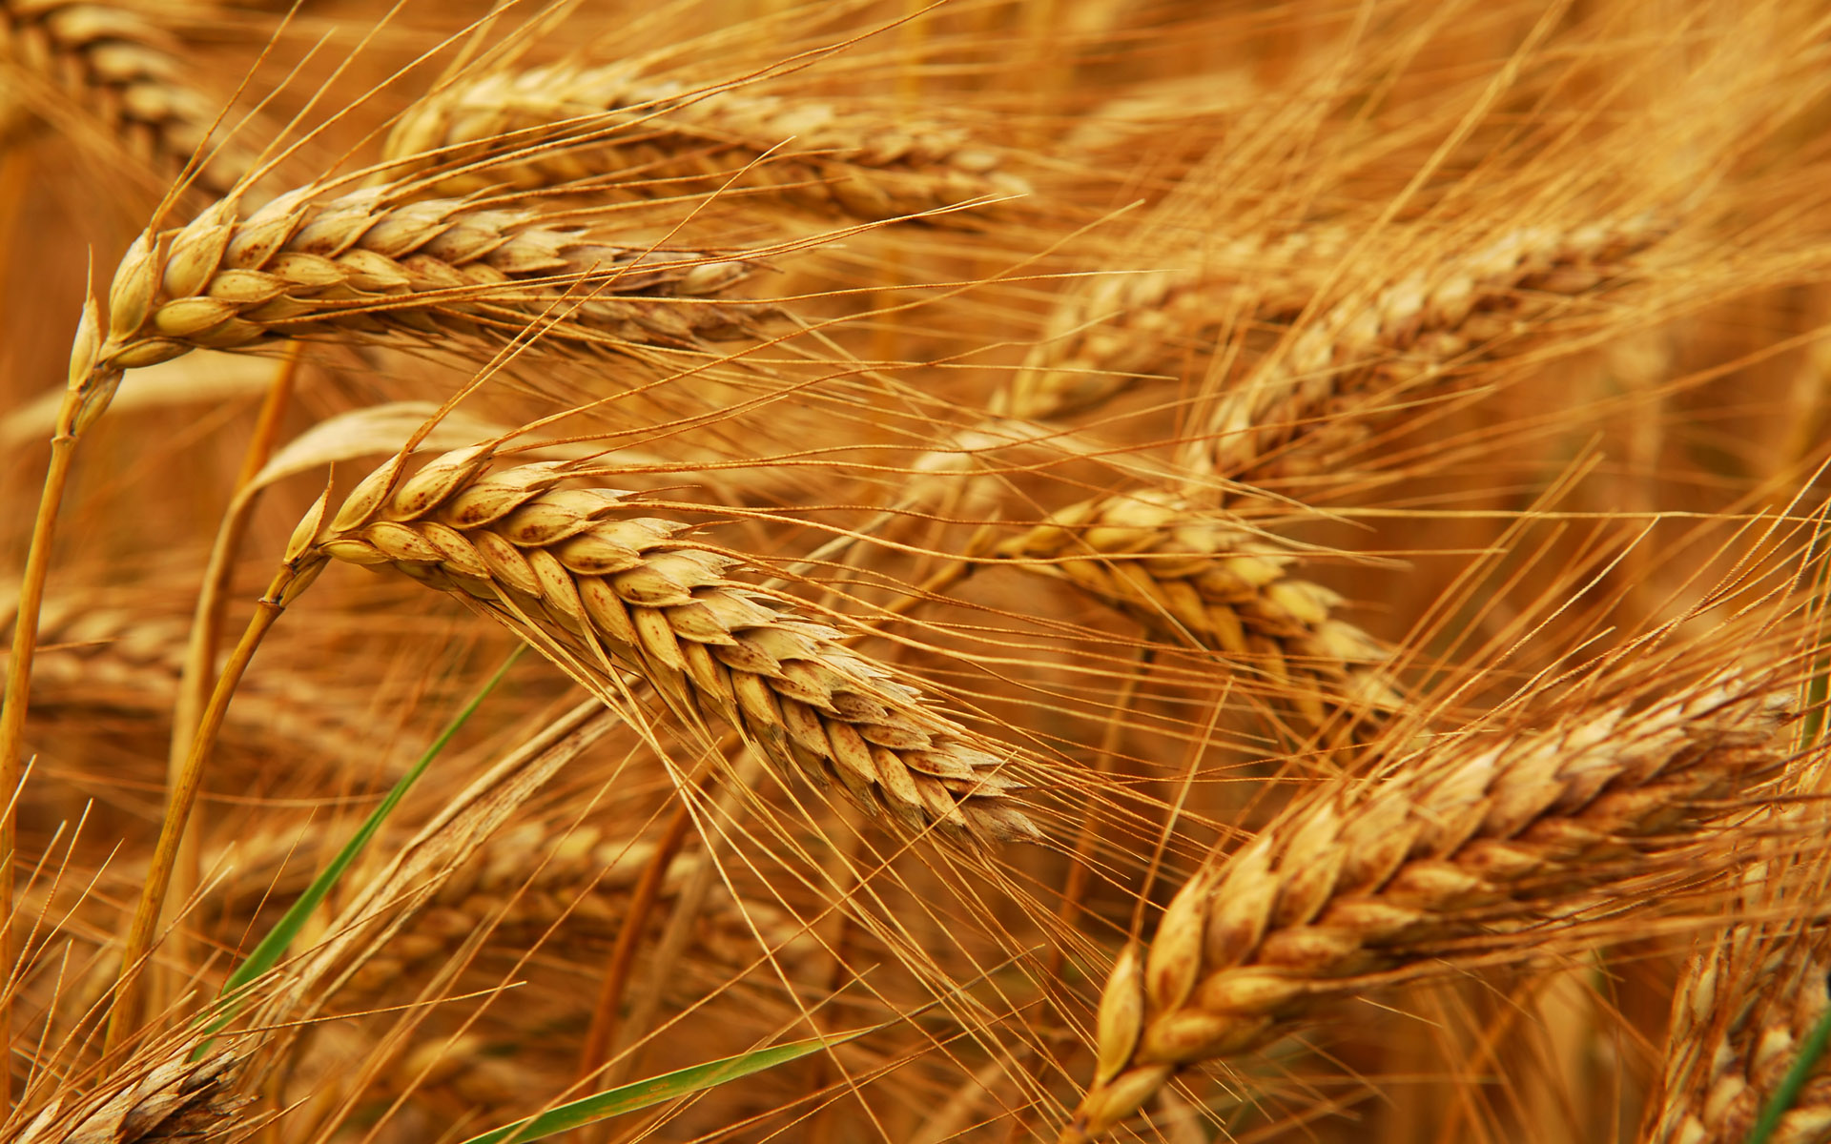
Glyphosate and Celiac Disease*
Glyphosate
Use on wheat
Celiac disease
*Samsel and Seneff, Interdiscip Toxicol. 2013;6(4): 159–184.

Slide 23
Glyphosate and Heart Disease*
Glyphosate usage
Enlarged Right Ventricle, Adults
Congenital Heart Condition, Newborns
* Figure 22, J. Hoy et al. Poult Fish Wildl Sci 2015, 3:1
Notes:
2015/JudyHoy/submission/figures/

Slide 24
Disorders of the
Lymph System
* Figure 19, J. Hoy et al. Poult Fish Wildl Sci 2015, 3:1

Slide 25
Newborn Blood
Disorders
* Figure 19, J. Hoy et al. Poult Fish Wildl Sci 2015, 3:1

Slide 26
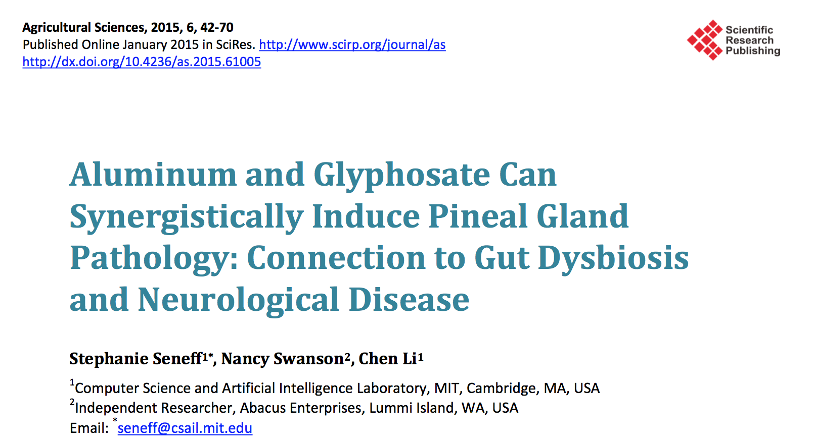

Slide 27
Sleep Disorder
*Figure 5, S. Seneff et al., Agricultural Sciences 2015; 6:42-70.
Notes:
Pineal_gland_paper_2015.pdf

Slide 28
ADHD
*Figure 7, S. Seneff et al., Agricultural Sciences 2015; 6:42-70.
Notes:
Pineal_gland_paper_2015.pdf

Slide 29
Anxiety
*Figure 8, S. Seneff et al., Agricultural Sciences 2015; 6:42-70.

