Slide 1
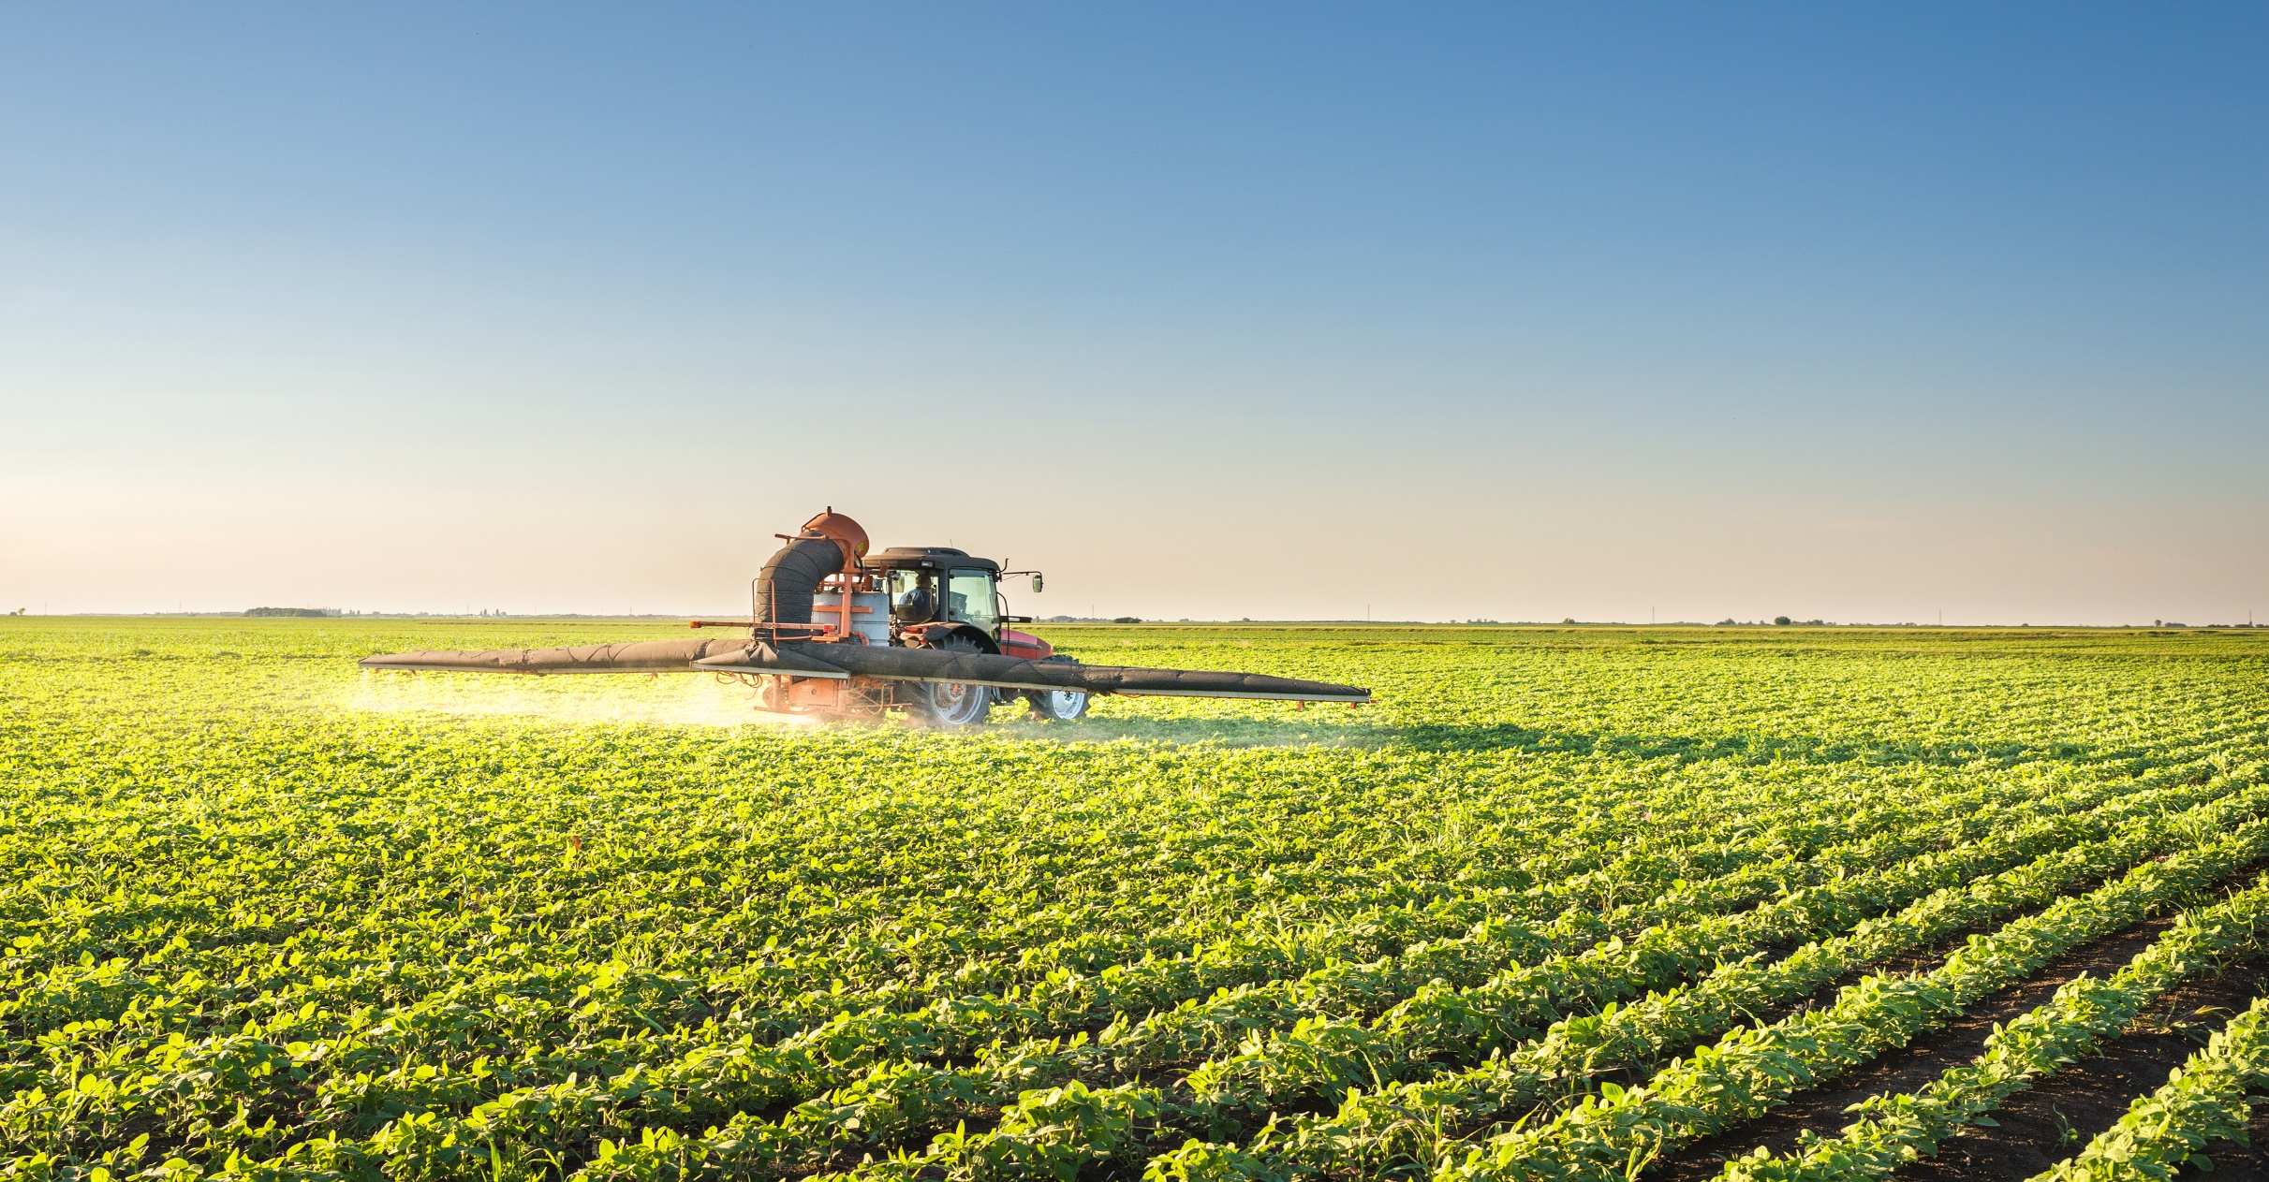
Glyphosate, And How it Impacts DNA
Sterling Hill
U.S. Congressional Hearing
June 14, 2016

Slide 2
FUT2
Since oxalate inhibits the breakdown of glyoxylate, which is a disintegration product of glyphosate, this would lead to an accumulation of glyoxylate, a strong glycating agent.
Oxalobacter formigines, a resident gut species that degrades dietary oxalates, is associated with protection from hyperoxaluria.
Akkermansia have α-L-fucosidases, and β-galactosidases allowing them to remove the terminal and other sugar moieties of the ABO (FUT2) histo-blood group antigens, whereas Oxalobacter, unable to grow on sugars , could benefit from end products of Akkermansia.

Slide 3
19% Of The Population Are FUT2 Non Secretors
Creates a soluble precursor oligosaccharide FuC-alpha ((1,2)Galbeta-) called the H antigen which is an essential substrate for the final step in the soluble A and B antigen synthesis pathway. H and Se enzymes fucosylate the same acceptor substrates but exhibit different Km values.

Slide 4
DAO
DAO’s metabolic process part of glyoxylate.
Glyoxylate accumulation in the cytosol is readily transformed by lactate dehydrogenase into oxalate, a dicarboxylic acid that cannot be metabolized by mammals and forms tissue-damaging calcium oxalate crystals.
Catalyzes the degradation of compounds such as putrescine, histamine, spermine, and spermidine, substances involved in allergic and immune responses, cell proliferation, tissue differentiation, tumor formation, and possibly apoptosis. Placental DAO is thought to play a role in the regulation of the female reproductive function.

Slide 5
DAO Enzyme Deficiency
Schizoprhenia
Miscarriage
Mast Cell
Diarrhea
Headache
Rhinoconjunctival symptoms
Asthma
Hypotension
Arrhythmia
Urticaria
Pruritus

