Slide 1
GMOs and Glyphosate: A Dangerous Combination
Stephanie Seneff, MIT CSAIL, Oct 6, 2014

Slide 2
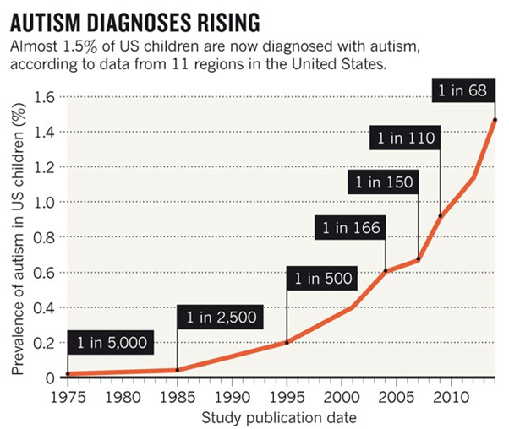
A Frightening Trend*
?
?
*K. Weintraub, Nature 479, Nov. 3 2011, 22-24.
Notes:
./NatureAutismRising.pdf

Slide 3
“If it is an environmental cause contributing to an increase, we certainly want to find it.”*
*K. Weintraub, Nature 479, Nov. 3 2011, 22-24.

Slide 4
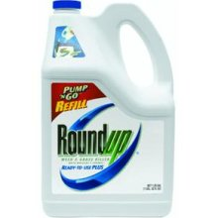
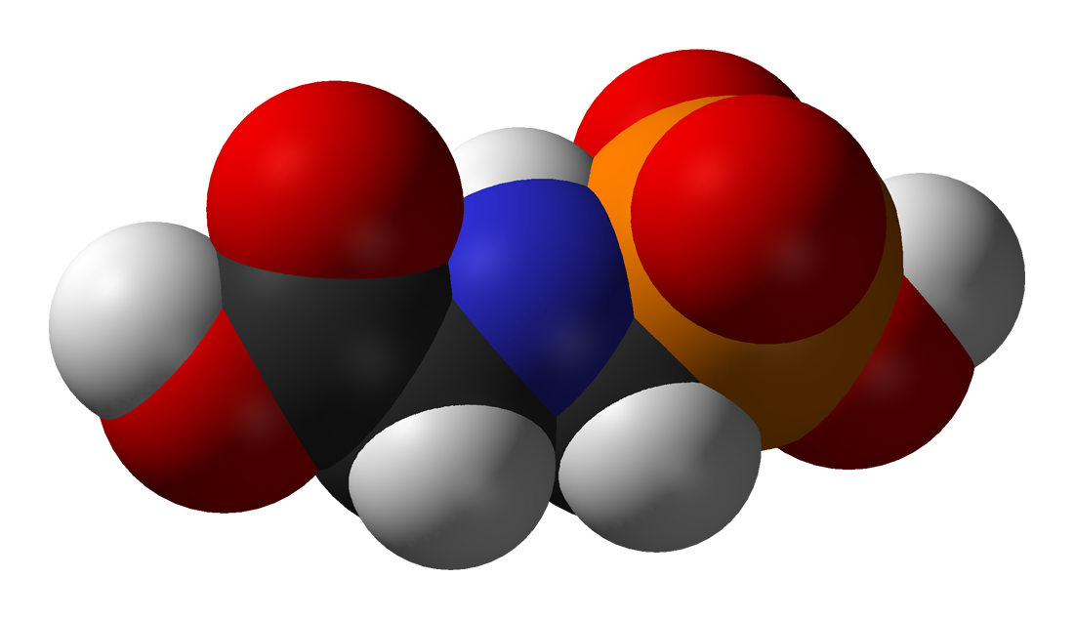
GLYPHOSATE

Slide 5
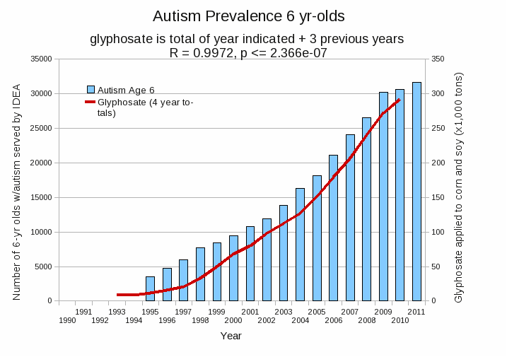
Autism Prevalence: 6 year olds
R = 0.9972
*Plot provided by Nancy Swanson, with permission
Data sources: autism: US Department of Education; Glyphosate: US Department of Agriculture
Notes:
Nancy/latest_plots/6-yr-old autism.gif
autism: USDE
oil consumption: USDA
glyphosate: USDA
GE crops: USDA
Mortality data: CDC

Slide 6
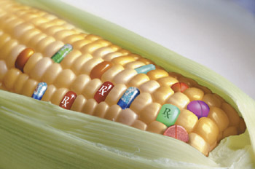
GMO Roundup Ready Crops
Core crops of processed food industry: corn, soy, canola, alfalfa, sugar beets, cotton
Introduced around 1998 – dramatic increase up to 80-90% of the crop by 2010
“Roundup-ready” weeds quickly evolved
Escalating use of Roundup followed
Now they’re introducing 2,4-D resistant corn and soy
“Triple-stack” Bt, Roundup-ready and 2,4-D resistant corn coming?
Bt is a toxin that blows up the stomach of insects
2,4-D is a component of Agent Orange
Notes:
Enlist Duo 2,4 D and glyphosate – cotton corn, soy

Slide 7
Percent of GM herbicide-tolerant corn crops plotted alongside %corn treated with glyphosate
Plot provided by Dr. Nancy Swanson, with permission:
gathered from US data readily available on the web

Slide 8
Is Glyphosate Toxic?
Monsanto has argued that glyphosate is harmless to humans because our cells don’t have the shikimate pathway, which it inhibits
However, our gut bacteria DO have this pathway
We depend upon them to supply us with essential amino acids (among many other things)
Other ingredients in Roundup greatly increase glyphosate’s toxic effects
Studies done by the chemical industry leave these out
Insidious effects of glyphosate accumulate over time
Most studies are too short to detect damage

Slide 9
The Enhancing Effect of Adjuvants*
“Adjuvants in pesticides are generally declared as inerts, and for this reason they are not tested in long-term regulatory experiments. It is thus very surprising that they amplify up to 1000 times the toxicity of their APs [Active Principles] in 100% of the cases where they are indicated to be present by the manufacturer.”
*R. Mesnage et al.BioMed Research International 2014; Article ID:179691.
Notes:
Glyphosate/seralini_2014_pesticide_toxicity_adjuvants.pdf

Slide 10
Roundup Safety Claims Disputed*
“It is commonly believed that Roundup is among the safest pesticides. … Despite its reputation, Roundup was by far the most toxic among the herbicides and insecticides tested. This inconsistency between scientific fact and industrial claim may be attributed to huge economic interests, which have been found to falsify health risk assessments and delay health policy decisions.”
*R. Mesnage et al., Biomed Research International, Volume 2014 (2014),
Article ID 179691
Notes:
Glyphosate/ Mesnage_Seralini_2014_glyphosate_toxicity_proven.pdf
This is the first time that all these formulated pesticides have been tested on human cells well below agricultural dilutions.
adjuvants were also more cytotoxic through the disruption of membrane and mitochondrial respiration,
1000-fold enhancement w/ adjuvants

Slide 11
Main Toxic Effects of Glyphosate*
Kills beneficial gut bacteria and allows pathogens to overgrow
Interferes with function of cytochrome P450 (CYP) enzymes
Chelates important minerals (iron, cobalt, manganese, etc.)
Interferes with synthesis of aromatic amino acids and methionine
Leads to shortages in critical neurotransmitters and folate
Disrupts sulfate synthesis and sulfate transport
*Samsel and Seneff, Entropy 2013, 15, 1416-1463

Slide 12
These biological effects of glyphosate align remarkably well with the complex disease profile of autism spectrum disorder

Slide 13
“Another claim of Monsanto's has been that residue levels of up to 5.6 mg/kg in GM-soy represent "...extreme levels, and far higher than those typically found" (Monsanto 1999).
Study of glyphosate and AMPA (breakdown product) residues in soy crops*
5.6
*Figure 1, T. Bohn et al. Food Chemistry 153, 15 June 2014, 207-215.
www.greenmedinfo.com/blog/how-extreme-levels-roundup-food-became-industry-normal
Notes:
http://www.greenmedinfo.com/blog/how-extreme-levels-roundup-food-became-industry-normal

Slide 14
Melatonin synthesis depends on shikimate pathway

Slide 15
“Dramatic Increase in Hospitalization of US Children With Inflammatory Bowel Disease”*
Study conducted at Case Western Reserve University School of Medicine
> 11 Million hospitalization records examined
Patients < 20 years old
49% increase from 2000 to 2009 in Crohn’s disease discharges
71% increase in ulcerative colitis discharges
* Science Daily, June 25, 2013
Notes:
./inflammatory_bowel_disease_children.text

Slide 16
*Plot provided by Dr. Nancy Swanson from available US data

Slide 17
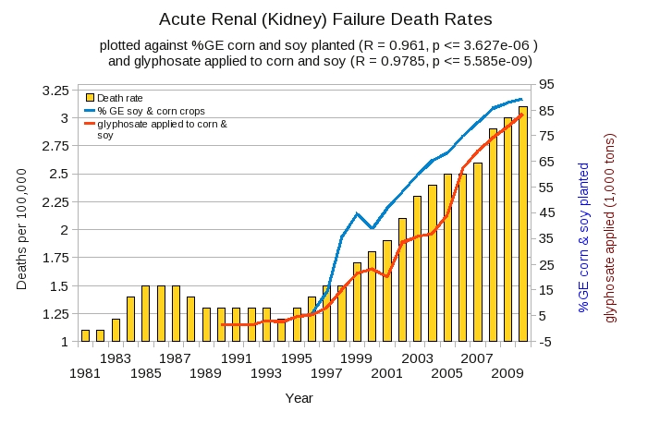
Acute Kidney Disease Death Rate Plotted Against Glyphosate and GMOs*
*Plot prepared by Nancy Swanson from available data online

Slide 18
Seralini’s study on rats fed GM corn and soy*
*G-E Séralini et al. Environmental Sciences Europe 2014, 26:13
Notes:
Glyphosate/seralini/1-, 2-, 3-
Also glyphosate/SeraliniPaper.pdf

Slide 19
Summary of Seralini’s study
Rats fed GM corn and soy throughout lifespan
Females developed massive mammary tumors
Males developed liver and kidney disease
Animals died prematurely

Slide 20
Is Glyphosate in Our Food?
Wheat desiccated with Roundup
High fructose GMO corn syrup
GMO soy protein filler
GMO Canola Oil
Cows fed GMO corn and soy
Potatoes desiccated with herbicides

Slide 21
Further Exploration
Samsel and Seneff paper:
http://www.mdpi.com/1099-4300/15/4/1416
Seralini paper
http://www.enveurope.com/content/26/1/14
Short video: Dr. Oz on new 2,4-D
http://www.doctoroz.com/episode/new-gmo-pesticide-doctors-are-warning-against
Dr. Mercola interview with Dr. Seneff:
http://articles.mercola.com/sites/articles/archive/2013/06/09/monsanto-roundup-herbicide.aspx
Jeffrey Smith interview with Dr. Seneff:
http://vimeo.com/65914121

Slide 22
Thank you for listening

