Slide 1
GMOs and Roundup:
A Marriage Made in Hell
Stephanie Seneff
Wise Traditions Workshop, London
February 8, 2014

Slide 2
Download These Slides
http://people.csail.mit.edu/seneff/London2014/SeneffGlyphosate2014.pptx

Slide 3
Never doubt that a small group of thoughtful, committed citizens can change the world. Indeed, it is the only thing that ever has.
-- Margaret Mead
US anthropologist (1901 - 1978)

Slide 5
Outline
Introduction
Autism
Obesity and Digestive Disorders
GMO Crops and Dying Species
Endocrine Disruption and Cancer
Nutrient Deficiencies and Climate Change
Summary

Slide 6
“Children today are sicker than they were a generation ago. From childhood cancers to autism, birth defects and asthma, a wide range of childhood diseases and disorders are on the rise. Our assessment of the latest science leaves little room for doubt: pesticides are one key driver of this sobering trend.”*
*http://www.emagazine.com/earth-talk/pesticides-and-childrens-health
Notes:
Rosemary:
http://gmandchemicalindustry9.wordpress.com/european-food-safety-authority-and-the-seralini-paper-on-rat-tumours/
http://www.emagazine.com/earth-talk/pesticides-and-childrens-health

Slide 7
Silent Spring (1962)
Argued that uncontrolled and unexamined pesticide use was harming and even killing not only animals and birds, but also humans.

Slide 8
Industry Attacks on Dissent: From Rachel Carson to Oprah*
“Monsanto manufactured DDT and polychlorinated biphenyls (PCBs) before they were banned by the U.S. Environmental Protection Agency in the 1970s. It still makes a long list of synthetic chemicals and aggressively markets genetically engineered products like bovine growth hormone … and genetically modified seeds. A billion-dollar company when "Silent Spring" first appeared, Monsanto published a parody of Carson's work, called "The Desolate Year," in the October 1962 issue of Monsanto Magazine. Since then, Monsanto has become a corporate role model in sugar-coating unpalatable facts and silencing dissent.”
*Laura Orlando
http://www.dollarsandsense.org/archives/2002/0302orlando.html
Notes:
Laura!!

Slide 9
Autism

Slide 10
“One of the puzzling aspects of autism is the marked increase in the incidence of autism that began in the United States in the early 1980s and has appeared to increase continuously since then.”
-William Shaw, Journal of Restorative Medicine 2013; 2: First line of Introduction.
The rate was one in fifty in the most recent estimate last year

Slide 11
Conditions Associated with Autism
Disrupted gut bacteria
Deficiencies in serotonin and melatonin
Impaired sulfur metabolism
Is there a toxic environmental substance that has been on the rise since 1980 and that could account for these comorbidities?

Slide 12
GLYPHOSATE

Slide 13
Glyphosate use rose 1500% from 1994 to 2005.*
100 million pounds of glyphosate is used every year on more than a billion acres.
*Cherry B. GM crops increase herbicide use in the United States.
Science in Society 45, 44-46, 2010

Slide 14
Nancy Swanson, http://www.examiner.com/article/
data-show-correlations-between-increase-neurological-diseases-and-gmos

Slide 15
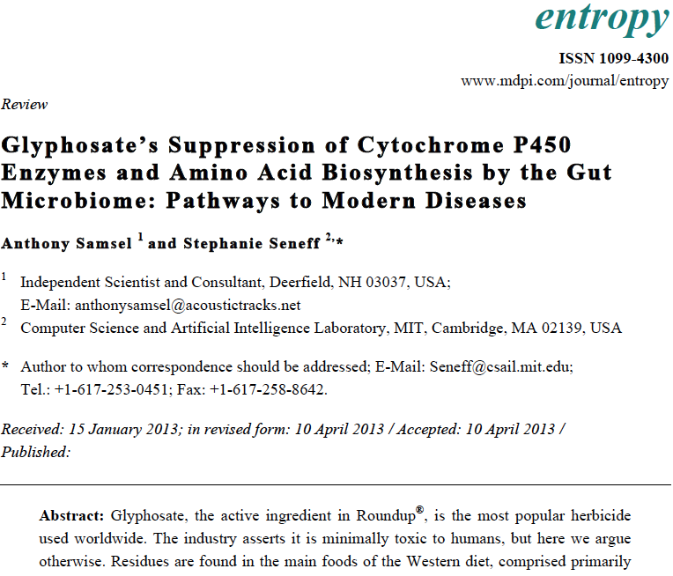
Recent Publication

Slide 16
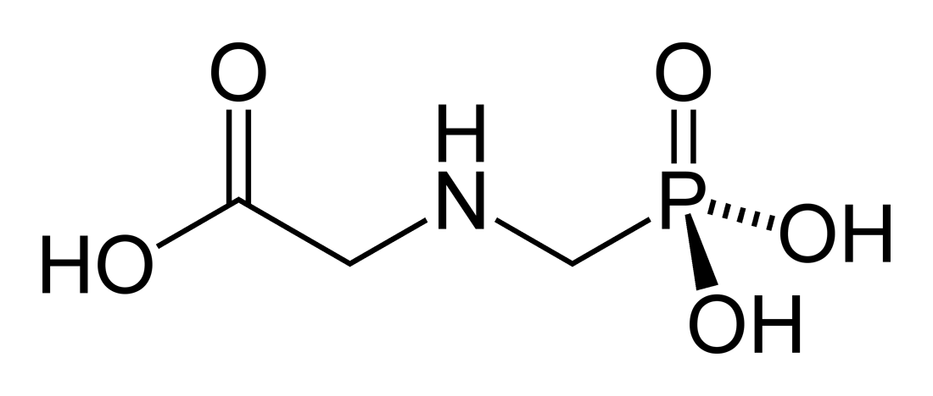
Glyphosate!!
Glyphosate is now the #1 herbicide in use in the U.S. and is increasingly used around the world
Developed and patented by Monsanto in the 1970’s
Introduced into the US food chain in 1974
Came out from under patent in 2000
Inhibits an enzyme in the shikimate pathway involved in synthesis of tyrosine, tryptophan and phenylalanine (the three aromatic amino acids)
Huge expansion of GMO corn, soy, cotton and canola crops has led to sharp increases in the last decade
Notes:
WIKI

Slide 17
Is Glyphosate Nontoxic?
Monsanto has argued that glyphosate is harmless to humans because we don’t have the shikimate pathway
However, our gut bacteria DO have this pathway
We depend upon them to supply us with essential amino acids (among many other things)
Other ingredients in Roundup greatly increase glyphosate’s toxic effects
Insidious effects of glyphosate accumulate over time
Most studies are too short to detect damage

Slide 18
Some Biomarkers for Autism
Disrupted gut bacteria; inflammatory bowel
Low serum sulfate
Methionine deficiency
Serotonin and melatonin deficiency
Defective aromatase
Zinc, iron and vitamin D deficiency
Urinary p-cresol
High serum nitrate and ammonia
Impaired immune function
Chronic low-grade inflammation in the brain
Notes:
Samantha/zinc_deficiency_autism.text

Slide 19
Some Biomarkers for Autism
Disrupted gut bacteria; inflammatory bowel
Low serum sulfate
Methionine deficiency
Serotonin and melatonin deficiency
Defective aromatase
Zinc and iron deficiency
Urinary p-cresol
High serum nitrate and ammonia
Impaired immune function
Chronic low-grade inflammation in the brain
These can all be explained as potential effects of glyphosate on biological systems
Notes:
Samantha/zinc_deficiency_autism.text

Slide 20
Main Toxic Effects of Glyphosate*
Kills beneficial gut bacteria and allows pathogens to overgrow
Interferes with function of cytochrome P450 (CYP) enzymes
Chelates important minerals
Interferes with synthesis of aromatic amino acids and methionine
Disrupts sulfate synthesis and sulfate transport
*Samsel and Seneff, Entropy 2013, 15, 1416-1463

Slide 21
Aromatase
“Aromatase protein is significantly reduced in the frontal cortex of autistic subjects relative to sex- and age-matched controls”*
Aromatase is a CYP enzyme that converts testosterone to estrogen
Its association with autism explains the fact that boys are four to five times as susceptible as girls to autism.
*T. Sarachana et al., PLoSONE, Feb. 2011, 6(2):e17116
Notes:
Samantha/aromatase_autism_PlosONE.pdf

Slide 22
Probiotics Treat Mouse Autism*
P-cresol
*Graphical Abstract from E.Y. Hsiao et al., Cell, Dec. 5, 2013
Notes:
./mouse_autism_probiotics.text
http://www.scientificamerican.com/article.cfm?id=bacterium-reverses-autism-like-behavior-in-mice&utm_source=feedburner&utm_medium=feed&utm_campaign=Feed%3A+ScientificAmerican-News+%28Content%3A+News%29

Slide 23
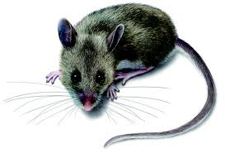
P-Cresol is Key*
Studied mice engineered to be autistic
They suffered from a leaky gut
Reduced levels of Bacteroides fragilis in gut
Level of 4-ethylphenylsulphate (4EPS) was 46x higher than that of the control group
4EPS is closely related to p-Cresol (a toxic phenol)
p-Cresol is produced by Clostridium difficile
Glyphosate induces Clostridium difficile overgrowth
Exposing normal mice to 4EPS induces autistic behaviors
*E.Y. Hsiao et al., Cell, Dec. 5, 2013
Notes:
p_cresol_sulfate_brain_mice_autism_Cell_2014.text
Treasures/p_cresol_sulfate_autism_Cell_2013.pdf
Virus infection in mother during pregnancy

Slide 24
CYP Enzymes Activate Vitamin D3*
This takes place in the liver, and the same enzymes detoxify a number of pharmaceutical drugs
* Figure 1 in Glenville Jones et al., Anticancer Research 26: 2589-2596 (2006)
Notes:
Celiac/hepatic_activation_D3_CYP_enzymes.pdf
Figure 1. Enzymatic activation of 1·-hydroxylated vitamin D prodrugs by liver enzymes. The putative cytochrome P450 species are indicated by the letter codes. All CYPs, except for the mitochondrial CYP27A1, are microsomal.

Slide 25
CYP Enzymes Activate Vitamin D3*
This takes place in the liver, and the same enzymes detoxify a number of pharmaceutical drugs
Might this explain the epidemic in vitamin D3 deficiency that we’re seeing now in the United States?
* Figure 1 in Glenville Jones et al., Anticancer Research 26: 2589-2596 (2006)
Notes:
Celiac/hepatic_activation_D3_CYP_enzymes.pdf
Figure 1. Enzymatic activation of 1·-hydroxylated vitamin D prodrugs by liver enzymes. The putative cytochrome P450 species are indicated by the letter codes. All CYPs, except for the mitochondrial CYP27A1, are microsomal.

Slide 26
CYP Enzymes Activate Vitamin D3*
This takes place in the liver, and the same enzymes detoxify a number of pharmaceutical drugs
Autism is associated with vitamin D3 deficiency
* Figure 1 in Glenville Jones et al., Anticancer Research 26: 2589-2596 (2006)
Notes:
Celiac/hepatic_activation_D3_CYP_enzymes.pdf
Figure 1. Enzymatic activation of 1·-hydroxylated vitamin D prodrugs by liver enzymes. The putative cytochrome P450 species are indicated by the letter codes. All CYPs, except for the mitochondrial CYP27A1, are microsomal.

Slide 27
How Glyphosate Depletes Serotonin and Melatonin
Plasma serotonin levels in autism mothers were significantly lower than in mothers of normal children (P = 0.002)*
Tryptophan, an aromatic amino acid disrupted by glyphosate, is the sole precursor to serotonin and melatonin
G
G
G
IDO
IDO
Synthesis by Gut Microbes
Kynurenine
(Macrophages)
Kynurenine
(Endothelial Wall)
Protein Synthesis
(Tissues)
Tryptophan
Kynurenine → NAD+
Metabolized to ATP
(Liver)
TDO
Dietary Sources
G
Serotonin →melatonin (Brain)
G
*S.L. Connors et al., Plasma Serotonin in Autism. Pediatric Neurology 35(3), Sep 2006, 182-186.
Notes:
http://www.sciencedirect.com/science/article/pii/S0887899406001949

Slide 28
How Glyphosate Depletes Serotonin and Melatonin
Serotonin deficiency is linked to not only autism but also obesity, depression, Alzheimer’s disease and violent behavior
G
G
G
IDO
IDO
Synthesis by Gut Microbes
Kynurenine
(Macrophages)
Kynurenine
(Endothelial Wall)
Protein Synthesis
(Tissues)
Tryptophan
Kynurenine → NAD+
Metabolized to ATP
(Liver)
TDO
Dietary Sources
G
Serotonin →melatonin (Brain)
G
*S.L. Connors et al., Plasma Serotonin in Autism. Pediatric Neurology 35(3), Sep 2006, 182-186.
Notes:
http://www.sciencedirect.com/science/article/pii/S0887899406001949

Slide 29
Recapitulation
Autism rates have been increasing at an alarming rate in recent years, in step with increases in glyphosate application to GMO crops
Autism is associated with disrupted gut bacteria, overproduction of p-cresol, and deficiencies in serotonin, zinc, iron, vitamin D3, and aromatase
Most of the biomarkers associated with autism can be explained by known biological effects of glyphosate

Slide 30
Obesity and Digestive Disorders

Slide 31
Dr. Roy Dittman*
“If the microbial world is the substrate for life, why are we waging war on it?”
“The same chemicals we use to sterilize our environment sterilize us.”
*Talk at AutismOne Conference, May 25, 2013 Chicago, Illinois

Slide 32
Is Glyphosate Making Us Obese?

Slide 33
Obesity in US over Time*
Glyphosate was introduced into the food chain in 1975
*Figure 1 in R.J. Johnson et al., Am J Clin Nutr 2007;86:899–906.
Notes:
Sugar intake per capita in the United Kingdom from 1700 to 1978 (30, 31; E) and in the United States from 1975 to 2000 (32; 􏰏) is compared with obesity rates in the United States in non-Hispanic white men aged60–69y(17;F).Valuesfor1880-1910arebasedonstudiesconducted in male Civil War veterans aged 50–59 y (18).

Slide 34
Nancy Swanson, http://www.examiner.com/article/
data-show-correlations-between-increase-neurological-diseases-and-gmos

Slide 35
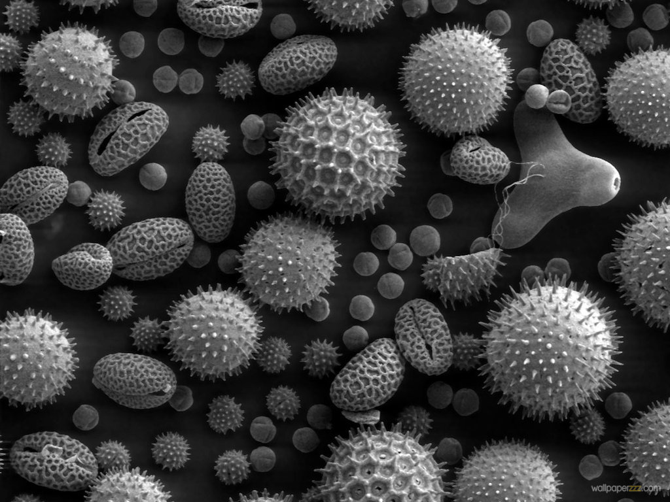
Gut Microbes and Obesity
Our microbes outnumber our own cells 10 to 1
There are between 200 and 300 different species in a typical person.
Environmental toxins like glyphosate can cause an overgrowth of pathogens in the gut
They release toxic phenols
This can lead to inflammatory bowel disease
And a direct path to obesity!
Gut microbes from an obese person induced obesity in mice*
*N. Fei and L. Zhao, The ISME Journal, Online Publication Dec. 2012
Notes:
*See: http://www.usaprepares.com/health/scientists-link-obesity-to-gut-bacteria

Slide 36
Obesity Switch*
Reduced sulfate
Loss of beneficial bacteria
Overgrowth of Pathogens
Leaky Gut
Glyphosate!!
*Figure 3, Le Chatelier et al., Nature 500, Aug 29, 2013, 541-548.
Notes:
Wendy/Chatelier_microbiome_metabolic_markers_2013.pdf
Also treasures/
Figure 3 | Functional and phylogenetic shifts in the LGC microbiome. Top, observed increase (red) or decrease (green) of functions and phylogenetic groups. Bottom, potential drivers (yellow) of inflammation related to decreased richness. Left, antibiotic-mediated perturbation of the richness; Right, proteobacterial lipopolysaccharide-mediated perturbation of the richness. AB, antibiotic; IR, insulin resistance.

Slide 37
America’s Two-Headed Pig*
Treating Nutritional Deficiencies and Disease in a Genetically Modified, Antibiotic Resistant and Pesticide Dependent World
*book by Leah Dunham, www.americastwoheadedpig.com, 2013
Notes:
./

Slide 38
Some Observations from Leah Dunham’s Book
Calves are born too weak to walk, with enlarged joints and limb deformities.
As many as 20% of piglets experience a “failure to thrive” following weaning
Cows on a diet of GMO corn and soy develop twisted gut, ulcers and other digestive disorders
She suspects glyphosate as a major player
Notes:
Chelate cobalt and manganese
Gut bacteria antibiotic

Slide 39
Pigs Fed GMOs Develop Inflamed Gut*
Pigs have a similar digestive system to humans
Digestive problems observed anecdotally in GMO-fed pigs
inflammation in stomach and intestine, stomach ulcers, thinning of intestinal walls, increase in haemorrhagic bowel disease
Follow-on Experiment:
168 just-weaned pigs fed "typical diet,” soy and corn, until slaughtered
Half fed GMO versions, half organic.
*J.A. Carman et al., Journal of Organic Systems, 8(1), 2013.
Notes:
Swine/pigs_fed_GMOs_inflamed_gut.pdf
Also pigs_GMOs_summary.pdf
./Pigs_Study_NaturalNews.pdf
http://www.beyondpesticides.org/dailynewsblog/?p=10823

Slide 40
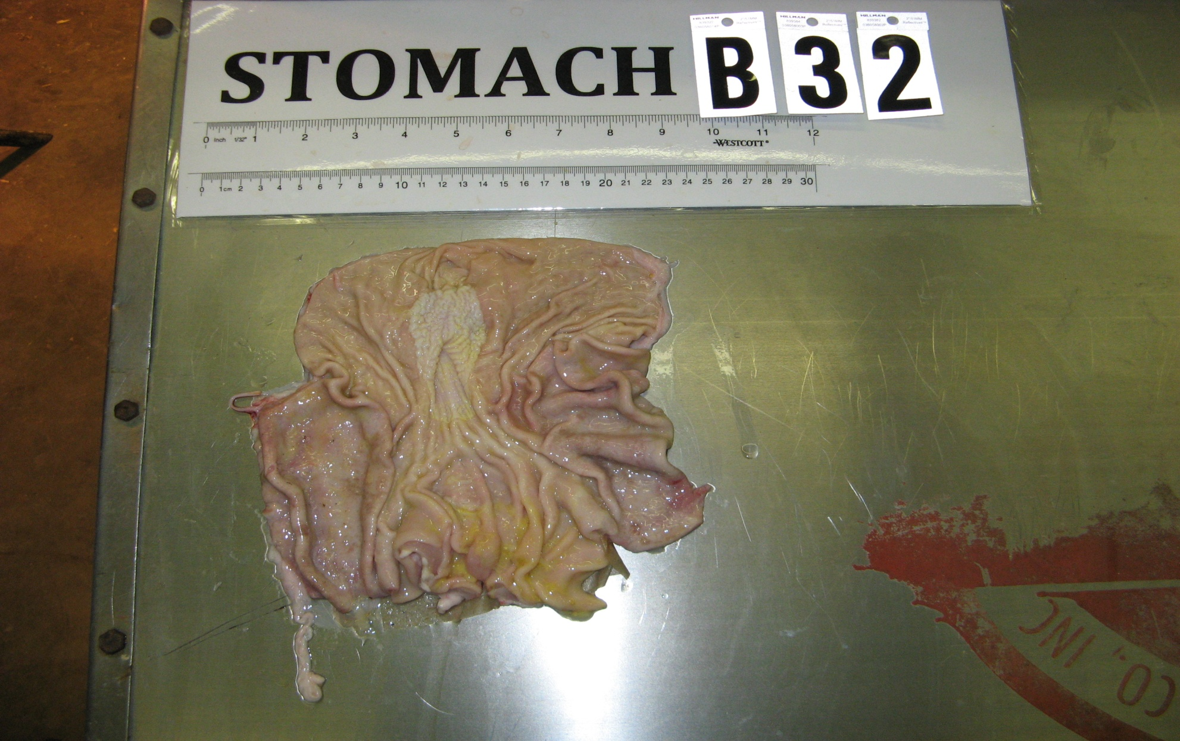
Pigs Fed GMOs Develop Inflamed Gut*
Blind autopsies conducted
Female pigs' uterus 25% larger in GMO-fed pigs
Female pigs 2.2x more likely to get severe stomach inflammation on GMO diet
Males were 4x more likely
Non-GMO Feed
GMO Feed
Photos kindly provided by Howard Vlieger
GMO Feed
*J.A. Carman et al., Journal of Organic Systems, 8(1), 2013.
Notes:
Swine/pigs_fed_GMOs_inflamed_gut.pdf
Also pigs_GMOs_summary.pdf
./Pigs_Study_NaturalNews.pdf

Slide 41
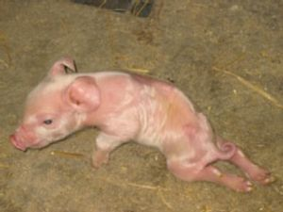
“Deformities, sickness and livestock deaths: the real cost of GM animal feed?”*
"When using GM feed I saw symptoms of bloat, stomach ulcers, high rates of diarrhoea, pigs born with the deformities ... but when I switched [to non GM feed] these problems went away, some within a matter of days.”
Quote from Ib Pedersen, producer of 13,000 pigs a year supplying Europe's largest pork company, Danish Crown
*Andrew Wasley, Nov. 28, 2013, The Ecologist., theecologist.org/News/news_analysis/2176082/
deformities_sickness_and_livestock_deaths_the_real_cost_of_gm_animal_feed.html
Notes:
2014/sickpigs.pdf
2014/naturalNews_on_GMO_feed_to_pigs_in_Europe.pdf

Slide 42
Human Digestive System Disorders
We are seeing an alarming increase in the US in many diseases related to the gut
Crohn’s disease, inflammatory bowel disease, colitis, acid reflux disease, gluten and casein intolerance, celiac disease, leaky gut
The gut-brain axis links neurological disorders with gut disorders
I believe that glyphosate is a major cause

Slide 43
Inflammatory Bowel Disease and Bt Corn*
*http://sustainablepulse.com/wp-content/uploads/GMO-health.pdf

Slide 46
Celiac Disease, Glyphosate and Non Hodgkin’s Lymphoma
Glyphosate preferentially kills bifidobacteria*
Bifidobacteria are depleted in celiac disease**
Celiac disease is associated with increased risk to non Hodgkin’s lymphoma***
Glyphosate itself is also linked directly to non Hodgkin’s lymphoma****
*A.A. Shehata et al., Curr Microbiol. 2013 Apr;66(4):350-8.
** M. Velasquez-Manoff, NY Times Sunday Review, Feb. 23, 2013.
*** C. Catassi et all, JAMA. 2002 Mar 20;287(11):1413-9.
****M. Eriksson et al., Int J Cancer. 2008 Oct 1;123(7):1657-63.
Notes:
**./ bifidobacteria_celiac_disease.text
Cancer/Celiac_disease_increases_hodgkins_lymphoma.text
./Celiac_and_bacteria.text

Slide 47
“Herbicide Resistant Ryegrass Troubling for Wheat Growers”*
“If you see ryegrass at harvest following an Axial XL application, it may be resistant. And you can scatter seed all over the field with the combine.”
“A reduced-tillage approach, using a burndown herbicide ahead of planting in a stale seedbed, also holds promise for improved control.”
“ ‘We may be able to knock out 80% to 90% of the resistant ryegrass with glyphosate.’ ”
-- Jim Swart, integrated pest management specialist
*Ron Smith, Western Farm Press, Mar. 23, 2013

Slide 48
Desiccation: It’s Not Just Wheat
Advantages:
Hastens maturity to harvest
Weed control for next year's crop
Reduces green material and therefore strain on harvesting machinery
Disadvantages
Herbicide cannot be washed out prior to human use.
Animals fed herbicide-treated crops --> contamination in animal products
Crops include wheat, barley, legumes, corn, sunflower, kiwi, grapes (wine), raspberries, apples, soybeans, alfalfa, sugar cane

Slide 49
wheat
Graph provided by Nancy Swanson, with permission

Slide 50
“Dramatic Increase in Hospitalization of US Children With Inflammatory Bowel Disease”*
Study conducted at Case Western Reserve University School of Medicine
> 11 Million hospitalization records examined
Patients < 20 years old
49% increase from 2000 to 2009 in Crohn’s disease discharges
71% increase in ulcerative colitis discharges
* Science Daily, June 25, 2013
Notes:
./inflammatory_bowel_disease_children.text

Slide 51
Pseudomonas and Formaldehyde
There are only a few bacteria that can break down glyphosate completely: Pseudomonas aeruginosa, Pseudomonas sp, and Alcaligenes sp.
Pseudomonas aeruginosa, a gram negative bacterium, is a major problem today in hospitals due to its resistance to multiple antibiotics*
It produces formaldehyde (a well established neurotoxin) as a by-product of glyphosate breakdown
It requires (and depletes) thiamine
*S. de Betnzmann and P. Plésiat Environ Microbiol. 2011 Jul;13(7):1655-65.

Slide 52
Kidney Failure in Agricultural Workers*
Workers in sugarcane fields in Central America and in India are dying at a young age in record numbers from kidney failure
Arsenic exposure from drinking water?
Excess use of tylenol?
Glyphosate disrupts the CYP enzyme that breaks down tylenol, leading to tylenol toxicity
*ticotimes.net, San Jose, Costa Rica, August 8, 2013.
Notes:
http://www.ticotimes.net/More-news/News-Briefs/What-is-killing-the-young-men-of-Canas-_Wednesday-August-07-2013
./diabetes_farmers_costa_rica.pdf

Slide 53
“What is killing the young men of Cañas?”*
Crop Dusting Plane
*ticotimes.net, San Jose, Costa Rica, August 8, 2013.
Notes:
http://www.ticotimes.net/More-news/News-Briefs/What-is-killing-the-young-men-of-Canas-_Wednesday-August-07-2013
./diabetes_farmers_costa_rica.pdf

Slide 54
“What is killing the young men of Cañas?”*
Abstract: The effect of the aerial application of 0.86 kg a.i./ha of glyphosate in 75 l of water on the ripening of 3 sugar cane varieties was studied in Costa Rica. …
*J.F. Subiros, The effect of applying glyphosate as ripener in three
sugar cane varieties, Turrialba 1990, 40(4), 527-534.
Notes:
http://www.ticotimes.net/More-news/News-Briefs/What-is-killing-the-young-men-of-Canas-_Wednesday-August-07-2013
./diabetes_farmers_costa_rica.pdf
http://www.cabdirect.org/abstracts/19916778875.html;jsessionid=93B05D1723894A0DF7BC4E82BD31A06F

Slide 55
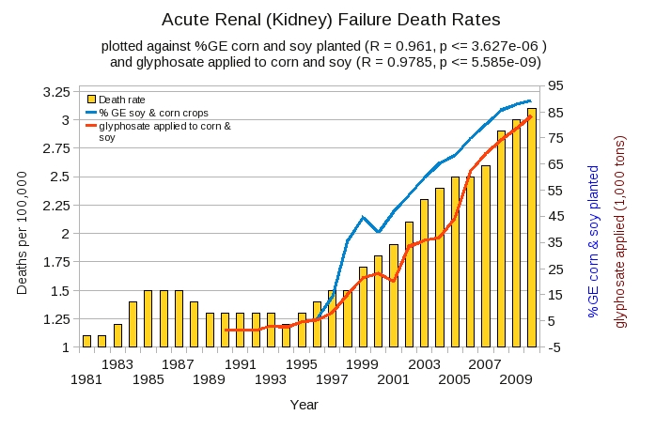
Acute Kidney Disease Death Rate Plotted Against Glyphosate and GMOs*
*Plot prepared by Nancy Swanson from available data online

Slide 56
Recapitulation
Glyphosate disrupts gut bacteria, favoring pathogen overgrowth
Obesity can be encoded in gut microbe distributions
Pigs fed a GMO diet develop inflammatory gut
Piglets fed GMOs fail to thrive
Inflammatory bowel diseases are on the rise in America’s youth
Kidneys are failing in agricultural workers exposed to glyphosate
Glyphosate application over time correlates with deaths from kidney disease

Slide 57
GMO Crops and Dying Species

Slide 58
https://www.commondreams.org/view/2013/05/29-4
Notes:
./move_over_God.pdf

Slide 59
From WIKILeaks*
“The United States is threatening nations who oppose Monsanto’s genetically modified (GM) crops with military-style trade wars.”
“Nations like France, which have moved to ban one of Monsanto’s GM corn varieties, were requested to be ‘penalized’ by the United States for opposing Monsanto and genetically modified foods.”
“The information reveals just how deep Monsanto’s roots have penetrated key positions within the United States government, with the cables reporting that many U.S. diplomats work directly for Monsanto.”
*http://www.bibliotecapleyades.net/ciencia/ciencia_monsanto81.htm
*http://www.youtube.com/watch?v=eiK_RF3ioRw&feature=youtu.be

Slide 60
Have GMOs Worked?*
“Exactly none of the supposed benefits of GM crops - increased yields, more food production, controlled pests and weeds, reductions in chemical use in agriculture or drought-tolerant seeds - have actually materialized. … GMOs have resulted in greater pesticide use and the predictable emergence of herbicide resistant super weeds. In fact, 130 types of weeds in 40 states are now herbicide-resistant, increasing costs, cutting yields and leading to the use of more powerful and increasingly toxic chemical herbicides.”
Dr. Brian Moench, Truthout, Mankind: Death by Corporation
*http://truth-out.org/opinion/item/17178-mankind-death-by-corporation

Slide 61
Tremendous Growth in GE Crops in Last 15 Years (U.S.)
2,4-D resistant plants are coming soon
Plots provided by Nancy Swanson, with permission
Notes:
2013?/GMO-Health.pdf

Slide 62
Glyphosate vs. Other Pesticides*
Glyphosate
*http://sustainablepulse.com/wp-content/uploads/GMO-health.pdf

Slide 63
Glyphosate and Superweeds: U.S.*
*http://sustainablepulse.com/wp-content/uploads/GMO-health.pdf
Notes:
Glyphosate/Nancy/GMO-health.pdf
http://sustainablepulse.com/wp-content/uploads/GMO-health.pdf

Slide 64
Glyphosate and AMPA in GMO Soy*
“we were able to discriminate GM, conventional and organic soybeans without exception, demonstrating ‘substantial non-equivalence’ in compositional characteristics for ‘ready-to-market’ soybeans.
*Figure 1, T. Bøhn et al., Compositional differences in soybeans on the market: glyphosate accumulates in Roundup Ready GM soybeans. Food Chemistry (2013) Epub ahead of print.

Slide 65
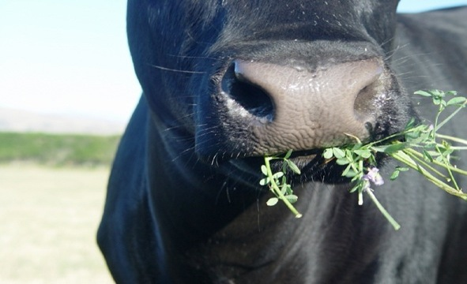
U.S. Approves Genetically Modified Alfalfa*
Alfalfa is the major source of hay for cattle and horses
Nation’s fourth-largest crop by acreage, behind corn, soybeans and wheat
GMO alfalfa is “Roundup Ready”
*http://www.nytimes.com/2011/01/28/business/28alfalfa.html?_r=0
Andrew Pollack, NY Times, January 27, 2011.
Notes:
./alfalfa_GMOs_NYTimes.text

Slide 66
Prof. Don Huber on Alfalfa*
Roundup-Ready alfalfa compared to traditional plants
Manganese levels reduced by 31%, sulfur by 52%, amino acids by 15%
EPA says 400 ppm glyphosate residue is okay in alfalfa
80% stays in plant and 20% moves into soil in root exudates
Rhizobia/Bradyrhizobia, Pseudomonads, Bacillus, Mycorrhizae, etc. etc. are harmed
It takes only 0.1 ppm to produce dysbiosis of the GI tract for chronic botulism, leaky gut, etc.
*Personal communication
Notes:
I had three paired plots (fields) of RR and non-RR alfalfa for a year before the RR was plowed because it 'gave' out early (after three years). The mineral levels are significantly reduced (Mn by 31" S by 52 %, amino acids by 15% etc.,etc.) EPA says 400 ppm is OK in alfalfa, 80 % stays in the plant and 20 % moves into the soil in root exudates to poison the soil microbes that have the shipmate pathway, etc. These are Rhizobia/Bradyrhizobia, Pseudomonads, Bacillus, Mycorrhizae, etc. etc. It only takes 0.1 ppm to produce dysbiosis of the GI tract for chronic botulism, leaky gut, etc. Don

Slide 67
One Square Foot
Public park near Cape Town, South Africa
*Robert Krulwich, http://www.npr.org/blogs/krulwich/2012/11/29/166156242/
cornstalks-everywhere-but-nothing-else-not-even-a-bee

Slide 68
GMO Corn: Cornstalks Everywhere But Nothing Else, Not Even A Bee*
*Robert Krulwich, http://www.npr.org/blogs/krulwich/2012/11/29/166156242/
cornstalks-everywhere-but-nothing-else-not-even-a-bee

Slide 69
Where Have all the Insects Gone?
“The nine-spotted beetle commonly made her home on farmlands for the rich source of insects these regions provided.”
“Until the mid-1970s, the nine-spotted beetle was one of the most common ladybug beetles”
*http://animals.pawnation.com/causes-decline-ninespotted-beetle-6492.html

Slide 70
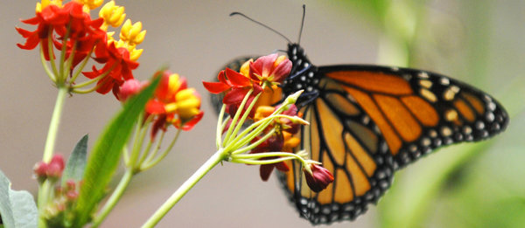
Monarch Butterfly Collapse*
“.. farmers have switched in droves to new varieties of crops that are genetically engineered to tolerate the most widely used weed killer in the United States. The resulting use of weed killers has wiped out much of the milkweed that once grew between crop rows and on buffer strips separating fields and roads.”
Glyphosate
*M. Wines, New York Times, Dec. 20, 2013.
nytimes.com/2013/12/21/us/setting-the-table-for-a-fluttering-comeback-with-milkweed.html

Slide 71
Bee Colony Collapse Syndrome (Explained in Mercola Interview with Don Huber)
Factors associated with bee colony collapse
Bees are mineral deficient for micronutrients
Plenty of food present, but they can’t utilize it
They’re devoid of the lactobacillus and bifidobacterium
They become disoriented (endocrine hormone disruption)
Glyphosate explains all of these features
Chelation of micronutrients and disruption of gut bacteria
30% mortality in bees drinking water containing glyphosate at levels found commonly in our drinking water
The other canary in the coal mine are frogs and amphibians: they’re disappearing just like the bees

Slide 72
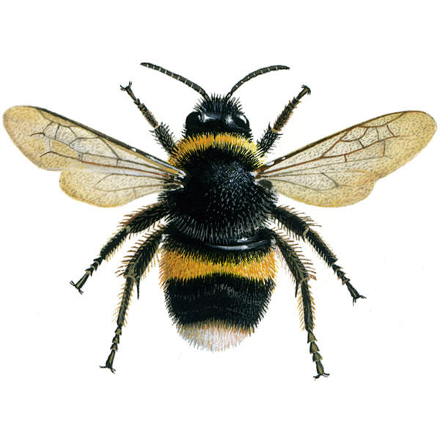
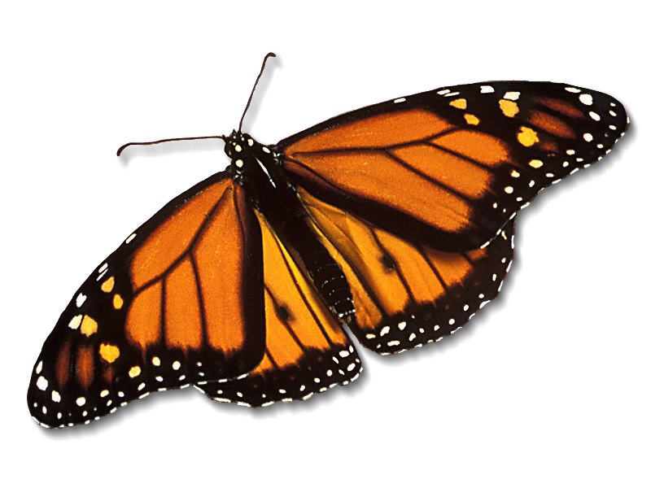
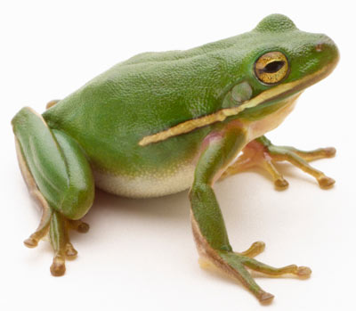
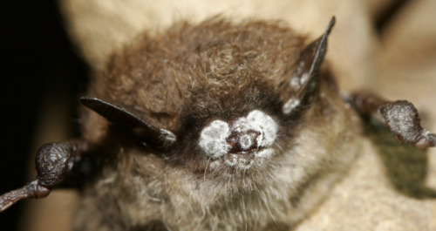
We Should be Alarmed!*
Bee Colony Collapse Disorder
Fungus Infection
Dissolving starfish
Disappearing monarch butterflies
Fungus Infection
After bees, butterflies are the second largest pollinators.
Bats eat an enormous number of insects
Fungus Infection
White-nose bat syndrome
Fungus Infection
*R. Mason et al., Journal of Environmental Immunology and Toxicology 1:1, 3-12; 2013
Notes:
Frogs -- drop 3.7% every year, meaning they could disappear in half of the habitats they now occupy nationwide in 26 years
Monarch butterflies – milkweed being killed by glyphosate
http://salsa3.salsalabs.com/o/1881/p/dia/action3/common/public/?action_KEY=12506

Slide 73
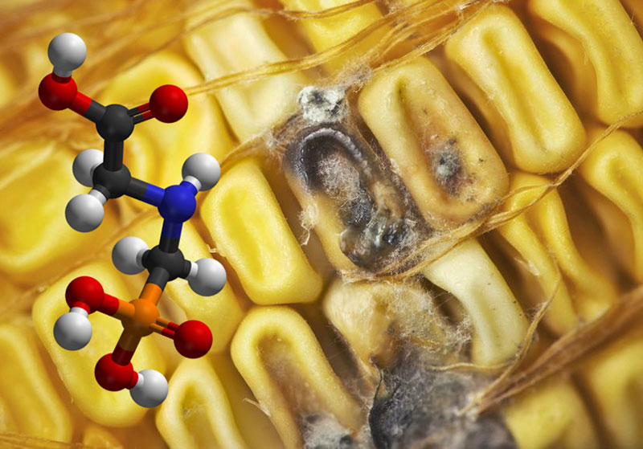
Roundup herbicide enhances the growth of aflatoxin-producing fungi*
Fungus is a growing threat in GMO Roundup-Ready corn
Research consistent with studies on other fungal strains such as Fusarium, Rust fungi and Blight fungi
*Barberis et al., Journal of Environmental Science and Health, Part B: Pesticides, Food Contaminants, and Agricultural Wastes. 2013, 48(12), 1070-1079.
Notes:
http://www.greenmedinfo.com/blog/breaking-study-links-roundup-weedkiller-overgrowth-deadly-fungal-toxins-1
13. Barberis CL, Carranza CS, Chiacchiera SM, Magnoli CE. Influence of herbicide glyphosate on growth and aflatoxin B1 production by Aspergillus section Flavi strains isolated from soil on in vitro assay. Journal of Environmental Science and Health, Part B: Pesticides, Food Contaminants, and Agricultural Wastes. 2013, 48(12), 1070-1079.

Slide 74
“Emerging fungal threats to animal, plant and ecosystem health”*
“The past two decades have seen an increasing number of virulent infectious diseases in natural populations and managed landscapes. In both animals and plants, an unprecedented number of fungal and fungal-like diseases have recently caused some of the most severe die-offs and extinctions ever witnessed in wild species, and are jeopardizing food security.”
*M.C. Fisher et al., Nature Reviews 484(7393), 186-194.
Notes:
./nature_fungus.text
./nature_fungus.pdf

Slide 75
Figure 1, Nature Reviews Paper*
Causes of Extinction
*M.C. Fisher et al., Nature Reviews 484(7393), 186-194.
Notes:
2014/nature_fungus.pdf
c, d, Relative proportions of species extinction and/or extirpation events for major classes of infectious disease agents (c) and their temporal trends for fungal pathogens (d). Primary data sources are given in the Supplementary Information.

Slide 76
Bee Colony Collapse Syndrome
Bees are exposed to many insecticides from pollen
Their resistance to neonicotinoids depends on CYP enzymes
These enzymes are disrupted by glyphosate
Disruption of CYP enzymes in the liver would impair humans’ ability to detoxify many environmental toxicants: synergistic effect

Slide 77
Honey Bees Have Fewer CYP Genes than other Insects*
“It is also a parsimonious interpretation that the deficit of detoxification genes in the honeybee will translate to less pesticide detoxification capability, which would then explain the species’ unusual sensitivity to pesticides.”
*Claudianos et al., Insect Molecular Biology (2006) 15(5), 615–636.
Notes:
AnthonySamsel/nextpaper/honey_be_detox_deficit_CYP_enyzme_2006

Slide 78
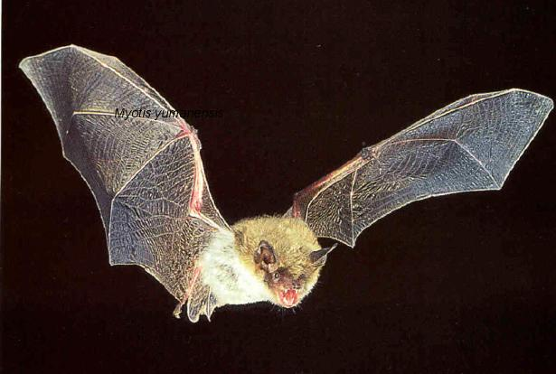
White Nose Syndrome: Bats
Has reached epidemic proportions in US Northeast since 2006
Corresponds to increases in glyphosate application
At least one million bats have died since 2006.
Gravest threat to bats ever seen
Bats wake up repeatedly during hibernation
Suggests melatonin deficiency
*W. Quarles, The IPM Practiioner, 33(9-10), June, 2013, 1-5.
Notes:
Csail/2013/Anthony/bats_white_nosed_syndrome_pesticides.pdf

Slide 79
“Glyphosate persistence in seawater”*
“Glyphosate degraded most rapidly under low light conditions at 25 °C with none detected by day 180, and most slowly in the dark at 31 °C where 52% remained by day 330“
*P. Mercurio et al., Marine Pollution Bulletin, 2014, In press
Notes:
Glyphosate/glyphosate_persistance_sea_coral_2014.pdf
http://www.greenmedinfo.com/blog/roundup-weed-killer-threatens-coral-reefs-persists-seawater

Slide 80
Recapitulation
According to WIKILeaks, the US is launching military style trade wars against other nations on GMO issues
Tremendous growth in GMO crops corresponds to tremendous growth in glyphosate usage
Bees, bats, frogs, lady bugs, starfish, monarch butterflies, and coral, among many other species, are suffering an unexplained collapse in recent years
Fungus infection is a major factor
Glyphosate induces fungus infection in plants
Fungus disease rates are growing alarmingly in both plants and animals

Slide 81
Endocrine Disruption and Cancer

Slide 82
Roundup Safety Claims Disputed*
“It is commonly believed that Roundup is among the safest pesticides. … Despite its reputation, Roundup was by far the most toxic among the herbicides and insecticides tested. This inconsistency between scientific fact and industrial claim may be attributed to huge economic interests, which have been found to falsify health risk assessments and delay health policy decisions.”
*R. Mesnage et al., Biomed Research International, 2014 In Press
Notes:
Glypohsate/ Mesnage_Seralini_2014_glyphosate_toxicity_proven.pdf

Slide 83
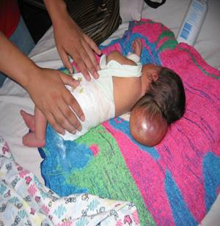
Glyphosate is an endocrine disruptor that promotes breast cancer*
Low and environmentally relevant concentrations of glyphosate possess estrogenic activity
Glyphosate caused human hormone-dependent breast cancer cells to proliferate at concentrations of parts per trillion
Estrogenic activity mediated by estrogen receptors
Additive effect from genistein, a phytoestrogen in soybeans
* S. Thongprakaisang et al., Food Chem Toxicol. 2013 Jun 8. S0278-6915(13)00363-3.
Notes:
./glyphosate_and_breast_cancer.text
Swine/glyphosate_breast_cancer.pdf
Please make a note that this study shows Glyphosate effects down to parts per trillion (10 to the minus12th).
In this study, we found that glyphosate at a log interval concentration ranging from 10-12 to 10-6 M increased the cell proliferation of a hormorne dependent breast cancer T47D ce

Slide 84
Glyphosate and Anencephaly*
Yakima, Benton and Franklin counties in Washington State have an unusually high number of pregnancies affected by the birth defect, anencephaly
75 pesticides were analyzed in studying contamination due to surrounding agriculture
47 (63%) of these were detected
Glyphosate was applied in large amounts, but was not studied
5% solution of glyphosate was also used heavily around irrigation ditches to control weeds
Main herbicide recommended due to its “low toxicity”
Glyphosate has been linked to anencephaly due to its effect on retinoic acid
*Barbara H. Peterson. Farm Wars, http://farmwars.info/?p=11137

Slide 85
Glyphosate Upregulates Retinoic Acid*
Small Brain
*A. Carrasco, Teratogenesis by glyphosate based herbicides and other pesticides. Relationship with the retinoic acid pathway. In Breckling, B. & Verhoeven, R. (2013) GM-Crop Cultivation – Ecological Effects on a Landscape Scale. Theorie in der Ökologie 17. Frankfurt, Peter Lang.

Slide 86
Fertility Rates are Dropping Worldwide*
Fertility rates are falling rapidly in countries around the world, often to below 2.0.
Cultural changes play a role
But glyphosate is likely contributing as well
Sperm depend on cholesterol sulfate for decapitation and fertilization
Cholesterol sulfate synthesis depends on cytochrome P450 (CYP) enzymes
Glyphosate disrupts CYP enzyme function
*A. Samsel and S. Seneff, Entropy 2013, 15, 1416-1463.

Slide 87
"Male fertility under threat as average sperm counts drop”*
Study of 26,600 men in France found sperm concentration had decreased by 32% since the 1990s.
Numbers steadily dropped by 2% per year from 1989 to 2005.
Proportion of normally formed sperm also declined by about 1/3.
* M. Rolland et al., Hum Reprod. 2013 Feb;28(2):462-70.
Notes:
./falling_sperm_counts.text
Falling_sperm_counts.article.text

Slide 88
This Defect Likely Transfers to Subsequent Generations*
Designer mice (obesity gene) fed a diet mimicking fast food diet
This initiated subfertility in both male and female offspring lasting over two generations
Suggest altering of epigenome of sperm, leading to developmental programming of subfertility outcome
*T. Fullston et al., Human Reproduction 27(5), 1391-1400, 2012.
Notes:
./falling_sperm_counts.text – SECOND HALF!!! (later in document)

Slide 89
Mammary Tumors in Rats*
Rats through their entire lifespan exposed to Roundup at levels well below established safety limits
*G.-E. Séralini et al., Food Chem. Toxicol. (2012)
http://dx.doi.org/10.1016/j.fct.2012.08.005
Notes:
Images/seralini_rats.png
./seralini_paper.pdf

Slide 90
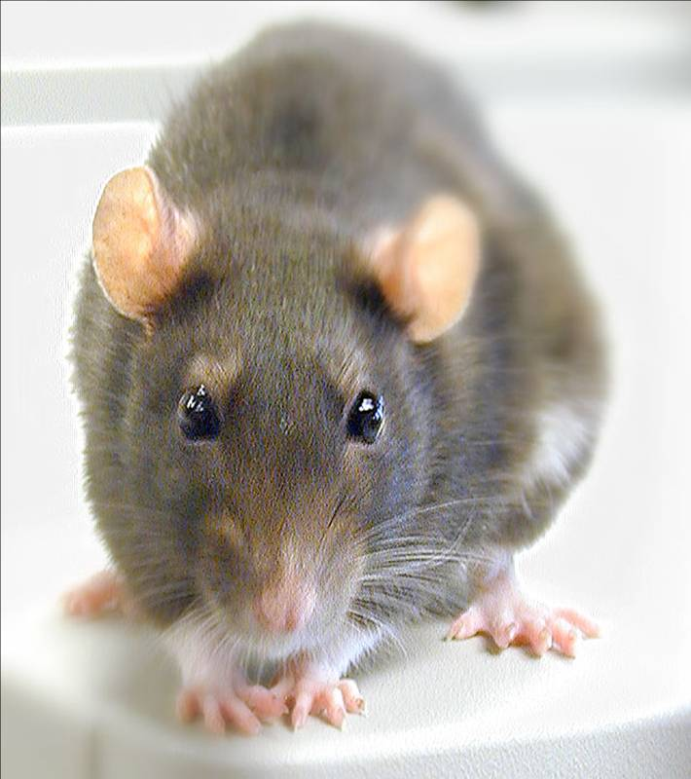
Conclusions from Rat Study *
Female rats had greatly increased risk of breast cancer
Males had significantly increased risk of tumors of the liver and kidney
Sex hormone disruption for both males and females
Enhanced oxidative stress
Very significant kidney dysfunction
Effects didn’t become apparent until after 4 months
*G.-E. Séralini et al., Food and Chemical Toxicology, 2012, in press
Notes:
Spacedoc/mercola/GMOS_mouse_study_2012.pdf

Slide 91
Conclusions from Rat Study *
Female rats had greatly increased risk of breast cancer
Males had significantly increased risk of tumors of the liver and kidney
Sex hormone disruption for both males and females
Enhanced oxidative stress
Very significant kidney dysfunction
Effects didn’t become apparent until after 4 months
Under a great deal of pressure from the agrichemical industry, the journal retracted this paper on Thanksigiving, 2013
*G.-E. Séralini et al., Food and Chemical Toxicology, 2012, in press
Notes:
Spacedoc/mercola/GMOS_mouse_study_2012.pdf

Slide 92
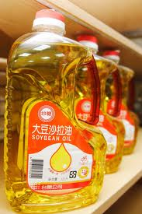
Dr. Mercola on Glyphosate in Soybean Oil*
“Glyphosate is easily one of the world's most overlooked poisons”
Birth defects in frog and chicken embryos occurred at 2 mg/kg
This is 10 times lower than the residue limit set by the European Union
Glyphosate causes endocrine disruption, DNA damage, developmental toxicity, neurotoxicity, reproductive toxicity, and cancer.
GMO crops soak up glyphosate so it can't be washed off
*Soybean Oil: One of the Most Harmful Ingredients in Processed Foods.
January 27, 2013

Slide 93
Glyphosate kills Liver Cells*
Doses far below those used in agriculture kill liver cells in vitro
Downregulated synthesis of glutathione, critical for detox of environmental chemicals
Upregulated synthesis of CYP enzymes
Likely due to interference with their function
*C. Gasnier et al., Journal of Occupational Medicine and Toxicology 2010, 5:29.

Slide 94
Photos from Argentina, where GMO Soy has replaced Grass-fed Cattle Farms
Boston Globe, October 30, 2013
Notes:
+ lots of respiratory illnesses
+ hydrocephalus
Moles with hairs growing out of them.
Aixa Cano, 5, who has hairy moles all over her body that doctors can't explain, sits on a stoop outside her home in Avia Terai, in Chaco province, Argentina on April 1. Although it's nearly impossible to prove, doctors say Aixa's birth defect may be linked to agrochemicals. In Chaco, children are four times more likely to be born with devastating birth defects since biotechnology dramatically expanded farming in Argentina. . (Natacha Pisarenko/Associated Press) #
Dying from exposure in agriculture
Former farmworker Fabian Tomasi, 47, shows the condition of his emaciated body as he stands inside his home in Basavilbaso, in Entre Rios province, Argentina on March 29. Tomasi's job was to keep the crop dusters flying by quickly filling their tanks but he says he was never trained to handle pesticides. Now he is near death from polyneuropathy. "I prepared millions of liters of poison without any kind of protection, no gloves, masks or special clothing. I didn't know anything. I only learned later what it did to me, after contacting scientists," he said. (Natacha Pisarenko/Associated Press) #
Multiple developmental problems.
Camila Veron, 2, born with multiple organ problems and severely disabled, stands outside her home in Avia Terai, in Chaco province, Argentina on March 31. Doctors told Camila's mother, Silvia Achaval, that agrochemicals may be to blame. It's nearly impossible to prove that exposure to a specific chemical caused an individual's cancer or birth defect, but doctors say these cases merit a rigorous government investigation. "They told me that the water made this happen, because they spray a lot of poison here," said Achaval. (Natacha Pisarenko/Associated Press) #

Slide 95
Recapitulation
Glyphosate has carcinogenic and endocrine disrupting properties → microcephaly
Low concentrations of glyphosate induce estrogenic activity
At parts per trillion, it can induce tumor growth in vitro
Female rats fed glyphosate contaminated food developed massive mammary tumors
Male rats had liver and kidney dysfunction
Glyphosate kills liver cells at low doses in vitro
Glyphosate in minute amounts causes birth defects in frog and chicken embryos
Exposed children and agricultural workers are getting sick

Slide 96
Nutrient Deficiencies & Climate Change

Slide 97
Glyphosate Depletes Nutrients*
*Jeffrey M. Smith, Jan 16, 2011
http://www.naturalnews.com/031138_Monsanto_Roundup.html
Notes:
Dr. Don Huber
http://drleonardcoldwell.com/2011/01/16/monsanto%E2%80%99s-roundup-triggers-over-40-plant-diseases-and-endangers-human-and-animal-health/
./roundup_depletes_plant_nutrients_DrHuber.pdf

Slide 98
Severe Deficiency in Manganese and Cobalt in Cows*
*M. Krüger et al., J Environ Anal Toxicol 2013, 3:5
Notes:
./cows_cobalt_deficiency_glyphosate.pdf

Slide 99
GMO Corn: Nutrient Deficient*
Nutrient | GMO | Non-GMO
sulfur | 3 | 42
zinc | 2.3 | 14
manganese | 2 | 14
iron | 2 | 14
copper | 2.6 | 16
molybdenum | 0.2 | 1.5
Toxin | GMO | Non-GMO
formaldehyde | 200 | 0
glyphosate | 13 | 0
Units are parts per million
*http://www.momsacrossamerica.com/stunning_corn_comparison_gmo_versus_non_gmo
Notes:
http://www.momsacrossamerica.com/stunning_corn_comparison_gmo_versus_non_gmo
./GMO_corn.nutrients
./MonsantoOnGMOCorn.pdf
A 2012 nutritional analysis of GMO versus non-GMO corn shows shocking differences in nutritional content. Non-GMO corn contains 437 times more calcium, 56 times more magnesium, and 7 times more manganese than GMO corn
· GMO corn was also found to contain 13 ppm of glyphosate, compared to zero in non-GMO corn. EPA “safe” level for glyphosate in American water supplies is 0.7 ppm, and organ damage in animals has occurred at levels as low as 0.1 ppm
· GMO corn contains extremely high levels of formaldehyde—about 200 times the amount found toxic to animals
· Research by a Texas teenager using fruit flies, which began when she was in middle school, shows that in virtually every health measure, including fertility, stress resistance and longevity, flies that fed on organic bananas and potatoes fared better than those who fed on conventionally raised produce. Her research was recently published in a respected science journal

Slide 100
GMO Corn: Nutrient Deficient*
Nutrient | GMO | Non-GMO
sulfur | 3 | 42
zinc | 2.3 | 14
manganese | 2 | 14
iron | 2 | 14
copper | 2.6 | 16
molybdenum | 0.2 | 1.5
Toxin | GMO | Non-GMO
formaldehyde | 200 | 0
glyphosate | 13 | 0
Units are parts per million
*http://www.momsacrossamerica.com/stunning_corn_comparison_gmo_versus_non_gmo
Notes:
http://www.momsacrossamerica.com/stunning_corn_comparison_gmo_versus_non_gmo
./GMO_corn.nutrients
./MonsantoOnGMOCorn.pdf
A 2012 nutritional analysis of GMO versus non-GMO corn shows shocking differences in nutritional content. Non-GMO corn contains 437 times more calcium, 56 times more magnesium, and 7 times more manganese than GMO corn
· GMO corn was also found to contain 13 ppm of glyphosate, compared to zero in non-GMO corn. EPA “safe” level for glyphosate in American water supplies is 0.7 ppm, and organ damage in animals has occurred at levels as low as 0.1 ppm
· GMO corn contains extremely high levels of formaldehyde—about 200 times the amount found toxic to animals
· Research by a Texas teenager using fruit flies, which began when she was in middle school, shows that in virtually every health measure, including fertility, stress resistance and longevity, flies that fed on organic bananas and potatoes fared better than those who fed on conventionally raised produce. Her research was recently published in a respected science journal

Slide 101
"Sulfur is deficient in 90(+)% of the soil samples I review, no matter where they come from.”*
Rainfall leaches sulfur out of the root zone in low humus soils
Humus levels have dropped considerably following industrial farming practices
Humus levels have fallen from as high as 20% to 3% or less.
Many commercial fertilizers used to be sulfated but this is changing.
Adequate amounts of sulfur are needed for nitrogen fixing soil bacteria
* Jerry Brunetti, soil expert, personal communication
Notes:
./sulfur_depletion_in_the_soil.text

Slide 102
Glyphosate and Climate Change*
“The metabolic quotient obviously signaled unfavorable soil maintenance with higher efflux of CO₂ to the atmosphere.”
“Dying plants upon desiccation leads to the highest average values … in the course of the experiment.”
“organic practices rapidly improve soil microbial characteristics and slowly increase soil organic C (Carbon).”
*M. Růžková et al., Plant Soil Environ 57(2), 2011, 88-94.
Notes:
Csail/2013/project/Anthony/glyphosate_soil_arylsulfatase_climate_change.pdf

Slide 103
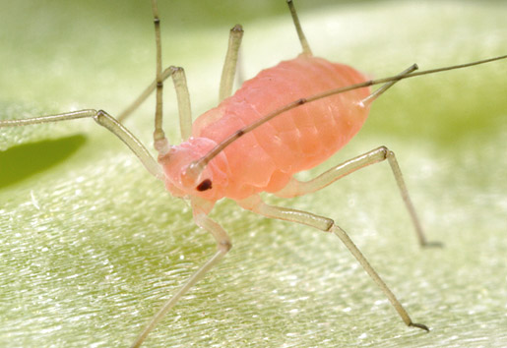
"Plants Warn One Another of Pest Attack through Mycorrhizal Fungal Network"*
Form symbiotic relationships with plants
Increase mineral uptake
Redistribute water during drought stress
Increase tolerance to root and shoot pathogens
When one plant is infected by aphids, chemical signals are transmitted through fungus network in ground to neighboring plants
Neighbors release chemicals to repel aphids and attract predatory wasps
Glyphosate disrupted growth of five species of ectomycorrhizal fungi tested in vitro**
*ISIS Report 28/10/13, http://www.i-sis.org.uk/mycorrhizae_and_plant_communication.php
** P. Chakravarty and S.S. Sidhu, European Journal of Forest Pathology 17(4-5), 204-210, 1987.
Notes:
Treasures/plants_warning_through_fungus.pdf
http://onlinelibrary.wiley.com/doi/10.1111/j.1439-0329.1987.tb01017.x/abstract
./glyphosate_mycorhizal_fungus.text

Slide 104
“Predators Help Plants Put Away Carbon”*
Yale University study
Plants with three conditions in enclosed environment:
No predators
Grasshoppers only
Grasshoppers and spiders
Surprisingly, the condition with spiders resulted in 20% more carbon storage in the plants compared to the isolated plants
*A Duhaime-Ross, Scientific American, September 2013, p. 16
Notes:
Meadow vegetation

Slide 105
“Predators Help Plants Put Away Carbon”*
Yale University study
Plants with three conditions in enclosed environment:
No predators
Grasshoppers only
Grasshoppers and spiders
Surprisingly, the condition with spiders resulted in 20% more carbon storage in the plants compared to the isolated plants
This has a direct effect on global warming!!
*A Duhaime-Ross, Scientific American, September 2013, p. 16
Notes:
Meadow vegetation

Slide 106
Corn (Maize) Monocrop in US*
“Maize production in the United States, the world’s largest producer, is heavily subsidised, coming to some $84 billion between 1995 and 2010.[15] In 2012 subsidies to US maize farmers were greater than South Africa’s entire agricultural budget.[16] Additionally, a range of tax incentives (worth $45 billion from 1980 to 2011)[17] mean that now over 40% of annual maize production is used to produce ethanol, a prodigious waste of resources.[18]
*GM Maize: lessons for Africa - Cartels collusion and control of South Africa's staple food. Nov. 5, 2013.
acbio.org.za/index.php/publications/rest-of-africa/449-gm-maize-lessons-for-africa

Slide 107
Biofuel? Maybe not!*
Inflammatory response was higher for the biofuel than for the standard diesel
Biofuel = 20/80 blend of soy biodiesel and standard diesel
Measured in bronchoalveolar lavage fluid of exposed mice
Levels were 20-30% higher for biodiesel fuel
Reduces particulate emissions but may be more damaging to health
Is this Due to Glyphosate Contamination?
*Environ. Sci. Technol. 2013, DOI: 10.1021/es403146c
Notes:
This is hard to find, but there is an article.
Environ. Sci. Technol. 2013, DOI: 10.1021/es403146c

Slide 108
Recapitulation
GMO corn is depleted in many nutrients, including sulfur, zinc, manganese, iron, and copper
Glyphosate may be playing a direct role in climate change by interfering with CO₂ fixation in plants and soil.
Destroying ectomycorrhizal fungi
Desiccation
Destroying predators
Soy and corn as biofuels may not be such a good idea due to toxicity of burning pesticides

Slide 109
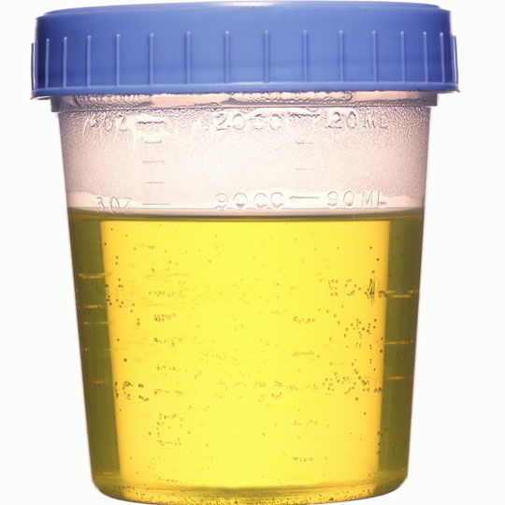
“Determination of Glyphosate residues in human urine samples from 18 European countries”*
182 urine samples from 18 European countries analyzed for glyphosate
city-dwellers who had never handled roundup or any herbicides.
44% of the samples contained quantifiable amounts of glyphosate
7% of the participants exceed 0.8 micrograms/Liter, the reference cutoff for "safety”
Diet seems to be the main source of exposure
These numbers would be much worse if they were measured in the U.S.
*https://www.foeeurope.org/sites/default/files/glyphosate_studyresults_june12.pdf
Notes:
Europe Urine
./WeedKillerHumanUrine.pdf
Swine/glyphosate_in_urine_Europe.pdf

Slide 110
“Determination of Glyphosate residues in human urine samples from 18 European countries”*
"Our testing highlights a serious lack of action by public authorities across Europe and indicates that this weed killer is being widely overused. Governments need to step-up their monitoring and bring in urgent measures to reduce its use. This includes rejecting any genetically modified crops that would increase the use of glyphosate."
182 urine samples from 18 European countries analyzed for glyphosate
city-dwellers who had never handled roundup or any herbicides.
44% of the samples contained quantifiable amounts of glyphosate
7% of the participants exceed 0.8 micrograms/Liter, the reference cutoff for "safety”
Diet seems to be the main source of exposure
These numbers would be much worse if they were measured in the U.S.
*https://www.foeeurope.org/sites/default/files/glyphosate_studyresults_june12.pdf
Notes:
Europe Urine
./WeedKillerHumanUrine.pdf
Swine/glyphosate_in_urine_Europe.pdf

Slide 111
One Final Message:
Go Organic!

Slide 112
Prof. Don Huber on Glyphosate*
“When future historians write about our time, they're not going to write about the tons of chemicals that we did or didn't apply. When it comes to glyphosate, they're going to write about our willingness to sacrifice our children and jeopardize our existence, while threatening and jeopardizing the very basis of our existence; the sustainability of our agriculture.”
*Retired professor from Purdue University; Expert in plant pathology
articles.mercola.com/sites/articles/archive/2012/01/15/dr-don-huber-interview-part-2.aspx
Notes:
Dr. Mercola interview:http://articles.mercola.com/sites/articles/archive/2012/01/15/dr-don-huber-interview-part-2.aspx

Slide 113
Summary
I believe we need to be very worried about glyphosate in the food and water supplies
Glyphosate’s disruption of gut bacteria, depletion of essential amino acids and minerals, and interference with cytochrome P450 enzymes have widespread consequences
Glyphosate may be the most important factor in the recent die-off of many species
Glyphosate may be the most important factor in the U.S. health crisis related to obesity, autism, celiac disease, kidney failure, infertility, etc.
Notes:
Mention paper has a lot more

