Slide 1
Cholesterol, Sulfur, Lactate, and Sunlight: a New Paradigm for Health
Stephanie Seneff
Computer Science and Artificial Intelligence Laboratory
MIT
WAPF Wise Traditions Conference
November 11, 2011

Slide 2
Outline
The Perfect Storm
What's bad about diets that are enriched in sugar and starch?
What's good about diets that are enriched in fat and cholesterol?
Choline, zinc and folate
Ketogenic diet
Lactate
Sulfur
Cholesterol sulfate and endothelial Nitric Oxide Synthase
(Time Permitting) The silver lining in cardiovascular disease

Slide 3
The Perfect Storm
Low dietary fats and (especially) cholesterol
Deficiencies in zinc, choline, folic acid, sulfur, …
High dietary carbohydrates, especially high fructose corn syrup (HFCS) and wheat
High consumption of heavily processed foods
Extreme avoidance of sun exposure
Cumulative exposure to aluminum
In deodorants, vaccines, sunscreen, cookware …

Slide 4
The Consequences
cancer
cardiovascular disease
Alzheimer’s
depression
asthma
multiple sclerosis
allergies
fibromyalgia
ADHD
diabetes
Parkinson’s disease
obesity
GERD
seizures
heart failure
autism

Slide 5
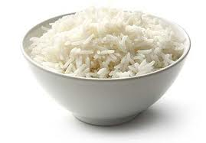
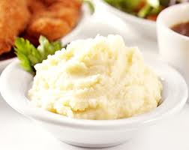
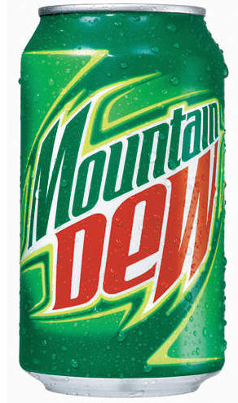
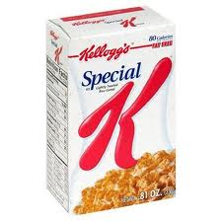
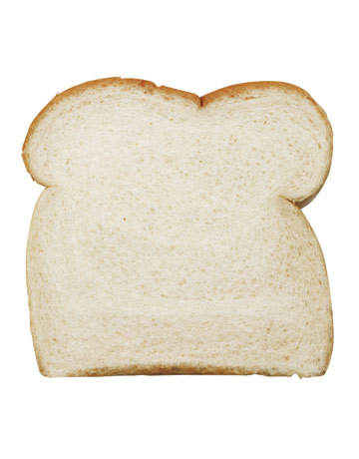
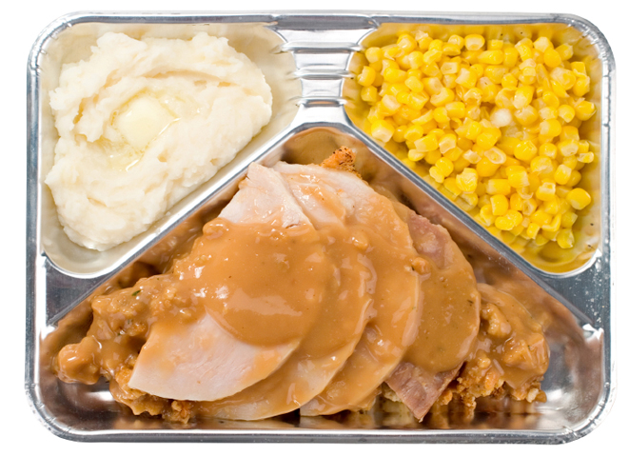
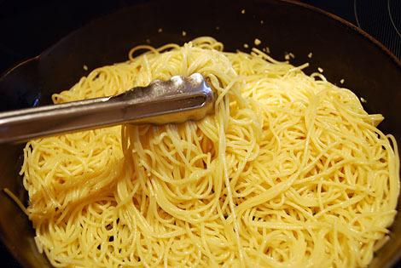
Unhealthy Foods

Slide 6
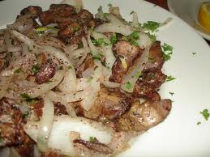
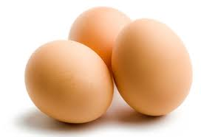
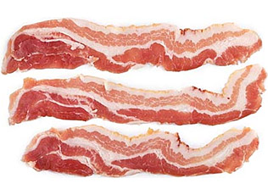
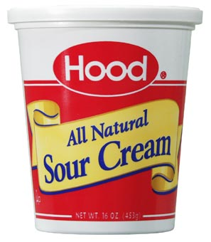
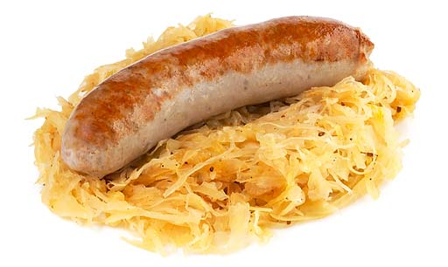
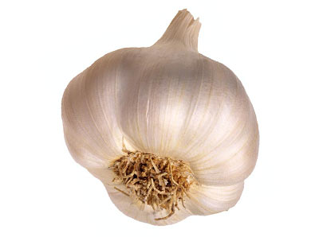
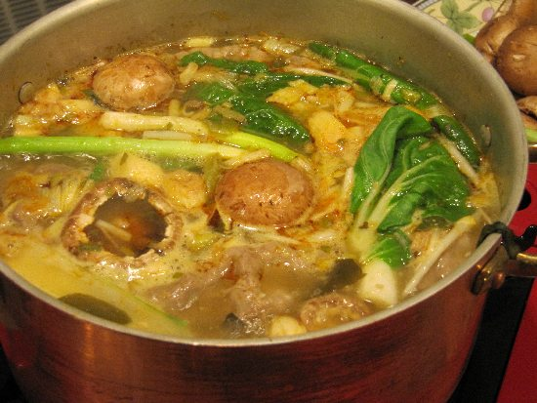
Healthy Foods
IRON
CHOLINE
ZINC
FOLATE
CHOLESTEROL
VITAMIN D3
VITAMIN A
LACTATE
SULFUR
SATURATED FAT
ELECTROLYTES

Slide 7
Two Truisms?
You should be sure to eat plenty of carbohydrates because the brain can not utilize fats as fuel
You should avoid dietary cholesterol because the body can synthesize all the cholesterol it needs

Slide 8
How I would Phrase it
You should be sure to eat plenty of dietary cholesterol because its synthesis process is complex and it is an essential nutrient for the brain and for the membranes of all the cells of the body
You should avoid dietary carbohydrates because the body can synthesize all the glucose it needs

Slide 9
Excellent YouTube Video
Enjoy Eating Saturated Fats: They're Good for You.
Donald W. Miller, Jr., M.D.
http://www.youtube.com/watch?v=vRe9z32NZHY

Slide 10
From Youtube video: Enjoy Eating Saturated Fats: They're Good for You.
Donald W. Miller, Jr., M.D.
http://www.youtube.com/watch?v=vRe9z32NZHY
Notes:
Dr. Miller is professor of surgery, cardiothoracic division, Univ. Washington, and writes frequently for http://www.Lewrockwell.com.
Mary Enig Univ of ?? Trans fats bad

Slide 11
From Youtube video: Enjoy Eating Saturated Fats: They're Good for You.
Donald W. Miller, Jr., M.D.
http://www.youtube.com/watch?v=vRe9z32NZHY
Notes:
Dr. Miller is professor of surgery, cardiothoracic division, Univ. Washington, and writes frequently for http://www.Lewrockwell.com.
./no_association_Sat_fat_heart_disease.pdf
Mary Enig Univ of ?? Trans fats bad
Replacing sat fats with carbs increases risk of heart disease
Coconut oil in group c other 20 took 30 ml soybean oil for twelve weeks
Coconut oil significant reduction in waist circumference 0.005 p-value.
No change in soybean group
-- coconut also raised HDL levels
Overweight people.
Sally Fallon: eat fat lose fat ….

Slide 12
From Youtube video: Enjoy Eating Saturated Fats: They're Good for You.
Donald W. Miller, Jr., M.D.
http://www.youtube.com/watch?v=vRe9z32NZHY
Notes:
Dr. Miller is professor of surgery, cardiothoracic division, Univ. Washington, and writes frequently for http://www.Lewrockwell.com.
Mary Enig Univ of ?? Trans fats bad

Slide 13
What’s bad about diets that are enriched in sugar and starch?

Slide 14
For a long time, we had falsely believed that carbohydrate was our best energy source because it neither was greasy nor caused us fat, and that we could not live without it.... Now, we have known that carbohydrate can harm our health and develop diseases such as morbid obesity, diabetes mellitus, cardiovascular diseases, cancer, Alzheimer’s disease, and many more.
Robert Su, M.D. Author, Carbohydrates Can Kill www.carbohydratescankill.com

Slide 15
The U.S. Obesity Epidemic*
1990
2008
2004
* Source: CDC Behavioral Risk Factor Surveillance System

Slide 16
Blood Sugar Levels after a Meal
Too many carbohydrates
Too few fats

Slide 17
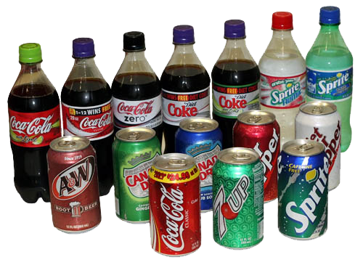
Soft Drink Consumption
Nurse's Health Study: 90,000 women monitored over 8 years
Women who reported drinking one soda per day gained on average ten pounds over four years
Women who drank one or more servings per day of a sugar-sweetened drink were twice as likely to have developed type 2 diabetes compared to those who rarely drank these beverages
Dhingra et al., Circulation (116) 480-488, 2007
Higher risk of obesity, high blood pressure, and diabetes for middle-aged adults who consumed at least one soft drink per day.
Notes:
Cancer/soft_drinks_cardiovascular_risk.pdf

Slide 18
Sugar: the Bitter Truth*
Robert Lustig, UCSF Professor
>1.7 million uploads
Blames fructose for the obesity epidemic
Discusses how liver converts fructose to fat and releases it as LDL
"You can make dog poop taste good with enough sugar. In essence, that is what the food industry has done.”
-Robert Lustig in interview with New Scientist
* http://www.youtube.com/watch?v=dBnniua6-oM

Slide 19
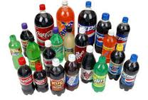
Advanced Glycation End Products (AGE’s)
Aptly named, as they accumulate as we age and make us age faster
Generated by reactions between sugars and proteins, and they're hard to get rid of
Interfere with function of affected proteins
Fructose is far more reactive than glucose
Methylglyoxal, generated as a by-product when corn starch is converted to fructose non-enzymatically, is the worst AGE'ing agent known
Hemoglobin A1c is an example of an AGE product

Slide 20
Sucrose vs HFCS Consumption in U.S.*
* Tappy and Le, Physiol Rev 90, 23–46, 2010
Notes:
cancer/fructose_review_LONG.pdf

Slide 21
More on AGE’s
Result of Maillard reaction, mainly involving lysines in proteins
Vegetarians have much higher risk
Attributable in part to excess fructose consumption and inadequate dietary lysine*
The enzyme glyoxalase converts methylglyoxal back to a non-toxic molecule **
Depends on glutathione (sulfur) and on zinc
These both depend on adequate dietary intake of foods containing cholesterol
* Krajcovicova-kudlackova et al. “Advanced Glycation End Products and Nutrition”, Physiol. Res. 51: 313-316, 2002
** Creighton and Hamilton, Arch Biochem Biophys. 387(1), 1-10, 2001.
Notes:
Cancer/vegetarians_AGE.pdf
Cancer/glyoxalase_I_zinc.text

Slide 22
Articles on Fructose and Health
These topics were covered in my talks last year at WAPF
“Is the metabolic syndrome caused by a high fructose, and relatively low fat, low cholesterol diet?'’ S. Seneff, G. Wainwright, and L. Mascitelli, Archives of Medical Science, 7(1) 8-20, 2011
“Nutrition and Alzheimer's Disease: the Detrimental Role of a High Carbohydrate Diet,'' S. Seneff, G. Wainwright, and L. Mascitelli, European Journal of Internal Medicine, 2011.

Slide 23
“Wheat Belly: Lose the Wheat, Lose the Weight”*
Wheat has a high glycemic index (even whole wheat)
Phytate in wheat chelates iron and zinc
Gliadin (peptide in wheat) causes psychological and neurological damage
Incidence of celiac disease (wheat allergy) has quadrupled over the last 50 years
Author proposes obesity epidemic due to excess dietary wheat
* By William Davis, M.D., published August 2011
Notes:
./wheat_belly.text

Slide 24
Schizophrenia and Gluten*
Observation:
Schizophrenia is rare in populations where grains are avoided
Case study:*
Woman, currently 70 years old
Schizophrenic since age of 17.
Treatment program: low-carb, gluten-free diet (ketogenic)
Auditory and visual hallucinations quickly disappeared
* Kraft and Westman, Nutrition and Metabolism, 2009.
Notes:
Nutrition\ \&\ Metabolism\ \|\ Full\ text\ \|\ Schizophrenia,\ gluten,\ and\ low-carbohydrate,\ ketogenic\ diets:\ a\ case\ report\ and\ review\ of\ the\ literature.pdf
Laurie_lentz/Nutrition_and_schizophrenia.text

Slide 25
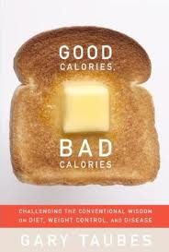
Dieting and Serum Cholesterol*
High carb diet:
Dieters lose weight only by starving themselves
Only show improvements in serum LDL/HDL if weight is lost (burn body fat)
High protein diet:
Dieters get to where they can’t stand to face another lean pork chop
Lose weight because food is repulsive
High fat diet:
Dieters can lose weight without feeling hungry all the time
Even those who don’t lose any weight improve their serum LDL/HDL levels**
* Gary Taubes, “Good Calories Bad Calories”
** Feinman and Volek, Nutrition and Metabolism, 2006
Notes:
Richard Feinman and Jeff Volek,
"Low carbohydrate diets improve atherogenic dyslipidemia even in the
absence of weight loss." Nutrition and Metabolism, 3:24, 2006.
Cancer/low_carb_diet_benefits_heart_richard_feinman.pdf

Slide 26
What’s good about diets that are enriched in fat and cholesterol?

Slide 27
All of these nutrients are likely to be deficient in a diet that actively avoids saturated fat and cholesterol
choline
zinc
sulfur
vitamin D
vitamin K
vitamin A
iron
folate
cholesterol
saturated fat

Slide 28
“Part of the reason for the evolution of human life and the presence or our outstanding well developed brains is the invention/discovery of proto-cholesterol 3/4 of a billion years ago and … sequestering and concentrating of it in our BRAINS. “ *
-- Laurie Lentz-Marino, chemist, Mount Holyoke
* Comment based on Love et al. 457(5), 2009
Notes:
Hopefully, Laurie is here!!!
Laurie_lentz/Loveetal09.pdf

Slide 29
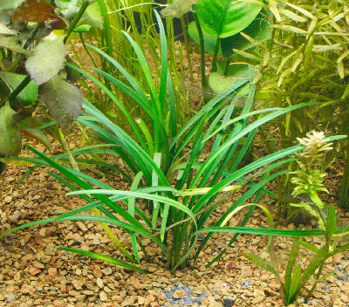
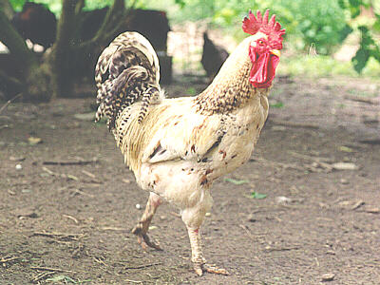
Cholesterol is Essential for Mobility and a Nervous System
Plants contain no cholesterol
Plants can’t move
Plants don’t have a nervous system
In a sense, cholesterol is to animals as chlorophyll is to plants

Slide 30
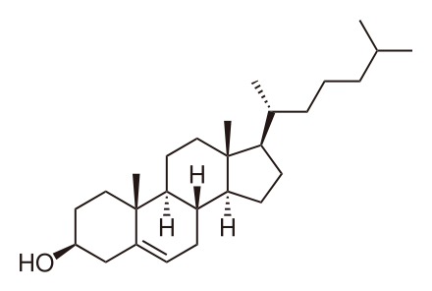
Cholesterol in the Brain
The brain contains 2% of the body’s weight and 25% of the body’s cholesterol
Cholesterol is essential in the brain for neurotransmitter transport at synapses and for signal insulation in the long-distance axons

Slide 31
Cholesterol-enriched Lipid Rafts
Lipid rafts are special regions of cell membranes
Prominent role in muscle metabolism and contraction
Regulate neurotransmission and receptor trafficking
Disruption of lipid rafts in neurons leads to:
Depletion of excitatory and inhibitory synapses
Loss of dendritic spines
Receptor instability

Slide 32
Nutrition and Physical Degeneration*
Weston Price, a dentist from Minnesota, traveled all around the world, comparing traditional diets with Western influenced diets
Repeatedly, he observed that foods the natives treasured were ones that I know to be extremely high in fat and cholesterol
Fish eggs, shrimp, coconut, organ meats, oysters, chicken eggs, sweetbreads, . . .
People who adopted the Western diet, particularly white flour and white sugar, were generally much less healthy
* Weston Price’s famous book, written in 1939

Slide 33
Choline, Zinc and Folate

Slide 34
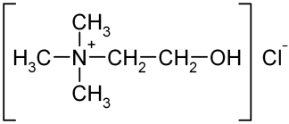
Choline’s Pathways
Cell Membrane Health
Protects from Cancer
Sulfur-containing amino acids
Important
neurotransmitter

Slide 35
Choline Content of Common Foods*
Source | Mg choline/100gram
egg white | 1
egg yolk | 682
caviar | 491
chicken liver (meats) | 300
shrimp (seafood) | 81
pistachio nuts (nuts) | 71
dried figs (fruits) | 16
brussel sprouts (vegetables) | 41
Each item is the best source in its class
Egg yolk contains all the choline in eggs
* USDA Database for Choline, March, 2004
Notes:
Desktop/Presentations/Project/2011/Choline.pdf

Slide 36
Choline Deficiency and Liver and Heart Disease*
Cholesterol-rich foods are a major source of choline, an essential nutrient
Choline is needed to release VLDL from liver
Especially in context of high fructose diet
Choline deficiency → fatty liver
Choline deficiency → elevated homocysteine
Elevated homocysteine is a risk factor for heart disease (and later I will explain why)
* Da Costa et al., Am J Clin Nutr, 440-4, 2005

Slide 37
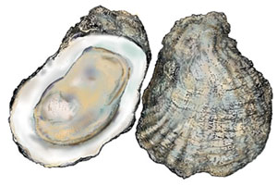
Zinc
Adequate zinc intake is essential for fighting off infectious disease, boosting immune function, repairing DNA damage and fighting cancer.
As many as 12% of Americans are deficient, and 40% of the elderly in America
Oysters are the very best source; other options are beef and poultry;
Zinc is poorly absorbed from plant sources
Notes:
http://medicalnewsonline.net/uncategorized/new-findings-on-role-of-zinc-in-overall-health-immunity/

Slide 38
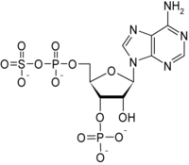
What’s the Role of Folic Acid?
Homocysteine is a precursor for methionine
Folic acid catalyzes the reaction
Folic acid absorption through the gut depends on sufficient cholesterol in lining of intestines
Methionine is critical for protein synthesis
When folic acid is insufficient, homocysteine is converted to PAPS* instead, and ultimately to sulfate
Protein synthesis is impaired
* phosphoadenosine phosphosulfate

Slide 39
Ketogenic Diet

Slide 40
New York Times Article*
“There is no crusade against unhealthful food in our house. Some might argue that unhealthful food is all we let Sam eat. His breakfast eggs are mixed with heavy cream and served with bacon. A typical lunch is full-fat Greek yogurt mixed with coconut oil. Dinner is hot dogs, bacon, macadamia nuts and cheese… Sam’s diet is just shy of 90% fat”.
*http://www.nytimes.com/2010/11/21/magazine/21Epilepsy-t.html
Notes:
Cancer/ketogenic_diet_alzheimers.pdf
Cancer/antidepressant_ketogenic_diet.pdf

Slide 41
The Ketogenic Diet is Good for a lot more than Epilepsy
Epilepsy (MacKracken and Scalizi J. Am Diet Assoc 1999)
Depression (Murphy et al. Biol Psych 2004)
Autism (Evangelieu et al. J. Child Neurol 2003)
Alzheimer’s (Reger et al. Neurobiol Aging 2004)
ADHD (Murphy et al Pediatr Res. 2005)
Parkinson’s disease ((VanItallie et al. Neurology 2005)
Schizophrenia (Kraft and Westman, Nutr Metab 2009)
Notes:
Cancer/ketogenic_diet_helps_depression.pdf
Cancer/

Slide 42
Why Ketogenic Diet is Good*
cholesterol
lactate
GABA
ATP
* Adapted from Freeman et al., Epilepsy Research (68) 2006
Notes:
Another random note: Aspartate transaminase catalyzes the interconversion of aspartate and
α-ketoglutarate to oxaloacetate and glutamate (this is the enzyme that’s monitored with statin therapy and shows up w/ niacin treatment as well)
Random Note: vitamin K2 catalyzes the conversion of glutamate to gamma-carboxy glutarate (possibly relevant)
Ketone_body_action.png, .caption
Cancer/ketogenic_diet_LONG.pdf
Fig. 3. Diagram illustrating the metabolic inter-relationships between
brain metabolism of glutamate, ketone bodies and glucose. In ketosis,
3-OH-butyrate (beta-hydroxybutyrate) and acetoacetate contribute
heavily to brain energy needs. A variable fraction of pyruvate (1) is
ordinarily converted to acetyl-CoA via pyruvate dehydrogenase. In
contrast, all ketone bodies generate acetyl-CoA which enters the
tricarboxylic acid (TCA) cycle via the citrate synthetase pathway
(2). This involves the consumption of oxaloacetate, which is necessary
for the transamination of glutamate to aspartate. Oxaloacetate is then
less available as a reactant of the aspartate aminotransferase pathway
which couples the glutamate–aspartate interchange via transamination
to the metabolism of glucose through the TCA cycle. Less glutamate is
converted to aspartate and thus, more glutamate is available for
synthesis of GABA (3) through glutamic acid decarboxylase
(GAD). Adapted from Yudkoff et al. (2004c) with permission.

Slide 43
Lactate

Slide 44
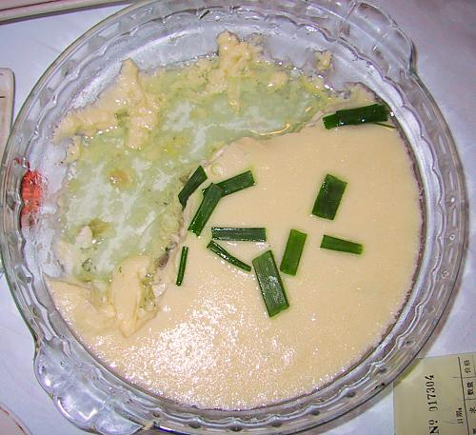
Lactate: The Perfect Food
Doesn’t generate AGEs like sugar and starch
Doesn’t generate oxidative damage like unsaturated fats
Carries a negative charge: helps fight acidosis
Binds with iron to form lactoferrin, a potent antibiotic
Heart, liver, and brain get first dibs

Slide 45
Lactate-rich Foods in Taiwan
Suan Cai Bai Rou Huo Guo
Chou Tofu
These foods are also a great source of vitamin K

Slide 46
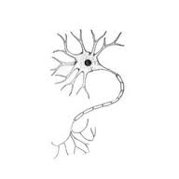
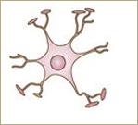
Lactate in the Brain*
lactate
glucose
galactose
Neuron
Astrocyte
lactate
Neuron requires lactate to be able to form long-term memories
Astrocyte can supply it (by conversion from glucose) or it can come directly from the medium (diet)
* Suzuki et al., Cell 144, 810–823, 2011
Notes:
Cancer/Lactate_neuron_memory.pdf

Slide 47
SULFUR!!!

Slide 48
“New scientific truth does not triumph by convincing its opponents and making them see the light, but rather because its opponents eventually die, and a new generation grows up that is familiar with it.” -- Max Planck

Slide 49
Places where Obesity and Heart Disease Rates are LOW
Worldwide:
Japan, Greece, Italy, Iceland
In the U.S.
Oregon has the lowest obesity rate among children
Hawaii has low obesity but is quickly losing ground (WalMart)
What do these places have in common??
Basalt Volcanic Rock!

Slide 50
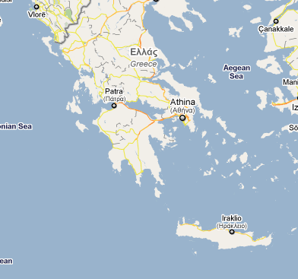
Corfu and Crete
Two islands in Mediterranean
Identical diet
5x risk of heart disease in Corfu compared to Crete
What’s different?
Corfu
Crete

Slide 51
The Geology!
Corfu is the old limestone summit of a submerged mountain
Crete has a volcanic rift zone cutting through it
Rift basin filled by flood basalt
“Thick basaltic andesitic volcanogenic sequence (lavas and volcaniclastic sediments).”*
*Tectonic development of the Eastern Mediterranean region
By A. H. F. Robertson and Demosthenis Mountrakis

Slide 52
Volcanic Rock is Sulfur-Enriched!!

Slide 53
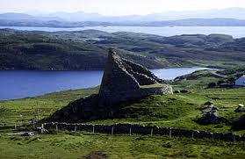
The Gaelics of the Outer Hebrides*
“This island has so little lime in its soil that it is said that there are no trees in the entire island except a few which have been planted” (p. 41)
* Chapter 4, Weston A. Price’s book

Slide 54
The Gaelics of the Outer Hebrides*
“The thatch of the roofs plays a very important role. It is replaced each October and the old thatch is believed by the natives to have great value as a special fertilizer for their soil because of its impregnation with chemicals that have been obtained from the peat smoke which may be seen seeping through all parts of the roof at all seasons of the year. Peat fires are kept burning for this explicit purpose even when the heat is not needed.” (p. 43)
* Chapter 4, Weston A. Price’s book

Slide 55
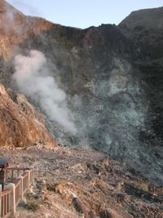
Taiwan and Sulfur Hot Springs
Beitou Hot Springs
Yangmingshan

Slide 56
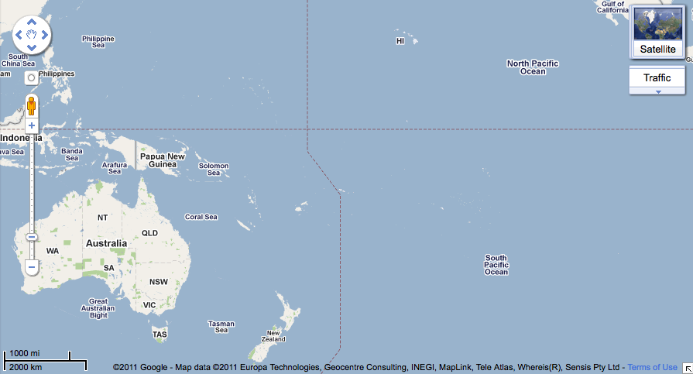
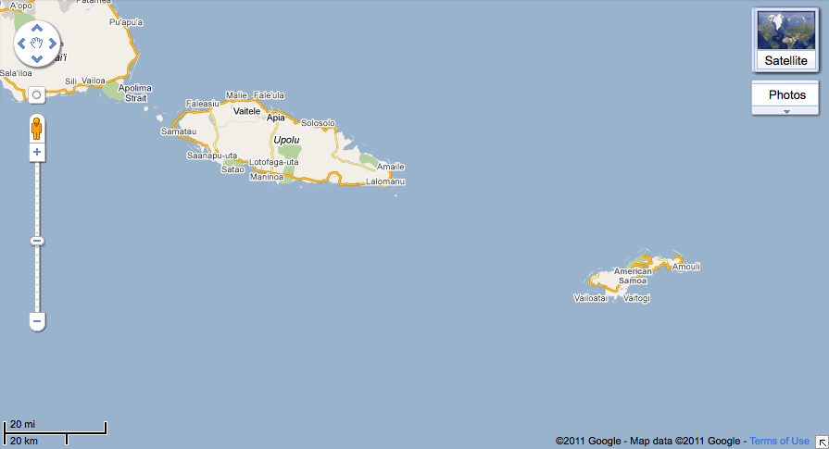
Highest Obesity Rates Here
The middle of the Pacific Ocean
Migratory birds: GUANO!!!
American Samoa
American Samoa
Cook
Islands
Tonga

Slide 57
Wikipedia on Guano
Guano consists of ammonia, along with uric, phosphoric, oxalic, and carbonic acids, as well as some earth salts and impurities. Guano also has a high concentration of nitrates.

Slide 58
Singapore and Sulfur: SHIPS!*
“Primary sulfate, or SO₄, is produced when ships burn a cheap, sulfur-rich fuel called "bunker oil." Most of the sulfur emitted by ships burning bunker oil is released as sulfur dioxide, or SO₂, a gaseous pollutant which is eventually converted to sulfate in the atmosphere. “
Singapore has high life expectancy rates and low infant mortality
* http://wildshores.blogspot.com/2008/10/singapore-to-be-sulphur-emission.html

Slide 59
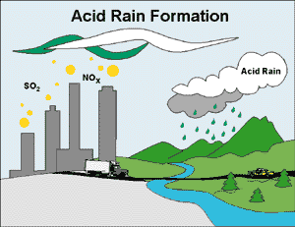
New York Times Article
“Farmers Seek Sulfur as Acid Rain Declines”
Wednesday, Sept. 9, 2009.
Notes:
Sulfur/acid_rain_sulfur_deficiency_soil.pdf

Slide 60
What does Cotton have to do with it?
Each dot represents 2,000 bales of cotton production in 1860
Notes:
Coastal Plain soils tend to be low in sulfur for several reasons. Many
are low in organic matter, which is a major source of sulfur, and most
are sandy and tend to loose nutrients easily, especially during rain
events. Several factors increase the problem: high analysis
fertilizers that contain little or no sulfur, high-yielding crops that
remove sulfur from the soil, reduction in crop residue turned to the
soil, stringent restrictions on industry sulfur emissions, and a
decline in the use of sulfur-containing pesticides.

Slide 61
Obesity and Heart Disease in the Cotton Belt
“Dr Richard Milani (Ochsner Health Center, Metairie, LA) speaks glumly about the swath of cardiometabolic disease shrouding Mississippi, Louisiana, and Alabama—with rates "typically in the highest decile for stroke and heart disease in the nation"—and New Orleans "right in the thick of it." New Orleans itself, he adds, consistently ranks as one of the most obese cities in the US.”
*Betty Crocker, Coke, and CardioSmart at ACC 2011 | theheart.org

Slide 62
Sulfur Deficiency in the Soil
Coastal plain soils are low in sulfur*
Low in organic matter: a major source of sulfur
Sandy soils lose nutrients easily
Fertilizers used often contain little or no sulfur
Stringent restrictions on industry sulfur emissions
High-yield crops and farming methods
Decline in use of sulfur-containing pesticides
* www.ncagr.gov/agronomi/release/5-00agrosulf.htm

Slide 63
How to Maintain Adequate Sulfur (and good health)
Eat eggs
Avoid filtered water
Soak in epsom salts
Bask in the sun

Slide 64
Cholesterol Sulfate and
Endothelial Nitric Oxide Synthase

Slide 65
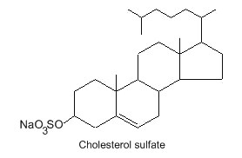
Cholesterol Sulfate: What’s It All About?*
Synthesized in the skin and by red blood cells and platelets
Omnipresent in blood serum in small amounts
Collects around exterior of red blood cells and gives them a negative charge field
Keeps cells from sticking together or sticking to capillary walls
Can travel freely in blood and readily enters cell walls
* Strott, J. Lipid Res. 44, 2003

Slide 66
Red Blood Cell Membrane
Cholesterol Sulfate easily pops out of membrane
Figure provided by Glyn Wainwright

Slide 67
Sulfated Glycosaminoglycans (GAGs)
Prominent in extracellular matrix of all cells
Amount of sulfate depends on availability
Crucial for maintaining negative charge and protecting from infection
http://www.science-autism.org/sulphate.htm

Slide 68
How It’s Supposed to Work
Plenty of dietary sulfur
Plenty of dietary cholesterol
Plenty of sun exposure

Slide 69
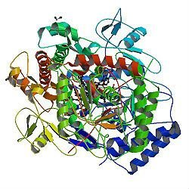
A Radical Proposal
Cholesterol sulfate supplies oxygen, sulfur, cholesterol, energy energy and negative charge to the tissues
Sulfate synthesized from sulfide in skin and blood stream utilizing energy in sunlight
Protects from UV damage and keeps microbes out
Endothelial Nitric Oxide Synthase (eNOS) performs the magic
The skin is a solar powered battery!

Slide 70
eNOS!!
Endothelial nitric oxide synthase (eNOS) is a very interesting molecule
It’s known for its role in synthesizing nitric oxide (NO) from L-arginine
But I think it has a much more important role as well, which is its primary role:
To synthesize sulfate from sulfur in the presence of sunlight
N → NO → NO₃⁻²
S → SO₂ → SO₄⁻²

Slide 71
Where is eNOS Found? What does it do?
In melanocytes in the skin (cells that synthesize melanin for tanning)
In the endothelial cells lining artery walls
In several cell types in the blood:
red blood cells, platelets, mast cells
eNOS synthesizes nitric oxide from L-arginine
It makes no sense for a red blood cell to synthesize nitric oxide!!

Slide 72
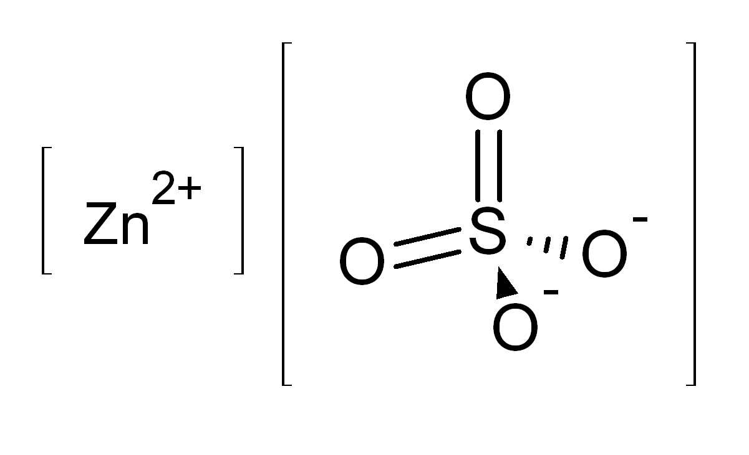
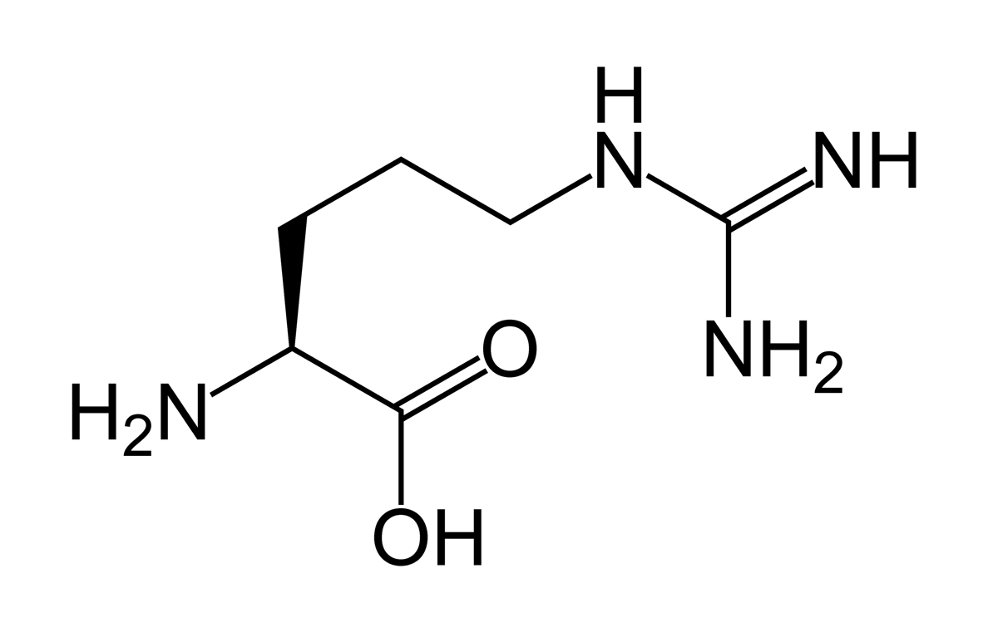
Hemoglobin binds strongly to nitric oxide: this neutralizes the effect of both of them!
The red blood cell keeps the substrate for nitric oxide synthesis out:
I hypothesize that it uses eNOS to make sulfate instead !
L-ARGININE
eNOS

Slide 73
eNOS and Caveolae
sulfate
Michel and Feron, J. Clin. Invest. 100(9) 2146-2152, 1997
Notes:
Cancer/NOS_review.pdf
Michel (Series Editor) and Olivier Feron
J. Clin. Invest. © The American Society for Clinical Investigation, Inc. 0021-9738/97/11/2146/07 $2.00 Volume 100, Number 9, November 1997, 2146–2152 http://www.jci.org
Michel and Feron, J. Clin. Invest. 100(9) 2146-2152, 1997
Palmitoylation contributes to membrane association.

Slide 74
eNOS with and without L-Arginine
If either L-arginine substrate or BH₄ cofactor is reduced, eNOS synthesizes O₂⁻ (superoxide) instead of NO
O₂⁻ and NO combine to make OONO⁻, a potent oxidizing agent
Katusic, Am J Physiol Heart Circ Physiol 281:H981-H986, 2001.
Notes:
Sulfur/tetrahydrobiopterin/tetrahydrobiopterin_endothelial_dysfunction.pdf

Slide 75
eNOS Dimer Synthesizes Sulfate: A proposal
Dimer (two eNOS molecules) creates cavity
Zinc atom in cavity creates positive charge field
Sulfurs in cysteine peptides attracted to zinc
Flavins respond to sunlight by emitting electrons
Electrons create charged oxygen dimers (O₂⁻)
Oxygen combines with sulfur to form sulfate (capture energy)
electrons
FLAVINS
HEME
O₂⁻
Sulfur
Sulfur
sulfate
+
+
Zinc
+
+
+
+
Sulfur
Sulfur
O₂⁻
HEME
FLAVINS
electrons

Slide 76
Storing Energy while Fixating Oxygen and Sulfur
Sunlight energy can be stored in the sulfate molecule
Oxygen and sulfur are also easily transported through the blood stream via sulfate
Extracellular matrix proteins are a silo for sulfate reserves
Stored energy can later be utilized by a muscle cell to contract
O⁻
O₂
-
O=
S
O=
S⁻²
-
O⁻
O₂
Exothermic Reaction: Energy Released

Slide 77
FAD, FMN: flavins (respond to sunlight by emitting electrons)
Fe = Iron in the heme group
BH₄ = tetrahydrobioperin (catalyst)
Zinc in the cavity
between the two
eNOS molecules
binds four sulfur
atoms and attracts ionized oxygen → SO₄⁻²
e⁻
In cells in the skin, endothelial cells lining the artery walls, red blood cells, platelets and mast cells
e⁻
Oxygen Anion
Fe
BH₄
e⁻
FMN
FAD
e⁻
FAD
FMN
Fe
BH₄
Oxygen Anion
S + 2O₂⁻
SO₄⁻²

Slide 78
Sunscreen Use and Skin Cancer
The use of sunscreen grew thirty fold in the same time interval!
http://evolvingwellness.com/wp-content/uploads/2011/07/malignant_melanoma_skin_cancer.gif
Notes:
http://evolvingwellness.com/posts/2533/is-sunscreen-protecting-you-from-skin-cancer-or-causing-you-to-get-it/
Cancer/sunscreen_problematic.pdf

Slide 79
Sunlight Exposure Fights Pneumonia*
Pneumonia is the single largest cause of death in children worldwide
Exposure to sunlight is a major factor in survival rate of pneumonia patients
29% mortality rate for those patients with low vitamin D status, as compared with 4% for the remainder
However….
* http://news.xinhuanet.com/english2010/health/2011-05/13/c_13873372.htm
Notes:
Cancer/vitamin_d_and_pneumonia.text
http://news.xinhuanet.com/english2010/health/2011-05/13/c_13873372.htm

Slide 80
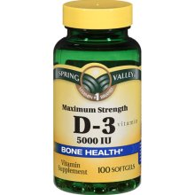
Vitamin D3 Supplements Don’t Help!!*
Ingested vitamin D can actually block Vitamin D Receptor (VDR) activation, the opposite effect to that of sunshine
Nominal doses of ingested vitamin D can suppress proper operation of the immune system
Hypothesis: serum Vitamin D3 level is a proxy for cholesterol sulfate, which is the true immune system enhancer
Hypothesis 2: Vitamin D needs to be sulfated to work in immune protection
* T.G. Marshall, Bioessays, 173-182, 2008
Notes:
http://www.sciencedaily.com/releases/2008/01/080125223302.htm
Marshall's research has demonstrated how ingested vitamin D can actually block VDR activation, the opposite effect to that of Sunshine.
Marshall TG. Vitamin D discovery outpaces FDA decision making. Bioessays. 2008 Jan 15;30(2):173-182 [Epub ahead of print] Online ISSN: 1521-1878 Print ISSN: 0265-9247 PMID: 18200565

Slide 81
Jellyfish Lake, Palau
Photosynthetic sulfur-bacteria produce energy from hydrogen sulfide
Abundant jellyfish thrive on the fixated sulfur
Collagen in jellyfish is enriched in sulfur

Slide 82
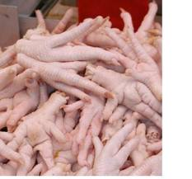
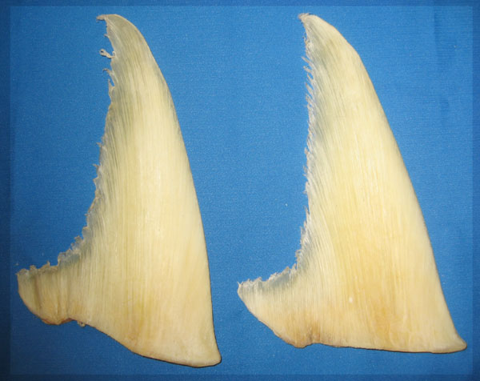
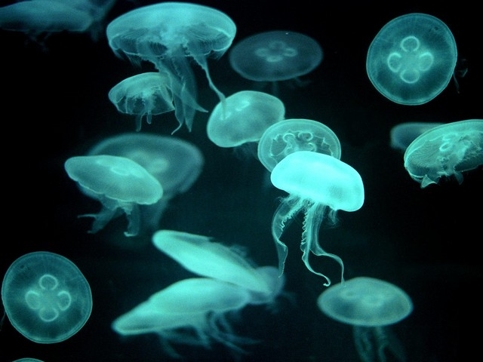
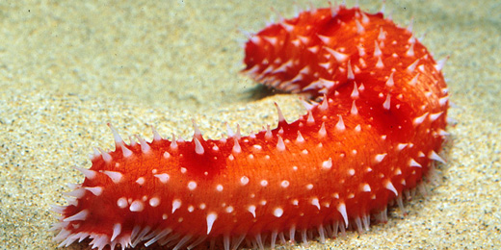
These Foods are all Treasured in Taiwan
Gelatin, shark’s fin, sea cucumbers, chickens’ feet and jellyfish are all healthy due to their high sulfur content

Slide 83
What Happens when Cholesterol Sulfate Synthesis is Impaired??
Cardiovascular disease!!!
Endothelial cells lining artery walls feeding the heart release inflammatory agents
Macrophages infiltrate artery wall
Macrophages extract cholesterol from oxidized LDL and deliver it to HDL-A1.
Platelets extract cholesterol from HLD-A1 and convert it to cholesterol sulfate
This will be the subject of a talk at the WAPF meeting in London in March

Slide 84
Summary
A diet high in carbohydrates and low in saturated fat, cholesterol, and lactate has devastating consequences
In addition, many important nutrients like folate, fat-soluble vitamins, and minerals like zinc and iron are deficient
There is a remarkable association between sulfur availability in soil and protection from cardiovascular disease and obesity, and the reverse holds as well
I propose that:
Sulfate synthesis in the skin, mediated by sunlight, holds the key to many health problems
Cholesterol-sulfate transport supplies cholesterol, sulfur, oxygen, negative charge, and energy to all the tissues
Atherosclerotic plaque is a factory for cholesterol sulfate production

Slide 85
The Silver Lining in Cardiovascular Disease

Slide 86
Steps in Atherosclerosis*
Inflamed epithelium provides adhesion molecules to trap and hold macrophages
Macrophages through scavenger process take up oxidized LDL and become foam cells
Interleukins and growth factors promote proliferation of smooth muscle cells (artery thickening)
Extracellular matrix proteins are degraded
Vulnerable plaque eruption : thrombosis
* Libby, et al., Circulation 105:1135-1143, 2002
Notes:
Libby –
.cancer/libby_inflammation_heart_disease.pdf

Slide 87
Steps in Atherosclerosis
Entrapment of macrophages
Build up of fatty deposits
Rupture and throbosis
Adapted from Libby, et al., Circulation 105:1135-1143, 2002
Notes:
Libby_inflammation_and_heart_disease.pdf

Slide 88
Many Good Reasons for ROS
ROS (reactive oxygen species) are a key component of inflammation in the artery
Oxidative stress converts hydrogen sulfide to sulfate *
Oxidation of glycated LDL makes it accessible to macrophages for breakdown**
Peroxynitrite is toxic to pathogens***
* Mitsuhashi et al. Shock 24(6) 529-34, 2005.
** Kaplan and Aviram, Arterioscler Thromb Vasc Biol 21(3) 386-93 2001.
*** Alvarez et al., J. Biol. Chem. 286, 6627-6640, 2011.
Notes:
Vitamink/peroxynitrite_fights_infetion.text

Slide 89
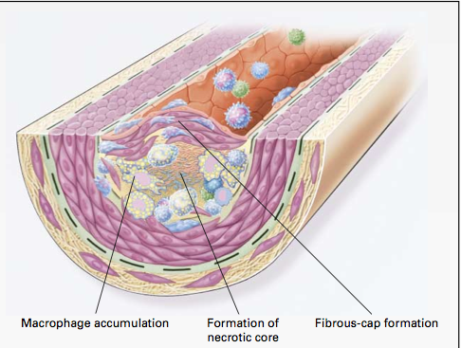
Macrophages and Cholesterol*
Macrophages in artery wall take up oxidized LDL and export extracted cholesterol to HDL-A1
Unsaturated fatty acids interfere with export process
Macrophages eventually become damaged by exposure to oxidizing and glycating agents → necrotic core
* Wang and Oram, J. Biol. Chem 277 (7) , 5692–5697, 2002

Slide 90
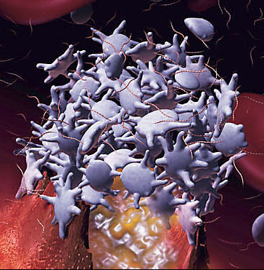
Platelets and Cholesterol Sulfate*
Platelets and RBCs both synthesize cholesterol sulfate (Ch-S)
Ch-S is present in the atherosclerotic lesions in the aorta
Platelets will accept cholesterol only from HDL-A1
Platelet synthesis rate increases 300-fold when PAPS is available.
PAPS is formed from ATP and sulfate
Platelet aggregation leads to thrombosis
HDL suppresses aggregation; LDL promotes it
* Yanai et al, Circulation 109, 92-96, 2004

Slide 91
Cholesterol Sulfate Synthesis in Artery Wall
homocysteine
Heart muscle cell
Synthesize sulfate
cysteine
ATP
PAPS
Lipid Raft
Red Blood Cell
Cholesterol Sulfate
RBC
Platelet
(3)
HDL-A1
macrophage
Ch
Ch
Artery Wall
oxLDL
LDL
ApoE
ROS
Inflammatory Agents
Endothelial Cell

Slide 92
Recapitulation
Endothelial cells lining artery walls feeding the heart release inflammatory agents
Macrophages infiltrate artery wall
Macrophages extract cholesterol from oxidized LDL and deliver it to HDL-A1.
Platelets extract cholesterol from HLD-A1 and convert it to cholesterol sulfate, with help from PAPS
Macrophages die and build up necrotic core

Slide 93
Summary
A diet high in carbohydrates and low in saturated fat, cholesterol, and lactate has devastating consequences
In addition, many important nutrients like folate, fat-soluble vitamins, and minerals like zinc and iron are deficient
There is a remarkable association between sulfur availability in soil and protection from cardiovascular disease and obesity, and the reverse holds as well
I propose that:
Sulfate synthesis in the skin, mediated by sunlight, holds the key to many health problems
Cholesterol-sulfate transport supplies cholesterol, sulfur, oxygen, negative charge, and energy to all the tissues
Atherosclerotic plaque is a factory for cholesterol sulfate production

Slide 95
Thank You!

