Slide 1
A Role for the Pineal Gland in Neurological Damage Following Aluminum-adjuvanted Vaccination
Stephanie Seneff
International Symposium on Vaccines
Nice, France
Mar. 26, 2014

Slide 2
Faculty Disclosure
Company | Nature of Affiliation
None
Off-Label Product Usage
None

Slide 3
Download These Slides
http://people.csail.mit.edu/seneff/SeneffNice2014.pptx (.pdf)

Slide 4
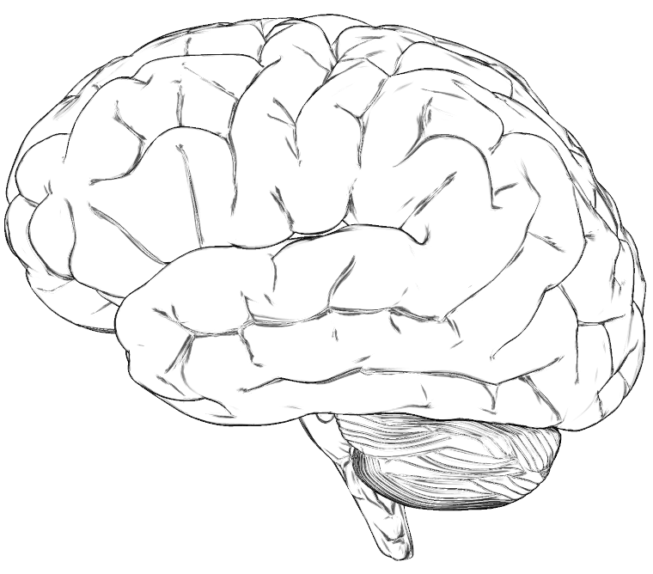
A Hypothesis
Many neurological diseases of the brain have a common origin:
Insufficient supply of sulfate to the brain
Enhanced toxic metal exposure (e.g., aluminum, mercury) due to impaired ability to detoxify and eliminate them
Toxic metals interfere with sulfate synthesis
This results in accumulation of cellular debris

Slide 5
Outline
Heparan sulfate in the lysosomes is critical for recycling cellular debris
Heparan sulfate deficiency leads to autism
Pineal gland delivers sulfate to cerebral spinal fluid via melatonin
Aluminum and mercury disrupt pineal gland
Sunlight deficiency is a contributing factor
Glyphosate works synergistically with aluminum
Summary

Slide 6
Outline
Heparan sulfate in the lysosomes is critical for recycling cellular debris
Heparan sulfate deficiency leads to autism
Pineal gland delivers sulfate to cerebral spinal fluid via melatonin
Aluminum and mercury disrupt pineal gland
Sunlight deficiency is a contributing factor
Glyphosate works synergistically with aluminum
Summary

Slide 7
An Important Role for Sleep
It has recently been argued that a crucial role for sleep is to clear cellular debris*
This takes place in the lysosome, which depends upon sulfate in heparan sulfate proteoglycans to protect from free radicals**
I will argue later that melatonin plays a critical role in supplying the sulfate
*Sleep Drives Metabolite Clearance from the Adult Brain. L Xie et al., Science 342:373-377, 2013
**Inhibition by heparin of Fe(II)-catalysed free-radical peroxidation of linolenic acid. M.A. Ross et al., Biochem. J. 1992, 286: 717-720.
Notes:
treasures/sleep_clears_garbage_in_brain_Science_2013.pdf
http://www.biochemj.org/bj/286/bj2860717.htm

Slide 8
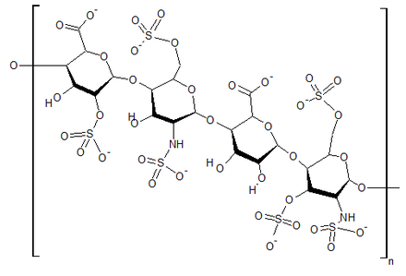
Heparin Protects from ROS due to Iron*
superoxide
Free radical production (Fenton reaction):
Fe(II) + 0₂ + 20H⁻ --> Fe(III)(OH) ₂ + 0₂⁻
But, in the acid environment of heparin:
4Fe(II) + 0₂ + 4H+ --> 4Fe(III) + 2H₂0
water
*M.A. Ross et al., Biochem. J. 1992, 286: 717-720.

Slide 9
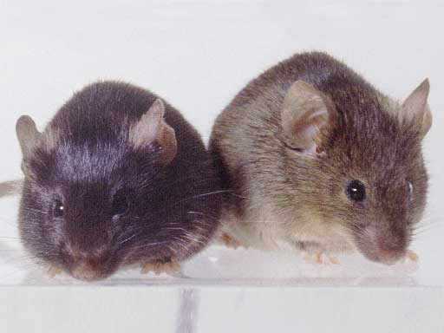
Autism-like socio-communicative deficits and stereotypies in mice lacking heparan sulfate*
Experiment with “designer” mice: impaired heparan sulfate synthesis in brain
Mice exhibited all the classic features of autism – both cognitive and social
* F. Irie et al., PNAS Mar. 27, 2012, 109(13), 5052-5056.
Notes:
vitaminK/mice_no_heparan_sulfate_get_autism_2012.pdf
Samantha/heparan_sulfate_knockout_mice_get_autism.pdf

Slide 10
Ventricles in the Brain

Slide 11
Another View
Notes:
http://en.wikipedia.org/wiki/File:Hirnventrikel_mittelgro%C3%9F.gif

Slide 12
“Heparan sulfate deficiency in autistic postmortem brain tissue from the subventricular zone of the lateral ventricles”*
“Aberrant extracellular matrix glycosaminoglycan function localized to the subventricular zone of the lateral ventricles may be a biomarker for autism, and potentially involved in the etiology of the disorder.”
*BL Pearson et al., Behav Brain Res. 2013;243:138-45
Notes:
Samantha/heparan_sulfate_deficiency_autism_postmortem_brain.pdf

Slide 13
Outline
Heparan sulfate in the lysosomes is critical for recycling cellular debris
Heparan sulfate deficiency leads to autism
Pineal gland delivers sulfate to cerebral spinal fluid via melatonin
Aluminum and mercury disrupt pineal gland
Sunlight deficiency is a contributing factor
Glyphosate works synergistically with aluminum
Summary

Slide 14
The Brain
Limbic System
Ventricles
Pineal Gland
Notes:
http://corticalchauvinism.files.wordpress.com/2013/03/locus_coeruleus.gif

Slide 15
Third Ventricle and Pineal Gland
The third ventricle is depleted in heparan sulfate in association with autism in both humans and mice*,**
Heparan sulfate depleted
Pineal Gland
*B.L. Pearson et al., Behav Brain Res. 2013 Apr 15;243:138-45.
**F Mercie et al., Neurosci Lett 506, 2012, 208-213.
Notes:
Where are they?

Slide 16
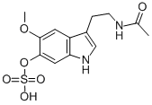
“Melatonin Enters the Cerebrospinal Fluid through the Pineal Recess”*
The tip of the third ventricle is encased in the pineal gland
The pineal gland delivers melatonin sulfate to the third ventricle and it diffuses to all the cerebrospinal fluid
I propose that a key purpose of melatonin is to deliver sulfate to the neurons at night.
Melatonin sulfate
*H. Tricoire et al., Endocrinology 143(1):84–90
Notes:
Wendy/melatonin_cerebrospinal_fluid_pineal_recess_DYNAMITE.pdf

Slide 17
Sulfate!!!
Pineal Gland

Slide 18
“Light-induced 3-O-Sulfotransferase Expression Alters Pineal Heparan Sulfate Fine Structure : A Surprising Link to Circadian Rhythm”*
Pineal gland builds up heparan sulfate supplies by day
Melatonin is sulfated in transport at night
Highly lipophilic molecule needs sulfate to make it water-soluble
This allows it to move through the cerebrospinal fluid
When melatonin is delivered, sulfate is released!
Melatonin is a sulfate-delivery system!!
*B. Kuberan et al., J. Biol. Chem. 2004, 279:5053-5054.
Notes:
Samantha/light_sulfotransferase_pineal_gland_heparan_sulfate.pdf

Slide 19
A Really Bad Idea!

Slide 20
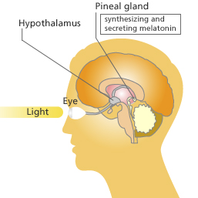
Pineal Gland: “Seat of the Soul”
The pineal gland produces sulfate by day (responding to light) and stores it in heparan sulfate molecules
The pineal gland produces melatonin in the evening and transports it as melatonin sulfate to various parts of the brain

Slide 21
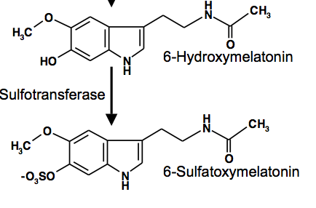
REM Sleep Cycle
Melatonin Induces REM sleep
Alzheimer’s is associated with reduced REM sleep cycle AND calcified pineal gland*
Pineal gland calcification correlates inversely with REM sleep**
DHEA SULFATE but not DHEA injections increase melatonin production in rats***
*R. Mahlberg et al., Neurobiol Aging. 2008 Feb;29(2):203-9
**R. Mahlberg et al., Sleep Med. 2009 Apr;10(4):439-45.
***Y. Djeridane et al., Steroids. 2004 May;69(5):343-9.
Notes:
Alzheimers/pineal_calcification_alzheimers.text
Treasures/pineal_calcification_melatonin_sleep.pdf
Treasures/DHEA_sulfate_boosts_melatonin.text
melatonin_review_2012.pdf

Slide 22
Outline
Heparan sulfate in the lysosomes is critical for recycling cellular debris
Heparan sulfate deficiency leads to autism
Pineal gland delivers sulfate to cerebral spinal fluid via melatonin
Aluminum and mercury disrupt pineal gland
Sunlight deficiency is a contributing factor
Glyphosate works synergistically with aluminum
Summary

Slide 23
Sleep Disorder, Aluminum, and the Pineal Gland
Sleep disorder is linked to many neurological diseases:
Autism, Alzheimer’s, depression, schizophrenia, ALS, Parkinson’s disease, etc.
Insomnia occurs much more frequently as an adverse reaction in VAERS to vaccines containing aluminum than to those not containing aluminum (p = 0.0025)
Pineal gland is heavily perfused and outside of the blood brain barrier
Susceptible to aluminum toxicity

Slide 24
New Paper
Notes:
Samantha//Thimerosal\ Exposure\ and\ the\ Role\ of\ Sulfation\ Chemistry\ and\ Thiol\ Availability\ in\ Autism.pdf .
In US 2013 > half flu shots are timerosol preserved
Mercury more toxic than lead in fetal tissue and neural cells

Slide 25
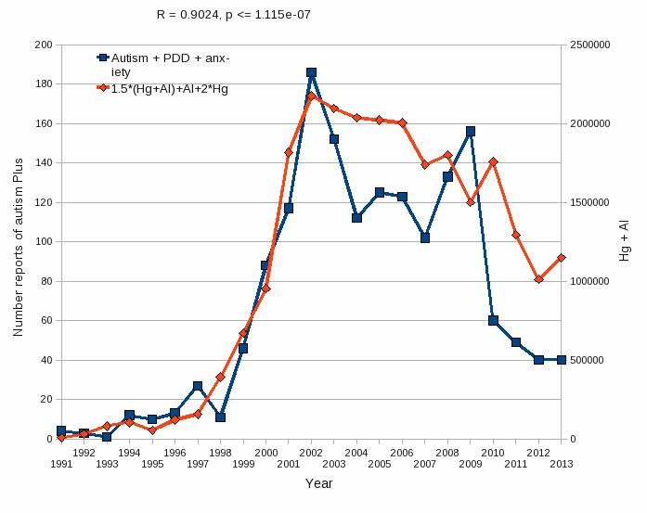
Aluminum & Mercury Autism & PDD & Anxiety
VAERS
database
Formula: Al + 1.5 x (Al w/ Hg) + 2.0 x Hg

Slide 26
We live in the age of aluminum*
*C.A. Shaw and L. Tomljenovic, Immunol. Res. Epub ahead of print, 2013
Notes:
Tomljenovich/ShawTomljenovichAluminumWorld.pdf

Slide 27
Aluminum in the Pineal Gland*
*S.B. Lang et al./Bioclectrochemistry and Bioenergetics 41(1996)191—195
Notes:
Csail/2013/ChrisShaw/piezoelectricity_aluminum_pineal_gland.pdf

Slide 28
Outline
Heparan sulfate in the lysosomes is critical for recycling cellular debris
Heparan sulfate deficiency leads to autism
Pineal gland delivers sulfate to cerebral spinal fluid via melatonin
Aluminum and mercury disrupt pineal gland
Sunlight deficiency is a contributing factor
Glyphosate works synergistically with aluminum
Summary

Slide 29
A Critical Role for Sunlight*
Hypothesis:
Endothelial and neuronal nitric oxide synthase (both present in the pineal gland) produce sulfate from reduced sulfur sources catalyzed by sunlight
Sulfate deficiency results when this process is impaired
Aluminum and retinoic acid, present in high SPF sunscreens, interfere with sulfate synthesis
Aluminum accumulation in pineal gland would disrupt sulfate supplies to brain
*S. Seneff et al., Entropy 2012, 14, 2492-2530.

Slide 30
We live in the age of aluminum*
*C.A. Shaw and L. Tomljenovic, Immunol. Res. Epub ahead of print, 2013
Notes:
Tomljenovich/ShawTomljenovichAluminumWorld.pdf

Slide 31
Aluminum Nanoparticles: Highly Destructive in the Brain*
Destroyed mitochondria and severely depleted ATP
Induced autophagy and programmed cell death
Increased permeability of blood brain barrier
Were persistent
Far more damaging than larger sized aluminum particles
*L Chen et al., Nanomedicine Feb 2013; 9(2): 212–221.
Notes:
./autophagy_brain_aluminum_nanoparticles.pdf

Slide 32
Demographic Studies on 50 States
Public schools in U.S. keep track of # students enrolled in each grade and # students enrolled in programs specifically targeting autism
Ratio becomes a measure for autism rate in the state
We used grades 1-6 only, in 2007-2008 school year
We can obtain statistics for many other factors
Weather related factors indicate sun exposure
Pearson’s correlation coefficient can be used to detect correlations (ranges from -1.0 to 1.0)
Correlation does not necessarily mean causation
Notes:
Say pearson’s coefficient
We looked at grades 1-6.

Slide 33
Demographics of 50 States
Demographic | Pearson Rating | Explanation
Rank, # clear days | -0.40 | Sunlight exposure
Latitude | 0.22 | Sunlight exposure
Annual rainfall | 0.16 | Sunlight exposure
RMS (rainfall, latitude) | 0.34 | Sunlight exposure
Temperature | -0.16 | Sunlight exposure
Elevation | -0.28 | Sunlight exposure
Vaccination rate | 0.38 | Aluminum, mercury

Slide 34
Vitamin D Prevents Sulfate Wasting*
Activated vitamin D prevents sulfate wasting from the kidney in urine
Mice engineered to have defective vitamin D receptors or with vitamin D deficiency had significantly reduced serum sulfate levels
This was associated with sulfate depletion in the skeleton
*M.J.G. Bolt et al., Am J Physiol Endocrinol Metab 287: E744 –E749, 2004.
Notes:
SteveKette/vitamin_D_regulates_sulfate_kidney.pdf

Slide 35
Outline
Heparan sulfate in the lysosomes is critical for recycling cellular debris
Heparan sulfate deficiency leads to autism
Pineal gland delivers sulfate to cerebral spinal fluid via melatonin
Aluminum and mercury disrupt pineal gland
Sunlight deficiency is a contributing factor
Glyphosate works synergistically with aluminum
Summary

Slide 36
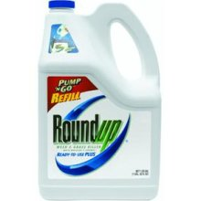
Glyphosate and Aluminum: Partners in Crime
Glyphosate induces pathogens like C. difficile in gut, leading to leaky gut syndrome
C. diff produces p-cresol which promotes aluminum uptake by cells
p-Cresol is a known biomarker for autism
p-Cresol is an important factor in kidney failure which leads to aluminum retention in tissues → dementia
Glyphosate cages aluminum to promote entry
Glyphosate promotes calcium uptake by voltage-activated channels
Aluminum gains entry as calcium mimetic
Aluminum promotes calcium loss from bones → pineal gland calcification

Slide 37
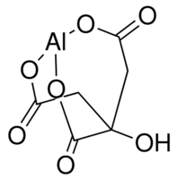
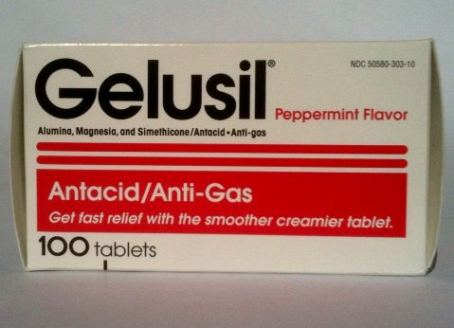
Aluminum Glyphosate*
Six different ways two glyphosate molecules can chelate aluminum
Aluminum citrate**
ALUMINA
aluminum
*M. Purgel et al., Journal of Inorganic Biochemistry 103 (2009) 1426–1438
** P. Sianina et al., Clin. Chem. 32/3, 539-541, 1986.
Notes:
AnthonySamsel/swine/aluminum_glyphosate.pdf
aluminum_citrate_absorbs_well_vinegar_antacids.pdf
Csail/2013/project/Anthony/

Slide 38
Glyphosate Suppresses Melatonin Synthesis!
Glyphosate interferes with shikimate pathway in plants and microbes → tryptophan depletion*
Tryptophan is sole precursor to melatonin
Melatonin binds to aluminum, cadmium, copper, iron and lead, reducing their toxicity**
*N. de María et al., J Agric Food Chem 2006, 54, 2621-2628.
**J. Limson et al. J. Pineal Res. 1998; 24:15–21.
Notes:
ChrisNice/Melatonin_binds_toxic_metals_1999.pdf

Slide 39
Autism, Glyphosate, Vaccine Reactions*
Glyphosate application to corn and soy, US
Children with Autism, US
# Adverse Reactions in VAERS
*Collaboration with Nancy Swanson
Notes:
Individuals with Disabilities Education Act

Slide 40
Summary
Autism and Alzheimer’s disease have reached epidemic proportions in the Western world
Hypothesis: Both are caused by a severe deficiency in sulfate supplies to the brain
Pineal gland can synthesize sulfate stimulated by sunlight and deliver it via melatonin sulfate
Aluminum, mercury and glyphosate work synergistically to derail this process
Sunlight deficiency contributes to the pathology

