Slide 1
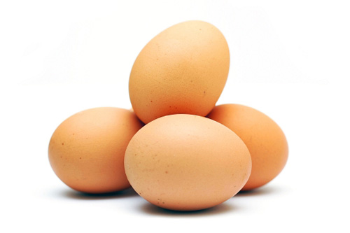
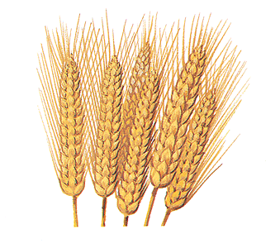
Nutrition, Toxins and Health: Facts and Speculation
Stephanie Seneff
Wise Traditions Workshop
Weston Price Foundation
Monday, Nov. 12, 2012

Slide 2
Part II: Biology
Download the slides from http://people.csail.mit.edu/seneff/

Slide 3
Outline
Introduction
Big Ideas: Dysfunction and Consequences
Dysfunction
Cholesterol Transport
Sulfate Deficiency
Obesity
Endothelial Nitric Oxide Synthase (eNOS)
SiNiC
Consequences
Blood Clots and Hemorrhages
Cardiovascular Disease
Impaired Gut Bacteria
Infection
Impaired Autophagy
The Environment
Environmental Toxins
Polyphenols
Summary

Slide 4
Introduction

Slide 5
Modern Diseases
cancer
cardiovascular disease
Alzheimer’s
depression
asthma
multiple sclerosis
allergies
fibromyalgia
ADHD
diabetes
Parkinson’s disease
obesity
GERD
seizures
heart failure
autism

Slide 6
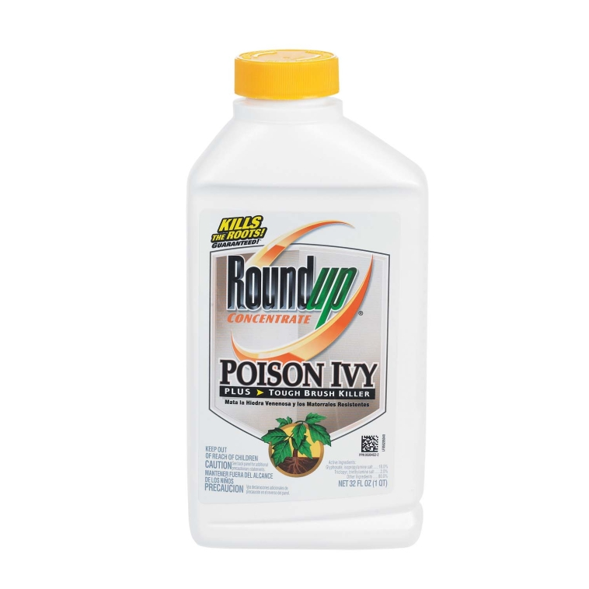
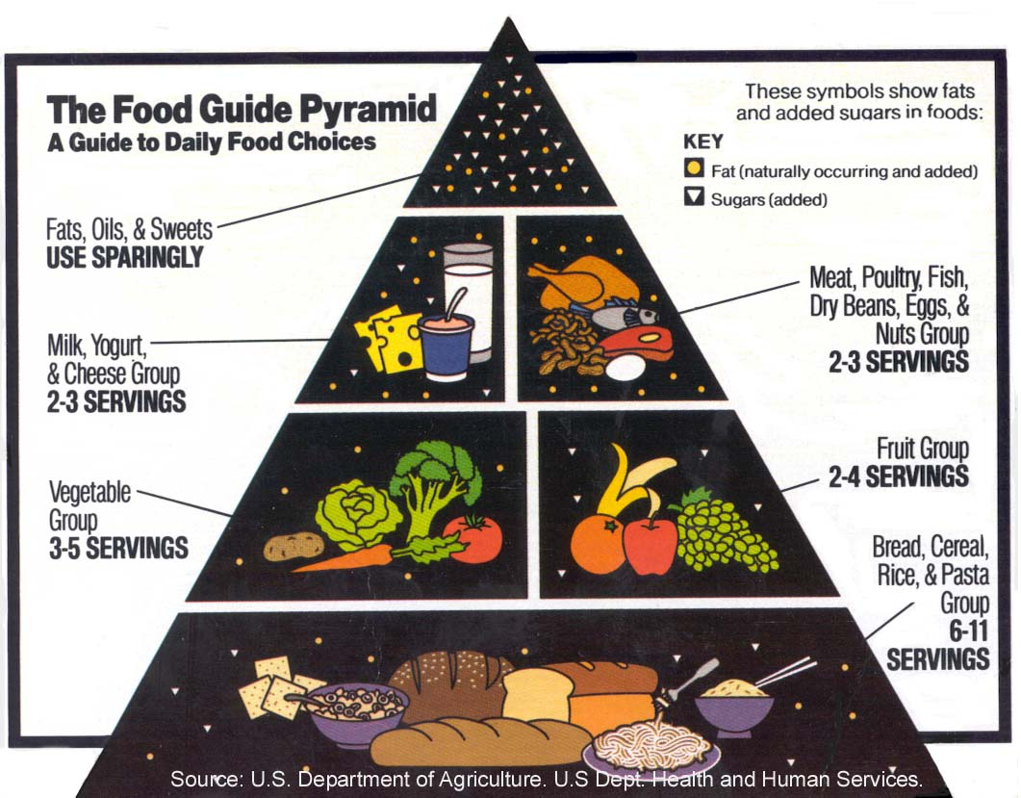
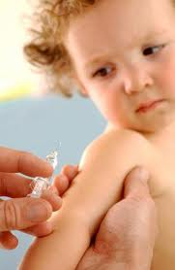
Why We are Sick

Slide 7
We need to worry about sulfur!
Current agricultural practices are depleting sulfate from the soil
This leads to insufficient dietary sulfur, especially for vegetarians
Environmental toxins deplete sulfur
Sulfate depletion in the body has widespread consequences

Slide 8
A Biological Definition of Aging
Cholesterol and sulfate depletion in cell membranes
Excess glycation damage to proteins (AGEs)
CELLS
Dysfunctional blood system leading to blood clots and hemorrhages
Increased susceptibility to infection and cancer
Diabetes and Obesity

Slide 9
Dysfunction
Cholesterol Transport
Sulfate Deficiency
Obesity
eNOS
SiNiC
Consequences
Blood Dysfunction
Diabetes
Heart Disease
Cancer
Impaired Gut Bacteria
Infections
Impaired Autophagy

Slide 10
Dysfunction

Slide 11
Cholesterol Transport
Under healthy conditions, abundant cholesterol sulfate is synthesized in the skin following sun exposure, and this results in generous supply of cholesterol and sulfate to the tissues.
Inadequate sun exposure and sunscreen impair this process.

Slide 12
Sulfate Deficiency
The body depends upon heparan sulfate proteoglycans (HSPGs) as a temporary storage bin for glucose
Impaired sulfate synthesis in the skin disrupts this process and leads to diabetes

Slide 13
Obesity
Insufficient HSPGs impairs muscles’ ability to utilize glucose as a fuel
Fat cells insinuate themselves into the loop by transforming glucose to fat for later release to supply safe usable fuel to muscles

Slide 14
eNOS
eNOS (endothelial Nitric Oxide Synthase) is a “moonlighting” enzyme: it makes sulfate upon sunlight stimulation, and switches to nitric oxide (nitrate) under stress

Slide 15
SiNiC
The slide from Sulfur into Nitrogen into Carbon as we age
Oxygen transport in the blood depends upon these three atomic elements (S, N, C) which can react with oxygen and form anions that stabilize the blood and safely carry oxygen
Sulfur is the healthiest choice; nitrogen is associated with many pathologies; carbon acting alone will lead to acidosis and cancer

Slide 16
Consequences

Slide 17
Blood Dysfunction
The stability of the blood colloidal system depends upon adequate cholesterol sulfate.
When sulfate is depleted, suspended cells and particles become deficient in negative charge, and start to stick together.
This leads to blood clots and hemorrhaging

Slide 18
Heart Disease
Cardiovascular plaque develops as an alternative mechanism to produce cholesterol sulfate from damaged LDL and homocysteine

Slide 19
Arthritis
Arthritis, and other chronic diseases like Alzheimer’s and multiple sclerosis, result because the body robs an organ system of sulfate in order to keep the blood from coagulating

Slide 20
Cancer
Cancer develops as a mechanism to massively convert glucose to lactate, which is a much safer fuel – especially when cells are insulin resistant

Slide 21
Infection
Susceptibility to infection is a consequence of impaired cholesterol sulfate synthesis, which introduces widespread pathology
Infection serves a useful role in resupplying critical nutrients such as cobalamin, folate, and heparan sulfate

Slide 22
Impaired Autophagy
Autophagy is the process by which cells dispose of the garbage that accumulates with living – they can recycle misfolded proteins into new proteins and replace broken mitochondria with fresh ones.
Excess nitric oxide leads to impaired autophagy, which results in accumulation of debris and busted mitochondria. Over time, the cell becomes so impaired that it has to shut down.

Slide 23
Outline
Introduction
Big Ideas: Dysfunction and Consequences
Dysfunction
Cholesterol Transport
Sulfate Deficiency
Obesity
Endothelial Nitric Oxide Synthase (eNOS)
SiNiC
Consequences
Blood Clots and Hemorrhages
Cardiovascular Disease
Impaired Gut Bacteria
Infection
Impaired Autophagy
The Environment
Environmental Toxins
Polyphenols
Summary

Slide 24
Cholesterol Transport
Under healthy conditions, abundant cholesterol sulfate is synthesized in the skin following sun exposure, and this results in generous supply of cholesterol and sulfate to the tissues.
Inadequate sun exposure and sunscreen impair this process.

Slide 25
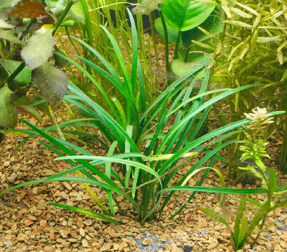
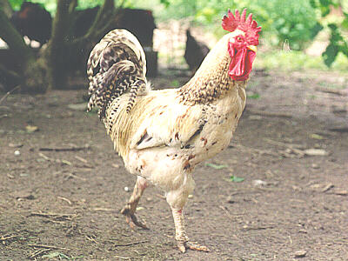
Cholesterol is Essential for Mobility and a Nervous System
Plants contain no cholesterol
Plants can’t move
Plants don’t have a nervous system
In a sense, cholesterol is to animals as chlorophyll is to plants

Slide 26
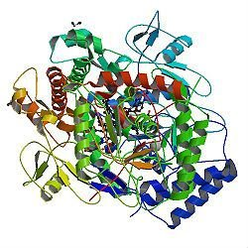
A Provocative Proposal
Cholesterol sulfate supplies oxygen, sulfur, cholesterol, energy energy and negative charge to the tissues
Sulfate is synthesized from sulfide in skin and blood stream utilizing energy in sunlight
Protects from UV damage and keeps microbes out
Endothelial Nitric Oxide Synthase (eNOS) performs the magic
The skin is a solar powered battery!

Slide 27
Cholesterol and Cholesterol Sulfate
Sulfation makes cholesterol water-soluble and therefore much easier to transport
SULFATE
Notes:
From cholesterol_sulfate_agile.pdf – this was the original article on that topic.

Slide 28
Think about Sulfate!
Cells in the skin produce vitamin D3 sulfate upon exposure to the sun
The precursor to vitamin D3 is cholesterol
Cells also produce an abundance of cholesterol sulfate
I believe this is the more important molecule!
Many of the alleged benefits of vitamin D3 are actually benefits of cholesterol sulfate
Protection against cancer, diabetes and cardiovascular disease; improved immune function

Slide 29
Heart Disease Mortality and Sunlight*
*Grimes et al., Q. J. Med. 1996; 89:579-589
Notes:
vitaminK/sunlight_heart_disease.pdf

Slide 30
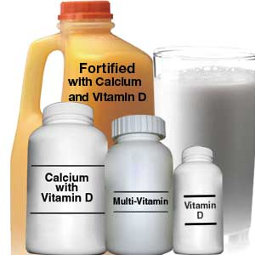
Vitamin D3 Supplements are Not the Answer!!*
151 people w/ diagnosed vitamin D deficiency and heart disease risk profile
50,000 IU vitamin D3 supplement for 8 weeks
Negative results
Increased serum calcium levels
Reduced serum parathyroid hormone levels
Increased serum LDL levels
* P.P. Manish et al., Arteriosclerosis, Thrombosis and Vascular Biology, Epub, 2012
http://www.medpagetoday.com/Cardiology/Dyslipidemia/34561.
Notes:
./vitamin_D_fails_LDL.pdf
Manish P. Ponda, Kathleen Dowd, Dennis Finkielstein, Peter R. Holt, and Jan L. Breslow. The Short-Term Effects of Vitamin D Repletion on Cholesterol: A Randomized, Placebo-Controlled Trial. Arteriosclerosis, Thrombosis and Vascular Biology, 2012; DOI:

Slide 31
Ultraviolet Exposure and Mortality among Women in Sweden*
38,472 Women selected in 1991-1992, aged 30-49
monitored for 15 years
Questionnaire asked about frequency of sunbathing vacations and sunburn
Increased sunburn frequency associated with reduced all-cause mortality
Sunbathing vacations more than once a year reduced risk to cardiovascular disease and mortality
* Yang et al., Cancer Epidemiol Biomarkers Prev. 20(4):683-690, 2011

Slide 32
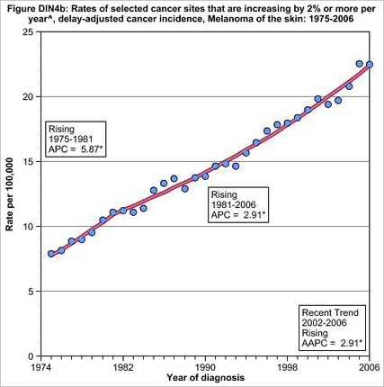
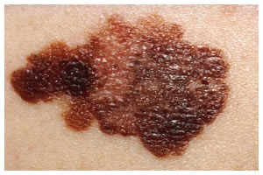
Skin Melanoma Increasing 2%/Yr since 1974*
This corresponds to a 30-fold increase in the use of sunscreen
* Andrew Schneider, Aol News, May 24, 2010
aolnews.com/2010/05/24/study-many-sunscreens-may-be-accelerating-cancer
Notes:
http://www.aolnews.com/2010/05/24/study-many-sunscreens-may-be-accelerating-cancer/

Slide 33
A Biological Definition of Aging
Cholesterol and sulfate depletion in cell membranes
Excess glycation damage to proteins (AGEs)
CELLS
Dysfunctional blood system leading to blood clots and hemorrhages
Increased susceptibility to infection and cancer
Diabetes and Obesity

Slide 34
Several Roads to Hell
Insufficient cholesterol sulfate synthesis in the skin
Synthesize cholesterol sulfate a different way
obesity, heart disease
Switch from cholesterol sulfate to nitric oxide synthesis
Steal sulfate from wherever it’s found
Arthritis, Crohn’s Disease, colitis, multiple sclerosis, type-1 diabetes, etc.
Autism, Alzheimer’s, ADHD, depression

Slide 35
How It’s Supposed to Work
Cholesterol sulfate synthesized in the skin upon sunlight exposure
Blood stream delivers cholesterol and sulfate to all the tissues

Slide 36
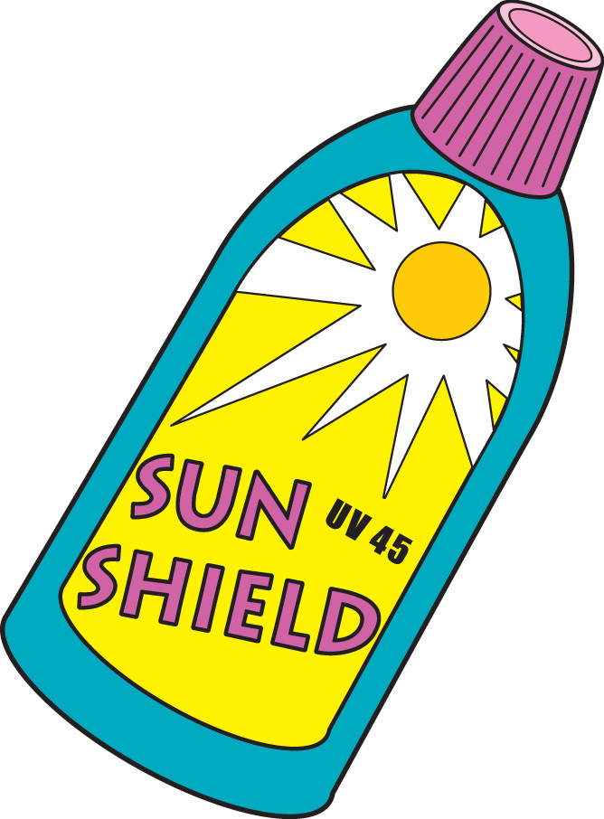
How It Works Instead
Aggressive sun protection prevents skin from producing cholesterol sulfate
Cholesterol sulfate is synthesized in the atherosclerotic plaque instead (from homocysteine and LDL)

Slide 37
And/Or …..
From the brain
Alzheimer’s, Multiple Sclerosis
Sulfate is stolen from whatever tissue is willing to give it up!
From the pancreas (diabetes, pancreatic cancer)
From the gut
(Crohn’s disease, colitis)
From the joints (arthritis)

Slide 38
And/Or …..
The body gives up on sulfate supply and confronts blood instabilities
Blood clots
hemorrhaging
Sudden cardiac arrest
Nitric oxide poisoning

Slide 39
Cholesterol Transport

Slide 40
HDL is “good” cholesterol and LDL is “bad” cholesterol – true or false?

Slide 41
FALSE!
Neither HDL nor LDL is “cholesterol”!
Both HDL and LDL are particles that transport cholesterol, fat, fat-soluble vitamins and antioxidants to all tissues

Slide 42
Some Facts and Speculation
Fact: Fibroblasts in the skin are major suppliers of cholesterol to HDL
Speculation: they depend upon sulfation for export of cholesterol to HDL
Fact: Cholesterol sulfate is synthesized in large quantities in the skin upon sunlight exposure
Speculation: this is a major supplier of cholesterol and sulfate to the tissues
Reduces need for serum LDL

Slide 43
HDL, VLDL, LDL, Chylomicron
HDL: Liver produces “nascent” particle; cholesterol-synthesizing cells (fibroblasts) fill it up
VLDL: Liver produces large particles; carry fat, cholesterol, fat-soluble vitamins and antioxidants
LDL: “remnant” after VLDL has delivered its goods
Chylomicron: HUGE particle produced in gut to deliver ingested fats and cholesterol to the tissues (mainly heart, liver and muscles)
o
o
o
o

Slide 44
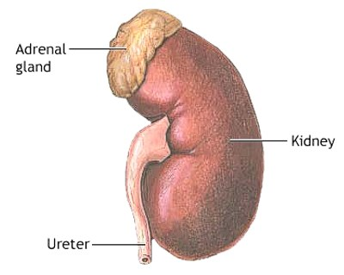
Cholesterol Transport
Bile
Gut
Cholesterol
Synthesis
Fibroblasts
Adrenal Glands
HDL
LDL
Supplies fat and cholesterol to the tissues
VLDL

Slide 45
HDL is like a rowboat that can go in to shore to pick up goods and deliver them to the ocean liner, which is the VLDL particle
VLDL
HDL

Slide 46
Cholesterol Ester Transport (CEPTP) Inhibitors*
This is a new class of drugs that raises HDL dramatically
It does so by trapping cholesterol in the HDL particle
These drugs have failed miserably in trials
Problem is that they prevent HDL from doing its job: delivering cholesterol from the cells in the skin that make it to the VLDL particles
HDL
CETP
VLDL
* Barkowski and Frishman, Cardiol Rev. 2008 16(3):154-62.
Notes:
./CETP_inhibitors.text

Slide 47
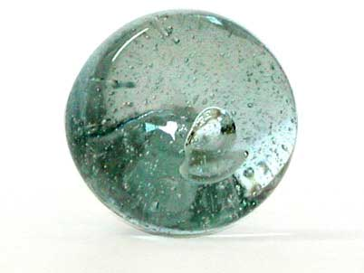
Sizes of Lipoprotein Particles in Blood Serum
Fats and cholesterol enter the bloodstream from the digestive system via the Chylomicron
AWESOME
VERY BAD: small dense LDL
“BAD”
“GOOD”

Slide 48
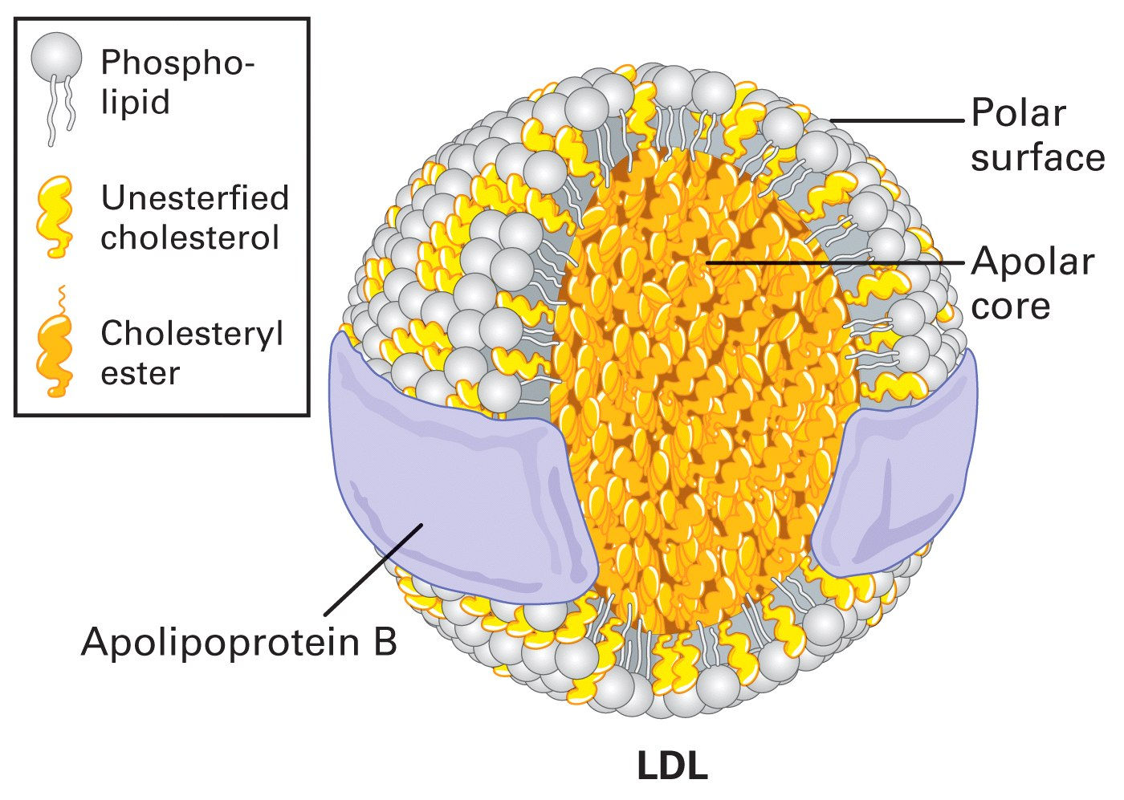
Structure of LDL
Subject to glycation damage which interferes with delivery of goods to tissues
Unesterified Cholesterol in membrane protects contents from damage and helps fight infection

Slide 49
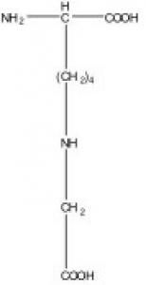
Glycation Damage
Due to excess sugars in the blood stream
Especially high fructose corn syrup
Messes up cholesterol transport
Glycated LDL is less efficient at delivering cholesterol to tissues
Glycated LDL can’t be recycled through LDL receptors in liver (LDLR)
Builds up in blood serum as “small dense particles” (The bad kind)
Cells become deficient in cholesterol
Notes:
Carboxy methyl lysine

Slide 50
Cholesterol Sulfate Protects LDL*
sulfate
* E.H. Epstein et al., Science, 214(4521, 659-660, Nov. 6 1981
Notes:
vitaminK/cholesterol_sulfate_LDL.text
Plasma cholesterol sulfate concentration is increased in patients with recessive X-linked ichthyosis, a disease in which steroid sulfatase activity is absent. In these patients, cholesterol sulfate is found primarily in the low-density lipoprotein fraction of plasma, and the electrophoretic mobility of these lipoproteins is greatly increased.

Slide 51
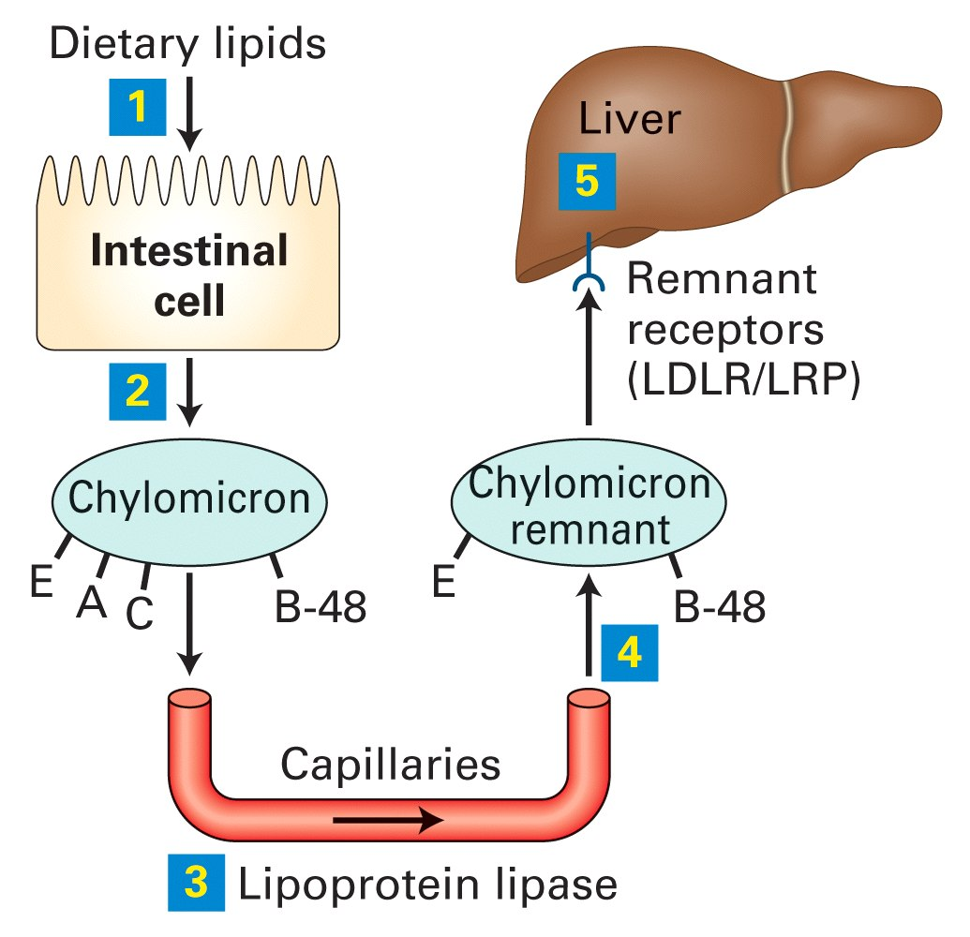
The Life Cycle of the Chylomicron
Heart, muscle and fat cells
Triglyceride composition closely resembles dietary intake

Slide 52
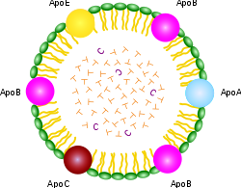
Dietary Cholesterol
Dietary fat and cholesterol enter the lymph system directly from the gut and exit into the blood stream at the subclavian vein
They travel in a large lipid particle called a chylomicron
It’s a short path from this major vein to the heart
Conclusion: the heart gets first dibs on dietary cholesterol and fat

Slide 53
Cholesterol Metabolism
adrenal glands
CETP
All the tissues
heart, liver

Slide 54
Cholesterol Transport to HDL
Cells in the skin are major producers of cholesterol sulfate and major suppliers of cholesterol to HDL-A1
Cells synthesize cholesterol in Endoplasmic Reticulum (ER)
Transport from ER to cell membrane
Is not vesicular
Ergo, requires migration through cytoplasm
Proposal: sulfation of cholesterol necessary step in transport (renders molecule water-soluble)

Slide 55
Cholesterol Management in the Cell*
Acetyl Coenzyme A
LDL
Free cholesterol
ER
HDL
lysosome
ER
Fat stores
Requires sulfation to cross through cytoplasm?
Esterified cholesterol
* E.M.L. Bastiaanse, Cardiovascular Research 33, 272–283, 1997
Notes:
vitaminK/membrane_cholesterol_ion_transport_1997.pdf
Fig. 1. Schematic representation of cholesterol supply, intracellular metabolic pathways, and cholesterol removal from the cell. 1 s apo B,E ŽLDL. receptor-mediated uptake of cholesterol-rich LDL; 2 s hydrolysis of LDL in the lysosomes leading to the formation of cholesteryl esters ŽCE. and free cholesterol ŽCHS.; 3 s de novo synthesis of cholesterol; 4 s esterificationrhydrolysis cycle of cholesterol; 5 s translocation of cholesterol to the membrane; 6 s HDL-mediated ‘reverse’ cholesterol transport.

Slide 56
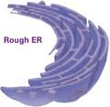
Sulfate and Cholesterol Transport
Researchers are puzzled as to how cholesterol is transported from the ER, where it is synthesized, to the cell membrane
Cholesterol’s insolubility in water is problematic
I propose that the solution is to add sulfate to make the molecule water-soluble
This allows cholesterol (as cholesterol sulfate) to move freely through the cytoplasm
This is how synthesized cholesterol makes it to the cell membrane AND how it gets from the membrane to HDL, the particle that transports it in the blood stream

Slide 57
Sulfate Gives Cholesterol Free Passage!
HDL
HDL
cell
Low cholesterol content in HDL is the strongest lipid predictor of heart disease
cholesterol

Slide 58
Cholesterol Sulfate Deficiency Explains Autistic Correlates
Autism is associated with several health issues:
Eczema, asthma, digestive problems (leaky gut)
Increased susceptibility to infection
Cholesterol sulfate in skin stimulates filaggrin synthesis*
Filaggrin deficiency leads to eczema and asthma
Sulfate protects cells in blood from bacteria
Sulfate deficiency leads to leaky gut syndrome **
* Nakae et al. The FASEB Journal 22:782.2, 2008
** Waring and Klovrza, J Nutr & Environ Medicine 10, 25-32, 2000.
Notes:
RH WARING PAPER 2000.pdf in robert_davidson/ThePaper/
Gastrointestinal FunctionSulphation capacity also affects the gastrointestinal tract. The mucins which line the gut, providing both protective and adhesive properties, are sulphated glycoproteins which rely on the degree of sulphation and the addition of negative charges to maintain their structures in an extended con􏲵guration [30]. Reduced sulphation has been associated with in􏲶 ammation and gut dysfunction, coupled with a breakdown in the protective properties of the mucins and an increase in permeability [31]. Many children with autism also have digestive problems and 9 out of 20 (42%) in one survey had increased gut permeability when challenged by the mannitol/lactulose test [32]. This 􏲵 nding has led to the idea that a “leaky” gut may be more permeable to dietary proteins and peptides. Groups working in two separate laboratories have found diet-derived peptides in urine from children with autism [33,34] which were attributed to incomplete hydrolysis of casein and gluten proteins from milk and wheat respectively [35]. Peptides of this type can show “opioid” activity, crossing the gut wall and penetrating the blood–brain barrier to act on the central nervous system [36]. They may be responsible for the social withdrawal, insensitivity to pain and altered responses to sensory stimuli which are commonly described in autism. Use of naloxone and other opiate antagonists has been reported to reduce the levels of self-injury, again suggesting that “opioid excess” may be a factor in autistic behaviour [37].

Slide 59
Recent Papers
“Might cholesterol sulfate deficiency contribute to the development of autistic spectrum disorder?”
Stephanie Seneff, Robert Davidson, Luca Mascitelli
Medical Hypotheses 2012, 78, 213–217
“Impaired Sulfate Metabolism and Epigenetics: Is There a Link in Autism?”
Samantha Hartzell and Stephanie Seneff Entropy 2012, 14, 1953-1977

Slide 60
Recapitulation
HDL, LDL, and chylomicron provide cholesterol and fat to all the tissues
Chylomicron supplies dietary cholesterol preferentially to the heart
High serum LDL is an indication of insufficient sulfate and excess glycation damage
Sulfate is essential for export of cholesterol to HDL particles
Cholesterol sulfate deficiency can explain autism

Slide 61
Outline
Introduction
Big Ideas: Dysfunction and Consequences
Dysfunction
Cholesterol Transport
Sulfate Deficiency
Obesity
Endothelial Nitric Oxide Synthase (eNOS)
SiNiC
Consequences
Blood Clots and Hemorrhages
Cardiovascular Disease
Impaired Gut Bacteria
Infection
Impaired Autophagy
The Environment
Environmental Toxins
Polyphenols
Summary

Slide 62
Sulfate Deficiency
The body depends upon heparan sulfate proteoglycans (HSPGs) as a temporary storage bin for glucose
Impaired sulfate synthesis in the skin disrupts this process and leads to diabetes

Slide 63
Heparan Sulfate Proteoglycans (HSPGs)

Slide 64
Heparan Sulfate: Wonder Worker
Polymers of sugars with attached nitrogen and sulfates: safe glucose storage

Slide 65
A Provocative Hypothesis
When cholesterol and sulfate are in short supply, storage of sugars in HSPGs becomes impaired
Cells store glucose temporarily in HSPGs, protected by sulfate
This is the source of insulin resistance and diabetes!

Slide 66
Sulfated Glycosaminoglycans (GAGs)
Prominent in extracellular matrix of all cells
Amount of sulfate depends on availability
Crucial for maintaining negative charge and protecting from infection
http://www.science-autism.org/sulphate.htm

Slide 67
Amazing Number of Roles for Heparan Sulfate in Cells*
* J.R. Bishop et al, Nature 446, 1030-1037, Apr. 2007
Notes:
vitaminK/heparan_sulfate_proteoglycans_review_Nature_2006.pdf

Slide 68
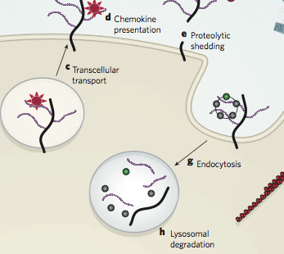
Recycling HSPGs w/ LDL*
Hypothesis: Sugars are temporarily housed in HSPGs
Hypothesis: sulfate in HSPGs is critically needed to recycle LDL
GLUCOSE
LDL
* J.R. Bishop et al, Nature 446, 1030-1037, Apr. 2007
Notes:
vitaminK/heparan_sulfate_proteoglycans_review_Nature_2006.pdf

Slide 69
LDL Uptake by Liver depends on Sulfate in Heparan Sulfate Proteoglycans (HSPGs)*
LDL recycled mainly through uptake by liver
This uptake depends critically on sulfate in HSPGs
Insufficient HSPGs leads to elevated serum LDL
“Our studies have shown that HSPG participate not only in the initial sequestration step, but also in the uptake step, either in association with the LRP or acting alone as a receptor.”
* Mahli and Ji, J. Lipid Research 40, 1999, 1-16.

Slide 70
LDL Clearance Depends on HSPGs*
LDL Remnant
* Figure 1, in Mahli and Ji, J. Lipid Research 40, 1999, 1-16.
Notes:
vitaminK/ApoE_heparan_sulfate_lipid_clearance.pdf

Slide 71
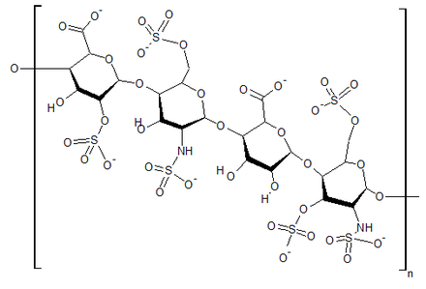
Proposed Role of eNOS in Heparan Sulfate synthesis
Heparan sulfate synthesized in Golgi apparatus
eNOS
cell
Hypothesis: depends upon eNOS AND SUNLIGHT to add sulfate

Slide 72
Recapitulation
Heparan sulfate proteoglycans (HSPGs) are everywhere in the body
They play a crucial role in ion transport, nutrient uptake, and cell signalling
They are central in LDL reuptake and recycling
I propose that they also provide a temporary storage depot for glucose
Deficient sulfate leads to diabetes
I propose that eNOS provides the sulfate, catalyzed by sun exposure

Slide 73
Outline
Introduction
Big Ideas: Dysfunction and Consequences
Dysfunction
Cholesterol Transport
Sulfate Deficiency
Obesity
Endothelial Nitric Oxide Synthase (eNOS)
SiNiC
Consequences
Blood Clots and Hemorrhages
Cardiovascular Disease
Impaired Gut Bacteria
Infection
Impaired Autophagy
The Environment
Environmental Toxins
Polyphenols
Summary

Slide 74
Obesity
Insufficient HSPGs impairs muscles’ ability to utilize glucose as a fuel
Fat cells insinuate themselves into the loop by transforming glucose to fat for later release to supply safe usable fuel to muscles

Slide 75
Fat Cells to the Rescue

Slide 76
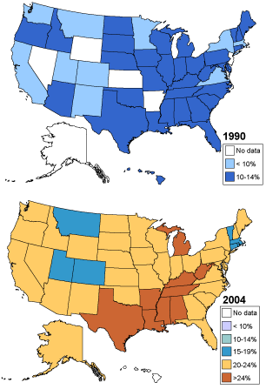
The U.S. Obesity Epidemic*
1990
2008
2004
WHY ARE WE GETTING FATTER AND FATTER?
* Source: CDC Behavioral Risk Factor Surveillance System

Slide 77
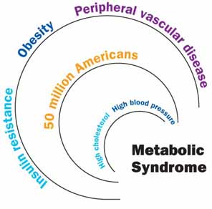
The Metabolic Syndrome
Abdominal obesity
Insulin resistance
High blood pressure
High serum triglycerides
High LDL ("bad" cholesterol), especially “small dense LDL”
Low HDL ("good" cholesterol)
Increased risk to heart disease

Slide 78
The Path to Obesity and Heart Disease
Too little cholesterol sulfate synthesis in the skin
Impaired HSPG synthesis
Excess blood sugar
Fat cells consume sugar and store it as fat
Fat cells proliferate
Sulfate synthesis in artery wall from homocysteine (inflammation required)
Glycated LDL
Fat cells take up damaged LDL and store cholesterol
Fat from fat cells becomes important fuel for muscles, including heart
Platelets synthesize cholesterol sulfate in artery wall
Fat cells release cholesterol to HDL-A1
Fat Cells Get Sick!

Slide 79
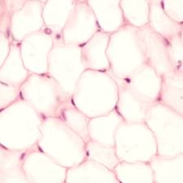
Fat Cells Get Sick!
Cholesterol depletion in membrane induces cholesterol synthesis and storage
Fat cells need sulfate to release fat stores
Too much cholesterol stuck inside the cell becomes problematic
Endoplasmic reticulum has trouble folding proteins
Fat cell calls in macrophages to orchestrate cell death and clean up the mess

Slide 80
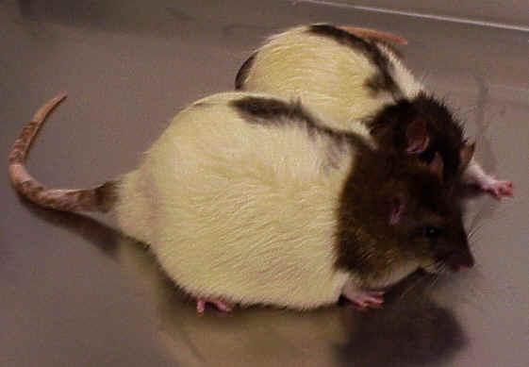
Experiment on Cholesterol Depletion in Fat Cells*
Normal fat cells from rats were exposed in vitro to MβCD
Depleted cholesterol from cell walls
Caused activation of cholesterol-acquiring proteins
Caused insulin resistance and increased synthesis of TNF-α, angiotensinogen, and IL-6
Related to hypertension, inflammation, and atherosclerosis
Conclusion:
fat cell membrane cholesterol depletion is key manifestation of metabolic syndrome
* Soazig Le Lay et al., J. Biol. Chem., 2001

Slide 81
Endoplasmic Reticulum Becomes Sick
Endoplasmic reticulum essential for protein folding and activation
Absence of sulfate leads to internal cholesterol accumulation
Excess cholesterol destroys cell’s ability to fold proteins
This causes major dysfunction and eventually leads to cell disintegration
Picture from Wan et Al., The FASEB Journal, 2007

Slide 82
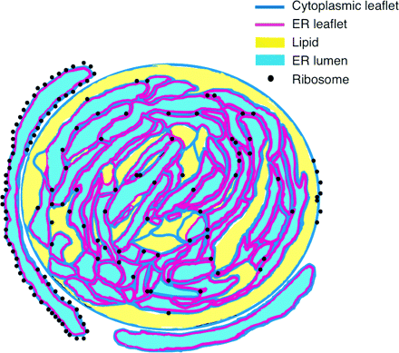
Fat Cells Become Dysfunctional
Endoplasmic Reticulum has too much cholesterol which inhibits calcium transport
Plasma membrane has too little cholesterol, which causes potassium leaks
Endoplasmic Reticulum: Cholesterol Overload
x
Ca⁺²
Plasma Membrane: Cholesterol Depleted
K⁺

Slide 83
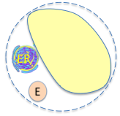
Fat Cells Launch Distress Cascade
Macrophage
Release IL-6 and TNF-α
Calls in macrophages
Induces inflammation
Release leptin
Decreases glucose uptake
Release angiotensin-II
Suppresses synthesis of apoE
Increases thirst due to sodium leaks
Promotes uptake of cholesterol from HDL for plasma membrane
F
F
F
F
Distressed Fat Cell

Slide 84
Visceral Fat
Damaged VLDL remnants leads to widespread cholesterol deficiency
Major organs are especially susceptible (e.g., pancreas, liver, adrenal glands, reproductive organs, etc.)
Hypothesis: Visceral fat deposits store reserve cholesterol supply for critical organs

Slide 85
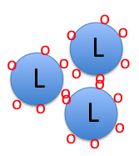
Putting it All Together
(2)
(1)
F
ER
E
(3)
H
AT-II
F
ER
(5)
(4)
F
F
F
F

Slide 86
“Reverse Epidemiology”*
Obesity, hypertension, and high cholesterol are all protective in:
Heart failure
Rheumatoid arthritis
AIDS
Post myocardial infarction
Cancer
The elderly
This is estimated to apply to 30 million Americans
* George T. Griffing, MD, Medscape Today, Aug 19, 2009.
http://www.medscape.com/viewarticle/707334?src=mp&spon=22

Slide 87
While these measures are risk factors for heart disease, they play a protective role in preventing other consequences that are arguably worse than heart disease

Slide 88
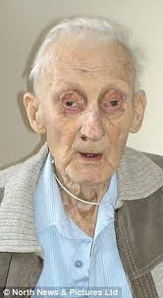
17 Year Study on Elderly*
Begun in 1990: all subjects were at least 70 years old
Measured serum cholesterol, ability to synthesize cholesterol, and ability to absorb cholesterol through the intestines
Low values of all three parameters were associated with accelerated mental decline and increased physical frailty
Subjects with low values on all three had 4 ½ years decreased life span
* Tilvis et al., Annals of Medicine, Early Online, 2011
Notes:
Cancer/serum_cholesterol_prognosis_elderly.pdf

Slide 89
AIDS Increases Risk to Heart Disease*
“Patients with HIV with chronic infection have significant vascular inflammation, and thus added CVD [cardiovascular disease] risk, beyond that estimated by traditional risk factors.”
I propose that AIDS is a cholesterol sulfate deficiency disease
* S. Subramanian, et al., Arterial Inflammation in Patients With HIV. JAMA, July 25, 201, 308( 4379), p. 386
Notes:
For_vic/AIDS_arterial_inflammation.pdf

Slide 90
High Fat Diet Protects from Heart Failure*
*From W.C. Stanley et al., Dietary Fat and Heart Failure: Moving From Lipotoxicity to Lipoprotection, Circulation Research 2012, 110:764-776
Notes:
For_vic/fats_protect_from_heart_failure.pdf

Slide 91
Recapitulation
Fat cells play an important service in cleaning up busted LDL and supplying cholesterol and fats to insulin-resistant muscle cells
This is a dirty job, and fat cells get sick
Too little membrane cholesterol, too much internal cholesterol
Macrophages are called in to clean up dying cells
This leads to inflammatory response and widespread tissue damage
Metabolic syndrome is protective in several modern diseases and conditions
High fat diet protects from these diseases

Slide 92
Outline
Introduction
Big Ideas: Dysfunction and Consequences
Dysfunction
Cholesterol Transport
Sulfate Deficiency
Obesity
Endothelial Nitric Oxide Synthase (eNOS)
SiNiC
Consequences
Blood Clots and Hemorrhages
Cardiovascular Disease
Impaired Gut Bacteria
Infection
Impaired Autophagy
The Environment
Environmental Toxins
Polyphenols
Summary

Slide 93
eNOS
eNOS (endothelial Nitric Oxide Synthase) is a “moonlighting” enzyme: it makes sulfate upon sunlight stimulation, and switches to nitric oxide (nitrate) under stress

Slide 94
Endothelial nitric oxide synthase (eNOS)

Slide 95
eNOS!!
Endothelial nitric oxide synthase (eNOS) is a very interesting molecule
It’s known for its role in synthesizing nitric oxide (NO) from L-arginine
But I think it has a much more important role as well, which is its primary role:
To synthesize sulfate from sulfur in the presence of sunlight
N → NO → NO₃⁻²
S → SO₂ → SO₄⁻²

Slide 96
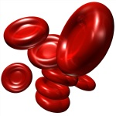
Where is eNOS Found? What does it do?
In keratinocytes in the skin
In the endothelial cells lining artery walls
In several cell types in the blood:
red blood cells, platelets, mast cells
eNOS synthesizes nitric oxide from L-arginine
It makes no sense for a red blood cell to synthesize nitric oxide!!

Slide 97
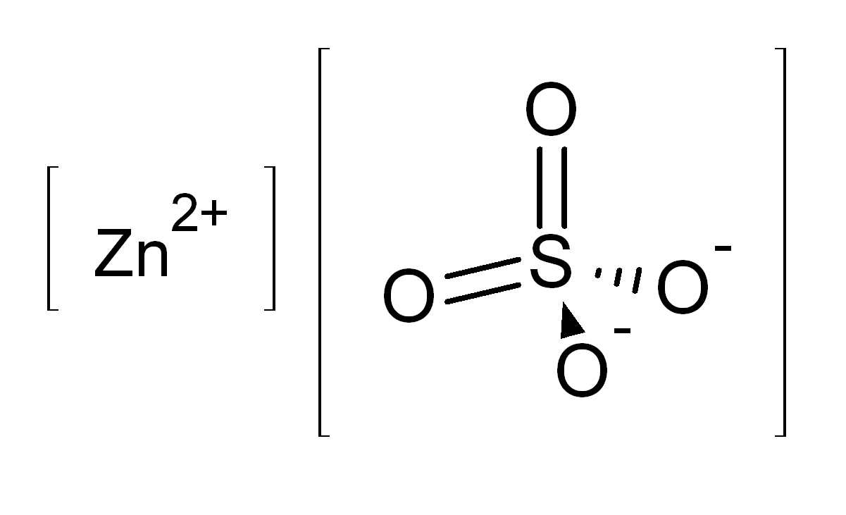
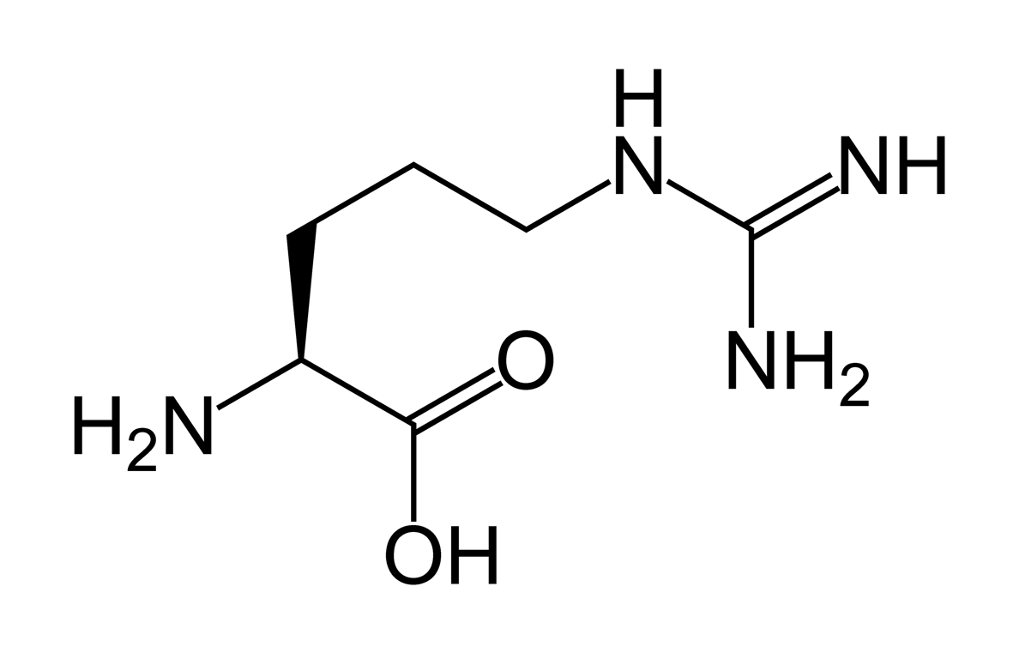
Hemoglobin binds strongly to nitric oxide: this neutralizes the effect of both of them!
The red blood cell keeps the substrate for nitric oxide synthesis out:
I hypothesize that it uses eNOS to make sulfate instead !
L-ARGININE
eNOS

Slide 98
eNOS and Caveolae
sulfate
Michel and Feron, J. Clin. Invest. 100(9) 2146-2152, 1997
Notes:
Cancer/NOS_review.pdf
Michel (Series Editor) and Olivier Feron
J. Clin. Invest. © The American Society for Clinical Investigation, Inc. 0021-9738/97/11/2146/07 $2.00 Volume 100, Number 9, November 1997, 2146–2152 http://www.jci.org
Michel and Feron, J. Clin. Invest. 100(9) 2146-2152, 1997
Palmitoylation contributes to membrane association.

Slide 99
eNOS with and without L-Arginine
If either L-arginine substrate or BH₄ cofactor is reduced, eNOS synthesizes O₂⁻ (superoxide) instead of NO
O₂⁻ and NO combine to make OONO⁻, a potent oxidizing agent
Katusic, Am J Physiol Heart Circ Physiol 281:H981-H986, 2001.
Notes:
Sulfur/tetrahydrobiopterin/tetrahydrobiopterin_endothelial_dysfunction.pdf

Slide 100
eNOS Dimer Synthesizes Sulfate: A proposal
Dimer (two eNOS molecules) creates cavity
Zinc atom in cavity creates positive charge field
Sulfurs in cysteine peptides attracted to zinc
Flavins respond to sunlight by emitting electrons
Electrons create charged oxygen dimers (O₂⁻)
Oxygen combines with sulfur to form sulfate (capture energy)
electrons
FLAVINS
HEME
O₂⁻
Sulfur
Sulfur
sulfate
+
+
Zinc
+
+
+
+
Sulfur
Sulfur
O₂⁻
HEME
FLAVINS
electrons

Slide 101
Recapitulation
eNOS is a moonlighting enzyme whose day job is cholesterol sulfate synthesis
Depends on sunlight to catalyze reaction
Switches to nitric oxide (nitrate) synthesis under pathological conditions
Red blood cells, platelets, endothelial cells, keratinocytes and other cells use eNOS to make sulfate
Mechanism involves zinc atom in cavity in eNOS dimer
These cells need sulfate to produce cholesterol sulfate and/or heparan sulfate

Slide 102
Outline
Introduction
Big Ideas: Dysfunction and Consequences
Dysfunction
Cholesterol Transport
Sulfate Deficiency
Obesity
Endothelial Nitric Oxide Synthase (eNOS)
SiNiC
Consequences
Blood Clots and Hemorrhages
Cardiovascular Disease
Impaired Gut Bacteria
Infection
Impaired Autophagy
The Environment
Environmental Toxins
Polyphenols
Summary

Slide 103
SiNiC
The slide from Sulfur into Nitrogen into Carbon as we age
Oxygen transport in the blood depends upon these three atomic elements (S, N, C) which can react with oxygen and form anions that stabilize the blood and safely carry oxygen
Sulfur is the healthiest choice; nitrogen is associated with many pathologies; carbon acting alone will lead to acidosis and cancer

Slide 104
Signaling Gas Molecules and Oxygen*
Sulfur-based
2O₂⁻
Superoxide and hydrogen peroxide are both highly reactive and sources of inflammation damage
H₂S
Superoxide or hydrogen peroxide reacts
with a gas to produce a stable anion
H₂SO₄
into
Nitrogen-based
H₂O₂
NO
H₂NO₃
into
Carbon-based
H₂O₂
CO
H₂CO₃
SiNiC
* Mancuso et al., J. Neurochem. 113, 563–575, 2010
Notes:
See:
Cancer/CO_NO_H2S_Pituitary.pdf

Slide 105
Signaling Gases
Hydrogen sulfide (H₂S), nitric oxide (NO), and carbon monoxide (CO) are all released into the blood stream in small amounts
All of these gases have the effect of relaxing the artery wall and increasing oxygen supply to the tissues

Slide 106
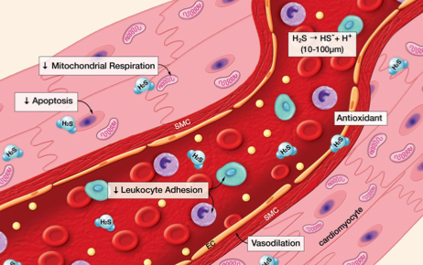
Hydrogen Sulfide as a Signaling Molecule*
“It appears that H₂S possesses all of the positive effects of NO without the capacity to form a toxic metabolite.”
* D. Lefer, PNAS 104(46), 17907–17908, 2007
Notes:
vitaminK/h2s_signaling_molecule.pdf

Slide 107
Hydrogen Sulfide Protects from Cardiovascular Disease*
BCA blocks H₂S Synthesis
This causes white blood cell adherence to the artery wall and infiltration beyond it, leading to atherosclerosis
* Renada et al., The Faseb Journal, 20, E1411-E1418, 2006.
Notes:
vitaminK/h2s_inflammation_leukocyte_infiltration.pdf
beta-cyano-L-Alanine (BCA) is a reversible inhibitor of the Hydrogensulfide-synthesizing enzyme cystathionine gamma lyase (CSE).

Slide 108
eNOS and Caveolae*
When calcium enters the cell, eNOS stops making sulfate and starts making nitrate instead
sulfate
nitrate
* Michel and Feron, J. Clin. Invest. 100(9) 2146-2152, 1997
Notes:
Cancer/NOS_review.pdf
Michel (Series Editor) and Olivier Feron
J. Clin. Invest. © The American Society for Clinical Investigation, Inc. 0021-9738/97/11/2146/07 $2.00 Volume 100, Number 9, November 1997, 2146–2152 http://www.jci.org
Michel and Feron, J. Clin. Invest. 100(9) 2146-2152, 1997
Palmitoylation contributes to membrane association.

Slide 109
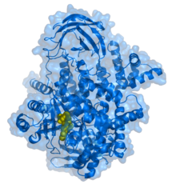
Transition to Nitrogen-based Oxygen Transport*
eNOS Requires L-Arginine as Substrate for NO Synthesis
VEGF
PI3K
Cell Interior
PI3K
Ca⁺²
Ca⁺²
Ca⁺²
CaM
CaM
Akt
Caveola
Ca⁺²
Ca⁺²
Ca+: Calcium
NO: Nitric Oxide
CaM: Calmodulin
VEGF: Vascular endothelial growth factor
PI3K: Phosphatidylinositol-3-kinase
eNOS: endothelial nitric oxide synthase
Ca⁺²
eNOS
P
Ca⁺²
NO
NO
NO
NO
NO
* Navarro et al., The Faseb Journal 18, 2004
Notes:
Cancer/caveolae_in_cell_migration.pdf

Slide 110
Protamine Treatment*
Protamine causes eNOS to detach from the membrane and start profusely producing nitric oxide
Protamine is a cationic polypeptide highly enriched in L-arginine
Protamine treatment can lead to extreme systemic hypotension, pulmonary hypertension, anaphylactic shock and cardiac failure
Excess nitric oxide is highly toxic, especially under well-oxygenated conditions
* Viaro et al., Chest 122;1061-1066, 2002
Notes:
vitaminK/protamine_sulfate_cardiac_crisis.pdf
Protamine sulfate is a polycationic peptide that is used in order to reverse the anticoagulant effects of heparin. Frequently, systemic hypotension is an undesired side effect of protamine infusion, some-
Catastrophic Cardiovascular Adverse Reactions to Protamine Are Nitric Oxide/Cyclic Guanosine Monophosphate Dependent and Endothelium Mediated * : Should Methylene Blue Be the Treatment of Choice?
Wiki:
The cardinal symptom of hypotension is lightheadedness or dizziness. If the blood pressure is sufficiently low, fainting and often seizures will occur.

Slide 111
The Relationship with Pathogens
Keep the pathogens out
2O₂⁻
H₂S
H₂SO₄
Fight the pathogens
H₂O₂
NO
H₂NO₃
Let the pathogens win
H₂O₂
CO
H₂CO₃
Notes:
See:
Cancer/CO_NO_H2S_Pituitary.pdf

Slide 112
How it Works
Keep the pathogens out (sulfur)
Both cholesterol sulfate in the skin and sulfate ions surrounding individual cells protect from bacterial invasion
Fight the pathogens (nitrogen)
Once the pathogens get in, nitric oxide is a good toxin to kill them
Let the pathogens win (carbon)
When cells themselves are too vulnerable to damage, it’s better to just learn to live with the pathogens –> autoimmune disease

Slide 113
Interleukins Control Strategy
IL-1, TNF-α; superoxide
2O₂⁻
H₂S
H₂SO₄
IL-6; muscle loss, anemia
H₂O₂
IL-6; muscle loss, anemia
NO
H₂NO₃
IL-10; autoimmunity
H₂O₂
CO
H₂CO₃
Notes:
See:
Cancer/CO_NO_H2S_Pituitary.pdf
Paper in endocrinology, 1991: (title)
Manganese superoxide dismutase: a hepatic acute phase protein regulated by interleukin-6 and glucocorticoids.
“they are thought to be the main enzymes in the antioxidant defense system”
O2- ➔ H2O2 !!!!!

Slide 114
How Insufficient Sulfate Leads to Anemia*
Bacterial infections rage in blood stream
Triggers IL-6 synthesis by macrophages
Induces mechanisms to deplete blood of iron
Iron feeds the bacteria!
Iron is drawn into macrophages, to lure bacteria to their death through nitric oxide poisoning
Serum iron is depleted → anemia
* Paradkar et al. Blood, 112:3, 866-874, 2008

Slide 115
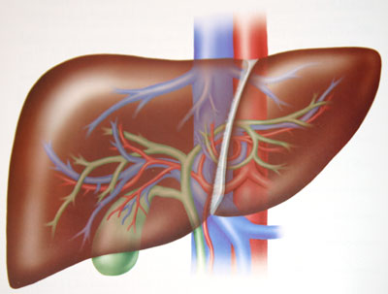
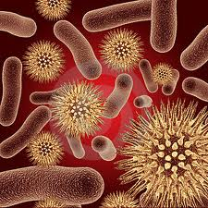
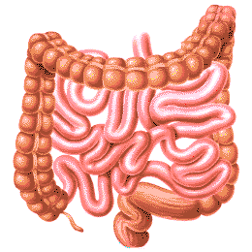
How Bacterial Infection Leads to Anemia through IL-6*
bacteria
hepcidin
IRON
hepcidin
IRON
IL-6
IRON
IRON
IRON
IRON
* Paradkar et al. Blood, 112:3, 866-874, 2008
Notes:
vitaminK/macrophages_iron_bacteria.pdf
Introduction
Hypoferremia is a hallmark of inflammation and results from increased secretion of the liver hormone hepcidin (for review, see Nemeth and Ganz1). Hepcidin is secreted by hepatocytes in response to inflammatory stimuli, notably interleuklin-6 (IL-6).2–4 Hepcidin binds to the iron exporter ferroportin (Fpn), leading to its internalization and degradation.5 Fpn is the only identified cellular iron exporter and is present on macrophages, absorptive enterocytes, and placenta. Loss of cell surface Fpn results in hypoferremia, which, if persistent, leads to iron-limited erythropoiesis.6 The hypoferremia of inflammation is thought to represent an antibacterial defense response, as iron acquisition proteins are virulence factors for many species of bacteria.7

Slide 116
Conditions Associated with Deficiencies
Obesity, heart disease, arthritis
2O₂⁻
H₂S
H₂SO₄
Anorexia, cachexia, ALS
H₂O₂
NO
H₂NO₃
Lupus, AIDS, cancer
H₂O₂
CO
H₂CO₃
Notes:
See:
Cancer/CO_NO_H2S_Pituitary.pdf

Slide 117
Recapitulation
Three signaling gases relate to three systems of oxygen/acid management: S, N, and C
Adequate sunlight exposure to skin allows S system to thrive
When S is deficient, bacteria invade
N based system fights bacteria
C based system gives up →
autoimmune disease

Slide 118
BREAK!

Slide 119
Outline
Introduction
Big Ideas: Dysfunction and Consequences
Dysfunction
Cholesterol Transport
Sulfate Deficiency
Obesity
Endothelial Nitric Oxide Synthase (eNOS)
SiNiC
Consequences
Blood Clots and Hemorrhages
Cardiovascular Disease
Impaired Gut Bacteria
Infection
Impaired Autophagy
The Environment
Environmental Toxins
Polyphenols
Summary

Slide 120
Blood Dysfunction
The stability of the blood colloidal system depends upon adequate cholesterol sulfate.
When sulfate is depleted, suspended cells and particles become deficient in negative charge, and start to stick together.
This leads to blood clots and hemorrhaging

Slide 121
Blood Clots and Hemorrhages

Slide 122
Blood Clots and Disease
“How and when our blood clots is one of those incredibly complex and important processes in our body that we rarely think about. If your blood doesn't clot and you cut yourself, you could bleed to death, if your blood clots too much, you could be in line for a heart attack or stroke. “*
* http://medicalxpress.com/news/2012-03-mystery-blood-clotting.html
Notes:
http://medicalxpress.com/news/2012-03-mystery-blood-clotting.html

Slide 123
“Platelet Up-and-Comers”*
“The quest for ever-more effective drugs to decrease platelet aggregation and reduce the risk of thrombus formation, without unduly increasing the risk of bleeding, will always be a holy grail of cardiovascular disease research. With each new contender comes fresh excitement as well as more questions.”
* http://www.theheart.org/collection/Antiplatelet-up-and-comers.do

Slide 124
Hemostasis
Hemostasis keeps the blood in circulation and prevents excessive blood loss upon injury
Maintained by coagulation system involving clotting factors
Complex coagulation cascade involving calcium, thromboplastin, phospholipids and several serum proteins
Extrinsic pathway
Intrinsic pathway
Common pathway
Final product is insoluble fibrin (blood clot)
Hypothesis: insufficient sulfate supply to blood leads to fragile state of constant tension between hemorrhage and blood clots
Notes:
hemCoagulation.ppt -- modified slide.

Slide 125
The Glycocalyx
Negatively charged gel-like mesh lining the walls of all arteries, veins and capillaries
Depends crucially on sulfated polysaccharides
Particularly heparan sulfate proteoglycans (HSPGs)
Sulfate creates exclusion zones
Helps protect cells in wall from ion leaks and contact with enzymes suspended in blood
Greatly reduces amount of flowing blood (decreases resistance, lowers blood pressure)

Slide 126
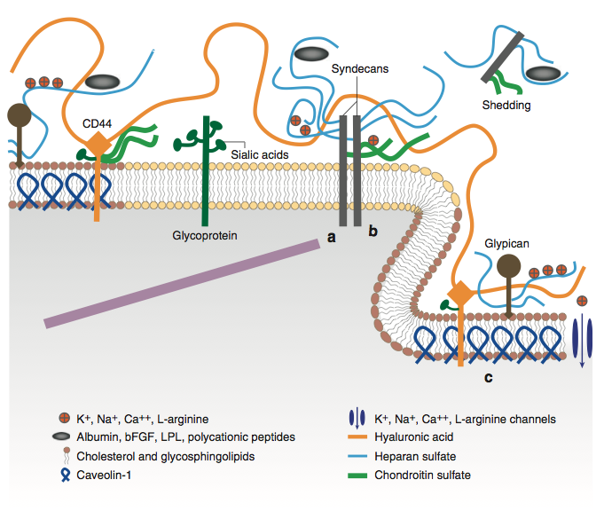
The Glycocalyx
Figure 1 from Weinbaum et al., Annu. Rev. Biomed. Eng. 2007. 9:121–67
Notes:
vitaminK/glycocalyx_review_LONG.pdf
Representation of proteoglycans and glycoproteins on the surface of ECs. Caveolin-1 associates with regions high in cholesterol and sphingolipids in the membrane (darker circles, left) and forms cave-like structures, caveolae (right). Glypicans, along with their HS chains localize in these regions. Transmembrane syndecans are shown to cluster in the outer edge of caveolae. Besides HS, syndecans also contain CS, further down the core protein. A glycoprotein with its short oligosaccharide branched chains and their associated SA “caps” are displayed in the middle part of the figure. HA is a very long GAG that weaves into the glycocalyx and binds with CD44. Transmembrane CD44 can have CS, HS, and oligosaccharides attached to it and it localizes in caveolae. Plasma proteins, along with cations and cationic amino acids (red circles), are known to associate with GAGs. (a) The cytoplasmic domains of syndecans can associate with linker molecules, which connect them to cytoskeletal elements. (b) Oligomerization of syndecans helps them make direct associations with intracellular signaling effectors. (c) A series of molecules involved in eNOS signaling localize in caveolae. (This illustration is not drawn to scale and a few GAG attachments were omitted for simplicity.)

Slide 127
The Glycocalyx
Sulfate maintains negative charge and creates exclusion zones
Heparan sulfate proteoglycans (HSPGs)
Figure 1 from Weinbaum et al., Annu. Rev. Biomed. Eng. 2007. 9:121–67
Notes:
a) The cytoplasmic domains of syndecans can associate with linker molecules, which connect them to cytoskeletal elements. (b)

Slide 128
Key Role for Sulfates
Sulfates decorate exterior of cell, e.g., as heparan sulfate proteoglycans (HSPGs) or as cholesterol sulfate (Ch-S)
Sulfates carry negative charge and keep cells from sticking together
Sulfates, as kosmotropes, create exclusion zone – gel-like environment to protect cell
Red Blood Cell

Slide 129
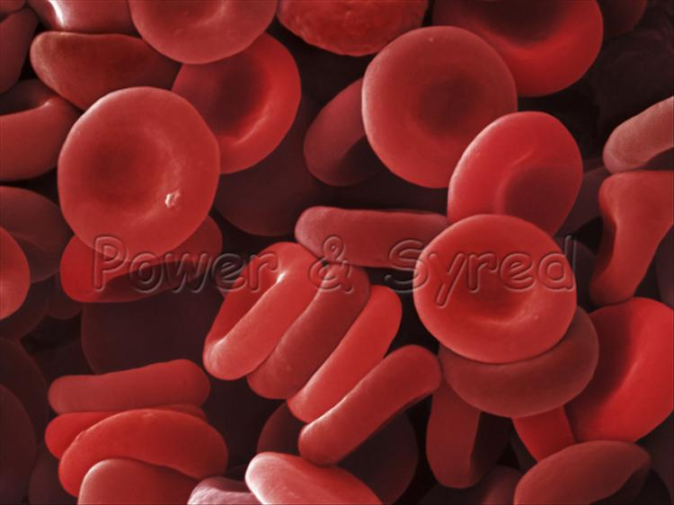
Zeta Potential
Zeta potential indicates degree of repulsion between similarly charged particles in a dispersion (e.g., the blood)
High zeta potential confers stability
RBCs and platelets resist aggregation
Low zeta potential causes flocculation and coagulation (blood clot)
Proposal: a steady drop in zeta potential in the blood as we age is the source of many modern diseases

Slide 130
Grounding the Human Body Reduces Blood Viscosity*
Blood viscosity is strongly influenced by the surface charge on the suspended particles (like RBCs)
A higher repulsive surface charge increases spacing between RBCs, reduces clumping, lowers viscosity, and lowers peripheral resistance to flow (blood pressure)
Grounding transfers electrons from soil to the body
Increases zeta potential, lowers blood viscosity
*G. Chevalier et al., J Alternative and Complementary Medicine, 1–9, 2012

Slide 131
Negative Charge Builds on Artery Wall*
-
-
-
-
-
-
-
-
-
-
-
-
-
-
-
-
-
-
-
-
-
-
-
-
-
-
-
-
-
-
-
-
-
-
-
-
-
-
-
-
-
-
-
-
-
-
-
-
-
-
-
-
-
-
-
-
-
Red blood cells export cholesterol sulfate to the artery wall, supplying it with cholesterol, sulfate, and negative charge
* Davidson and Seneff, Entropy 14, 1399-1442, 2012.

Slide 132
A Battery!
* Davidson and Seneff, Entropy 14, 1399-1442, 2012.

Slide 133
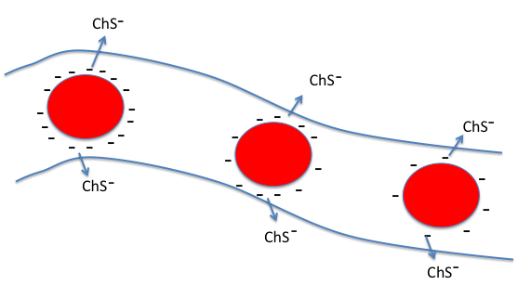
Battery Poles Between Artery and Vein
“current”
-
+
VEIN
ARTERY
RBC’s lose charge as they travel through the capillary
This sets up voltage gradient between vein and artery
Negatively charged RBC’s are propelled towards positive pole of “battery”
This creates force field that promotes blood flow
* Davidson and Seneff, Entropy 14, 1399-1442, 2012.

Slide 134
Zeta potential measures rate at which negatively charged particles travel in an electric force field

Slide 135
Hypothesis
When blood becomes deficient in negative charge (sulfates), glycocalyx becomes unhealthy
Endothelial cells develop gaps that allow blood to seep into tissues
Blood clots are needed to plug the holes
Mistakes can lead to dangerous blockage
Deep vein thrombosis
Pulmonary thrombosis

Slide 136
Recapitulation
Hemostasis is the regulatory system that maintains blood stability
Tension between clotting and hemhorraging
Sulfates in the glycocalyx are protective
Grounding can improve blood stability by providing negative charge through currents from the ground
Red blood cells discharge negative charge by releasing cholesterol sulfate in capillaries
This helps maintain pH difference between arteries and veins to drive circulation

Slide 137
Outline
Introduction
Big Ideas: Dysfunction and Consequences
Dysfunction
Cholesterol Transport
Sulfate Deficiency
Obesity
Endothelial Nitric Oxide Synthase (eNOS)
SiNiC
Consequences
Blood Clots and Hemorrhages
Cardiovascular Disease
Impaired Gut Bacteria
Infection
Impaired Autophagy
The Environment
Environmental Toxins
Polyphenols
Summary

Slide 138
Heart Disease
Cardiovascular plaque develops as an alternative mechanism to produce cholesterol sulfate from damaged LDL and homocysteine

Slide 139
What Happens when Cholesterol Sulfate Synthesis is Impaired??
Cardiovascular disease!!!
Activities in Plaque Produce Cholesterol Sulfate to Supply the Heart

Slide 140
They Knew a Long Time Ago*
Article published in 1960
Fed cholesterol to monkeys
induced atherosclerosis
If sulfur-containing nutrients are added, atherosclerosis is prevented
These nutrients provide source of sulfate to enable cholesterol transport
* G.V. Mann et al., Am. J. Clin. Nutr. 8, 491-497, 1960.

Slide 141
Steps in Atherosclerosis*
Inflamed endothelium provides adhesion molecules to trap and hold macrophages
Macrophages through scavenger process take up oxidized LDL and become foam cells
Interleukins and growth factors promote proliferation of smooth muscle cells (artery thickening)
Extracellular matrix proteins are degraded
Vulnerable plaque eruption: thrombosis
* Libby et al., Circulation 105:1135-1143, 2002
Notes:
Libby –
.cancer/libby_inflammation_heart_disease.pdf

Slide 142
Steps in Atherosclerosis
Entrapment of macrophages
Build up of fatty deposits
Rupture and thrombosis
Adapted from Libby, et al., Circulation 105:1135-1143, 2002
Notes:
Libby_inflammation_and_heart_disease.pdf

Slide 143
Many Good Reasons for ROS
ROS (reactive oxygen species) are a key component of inflammation in the artery
ROS are needed to produce sulfate *
Oxidation of glycated LDL makes it accessible to macrophages for breakdown**
Peroxynitrite (product of reaction between superoxide and nitric oxide) is toxic to pathogens***
* Mitsuhashi et al. Shock 24(6) 529-34, 2005.
** Kaplan and Aviram, Arterioscler Thromb Vasc Biol 21(3) 386-93 2001.
*** Alvarez et al., J. Biol. Chem. 286, 6627-6640, 2011.
Notes:
Vitamink/peroxynitrite_fights_infetion.text
vitaminK/ROS_h2s_to_sulfite_shock_2005.text

Slide 144
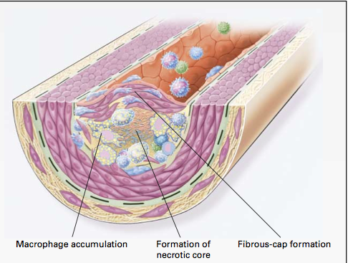
Macrophages and Cholesterol*
Macrophages in artery wall take up oxidized LDL and export extracted cholesterol to HDL-A1
Unsaturated fatty acids interfere with export process
Macrophages eventually become damaged by exposure to oxidizing and glycating agents → necrotic core
* Wang and Oram, J. Biol. Chem. 277 (7) , 5692–5697, 2002
Notes:
Results showed that unsaturated fatty acids markedly inhibited ABCA1-mediated cholesterol and phospholipid efflux from macrophages when ABCA1 was induced by a cAMP analog. This was accompanied by a reduction in the membrane content of ABCA1 and a decrease in apoA-I binding to whole cells and to ABCA1. In contrast, saturated fatty acids had no effect on these processes.
vitaminK/unsaturated_fatty_acids_inhibit_cholesterol_efflux_from_macrophages.pdf
vitaminK/unsaturated_fatty_acids_inhibit_cholesterol_efflux_from_macrophages.pdf

Slide 145
Quote from the Abstract*
“These findings raise the possibility that an in- creased supply of unsaturated fatty acids in the artery wall promotes atherogenesis by impairing the ABCA1 cholesterol secretory pathway in macrophages.”
* Wang and Oram, J. Biol. Chem. 277 (7) , 5692–5697, 2002

Slide 146
Pathway from Homocysteine to Sulfate*
When folate and B12 are deficient, nearly all homocysteine is converted to homocysteine thiolactone
homocysteine thiolactone
Vitamin A
thioretinamide
Superoxide:
Reactive oxygen species
(ROS)
Vitamin C
sulfite
alpha keto butyrate
retinoic acid
Sulfite oxidase
PAPS
*McCully, Annals of Clinical and Laboratory Science 41:4, 300-313, 2011
sulfate
Notes:
Spacedoc/McCully/ChemicalPathologyHomocysteineV_McCully.pdf
Figure 1. Hypothetical scheme for synthesis of thioretinamide, oxidation to sulfite and sulfate, and activation of sulfate to phosphoadenosine phosphosulfate, explains sulfation of glycosaminoglycans (GAG) to form sulfate esters [2]. In this scheme superoxide is synthesized from the heme oxygenase group of cystathionine synthase [34], catalyzing retinoic acid synthesis from retinol. Synthesis of thioretinamide from retinoic acid and homocysteine thiolactone is catalyzed by cystathionine synthase and dehydroascorbate.
is hydro- lyzed to Hcy by a calcium-dependent Hcy thiolactonase (HTase) tightly associated with HDL in serum (Jakubowski 1999a). !!
When methionine synthase activity is inhibited by folate or vitamin B-12 deprivation, almost all Hcy is converted to thiolactone.
!

Slide 147
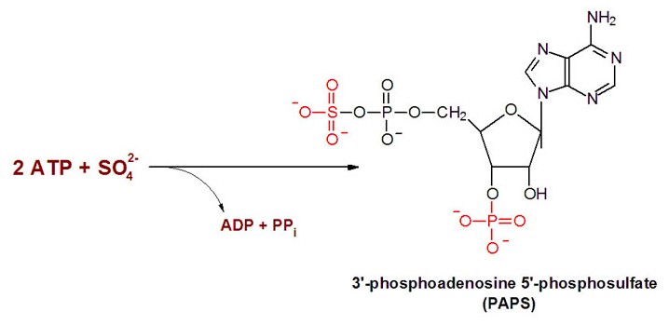
Synthesis of PAPS consumes ATP
eNOS’ synthesis of sulfate upon sunlight exposure in skin may avoid loss of ATP by exploiting energy from light instead

Slide 148
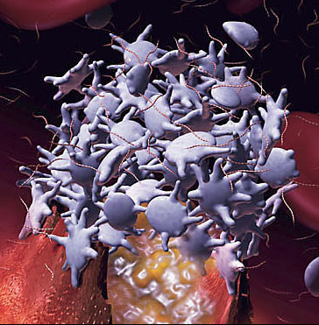
Platelets and Cholesterol Sulfate*
Platelets and RBCs both synthesize cholesterol sulfate (Ch-S)
Ch-S is present in the atherosclerotic lesions in the aorta
Platelets will accept cholesterol only from HDL-A1
Platelet synthesis rate increases 300-fold when PAPS is available.
PAPS is formed from ATP and sulfate
Platelet aggregation leads to thrombosis
HDL suppresses aggregation; LDL promotes it
* Yanai et al, Circulation 109, 92-96, 2004

Slide 149
Putting it All Together
homocysteine
Heart muscle cell
Synthesize sulfate
sulfate
Cholesterol protects the heart from ion leaks and sulfate allows it to safely metabolize glucose
ATP
PAPS
Lipid Raft
Red Blood Cell
Cholesterol Sulfate
RBC
insulin
Platelet
glucose
(3)
HDL-A1
macrophage
Ch
Ch
Artery Wall
oxLDL
LDL
ApoE
ROS
Inflammatory Agents
Endothelial Cell

Slide 150
Steps in Atherosclerosis: Reinterpreted
Endothelial cells lining artery walls feeding the heart release inflammatory agents
Macrophages infiltrate artery wall
Macrophages extract cholesterol from oxidized LDL and deliver it to HDL-A1.
Platelets extract cholesterol from HLD-A1 and convert it to cholesterol sulfate, with help from PAPS
Macrophages die and build up necrotic core

Slide 151
I hypothesize that treatments aimed at reducing the supply of cholesterol to the plaque will eventually lead to severe deficiencies in cholesterol and sulfate supply to the heart, resulting in heart failure.

Slide 152
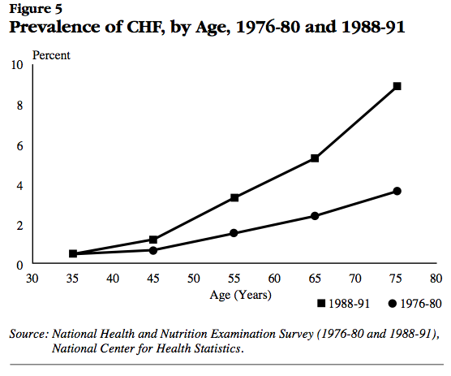
Post-statins
Pre-statins
National Heart, Lung, and Blood Institute National Institutes of Health Data Fact Sheet
Notes:
http://library.thinkquest.org/27533/facts.html
./heart_failure_stats_1990s.pdf

Slide 153
Recapitulation
I believe that cardiovascular disease can be best characterized as a factory to supply cholesterol and sulfate to the heart
Unsaturated fats, but not saturated fats, interfere with the supply chain
Statin drugs, through their ability to deplete the supply of cholesterol to the plaque, can lead to heart failure down the road

Slide 154
Outline
Introduction
Big Ideas: Dysfunction and Consequences
Dysfunction
Cholesterol Transport
Sulfate Deficiency
Obesity
Endothelial Nitric Oxide Synthase (eNOS)
SiNiC
Consequences
Blood Clots and Hemorrhages
Cardiovascular Disease
Impaired Gut Bacteria
Infection
Impaired Autophagy
The Environment
Environmental Toxins
Polyphenols
Summary

Slide 155
Impaired Gut Bacteria

Slide 156
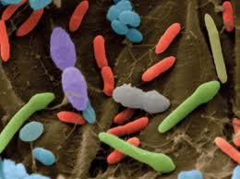
Gut Bacteria and Health*
We are an ecosystem: a community of interacting cells
Trillions of bacteria live in our body
They outnumber our own cells 10:1
Killing them off may make us sick or fat
5-8 million microbial genes in our bodies (3 million in digestive system from more than 1000 species)
They play very essential roles in our bodies
Digest foods, absorb nutrients, provide enzymes, make vitamins and antiinflammatories
Regulate appetite and brain function
Vaginal birth matters
Everyone has unique set of gut bacteria
* NPR’s On Point: Your Inner Ecosystem, http://onpoint.wbur.org/2012/06/20/bacteria-2

Slide 157
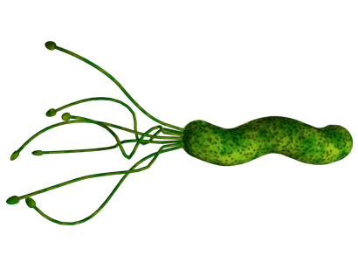
“Our microbes are under threat — and the enemy is us”*
“Microbiome”
Microbes in our body outnumber us 10:1
99% of them are benign or offer protection
Synthesize vitamins B12 and folate
Birth through birth canal (v.s. C section)
Infant picks up mother's microbiome
Colostrum provides food for gut bacteria
Industrialized countries are too clean
Drastically altered microbiome
H. pylori 90% --> < 10% in last hundred years in U.S.
Esophageal cancer and childhood asthma have risen in step
* Liz Szabo, USA Today,
http://www.usatoday.com/news/health/story/2012-07-13/body-bugs-microbes/56255904/1
Notes:
./microbes_usatoday.text

Slide 158
H. pylori: There are Benefits!*
The Western world has now significantly reduced the presence of H. pylori in the gut
This has reduced the incidence of stomach ulcers and stomach cancer
But it has also increased the incidence of esophageal reflux disease and esophageal cancer
H. pylori serve a useful role in reducing acid production by stomach: excess acid aggravates esophagus
We host a colony of bacteria and they work together with us for a jointly beneficial solution
*Caroline Hadley, EMBO reports 7(5), 471-473, 2006
Notes:
gut_bacteria.pdf

Slide 159
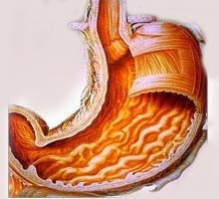
“Folate synthesized by bacteria in the human upper small intestine is assimilated by the host”*
Folate synthesized by flora in the small intestine is absorbed through the gut
Atrophic gastritis associated with higher duodenal pH
Leads to bacterial overgrowth
Increased supply of folate
This could be an important benefit to assure adequate folate
* E. Camilo et al., Gastroenterology 110(4), 991-998, 1996
Notes:
./folate_synthesis_bacteria.text
Abstract
BACKGROUND & AIMS: Some intestinal flora are known to synthesize folate. The aim of this study was to determine whether folate synthesized by small intestinal flora is assimilated by the human host. METHODS: Subjects with atrophic gastritis and healthy volunteers were studied before and after omeprazole administration. A double-lumen perfusion tube was placed in the duodenum. 3H-labeled P-aminobenzoic acid, a precursor substrate for bacterial folatesynthesis, was perfused. Downstream intestinal aspirates and a 48-hour urine collection were obtained. RESULTS: Atrophic gastritis and omeprazole administration were associated with increases in duodenal pH and in small intestinal flora. Bacterially synthesized folates were isolated from the intestinal aspirates. Tritiated 5-methyltetrahydrofolate, a major metabolite of folate, was isolated from the urine of omeprazole- treated subjects in greater quantities than from drug-free subjects (P<0.01); the quantity of tritiated 5-methyltetrahydrofolate in the urine of the subjects with atrophic gastritis was similarly elevated. CONCLUSIONS: (1) Mild bacterial overgrowth caused by atrophic gastritis and administration of omeprazole are associated with de novo folatesynthesis in the lumen of the small intestine; (2) the human host absorbs and uses some of these folates; and (3) the contribution to folate nutriture from this source remains unclear. (Gastroenterology 1996 Apr;110(4):991-8)
Copyright © 1996 Published by Elsevier Inc.

Slide 160
Wild Speculation
Leaky gut and leaky skin and leaky blood brain barrier lead to infiltration of microbes from gut or skin into brain
Bacteria are “lured” into the body & into the brain and then killed and harvested to renew important nutrients
Possible nutrients include:
Vitamin B12 (cobalamin), vitamin B9 (folate), thiamine, vitamin K and heparan sulfate

Slide 161
“The Infection Connection”*
Barry Marshall drank H. pylori broth and developed gastritis
Proved that H. Pylori “causes” stomach ulcers
Other examples:
Cervical cancer & HPV
Liver cancer & Hepatitis B and C
Lymphoma & Epstein-Barr virus
Cardiovascular disease & chronic infection?
Alzheimer’s & brain infection?
*Caroline Hadley, EMBO reports 7(5), 471-473, 2006
Notes:
./gut_bacteria.pdf

Slide 162
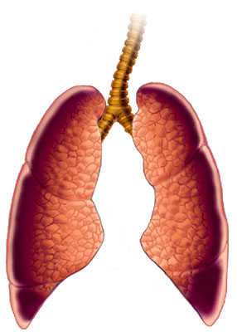
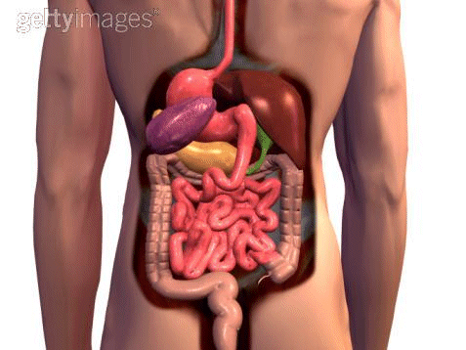
What Causes Increased Infection?
Impaired Cholesterol Sulfate Synthesis!
Microbes
Microbes
Microbes

Slide 163
Leaky Gut
Collitis and Crohn’s disease are associated with significantly reduced sulfate in the GAGs in the walls of the intestines
Cells are defective in transporting nutrients
Leads to severe vitamin deficiencies (e.g., B12)
Tight junctions between cells become loose
Microbes can penetrate the gut wall and enter the blood stream
They can be harvested by macrophages!

Slide 164
Microvilli in Gall Bladder Epithelium*
Healthy – negative charge makes them stand tall
Unhealthy – addition of cationic polymer destroys them
* Figures 1 and 2 in Quinton and Philpott, J. Cell Biol. 56, 1978, 787-796.
Notes:
vitaminK/epithelium_anionic_1978.pdf
1.0 microgram/ml of poly-L-lysine
FIGURE 1Control gall bladder epithelium not exposed to cationic polymers. Note the structural indi- viduality of the microvilli (my) and lateral invaginations (li). The cytoplasmic ground substance, mitochondrial size and ground substance, and nuclear size and ground substance are comparatively con- sistent from one cell to another. Scale bar, 1/zm; 5,800 diameters.
mURE o Gall bladder epithelium exposed to 1.0 /zg/ml of poly-L-lysine. Note: (a) the collapse of the microvillar structure, (b) the membrane folds extending from the apical border into the terminal web, and (c) the contrasting densities of the cytoplasmic ground substances of adjacent ceils. Scale bar, 1 gm; 6,600 diameters.

Slide 165
Bacteria can Swim Across Gut Barrier!

Slide 166
Microbial Invasion through BBB*
* Figure 5, p. 380, J.A. Orellana et al., Antioxidants and Redox Signaling 11(2), 2009
Notes:
vitamink/neurodegeneration_inflammation_gap_junctions_2009.pdf
FIG. 5.Connexin based channels in brain cells during bacterial meningitis. During bacterial infection blood levels of cytokine (e.g., TNF-􏰃 and IL-􏰉) are elevated. Both, TNF-􏰃 and IL-1􏰉 enhance hemichannel activity (1) of brain endothelial cells. Furthermore, these cytokines induce BBB discontinuity favoring bacterial extravasation (2). Once in the interstitium, bacteria and their extracellular wall components such as LPS and PGN are recognized by microglia (3) which are activated and release cytokines that further activate them (reciprocal arrows). ATP released via hemichannels from microglia (4) pro- motes microglial migration from less affected regions. Activated microglia can also release glutamate through hemichan- nels and oxygen- and nitrogen-derived free radicals that are neurotoxic (5). The enhanced hemichannel activity of activated astrocytes induces neuronal damage through the release of neurotoxic and/or inflammatory compounds such as glutamate and PGE2 (6). These compounds may also increase the activity of neuronal pannexin hemichannels (7), causing electro- chemical imbalance and Ca2􏰁 overload in neurons. In contrast to increased opening of hemichannels, astroglial gap junc- tion communication is reduced (8) (depicted in the figure as reduction in channel number, but could also be the conse- quence of a reduction in permeability or open probability), impairing glutamate and K􏰁 spatial buffering, which enhances neuronal susceptibility to insults. Bacterial meningitis can also induce demyelination (9), possibly via microglial cytokine release. Severe inflammation induces recruitment of leucocytes (10) to the infected loci. Gap junction communication be- tween leucocytes and endothelial cells (11) may contribute to stronger heterocellular adhesion and allow transfer of signals that regulate leucocyte diapedesis across the endothelium (12). Activated microglia may perform antigen cross-presenta- tion interaction with infiltrating leucocytes in which gap junctions between them may play an important role (13). Direct microglial interaction with LPS or PGN induces gap junction communication between microglia which can coordinate mi- croglial function (14). (For interpretation of the references to color in this figure legend, the reader is referred to the web version of this article at www.liebertonline.com/ars).

Slide 167
The Good Side of Infection and Inflammation in the Brain
Inflammation activates microglia to phagocytose dying cells and Amyloid beta
Bacterial exposure promotes phagocytosis of dying cells
Both dying cells and bacteria can be recycled into new raw materials!
These nutrients may be essential to brain health

Slide 168
Outline
Introduction
Big Ideas: Dysfunction and Consequences
Dysfunction
Cholesterol Transport
Sulfate Deficiency
Obesity
Endothelial Nitric Oxide Synthase (eNOS)
SiNiC
Consequences
Blood Clots and Hemorrhages
Cardiovascular Disease
Impaired Gut Bacteria
Infection
Impaired Autophagy
The Environment
Environmental Toxins
Polyphenols
Summary

Slide 169
Infection
Susceptibility to infection is a consequence of impaired cholesterol sulfate synthesis, which introduces widespread pathology
Infection serves a useful role in resupplying critical nutrients such as cobalamin, folate, and heparan sulfate

Slide 170
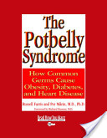
The Falling Apart Syndrome*
The key message: All chronic diseases can be linked to infections
The author, Russell Farris, previously published another book:
The Potbelly Syndrome: How Common Germs Cause Obesity, Diabetes and Heart Disease.
* Russell Farris, http://www.polymicrobial.com

Slide 171
Figure from Chapter 6 in The Potbelly Syndrome*
* By Russell Farris

Slide 172
A Possible Cause-and-Effect Relationship
First comes impaired barriers, impaired nutrient transport and impaired blood colloidal suspension
Certain nutrients are desperately needed to fix the problems: e.g., cobalamin, vitamin K, heparan sulfate
Bacteria are invited in to provide those nutrients!
The disease may be uncomfortable, but the alternative may be worse!

Slide 173
Infection and Atherosclerosis*
* A. Tufano et al., Semin Thromb Hemost 2012(38), 515–523.
Notes:
vitaminK/infection_atheroma_2012_Luca.pdf
./infection_and_atheroma.png
Figure 1Postulated mechanisms by which infectious agents may contribute to the development of atherosclerosis. Infections of vascular cells (direct or via dissemination from extravascular sites, through monocyte/macrophage migration in the case of intracellular pathogens) exert direct effects, whereas the inflammatory response secondary to the infection is responsible for indirect effects. Direct infections of macrophages and smooth muscular cells (SMC) and effects of pathogens on endothelial cells and T cells induce tissue factor expression and generation of reactive oxygen species and of a series of cytokines, growth factors and adhesion molecules. An inflammatory state of the vascular wall is progressively amplified, resulting in SMC migration and proliferation, low-density lipoprotein oxidation and uptake by macrophages transforming into foam cells, and procoagulant imbalance of endothelial function, all crucial atherogenic mechanisms. LDL, low-density lipoprotein; ROS, reactive oxygen species; TF, tissue factor.

Slide 174
What Happens if you Treat with Antibiotics?*
* A. Tufano et al., Seminars in Thrombosis & HemostasisVol. 38(5), 2012, 515-523.
Notes:
vitaminK/antibiotics_increase_cardiovascular_disease.pdf
Kaplan-Meier estimate (with 95% confidence intervals) of cardiovascular mortality according to intervention. Figures below the diagram are biannual number at risk in the clarithromycin and placebo groupsFig 3

Slide 175
What Happens if you Treat with Antibiotics?*
Significantly more people die of cardivascular disease following antibiotic treatment (p=0.01)
* A. Tufano et al., Seminars in Thrombosis & HemostasisVol. 38(5), 2012, 515-523.
Notes:
vitaminK/antibiotics_increase_cardiovascular_disease.pdf
Kaplan-Meier estimate (with 95% confidence intervals) of cardiovascular mortality according to intervention. Figures below the diagram are biannual number at risk in the clarithromycin and placebo groupsFig 3

Slide 176
Chlamydia Produce Heparan Sulfate!*
Chlamydia are viable only inside host cells
They set up housekeeping in vacuoles within the cell (e.g., a macrophage in the plaque)
They produce a glucosamine-containing sulphated polysaccharide that is nearly indistinguishable from heparan sulfate
* S.J. Rasmussen-Lathrop et al, Cell Microbiol. 2000 Apr, 2(2), 137-44.
Notes:
vitaminK/chlamydia_produce_heparan_sulfate.text

Slide 177
Special Issue Devoted to Alzheimer's and Infection:* Key Points
Pathogens can produce progressive chronic diseases like Alzheimer’s, asthma, and heart disease
Alzheimer himself proposed involvement of infective agents in Alzheimer's 100 years ago
Pathogens stimulate inflammation
Pathogens evade host defenses and establish chronic latent infections
Persistent superoxide, nitric oxide and peroxynitrite (ROS) cause DNA damage and apoptosis and alter gene expression
Environmental toxins and poor nutrition weaken immune system and provide opportunity to bacteria and viruses
* Special Issue of the Journal of Alzheimer’s Disease, 2008

Slide 178
Amyloid Plaque Structure*
Microglia and amyloid plaque accumulate side-by-side in a central region surrounded by astrocytes
Microglia harbor dormant bacteria
Should the bacteria leave, they will encounter the plaque, which will kill them
The astrocytes guard the gates and shield the neurons from the damaging plaque
Chlamydia in plaque region produce heparan sulfate!
* Microphotograph from Schwab et al., Journal of Alzheimer’s Disease 13 359–369, 2008.
Notes:
Picture from alzhiemers_inflammation_2008.pdf

Slide 179
Amyloid Beta and Nitric Oxide*
Aβ produced by the neuron induced increased synthesis of nitric oxide
Nitric oxide reacts with superoxide to produce peroxynitrite
Peroxynitrite is extremely damaging to mitochondria and disrupts their function
Cell commits apoptosis due to insufficient energy supply
* U. Keil et al., J. Biol. Chem, 2004 279(48), 50310-50320
Notes:
vitaminK/2004_Keil_amyloid_beta_induced_changes_NO_mitochondrial_activity_apoptosis.pdf

Slide 180
Sepsis and the Vasculature*
Impaired ability to modulate blood flow
Immune cells stick to wall of venule and block flow
Small blood clots form in capillaries and block flow
* S. Trzeciak et al., Acad Emerg Med. 2008 May ; 15(5): 399–413
Notes:
vitaminK/
2008_Trzeciak_resuscitating_microcirculation_septic_shock_Bob.pdf
Figure 1.Sepsis is a disorder of the microcirculation. Much of the pathophysiology of sepsis can be explained within the microcirculatory unit – the terminal arteriole, capillary bed, and the post- capillary venule. The arteriole is where the characteristic vasodilation and vasopressor hyporesponsiveness of sepsis occurs. The capillary bed is where the effects of endothelial cell activation/dysfunction are most pronounced and microvascular thromboses are formed. The post-capillary venule is where leukocyte trafficking is most disordered – leukocytes adhere to the vessel wall, aggregate, and further impair flow through the microcirculation.
Figure 1.
Sepsis is a disorder of the microcirculation. Much of the pathophysiology of sepsis can be
explained within the microcirculatory unit – the terminal arteriole, capillary bed, and the postcapillary
venule. The arteriole is where the characteristic vasodilation and vasopressor
hyporesponsiveness of sepsis occurs. The capillary bed is where the effects of endothelial cell
activation/dysfunction are most pronounced and microvascular thromboses are formed. The
post-capillary venule is where leukocyte trafficking is most disordered – leukocytes adhere to
the vessel wall, aggregate, and further impair flow through the microcirculation.

Slide 181
Hypothesis
Blood flow needs to nearly shut down during sepsis; organs need to shut down; the entire body focuses on harvesting heparan sulfate from the invasive microbes to recover blood stability.

Slide 182
GSK-3: Inducing Inflammation*
GSK-3 is a protein that interferes with insulin-mediated glucose uptake and with glucose storage into glycogen
It also promotes inflammation in association with mood disorders, Alzheimer’s disease, diabetes, and cancer
This shows a clear link between glucose impairment and inflammation
* R.S. Jope et al., Neurochem Res. 2007 ; 32(4-5): 577–595.
Notes:
WIKI phosphorylates a number of enzymes involved in glucose transport, storage and synthesis

Slide 183
Figure 2 from R.S. Jope et al., Neurochem Res. 2007 ; 32(4-5): 577–595.
Notes:
./GSK-3_inflammation_review.pdf
Images/GSK_xxx

Slide 184
Inflammation and impaired glucose metabolism are closely linked
Inflammation is needed to generate more sulfate!
Figure 2 from R.S. Jope et al., Neurochem Res. 2007 ; 32(4-5): 577–595.
Notes:
./GSK-3_inflammation_review.pdf
Images/GSK_xxx

Slide 185
Recapitulation
Infection is associated with many chronic diseases like heart disease and Alzheimer’s
Treating with antibiotics doesn’t help
Infection serves useful role in supplying nutrients?
Support comes from Chlamydia’s ability to produce heparan sulfate
Amyloid beta plaque provides home for microbes
Sepsis reflects blood melt-down due to sulfate deficiency
Inflammation and impaired glucose metabolism are closely linked
Linking element is sulfate deficiency?

Slide 186
Outline
Introduction
Big Ideas: Dysfunction and Consequences
Dysfunction
Cholesterol Transport
Sulfate Deficiency
Obesity
Endothelial Nitric Oxide Synthase (eNOS)
SiNiC
Consequences
Blood Clots and Hemorrhages
Cardiovascular Disease
Impaired Gut Bacteria
Infection
Impaired Autophagy
The Environment
Environmental Toxins
Polyphenols
Summary

Slide 187
Impaired Autophagy
Autophagy is the process by which cells dispose of the garbage that accumulates with living – they can recycle misfolded proteins into new proteins and replace broken mitochondria with fresh ones.
Excess nitric oxide leads to impaired autophagy, which results in accumulation of debris and busted mitochondria. Over time, the cell becomes so impaired that it has to shut down.

Slide 188
Inflammation and Repair*
Inflammation is at the root of a host of diseases, from diabetes to cancer
Induces permeability of vascular walls and movement of immune cells into the tissues
Leads to production of ROS and tissue damage
Acute inflammation follows infection or tissue injury
Chronic inflammation characterizes diseases like heart disease, diabetes, and Alzheimer's disease
Cell debris is phagocytized by leukocytes
* Kolattukudy, and Niu, Circulation Research 2012, 110:174-189

Slide 189
MCP-1 is a Key Signaling Molecule*
“The increased level of serum MCP-1 found in humans correlated with markers of the metabolic syndrome, including obesity, insulin resistance, type 2 diabetes, hypertension, and increased serum concentration of triacylglycerol.”
* p. 181, Kolattukudy, and Niu, Circulation Research 2012, 110:174-189
Notes:
vitaminK/inflammation_ER_stress_UPR_2012.pdf

Slide 190
Inflammation and ER Stress*
MCP-1
Progenitor Cells Build New Tissues
Cell Death
* Figure 3, Kolattukudy, and Niu, Circulation Research 2012, 110:174-189
Notes:
vitaminK/inflammation_ER_stress_UPR_2012.pdf

Slide 191
A Picture Emerges …
Insufficient cholesterol sulfate synthesis in the skin
Long-term recovery
Inflammatory agents
(TNF-α, LPS, IL-1)
Emergency reaction
MCP-1
MCPIP
NFκB
NO, ONOO⁻
Heart disease
obesity
Mitochondrial dysfunction Autophagy dysfunction
Unfolded protein response
Cholesterol sulfate restored
Heparan sulfate restored

Slide 192
Autophagy
Allows cell to recycle damaged goods
Both damaged mitochondria and damaged endoplasmic reticulum are absorbed into the lysosome and broken down
Autophagy depends on sulfates in HSPGs
http://www.wormbook.org/chapters/www_autophagy/autophagy.html
Notes:
http://www.wormbook.org/chapters/www_autophagy/autophagy.html
Figure 1: Schematic diagram of the steps of autophagy. Autophagy begins with the formation of the phagophore or isolation membrane (vesicle nucleation step). The concerted action of the autophagy core machinery proteins at the phagophore assembly site (PAS) is thought to lead to the expansion of the phagophore into an autophagosome (vesicle elongation). The autophagosome can engulf bulk cytoplasm nonspecifically, including entire organelles, or target cargos specifically. When the outer membrane of the autophagosome fuses with an endosome (forming an amphisome before fusing with the lysosome) or directly with a lysosome (docking and fusion steps), it forms an autophagolysosome. Finally, the sequestered material is degraded inside the autophagolyosome (vesicle breakdown and degradation) and recycled.

Slide 193
The Lysosome is Central to the Cell*
* M. Jeyakumar, et al., Nature Reviews 6, Sep. 2005, Box 1, p. 2
Notes:
vitaminK/lysosomal_disorders_brain.pdf
The endosomal/lysosomal system mediates the internalization, recycling, transport and breakdown of cellular and extracellular components and facilitates dissociation of receptors from their ligands111. There are discrete compartments within this highly dynamic system. Early endosomes are part of the main receptor-recycling pathway, whereas late endosomes are involved in the breakdown of internalized cargo and delivery of molecules to the trans-Golgi network.Intracellular components are degraded in lysosomes by a process called autophagy (see figure). In this process, complete regions of the cytoplasm, including cytosolic proteins and entire organelles, are surrounded by a membrane and form an autophagosome. Autophagosomes fuse with late endosomes, which then give rise to lysosomes. These primarily function in the final breakdown of the internalized cargo and can catabolize the different macromolecules found in cells. They also retain molecules that cannot be degraded. Catabolic enzymes are present in endosomes and lysosomes, and within this system there is a pH gradient, with the lysosomes being the most acidic subcompartment. The catabolic enzymes of the lysosome function optimally at acidic pH.

Slide 194
Recycling HSPGs w/ LDL*
Hypothesis: Sugars are temporarily housed in HSPGs
Hypothesis: sulfate in HSPGs is critically needed to recycle LDL
GLUCOSE
LDL
* J.R. Bishop et al, Nature 446, 1030-1037, Apr. 2007
Notes:
vitaminK/heparan_sulfate_proteoglycans_review_Nature_2006.pdf

Slide 195
Fasting Induces Autophagy*
Upregulation of autophagy is neuroprotective
Much effort has been expended trying to develop drugs that pass through the blood brain barrier and enhance autophagy in the brain
Short-term fasting leads to a dramatic upregulation in neuronal autophagy
* M. Alirezaei et al., Autophagy 6(6):702-710, Aug 16, 2010.
Notes:
vitaminK/fasting_induces_autophagy_Laurie.pdf

Slide 196
Fasting Induces Autophagy*
Upregulation of autophagy is neuroprotective
Much effort has been expended trying to develop drugs that pass through the blood brain barrier and enhance autophagy in the brain
Short-term fasting leads to a dramatic upregulation in neuronal autophagy
“Our data lead us to speculate that sporadic fasting might represent a simple, safe and inexpensive means to promote this potentially therapeutic neuronal response”
* M. Alirezaei et al., Autophagy 6(6):702-710, Aug 16, 2010.
Notes:
vitaminK/fasting_induces_autophagy_Laurie.pdf

Slide 197
Autophagy and Insulin*
Autophagy is suppressed by insulin
Insulin resistance leads to impaired autophagy
Impaired autophagy may explain build-up of amyloid beta and tau protein in senile plaque of Alzheimer’s disease
Impaired autophagy is also associated with metabolic syndrome, cancer, asthma, and cardiac hypertrophy
* H.-Y. Liu et al., JBC 284(45):31484–31492,2009
Notes:
vitaminK/hyperinsulinemia_autophagy

Slide 198
Nitric Oxide and Autophagy
Autophagy is a natural mechanism by which cells clean up debris and dysfunctional organelles
Excess nitric oxide inhibits autophagy
Switchover to nitric oxide by eNOS leads to autophagy dysfunction and accumulation of garbage in the cell
Long-term autophagy inhibition leads to cellular dysfunction and cell death

Slide 199
Some Effects of Excess Nitric Oxide on the Brain*
Impairs autophagy
Damages lipids in cell membranes
Disrupts mitochondrial synthesis of ATP
Interferes with reuptake of serotonin, dopamine, and epinephrine
*O. Akyol et al., In Vivo 18: 377-390, 2004
Notes:
Samantha/nitric_oxide_in_neuropsychiatric_disorders.pdf

Slide 200
Common Underlying Pathology*
NITRIC OXIDE
CALCIUM
Applies to autism, Alzheimer’s disease, Parkinson’s disease, ALS, depression and seizures,
as well as lysosomal storage disorders (rare genetic diseases)
* Jeyakumar et al., Nature Reviews:Neuroscience 6, Sep. 2005.
Notes:
vitaminK/lysosomal_disorders_brain.pdf
Figure 2 | Neuroinflammation — the point of convergence for distinct neurodegenerative disorders. Chronic microglial activation and macrophage infiltration are prominent features in the CNS of patients and mouse models with the gangliosidoses and non-lysosomal storage disorders — namely, Alzheimer’s disease, Parkinson’s disease, amyotrophic lateral sclerosis, Huntington’s disease and prion diseases (see also BOX 3). Activated resident microglial cells and recruited macrophages that cross the blood–brain barrier (BBB) generate oxygen-free radicals, nitric oxide and other potentially toxic products, such as cytokines. This leads to chronic inflammation, which is accompanied by oxidative stress — a process that parallels disease progression in animal models of both lysosomal storage disorders and more common neurodegenerative diseases. Although these diseases have distinct pathogenic causes that lead to microglial activation, the mechanisms that contribute to neurodegenerative processes, such as neuronal dysfunction and apoptosis, are not exclusive to each disorder; for example, altered calcium homeostasis is another common feature of many lysosomal storage disorders and more common neurodegenerative diseases.

Slide 201
Recapitulation
Autophagy is the process by which cells clean up their accumulating debris
Insulin and nitric oxide suppress autophagy
Fasting enhances it
Autophagy and phagocytosis are closely related in that both take place in the lysosome, and the lysosome depends on both cholesterol and sulfate to function properly
Autophagy failure is a common pathology associated with many diseases
Leads to broad restructuring of process of cell maintenance and explains the onset of these diseases

Slide 202
Outline
Introduction
Big Ideas: Dysfunction and Consequences
Dysfunction
Cholesterol Transport
Sulfate Deficiency
Obesity
Endothelial Nitric Oxide Synthase (eNOS)
SiNiC
Consequences
Blood Clots and Hemorrhages
Cardiovascular Disease
Impaired Gut Bacteria
Infection
Impaired Autophagy
The Environment
Environmental Toxins
Polyphenols
Summary

Slide 203
Environmental Toxins

Slide 204
Some Environmental Toxins
PCB’s (plastic)
Pesticides
Perfluorooctanoic Acid (PFOA) (teflon)
Glyphosate (Roundup) → hydroxybenzoic acid
Arsenic
Aluminum

Slide 205
Synergy between Environmental Toxins and Epigenetics*
Epigenetics is interface between inherited genome and environment
Epigenetic dysregulation is increasingly implicated in disease
Dutch Hunger Winter (1944-45) associated with hypomethylation of IGF2 leading to diabetes in offspring several decades later
Hypomethylation also associated w/ arthritis, heart disease autism, and cancer
We are exposed to a growing number of environmental toxins
Particularly lipophilic xenobiotics like PCB’s, dioxins, pesticides
* D.-H. Lee et al., Environmental Health Perspectives 117(12) Dec. 2009, 1799-1802.
Notes:
vitaminK/2009_Lee_Modulators_of_DNA_hypomethylation.pdf

Slide 206
Synergy between Environmental Toxins and Epigenetics* (Cont’d)
Dietary deficiencies compound effects
S-adenosyl methionine (SAM) (methyl donor) requires methionine, folate, choline, betaine, and B12
Mother’s deficiencies may induce epigenetic bias
Chronic low-grade exposure to environmental toxins depletes glutathione
Methionine is precursor to glutathione → methionine drain → methylation impairment → cancer, etc.
* D.-H. Lee et al., Environmental Health Perspectives 117(12) Dec. 2009, 1799-1802.
Notes:
vitaminK/2009_Lee_Modulators_of_DNA_hypomethylation.pdf

Slide 207
Impaired Sulfate Metabolism and Epigenetics: Is There a Link in Autism?*
DNA methylation
Hypomethylation
Methionine
Sulfate
Methionine
Methionine sits at the crossroads of the pathway to sulfate and to DNA methylation
Decreased sulfate synthesis in the skin leads to depletion of methionine (drain to sulfate)
This induces hypomethylation of DNA in utero and reprogramming towards a model of a sunless world → autism
* S. Hartzell and S. Seneff, , Entropy, 14, 1953-1977.

Slide 208
“Perfluorooctanoic Acid and Cardiovascular Disease in US Adults”*
PFOA is a toxin and carcinogen found in Teflon and Gore-Tex
Increasing serum levels of PFOA are associated with increased risk to cardiovascular disease
* A. Shankar et al., Archives of Internal Medicine, 2012.
sciencedaily.com/releases/2012/09/120903221128.htm
Notes:
From THINCS (saved in archives – Carlos Monteiro
Perfluorooctanoic acid also elevates cholestrerol.....
Possible Association Between Cardiovascular Disease, Chemical Exposure, Study Suggests
ScienceDaily (Sep. 3, 2012) — Exposure to perfluorooctanoic acid (PFOA), an artificial chemical used in the manufacture of some common household products, appears to be associated with cardiovascular disease and peripheral arterial disease in a study of 1,216 individuals, according to a report published Online First by Archives of Internal Medicine, a JAMA Network publication.
Surveys have suggested that PFOA (widely used in the manufacture of products such as lubricants, polishes, paper and textile coatings, and food packaging) is detectable in the blood of more than 98 percent of theU.S.population. Some evidence has suggested that an association may be biologically plausible between PFOA exposure and cardiovascular disease (CVD), according to the study background.
"Cardiovascular disease (CVD) is a major public health problem. Identifying novel risk factors for CVD, including widely prevalent environmental exposures, is therefore important," according to the study background.
Anoop Shankar, M.D., Ph.D., and colleagues from the West Virginia University School of Public Health, Morgantown, examined the association between serum (blood) levels of PFOA and the presence of CVD and PAD, a marker of atherosclerosis, in a nationally representative group of adults. The study used merged data from the 1999-2000 and 2003-2004 National Health and Nutrition Examination Survey (NHANES).
The study suggests that increasing serum PFOA levels were positively associated with the presence of CVD and PAD, and the association appeared to be independent of confounders such as age, sex, race/ethnicity, smoking status, body mass index, diabetes mellitus, hypertension and serum cholesterol level, the authors comment.
"Our results contribute to the emerging data on health effects of PFCs [perfluoroalkyl chemicals], suggesting for the first time that PFOA exposure is potentially related to CVD and PAD. However, owing to the cross-sectional nature of the present study, we cannot conclude that the association is causal," the authors comment.
Compared with the reference level of PFOA in quartile 1, the multivariable odds ratio among participants in quartile 4 was 2.01 for CVD and 1.78 for PAD, according to the results.
"In summary, in a representative cross-sectional sample of theU.S.population, we found that higher PFOA levels are positively associated with self-reported CVD and objectively measured PAD. Our findings, however, should be interpreted with caution because of the possibility of residual confounding and reverse causality. Future prospective studies are needed to confirm or refute our findings," the authors conclude.
Commentary: Perfluorooctanoic Acid Exposure, Cardiovascular Disease
In a commentary, Debabrata Mukherjee, M.D., M.S., of Texas Tech University Health Sciences Center, El Paso, writes: "These results contribute to the evolving data on the adverse health effects of PFOA, suggesting that PFOA exposure may be potentially related to CVD."
"However, a major limitation is the cross-sectional nature of the study. Given this significant limitation, causality or the temporal nature of the association between PFOA and CVD cannot be concluded from the current analysis," Mukherjee continues.
"Although it seems clear that additional prospective research is needed to tease out the true adverse cardiovascular effects of PFOA, given the concerns raised by this and prior studies, clinicians will need to act now. From a societal point of view, it would make sense to limit or to eliminate the use of PFOA and its congeners in industry through legislation and regulation while improving water purification and treatment techniques to try and remove this potentially toxic chemical from our water supply," Mukherjee concludes.
1. Shankar A, Xiao J, Ducatman A. Perfluorooctanoic Acid and Cardiovascular Disease in US Adults. Archives of Internal Medicine, 2012; DOI: 10.1001/archinternmed.2012.3393
2. Mukherjee D. Perfluorooctanoic Acid Exposure and Cardiovascular Disease: Potential Role and Preventive Measures Comment on 'Perfluorooctanoic Acid and Cardiovascular Disease in US Adults'. Archives of Internal Medicine, 2012; DOI: 10.1001/archinternmed.2012.3397
__._,_.___
Reply to sender | Reply to group | Reply via web post | Start a New Topic
Messages in this topic (1)
Recent Activity:
Visit Your Group
Switch to: Text-Only, Daily Digest • Unsubscribe • Terms of Use
.
__,_._,___

Slide 209
Glyphosate
Glyphosate is now the #1 herbicide in the U.S. and is increasingly used around the world
Developed and patented by Monsanto in the 1970’s
Came out from patent in 2000
Inhibits an enzyme involved in synthesis of tyrosine, tryptophan and phenlalanine (the three aromatic amino acids)
Surfactant POEA (polyethoxylated tallow amine) is often included in products, and is highly toxic to animals and people
Notes:
WIKI

Slide 210
Benzene Toxicity!
Glyphosate disrupts synthesis of aromatic amino acids
Leads to build-up of intermediate product: shikimate → 4-hydroxybenzoic acid
This is a toxic compound!
Glyphosate is claimed to be relatively safe because humans don’t have shikimate pathway
However, gut bacteria do!!!!
Notes:
AnthonySamsel/benzene_reduction_formula.png
benzene_metabolism_anaerobic_sulfate_reduction.pdf

Slide 211
Sulfate-reducing Bacteria can Detoxify Benzene Compounds*
Study involved anaerobic bacteria in marine sediment
Analogy can be drawn with human colon
Sulfate-reducing bacteria are overabundant in association with autism
Are they needed to detoxify benzene?
Benzene + sulfate + water → carbonate + hydrogen sulfide
* F. Musat and F. Widdel, Environmental Microbiology 10(1), 10–19, 2008.

Slide 212
Arsenic
Arsenic exposure leads to increased risk to cardiovascular disease*
Soil bacteria chelate arsenic through sulfate synthesis**
My hypothesis: glyphosate (Roundup) kills soil bacteria and permits arsenic accumulation
* Y..C. Hsieh et al., Environ Res. 2011 Aug, 111(6), 804-10.
** M.F. Kirk et al. Geology; Nov. 2004, 32(11), 953-956
Notes:
./bacterial_sulfate_reduction_limits_arsenic_groundwater.pdf
./arsenic.text
See also: arsenic_rabbits.text

Slide 213
Quote From Abstract*
“Where sulfate-reducing bacteria are active, the sulfide produced reacts to precipitate arsenic, or coprecipitate it with iron, leaving little in solution. In the absence of sulfate reduction, methanogenesis is the dominant type of microbial metabolism, and arsenic accumulates to high levels.”
* M.F. Kirk et al. Geology; Nov. 2004, 32(11), 953-956

Slide 214
Consumer Reports (CR) Study on Rice*
76% of US Rice Grown in Cotton Belt
* http://www.consumerreports.org/cro/arsenicinfood.htm

Slide 215
Summary of CR Study
Samples from American Cotton Belt had higher levels than those from other countries
Brown rice higher than white rice
People who ate rice had 44% greater body burden of arsenic
Action: Asking Food and Drug Administration to set limits in rice products and fruit juices

Slide 216
Aluminum: The Worst Toxin?
Notes:
vitaminK/aluminum_superoxide_2011.pdf

Slide 217
We are Too Comfortable with Aluminum!

Slide 218
"Aluminum is not perceived, I believe, by the public as a dangerous metal and, therefore, we are in a much more comfortable wicket in terms of defending its presence in vaccines”
-- Dr. John Clement, World Health Organization, San Juan, Puerto Rico, May 11th - 12th, 2000, p. 64

Slide 219
Aluminum and Alzheimer’s Disease*
Aluminum is a neurotoxin that inhibits more than 200 biologically important functions
Aluminum has been associated with multiple diseases affecting the nervous system:
Dialysis encephalopathy
ALS (Lou Gehrig's disease)
Parkinsonism dementia in Guam
Alzheimer's disease
Aluminum may play crucial role as a cross-linker in amyloid beta oligomerization
* Kawahara and Kato-Negishi, International J. Alzheimer's Disease, Article ID 276393,2011
Notes:
vitaminK/aluminum_alzheimers_amyloid.pdf

Slide 220
Aluminum, Dialysis, and Dementia*
Patients with end-stage kidney disease
Aluminum in water in the dialysate
Leads to severe dementia
Occurs after three to five years of dialysis
Can be avoided by careful filtering of water supply
* Wills and Savory, Environmental Health Perspectives 63, 141-147, 1985

Slide 221
Aluminum’s Many Effects in the Brain
Kawahara and Kato-Negishi, International J. Alzheimer’s Disease 2011, Article ID 276393
Notes:
http://www.hindawi.com/journals/ijad/2011/276393/cta/

Slide 222
Aluminum Exposure and Memory, Depression*
25 symptomatic workers from the same aluminum smelting plant
22 (88%) reported frequent loss of balance
21 (84%) reported memory loss
21 (84%) showed physical signs of incoordination
19 were tested for depression on the Minnesota Multiphasic Personality Inventory
17 (89%) tested positive for depression
*White et al., Arch Intern Med. 152(7):1443-1448, 1992.

Slide 223
Our Studies with VAERS Database on Aluminum & Depression
VAERS: Vaccine Adverse Event Reporting System, maintained by CDC
Tabulate word frequencies for mentions of "depression" in adverse reactions to aluminum-containing vaccines versus non-aluminum-containing vaccines.
231 mentions in aluminum-containing vaccines versus 85 in age-matched controls
Highly significant result (p = 0.005)

Slide 224
Aluminum’s effect on Red Blood Cells*
Aluminum causes microcytic anemia
Induces severe morphological changes in RBCs
Leads to eryptosis – cell dies
N-acetyl cysteine (a source of sulfur) affords some protection
Normal
With Aluminum
* D.M. Vota et al., Journal of Cellular Biochemistry 113:1581–1589, 2012.
Notes:
vitaminK/aluminum_eryptosis_2012.pdf

Slide 225
Antiperspirants and Breast Cancer *
A: antiperspirant
D: deodorant
S: shaving
* K.G. McGrath, European Journal of Cancer Prevention 2003, 12:479–485
Notes:
./antiperspirants_breast_cancer.pdf
437 females with breast cancer
Additional usage group’s mean age of breast cancer diagnosis and average age of breast cancer diagnosis in USA (SEER Cancer Incidence Public-Use Database, 2001). A, antiperspirant; D, deodorant; S, underarm shaving; Freq, frequency.
McGrath KG (December 2003). “An earlier age of breast cancer diagnosis related to more frequent use of antiperspirants/deodorants and underarm shaving” (PDF). European Journal of Cancer Prevention 12 (6): 479–85
Gikas PD, Mansfield L, Mokbel K (September–October 2004). “Do underarm cosmetics cause breast cancer?”. Int J Fertil Womens Med 49 (5): 212–4*

Slide 226
Antiperspirants and Breast Cancer *
“Ninety per cent of the United States population regularly uses antiperspirants and deodorants, with their daily use ($ sales) only exceeded by toothpastes”
A: antiperspirant
D: deodorant
S: shaving
* K.G. McGrath, European Journal of Cancer Prevention 2003, 12:479–485
Notes:
./antiperspirants_breast_cancer.pdf
437 females with breast cancer
Additional usage group’s mean age of breast cancer diagnosis and average age of breast cancer diagnosis in USA (SEER Cancer Incidence Public-Use Database, 2001). A, antiperspirant; D, deodorant; S, underarm shaving; Freq, frequency.
McGrath KG (December 2003). “An earlier age of breast cancer diagnosis related to more frequent use of antiperspirants/deodorants and underarm shaving” (PDF). European Journal of Cancer Prevention 12 (6): 479–85
Gikas PD, Mansfield L, Mokbel K (September–October 2004). “Do underarm cosmetics cause breast cancer?”. Int J Fertil Womens Med 49 (5): 212–4*

Slide 227
Aluminum Foil in Cooking*
Leaching from aluminum foil into foods during cooking may carry significant health risks
Provides an easy channel for metal entry into the body
Factors leading to more leaching:
Higher temperature
Higher acidity
Salt and spices
Particularly problematic for people with leaky gut syndrome
* G. Bassioni, Int. J. Electrochem. Sci., 7 (2012) 4498 - 4509
Notes:
./Risk-Assessment-of-Using-Aluminum-Foil-in-Food-Preparation.pdf

Slide 228
Aluminum in Vaccines: A Neurological Gamble*
In 1999, vaccine industry responded to autism parents’ concerns about mercury, but simultaneously began increasing aluminum exposure
* Neil Z. Miller, Thinktwice Global Vaccine Institute, www.thinktwice.com
Notes:
robert_davidson/Miller on Alum in vaccines.pdf
--> images/aluminum_in_vaccines.png

Slide 229
“Empirical Data Confirm Autism Symptoms Related to Aluminum and Acetaminophen Exposure”*
Hypothesis: Vaccine industry removed mercury from vaccines but simultaneously augmented aluminum burden
This is what prevented autism rates from falling following mercury reduction
MMR association with autism is in part attributable to administering Tylenol to curb fever
Tylenol detoxification depletes sulfate
* S. Seneff, R.M. Davidson, and J. Liu, Entropy, Special Issue on Semiotics, 2012

Slide 230
Recapitulation
We live with multiple environmental toxins
Two that I am particularly worried about are aluminum and glyphosate
Aluminum likely plays a role in autism, Alzheimer’s disease, depression and breast cancer
We have become complacent with these toxins, and they are slowly eroding our collective health

Slide 231
Outline
Introduction
Big Ideas: Dysfunction and Consequences
Dysfunction
Cholesterol Transport
Sulfate Deficiency
Obesity
Endothelial Nitric Oxide Synthase (eNOS)
SiNiC
Consequences
Blood Clots and Hemorrhages
Cardiovascular Disease
Impaired Gut Bacteria
Infection
Impaired Autophagy
The Environment
Environmental Toxins
Polyphenols
Summary

Slide 232
Polyphenols

Slide 233
Polyphenols
Tannin in tea
Flavonoids in fruits
Resveratrol in wine
Curcumin in curries
Polyphenols in coffee and chocolate
These compounds all have significant health benefits, but it’s not clear why!

Slide 234
Polyphenols in Coffee*
"Supplementation with CPP [Coffee Polyphenols] significantly reduced body weight gain, abdominal and liver fat accumulation, and infiltration of macrophages into adipose tissues."
* T. Murase et al., Am J Physiol Endocrinol Metab 300: E122–E133, 2011
Notes:
./polyphenols_coffee_mice_2011.pdf

Slide 235
Four Related Molecules
Resveratrol
Curcumin
All of the OH groups can become sulfates
Benzene
Phenol

Slide 236
“High Absorption but Very Low Bioavailability of Oral Resveratrol in Humans”*
Researchers studied absorption of resveratrol
Wanted to understand its role in biology
Found that it was sulfated in the gut, went into the bloodstream and promptly disappeared
I hypothesize that its health benefit has solely to do with its ability to transport sulfate
*T. Walle et al., Drug Metabolism and Disposition, 32(12), 1377-1382, 2004

Slide 237
Vitamin C Sulfate!
OH
OH

Slide 238
Recapitulation
A variety of “healthy” compounds in foods have the interesting property that they can be sulfated
These include coffee, tea, resveratrol (wine), flavonoids in berries and other fruits, curcumin in curries and vitamin C
I maintain that the health benefits of these foods are solely due to their ability to transport sulfate in the blood stream

Slide 239
Summary

Slide 240
Modern Environment Depletes Sulfate Everywhere
Sunscreen blocks sunlight and disables eNOS function

Slide 241
Modern Environment Depletes Sulfate Everywhere
Glyphosate induces toxic phenols that deplete sulfate in their breakdown by colon bacteria

Slide 242
Modern Environment Depletes Sulfate Everywhere
Depleted sulfur in our food supply due to modern farming practices

Slide 243
Modern Environment Depletes Sulfate Everywhere
Vaccines deplete sulfate via aluminum and mercury detoxification; these toxins also interfere with eNOS function

Slide 244
Modern Environment Depletes Sulfate Everywhere
Various pharmaceutical drugs like acetaminophen deplete sulfate in their detoxification process

Slide 245
Modern Environment Depletes Sulfate Everywhere
Antibiotics kill gut bacteria that we depend on for critical bioactive molecules like cobalamin and vitamin K

Slide 246
What You Can Do!

Slide 247
Eat Foods Containing Sulfur!
Notes:
http://healthyeatingclub.com/info/books-phds/books/foodfacts/html/data/data5g.html

Slide 248
Go Organic!

Slide 249
Probiotics!

Slide 250
Escape to a sunny place in winter!
Notes:
Summer vacation on Mediterranean Sea resort, Antalya, Turkey

Slide 251
If you Live in Canada, Use a Sunlamp!

Slide 252
Epsom Salts!
Magnesium Sulfate in hot bath water is a cheap and easy way to get sulfate supply to the skin

Slide 253
Don’ts!

Slide 254
Summary
I have identified impaired cholesterol sulfate synthesis as a key factor in the diseases of modern times
I have shown how this can lead to diabetes, obesity, autism, Alzheimer’s disease and heart disease
Microbes are often unsung heroes who help rescue us from pathological situations of our own making
Environmental toxins play an important role in our current state of health crisis

Slide 255
Thank you!

