Slide 1
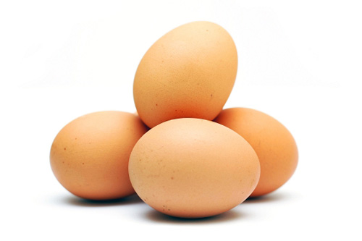
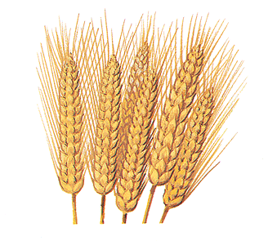
Nutrition, Toxins and Health: Facts and Speculation
Stephanie Seneff
Wise Traditions Workshop
Weston Price Foundation
Monday, Nov. 12, 2012

Slide 2
Never doubt that a small group of thoughtful, committed citizens can change the world. Indeed, it is the only thing that ever has.
-- Margaret Mead
US anthropologist (1901 - 1978)

Slide 3
A Personal Journey
Health Issue Awareness WAPF Talks Journal Papers
1980’s
Low-fat diet, sunscreen
2007
Statins
Metabolic Syndrome
2010-WAPF
Cancer
Alzheimer’s
Gut bacteria
2011
Taurine
Metabolic Syndrome
2011-WAPF
Sulfur
Autism
Statins
Vaccines
Alzheimer’s
2012-WAPF
London
Autism and Alzheimer’s
Autism and sulfur
Cancer and Heart Disease
2012
2012-WAPF
Indianapolis
GMOs
Sunlight
Sudden Death Syndrome
Aluminum in Vaccines
Taurine, GMO’s Aluminum,
gut bacteria, food processing, etc.
Autism and Epigenetics
2012-WAPF
Santa Clara
Preeclampsia, Autism and Pernicious Anemia

Slide 4
Part I: Nutrition
Download the slides from http://people.csail.mit.edu/seneff/

Slide 5
Outline
Introduction
What is good nutrition?
Food processing
Glyphosate and GMOs
Animal-based fats
Shore-based foods
Sulfur
Vegan diets
Diet and diabetes
Lactose, lactate, and electrolytes
Summary

Slide 6
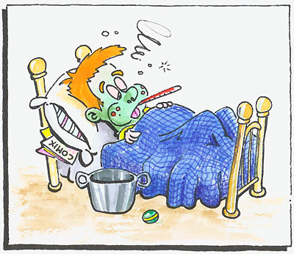
Introduction
Key Messages
Modern dietary and lifestyle practices are making us sick
“Expert” nutritional advice is incorrect
I will argue that good health comes from
Eating abundant dietary fat and cholesterol
Eating plenty of animal-based foods
Eating lots of cruciferous vegetables
Getting abundant sunlight exposure to the skin
Avoiding processed foods (especially high fructose corn syrup)
Eating organic foods

Slide 7
What is good nutrition?

Slide 8
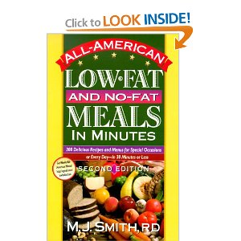
Why We Are Unhealthy!
too little sun exposure
too much sugar
too little dietary fat, cholesterol and sulfur

Slide 9
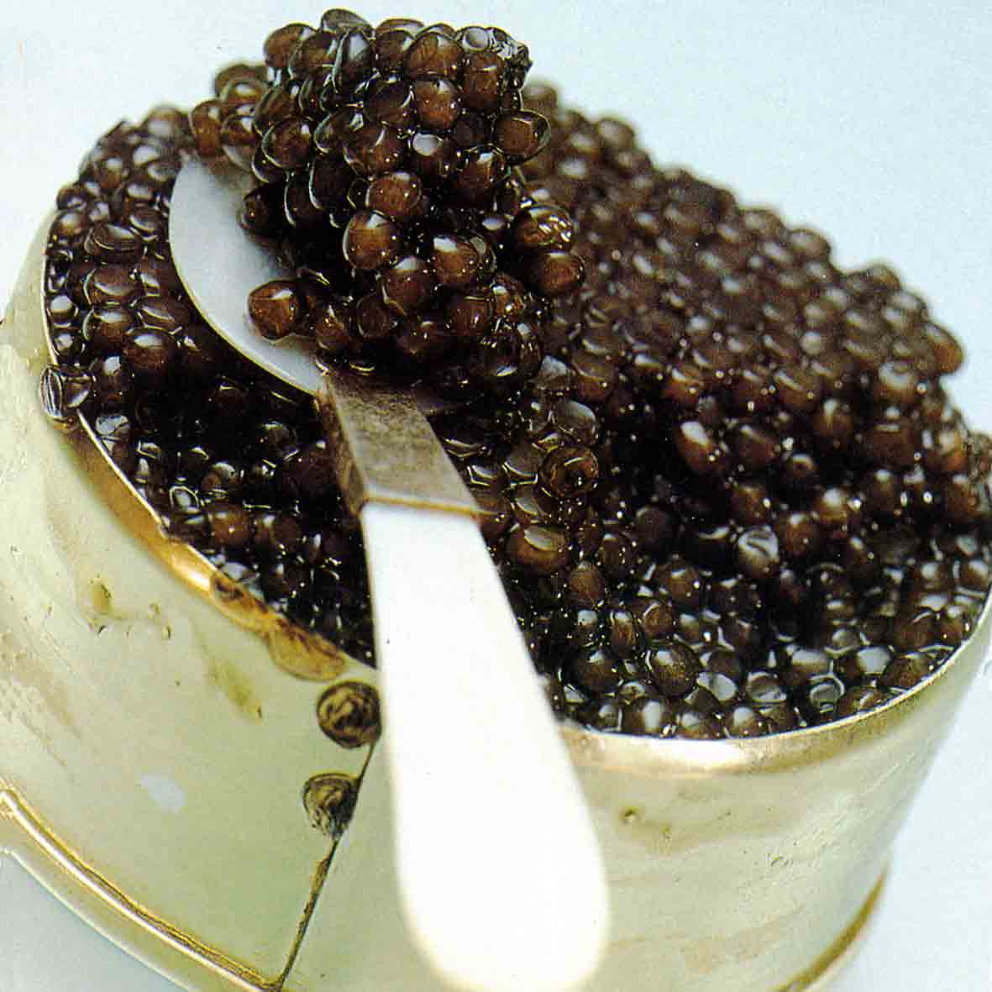
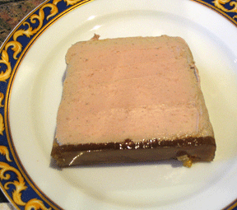
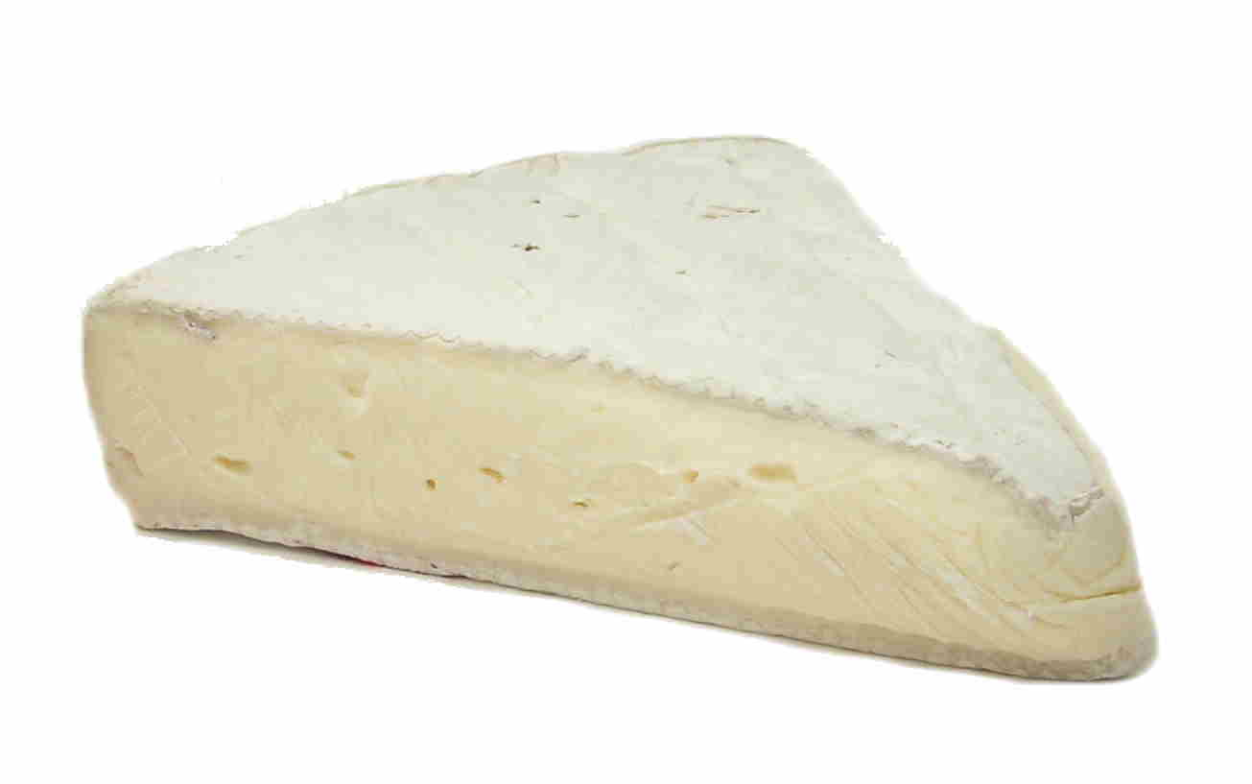
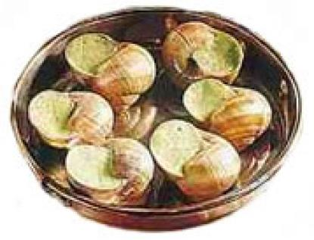
The French Paradox is No Paradox
Caviar, crème brulée, liver paté, brie, escargots
These foods contain lots of fat and cholesterol
The Mediterranean sun

Slide 10
The Kuna of Panama*
“Here's my interpretation. The Kuna are healthier than their city-dwelling cousins for a number of reasons. They have a very favorable omega 3:6 ratio due to seafood, wild game and relatively saturated vegetable fats. Their carbohydrate foods are mostly unprocessed and mostly from non-grain sources. They also live an outdoor life full of sunshine (vitamin D) and exercise. The chocolate may also contribute to their health, as it contains high levels of potentially protective polyphenols. They're healthier than industrialized people because they live more naturally.”
* Stephan Guyenet, B.S. Biochemistry, PhD Neurobiology
http://wholehealthsource.blogspot.com/2008/03/say-hello-to-kuna.html
Notes:
They eat lots of carbs but they don’t get fat.
indigenous
Sunlight; sulfane sulfur in chocolate.

Slide 11
WBUR Interview with Dr. David Ludwig*
Professor of pediatrics and nutrition and director of the Obesity Program at the Children’s Hospital Boston.
Conducted diet study on 21 obese adults
Low fat diet (20% fat)
Atkins diet (60% fat)
Low glycemic index diet (carbs less processed)
Each person switched among these three diets over three month period
* http://onpoint.wbur.org/2012/07/05/new-research-on-carbs
Notes:
http://onpoint.wbur.org/2012/07/05/new-research-on-carbs
Steel cut oats stone-ground bread
Talk about fixing health and health care in America and you’ve got to talk about fixing our national weight. American obesity rates have climbed and climbed. We’ve had all kinds of advice about how to turn back the tide. And we struggle, one by one, to try.
A new study says we’ve got to look again and very critically at carbohydrates. That calories from carbs are not like others. That they drive up our weight and make it harder to bring it down and keep it down.
This hour, On Point: we’re looking again at carbs, and getting serious about the path to a leaner USA.

Slide 12
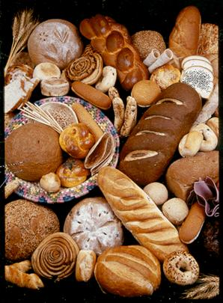
A Calorie is a Calorie?*
Low-fat diet led to metabolic syndrome
insulin resistance, triglycerides, and HDL cholesterol all worse
Low-carb diet led to 350 extra calories burned per day compared to low-fat diet
Equivalent to 1 hour of moderate-intensity exercise
Low glycemic index diet had only 150 extra calories dissipated compared to low-carb
* C.B. Ebbeling et al, JAMA 2012, 307, 2627-2634
Notes:
Despite encouragement to eat fruits and veggies.
./diet_and_exercise_weight_loss.pdf
Heartwire
Not all calories are the same, new research finds
Ebbeling CB, Swain JF, Feldman HA, et al. Effects of dietary composition on energy expenditure during weight-loss maintenance. JAMA 2012; 307:2627-2634.

Slide 13
“As Dr. Ludwig explained, when the subjects were eating low-fat diets, they’d have to add an hour of moderate-intensity physical activity each day to expend as much energy as they would effortlessly on the very-low-carb diet. And this while consuming the same amount of calories.”
* http://www.nytimes.com/2012/07/01/opinion/sunday/what-really-makes-us-fat.html?
Notes:
./What\ Really\ Makes\ Us\ Fat\ -\ NYTimes.com.pdf

Slide 14
Ludwig’s Key Take-away Message
It’s the quality, not the quantity, that counts
Quality of fat (NOT TRANS FAT)
Quality of carbs (LOW GLYCEMIC INDEX)
Highly processed starch explodes into glucose
Farm subsidies and special interest groups control the government’s message, determined largely by profit motive for food manufacturers

Slide 15
An Important Question
How come in the ‘60’s we ate a lot of carbs and we didn’t get fat like we do today?

Slide 16
The Big Six… How We’ve Regressed
1960’s | Today
stone ground wheat, steel cut oats | processed grains, GMOs
sugar | high fructose corn syrup
lard, butter | processed vegetable oils
sun worship | fear of sun
natural fertilizers | synthetic nitrates
liver is a healthy choice | cholesterol phobia

Slide 17
Recapitulation
We need to return to a diet that reflects an earlier time
Less food processing; fewer refined carbs
Fewer chemical toxins; natural fertilizers
More dietary fat; less dietary sugar
We need to get outdoors more to reap the benefits of sunlight
A calorie is not a calorie!

Slide 18
Food Processing

Slide 19
Food Processing
The nutrients are taken out of the food
The food gets broken down into chemical components
The chemical components are reassembled into pseudo-food
Synthetic vitamins are added

Slide 20
Stone Ground Grains!

Slide 21
The Mystery of the Mill *
“What else did the new high-speed steel roller-mills do except to grind grain 100 times faster? Well, it was soon evident that the germ gummed up the high speed rollers. Therefore, by a series of graduated siftings it was possible to screen out this germ. This epoch-making discovery allowed the millers to expedite their operations, but more significant, they discovered soon enough that flour from which the live and perishable germ was screened out would keep indefinitely on store shelves.”
* http://www.angelfire.com/folk/molinologist/orton.html

Slide 22
Quote from Geoffrey Bowles, British Countryman
Much of our national illness is caused by crazes for food that is
(1) white,
(2) refined, and
(3) keepable.
White flour, white sugar, refined vegetable oils, and, now, high fructose corn syrup

Slide 23
Processing Corn: Sulfur Dioxide*
Corn wet-milling produces starch from corn
149 million bushels during 1957–1959
1,700 million bushels during 1996–1997
“The absorbed sulfur dioxide cleaves the disulfide bonds in the protein matrix that encapsulates the starch granules, dispersing the protein matrix, and enhancing starch release”
This means the food is partially digested before it hits the stomach
* Eckhoff et al., Cereal Chem. 76(1):96-99, 1999
Notes:
http://www.ncbi.nlm.nih.gov/pubmed/6357846

Slide 24
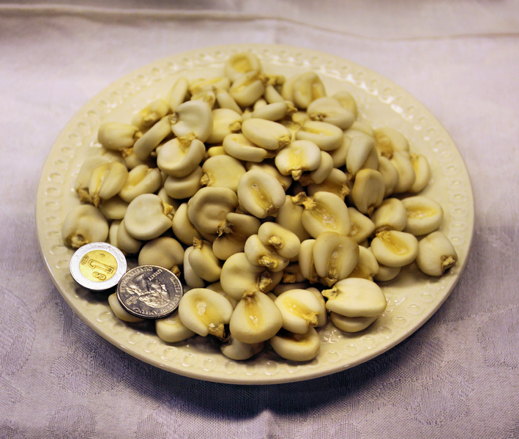
Nixtamization of Corn
Ancient process, first developed in Mesoamerica by the Indians
Grain is soaked in lime and hulled
Makes free niacin available for absorption: prevents pellagra
Grain absorbs mineral from alkali used
Increases calcium by 750%
Increases iron, copper, zinc absorption
Reduces infiltration of mycotoxins (molds) that infect maize, leading to cancer

Slide 25
Now We Use Machines to Process Corn and Wheat
Added digestive enzymes make the process go much faster.
How does this affect our bodies? We don’t know!

Slide 26
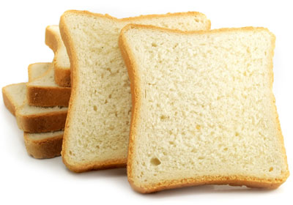
Gluten Intolerance*
Manifested as diarrhea, weight loss, bloating
Often associated with neurological problems
A growing problem: currently affects 15% of U.S. population
Why?
Wheat products are too refined
Complex carbohydrates containing sugar and protein are decomposed into free amino acids
Bread is partially digested before we eat it
Contamination with herbicides?
* http://www.precisionnutrition.com/all-about-gluten
Notes:
Initially, gluten intolerance can manifest as diarrhea, bloating, flatulence, uncomfortable stools, weight loss and malnutrition. Other inflammatory symptoms can also result.

Slide 27
Why Gluten and Glutamate are Dangerous to the Nervous System*
Gliadin (from gluten) is a major source of glutamate in the small intestine
Leaky gut allows glutamate to enter blood circulation
Free glutamate is the key problem – neurotoxin
Causes cellular death in the brain and nervous system
Fast food has lots of free glutamate
Example: patient sensitive to gluten and MSG
Used canned chicken broth, cooked at home
No added MSG but broth had free glutamate in it
Resulted in allergic reaction
*Dr. Vikki Petersen,
http://wn.com/why_gluten_and_glutamate_are_dangerous_to_the_nervous_system
Notes:
Dr. Vikki Petersen
Can said “no added MSG” but it had free glutamate in it.
Risotto.
Bound form is not a problem.
Half of people with gluten intolerance have neurological problems

Slide 28
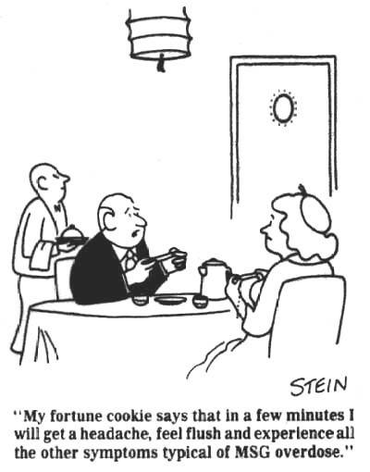
Monosodium Glutamate (MSG)
Notes:
Cartoon from http://www.truthinlabeling.org/

Slide 30
Deamidated Gliadin*
Enzymatic treatment with transglutaminase
Breaks down gluten to produce free glutamate
"Deamidated gliadin is the product of acid or enzymatic treatment of gluten often used in the food processing industry.
The purpose of deamidating gluten ... is to make the gliadin able to mix with other foods (like milk) without changing the foods' qualities."
* Dr. Karl Johnson
http://www.helpmychronicpain.com/blog/bid/54865/
Gluten-Epitopes-Your-Hope-For-Recovery-From-Your-Illness

Slide 31
How Gluten Causes Trouble
* http://www.precisionnutrition.com/all-about-gluten
Notes:
./gluten_web_page.text
Initially, gluten intolerance can manifest as diarrhea, bloating, flatulence, uncomfortable stools, weight loss and malnutrition. Other inflammatory symptoms can also result. (See below for a list.)
For an intolerant person, regularly consuming gluten will result in long-term damage, including intestinal scarring and nutrient malabsorption.
Chronic inflammation can atrophy and flatten the intestinal lining, which impairs digestion.
Gluten and other inflammatory proteins can weaken the intestinal wall by opening tight junctions (see figure below).
When the intestinal lining is compromised, more food antigens can then cross the barrier and enter the bloodstream. Other pathogens get into general circulation. This causes the body to produce more antibodies, attempting to fight the antigens. It can also mean that depending on the pathogen, the body is more susceptible to harmful micro-organisms and unwanted invaders

Slide 32
Leaky Gut Syndrome*
* From http://www.precisionnutrition.com/all-about-gluten
Notes:
./gluten_web_page.text

Slide 33
Lectins and Leptin Resistance*
Lectins are found in legumes and cereals
They bind to and inactivate leptin receptors (particularly problematic with leaky gut?)
This leads to “leptin resistance,” a defect found in association with obesity and preceding “insulin resistance”
Zucker rats are obese and have a defective leptin receptor gene
* http://www.realfooduniversity.com/real-truth-healthy-grains/
Notes:
WIKI, Stephen Gayanet
http://www.realfooduniversity.com/real-truth-healthy-grains/

Slide 34
Lectins and Leptin, Cont’d*
Study on 24 domestic pigs
Cereal-free hunter- gatherer diet promoted significantly higher insulin sensitivity, lower diastolic blood pressure and lower C-reactive protein, compared to a cereal-based swine feed.
Sourdough lactic acid bacteria hydrolyze gliadin peptides and inhibit their lectin-like behavior
* T. Jonsson et al., BMC Endocrine Disorders 2005, 5:10.
Notes:
./dietary_lectins_cause_leptin_resistance.pdf

Slide 35
Symptoms Associated w/ Gluten Intolerance*
Weight loss or weight gain
Nutritional deficiencies due to malabsorbtion (e.g. low iron levels)
Fat in the stools (due to poor digestion)
Aching joints
Depression, anxiety, irritability and other behavioural changes
Eczema and skin rashes
Headaches
Chronic fatigue and low energy
Infertility, irregular menstrual cycle and miscarriage
Cramps, tingling and numbness (often due to vitamin B12 malabsorption)
Slow infant and child growth
Decline in dental health
Asthma and allergies
Food cravings, especially for baked goods and sweets
* See: http://www.precisionnutrition.com/all-about-gluten

Slide 36
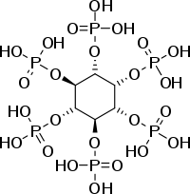
The Problem with Phytates*
Grains were introduced relatively recently into the human diet (last 10,000 years)
Phytates are phosphorus- containing compounds found in gluten and other grains
They are the indigestible dietary fiber
Decrease iron absorption by a factor of 15
Also bind calcium, magnesium, and zinc
Fermentation reduces phytate content
* http://www.thenaturalrecoveryplan.com/articles/phytates.html
Notes:
http://www.thenaturalrecoveryplan.com/articles/phytates.html
./phytates.text
./phytates.pdf

Slide 37
“Wheat Belly: Lose the Wheat, Lose the Weight”*
Wheat has a high glycemic index (even whole wheat)
Phytate in wheat chelates iron and zinc
Gliadin (peptide in wheat) causes psychological and neurological damage
Incidence of celiac disease (wheat allergy) has quadrupled over the last 50 years
Author proposes obesity epidemic due to excess dietary wheat
* By William Davis, M.D., published August 2011
Notes:
./wheat_belly.text

Slide 38
Four Other Good Books!
Good Calories, Bad Calories, by Gary Taubes
Argues that its carbs, not fats that cause obesity
Breaking the Vicious Cycle: Intestinal Health through Diet, by Elaine Gottschall
Solving Crohn’s disease and Colitis through “Specific Carbohydrate Diet”
Cereal Killer, by Alan Watson
Handbook on role of carbs in heart disease; easy to read
Trick and Treat: How ‘Healthy Eating’ is Making us Ill, by Barry Groves
Lots of food for thought on why the “expert” dietary advice is broken
Notes:
I think of Alan Watson's very inviting and easy-to-read 144-page Cereal Killer as a handbook. Both authors address a gamut of health issues, but Watson centers on cardiovascular health while Taubes spends more time on weight gain and obesity. Watson's style is brief and to the point. His succinct review of fats, a complex subject, seems exceptionally understandable. Bulleted lists are presented in place of paragraphs of prose. Each chapter ends with a friendly "More to Explore..." section that provides helpful suggestions for further reading. A sprinkling of photos--of the Watson family, cows, and such--give it a pleasant and homespun quality. Cereal Killer goes beyond the narrow focus on carbohydrates vs. fats, to other related topics, such as grass-fed beef, and lard, but it left me wondering whether these topics were as well-supported by clinical studies as the fundamental carbohydrate vs. fat issue. Throughout, this book is a model of clarity and conciseness while presenting valuable information about which the author is passionate.

Slide 39
Recapitulation
Efficiency and cost have been the drivers behind the food industry’s processing methods
Wheat and corn have been converted into toxic pseudo-foods
Diet high in processed foods leads to leaky gut syndrome, gluten intolerance, colitis, and Crohn’s disease
Gliadin, phosphates,and glutamate are all problematic factors

Slide 40
Glyphosate and GMOs

Slide 41
Prof. Don Huber on Glyphosate
“When future historians write about our time, they're not going to write about the tons of chemicals that we did or didn't apply. When it comes to glyphosate, they're going to write about our willingness to sacrifice our children and jeopardize our existence, while threatening and jeopardizing the very basis of our existence; the sustainability of our agriculture.”
Notes:
Dr. Mercola interview:http://articles.mercola.com/sites/articles/archive/2012/01/15/dr-don-huber-interview-part-2.aspx

Slide 42
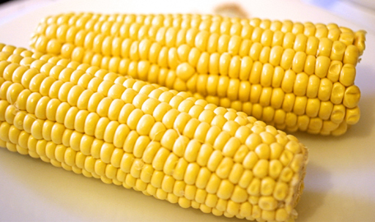
Glyphosate!!!
Glyphosate is the active ingredient in Roundup, developed and patented by Monsanto in the 1970’s
Since 2000, when Roundup patent expired, glyphosate is being used much more extensively on crops around the world
“Roundup Ready” crops have been genetically modified (GMOs) to tolerate glyphosate
They readily take it up into their leaves, which we then eat!
Corn, soybeans, cotton (clothing), alfalfa (cows)

Slide 43
Increased Use of Glyphosate Over Time*
* Figure 5 from S. Bonny, Sustainability 2011, 3, 1302-1322.
Notes:
AnthonySamsel/paper/glyphosate_tolerance_weed_resistance.pdf
Herbicide-tolerant Transgenic Soybean over 15 Years of Cultivation: Pesticide Use, Weed Resistance, and Some Economic Issues. The Case of the USA

Slide 44
GMO-engineered Soy Crops*
Argentina
USA
Worldwide
Brazil
* From GMO Compass, article by Dr. Mercola, Nov. 1, 2012
Notes:
DrMercola_on_GMO_soy.pdf

Slide 45
Increase in Weed Resistance Over Time*
* Figure 7 from S. Bonny, Sustainability 2011, 3, 1302-1322.
Notes:
Number of weeds that have become resistant to glyphosate in the world and the USA, 1996–mid-2011

Slide 46
Tremendously increased usage: 1994
Glyphosate discovered: 1970
Notes:
From mercola article but can be related to glyphosate through endocrine disruption.

Slide 47
Mercola Interview with Dr. Huber*
Glyphosate chelates cations
Manganese, zinc, iron, copper, etc.
This creates deficiencies, especially if you’re also eating micronutrient-depleted foods
It hurts our own physiology if we eat the plant, which has taken up the glyphosate – you can’t wash it off!
The plant itself is nutritionally deficient
12 grams per acre is enough to reduce iron by 50%, manganese by 80%, zinc by ~80%
* December 2, 2011
Notes:
http://www.youtube.com/watch?v=X4swW9OFmf8

Slide 48
Mercola Interview with Dr. Huber*
Microorganisms in the soil essential for nitrogen-fixation
Glyphosate chelates nickel needed to fixate
Glyphosate is extremely toxic to these microorganisms – eliminating them from the soil
Plants are getting new diseases – Goss’ wilt
Corn, soybeans, cotton, alfalfa – all contain GMOs to make them glyphosate resistant (“Roundup-Ready”)
Alfalfa feeds herbivores
In animals, glyphosates can kill “good” gut bacteria
Clostridium botulinum overgrows in intestinal track
Animal dies from toxin
Reduction in mineral content makes them much more susceptible
Animals are also becoming infertile
There’s no good reason why it shouldn’t happen to humans as well
* December 2, 2011
Notes:
http://www.youtube.com/watch?v=X4swW9OFmf8

Slide 49
Monsanto’s Roundup triggers Over 40 Plant Diseases and Endangers Human and Animal Health*
*article on Web by Jeffrey M. Smith, Jan 16, 2011
Notes:
Dr. Don Huber
http://drleonardcoldwell.com/2011/01/16/monsanto%E2%80%99s-roundup-triggers-over-40-plant-diseases-and-endangers-human-and-animal-health/
./roundup_depletes_plant_nutrients_DrHuber.pdf

Slide 50
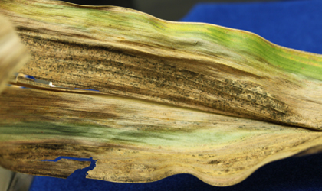
New Plant Diseases*
Driving down yields in corn and soy crops
“Sudden Death Syndrome” (SDS) in soy, and Goss’ wilt in corn
Associated with strange new pathogen: similar in size to a medium sized virus
Microfungal-like organism
Same pathogen infects the fungus that causes SDS: Fusarium solani
* http://farmandranchfreedom.org/gmo-miscarriages
Notes:
This previously unknown organism is only visible under an electron microscope (36,000X), with an approximate size range equal to a medium size virus. It is able to reproduce and appears to be a micro-fungal-like organism. If so, it would be the first such micro-fungus ever identified. There is strong evidence that this infectious agent promotes diseases of both plants and mammals, which is very rare.
But watch out for www.cropgen.org – defends GMOs and glyphosate!!
The organism is prolific in plants infected with two pervasive diseases that are driving down yields and farmer income—sudden death syndrome (SDS) in soy, and Goss’ wilt in corn. The pathogen is also found in the fungal causative agent of SDS (Fusarium solani fsp glycine)

Slide 51
Glyphosate Depletes Nutrients
*article on Web by Jeffrey M. Smith, Jan 16, 2011
Notes:
Dr. Don Huber
http://drleonardcoldwell.com/2011/01/16/monsanto%E2%80%99s-roundup-triggers-over-40-plant-diseases-and-endangers-human-and-animal-health/
./roundup_depletes_plant_nutrients_DrHuber.pdf

Slide 52
A Remarkable Study on Mice*
Compared control group with mice exposed to either Roundup (R) or GMO corn or both
*G.-E. Séralini et al., Food and Chemical Toxicology, 2012, in press
Notes:
Spacedoc/mercola/GMOS_mouse_study_2012.pdf

Slide 53
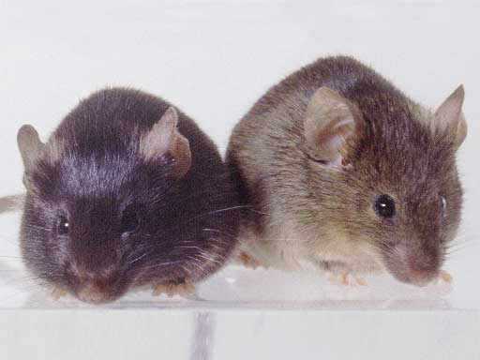
Conclusions from Mouse Study *
Female mice had greatly increased risk of breast cancer
Males had significantly increased risk of tumors of the liver and kidney
Sex hormone disruption for both males and females
Enhanced oxidative stress
Very significant kidney dysfunction
*G.-E. Séralini et al., Food and Chemical Toxicology, 2012, in press
Notes:
Spacedoc/mercola/GMOS_mouse_study_2012.pdf

Slide 54
Glyphosate in our Food and in our Urine*
“Beer does not brew with grains that were `sprayed to death’ with glyphosate. For bread and fodder grain, however, this reduced germi-nation capacity is not a concern.”*
This gives new motivation for consuming sour dough bread!
* Herbicides found in Human Urine. Ithaka Journal 1/2012: 270–272 (2012), Translated into English: http://www.gmwatch.org/latest-listing/1-news-items/14040
Notes:
http://www.gmwatch.org/latest-listing/1-news-items/14040

Slide 55
Glyphosate in Our Food (Cont’d)
“We should ask ourselves what our health is worth to us and whether we want ourselves and our children to consume more and more glyphosate in the future. There were alternatives to DDT, and there are alternatives to Roundup now. It is up to consumers, farmers and the relevant agencies to stop the accumulation of glyphosate in our food supply and environment.”*
* Herbicides found in Human Urine. Ithaka Journal 1/2012: 270–272 (2012), Translated into English: http://www.gmwatch.org/latest-listing/1-news-items/14040

Slide 56
Recapitulation
Glyphosate is the dominant weed killer in the U.S., and, increasingly, in the world
It also kills the bacteria in the soil
The most common GMO is a “Roundup-ready” gene that provides tolerance to roundup
Also leads to decreased yield, higher water consumption, and nutrient depletion, and increased roundup usage
Glyphosate likely also disturbs gut bacteria and leads to fertility problems in cattle
Glyphosate chelates important nutrients like iron, manganese, and zinc
Experiments with mice show severe toxicity with exposure to both Roundup and GMOs

Slide 57
Animal-based Fats

Slide 58
The Saturated Fat and Carbohydrate Debate
“Fifteen years ago, this debate would have been considered impossible because it was believed that SFA intake was the primary determinant of the high rates of CVD in Western countries. However, in recent years, that question has been reexamined, or, more accurately, seriously examined for the first time. In truth, there was not very good epidemiological evidence for this relationship from the beginning.”
-- Walter C. Willett, MD, PhD
Harvard School of Public Health, Boston, MA, USA
Notes:
For_vic/fatty_acids_in_health_and_disease_2012.pdf

Slide 59
"The diet–heart hypothesis: a critique"*
"A balanced appraisal of the diet–heart hypothesis must recognize the unintended and unanticipated role that the LF-HCarb diet may well have played in the current epidemic of obesity, abnormal lipid patterns, type II diabetes, and the metabolic syndrome. Defense of the LF-HCarb diet, because it conforms to current traditional dietary recommendations, by appealing to the authority of its prestigious medical and institutional sponsors or by ignoring an increasingly critical medical literature, is no longer tenable."
* S.L. Weinberg, J. Am. Coll. Cardiol. 2004;43;731-733.

Slide 60
Dietary Saturated Fats: It’s complicated*
It matters which food it comes from
Processed meats contain nitrates and added salt which may be detrimental
Saturated fat from dairy is clearly beneficial
“Each 5-unit increase in the percentage of energy from dairy SF was associated with 38% lower risk of CVD”
* De Oliviera et al., Am J Clin Nutr, electronic form, July 3, 2012
Notes:
./saturated_fats_dairy_meat.pdf

Slide 61
Saturated Fats and Heart Disease: Europe, 1998 *
* Hoenselaar, R. British Journal of Nutrition (2012), 108, 939-942.
Notes:
High School student! Letter to the Editor in rebuttal of an article on saturated fats & cardiovascular disease.
See: ./SFA_heart_disease_highschool.text, .pdf
R. H. is a student at the High School of Arnhem and Nijmegen (The
Netherlands). There is no conflict of interest. The research received
no specific grant from any funding agency in the public, commercial or
not-for-profit sectors.
At least one fairly recent report is available though, which allows
ecological data to be directly correlated. In 2008, the European
Cardiovascular Disease Statistics were published. The report provided
data about per-capita SFA intake in 1998 and annual CHD death rates
from 1972 to 2005 for adults aged 0–64years(8).Based on these data,
SFA intake in 1998 was inversely correlated to CHD mortality in 1998
among males for all countries with available data for this year (n 41)
using SPSS statistical software package version 17.0 (IBM
corporation). Results are shown in Fig. 1 (Pearson correlation 2 0·58;
P, 0·01). Findings were similar for women and for both CHD and stroke
end- points (P for all ,0·01).

Slide 62
Nutrition and Physical Degeneration*
Dr. Weston Price, a dentist in Cleveland, Ohio, traveled all around the world, comparing traditional diets with Western influenced diets
Repeatedly, he observed that foods the natives treasured were ones that I know to be extremely high in fat and cholesterol
Fish eggs, shrimp, coconut, organ meats, oysters, chicken eggs, sweetbreads, . . .
People who adopted the Western diet, particularly white flour and white sugar, were generally much less healthy
* Weston Price’s famous book, written in 1939

Slide 63
From Youtube video: Enjoy Eating Saturated Fats: They're Good for You.
Donald W. Miller, Jr., M.D.
http://www.youtube.com/watch?v=vRe9z32NZHY
Notes:
Dr. Miller is professor of surgery, cardiothoracic division, Univ. Washington, and writes frequently for http://www.Lewrockwell.com.
Mary Enig Univ of ?? Trans fats bad

Slide 64
Dr. Andrew Weil on Low-Fat Diet*
3,386 “fat-free” foods on Amazon.com
3,597 “low-fat” foods on Amazon.com
Replace fat with extra sugar or corn syrup
“No one's health is improved by swapping out natural saturated or monounsaturated fats for skim milk, sugars or processed grains.”
*http://www.drweilblog.com/home/2012/8/23/low-fat-foods-are-they-better.html

Slide 65
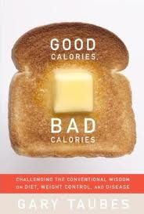
Dieting and Serum Cholesterol*
High carb diet:
Dieters lose weight only by starving themselves
Only show improvements in serum LDL/HDL if weight is lost (burn body fat)
High protein diet:
Dieters get to where they can’t stand to face another lean pork chop
Lose weight because food is repulsive
High fat diet:
Dieters can lose weight without feeling hungry all the time
Even those who don’t lose any weight improve their serum LDL/HDL levels**
* Gary Taubes, “Good Calories Bad Calories”
** Feinman and Volek, Nutrition and Metabolism, 2006
Notes:
Richard Feinman and Jeff Volek,
"Low carbohydrate diets improve atherogenic dyslipidemia even in the
absence of weight loss." Nutrition and Metabolism, 3:24, 2006.
Cancer/low_carb_diet_benefits_heart_richard_feinman.pdf

Slide 66
322 Moderately Obese People: Dietary Study*
Weight
LDL/HDL Ratio
Triglycerides
Total Cholesterol
* D.Schwarzfuchs and R. Golan, N. Engl. J. Med 367, 14, Oct. 4, 2012.
Notes:
./Schwarzfuchs_low_carb_diet_good.pdf

Slide 67
Dr. David Diamond on Fats*
Professor and neuroscientist at U. of South Florida
Lecture on myths about saturated fat posted on Youtube
Personal experiment: switch from high-carb to high-fat diet
triglycerides: 800 → 140
HDL cholesterol: 25 → 50
“People should understand that animal fat is one of the healthiest foods you can eat.”
* http://www.cas.usf.edu/news/s/332/
Notes:
http://www.cas.usf.edu/news/s/332/

Slide 68
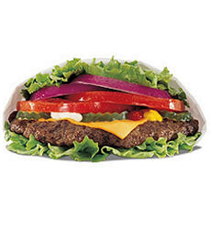
Results of Low-Carb Diet from 17 Trials *
Significantly decreased body weight, BMI, and abdominal circumference
Lower blood pressure
Lower plasma triglycerides
Lower fasting plasma glucose
Reduced glycated hemoglobin
Reduced plasma C-reactive protein (an inflammatory marker)
Increased HDL-C (the “good” lipoprotein)
* F.L. Santos et al., Obesity Reviews, July 2012

Slide 69
Obesity and Gallstones *
Cross-sectional study of over 510,000 patients
Obese children have increased risk to gallstones
Extremely obese kids have nearly eight times the risk of normal-weight kids
Due to formation of cholesterol crystals in gall bladder
Hypothesis: Bile acid production is low due to insufficient dietary fats
Corollary: Low-fat diet leads to obesity.
* K.C. Smith et al., J Pediatr Gastroenterol Nutr 2012 Feb 6. [Epub ahead of print]
Notes:
http://thunderfeeds.com/reader/news/heavy-kids-at-risk-for-gallstones-medpage-today

Slide 70
Recapitulation
European study showed inverse relationship between dietary saturated fat and heart disease
Indigenous peoples with high-fat diet have very low heart disease risk
High fat diet leads to more painless weight loss and improved lipid markers
Obese children have increased risk to gallstones

Slide 71
Shore-based Foods

Slide 72
The “Eatwell” Plate
Where are the Shore-based Foods?
Way too big
Fat and Sugar Combined
* http://www.nhs.uk/Livewell/Goodfood/Pages/eatwell-plate.aspx

Slide 73
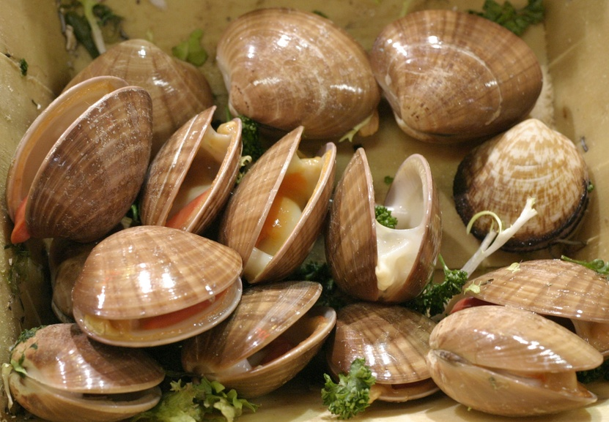
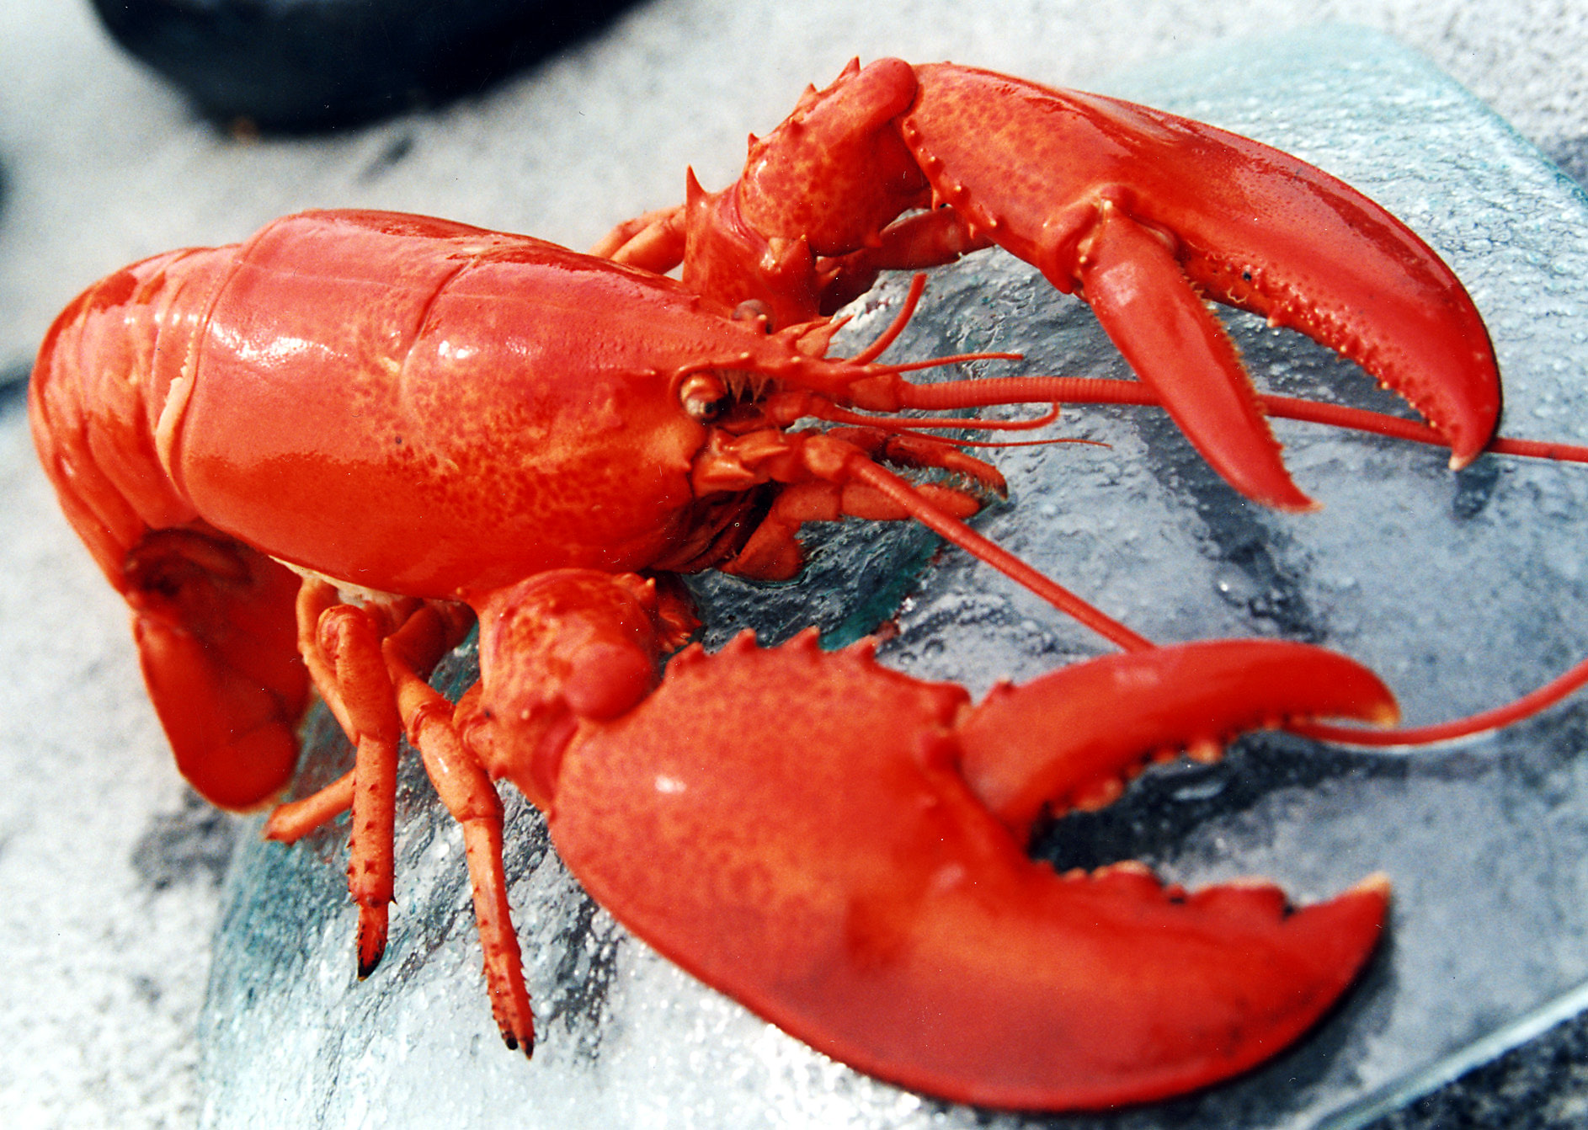
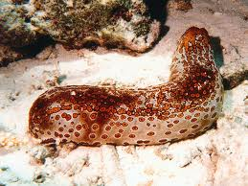
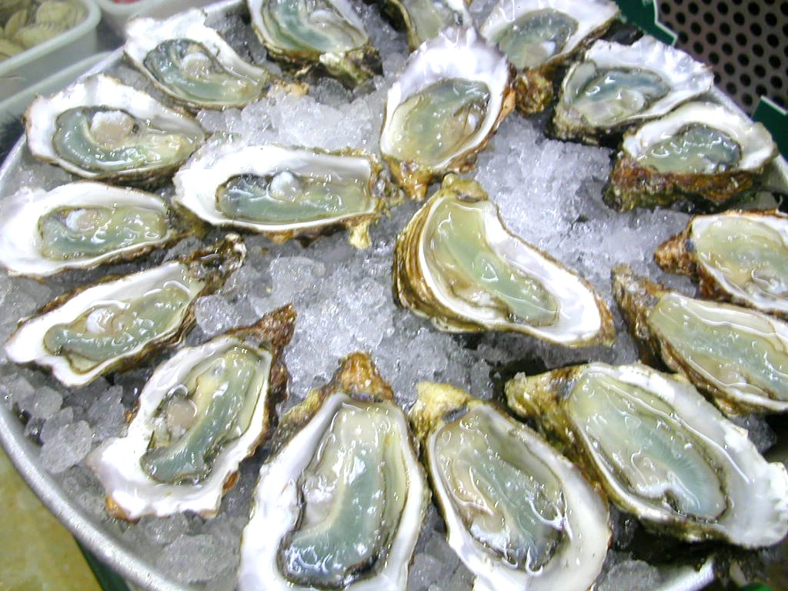
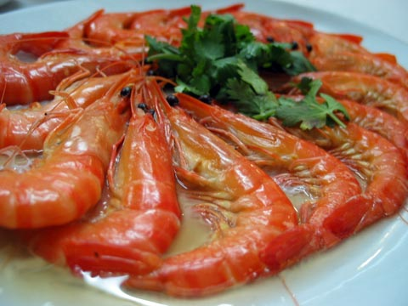
zinc
selenium
SULFUR
Copper
iron
iodine

Slide 74
Elaine Morgan and the Aquatic Theory
Proposed that we evolved to be human on ancient seashores, surviving the drought by eating seafood
The Descent of Woman
The Aquatic Ape
The Scars of Evolution
Descent of the Child
Aquatic Ape Hypothesis
Notes:
Alistair Hardy’s aquatic ape hypothesis

Slide 75
Survival of the Fattest*
“The prediction is that a functional deficit in brain development will occur if human infants consume inadequate amounts of shore-based foods”
* S.C. Cunnane, Survival of the Fattest, World Scientific Publishing Company, June 2005

Slide 76
Survival of the Fattest: The Key to Human Brain Evolution*
Iron, iodine, selenium, zinc, copper, and the long-chain polyunsaturated fatty acid, docosahexaenoic acid, are needed to support our large and complex brain
Maritime foods are among the best sources of these nutrients
The shore-based diet hypothesis proposes that human “encephalization” was triggered by adaptation to life at the shoreline.
* S.C. Cunnane, Survival of the Fattest, World Scientific Publishing Company, June 2005
Notes:
SURVIVAL OF THE FATTEST: THE KEY TO HUMAN BRAIN EVOLUTION. By Stephen C. Cunnane.
But see:
./critical_review_of_Cunnane_shore_based_diets.pdf

Slide 77
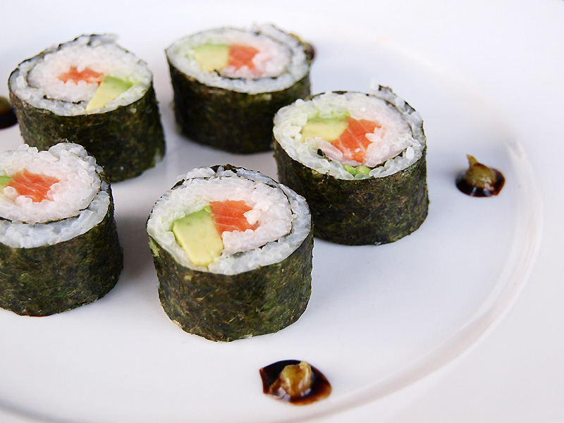
Iodine Deficiency*
Iodine is essential for proper thyroid function
Thyroid hormones control metabolism
Essential in development of skeletal and central nervous system in the fetus
In animal studies, iodine normalized stress-related elevation in cortisol
Iodine deficiency is the most preventable cause of mental retardation
Most of the earth’s available iodine is in the sea
Seaweed is the best natural source
Shrimp, fish, eggs, other seafood
* L. Patrick, Alternative Medicine Review 13(2), 116-127, 2008
Notes:
vitaminK/iodine_deficiency.pdf

Slide 78
Iodine and Breast Cancer*
Breast cancer rates in Japan are 6.6 per 10,000, v.s. 22 in U.S. and 27 in U.K.
25-fold higher intake of iodine in Japan
Iodine supplements shrink breast tumors in animal models
Perchlorate is a toxicant that inhibits iodine uptake
Perchlorate contamination of food and water is growing problem in U.S.
Present in nitrate fertilizers and in pharmaceuticals
* L. Patrick, Alternative Medicine Review 13(2), 116-127, 2008

Slide 79
Recapitulation
Aquatic theory of human origins proposes that we became human on the seashore
Shore-based foods provide zinc, iron, sulfur, selenium, iodine, copper, and long-chain fats
Shore-based foods are sorely lacking in the modern American diet
Anticipitate deficit in brain function in infants deprived of shore-based foods
Iodine deficiency is associated with mental retardation and breast cancer

Slide 80
Vegan Diets

Slide 81
“Somewhere between 30 and 50 percent of the girls and women seeking treatment for anorexia and bulimia are vegetarian.”
-- The Vegetarian Myth – Lierre Keith
Notes:
http://www.zoeharcombe.com/2011/08/the-vegetarian-myth-lierre-keith/
Zoe!!!!

Slide 82
Barry Groves* on Human Diets**
About half our brain consists of long-chain fatty acids
Modern hunter-gatherers treasure animal fats
Human milk contains much more fat than cow’s milk
Our gut matches much better to carnivores’ guts than to herbivores’ gut
“With such a small gut with which to absorb all the nutrients and energy our bodies need, a modern low-calorie, low-fat, fibre-rich, plant-based diet is woefully inadequate as an energy source for our energy-hungry system to function at peak efficiency.”
* Author of “Trick and Treat”
** http://www.second-opinions.co.uk/vegetarians-have-smaller-brains.html
Notes:
http://www.second-opinions.co.uk/vegetarians-have-smaller-brains.html
./vegetarians_have_smaller_brains.pdf

Slide 83
Barry Groves on Human Brains*
Vegetarians experience brain shrinkage
Research shows a link between brain shrinkage and low B12, and between brain shrinkage and vegetarian diet
Our species’ brain has shrunk by 11% from its peak size
Vegetarians have severe problem with B12 deficiency
B12 is unavailable from plant-based foods except as a supplement
Best sources of B12 are “meat, particularly liver, milk, and fish”
“As brain size and energy use is so high, and our gut size so small, the amount of energy available to the brain is dependent … on the ability of our gut to extract sufficient energy from our food. That also confirms that the kind of diet we should eat must have the high nutrient density found in foods such as meat and fat.”
* http://www.second-opinions.co.uk/vegetarians-have-smaller-brains.html
Notes:
http://www.second-opinions.co.uk/vegetarians-have-smaller-brains.html
./vegetarians_have_smaller_brains.pdf
90,000 years ago – peak size.

Slide 84
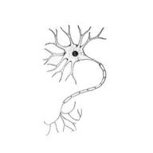
Nutritive Supplement Improves Alzheimer’s*
Contains choline, uridine and the omega-3 fatty acid DHA
Uridine is a basic component of RNA
Choline is a precursor for phosphatidylcholine, and sphingomyelin, essential components of cell membranes, and acetylcholine, a major neurotransmitter.
DHA → Important fatty acid in cell membranes
* http://web.mit.edu/newsoffice/2012/alzheimers-nutrient-mixture-0709.html
Notes:
http://web.mit.edu/newsoffice/2012/alzheimers-nutrient-mixture-0709.html
MIT research patent nutritional supplement THIS WILL BE HUGE!!!

Slide 85
Vegetarian Diet and Mental Disorders*
Compared vegetarians with matched sample from general population (sex, age, educational level, marital status, urban residency)
Elevated prevalence rates in vegetarians for depressive disorders, anxiety disorders, somatoform disorders and eating disorders (anorexia, bulimia)
Suggested low dietary intake of cobalamin (vitamin B12) and long-chain omega-3 fatty acids might contribute
*J. Michalak et al., International Journal of Behavioral Nutrition and Physical Activity 2012, 9:67
Notes:
./vegetarian_diet_mental_disorders.pdf
These somatoform disorder physical complaints challenge medical providers who must distinguish between a physical and psychiatric source for the patient's complaints.
wiki
In psychology, a somatoform disorder is a mental disorder characterized by physical symptoms that suggest physical illness or injury – symptoms that cannot be explained fully by a general medical condition, direct effect of a substance, or attributable to another mental disorder (e.g. panic disorder).^{[1]} The symptoms that result from a somatoform disorder are due to mental factors. In people who have a somatoform disorder, medical test results are either normal or do not explain the person's symptoms. Patients with this disorder often become worried about their health because the doctors are unable to find a cause for their health problems. This causes severe stress, due to preoccupations with the disorder that portrays an exaggerated belief about the severity of the disorder.^{[2]} Symptoms are sometimes similar to those of other illnesses and may last for several years. Usually, the symptoms begin appearing during adolescence, and patients are diagnosed before the age of 30 years.^{[3]} Symptoms may occur across cultures and gender.^{[4]} Other common symptoms include anxiety and depression.^{[3]} In order for an individual to be diagnosed with somatoform disorder, they must have recurring somatic complaints for several continuous years. ^{[3]}

Slide 86
Recapitulation
Our digestive system is designed for animal based foods
Vegetarians have increased risk to anorexia, depression and anxiety disorders
Vitamin B12 deficiency is common in vegetarians and carries great risk
Nutritive supplement containing choline and omega-3 fats helps Alzheimer’s disease

Slide 87
Sulfur!

Slide 88
Sulfur: the Forgotten Nutrient*
“ … the available knowledge on elemental sulfur in human nutrition looks like a black hole. Despite the fact that S8 follows H, C, O, N, Ca and P as the seventh most abundant element in mammalian tissues, it appears as a forgotten item. Not the slightest attention is dedicated to S8 in the authoritative “Present Knowledge in Nutrition” series of monographs even though they go over most oligo- and trace-elements in minute detail.”
* p. 40, Y. Ingenbleek, The Open Clinical Chemistry Journal, 2011, 4, 34-44.
Notes:
vitaminK/oxidative_stress_homocysteine_sulfur_containing-reductants.pdf

Slide 89
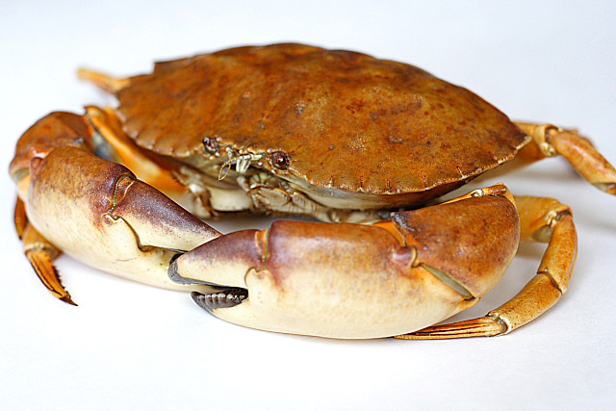
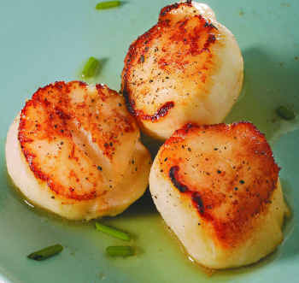
Foods Containing Sulfur
Notes:
http://healthyeatingclub.com/info/books-phds/books/foodfacts/html/data/data5g.html

Slide 90
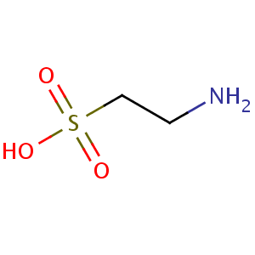
Taurine has Many Known Roles*
Maintains osmotic balance in cells
Bile acid formation (digest fats)
Roles in mitochondria
Helps them maintain their membrane potential
Suppresses superoxide synthesis (oxidation damage)
Clinical observations
Maintains healthy skin
Protects against diabetes and heart disease
Protects against heart arrhythmias
Low taurine in blood associated with many cancers
* Wesseling et al., Hypertension. 2009, 53, 909-911
Notes:
vitaminK/taurine_2009.pdf

Slide 91
Cruciferous Vegetables! The Really Healthy Vegetables
Sulforaphane!

Slide 92
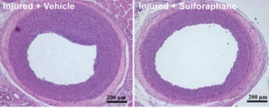
Sulforaphane*
Experiment conducted on rats subjected to carotid artery balloon injury
Half the rats were given sulforaphane as nasal gel
Treated rats had reductions in inflammatory markers
Artery wall 14 days after injury
Sulfur is protective!
+ sulforaphane
* J.-S. Kwon et al., Atherosclerosis, In Press
Notes:
./broccoli_protects_from_restenosis.pdf

Slide 93
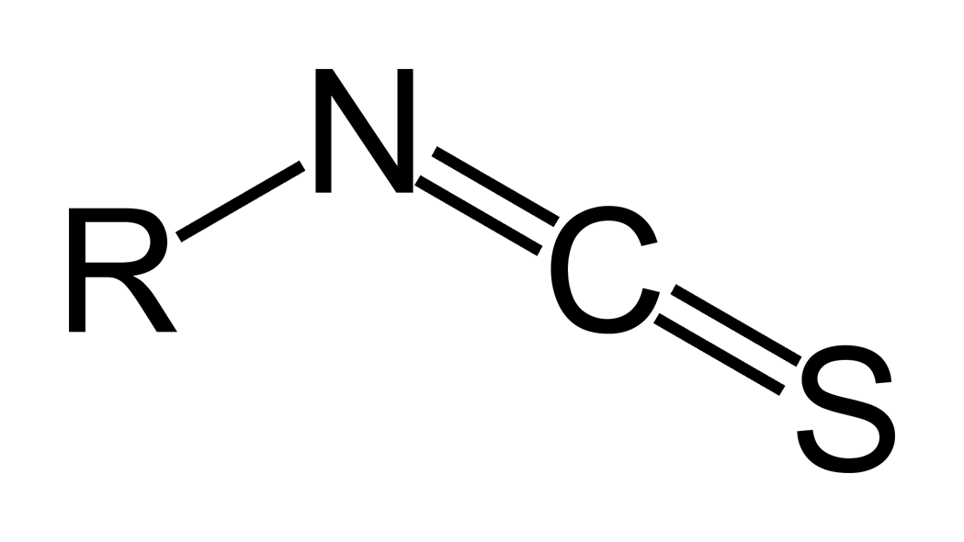
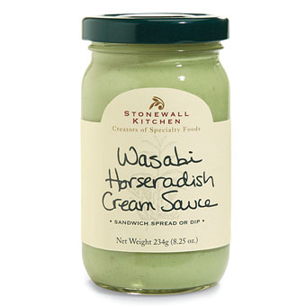
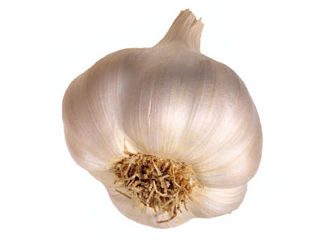
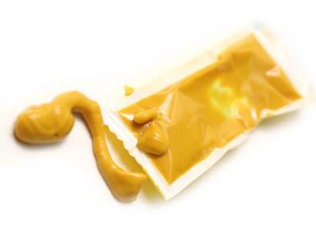
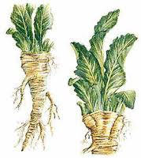
Healthy Spices!
Allyl Isothiocyanate
Horseradish garlic mustard?
Notes:
Allyl isothiocyanate (AITC) is the organosulfur compound with the formula CH₂CHCH₂NCS. This colorless oil is responsible for the pungent taste of mustard, horseradish, and wasabi. This pungency and the lachrymatory effect of AITC is mediated through the TRPA1 and TRPV1 ion channels.^{[1][2][3]} It is slightly soluble in water, but well soluble in most organic solvents.^{[4]}

Slide 94
Isothiocyanates Inhibit Prostate Tumor Growth*
Isothiocyanates protect laboratory animals from chemically induced tumors
Experiment exposed human prostate tumor cells and normal prostate epithelial cells to isothiocyanates
Caused arrest of tumor cells in G2/M phase (aborted DNA duplication, arrested growth)
Non-toxic to normal cells
*D. Xiao et al., Carcinogenesis 24(5), 891-897, 2003
Notes:
./allyl_isothiocyanate_inhibits_prostate_tumor.pdf

Slide 95
Cruciferous Vegetables and Pancreatic Cancer*
“In this large population-based prospective study of Swedish women and men, overall fruit and vegetable consumption was not associated with pancreatic cancer risk. However, we observed an inverse association between consumption of cruciferous vegetables, especially of cabbage, and risk of pancreatic cancer.”*
* Larsson et al., Cancer Epidemiol Biomarkers Prev 2006, 15:301-305.
Notes:
Cancer/cruciferous_veggies_pancreatic_cancer.pdf

Slide 96
Cruciferous Vegetables and Pancreatic Cancer*
Retrospective studies on pancreatic cancer patients are often biased
For “all fruits and vegetables,” there was an insignificant increased risk of pancreatic cancer with greater consumption
Cruciferous vegetables are an excellent source of sulfane sulfur, which can help supply heparan sulfate to the pancreas
The pancreas depends critically on heparan sulfate to protect from damage to beta cells with insulin processing
* Larsson et al., Cancer Epidemiol Biomarkers Prev 2006, 15:301-305.
Notes:
Cancer/cruciferous_veggies_pancreatic_cancer.pdf

Slide 97
Recapitulation
Sulfur is an incredibly important but highly neglected nutrient
Taurine is a sulfur-containing amino acid found only in animal-based foods
Cruciferous vegetables are an excellent source of sulfane sulfur, and protect from pancreatic cancer
Isothiocyante in garlic, mustard and horseradish has antitumor properties

Slide 98
Diet and Diabetes

Slide 99
The U.S. Obesity Epidemic*
1990
2008
2004
* Source: CDC Behavioral Risk Factor Surveillance System

Slide 100
Diabesity: The Curse of Modern Times*
“Seventy percent of the federal budget is for Medicare, Medicaid, and Social Security. By 2042, 100% of the federal budget will be required to pay for Medicare and Medicaid, leaving nothing for defense, transportation, education, agriculture, environment, or any of the government’s other basic services.”
-- Dr. Mark Hyman
* drhyman.com/blog/2012/06/29/why-obamacare-is-not-enough-its-the-health-care-costs-stupid

Slide 101
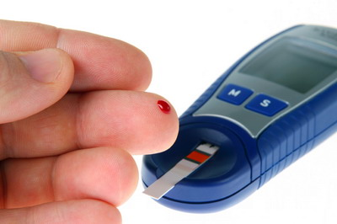
Type 2 Diabetes: A Global Problem*
Type 2 diabetes is increasing at an alarming rate worldwide
285 million people worldwide in 2010
Projection → 439 million by 2030
6.4% → 7.7% by 2030
* N. Grantham et al., Public Health Nutr. 2012 Jun 7:1-7. [Epub ahead of print]
Notes:
./dairy_good_australia_diabetes.pdf

Slide 102
“Western-Style Fast Food Intake and Cardio-Metabolic Risk in an Eastern Country” *
“In an analysis of more than 50,000 Chinese Singaporeans, those who ate fast food twice a week or more had a 27% increased risk of developing diabetes and a 56% increased risk of dying from coronary heart disease.”
* A. Odegaard et al, Circulation, published online, July 2, 2012
Notes:
./singaporean_fast_food_bad.text
singaporean_fast_food_bad.pdf
http://www.theheart.org/article/1422355.do?utm_medium=email&utm_source=20120705_EN_Heartwire&utm_campaign=newsletter
July 2, 2012 in Circulation.

Slide 103
Diabetes due to Sugar Imports*
“ … the level of food importation significantly shifts the content of markets such that a greater proportion of available joules is composed of sugar and related sweeteners. Sugar exposure statistically explained why urbanization and income have been correlated with diabetes rates.”
* S. Basu et al., Public Health Nutr. 2012 Jun 13:1-8. [Epub ahead of print]
Notes:
173 countries examined.
./173_countries_diabetes_import_sugar.pdf

Slide 104
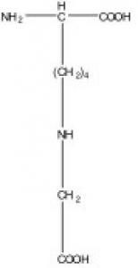
Glycation of Serum Proteins
Due to excess sugars in the blood stream
Especially high fructose corn syrup
Glycated hemoglobin is less efficient at delivering oxygen to tissues
Glycated LDL is less efficient at delivering cholesterol to tissues
Glycated LDL can’t be recycled through LDL receptors in liver
Builds up in blood serum as “small dense particles” (The bad kind)
Cells become deficient in cholesterol
Notes:
Carboxy methyl lysine

Slide 105
Advanced Glycation End (AGE) Products
AGEs: nonenzymatic glycation and oxidation of proteins, fats, and nucleic acids (DNA, RNA)
Accumulate at much higher rate in diabetics
Cross-links extracellular matrix proteins
AGEd LDL is impaired in recycling in liver
Picked up in plaque and consumed by macrophages
Heart failure is associated with high AGE levels

Slide 106
“Why Half of America May Have Impaired Brain Function by 2030”*
Dr. Mercola has argued tirelessly against high fructose corn syrup
UCLA Study on Rats
Fructose-fed rats struggled to solve a maze
Brains showed decline in synaptic activity
Extra omega-3 fats afforded partial protection
Drugs are a terrible answer to diabetes
New drug Actos causes increased risk to heart disease, heart failure, kidney failure, bladder cancer, etc.
Proposed solution
start taxing and stop subsidizing junk food
* Dr. Mercola, Sept. 2, 2012,
articles.mercola.com/sites/articles/archive/2012/09/02/fructose-affects-brain-health.aspx
Notes:
Dr. Mercola, Sept. 2, 2012,
./Mercola_on_Fructose.pdf

Slide 107
Dietary Methylglyoxal*
Compared low-AGE and high-AGE dietary differences in mice
Monitored over 3 month period
Serum AGE levels increased by 53% in high-AGE group and decreased by 7.8% in low-AGE group.
Inverse correlation between circulating AGE and time to healing of skin wounds
High-AGE group also had accelerated kidney dysfunction.
Connecting link is AGE-dependent inflammatory response
* M. Peppa et al., Diabetes 52, Nov. 2003, 2805-2813.
Notes:
./AGEd_food_mice_slow_wound_healing.pdf

Slide 108
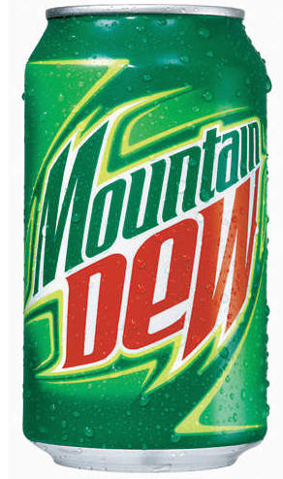
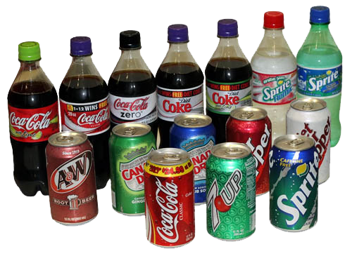
Soft Drink Consumption
Schultze et al., JAMA 292(8), 927-34, 2004 Nurse's Health Study
90,000 women monitored over 8 years
Women who reported drinking one soda per day gained on average ten pounds over four years
Women who drank one or more servings per day of a sugar-sweetened drink were twice as likely to have developed type 2 diabetes compared to those who rarely drank these beverages
Dhingra et al., Circulation 116, 480-488, 2007
Higher risk of obesity, high blood pressure, and diabetes for middle-aged adults who consumed at least one soft drink per day.
Notes:
Cancer/soft_drinks_cardiovascular_risk.pdf

Slide 109
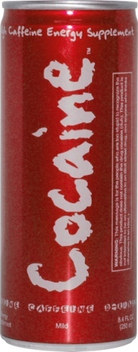
D-Ribose: Energy Drinks
D-ribose is even worse than fructose in its ability to glycate proteins

Slide 110
D-ribose Damages Neurons*
* Y. Wei et al., Biochimica et Biophysica Acta 1820 (2012) 488–494
Notes:
Treasures/D-ribose_glycation_damage_2012.pdf

Slide 111
AGEd Lysine*
* Figure 1, Hegab et al., World J Cardiol 2012 April 26; 4(4): 90-102
Notes:
./AGEs_cardiovascular_disease_2012.pdf

Slide 112
Study Shows Fructose is Bad for your Health*
559 adolescents in the study
Found that high fructose intake was associated with:
Increased visceral fat
Increased blood pressure
Increased C-reactive protein (inflammation indicator)
Reduced HDL (good lipid marker)
* N.K. Pollack et al., J. Nutr. 142(2):251-257, Feb 1, 2012.

Slide 113
Recapitulation
Diabetes and obesity are now a global problem
Likely due to excess of highly processed carbohydrates, particularly sugars.
Fructose is a worse glycating agent than glucose. D-ribose and methylglyoxal are even worse than fructose.
Methylglyoxal is found in carbonated beverages
High fructose corn syrup is particularly bad, and it should be eliminated from the diet.
Glycation causes damage to neurons, skin, and kidneys, and impairs serum protein function

Slide 114
Lactose, Lactate, and Electrolytes

Slide 115
“The Consumption of Milk and Dairy Foods and the Incidence of Vascular Disease and Diabetes: An Overview of the Evidence”*
-- benefit found in all cause mortality, heart disease, diabetes, and stroke
“In conclusion, there appears to be an enormous mismatch between the evidence from long-term prospective studies and perceptions of harm from the consumption of dairy food items.”
* P.C. Elwood et al., Lipids (2010) 45:925–939
Notes:
./dairy_consumption_heart_disease_study_2010.pdf

Slide 116
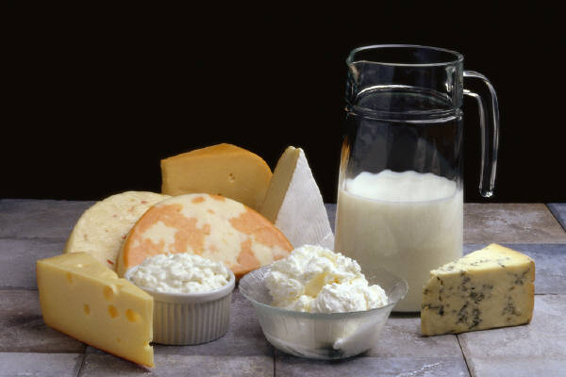
Argument Against the Dairy Myths*
5582 participants in Australia
Higher dietary dairy reduced risk for diabetes, especially for men
Men in the highest tertile (top third) reduced their risk for diabetes over five years by nearly 50% compared to first tertile
* N. Grantham et al., Public Health Nutr. 2012 Jun 7:1-7. [Epub ahead of print]
Notes:
./dairy_good_australia_diabetes.pdf

Slide 117
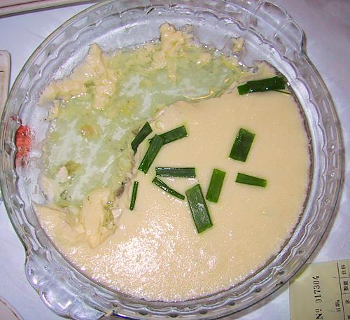
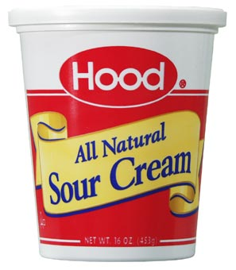
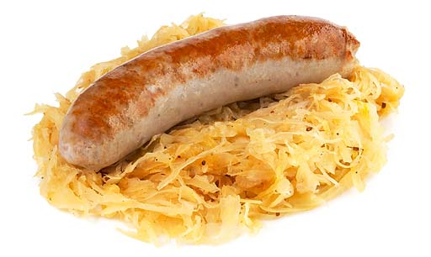
Lactate: The Perfect Food
Doesn’t generate AGEs like sugar and starch
Doesn’t generate oxidative damage like unsaturated fats
Carries a negative charge: helps fight acidosis
Heart, liver, and brain get first dibs
These foods also contain vitamin K

Slide 118
Lactate-rich Foods in Taiwan
These foods are also a great source of vitamin K
Suan Cai Bai Rou Huo Guo (Fermented Cabbage & Pork Firepot)
Chou Doufu
(Stinky Tofu)

Slide 119
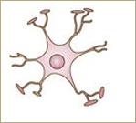
Lactate in the Brain*
lactate
glucose
galactose
Neuron
Astrocyte
lactate
Neuron requires lactate to be able to form long-term memories
Astrocyte can supply it (by conversion from glucose) or it can come directly from the medium (diet)
* Suzuki et al., Cell 144, 810–823, 2011
Notes:
Cancer/Lactate_neuron_memory.pdf

Slide 120
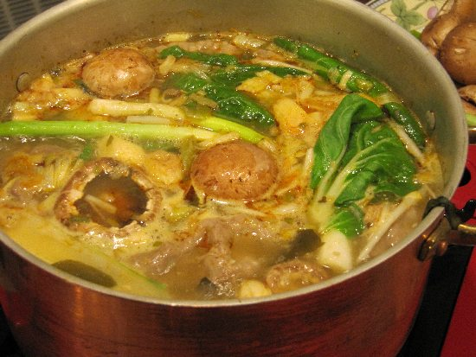
Soup: The Forgotten Food
Bone marrow is a rich source of electrolytes, minerals, and fat-soluble vitamins
Bone-based soups are extremely nutritious!

Slide 121
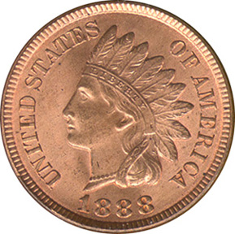
Homocysteine and Copper Deficiency *
Copper deficiency leads to elevated cholesterol, blood pressure, homocysteine, isoprostanes, and uric acid
Copper stimulates synthesis of paraoxonase (PON)
PON lowers risk of coronary artery disease and atherosclerosis
Prevents oxidation of LDL leading to plaque formation
Copper supplementation benefits heart failure
* L. Klevay, Arterioscler Thromb Vasc Biol. 2008, 28, p. e160
Notes:
Scrappy one-page letter by Leslie M. Klevay --- carried w/ laptop.
Homocysteine is not so paradoxical
Arterisclerosis thrombosis vascular biology 2008 28, p. e160
Isoprostanes??
The isoprostanes are prostaglandin-like compounds formed in vivo from the free radical-catalyzed peroxidation of essential fatty acids (primarily arachidonic acid) without the direct action of cyclooxygenase (COX) enzyme. ^{[1][2]} These nonclassical eicosanoids possess potent biological activity as inflammatory mediators that augment the perception of pain.^{[3]} These compounds are accurate markers of lipid peroxidation in both animal and human models of oxidative stress.
Uric acid
Iron (Fe) activates xanthine oxidase (XO) and copper (Cu) deactivates it, so as men accumulate Fe with age (ferritin levels rise above 45 ng/dl) and Cu levels decline as testosterone levels drop with age (testosterone increases Cu half life), eventually the high Fe/Cu results in more active XO and higher urate levels.^{[citation needed]} Excess Fe can be eliminated through phlebotomy (blood donation) and low Cu can be corrected through daily intake of 2 mg Cu per day, reducing urate levels.^{[citation needed]}

Slide 122
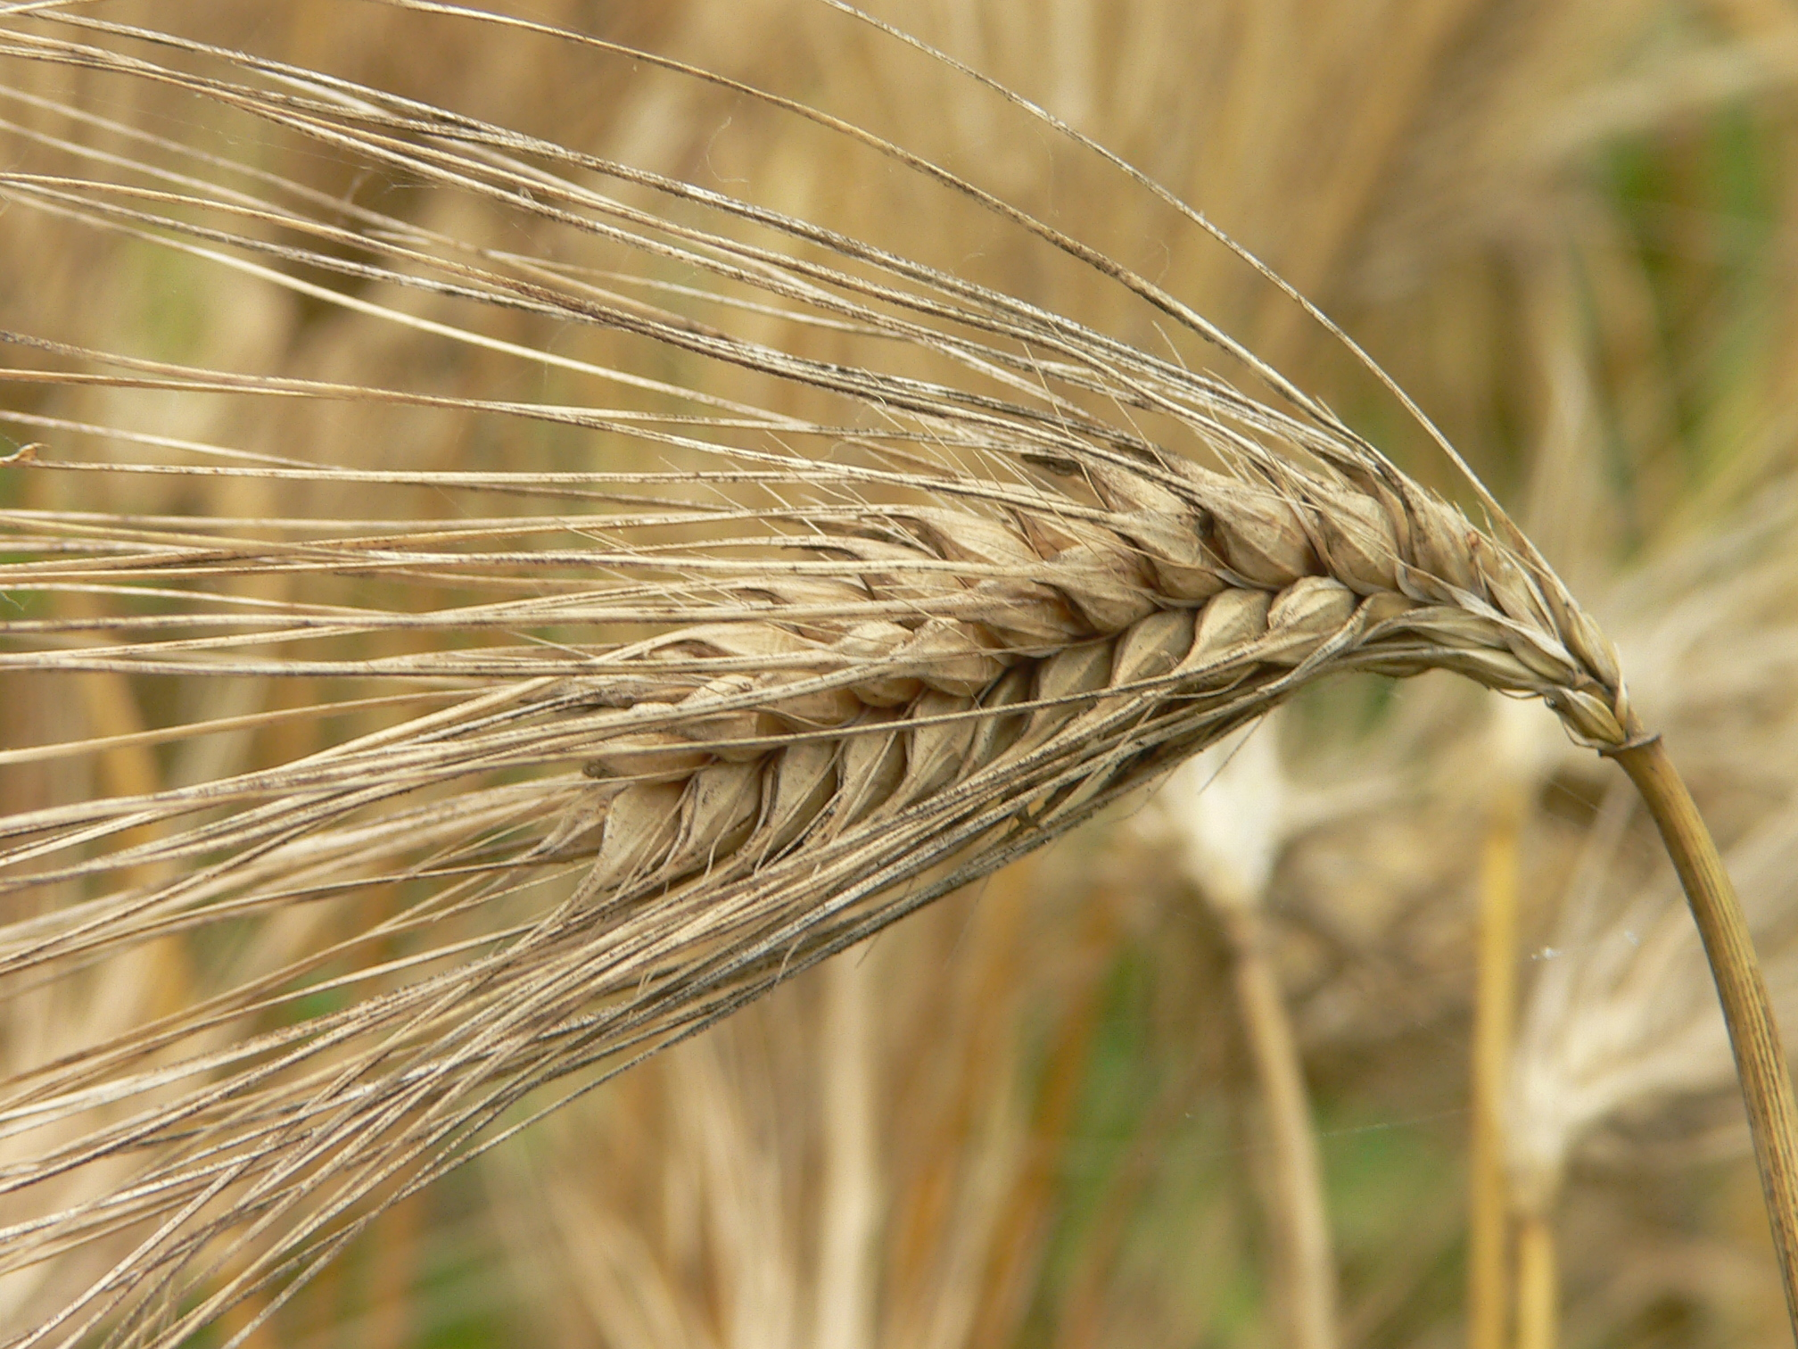
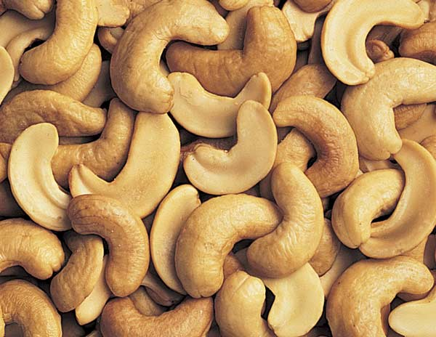
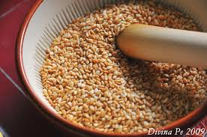
Food Sources of Copper
Sesame seeds, cashews, soybeans, lentils, lima beans, barley

Slide 123
In Summary…

Slide 124
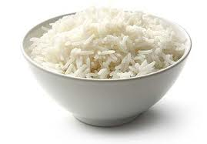
Unhealthy Foods

Slide 125
Healthy Foods
IRON
CHOLESTEROL
SULFUR
FOLATE
VITAMIN D3
LACTATE
CHOLINE
VITAMIN K
VITAMIN A
ZINC
SATURATED FAT
ELECTROLYTES

Slide 126
Conclusions
We are headed for an enormous crisis in our food supply due to industrialized farming methods
Depletion of nutrients; exposure to toxins
We need to move fast to avoid the point of no return
The crisis is made worse by misguided “expert” nutritional advice – low fat/low cholesterol/high carbohydrate diets
Cholesterol is healthy
High fructose corn syrup is toxic
We need to think in terms of “nutrient-dense” foods
We have forgotten how to prepare foods properly
We pay for it in major health problems like diabetes, obesity and heart disease

Slide 127
Thank you!

