Slide 1
Nutrition, Toxic Chemicals and Disease: How to Stay Healthy in Today's World or Sulfur - It Does the Body Good!
Stephanie Seneff
Wise Traditions Workshop
November 8, 2013

Slide 2
Part 1: Introduction
Stephanie Seneff
Wise Traditions Workshop
Weston Price Foundation
Nov. 8, 2013
people.csail.mit.edu/seneff/WAPF_Slides_2013/1_Intro.pdf

Slide 3
"An important scientific innovation rarely makes its way by gradually winning over and converting its opponents.
What does happen is that its opponents gradually die out and that the growing generation is familiar with the idea from the beginning. "
-- Max Planck

Slide 4
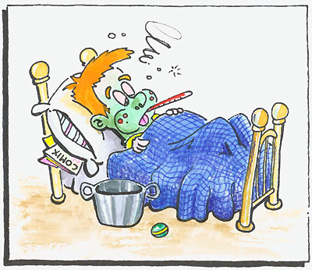
What’s Wrong Today
Key Message
Modern dietary and lifestyle practices are making us sick
I will argue that good health comes from
Getting abundant sunlight exposure to the skin and eyes
Eating abundant dietary fat and cholesterol
Eating lots of cruciferous vegetables
Eating organic whole foods
Avoiding processed foods
Avoiding prescription drugs and vaccines

Slide 5
The Kuna of Panama
“The Kuna are healthier than their city-dwelling cousins for a number of reasons. They have a very favorable omega 3:6 ratio due to seafood, wild game and relatively saturated vegetable fats. Their carbohydrate foods are mostly unprocessed and mostly from non-grain sources. They also live an outdoor life full of sunshine (vitamin D) and exercise. The chocolate may also contribute to their health, as it contains high levels of potentially protective polyphenols. They're healthier than industrialized people because they live more naturally.”
*wholehealthsource.blogspot.com/2008/03/say-hello-to-kuna.html
Notes:
They eat lots of carbs but they don’t get fat.
indigenous
Stephan Guyenet, B.S. Biochemistry, PhD Neurobiology
Sunlight; sulfane sulfur in chocolate.

Slide 6
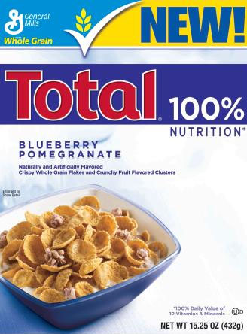
100% of the MDR of nearly EVERYTHING!
Where’s the sulfur?

Slide 7
We need to worry about sulfur!
Current agricultural practices are depleting sulfur from the soil
This leads to insufficient dietary sulfur, especially for vegetarians
Environmental toxins deplete sulfur in the body
Sulfur depletion in the body has widespread consequences

Slide 8
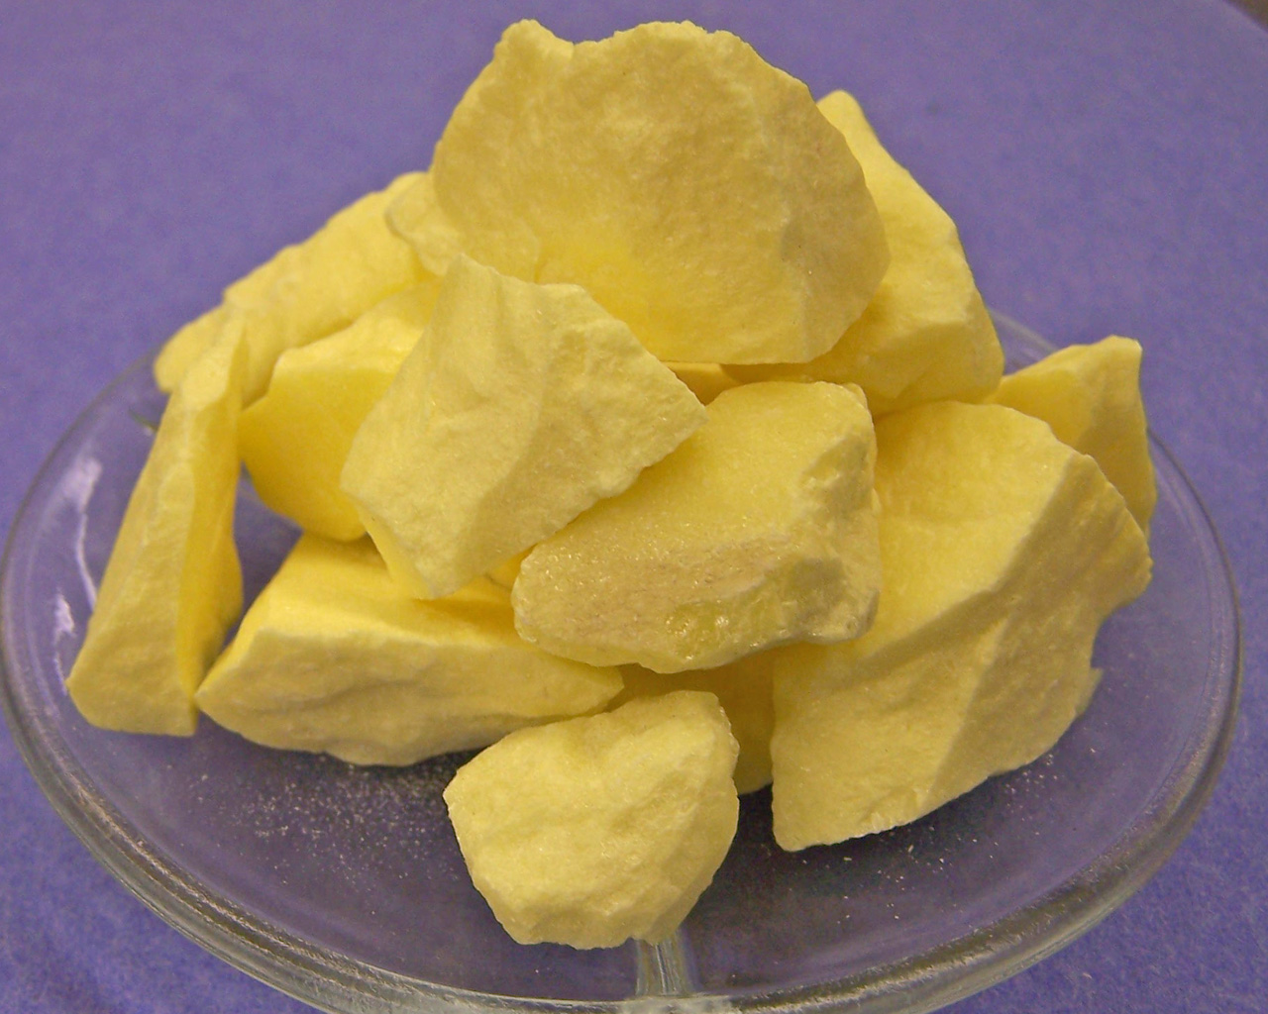
Sulfur, Sulfide and Sulfate
Superoxide
Hydrogen sulfide gas
Sulfuric acid (hydrogen sulfate)
2O₂⁻
H₂S
H₂SO₄
-
-
S₈
Sulfate!
Sulfur Crystal
Two extra electrons = negative charge!!

Slide 9
A Biological Definition of Aging
Cholesterol and sulfate depletion in cell membranes
Excess glycation damage to proteins (AGEs)
CELLS
Dysfunctional blood system leading to blood clots and hemorrhages
Increased susceptibility to infection and cancer
Diabetes and Obesity

Slide 10
Highlights of What’s Coming

Slide 11
Cholesterol Sulfate
Under healthy conditions, abundant cholesterol sulfate is synthesized in the skin following sun exposure, and this results in generous supply of cholesterol and sulfate to the tissues.
Inadequate sun exposure and sunscreen impair this process.

Slide 12
Heart Disease
When cholesterol sulfate synthesis in the skin is impaired, cardiovascular plaque develops as an alternative mechanism to produce cholesterol sulfate from damaged LDL and homocysteine

Slide 13
Blood Dysfunction
The stability of the blood colloidal system depends upon adequate cholesterol sulfate.
When sulfate is depleted, suspended cells and particles become deficient in negative charge, and start to stick together.
This leads to blood clots and hemorrhaging

Slide 14
Statin Drugs
Statin drugs are a huge money-maker, worldwide
They are causing tens of millions of people significant deterioration in quality of life with no gains in life expectancy

Slide 15
Cancer
Cancer develops as a mechanism to massively convert glucose to lactate, which is a much safer fuel – especially when cells are insulin resistant.
Cancer cells provide sulfate to the vasculature

Slide 16
Gut Bacteria
Our gut bacteria outnumber our own cells 10 to 1.
They produce signaling molecules that can influence neuronal responses in the brain
They help us out in many ways, and if they’re not healthy, we’re not healthy

Slide 17
Infection
Susceptibility to infection is a consequence of impaired cholesterol sulfate synthesis, which introduces widespread pathology
Infection serves a useful role in resupplying critical nutrients such as cobalamin, folate, and heparan sulfate

Slide 18
Autism
Autism is a childhood disorder that is alarmingly on the rise.
Many environmental factors contribute to it, including micronutrient-deficient food, inadequate sunlight exposure, aluminum and mercury in vaccines, exposure to vehicle exhaust fumes, and pesticides (especially Roundup),

Slide 19
The Pineal Gland
The pineal gland is the “seat of the soul”
It produces sulfate by day and supplies it to the brain by night
Pineal gland calcification is a major feature of Alzheimer’s, together with impaired sleep

Slide 20
Impaired Autophagy
Cells dispose of the garbage that accumulates with living via autophagy – they can recycle misfolded proteins into new proteins and replace broken mitochondria with fresh ones.
Excess nitric oxide leads to impaired autophagy, which results in accumulation of debris and busted mitochondria. Over time, the cell becomes so impaired that it has to shut down.

Slide 21
Glyphosate
Glyphosate is the active ingredient in the weedkiller, Roundup
It is likely a major contributor to autism, obesity, Alzheimer’s disease, kidney disease, diabetes, infertility, etc.

Slide 22
Polyphenols and Flavonoids
Polyphenols and flavonoids are components in certain foods that are considered healthy due to their “antioxidant” abilities.
The real reason why they are healthy is because they transport sulfate.

Slide 23
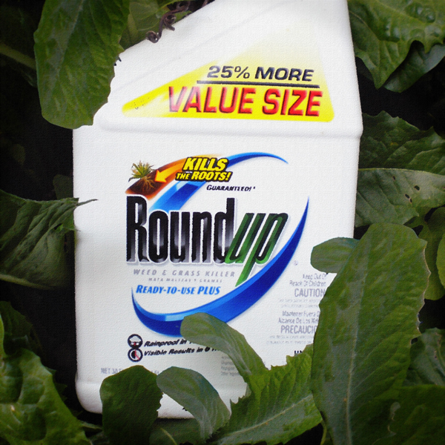
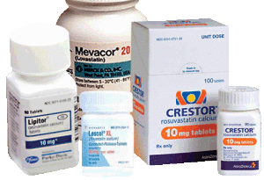
Some Themes
Too many pesticides
Glyphosate (Roundup)
Too many vaccines
Aluminum
Too many prescription drugs
Statin drugs (lower cholesterol)

Slide 24
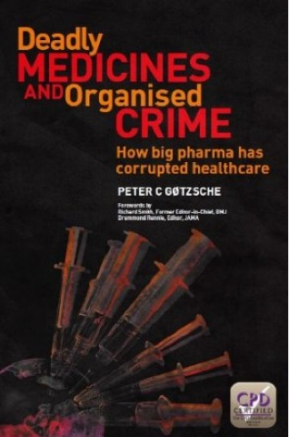
The US medical system is the third leading cause of death after heart disease and cancer.
Notes:
http://pharmagossip.blogspot.se/2013/09/deadly-medicines-and-organized-crime-by.html
Peter Gøtzsche, none other than the head of the Nordic Cochrane Centre, the Scandanavian arm of the Cochrane Collaboration, an independent research and information centre committed to preparing, maintaining, and disseminating reviews of the various treatments of mainstream medicine and examining whether they have adequate evidence of safety and effectiveness. Cochrane was the first group of individuals to champion the notion of`evidence-based' medicine - that is, medicine shouldn't be used unless there's evidence that the stuff works.
In the book, Smith points out, the characteristics of organized crime include extortion, fraud, federal drug offences, bribery, embezzlement, obstruction of justice obstruction of law enforcement, tampering with witnesses and political corruption.
The book essentially makes the point that the drugs industry uses virtually every tactic used by the mob to sell its products.

Slide 25
Hilarious Video!
http://www.youtube.com/embed/4U1ShwjleSE
Notes:
Sent by Rob Moore

Slide 26
Too Many Drugs: the Elderly*
Polypharmacy: the administration of more medications than are clinically indicated
Study in nursing home environment resulted in significant improvement in health by eliminating several drugs
Quality of life improved and mortality rate reduced by 50%
Estimated savings in US of $100-$340 million if fully implemented in nursing homes
*D. Garfinkel et al., IMAJ 9, June, 2007, 430-434
Notes:
./too_many_drugs_elderly.pdf

Slide 27
Sponsorship Bias in Drug Effectiveness Studies*
Researchers know what sponsors want to hear and what will affect the probability of subsequent support
Industry-funded economic evaluations are designed from the outset to suggest greater cost effectiveness of high cost drugs
This generates confusion about the true therapeutic value of new drugs and a loss of credibility
*F. Catalá-López et al., Plos ONE, July 2013 8(7): e69462
,
Notes:
For_vic/statin_effective_studies_biased.pdfDecisions about what to study and study design
Manuscript writing
Decision on whether to publish

Slide 28
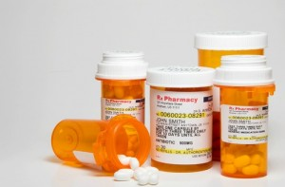
Six dangerous prescription drugs you should think twice before taking*
1) Proton pump inhibitors (PPIs).
2) Statins
3) Antibiotics.
4) Antipsychotics.
5) Opioid pain relievers.
6) Selective serotonin reuptake inhibitors (SSRIs).
*E.A. Huff, Natural News, Apr. 17, 2013.
Notes:
./six_bad_drugs_NaturalNews.text
4 in 10 americans suffer from GERD!!

Slide 29
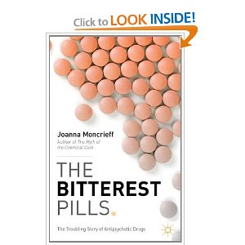
“The Bitterest Pills”*
Subtitle: The troubling story of antipsychotic drugs
Argues that the pharmaceutical industry enticed psychiatrists into believing that these drugs would cure mental illness and were very low-risk
Truth is that they cause debilitating dyskinesias and mental impairment
*Joanna Moncrieff,Palgrave MacMillan 2013

Slide 30
Six dangerous prescription drugs you should think twice before taking*
1) Proton pump inhibitors (PPIs).
2) Statins
3) Antibiotics.
4) Antipsychotics.
5) Opioid pain relievers.
6) Selective serotonin reuptake inhibitors (SSRIs).
*E.A. Huff, Natural News, Apr. 17, 2013.
Notes:
./six_bad_drugs_NaturalNews.text

Slide 31
“The Ugly Side of Statins. Systemic Appraisal of the Contemporary Un-Known Unknowns”*
“The statin industry, with all of its spin-off, is a 20-billion-a-year industry. We are observing the revealing of the utmost medical tragedy of all times. It is unprecedented that the healthcare industry has inadvertently induced life-threatening nutrient deficiency in millions of otherwise healthy people. What is even more disparaging is that not only has there been a failure to report on these negative side-effects of statins, there has actually been active discouragement to publish any negative studies on statins.”
*S. Sultan and N. Hynes, Open Journal of Endocrine and Metabolic Diseases, 2013, 3, 179-185
Notes:
For_vic/ugly_side_of_statins.pdf

Slide 32
The Ugly Side of Statins*
Conclusion: “There is increased risk of Diabetes Mellitus, Cataract formation, and Erectile Dysfunction in young statin users, all of which are Alarming. Furthermore there is a significant increase in the risk of cancer and neurodegenerative disorders in the elderly plus an enhanced risk of a myriad of infectious diseases.”
*S. Sultan and N. Hynes, Open Journal of Endocrine and Metabolic Diseases, 2013, 3, 179-185

Slide 33
Catalyst: Half-Hour Segment on Statins Oct 31, 2013
Heart of the Matter Part 2
– Cholesterol Drug War
http://www.abc.net.au/catalyst/stories/3881441.htm

Slide 34
“A recent `real world’ study of 150 000 patients who were taking 10 statins showed `unacceptable’ side effects—including myalgia, gastrointestinal upset, sleep and memory disturbance, and erectile dysfunction—in 20% of participants, resulting in discontinuation of the drug [19]. This is massively at odds with the major statin trials that report significant side effects of myopathy or muscle pain in only one in 10,000.” *
*A. Malhotra, BMJ 2013;347:f6340.
Notes:
./Malhotra\ 13\ Saturated\ Fat\ is\ not\ the\ major\ issue.pdf

Slide 35
Summary
Sulfur is an essential nutrient that has been overlooked and is severely depleted
Sunlight catalyzed production of cholesterol sulfate in the skin is essential to good health
Depleted sulfate supplies, systemically, lead to many diseased states
Modern lifestyle practices promote this dysfunction
Toxic chemicals in food and drugs derail sulfate homeostasis
A war on cholesterol is the wrong solution
Statin drugs are causing debilitating side effects

Slide 36
What’s Coming
Morning (10 a.m. – 12 p.m.)
Introduction
Cholesterol Sulfate
Early afternoon (1:30 p.m. – 3 p.m.)
Gut Microbes: How They Help Us Out
Autism, Depression, and Alzheimer's Disease
Late afternoon (3:30 p.m. – 5 p.m.)
Glyphosate: The Elephant in the Room
Nutrition: Facts and Fiction

