Slide 1
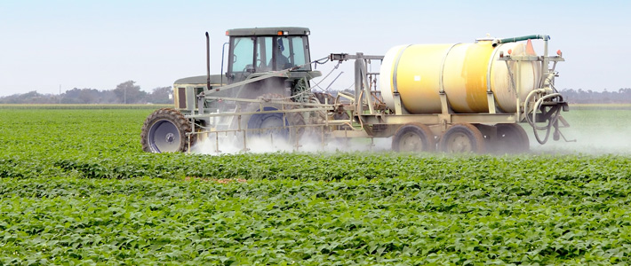
Roundup and Autism: Why Correlation IS Causation This Time
Stephanie Seneff
MIT CSAIL
April 16, 2016
Notes:
Some of these slides came from February.pptx

Slide 2
Outline
Correlation between glyphosate and autism
Glyphosate’s general mechanisms of toxicity
Metal chelation, especially manganese
Glyphosate’s potential substitution for glycine during protein synthesis: broad consequences
Summary

Slide 3
Correlation between
glyphosate and autism

Slide 4
1 in 45!

Slide 5
Roundup and GMO Crops
GMO Roundup-Ready corn, soy, canola, sugar beets
cotton, tobacco and alfalfa
What is glyphosate?

Slide 6
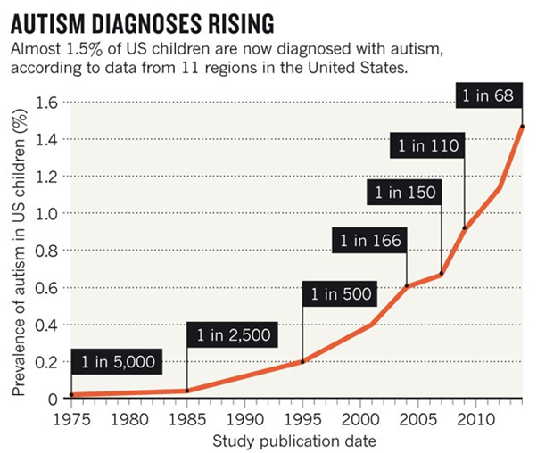
A Frightening Trend*
These numbers are for children who are 12 years old
12 years
*K. Weintraub, Nature 479, Nov. 3 2011, 22-24.
Notes:
./NatureAutismRising.pdf

Slide 7
A Frightening Trend*
?
12 years
*K. Weintraub, Nature 479, Nov. 3 2011, 22-24.
Notes:
./NatureAutismRising.pdf

Slide 8
Percentage of children with Autism in the US
50%
2032

Slide 9
Percentage of children with Autism in the US
50%
If we stay the course, half the children born in 2032 will be diagnosed with autism –
That will be 80% of the boys
2032

Slide 10
Is glyphosate a major factor in the autism epidemic?

Slide 11
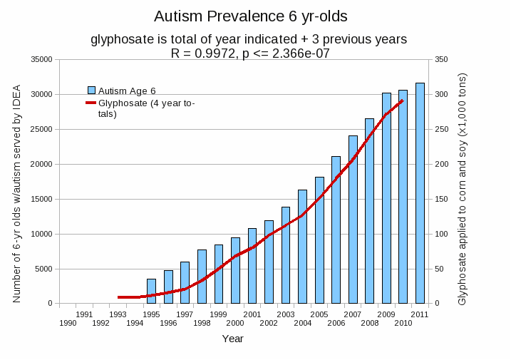
Autism Prevalence: 6 year olds*
R = 0.9972
* Figure 15, Seneff et al., Agricultural Sciences, 2015, 6, 42-70
Notes:
Nancy/latest_plots/6-yr-old autism.gif
autism: USDE
oil consumption: USDA
glyphosate: USDA
GE crops: USDA
Mortality data: CDC

Slide 12
Glyphosate’s general
mechanisms of toxicity

Slide 13
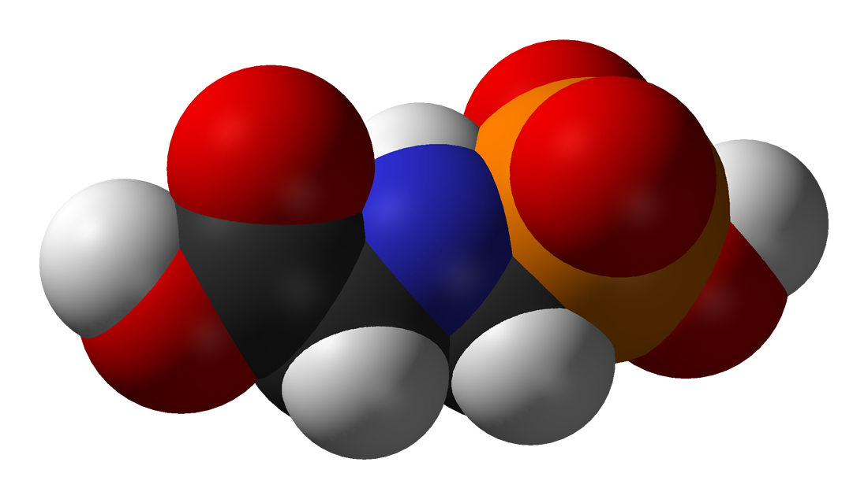
Is Glyphosate Toxic?
Monsanto has argued that glyphosate is harmless to humans because our cells don’t have the shikimate pathway, which it inhibits
However, our gut bacteria DO have this pathway
We depend upon them to supply us with essential amino acids (among many other things)
Other ingredients in Roundup greatly increase glyphosate’s toxic effects
Insidious effects of glyphosate accumulate over time
Most studies are too short to detect damage

Slide 14
Growth of GM Corn, Soy and Cotton in US, 1996-2012*
Soy
*N. Swanson et al., Journal of Organic Systems, 9(2), 2014, 6-37.

Slide 15
Another claim of Monsanto's has been that residue levels of up to 5.6 mg/kg in GM-soy represent “...extreme levels, and far higher than those typically found” (Monsanto 1999).
Study of glyphosate and AMPA (breakdown product) residues in soy crops*
5.6
*Figure 1, T. Bohn et al. Food Chemistry 153, 15 June 2014, 207-215.
www.greenmedinfo.com/blog/how-extreme-levels-roundup-food-became-industry-normal
Notes:
http://www.greenmedinfo.com/blog/how-extreme-levels-roundup-food-became-industry-normal

Slide 16
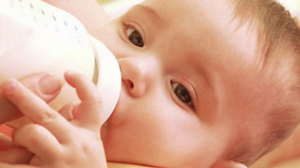
Soy Formula Linked to Seizures in Autism*
"There was a 2.6-fold higher rate of febrile seizures, a 2.1-fold higher rate of epilepsy comorbidity and a 4-fold higher rate of simple partial seizures in the autistic children fed soy-based formula"
*CJ Westmark, PLOSOne March 12, 2014, DOI: 10.1371/journal.pone.0080488.
Notes:
./SoyFormulaSeizuresAutism.pdf

Slide 17
Nutrients, Hormones and Neurotransmitters Disrupted by Glyphosate
Vitamins:
Folate, niacin, cobalamin, vitamins A, K, and D
Proteins:
Aromatic amino acids, glycine, methionine
Cytochrome P450 enzymes in the liver
Minerals:
Iron, manganese, cobalt, selenium, zinc, sulfur
Neurotransmitters:
Serotonin, melatonin, dopamine, thyroid hormone
Melanin (skin tanning agent)
Glutathione (antioxidant defenses)
Notes:
Glyphosate/gut_microbes_synthesize_B_vitamins.pdf

Slide 18
Nutrients, Hormones and Neurotransmitters Disrupted by Glyphosate
Vitamins:
Folate, niacin, cobalamin, vitamins A, K, and D
Proteins:
Aromatic amino acids, glycine, methionine
Cytochrome P450 enzymes in the liver
Minerals:
Iron, manganese, cobalt, selenium, zinc, sulfur
Neurotransmitters:
Serotonin, melatonin, dopamine, thyroid hormone
Melanin (skin tanning agent)
Glutathione (antioxidant defenses)
Many of these deficiencies have been linked to autism
Notes:
Glyphosate/gut_microbes_synthesize_B_vitamins.pdf

Slide 19
Glyphosate and Autism: Some Biological Mechanisms
Disruption of gut microbes¹
Children with autism suffer from many digestive issues
Disruption of sulfur metabolism, glutathione deficiency, impaired methylation pathways¹
Metal chelation (especially manganese)²
Manganese deficiency leads to impaired mitochondrial function and glutamate toxicity in the brain
Inhibition of pituitary release of thyroid stimulating hormone → hypothyroidism³
Moms with hypothyroidism have 4-fold increased risk to autism in the fetus
1. Samsel and Seneff, Entropy 2013;15(4):1416-1463.
2. Samsel and Seneff, Surg Neurol Int. 2015;6:45.
3. Beecham and Seneff, Journal of Autism 2016;3:1.

Slide 20
Metal chelation,
especially manganese

Slide 21
Glyphosate Depletes Iron, Manganese and Zinc in Plants*
*D Huber, What About Glyphosate-Induced Manganese Deficiency?
Fluid Journal, 20-22.
Notes:
Glyphosate/glyphosate_induced_manganese_deficiency_plants_Huber.pdf

Slide 22
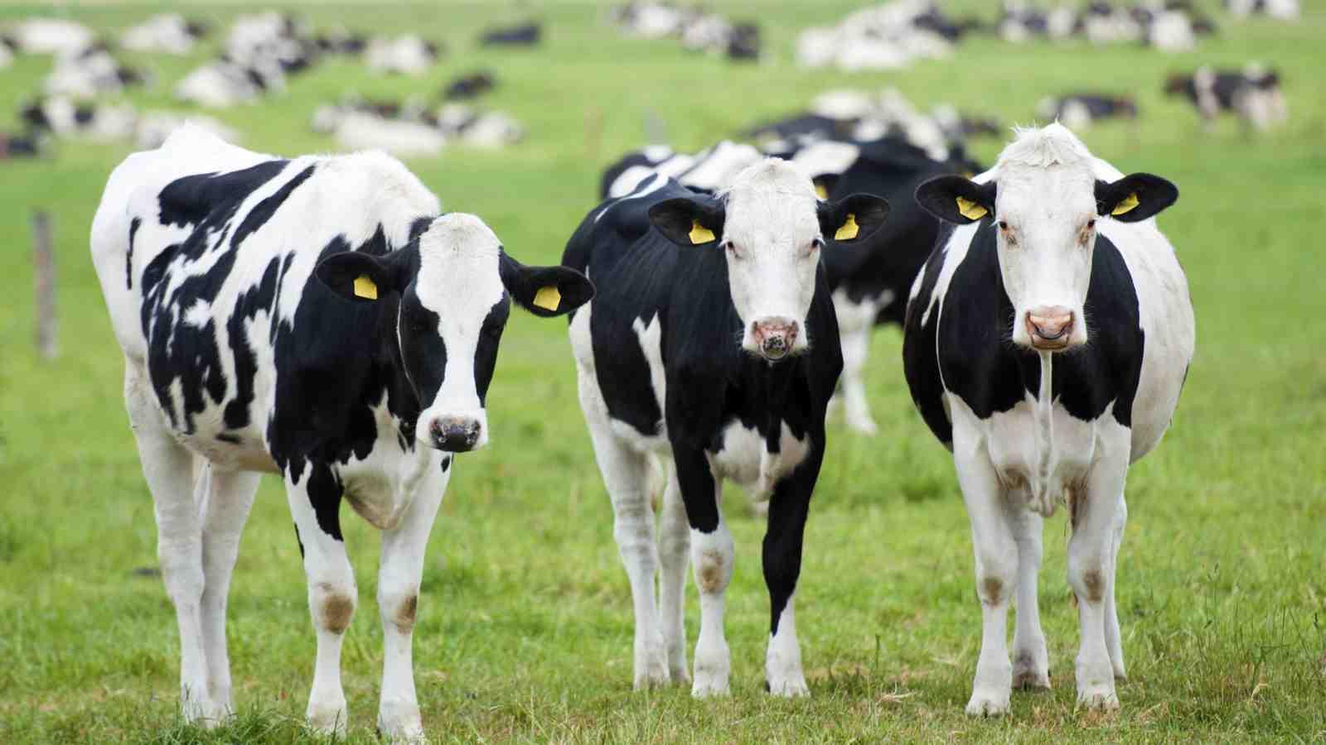
Severe Deficiency in Serum Cobalt and Manganese in Cows*
Cows at 8 different farms consumed GM Roundup-Ready corn and soy feed
cobalt
manganese
All cows tested had glyphosate in the urine
*M. Krüger et al., J Environ Anal Toxicol 2013, 3:5
Notes:
glyphosate//cows_cobalt_deficiency_glyphosate.pdf

Slide 23
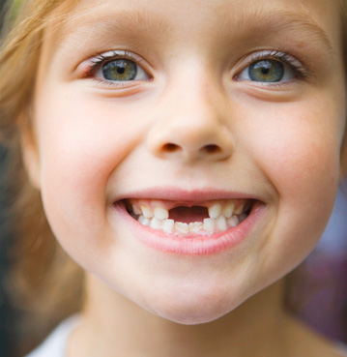
Low Manganese in Teeth Linked to Autism*
Studied lead, mercury and manganese levels in tooth enamel of shed primary teeth in 84 children
Manganese accumulated after birth was down by 60% in autistic children
No other result was statistically significant
*MM Abdullah et al., J Autism Dev Disord. 2012 Jun;42(6):929-36.
Notes:
Samantha/heavy_metal_in_childrens_tooth_enamel_as_diagnostic_autism.pdf

Slide 24
Low Manganese in Teeth Linked to Autism*
Studied lead, mercury and manganese levels in tooth enamel of shed primary teeth in 84 children
Manganese accumulated after birth was down by 60% in autistic children
No other result was statistically significant
Other studies have shown low serum manganese and low manganese in urine samples in association with autism
*MM Abdullah et al., J Autism Dev Disord. 2012 Jun;42(6):929-36.
Notes:
Samantha/heavy_metal_in_childrens_tooth_enamel_as_diagnostic_autism.pdf

Slide 25
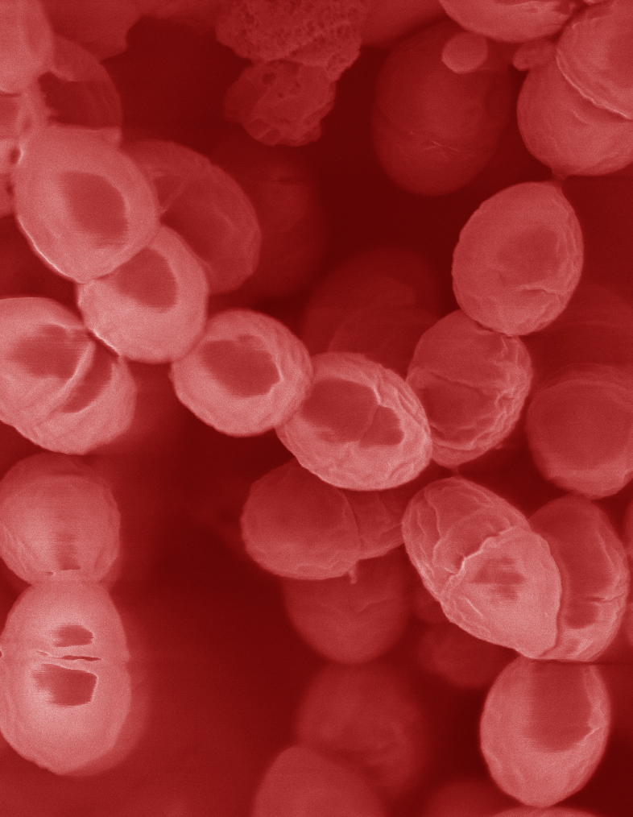
Lactobacillus Depends on Manganese!*
Many lactic acid bacteria contain very high intracellular manganese levels
Scavenges toxic oxygen species, particularly superoxide
Manganese deprivation suppresses growth
* FS Archibald and M-N Duong. Journal of Bacteriology Apr 1084, 1-8.
Notes:
Glyphosate/manganese/manganese_acquisition_by_lactobacillus.pdf

Slide 26
Lactobacillus Depends on Manganese!*
Many lactic acid bacteria contain very high intracellular manganese levels
Scavenges toxic oxygen species, particularly superoxide
Manganese deprivation suppresses growth
Lactobacillus levels are low in the gut in association with autism
* FS Archibald and M-N Duong. Journal of Bacteriology Apr 1084, 1-8.
Notes:
Glyphosate/manganese/manganese_acquisition_by_lactobacillus.pdf

Slide 27
Impaired Thyroid Function
Low thyroid hormone in mother → 4-fold increased risk to autism in child*
Thyroid hormone is derived from tyrosine, a product of the shikimate pathway
Thyroid depends on selenium (chelated by glyphosate) to protect it from oxidative damage and for hormone activation
Thyroid stimulating hormone (pituitary) depends on manganese
*GC Román et al., Ann Neurol. 2013 Nov;74(5):733-42.
Notes:
Whence???
Samantha/low_thyroid_hormone_mom_autism.text

Slide 28
Glyphosate’s potential
substitution for glycine
during protein synthesis:
broad consequences

Slide 29
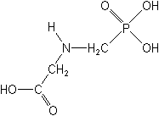
What If Glyphosate Could Insert Itself Into Protein Synthesis???
glyphosate
Code for glycine
GGC
mRNA
. . .
. . .
. . .
Glyphosate
Alanine
Proline
Any proteins with conserved glycine residues are likely to be affected in a major way

Slide 30
What If Glyphosate Could Insert Itself Into Protein Synthesis???
Glyphosate is a synthetic
amino acid analogue of glycine
glyphosate
Code for glycine
GGC
mRNA
. . .
. . .
. . .
Glyphosate
Alanine
Proline
Any proteins with conserved glycine residues are likely to be affected in a major way

Slide 31
What If Glyphosate Could Insert Itself Into Protein Synthesis???
Damaged proteins would slowly accumulate throughout the body over time, causing widespread pathologies
glyphosate
Code for glycine
GGC
mRNA
. . .
. . .
. . .
Glyphosate
Alanine
Proline
Any proteins with conserved glycine residues are likely to be affected in a major way

Slide 32
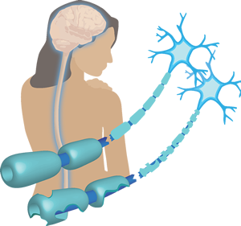
An Analogy: Multiple Sclerosis & Sugar Beets*
Sugar beets contain an analogue of proline called Aze
Remarkable correlation between MS frequency and proximity to sugar beet agriculture
Myelin basic protein contains a cluster of proline residues that are absolutely essential for its proper function
*E. Rubenstein, J Neuropathol Exp Neurol 2008;67(11): 1035-1040.
Notes:
./misincorporation_of_proline_analogue_MS.pdf

Slide 33
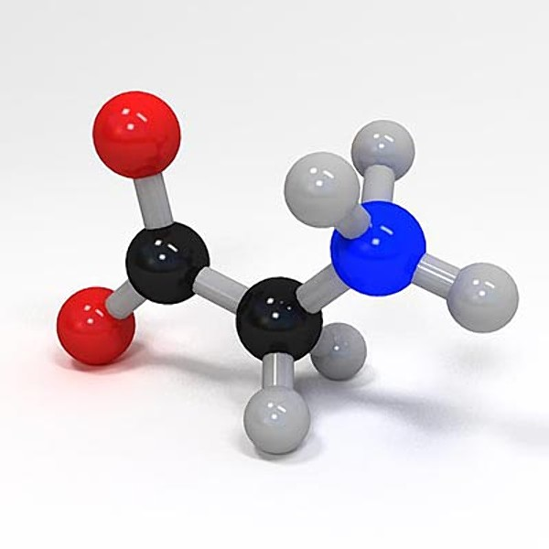
Glycine, Methyl-folate and One-carbon Metabolism
Glycine is a key source of methyl groups for the one-carbon cycle (methylation pathway) via the glycine cleavage system
A glycine-rich region maintains shape and flexibility of glycine decarboxylase, a key enzyme in the glycine cleavage system*
Methyl group
Methyl Folate
*A Kume et al., JBC 1991; 266(5): 3323-3329.

Slide 34
Glycine, Methyl-folate and One-carbon Metabolism
Glycine is a key source of methyl groups for the one-carbon cycle (methylation pathway) via the glycine cleavage system
A glycine-rich region maintains shape and flexibility of glycine decarboxylase, a key enzyme in the glycine cleavage system*
Autism is associated with impaired methylation pathway
Methyl group
Methyl Folate
*A Kume et al., JBC 1991; 266(5): 3323-3329.

Slide 35
Celiac Disease and Prolyl Aminopeptidase
Gluten intolerance and Celiac disease result from inability to break down gluten, which is enriched in proline*
Prolyl aminopeptidase, the enzyme that breaks down proline-containing peptides, depends on manganese as a catalyst
Prolyl aminopeptidase also contains a highly conserved GxSxGG motif plus two other regions with conserved glycines**
Malabsorption due to celiac disease can lead to nutritional deficiencies and symptoms of autism***
*G. Janssen et al., PLoS One 2015; 10(6): e0128065
**F Morel et al., Biochimica et Biophysica Acta 1999;1429: 501-505
***SJ Genuis and TP Bouchard, J Child Neurol. 2010;25(1):114-9
Notes:
Plos One:
Ineffective Degradation of Immunogenic Gluten Epitopes by Currently Available Digestive Enzyme Supplements
Glyphosate/ineffective_proteolysis_of_proline_in_gluten_digestive_enzymes.pdf

Slide 36
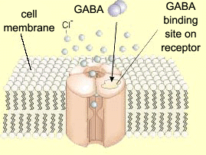
Impaired GABA Receptor Activity and Autism
Autism has been linked to a weakened response of the inhibitory GABA receptor to stimuli*
The GABA receptor has a conserved glycine at the entrance to the first membrane-spanning domain that is essential for its function**
*CD Robertson et al., Current Biology 2016;26: 80-85
**BX Carlson et al., Mol Pharmacol. 2000;57(3):474-84
Notes:
2016/Anthony/
reduced_GABAergic_activity_autism_brain.pdf
ABA_conserved_glycine_2000.pdf

Slide 37
Summary
Contrary to Monsanto’s claims, glyphosate is toxic to humans
Mineral chelation, disruption of gut microbes, and inhibition of liver enzymes have broad consequences
Causes deficiencies in vitamins, minerals, amino acids, neurotransmitters, melatonin and antioxidants
Makes other toxic agents more toxic (synergy)
Glyphosate may insert erroneously into protein synthesis
Multiple proteins with conserved glycines would be severely affected, causing widespread disease

