Slide 1
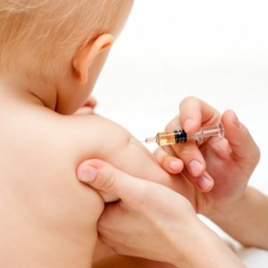
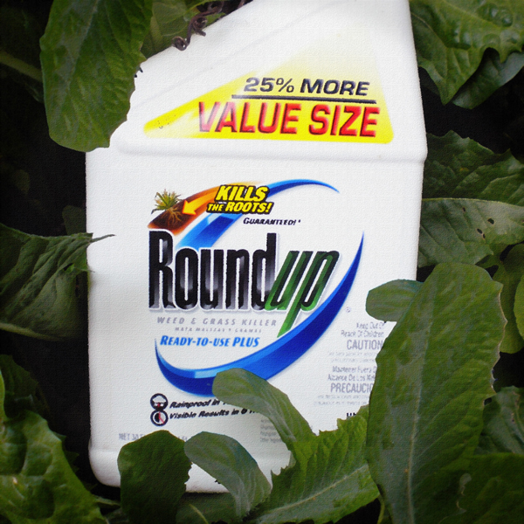
Autism Explained: Synergistic Poisoning from Aluminum and Glyphosate
Stephanie Seneff
MIT CSAIL
May 24, 2014

Slide 2
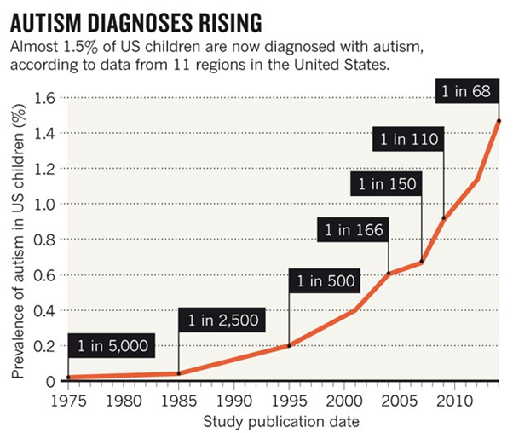
A Frightening Trend*
?
?
*K. Weintraub, Nature 479, Nov. 3 2011, 22-24.
Notes:
./NatureAutismRising.pdf

Slide 3
“If it is an environmental cause contributing to an increase, we certainly want to find it.”*
*K. Weintraub, Nature 479, Nov. 3 2011, 22-24.

Slide 4
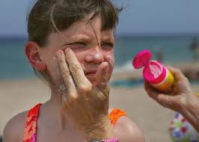
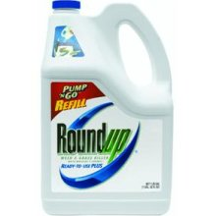
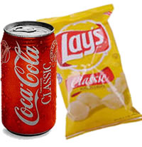
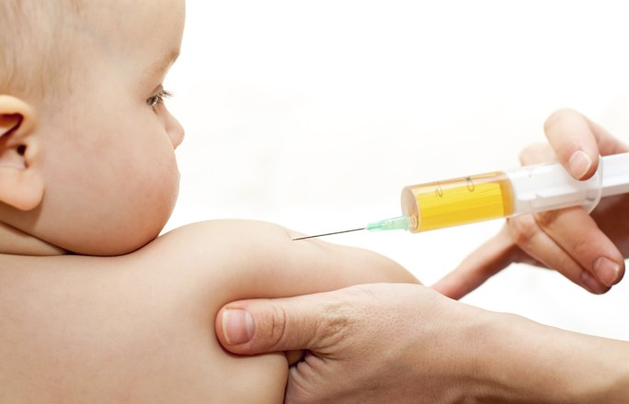
Sunscreen
GLYPHOSATE
Sunglasses
Poor Diet
Vaccines

Slide 5
Outline
Glyphosate and Autism
Aluminum, glyphosate, sulfate and the pineal gland
Sunlight Deficiency
Synergistic Effects of Glyphosate and Aluminum
Sunlight and Melatonin Sulfate
Digestive system disorders
Infertility and Birth Defects
Glyphosate chelates manganese
Lactobacillus and Anxiety
Glutamate and Ammonia
Mitochondrial Disorder
Impaired Bone Development
How You can Protect Yourself and Your Family

Slide 6
Glyphosate and Autism

Slide 7
Glyphosate and Autism*
R = 0.9898; p <= 2.6e-06
Pearson Correlation Coefficient = 0.99
*Nancy Swanson, http://www.examiner.com/article/
data-show-correlations-between-increase-neurological-diseases-and-gmos
Notes:
Nancy Swanson – I have a fanclub account for her.
Individuals with disabilities in education act IDEA

Slide 8
Glyphosate and Autism*
U.S. Market is 25% of World Market of Roundup
R = 0.9898; p <= 2.6e-06
Pearson Correlation Coefficient = 0.99
*Nancy Swanson, http://www.examiner.com/article/
data-show-correlations-between-increase-neurological-diseases-and-gmos
Notes:
Nancy Swanson – I have a fanclub account for her.
Individuals with disabilities in education act IDEA

Slide 9
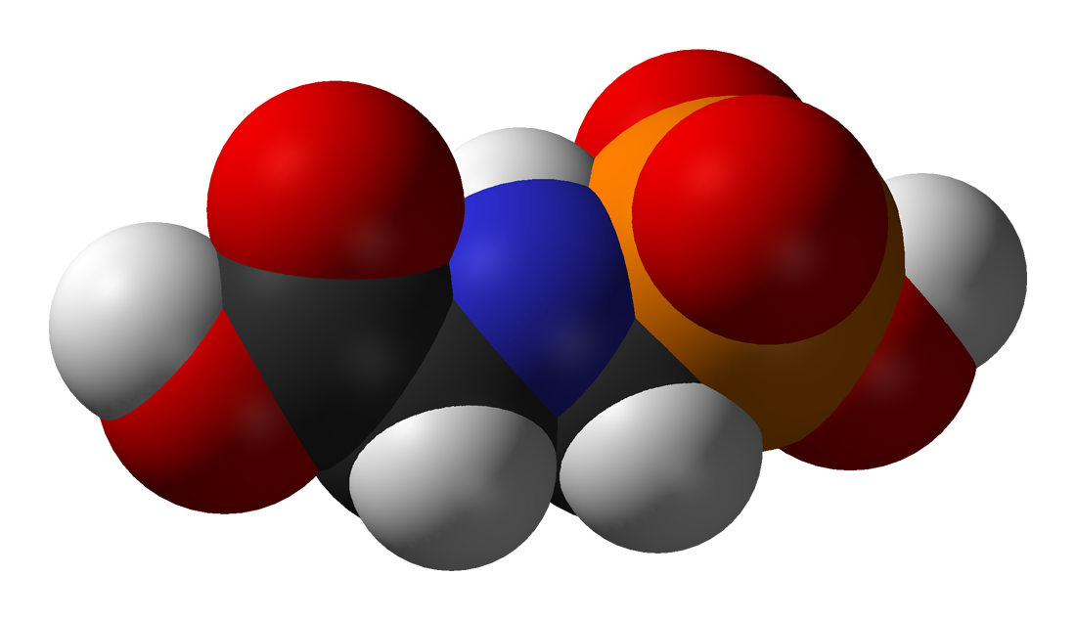
Is Glyphosate Toxic?
Monsanto has argued that glyphosate is harmless to humans because our cells don’t have the shikimate pathway, which it inhibits
However, our gut bacteria DO have this pathway
We depend upon them to supply us with essential amino acids (among many other things)
Other ingredients in Roundup greatly increase glyphosate’s toxic effects
Insidious effects of glyphosate accumulate over time
Most studies are too short to detect damage

Slide 10
Main Toxic Effects of Glyphosate*
Kills beneficial gut bacteria and allows pathogens to overgrow
Interferes with function of cytochrome P450 (CYP) enzymes
Chelates important minerals (iron, cobalt, manganese, etc.)
Interferes with synthesis of aromatic amino acids and methionine
Leads to shortages in critical neurotransmitters and folate
Disrupts sulfate synthesis and sulfate transport
*Samsel and Seneff, Entropy 2013, 15, 1416-1463

Slide 11
The Enhancing Effect of Adjuvants*
“Adjuvants in pesticides are generally declared as inerts, and for this reason they are not tested in long-term regulatory experiments. It is thus very surprising that they amplify up to 1000 times the toxicity of their APs [Active Principles] in 100% of the cases where they are indicated to be present by the manufacturer.”
*R. Mesnage et al.BioMed Research International 2014; Article ID:179691.
Notes:
Glypohsate/seralini_2014_pesticide_toxicity_adjuvants.pdf

Slide 12
Roundup Safety Claims Disputed*
“It is commonly believed that Roundup is among the safest pesticides. … Despite its reputation, Roundup was by far the most toxic among the herbicides and insecticides tested. This inconsistency between scientific fact and industrial claim may be attributed to huge economic interests, which have been found to falsify health risk assessments and delay health policy decisions.”
*R. Mesnage et al., Biomed Research International, Volume 2014 (2014),
Article ID 179691
Notes:
Glyphosate/ Mesnage_Seralini_2014_glyphosate_toxicity_proven.pdf
This is the first time that all these formulated pesticides have been tested on human cells well below agricultural dilutions.
adjuvants were also more cytotoxic through the disruption of membrane and mitochondrial respiration,
1000-fold enhancement w/ adjuvants

Slide 13
Okay, It’s toxic!
But are we exposed?
Very little data!

Slide 14
Glyphosate Test Report: Findings in American Mother's Breast milk, urine and water*
Moms Across America initiative!
Breast milk levels ranging from 76 ug/l to 166 ug/l are 760 to 1600 times higher than the European Drinking Water Directive allows
Urine testing shows glyphosate levels over 10 times higher than in Europe
Monsanto is wrong regarding bioaccumulation
*Posted on Apr 6 2014 - 4:19am by Sustainable Pulse

Slide 15
“Another claim of Monsanto's has been that residue levels of up to 5.6 mg/kg in GM-soy represent "...extreme levels, and far higher than those typically found" (Monsanto 1999).
Study of glyphosate and AMPA (breakdown product) residues in soy crops*
5.6
*Figure 1, T. Bohn et al. Food Chemistry 153, 15 June 2014, 207-215.
www.greenmedinfo.com/blog/how-extreme-levels-roundup-food-became-industry-normal
Notes:
http://www.greenmedinfo.com/blog/how-extreme-levels-roundup-food-became-industry-normal

Slide 16
Soy Formula Linked to Seizures in Autism*
"There was a 2.6-fold higher rate of febrile seizures, a 2.1-fold higher rate of epilepsy comorbidity and a 4-fold higher rate of simple partial seizures in the autistic children fed soy-based formula"
*CJ Westmark, PLOSOne March 12, 2014, DOI: 10.1371/journal.pone.0080488.
Notes:
./SoyFormulaSeizuresAutism.pdf

Slide 17
Some Biomarkers for Autism
Disrupted gut bacteria; inflammatory bowel
Low serum sulfate
Methionine deficiency
Serotonin and melatonin deficiency
Defective aromatase
Zinc and iron deficiency
Urinary p-cresol
Mitochondrial disorder
Seizures; Glutamate toxicity in the brain
Notes:
Samantha/zinc_deficiency_autism.text

Slide 18
Some Biomarkers for Autism
Disrupted gut bacteria; inflammatory bowel
Low serum sulfate
Methionine deficiency
Serotonin and melatonin deficiency
Defective aromatase
Zinc and iron deficiency
Urinary p-cresol
Mitochondrial disorder
Seizures; Glutamate toxicity in the brain
These can all be explained as potential effects of glyphosate on biological systems
Notes:
Samantha/zinc_deficiency_autism.text

Slide 19
“Microbiology of Regressive Autism”*
Nitrate
Glyphosate
Depete sulfate
Endotoxin
Feedback Loop
Nitric Oxide Synthesis
* S.M. Finegold et al., Anaerobe 1-3, 2012

Slide 20
Probiotics Treat Mouse Autism*
p-Cresol is produced by Clostridium difficile, a pathogen that is resistant to glyphosate
p-Cresol
*Graphical Abstract from E.Y. Hsiao et al., Cell, Dec. 5, 2013
Notes:
./mouse_autism_probiotics.text
http://www.scientificamerican.com/article.cfm?id=bacterium-reverses-autism-like-behavior-in-mice&utm_source=feedburner&utm_medium=feed&utm_campaign=Feed%3A+ScientificAmerican-News+%28Content%3A+News%29

Slide 21
Probiotics Treat Mouse Autism*
p-Cresol has been found in the urine of autistic kids
p-Cresol
*Graphical Abstract from E.Y. Hsiao et al., Cell, Dec. 5, 2013
Notes:
./mouse_autism_probiotics.text
http://www.scientificamerican.com/article.cfm?id=bacterium-reverses-autism-like-behavior-in-mice&utm_source=feedburner&utm_medium=feed&utm_campaign=Feed%3A+ScientificAmerican-News+%28Content%3A+News%29

Slide 22
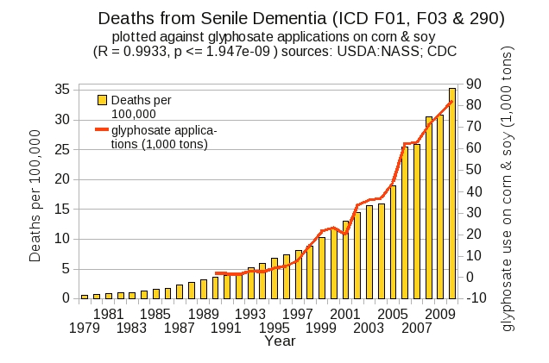
Dementia and Autism Have Much in Common
Plot kindly provided by Nancy Swanson

Slide 23
Aluminum, Glyphosate,
Sulfate
and the Pineal Gland

Slide 24
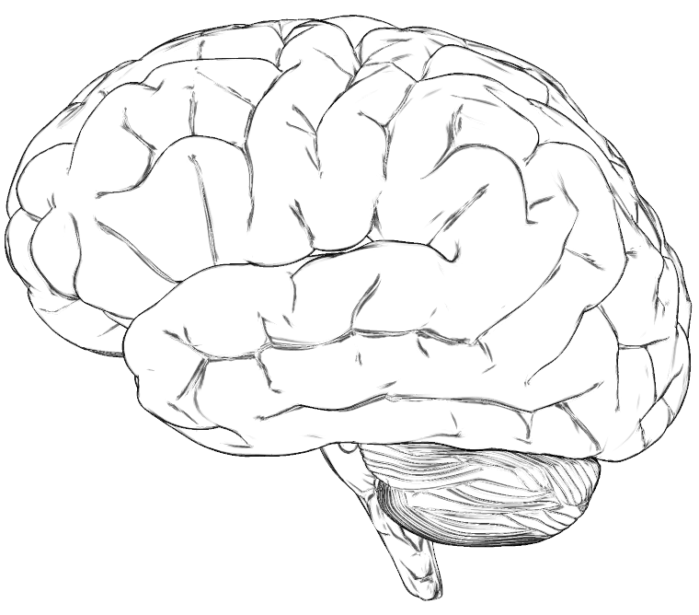
A Hypothesis
Many neurological diseases of the brain have a common origin:
Insufficient supply of sulfate to the brain
Powerful burden of toxic metal exposure (e.g., aluminum, mercury) due to impaired ability to detoxify and eliminate them
Toxic metals interfere with sulfate synthesis
This results in accumulation of cellular debris

Slide 25
Glyphosate, Autism and Vaccine Reactions*
Glyphosate application to corn and soy, US
Children with Autism, US
# Adverse Reactions in VAERS
*Collaboration with Nancy Swanson

Slide 27
A New Paper
Several studies suggest that children diagnosed with an ASD have abnormal sulfation chemistry, limited thiol availability, and decreased glutathione (GSH) reserve capacity, with a resulting and subsequent compromised oxidation/reduction (redox) and detoxification capacity
Notes:
Samantha//Thimerosal\ Exposure\ and\ the\ Role\ of\ Sulfation\ Chemistry\ and\ Thiol\ Availability\ in\ Autism.pdf .
In US 2013 > half flu shots are timerosol preserved
Mercury more toxic than lead in fetal tissue and neural cells

Slide 28
A Key Factor: Molybdopterin*
Molybdopterin is a cofactor for the conversion of sulfite to sulfate
Sulfite is neurotoxic; sulfate is essential
Mercury can replace the molybdenum atom in molybdopterin, disrupting its function
Children with autism whose ASD symptoms manifested after 15 months of age had a 50-fold increase in serum sulfite
*JK Kern et al. Int. J. Environ. Res. Public Health 2013, 10, 3771-3800;
Notes:
Sulfite is very neurotoxic and the inability of children diagnosed with an ASD to convert it to sulfate may be due to lack of molybdopterin caused by the displacement of molybdenum (Mo) from this cofactor by Hg. The plausibility of this occurring is evident in the structure of molybdopterin, the organometalic complex cofactor for sulfite oxidase which converts sulfite (SO3−) to sulfate (SO42‒). Molybdenum is held in molybdopterin by two bonds to sulfur in the pterin and could easily be displaced by Hg2+, which has the highest affinity for sulfur binding. Some evidence suggests lower Mo levels in children diagnosed with an ASD [79]. In addition, Waring and Klovrza [76] reported improvements in children with autism who were given Mo supplementation. (Infants who lack molybdopterin can die of seizures early in life, which is thought to be caused by sulfite toxicity that has negative effects on white matter production.)

Slide 29
An Important Role for Sleep
It has recently been argued that a crucial role for sleep is to clear cellular debris*
This takes place in the lysosome, which depends upon sulfate in heparan sulfate proteoglycans to protect from free radicals**
I propose that melatonin plays a critical role in supplying the sulfate
*Sleep Drives Metabolite Clearance from the Adult Brain. L Xie et al., Science 342:373-377, 2013
**Inhibition by heparin of Fe(II)-catalysed free-radical peroxidation of linolenic acid. M.A. Ross et al., Biochem. J. 1992, 286: 717-720.
Notes:
treasures/sleep_clears_garbage_in_brain_Science_2013.pdf
http://www.biochemj.org/bj/286/bj2860717.htm

Slide 30
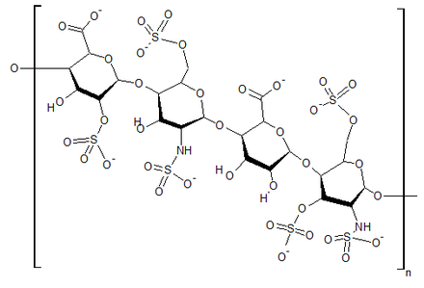
Heparin Protects from free radicals due to Iron*
superoxide
Free radical production:
Fe(II) + 0₂ + 20H⁻ --> Fe(III)(OH) ₂ + 0₂⁻
But, in the acid environment of heparin:
4Fe(II) + 0₂ + 4H+ --> 4Fe(III) + 2H₂0
water
sulfate
*M.A. Ross et al., Biochem. J. 1992, 286: 717-720.

Slide 31
Heparin Protects from free radicals due to Iron*
superoxide
Free radical production:
Fe(II) + 0₂ + 20H⁻ --> Fe(III)(OH) ₂ + 0₂⁻
But, in the acid environment of heparin:
4Fe(II) + 0₂ + 4H+ --> 4Fe(III) + 2H₂0
water
Heparin produces acidic environment where reactions with iron produce water (harmless) instead of superoxide (free radicals)
*M.A. Ross et al., Biochem. J. 1992, 286: 717-720.

Slide 32
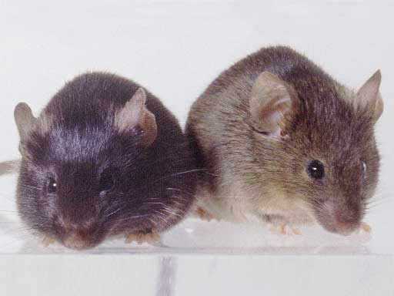
Heparan Sulfate Deficiency and Autism*
Experiment with “designer” mice: impaired heparan sulfate synthesis in brain
Mice exhibited all the classic features of autism – both cognitive and social
* F. Irie et al., Autism-like socio-communicative deficits and stereotypies in mice lacking heparan sulfate. PNAS Mar. 27, 2012, 109(13), 5052-5056.
Notes:
vitaminK/mice_no_heparan_sulfate_get_autism_2012.pdf

Slide 33
Sleep Disorder, Aluminum, and the Pineal Gland
Sleep disorder is linked to many neurological diseases:
Autism, Alzheimer’s, depression, schizophrenia, ALS, Parkinson’s disease, etc.
Insomnia occurs much more frequently as an adverse reaction in VAERS to vaccines containing aluminum than to those not containing aluminum (p = 0.0025)
Pineal gland is heavily perfused and outside of the blood brain barrier
Susceptible to aluminum toxicity

Slide 34
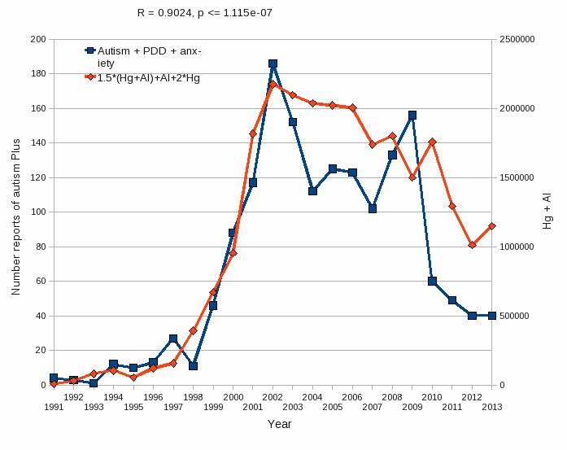
Aluminum & Mercury Autism & PDD & Anxiety*
VAERS
database
Formula: Al + 1.5 x (Al w/ Hg) + 2.0 x Hg
*Data compiled and graphed in collaboration with Nancy Swanson

Slide 35
We live in the age of aluminum*
*C.A. Shaw and L. Tomljenovic, Immunol. Res. Epub ahead of print, 2013
Notes:
Tomljenovich/ShawTomljenovichAluminumWorld.pdf

Slide 36
Aluminum’s Many Effects in the Brain
Kawahara and Kato-Negishi, International J. Alzheimer’s Disease 2011, Article ID 276393
Notes:
http://www.hindawi.com/journals/ijad/2011/276393/cta/

Slide 37
Aluminum in the Pineal Gland*
*S.B. Lang et al./Bioclectrochemistry and Bioenergetics 41(1996)191—195
Notes:
Csail/2013/ChrisShaw/piezoelectricity_aluminum_pineal_gland.pdf

Slide 38
Aluminum in the Pineal Gland*
The pineal gland takes up more than twice as much aluminum as other regions of the brain
*S.B. Lang et al./Bioclectrochemistry and Bioenergetics 41(1996)191—195
Notes:
Csail/2013/ChrisShaw/piezoelectricity_aluminum_pineal_gland.pdf

Slide 39
Sunlight Deficiency

Slide 40
A Critical Role for Sunlight*
Hypothesis:
Endothelial and neuronal nitric oxide synthase (both present in the pineal gland) produce sulfate from reduced sulfur sources catalyzed by sunlight
Sulfate deficiency results when this process is impaired
Aluminum and retinoic acid, present in high SPF sunscreens, interfere with sulfate synthesis in the skin
Aluminum accumulation in the pineal gland would disrupt sulfate supplies to brain
*S. Seneff et al., Entropy 2012, 14, 2492-2530.

Slide 41
A Really Bad Idea!

Slide 42
Demographic Studies on 50 States
Public schools in U.S. keep track of # students enrolled in each grade and # students enrolled in programs specifically targeting autism
Ratio becomes a measure for autism rate in the state
We used grades 1-6 only, in 2007-2008 school year
We can obtain statistics for many other factors
Weather related factors indicate sun exposure
Pearson’s correlation coefficient can be used to detect correlations (ranges from -1.0 to 1.0)
Correlation does not necessarily mean causation
Notes:
Say pearson’s coefficient
We looked at grades 1-6.

Slide 43
Demographics of 50 States
Demographic | Pearson Rating | Explanation
Rank, # clear days | -0.40 | Sunlight exposure
Latitude | 0.22 | Sunlight exposure
Annual rainfall | 0.16 | Sunlight exposure
RMS (rainfall, latitude) | 0.34 | Sunlight exposure
Temperature | -0.16 | Sunlight exposure
Elevation | -0.28 | Sunlight exposure
Vaccination rate | 0.38 | Aluminum, mercury
All measures of sun availability correlate with autism in such a way that sunlight is protective

Slide 44
Vitamin D Prevents Sulfate Wasting*
Activated vitamin D prevents sulfate wasting from the kidney in urine
Mice engineered to have defective vitamin D receptors or with vitamin D deficiency had significantly reduced serum sulfate levels
This was associated with sulfate depletion in the skeleton
*M.J.G. Bolt et al., Am J Physiol Endocrinol Metab 287: E744 –E749, 2004.
Notes:
SteveKette/vitamin_D_regulates_sulfate_kidney.pdf

Slide 45
Sulfate in Fetal Development*
Fetus depends on mother for sulfate supply
Sulfate is essential for transporting sterols (like estrogen and DHEA) and supplying extracellular matrix proteins everywhere with sufficient negative charge
Sulfate detoxifies xenobiotics like acetaminophen (tylenol) and is essential for excreting toxins like aluminum and mercury
Sulfate is severely deficient in autistic children (1/3 the normal level of free sulfate in blood stream)
* Dawson, “Sulfate in Fetal Development,” Semin Cell Dev Biol 2011
Notes:
Cancer/sulfate_in_fetal_development.pdf
Dawson PA. Sulfate in fetal development. Semin Cell Dev Biol (2011), doi:10.1016/j.semcdb.2011.03.004

Slide 46
DHEA Sulfate
DHEA is a sterol synthesized from cholesterol
Most common steroid in the blood stream
Autistic adults had significantly lower serum levels of DHEA sulfate*
DHEA sulfate stimulates dendritic growth in mouse neurons**
Genetically engineered mice with defective DHEA synthesis die as 8 day-old embryos
* Strous et al. Neuropsychopharmacol, 15(3):305-9, 2005
** Bair and Melon, Molecular and Cellular Biology 24(12):5383–5390, 2004
Notes:
Cancer/dhea_sulfate_reduced_autism.text
Cancer/DHEA_deficiency_lethal_mouse_embryos.pdf

Slide 47
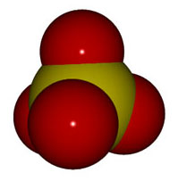
Sulfate and Alzheimer’s*
As in autism, Alzheimer’s patients have extremely low sulfate levels in the blood
Similar reduction to 20% of normal value
Serum cysteine/sulfate ratio:
Alzheimer’s 477
Parkinson’s 521
ALS 506
Controls 96
Cysteine levels were not significantly different
* Heafield et al., Neuroscience Letters 110:216-220, 1990

Slide 48
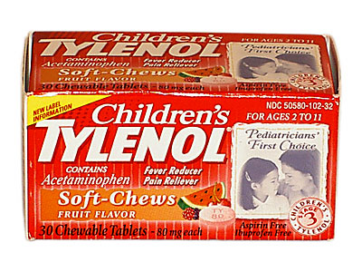
Tylenol and Autism*
Tylenol is detoxified and eliminated via sulfation
Autistic kids are severely impaired in this process
Reflects reduced supply of sulfate
Tylenol therapy could result in further depletion of sulfate stores
This same pathway is necessary to eliminate excess adrenalin and dopamine from the brain
Impairment could lead to the formation of neurotoxic substances with psychedelic effects
* Alberti et al., Biol Psychiatry 46, 420–424, 1999.
Notes:
vitaminK/autism_sulfation_deficit.pdf
vitaminK/sulfur_metabolism_in_autism.pdf

Slide 49
Glyphosate suppresses tryptophan synthesis by plants and gut bacteria
Glyphosate suppresses aromatase which converts testosterone to estrogen
Glyphosate suppresses vitamin D activation in the liver
Autism is associated with low activated vitamin D and low brain serotonin
Vitamin D activates serotonin receptors in the brain
Estrogen rescues females by boosting serotonin levels in brain
Recommendation is supplements in both vitamin D and tryptophan (precursor to serotonin)
Notes:
Samantha/vitamin_D_regulates_serotonin_synthesis_2014.pdf

Slide 50
Recapitulation
Measures of sunlight availability based on weather information reveal correlation of less sun with higher autism rates
Sulfate is synthesized in the skin and in the pineal gland upon sunlight exposure
Sulfate is essential in the fetus and is supplied by the mother
Vitamin D prevents sulfate wasting from kidney
Sulfate deficiency is associated with autism and Alzheimer’s
Vitamin D activates serotonin receptors
Impaired serotonin function is associated with autism

Slide 51
Synergistic Effects of
Glyphosate and Aluminum

Slide 52
Glyphosate and Aluminum: Partners in Crime
Glyphosate induces pathogens like C. difficile in gut, leading to leaky gut syndrome
C. diff produces p-cresol which promotes aluminum uptake by cells
p-Cresol is a known biomarker for autism
p-Cresol is an important factor in kidney failure which leads to aluminum retention in tissues → dementia
Glyphosate cages aluminum to promote entry
Glyphosate promotes calcium uptake by voltage-activated channels
Aluminum gains entry as calcium mimetic
Aluminum promotes calcium loss from bones → pineal gland calcification

Slide 53
Autism, Glyphosate, Vaccine Reactions*
Glyphosate application to corn and soy, US
Children with Autism, US
# Adverse Reactions in VAERS
*Collaboration with Nancy Swanson

Slide 54
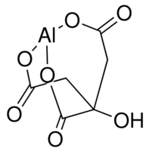
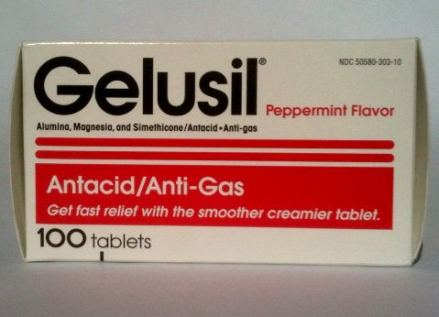
Aluminum Glyphosate*
Six different ways two glyphosate molecules can chelate aluminum
Aluminum citrate**
ALUMINA
aluminum
*M. Purgel et al., Journal of Inorganic Biochemistry 103 (2009) 1426–1438
** P. Sianina et al., Clin. Chem. 32/3, 539-541, 1986.
Notes:
AnthonySamsel/swine/aluminum_glyphosate.pdf
aluminum_citrate_absorbs_well_vinegar_antacids.pdf
Csail/2013/project/Anthony/

Slide 55
Aluminum Glyphosate*
Six different ways two glyphosate molecules can chelate aluminum
Aluminum citrate**
Citrate has been shown to promote entry of aluminum past the gut barrier via chelation. Glyphosate can be expected to do the same thing.
ALUMINA
aluminum
*M. Purgel et al., Journal of Inorganic Biochemistry 103 (2009) 1426–1438
** P. Sianina et al., Clin. Chem. 32/3, 539-541, 1986.
Notes:
AnthonySamsel/swine/aluminum_glyphosate.pdf
aluminum_citrate_absorbs_well_vinegar_antacids.pdf
Csail/2013/project/Anthony/

Slide 56
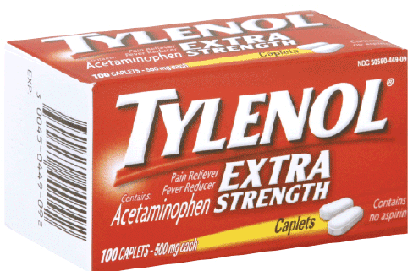
Glyphosate enhances aluminum toxicity
Glyphosate interferes with acetaminophen metabolism

Slide 57
Sunlight and
Melatonin Sulfate

Slide 58
The Brain
Limbic System
Ventricles
Pineal Gland
Notes:
http://corticalchauvinism.files.wordpress.com/2013/03/locus_coeruleus.gif

Slide 59
Ventricles in the Brain

Slide 60
“Heparan Sulfate Deficiency in Autistic Postmortem Brain Tissue from the Subventricular Zone of the Lateral Ventricles”*
*Behav Brain Res. 2013 Apr 15;243:138-45. doi: 10.1016/j.bbr.2012.12.062.
Epub 2013 Jan 11.

Slide 61
Third Ventricle and Pineal Gland
Pineal gland is attached to the third ventricle
The third ventricle is depleted in heparan sulfate in association with autism in both humans and mice*,**
Heparan sulfate depleted
Pineal Gland
*B.L. Pearson et al., Behav Brain Res. 2013 Apr 15;243:138-45.
**F Mercie et al., Neurosci Lett 506, 2012, 208-213.
Notes:
Where are they?

Slide 62
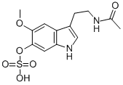
“Melatonin Enters the Cerebrospinal Fluid through the Pineal Recess”*
The tip of the third ventricle is encased in the pineal gland
The pineal gland delivers melatonin to the third ventricle and it diffuses to all the cerebrospinal fluid
I propose that a key purpose of melatonin is to deliver sulfate to the neurons at night.
Melatonin sulfate
*H. Tricoire et al., Endocrinology 143(1):84–90
Notes:
Wendy/melatonin_cerebrospinal_fluid_pineal_recess_DYNAMITE.pdf

Slide 63
Sulfate!!!
Pineal Gland

Slide 64
“Light-induced 3-O-Sulfotransferase Expression Alters Pineal Heparan Sulfate Fine Structure : A Surprising Link to Circadian Rhythm”*
Pineal gland builds up heparan sulfate supplies by day
Melatonin is sulfated in transport at night
Highly lipophilic molecule needs sulfate to make it water-soluble
This allows it to move through the cerebrospinal fluid
When melatonin is delivered, sulfate is released!
Melatonin is a sulfate-delivery system!!
*B. Kuberan et al., J. Biol. Chem. 2004, 279:5053-5054.
Notes:
Samantha/light_sulfotransferase_pineal_gland_heparan_sulfate.pdf

Slide 65
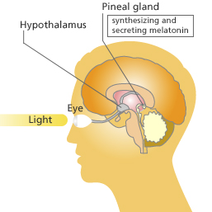
Pineal Gland: “Seat of the Soul”
The pineal gland produces sulfate by day (responding to light) and stores it in heparan sulfate molecules
The pineal gland produces melatonin in the evening and transports it as melatonin sulfate to various parts of the brain

Slide 66
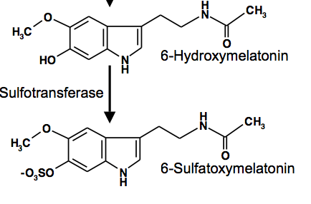
REM Sleep Cycle
Melatonin Induces REM sleep
Alzheimer’s is associated with reduced REM sleep cycle AND calcified pineal gland*
Pineal gland calcification correlates inversely with REM sleep**
DHEA SULFATE but not DHEA injections increase melatonin production in rats***
*R. Mahlberg et al., Neurobiol Aging. 2008 Feb;29(2):203-9
**R. Mahlberg et al., Sleep Med. 2009 Apr;10(4):439-45.
***Y. Djeridane et al., Steroids. 2004 May;69(5):343-9.
Notes:
Alzheimers/pineal_calcification_alzheimers.text
Treasures/pineal_calcification_melatonin_sleep.pdf
Treasures/DHEA_sulfate_boosts_melatonin.text
melatonin_review_2012.pdf

Slide 67
Recapitulation
Hypothesis: Autism is associated with a severe deficiency in sulfate supplies to the brain
Pineal gland can synthesize sulfate stimulated by sunlight and deliver it via melatonin sulfate
Aluminum, mercury and glyphosate work synergistically to derail this process
Impaired sleep due to melatonin deficiency characterizes many neurological diseases
Sunlight deficiency contributes to the pathology

Slide 68
Digestive System Disorders

Slide 69
Dr. Roy Dittman*
“If the microbial world is the substrate for life, why are we waging war on it?”
“The same chemicals we use to sterilize our environment sterilize us.”
*Talk at AutismOne Conference, May 25, 2013 Chicago, Illinois

Slide 70
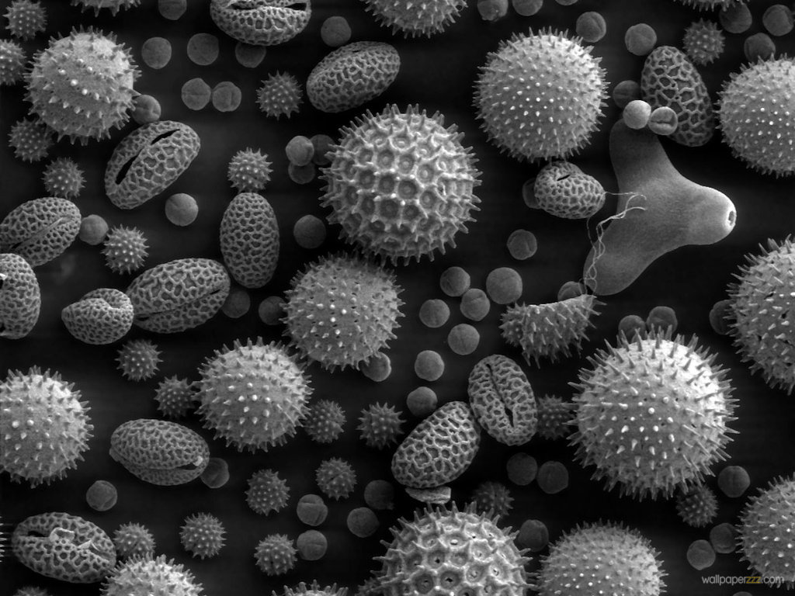
Gut Microbes and Obesity
Our microbes outnumber our own cells 10 to 1
There are between 200 and 300 different species in a typical person.
Glyphosate causes a loss of beneficial bacteria and an overgrowth of pathogens in the gut
Pathogens release toxic phenols (e.g., p-cresol)
This can lead to inflammatory bowel disease
And a direct path to obesity!
Gut microbes from an obese person induced obesity in mice*
*N. Fei and L. Zhao, The ISME Journal, Online Publication Dec. 2012
Notes:
*See: http://www.usaprepares.com/health/scientists-link-obesity-to-gut-bacteria

Slide 71
Obesity Switch*
Reduced sulfate
Loss of beneficial bacteria
Overgrowth of Pathogens
Leaky Gut
Glyphosate!!
*Figure 3, Le Chatelier et al., Nature 500, Aug 29, 2013, 541-548.
Notes:
Wendy/Chatelier_microbiome_metabolic_markers_2013.pdf
Also treasures/
Figure 3 | Functional and phylogenetic shifts in the LGC microbiome. Top, observed increase (red) or decrease (green) of functions and phylogenetic groups. Bottom, potential drivers (yellow) of inflammation related to decreased richness. Left, antibiotic-mediated perturbation of the richness; Right, proteobacterial lipopolysaccharide-mediated perturbation of the richness. AB, antibiotic; IR, insulin resistance.

Slide 72
Obesity in US over Time*
Glyphosate was introduced into the food chain in 1975
*Figure 1 in R.J. Johnson et al., Am J Clin Nutr 2007;86:899–906.
Notes:
Sugar intake per capita in the United Kingdom from 1700 to 1978 (30, 31; E) and in the United States from 1975 to 2000 (32; 􏰏) is compared with obesity rates in the United States in non-Hispanic white men aged60–69y(17;F).Valuesfor1880-1910arebasedonstudiesconducted in male Civil War veterans aged 50–59 y (18).

Slide 73
Pigs Fed GMOs Develop Inflamed Gut*
Pigs have a similar digestive system to humans
Digestive problems observed anecdotally in GMO-fed pigs
inflammation in stomach and intestine, stomach ulcers, thinning of intestinal walls, increase in haemorrhagic bowel disease
Follow-on Experiment:
168 just-weaned pigs fed "typical diet,” soy and corn, until slaughtered
Half fed GMO versions, half organic.
*J.A. Carman et al., Journal of Organic Systems, 8(1), 2013.
Notes:
Swine/pigs_fed_GMOs_inflamed_gut.pdf
Also pigs_GMOs_summary.pdf
./Pigs_Study_NaturalNews.pdf
http://www.beyondpesticides.org/dailynewsblog/?p=10823

Slide 74
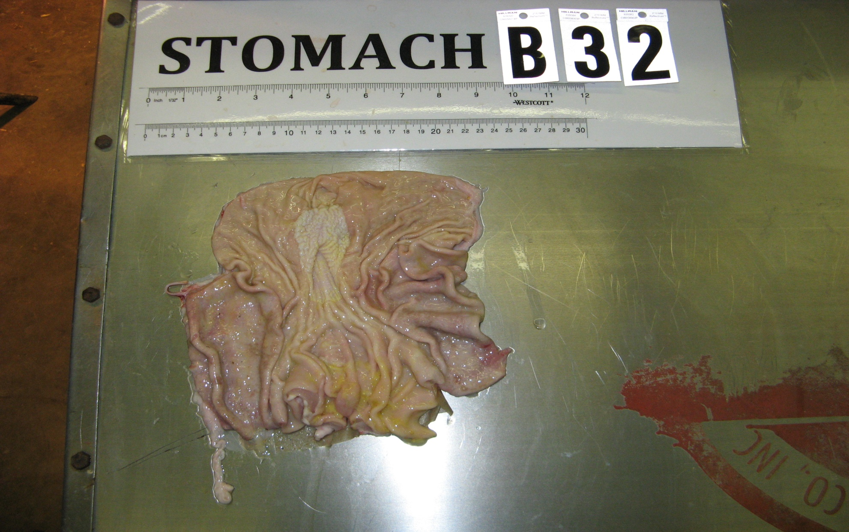
Pigs Fed GMOs Develop Inflamed Gut*
Blind autopsies conducted
Female pigs' uterus 25% larger in GMO-fed pigs
Female pigs 2.2x more likely to get severe stomach inflammation on GMO diet
Males were 4x more likely
Non-GMO Feed
GMO Feed
Photos kindly provided by Howard Vlieger
GMO Feed
*J.A. Carman et al., Journal of Organic Systems, 8(1), 2013.
Notes:
Swine/pigs_fed_GMOs_inflamed_gut.pdf
Also pigs_GMOs_summary.pdf
./Pigs_Study_NaturalNews.pdf

Slide 75
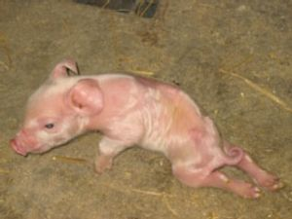
“Deformities, sickness and livestock deaths: the real cost of GM animal feed?”*
"When using GM feed I saw symptoms of bloat, stomach ulcers, high rates of diarrhoea, pigs born with the deformities ... but when I switched [to non GM feed] these problems went away, some within a matter of days.”
Quote from Ib Pedersen, producer of 13,000 pigs a year supplying Europe's largest pork company, Danish Crown
*Andrew Wasley, Nov. 28, 2013, The Ecologist., theecologist.org/News/news_analysis/2176082/
deformities_sickness_and_livestock_deaths_the_real_cost_of_gm_animal_feed.html
Notes:
2014/sickpigs.pdf
2014/naturalNews_on_GMO_feed_to_pigs_in_Europe.pdf

Slide 76
America’s Two-Headed Pig*
Treating Nutritional Deficiencies and Disease in a Genetically Modified, Antibiotic Resistant and Pesticide Dependent World
*book by Leah Dunham, www.americastwoheadedpig.com, 2013
Notes:
./

Slide 77
Human Digestive System Disorders
Alarming increase in the US in many diseases related to the gut
Crohn’s disease, inflammatory bowel disease, colitis, acid reflux disease, gluten and casein intolerance, celiac disease, leaky gut
The gut-brain axis links neurological disorders with gut disorders
I believe that glyphosate is a major cause
Notes:
Celiac disease has quadrupled in the US in last 50 years

Slide 79
Celiac Disease has Quadrupled in the US in the Last 50 Years
Notes:
Today’s serum is more than four times as likely to carry those
Antibodies (to gluten)

Slide 80
Wheat! Not corn and soy!
Graph provided by Nancy Swanson, with permission

Slide 81
Why is glyphosate usage on wheat going up?

Slide 82
“Herbicide Resistant Ryegrass Troubling for Wheat Growers”*
“If you see ryegrass at harvest following an Axial XL application, it may be resistant. And you can scatter seed all over the field with the combine.”
“A reduced-tillage approach, using a burndown herbicide ahead of planting in a stale seedbed, also holds promise for improved control.”
“ ‘We may be able to knock out 80% to 90% of the resistant ryegrass with glyphosate.’ ”
-- Jim Swart, integrated pest management specialist
*Ron Smith, Western Farm Press, Mar. 23, 2013
Notes:
Glyphosate/pesticides_for_wheat_slides.pdf
glyphosate/Axial_XL.text

Slide 83
Desiccation: It’s Not Just Wheat
Advantages:
Hastens maturity to harvest
Weed control for next year's crop
Reduces green material and therefore strain on harvesting machinery
Disadvantages
Herbicide cannot be washed out prior to human use.
Animals fed herbicide-treated crops --> contamination in animal products
Crops include wheat, barley, legumes, corn, sunflower, kiwi, grapes (wine), raspberries, apples, soybeans, alfalfa, sugar cane

Slide 84
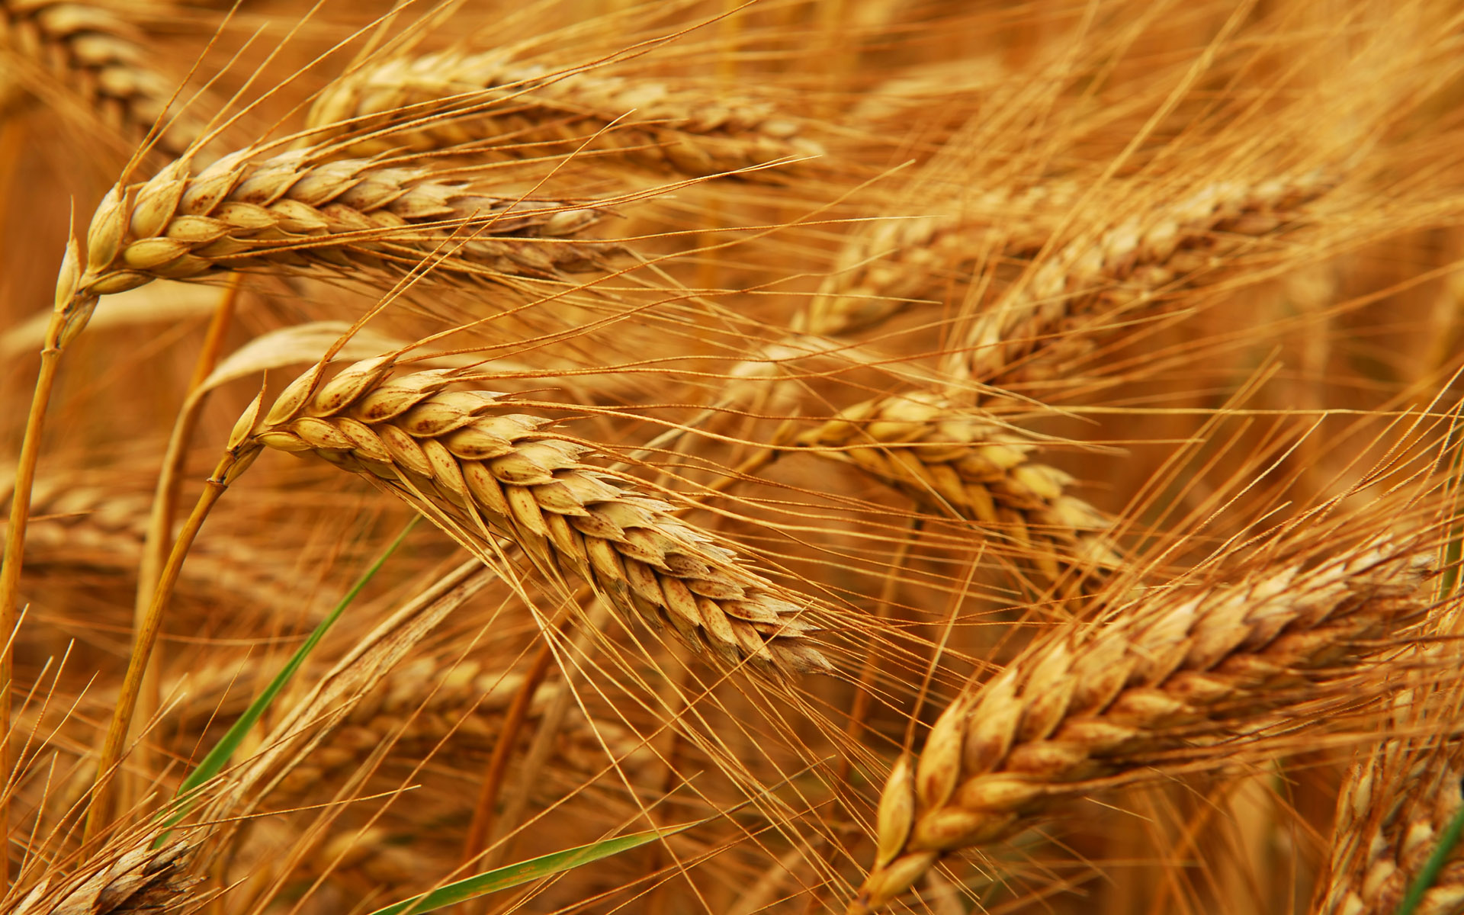
Human Dietary Experiment on Wheat & Inflammatory Bowel Syndrome*
Significant improvement in symptoms with dietary organic wheat from ancient source
Abdominal pain (P< 0.0001)
Bloating (P=0.004)
Stool consistency (P<0.001)
Tiredness (P< 0.0001)
Reduced pro-inflammatory cytokines: IL-6, IL-17, interferon-gamma, VEGF
*F. Sofi et al., Br J Nutr. 2014 Feb 13:1-8. [Epub ahead of print]
Notes:
Csail/2014/Anthony/ancient_wheat_not_allergenic.text

Slide 85
Paper on Glyphosate and Celiac Disease

Slide 86
Celiac Disease, Glyphosate and Non-Hodgkin’s Lymphoma
Bifidobacteria are depleted in celiac disease*
They convert gluten to less toxic form
Glyphosate preferentially kills bifidobacteria**
Celiac disease is associated with increased risk to non-Hodgkin’s lymphoma***
Glyphosate itself is also linked directly to non-Hodgkin’s lymphoma****
*M. Velasquez-Manoff, NY Times Sunday Review, Feb. 23, 2013
**A.A. Shehata et al., Curr Microbiol. 2013 Apr;66(4):350-8.
.*** C. Catassi et all, JAMA. 2002 Mar 20;287(11):1413-9.
****M. Eriksson et al., Int J Cancer. 2008 Oct 1;123(7):1657-63.
Notes:
**./ bifidobacteria_celiac_disease.text
Cancer/Celiac_disease_increases_hodgkins_lymphoma.text
3-4 fold increased risk to non-Hodgkins lymphoma
./Celiac_and_bacteria.text

Slide 87
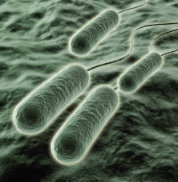
Pseudomonas and Glyphosate*
Pseudomonas aeruginosa, a gram negative bacterium, is a major problem today in hospitals due to its resistance to multiple antibiotics
P. aeruginosa is one of only three bacterial species that can break down glyphosate.
It produces formaldehyde as a by-product
Formaldehyde is a well established neurotoxin
*S. de Betnzmann and P. Plésiat Environ Microbiol. 2011 Jul;13(7):1655-65.

Slide 88
“Dramatic Increase in Hospitalization of US Children With Inflammatory Bowel Disease”*
Study conducted at Case Western Reserve University School of Medicine
> 11 Million hospitalization records examined
Patients < 20 years old
49% increase from 2000 to 2009 in Crohn’s disease discharges
71% increase in ulcerative colitis discharges
* Science Daily, June 25, 2013
Notes:
./inflammatory_bowel_disease_children.text

Slide 89
*Plot prepared by Nancy Swanson from available data online

Slide 90
Kidney Failure in Agricultural Workers*
Workers in sugarcane fields in Central America and in India are dying at a young age in record numbers from kidney failure
Arsenic exposure from drinking water?
Excess use of tylenol?
Glyphosate disrupts the enzyme that breaks down tylenol, leading to tylenol toxicity
*ticotimes.net, San Jose, Costa Rica, August 8, 2013.
Notes:
http://www.ticotimes.net/More-news/News-Briefs/What-is-killing-the-young-men-of-Canas-_Wednesday-August-07-2013
./diabetes_farmers_costa_rica.pdf

Slide 91
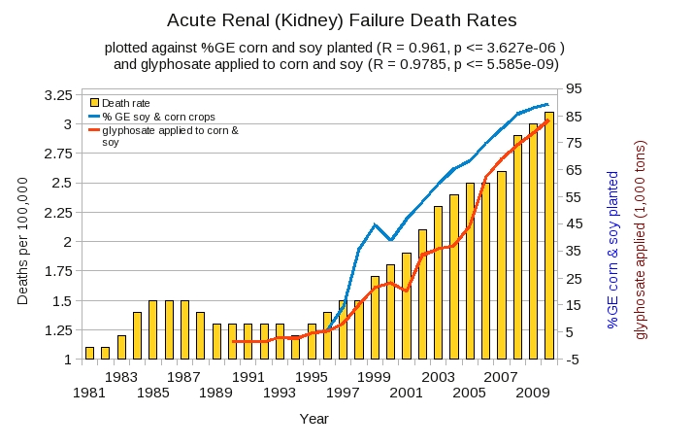
Acute Kidney Disease Death Rate Plotted Against Glyphosate and GMOs*
*Plot prepared by Nancy Swanson from available data online

Slide 92
Sri Lanka is the first Country to Ban Glyphosate
arsenic
This is analogous to glyphosate’s chelation of aluminum.
This problem did not exist in Sri Lanka prior to the 1990s.
Notes:
Project/Glyphosate/glyphosate_sri_lanka_kidney_failure_epidemiology.pdf

Slide 93
Another Country Responds to Kidney Failure in Agricultural Workers!
Notes:
Sri Lanka is the only other nation that has banned glyphosate.

Slide 94
Recapitulation
We depend on our gut bacteria in many ways
Bacteria from an obese person induce obesity in mice
Glyphosate is an antibiotic that preferentially kills the good bacteria
Pigs fed GMO corn and soy develop inflammatory gut
Humans are experiencing an epidemic in gut disorders like inflammatory bowel disease and gluten intolerance
Due to herbicide-resistant rye grass, farmers use glyphosate as a desiccant at harvest time
Kidney failure among agricultural workers can be explained by glyphosate

Slide 95
Infertility and Birth Defects

Slide 96
Fertility Rates are Dropping Worldwide*
Fertility rates are falling rapidly in countries around the world, often to below 2.0.
Cultural changes play a role
But glyphosate is likely contributing as well
Sperm depend on cholesterol sulfate for decapitation and fertilization
Cholesterol sulfate synthesis depends on cytochrome P450 (CYP) enzymes
Glyphosate disrupts CYP enzyme function
*A. Samsel and S. Seneff, Entropy 2013, 15, 1416-1463.

Slide 97
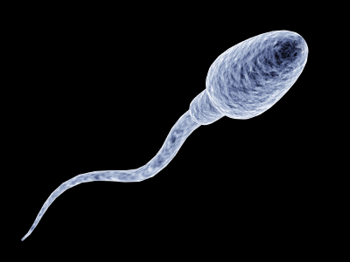
"Male fertility under threat as average sperm counts drop”*
Study of 26,600 men in France found sperm concentration had decreased by 32% since the 1990s.
Numbers steadily dropped by 2% per year from 1989 to 2005.
Proportion of normally formed sperm also declined by about 1/3.
* M. Rolland et al., Hum Reprod. 2013 Feb;28(2):462-70.
Notes:
./falling_sperm_counts.text
Falling_sperm_counts.article.text

Slide 98
This Defect Likely Transfers to Subsequent Generations*
Designer mice (obesity gene) fed a diet mimicking fast food diet
This initiated subfertility in both male and female offspring lasting over two generations
Suggest altering of epigenome of sperm, leading to developmental programming of subfertility outcome
*T. Fullston et al., Human Reproduction 27(5), 1391-1400, 2012.
Notes:
./falling_sperm_counts.text – SECOND HALF!!! (later in document)

Slide 99
Roundup and birth defects: Is the public being kept in the dark?*
“Our examination of the evidence leads us to the conclusion that the current approval of glyphosate and Roundup is deeply flawed and unreliable. …. We show that industry and regulators knew as long ago as the 1980s and 1990s that glyphosate causes malformation – but that this information was not made public.”
*Michael Antoniou et al., Earth Open Source, June, 2011

Slide 100
Glyphosate and Anencephaly*
Yakima, Benton and Franklin counties in Washington State have an unusually high number of pregnancies affected by the birth defect, anencephaly
75 pesticides were analyzed in studying contamination due to surrounding agriculture
47 (63%) of these were detected
Glyphosate was applied in large amounts, but was not studied
5% solution of glyphosate was also used heavily around irrigation ditches to control weeds
Main herbicide recommended due to its “low toxicity”
Glyphosate has been linked to anencephaly due to its effect on retinoic acid
*Barbara H. Peterson. Farm Wars, http://farmwars.info/?p=11137

Slide 101
Glyphosate Upregulates Retinoic Acid*
Small Brain
*A. Carrasco, Teratogenesis by glyphosate based herbicides and other pesticides. Relationship with the retinoic acid pathway. In Breckling, B. & Verhoeven, R. (2013) GM-Crop Cultivation – Ecological Effects on a Landscape Scale. Theorie in der Ökologie 17. Frankfurt, Peter Lang.

Slide 102
Article on GM Soy Imports in China*
“The Zhengzhou Daily News reported on April 2, 2013: The number of children confirmed with autism has increased 100 times during the past 20 years”
Infertility rates: 15.6% 2012; 8% 2002; 3% 1972.
Parkinson's disease in China has increased over 20 fold during the last 20 years
*http://blog.sina.com.cn/s/blog_502041670102em9z.html
former Vice President of the Academy of Military Science of China
Notes:
Csail/2014/project/Chenny/ChineseArticle_on_GMO_soy_Chenny_2014.pdf
http://blog.sina.com.cn/s/blog_502041670102em9z.html

Slide 103
Glyphosate chelates manganese!

Slide 104
“The mechanism by which glyphosate disrupts the EPSPS enzyme in plants and microorganism is by chelating the manganese metal co-factor of this enzyme. In other words it steals the ‘ignition key’ of the enzyme.”
Dr. Arden Andersen, D.O.,
Food Plague Primer: Glyphosate and Genetically Engineered Crops
Notes:
attached/Huber2/FoodPlaguePrimer.pdf

Slide 105
“Fundamentally the herbicidal effect of glyphosate is ultimately due to soil pathogens gaining access to the “weed” thanks to glyphosate’s weakening of the plant and killing of beneficial microbes by the chelation of manganese and other trace elements.”
Dr. Arden Andersen, D.O.,
Food Plague Primer: Glyphosate and Genetically Engineered Crops
Notes:
attached/Huber2/FoodPlaguePrimer.pdf

Slide 106
“Fundamentally the herbicidal effect of glyphosate is ultimately due to soil pathogens gaining access to the “weed” thanks to glyphosate’s weakening of the plant and killing of beneficial microbes by the chelation of manganese and other trace elements.”
Dr. Arden Andersen, D.O.,
Food Plague Primer: Glyphosate and Genetically Engineered Crops
This is analogous to glyphosate’s effect on gut bacteria: killing the beneficial bacteria and allowing the pathogens to overgrow
Notes:
attached/Huber2/FoodPlaguePrimer.pdf

Slide 107
Glyphosate Depletes Iron, Manganese and Zinc in Plants*
Manganese uptake is already drastically reduced in the root
*D Huber, What About Glyphosate-Induced Manganese Deficiency?
Fluid Journal, 20-22.
Notes:
Glyphosate/glyphosate_induced_manganese_deficiency_plants_Huber.pdf

Slide 108
Severe Deficiency in Serum Manganese and Cobalt in Cows Fed GMO Roundup-Ready Corn and Soy*
Cobalt
Manganese
Eight different farms: all cows tested had glyphosate in the urine
*M. Krüger et al., J Environ Anal Toxicol 2013, 3:5
Notes:
glyphosate//cows_cobalt_deficiency_glyphosate.pdf

Slide 109
Severe Deficiency in Serum Manganese and Cobalt in Cows Fed GMO Roundup-Ready Corn and Soy*
Cobalt
Cobalamin Deficiency
Manganese
???
Eight different farms: all cows tested had glyphosate in the urine
*M. Krüger et al., J Environ Anal Toxicol 2013, 3:5
Notes:
glyphosate//cows_cobalt_deficiency_glyphosate.pdf

Slide 110
Manganese Deficiency:
Lactobacillus and Anxiety

Slide 111
Glyphosate Kills Beneficial Bacteria*
Examined effect of glyphosate and Roundup on three food microorganisms widely used as starters in dairy technologies
Two are species of Lactobacillus
Roundup is always more potent than glyphosate, and in all cases, toxic from levels 10–100 times below the lowest agricultural uses (10,000 ppm).
Unpredictable consequences of Roundup on soil microorganisms have to be considered
*E Clair et al. Curr Microbiol (2012) 64:486–491
Notes:
Glyphosate/Clair_glyphosate_toxic_to_lactobacillus_2012.pdf

Slide 112
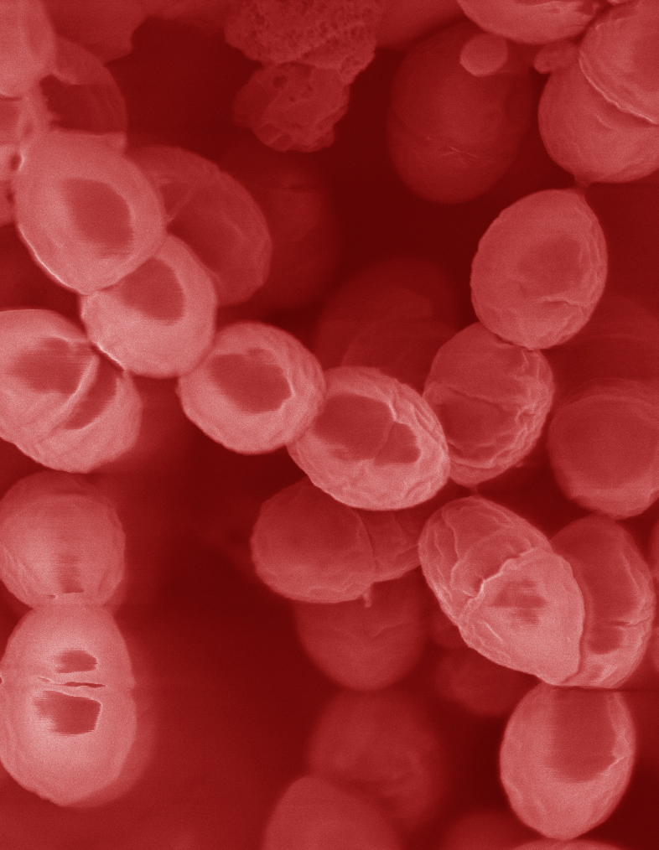
Lactobacillus Depends on Manganese!*
Many lactic acid bacteria contain very high intracellular manganese levels
Scavenges toxic oxygen species, particularly superoxide
Manganese deprivation suppresses growth
* FS Archibald and M-N Duong. Journal of Bacteriology Apr 1084, 1-8.
Notes:
Glyphosate/manganese/manganese_acquisition_by_lactobacillus.pdf

Slide 113
Lactobacillus Depends on Manganese!*
Many lactic acid bacteria contain very high intracellular manganese levels
Scavenges toxic oxygen species, particularly superoxide
Manganese deprivation suppresses growth
Lactobacillus levels are low in the gut in association with autism
* FS Archibald and M-N Duong. Journal of Bacteriology Apr 1084, 1-8.
Notes:
Glyphosate/manganese/manganese_acquisition_by_lactobacillus.pdf

Slide 114
Lactobacillus Alleviate Anxiety*
Patients suffered from chronic fatigue syndrome and associated anxiety
Patients were treated with probiotic strain of Lactobacillus (control group got a placebo)
Significant rise in both Latobacillus and Bifidobacteria in gut
Significant decrease in anxiety symptoms (p = 0.01)
Supports concept of gut-brain axis (communicate with brain via vagal nerve)
*R Av et al. Gut Pathog. 2009 Mar 19;1(1):6. doi: 10.1186/1757-4749-1-6.
Notes:
Glyphosate/manganese/manganese_alleviates_anxiety.text

Slide 115
Lactobacillus Alleviate Anxiety*
Patients suffered from chronic fatigue syndrome and associated anxiety
Patients were treated with probiotic strain of Lactobacillus (control group got a placebo)
Significant rise in both Latobacillus and Bifidobacteria in gut
Significant decrease in anxiety symptoms (p = 0.01)
Supports concept of gut-brain axis (communicate with brain via vagal nerve)
Increased anxiety is a comorbidity of autism
*R Av et al. Gut Pathog. 2009 Mar 19;1(1):6. doi: 10.1186/1757-4749-1-6.
Notes:
Glyphosate/manganese/manganese_alleviates_anxiety.text

Slide 116
Anxiety and Autism*
Children with autism suffer from many forms of anxiety disorder in higher numbers than the general population
Specific Phobia | 30%
Obsessive-Compulsive Disorder | 17%
Social Anxiety Disorder/Agoraphobia | 17%
Generalized Anxiety Disorder | 15%
Separation Anxiety Disorder | 9%
Panic Disorder | 2%
*Van Steensel, F.J.A., Bogels, S.M., & Perrin, S. (2011). Anxiety disorders in children and adolescents with autistic spectrum disorders: A meta-analysis. Clinical Child and Family Psychology Review, 14, 302-317.
Notes:
http://www.iidc.indiana.edu/?pageId=3616

Slide 117
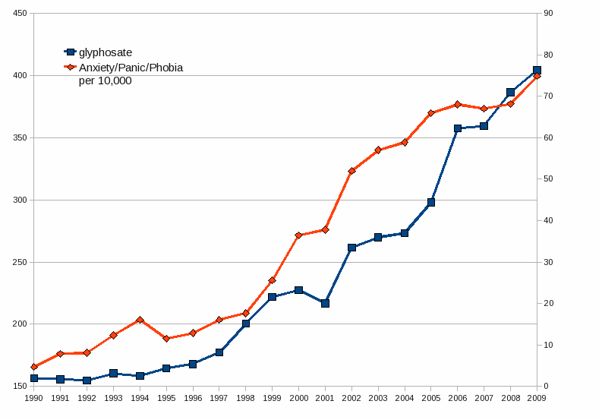
Glyphosate Application on Corn and Soy Plotted against Anxiety, Panic Disorder and Phobias*
*Plots provided by Dr. Nancy Swanson
Notes:
2014/AutismOne/images/anxiety.gif

Slide 118
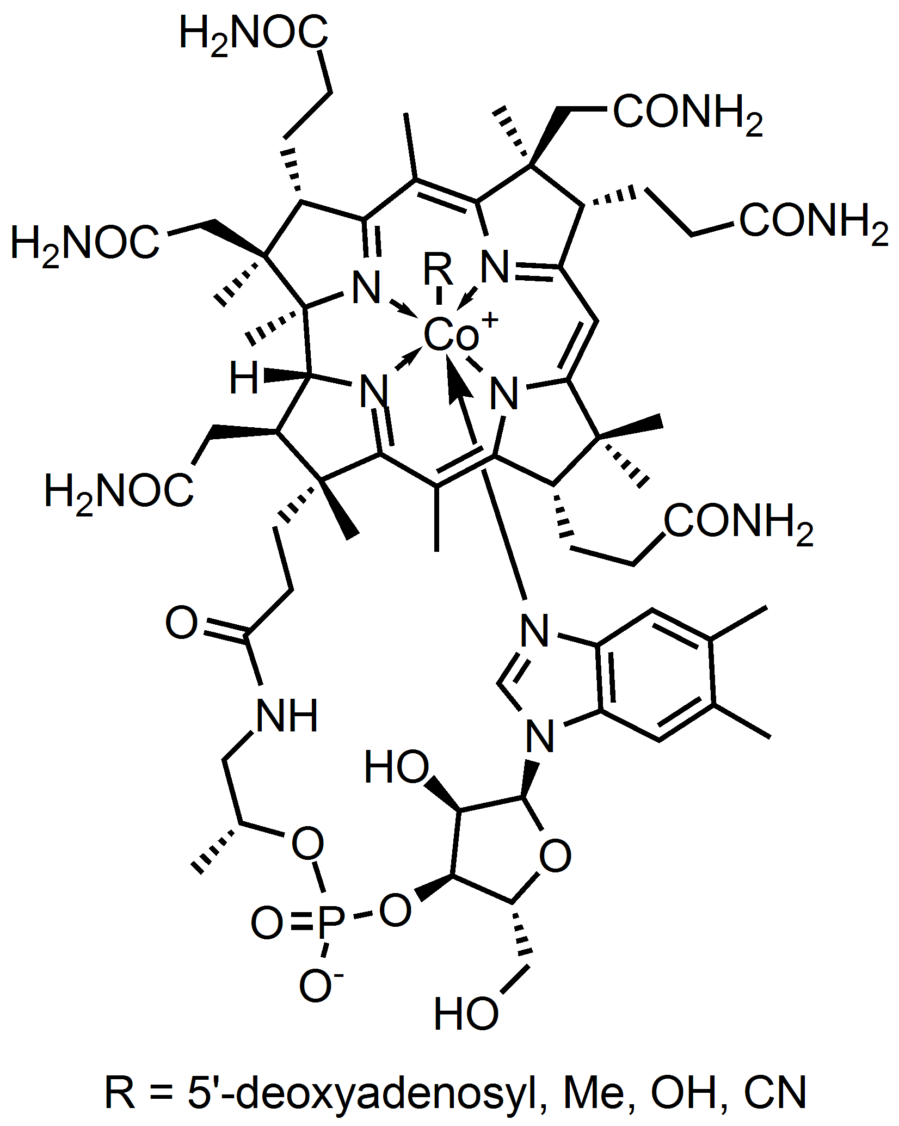
Bacteria Incorporate Cobalt and Iron into Cobalamin and Heme
Heme Iron
Cobalamin

Slide 119
Bacteria Incorporate Cobalt and Iron into Cobalamin and Heme
Glyphosate chelates cobalt and iron and prevents bacteria from producing these important molecules
Heme Iron
Cobalamin

Slide 120
Manganese Deficiency:
Glutamate and Ammonia

Slide 121
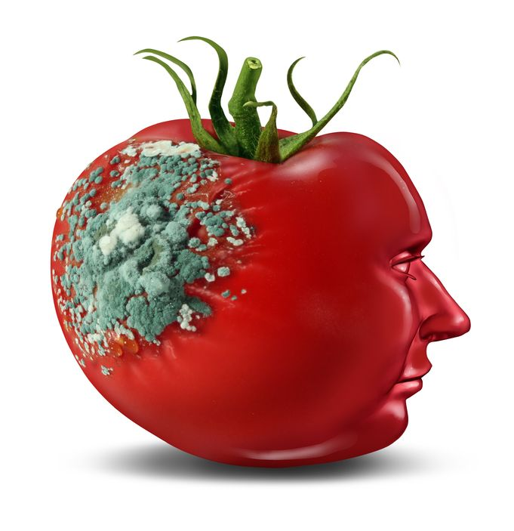
Glyphosate and Glutamate*
Acute exposure activates NMDA receptors and voltage-dependent calcium channels
Oxidative stress and neural cell death
Increased glutamate released into the synaptic cleft → excessive extracellular glutamate levels
Decreased glutathione content
Increased peroxidation of lipids (fats)
Chronic exposure:
Decreased glutamate uptake and metabolism
Induced calcium uptake
Induced oxidative stress
*http://www.greenmedinfo.com/blog/roundup-weedkiller-brain-damaging-neurotoxin
Notes:
http://www.greenmedinfo.com/blog/roundup-weedkiller-brain-damaging-neurotoxin
acute exposure (30 minutes) and chronic (pregnancy and lactation) exposure.
Why was this referenced??
T. Bohn et al. Food Chemistry 153, 15 June 2014, 207-215.

Slide 122
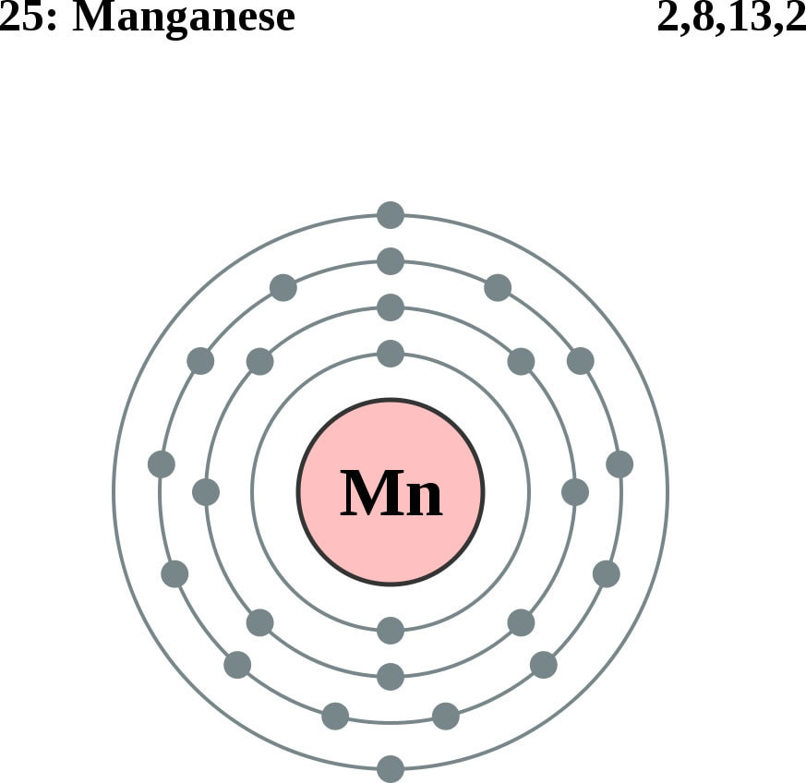
Glutamine Synthesis Depends on Manganese!
Glutamine synthetase
glutamate
glutamine
water
ammonium
Ammonium and glutamate toxicity in the brain
can arise because of insufficient manganese

Slide 123
“Alteration of Plasma Glutamate and Glutamine Levels in Children with High-Functioning Autism”*
P-value
*C. Shimmura et al. PLoSone October 2011 6(1):e25340
Notes:
Table 1. Plasma Levels of Amino Acids and related compounds in Control Subjects and Individuals with HFA.
Glyphosate/glutamate_glutamine_autism_2011.pdf

Slide 124
“Alteration of Plasma Glutamate and Glutamine Levels in Children with High-Functioning Autism”*
Of all the proteins measured, only glutamate and glutamine were abnormal
P-value
*C. Shimmura et al. PLoSone October 2011 6(1):e25340
Notes:
Table 1. Plasma Levels of Amino Acids and related compounds in Control Subjects and Individuals with HFA.
Glyphosate/glutamate_glutamine_autism_2011.pdf

Slide 125
Journal of Personal Science: One Child’s Autism Eliminated by Removal of Glutamate From Her Diet* By Katherine Reid
First Round:
Kale, cucumber, cilantro, nuts, seeds, fruits
Magnesium B-complex, vitamin D3, omega 3 fats (EPA, DHA)
Probiotics
Gluten free and casein free (no wheat, no milk)
Child improved significantly but still had autistic behaviors
Second Round:
ADD: ELIMINATE FREE GLUTAMATE
Child lost the "autism" label!
*blog.sethroberts.net/2013/05/17/journal-of-personal-science-
one-childs-autism-eliminated-by-removal-of-glutamate-from-her-diet
Notes:
./glutamate_autism_personal_story.pdf

Slide 126
Manganese Deficiency:
Mitochondrial Disorder

Slide 127
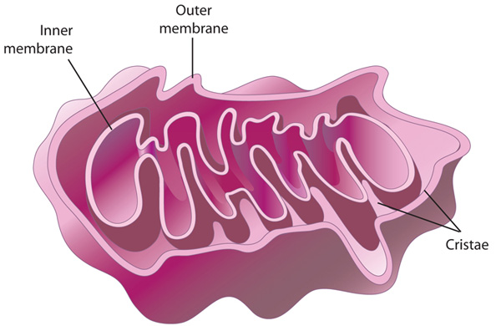
Autism and Mitochondrial Disorder*
“Five of 11 patients studied were classified with definite mitochondrial respiratory chain disorder, suggesting that this might be one of the most common disorders associated with autism”
Manganese superoxide dismutase plays a critical role in protecting mitochondria from oxidative damage
*G Oliveira et al. Developmental Medicine & Child Neurology 47(3), 185-189, 2005.
Notes:
http://onlinelibrary.wiley.com/doi/10.1111/j.1469-8749.2005.tb01113.x/full
69 kids total, they picked the 11 based on them being most likely to have it?
7.2% of 69 is still very high.

Slide 128
Detoxification of Superoxide (O₂⁻)
GLUTATHIONE
SELENIUM
MANGANESE
Glyphosate disrupts all of these!
IRON

Slide 129
Citric Acid Cycle in Mitochondria
Aconitase
*PR Gardner. Methods in Enzymology 349:9–23.
Notes:
WIKI on aconitase – in definitions (notes)

Slide 130
Citric Acid Cycle in Mitochondria
Aconitase
The iron sulfur cluster in aconitase is highly sensitive to oxidation by superoxide*
*PR Gardner. Methods in Enzymology 349:9–23.
Notes:
WIKI on aconitase – in definitions (notes)

Slide 131
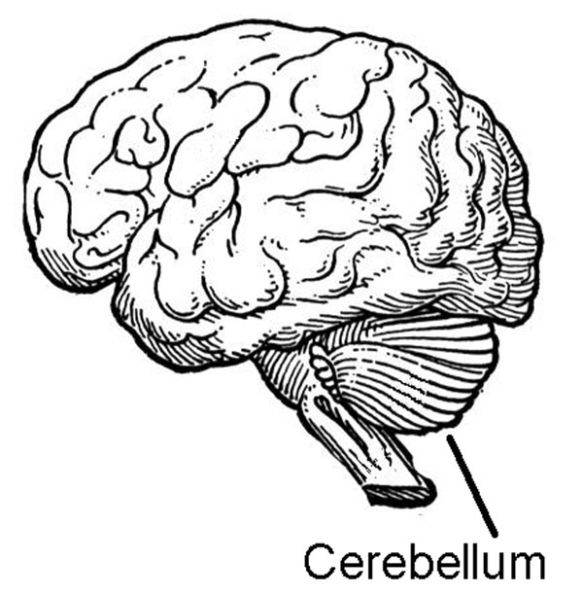
Aconitase Dysfunction and Brain Inflammation in Autism*
Frozen samples of post-mortem tissues from cerebellum and temporal cortex of autism patients compared with controls.
Compared to controls:
Aconitase activity was significantly reduced in the cerebellum and correlated with low glutathione levels
Biomorkers of inflammation were increased
*S. Rose et al. Transl Psychiatry (2012) 2:e134.
Notes:
Glyphosate/aconitase_autism.text

Slide 132
Aconitase & Glutathione in Cerebellum in Autism*
* S Rose et al. Transl Psychiatry (2012) 2:e134.
Notes:
Samantha/Evidence_of_oxidative_damage_and_inflammation_associated_with_lowglutathione_redox_status_in_the_Autism_Brain.pdf
From Gerry Koenig!!

Slide 133
Manganese Deficiency:
Impaired Bone development

Slide 134
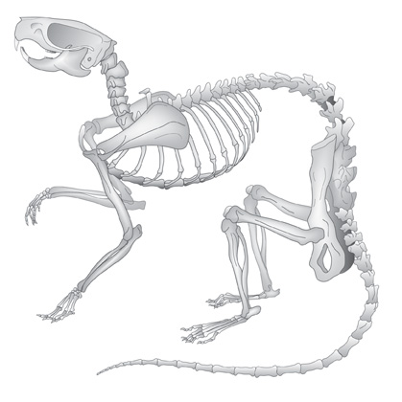
Glyphosate and Bone Development*
Dams treated with glyphosate in water from days 6 to 15 of their pregnancy
Effects on pups:
Lack of development of the ossification centers of the terminal phalanges (bones in fingers and toes)
Larger fontanelles ("soft spot") and incomplete development of skull bones
Absence of important bones or parts of bones, shortenings, bendings, asymmetry, fusions or clefts.
Surfactant polyoxyethyleneamine increased glyphosate's toxicity
*E. Dallegrave et al. Toxicology Letters 142 (2003) 45-52.
Notes:
Glyphosate/./abnormal_ossification_skeleton_glyphosate_rats_2003.pdf

Slide 135
Manganese and Bones*
“The multiple cellular effects of Mn deficiency include: decreased bone resorption, production of labile bone, and decreased synthesis of organic matrix. The serum level of Mn in a group of osteoporotic postmenopausal women was significantly lower than age-matched controls.”
*L. Strause and P. Saltman. Role of Manganese in Bone Metabolism.
Chapter 5, pp 46–55 in Nutritional Bioavailability of Manganese.
Notes:
http://pubs.acs.org/doi/abs/10.1021/bk-1987-0354.ch005
Glyphosate/manganese_and_bones.text

Slide 136
Osteoblasts build “Ground Substance”
Ground substance is made of chondroitin sulfate and osteocalcin – collagen is layered over this
Poor mineralization results from impaired chondroitin sulfate synthesis
Osteoblasts in bone
Childhood osteoarthritis and osteomalacia are an epidemic in the US today

Slide 137
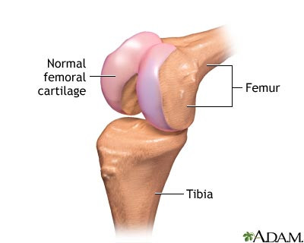
Chondroitin Sulfate Synthesis in Cartilage depends on Manganese*
Two critical enzymes are manganese dependent:
One forms the sugar chain and the other one links the sugar chain to the protein associated with it
*RM Leach et al. Archives of Biochemistry and Biophysics 133(1), 1969, 22-28.
Notes:
glyphosate/chondroitin_sulfate_manganese_cartilege.text
Polymerase enzyme forms the polysaccharide
Galactotransferase incorporates galactose that links the polysaccharide to the protein associated with it.

Slide 138
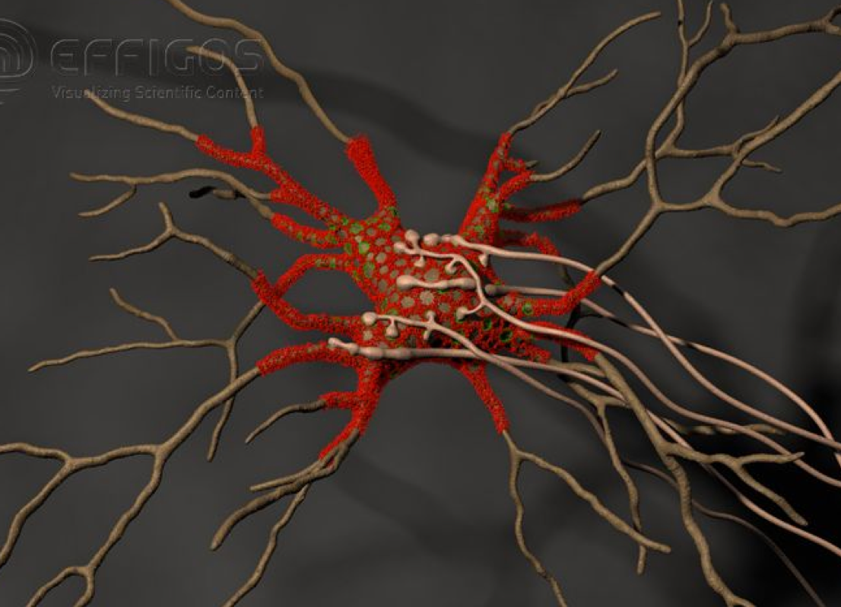
Perineuronal Nets*
Perineuronal nets (PNs) formed from chondroitin sulfate attached to hyaluronan, modulate GABAergic inhibitory signaling
Removal of PNs increased the excitability of interneurons in cultures
They provide an environment rich in anions (negative charge)
*G. Bruckner et al. Glia 8(3), 183-200, 1993.
Notes:
http://onlinelibrary.wiley.com/doi/10.1002/dneu.20361/full

Slide 139
Perineuronal Nets*
Perineuronal nets (PNs) formed from chondroitin sulfate attached to hyaluronan, modulate GABAergic inhibitory signaling
Removal of PNs increased the excitability of interneurons in cultures
They provide an environment rich in anions (negative charge)
Might manganese deficiency lead to impaired synthesis of perineuronal nets and increased neuronal excitability leading to cell death??
*G. Bruckner et al. Glia 8(3), 183-200, 1993.
Notes:
http://onlinelibrary.wiley.com/doi/10.1002/dneu.20361/full

Slide 140
Coral Die-Off & Chondroitin Sulfate*
Large amounts of chondroitin sulfate are adsorbed onto coral
Sulfate groups are of paramount importance to the adsorption process
Adsorption rate is a direct function of the amount of negative charge
*N. Volpi. Biomaterials 2002 Jul;23(14):3015-22.
Notes:
Project/glyphsate/chondroitin_sulfate_coral.text

Slide 141
“Disease Causes Starfish to Lose Arms, Dissolve into White Blobs of Goo” *
Glyphosate is used to kill seagrass in oyster beds
"Glyphosate and diuron are among the most frequently detected herbicides in oyster production areas"**
Starfish eat oysters
*http://natureworldnews.com/articles/4749/20131104/
disease-causes-starfish-lose-arms-dissolve-white-blobs-goo-video.htm
**F. Akcha et al. Aquatic Toxicology. 106-107 (pp 104-113), 2012
Notes:
Glyphosate/glyphosate_oyster_toxicity.text

Slide 142
Recapitulation
Glyphosate chelates manganese
Manganese deficiency leads to:
Disrupted gut bacteria → anxiety
Glutamate and ammonium toxicity in the brain as well as glutamine deficiency
Mitochondrial damage
Impaired bone development and osteoporosis
Impaired development of perineuronal nets
Many of these are associated with autism
Effects on coral and starfish are related

Slide 143
How You can Protect Yourself and Your Family

Slide 144
Go Organic!

Slide 145
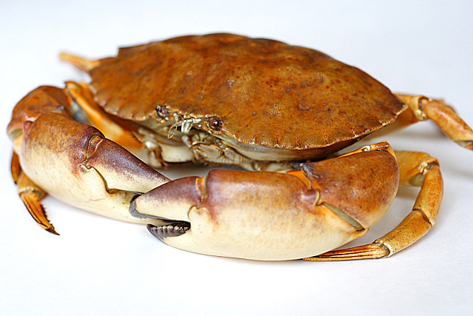
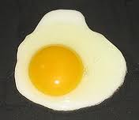
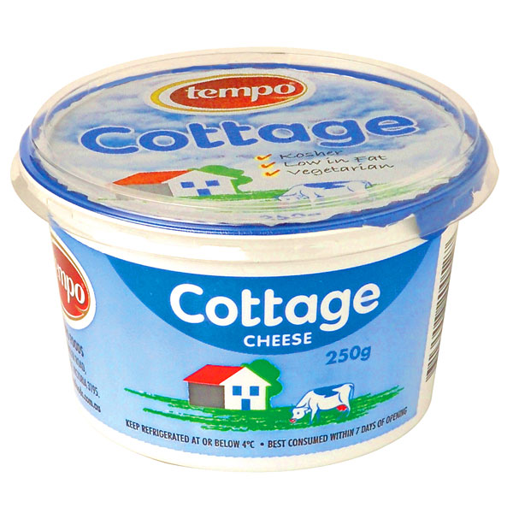
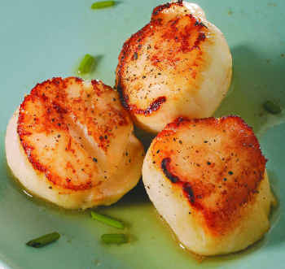
Eat Foods High in Sulfur
Notes:
http://healthyeatingclub.com/info/books-phds/books/foodfacts/html/data/data5g.html

Slide 146
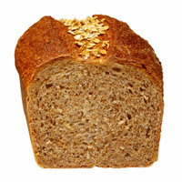
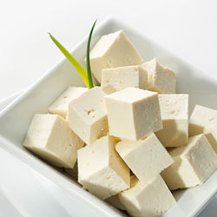
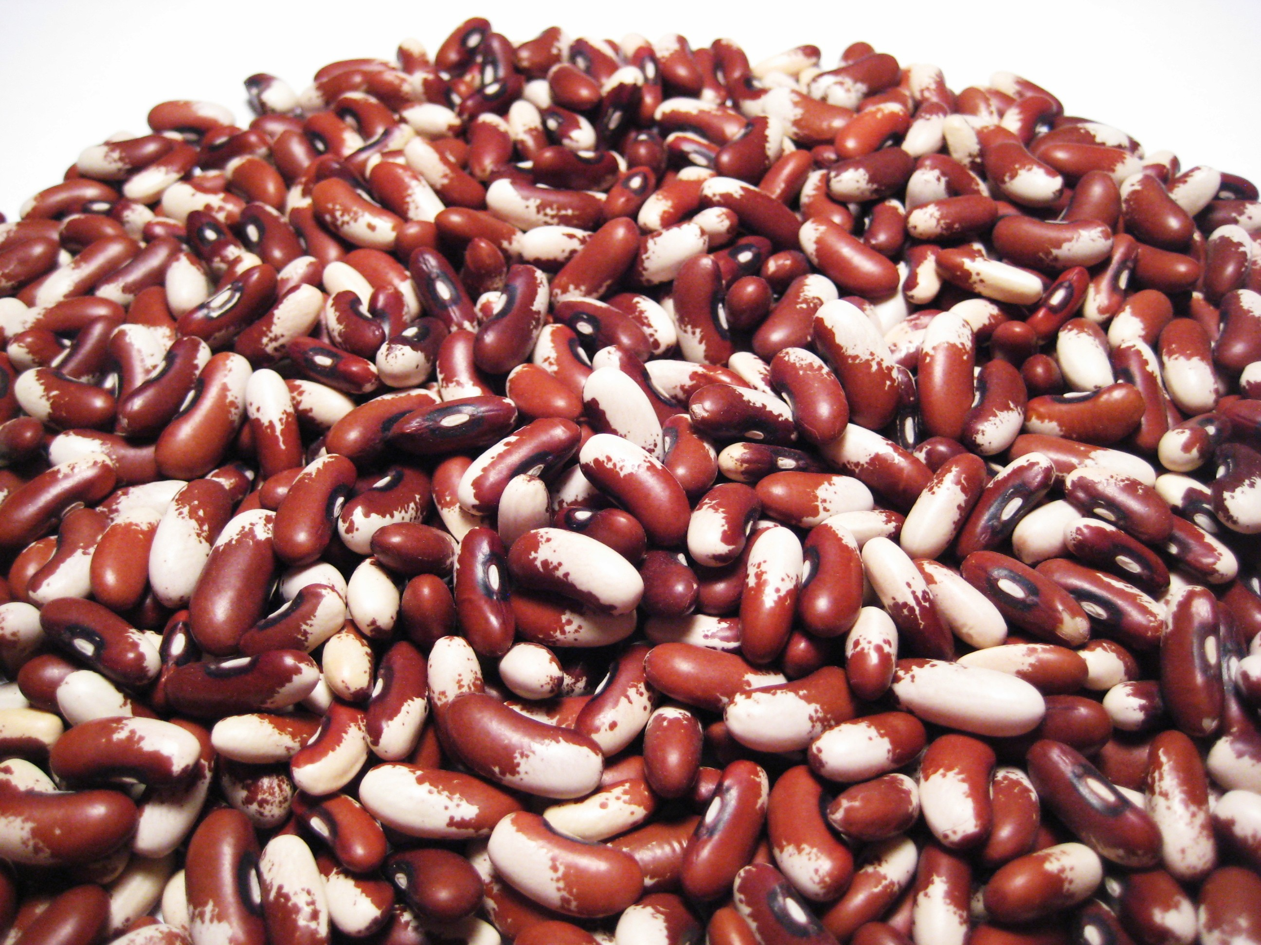
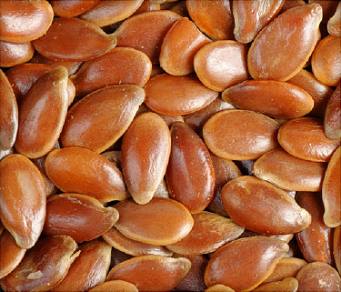
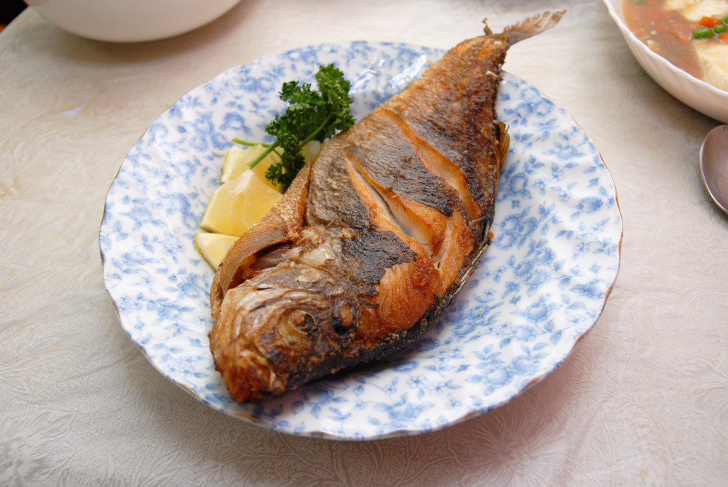
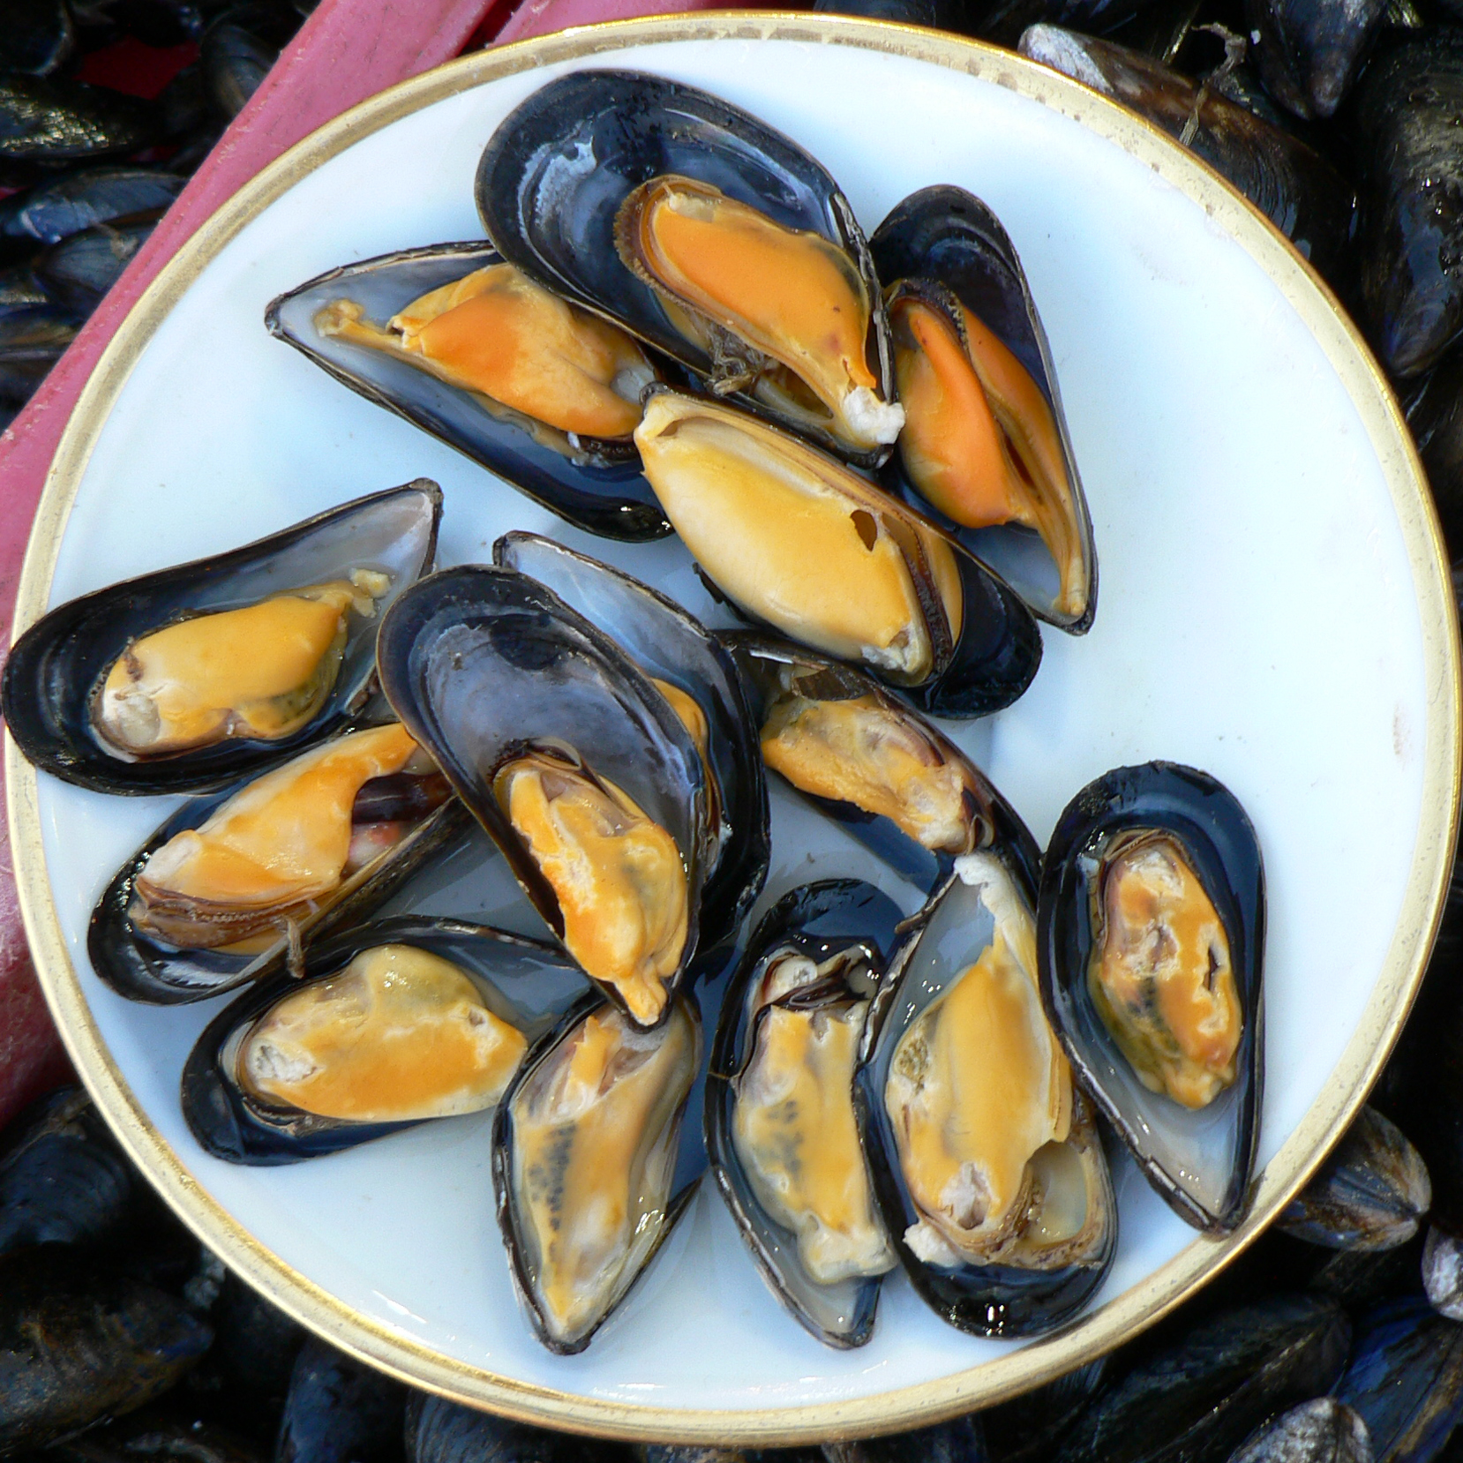
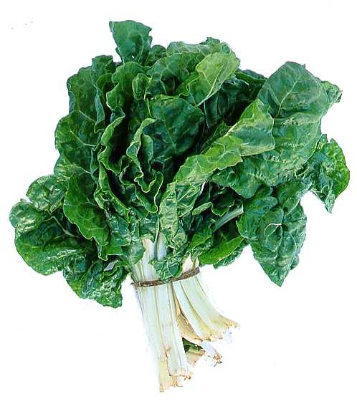
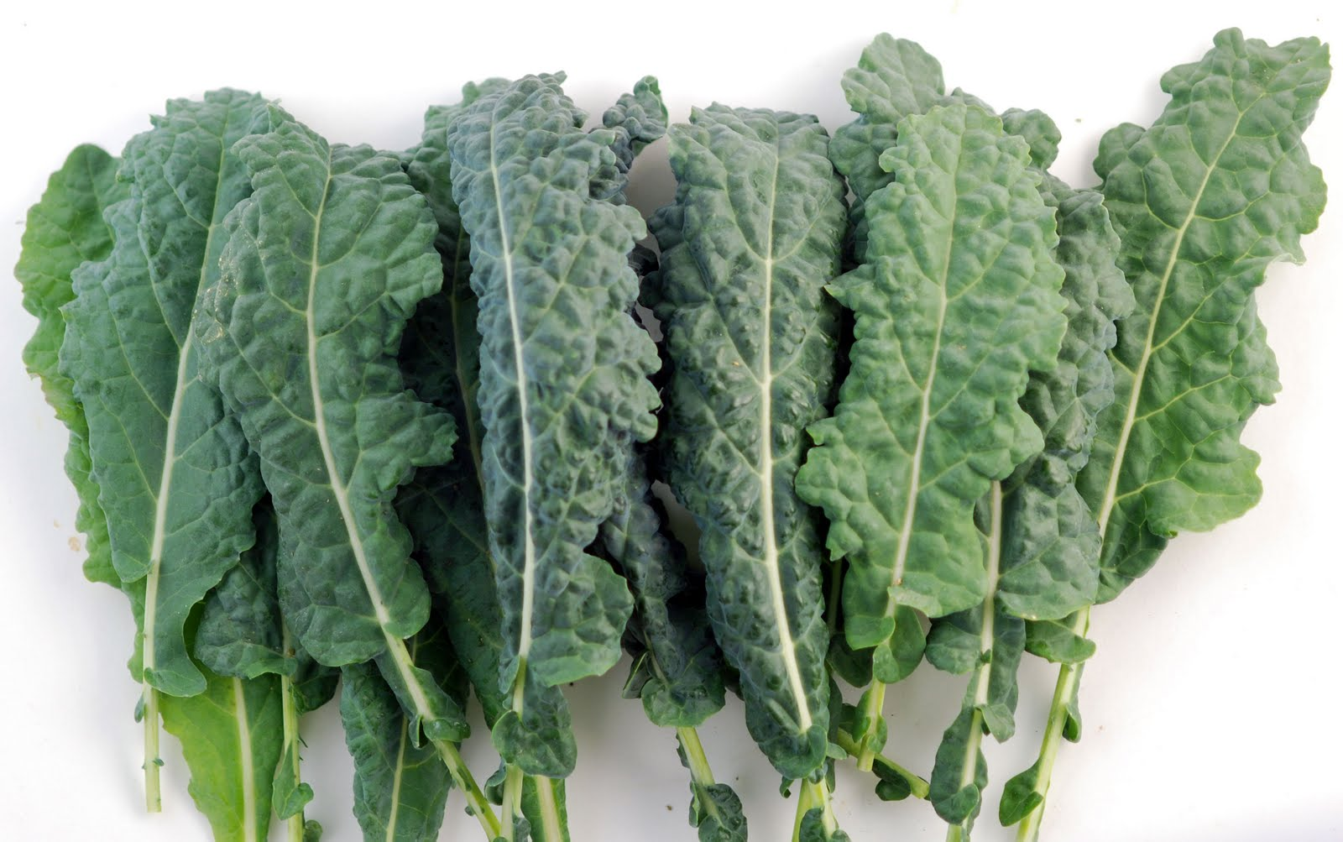
Eat Foods Containing Manganese

Slide 147
Hang Out in the Water at the Seashore

Slide 148
Escape to a sunny place in winter!
Notes:
Summer vacation on Mediterranean Sea resort, Antalya, Turkey

Slide 149
Epsom Salts!
Magnesium Sulfate in hot bath water is a cheap and easy way to get sulfate supply to the skin
Infrared heat also beneficial!

Slide 150
Take Off the Sunglasses and Look at the Blue Sky!

Slide 151
Don’ts!

Slide 152
Summary
The autism epidemic is caused by:
Glyphosate working synergistically with aluminum and mercury and insufficient sun exposure to the skin and eyes
Diet depleted in micronutrients: vitamins and minerals
Glyphosate’s chelation of metals is a core component of its toxicity
Disrupted gut bacteria leads to brain pathology
Aluminum, mercury and manganese can account for many aspects of autism
Pineal gland plays an important role in brain dysfunction
Autism may be treatable through organic diet enriched in sulfur and manganese, along with abundant sun exposure

