Slide 1
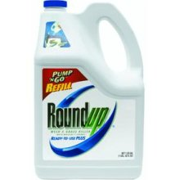
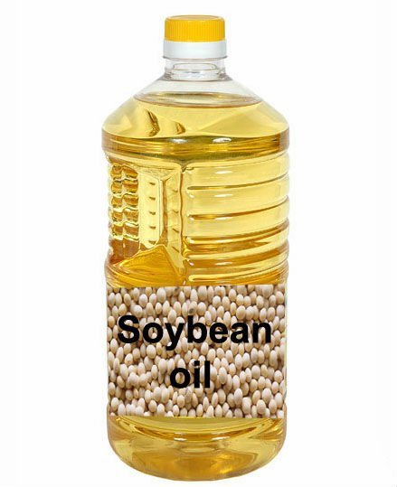
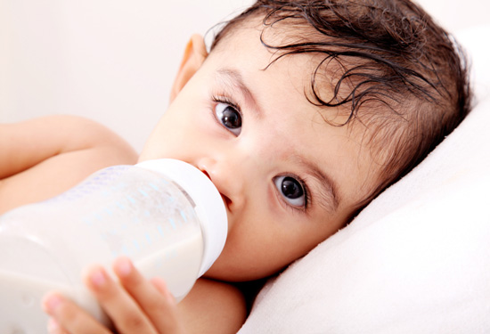
Roundup and GMOs: Are we gambling with the future of food?
Stephanie Seneff
MIT CSAIL
July 29, 2014

Slide 2
“There are three things that can’t be long hidden: the sun, the moon and the truth”
--Buddha

Slide 3
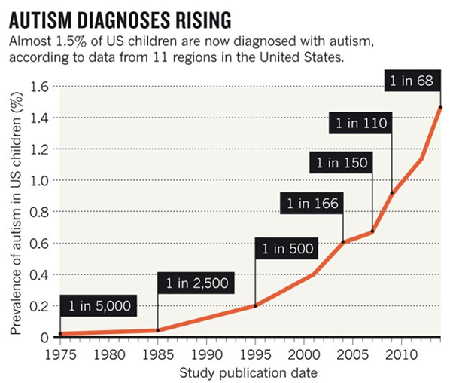
A Frightening Trend*
?
?
*K. Weintraub, Nature 479, Nov. 3 2011, 22-24.
Notes:
./NatureAutismRising.pdf

Slide 4
“If it is an environmental cause contributing to an increase, we certainly want to find it.”*
*K. Weintraub, Nature 479, Nov. 3 2011, 22-24.

Slide 5
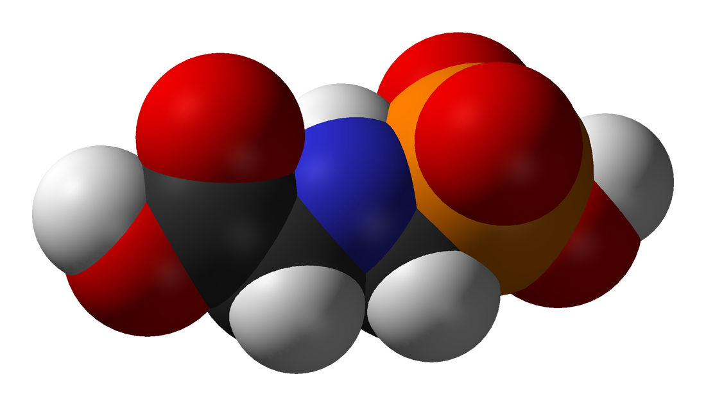
GLYPHOSATE

Slide 6
Glyphosate and Autism
草甘膦和自閉症

Slide 7
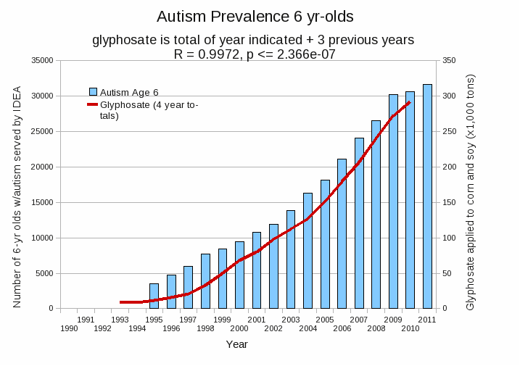
Autism Prevalence: 6 year olds
R = 0.9972
*Plot provided by Nancy Swanson, with permission
Data sources: autism: US Department of Education; Glyphosate: US Department of Agriculture
Notes:
Nancy/latest_plots/6-yr-old autism.gif
autism: USDE
oil consumption: USDA
glyphosate: USDA
GE crops: USDA
Mortality data: CDC

Slide 8
Autism Prevalence: 6 year olds
U.S. Market is 25% of World Market of Roundup
R = 0.9972
*Plot provided by Nancy Swanson, with permission
Data sources: autism: US Department of Education; Glyphosate: US Department of Agriculture
Notes:
Nancy/latest_plots/6-yr-old autism.gif
autism: USDE
oil consumption: USDA
glyphosate: USDA
GE crops: USDA
Mortality data: CDC

Slide 9
Glyphosate vs. Other Pesticides*
Glyphosate
*http://sustainablepulse.com/wp-content/uploads/GMO-health.pdf

Slide 10
A Brief History of Glyphosate
Glyphosate is the active ingredient in the pervasive herbicide, Roundup®
GMO “Roundup Ready” soy, corn, canola, sugar beets, cotton, tobacco and alfalfa
Plants soak up the glyphosate and don’t die
Roundup-Ready crops → Roundup-Ready weeds
Monsanto assures regulatory bodies that glyphosate is practically nontoxic to humans
Disrupts shikimate pathway which our cells don’t have
Very little monitoring of glyphosate levels in food

Slide 11
Is Glyphosate Toxic?
Monsanto has argued that glyphosate is harmless to humans because our cells don’t have the shikimate pathway, which it inhibits
However, our gut bacteria DO have this pathway
We depend upon them to supply us with essential amino acids (among many other things)
Other ingredients in Roundup greatly increase glyphosate’s toxic effects
Insidious effects of glyphosate accumulate over time
Most studies are too short to detect damage

Slide 12
Main Toxic Effects of Glyphosate*
Kills beneficial gut bacteria and allows pathogens to overgrow
Interferes with function of cytochrome P450 (CYP) enzymes
Chelates important minerals (iron, cobalt, manganese, etc.)
Interferes with synthesis of aromatic amino acids and methionine
Leads to shortages in critical neurotransmitters and folate
Disrupts sulfate synthesis and sulfate transport
*Samsel and Seneff, Entropy 2013, 15, 1416-1463

Slide 13
The Enhancing Effect of Adjuvants*
“Adjuvants in pesticides are generally declared as inerts, and for this reason they are not tested in long-term regulatory experiments. It is thus very surprising that they amplify up to 1000 times the toxicity of their APs [Active Principles] in 100% of the cases where they are indicated to be present by the manufacturer.”
*R. Mesnage et al.BioMed Research International 2014; Article ID:179691.
Notes:
Glypohsate/seralini_2014_pesticide_toxicity_adjuvants.pdf

Slide 14
Roundup Safety Claims Disputed*
“It is commonly believed that Roundup is among the safest pesticides. … Despite its reputation, Roundup was by far the most toxic among the herbicides and insecticides tested. This inconsistency between scientific fact and industrial claim may be attributed to huge economic interests, which have been found to falsify health risk assessments and delay health policy decisions.”
*R. Mesnage et al., Biomed Research International, Volume 2014 (2014),
Article ID 179691
Notes:
Glyphosate/ Mesnage_Seralini_2014_glyphosate_toxicity_proven.pdf
This is the first time that all these formulated pesticides have been tested on human cells well below agricultural dilutions.
adjuvants were also more cytotoxic through the disruption of membrane and mitochondrial respiration,
1000-fold enhancement w/ adjuvants

Slide 15
Okay, It’s toxic!
But are we exposed?
Very little data!

Slide 16
Autism and Pesticide Exposure during Pregnancy*
“In general, exposure during the third trimester appeared to be riskiest, and odds of having a child with autism went up the closer the family had been living to the pesticide application, suggesting that doses got higher the nearer women were to the chemicals.”
*cbsnews.com/news/pesticide-exposure-in-pregnancy-linked-to-autism-risk-in-kids
Notes:
http://www.cbsnews.com/news/pesticide-exposure-in-pregnancy-linked-to-autism-risk-in-kids/
. /PesticidesPregnancyAutism.pdf
Close proximity to pesticide sites during pregnancy 'increased autism risk by two thirds'

Slide 17
Glyphosate in Air and Rain*
Study conducted by the US Geological Survey in Mississippi
18-fold increase in glyphosate application since 1995
Glyphosate was the predominant new herbicide detected in both air (86%) and rain (77%) in 2007 (not measured in 1995)
*M.S Majewski et al., Environ Toxicol Chem. 2014 Feb 19. Epub ahead of print.
Notes:
Glyphosate/glyphosate_and_other_pesticides_residues_rain_air_US_South.pdf

Slide 18
Glyphosate Test Report: Findings in American Mother's Breast milk, urine and water*
Moms Across America initiative!
Breast milk levels ranging from 76 ug/l to 166 ug/l are 760 to 1600 times higher than the European Drinking Water Directive allows
Urine testing shows glyphosate levels over 10 times higher than in Europe
Monsanto is wrong regarding bioaccumulation
*Posted on Apr 6 2014 - 4:19am by Sustainable Pulse

Slide 19
“Another claim of Monsanto's has been that residue levels of up to 5.6 mg/kg in GM-soy represent "...extreme levels, and far higher than those typically found" (Monsanto 1999).
Study of glyphosate and AMPA (breakdown product) residues in soy crops*
5.6
*Figure 1, T. Bohn et al. Food Chemistry 153, 15 June 2014, 207-215.
www.greenmedinfo.com/blog/how-extreme-levels-roundup-food-became-industry-normal
Notes:
http://www.greenmedinfo.com/blog/how-extreme-levels-roundup-food-became-industry-normal

Slide 20
Soy Formula Linked to Seizures in Autism*
"There was a 2.6-fold higher rate of febrile seizures, a 2.1-fold higher rate of epilepsy comorbidity and a 4-fold higher rate of simple partial seizures in the autistic children fed soy-based formula"
*CJ Westmark, PLOSOne March 12, 2014, DOI: 10.1371/journal.pone.0080488.
Notes:
./SoyFormulaSeizuresAutism.pdf

Slide 21
Some Biomarkers for Autism
Disrupted gut bacteria; inflammatory bowel
Low serum sulfate
Methionine deficiency
Serotonin and melatonin deficiency
Defective aromatase
Zinc and iron deficiency
Urinary p-cresol
Mitochondrial disorder
Seizures; Glutamate toxicity in the brain
Notes:
Samantha/zinc_deficiency_autism.text

Slide 22
Some Biomarkers for Autism
Disrupted gut bacteria; inflammatory bowel
Low serum sulfate
Methionine deficiency
Serotonin and melatonin deficiency
Defective aromatase
Zinc and iron deficiency
Urinary p-cresol
Mitochondrial disorder
Seizures; Glutamate toxicity in the brain
These can all be explained as potential effects of glyphosate on biological systems*
*A Samsel and S Seneff, Entropy 2013, 15, 1416-1463
Notes:
Samantha/zinc_deficiency_autism.text

Slide 23
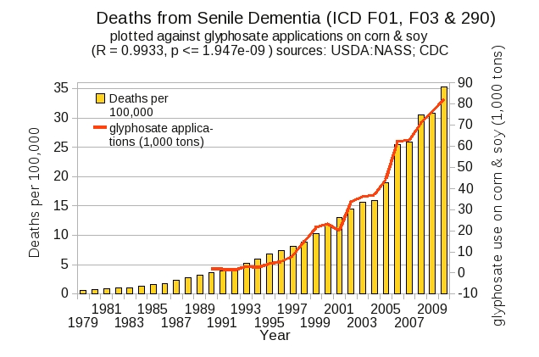
Dementia (癡呆症) and Autism Have Much in Common
Plot kindly provided by Nancy Swanson

Slide 24
Digestive System Disorders

Slide 25
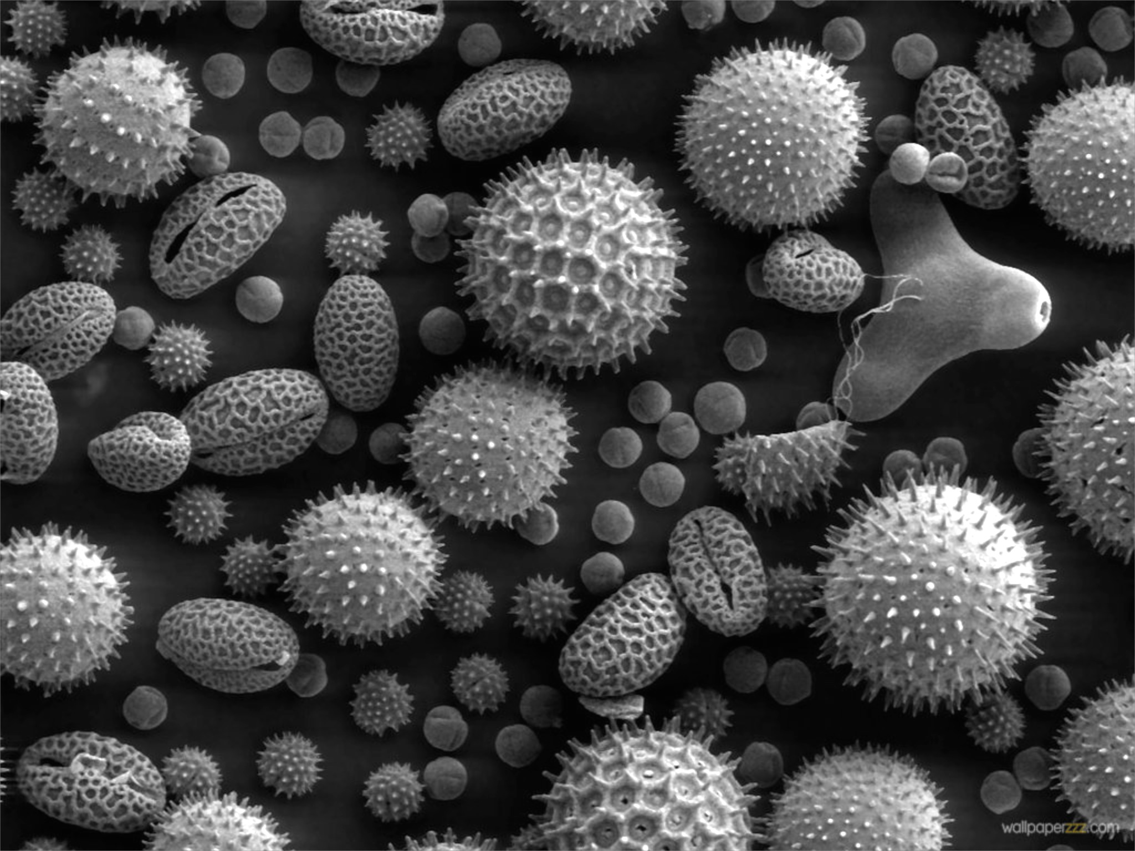
Gut Microbes and Obesity
Our microbes outnumber our own cells 10 to 1
There are between 200 and 300 different species in a typical person.
Glyphosate causes a loss of beneficial bacteria and an overgrowth of pathogens in the gut
Pathogens release toxic phenols (e.g., p-cresol)
This can lead to inflammatory bowel disease
And a direct path to obesity!
Gut microbes from an obese person induced obesity in mice*
*N. Fei and L. Zhao, The ISME Journal, Online Publication Dec. 2012
Notes:
*See: http://www.usaprepares.com/health/scientists-link-obesity-to-gut-bacteria

Slide 26
Obesity in US over Time*
Glyphosate was introduced into the food chain in 1975
*Figure 1 in R.J. Johnson et al., Am J Clin Nutr 2007;86:899–906.
Notes:
Sugar intake per capita in the United Kingdom from 1700 to 1978 (30, 31; E) and in the United States from 1975 to 2000 (32; 􏰏) is compared with obesity rates in the United States in non-Hispanic white men aged60–69y(17;F).Valuesfor1880-1910arebasedonstudiesconducted in male Civil War veterans aged 50–59 y (18).

Slide 27
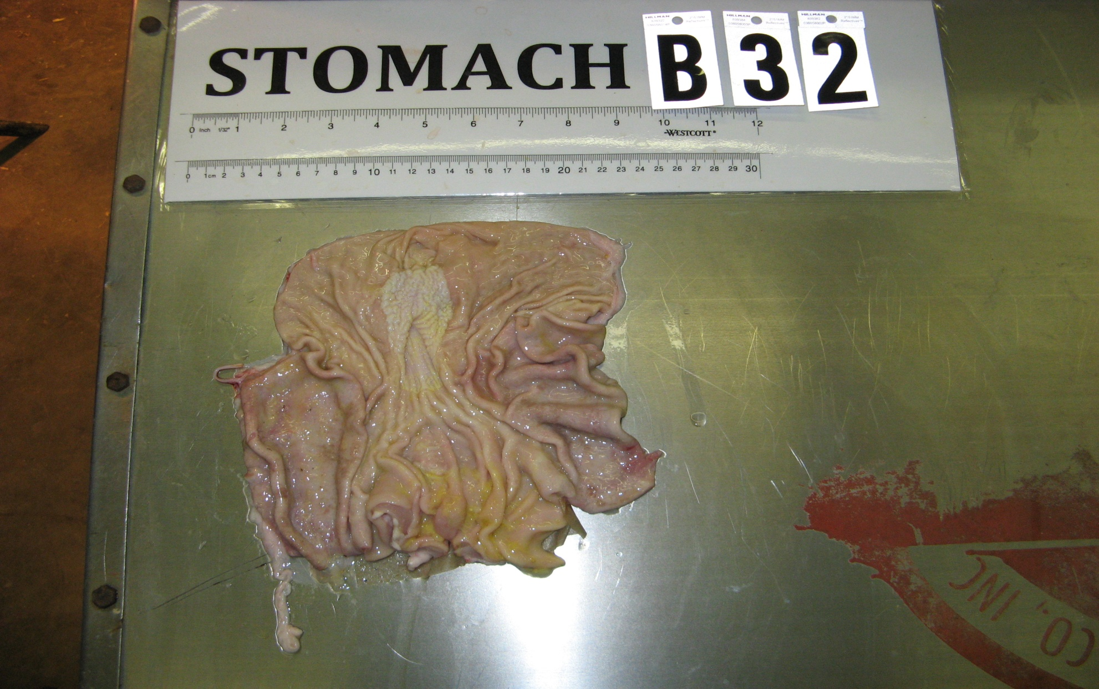
Pigs Fed GMOs Develop Inflamed Gut*
Blind autopsies conducted
Female pigs' uterus 25% larger in GMO-fed pigs
Female pigs 2.2x more likely to get severe stomach inflammation on GMO diet
Males were 4x more likely
Non-GMO Feed
GMO Feed
Photos kindly provided by Howard Vlieger
GMO Feed
*J.A. Carman et al., Journal of Organic Systems, 8(1), 2013.
Notes:
Swine/pigs_fed_GMOs_inflamed_gut.pdf
Also pigs_GMOs_summary.pdf
./Pigs_Study_NaturalNews.pdf

Slide 28
Human Digestive System Disorders
Alarming increase in the US in many diseases related to the gut
Crohn’s disease, inflammatory bowel disease, colitis, acid reflux disease, gluten and casein intolerance, celiac disease, leaky gut
The gut-brain axis links neurological disorders with gut disorders
I believe that glyphosate is a major cause
Notes:
Celiac disease has quadrupled in the US in last 50 years

Slide 30
Celiac Disease has Quadrupled in the US in the Last 50 Years
Notes:
Today’s serum is more than four times as likely to carry those
Antibodies (to gluten)

Slide 31
Wheat! Not corn and soy!
Graph provided by Nancy Swanson, with permission

Slide 32
Why is glyphosate usage on wheat going up?

Slide 33
“Herbicide Resistant Ryegrass Troubling for Wheat Growers”*
“If you see ryegrass at harvest following an Axial XL application, it may be resistant. And you can scatter seed all over the field with the combine.”
“A reduced-tillage approach, using a burndown herbicide ahead of planting in a stale seedbed, also holds promise for improved control.”
“ ‘We may be able to knock out 80% to 90% of the resistant ryegrass with glyphosate.’ ”
-- Jim Swart, integrated pest management specialist
*Ron Smith, Western Farm Press, Mar. 23, 2013
Notes:
Glyphosate/pesticides_for_wheat_slides.pdf
glyphosate/Axial_XL.text

Slide 34
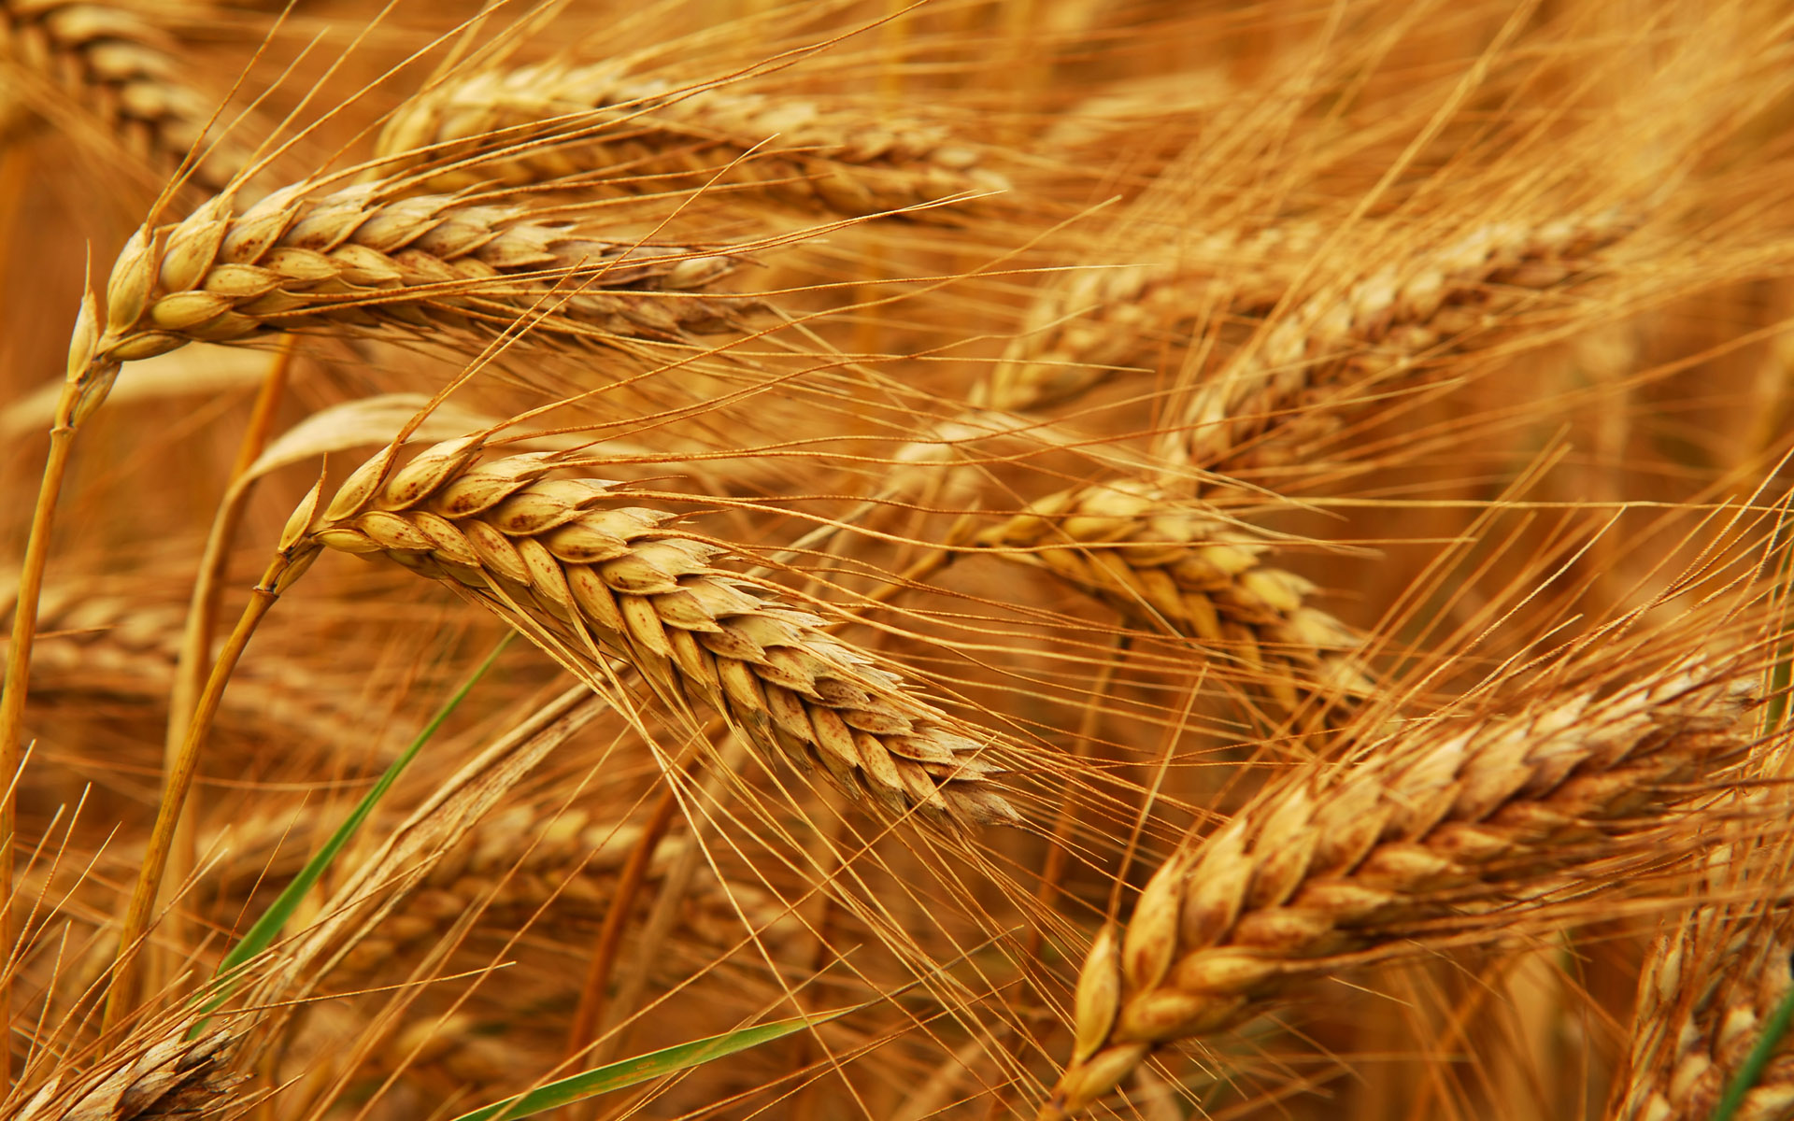
Human Dietary Experiment on Wheat & Inflammatory Bowel Syndrome*
Significant improvement in symptoms with dietary organic wheat from ancient source
Abdominal pain (P< 0.0001)
Bloating (P=0.004)
Stool consistency (P<0.001)
Tiredness (P< 0.0001)
Reduced pro-inflammatory cytokines: IL-6, IL-17, interferon-gamma, VEGF
*F. Sofi et al., Br J Nutr. 2014 Feb 13:1-8. [Epub ahead of print]
Notes:
Csail/2014/Anthony/ancient_wheat_not_allergenic.text

Slide 35
Paper on Glyphosate and Celiac Disease

Slide 36
Celiac Disease, Glyphosate and Non-Hodgkin’s Lymphoma
Bifidobacteria are depleted in celiac disease*
They convert gluten to less toxic form
Glyphosate preferentially kills bifidobacteria**
Celiac disease is associated with increased risk to non-Hodgkin’s lymphoma***
Glyphosate itself is also linked directly to non-Hodgkin’s lymphoma****
*M. Velasquez-Manoff, NY Times Sunday Review, Feb. 23, 2013
**A.A. Shehata et al., Curr Microbiol. 2013 Apr;66(4):350-8.
.*** C. Catassi et all, JAMA. 2002 Mar 20;287(11):1413-9.
****M. Eriksson et al., Int J Cancer. 2008 Oct 1;123(7):1657-63.
Notes:
**./ bifidobacteria_celiac_disease.text
Cancer/Celiac_disease_increases_hodgkins_lymphoma.text
3-4 fold increased risk to non-Hodgkins lymphoma
./Celiac_and_bacteria.text

Slide 37
“Dramatic Increase in Hospitalization of US Children With Inflammatory Bowel Disease”*
Study conducted at Case Western Reserve University School of Medicine
> 11 Million hospitalization records examined
Patients < 20 years old
49% increase from 2000 to 2009 in Crohn’s disease discharges
71% increase in ulcerative colitis discharges
* Science Daily, June 25, 2013
Notes:
./inflammatory_bowel_disease_children.text

Slide 38
*Plot prepared by Nancy Swanson from available data online

Slide 39
Kidney Failure in Agricultural Workers*
Workers in sugarcane fields in Central America and in India are dying at a young age in record numbers from kidney failure
Arsenic exposure from drinking water?
Excess use of tylenol?
Glyphosate disrupts the enzyme that breaks down tylenol, leading to tylenol toxicity
*ticotimes.net, San Jose, Costa Rica, August 8, 2013.
Notes:
http://www.ticotimes.net/More-news/News-Briefs/What-is-killing-the-young-men-of-Canas-_Wednesday-August-07-2013
./diabetes_farmers_costa_rica.pdf

Slide 40
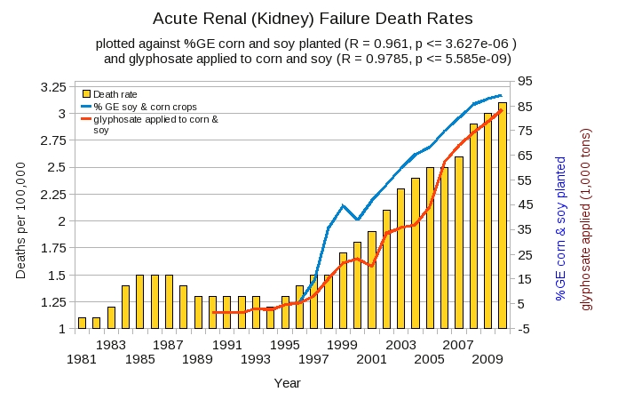
Acute Kidney Disease Death Rate Plotted Against Glyphosate and GMOs*
*Plot prepared by Nancy Swanson from available data online

Slide 41
Sri Lanka is the first Country to Ban Glyphosate
arsenic
Notes:
Project/Glyphosate/glyphosate_sri_lanka_kidney_failure_epidemiology.pdf

Slide 42
Another Country Responds to Kidney Failure in Agricultural Workers!
Notes:
Sri Lanka is the only other nation that has banned glyphosate.

Slide 43
Recapitulation
We depend on our gut bacteria in many ways
Bacteria from an obese person induce obesity in mice
Glyphosate is an antibiotic that preferentially kills the good bacteria
Pigs fed GMO corn and soy develop inflammatory gut
Humans are experiencing an epidemic in gut disorders like inflammatory bowel disease and gluten intolerance
Due to herbicide-resistant rye grass, farmers use glyphosate as a desiccant at harvest time
Kidney failure among agricultural workers can be explained by glyphosate

Slide 44
Hexane (正己烷), Glyphosate and Aluminum in Vaccines

Slide 45
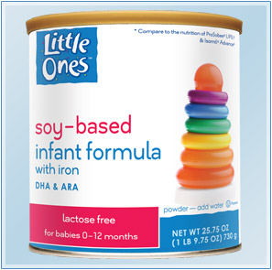
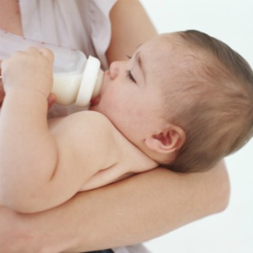
Soybean Oil and Protein Products*
Heavily used in processed foods
“White flakes" made by defatting soybeans by hexane extraction
→ Protein isolate and soy lecithin
Fat separated into soybean oil and used in soy infant formula
* EW Lusas and MN Riaz, J Nutr 1995, 125(3 Suppl): 573S-580S.
Notes:
http://europepmc.org/abstract/MED/7884536
Chenny/soy_protein_products.text

Slide 46
Protein Bars!
“Most soy protein ingredients in meat analogs and nutrition bars, which are listed on labels as soy protein isolate, soy protein concentrate or textured vegetable protein, have undergone hexane processing.”*
*berkeleywellness.com/healthy-eating/food-safety/article/hexane-soy-food
Notes:
It’s hard to get a measure of soy protein consumption but a proxy is the measure of vegetable oil consumption – the residue from extraction of oil from soy is used as a protein additive

Slide 47
Toxic Effects of Inhaled Hexane*
Low: Dizziness, headache, nausea, vomiting
High: Death from asphyxiation
Chronic: Peripheral neuropathy, pain, weakness, loss of sensation, impaired gait, muscle atrophy, visual disturbances
*N-HEXANE. Toxicology data network Hazardous Substances Data Bank. US National Library of Medicine
Notes:
Chenny/hexane_microbes_1991.pdf
ADD THIS

Slide 48
Human Fat and Oil Consumption: US*
*Graphs provided by Dr. Nancy Swanson, with permission
Notes:
Nancy/oils/domestic\ oil\ consumption.gif

Slide 49
Oil Consumption Autism & Developmental Delay & Anxiety
Tabulations from US Vaccine Adverse Event Reporting System (VAERS)
* Plots provided by Dr. Nancy Swanson with permission
Notes:
./under\ 6\ ADD\ etc\ vs\ veg\ oil.gif

Slide 50
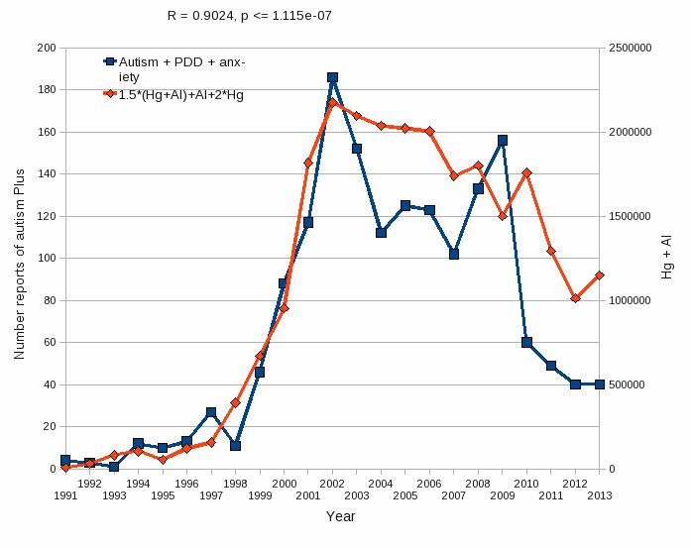
Aluminum & Mercury Autism & Developmental Delay & Anxiety
VAERS
database
Tabulations from US Vaccine Adverse Event Reporting System (VAERS)
Formula: Al + 1.5 x (Al w/ Hg) + 2.0 x Hg
* Plots provided by Dr. Nancy Swanson with permission

Slide 51
Aluminum & Mercury Autism & Developmental Delay & Anxiety
VAERS
database
Hypothesis: Glyphosate makes the aluminum and mercury in vaccines more toxic than they would otherwise be
Tabulations from US Vaccine Adverse Event Reporting System (VAERS)
Formula: Al + 1.5 x (Al w/ Hg) + 2.0 x Hg
* Plots provided by Dr. Nancy Swanson with permission

Slide 52
Glyphosate, Autism and Vaccine Reactions*
Glyphosate application to corn and soy, US
Children with Autism, US
# Adverse Reactions in VAERS
*Collaboration with Nancy Swanson

Slide 53
Glyphosate and Aluminum: Partners in Crime
Glyphosate induces pathogens like C. difficile in gut, leading to leaky gut syndrome
C. diff produces p-cresol which promotes aluminum uptake by cells
p-Cresol is a known biomarker for autism
p-Cresol is an important factor in kidney failure which leads to aluminum retention in tissues → dementia
Glyphosate cages aluminum to promote entry
Glyphosate promotes calcium uptake by voltage-activated channels
Aluminum gains entry as calcium mimetic
Aluminum promotes calcium loss from bones → pineal gland calcification

Slide 54
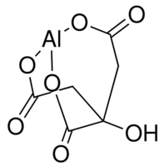
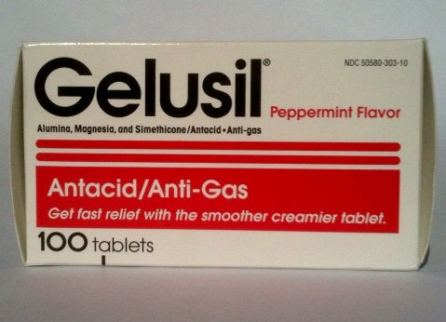
Aluminum Glyphosate*
Six different ways two glyphosate molecules can chelate aluminum
Aluminum citrate**
ALUMINA
aluminum
*M. Purgel et al., Journal of Inorganic Biochemistry 103 (2009) 1426–1438
** P. Sianina et al., Clin. Chem. 32/3, 539-541, 1986.
Notes:
AnthonySamsel/swine/aluminum_glyphosate.pdf
aluminum_citrate_absorbs_well_vinegar_antacids.pdf
Csail/2013/project/Anthony/

Slide 55
Recapitulation
GM Roundup-Ready soy is a core food crop
It is processed into soy formula and protein bars that are contaminated with glyphosate and hexane
The current vaccine schedule in the US includes many aluminum-containing vaccines
Aluminum, hexane and glyphosate are synergistically toxic
Studies of the VAERS database reveal interesting links among aluminum in vaccines, oil consumption and autism, developmental delay and anxiety

Slide 56
Summary
We should be very worried about glyphosate contamination in the food supply
Glyphosate usage on corn and soy crops correlates with the epidemic we’re seeing in autism, Alzheimer’s disease, celiac disease, and other intestinal disorders
This correlation can be explained by the known effects of glyphosate in biological systems
Glyphosate works synergistically with other important toxic chemicals in our environment, especially arsenic, aluminum and hexane
Glyphosate should be banned like DDT

Slide 57
Go Organic!

Slide 58
Thank You!
謝謝!

