Slide 1
How Statins Really Work Explains Why They Don’t Really Work
Stephanie Seneff
Computer Science and Artificial Intelligence Laboratory
MIT
WAPF Wise Traditions Conference
November 11, 2011

Slide 2
Outline
Statin Usage and Health Outcome
Statins and dementia
Statins and heart failure
Statins and infection
Other evidence that statins are harmful
Patient-provided statin reviews
Summary

Slide 3
Statin Usage and Health Outcome

Slide 4
“Last year, statin and other lipid-regulating drugs were the nation's most commonly prescribed medications, with more than 355 million prescriptions dispensed, according to information firm IMS Health.”*
* http://jewishworldreview.com/0811/new_thinking_on_cholesterol

Slide 5
"Statin medications have proven to be somewhat beneficial to a small group of people; that is a middle aged man with a previous heart attack. They have never been documented to benefit any woman of any age with any condition. They have not been documented to help people who have not had a previous heart attack of any age or gender.” Dr. Dwight Lundell*
* Interview, “The True Cause of Heart Disease”
http://www.totalhealthbreakthroughs.com/2010/07/
Notes:
http://www.totalhealthbreakthroughs.com/2010/07/the-true-cause-of-heart-disease-part-one-of-two/

Slide 6
“The US Centers for Disease Control and Prevention recently reported that the prevalence of heart disease in the US population remained stable over the past decade, while the use of statin drugs increased 10-fold, from 2% to 25%, over the past 2 decades.”*
* Voelker, JAMA 305:16, p. 1641, 2011
Notes:
http://tinyurl.com/dysxoa).
http://jama.ama-assn.org/content/305/16/1641.full

Slide 7
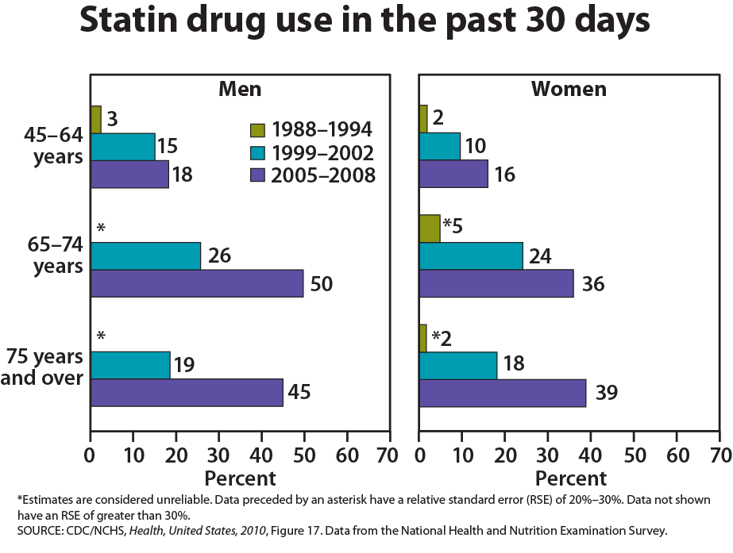
Dramatic Rise in Statin Prescriptions, for Men, Women, and Elderly, Since 2005

Slide 8
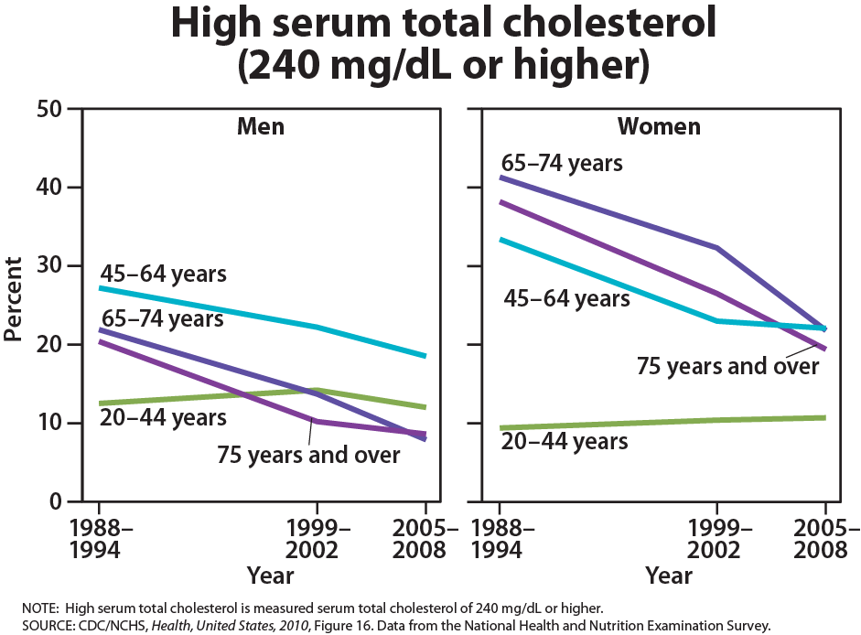
And These Prescriptions have been Successful in Lowering Serum Cholesterol

Slide 9
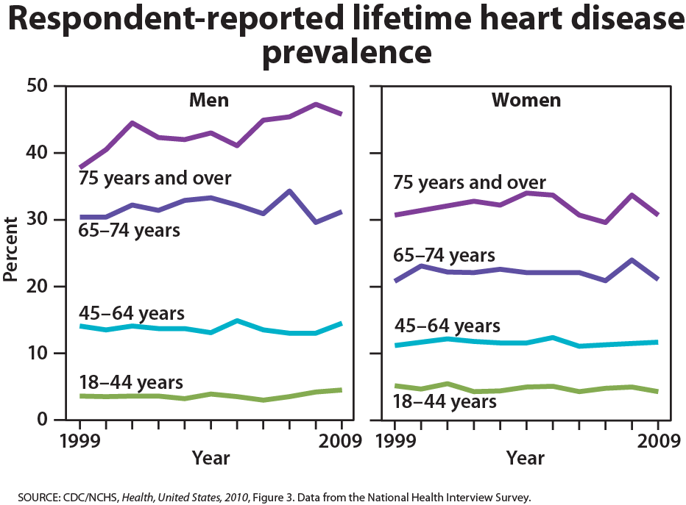
Reported Heart Disease Rates have Remained Steady, or Even Gone UP(!) for Elderly Men
Notes:
More such slides in;
Project/2011/US_HealthReport2010.ppt

Slide 10
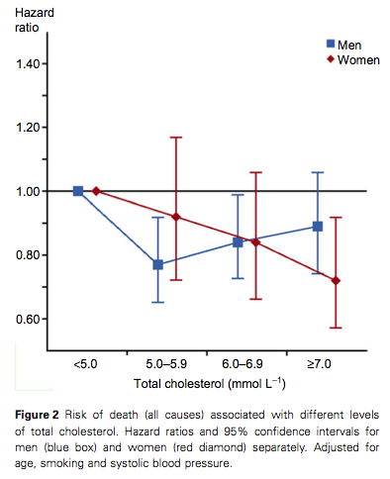
“Many individuals who could otherwise call themselves healthy struggle conscientiously to push their cholesterol under the presumed ‘danger’ limit … . Massive commercial interests are linked to drugs and other remedies marketed for this purpose. It is therefore of immediate and wide interest to find out whether our results are generalizable to other populations.”
-- Petursson et al., J Eval Clin Practice 1-10, 2011.
All-cause mortality is highest, for both men and women, when total serum cholesterol is lowest
Notes:
For_vic/norwegians_low_cholesterol_early_death.pdf
Population-based study in Norway.

Slide 11
Statin Drugs and Cholesterol
Cholesterol is essential to human life. It gives animals mobility and a nervous system.
Cholesterol is the precursor to vitamin D3, the sex hormones estrogen and testosterone, and the stress hormone cortisol.
Cholesterol plays a crucial role in cell membranes in protecting from ion leaks and in transport of nutrients and signaling elements across the membrane.
Statin drugs interfere with mevalonate synthesis, an early step in cholesterol synthesis.

Slide 12
Statin Therapy and the Mevalonate Pathway
Acetyl-CoA
HMG-CoA
Statins
HMG-CoA Reductase
Mevalonate
Geranyl-PP
Rab, Rho
Farnesyl-PP
Ras, dolichol, coenzyme Q10
Squalene
Vitamin D3, estrogen, testosterone, progesterone, cortisol, bile acids
Cholesterol
Notes:
Ras, Rho: cell migration and cell-cell adhesion Rab likely but not proven
Dolichols are long-chain unsaturated polyisoprenoids with multiple cellular functions, such as serving as lipid carriers of sugars used for protein glycosylation, which affects protein trafficking in the endoplasmic reticulum.

Slide 13
Statins and Dementia

Slide 14
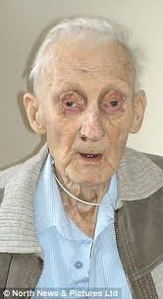
17 Year Study on Elderly*
Begun in 1990: all subjects were at least 70 years old
Measured serum cholesterol, ability to synthesize cholesterol, and ability to absorb cholesterol through the intestines
Low values of all three parameters were associated with accelerated mental decline and increased physical frailty
Subjects with low values on all three had 4 ½ years decreased life span
Low cholesterol is associated with increased frailty and accelerated mental decline, as well as early death
* Tilvis et al., Annals of Medicine, Early Online, 2011
Notes:
Cancer/serum_cholesterol_prognosis_elderly.pdf

Slide 15
Alzheimer’s and Serum Cholesterol
"Significantly lower lipid levels were found in patients with AD, than in controls. Patients in the late phase of AD had significantly lower entire lipid profile than controls and significantly lower cholesterol and LDL-C levels than patients in the middle stage of AD.”*
*Presečki et al., Coll. Antropol. 35, Suppl. 1: 115–120, 2011.
Notes:
For_vic/alzheimers_low_cholesterol.pdf

Slide 16
Statins and Alzheimer’s
Early epidemiological studies seemed to show that statins protect from Alzheimer’s
Later studies could not reproduce this result
Compounding problem is that an Alzheimer’s diagnosis may be “protective” against statin usage:
Doctors discontinue statin therapy when Alzheimer’s is diagnosed

Slide 17
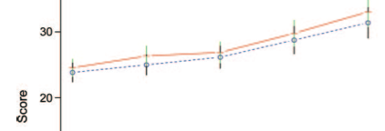
“A randomized, double-blind,
placebo-controlled trial of simvastatin to
treat Alzheimer disease”*
This Study was Funded by Pfizer’s
Treatment Group
ADAS-Cog Score
time
18 months
Patients whose caretaker decided to withdraw them from the trial were likely the most negatively affected
Despite this, treatment group suffered more decline than non-treatment group
* Sano et al., Neurology 77, 557-563, 2011
Notes:
Simvastatin_does_not_help_alzheimers.pd
fMean of ADAS-Cog 􏱎 Alzheimer’s Disease Assessment Scale–cognitive portion

Slide 18
“Former Use” of Statins is Associated with Increased Risk to Alzheimer’s
"However, former use of statins was associated with an elevated risk of all-cause dementia (HR, 1.88; 95% CI, 1.05-3.36) and AD alone (HR, 2.54; 95% CI, 1.24- 5.20) compared with never users.” *
Hazard ratio 1.21 for Alzheimer’s for “ever used statins” v.s. “never used statins.”
* Rea et al., “Statin Use and the Risk of Incident Dementia: The Cardiovascular Health Study,” Arch Neurol. 62, 2005
Notes:
Hazard ratio
1.21 Alzheimer’s alone
1.36 Dementia alone
statin_use_increases_dementia.pdf in for_vic

Slide 19
Statins and Dementia: Recapitulation
Elderly with low cholesterol have increased frailty, increased mental decline, and early death
Alzheimer's patients have low cholesterol
Late phase lower than early phase
Statin drugs and Alzheimer’s
Former use of statins is associated with a 2 1/2 fold increase in risk for Alzheimer's
Double-blind placebo-controlled study funded by Pfizer showed that statins accelerate mental decline

Slide 20
Statins and Heart Failure

Slide 21
Heart failure affects about 5 million Americans. The incidence of heart failure is increasing at an alarming rate. Death from heart failure went up by 28% between 1994 and 2004.
Heart FAILURE!!!
NO!!!!
What is the Leading Cause of Death in America?
Heart Attack??
Notes:
p. 156, cancer/cam_K_II_myocardial_physiology.pdf

Slide 22
The incidence of heart failure doubled in the ten years following the introduction of statin therapy to lower cholesterol, and heart failure is now the number one cause of death in America and the biggest single drain on our healthcare funds.*
* R. Foelker, JAMA. 2011;305(16):1641
http://www.cdc.gov/nchs/hus.htm
Notes:
http://tinyurl.com/dysxoa).
http://jama.ama-assn.org/content/305/16/1641.full

Slide 23
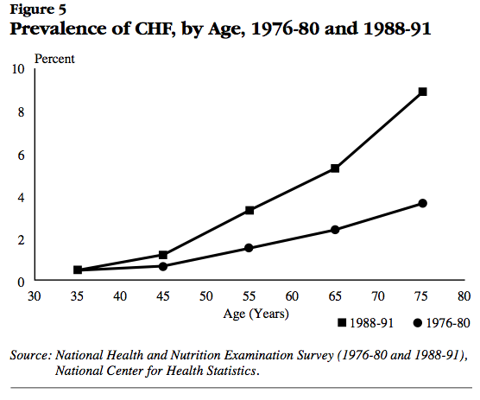
Post-statins:
‘88-’91
Pre-statins:
‘76-’80
National Heart, Lung, and Blood Institute National Institutes of Health Data Fact Sheet
Notes:
http://library.thinkquest.org/27533/facts.html
./heart_failure_stats_1990s.pdf

Slide 24
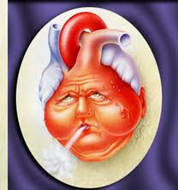
Heart Failure in the U.S.*
An estimated 5.8 million Americans have heart failure
670,000 new cases occur each year
In 2007 alone, America spent 33 billion dollars on heart failure
Heart failure is our largest single drain on health care funds
*from Schocken et al., Prevention of Heart Failure, Circulation 117; 2544-2565, 2008

Slide 25
Correlation does not necessarily mean causality
However……
Notes:
http://tinyurl.com/dysxoa).
http://jama.ama-assn.org/content/305/16/1641.full

Slide 26
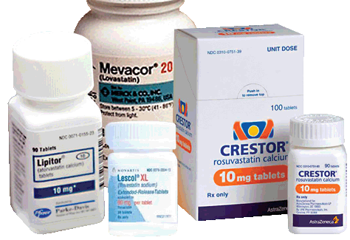
Three Ways Statins Could Cause Heart Failure
Deplete Coenzyme Q10: interfere with energy generation in mitochondria
Increase activity of sodium/potassium pump due to ion leaks (increased energy consumption)
Decrease number of lipid rafts → decreased number of calcium sparks to trigger contraction

Slide 27
Heart Cells: Energy Generation and Consumption
Energy (ATP) is generated by breaking down glucose and fats into carbon dioxide and water via the oxygen-dependent Krebs cycle in the mitochondria
Coenzyme Q10 plays a major role
ATP is consumed by:
Maintaining voltage gradients across membranes
Pumping calcium into special stores to trigger contraction
Protein synthesis and disposal, etc.

Slide 28
CoEnzyme Q10 Depletion
"The depletion of the essential nutrient CoQ10 by the increasingly popular cholesterol lowering drugs, HMG CoA reductase inhibitors (statins), has grown from a level of concern to one of alarm. … This drug-induced nutrient deficiency is dose related and more notable in settings of pre-existing CoQ10 deficiency such as in the elderly and in heart failure.”
- Quote from abstract, Langsjoen and Langsjoen, Biofactors 18, 104, 101-111, 2003.
Notes:
For_vic/Statins_coq10.text

Slide 29
Heart Failure: Serum Markers
Heart failure means that the heart is tired and weak, and can no longer pump blood efficiently
Heart failure patients have low serum Coenzyme Q10*
Among heart failure patients, higher Co-Q10 is associated with lower mortality risk
Low serum cholesterol is also associated with increased mortality **
Statins interfere with synthesis of both Co-Q10 and cholesterol
* S. Sinatra, http://www.faim.org/guestwriters/sinatraheartfailureroundup.html
** Kalantar-Zadeh et al.,J. American College of Cardiology 43(8) 1439-1444, 2004.
Notes:
For_vic/reverse_biometrics_heart_failure.text

Slide 30
Small Cations
Small cations are positively charged atoms from the low end of the periodic table
The most important ones in the cell are potassium, sodium, calcium, and magnesium.
Cells keep potassium (K⁺) inside and sodium (Na⁺) outside.
Calcium (Ca⁺) is stored in high concentration in the sarcoplasmic reticulum (SR)
Muscle contraction is triggered by releasing calcium stores from the SR

Slide 31
Effect of Cholesterol on Ion Leaks
Consume Energy
Cell walls typically contain 50 mole percent cholesterol
Activity of Na+/K+ pump
Mole Percent Cholesterol
As membrane cholesterol is depleted, Na⁺/K⁺ pump must consume more ATP to keep K⁺ ions inside and Na⁺ ions outside
Notes:
Cancer/haines_sodium_leaks.pdf

Slide 32
Caveolae and Lipid Rafts

Slide 33
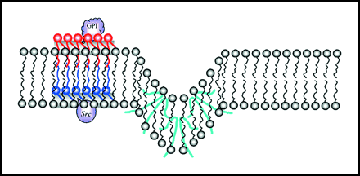
Caveolae and Lipid Rafts
Lipid rafts are a prominent feature of cell membranes
They contain 4-5 times as much cholesterol as non-lipid-raft regions
Special invaginations at lipid rafts are called caveolae
In heart muscle cells, calcium influx at caveolae causes release of more calcium from the sarcoplasmic reticulum to trigger contraction
This is how the heart pumps blood

Slide 34
What Happens to a Muscle Cell Deprived of Cholesterol?
Cholesterol depletion introduces two major problems:
Sodium and potassium leaks
Reduced number of caveolae: fewer calcium sparks
Cholesterol enriched
Na⁺
Cholesterol depleted
K⁺
ATP->ADP (pump)
Na⁺
K⁺

Slide 35
Calcium Sparks Trigger Contraction in Heart Muscle Cell*
Cell Wall
Caveola
Caveola
Cavelola
Sarcoplasmic Reticulum
Calcium “sparks”
* Meier et al, Circulation 92:778-784, 1995
Notes:
Cancer/heart_failure_SR_calcium.text
The calcium sensitive SR calcium release channel (ryanodine receptor) plays a key role in excitation-contraction coupling. The ryanodine receptor is regulated by calcium, which enters the cell through voltage-gated calcium channels in the sarcolemma. Once activated by calcium influx, the channel opens and releases calcium for activation of contractile proteins.²³ ²⁴ ²⁵ This process is called calcium-induced calcium release
In summary, the present study shows that protein levels of the SR calcium release channel (ryanodine receptor), as well as protein levels of calsequestrin and calreticulin, are not significantly altered in end-stage failing dilated cardiomyopathy. In contrast, protein levels of SR Ca²⁺-ATPase were found to be significantly reduced relative to total protein, to calsequestrin, to the ryanodine receptor, and to phospholamban. This is consistent with the concept that reduced capacity of the SR to accumulate calcium may be of major pathophysiological relevance in failing human myocardium.
http://circ.ahajournals.org/cgi/content/full/92/4/778

Slide 36
Getting the Calcium Back!
ATP -> ADP
3 to 1 Sodium Calcium Exchanger
Ca⁺²
Cell Wall
Na⁺
Na⁺
Na⁺
Caveola
Caveola
Cavelola
Sarcoplasmic Reticulum
Ca⁺²
SR Calcium ATPase Pump
ATP -> ADP
* Meier et al, Circulation 92:778-784, 1995
Notes:
sarcoplasmic reticulum Ca2+ ATPase [25] gets nitrosylated – see NOS oxidase paper 1.pdf in robert_davidson/unified_theory/NOS_oxidase_papers/
The calcium sensitive SR calcium release channel (ryanodine receptor) plays a key role in excitation-contraction coupling. The ryanodine receptor is regulated by calcium, which enters the cell through voltage-gated calcium channels in the sarcolemma. Once activated by calcium influx, the channel opens and releases calcium for activation of contractile proteins.²³ ²⁴ ²⁵ This process is called calcium-induced calcium release
In summary, the present study shows that protein levels of the SR calcium release channel (ryanodine receptor), as well as protein levels of calsequestrin and calreticulin, are not significantly altered in end-stage failing dilated cardiomyopathy. In contrast, protein levels of SR Ca²⁺-ATPase were found to be significantly reduced relative to total protein, to calsequestrin, to the ryanodine receptor, and to phospholamban. This is consistent with the concept that reduced capacity of the SR to accumulate calcium may be of major pathophysiological relevance in failing human myocardium.
http://circ.ahajournals.org/cgi/content/full/92/4/778

Slide 37
What Happens in Heart Failure?
ATP -> ADP
3 to 1 Sodium Calcium Exchanger
Ca⁺²
Cell Wall
Calcium becomes depleted from SR as too much calcium is pumped out and not enough is returned.
Na⁺
Na⁺
Na⁺
X
Caveola
Cavelola
Calcium ATPase gets nitrosylated by too much nitric oxide.
Sarcoplasmic Reticulum
Ca⁺
Ca⁺²
SR Calcium ATPase Pump
ATP -> ADP
* Meier et al, Circulation 92:778-784, 1995
Notes:
The calcium sensitive SR calcium release channel (ryanodine receptor) plays a key role in excitation-contraction coupling. The ryanodine receptor is regulated by calcium, which enters the cell through voltage-gated calcium channels in the sarcolemma. Once activated by calcium influx, the channel opens and releases calcium for activation of contractile proteins.²³ ²⁴ ²⁵ This process is called calcium-induced calcium release
In summary, the present study shows that protein levels of the SR calcium release channel (ryanodine receptor), as well as protein levels of calsequestrin and calreticulin, are not significantly altered in end-stage failing dilated cardiomyopathy. In contrast, protein levels of SR Ca²⁺-ATPase were found to be significantly reduced relative to total protein, to calsequestrin, to the ryanodine receptor, and to phospholamban. This is consistent with the concept that reduced capacity of the SR to accumulate calcium may be of major pathophysiological relevance in failing human myocardium.
http://circ.ahajournals.org/cgi/content/full/92/4/778

Slide 38
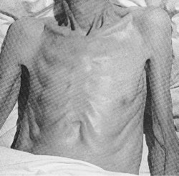
Cardiac Cachexia*
Cachexia, “Bad Condition,” from Greek: “kakos” (= “bad”) “hexis” = “condition”
Present in up to 16% of heart failure patients
Predicts increased mortality risk: 50% of studied population died within 18 months
Biomarkers:
Elevated TNF-α
Reduced muscle mass
Muscle wasting
* Anker and Coats, Chest, pp. 836-847, 1999
Notes:
Cancer/cardiac_cachexia.pdf EXCELLENT PAPER!!!

Slide 39
Other Conditions Associated with Cachexia*
AIDS
Chronic fatigue syndrome; fibromyalgia
End stage cancer and renal disease
Excess exercise(!)
Statin drugs!!!!
This makes sense, as the most frequent side effect of statins is muscle pain and weakness
* Anker and Coats, Chest, pp. 836-847, 1999

Slide 40
Statins and Cachexia*
Conclusion: “Simvastatin administration, although capable of negatively modulating the inflammatory response, did not prevent muscle wasting in this experimental model of cancer cachexia. Moreover, the further muscle loss observed in simvastatin-treated tumor-bearing animals suggests that a note of caution should be introduced in treating cancer patients with statins in view of the possible occurrence of harmful side effects.”
* Muscaritoli et al., Nutrition 19:11, 936-939, 2003
Notes:
Cancer/statins_cachexia.text
simvastatin_made_cachexia_worse.text (same)

Slide 41
Statins and Heart Failure: Recapitulation
Heart failure is alarmingly on the rise
Statins are likely a contributing factor
High cholesterol is protective in heart failure
Statins impair heart function in at least three ways:
Reduced energy production due to coenzyme Q10 depletion
Excess energy burn due to potassium leaks
Reduced number of cholesterol-rich caveolae and excess nitric oxide interfere with calcium sparks
Muscle damage and loss is well-documented side effect: the heart is a muscle

Slide 42
Statins, Cholesterol and Infection

Slide 43
Statins and Infection
The statin industry likes to claim that statins protect from sepsis (“blood poisoning”)
The opposite is actually true
LDL can trap and neutralize bacteria
Cholesterol in cell walls helps cells fight infection
Statins cause pathological changes in immune response

Slide 44
Statins and Sepsis
Industry hype: potential off-label use for the drug
The reality:
At least 5 placebo-controlled studies can be found on the web:
http://clinicaltrials.gov/ct2/show/NCT00702130
http://clinicaltrials.gov/ct2/show/NCT00450840
http://clinicaltrials.gov/ct2/show/NCT00452608
http://www.controlled-trials.com/ISRCTN92093279
http://clinicaltrials.gov/ct2/show/NCT00452608
All five studies have no results and no publications

Slide 45
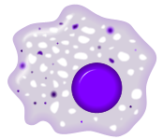
VLDL Fights Infections*
TNF-α
LBP
LPS (toxic)
LPS (toxic)
VLDL
LBP
LPS: Lipopolysaccharide
LBP: Lipopolysaccharide binding protein
VLDL
* Barcia and Harris,”Triglyceride Rich Lipoproteins as Agents of Innate Immunity CID, 2005
Notes:
Cancer/triglycerides_immunity.pdf

Slide 46
The Endotoxin Lipoprotein Hypothesis *
Statins interfere with the liver’s ability to synthesize LDL
Endotoxin (bacteria)
suppress
Serum Lipoproteins (LDL)
Proinflammatory cytokines
Liver
Heart Failure Worsens
Heart failure patient needs high serum cholesterol
Mortality
* Rauchhaus et al., The Lancet, 356, 930-933, 2000
Notes:
M Rauchhaus et al. The endotoxin-lipoprotein hypothesis. Lancet 2000 356: 930-933.
Summary
The advent of 3-hydroxy-3-methylglutaryl-coenzyme A reductase inhibitors (statins) has revolutionised the treatment of hypercholesterolaemia. Statin treatment, by lowering the atherogenic lipoprotein profile, reduces morbidity and mortality in patients with cardiovascular disease. Treatment with simvastatin causes a reduction of events of new-onset heart failure, but this may be attributable to properties other than its lipid-lowering effects. There is some evidence that lower serum cholesterol concentrations (as a surrogate for the totality of lipoproteins) relate to impaired survival in patients with chronic heart failure (CHF). Inflammation is a feature in patients with CHF and increased lipopolysaccharide may contribute substantially. We postulate that higher concentrations of total cholesterol are beneficial in these patients. This is potentially attributable to the property of lipoproteins to bind lipopolysaccharide, thereby preventing its detrimental effects. We hypothesise there is an optimum lipoprotein concentration below which lipid reduction would, on balance, be detrimental. We also propose that, in patients with CHF, a non-lipid-lowering statin (with ancillary properties such as immune modulatory and anti-inflammatory actions) could be as effective or even more beneficial than a lipid-lowering statin.

Slide 47
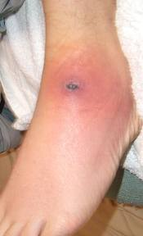
LDL Protects from MRSA*
Methicillin-resistant Staphylococcus aureus (MRSA) has become a major problem in hospitals worldwide
Researchers have found that ApoB (in LDL) limits invasion by binding to and neutralizing a key enzyme responsible for promoting invasion through the skin
In experiments, skin penetration and serum bacterial density were significantly greater in ApoB deficient mice.
* Peterson et al., Cell Host Microbe 4(6): 555–566, 2008
Notes:
For_vic/apoB_protects_from_staph_MRSA.pdf

Slide 48
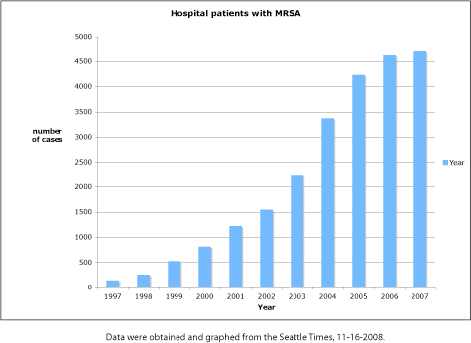
The MRSA Epidemic*
Could Increased Statin Use, Resulting in Reduced LDL Levels, be Contributing to this Epidemic?
* M. Berens and K. Armstrong, How our hospitals unleashed a MRSA epidemic, Seattle Times 11-16,2008
Notes:
http://scienceblogs.com/digitalbio/2008/11/the_seattle_times_takes_on_hos.php
In 2008 – 33 fold in past ten years in Washington State

Slide 49
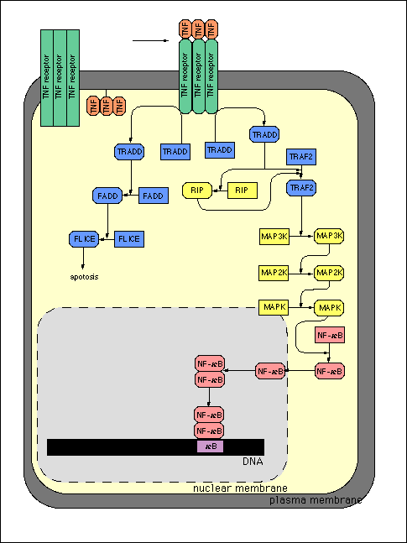
Cholesterol is Essential for fighting Infection in the Cells
Cholesterol depletion in the cell wall suppresses synthesis of TNF-α , which is critical for eradication of gram-negative bacteria by macrophages
Notes:
From Laurie: article on ERK and cholesterol Oxysterol binding protein & ERK
ERK = extracellular signal-regulated kinase
ERK1 = MAP3
ERK2 = MAP1 lethal if defective
Assembly of this receptor complex occurs in lipid rafts. Intracellular phosphorylation and activation of MAPK (ERK ½ , p38, c_jun N-terminal kinase (JNK) stress-activated protein kinase (SAPK). The activation of these kinases is essential for the production and liberation of the various inflammatory mediators required for the subsequent host proinflammatory phenotype characteristic of sepsis.
J. Cuschieri, 2004, Presented at 65th meeting of the society of university surgeons. Implications of lipid raft disintegration: enhanced anti-inflammatory macrophage phenotype.
G alpha 1: cholesterol depletion through MbetaCD causes loss of G-protein alpha 1 expression on lipid rafts.
Cholesterol depletion → TNF-alpha significantly depleted, IL-10 doubled.
Endotoxin is known to result in the activation of the tissue-fixed macrophage, which is critical in the eradication of gram-negative infections.

Slide 50
Depleting Membrane Cholesterol during Infection*
Expose macrophages to endotoxin (from bacteria)
Pretreat with MβCD (extracts membrane cholesterol)
Lipid rafts disintegrate
Switches off inflammatory agents
TNF-α goes down 4-fold
Interleukin-10 goes up 2-fold (immune suppression)
Can’t fight infection
* Cuschieri, Surgery, 169-175, 2004
Notes:
Cancer/macrophage_cholesterol_depletion_response.pdf

Slide 51
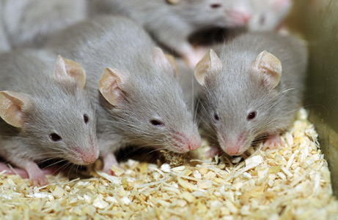
Defective Immune Response with Statin Exposure in Mice*
Mouse white blood cells cultured in vitro with statins
Resulted in defective immunity against pathogens
Reduced ability to kill microbes
Reduced defense against reactive oxygen species
Similar results were obtained in vivo
* Dominguez et al, European J Immunol, to appear, 2011
Notes:
Defective activation of iNOS/HO-1 resulted in limited cytoprotective capacity against ROS and reduced microbicidal potential. These data were validated using an in vivo model of L. monocytogenes infection that revealed that iNOS activation by splenic inflammatory moDCs, specialized in NO and TNF-α production, was strongly reduced in lovastatin-treated, Listeria-infected mice. Statin treatment could have severe implications in immunity against pathogens due to defective iNOS/HO-1 metabolism activation in inflammatory moDCs that might lead to immune failure.
Robert_davidson/sep14/EJImmunology Statin immune failure.pdf

Slide 52
Statins Alter Phagocyte Behavior*
Phagocytes normally “eat” bacteria and then kill them
Statins turn phagocytes into suicide bombers
Hypothesized reason:
Reduced membrane cholesterol
Can’t handle oxidation damage
This would also impair their clean-up role in atherosclerotic plaque
* Chow et al, Cell Host & Microbe 8:445-454, 2010
Notes:
Spacedoc/spacdoc/sepsis/statins_phagocyte_traps.pdf

Slide 53
Statins and Infection: Recapitulation
Industry claims that statins protect from sepsis are highly suspect
Five non-newsworthy placebo-controlled studies
There are many reasons why statins might impair the body’s ability to fight infection
LDL prevents staph (MRSA) from penetrating skin
LDL can bind and neutralize bacteria
Cholesterol in cell wall is important for immune cells to be able to function properly
Macrophages and phagocytes are both impaired
Atherosclerosis could be worsened by inability of phagocytes to dispose of cell debris

Slide 54
Other Evidence that
Statins are Harmful

Slide 55
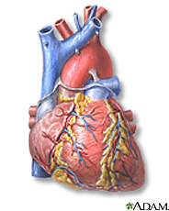
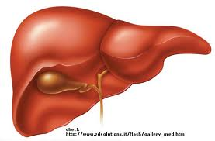
Liver Detoxifies Fructose
LDL (fats)
Fructose
Dietary fructose is toxic -- a severe glycating agent
Liver aggressively processes fructose and turns it into fat
Fat is exported to tissues packaged in LDL particles
Cholesterol is required to “wrap” synthesized fats

Slide 56
How Statins Change Fructose Metabolism
LDL (fats)
Statins
Lactate
Fructose
Liver can’t come up with enough cholesterol to “wrap” synthesized fats with LDL
Muscle cells must dispose of fructose via anaerobic metabolism (convert to lactate)
Heart and liver benefit from a healthy fuel source

Slide 57
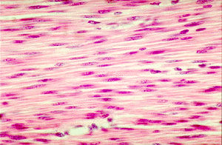
But, …The Muscle Cells Get Wrecked*
Patients on statins routinely get creatine phosphokinase levels monitored for possible muscle damage
However, even when creatine phosphokinase levels are not elevated, myopathy (muscle weakness) can occur, and is often associated with muscle damage
Patients on statins are often advised to continue statin therapy in this circumstance
This is bad advice
* Mohaupt et al., CMAJ 181(1-2), E11-E18, Jul 2009
Notes:
In current clinical practice, patients who present with muscle symptoms while receiving statin therapy have their creatine phosphokinase levels measured. If the level is within normal limits or is modestly elevated (current recommendations in- clude creatine phosphokinase < 1950 U/L6), patients are fre- quently advised to continue their current statin therapy. This is based on the assumption that a lack of increased creatine phosphokinase levels supports a lack of underlying muscle damage. Our findings suggest that normal or moderately ele- vated levels of creatine phosphokinase do not exclude statin- associated muscle injury. Thus, alternative treatment strate- gies for patients with muscle symptoms need to be evaluated.

Slide 58
80% of athletes prescribed statins for high cholesterol reported muscle side-effects
-- Sinzinger and O’Grady, Br J Clin Pharmacol 57, 525–528, 2004
Low LDL cholesterol is associated with depression among US households
-- S. H. Tedders et al., J. Affect. Disord., 2011
Notes:
For_vic/statins_wreck_mitochondria.pdf
For_vic/depression_low_cholesterol.pdf
Sinzinger H & O’Grady J (2004) Professional athletes suffering from familial hypercholesterolaemia rarely tolerate statin treatment because of muscular problems. Br J Clin Pharmacol 57: 525–528.

Slide 59
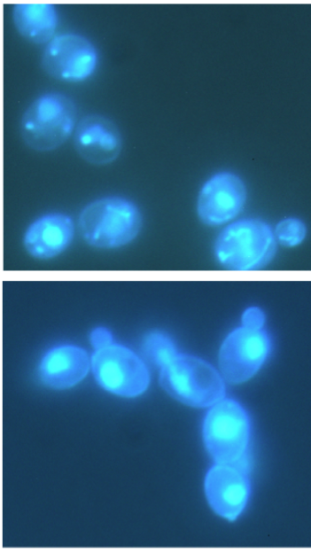
Yeast on Statins
mitochondria
on statins
Simvastatin and Atorvastatin caused the yeast cells to completely lose their mitochondria*
* Westermeyer and Macreadie, FEMS Yeast Res 7, 436–441, 2007.

Slide 60
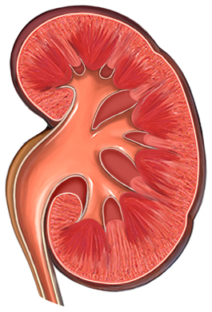
Statins and Sodium in the Kidney*
Sodium reabsorption in the kidney is impaired when cholesterol is depleted from cell membranes
Defective reaction to stresses like hypotonic shock
Reduced sodium-potassium-ATPase activity in the basolateral membrane
* Balut it al., Am J Physiol Cell Physiol 290:C87-C94, 2006
Notes:
Cancer/statins_sodium_channel.pdf

Slide 61
Chloride Homeostasis in the Kidney*
Three different conditions resulted in same pathology
Conditions:
Cholesterol depletion
Oxidative damage
Energy depletion
Pathology:
Chloride channels not restricted to lipid rafts and excess chloride leaves the cell
Additional cholesterol enrichment protects from effects of oxidative damage and energy depletion
Cl⁻
Cholesterol enriched
Cl⁻
Cl⁻
Cholesterol depleted
Cl⁻
Cl⁻
* Hinzpeter et al., JBC Vol 282, No. 2, January 26, 2007

Slide 62
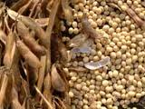
Statins and Plant Sterols*
Statins increase absorption of plant sterols 2-fold
Plant sterols are highly oxidized (140x more than cholesterol)
promote macrophage apoptosis and plaque destabilization
Statins increase risk of heart attack in sterol "hyperabsorbers”
estimated as 25% of population
Dietary plant sterol enrichment and statin therapy are additive in effect
* Goldstein et al., Journal of Clinical Lipidology (2008) 2, 304–305
Notes:
For_vic/statins_plant_sterols.pdf

Slide 63
More Bad News about Statins
Lovastatin treatment in mice caused a profound defect in immune system dendritic cells, leading to an impaired ability to fight infection (Dominguez et al., Eur. J. Immunol. 2011)
Statin therapy is associated with increased risk of developing lupus (de Jong et al., Semin Arthritis Rheum. 2011)
Statins increase risk to diabetes (Goldstein and Mascitelli, Q. J. Med, 2010)
Notes:
from_luca/EJimmunology Statin immune failure.pdf -- do a slide with this info on it.
From_luca/statins lupus-like syndrome.pdf

Slide 64
JOIMR Article on Statin Side Effects*
* Jeff Cable, JOIMR 7:1, Dec 2009

Slide 65
JOIMR Article on Statins Side Effects*
* Jeff Cable, JOIMR 7:1, Dec 2009

Slide 66
Other Adverse Effects: Recapitulation
Statins wreck muscles by exposing them to excess fructose that the liver can no longer metabolize
Statins interfere with exercise
Low cholesterol is associated with depression
Statins destroy yeast mitochondria
Statins impair sodium and chloride ion transport in kidneys
Statins increase risk to diabetes and lupus
Statins are associated with a host of side effects that can be best characterized as "getting older faster"

Slide 67
Experiments with Patient-provided Statin Reviews

Slide 68
Experimental Design
T-Party
Over 105,00 drug reviews were collected from various drug forums, such as AskAPatient.com, Medications,com, and WebMD.com on a broad spectrum of drugs to treat different conditions
A subset of over 8000 statin reviews were compared with a randomly sampled subset from the general pool, matched for age distribution
Side-effect related words were organized into classes, and counts were tabulated for both data sets
A log likelihood ratio technique quantified the significance of the observed differences
Notes:
So we collected over 105 thousand drug reviews from various forums on various drugs. From all these reviews, we extracted over 7000 words and phrases that describe common side effects. These reviews are then subjected to a process of data cleaning and clustering.

Slide 69
Example Review
This medication did a good job of dropping my cholesterol levels. I quit because of the extreme muscle pains it caused in my lower back and some leg muscles. These were so severe that I could barely get out of bed and could not drive safely. Once I stopped, within two weeks I was back to normal.

Slide 70
Side Effects Related to Muscles*
Side effects | Count1 | Count2 | p-value
muscle cramps | 678 | 193 | 0.00005
general weakness | 687 | 210 | 0.00006
muscle weakness | 302 | 45 | 0.00023
difficulty walking | 419 | 128 | 0.00044
loss of muscle mass | 54 | 5 | 0.01332
general numbness | 293 | 166 | 0.01552
muscle spasms | 136 | 57 | 0.01849
rhabdomyolysis | 31 | 0 | 0.02177
tendonitis | 42 | 8 | 0.03193
balance problems | 71 | 32 | 0.05371
* J. Liu, A. Li and S. Seneff,, IMMM, 2011

Slide 71
Some Other Side Effects Associated with Statin Drugs*
Side effects | Count1 | Count2 | p-value
ALS | 71 | 7 | 0.00819
memory problems | 545 | 353 | 0.01118
Parkinson's disease | 53 | 3 | 0.01135
neuropathy | 133 | 73 | 0.04333
liver damage | 326 | 133 | 0.00285
diabetes | 185 | 62 | 0.00565
arthritis | 245 | 120 | 0.01117
heart failure | 36 | 8 | 0.04473
* J. Liu, A. Li and S. Seneff,, IMMM, 2011

Slide 72
Summary
Statin drugs are one of the biggest money-makers on the pharmaceutical market
They are causing a great deal of damage to a great number of individuals
Since the industry and the medical professionals are not going to protect you, it is up to you the consumer to take control of your own life and say “No” to statins

Slide 73
Thank You!

