Slide 1
BlueCache: A Distributed Flash-based Key Value Store
Shuotao Xu, Sungjin Lee*, Sang-Woo Jun
Ming Liu, Jamey Hicks⁺, Arvind
MIT Computer Science and Artificial Intelligence Laboratory
*DGIST, S. Korea
⁺Accelerated Tech, Inc
VLDB 2017, Munich, Germany
August 29, 2017
Notes:
Hi, I am Shuotao Xu from MIT
Today I am gonna present my work on BlueCache: a distributed flash-based key value store
This is work is done with my advisor and colleagues from MIT.
With the help with my collaborators from DGIST and Accelerated Tech

Slide 2
Big data era is life-changing
Instantaneous searches on Internet is changing people’s life
In 2014 Google got 4M searches/min, ~=20 PB/day
AI-assisted search: Siri, Cortona, Google Assistant
Social networks have become a way of life
Twitter storms by POTUS
People constantly interact with friends via Facebook, Instagram, ...
Massive amount of contents is being created constantly
Fast content-based services on massive amount of data require massive caches in data centers
Notes:
Big data is changing people’s life
Instantaneous searches is becoming increasingly popular
In 2014, Google receives 4 millions searches per minute and processes 20 PB everyday
The recent growth of AI-assisted search will generate more queries and data be searched and processed
Meanwhile, social networks have become a way of life
For example, there is a phenomena called twitter storms from the president of the United States
And people constantly checks their facebook and instagrams to interact with friends
And massive amount of contents are constantly being generated
Therefore, fast content-based services with massive amount of data requires big caches in data centers

Slide 3
KVS cache is the first-line-of-defense in fast Internet services
DB engines are transactional, store massive amount data and cannot sustain high user request rate
Key-value Store(KVS) caches DB queries to speed up lookups
Searches are maintained as key-value pairs in memory, where keys represent queries, values represent the associated answers
Distributed on a cluster of machines to provide large cache capacity and throughput, e.g., Redis, memcached, etc
Notes:
In data centers, database engines which stores massive amount of data, are transactional, and cannot sustain high user request rate for fast Internet services
Therefore, KVS are used to cache database queries to speed up lookups
For those key-value caches, searches are maintained as key value pairs in memory, where key is the query string, and value is the answer to the query.
And a cluster of such KVS machines are formed as a distributed cache to provide high throughput and large capacity
Popular examples include redis and memcached

Slide 4
KVS cache in data center
User Requests
Application Server
…
Application Server
Application Server
Key-Value
Requests
Cache misses,
Updates
KVS node
…
KVS node
MySQL
…
Postgres
SciDB
Cache Layer
Backend Storage Layer
A fast in-memory KVS cache layer to hold DB results indexed by query strings
Extensively used by database-driven websites
Facebook, Flicker, Twitter, Wikipedia, Youtube …
Facebook’s memcached cluster (2008):
800 servers with 28TBs DRAM
18X growth in users since 2008
Notes:
Data centers use x86 servers to support three distinct functionalities.
The first kind of servers are application servers, which takes end user requests, and return with response.
The second kind of servers are backend storage servers, which stores persistent data on disks, and are managed by complicated software such as MySQL
The third kind are key-value cache servers, which caches database query results indexed by query strings in DRAM.
Such KVS servers are extensively used by websites with massive amount data, such facebook, twitter, and etc.
In 2008, there are more than 800 servers with 28 TBs of DRAM in Facebook’s memcached key-value store cluster.
And since that, the user has grown by 18X which means more than 500TBs KVS memory is possibly needed in 2016
In this work, we will only focus on the KVS cache layer, without modifying other datacenter components.

Slide 5
KVS operations GET/SET/DELETE
User Requests
Application Server
…
Application Server
Application Server
Key-Value
Requests
Cache misses,
Updates
KVS node
…
KVS node
MySQL
…
Postgres
SciDB
Cache Layer
Backend Storage Layer
Application servers transform user read-requests into multiple GET requests
A GET cache-miss requires a backend query followed by a cache refill by a SET request
User write-requests DELETE relevant KV pairs and update the backend
Subsequent GET request causes a miss and cache refill
Notes:
Such key-value stores three primitive operations, GET SET and DELETE on key-value pairs.
To use KVS as a cache, application servers transform user read-request into multiple GET-requests. If a GET hits, it returns the cached result to the application. If a GET misses, a backend database query is issued, followed by a cache refill with a SET request.
A user write-requests, will invalidate the relevant key-value pairs by DELETE requests and update the backend.
The next GET request will force a cache miss followed a cache refill.

Slide 6
A social networking example
BG a social networking benchmark* [CIDR’13]
Transforms facebook-like social actions into MySQL queries
Uses KVS to cache MySQL queries
Average query result is 1KB
Can we make searches more cost effective by using enormously larger flash-based KV caches?
*Open-source project by Twitter, Inc.
Notes:
Here is an example of a key-value cache use case is BG, an open-source social networking benchmark.
BG transforms facebook-like social actions into MySQL queries, uses KVS to cache the DB queries.
And average query answer for BG is 1KB.
This graph shows the miss rate vs. active user count.
As the user count increases, more db query answers need to be cached, and miss rate goes up if total KVS cache size can no longer cache all items.
Consequently, the application throughput goes down since each miss is penalized by accessing the slow backend.
So can we make searches more cost effective by using an enourmously large flash-based KV cache, so that we don’t miss because of lack of cache capacity.

Slide 7
Size of KVS is of great importance
KVS caches are shared by many applications
Number of web users is growing
From 2008 to 2016 facebook users grew by 18X
New applications are emerging
Instagram, WhatsApp, …
Application mix changes rapidly
Several times a day
Applications have unique characteristics and do not share KV pairs but do share the cache
Effective size of KVS = #applications $×$ working set of each application
Notes:
Providing a KVS cache that is large enough for applications can be challenging because …
Many applications share KVS caches.
The size of each application has been growing
At the same time, new applications are emerging, and application mix changes rapidly
Applications do not share KV pairs, but do share KV cache because of their distinct characteristics
Thus, the effective size of KVS cluster is the sum the working sets of all applications

Slide 8
Traditional Architecture of KVS
KVS Node
App Server
NIC
Key-value
data
access
Main Memory
CPU
Cores
KV-Index
Cache
App Server
Network
stack
App Server
KV-Data
Store
App Server
Hardware components
Software components
Key-Value Data structures
Clients communicate with the KVS server via NIC*
x86 CPUs process key-value requests stored in memory
KV-Index Cache only keeps the pointers to the objects
KV-Data Store keeps the object data
GPUs can accelerate KV-Index Cache access
NIC=Network Interface Card
Notes:
The traditional architecture of KVS is x86-based servers with CPU processors, fast nework interface card, and lots of DRAM, running KVS software.
Clients or application servers communicate with KVS server via network interface card
And x86 CPUs process KV requests in DRAM.
There are two distinctive data structures on DRAM to manage KV pairs.
The first is KV-Index Cache with only the pointers to the objects, so that we can have variable length of key-value pairs.
The second is KV-Data Store where object payload is kept.
And in some cases, GPUs can accelerate KV-Index Cache accesses

Slide 9
Current KVS are fast but not power-efficient
State-of-the-art KVSs (>120 MRPS, |KV| = 16 bytes)
Direct packet injection from NIC* to LLC* (Intel DDIO)
MICA[ISCA’15, NSDI’14] , Mega-KV[VLDB’15]
High throughput takes lot of hardware
MICA uses 24 cores and 12 10GbE to produce 120MRPS
Mega-KV uses 2 GTX 780 GPUs to produce 160MRPS
Power hungry: 400W for MICA, 900W for Mega-KV
Superscalar OOO core pipeline is underutilized for KVS [ISCA’13]
Only 3MB LLC is needed to sustain MICA’s throughput while Intel processor has 60MB of LLC!
A distributed flash-based KVS system can offer a more power-efficient data-center cache solution
NIC=Network Interface Card, LLC=Last Level Cache
Notes:
KVS Research with traditional x86 server architecture has shown 120+MRPS of performance
They use Intel DDIO Technology, which directly injects NIC packets to processor’s LLC, and steers the packets to dedicated cores based on headers
The state of art systems are MICA and Mega-KV
But high performance comes at high cost.
MICA uses 24 physical cores and 12 10GbE ports, that is 2 cores per port
Mega-KV uses 2 Nvidia GTX 780 GPUs in addition to a CPUs, to push the performance 160MPRS
Both solutions are both power hungry, and needs hundreds of watts
A Past study shows that superscalar OOO core pipeline is underutilized for simple KVS operations
Only 3MB LLC is needed for the throughput
All of the above solutions are DRAM-based, and power hungry, and a distributed flash-based KVS system can offer a more power-efficient solution to data-center caching

Slide 10
Million Requests Per Second (MRPS)?
On normalized scale MICA supports 10MRPS per 10GbE for 16B KV pairs
Two physical cores per 10GbE
Uses about 1Gbps BW (10X underutilization)
MRPS depends on miss rates
MRPS drops if miss rate increases
Bigger cache can provide higher MRPS
MRPS depends on KV-pair size
1MRPS if |KV| = 1KB (MICA [NSDI’14])
125KRPS if |KV| = 8KB
128X less items if |KV| = 1KB as to 16B (more misses!)
Notes:
So 120MRPS are very fast. But what does MRPS actually mean? How can we understand MRPS in a normalized way? What other factors contribute to KVS throughput?
On a normalized scale, MICA supports 10MRPS, per 10GbE for 16B kV pairs.
And per 10GbE port, MICA needs two beefy x86 physical processors.
And if you do a back-of-the-envelop calculation, the effective bandwidth is 1Gbps, which means network is still underutilized by 10X
KVS throughput depends on miss rate
If miss rate increases, throughput will go down.
Therefore, a bigger cache can lower miss rate, and provie higher MRPS
MRPS also depends on KV-pair size.
If size of kv pairs = 1KB, throughput is going to 1MRPS
If size is 8KB, then it becomes 8KB
And if you also consider misses, When KV size is 1KB as opposed to 16B, we can hold 128 times less items, which means the KVS of the same capacity could suffer more misses.

Slide 11
Challenges in using Flash as a cache
Flash has 100X capacity/area than DRAM but
Flash has 10⁴X higher latency than DRAM
Flash has 100X lower bandwidth than DRAM
Key-Value sizes can be much smaller than the 8KB access-granularity of flash
Proposed solutions:
Reduce all other system latencies, i.e., software-related, dramatically
Flash-based cache can be effective only if the application can tolerate the resulting latency
Pipeline the system to make full use of flash bandwidth
Fortunately current systems are not DRAM-bandwidth limited
Merge requests for the same flash page by sorting
Notes:
So using flash as a cache, we can cache more data with lower power, but there challenges using flash as a cache.
Compared to DRAM, flash has 100X storage density, but it has 1) 4 orders of magnitude of access latency, 2) 100 times lower bandwidth, and 3) much bigger access granularity at 8KB sizes
To effectively use flash as a cache, we should
Reduce all other system latencies, which is software related, dramatically,
Still we cannot process faster than flash device itself, so for application that really need 10s of us latency, there is nothing too much flash-based KVS can do.
Pipeline the system to fully use the flash bandwidth
Fortunately or unfortunately, current systems are not DRAM-bandwidth limited
We should merge all the requests to the same flash page address by sorting

Slide 12
Reducing Latency
Flash
Access
75 μs
Storage
Software
100 μs
Network
20 μs
KVS processing
50~100 μs
< 20μs
…
100~1000 μs
20~1000 μs
…
Near-storage processing
Cross-layer optimization of flash management software
Dedicated storage area network for scalability
Accelerator – special-purpose hardware for GET/PUT/DELETE
Notes:
Typically latency of flash is 1ms, but I can cut it down to 100us
Here is an illustration on how architectural modifications can help remove or reduce latencies from system component.
For example, with near-storage computation and cross-layer optimization of flash management software, we can remove the storage software overhead.
A dedicated storage area network can reduce the network latency
And accelerators further reduce KVS processing time.

Slide 13
BlueCache: Flash-based KVS Architecture
KVS Node
DRAM
App Server
Dedicated Storage Network Engines
Key-value
data
access
NIC
KV-Index
Cache
CPU
Cores
CPU
Cores
App Server
Network
stack
Accelerators
App Server
NAND Flash
KV-Data
Store
App Server
Directly store KV pairs on raw NAND flash chips
DRAM is small and power hungry
Use pipelined accelerators instead of CPUs to more efficiently process KV requests
CPUs are power-hungry and underutilized
Use dedicated storage network engines for communication
Network software overhead can be significant
NIC=Network Interface Card
Notes:
With those motivations, we propose a new architecture for a flash-based KVS, called BlueCache
First, because DRAM is small and power hungry, we store KV pairs directly on raw NAND flash chips. A small amount of DRAM is kept to manage KV-Index cache which requires frequent updates.
Second, because CPUs are underutilized and consume a lot of power, we use pipelined hardware accelerators instead of CPUs to process KV requests.
Third, since network software overhead can be significant, we use dedicated storage engines for communications

Slide 14
BlueCache Architecture continued
App Server
PCIe
Remote BlueCache Devices
DRAM
NAND Flash
App Server
Remote BlueCache Devices
App Server
Remote FPGAs
KV-Index
Cache
KV-Data
Store
High-speed Serial Link
Network Engine
Network Engine
KV-Data Store Manager
KVS Protocol Engine
KV-Data Store Manager
KVS Protocol Engine
KV-Index Cache Manager
PCIe
KV-Index Cache Manager
App Server
FPGA
BlueCache KVS Node
Accelerators
Storage Media
Key-value Data structures
BlueCache implements hardware accelerators on FPGA boards on BlueDBM [ISCA2015]
KVS Protocol Engine auto-batches KVS requests
In-storage Network Engines with dynamic allocation of virtual channels per application
4-way set-associative KV-index cache on DRAM
Log-structured KV-Data Store without FTL
Some hot data is cached in DRAM
No time to go into gritty details!
Notes:
We have built a prototype system of BlueCache with 4 KVS nodes, and it is implemented on the BlueDBM platform with FPGAs.
On each FPGA node, we have 4 hardware accelerators
KVS Protocol Engine which batches KVS requests automatically
In-storage Network Engines with dynamic allocation of virtual channels for each application
A 4-way set associative KV-index cache on DRAM, to have fast access to index structures.
FTL-free light-weight Log-structured KV-Data Store
Some of the hot data is cached in DRAM also
All the components involve a lot of engineering and ideas and there is just no time to present everything in detail.
The details are in the paper, and we can talk about details separately after the talk.

Slide 15
Performance of BlueCache
Notes:
Now let me present the performance of BlueCache

Slide 16
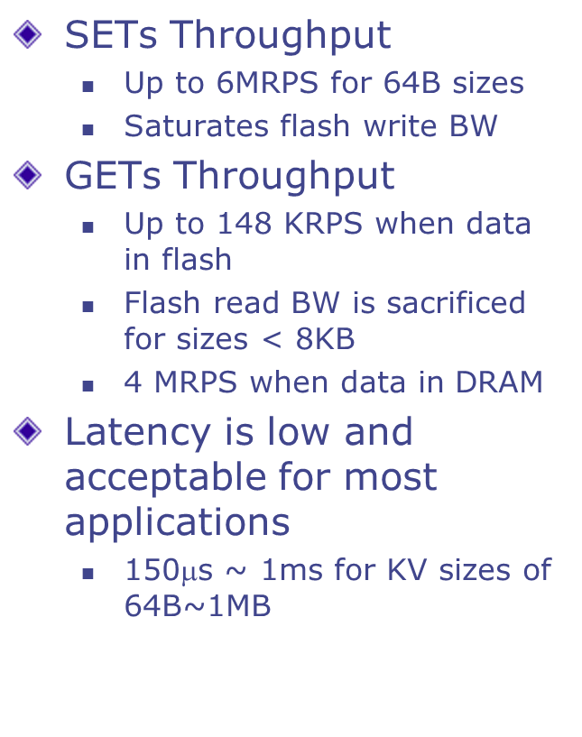
Single-node Performance
SETs Throughput
Up to 6MRPS for 64B sizes
Saturates flash write BW
GETs Throughput
Up to 148 KRPS when data in flash
Flash read BW is sacrificed for sizes < 8KB
4 MRPS when data in DRAM
Latency is low and acceptable for most applications
150$$s ~ 1ms for KV sizes of 64B~1MB
Notes:
A single-node Performance is great
For SET, we have up to 6 MRPS for small data sizes
And it saturates flash write bandwidth
For GET, we have up 148 KRPS from flash
Since flash accesses at page granularity is page, flash read bandwidth is wasted for data sizes smaller than 8KB.
And latency is low, from 150us to 1ms depending on data sizes

Slide 17
Experimental Setup to evaluate KVS servers
KVS server nodes to be evaluated
memcached: in-memory, 16GB DRAM
FatCache*: flash-based, 1GB DRAM, 0.5TB m.2 SSD
BlueCache: flash-based with accelerators, 1GB DRAM, 0.5TB NAND flash
Frontend: BG server [CIDR’13]
Backend: MySQL server
32-core xeon server, 64GB DRAM, 3 m.2 SSDs (1.5TB)
*Open-source project by Twitter, Inc.
Notes:
We also ran experiments to evaluate KVS servers using BG benchmark.
We have three different KVS servers to be evaluated.
1st is Memcached, which is in-memory KVS with 16GB of DRAM
2nd isFatCache, which runs twitter’s flash-based KVS software with 1GB DRAM and half-Terabyte of flash
3rd is BlueCache, which is a flash-based KVS with hardware accelerator coming with 1GB of DRAM and half terabyte of flash
On the frontend runs BG servers.
For the MySQL backend, we use a machine a 32-core xeon server with 64GB of DRAM and 1.5TB of SSDs.

Slide 18
What happens if DRAM-based KVS cache is too small
(4.0M, 7.4%)
(4.0M, 130KRPS)
4.18X
FatCache and BlueCache have no capacity misses but BlueCache is 4.18X faster because it performs all operations in hardware
BlueCache outperforms in-memory KVS when the latter has more than 7.4% misses
Average payload size ~= 1KB
Notes:
We have collected some interesting results from the experiments.
For memcached, we can see as user count increases, miss rates increase because DRAM is out of capacity, and as a result application throughput decreases.
For both BlueCache, and FatCache, miss rates and throughput are constant since capacity is never an issue.
And BlueCache has 4 times faster than BlueCache because we have hardware accelerators, and use flash more effectively.
When there is no misses because of capacity, DRAM is much faster than flash-based solutions.
But, when cache misses are taken into account, BlueCache can outperform in-memory KVS when latter has more than 7% misses.

Slide 19
Scalability of BlueCache
A single-node BlueCache is flash bandwidth limited
100 nodes should offer 100X throughput in theory, i.e. 15MRPS
4-nodes = 4X Throughput
BW is fairly distributed to application servers
4-node system uses 92.7% of total flash BW
Latency increase is small
DRAM access: ~2$$s increase in access latency per hop
Flash access: negligible increase access latency
Notes:
Fort a single node of BlueCache, the system is flash bandwidth limited.
So theoretically, if we have 100 nodes, we should have 100 times the throughput, i.e. 15MRPS
Because of limited hardware and other constraints, we tried with a system with 4 nodes, and it provides 4X the performance.
We can see that bandwidth is fairly distributed to application servers, and uses 93% of total internal flash bandwidth
Network Latency is small.
From DRAM, there is only 2us of increase per network hop because we chained the nodes in a linked list for simplicity.
And from flash, the network latency is negligible and access time is uniform.

Slide 20
BlueCache is low power
A BlueCache node uses 40 Watts at peak
20-node system consumes 800 Watts and provides 20TB storage
> 25X lower GB/Watt than x86-based systems
Platforms | Capacity (GB) | Power (Watt) | Capacity/Power (GB/Watt)
BlueCache | 20,000 | 800 | 25.00
FlashStore [VLDB’10] | 80 | 83.5 | 0.96
MICA [ISCA’15] | 128 | 399.2 | 0.32
Mega-KV [VLDB’15] | 128 | 899.2 | 0.14
Notes:
Each BlueCache nodes consumes 40 watts at peak.
And a 20 node systems consumes 800 watts and can provide 20TB storage on BlueDBM
BlueCache is 25X lower GB per watt than x86 machines.
Therefore BlueCache is low power

Slide 21
Conclusion
Distributed flash-based KVS offers a good big-data caching solution
Reducing access latency for distributed storage requires architectural modifications, including in-storage processors and fast storage networks
A properly designed KVS using flash and accelerators can outperform DRAM-based solution when cache misses are taken into account
Thank you
Notes:
To conclude:

Slide 22
Extras

Slide 23
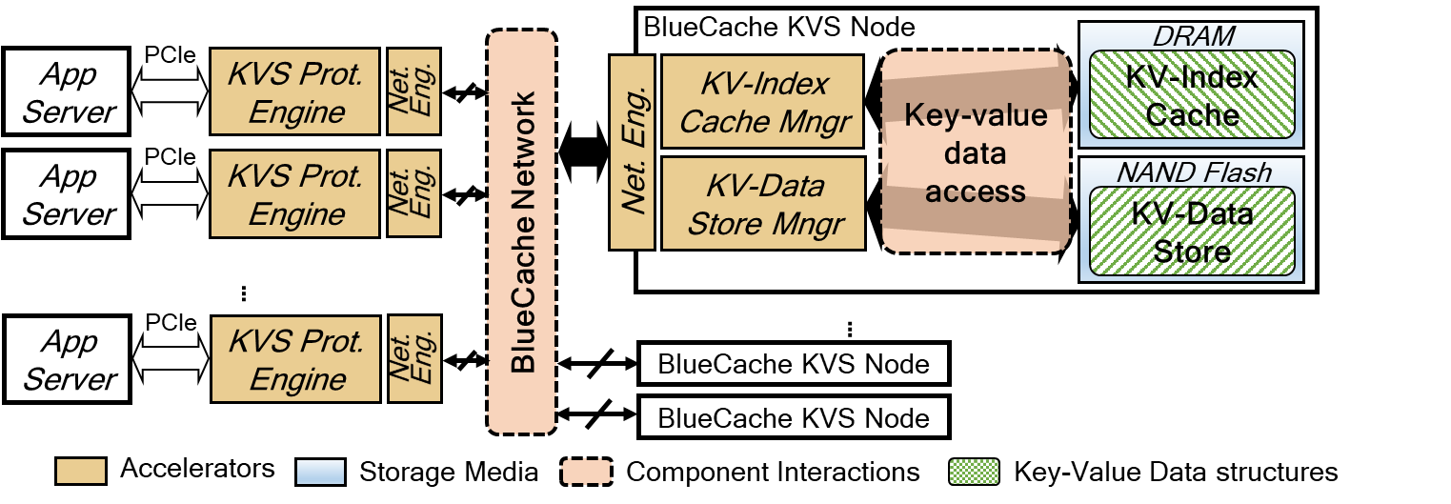
BlueCache: Flash-based KVS architecture
A Distributed NoFTL flash-based KVS with hardware accelerators
Application servers uses KVS Protocol Engine via PCIe to communicate with KVS nodes
KVS node uses hardware accelerators to directly manage KV pairs on raw NAND-flash array of chips
Notes:
Takes
With those motivations, we propose a new architecture for a flash-based KVS, called BlueCache
BlueCache is a distributed NoFTL flash-based KVS with hardware accelerators.
Applications servers, uses KVS Protocol engines via PCIe to communicate with KVS nodes.
And each KVS node uses hardware accelerators to directly manage KV pairs on raw NAND flash chips.
We also have DRAM on the node to mangage KV index cache, a small amount of DRAM is used to cache popular objects.
We have built a prototype system of BlueCache with 4 KVS nodes, and it is implemented on the BlueDBM platform with FPGAs.

Slide 24
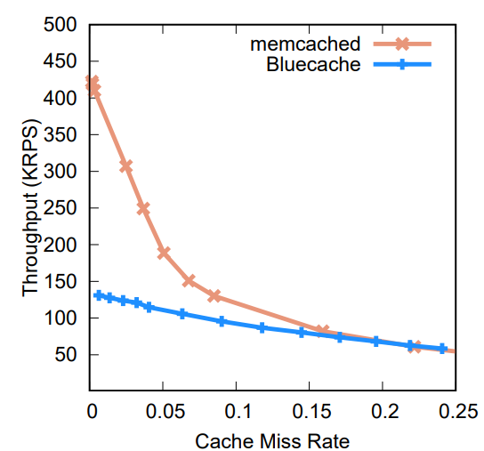
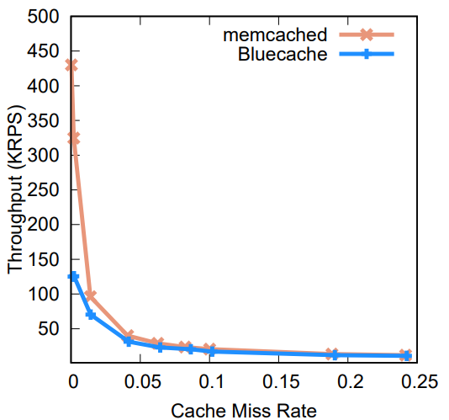

Application Throughput vs. Miss Rate
$T_{application}=miss\%×T_{backend}+(1−miss\%)×T_{KVS}$
Throughput vs. Capacity Miss Rate*
Throughput vs. Coherence Miss Rate⁺
Capacity Misses*= Cache misses due to lack of cache capacity
Coherence Misses⁺ = Cache misses due to the effect of application updates

Slide 25
Cache or Store on Disk?
Jim Gray’s 5-min Rule [1987]: Cache data in DRAM if DRAM Page cost < Disk IO-access cost
Thus in 1987 technology, if a randomly accessed disk page was re-used every 5 mins or less, it could be cached profitably
Need for cache size has grown with time because the DRAM cost has dropped relative to the cost of fast IO
2006, the break-even interval became 90 mins
2016, the break-even interval is 300 mins!
DRAM Page cost = (Pages per MB of DRAM / Price Per MB of DRAM)
DISK Page access cost = (IOPS Per Disk / Price Per Disk)
Notes:
How much cache should be properly provisioned in terms of cost and performance?
In 1987, Jim Gray and his colleague published the now-famous 5-minute rule for trading off memory and I/O capacity.
Their calculation compares the cost of holding a data permanently in DRAM with cost of performing disk I/O each time a record is accessed.
With the technology in 1987, pages referenced very 5 minutes should be memory resident by Jim’s Gray.
As the technology progresses, the cost of DRAM storage has dropped relatively to the cost of fast disk IO, and more data should be cached in memory
20 years after Gray’s rule, the break-even interval is 90 mins.
And more recently, in 2016, the break-even interval is 300 mins, roughly 5 hours.

Slide 26
Flash storage changes the tradeoff differently
Flash(SSD) is 100X faster than Disk (HDD)
Suppose we use flash instead of DRAM as cache
 | Break-even interval for caching 4KB pages*
RAM-HDD | 300mins (= 5hrs)
RAM-Flash | 0.8mins (~6.25X less than RAM-HDD)
No need to cache so much
 | Break-even interval for caching 4KB pages*
RAM-HDD | 5hrs
Flash-HDD | 45hrs (9X more than RAM-HDD)
We should and can cache a lot in flash
but ...
*Calculated with 2017 data
Notes:
Recent advances of flash memory technology also adds changes to Gray’s rule.
Flash memory is two orders-of-magnitude faster than rotating disks.
If we swap hard drives with flash memory, the break-even interval shortens by 6 folds, and becomes less than a minute.
This means there is no need to cache so much.
Suppose we use flash memory instead of DRAM as a cache.
Then the break-even interval increases by 9X, which means we should and we can cache a lot in flash

Slide 27
What Gray’s rule does not capture
Speed of the cache
Flash has 100X lower bandwidth than DRAM
Flash has 10⁴X higher latency than DRAM
Flash as a cache is not suitable for applications that cannot tolerate long latencies
Storage density
Flash has 100X capacity/area than DRAM
It is easier to satisfy Gray’s rule
Cached data format
Not all data is cached as raw pages
Data centers cache key-value pairs
Notes:
But there are several factors that Gray’s rule does not capture.
The first is the speed of the cache.
Compared with DRAM, Flash has about 100X lower bandwidth.
In terms of latency, flash has about 4 orders-of-magnitude longer latency than DRAM.
Thus, for certain applications which cannot tolerate long latencies, flash is not suitable as a cache
The second factor is the storage density.
Flash memory offers more than 100X higher density than DRAM.
Thus it is easier to fulfill Gray’s rule using flash as a cache.
The third is cached data format
Not all data is cached as raw disk pages
In data centers, data is cached key-value pairs

Slide 28
Key-value cache designs
Notes:
Now I am gonna discuss the designs of key-value caches in data centers

Slide 29
Latency profile of distributed flash-based KVS
Distributed processing involves many system components
Flash
Access
75 μs
Storage
Software
(OS, FTL, …)
100 μs
Network
20 μs
(10gE, Infi…)
KVS Processing
50~100 μs
100~1000 μs
20~1000 μs
…
Latency is additive
Notes:
Distributed processing of KV operation with flash incurs latencies from many system components.
For such a system, we have latencies from flash chip access, storage software from FTL and operation system, network and KVS processing.
Latency is additive because data needs to be copied to and from DRAM

