Slide 1
Local Laplacian Filters: Edge-aware Image Processing with a Laplacian Pyramid
Sylvain Paris, Adobe
Samuel W. Hasinoff, Toyota Technological Institute at Chicago and MIT CSAIL
Jan Kautz, University College London

Slide 2
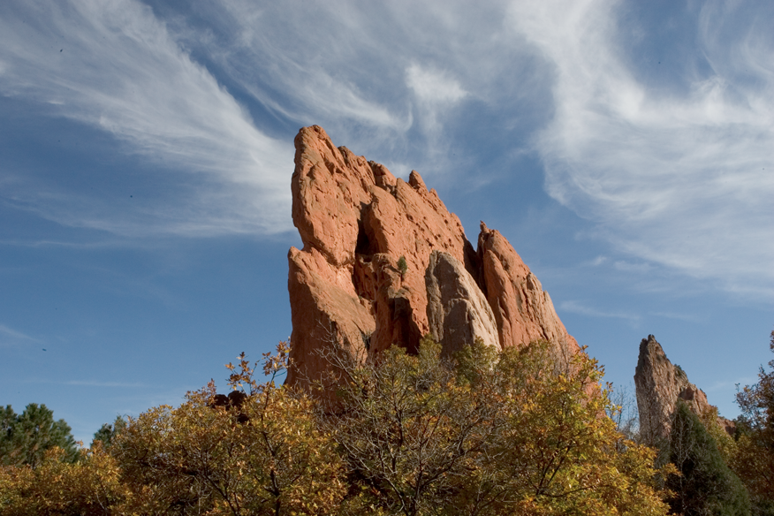
Example Application: Increase Level of Detail
input

Slide 3
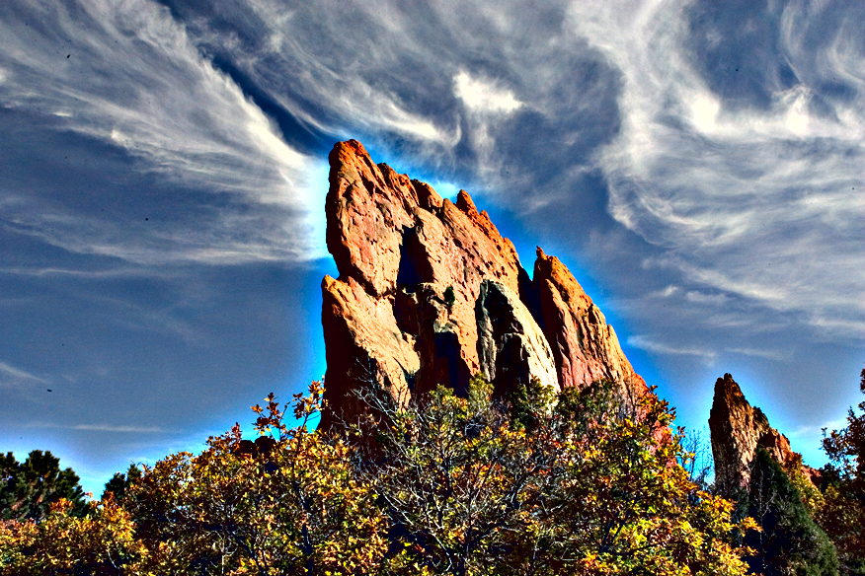
Naïve Solution: Boost High Frequencies
Halo ☹
unsharp mask

Slide 4
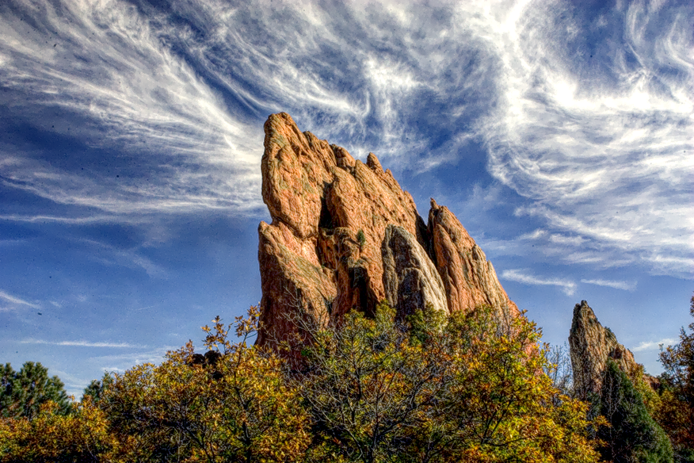
Taking Edges into Account for Halo-free Result
our result

Slide 5
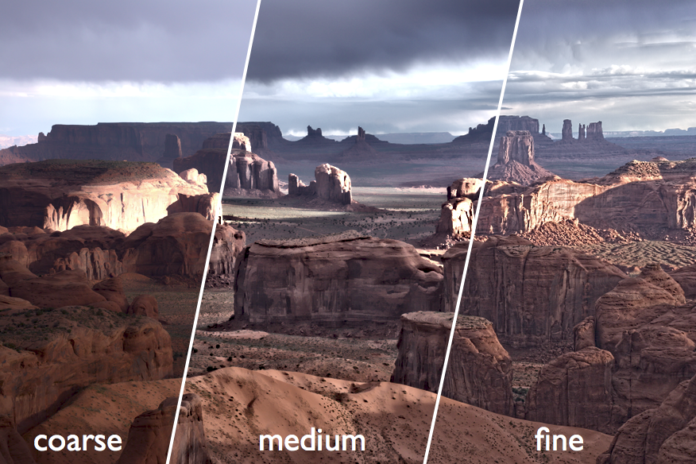
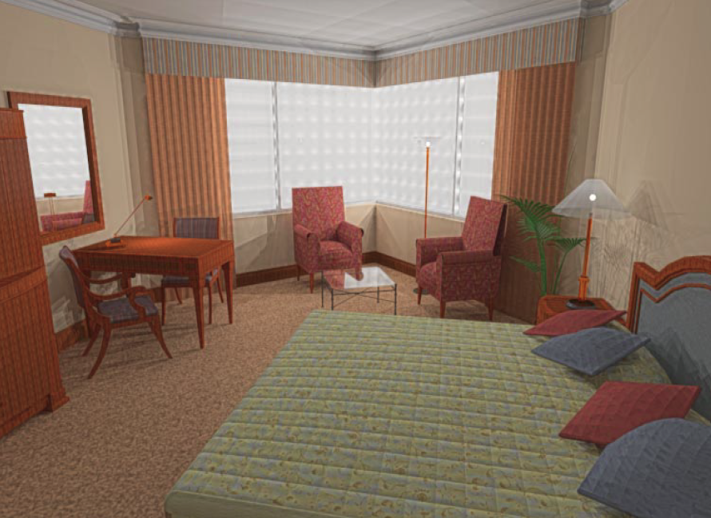
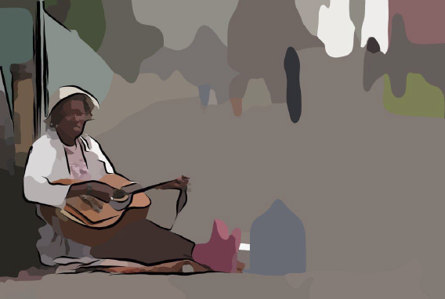
Applications
[Farbman et al. 2008]
Photo editing [Eisemann 04, Bae 06, Farbman 08…]
Tone mapping [Tumblin 99, Durand 02…]
Abstraction [DeCarlo 02, Winnemoeller 06…]
[Tumblin and Turk 1999]
[DeCarlo and Santella 2002]

Slide 6
Talk Outline
Background and related work
Our algorithm
Analysis
Results

Slide 7
Background on Gaussian Pyramids
Resolution halved at each level using Gaussian kernel
level 3
(residual)
level 2
level 1
level 0

Slide 8
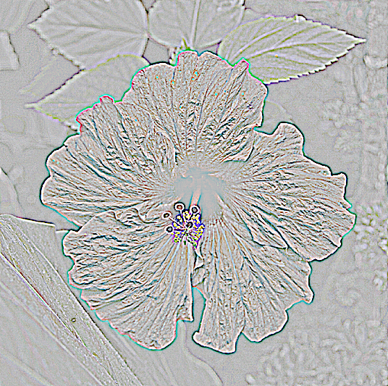
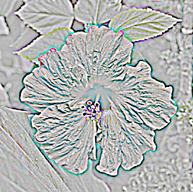
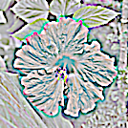
Background on Laplacian Pyramids
Difference between adjacent Gaussian levels
level 3
(residual)
level 2
level 1
level 0

Slide 9
Pros and Cons of Pyramids
Useful for compression [Burt 83], texture synthesis [Heeger 95], harmonization [Sunkavalli 10]…
Believed to be unsuitable for edge-aware processing
Use isotropic & spatially invariant kernels
But edges are anisotropic & well located
“Manipulating pyramids generate halos”
We show otherwise!
boosting high-frequency bands
Notes:
- isotropic filters
- correlations over different scales

Slide 10
Two-scale Alternatives
Dedicated schemes to account for edges
Anisotropic diffusion [Perona 90], bilateral filter [Tomasi 98], weighted least squares [Farbman 08]…
Sophisticated tools: PDEs, spatially varying kernels…
All work well for standard applications
But parameters can be difficult to set, some may have edge artifacts…
Notes:
- but is anyone (else) really asking this question?
- WLS is multiscale too, just no downsampling

Slide 11
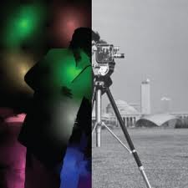
Pyramid Approaches
Iterated filters [Fattal 07, Farbman 08]
Same pros and cons as two-scale versions
Edge-avoiding wavelets [Fattal 09]
Decorrelate pyramid coefficients
Smooth gain maps [Li 05]
Preserve coefficient correlation
Works well with Haar wavelets, not great with Laplacian pyramids
[Fattal 09]
[Li et al. 05]
Notes:
- but not for detail enhancement or extreme settings

Slide 12
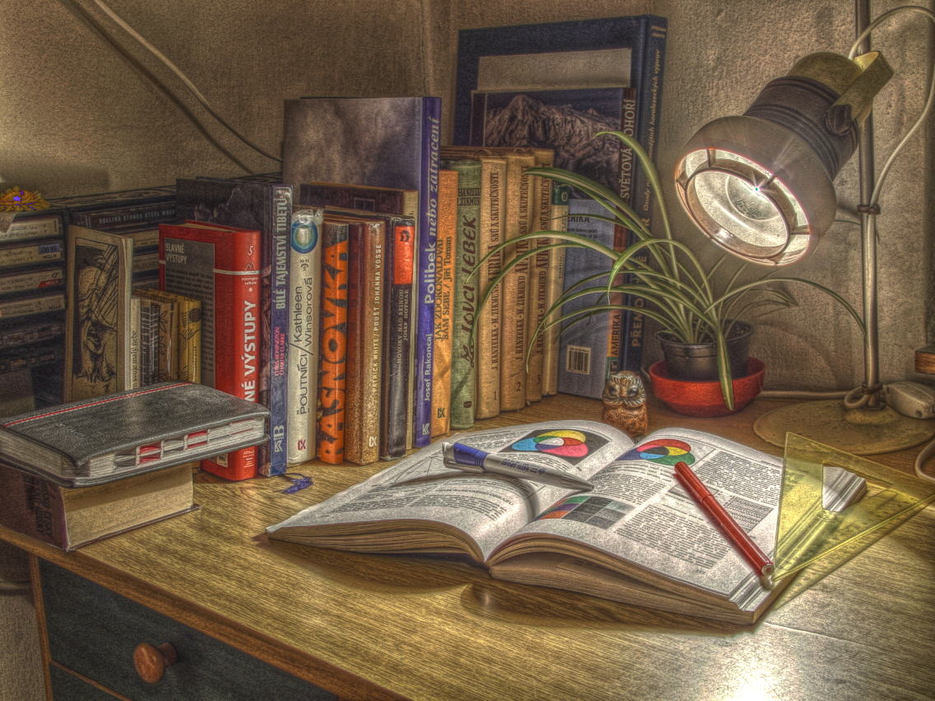
Our Contributions
Edge-aware editing with Laplacian pyramids
We use a classical multi-scale representation
Robustness: strong effects, no artifacts
We achieve extreme enhancements where other methods fail

Slide 13
Talk Outline
Background and related work
Our algorithm
Analysis
Results

Slide 14
Our Strategy: Local Adaptation
Generate an image that looks good for a small neighborhood
It may look bad elsewhere
“Combine data from all neighborhoods”
Notes:
- bring up the notion of “reference value” here
(just center pixel in neigh), to lead in to
Gaussian pyramid coeff as ref. value later

Slide 15
Example: Local Contrast Increase
input

Slide 16
Example: Local Contrast Increase
input

Slide 17
Example: Local Contrast Increase
input
output with local contrast increased

Slide 18
Simple Local S-shaped Curve
output
input

Slide 19
Only Local Result Matters
Artifacts appear elsewhere
Not a problem, we use only local data
Flat ☹
The processed image only needs to look good locally
Unchanged ☹
output with local contrast increased
Notes:
----- Meeting Notes (8/8/11 15:30) -----
hold local function fixed.. dont' change at every point

Slide 20
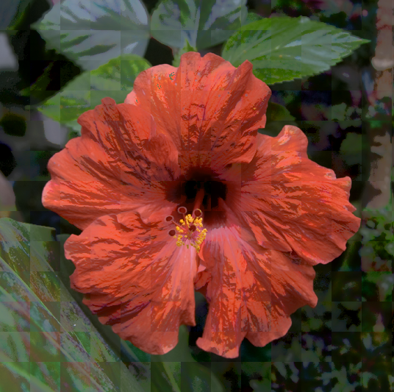
Naïve Stitching
Paste local results side by side?
Visible seams, artifacts…
Possible heuristics: vary patch size, smooth seams…
But ad hoc and brittle
Notes:
- good idea for visualization
- note that it’s single-scale only

Slide 21
Our Multi-scale Approach
We build the Laplacian pyramid of the output coefficient by coefficient
For each coefficient
Generate “locally good” image
Compute Laplacian pyramid of that image
Copy coefficient to output pyramid
Notes:
- say that the “reference value” is a Gaussian pyramid coeff?

Slide 22
Illustration
Output Laplacian pyramid
level 2
level 1
level 0
input image

Slide 23
Illustration
Output Laplacian pyramid
level 2
level 1
level 0
input image

Slide 24
Illustration
Output Laplacian pyramid
level 2
level 1
level 0
input image
“locally good” image

Slide 25
Illustration
Output Laplacian pyramid
level 2
level 1
level 0
input image
“locally good” image
partial pyramid

Slide 26
Illustration
Output Laplacian pyramid
copy
level 2
level 1
level 0
input image
“locally good” image
partial pyramid

Slide 27
Illustration
Output Laplacian pyramid
level 2
level 1
level 0
input image

Slide 28
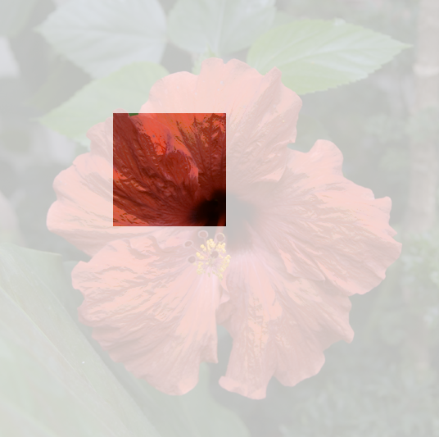
Illustration
Output Laplacian pyramid
level 2
copy
level 1
level 0
input image
“locally good” image
partial pyramid

Slide 29
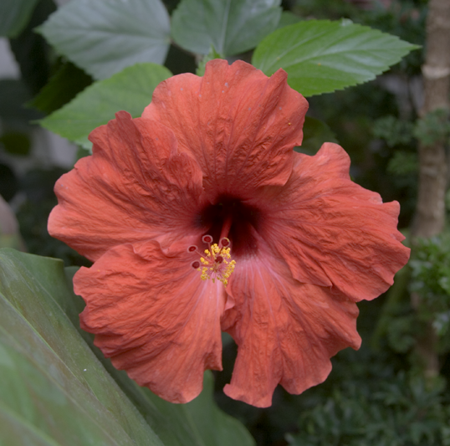
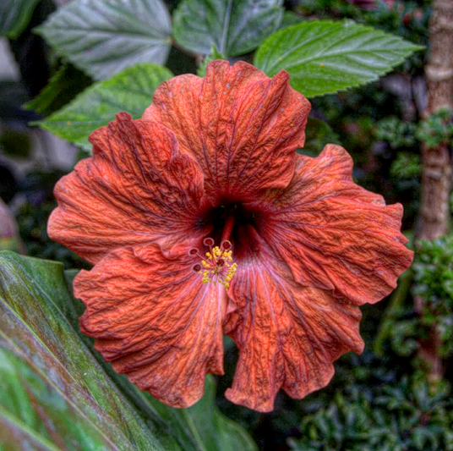
Possible Nonlinearities
Detail manipulation
σ
σ
g₀
input image
details enhanced

Slide 30
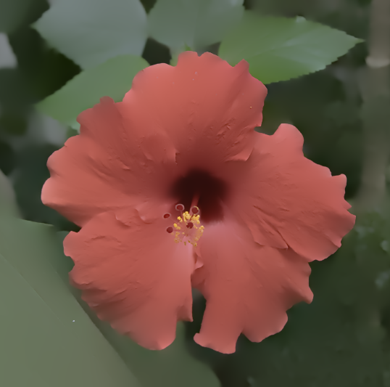
Possible Nonlinearities
Detail manipulation
σ
σ
g₀
input image
details reduced

Slide 31
Possible Nonlinearities
Dynamic range manipulation
σ
σ
g₀
input image
tone mapped

Slide 32
Possible Nonlinearities
Can be combined, e.g. tone map + boost details
σ
σ
g₀
input image
tone mapped +
details enhanced

Slide 33
Talk Outline
Background and related work
Our algorithm
Analysis
Results
Notes:
Thanks, Sylvain.
I'll start with some analysis to build up intuition why our method works.

Slide 34
Analysis
Laplacian pyramids built with tiny kernels
Each Laplacian coefficient depends only on 9 × 9 Gaussian coefficients at same scale
Laplacian coefficients akin to 2nd derivatives
Notes:
The first thing to point out is that Laplacian pyramids are built from tiny kernels, so the influence of a given coefficient is limited. At a given scale, each coefficient only depends on a 9x9 neighborhood
And second, we can think about Laplacian coefficients as approximating a 2nd derivative quantity at a given scale.

Slide 35
Intuition for 1D Edge
=
Input signal
Decomposition for the sake of analysis only
We do not compute it in practice
Notes:
So for illustration let's take a look at a particular 1D edge, and look at how it gets processed at a given scale.
For the sake of analysis, we can decompose this edge into 3 components:

Slide 36
Intuition for 1D Edge
=
Input signal
Discontinuity
Decomposition for the sake of analysis only
We do not compute it in practice
Notes:
First, an ideal step edge, representing a large discontinuity in tone.

Slide 37
Intuition for 1D Edge
=
+
Input signal
Discontinuity
Texture
Decomposition for the sake of analysis only
We do not compute it in practice
Notes:
Second, high-frequency texture, representing image detail

Slide 38
Intuition for 1D Edge
=
+
+
Input signal
Discontinuity
Texture
Smooth
Decomposition for the sake of analysis only
We do not compute it in practice
Notes:
And finally, a smooth component, that describes smooth tonal variation

Slide 39
Intuition for 1D Edge
=
+
+
Input signal
Discontinuity
Texture
Smooth
Does not contribute to Lap. pyramid
at that scale (d²/dx²=0)
Notes:
For the rest of our analysis we ignore the smooth component.
We can do this because it has zero 2nd derivatives, so it doesn't contribute to any coefficients at this scale

Slide 40
Ideal Texture Increase
Discontinuity
Texture
Keep unchanged
Amplify
Notes:
As an example, let's consider the application of detail enhancement, which corresponds to increasing the texture.
In terms of our decomposition, ideally … we would hold the discontinuity unchanged … and amplify the texture component

Slide 41
Our Texture Increase
σ
σ
σ
σ
Input signal
Local nonlinearity
“Locally good” version
user-defined parameter σ defines texture vs. edges
Notes:
In our approach, we consider each coefficient separately – and in particular let's take a look at the coefficient corresponding to the circled pixel. By applying a nonlinearity that's specific to that coefficient, we get a processed version of the input that has the desired local properties
Here, the circled coefficient is on the left side of the discontinuity, its local result only affects the left side. … The coefficients on the right get processed too, but they have their own local results.
For texture increase, we use an S-shaped curve, where the S is centered at the value of the circled coefficient. This S has a limited range, defined by a user parameter, that distinguishes fine-scale texture (which gets enhanced) from larger discontinuities (which are unaffected). We can also visualize this on the input signal to see how only some coefficients affect the result.

Slide 42
Our Texture Increase
=
+
+
“Locally good”
Only left side is affected
Discontinuity
Unaffected
☺
Texture
Left side is ok,
right side is not
😐
Smooth
Does not contribute to Lap. pyramid
at that scale (d²/dx²=0)
Notes:
Let’s look at the locally-good result In terms of our decomposition.
The step edge, as desired, is unaffected,
For the texture component, only the left side has been processed – but intuitively, that’s okay.

Slide 43
Discussion
Negligible because collocated with discontinuity
=
+
+
“Locally good”
Only left side is affected
Discontinuity
Unaffected
☺
Texture
Left side is ok,
right side is not
😐
Smooth
Does not contribute to Lap. pyramid
at that scale (d²/dx²=0)
Notes:
Texture values just on the other side of the discontinuity have little impact, because they’re dominated by the much bigger discontinuity

Slide 44
Discussion
Negligible because collocated with discontinuity
Negligible because Gaussian kernel ≈ 0
=
+
+
“Locally good”
Only left side is affected
Discontinuity
Unaffected
☺
Texture
Left side is ok,
right side is not
😐
Smooth
Does not contribute to Lap. pyramid
at that scale (d²/dx²=0)
Notes:
And texture values further away have less impact because the kernel that combines them is close to zero there.

Slide 45
Discussion
Negligible because collocated with discontinuity
Negligible because Gaussian kernel ≈ 0
=
+
+
“Locally good”
Only left side is affected
Discontinuity
Unaffected
☺
Texture
Left side is ok,
right side is not
😐
Smooth
Does not contribute to Lap. pyramid
at that scale (d²/dx²=0)
Good approximation
to ideal case overall ☺
(formal treatment in paper)
Notes:
The takeaway message is that overall, the locally-good result is a good approximation to the ideal case.
In the paper, we have a more formal version of this analysis.

Slide 46
Talk Outline
Background and related work
Our algorithm
Analysis
Results
Notes:
Finally, I'd like to show some results and compare to other methods.

Slide 47
Running Times
Main shortcoming of the approach: it is slow
1 megapixel in 1 minute
Can be sped up with heuristic (see paper)
Highly data parallel
8 cores: 1 megapixel in 4 seconds
Notes:
The main limitation of our method is that it's relatively slow. A straightforward C++ implementation takes about 1 minute to process a 1 megapixel image (using a single thread).
In the paper we describe a heuristic for speeding this up, without noticeable loss in quality.
Note that since our method computes each coefficient independently, the method is highly parallel. For example, by using an 8-core CPU, we can go 8x faster, which gets the running time down to about 4 seconds per megapixel.

Slide 48
Texture Manipulation Input
Notes:
I’ll start by showing some results of our method for texture manipulation
Here’s a sample input image

Slide 49
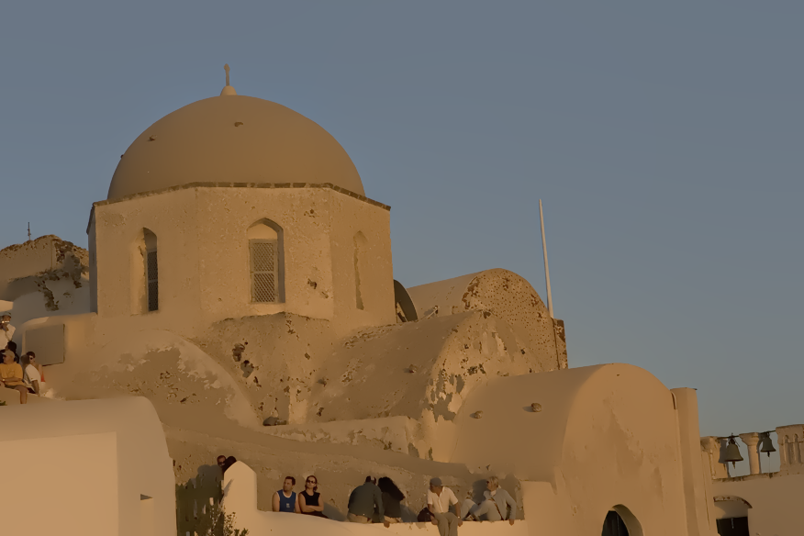
Texture Manipulation Decrease
Notes:
Here’s our result for decreasing the texture. It shows clean edge-preserving blur, without bleeding artifacts. You can see that important edges are preserved over different scales, maintaining detail over both the architecture and the people in the scene.
(the banding artifacts in sky are due to the projector)

Slide 50
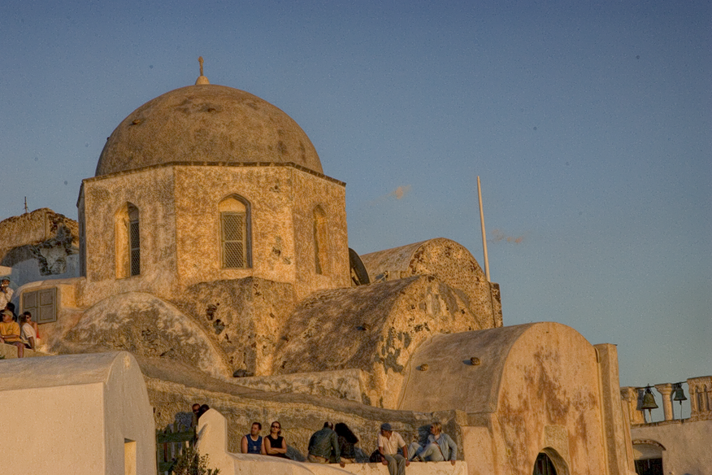
Texture Manipulation Small Increase
Notes:
Here’s out result for increasing texture, amplifying detail, again with no visible artifacts.
And we can push this even further.

Slide 51
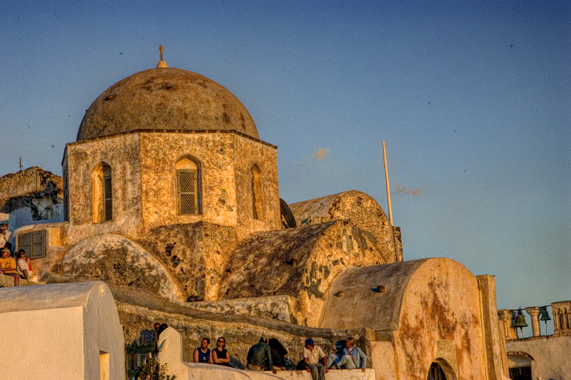
Texture Manipulation Large Increase
Notes:
Where our method really shines is for very strong detail enhancement.
Our method is robust enough to support very strong enhancement like this, without artifacts.

Slide 52
Texture Manipulation Input
Notes:
For reference, here’s the original input image.

Slide 53
Texture Manipulation Large Increase
Notes:
And again, here’s our strong texture enhancement result.

Slide 54
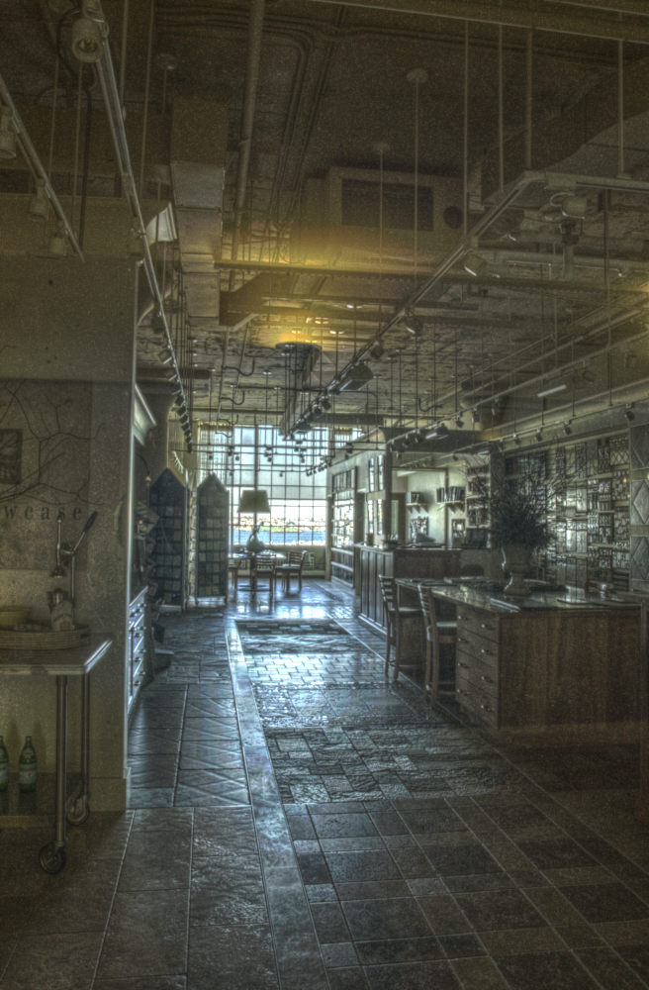
Compared to Bilateral Filter
Rim ☹
tone mapped HDR image
close-up (bilateral filter)
close-up (our result)
Notes:
When comparing to other methods, differences in quality can really be appreciated at edges. Bilateral filtering, for example, can give rise to rims at strong edges. Although this problem can be addressed with post-processing, our method delivers clean edges without any extra steps or parameters to tune.

Slide 55
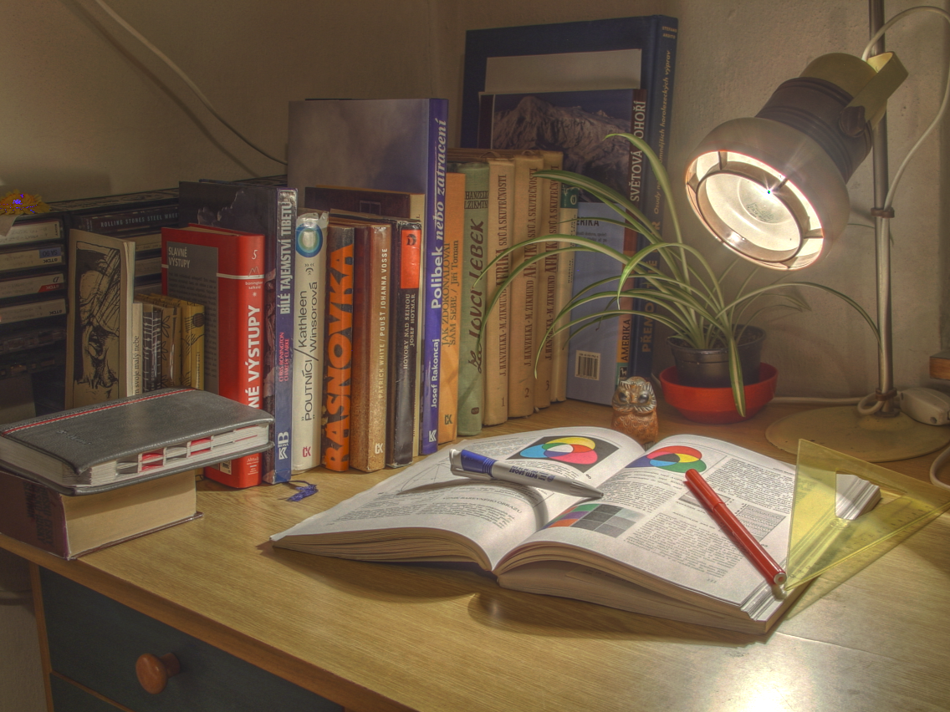
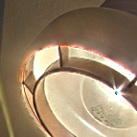
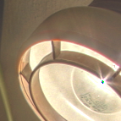
Compared to Edge-avoiding Wavelets
Aliasing ☹
tone mapped HDR image
close-up (edge-avoiding wavelets)
reproduced from [Fattal 09]
close-up (our result)
Notes:
Edge-avoiding wavelets can also have issues at edges, sometimes showing strong aliasing artifacts at discontinuities. By contrast, our results don’t suffer from this kind of artifact.

Slide 56
Naïve gamma compression
Notes:
Moving on to some tone mapping results, here’s a baseline showing an HDR (or high dynamic range) image compressed with naïve gamma curve. We can do much better with local, edge-preserving tone mapping.

Slide 57
Neutral rendition Smooth Gain Maps [Li et al. 2005] Parameters from the original paper
Notes:
Here’s a result from Li et al’s smooth gain maps method, showing a neutral photographic-style rendition. And this result is very satisfying.

Slide 58
Neutral rendition Weighted Least Squares [Farbman et al. 2008] Parameters set by the authors
Notes:
Here’s the result from Farbman et al’s weighted least squares approach – again a very satisfying result.

Slide 59
Neutral rendition Our result
Notes:
And here’s our result for this scene, which is very satisfying as well. Apart from some differences in overall tone, these methods all look about the same and perform at roughly the same level.
The real challenge is for more exaggerated renditions.

Slide 60
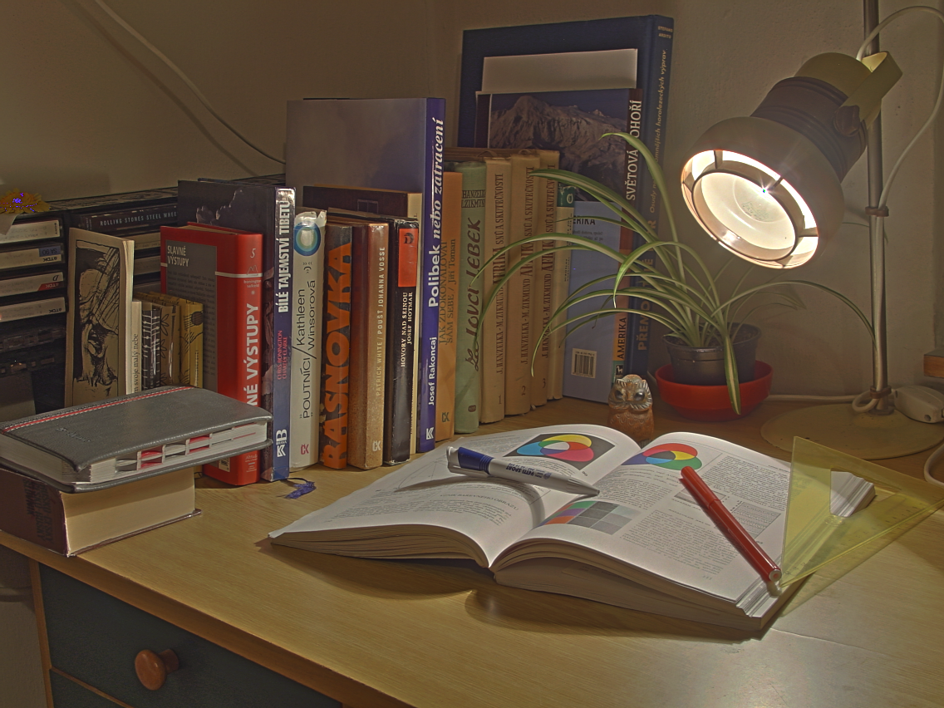
Exaggerated rendition Smooth Gain Maps [Li et al. 2005] Parameters from the original paper
close-up
Halo ☹
close-up
Halo ☹
Limited details ☹
Notes:
When we tone map *and* increase the level of detail, other methods start to show problems.
Smooth gain maps, for example, are not well suited for increasing detail. Using them for this purpose gives rise to halo artifacts at edges.

Slide 61
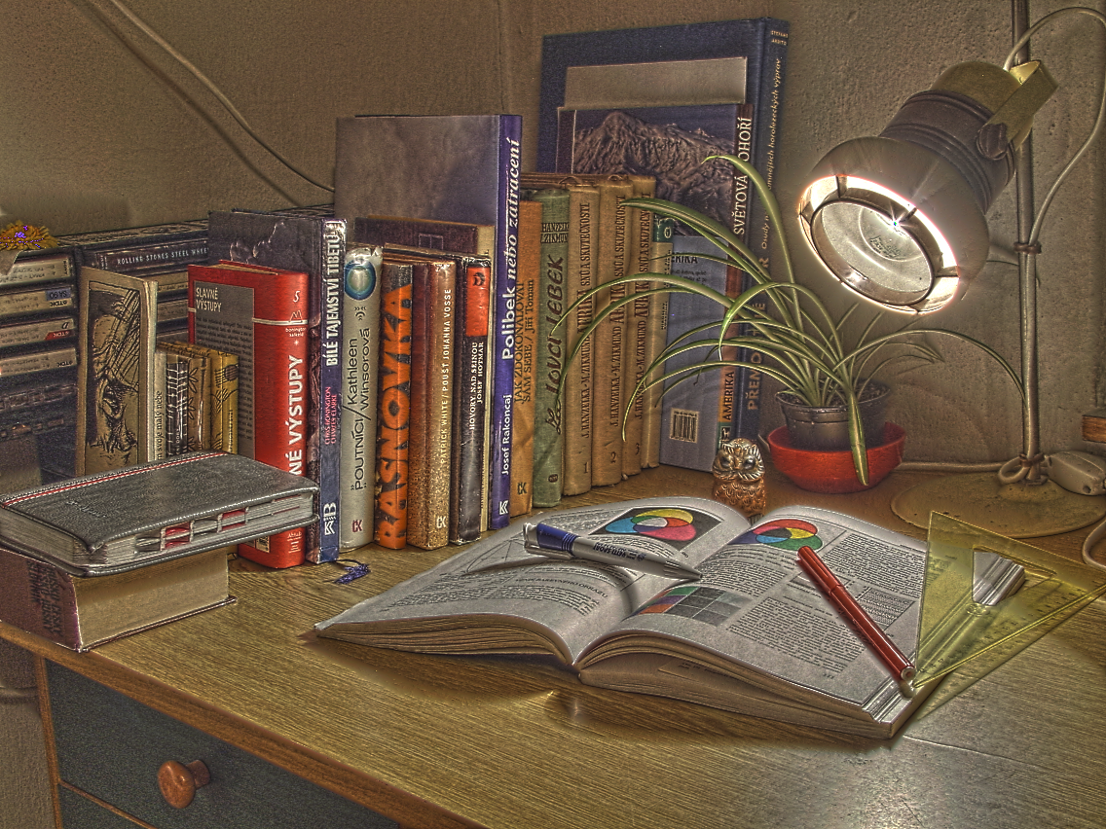
Exaggerated rendition Weighted Least Squares [Farbman et al. 2008] Parameters set by the authors
close-up
Rim ☹
close-up
Rim ☹
Notes:
Weighted least squares is better at enhancing details, but it too leads to artifacts at edges.
The problem here isn’t about us being bad at setting parameters for these methods. In this case, Dani Lischinski has been very kind to spend time tuning the parameters for us. But even with good settings, some problems remain

Slide 62
Exaggerated rendition Our result
close-up
close-up
Notes:
By comparison, our result lets us increase detail aggressively – but without suffering from any of those artifacts. This gives a look that’s reminiscent of classic exaggerated HDR tonemapping - but without the distracting halos and rims.

Slide 63
Summary of Comparisons
All methods do well on neutral renditions
Previous work exhibits halos for large increases in detail
Our approach produces clean results even on hard cases: no aliasing, no rims, no halos
Notes:
Just to reiterate, while previous methods do well on neutral renditions, they start to break for large increases in detail. Our method is more robust, and lets us push effects further without artifacts.

Slide 64
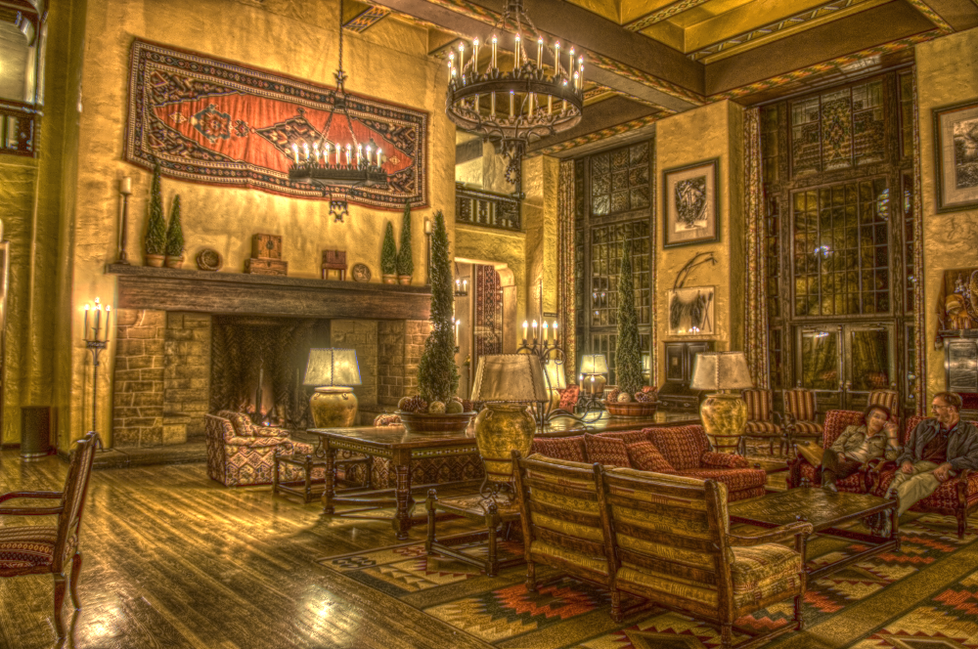
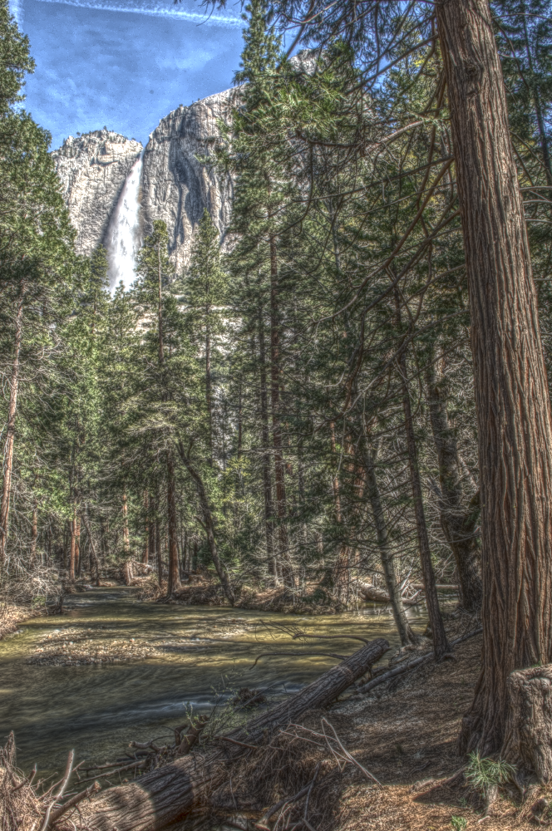
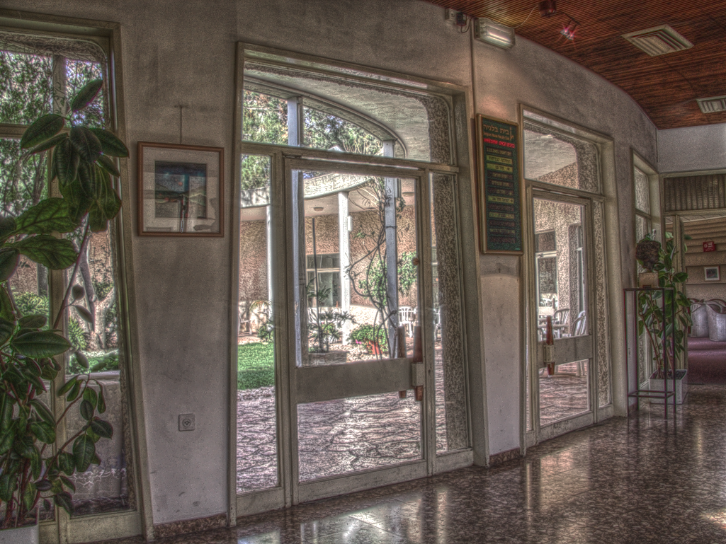
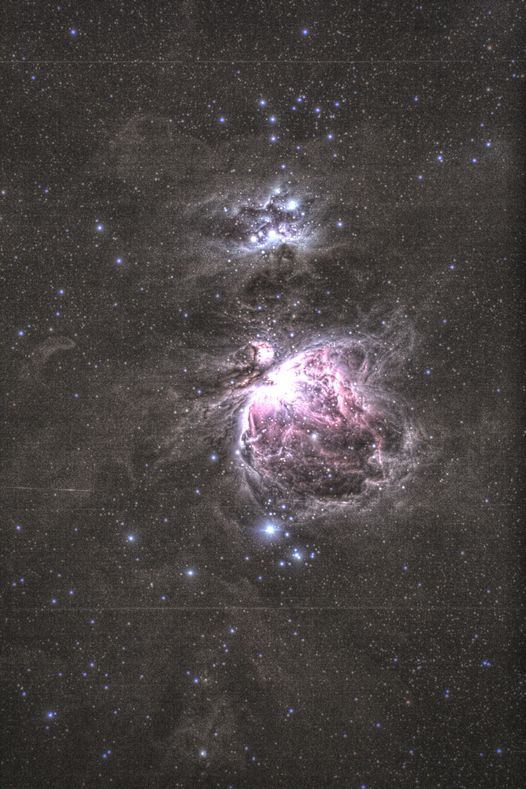
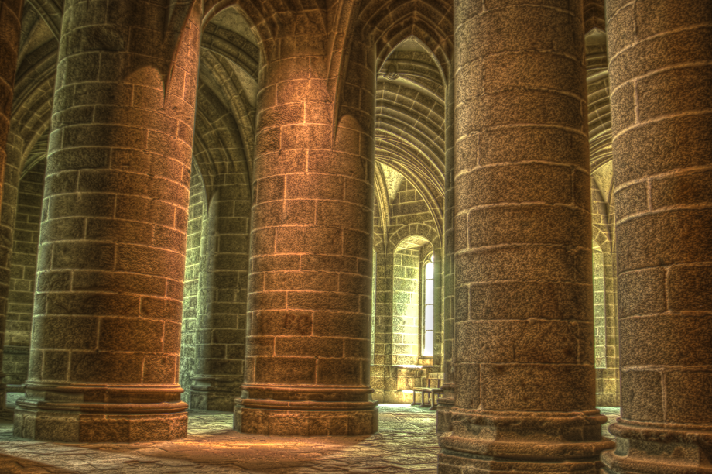
In Supplemental Material
Extensive validation and comparison
No hand tuning: all results generated by a script
Matlab source code to reproduce the results
Notes:
In the supplemental material you can find many more results and comparisons. None of our results were hand tuned - we used the same settings for all datasets, and we provide Matlab code to reproduce the results.

Slide 65
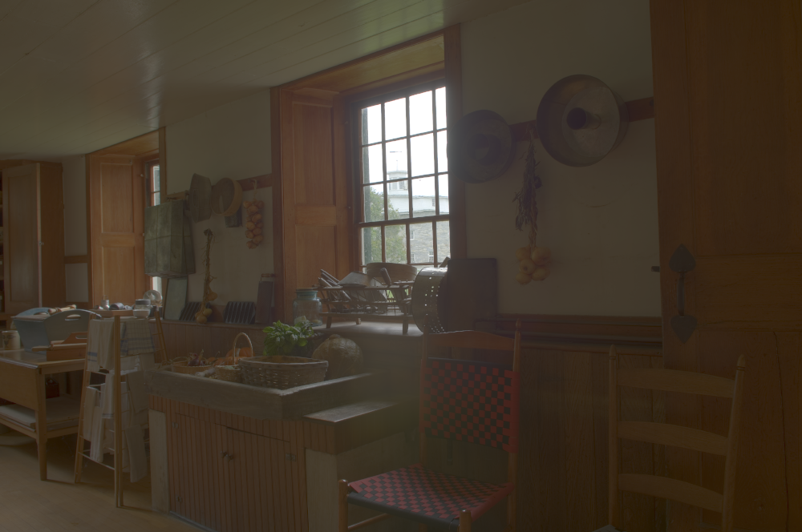
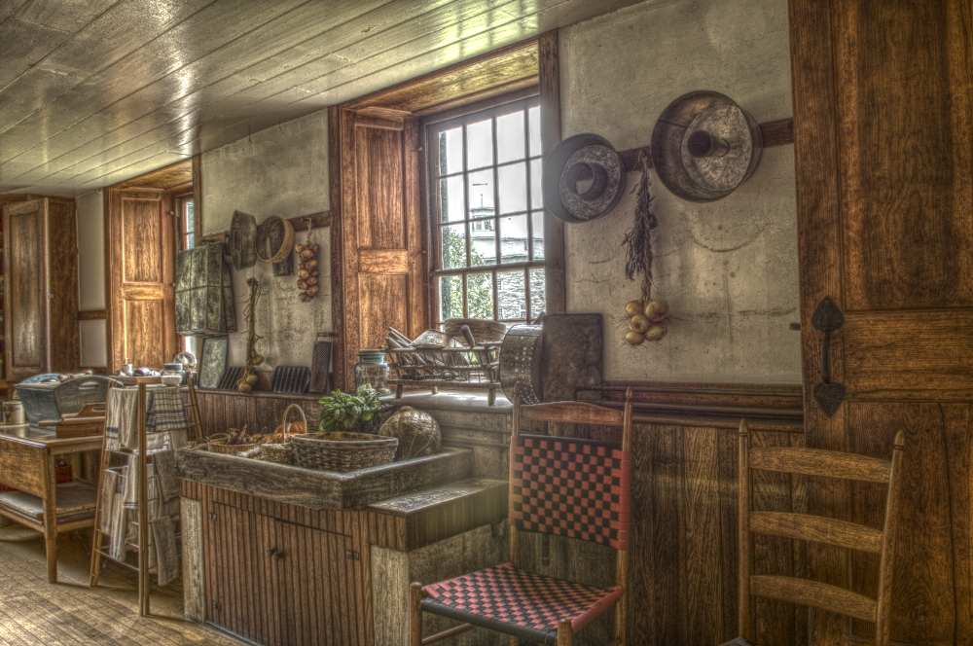
Conclusions
HDR input (gamma compressed)
Laplacian pyramids good for edge-aware editing
Classical notion of multi-scale
Standard image resizing routines
Enables wider range of effects
our result
Notes:
To conclude, we’ve shown, contrary to popular belief, that classic Laplacian pyramids are well-suited for edge-aware editing. Our method builds on well known, basic tools and can be implemented using image resizing and pointwise functions
Our method is also particularly robust. This lets us achieve stronger effects than previously possible, without artifacts.

Slide 66
We would like to thank…
Ted Adelson, Bill Freeman, Frédo Durand, and the MIT Graphics Group for their insightful discussion and feedback
The people who make their data available on the web
The authors of [Li et al. 05] and [Farbman et al. 08] who helped us compare to their work
The anonymous reviewers for their constructive comments
This work was supported in part by an NSERC Postdoctoral Fellowship, the Quanta T-Party, NGA NEGI-1582-04-0004, MURI Grant N00014-06-1- 0734, and gifts from Microsoft, Google, and Adobe
Notes:
We’d like to thank all of these people and funding sources for their support. In particular we’d like to acknowledge Ted Adelson, Bill Freeman, Fredo Durand, and the rest of the MIT graphics group for their feedback on this project.
Thanks for your attention.

Slide 67
Conclusions
HDR input (gamma compressed)
Laplacian pyramids good for edge-aware editing
Classical notion of multi-scale
Standard image resizing routines
Enables wider range of effects
our result

Slide 68
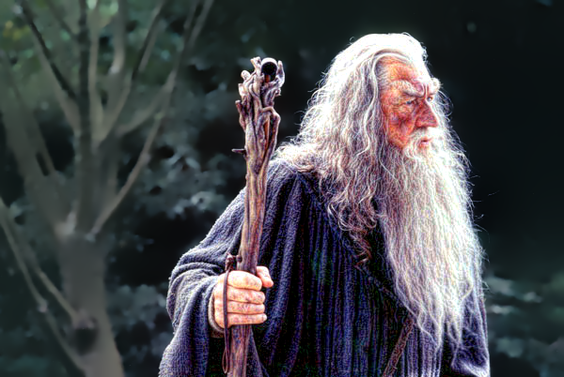
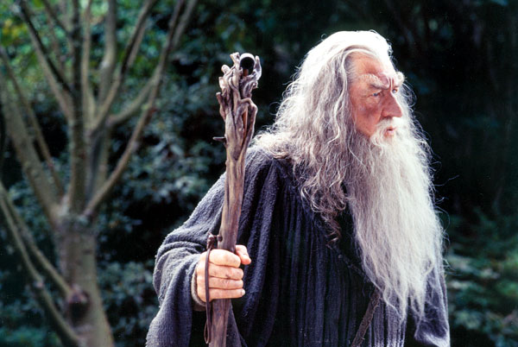
Spatially-varying Processing
input image
fg details enhanced, bg details reduced
user-provided mask

