Slide 1
Beyond the Piece of Cardboard: Learning to Adjust Photographs
Sylvain Paris, Adobe (sparis@adobe.com)
with Mathieu Aubry (ENS/INRIA), Soonmin Bae (MIT), Vladimir Bychkovsky (MIT), Eric Chan (Adobe), Sam Hasinoff (Google), Jan Kautz (UCL), Frédo Durand (MIT),

Slide 2
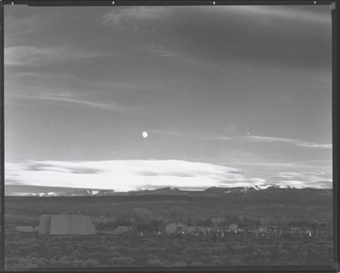
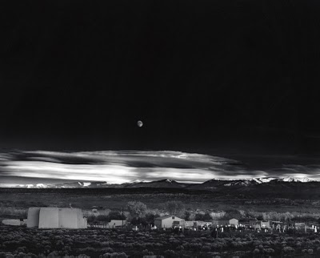
Photos need be retouched
contact print
final print by Ansel Adams

Slide 3
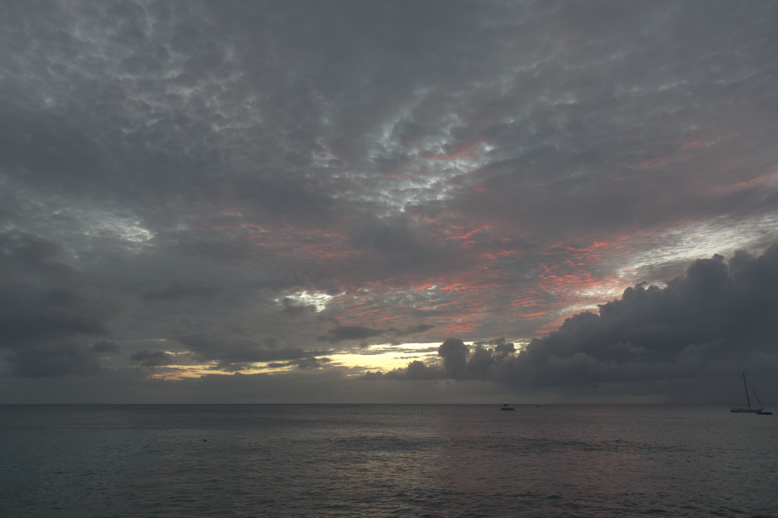
“Straight out of the camera”

Slide 4
After adjustment

Slide 5
Printing photos in the darkroom
projector with negative
choice of paper
grade paper, properties vary with light color
projecting negative onto paper
dodging and burning
finishing the print
choice of chemicals, possibly painting them
critical process to get top prints
tedious, error-prone
piece of cardboard
paper

Slide 6
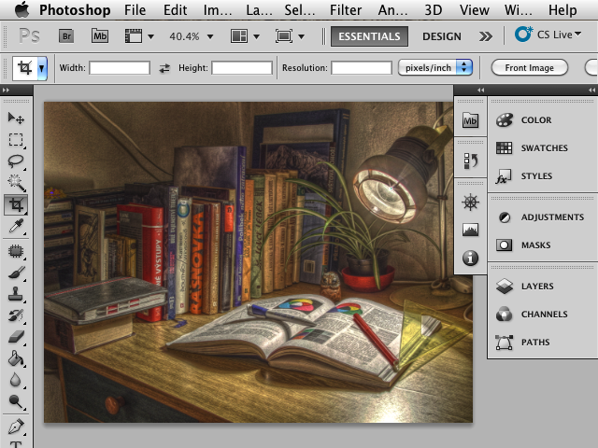
The digital era: Photoshop
Zoom
Unlimited undo
Accurate selection
Preview
HDR
Panorama
And more…

Slide 7
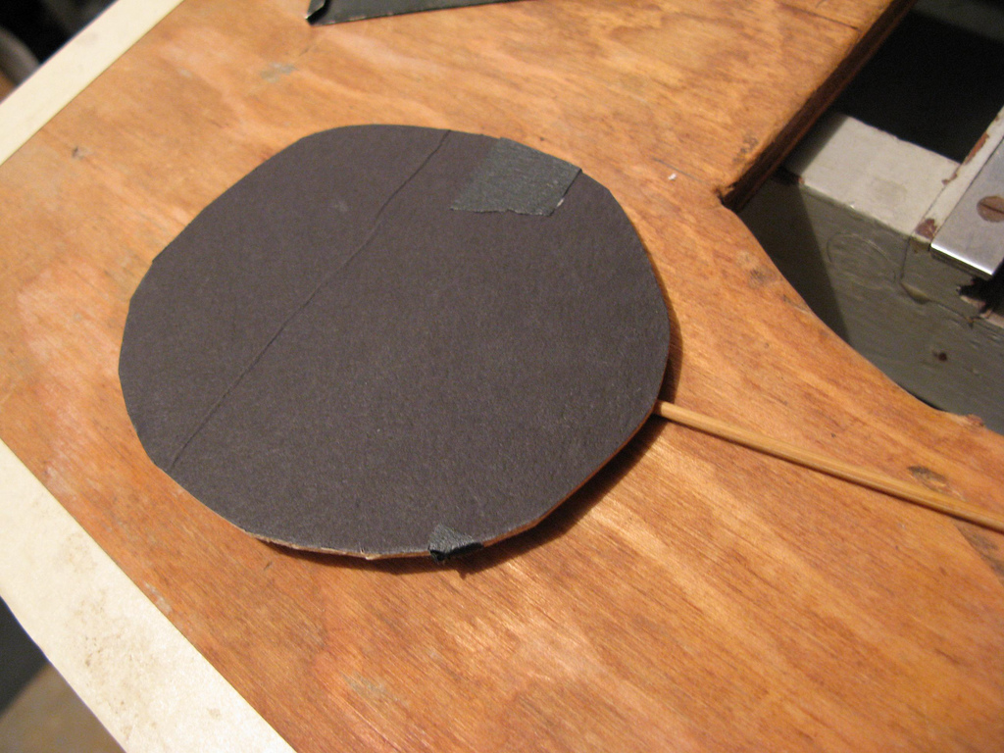
The digital era: Photoshop
Photoshop is only a better piece of cardboard.
We need algorithms that help users make better pictures!
Zoom
Unlimited undo
Accurate selection
Preview
HDR
Panorama
And more…

Slide 8
Solution #1 Model-based Adjustment
with Soonmin Bae and Frédo Durand
[SIGGRAPH’06]

Slide 9
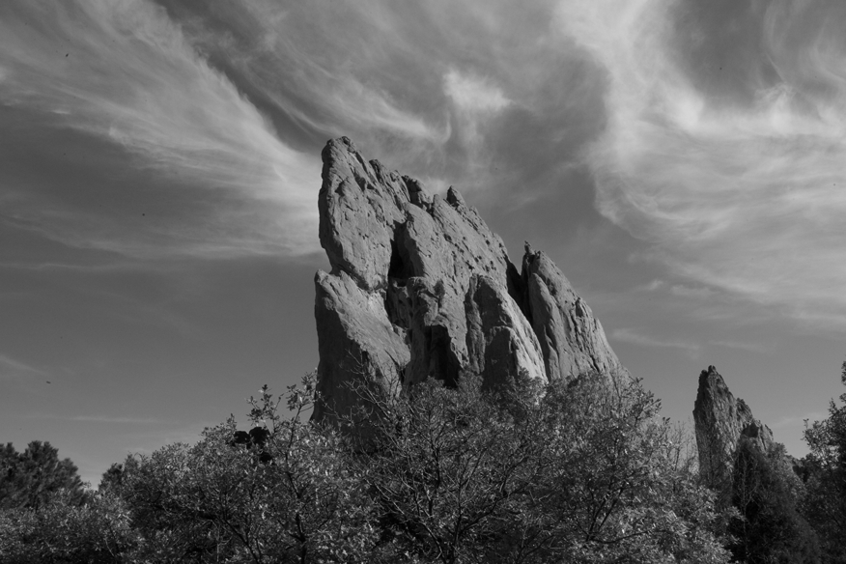
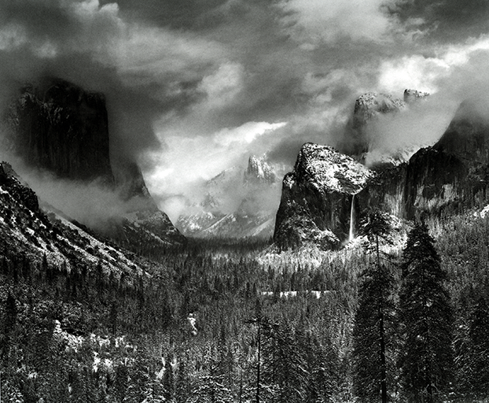
Scenario
We want
with the look of
Notes:
The goal of our work is to allow users to achieve a particular photographic look.
To specify “look”, we propose to use model photographs.
For example, we want to take this casual photograph as an input and give it the look of Ansel Adams’ landscape.

Slide 10
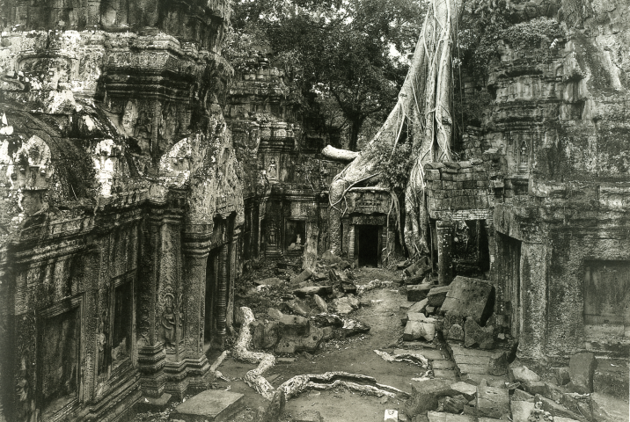
Tonal Aspects of Look
Ansel Adams
Kenro Izu
Notes:
Let us look closely at what we call the tonal aspects of look. We will see that they can be discussed in terms of multiscale contrast.
Let us compare two photos.

Slide 11
Tonal aspects of Look: Global Contrast
Ansel Adams
Kenro Izu
High Global Contrast
Low Global Contrast
Notes:
First look at the overall contrast.
Ansel Adams’ photo, on the left, has a high global contrast. The rocks and trees are dark, but the sky is bright.
In comparison, Kenro Izu’s photo is gray overall and has a lower global contrast.

Slide 12
Tonal aspects of Look: Local Contrast
Ansel Adams
Kenro Izu
Variable amount of texture
Texture everywhere
Notes:
Now, consider local contrast.
The photo by Ansel Adams has very textured regions like trees, but it also has smooth regions in the sky.
In comparison, Kenro Izu’s photo exhibits texture everywhere and has a rather uniform amount of local contrast.
We have seen that photographs differ in their global contrast, but also in the variation of their local contrast. This inspires us to transfer tonal aspect of photographic look using a two-scale approach.
Now, let’s have a look at the related work.

Slide 13
Our approach: Match global and local contrasts

Slide 14
Related Work: Scale/Frequency Manipulation
Used for audio visual equalizer
controls sound ambiance
Not really used yet for images
Exception: Kai’s Power Tools
WinAmp
Notes:
First, the notion of transferring style using a multiscale approach is similar to the visual equalizer present in all audio devices.
By controlling different frequency bands, the user modifies the “ambiance” of the sounds. Different presets such as rock, jazz and classical provide a simple interface.
In image manipulation, there has been surprisingly little equivalent to the visual equalizer.

Slide 15
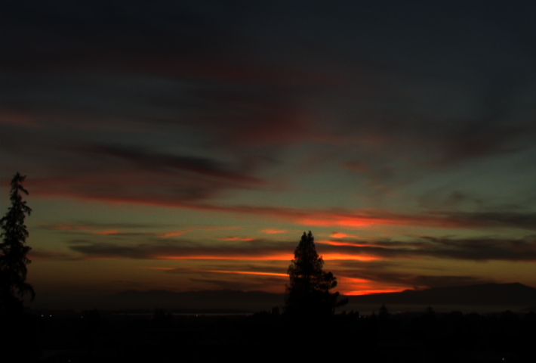
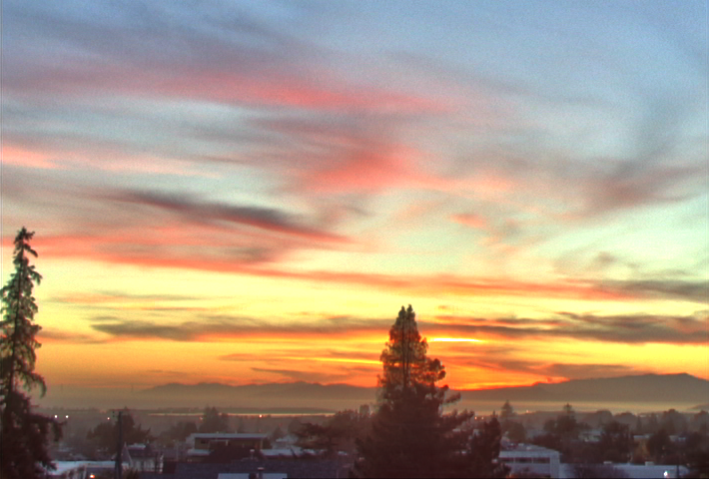
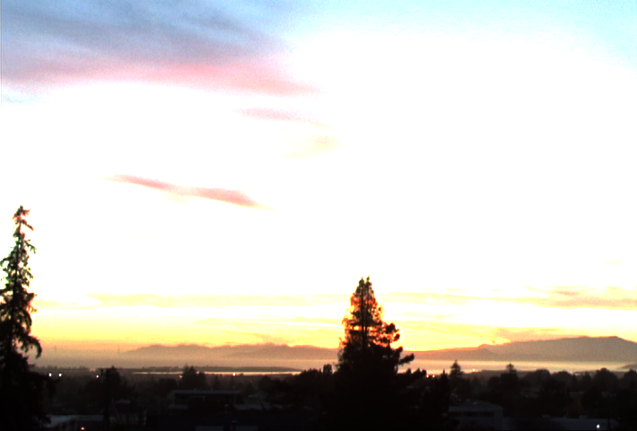
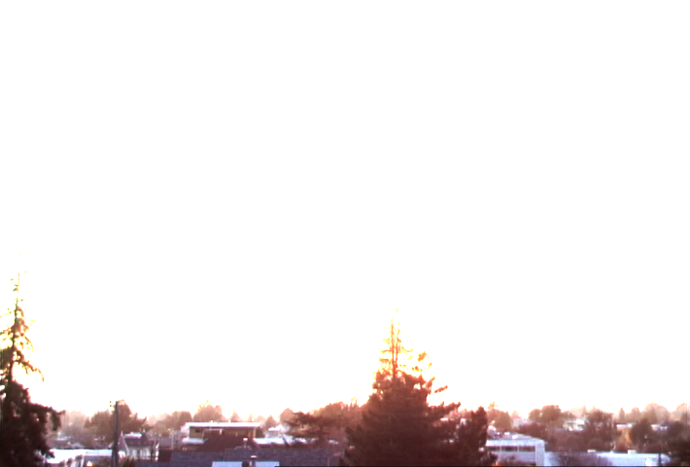
Related Work: Tone Mapping
Reduce global contrast
[Pattanaik 98;Tumblin 99;Ashikhmin 02; Durand 02;Fattal 02;Reinhard 02;Li 05…]
Seeks neutral reproduction
Little control over look
In contrast, we want to achieve particular looks.
[Durand 02]
Notes:
Tone mapping is most related to our work because it reduces the global contrast of an image. However, it seeks a neutral reproduction.
A notable exception is the next talk by Lischinski et al.
The main difference with our work is that we focus on transferring a particular photographic “look” from a model photo.

Slide 16
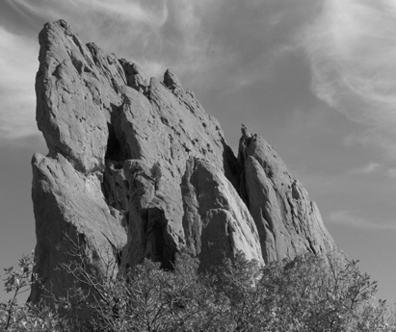
Pipeline
Model
Input Image
Notes:
To recap, we transfer the look of the model to the input.
First, we split an input image using bilateral filtering.
Then, we use the base layer and detail layer to manipulate global and local contrast separately.
We recombine two modified layers using constrained Poisson equation.
As a post-processing, we add soft focus, toning, and grain effect.

Slide 17
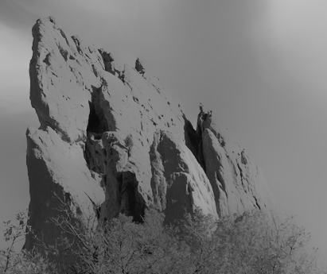
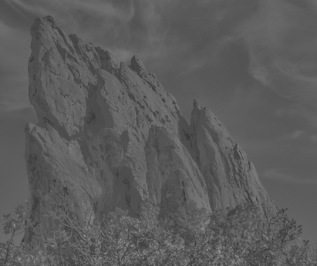
Pipeline
Global contrast
(large-scale variations
“input minus the texture”)
Decompose
Local contrast
(small-scale variations
“texture”)
Input Image
Made fast in [ECCV’06, SIGGRAPH’07]
Notes:
To recap, we transfer the look of the model to the input.
First, we split an input image using bilateral filtering.
Then, we use the base layer and detail layer to manipulate global and local contrast separately.
We recombine two modified layers using constrained Poisson equation.
As a post-processing, we add soft focus, toning, and grain effect.

Slide 18
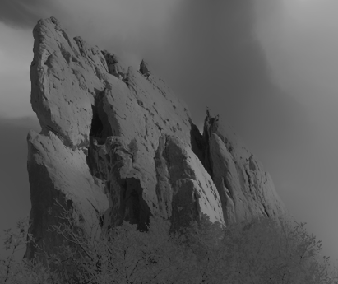
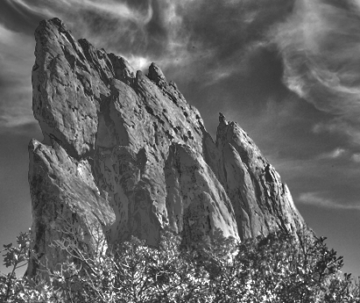
Pipeline
Global contrast
Histogram transfer
Decompose
Input Image
“Histogram transfer”
Local contrast
User study in [ICCP’11]
Notes:
To recap, we transfer the look of the model to the input.
First, we split an input image using bilateral filtering.
Then, we use the base layer and detail layer to manipulate global and local contrast separately.
We recombine two modified layers using constrained Poisson equation.
As a post-processing, we add soft focus, toning, and grain effect.

Slide 19
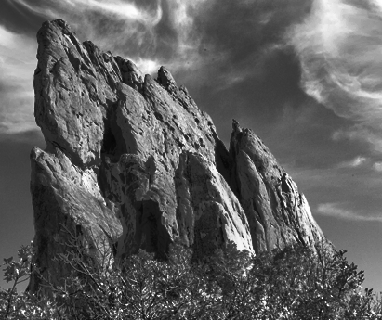
Pipeline
Global contrast
Histogram transfer
Decompose
Recombine
Input Image
“Histogram transfer”
Local contrast
Notes:
To recap, we transfer the look of the model to the input.
First, we split an input image using bilateral filtering.
Then, we use the base layer and detail layer to manipulate global and local contrast separately.
We recombine two modified layers using constrained Poisson equation.
As a post-processing, we add soft focus, toning, and grain effect.

Slide 20
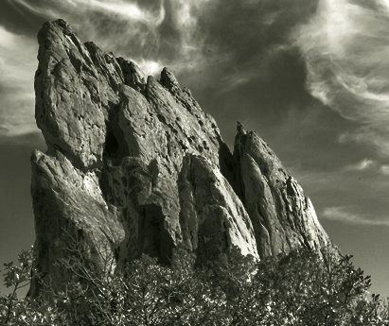
Pipeline
Global contrast
Histogram transfer
Decompose
Recombine
Input Image
“Histogram transfer”
Local contrast
Result
Notes:
To recap, we transfer the look of the model to the input.
First, we split an input image using bilateral filtering.
Then, we use the base layer and detail layer to manipulate global and local contrast separately.
We recombine two modified layers using constrained Poisson equation.
As a post-processing, we add soft focus, toning, and grain effect.

Slide 21
Pipeline
Global contrast
Histogram transfer
Decompose
Recombine
Input Image
Soft focus
Toning
Grain
“Histogram transfer”
Local contrast
Result
Notes:
To recap, we transfer the look of the model to the input.
First, we split an input image using bilateral filtering.
Then, we use the base layer and detail layer to manipulate global and local contrast separately.
We recombine two modified layers using constrained Poisson equation.
As a post-processing, we add soft focus, toning, and grain effect.

Slide 22
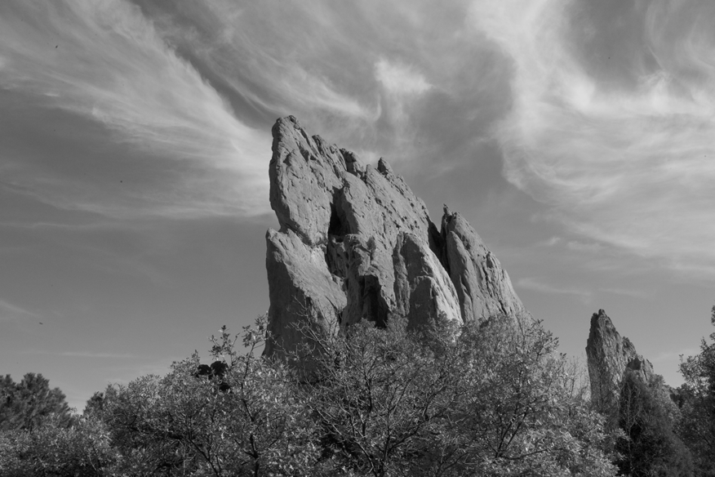
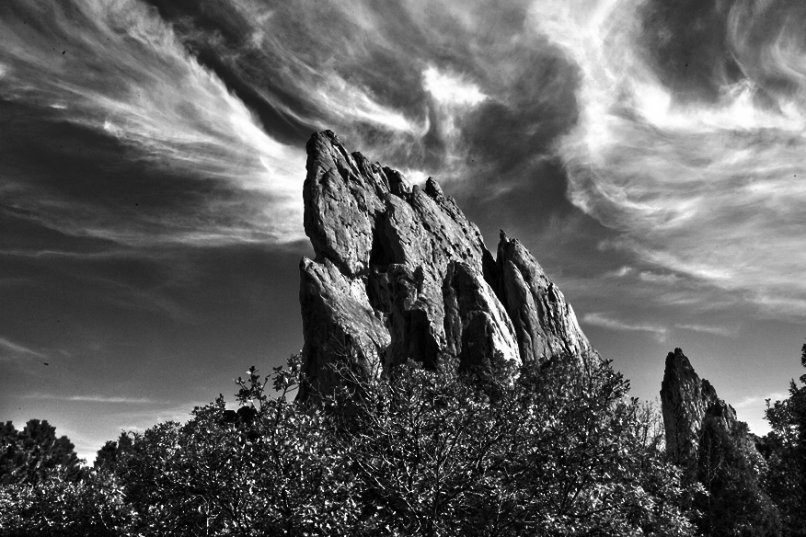
Input
Result
Model
Notes:
With this input picture, let us transfer the look of Ansel Adams picture.
( with its strong global contrast and variation of local contrast. )
<click>
This is our result. Global contrast has been increased and
details in the leaves, rocks, and clouds have been increased.
Our output would probably not be mistaken for an Ansel Adams picture, but we argue that the tonal look that we achieve has taken the image much closer to the look of Adams. .

Slide 23
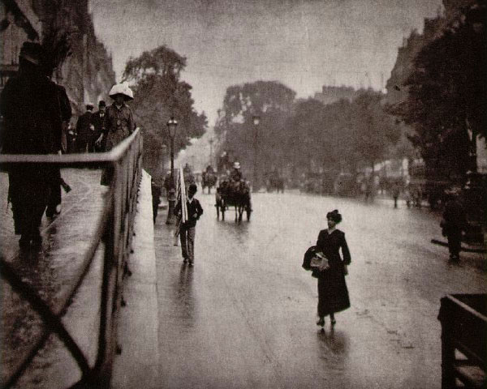
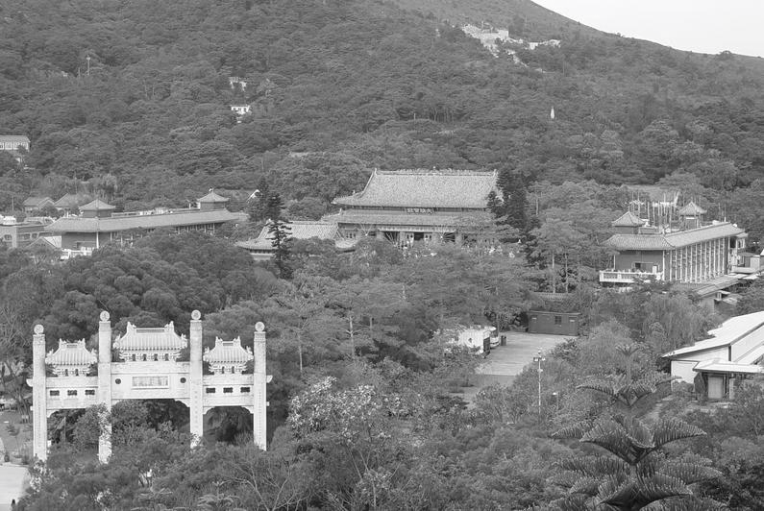
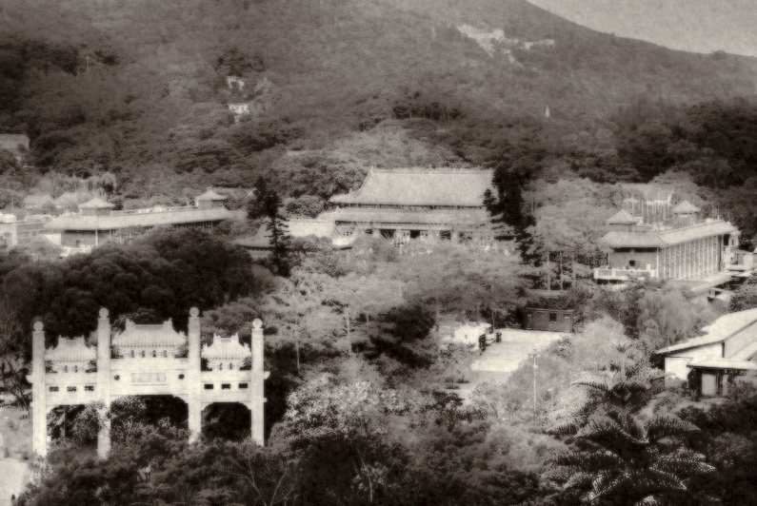
Model
Input
Result
Notes:
With this temple photo as an input image, and the model photo by Alfred Stieglitz,
<click>
We can generate an old-looking picture.
( with paper grains and global tonal balance.)
You can see the sky and buildings got the grain effects and global contrast got transferred from the model image.

Slide 24
Try it yourself!
Slightly simplified version available
Adobe Photoshop Elements 9
On-line demo at: http://www.photoshop.com/tools/stylematch
Inspired “HDR Pro” in Photoshop CS5

Slide 25
Alternative Algorithm with Mathieu Aubry, Sam Hasinoff, Jan Kautz, Frédo Durand
GLOBAL (intensity histogram transfer)
LOCAL (gradient histogram transfer)
Advantage: no image decomposition ➔ faster, more robust

Slide 26
Alternative Algorithm with Mathieu Aubry, Sam Hasinoff, Jan Kautz, Frédo Durand
GLOBAL (intensity histogram transfer)
Nontrivial (cf. tech report)
LOCAL (gradient histogram transfer)
Advantage: no image decomposition ➔ faster, more robust

Slide 27
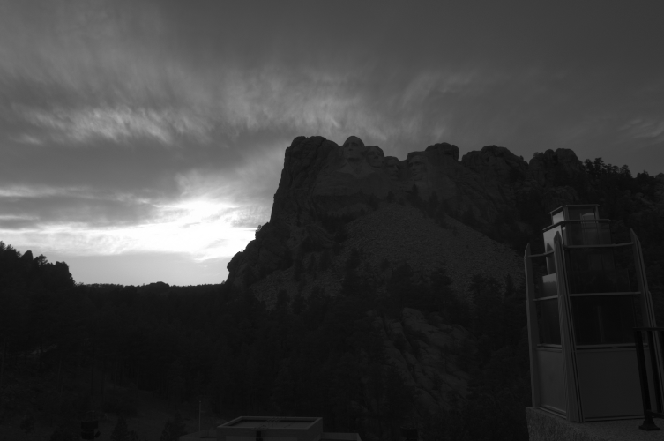
input (HDR)
model

Slide 28
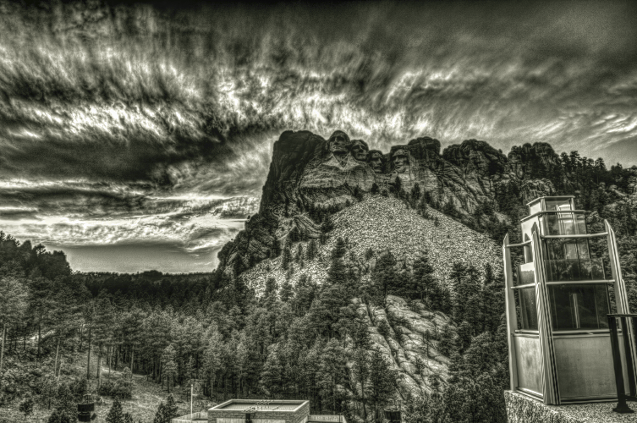
output
model

Slide 29
Summary
Model-based adjustment is easy
only need to have an example of the desired look
Tonal aspects of “look” well characterized by
0th order statistics: luminance histogram
1st order statistics: “texture” histogram

Slide 30
Solution #2 Machine Learning
with Vladimir Bychkovsky, Eric Chan, and Frédo Durand
[CVPR’11]

Slide 31
Objective: Fully Automatic Adjustment
Input: new, unadjusted photo
Output: adjusted photo
We focus on global transformations, i.e. no brush, no mask…

Slide 32
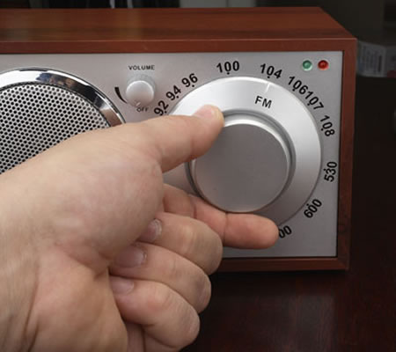
Previous Work: Hand-tuned Algorithms
Easy to understand, total control
Depends on the photographic skills of developer
Painstaking to adapt to specific styles

Slide 33
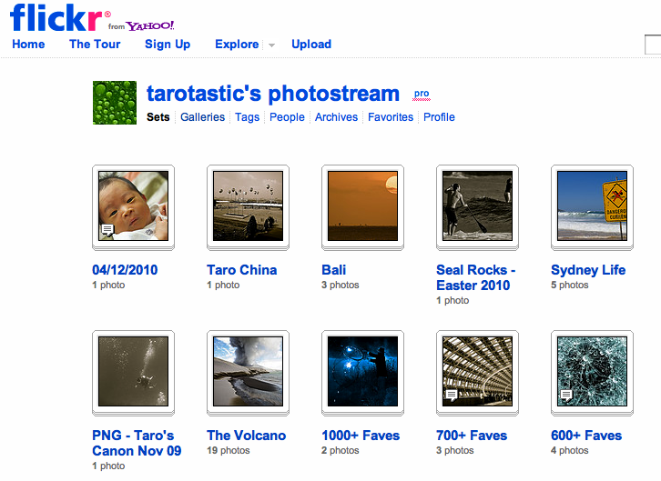
Previous Work: Flickr-based Restoration [Dale 2009]
Many images (cheap to get)
Only output is available
Image descriptor must be invariant to the adjustment
Demonstrated on degraded images
Our input photos are ok.

Slide 34
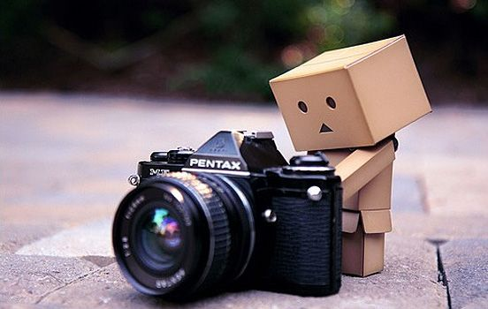
Previous Work: Machine Learning on Synthetic Data [Kang et al. 2010]
Principled
Limited because of lack of data
does not perform better than best hand-tuned algorithm

Slide 35
Our Approach: Supervised Learning
A dataset of input and retouched photos
Transformation as labels
Image descriptors as features
We learn the mapping from features to labels

Slide 36
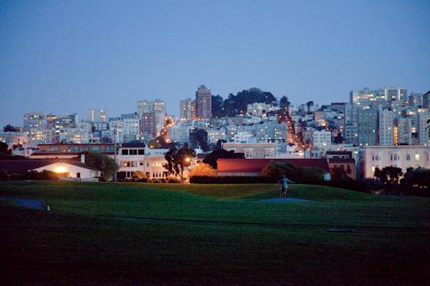
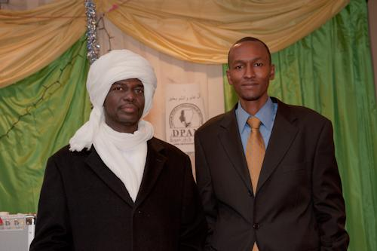
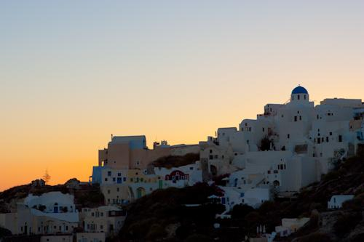
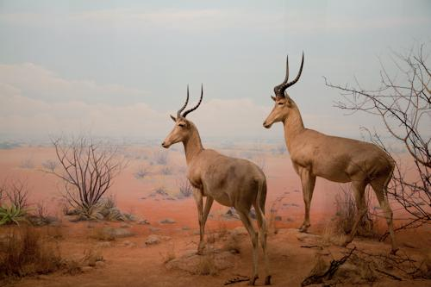
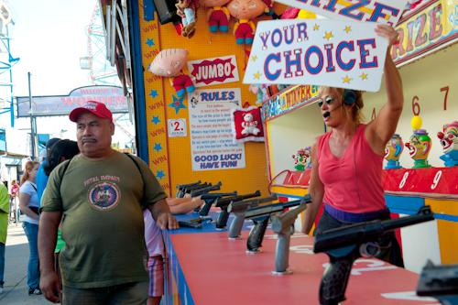
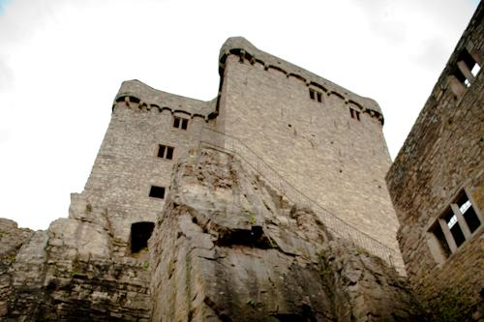
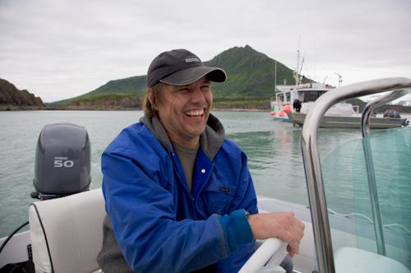
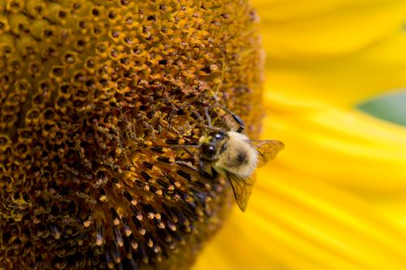
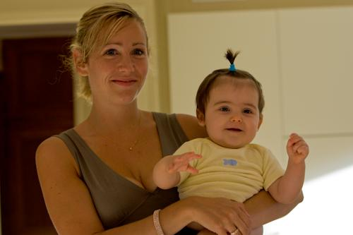
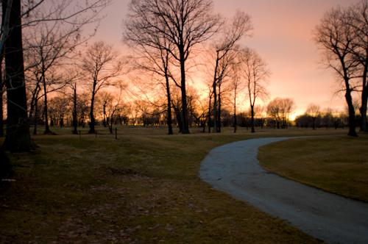
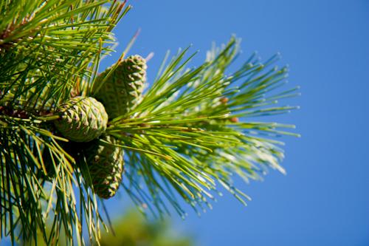
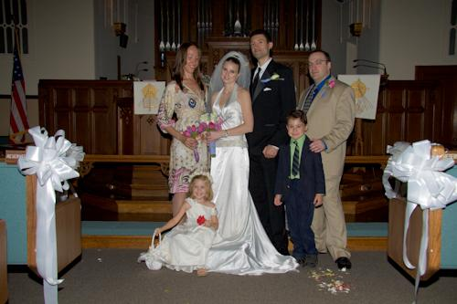
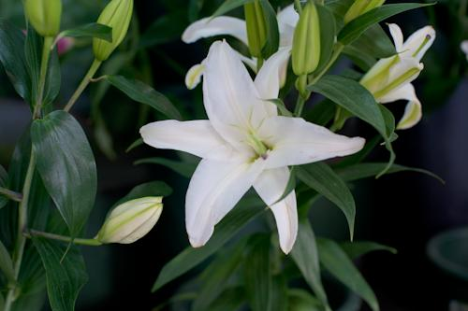
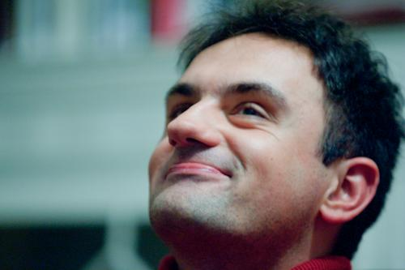
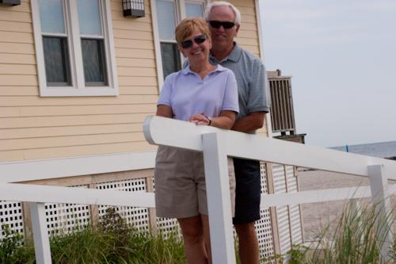
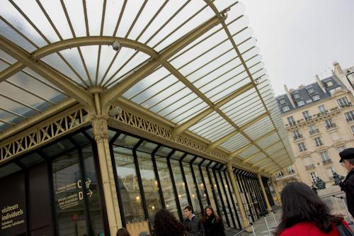
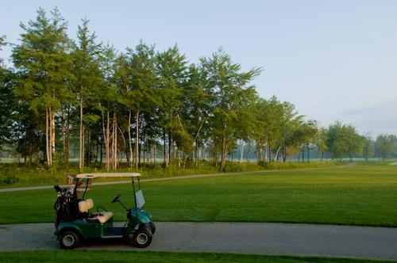
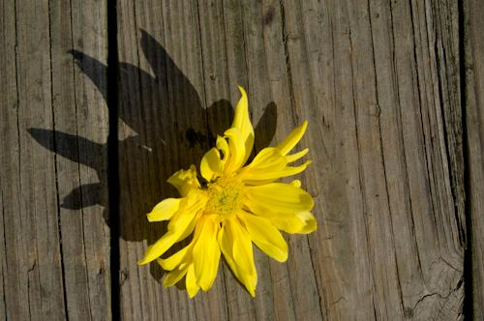
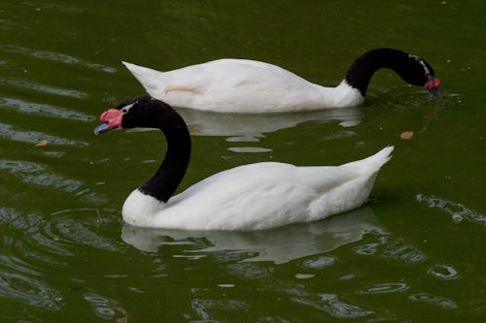
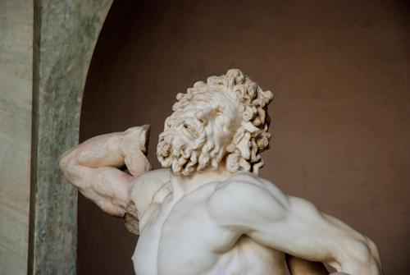
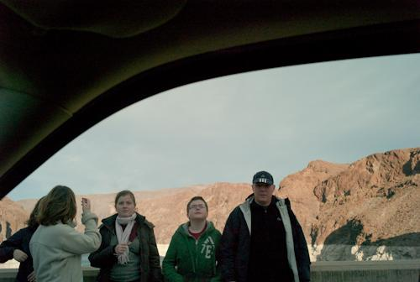
Our Dataset
5000 photos in RAW format
5 students retouched them by hand
Trained a the Visual School of Art in New York
Paid for their work (5000 photos in 2 months)

Slide 37
It is available on-line. http://groups.csail.mit.edu/graphics/fivek_dataset/

Slide 39
Tags from Mech. Turks

Slide 40
Examples from our dataset
“input photo”
photographer A
photographer B
photographer C
photographer D
photographer E

Slide 41
Examples from our dataset
“input photo”
photographer A
photographer B
photographer C
photographer D
photographer E

Slide 42
Remapping Curve
We focus on luminance, e.g. brightness / contrast.
output luminance = f(input luminance)
extracted from the image only
does not assume a specific software
brightness & contrast explain ~95% of expert’s adjustments
brightness alone explains 80 to 90%.

Slide 43
Image Descriptor
Ideally, correlates with the adjustment.
We tried many descriptors:
Luminance, color, and gradient distributions
Global and local (3x3, 5x5, center / surround…)
Scene descriptor (GIST)
The winner is: global luminance distribution + faces

Slide 44
Discussion about Scene Descriptors
Scene descriptors are meant to recognize scenes, e.g. street or forest.
Good with millions of images, e.g. Flickr.
Time of the day, lighting conditions, mood matter more to us than the type of scene.
Scene descriptors do not help us.
Complimentary problem: we want to be sensitive to criteria to which scene descriptors are invariant.

Slide 45
Learning Algorithms
We tested Nearest Neighbor, Least Squares, LASSO (Sparse Least Squares), Gaussian Process Regression (GPR).
All perform more or less the same
GPR is best and safely extrapolates
goes back to neutral adjustment instead of exaggerating

Slide 46
More on Extrapolation
-10
training set
+10
brightness

Slide 47
More on Extrapolation
outlier photo
(very different from any training photo)
-10
training set
+10
brightness

Slide 48
More on Extrapolation
Linear extrapolation
out of range
☹
outlier photo
(very different from any training photo)
-10
training set
+10
brightness

Slide 49
More on Extrapolation
GPR
average of training set
☺
Linear extrapolation
out of range
☹
outlier photo
(very different from any training photo)
-10
training set
+10
brightness

Slide 50
Results
We selected one of the experts and seek to predict his adjustments.
Dataset split into training and testing sets
Input: test photo never seen before
Goal: reproduce the expert’s version (hidden from the algorithm)
L2 norm in CIE Lab

Slide 51
Sample result
input
expert’s version
Adobe Lightroom
our version

Slide 52
Sample result (representative performance)
input
expert’s version
Adobe Lightroom
our version

Slide 53
“Failure”, did not recognize it as a night picture, yet does not do anything wrong
input
expert’s version
Adobe Lightroom
our version

Slide 54
Learning User Preferences
Train the algorithm off-line on 2500 photos
User gives a few examples (3+) and we learn preferences from them.

Slide 55
Learning User Preferences
Train the algorithm off-line on 2500 photos
User gives a few examples (3+) and we learn preferences from them.
Our algorithm adapts and apply the user’s style
automatic

Slide 56
Summary
Photographers are consistent
makes it possible to use machine learning
Brightness & contrast explain most tonal adjustments
Appearance-based features are useful
Failsafe prediction is important in practice

Slide 57
Discussion

Slide 58
Tones vs Colors
Tones are comparatively easier
e.g. mid-day sky can almost be anything from black to white but must be blue
Colors conflate physical white balance and “subjective temperature”
white balance: is this object white?
still an open problem
temperature: warm (red) or cold (blue) rendition
Ansel Adams

Slide 59
Are we stealing photographers’ jobs? No!
Machine learning finds repeated patterns and reproduces them.
Does the repetitive tedious task
Does not do the one-of-a-kind adjustment
It never will. The artist remains in charge.

Slide 60
User Studies Does this adjustment make the picture look good?
Different task, we seek to answer “Is this what a photographer would have done?”
Many ways to make a picture look good
not ideal for research, comparisons
User studies are difficult
dependencies on the protocol, image content, viewer’s background…
biases, e.g. contrasted images stand out
Yet, it’s a legitimate question for the “I am feeling lucky” button
subtle, not easy

Slide 61
Conclusion
Smarter-than-cardboard tools that reproduce a photographer’s look from a model or from a training set.
Some insights into photography.
More needs to be done!

