Slide 1

Submodular functions – Part II
MSR Summer School
Stefanie Jegelka
MIT

Slide 2
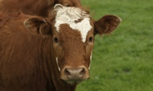
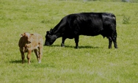

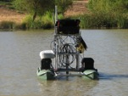
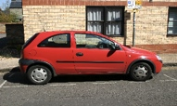
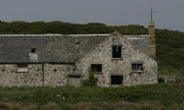



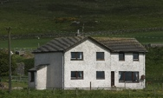
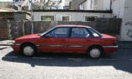
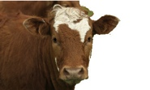
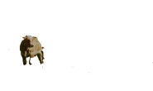


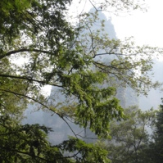
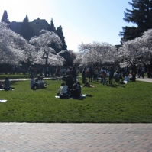
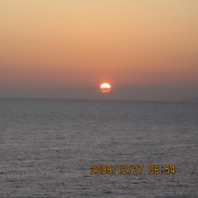
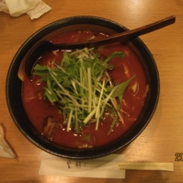

Subset selection problems
sky
tree
house
grass

Slide 3
Setup
ground set

Slide 4
Setup
ground set
(scoring) function
We will assume:
.
black box “oracle” to evaluate F

Slide 5


Submodularity
extra cost:
one drink
extra cost:
free refill ☺
diminishing marginal costs – economies of scale
Notes:
\underbrace{\textcolor{white}{\hspace{25pt}.}}

Slide 6

Diminishing marginal gains
placement A = {1,2}
placement B = {1,…,5}
X₁
X₂
X₂
X₁
X₃
X₄
X₅
Big gain
Adding s helps a lot!
X_{s}
small gain
new sensor s
+ s
A
B
+ s

Slide 7
Lovasz extension
Edmonds’ greedy algorithm:
sort
chain of sets
assign values
Notes:
x_{\pi(1)} \geq x_{\pi(2)} \geq \ldots \geq x_{\pi(n)}
y_{\pi(i)} = F(S_i) - F(S_{i-1})

Slide 8
Recap: last lecture
relaxation: convex optimization (non-smooth)
relaxation is exact!
➔ submodular minimization in polynomial time!
Notes:
\min_{S \subseteq \mathcal{V}}\, F(S)
\min_{x \in [0,1]^n}\; f(x)

Slide 9
Outline
submodularity and convexity
  Lovasz extension: exact relaxations
  fast algorithms
  structured norms …
constrained minimization
submodular maximization
  efficiently finding diverse, informative subsets
morning
lecture

Slide 10
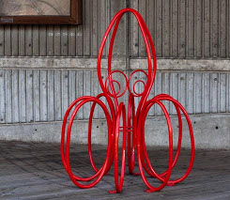
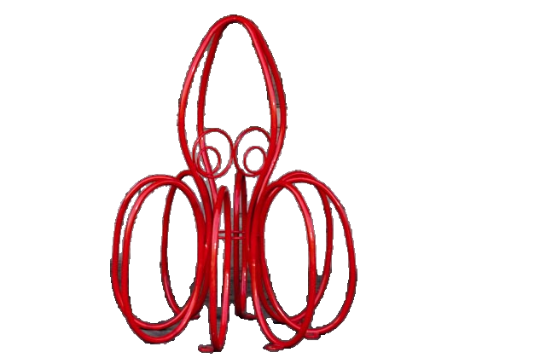
Segmenting images
label
pixel
labels
pixel
values
Notes:
\propto \exp(-E(\mathbf{x}; \mathbf{z}))
\max_{\mathbf{x} \in \{0,1\}^n}
\min_{\mathbf{x} \in \{0,1\}^n} \; E(\mathbf{x}; \mathbf{z})

Slide 11
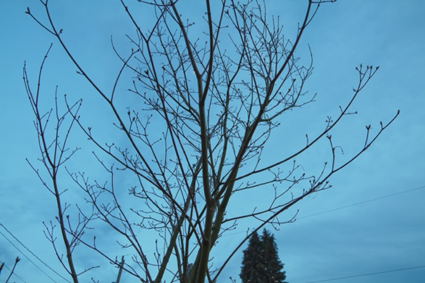
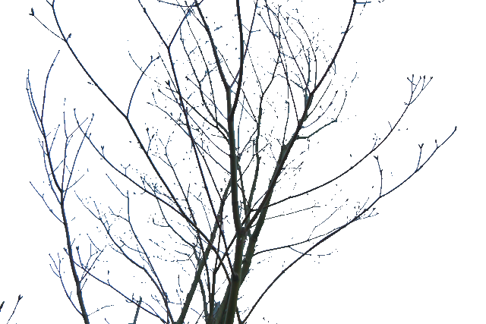
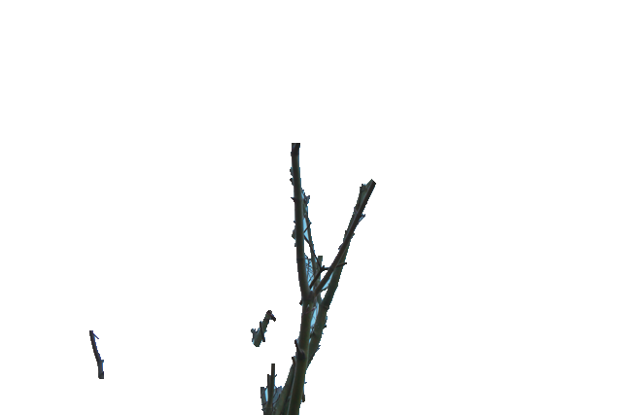
Recall: MAP and cuts
binary labeling:
pairwise random field:
What’s the problem?
aim
reality
minimum cut: prefer
short cut = short object boundary

Slide 12
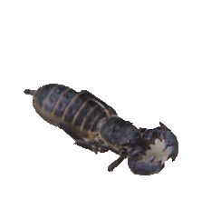
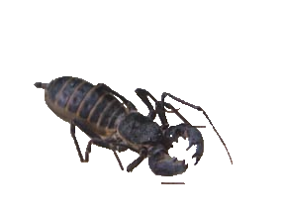
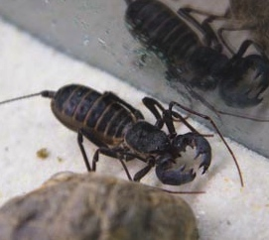
What’s wrong?
we get …
ideally …
local coherence
= short cut
homogeneous cut
global dependencies!
not homogeneous
homogeneous
11273
4849
cut weight
= energy
Notes:
25

Slide 13
Cooperative cuts
ideally …
local coherence
= short cut
homogeneous cut
global dependencies!
cooperative graph cut
edges are independent
edges are not independent
cut weight
= energy
Notes:
25

Slide 14
Homogeneity via group sparsity
sum of weights:
use few edges
submodular cost function:
use few types of edges
cost
|Cut|
One type (13 edges)
Many types ( 6 edges)
(Jegelka & Bilmes 2011)

Slide 15
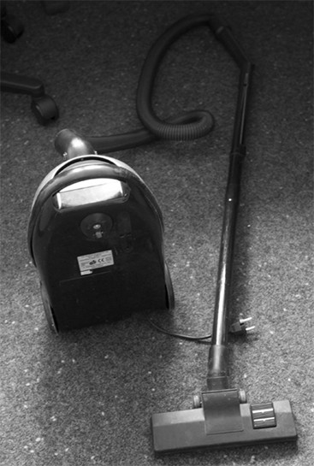
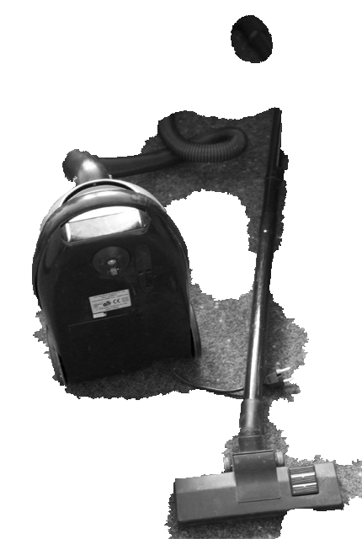
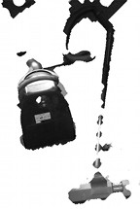
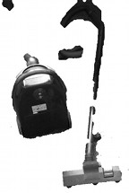
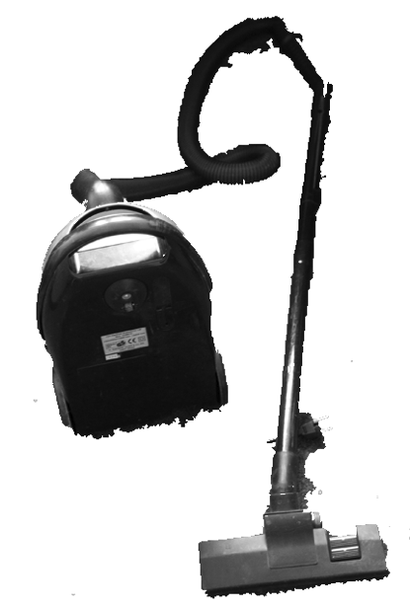
Results
Random Walker
[Grady 06]
Curvature Reg.
[El-Zehiry & Grady 10]
Graph Cut
[Boykov & Jolly 01]
Cooperative
Cut
Quantitatively: up to 70% reduction in error!

Slide 16
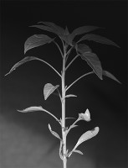
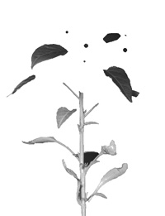
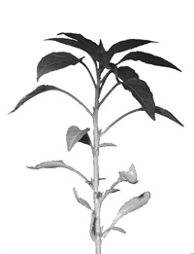
Results
Graph cut
Cooperative cut
Notes:
28

Slide 17
Similarly: contour completion RF
geometric edge groups:
straight lines
parabolas
(Silberman et al 2014)

Slide 18
Inference?
not a submodular energy function
find a minimum cut
cost function:
normally:
now:

Slide 19
Constrained minimization
e.g.
S is a cut
S is a spanning tree
in most cases very hard. ➔ approximations
convex relaxation
(not exact!)
approximate F
(Goel et al. 09, Iwata & Nagano 09, Goemans et al. 09, Jegelka & Bilmes 11, Iyer et al. ICML 13, Kohli et al 13...)

Slide 20
A practical algorithm
idea: submodularity = discrete concavity
“super-gradient”
For i = 1,2,…
compute linear upper bound with
find tree/path/… with minimum .
familiar ☺
e.g. min-cut
fast: only need to solve linear optimization problem!
(Jegelka & Bilmes 2011; Iyer, Jegelka, Bilmes 2013)

Slide 21
Different approximation of F
recall: for
approximate polyhedron
by ellipsoid
(Goemans et al 2009)
Notes:
F(S) = f(x) = \max_{y \in {\color[rgb]{1.000000,0.000000,0.000000}\mathcal{B}_F}} y^\top x

Slide 22


Does it work?
minimum cut solution
approximate solution
optimal solution
often works well in practice
theory: approximation guarantees depending on curvature of F
(Iyer et al 2013)
special cases: exact solution (Kohli et al 2013)
(Jegelka & Bilmes 2011)
(Kohli, Osokin, Jegelka 2013)
Notes:
38

Slide 23
Outline
submodularity and convexity
  Lovasz extension: exact relaxations
  fast algorithms
  structured norms …
constraints
submodular maximization
  efficiently finding diverse, informative subsets
morning
lecture

Slide 24
Setup
ground set
(scoring) function

Slide 25

Informative Subsets
where put sensors?
which experiments?
summarization

Slide 26
Maximizing Influence
Kempe, Kleinberg & Tardos 2003

Slide 27
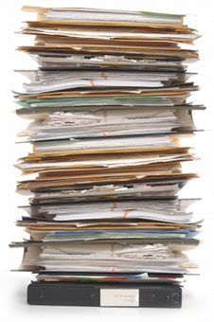
Summarization
videos, text, pictures …
would like:
relevance, reliability, diversity

Slide 28
Summarization
Coverage / relevance
Diversity
(Simon et al 2007, Lin & Bilmes 2011&2012, Tschiatschek et al 2014, Kim et al 2014, Gygli et al 2015, …)
Notes:
R(S) = \sum_{a \in \mathcal{V}}\; \max_{b \in S} s_{a,b}
F(S) \; = \; {\color[rgb]{0.250980,0.501961,0.000000}R(S)} \; + \; {\color[rgb]{1.000000,0.000000,0.000000}D(S)}
D(S) = \sum_{j=1}^m \sqrt{ | S \cap P_j|}
31,36 images
Simon, Snavely, Seitz: Scene summarization for online image collections. CVPR 2007.
Tschiatschek & Bilmes. Learning Mixtures of submodular functions for image collections. NIPS 2014.

Slide 29
Diversity
Diversity
Another diversity function …
increasing
decreasing

Slide 30
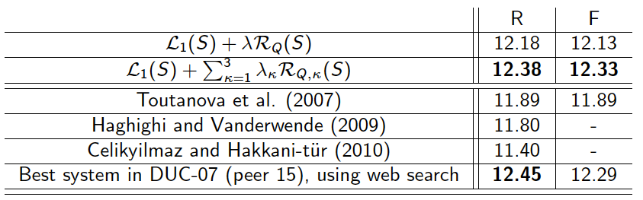
Summarization: results
(Lin & Bilmes 2011)
Many more functions are possible …
Learn a weighted combination: structured prediction
works even better!
(Lin & Bilmes 2012, Tschiatschek et al 2014, Gygli et al 2015, Xu et al 2015,…)

Slide 31
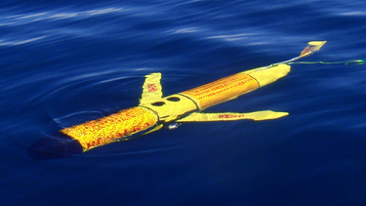







More maximization …
co-segmentation
by maximizing
anisotropic diffusion
(Kim et al 2011)
environmental monitoring
(Krause, …)
weakly supervised
object detection
(Song et al 2014)
diverse
recommendations
(Yue & Guestrin)
inferring networks
(Gomez Rodriguez et al 2012)

Slide 32
Monotonicity
3
5
1

Slide 33
Monotonicity – how check?
gain: +5
- 8
Notes:
F(A) = \left|\bigcup_{a \in A}\text{area($a$)}\right|
\text{if } {\color[rgb]{0.000000,0.000000,1.000000}A} \subseteq {\color[rgb]{0.000000,0.501961,0.250980}B}\;\; \text{ then } \;\; F({\color[rgb]{0.000000,0.000000,1.000000}A}) \, \leq \, F({\color[rgb]{0.000000,0.501961,0.250980}B})
{\color[rgb]{0.000000,0.501961,0.250980}F(A \cup \{a\})} - {\color[rgb]{0.000000,0.000000,1.000000}F(A)} \geq 0

Slide 34
Maximizing monotone functions
NP-hard
approximation: greedy algorithms

Slide 35
Maximizing monotone functions
greedy algorithm:
for i = 0, …, k-1
How “good” is ?
Notes:
e^* = \arg\max_{e \in \mathcal{V} \setminus S_i} F(S_i \cup \{e\})

Slide 36






Pedestrian detection
x₁=1
y₁
x₂=1
x₃=1
y₂
x₄=1
x_{j} = index of hypothesis
explaining x_{j}
y_{i} = 1: object i
present
y_{i} = 0: object i
not present
x₅=1
x₆=1
y₃
x₇=1
x₈=1
Voting elements
Hypotheses
Illustrations courtesy of Pushmeet Kohli
(Barinova et al.’10)

Slide 37
Object detection
x₁=1
y₁=1
x₂=1
x₃=1
y₂=1
x₄=2
x_{j} = index of hypothesis
explaining x_{j}
y_{i} = 1: object i
present
y_{i} = 0: object i
not present
x₅=2
x₆=0
y₃₌₀
Joint MAP inference:
submodular
maximization!
x₇=2
x₈=2
Voting elements
Hypotheses
Weight element i wrt hyp. j
Illustrations courtesy of Pushmeet Kohli

Slide 38
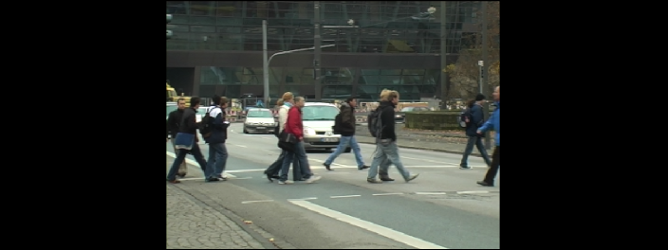
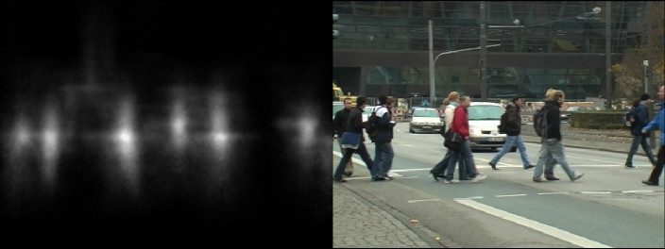
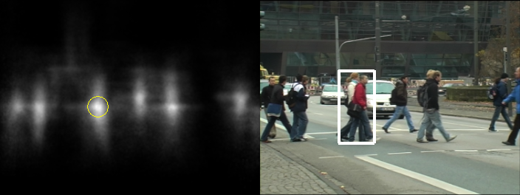
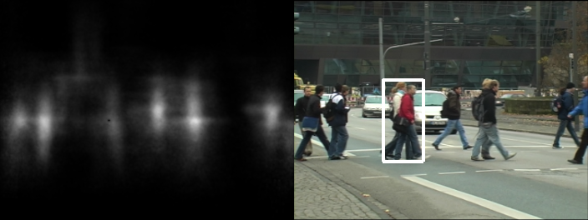
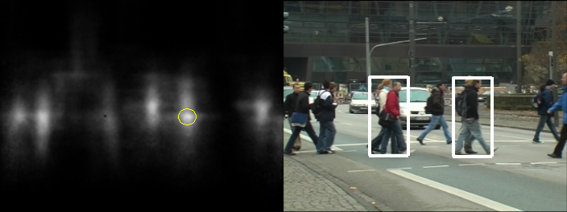
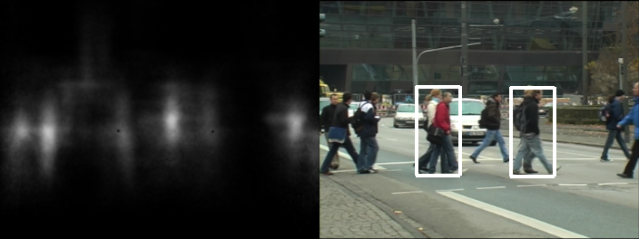
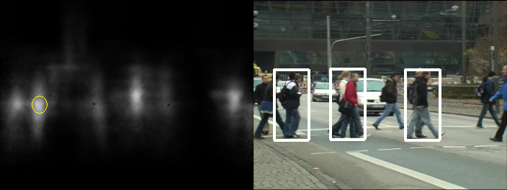
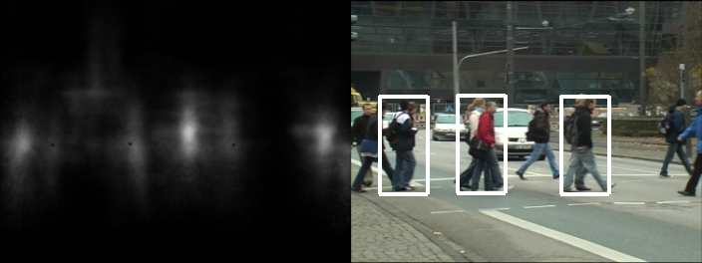
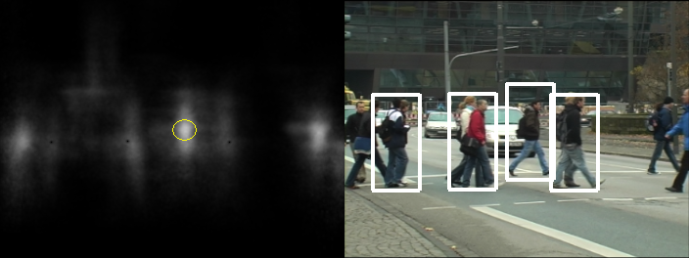

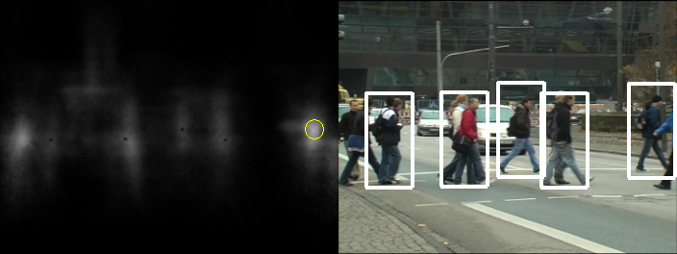
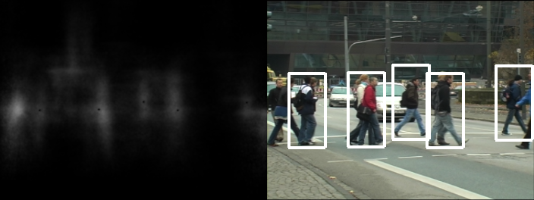
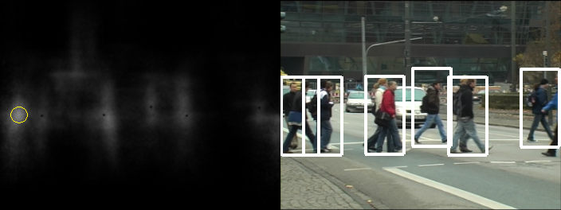
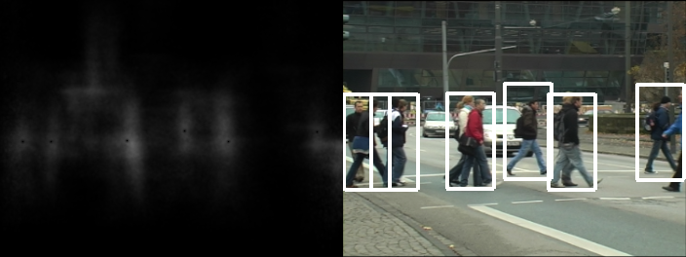

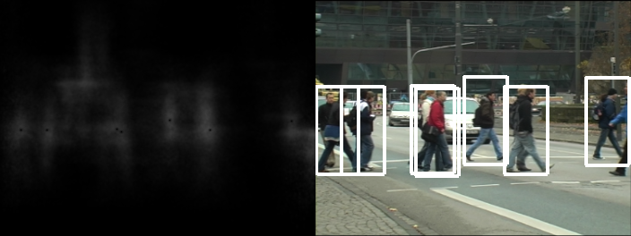

Inference
Datasets from [Andriluka et al. CVPR 2008]
(with strongly occluded pedestrians added)
Using the Hough forest trained in [Gall&Lempitsky CVPR09]
Illustrations courtesy of Pushmeet Kohli

Slide 39
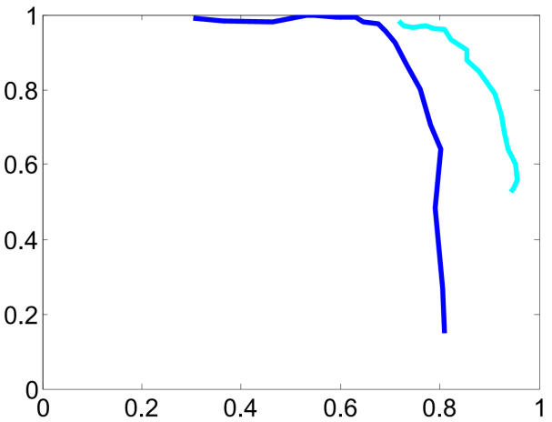
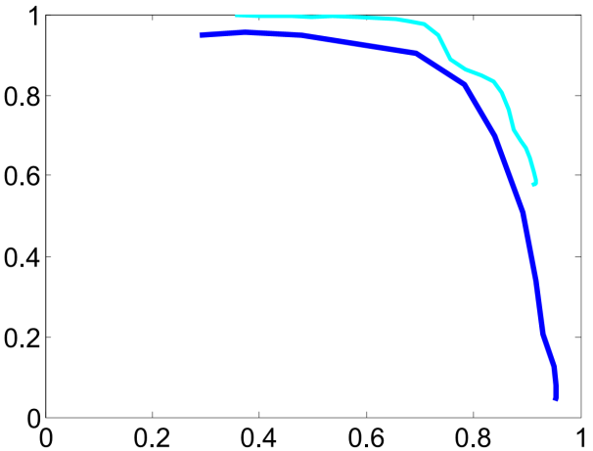
Results for pedestrians detection
TUD-campus
TUD-crossing
Precision
Precision
Recall
Recall
Blue = Hough transform + non-maximum suppression
Light-blue = greedy detection
(submodularity for detection also in (Blaschko’11)

Slide 40
How good is greedy? in practice…
empirically:
optimal
sensor placement
greedy
information gain

Slide 41
How good is greedy? … in theory
Theorem (Nemhauser, Fisher, Wolsey `78)
F monotone submodular, solution of greedy. Then
optimal solution
in general, no poly-time algorithm can do better than that!
Notes:
e^* = \arg\max_{e \in \mathcal{V} \setminus S_i} F(S_i \cup \{e\})

Slide 42
Questions
What if I have more complex constraints?
  budget constraints
  matroid constraints
Greedy takes O(nk) time. What if n, k are large?
What if my function is not monotone?

Slide 43
More complex constraints: budget
run greedy:
run a modified greedy:
pick better of ,
➔ approximation factor:
even better but less fast:
partial enumeration
(Sviridenko, 2004) or
filtering (Badanidiyuru &
Vondrák 2014)
(Leskovec et al 2007)

Slide 44
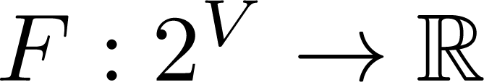
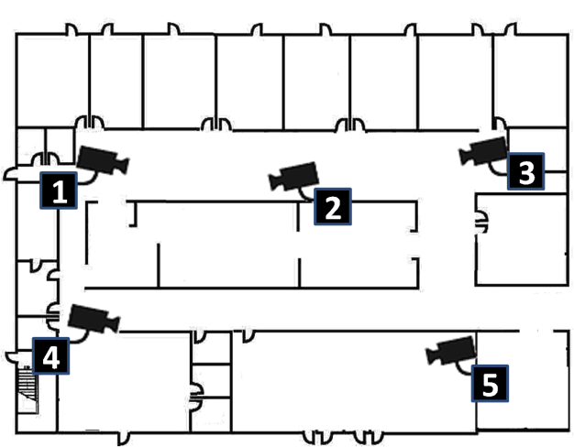
Example: Camera network
Ground set:
Sensing quality model:
Configuration (subset) is feasible if no camera is pointed in two directions
at once
(partition) matroid
constraint!

Slide 45
Matroids (semi-formally)
S is independent ( = feasible) if …
… |S| ≤ k
Uniform matroid
… S contains at most one element from each square
Partition matroid
… S contains no cycles
Graphic matroid
matroid properties:
S independent ➔ T S also independent
Exchange property: S, U independent, |S| > |U|
➔ some can be added to U: independent
All maximal independent sets have the same size

Slide 46
Matroids
S is independent (=feasible) if …
… |S| ≤ k Uniform matroid | … S contains at most one element from each group Partition matroid | … S contains no cycles Graphic matroid
S independent ➔ T S also independent
Exchange property: S, U independent, |S| > |U|
➔ some can be added to U: independent
All maximal independent sets have the same size
Notes:
\textcolor{blue}{e} \in \textcolor{red}{S}
\textcolor{green}{U} \cup \textcolor{blue}{e}

Slide 47
Example: Camera network
Ground set:
Sensing quality model:
Configuration (subset) is feasible if no camera is pointed in two directions at once
(partition) matroid
constraint:
require:

Slide 48
Greedy algorithm for matroids
Theorem (Nemhauser, Wolsey, Fisher 78)
For monotone submodular functions:
better approximation (1-1/e): relaxation
Notes:
\text{\bf {\color[rgb]{0.000000,0.000000,0.501961}While }}\; \exists e: S \cup e \text{ independent}
S \leftarrow S \cup\, \argmax_{e: S \cup e \text{ indep.}}\; F(S \cup e)

Slide 49
Relaxation?
concave analog of Lovasz extension: not poly-time ☹
multi-linear extension:
given x, sample element e with probability x_{e}
Algorithm:
  approximately maximize f_{M} (Frank-Wolfe like algorithm)
  round (pipage rounding)
(Calinescu-Chekuri-Pal-Vondrak 2011)

Slide 50
Multilinear relaxation vs. Lovász ext.
concave in certain directions, convex in others
approximate by sampling
convex
computable in O(n log n)

Slide 51
Multilinear relaxation vs. Lovász ext.
example: cut function

Slide 52
Questions
What if I have more complex constraints?
  budget constraints
  matroid constraints
Greedy takes O(nk) time. What if n, k are large?
  faster sequential algorithms
  filtering
  parallel / distributed
What if my function is not monotone?

Slide 53
Making greedy faster: stochastic
for i=1…k:
randomly pick set T of size
find best a element in T and add
(Mirzasoleiman et al 2014)
Notes:
\frac{n}{k}\log \frac{1}{\epsilon}
S_i \leftarrow\, S_{i-1} \cup \{a_i\}

Slide 54
Performance
“Lazy greedy”
stochastic
greedy
better solution
faster

Slide 55

Distributed greedy algorithms
even more data …
distributed greedy algorithm?

Slide 56

Distributed greedy algorithms
greedy is sequential.
pick in parallel??
pick k elements
on each machine.
combine and run
greedy again.
Is this useful?

Slide 57

Distributed greedy algorithms
pick in parallel
from m machines
Is this useful?
Pick the best of m+1 solutions
Approximation factor:
better with geometric
structure
New approximation factor:
(Mirzasoleiman et al 2013, de Ponte Barbosa et al 2015)
Notes:
\frac{1}{\min \{\sqrt{k}, m\}}

Slide 58
Questions
What if I have more complex constraints?
  matroid constraints: later (Sri)
  budget constraints
Greedy takes O(nk) time. What if n, k are large?
  stochastic
  distributed
  structured
What if my function is not monotone?

Slide 59
Non-monotone functions
still assume:
3
5
1

Slide 60
Determinantal point processes
normalized similarity matrix
sample Y:
repulsion
is submodular

Slide 61
Greedy can fail …
greedy solution:
optimal solution
sensor 1
sensor 2
sensor 3
sensor 4
coverage: 100
cost: -60
gain 40
coverage: 30
cost: - 1
gain 29
coverage: 30
cost: - 1
gain 29
coverage: 40
cost: - 3
gain 37
Notes:
S_1 = \emptyset \cup\; {\color[rgb]{0.000000,0.501961,0.250980}\arg\max_{a \in \mathcal{V}} F(a)}
\underbrace{ {\color[rgb]{0.000000,0.501961,0.250980}F(A \cup \{a\})} - {\color[rgb]{0.000000,0.000000,1.000000}F(A)} }_{\text{marginal gain}} \geq 0

Slide 62
Greedy can fail …
greedy solution:
optimal solution:
sensor 1
sensor 2
sensor 3
sensor 4
coverage: 100
cost: -60
gain 40
coverage: 30
cost: - 1
gain 29
coverage: 30
cost: - 1
gain 29
coverage: 40
cost: - 3
gain 37
Notes:
S_1 = \emptyset \cup\; {\color[rgb]{0.000000,0.501961,0.250980}\arg\max_{a \in \mathcal{V}} F(a)}
\underbrace{ {\color[rgb]{0.000000,0.501961,0.250980}F(A \cup \{a\})} - {\color[rgb]{0.000000,0.000000,1.000000}F(A)} }_{\text{marginal gain}} \geq 0

Slide 63
Double (bidirectional) greedy
Start:
for i=1, …, n
//add or remove?
gain of adding (to A):
gain of removing (from B):
add with probability
coverage: 100
cost: -60
= 40%

Slide 64
Double (bidirectional) greedy
Start:
for i=1, …, n
//add or remove?
add with probability
add to A or remove from B
coverage: 100
cost: -60

Slide 65
Double (bidirectional) greedy
Start:
for i=1, …, n
//add or remove?
add with probability
add to A or remove from B
coverage: 30
cost: - 1

Slide 66
Double (bidirectional) greedy
Start:
for i=1, …, n
//add or remove?
add with probability
add to A or remove from B
coverage: 30
cost: - 1

Slide 67
Double greedy
Theorem (Buchbinder, Feldman, Naor, Schwartz ‘12)
F submodular, solution of double greedy. Then
optimal solution
Notes:
{\color[rgb]{1.000000,0.000000,0.000000}F(S_g)}\; \geq\; \tfrac{1}{2} \, {\color[rgb]{0.000000,0.000000,1.000000}F(S^*)}

Slide 68
Non-monotone maximization
alternatives to double greedy?
local search (Feige et al 2007)
constraints?
possible, but different algorithms
distributed algorithms? yes!
  divide-and-conquer as before (de Ponte Barbosa et al 2015)
  concurrency control / Hogwild (Pan et al 2014)

Slide 69
Submodular maximization: summary
many applications: diverse, informative subsets
NP-hard, but greedy or local search
distinguish monotone / non-monotone
several constraints possible
(monotone and non-monotone)

Slide 70
What we could not cover
many more applications …
probabilistic diversity models:
determinantal point processes
learning submodular functions
adaptive submodularity

Slide 71
Learning submodular functions
observe
or: sets that users pick
learn (utility function) F ?
can be hard (Balcan & Harvey 2010)
general idea: find (approximate) representation of F, e.g.
learn w.
  compressive sensing (Stobbe & Krause)
  structured prediction (Lin & Bilmes)
several other works: see reference list

Slide 72
Learning to optimize
optimize an unknown submodular function?
e.g. for recommending, robot planning, …
bandit problem!
minimization: online convex optimization
maximization: imitate greedy – learn a permutation
(Hazan & Kale, jegelka & Bilmes, Streeter & Golovin, Golovin-Streeter-Krause, Ross et al)

Slide 73
Online submodular maximization
Pick sets
A₁
A₂
A₃
…
A_{T}
Observe either
F_{t}, or only F_{t}(A_{t})
SFs
F₁
F₂
F₃
…
F_{T}
Reward
r₁=F₁(A₁)
r₂
r₃
…
r_{T}
Total: ∑_{t} r_{t} → max
Time
Goal: Want to choose A₁,…A_{t} s.t. the regret
grows sublinearly, i.e.,

Slide 74



Online Greedy Algorithm
Replace each stage of greedy algorithm with a
multi-armed bandit algorithm.
a₁
a₂
a₃
a_{k}
Select { , , , … , } .
Feedback to for action a_{j} is (unbiased est. of)
F_{t}({a₁, a₂, …, a_{j-1}, a_{j}}) – F_{t}({a₁, a₂, …, a_{j-1}})

Slide 75
Online submodular maximization
Theorem
Online greedy algorithm chooses A₁,…,A_{T} s.t.
for any sequence F₁,…,F_{T}
Can get ‘no-regret’ over greedy algorithm in hindsight
I.e., can learn “enough” about F to optimize greedily!
Notes:
\sum_{t=1}^T F_t(A_t)\geq \color{blue}(1-1/e)\color{black}\max_{|A|\leq k}\sum_{t=1}^T F_t(A)-\color{red}{O\Bigl(n T^{2/3}\Bigr)}

Slide 76












Submodularity and machine learning
distributions over labels, sets
log-submodular/supermodular probability
e.g. “attractive” graphical models,
determinantal point processes
diffusion processes,
covering, rank,
connectivity,
entropy,
economies of scale,
summarization, …
submodular
phenomena
submodularity
& machine learning!
(convex) regularization
submodularity: “discrete convexity”
e.g. combinatorial sparse estimation
bla blablala oh bla bl abl lba bla
gggg hgt dfg uyg sd djfkefbjal
odh wdbfeowhjkd fenjk jj
bla blablala oh bla dw
bl abl lba bla gggg hgt dfg uyg
sd djfkefbjal odh wdbfeowhjkd
fenjk jj
bla blablala oh bla bl abl lba bla
gggg hgt dfg uyg efefm o
sd djfkefbjal odh wdbfeowhjkd
fenjk jj ef
owskf wu

