Slide 1
Submodularity in Machine Learning
- New Directions -
Andreas Krause
Stefanie Jegelka

Slide 2
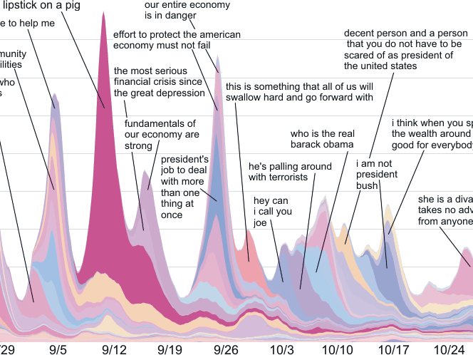
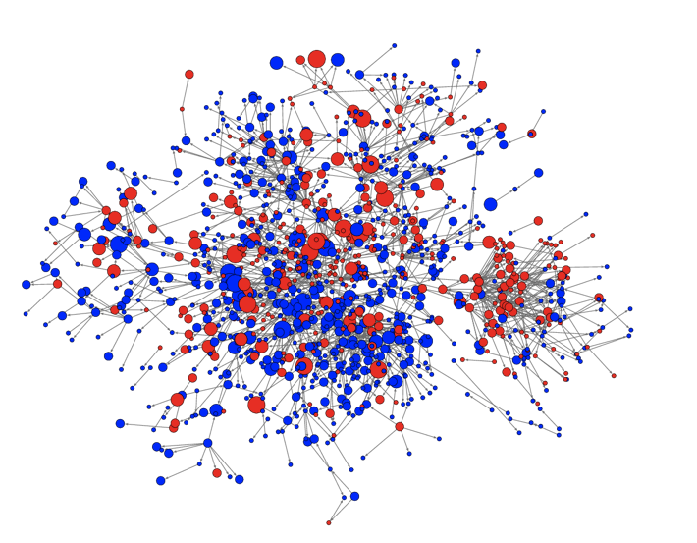
Network Inference
How learn who influences whom?

Slide 3

Summarizing Documents
How select representative sentences?

Slide 4
MAP inference
sky
tree
house
grass
How find the MAP labeling in discrete graphical models
efficiently?

Slide 5
What’s common?
Formalization:
Optimize a set function F(S) under constraints
generally very hard
but: structure helps!
… if F is submodular, we can …
  solve optimization problems with strong guarantees
  solve some learning problems

Slide 6
Outline
many new
results! ☺
What is submodularity?
Optimization
  Minimization
  Maximization
Learning
Learning for Optimization: new settings
Part I
Break
Part II

Slide 7
Outline
many new
results! ☺
What is submodularity?
Optimization
  Minimization: new algorithms, constraints
  Maximization: new algorithms (unconstrained)
Learning
Learning for Optimization: new settings
Part I
Part II
… and many new applications!

Slide 8
submodularity.org
slides, links, references, workshops, …

Slide 9


Example: placing sensors
Place sensors to monitor temperature

Slide 10


Set functions
finite ground set
set function
will assume (w.l.o.g.)
assume black box that can evaluate
for any

Slide 11

Example: placing sensors
Utility of having sensors at subset of all locations
X₄
X₁
X₃
X₁
X₅
X₂
A={1,2,3}: Very informative
High value F(A)
A={1,4,5}: Redundant info
Low value F(A)

Slide 12

Marginal gain
Given set function
Marginal gain:
X₁
X₂
X_{s}
new sensor s

Slide 13
Decreasing gains: submodularity
placement A = {1,2}
placement B = {1,…,5}
X₁
X₂
X₂
X₁
X₃
X₄
X₅
Big gain
Adding s helps a lot!
X_{s}
Adding s doesn’t help much
small gain
new sensor s
+ s
A
B
+ s

Slide 14
Equivalent characterizations
Diminishing gains: for all
Union-Intersection: for all
A
+ s
B
+ s

Slide 15
Questions
How do I prove my problem is submodular?
Why is submodularity useful?

Slide 16


Example: Set cover
place sensors
in building
goal: cover floorplan with discs
Possible
locations
Node predicts
values of positions
with some radius
:
“area covered by sensors placed at A”
Formally:
Finite set , collection of n subsets
For define

Slide 17
Set cover is submodular
A={s₁,s₂}
S₁
S₂
S’
F(A U {s’}) – F(A)
≥
F(B U {s’}) – F(B)
S₁
S₂
S₃
S₄
S’
B = {s₁,s₂,s₃,s₄}

Slide 18

More complex model for sensing
Y₁
Y₂
Y₃
Y_{s}: temperature
at location s
X₁
X₃
X₂
X_{s}: sensor value
at location s
Y₆
Y₄
Y₅
X₆
X_{s} = Y_{s} + noise
X₄
X₅
Joint probability distribution
P(X₁,…,X_{n},Y₁,…,Y_{n}) = P(Y₁,…,Y_{n}) P(X₁,…,X_{n} | Y₁,…,Y_{n})
Prior
Likelihood

Slide 19
Example: Sensor placement
Utility of having sensors at subset A of all locations
Uncertainty
about temperature Y
before sensing
Uncertainty
about temperature Y
after sensing
X₄
X₁
X₃
X₁
X₅
X₂
A={1,2,3}: High value F(A)
A={1,4,5}: Low value F(A)

Slide 20
Submodularity of Information Gain
Y₁,…,Y_{m}, X₁, …, X_{n} discrete RVs
F(A) = I(Y; X_{A}) = H(Y)-H(Y | X_{A})
F(A) is NOT always submodular
If X_{i} are all conditionally independent given Y,
then F(A) is submodular! [Krause & Guestrin `05]
Y₁
Y₂
Y₃
Proof:
“information never hurts”
X₁
X₂
X₃
X₄
F(A) is always monotone

Slide 21
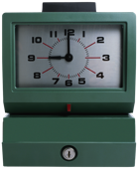




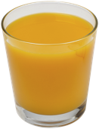

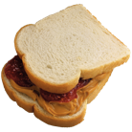
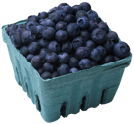

Example: costs
cost:
time to reach shop
+ price of items
Market 3
breakfast??
t₃
ground set
t₁
t₂
Market 1
Market 2
each item
1 $

Slide 22






Example: costs
cost:
time to shop
+ price of items
Market 3
breakfast??
F( ) = cost( ) + cost( , )
= t₁ + 1 + t₂ + 2
= #shops + #items
Market 1
Market 2
submodular?

Slide 23











Shared fixed costs
A
B
marginal cost: #new shops + #new items
decreasing ➔ cost is submodular!
shops: shared fixed cost
economies of scale

Slide 24
Another example: Cut functions
2
1
3
a
c
e
g
V={a,b,c,d,e,f,g,h}
2
3
2
2
2
3
3
3
b
d
f
h
2
1
3
Cut function is submodular!

Slide 25
Why are cut functions submodular?
w
S | F_{ab}(S)
{} | 0
{a} | w
{b} | w
{a,b} | 0
a
b
2
1
3
a
c
e
g
2
3
2
2
2
3
3
3
Submodular if
w ≥ 0!
b
d
f
h
2
1
3
Cut function in subgraph {i,j}
➔ Submodular!
Restriction: still submodular

Slide 26
Closedness properties
F₁,…,F_{m} submodular functions on V and λ₁,…,λ_{m} > 0
Then: F(A) = ∑_{i} λ_{i} F_{i}(A) is submodular
Submodularity closed under nonnegative linear combinations!
Extremely useful fact:
  F_{θ}(A) submodular ➔ ∑_{θ} P(θ) F_{θ}(A) submodular!
  Multicriterion optimization
  A basic proof technique! ☺

Slide 27
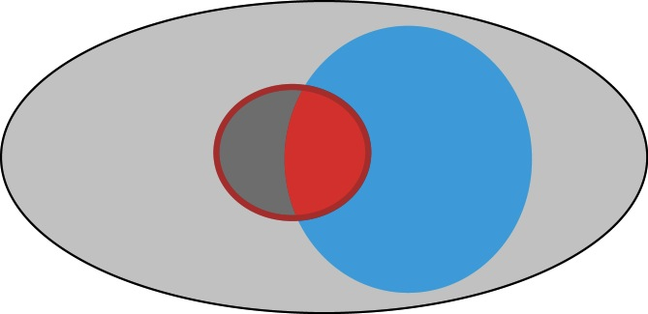
Other closedness properties
Restriction: F(S) submodular on V, W subset of V
Then is submodular
S
V
W

Slide 28
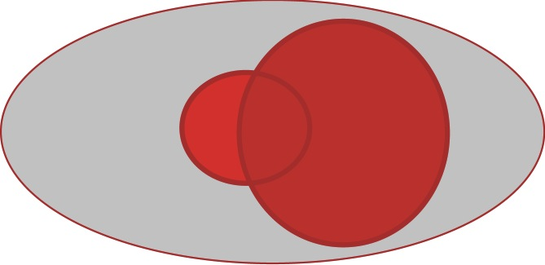
Other closedness properties
Restriction: F(S) submodular on V, W subset of V
Then is submodular
Conditioning: F(S) submodular on V, W subset of V
Then is submodular
S
V
W

Slide 29
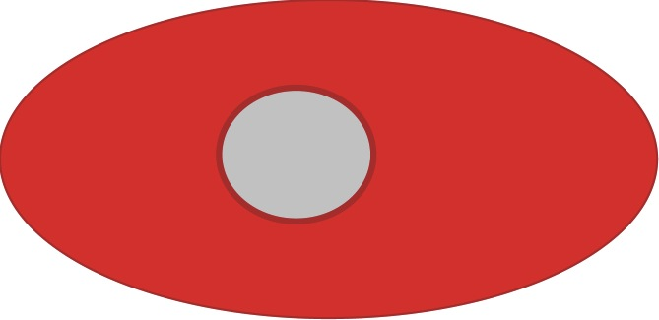
Other closedness properties
Restriction: F(S) submodular on V, W subset of V
Then is submodular
Conditioning: F(S) submodular on V, W subset of V
Then is submodular
Reflection: F(S) submodular on V
Then is submodular
S
V

Slide 30
Submodularity …
discrete convexity ….
… or concavity?

Slide 31
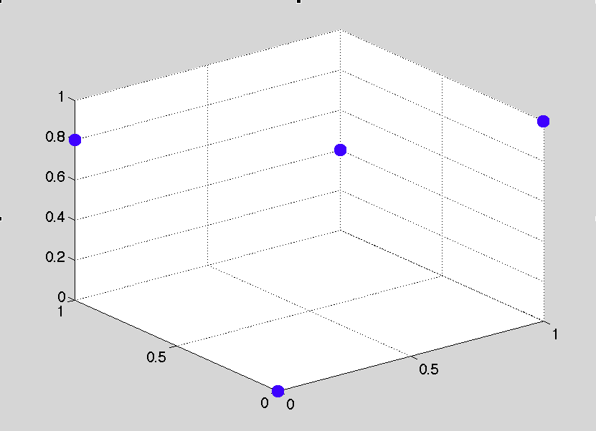
Convex aspects
convex extension
  duality
  efficient minimization
But this is only
half of the story…

Slide 32
Concave aspects
submodularity:
concavity:
A
+ s
B
+ s
F(A) “intuitively”
|A|

Slide 33
Submodularity and concavity
suppose and
submodular if and only if …
is concave

Slide 34
Maximum of submodular functions
submodular. What about
?
F(A) = max(F₁(A),F₂(A))
F₁(A)
F₂(A)
|A|
max(F₁,F₂) not submodular in general!

Slide 35
Minimum of submodular functions
Well, maybe F(A) = min(F₁(A),F₂(A)) instead?
 | F₁(A) | F₂(A) | F(A)
{} | 0 | 0 | 0
{a} | 1 | 0 | 0
{b} | 0 | 1 | 0
{a,b} | 1 | 1 | 1
F({b}) – F({})=0
<
F({a,b}) – F({a})=1
min(F₁,F₂) not submodular in general!

Slide 36

Two faces of submodular functions
Convex aspects
➔minimization!
Concave aspects
➔maximization!
Convex aspects
  Useful for minimization
  Convex extension
Concave aspects
  Useful for maximization
  Multilinear extension
Not closed under
minimum and maximum

Slide 37
What to do with submodular functions
Optimization
Learning
Minimization
Online/
adaptive
optim.
Maximization

Slide 38
What to do with submodular functions
Optimization
Learning
Minimization
Online/
adaptive
optim.
Maximization
Minimization and maximization not the same??

Slide 39
Submodular minimization
clustering
structured sparsity
regularization
s
t
MAP inference
minimum cut

Slide 40
Submodular minimization
➔ submodularity and convexity

Slide 41
Set functions and energy functions
any set function
with .
… is a function on
binary vectors!
A
1
a
a
1
b
b
0
c
c
0
d
d
pseudo-boolean function

Slide 42
Submodularity and convexity
extension
minimum of f is a minimum of F
submodular minimization as convex minimization:
polynomial time! Grötschel, Lovász, Schrijver 1981
Lovász extension
convex
Lovász, 1982

Slide 43
Submodularity and convexity
extension
minimum of f is a minimum of F
submodular minimization as convex minimization:
polynomial time!
Lovász extension
convex
Lovász, 1982

Slide 44
The submodular polyhedron P_{F}
Example: V = {a,b}
A | F(A)
{} | 0
{a} | -1
{b} | 2
{a,b} | 0
x_{{b}}
2
x({b}) ≤ F({b})
P_{F}
1
x({a,b}) ≤ F({a,b})
-2
-1
0
1
x_{{a}}
x({a}) ≤ F({a})

Slide 45
Evaluating the Lovász extension
Linear maximization over P_{F}
Exponentially many constraints!!! ☹
Computable in O(n log n) time ☺
[Edmonds ‘70]
y*
x_{{b}}
2
x
1
-2
-1
0
1
x_{{a}}
Subgradient
Separation oracle
greedy algorithm:
sort x
order defines sets

Slide 46
Lovász extension: example
F(a)
F(b)
A | F(A)
{} | 0
{a} | 1
{b} | .8
{a,b} | .2
F(a,b)
F({})

Slide 47
Submodular minimization
minimize convex extension
ellipsoid algorithm
[Grötschel et al. `81]
subgradient method,
smoothing [Stobbe & Krause `10]
duality: minimum norm point algorithm
[Fujishige & Isotani ’11]
combinatorial algorithms
Fulkerson prize
Iwata, Fujishige, Fleischer ‘01 & Schrijver ’00
state of the art:
O(n⁴T + n⁵logM) [Iwata ’03]
O(n⁶ + n⁵T) [Orlin ’09]
T = time for evaluating F

Slide 48
The minimum-norm-point algorithm
Example: V = {a,b}
Lovász extension
dual: minimum norm problem
regularized problem
A | F(A)
{} | 0
{a} | -1
{b} | 2
{a,b} | 0
Base polytope B_{F}
u({a,b})=F({a,b})
x_{{b}}
2
u*
minimizes F:
[-1,1]
1
-2
-1
0
1
Fujishige ‘91, Fujishige & Isotani ‘11
x_{{a}}

Slide 49
The minimum-norm-point algorithm
find
can we solve this??
u({a,b})=F({a,b})
x_{{b}}
yes! ☺
recall: can solve
linear optimization over P_{F}
similar: optimization over B_{F}
➔ can find
(Frank-Wolfe algorithm)
2
u*
[-1,1]
1
-2
-1
0
1
x_{{a}}
Fujishige ‘91, Fujishige & Isotani ‘11

Slide 50
Empirical comparison
combinatorial
algorithms
Cut functions
from DIMACS
Challenge
Running time (seconds)
Lower is better (log-scale!)
Minimum norm point
algorithm
64
128
256
512
1024
Problem size (log-scale!)
Minimum norm point algorithm: usually orders of magnitude faster
[Fujishige & Isotani ’11]

Slide 51
Applications?

Slide 52

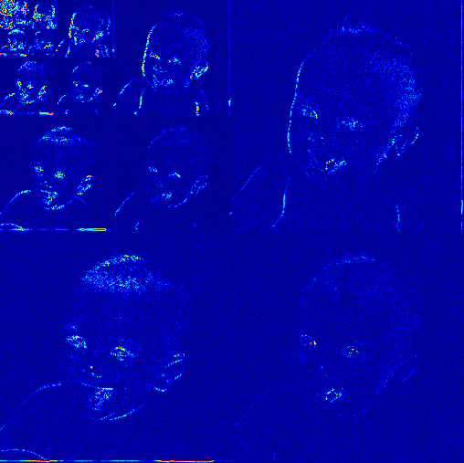
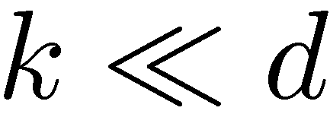


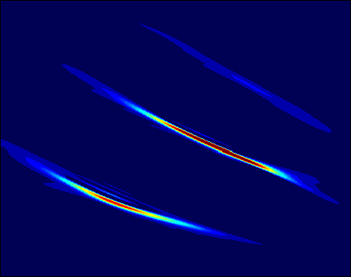

Example I: Sparsity
large
wavelet
coefficients
pixels
wideband
signal
samples
large
Gabor (TF)
coefficients
frequency
time
Many natural signals sparse in suitable basis.
Can exploit for learning/regularization/compressive sensing...

Slide 53
Sparse reconstruction
explain y with few columns of M: few x_{i}
subset
selection:
S = {1,3,4,7}
discrete regularization on support S of x
relax to convex envelope
in nature: sparsity pattern often not random…

Slide 54
Structured sparsity
Incorporate tree preference in regularizer?
Set function:
if T is a tree and S not
|S| = |T|
x
S
m₁
m₁
m₂
m₅
m₂
m₃
m₃
m₄
m₄
m₆
m₇
m₆
m₇

Slide 55
Structured sparsity
Incorporate tree preference in regularizer?
Set function:
If T is a tree and S not,
|S| = |T|
x
S
m₁
m₁
m₂
m₅
m₂
m₃
m₃
m₄
m₆
m₇

Slide 56

Structured sparsity
Incorporate tree preference in regularizer?
Set function:
If T is a tree and S not,
|S| = |T|
x
S
m₁
m₂
m₅
Function F is …
submodular! ☺
m₃
m₄
m₇
m₄
m₆
m₆
m₇
S

Slide 57
Sparsity
explain y with few columns of M: few x_{i}
prior knowledge: patterns of nonzeros
submodular function
discrete regularization on support S of x
relax to convex envelope
➔ Lovász extension
Optimization: submodular minimization
[Bach`10]

Slide 58
Further connections: Dictionary Selection
Where does the dictionary M come from?
Want to learn it from data:
Selecting a dictionary with near-max. variance reduction
Maximization of approximately submodular function
[Krause & Cevher ‘10; Das & Kempe ’11]

Slide 59
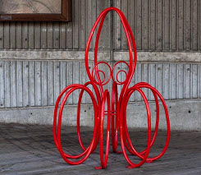
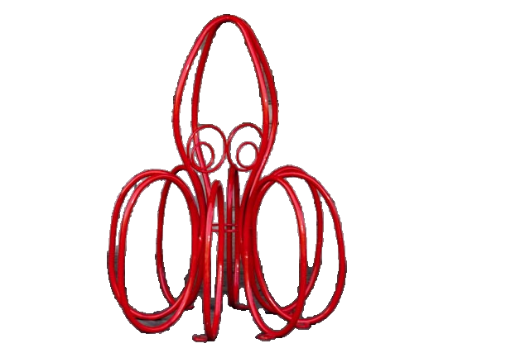
Example: MAP inference
label
pixel
labels
pixel
values

Slide 60
Example: MAP inference
1
1
0
0
1
1
0
0
0
0
0
0
Recall: equivalence
function on binary vectors
set function
A
1
a
a
1
b
b
0
c
if is submodular (attractive potentials), then
MAP inference = submodular minimization!
polynomial-time
c
0
d
d

Slide 61
Special cases
Minimizing general submodular functions:
poly-time, but not very scalable
Special structure ➔ faster algorithms
Symmetric functions
Graph cuts
Concave functions
Sums of functions with bounded support
...

Slide 62
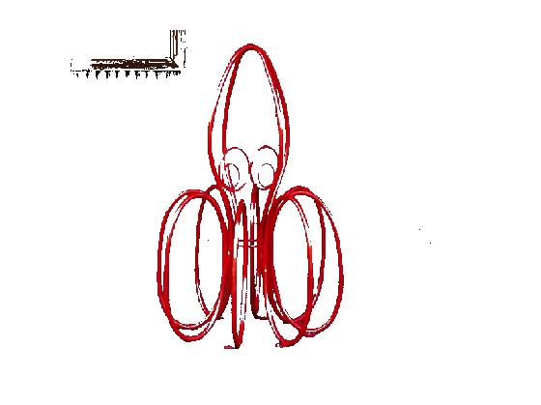
MAP inference
1
1
0
0
1
1
0
0
0
0
0
0
if each is submodular:
a
b
a
b
then is a graph cut function.
MAP inference = Minimum cut: fast ☺

Slide 63


Pairwise is not enough…
color + pairwise
color + pairwise +
Pixels in one tile should have the same label
[Kohli et al.`09]

Slide 64
Enforcing label consistency
Pixels in a superpixel should have the same label
E(x)
n_{c}: number of x_{i}
taking minority label
concave function of cardinality ➔ submodular ☺
> 2 arguments: Graph cut ??
A graph cut is a submodular function.
Can each submodular function be transformed into a cut?

Slide 65
Higher-order functions as graph cuts?
works well for some particular
[Billionet & Minoux `85, Freedman & Drineas `05, Živný & Jeavons `10,...]
necessary conditions complex and
not all submodular functions equal such graph cuts [Živný et al.‘09]
General strategy:
reduce to pairwise case by adding auxiliary variables

Slide 66
Fast approximate minimization
Not all submodular functions can be optimized as graph cuts
Even if they can: possibly many extra nodes in the graph ☹
Other options?
minimum norm algorithm
other special cases:
e.g. parametric maxflow
[Fujishige & Iwata`99]
speech corpus selection [Lin&Bilmes `11]
Approximate! ☺
Every submodular function
can be approximated by
a series of graph cut
functions [Jegelka, Lin & Bilmes `11]

Slide 67
Fast approximate minimization
Not all submodular functions can be optimized as graph cuts
Even if they can: possibly many extra nodes in the graph ☹
speech corpus selection [Lin&Bilmes `11]
Approximate! ☺
decompose:
represent as much as
possible exactly by a graph
rest: approximate iteratively
by changing edge weights
solve a series of cut problems

Slide 68
Other special cases
Symmetric:
  Queyranne‘s algorithm: O(n³) [Queyranne, 1998]
Concave of modular:
  [Stobbe & Krause `10, Kohli et al, `09]
Sum of submodular functions, each bounded support
[Kolmogorov `12]

Slide 69
Submodular minimization
Optimization
unconstrained
Learning
constrained
Online/
adaptive
optim.
Maximization

Slide 70
Submodular minimization
unconstrained:
  nontrivial algorithms,
  polynomial time
constraints: e.g.
  limited cases doable:
  odd/even cardinality, inclusion/exclusion of a set
special case:
balanced
cut
General case: NP hard
hard to approximate within polynomial factors!
But: special cases often still work well
[Lower bounds: Goel et al.`09, Iwata & Nagano `09, Jegelka & Bilmes `11]

Slide 71
Constraints
minimum…
cut
matching
path
spanning tree
ground set: edges in a graph

Slide 72
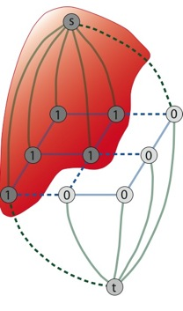



Recall: MAP and cuts
binary labeling:
pairwise random field:
What’s the problem?
aim
reality
minimum cut: prefer
short cut = short object boundary

Slide 73
MAP and cuts
Minimum cut
Minimum cooperative cut
implicit criterion:
short cut =
short boundary
new criterion:
boundary may be long if the boundary is homogeneous
minimize
sum of edge weights
minimize
submodular function of edges
not a sum of
edge weights!

Slide 74
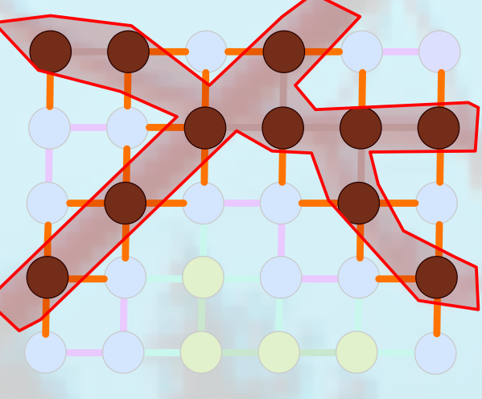
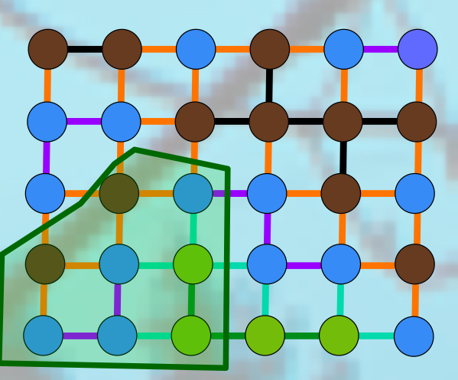
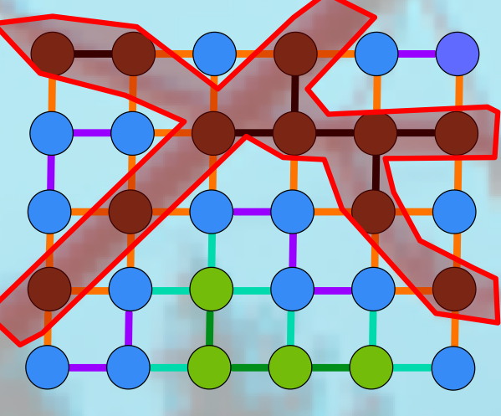
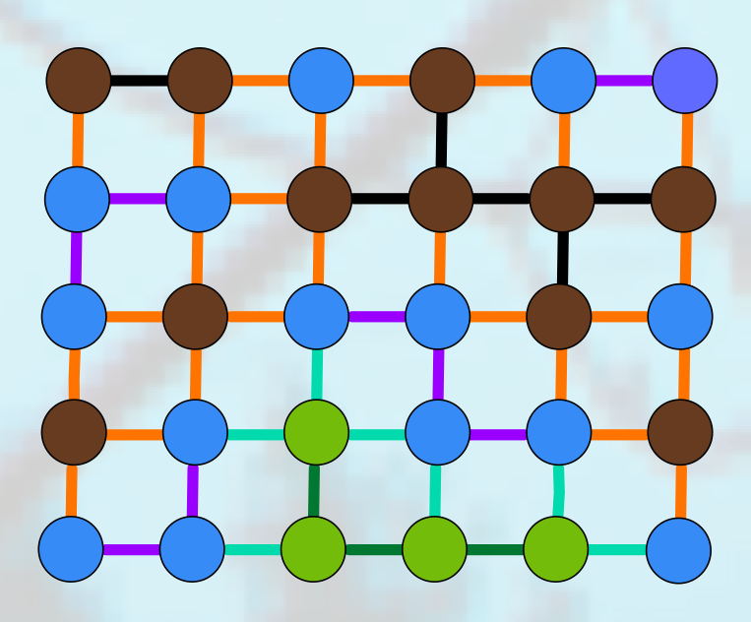
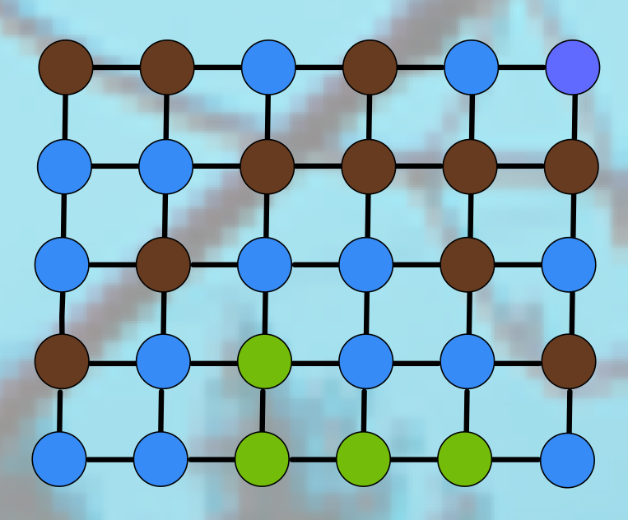
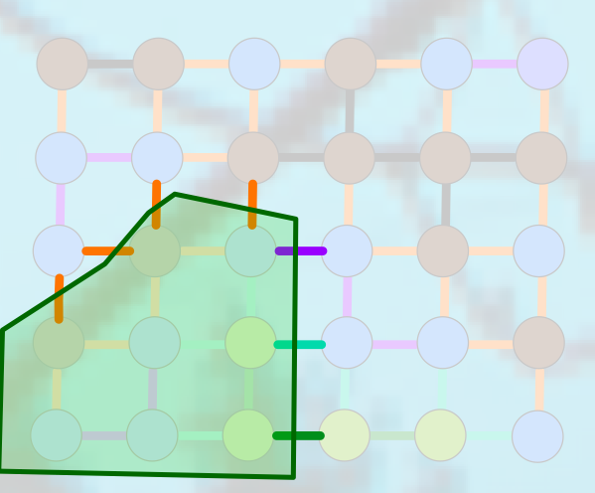
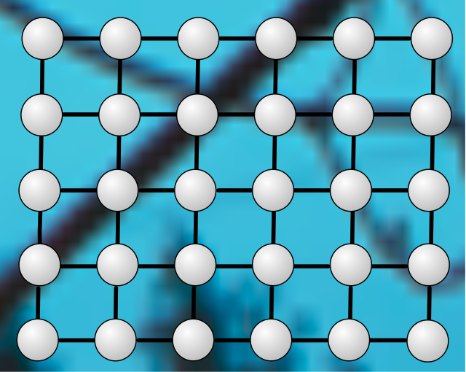
Reward co-occurrence of edges
sum of weights:
use few edges
submodular cost function:
use few groups S_{i} of edges
25 edges, 1 type
7 edges, 4 types

Slide 75
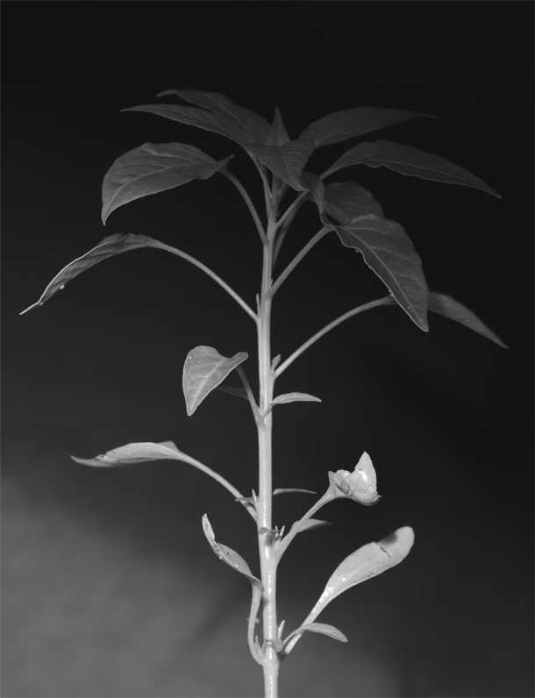

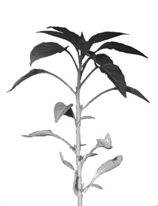
Results
Graph cut
Cooperative cut

Slide 76
Optimization?
not a standard graph cut
MAP viewpoint:
global, non-submodular energy function

Slide 77
Constrained optimization
cut
matching
path
spanning tree
approximate optimization
convex relaxation
minimize surrogate function
approximation bounds dependent on F:
polynomial – constant – FPTAS
[Goel et al.`09, Iwata & Nagano `09, Goemans et al. `09, Jegelka & Bilmes `11, Iyer et al. ICML `13,
Kohli et al `13...]

Slide 78
Efficient constrained optimization
minimize a series of surrogate functions
1. compute linear upper bound
2. Solve easy sum-of-weights problem:
and repeat.
spanning
tree
cut
efficient
only need to solve sum-of-weights problems
unifying viewpoint of submodular min and max
see Wed best student paper talk
path
matching
[Jegelka & Bilmes `11, Iyer et al. ICML `13]

Slide 79
Submodular min in practice
Does a special algorithm apply?
  symmetric function? graph cut? …. approximately?
Continuous methods: convexity
  minimum norm point algorithm
Other techniques [not addressed here]
  LP, column generation, …
Combinatorial algorithms: relatively high complexity
Constraints: hard
  majorize-minimize or relaxation

Slide 80
Outline
What is submodularity?
Optimization
  Minimize costs
  Maximize utility
Learning
Learning for Optimization: new settings
Part I
Break!
Part II
see you in half an hour ☺

