Slide 1

Outline
What is submodularity?
Optimization
  Minimize costs
  Maximize utility
Learning
Learning for Optimization: new settings
Part I
X₄
X₁
X₂
X₅
Part II

Slide 2
Optimization
Optimization
Minimization
Learning
Online/
adaptive
optim.
Maximization

Slide 3
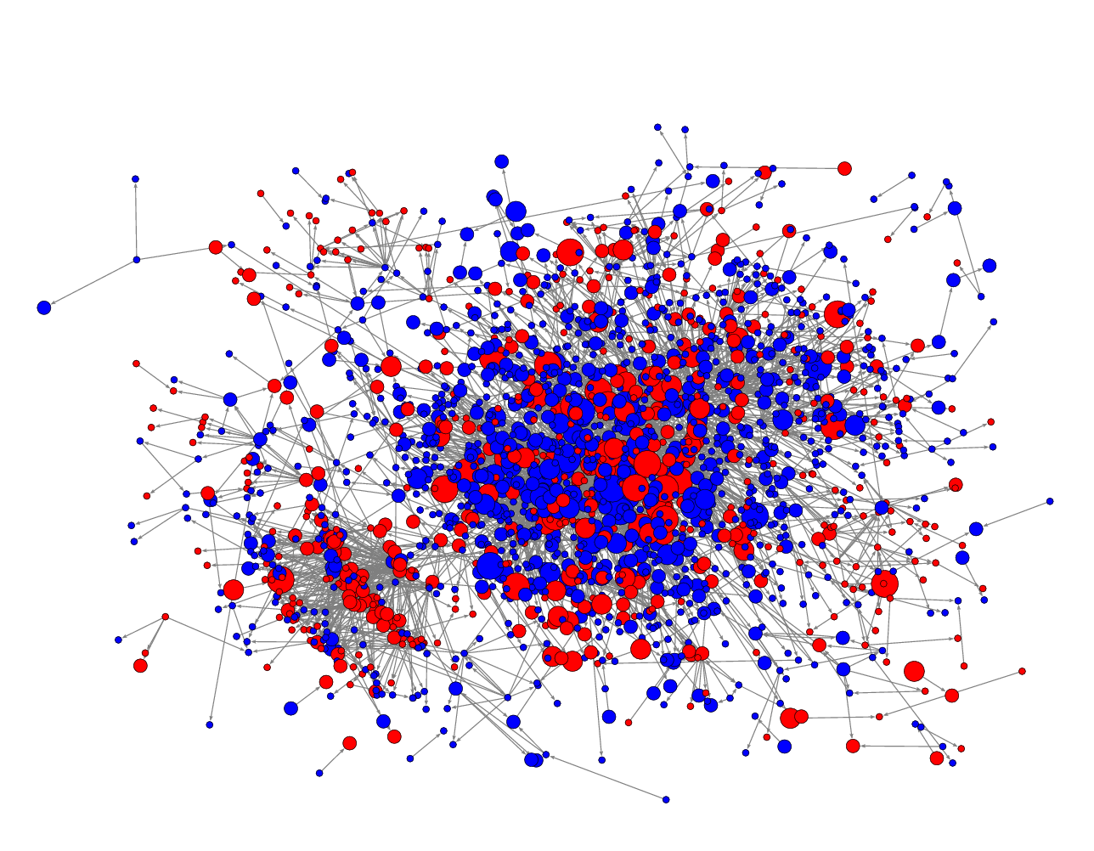

Submodular maximization
.
.
.
X₄
.
.
.
.
.
.
X₁
.
.
X₂
X₅
covering
sensing
summarization
network inference

Slide 4

Two faces of submodular functions
Convex aspects
➔minimization!
Concave aspects
➔maximization!
Convex aspects
  Useful for minimization
  Convex extension
Concave aspects
  Useful for maximization
  Multilinear extension
Not closed under
minimum and maximum

Slide 5
Submodular maximization
➔ submodularity and concavity

Slide 6
Concave aspects
submodularity:
concavity:
F(A) “intuitively”
|A|

Slide 7
Optimization
Optimization
Minimization
Learning
Online/
adaptive
optim.
Maximization

Slide 8
Optimization
Optimization
Minimization
Learning
Online/
adaptive
optim.
unconstrained
constrained

Slide 9
Maximizing submodular functions
maximum
Suppose we want for submodular F
Example:
  F(A) = U(A) – C(A) where U(A) is submodular utility,
  and C(A) is supermodular cost function
In general: NP hard. Moreover:
If F(A) can take negative values:
As hard to approximate as maximum independent set
(i.e., NP hard to get O(n^{1-ε}) approximation)
|A|

Slide 10
Exact maximization of SFs
Mixed integer programming
  Series of mixed integer programs [Nemhauser et al ‘81]
  Constraint generation [Kawahara et al ‘09]
Branch-and-bound
  „Data-Correcting Algorithm“ [Goldengorin et al ’99]
Useful for small/moderate problems
All algorithms worst-case exponential!

Slide 11
Randomized USM (Buchbinder et al ‘12)
A
B
{}
V
Start with A={}, B=V
For i=1 to n
  Pick
  If set
  Else
Return

Slide 12
Maximizing positive submodular functions
[Feige, Mirrokni, Vondrak ’09; Buchbinder, Feldman, Naor, Schwartz ’12]
Theorem
Given a nonnegative submodular function F,
RandomizedUSM returns set A_{R} such that
F(A_{R}) ≥ 1/2 max_{A} F(A)
Cannot do better in general than ½ unless P = NP

Slide 13
Unconstrained vs. constraint maximization
Given monotone utility F(A) and cost C(A), optimize:
Option 1:
Option 2:
“Scalarization”
“Constrained maximization”
Can get 1/2 approx…
if F(A)-C(A) ≥ 0
for all sets A
What is possible?
Positiveness is a
strong requirement ☹

Slide 14
Optimization
Optimization
Minimization
Learning
Online/
adaptive
optim.
unconstrained
constrained

Slide 15

Monotonicity
Placement A = {1,2}
Placement B = {1,…,5}
X₁
X₂
X₁
X₂
X₃
X₄
X₅
F is monotonic:
Adding sensors can only help

Slide 16


Cardinality constrained maximization
Given: finite set V, monotone SF F
Want: such that
NP-hard!
X₄
X₃
X₁
X₂
X₅

Slide 17
Greedy algorithm
Given: finite set V, monotone SF F
Want: such that
NP-hard!
How well can this simple heuristic do?
X₄
X₃
X₁
Greedy algorithm:
  Start with
  For i = 1 to k
X₂
X₅

Slide 18
Performance of greedy
Optimal
Greedy
Temperature data
from sensor network
Information gain
Greedy empirically close to optimal. Why?

Slide 19
One reason submodularity is useful
Theorem [Nemhauser, Fisher & Wolsey ’78]
For monotonic submodular functions,
Greedy algorithm gives constant factor approximation
F(A_{greedy}) ≥ (1-1/e) F(A_{opt})
Greedy algorithm gives near-optimal solution!
In general, need to evaluate exponentially many sets to do better!
[Nemhauser & Wolsey ’78]
Also many special cases are hard (set cover, mutual information, …)
~63%

Slide 20
Scaling up the greedy algorithm [Minoux ’78]
In round i+1,
  have picked A_{i} = {s₁,…,s_{i}}
  pick s_{i+1} = argmax_{s} F(A_{i} U {s})-F(A_{i})
I.e., maximize “marginal benefit” Δ(s | A_{i})
Δ(s | A_{i}) = F(A_{i} U {s})-F(A_{i})
Key observation: Submodularity implies
i ≤ j => Δ(s | A_{i}) ≥ Δ(s | A_{j})
Marginal benefits can never increase!
Δ (s | A_{i})
≥ Δ(s | A_{i+1})
s

Slide 21
“Lazy” greedy algorithm [Minoux ’78]
Lazy greedy algorithm:
  First iteration as usual
  Keep an ordered list of marginal benefits Δ_{i} from previous iteration
  Re-evaluate Δ_{i} only for top element
  If Δ_{i} stays on top, use it,
  otherwise re-sort
Benefit Δ(s | A)
a
a
a
b
b
d
b
c
c
e
d
d
c
e
e
Note: Very easy to compute online bounds, lazy evaluations, etc.
[Leskovec, Krause et al. ’07]
Notes:
21

Slide 22
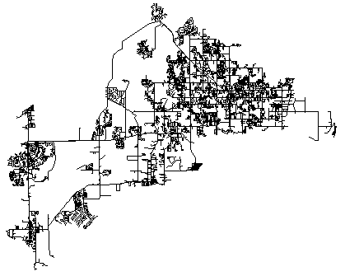

Empirical improvements [Leskovec, Krause et al’06]
400
300
Exhaustive search
Exhaustive search
(All subsets)
300
(All subsets)
200
Lower is better
Naive
Lower is better
Naive
Running time (minutes)
Running time (seconds)
greedy
200
greedy
100
Fast greedy
100
Fast greedy
0
0
1
2
3
4
5
6
7
8
9
10
1
2
3
4
5
6
7
8
9
10
Number of sensors selected
Number of blogs selected
Sensor placement
Blog selection
30x speedup
700x speedup

Slide 23
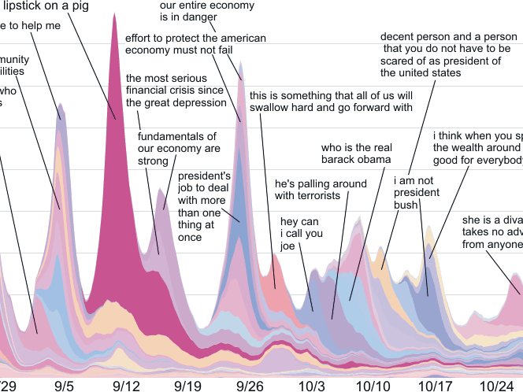
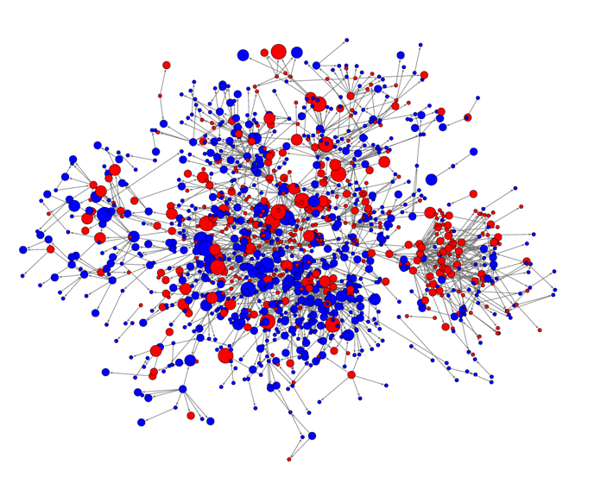
Network inference
How can we learn who influences whom?

Slide 24






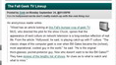



Cascades in the Blogosphere
Time
Information cascade
Notes:
24

Slide 25





Inferring diffusion networks
[Gomez Rodriguez, Leskovec, Krause ACM TKDE 2012]
Given:
Want:
1
3
4
5
2
2
4
3
1
Given traces of influence, wish to infer sparse
directed network G=(V,E)
➔ Formulate as optimization problem

Slide 26





Estimation problem
1
1
3
5
3
5
2
2
4
4
Many influence trees T consistent with data
For cascade C_{i}, model P(C_{i}| T)
Find sparse graph that maximizes likelihood for all observed cascades
➔ Log likelihood monotonic submodular in selected edges

Slide 27
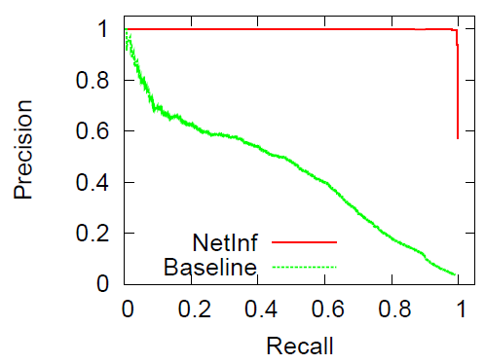
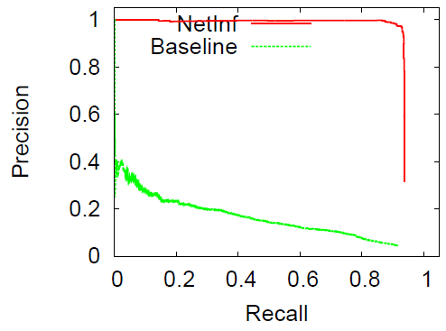
Evaluation: Synthetic networks
1024 node hierarchical Kronecker exponential transmission model
1000 node Forest Fire (α = 1.1) power law transmission model
Performance does not depend on the network structure:
  Synthetic Networks: Forest Fire, Kronecker, etc.
  Transmission time distribution: Exponential, Power Law
Break-even point of > 90%

Slide 28
Diffusion Network
[Gomez Rodriguez, Leskovec, Krause ACM TKDE 2012]
Blogs
Mainstream media
Actual network inferred from 172 million
articles from 1 million news sources

Slide 29


Document summarization [Lin & Bilmes ‘11]
Which sentences should we select that best summarize a document?

Slide 30
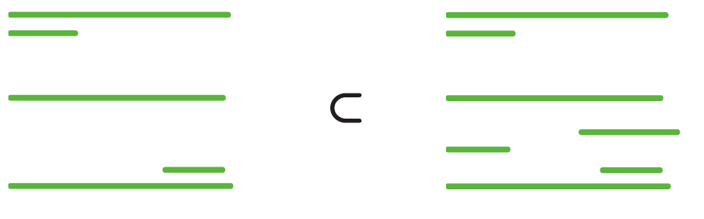
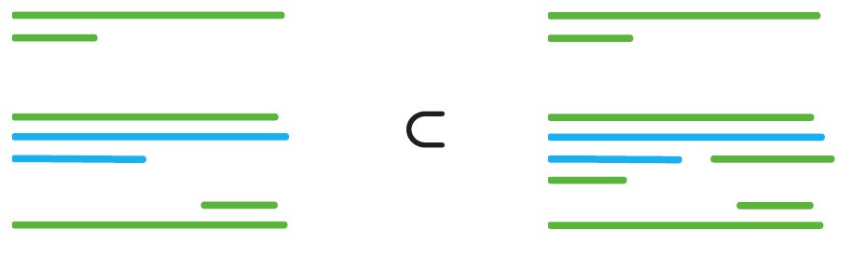
Marginal gain of a sentence
Many natural notions of „document coverage“ are submodular [Lin & Bilmes ‘11]

Slide 31
Document summarization
Relevance
Diversity

Slide 32
Relevance of a summary
How well is sentence i „covered“ by S
Similarity between i and j
a

Slide 33
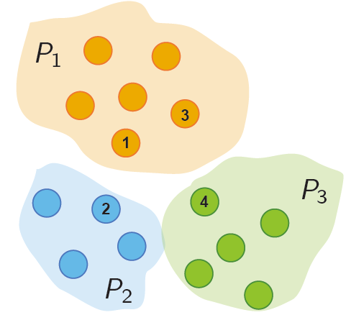
Diversity of a summary
Relevance of sentence j to doc.
Clustering of sentences
in document
Similarity between i and j

Slide 34
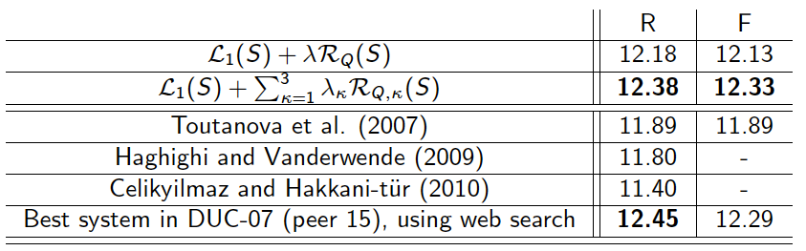
Empirical results [Lin & Bilmes ‘11]
Best F1 score on benchmark corpus DUC-07!
Can do even better using submodular structured prediction! [Lin & Bilmes ‘12]

Slide 35
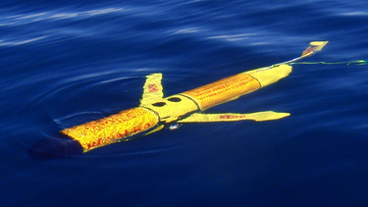

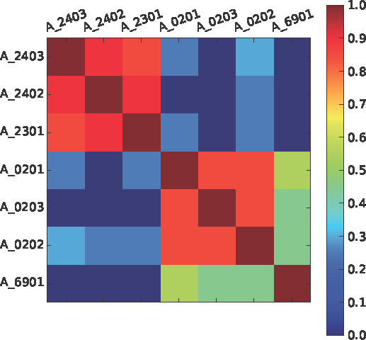


Submodular Sensing Problems
[with Guestrin, Leskovec, Singh, Sukhatme, …]
Water distribution networks
[J WRPM ’08]
Environmental monitoring
[UAI’05, JAIR ’08, ICRA ‘10]
Recommending blogs & news
[KDD ‘07, ’10]
Experiment design
[NIPS ‘10, ’11, PNAS’13]
Can all be reduced to monotonic submodular maximization

Slide 36
More complex constraints
So far:
Can one handle more complex constraints?

Slide 37
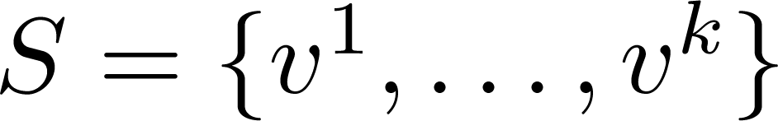
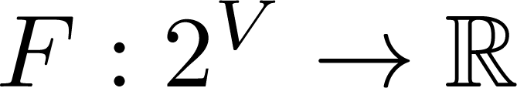
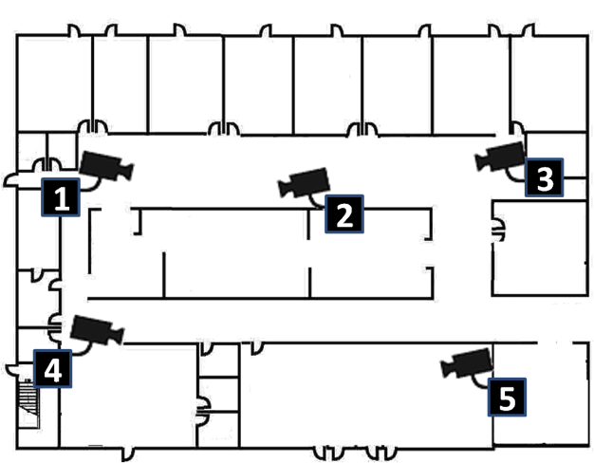
Example: Camera network
Ground set
Configuration:
Sensing quality model
Configuration is feasible if no camera is pointed in two directions at once

Slide 38
Matroids
Abstract notion of feasibility: independence
S is independent if …
… |S| ≤ k
Uniform matroid
… S contains at most one element from each square
Partition matroid
… S contains no cycles
Graphic matroid
S independent ➔ T S also independent
Exchange property: S, U independent, |S| > |U|
➔ some can be added to U: independent
All maximal independent sets have the same size

Slide 39
Matroids
Abstract notion of feasibility: independence
S is independent if …
… |S| ≤ k Uniform matroid | … S contains at most one element from each group Partition matroid | … S contains no cycles Graphic matroid
S independent ➔ T S also independent
Exchange property: S, U independent, |S| > |U|
➔ some can be added to U: independent
All maximal independent sets have the same size

Slide 40
Example: Camera network
Ground set
Configuration:
Sensing quality model
Configuration is feasible if no camera is pointed in two directions at once
This is a partition matroid:
Independence:

Slide 41
Greedy algorithm for matroids:
Given: finite set V
Want: such that
Greedy algorithm:
  Start with
  While

Slide 42
Maximization over matroids
Theorem [Nemhauser, Fisher & Wolsey ’78]
For monotonic submodular functions,
Greedy algorithm gives constant factor approximation
F(A_{greedy}) ≥ ½ F(A_{opt})
Greedy gives 1/(p+1) over intersection of p matroids
  Can model matchings / rankings with p=2:
  Each item can be assigned ≤ 1 rank, each rank can take ≤ 1 item
Can get also obtain (1-1/e) for arbitrary matroids [Vondrak et al ’08]
using continuous greedy algorithm

Slide 43
Maximization: More complex constraints
Approximate submodular maximization possible
under a variety of constraints:
  (Multiple) matroid constraints
  Knapsack (non-constant cost functions)
  Multiple matroid and knapsack constraints
  Path constraints (Submodular orienteering)
  Connectedness (Submodular Steiner)
  Robustness (minimax)
  ...
Survey on „Submodular Function Maximization“
[Krause & Golovin ‘12] on submodularity.org
Greedy
works well
Need
non-greedy
algorithms

Slide 44
Key intuition for approx. maximization
For submod. functions,
local maxima
can‘t be too bad
E.g., all local maxima under cardinality constraints
are within factor 2 of global maximum
Key insight for more complex maximization
➔ Greedy, local search, simulated annealing
for (non-monotone, constrained, ...)

Slide 45
Two-faces of submodular functions
Cuts, clustering,
similarity
Coverage,
diversity
Convex aspects
➔minimization!
MAP inference
summarization
Concave aspects
➔maximization!
structured sparsity
regularization
sensing
Convex aspects
  Useful for minimization
  Convex extension
Concave aspects
  Useful for maximization
  Multilinear extension
Not closed under
minimum and maximum

Slide 46
Summary Optimization
 | Maximization | Minimization
Unconstrained | NP-hard, but well-approximable (if nonnegative) | Polynomial time! Generally inefficent (n^6), but can exploit special cases (cuts; symmetry; decomposable; ...)
Constrained | NP-hard but well-approximable „Greedy-(like)“ for cardinality, matroid constraints; Non-greedy for more complex (e.g., connectivity) constraints | NP-hard; hard to approximate, still useful algorithms

Slide 47
What to do with submodular functions
Optimization
Minimization
Learning
Online/
adaptive
optim.
Maximization

Slide 48
What to do with submodular functions
Optimization
Minimization
Learning
Online/
adaptive
optim.
Maximization

Slide 49
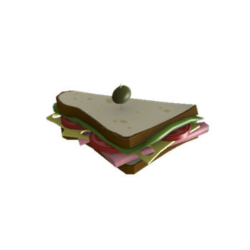
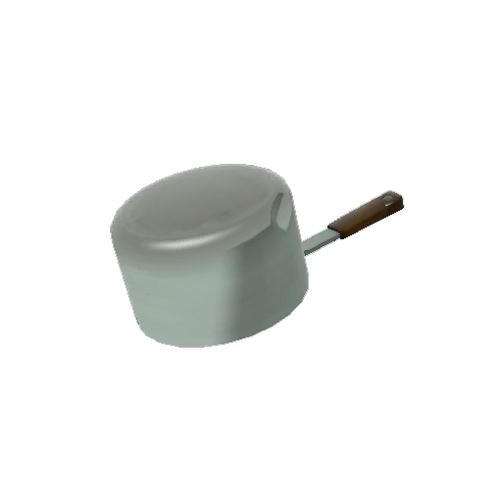


Example 1: Valuation Functions
= $ 3
= $ 88
And so on…
For combinatorial auctions, show bidders various subsets of items, see their bids
Can we learn a bidder’s utility function from few bids?

Slide 50
Example 2: Graph Evolution
A
A
C
D
E
C
D
E
B
F
B
F
G
K
G
K
H
I
H
I
J
J
L
M
N
L
M
N
O
O
P
P
Want to track changes in a graph
Instead of storing entire graph at each time step, store some measurements
Hope: # of measurements << # of edge changes in graph

Slide 51
Random Graph Cut #1
A
A
C
D
E
C
D
E
B
F
B
F
G
K
G
K
H
I
H
I
J
J
L
M
N
L
M
N
O
O
P
P
Cut value = 13
Cut value = 14
Choose a random partition of vertices
Count total # of edges across partition

Slide 52
Random Graph Cut #2
A
A
C
D
E
C
D
E
B
F
B
F
G
K
G
K
H
I
H
I
J
J
L
M
N
L
M
N
O
O
P
P
Cut value = 13
Cut value = 12
Choose another random partition of vertices
Count total # of edges across partition

Slide 53
Symmetric Graph Cut Function
A
V\A
F(A) = sum of weights of edges between A and V\A
V = set of vertices
One-to-one correspondence of graphs and cut functions
Can we learn a graph from the value of few cuts?
[E.g., graph sketching, computational biology, …]

Slide 54



General Problem: Learning Set Functions
Base Set
Set function
Can we learn F from few measurements / data?

Slide 55
“Regressing” submodular functions
[Balcan, Harvey STOC ‘11]
Sample m sets A₁ … A_{m}, from dist. D; see F(A₁), …, F(A_{m})
From this, want to generalize well
is (α,ε,δ)-PMAC iff with prob. 1-δ it holds that
Theorem: cannot approximate better than
α = n^{1/3} / log(n)
unless one looks at exponentially many samples A_{i}
But can efficiently obtain α = n^{½}

Slide 56
Approximating submodular functions
[Goemans, Harvey, Kleinberg, Mirrokni, ’08]
Pick m sets, A₁ … A_{m}, get to see F(A₁), …, F(A_{m})
From this, want to approximate by s.t.
for all A
Theorem: Even if
  F is monotonic
  we can pick A_{i} adaptively,
cannot approximate better than α = n^{½} / log(n)
unless one looks at exponentially many sets A_{i}
But can efficiently obtain α = n^{½} log(n)

Slide 57
What if we have structure?
To learn effectively, need additional assumptions beyond submodularity.
Sparsity in Fourier domain [Stobbe & Krause ’12]
  „Submodular“ compressive sensing
  Cuts and many other functions sparse in Fourier domain!
Also can learn XOS valuations [Balcan et al ‘12]
Sparsity: Most coefficients ≈0

Slide 58

Results: Sketching Graph Evolution
[Stobbe & Krause ‘12]
Tracking evolution of 128-vertex subgraph using random cuts
Δ = number of differences between graphs
1
0.9
0.8
0.7
Week
Week
7 to 9
1 to 3
0.6
Δ
=161
Δ
=245
Reconstruction error
Week
0.5
3 to 5
0.4
Δ
=122
0.3
0.2
Week
5 to 7
0.1
Δ
=62
0
0
200
400
600
800
1000
1200
1400
Number of measurements
Autonomous Systems Graph (from SNAP)
For low error, observing random cuts suffices

Slide 59
What to do with submodular functions
Optimization
Minimization
Learning
Online/
adaptive
optim.
Maximization

Slide 60
Learning to optimize
Have seen how to
  optimize submodular functions
  learn submodular functions
What if we only want to
learn enough to optimize?

Slide 61
Learning to optimize submodular functions
Online submodular optimization
  Learn to pick a sequence of sets to maximize a sequence of (unknown) submodular functions
  Application: Making diverse recommendations
Adaptive submodular optimization
  Gradually build up a set, taking into account feedback
  Application: Experimental design / Active learning

Slide 62


News recommendation

Slide 63

Application: Diverse Recommendations
“Google to DOJ: Let us prove to users that NSA isn't snooping on them”
“US tech firms push for govt transparency on securityReuters”
“Internet Companies Call For More Disclosure of Surveillance”
“NSA scandal: Twitter and Microsoft join calls to disclose data requests”
“NSA Secrecy Prompts a Pushback”
“Google to DOJ: Let us prove to users that NSA isn't snooping on them”
“Storms Capable of Producing Derecho Possible in Midwest Today”
“Ohio kidnap suspect pleads not guilty”
“Five takeaways from Spurs-Heat in Game 3 of the NBA Finals”
“Samsung Unveils Galaxy S4 Zoom With 16MP Camera”
Prefer recommendations that are both relevant and diverse

Slide 64
Simple model
We‘re given a set of articles
Each round:
  A user appears, interested in a subset of the articles
  We recommend a set of articles
  The user clicks on any displayed article that she is interested in
Goal: Maximize the total #of clicks
Challenge:
  We don‘t know which articles the user is interested in!

Slide 65
Online maximization of submodular functions
[Streeter, Golovin NIPS ‘08]
Pick sets
A₁
A₂
A₃
…
A_{T}
Observe either
F_{t}, or only F_{t}(A_{t})
SFs
F₁
F₂
F₃
…
F_{T}
Reward
r₁=F₁(A₁)
r₂
r₃
…
r_{T}
Total: ∑_{t} r_{t} → max
Time
Goal: Want to choose A₁,…A_{t} s.t. the regret
grows sublinearly, i.e.,
For k=1, many good algorithms known! ☺
But what if k>1?

Slide 66



Online Greedy Algorithm
[Streeter & Golovin, NIPS `08]
Replace each stage of greedy algorithm with a
multi-armed bandit algorithm.
a₁
a₂
a₃
a_{k}
Select { , , , … , } .
Feedback to for action a_{j} is (unbiased est. of)
F_{t}({a₁, a₂, …, a_{j-1}, a_{j}}) – F_{t}({a₁, a₂, …, a_{j-1}})

Slide 67
Online maximization of submodular functions
[Streeter, Golovin NIPS ‘08]
Theorem
Online greedy algorithm chooses A₁,…,A_{T} s.t.
for any sequence F₁,…,F_{T}
Can get ‘no-regret’ over greedy algorithm in hindsight
I.e., can learn ``enough’’ about F to optimize greedily!

Slide 68
Stochastic linear submodular bandits
[Yue & Guestrin ‘11]
Basic submodular bandit algorithm has slow convergence
Can do better if we make stronger assumptions
  Submodular function is linear combination of m SFs
  We evaluate it up to (stochastic) noise*
➔ LSBGreedy algorithm
*some independence conditions

Slide 69

User Study [Yue & Guestrin ’11]
Real data: >10k articles
T=10 days, rec. 10 articles per day
27 users rate articles, aim to maximize #likes
LSBGreedy outperforms baselines that fail to …
  adapt weights (no personalization)
  address the exploration—exploitation tradeoff
  model diversity explicitly
“Google to DOJ: Let us prove to users that NSA isn't snooping on them”
“Storms Capable of Producing Derecho Possible in Midwest Today”
“Ohio kidnap suspect pleads not guilty”
“Five takeaways from Spurs-Heat in Game 3 of the NBA Finals”
“Samsung Unveils Galaxy S4 Zoom With 16MP Camera”

Slide 70
Other results on online submodular optimization
Online submodular maximization
  No (1-1/e) regret for ranking (partition matroids)
  [Streeter, Golovin, Krause 2009]
  Distributed implementation [Golovin, Faulkner, Krause ‘2010]
Online submodular coverage
  Min-cost / Min-sum submodular cover
  [Streeter & Golovin NIPS 2008, Guillory & Bilmes NIPS 2011]
Online Submodular Minimization
  Unconstrained [Hazan & Kale NIPS 2009]
  Constrained [Jegelka & Bilmes ICML 2011]
See also the „submodular secretary problem“

Slide 71
Learning to optimize submodular functions
Online submodular optimization
  Learn to pick a sequence of sets to maximize a sequence of (unknown) submodular functions
  Application: Making diverse recommendations
Adaptive submodular optimization
  Gradually build up a set, taking into account feedback
  Application: Experimental design / Active learning

Slide 72


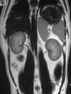
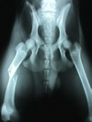
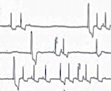
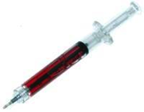
Adaptive Sensing / Diagnosis
x₁
=
0
1
x₂
=
x₄ =
1
0
1
0
x₃
=
Want to effectively diagnose while minimizing cost of testing!
Classical submodularity does not apply ☹
Can we generalize submodularity for sequential decision making?
Notes:
72

Slide 73







Adaptive selection in diagnosis
Prior over diseases P(Y)
Deterministic test outcomes P(X_{V} | Y)
Each test eliminates hypotheses y
Y
“Sick”
X₁
“Fever”
X₂
“Rash”
X₃
“Cough”
States y
X₁=1
X₃=0
X₂=0
X₂=1

Slide 74
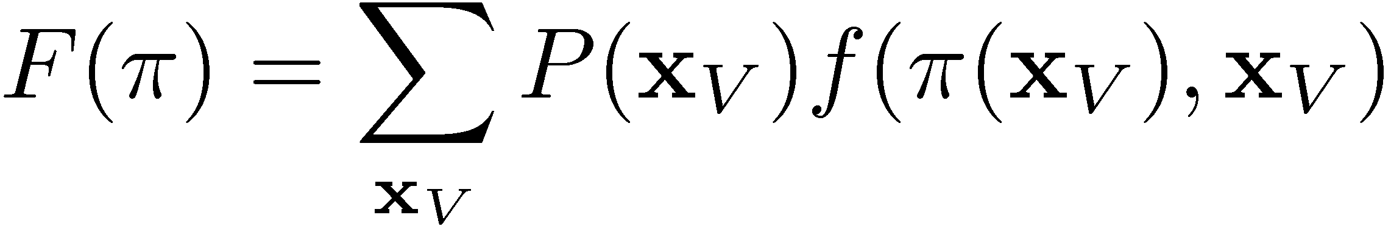
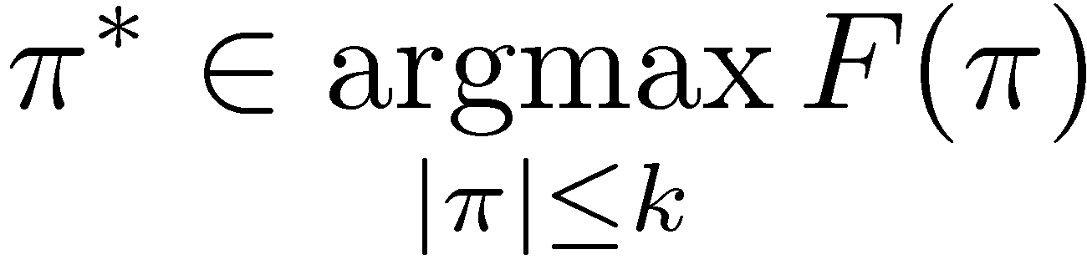
Problem Statement
Given:
  Items (tests, experiments, actions, …) V={1,…,n}
  Associated with random variables X₁,…,X_{n} taking values in O
  Objective:
  Policy π maps observation x_{A} to next item
Value of policy π:
Want
NP-hard (also hard to approximate!)
Tests run by π
if world in state x_{V}

Slide 75
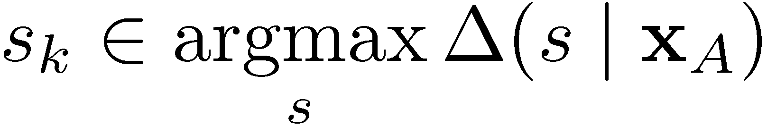
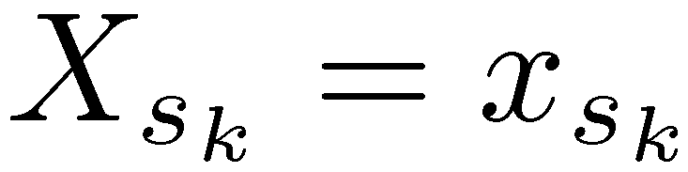
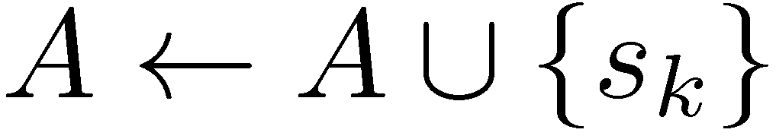
Adaptive greedy algorithm
Suppose we’ve seen X_{A} = x_{A.}
Conditional expected benefit of adding item s:
Adaptive Greedy algorithm:
Start with
For i = 1:k
  Pick
  Observe
  Set
Benefit if world in state x_{V}
Conditional on
observations x_{A}
When does this adaptive greedy algorithm work??

Slide 76
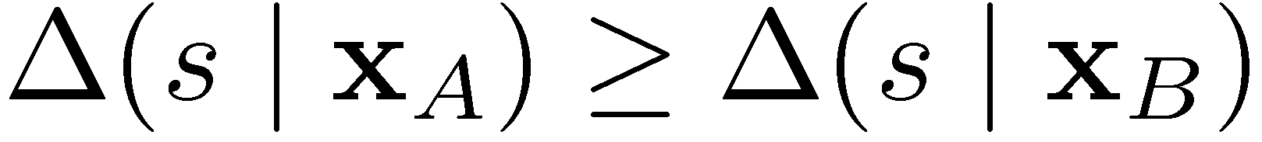
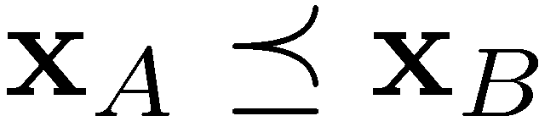
Adaptive submodularity
[Golovin & Krause, JAIR 2011]
Adaptive monotonicity:
Adaptive submodularity:
Theorem: If f is adaptive submodular and adaptive monotone w.r.t. to distribution P, then
F(π_{greedy}) ≥ (1-1/e) F(π_{opt})
x_{B} observes
more than x_{A}
whenever
Many other results about submodular set functions
can also be “lifted” to the adaptive setting!

Slide 77
From sets to policies
Submodularity
Adaptive submodularity
Applies to: set functions
Greedy algorithm provides
(1-1/e) for max. w card. const.
1/(p+1) for p-indep. systems
log Q for min-cost-cover
4 for min-sum-cover
policies, value functions
Greedy policy provides
(1-1/e) for max. w card. const.
1/(p+1) for p-indep. systems
log Q for min-cost-cover
4 for min-sum-cover

Slide 78
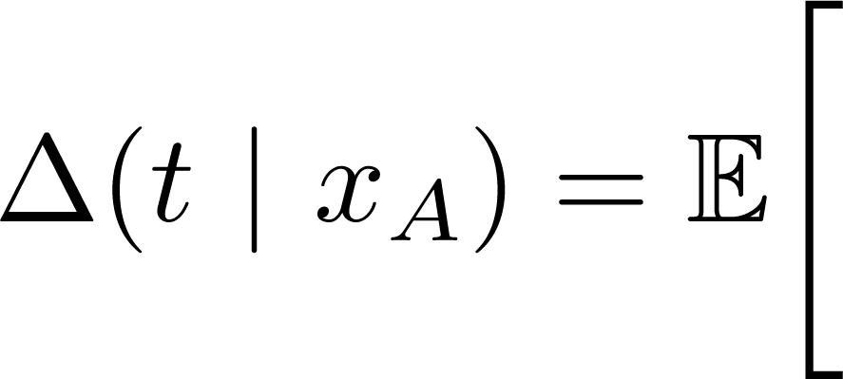
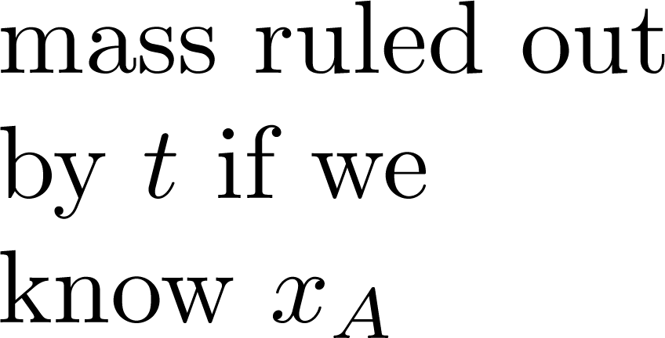

Optimal Diagnosis
Prior over diseases P(Y)
Deterministic test outcomes P(X_{V} | Y)
How should we test to
eliminate all incorrect hypotheses?
“Generalized binary search”
Equivalent to max. infogain
Y
“Sick”
X₁
“Fever”
X₂
“Rash”
X₃
“Cough”
X₁=1
X₃=0
X₂=0
X₂=1

Slide 79

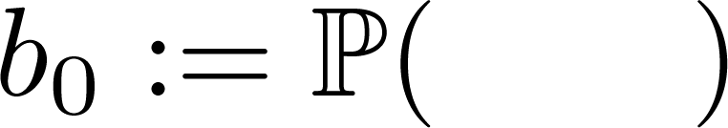

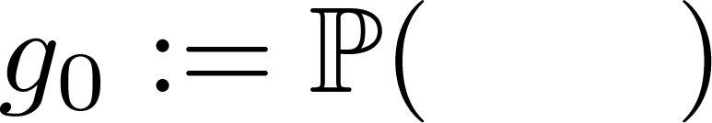
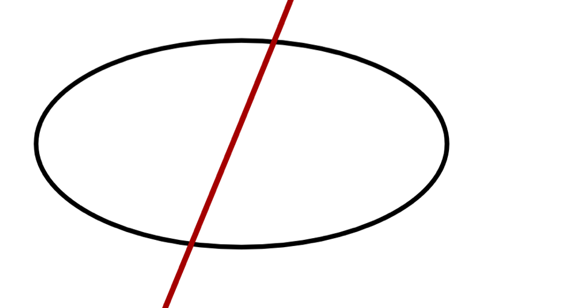
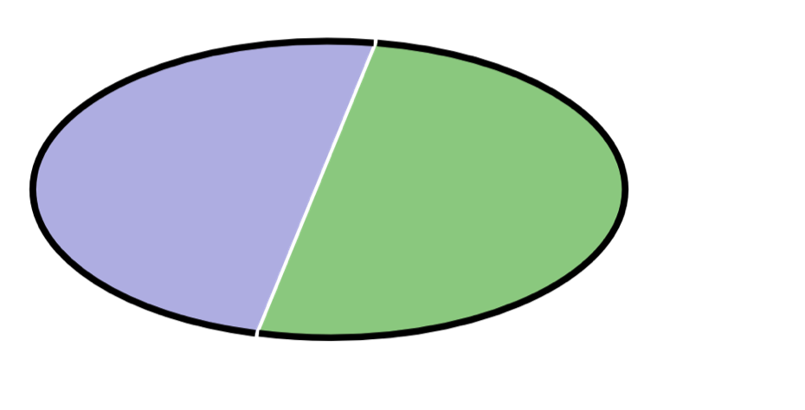



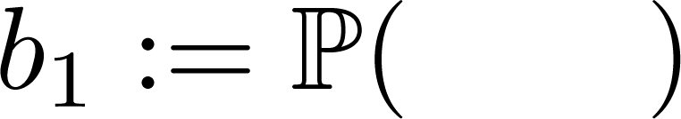




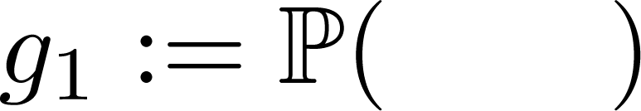
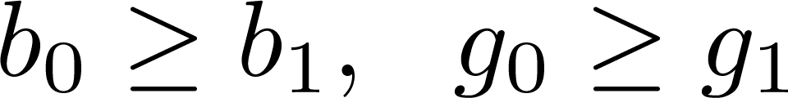
OD is Adaptive Submodular
Objective = probability mass of hypotheses
you have ruled out.
Test s
Test w
Test v
Outcome = 0
Outcome = 1
Not hard to show that

Slide 80








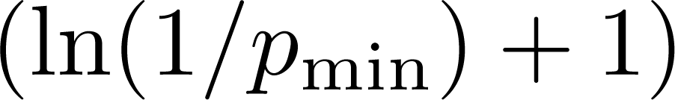
Theoretical guarantees
x₁
=
Garey & Graham, 1974;
Loveland, 1985;
Arkin et al., 1993;
Kosaraju et al., 1999;
Dasgupta, 2004;
Guillory & Bilmes, 2009;
Nowak, 2009;
Gupta et al., 2010
0
1
x₂
=
0
1
0
1
x₃
=
0
1
With adaptive
submodular analysis!
Result requires that tests are exact (no noise)!

Slide 81
What if there is noise?
[w Daniel Golovin, Deb Ray, NIPS ‘10]
Prior over diseases P(Y)
Noisy test outcomes P(X_{V} | Y)
How should we test
to learn about y (infer MAP)?
Existing approaches:
  Generalized binary search?
  Maximize information gain?
  Maximize value of information?
Theorem: All these approaches can have cost
more than n/log n times the optimal cost!
Y
“Sick”
X₁
“Fever”
X₂
“Rash”
X₃
“Cough”
Not adaptive submodular!
➔ Is there an adaptive submodular criterion??

Slide 82
Theoretical guarantees
[with Daniel Golovin, Deb Ray, NIPS ‘10]
Theorem: Equivalence class edge-cutting (EC²) is adaptive monotone and adaptive submodular.
Suppose for all
Then it holds that
First approximation guarantees for nonmyopic VOI
in general graphical models!

Slide 83
Example: The Iowa Gambling Task
[with Colin Camerer, Deb Ray]
What would you prefer?
A)
B)
.7
.7
Prob.
Prob.
.3
.3
-10$
0$
+10$
-10$
0$
+10$
Various competing theories on how people make decisions under uncertainty
  Maximize expected utility? [von Neumann & Morgenstern ‘47]
  Constant relative risk aversion? [Pratt ‘64]
  Portfolio optimization? [Hanoch & Levy ‘70]
  (Normalized) Prospect theory? [Kahnemann & Tversky ’79]
How should we design tests to distinguish theories?

Slide 84
Iowa Gambling as BED
Every possible test X_{s} = (g_{s,1},g_{s,2}) is a pair of gambles
Theories parameterized by θ
Each theory predicts utility for
every gamble U(g,y,θ)
Y
Theory
θ
Param’s
X₁
(g_{1,1},g_{1,2})
X₂
(g_{2,1},g_{2,2})
X_{n}
(g_{n,1},g_{n,2})
…

Slide 85
Simulation Results
Adaptive submodular criterion (EC²)
outperforms existing approaches

Slide 86
Experimental Study
[with Colin Camerer, Deb Ray]
Study with 57
naïve subjects
32,000 designs
Num. classified
40s per test ☹
Using lazy
evaluations:
<5s per test ☺
Strongest support for PT, with some heterogeneity
Unexpectedly no support for CRRA
Submodularity enables real-time performance!

Slide 87

Application: Touch-based localization
[Javdani, Klingensmith, Bagnell, Pollard, Srinivasa, ICRA 2013]

Slide 88
Interactive submodular coverage
Alternative formalization of adaptive optimization [Guillory & Bilmes, ICML ‘10]
  Addresses the worst case setting
Applications to (noisy) active learning, viral marketing
[Guillory & Bilmes, ICML ‘11]

Slide 89
What to do with submodular functions
Optimization
Minimization
Learning
Online/
adaptive
optim.
Maximization

Slide 90
Other directions
Game theory
  Equilibria in cooperative (supermodular) games / fair allocations
  Price of anarchy in non-cooperative games
  Incentive compatible submodular optimization
Generalizations of submodular functions
  L#-convex / discrete convex analysis
  XOS/Subadditive functions
More optimization algorithms
  Robust submodular maximization
  Maximization and minimization under complex constraints
  Submodular-supermodular procedure / semigradient methods
Structured prediction with submodular functions

Slide 91



Further resources
submodularity.org
  Tutorial Slides
  Annotated bibliography
  Matlab Toolbox for Submodular Optimization
  Links to workshops and related meetings
discml.cc
  NIPS Workshops on Discrete Optimization in Machine Learning
  Videos of invited talks on videolectures.net
...

Slide 92
Conclusions
Discrete optimization abundant in applications
Fortunately, some of those have structure: submodularity
Submodularity can be exploited to develop efficient, scalable algorithms with strong guarantees
Can handle complex constraints
Can learn to optimize (online, adaptive, …)

