Slide 1
Personalization and Search
Jaime Teevan
Microsoft Research

Slide 2
Information Retrieval
> Query
User Context
Query Words
Query Words
Ranked List
Ranked List
Domain Context
Task/Use Context
Notes:
Search is a query, entered in a box, that returns a ranked list of results.
A lot of interesting research goes into making that process work better.
But really, there’s a lot more to the user’s information need than a few word query.
There’s the user context: who the person is, what background they have, what they understand
There’s the domain context: what information is available and how it is used
And there’s the task context: how the information will be used and why it’s needed

Slide 3
Personalization and Search
Measuring the value of personalization
  Do people’s notions of relevance vary?
Understanding the individual
  How can we model a person’s interests?
Calculating personal relevance
  How can we use the model to measure relevance?
Other ways to personalize search
  What other aspects can we personalize?

Slide 4
Personalization and Search
Measuring the value of personalization
  An example
  Lots of relevant results ranked low
  Best group ranking v. individual ranking
Understanding the individual
Calculating personal relevance
Other ways to personalize search
Notes:
Imagine the results you’d expect for the query “berkeley”

Slide 5
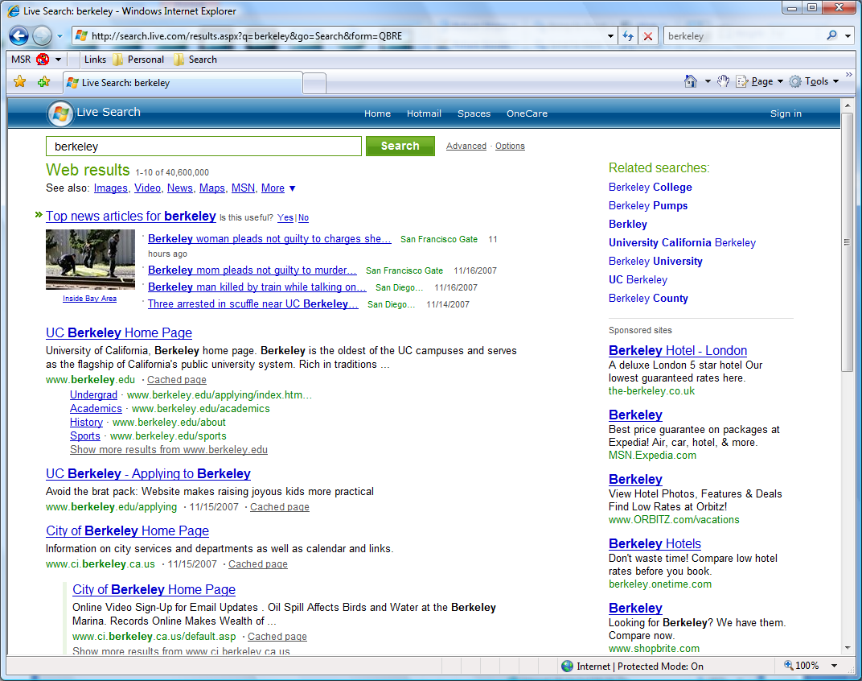



Notes:
Here’s the set of results returned by Live search.
Tell me if you think each one is relevant TO YOU.
UC Berkeley home page.
But Berkeley could also refer to a city in Illinois. How many people think that is relevant?
And even for people who refer to the California city, you may be interested in the city, or you may not.
And for people interested in Cal, they have different needs – probably very few of you are interested in applying to Berkeley, given you’re already here.
What about the EECS department?
Restaurants in Berkeley?

Slide 6
Relevant Content Ranked Low
Highly Relevant
Relevant
Irrelevant
Notes:
We’ve asked these same questions from people – to rate the results to queries and tell us what they find personally relevant.
(Note: not what they think is “objectively” relevant, but what they’d want to see.)
We know from these experiments that there is lots of relevant content ranked down low in a result list – so there’s room for improvement.
The question is: Can search engines actually capitalize on this to improve rankings?
Can we identify the low ranking relevant results and bump them up?
Or is this an artifact of trying to satisfy many people? Do some people think these results are bad? And disagree on others?
We can look at this further by thinking about the BEST ranking we could return (v. what is currently returned).

Slide 7
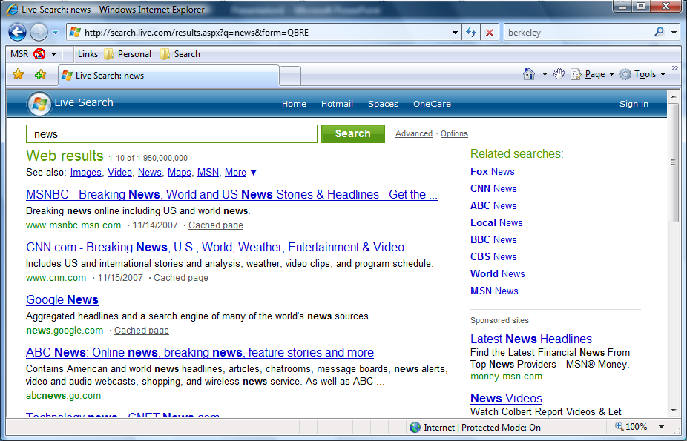
Best Rankings
…
…
…
Notes:
So, here’s the result set we saw earlier.
A person may judge some of them to be relevant.
The best ranking for that person lists what they think is relevant first.
And the rest of the results next.
Similarly, for someone else who thinks a different set of results are relevant,
The best ranking for that person lists what they think is relevant first.
And the rest of the results next.
If we were to measure the quality of these lists on a scale of 0 to 1, they would be 1.
The challenge is search engines only get to return one list right now.
The best list for both people lists the result they both thought was relevant first,
Then the results only one of them thought was relevant
And then the rest of the results.
If we now measure the quality of this list, it’s lower, because the red guy has this blue result here.

Slide 8
Potential for Personalization
Notes:
So here’s the same thing graphically.
On the y-axis is a normalized measure of quality.
The red line shows that if we give people the best result for them individually, their perceived quality is 1.
That’s for individual rankings.
Let’s consider what happens when we have to satisfy more than one person.
On the x-axis is the number of people we are trying to satisfy with a list.

Slide 9
Potential for Personalization
Potential for personalization
Notes:
As we add more people that we have to consider, the best we can do drops.
So here, at 2, is like when we had to satisfy the blue person and the red person, and neither of them gets exactly what they want.
At three, we have to satisfy three people, so everyone gets what they want a little less.
It keeps dropping of as we go out.
I only have data for groups of 6 people evaluating the same results, but you can imagine it goes out even further.
The gap is the potential for personalization.

Slide 10
Potential for Personalization
Potential for personalization
Notes:
The Web ranking is down here.
So there’s room to improve it
But also a huge gap that just improving the raw list won’t be able to pass.

Slide 11
Overview
Measuring the value of personalization
Understanding the individual
  Gather information beyond the query
  Explicit v. implicit
  Client-side v. server-side
Calculating personal relevance
Other ways to personalize search

Slide 12
Learning More Explicitly v. Implicitly
Explicit
  User shares more about query intent
  User shares more about interests
  Hard to express interests explicitly
Query Words
berkeley
restaurants
California or Illinois?
Fancy or low key?
Notes:
Help people express more
E.g., query suggest
People have a hard time with this
Asked people to elaborate on “UW”
They said, “Information about UW”
Doesn’t provide any additional info, and doesn’t even say whether they mean “university of washington” or “wisconsin”
And even when they provide more information, there’s still lots that remains unsaid.
Do we really want to say it ALL?

Slide 13
Learning More Explicitly v. Implicitly
Explicit
  User shares more about query intent
  User shares more about interests
  Hard to express interests explicitly
Intellectual property?
Rock climbing?
Tobacco and guns
Arts | Business | Computers
Games | Health | Home
Kids and Teens | News | Recreation
Reference | Regional | Science
Shopping | Society | Sports
Notes:
We can also try to get people to state general interests.
E.g., chose interesting top-level categories from ODP.
But it’s hard to do.
Poll who is interested in which categories. Hard to say!
Also hard to figure out where your interests like. Interested in IP? Where’s that fall?
What about rock climbing? Recreation. But tobacco and guns also fall in there!

Slide 14
Learning More Explicitly v. Implicitly
Explicit
  User shares more about query intent
  User shares more about interests
  Hard to express interests explicitly
Implicit
  Query context inferred
  Profile inferred about the user
  Less accurate, needs lots of data
Notes:
Another option is to infer information implicitly.
Query context (prev. visited documents, past queries in the session)
Long term context (clicked results, documents)

Slide 15

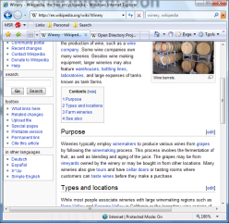
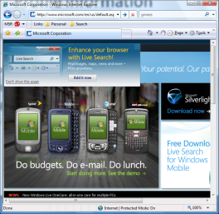
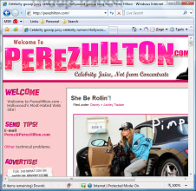

Profile Information
Behavior-based
  Click-through
  Personal PageRank
Content-based
  Categories
  Term vector
[topic: computers]
→ [computers: 2, microsoft: 1, click: 4, what: 3, tablet: 1]

Slide 16

Profile Information
Server information
Web page index
Link graph
Group behavior
Behavior-based
  Click-through
  Personal PageRank
Content-based
  Categories
  Term vector

Slide 17
Server-Side v. Client-Side Profile
Server-side
  Pros: Access to rich Web/group information
  Cons: Personal data stored by someone else
Client-side
  Pros: Privacy
  Cons: Need to approximate Web statistics
Hybrid solutions
  Server sends necessary Web statistics
  Client sends some profile information to server

Slide 18
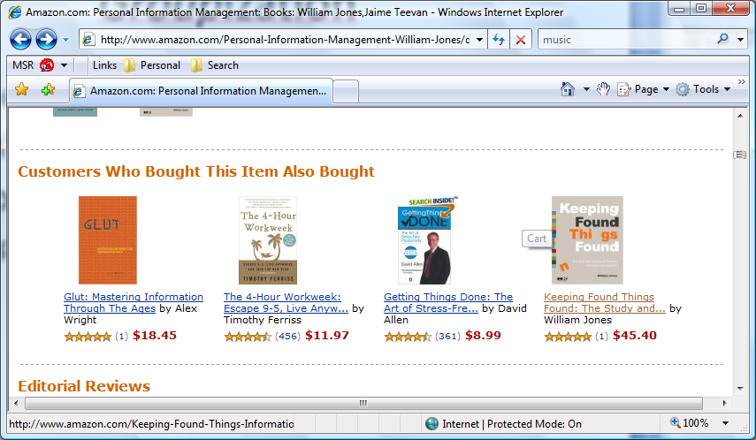
Match Individual to Group
Can use groups of people to get more data
Back off from individual → group → all
Collaborative filtering

Slide 19
Overview
Measuring the value of personalization
Understanding the individual
Calculating personal relevance
  Behavior-based example
  Content-based example
Other ways to personalize search

Slide 20
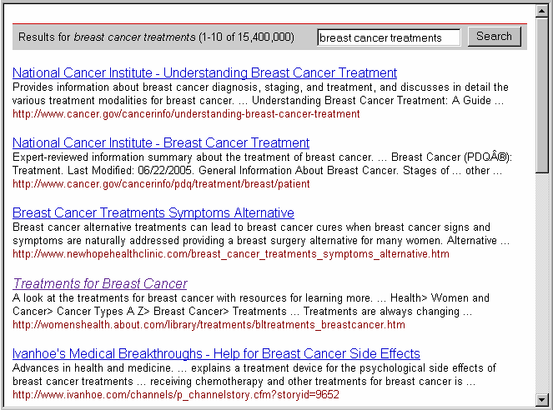
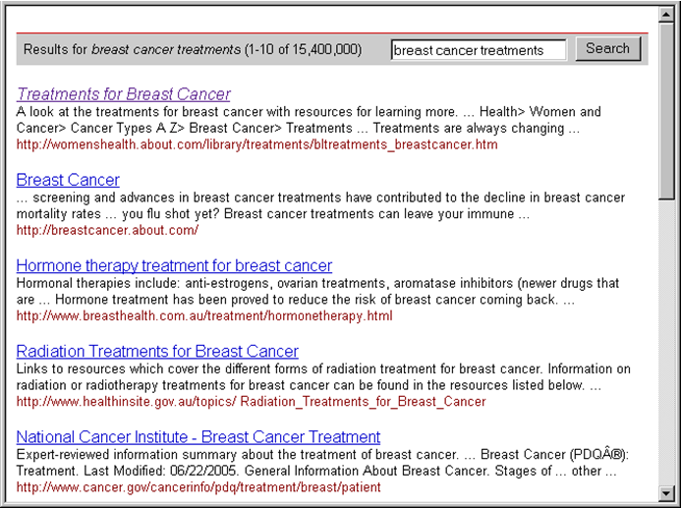
Behavior-Based Relevance
People often want to re-find
People have trusted sites
Boost previously viewed URLs

Slide 21
Content-Based Relevance
Explicit relevance feedback
  Mark documents relevant
  Used to re-weight term frequencies

Slide 22
Content-Based Relevance
World
Score = Σ tf_{i} * w_{i}
N
(N)
(n_{i})
w_{i} = log
n_{i}
r_{i}
(r_{i}+0.5)(N-n_{i}-R+r_{i}+0.5)
(n_{i}-r_{i}+0.5)(R-r_{i}+0.5)
R
w_{i} = log

Slide 23
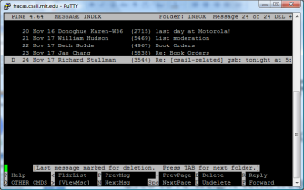
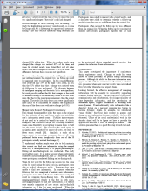
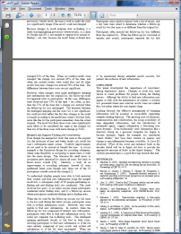
Content-Based Relevance
Explicit relevance feedback
  Mark documents relevant
  Used to re-weight term frequencies
Lots of information about the user
  Consider read documents relevant
  Use to re-weight term frequencies

Slide 24
Content-Based Relevance
World
Score = Σ tf_{i} * w_{i}
N
(N)
(n_{i})
w_{i} = log
n_{i}
r_{i}
(r_{i}+0.5)(N-n_{i}-R+r_{i}+0.5)
(n_{i}-r_{i}+0.5)(R-r_{i}+0.5)
R
w_{i} = log
(r_{i}+0.5)(N’-n’_{i}-R+r_{i}+0.5)
(n’_{i}-r_{i}+0.5)(R-r_{i}+0.5)
Client
w_{i} = log
r_{i}
R
Where: N’ = N+R, n_{i}’ = n_{i}+r_{i}

Slide 25
Personalization Performance
Personalized search hard to evaluate
Mostly small improvements despite big gap
Identify ambiguous queries
  Personalize: “berkeley”
  Don’t personalize: “uc berkeley homepage”
Identify easily personalized queries
  Re-finding queries

Slide 26
Other Ways to Personalize
Measuring the value of personalization
Understanding the individual
Calculating personal relevance
Other ways to personalize search
  Match expectation for re-finding queries
  Personalized snippets

Slide 27
Ranking Results for Re-Finding

Slide 28

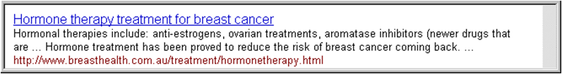
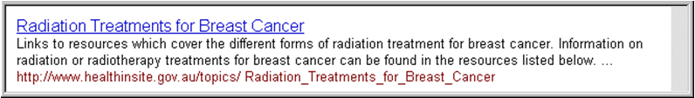
Ranking Results for Re-Finding

Slide 29


People Don’t Notice Change

Slide 30
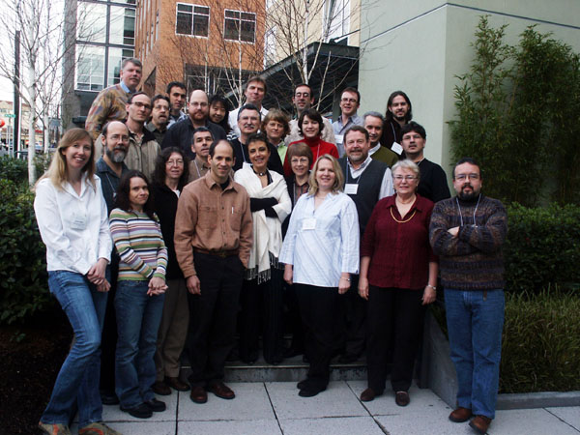
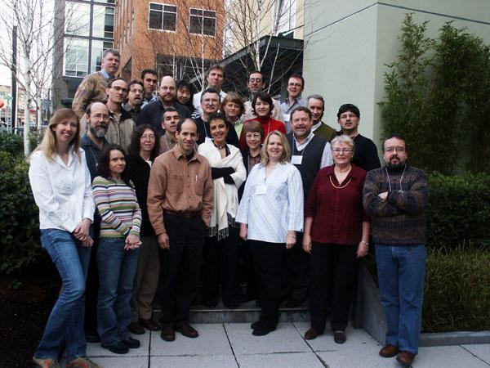
People Don’t Notice Change

Slide 31
People Don’t Notice Change

Slide 32
Snippets to Support Re-Finding
Query: “winery”
Winery - Wikipedia, the free encyclopedia
A winery is a building or property that produces wine, or a business involved in the production of wine, such as a wine company. Some wine companies own many wineries. Besides wine making equipment ...
en.wikipedia.org/wiki/Winery
If the person has visited the page before:
Winery - Wikipedia, the free encyclopedia
A winery is a building or property that produces wine, or a business involved in the production of wine, such as a wine company. Some wine companies own many wineries. Besides wine making equipment ...
en.wikipedia.org/wiki/Winery
Last visit: November 14, 2007

Slide 33
Snippets to Support Re-Finding
Query: “winery”
Winery - Wikipedia, the free encyclopedia
A winery is a building or property that produces wine, or a business involved in the production of wine, such as a wine company. Some wine companies own many wineries. Besides wine making equipment ...
en.wikipedia.org/wiki/Winery
If the person has visited the page before:
Winery - Wikipedia, the free encyclopedia
New content: It has been suggested that Winery wastewater be merged into this article or section.
en.wikipedia.org/wiki/Winery
Last visit: November 14, 2007

Slide 34
Interest-Based Snippets
Query: “winery”
Winery - Wikipedia, the free encyclopedia
A winery is a building or property that produces wine, or a business involved in the production of wine, such as a wine company. Some wine companies own many wineries. Besides wine making equipment ...
en.wikipedia.org/wiki/Winery
If the person is interested in Maui:
Winery - Wikipedia, the free encyclopedia
A winery is a building or property that produces wine, or a business involved in the production of wine, such as a wine company… For example, in Maui there is a pineapple winery. …
en.wikipedia.org/wiki/Winery

Slide 35
Interest-Based Snippets
Query: “winery”
Winery - Wikipedia, the free encyclopedia
A winery is a building or property that produces wine, or a business involved in the production of wine, such as a wine company. Some wine companies own many wineries. Besides wine making equipment ...
en.wikipedia.org/wiki/Winery
If the person is interested in Maui:
Winery - Wikipedia, the free encyclopedia
A winery is a building or property that produces wine, or a business involved in the production of wine, such as a wine company… For example, in Maui there is a pineapple winery. …
en.wikipedia.org/wiki/Winery

Slide 36
Summary
Measuring the value of personalization
  There’s a big gap between group and individual
Understanding the individual
  Building a profile, explicit v. implicit
Calculating personal relevance
  Relevance feedback, boost click through
Other ways to personalize search
  Rank based on expectation, personalized snippets

