Slide 1
Visual Snippets Summarizing Web Pages for Search and Revisitation
Jaime Teevan, Ed Cutrell, Danyel Fisher, Steven Drucker, Gonzalo Ramos, Paul André¹, Chang Hu²
Microsoft Corporation
¹University of Southampton ²University of Maryland

Slide 2
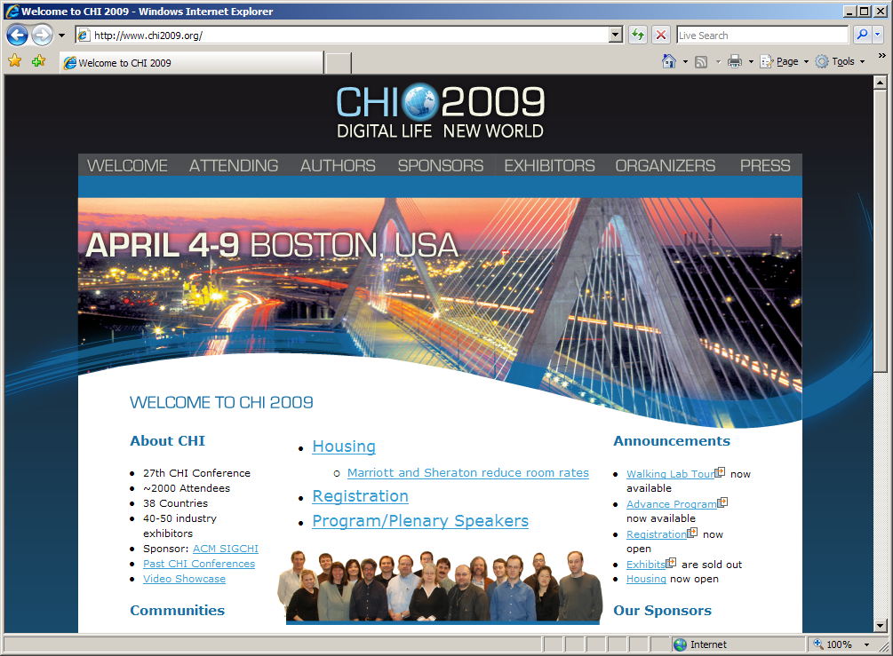
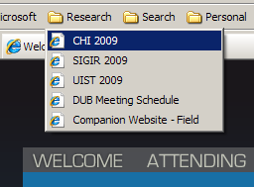
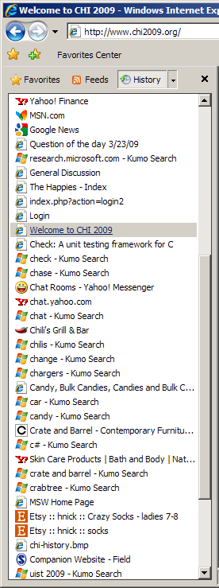
Lots of Ways to Represent a Page
Notes:
There are lots of different ways to represent a Web page.
Here are just a few ways that a person can interact with the CHI web page.

Slide 3
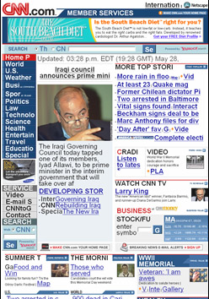
What is the Best Representation?
For recognition?
Thumbnails
[Hightower et al. ’98]
Right size
[Kaasten et al. ’02]
Interaction history
[Cockburn & McKenzie ’01]
For search?
Context sensitive call out
[Woodruff et al. ’01]
For other tasks?
[Baudisch et al. ’04]
Notes:
Recognition: Thumbnails. Right size? Interaction history
Search: Search engine snippet, enhanced thumbnail. Call out context sensitive information.
Mobile browsing: Enhance important content.
Each representation optimized to a particular task.

Slide 4
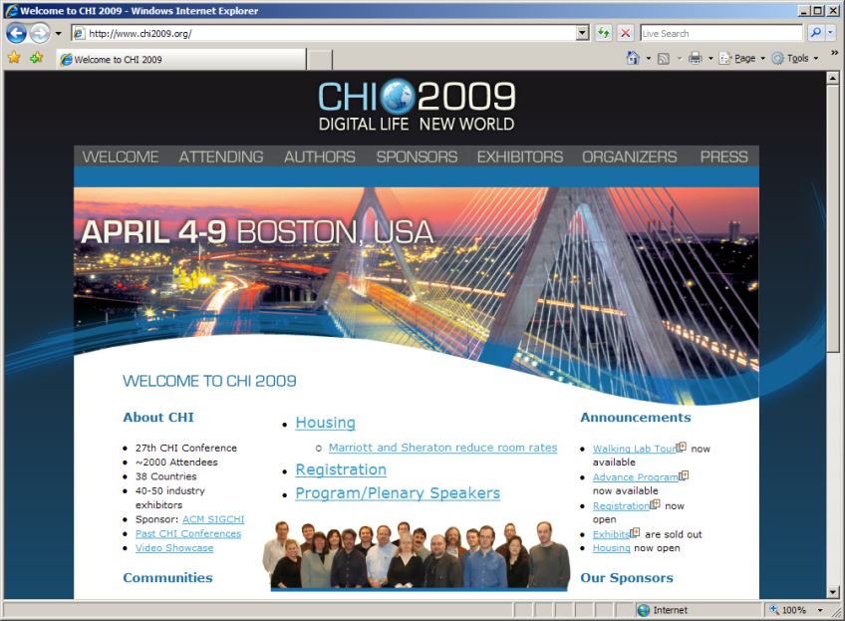
What is the Best Representation?
Recognition
Search
Notes:
Of course, each representation points to the same page.
Lots of work looking at the best representation for a particular task.
Question we set out to answer was whether it mattered that there were different representations.
We look at two tasks: Recognition and Search
And use the two most common representations of each.
As well as a hybrid representation.

Slide 5
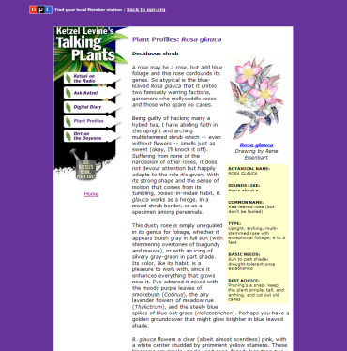
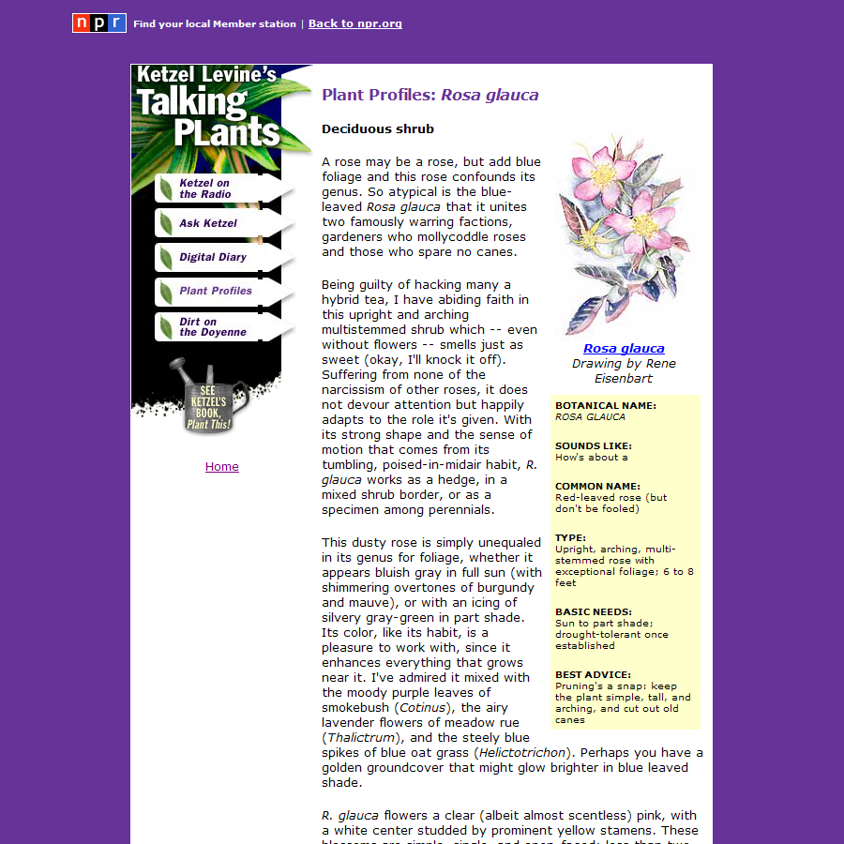
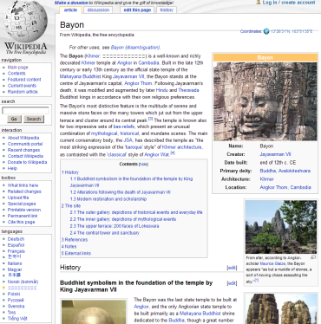
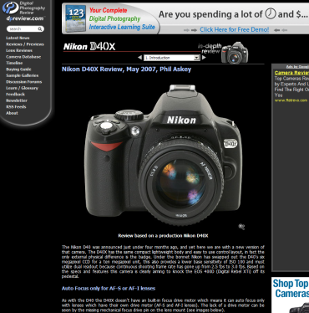
Designer Representations
Designer created representations
Consistent pattern
Salient image
Text
Branding
Notes:
The way we arrived at the hybrid representation was to work with several designers to come up with the best designer-y representation of a page.
Consistent pattern arose.

Slide 6
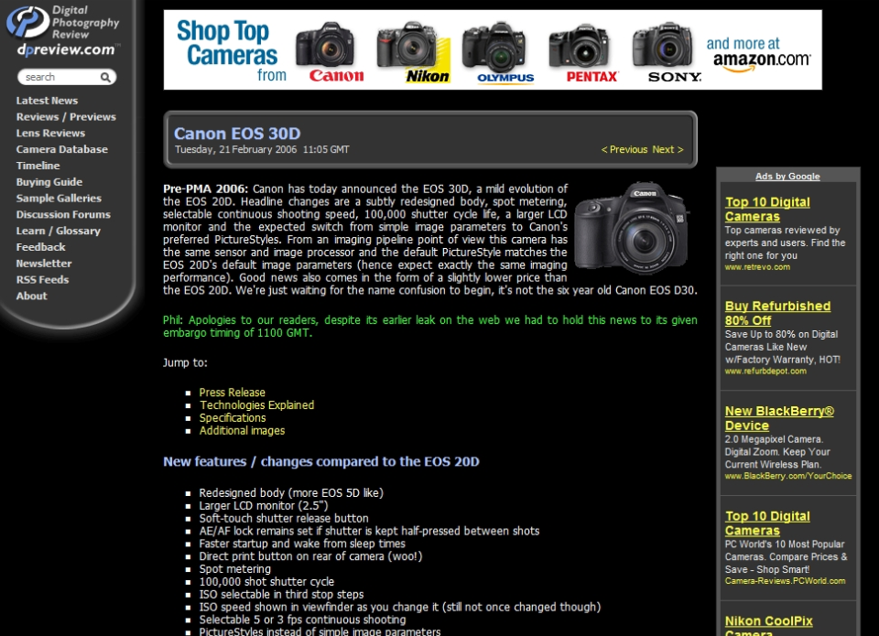
Canon EOS 30D: Digital Photography Review
Notes:
And so that’s how we created “Visual Snippets”.
Here’s an example. Can see in 90x120 pixels we can fit a lot more useful information than the thumbnail.

Slide 7
Auto-Generated Visual Snippets
Extract
Salient image
Text: Title
Branding: Logo
Compile

Slide 8
Studying Representations
Three representations
Two ways representations can be used
Search
Recognition
Notes:
Note: Visual representations a lot smaller.

Slide 9
Study Design
Phase I: Search
12 search tasks (medical, shopping, homepage)
Within-subject: 4 tasks with each representation
276 participants
Phase II: Recognition
Same 12 tasks: Re-find yesterday’s answer
Between-subject: All with same representation
197 participants (from Phase I)
Notes:
Phase I: Everyone worked with the same representation
Phase II: Between-subject means that for some, representation the same, others different.

Slide 10
Phase I: Search
No difference in speed for representations
Clicks different
Text < Visual < Thumbs
Different strategies
Qualitative difference
Text = Visual > Thumbs
Ease of use, like

Slide 11
Phase II: Recognition
Visual representations faster than text
Visual snippets < Text
Congruency important
Thumbnails significant
Need to be seen before to support re-finding
Notes:
VS and T same for congruent, different for incongruent.
More important that T seen before.

Slide 12
Discussion of Results
Search
Text snippets > visual snippets > thumbnails
Trend in time, significant in preference
Representations used different ways
Recognition
Visual representations > text representations
Congruency important
Significant difference for thumbnails
Visual snippets work across tasks
Notes:
For search, not so much a difference in task completion time, but in how they’re used and how people like them.
For recognition, visual representations important.
Search engines, which have lots of re-finding, may want to consider adding a visual representation for previously viewed results.
Congruency important means thumbnails on their own aren’t very useful for things like histories or returning to items unless the person has been primed.
Visual snippets work across tasks, don’t require priming.

Slide 13
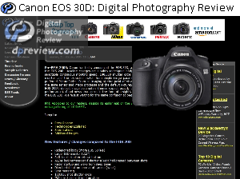
Improving Visual Snippets
Problems
Distinct from page
Does not scale
Extraction errors
Solution
Shrink elements at different rates
Notes:
Smooth transition allows for orientation in page

Slide 14
Consistency v. Task Support
For recognition
Thumbnails
[Hightower et al. ’98]
Right size
[Kaasten et al. ’02]
Interaction history
[Cockburn & McKenzie ’01]
For search
Context sensitive call out
[Woodruff et al. ’01]
For other tasks?
[Baudisch et al. ’04]
review
EOS

Slide 15
Questions?
Thank you

Slide 16
Designer Thumbnails

