Slide 1
Potential for Personalization
Transactions on Computer-Human Interaction, 17(1), March 2010
Data Mining for Understanding User Needs
Jaime Teevan, Susan Dumais, and Eric Horvitz
Microsoft Research
Notes:
Potential for Personalization
Jaime Teevan, Microsoft Research, USA
Susan T. Dumais, Microsoft Research, USA
Eric Horvitz, Microsoft Research, USA
Identifies what different people consider relevant to the same query using explicit relevance judgments and implicit measures (click behavior and desktop content); applies to a personalized search system.
--
Does everyone want the same results for the same query?
Most queries aren’t like Jaguar or Java.

Slide 2
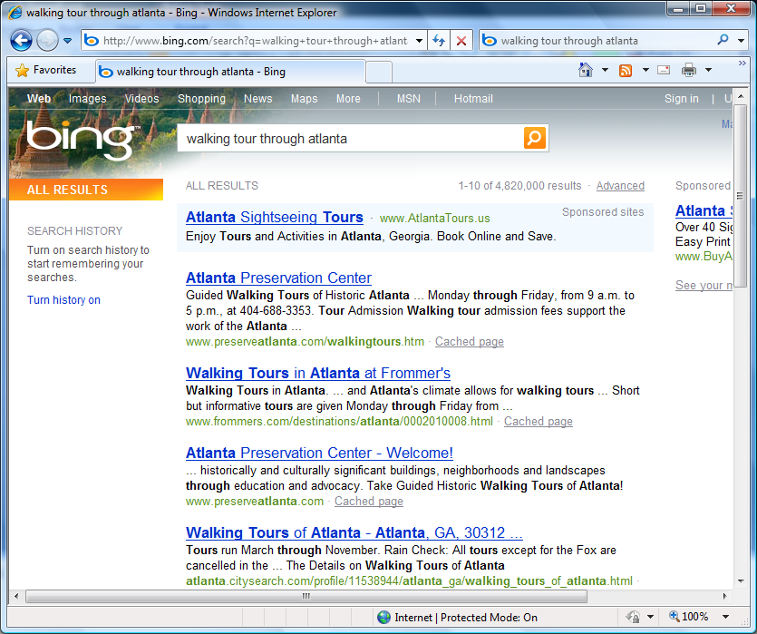
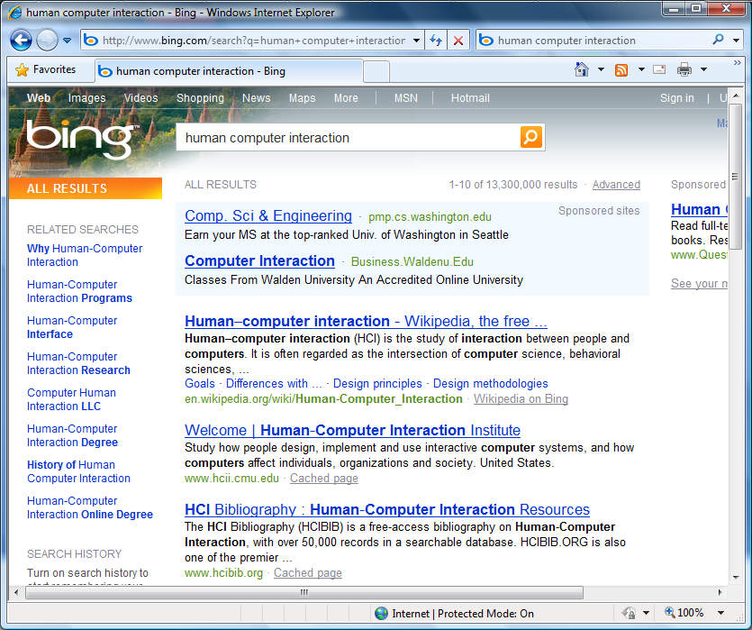
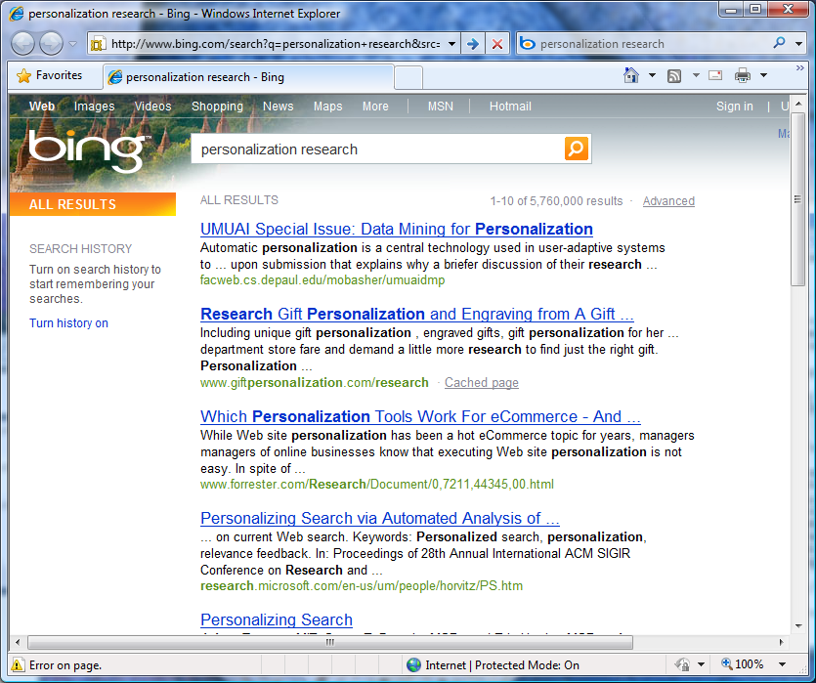
CFP
Paper
Notes:
Most queries we might think we know what someone is looking for.
Some examples: Walking tours in Atlanta. Human computer interaction.
Consider, for example, the query personalization research
There are many different ways those of us interested in academic personalization research may choose to value results:
Based on the exact aspect of personalization, the outlet, the source, how we use the info, etc….

Slide 3
Questions
How good are search results?
Do people want the same results for a query?
How to capture variation in user intent?
  Explicitly
  Implicitly
How can we use what we learn?

Slide 4
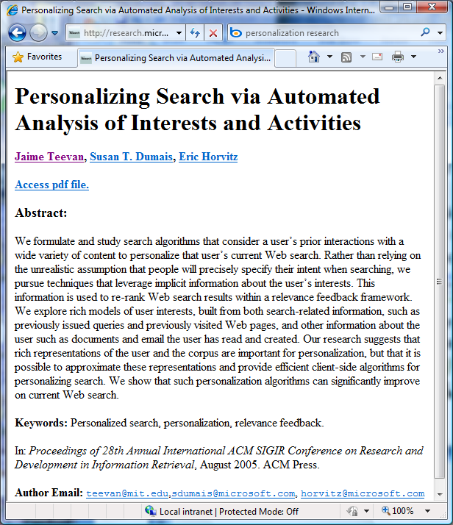

personalization research
Ask the searcher
  Is this relevant?
Look at searcher’s clicks
Similarity to content searcher’s seen before
Notes:
Query: personalization research
Result: a Web page
How can we tell if the page is relevant to the query?

Slide 5
Ask the Searcher
Explicit indicator of relevance
Benefits
  Direct insight
Drawbacks
  Amount of data limited
  Hard to get answers for the same query
  Unlikely to be available in a real system

Slide 6
Searcher’s Clicks
Implicit behavior-based indicator of relevance
Benefits
  Possible to collect from all users
Drawbacks
  People click by mistake or get side tracked
  Biased towards what is presented

Slide 7
Similarity to Seen Content
Implicit content-based indicator of relevance
Benefits
  Can collect from all users
  Can collect for all queries
Drawbacks
  Privacy considerations
  Measures of textual similarity noisy

Slide 8
Summary of Data Sets
 | Explicit Indicator | Implicit Indicators
 |  | Behavior | Content
# Users | 125 | 1.5 M | 59
# Queries | 119 | 44 K | 24
>5 Users | 17 | 44 K | 24
# Instances | 308 | 2.4 M | 822

Slide 9
Questions
How good are search results?
Do people want the same results for a query?
How to capture variation in user intent?
  Explicitly
  Implicitly
How can we use what we learn?

Slide 10
How Good Are Search Results?
Lots of relevant results ranked low

Slide 11
How Good Are Search Results?
Behavior data has presentation bias
Lots of relevant results ranked low

Slide 12
How Good Are Search Results?
Behavior data has presentation bias
Content data also identifies low results
Lots of relevant results ranked low

Slide 13
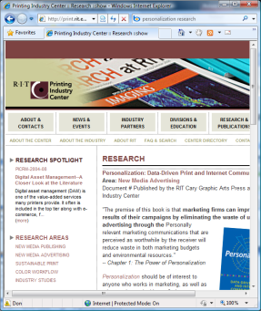
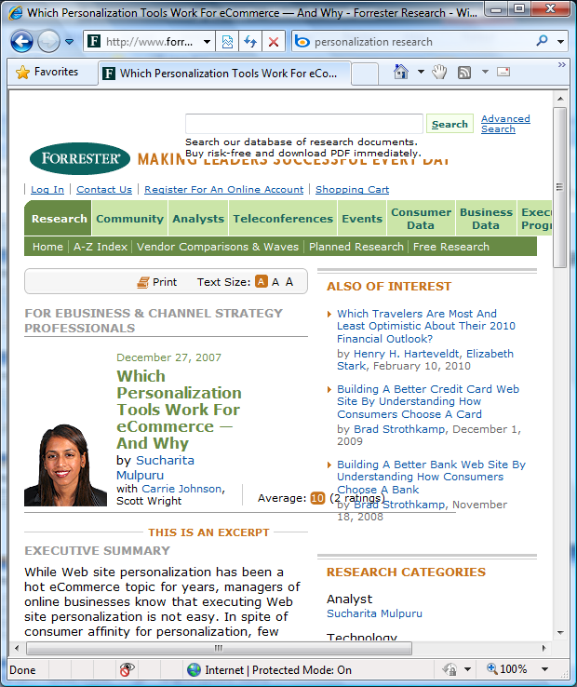
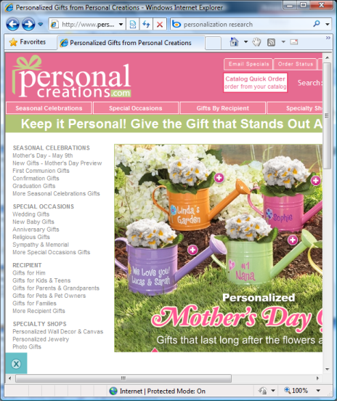
Do People Want the Same Results?
What’s best for
  For you?
  For everyone?
When it’s just you, can rank perfectly
With many people, ranking must be a compromise
personalization research?

Slide 14
Do People Want the Same Results?
Potential for Personalization

Slide 15
Do People Want the Same Results?
Potential for Personalization

Slide 16
How to Capture Variation?
Behavior gap smaller because of presentation bias

Slide 17
How to Capture Variation?
Behavior gap smaller because of presentation bias
Content data shows more variation than explicit judgments

Slide 18
How to Use What We Have Learned?
Identify ambiguous queries
Solicit more information about need
Personalize search
  Using content and behavior-based measures
Web
Personalized

Slide 19
Answers
Lots of relevant content ranked low
Potential for personalization high
Implicit measures capture explicit variation
  Behavior-based: Highly accurate
  Content-based: Lots of variation
Example: Personalized Search
  Behavior + content work best together
  Improves search result click through

Slide 20
Thank you!
Potential for Personalization

