Slide 1
Discovering and Using Groups to Improve Personalized Search
Jaime Teevan, Merrie Morris, Steve Bush
Microsoft Research

Slide 2
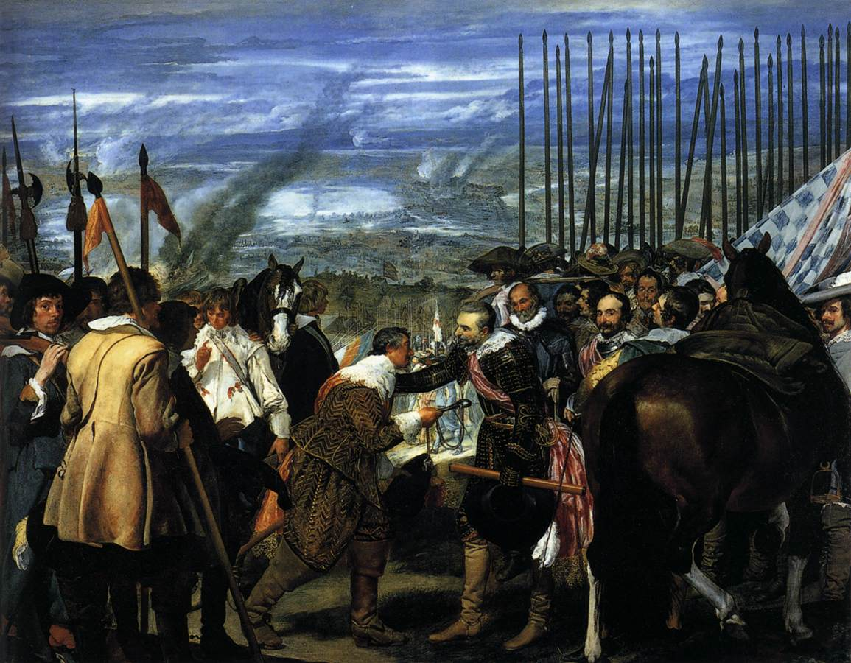
Diego Velasquez, Las Lanzas
Notes:
Think of a few words to describe this painting.
Share them with your neighbor.
Poll: Same as your neighbor, or different?
The point is that we use different words to describe the same things.

Slide 3
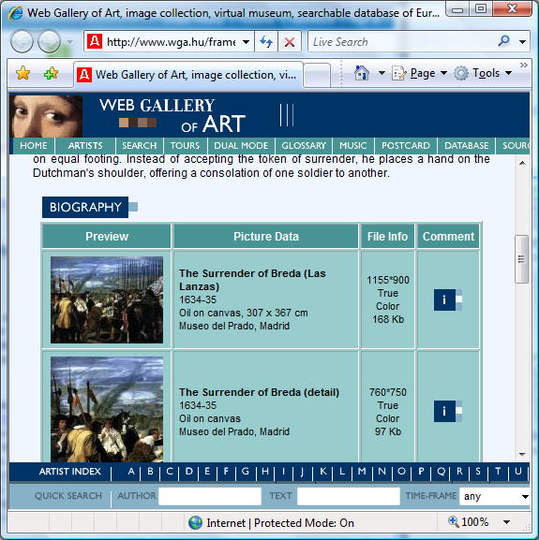
People Express Things Differently
Differences can be a challenge for Web search
Picture of a man handing over a key.
Oil painting of the surrender of Breda.

Slide 4
People Express Things Differently
Differences can be a challenge for Web search
Picture of a man handing over a key.
Oil painting of the surrender of Breda.
Personalization
Closes the gap using more about the person
Groupization
Closes the gap using more about the group

Slide 5
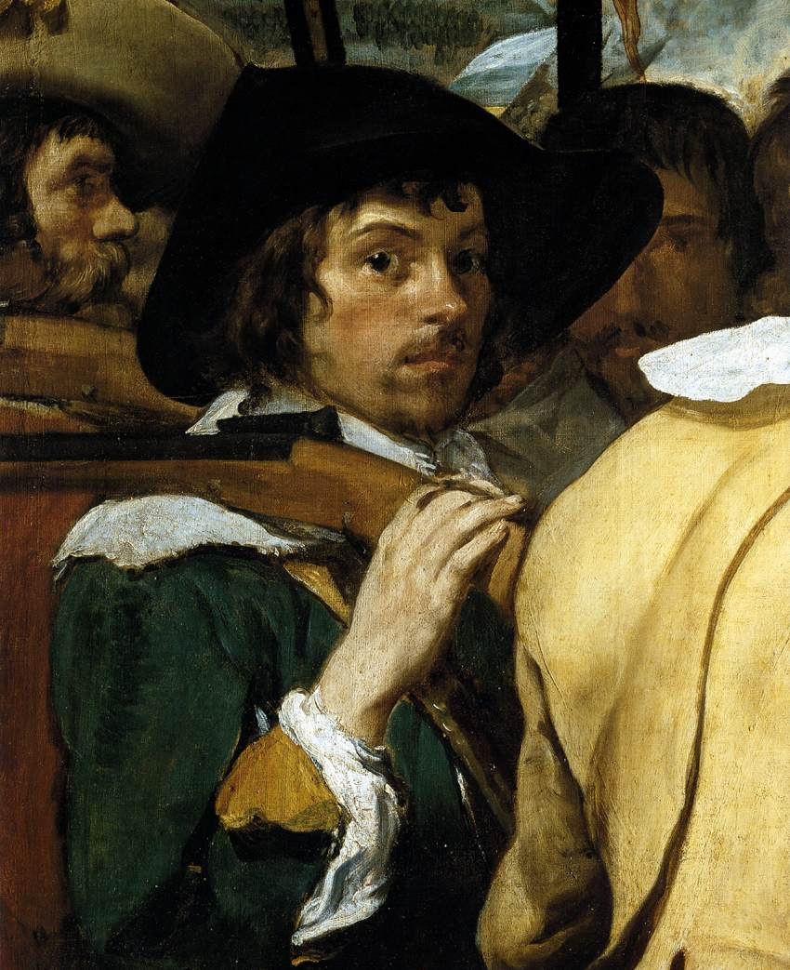
How to Take Advantage of Groups?
Who do we share interests with?
Do we talk about things similarly?
What algorithms should we use?

Slide 6
Related Work
Personalization
Implicit information valuable [Dou et al. 2007; Shen et al. 2005]
More data = better performance [Teevan et al. 2005]
Collaborative filtering & recommender systems
Identify related groups
Browsed pages [Almeida & Almeida 2004; Sugiyama et al. 2005]
Queries [Freyne & Smyth 2006; Lee 2005]
Location [Mei & Church 2008], company [Smyth 2007], etc.
Use group data to fill in missing personal data
Typically data based on user behavior

Slide 7
How We Answered the Questions
Who do we share interests with?
Similarity in query selection
Similarity in what is considered relevant
Do we talk about things similarly?
Similarity in user profile
What algorithms should we use?
Groupize results using groups of user profiles
Evaluate using groups’ relevance judgments
Who do we share interests with?
Similarity in query selection
Similarity in what is considered relevant
Do we talk about things similarly?
Similarity in user profile
What algorithms should we use?
Groupize results using groups of user profiles
Evaluate using groups’ relevance judgments
Who do we share interests with?
Similarity in query selection
Similarity in what is considered relevant
Do we talk about things similarly?
Similarity in user profile
What algorithms should we use?
Groupize results using groups of user profiles
Evaluate using groups’ relevance judgments
Who do we share interests with?
Similarity in query selection
Similarity in what is considered relevant
Do we talk about things similarly?
Similarity in user profile
What algorithms should we use?
Groupize results using groups of user profiles
Evaluate using groups’ relevance judgments

Slide 8
Interested in Many Group Types
Group longevity
Task-based
Trait-based
Group identification
Explicit
Implicit
Task
Age
Gender
Job team
Job role
Identification
Implicit Explicit
Location
Interest group
Relevance judgments
Query selection
Desktop content
Task-based Trait-based
Longevity

Slide 9
People Studied
Trait-based dataset
110 people
Work
Interests
Demographics
Microsoft employees
Task-based dataset
10 groups x 3 (= 30)
Know each other
Have common task
“Find economic pros and cons of telecommuting”
“Search for information about companies offering learning services to corporate customers”

Slide 10
Queries Studied
Trait-based dataset
Challenge
Overlapping queries
Natural motivation
Queries picked from 12
Work
c# delegates, live meeting
Interests
bread recipes, toilet train dog
Task-based dataset
Common task
Telecommuting v. office
pros and cons of working in an office
social comparison telecommuting versus office
telecommuting
working at home cost benefit

Slide 11
Data Collected
Queries evaluated
Explicit relevance judgments
20 - 40 results
Personal relevance
Highly relevant
Relevant
Not relevant
User profile: Desktop index

Slide 12
Answering the Questions
Who do we share interests with?
Do we talk about things similarly?
What algorithms should we use?

Slide 13
Who do we share interests with?
Variation in query selection
Work groups selected similar work queries
Social groups selected similar social queries
Variation in relevance judgments
Judgments varied greatly (κ=0.08)
Task-based groups most similar
Similar for one query ≠ similar for another

Slide 14
Do we talk about things similarly?
Group profile similarity
Members more similar to each other than others
Most similar for aspects related to the group
Clustering profiles recreates groups
Index similarity ≠ judgment similarity
Correlation coefficient of 0.09
 | In task group | Not in group | Difference
 | 0.42 | 0.31 | 34%
 | In task group | Not in group | Difference
All queries | 0.42 | 0.31 | 34%
Group queries | 0.77 | 0.35 | 120%

Slide 15
What algorithms should we use?
Calculate personalized score for each member
Content: User profile as relevance feedback
Behavior: Previously visited URLs and domains
[Teevan et al. 2005]
Sum personalized scores across group
Produces same ranking for all members
Σ
(r_{i}+0.5)(N-n_{i}-R+r_{i}+0.5)
(n_{i}-r_{i}+0.5)(R-r_{i}+0.5)
tf_{i} log
terms i

Slide 16
Performance: Task-Based Groups
Personalization improves on Web
Groupization gains +5%
Web Personalized Groupized

Slide 17
Performance: Task-Based Groups
Personalization improves on Web
Groupization gains +5%
Split by query type
On-task v. off-task
Groupization the same as personalization for off-task queries
11% improvement for on-task queries
Off-task queries
On-task queries
Web Personalized Groupized

Slide 18
Performance: Trait-Based Groups
Interests
Work
Groupization
Personalization
Notes:
Overall, we see an improvement for groupization for most group types.
In particular for interest based groups.
Reason: Break down by query type – work, social

Slide 19
Performance: Trait-Based Groups
Interests
Work
Work
queries
Interest queries
Groupization
Personalization

Slide 20
Performance: Trait-Based Groups
Interests
Work
Work
queries
Interest queries
Groupization
Personalization
Notes:
Improvement higher for work queries in general
And for social

Slide 21
What We Learned
Who do we share interests with?
Depends on the task
Do we talk about things similarly?
Variation in profiles even with similar judgments
What algorithms should we use?
Groupization can take advantage of variation for group-related tasks

Slide 22
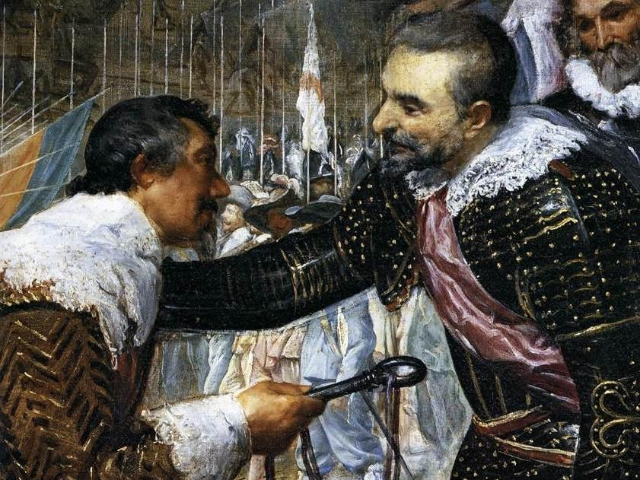
Thank you.
Jaime Teevan, Merrie Morris, Steve Bush
Microsoft Research

Slide 23
Groupization Performance

Slide 24
Related Work: Collaborative Search
People collaborate on search
Students [Twidale et al. 1997], professionals [Morris 2008]
Tasks: Travel, shopping, research, school work
Systems to support collaborative search
SearchTogether [Morris & Horvitz 2007]
Cerchiamo [Pickens et al. 2008]
CoSearch [Amershi & Morris 2008]
People form explicit task-based groups

Slide 25
Related Work: Algorithms
Personalization
Implicit information valuable [Dou et al. 2007; Shen et al. 2005]
More data = better performance [Teevan et al. 2005]
Collaborative filtering & recommender systems
Identify related groups
Browsed pages [Almeida & Almeida 2004; Sugiyama et al. 2005]
Queries [Freyne & Smyth 2006; Lee 2005]
Location [Mei & Church 2008], company [Smyth 2007], etc.
Use group data to fill in missing personal data
Typically data based on user behavior

Slide 26
Identifying Groups
Explicitly
Tasks: Tools for collaboration [Morris & Horvitz 2007]
Traits: Profiles
Implicitly
Interests: Sites visited, queries
Tasks: Query
Location: IP address [Mei & Church 2008]
Gender: Queries [Jones et al. 2007]
Interesting area to explore: Social networks

