Slide 1
ICCV 2009 Kyoto, Short Course, September 24
Recognizing and Learning Object Categories: Year 2009
Li Fei-Fei, Stanford
Rob Fergus, NYU
Antonio Torralba, MIT
Testimonials: “since I attended this course, I can recognize all the objects that I see”

Slide 2
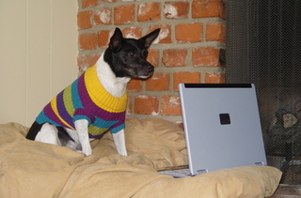
Why do we care about recognition?
Perception of function: We can perceive the 3D shape, texture, material properties, without knowing about objects. But, the concept of category encapsulates also information about what can we do with those objects.
“We therefore include the perception of function as a proper –indeed, crucial- subject for vision science”, from Vision Science, chapter 9, Palmer.

Slide 3
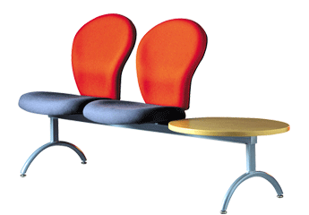
The perception of function
Direct perception (affordances): Gibson
Flat surface Horizontal Knee-high …
Sittable upon
Mediated perception (Categorization)
Flat surface Horizontal Knee-high …
Chair
Sittable upon
Chair
Chair
Chair?

Slide 4
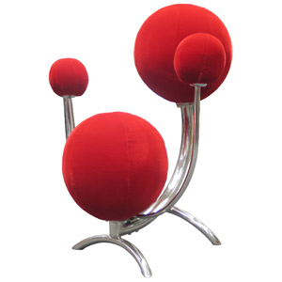
Direct perception
Some aspects of an object function can be perceived directly
Functional form: Some forms clearly indicate to a function (“sittable-upon”, container, cutting device, …)
Sittable-upon
Sittable-upon
It does not seem easy to sit-upon this…
Sittable-upon

Slide 5
Direct perception
Some aspects of an object function can be perceived directly
Observer relativity: Function is observer dependent
From http://lastchancerescueflint.org

Slide 6
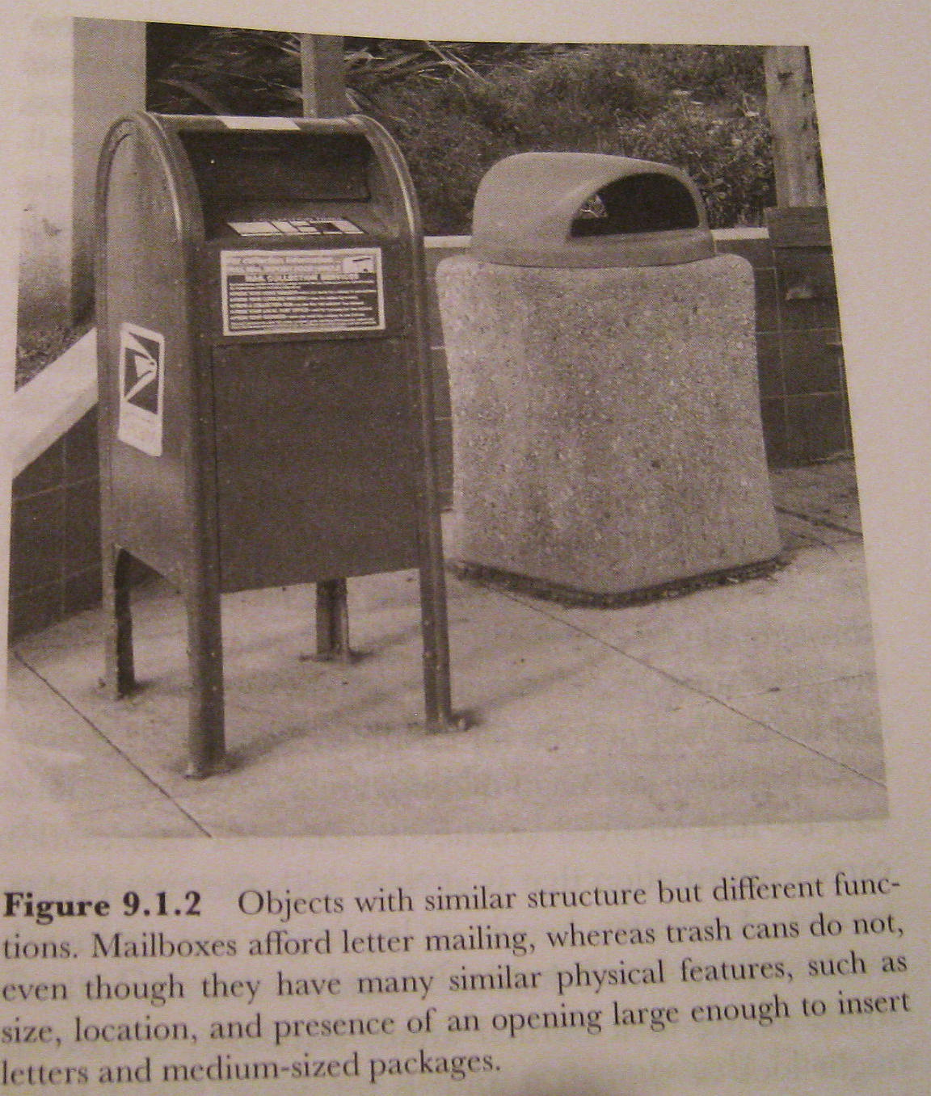
Limitations of Direct Perception
Objects of similar structure might have very different functions
Not all functions seem to be available from direct visual information only.
The functions are the same at some level of description: we can put things inside in both and somebody will come later to empty them. However, we are not expected to put inside the same kinds of things…

Slide 7
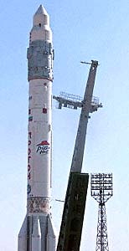
Limitations of Direct Perception
Visual appearance might be a very weak cue to function
Propulsion system
Strong protective surface
Something that looks like a door
Sure, I can travel to space on this object

Slide 8
How do we achieve Mediated perception?
Well… this requires object recognition (for more details, see entire course)

Slide 9
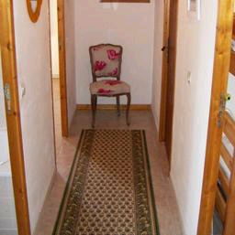
Object recognition Is it really so hard?
Find the chair in this image
Output of normalized correlation
This is a chair

Slide 10
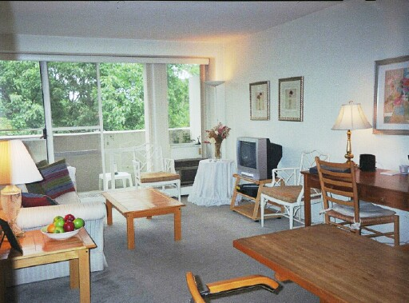
Object recognition Is it really so hard?
Find the chair in this image
Pretty much garbage
Simple template matching is not going to make it

Slide 11
Object recognition Is it really so hard?
Find the chair in this image
A “popular method is that of template matching, by point to point correlation of a model pattern with the image pattern. These techniques are inadequate for three-dimensional scene analysis for many reasons, such as occlusion, changes in viewing angle, and articulation of parts.” Nivatia & Binford, 1977.

Slide 12
And it can get a lot harder
Brady, M. J., & Kersten, D. (2003). Bootstrapped learning of novel objects. J Vis, 3(6), 413-422

Slide 13
your visual system is amazing

Slide 14
is your visual system amazing?

Slide 15
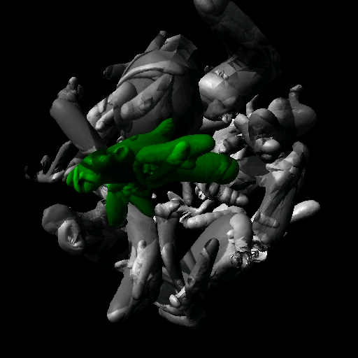
Discover the camouflaged object
Brady, M. J., & Kersten, D. (2003). Bootstrapped learning of novel objects. J Vis, 3(6), 413-422

Slide 16
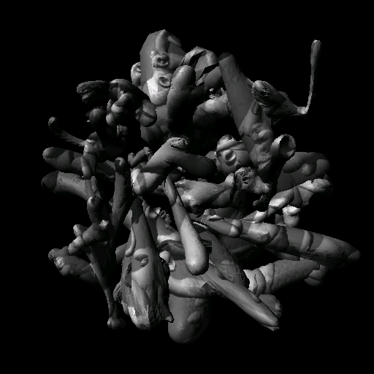
Discover the camouflaged object
Brady, M. J., & Kersten, D. (2003). Bootstrapped learning of novel objects. J Vis, 3(6), 413-422

Slide 17
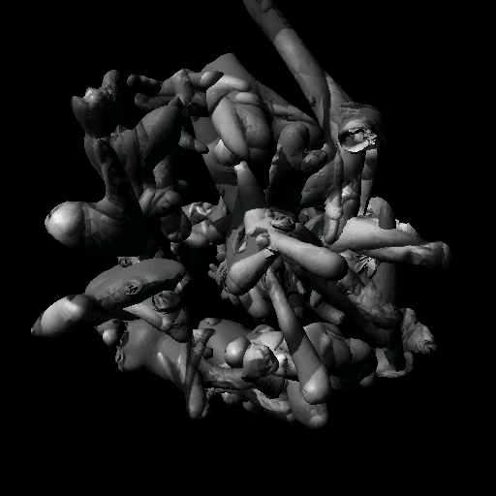

Slide 18
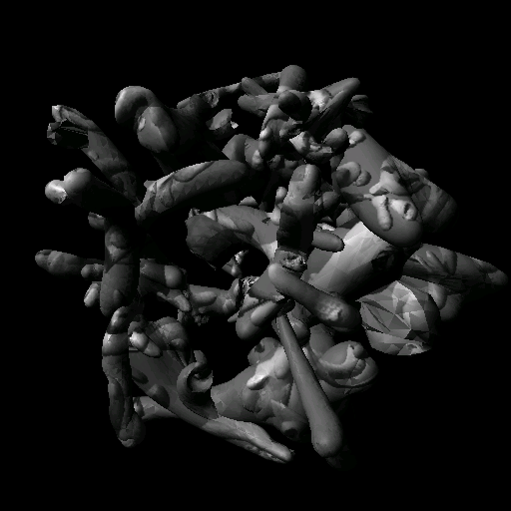

Slide 19
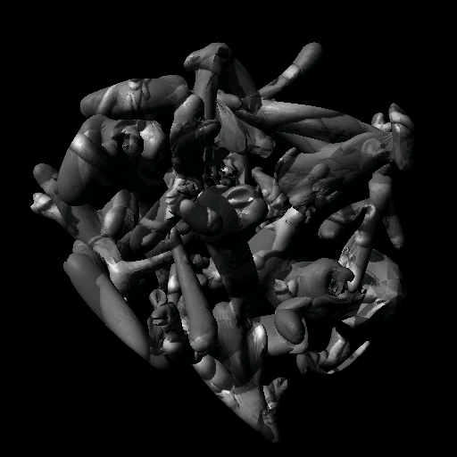

Slide 20
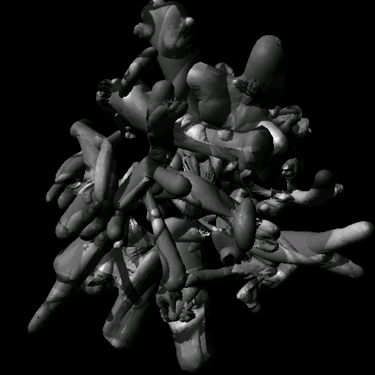

Slide 22
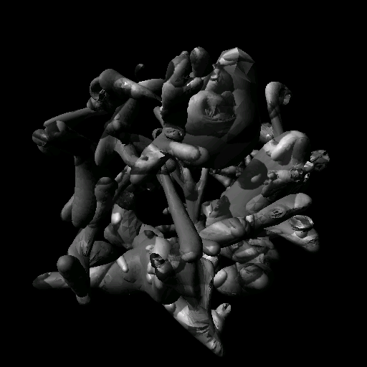
Any guesses?

Slide 24
Outline
1. Introduction (15’)
2. Single object categories (1h15’)
- Bag of words (rob)
- Part-based (rob)
- Discriminative (rob)
- Detecting single objects in contexts (antonio)
- 3D object classes (fei-fei)
15:30 – 16:00 Coffee break
3. Multiple object categories (1h30’)
- Recognizing a large number of objects (rob)
- Recognizing multiple objects in an image (antonio)
- Objects and annotations (fei-fei)
4. Object-related datasets and challenges (30’)

