Slide 1
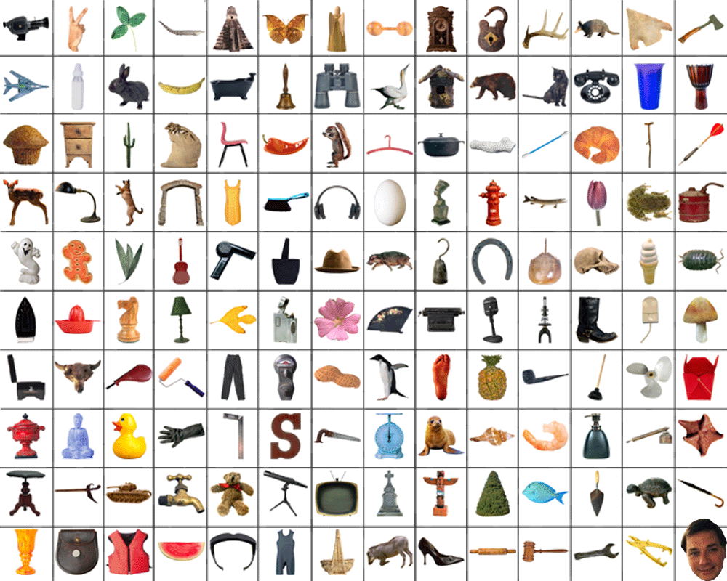
Large Scale Recognition and Retrieval

Slide 2
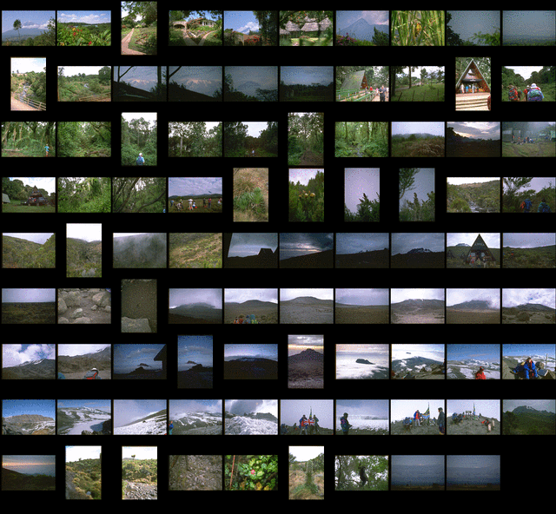
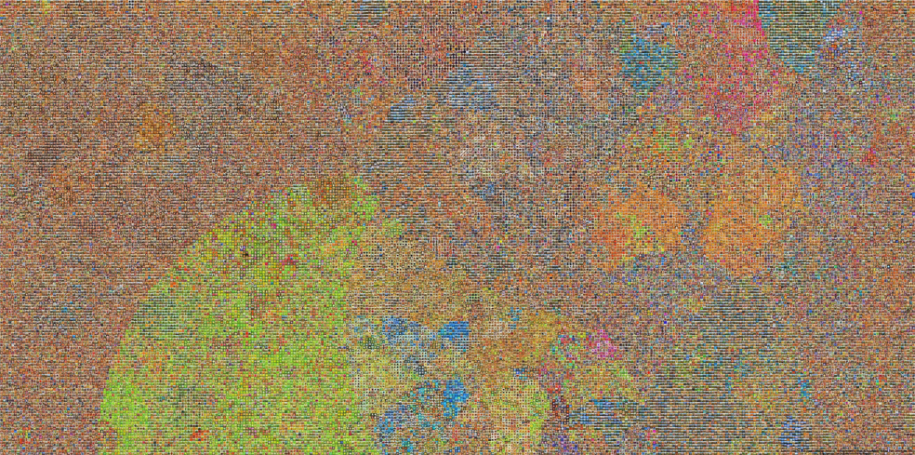
What does the world look like?
Scaling to billions of images
Object Recognition for large-scale search
Focus on scaling rather than understanding image
High level image statistics
Notes:
And also the relationships between objects and the scene in general.

Slide 3
Content-Based Image Retrieval
Variety of simple/hand-designed cues:
Color and/or Texture histograms, Shape, PCA, etc.
Various distance metrics
Earth Movers Distance (Rubner et al. ‘98)
QBIC from IBM (1999)
Blobworld, Carson et al. 2002

Slide 4
Some vision techniques for large scale recognition
Efficient matching methods
Pyramid Match Kernel
Learning to compare images
Metrics for retrieval
Learning compact descriptors

Slide 5
Some vision techniques for large scale recognition
Efficient matching methods
Pyramid Match Kernel
Learning to compare images
Metrics for retrieval
Learning compact descriptors

Slide 6
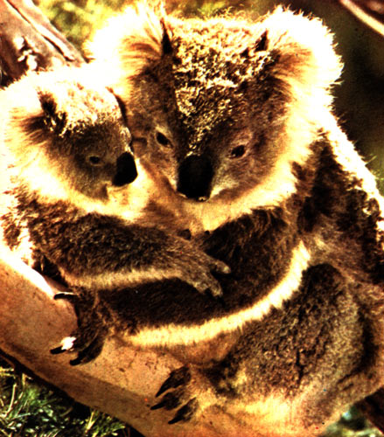
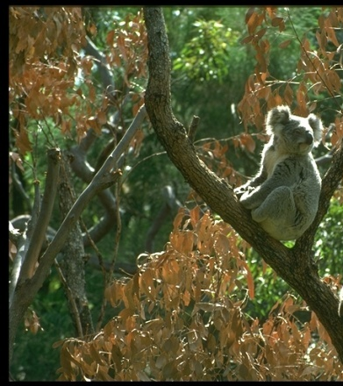
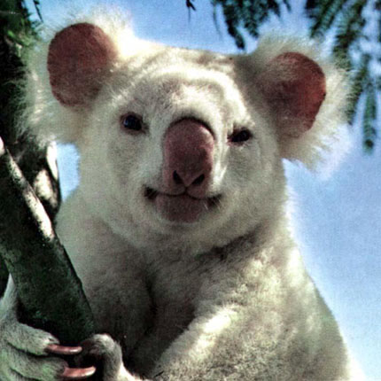
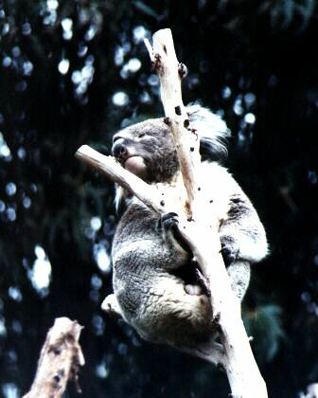
Matching features in category-level recognition

Slide 7
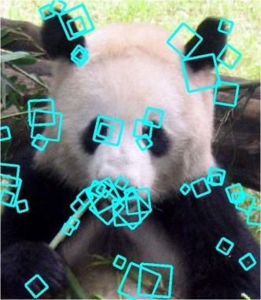
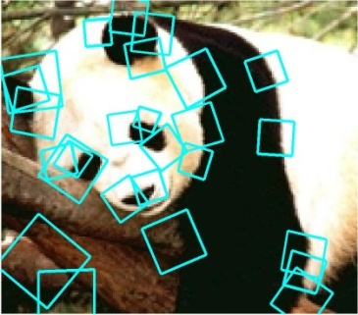
Comparing sets of local features
Previous strategies:
Match features individually, vote on small sets to verify
[Schmid, Lowe, Tuytelaars et al.]
Explicit search for one-to-one correspondences
[Rubner et al., Belongie et al., Gold & Rangarajan, Wallraven & Caputo, Berg et al., Zhang et al.,…]
Bag-of-words: Compare frequencies of prototype features
[Csurka et al., Sivic & Zisserman, Lazebnik & Ponce]
Slide credit: Kristen Grauman

Slide 8
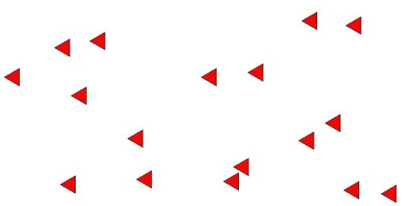
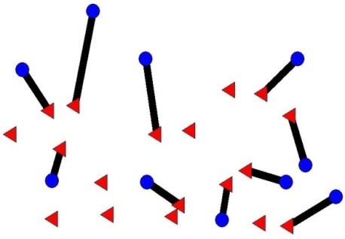
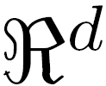
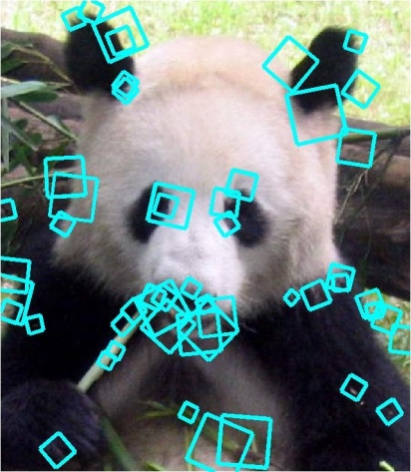
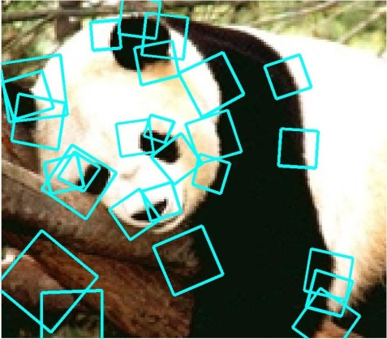
Pyramid match kernel
[Grauman & Darrell, ICCV 2005]
Optimal match: O(m³)
Pyramid match: O(mL)
m = # features
L = # levels in pyramid
optimal partial matching
Slide credit: Kristen Grauman

Slide 9
Pyramid match: main idea
Feature space partitions serve to “match” the local descriptors within successively wider regions.
descriptor space
Slide credit: Kristen Grauman

Slide 10
Pyramid match: main idea
Histogram intersection counts number of possible matches at a given partitioning.
Slide credit: Kristen Grauman

Slide 11
Computing the partial matching
Earth Mover’s Distance
[Rubner, Tomasi, Guibas 1998]
Hungarian method
[Kuhn, 1955]
Greedy matching
…
Pyramid match
[Grauman and Darrell, ICCV 2005]
for sets with features of dimension

Slide 12
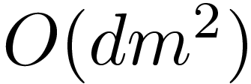
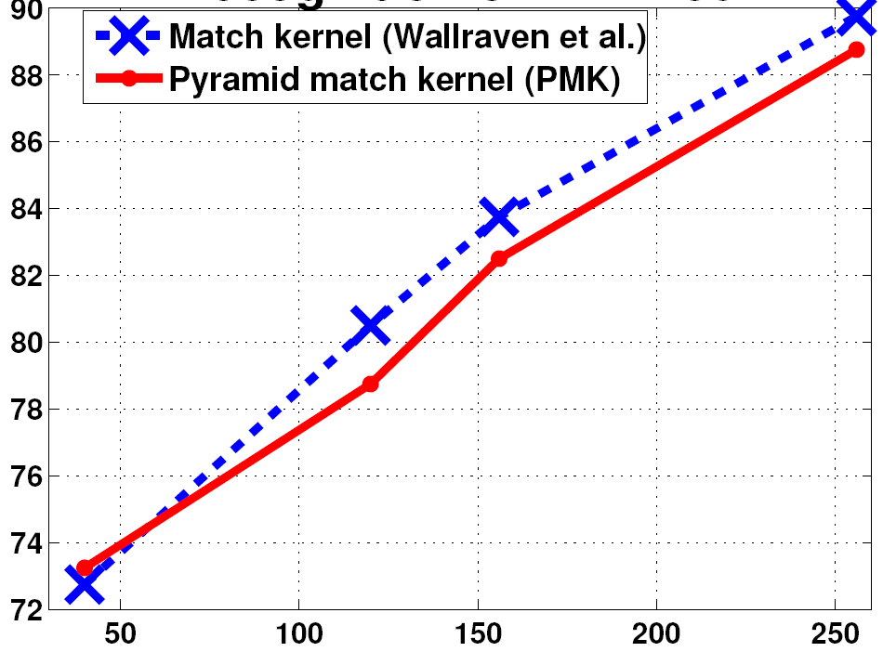
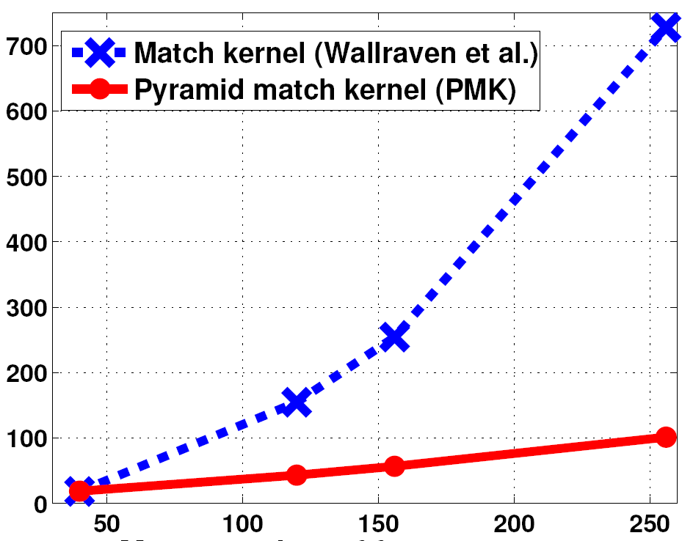
Recognition on the ETH-80
Kernel
Complexity
Match [Wallraven et al.]
Pyramid match
Recognition accuracy (%)
Testing time (s)
Mean number of features per set (m)
Mean number of features per set (m)
Slide credit: Kristen Grauman

Slide 13
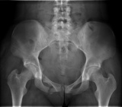
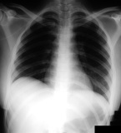
Pyramid match kernel: examples of extensions and applications by other groups
L=0
L=1
L=2
Spatial Pyramid Match Kernel
Lazebnik, Schmid, Ponce, 2006.
Representing Shape with a Pyramid Kernel
Bosch & Zisserman, 2007.
Dual-space Pyramid Matching Hu et al., 2007.
Scene recognition
Shape representation
Medical image classification
Slide credit: Kristen Grauman

Slide 14
Pyramid match kernel: examples of extensions and applications by other groups
wave
sit down
Single View Human Action Recognition using Key Pose Matching, Lv & Nevatia, 2007.
Spatio-temporal
Pyramid Matching for Sports Videos, Choi et al., 2008.
From Omnidirectional Images to Hierarchical Localization, Murillo et al. 2007.
Action recognition
Video indexing
Robot localization
Slide : Kristen Grauman

Slide 15
Some vision techniques for large scale recognition
Efficient matching methods
Pyramid Match Kernel
Learning to compare images
Metrics for retrieval
Learning compact descriptors

Slide 16
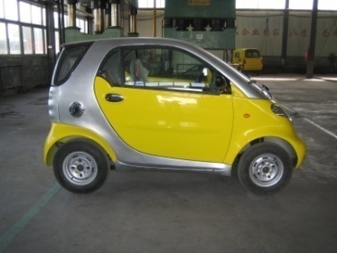
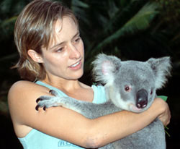
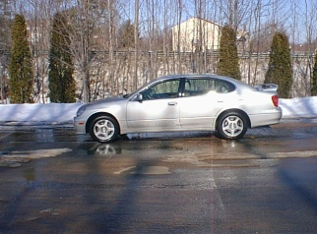
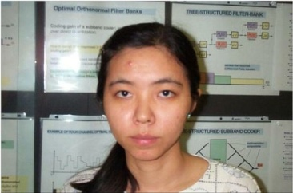
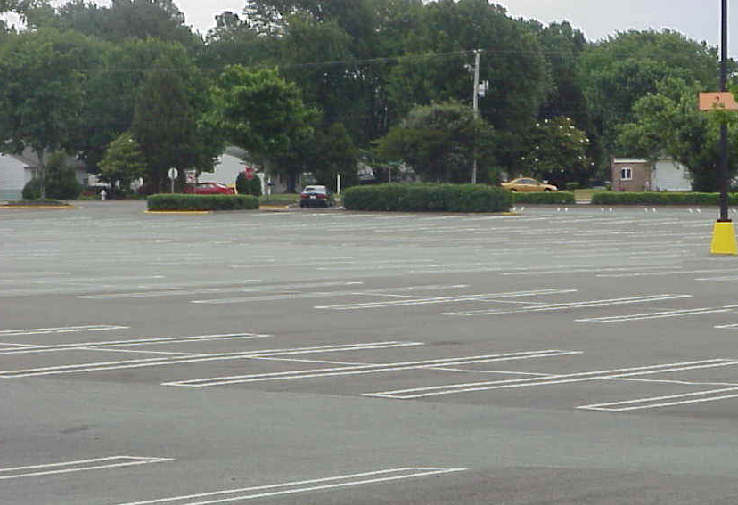
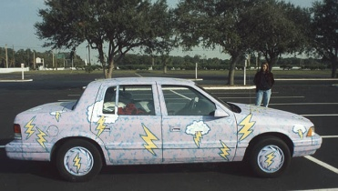
Learning how to compare images
Exploit (dis)similarity constraints to construct more useful distance function
Number of existing techniques for metric learning
dissimilar
similar
[Weinberger et al. 2004, Hertz et al. 2004, Frome et al. 2007, Varma & Ray 2007, Kumar et al. 2007]
Notes:
16

Slide 17
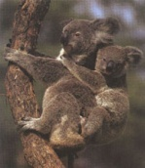
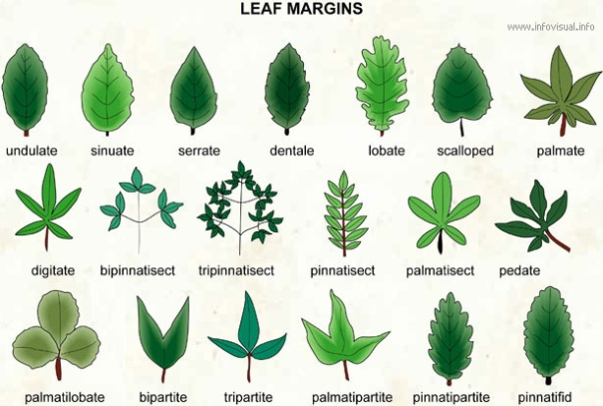
Example sources of similarity constraints
Partially labeled image databases
Fully labeled image databases
Problem-specific knowledge
Notes:
17
17

Slide 18
Locality Sensitive Hashing (LSH)
Gionis, A. & Indyk, P. & Motwani, R. (1999)
Take random projections of data
Quantize each projection with few bits
0
101
Descriptor in high D space
1
0
1
1
0

Slide 19
Fast Image Search for Learned Metrics Jain, Kulis, & Grauman, CVPR 2008
Learn a Malhanobis metric for LSH
h( ) = h( )
h( ) ≠ h( )
Less likely to split pairs like those with similarity constraint
More likely to split pairs like those with dissimilarity constraint
Slide : Kristen Grauman
Notes:
19

Slide 20
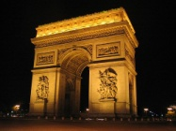
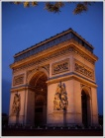
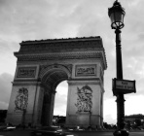
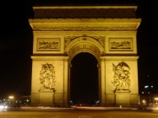
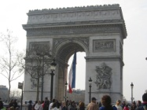
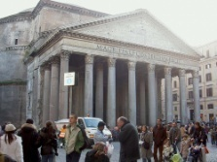
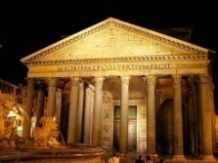
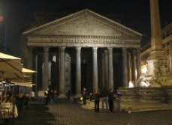
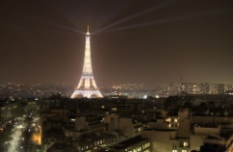
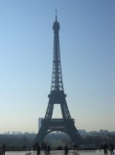
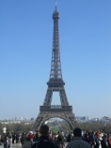
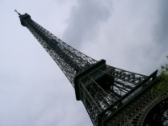
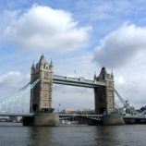
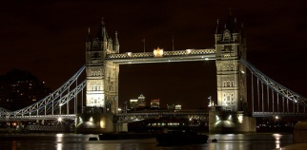
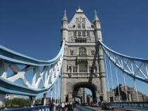
Results: Flickr dataset
Query time:
Error rate
18 classes, 5400 images
Categorize scene based on nearest exemplars
Base metric: Ling & Soatto’s Proximity Distribution Kernel (PDK)
slower search faster search
30% of data 2% of data
Slide : Kristen Grauman
Notes:
Goal – match image to others in order to name location
Make point of high dimensions here.
Smaller gap with ML because also serves as dim reduction, so need fewer bits. Here num bits is the same for both. PDK is higher d than PMK. So we didn’t observe this gap discrepancy for ML PMK hash because num bits used was enough for both.
To evaluate our learned hash functions when the base kernel is the
proximity distribution kernel (PDK), we performed experiments with a dataset of 5400 images of 18 different tourist attractions from the photo-sharing site Flickr. We took three cities in
Europe that have major tourist attractions: Rome, London, and Paris. The tourist sites for each
city were taken from the top attractions in www.TripAdvisor.com under the headings Religious
site, Architectural building, Historic site, Opera, Museum, and Theater. Overall, the list yielded
18 classes: eight from Rome, five from London, and five from Paris. The classes are: Arc de
Triomphe, Basilica San Pietro, Castel SantAngelo, Colosseum, Eiffel Tower, Globe Theatre,
Hotel des Invalides, House of Parliament, Louvre, Notre Dame Cathedral, Pantheon, Piazza
Campidoglio, Roman Forum, Santa Maria Maggiore, Spanish Steps, St. Pauls Cathedral, Tower

Slide 21
Results: Flickr dataset
Query time:
Error rate
18 classes, 5400 images
Categorize scene based on nearest exemplars
Base metric: Ling & Soatto’s Proximity Distribution Kernel (PDK)
slower search faster search
30% of data 2% of data
Slide : Kristen Grauman
Notes:
Left side – 30% of data searched. Right side – 2-3% searched

Slide 22
Some vision techniques for large scale recognition
Efficient matching methods
Pyramid Match Kernel
Learning to compare images
Metrics for retrieval
Learning compact descriptors

Slide 23
Semantic Hashing
[Salakhutdinov & Hinton, 2007] for text documents
Query Image
Semantic Hash Function
Address Space
Binary code
Images in database
Semantically similar images
Query address
Quite different to a (conventional) randomizing hash

Slide 24
Exploring different choices of semantic hash function
Torralba, Fergus, Weiss, CVPR 2008
Image 1
<10μs
Binary code
3. RBM
2. BoostSSC
1.LSH
Retrieved images
<1ms
Semantic Hash
Query Image
Gist descriptor
Compute Gist
~1ms (in Matlab)

Slide 25
Learn mapping
Neighborhood Components Analysis [Goldberger et al., 2004]
Adjust model parameters to move:
Points of SAME class closer
Points of DIFFERENT class away
Points in code space

Slide 26
LabelMe retrieval comparison
32-bit learned codes do as well as 512-dim real-valued input descriptor
Learning methods outperform LSH
% of 50 true neighbors in retrieval set
0 2,000 10,000 20,0000
Size of retrieval set

Slide 27
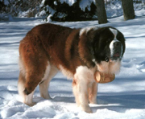
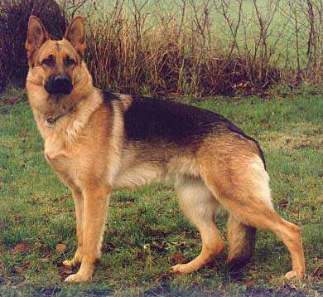
Review: constructing a good metric from data
Learn the metric from training data
Two approaches that do this:
Jain, Kulis, & Grauman, CVPR 2008: Learn Malhanobis distance for LSH.
Torralba, Fergus, Weiss, CVPR 2008: Directly learn mapping from image to binary code.
Use Hamming distance (binary codes) for speed
Learning metric really helps over plain LSH
Learning only applied to metric, not representation

